Slide 1
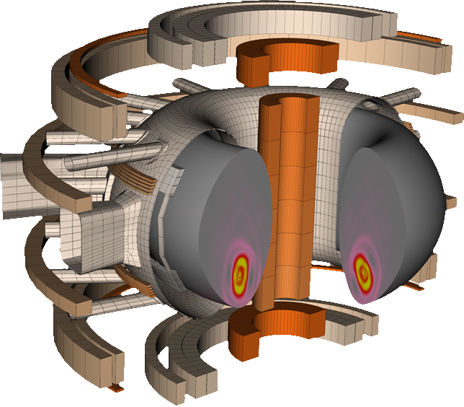
Simulating large-scale transient plasma dynamics in magnetically confined fusion plasmas
Matthias Hoelzl for the TSVV 8 team & collaborators acknowledgements: on the slides + references at the end

Slide 2
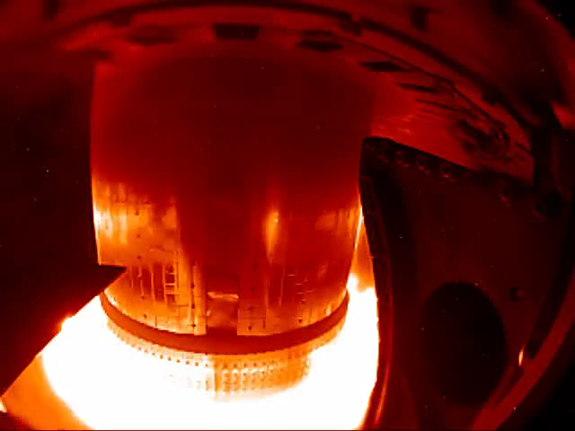
Why simulate large scale plasma instabilities?
A well confined fusion plasma with high pressure gradients and plasma currents can give rise to violent instabilities
While a reactor aims to operate in the absence of such events, they can never be fully avoided, in particular in the research phase or as a result of technical failures
Movie: courtesy R Granetz

Slide 3
Challenges
Multi-scale in time and space
Global simulations ↔ fine local structures
Long time scales ↔ fast bursts of instabilities
Truly multi-physics
Main plasma • impurities • neutrals • atomic physics • radiation • plasma-wall interaction • relativistic electrons • pellets • turbulence • electro-magnetic interaction with conducting structures • …
Absolutely non-perturbative
Complete change of magnetic topology • enormous spatio-temporal variations • global re-distribution and loss of heat, particles and current
Extreme anisotropy
Heat transport along field lines ~10⁹ times faster than perpendicular to them

Slide 4

Main codes & models
3D non-linear extended MHD & hybrid fluid-kinetic
Full or reduced MHD with two-fluid extensions
Full-f particle-in-cell for neutrals, impurities, runaway electrons (REs), energetic particles (EPs)
Novel electrostatic GK capabilities
CARIDDI 3D volumetric resistive wall code // STARWALL for simpler walls
TRIMEG
3D GK PiC, high order FEM, electromagnetic capabilities, full-f/delta-f, non-linear collisions, …
CASTOR3D
3D linear extended visco-resistive MHD for tokamak and stellarators
+

Slide 5
Subjects
Pedestal: ELMs, small-ELM / ELM-free, X-point radiator, resonant magnetic perturbations
3D Div/SOL: 3D divertor, scrape-off layer and (neoclassical) impurity transport physics
Core: e.g. sawtooth prevention, NTMs, …
Disruptions: including vertical displacement events, shattered pellet injection, halo currents
Stellarator MHD (supported by us; mostly outside TSVVs)
Energetic particles (supported by us and building up on our PiC developments; lead by TSVV 10)
Runaway electrons (supported by us and building up on our PiC developments; lead by TSVV 9)

Slide 6
Selected highlights from our different research fields
Edge & SOL
Core
Disruptions

Slide 7
Selected highlights from our different research fields
Edge & SOL
Core
Disruptions

Slide 8
Edge instabilities in a nutshell
High confinement plasmas (“H-mode”) feature a pedestal region at the edge with particularly high pressure gradients, current densities and shear flows
Pressure gradients and current densities can destabilize “peeling-ballooning modes”. Shear flows act stabilizing. Depending on the regime, this can lead to large periodic edge localized mode (ELM) crashes, which expel ~10% of the plasma stored energy in a time scale of a millisecond.
Such transient heat loads are problematic for the lifetime of material components.
Thus, deep understanding of the processes is needed to either actively control these ELMs or reliably operate in naturally ELM free regimes
Plasma edge instabilities are directly connected to exhaust questions regarding scrape-off layer and divertor

Slide 9
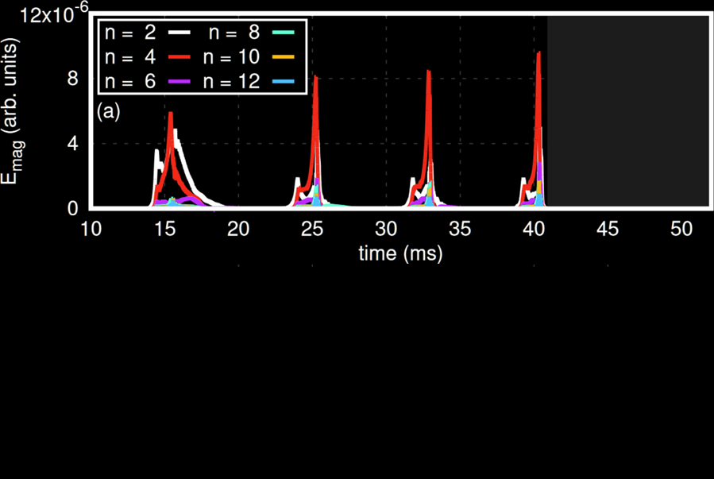
Edge localized mode cycles
The interplay between stabilizing and destabilizing effects leads to periodic edge localized modes with very similar properties as in the experiment in terms of size, precursors and explosive onset
A Cathey, M Hoelzl et al

Slide 10
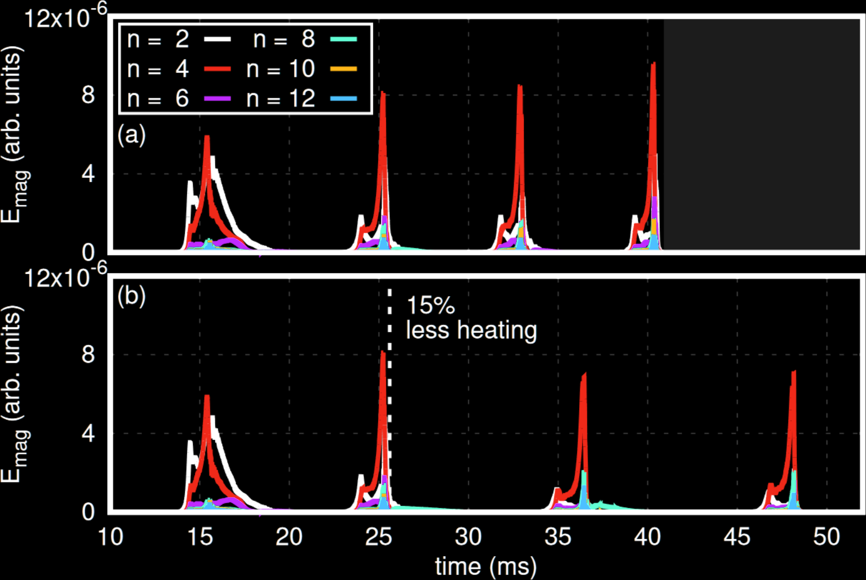
Edge localized mode cycles
The interplay between stabilizing and destabilizing effects leads to periodic edge localized modes with very similar properties as in the experiment in terms of size, precursors and explosive onset
The ELM frequency reacts to changes in heating power like in the experiment
A Cathey, M Hoelzl et al

Slide 11
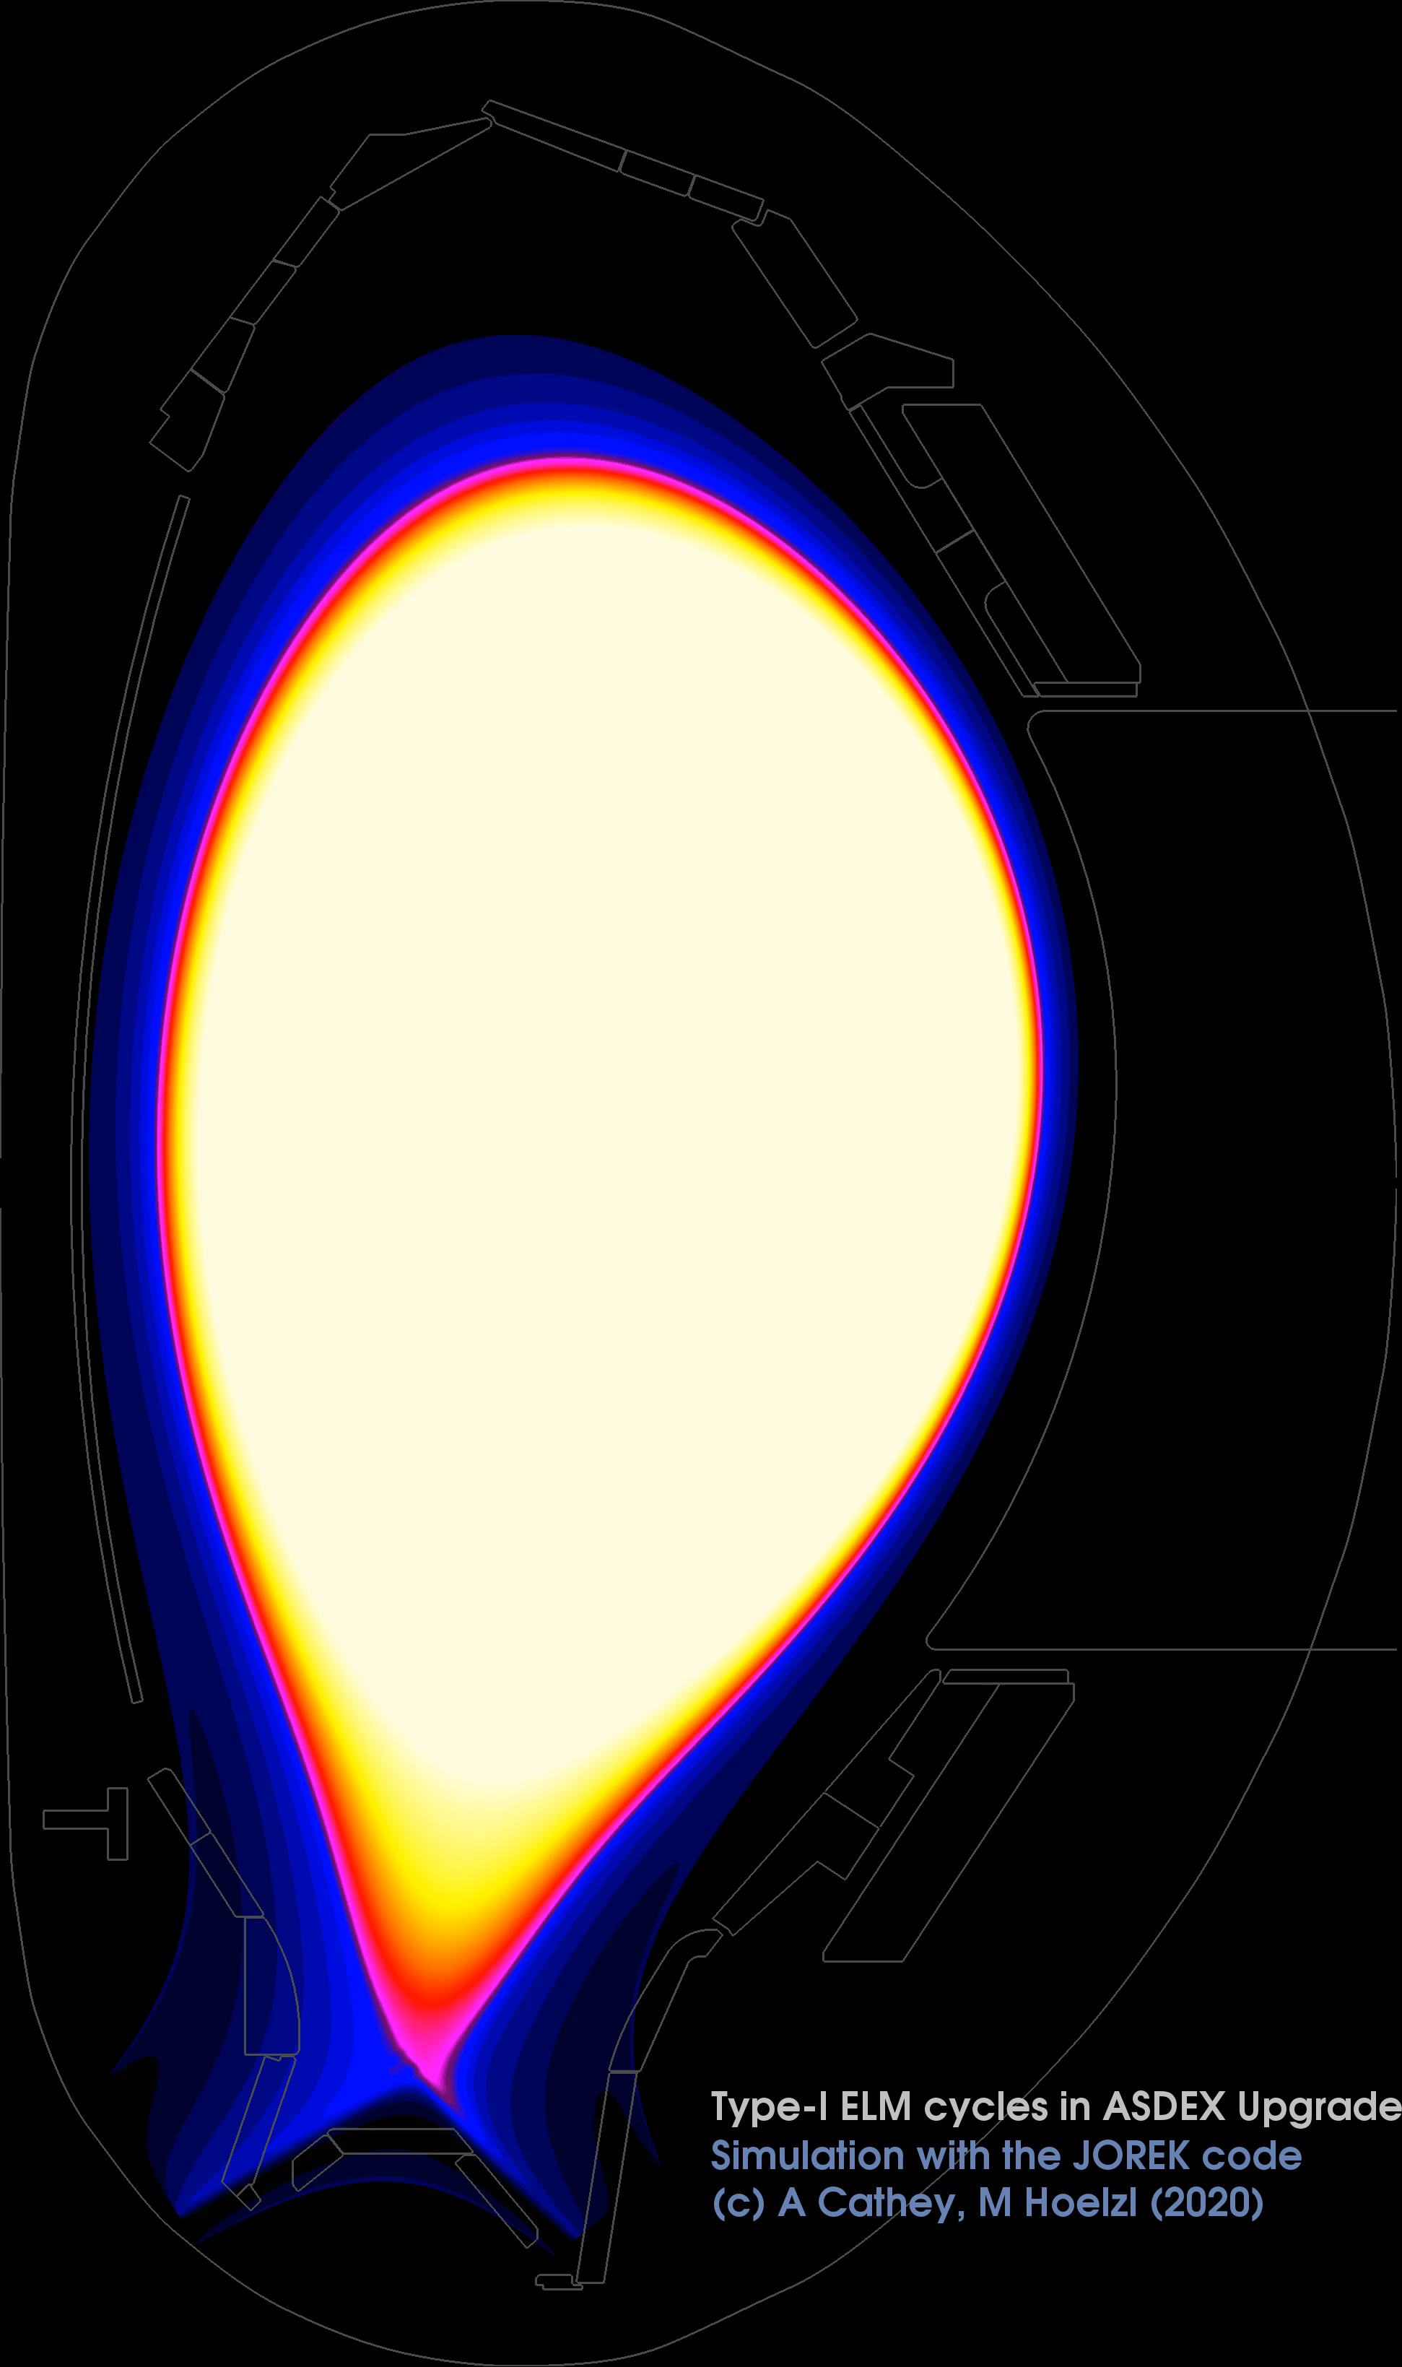
Edge localized mode cycles
A Cathey, M Hoelzl et al

Slide 12
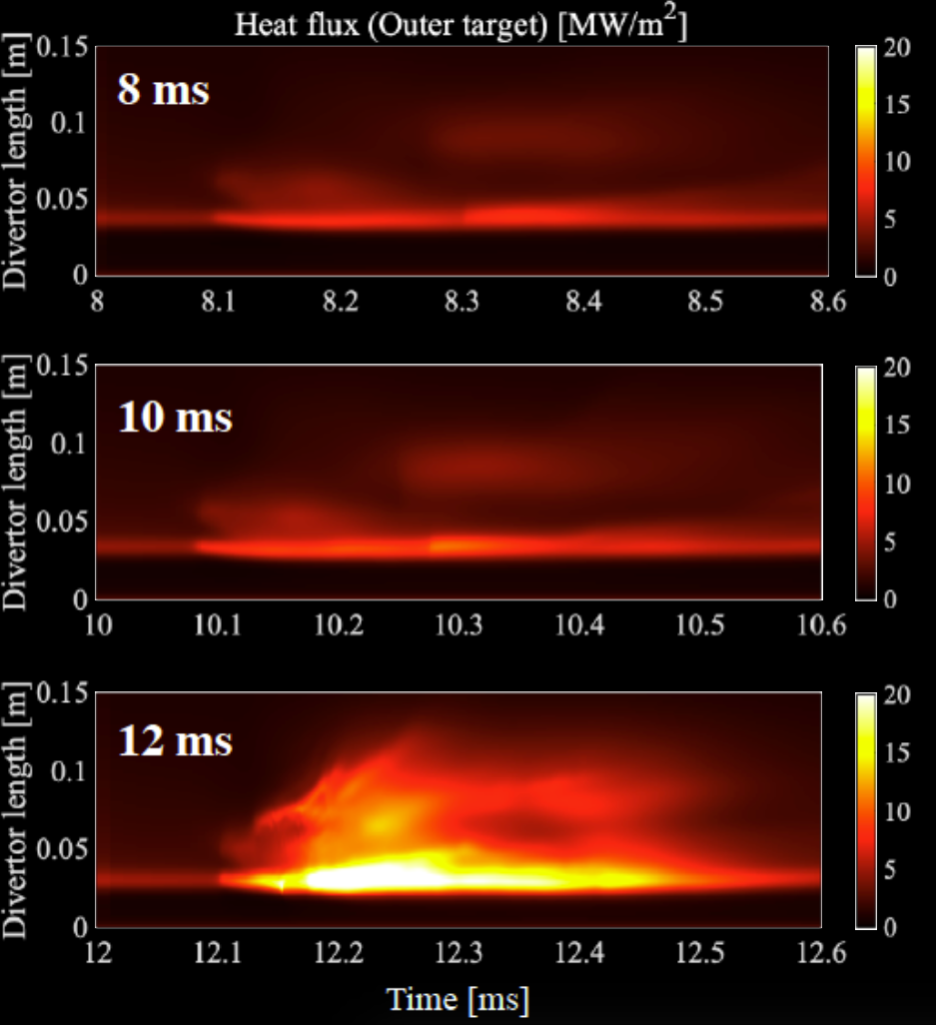
Pellet ELM triggering
An approach is to periodically inject frozen deuterium pellets to trigger ELMs before they would naturally occur – increase frequency, reduce size
Unfortunately, ELM triggering does not work immediately after a previous ELM limiting it to a fallback solution
Research continues to study how unintentional ELM triggering by fueling pellets can be avoided
S Futatani, A Cathey, M Hoelzl et al

Slide 13
Pellet ELM triggering
An approach is to periodically inject frozen deuterium pellets to trigger ELMs before they would naturally occur – increase frequency, reduce size
Unfortunately, ELM triggering does not work immediately after a previous ELM limiting it to a fallback solution
Research continues to study how unintentional ELM triggering by fueling pellets can be avoided
S Futatani, A Cathey, M Hoelzl et al

Slide 14
Pellet ELM triggering
An approach is to periodically inject frozen deuterium pellets to trigger ELMs before they would naturally occur – increase frequency, reduce size
Unfortunately, ELM triggering does not work immediately after a previous ELM limiting it to a fallback solution
Research continues to study how unintentional ELM triggering by fueling pellets can be avoided
S Futatani, A Cathey, M Hoelzl et al

Slide 15
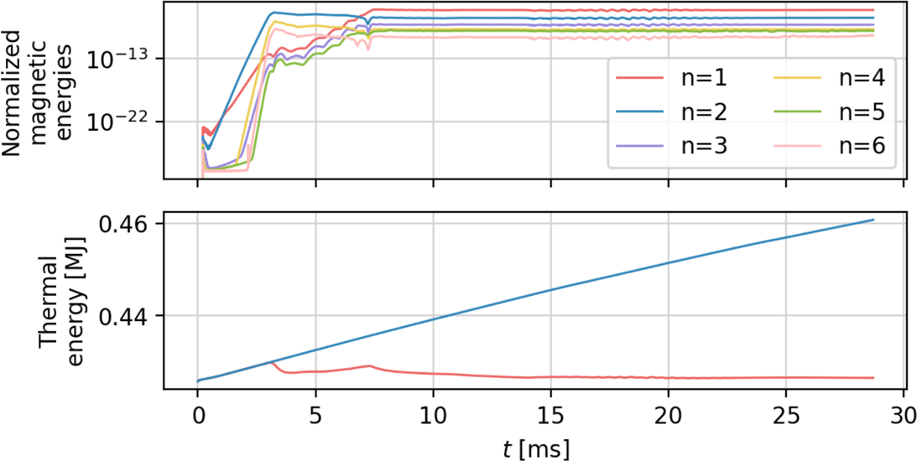
ELM free regimes
Regimes exist, where saturated or fluctuating modes at the edge of the plasma prevent pressure pedestal build-up to an ELM unstable state
A “quiescent H-mode” is such a regime and was simulated successfully for present experiments, improving the understanding significantly
Extrapolation to future devices is an area of active research
L Meier, M Hoelzl, A Cathey et al
Similar work for HL-3: Liang Z., Hoelzl M., Cathey A., et al., Physics of Plasmas 32, 012502 (2025)

Slide 16
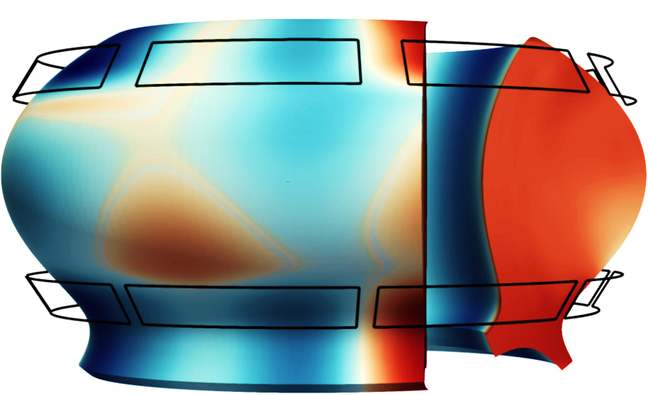
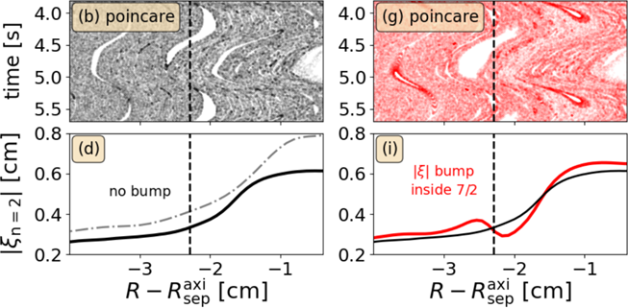
Active ELM control
Another active control technique for ELMs relies on the application of external magnetic perturbation fields – an important technique foreseen for ITER
Recent experiments and simulations proved magnetic island penetration at the pedestal top, which has been a long standing open question
Island not penetrated Island penetrated
M Willensdorfer, V Mitterauer et al

Slide 17
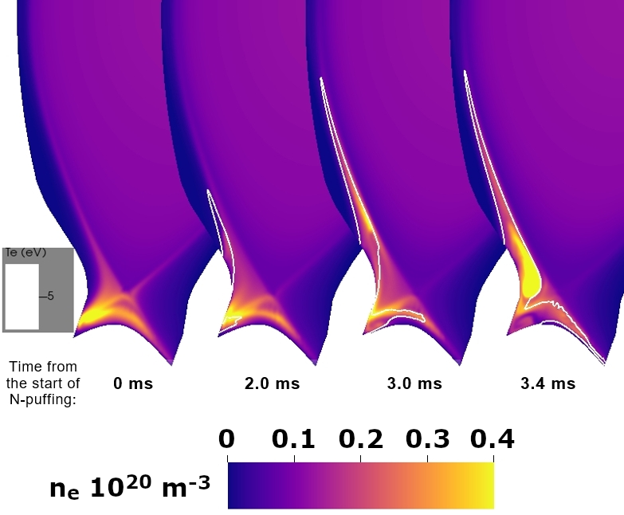
Incorporating advanced physics effects
Previously, edge MHD simulations were relying on simple models for scrape-off layer and divertor
Incorporating full-f kinetic PiC models for neutrals and impurities starts to capture the relevant physics and close this gap
Here: evolution of electron density distribution after impurity puffing
Recently demonstrated realistic XPR formation, small-ELM burn-through, time evolving detachment
S Korving et al
Y-C Liang, S Korving, M Szucs, D Maris et al
Y-C Liang et al; M Szucs et al; D Maris et al

Slide 18
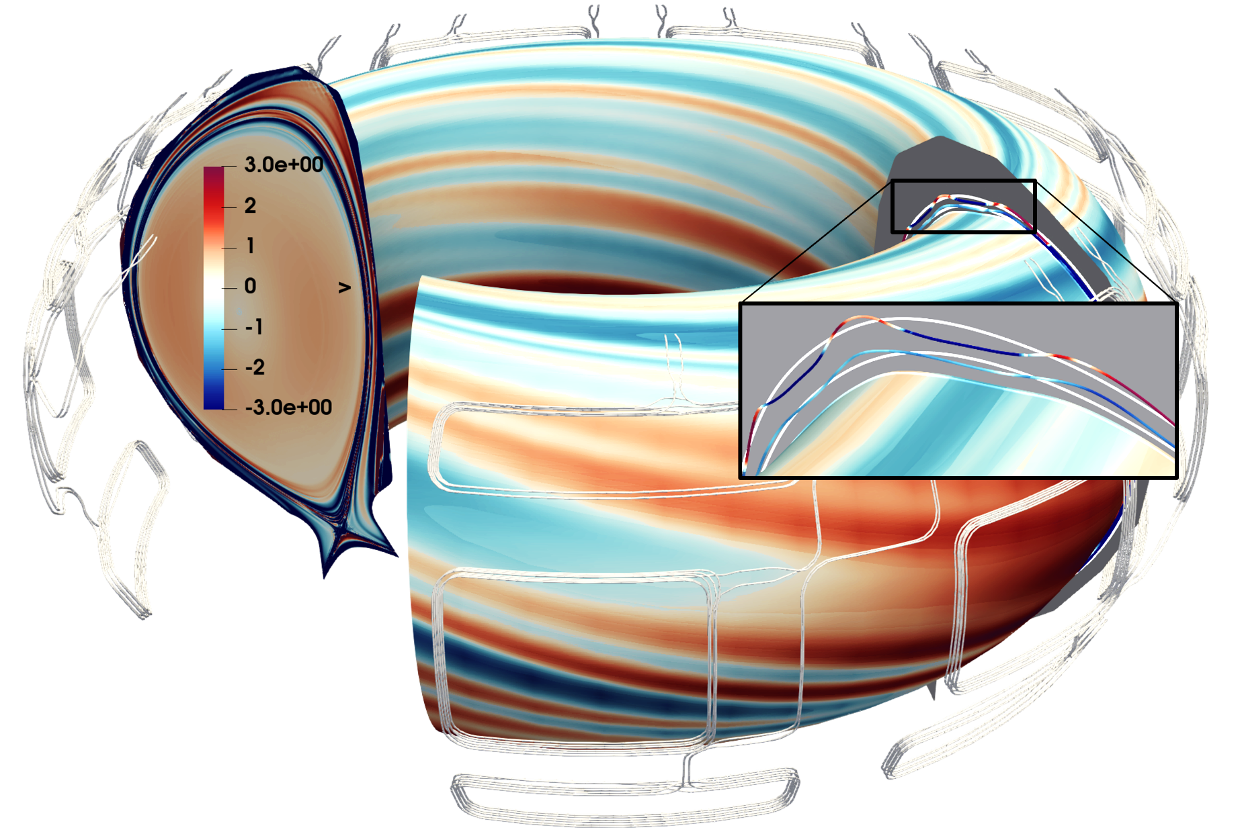
Tungsten in RMP plasmas
ITER 15 MA H-Mode plasma with RMPs applied
Tungsten transport by neoclassical processes
Found that ExB convection cells can increase tungsten penetration into the core plasma
S Korving et al

Slide 19
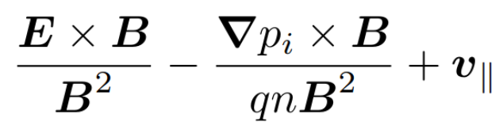
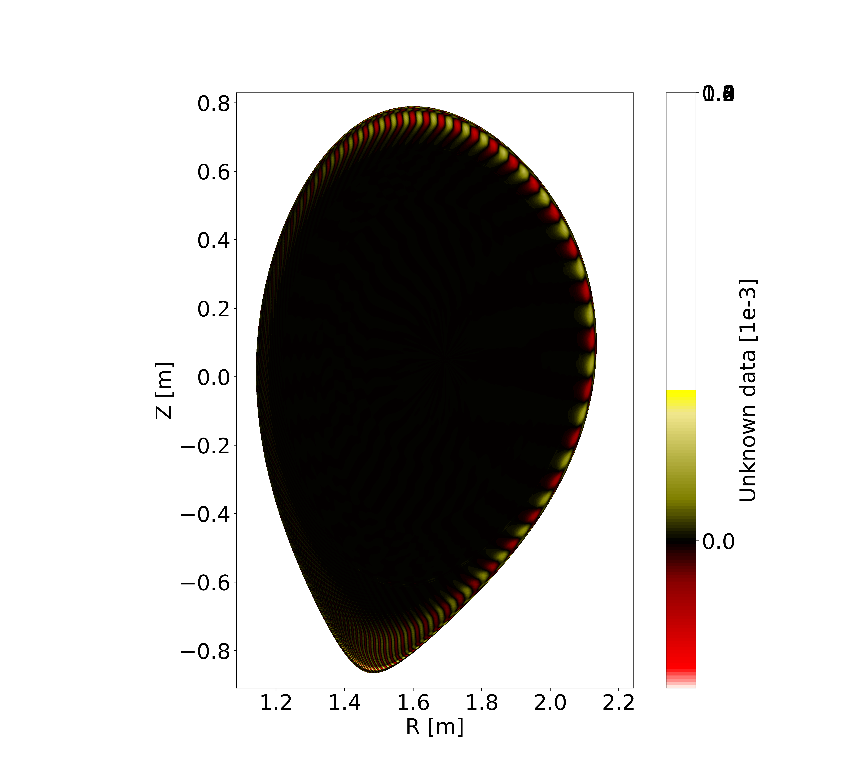
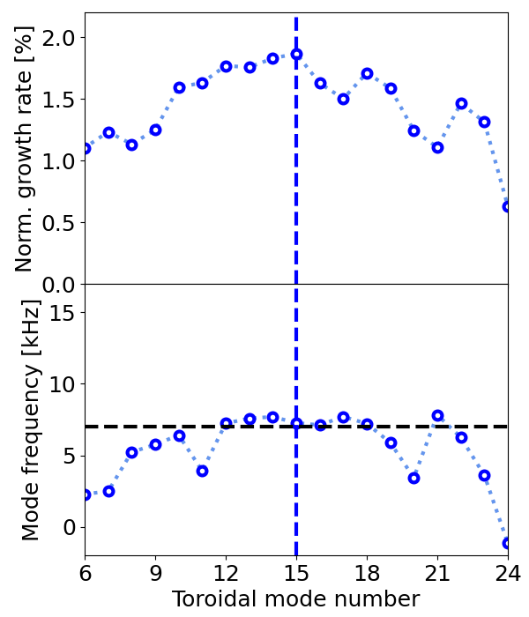
CASTOR3D: Linear extended visco-resistive MHD with neoclassical flows applied to ASDEX Upgrade
Enhanced equilibrium flow model Drift flows (ion diamagnetic + ExB) + parallel flows
Enables more accurate interpretation / prediction of experimental observations
Application to resistive ballooning modes in an AUG discharge
most unstable mode
J Puchmayr et al
Exp. mode frequency ~7kHz

Slide 20
Selected highlights from our different research fields
Edge & SOL
Core
Disruptions

Slide 21
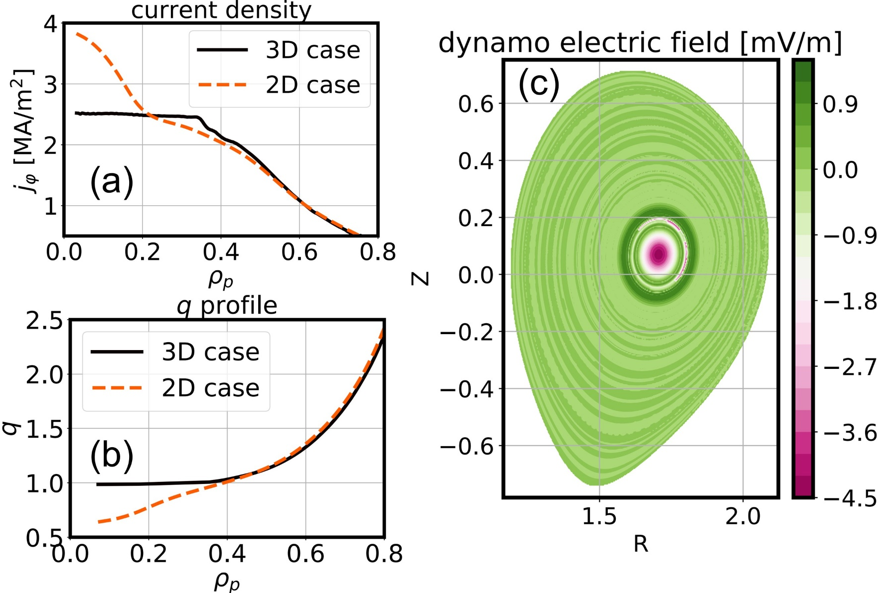
Flux pumping
Flux pumping is a method exploiting quasi-interchange mode activity for sawtooth prevention
Recent simulations for ASDEX Upgrade at fully realistic plasma parameters demonstrate the clamping of q0 to unity and quantitatively reproduce the experimental dynamo loop voltage
Also looking at EP effects
HW Zhang, M Hoelzl et al

Slide 22
Selected highlights from our different research fields
Edge & SOL
Core
Disruptions

Slide 23
Disruptions in a nutshell
Loss of temperature (Thermal quench)
Large MHD activity causes “stochastic magnetic fields” such that electrons can efficiently transport thermal energy from inside the plasma to the walls (10 keV → 100 eV). Impurity radiation reduces the temperatures further (100 eV → ~1 eV). ► Large heat loads
Loss of the plasma current (Current quench)
The strongly enhanced resistivity after the temperature drop causes the plasma current to decay on the resistive time scale.
Runaway electrons
If acceleration by the toroidal electric field exceeds the collisional drag, electrons continuously gain energy. An avalanching can set in such that a beam of relativistic electrons forms. ► Deep melting in the walls
Vertical instability
Since the plasma is vertically elongated to get good performance, it becomes vertically unstable during a disruption. ► Large electromagnetic forces
Thus, avoidance and mitigation are essential. Simulations aim to predict the efficiency in future devices.

Slide 24
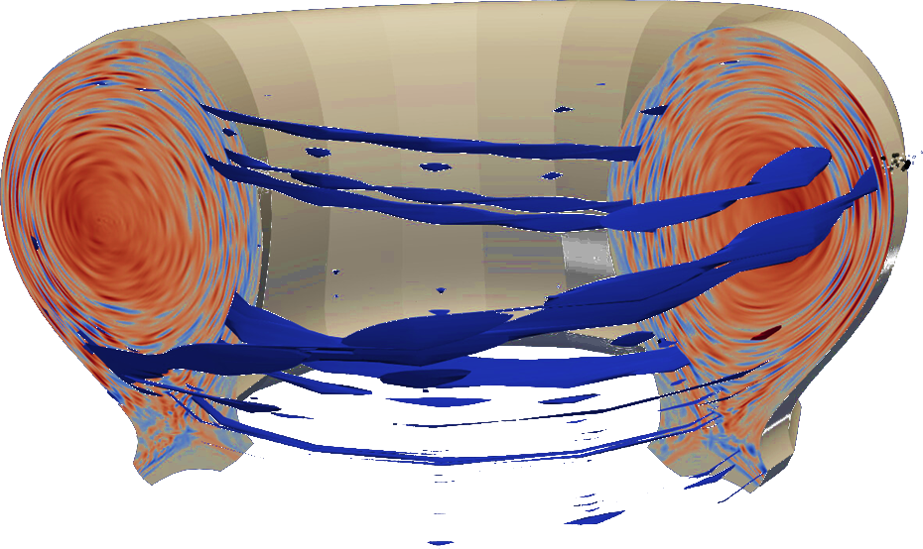
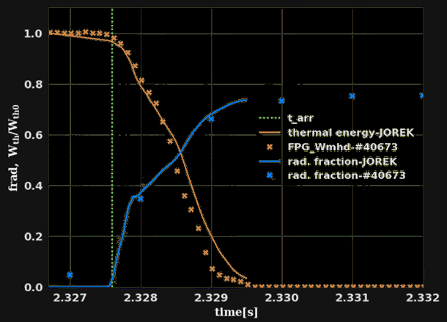
Mitigation
The leading disruption mitigation method relies on injection of “shattered pellets” (SPI) composed of deuterium and impurity doping (e.g., Neon)
Simulations of the resulting “thermal quench” and “current quench” in 3D are very challenging, but match experiments increasingly well regarding thermal collapse, impurity radiation, current evolution, etc.
AUG results are shown
There are excellent results on JET by M Kong et al, D Bonfiglio et al
W Tang, M Hoelzl et al

Slide 25
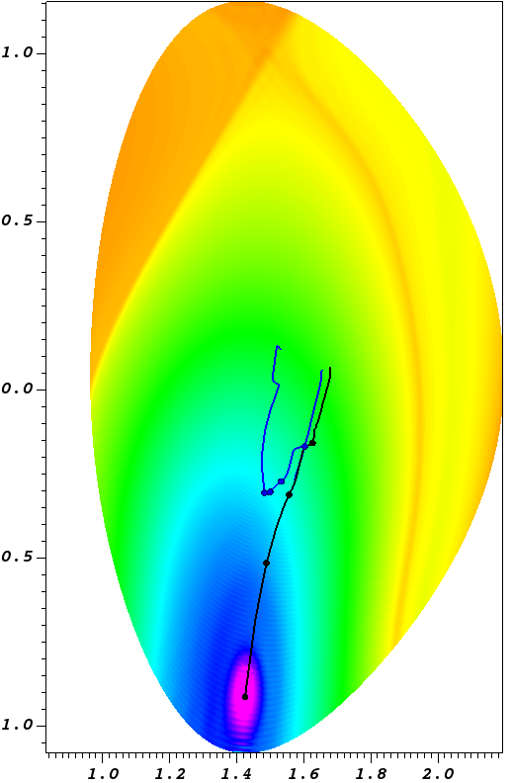
Mechanism of vertical force mitigation
Recent simulations reveal how impurity injection is able to mitigate the vertical electromagnetic forces onto the vessel
It is a result of a flattening of the current distribution across the region of the main plasma into the surrounding “vacuum region”
Simulations are in excellent agreement with dedicated experiments and allow reliable predictions for ITER
Trajectory of current centroid
Trajectory of magnetic axis
N Schwarz, FJ Artola, F Vannini, M Hoelzl et al

Slide 26
Incorporating accurate 3D plasma 3D wall effects
The horizontal forces onto future machines during a disruption are still very uncertain
To resolve this, JOREK was coupled to the 3D volumetric resistive wall code CARIDDI for eddy currents – a first of a kind 3D plasma 3D wall model
The figure shows a first application to a “vertical displacement event” in the ASDEX Upgrade tokamak
The extension to “halo currents”, which flow from the plasma directly into the walls is ongoing to complete the picture
N Schwarz, N Isernia et al

Slide 27
Selected highlights from our different research fields
Edge & SOL
Core
Disruptions
Enabling new work on
PiC / GK, REs, EPs, stellarators

Slide 28
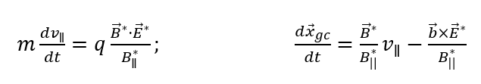


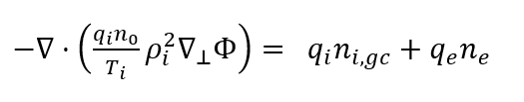
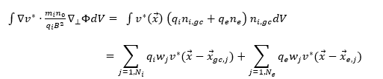


JOREK as GK Code
Ions: // and ExB motion of gyro-centers in gyro-averaged electric field. Electrons: guiding centers.
Particles initialized in JOREK MHD fields
Including SOL
Non-linear full-f
RK4 pusher
Electrostatic turbulence
GK Ions
Adiabatic/drift-kinetic electrons
Electron-ion collisions
Poisson equation for kinetic electrons solved in weak form:
Moments (particles => finite elements projections)
GTA Huijsmans, M Becoulet et al

Slide 29
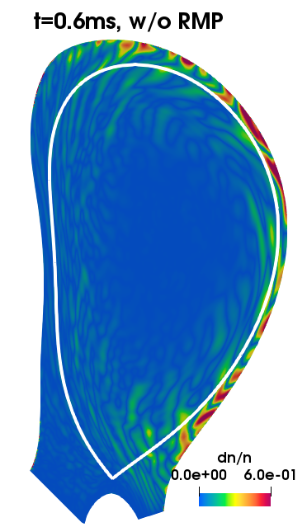
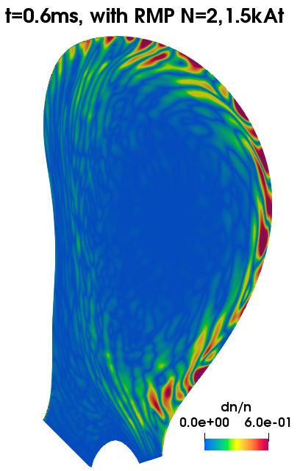
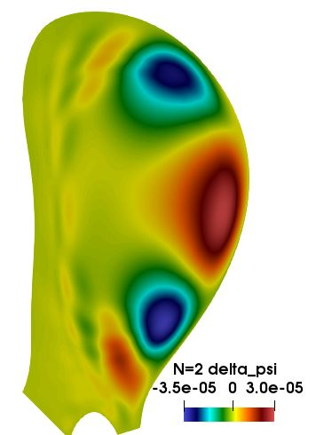
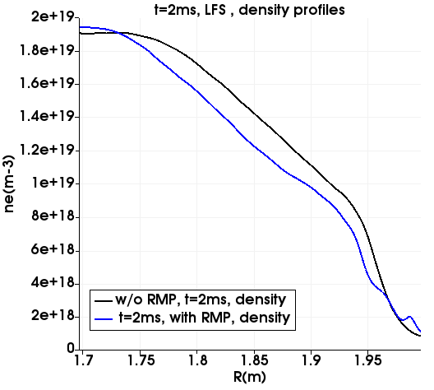
JOREK as GK Code: ITG/TEM in COMPASS L-Mode
Density fluctuations without RMPs
Magnetic flux perturbation with RMP(1.5kAt, N=2) with plasma response calculated by JOREK
Density fluctuations with RMPs are increased=> density pump-out
Density pump-out with RMPs due to increased turbulence
M Becoulet , GTA Huijsmans et al
+ broad application e.g. to turbulence in negative triangularity

Slide 30
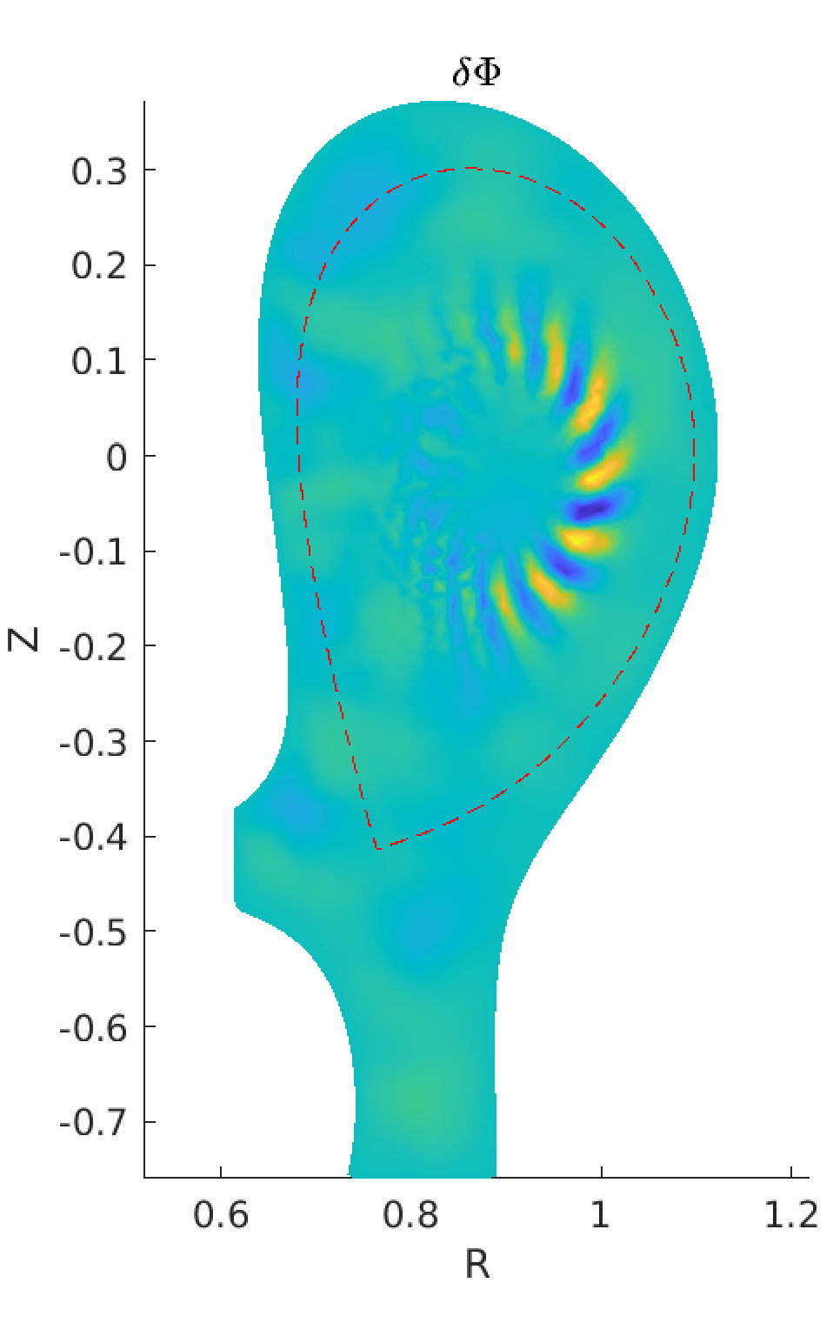
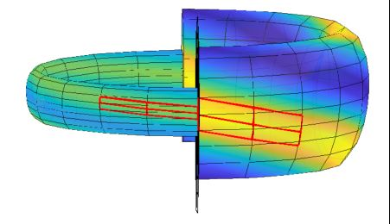
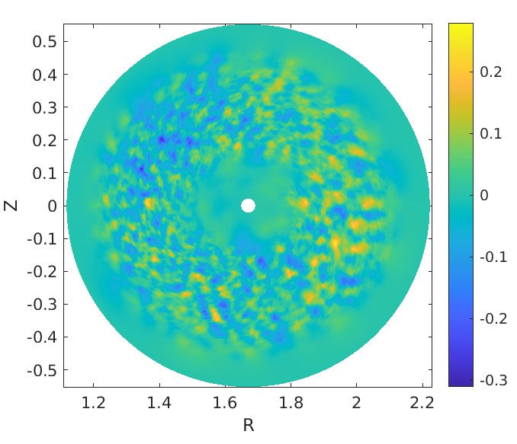
Piecewise Field-Aligned Finite Elements for Multi-Harmonic PiC Simulations in TRIMEG
Multi-harmonic simulations enhanced by the piecewise field-aligned finite element method (PFAFEM)
Traditional grid, but basis functions piecewisely field-aligned
>10× efficiency in grid and particle usage
Multi-harmonics simulations of the ion temperature gradient mode capture the nonlinear spreading of turbulence
Applicability: Core and edge across separatrix
Some methods were transferred from TRIMEG to JOREK already and some are being implemented into EUTERPE
ZX Lu et al

Slide 31
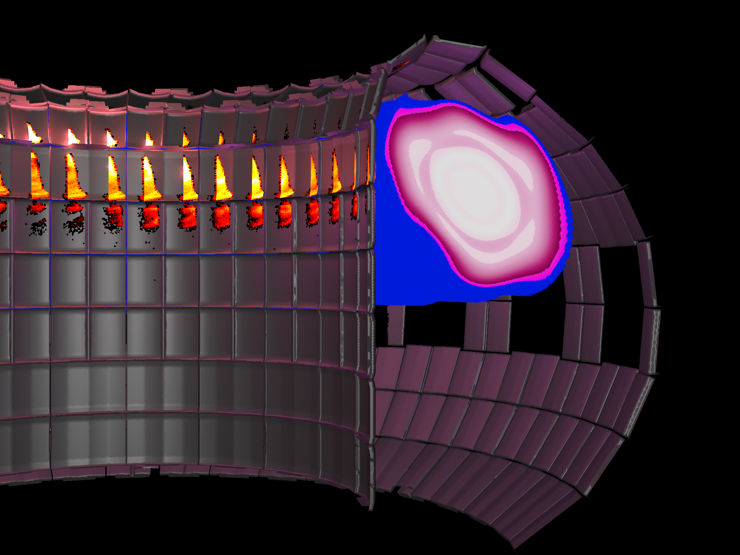
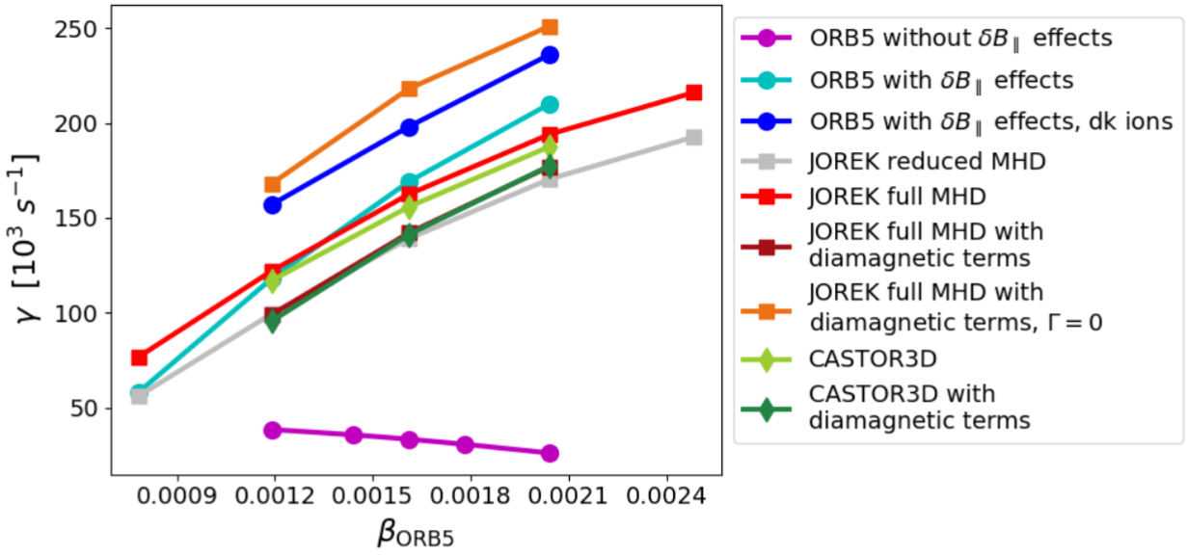
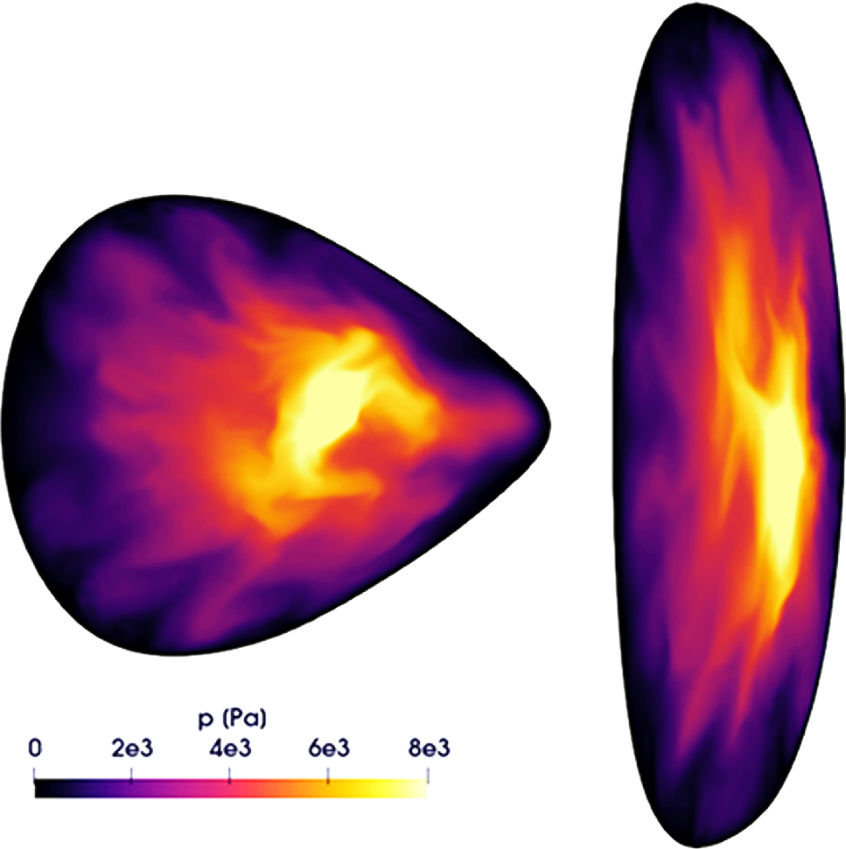
Support of further work
REs: Our work supported and to some extent enabled 3D RE beam termination studies with fluid as well as advanced hybrid fluid-kinetic models (lead by TSVV 9)
EPs: Our work supported and to some extent enabled studies of q=1 instabilities and interaction with EPs (lead by TSVV 10)
Stellarator: Our work established novel modeling capabilities in Europe to study questions regarding island divertor geometry, pellet ablation, ECCD induced core crashes, edge instabilities, and exhaust

Slide 32
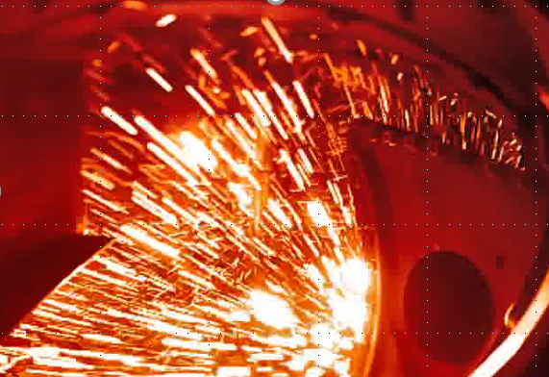
Summary
Large scale plasma instabilities
True multi-physics multi-scale full-f
Major model developments
200 pinboard entries since Mar 2022
Edge & SOL
Core
Disruptions
Enabling new work on
PiC / GK, REs, EPs, stellarators
Work of TSVVs 8 and 9 on disruptions and REs continues in TSVV-F

Slide 33
BACKUP SLIDES

Slide 34
International team (as of IAEA-FEC overview poster)
M Hoelzl¹, GTA Huijsmans², FJ Artola³, N Schwarz³, D Hu⁴, G Su^{1,5}, E Nardon², N Isernia⁶, P Rac¹, A Cathey¹, M Kong⁷, K Aleynikova¹, F Antlitz¹, T Atane¹, S Bakes⁸, V Bandaru⁹, M Becoulet², H Bergstroem¹, A Bhole¹⁰, D Bonfiglio¹¹, M Calcagno¹¹, J Carpenter¹², E Carra¹, F Cipolletta¹³, E Crovini¹⁴, V Dwarka¹⁵, L Edes⁷, E Emanuelli¹⁶, A Fil², LV Greco¹, I Holod¹, S Hu¹⁷, C Jiang⁴, T Kant^{18,3}, SK Kim¹⁹, S Korving³, A Kryzhanovskyy¹¹, SJ Lee²⁰, Y-C Liang¹, Z Liang^{21,1}, S-J Liu¹, YL Liu²¹, ZX Lu¹, D Maris^{22,3}, D Mendonca¹, V Mitterauer¹, K Munechika³, N Nikulsin¹, B Nkonga¹⁰, H Nystroem²³, K Obrejan², SJP Pamela⁸, J Puchmayr¹, L Puel^{2,3}, R Ramasamy¹, C Rogge¹, G Rubinacci⁶, L Singh², C Sommariva⁷, R Sparago^{1,3}, Y Sun⁴, M Szucs^{1,3}, W Tang¹, F Vannini¹, O Varley¹, S Ventre⁶, F Villone⁶, C Wang⁷, L Wang¹⁷, F Wouters¹, and H Zhang¹
¹Max Planck Institute for Plasma Physics, Garching and Greifswald, Germany ²CEA, IRFM, Saint-Paul-lez-Durance, France ³ITER Organization, Saint Paul Lez Durance, France ⁴School of Physics, Beihang University, Beijing, China ⁵Department of Applied Physics and Applied Mathematics, Columbia University, New York, USA ⁶Consorzio CREATE, Universita degli Studi di Napoli Federico II, Napoli, Italy ⁷EPFL, Swiss Plasma Center SPC, CH-1015 Lausanne, Switzerland ⁸UKAEA, Abingdon, Oxfordshire, UK ⁹Indian Institute of Technology, Guwahati, India ¹⁰University Cote d’Azur and Inria d’UniCA, Nice Sophia-Antipolis, France ¹¹Consorzio RFX and CNR-ISTP Padova, Italy ¹²Department of Physics, Durham University, Durham, United Kingdom ¹³Barcelona Supercomputing Center (BSC), Placa d’Eusebi Guell, 1-3, 08034 Barcelona, Spain ¹⁴Department of Mathematics, Imperial College London, United Kingdom ¹⁵Delft University of Technology, Delft, the Netherlands ¹⁶NEMO Group, Dipartimento Energia, Politecnico di Torino, Torino, Italy ¹⁷Southwestern Institute of Physics, Chengdu, China ¹⁸Institute for Plasma Research (IPR), Gandhinagar, India ¹⁹Princeton Plasma Physics Laboratory, Princeton, USA ²⁰Seoul National University, Seoul, Republic of Korea ²¹School of Physics, Dalian University of Technology, Dalian, China ²²DIFFER, Eindhoven, The Netherlands ²³KTH Royal Institute of Technology, Stockholm, Sweden

Slide 35
Selected recent publications
See also: https://www.jorek.eu/ and https://mhoelzl.home.ipp.mpg.de/
Edge / SOL
Liu YL, Liang Z, Feng Y, Bai JS, Wang YM, Liang YF, Hu D, Hoelzl M, Dai SY, JOREK Team. JOREK simulations of ELM effects on heat load and target erosion in the EHL-2 spherical torus (in preparation)
Liu YL, Hu D, Dai SY, Liang Z, Gao ZH, Hoelzl M, Korving SQ, Huijsmans GTA, Wang L, Wang DZ, JOREK Team. Simulations of tungsten sputtering and transport behaviors on EAST using JOREK. Nuclear Fusion 65, 076014 (2025)
Liang Z., Hoelzl M., Cathey A., Hu D., Dai S. Y., Liu Y.L., Wang D. Z., the JOREK Team. Exploration of quiescent H-mode plasma on HL-3 tokamak device with nonlinear MHD simulations. Physics of Plasmas 32, 012502 (2025)
Willensdorfer M, Mitterauer V, Hoelzl M, Suttrop W, Cianciosa M, Dunne M, Fischer R, Leuthold N, Puchmayr J, Samoylov O, Suarez G, Wendler D, ASDEX Upgrade Team. Observation of magnetic islands in tokamak plasmas during the suppression of edge-localised modes. Nature Physics 20, 1980 (2024)
Cathey A., Hoelzl M., Meier L., Dunne M.G., Huijsmans G.T.A., Gil L., Harrer G.F., Aiba N., Cruz-Zabala D.J., Lackner K., Pamela S.J.P., Viezzer E., Wolfrum E., Günter S., the JOREK team, the ASDEX Upgrade Team, the EUROfusion MST Team. Non-linear MHD investigations of high-confinement regimes without type-I ELMs in ASDEX Upgrade and JT-60SA. Nuclear Fusion 64, 096003 (2024)
Korving S.Q., Mitterauer V., Huijsmans G.T.A., Loarte A., Hoelzl M., JOREK team, ASDEX Upgrade team. Simulation of neoclassical heavy impurity transport in ASDEX Upgrade with applied 3D magnetic fields using the nonlinear MHD code JOREK. Physics of Plasmas 31, 052504 (2024)
Kim S.K., Logan N.C., Becoulet M., Hoelzl M., Yu Q., Hu Q., Yang S.M., Park J.-M., Huijsmans G.T.A., Pamela S., Kolemen E., Paz-Soldan C. Transition in particle transport under resonant magnetic perturbations in a tokamak. Nuclear Fusion 63, 106013 (2023)
Meier L, Hoelzl M, Cathey A, Huijsmans GTA, Viezzer E, Dunne M, van Dijk J. et al. MHD simulations of formation, sustainment and loss of Quiescent H-mode in the all-tungsten ASDEX Upgrade. Nuclear Fusion 63, 086026 (2023). https://arxiv.org/abs/2301.07607
Cathey A., Hoelzl M., Gil L., Dunne M.G., Harrer G.F., Huijsmans G.T.A., Kalis J., Lackner K., Wolfrum E., Pamela S.J.P., Günter S., JOREK Team, ASDEX Upgrade Team, EUROfusion MST1 Team. Probing non-linear MHD stability of the enhanced D-alpha H-mode in ASDEX Upgrade. Nuclear Fusion 63, 062001 (2023). http://arxiv.org/abs/2301.09066
Disruptions / VDEs / REs / SPI
Ratynskaia S, Paschalidis K, Rizzi T, Tolias P, Pitts RA, Artola FJ, Bergstroem H, Bandaru VK, Hoelzl M, Nicolici S. Thermal resilience of the ITER tungsten first wall to runaway electron impact. Plasma Physics and Controlled Fusion (submitted) https://arxiv.org/abs/2509.20261
Liu S-J, Liu T, Bergstroem H, Zhang H-W, Hoelzl M, JOREK Team. Hybrid fluid-kinetic simulations of resistive instabilities in runaway electron beams. Journal of Plasma Physics (submitted)
Bonfiglio D., Hu D., Kong M., Nardon E., Artola F.J., Baylor L.R., Boboc A., Carvalho P., Gebhart T.E., Gerasimov S.N., Hawkes N.C., Hoelzl M., Jachmich S., Lee S.-J, Puglia P, Sheikh U., Silburn S., Stein-Lubrano B., Sun H., Sweeney R., Szepesi G, JOREK Team, JET Contributors. Validation of 3D MHD simulations of mixed Ne-D2 shattered pellet injection in JET. Nuclear Fusion (in preparation)
Isernia N, Sparago R, Artola J, Hoelzl M, Rubinacci G, Schwarz N, Ventre S, Villone F. Virtual Casing Principle in presence of sink/source currents. IEEE Transactions on Magnetics (submitted)
Ratynskaia S, Hoelzl M, Nardon E, Aleynikov P, Artola F.J, Bandaru V, Beidler M, Breizman B, del-Castillo-Negrete D, DeAngeli M, Dimitriou V, Ding R, Eriksson J, Ficker O, Granetz RS, Hollmann E, Hoppe M, Houry M, Jepu I, Koslowski HR, Liu C, Martin-Solis JR, Pautasso G, Peneliau Y, Pitts RA, Pokol G, Reux C, Sheikh U, Silburn SA, Tang T, Tinguely RA, Tolias P, Tomesova E, Villari R: Runaway electron-induced plasma facing component damage in tokamaks. Plasma Physics and Controlled Fusion (submitted) https://arxiv.org/abs/2506.10411
Emanuelli E, Vannini F, Hoelzl M, Schwarz N, Nardon E, Bandaru V, Bonfiglio D, Kryzhanovskyy A, Ramogida G, Subba F, JOREK Team. Simulation of runaway electron generation in the Day-0 scenario of DTT. Fusion Engineering and Design (submitted)
Tang W, Hoelzl M, Lehnen M, Hu D, Artola FJ, Halldestam P, Heinrich P, Jachmich S, Nardon E, Papp G, Patel A, ASDEX Upgrade Team, EUROfusion WP TE Team, JOREK Team. Non-linear shattered pellet injection modelling in ASDEX Upgrade. Nuclear Fusion (accepted). https://arxiv.org/abs/2412.03112
Sparago R, Artola FJ, Hoelzl M. Self-consistent full MHD coupling of JOREK and STARWALL for advanced plasma free boundary simulation. Plasma Physics and Controlled Fusion 67, 045021 (2025) https://arxiv.org/abs/2501.05956
Vannini F, Bandaru V, Bergstroem H, Schwarz N, Artola FJ, Hoelzl M, Pautasso G, Nardon E, Maviglia F, Richiusa ML, Emanuelli E, JOREK Team. Runaway electron beam formation, vertical motion, termination and wall loads in EU-DEMO. Nuclear Fusion 65, 046006 (2025). https://arxiv.org/abs/2407.03940
Bergstroem H, Liu S-J, Bandaru V, Hoelzl M. Introduction of a 3D global non-linear full-f particle-in-cell model for runaway electrons in JOREK. Plasma Physics and Controlled Fusion 67, 035004 (2025)
Bandaru V., Hoelzl M., Artola F.J., Lehnen M., JOREK Team. Axisymmetric predictions for mitigated vertically unstable disruptions in ITER with runaway electrons. Journal of Plasma Physics 91, E27 (2025). https://arxiv.org/abs/2406.09703
Wang C, Nardon E, Artola FJ, Bandaru V, Hoelzl M, Simulation of runaway electron generation during disruptions with vertical motion of the plasma in ITER. Nuclear Fusion 65, 016012 (2024)
Lee S.-J., Hu D., Lehnen M., Nardon E., Kim J., Bonfiglio D., Artola F.J., Hoelzl M. , Na Y.-S., JOREK team. Nonlinear MHD modelling of Neon Doped Shattered Pellet Injection with JOREK and Its Comparison to Experiments in KSTAR. Nuclear Fusion 64, 106042 (2024)
Bandaru V, Hoelzl M, Artola FJ, Vallhagen O, Lehnen M, JOREK Team. Runaway electron fluid model extension in JOREK and ITER relavant benchmarks. Physics of Plasmas 31, 082503 (2024)
Bergström H, Särkimäki K, Bandaru V, Skyllas MM, Hoelzl M, JOREK Team. Assessment of runaway electron load distribution in ITER during 3D MHD induced beam termination. Plasma Physics and Controlled Fusion 66, 095001 (2024)
Liu S-J, Wang F, Hu D, Wang Z-X, JOREK Team. Transport characteristic evaluation of runaway electrons in an ITER disruption simulation. Plasma Physics and Controlled Fusion 66, 085016 (2024).
Hu D., Artola F.J., Nardon E., Lehnen M., Kong M., Bonfiglio D., Hoelzl M., Huijsmans G.T.A., JOREK Team. Plasmoid drift and first wall heat deposition during ITER H-mode dual-SPIs in JOREK simulations. Nuclear Fusion 64, 086005 (2024)
Bandaru V, Hoelzl M, Bergstroem H, Artola FJ, Saerkimaeki K, Lehnen M, JOREK Team. Assessment of runaway electron beam termination and impact in ITER. Nuclear Fusion 64, 076053 (2024)
Kong M, Nardon E, Hoelzl M, Bonfiglio D, Hu D, Lee S-J, Samulyak R, Shekh UA, Silburn SA, Artola FJ et al, Interpretative 3D MHD modelling of deuterium SPI into a JET H-mode plasma. Nuclear Fusion 64, 066004 (2024)
Artola FJ, Schwarz N, Vannini F, Gerasimov S, Loarte A, Hoelzl M, Lehnen M, JOREK Team. Modeling of Vertical Displacement Events in tokamaks: status and challenges. Plasma Physics and Controlled Fusion 66, 055015 (2024)
Isernia N, Schwarz N, Artola FJ, Ventre S, Hoelzl M, Rubinacci G, Villone F, JOREK Team. Self-consistent coupling of JOREK and CARIDDI: On the electromagnetic interaction of 3D tokamak plasmas with 3D volumetric conductors. Physics of Plasmas 30 113901 (2023)
Schwarz N, Artola FJ, Vannini F, Hoelzl M, Bernert M, Bock A, Driessen T, Dunne M, Giannone L, Heinrich P, de Marne P, Papp G, Pautasso G, Gerasimov S, ASDEX Upgrade Team, JET Contributors, JOREK Team. The mechanism of the global vertical force reduction in disruptions mitigated by massive material injection. Nuclear Fusion 63 126016 (2023)
Bandaru V., Hoelzl M. Tokamak equilibria with relativistic runaway electrons. Physics of Plasmas 30, 092508 (2023)
Nardon E., Särkimäki K., Artola F.J., Sadouni S., JOREK Team, JET contributors. On the origin of the plasma current spike during a tokamak disruption and its relation with magnetic stochasticity. Nuclear Fusion 63, 056011 (2023)
Hu D, Nardon E, Artola FJ, Lehnen M, Bonfiglio D, Hoelzl M, Huijsmans GTA, Lee S-J, JOREK Team. Collisional-radiative simulation of impurity assimilation, radiative collapse and MHD dynamics after ITER Shattered Pellet Injection. Nuclear Fusion 63, 066008 (2023).
Nardon E., Särkimäki K., Artola F.J., Sadouni S., JOREK Team, JET Contributors. On the origin of the plasma current spike during a tokamak disruption and its relation with magnetic stochasticity. Nuclear Fusion 63, 056011 (2023)
Schwarz N, Artola FJ, Hoelzl M, Bernert M, Brida D, Giannone L, Maraschek M, Papp G, Pautasso G, Sieglin B, Zammuto I, ASDEX Upgrade Team, JOREK Team. Experiments and non-linear MHD simulations of hot vertical displacement events in ASDEX Upgrade. Plasma Physics and Controlled Fusion 65, 054003 (2023) https://iopscience.iop.org/article/10.1088/1361-6587/acc358/meta
Core / EPs
Antlitz F, Wang X, Hoelzl M, Huijsmans GTA, Zhang H, Puchmayr J, Lauber Ph, Hayward-Schneider T, Mishchenko A, E Poli, Lu ZX, JOREK Team. Comparisons of MHD and gyrokinetic simulations of linear instabilities at the q=1 surface (in preparation)
Feng Y, Liu YL, Liang Z, Huang XL, Liu B, Hu D, Hoelzl M, Dai SY, JOREK Team. JOREK predictive simulation of boron pellet injection in the EHL-2 spherical torus (in preparation)
Zhang H, Hoelzl M, Krebs I, Burckhart A, Bock A, Guenter S, Igochine V, Lackner K, Yu Q, Zohm H, JOREK Team. Quantitative magnetohydrodynamic modelling of flux pumping in AUG. Nuclear Fusion 65, 066001 (2025) https://arxiv.org/abs/2503.03344
Kong M, Nardon E, Bonfiglio D, Hoelzl M, Hu D, JOREK Team, EUROfusion TE Team. 3D MHD modelling of plasmoid drift following massive material injection in a tokamak. Nuclear Fusion 65, 016042 (2024)
Nardon E., Bandaru V., Hoelzl M., Artola F.J., Maget P., the JOREK team, JET contributors. Non-linear dynamics of the double tearing mode. Physics of Plasmas 30, 092502 (2023)
Stellarator
Ramasamy R, Zhang H, Geiger J, Nührenberg C, Smith HM, Lackner K, Igochine V, JOREK Team. A comparison of low-n Mercier unstable Wendelstein stellarators and quasi-interchange modes in tokamaks. Journal of Plasma Physics 91, E119 (2025). https://arxiv.org/abs/2505.03987
Ramasamy R., Aleynikova K., Nikulsin N., Hindenlang F., Holod I., Strumberger E., Hoelzl M., JOREK Team. Nonlinear MHD modeling of soft beta limits in W7-AS. Nuclear Fusion 64, 086030 (2024). https://arxiv.org/abs/2402.02881
Ramasamy R, Hoelzl M, Henneberg S, Strumberger E, Lackner K, Guenter S. How well can VMEC predict the initial saturation of external kink modes in near circular tokamaks and $l=2$ stellarators. Physics of Plasmas. Physics of Plasmas 30, 062506 (2023). https://arxiv.org/abs/2302.13291
Numerics / Review
Pamela S.J.P., Carey N., Brandstetter J., Akers R., Zanisi L., Buchanan J., Gopakumar V., Hoelzl M., Huijsmans G., Pentland K., James T., Antonucci G., JOREK Team. Neural-Parareal: Dynamically Training Neural PDE Solvers as Coarse Approximators for Time-Parallelisation of Fusion MHD Simulations. Computer Physics Communications 109391 (2024) https://arxiv.org/abs/2405.01355
Hoelzl M, Huijsmans GTA, Artola FJ, Nardon E, Becoulet M, Schwarz N, Cathey A, Pamela SJP, Aleynikova K, Antlitz F, Bandaru V, Bergstrom H, Bhole A, Bogaarts T, Bonfiglio D, Cipolletta F, Driessen T, Eides L, Futatani S, Hao G, Hindenlang F, Holod I, Hu D, Hu S, Isernia N, Isliker H, Kim SK, Kong M, Korving S, Kos L, Krebs I, Lee SJ, Liang Y-C, Liang Z, Liu S-J, Lu ZX, Meier L, Messfeldt L, Mitterauer V, Nikulsin N, Nkonga B, Ramasamy R, Reinking J, Rogge C, Rubinacci G, Sarkimaki K, Smits T, Sommariva C, Sparago R, Strien K, Szucs M, Tang W, van Tongeren J, Vannini F, Ventre S, Villone F, Wang C, Wang L, Wieschollek F, Wouters F, Zielinski J, Zhang H. Non-linear MHD modelling of transients in tokamaks: Recent advances with the JOREK code. Nuclear Fusion 64, 112016 (2024)
Cipolletta F., Schwarz N., Hoelzl M., Ventre S., Isernia N., Rubinacci G., Soba A., JOREK~Team. Implementation of matrix compression for the coupling of JOREK to the 3D realistic conducting wall structures. Plasma Physics and Controlled Fusion 66, 105009 (2024)
Bhole A, Nkonga B, Costa J, Huijsmans GTA, Pamela SJP, Hoelzl M, JOREK team. Stabilized Bi-cubic Hermite Bezier Finite Element Method with Application to Gas-Plasma Interactions Occurring During Massive Material Injection in Tokamaks. Computers and Mathematics with Applications 142, 225-226 (2023). Preprint: http://dx.doi.org/10.2139/ssrn.4359796

Slide 36
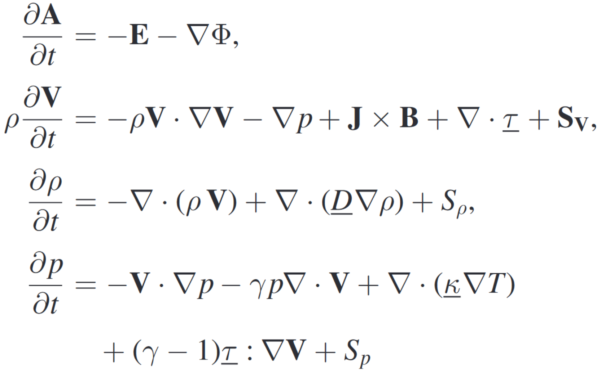
Physics models used in the JOREK code
Magneto-hydrodynamics (MHD) in different flavors and with various extensions
Kinetic full-f PiC for specific particle species coupled to the MHD, e.g., neutrals, impurities, energetic ions, relativistic electrons, …
There is a full MHD variant as well as a reduced MHD variant (neglecting δB||)

Slide 37
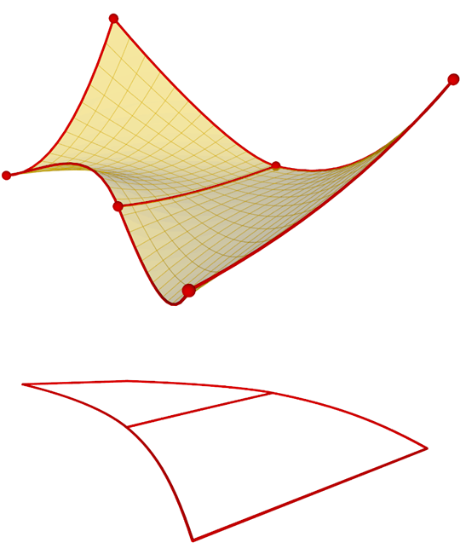
Numerical methods: Spatial discretization
2D iso-parametric G¹ continuous Bezier finite elements (or higher order)
Toroidal Fourier decomposition
Shock capturing
TG and VMS stabilization
In contrast to turbulence codes, no alignment of the grid to the magnetic field, only to initial flux surfaces, due to the extremely dynamic nature of most phenomena of interest

Slide 38
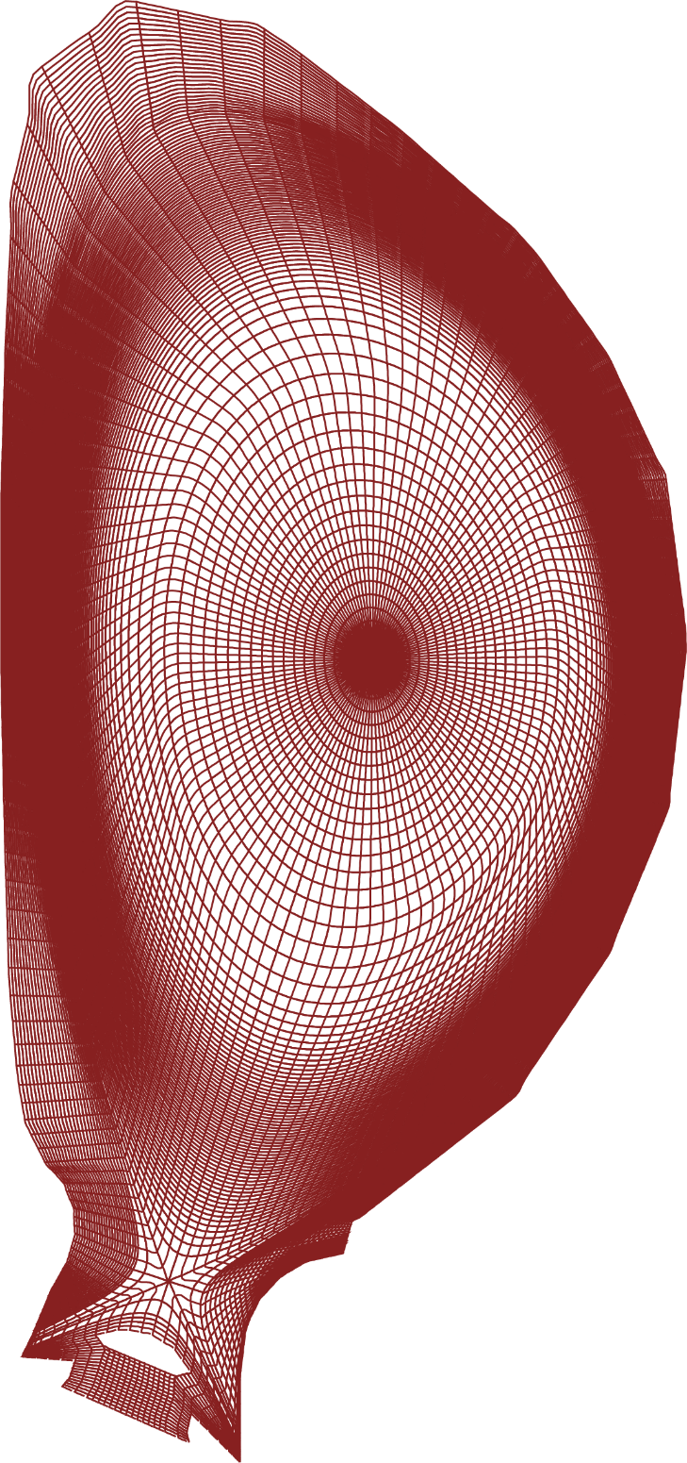
Numerical methods: Spatial discretization
2D iso-parametric G¹ continuous Bezier finite elements (or higher order)
Toroidal Fourier decomposition
Shock capturing
TG and VMS stabilization
In contrast to turbulence codes, no alignment of the grid to the magnetic field, only to initial flux surfaces, due to the extremely dynamic nature of most phenomena of interest
ITER example case SJP Pamela et al

Slide 39
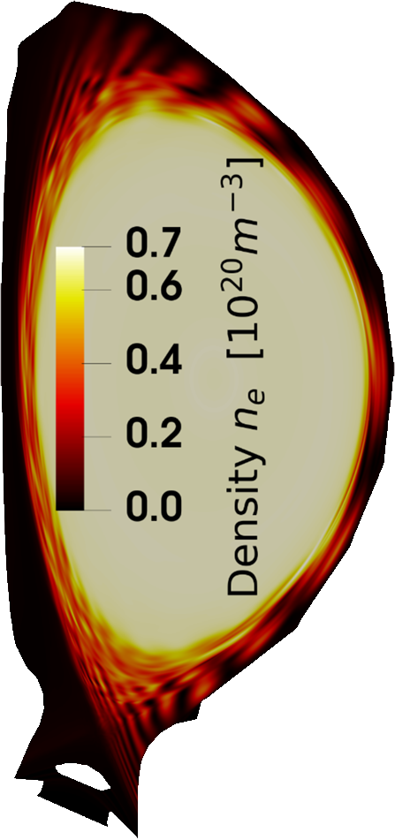
Numerical methods: Spatial discretization
2D iso-parametric G¹ continuous Bezier finite elements (or higher order)
Toroidal Fourier decomposition
Shock capturing
TG and VMS stabilization
In contrast to turbulence codes, no alignment of the grid to the magnetic field, only to initial flux surfaces, due to the extremely dynamic nature of most phenomena of interest
ITER example case SJP Pamela et al

Slide 40
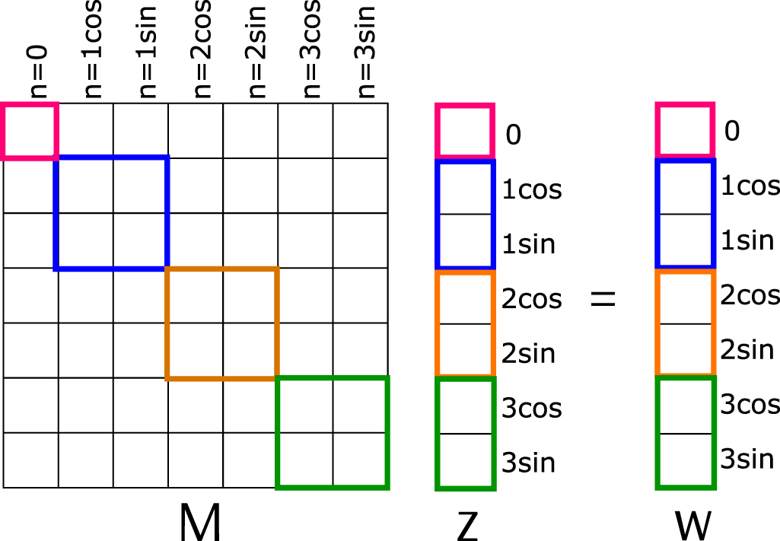
Problem size, solver and preconditioner
I Holod, M Hoelzl et al
Time integration is fully implicit to avoid excessive CGL criteria (e.g., parallel heat conduction)
Requires solving enormous sparse matrix systems
Large example: dimension 40 million, 500 billion non-zero entries
Selection of iterative solvers including gmres and bicgstab
Hybrid MPI + OpenMP
Non-linear time stepping
Hand-written preconditioner solving blocks of the matrix directly
We work with experts on optimizing our iterative solver algorithms.

Slide 41
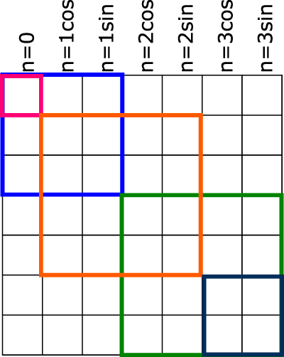
Problem size, solver and preconditioner
I Holod, M Hoelzl et al
Time integration is fully implicit to avoid excessive CGL criteria (e.g., parallel heat conduction)
Requires solving enormous sparse matrix systems
Large example: dimension 40 million, 500 billion non-zero entries
Selection of iterative solvers including gmres and bicgstab
Hybrid MPI + OpenMP
Non-linear time stepping
Hand-written preconditioner solving blocks of the matrix directly
We work with experts on optimizing our iterative solver algorithms.

Slide 42
HPC
Our community has projects on HPC systems worldwide including Germany, France, Italy, Japan, China, Korea, USA, Switzerland, …
Many Intel based, some AMD based, but also Tianhe, …
Limited library dependencies, fairly easily portable
Accelerated platforms (GPUs) are presently a main focus of numerics/HPC work
Hybrid fluid-kinetic production simulations have very recently been demonstrated both for AMD and Nvidia based systems
Main challenges
Huge sparse matrix systems
Memory bandwidth limited
High memory demand
Double precision floating point accuracy

Slide 43
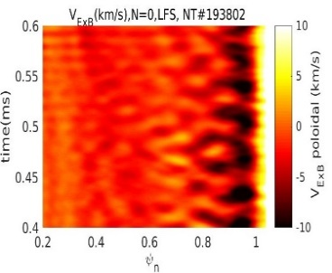
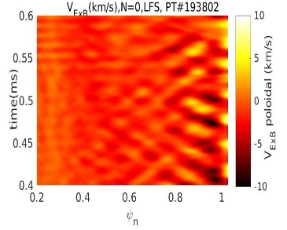
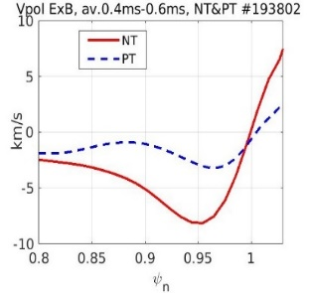
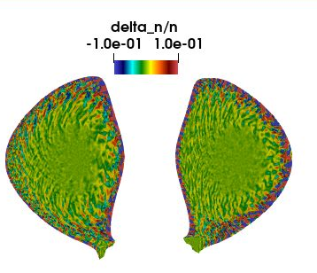
Non-linear gyrokinetic Ion Temperature Gradient and Trapped Electron Mode turbulence modelling in X-point geometry in negative and positive triangularity.
Collaboration: IRFM: Gyzela team, USA: GA, San Diego, LA Univ.,Germany: IPP Garching; Switzerland: EPFL, Netherlands: Eindhoven University of Technology .
Motivation: High confinement similar to H-mode, but without high pedestal and ELMs. TCV, DIII-D, AUG, WEST experiments, reactors design?
Main discoveries (simulations of DIII-D experiment):
Stronger and more sheared zonal flows in NT especially at the edge.
Smaller correlation length of density fluctuations in NT.
Bohm ρ* scaling in NT but NT generally performs better than PT.
Weak dependence on collisionality ν* (for tested here cases).
Intrinsic edge counter-current toroidal rotation in NT, co-current in PT.
NT
PT

