Slide 1








TSVV 9: Dynamics of runaway electrons during tokamak disruptions
E. Nardon, EUROfusion Science Meeting – TSVV final reports, 14/01/2026

Slide 2
Outline
Introduction to disruptions and Runaway Electrons (REs)
TSVV 9 team, tools, activities – with selected highlights:
Self-consistent MHD + kinetic REs in JOREK
Validation of RE generation models
Predictions on RE avoidance in ITER
Trying to understand RE beam benign terminations
Summary and perspectives
E. Nardon | EUROfusion Science Meeting | 14 Jan. 2026 | Page 2

Slide 3
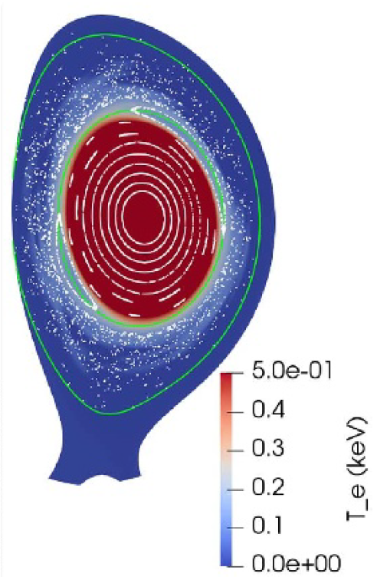
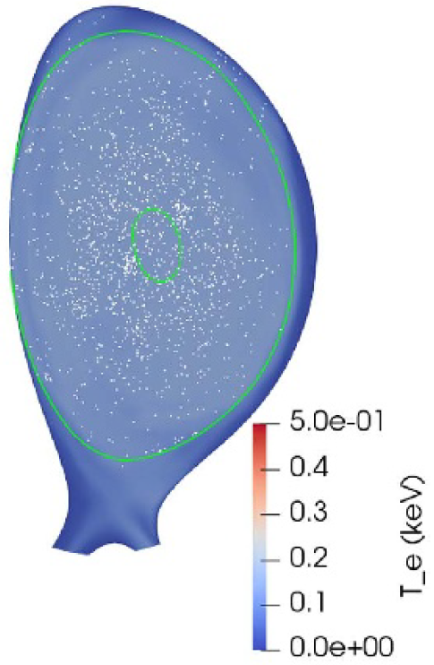
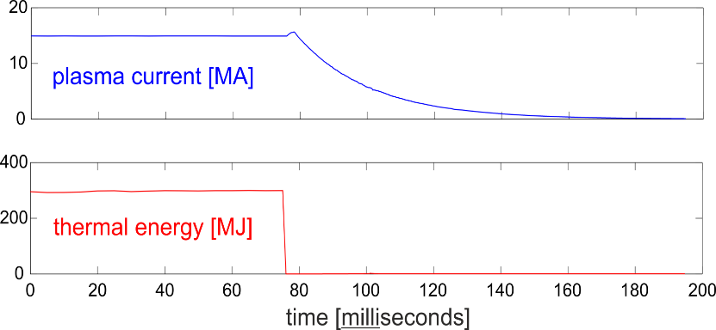
Disruptions
Thermal Quench (TQ):
MHD instability, stochastic B field
I_{p} spike
Radiative collapse
Thermal flash on PFCs
Current Quench (CQ):
Very resistive post-TQ plasma
I_{p} decay
Electromagnetic loads
Thermal flash on PFCs
Large electric field E_{φ}, typically >> E_{c}
→ Sometimes, RE beam
☹
[Courtesy M. Lehnen]
[Nardon PPCF 2021]
E. Nardon | EUROfusion Science Meeting | 14 Jan. 2026 | Page 3

Slide 4
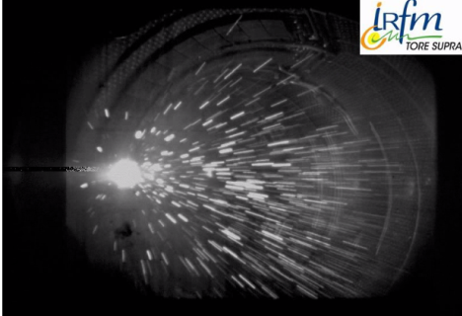
RE beam impact: often harmful… but can also be benign
Recent PPCF roadmap paper: [Ratynskaia PPCF 2026]
Impacts can be benign under specific conditions
Background plasma needs to be recombined
Accessible only inside a certain range of neutral pressure
E. Nardon | EUROfusion Science Meeting | 14 Jan. 2026 | Page 4

Slide 5
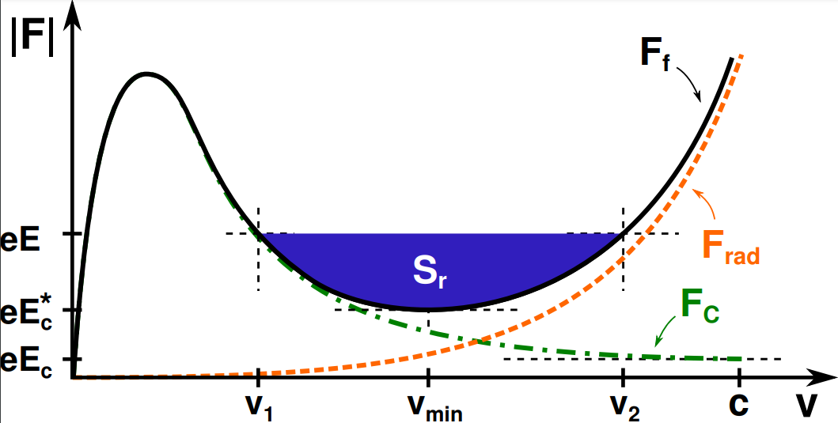
What are runaway electrons?
Force on an electron from collisional friction + synchrotron radiation
Electrons may run away whenever E > E_{c}
(‘critical electric field’)
When E > E_{c}, electrons faster than the
‘critical velocity’ v₁ will run away
RE energy is limited (typically to ~10-20 MeV)
by radiation reaction forces
eE
eE_{c}
Review papers: [Breizman NF 2019] [Boozer PoP 2015]
E. Nardon | EUROfusion Science Meeting | 14 Jan. 2026 | Page 5

Slide 6
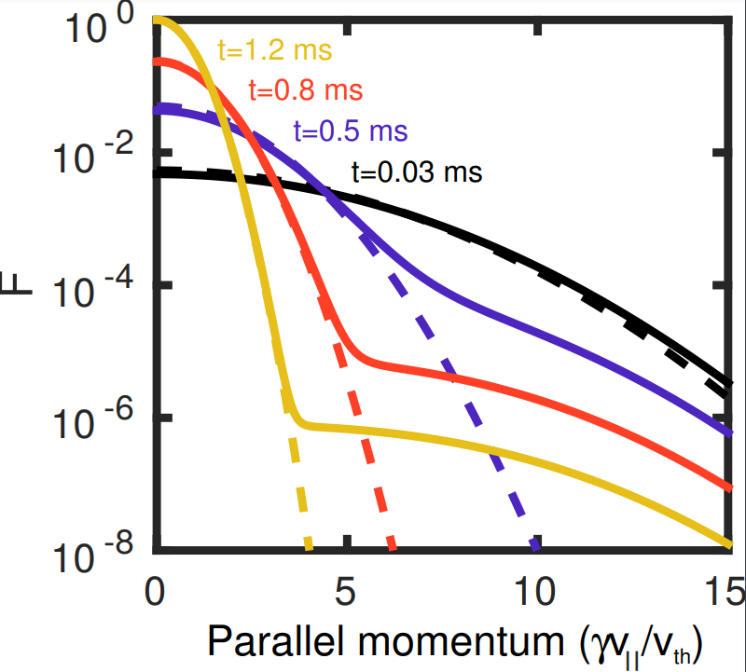
Primary (‘seed’) RE generation mechanisms (1/2)
Dreicer: collisional diffusion into RE domain [Connor NF 1975]
Typically negligible in ITER
Hot-tail:
In case of fast cooling, e⁻ distribution function F deviates from a Maxwellian
Strong RE production if E rises faster than collision time at critical velocity [Smith PoP 2007]
Hard to predict but potentially by far largest seed in ITER
F
E. Nardon | EUROfusion Science Meeting | 14 Jan. 2026 | Page 6

Slide 7
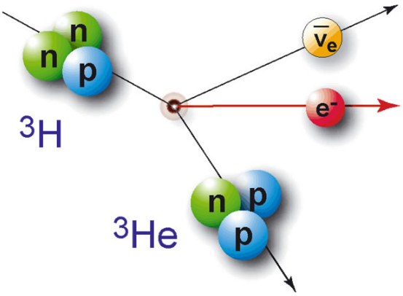
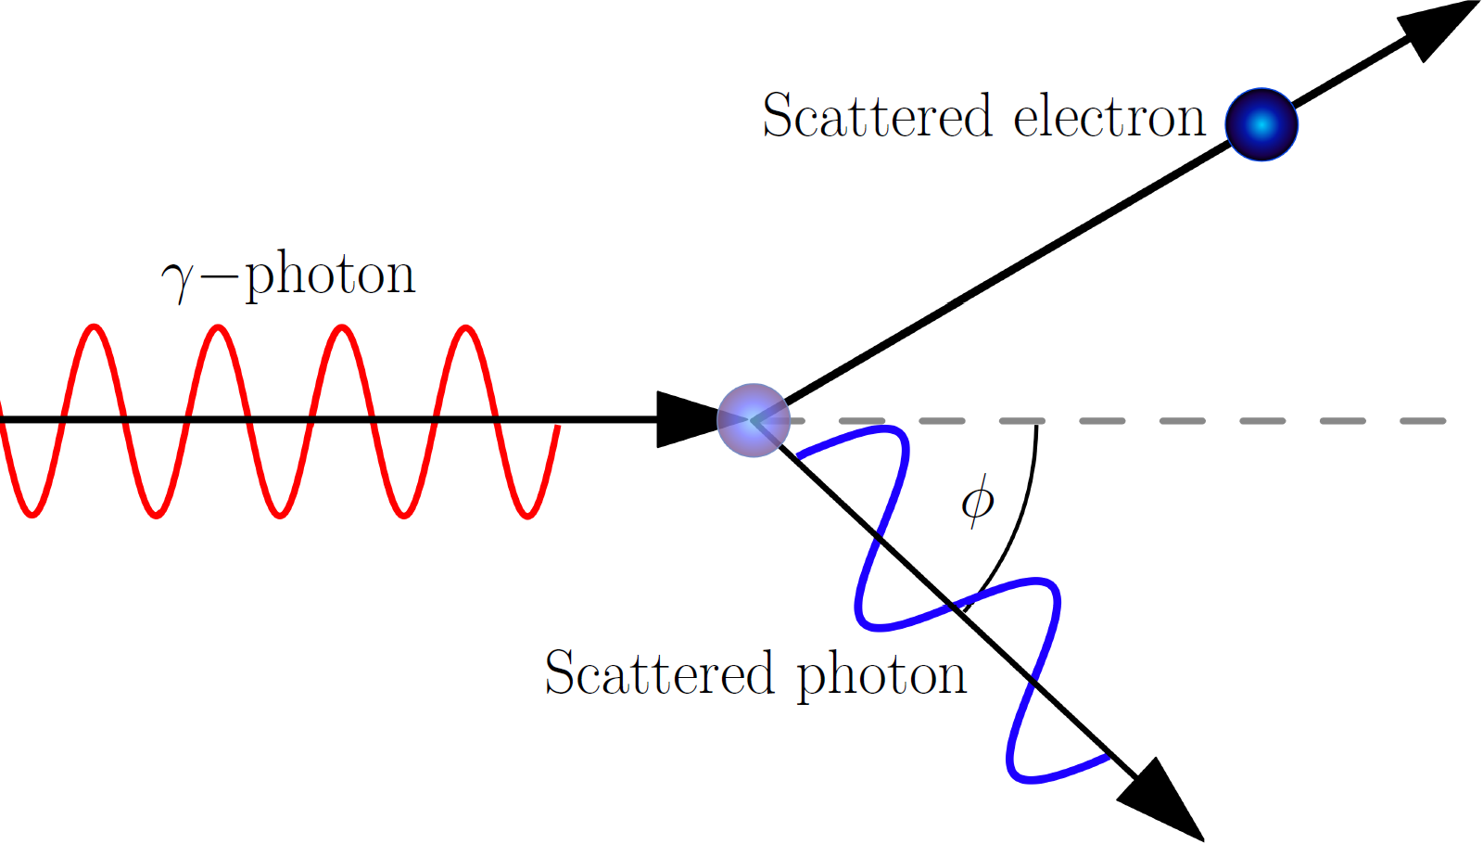
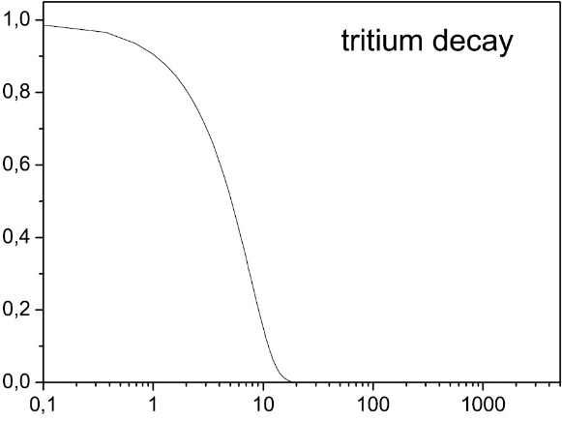
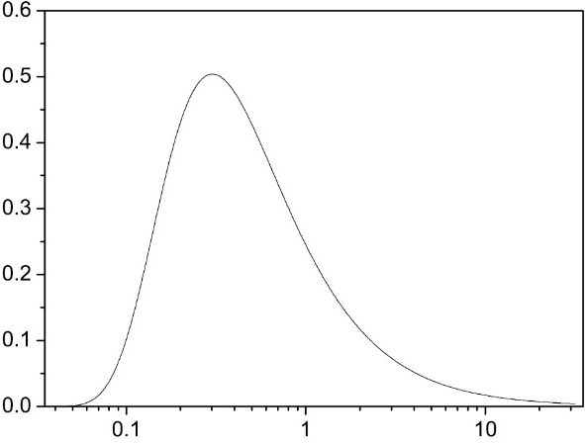
Primary (‘seed’) RE generation mechanisms (2/2)
‘Nuclear’ seeds:
Small but active throughout the CQ
Tritium β decay
Compton scattering by wall-emitted γ’s
ν(E) (a.u.)
Γ(E_{γ}) (MeV)
E (keV)
[Martín-Solís NF 2017]
E_{γ} (MeV)
E. Nardon | EUROfusion Science Meeting | 14 Jan. 2026 | Page 7

Slide 8
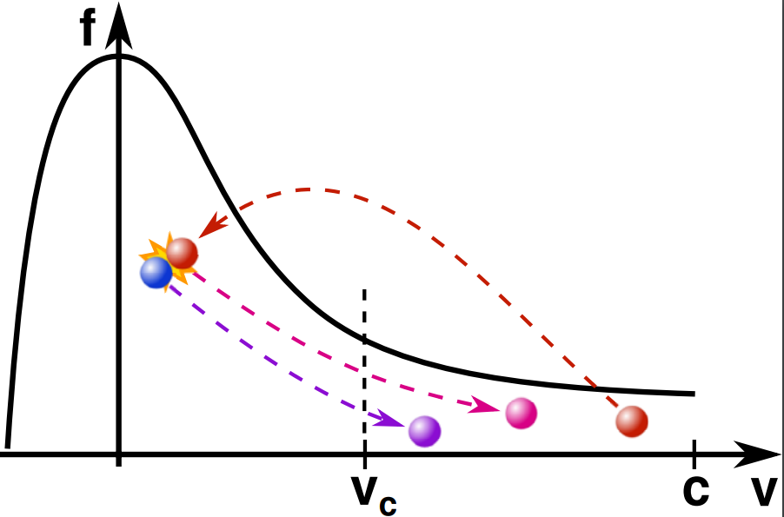
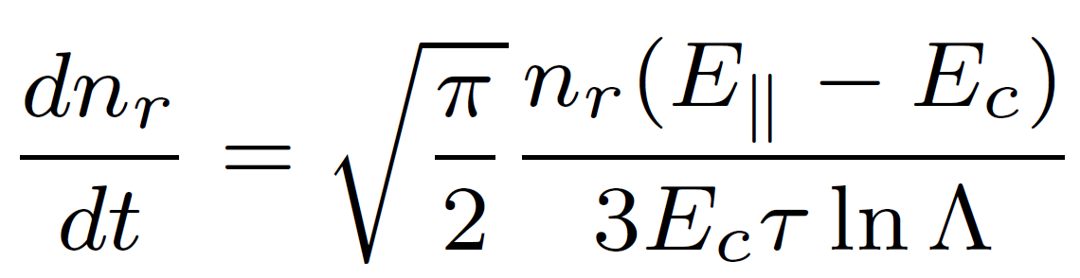
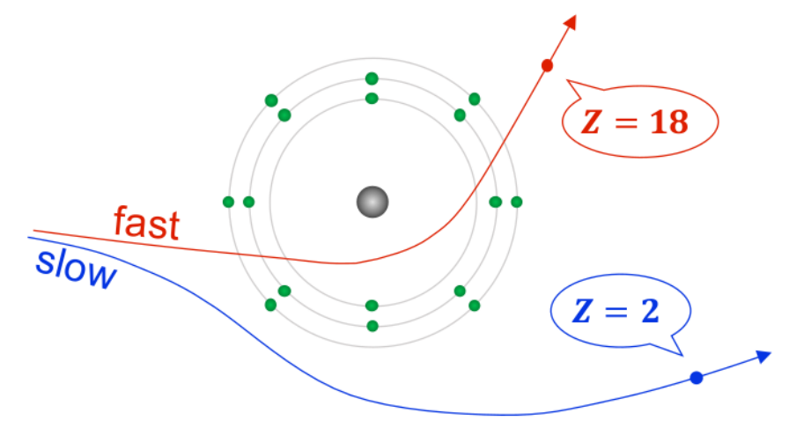
Secondary RE generation mechanism: the avalanche
Close (‘knock-on’) collisions can generate 2 REs from 1
→ Exponential growth in RE population
Initial theory by Rosenbluth and Putvinsky [Rosenbluth NF 1997]
(note: E|| ≈ ∂_{t}ψ/R)
→ When E|| >> E_{c}, log(G_{av}) ∝ Δψ ∝ ΔI_{p}
→ Avalanche gain G_{av} scales exponentially with I_{p}!
E.g. G_{av} = 1.9 × 10¹⁶ in ITER (15 MA) vs. 1.8 × 10³ in JET (3 MA) [Hender NF 2007]
Theory extended to account for bound electrons
Additional targets for knock-on collisions, not fully compensated by additional friction (because of charge screening)
→ Can strongly boost G_{av} [Hesslow NF 2019]
E. Nardon | EUROfusion Science Meeting | 14 Jan. 2026 | Page 8

Slide 9
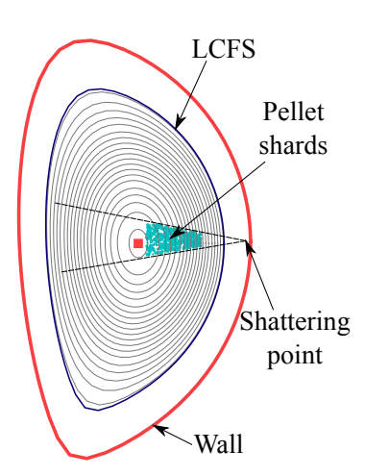
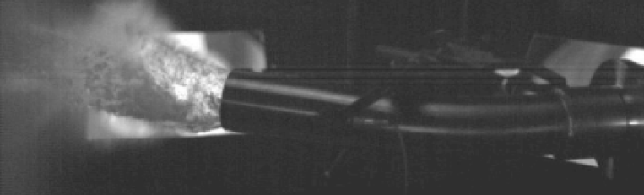
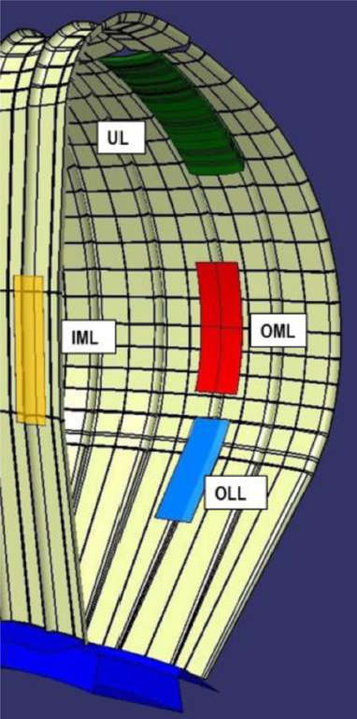
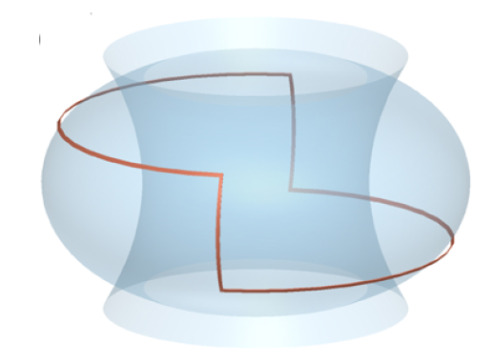
RE-handling strategies
ITER: Shattered Pellet Injection (SPI) [Lehnen JNM 2015]
One or several Ne+H pellets (flexible mixture ratio)
Aim: RE avoidance and/or mitigation
Also in charge of thermal and electromagnetic loads mitigation
EU-DEMO:
sacrificial limiters
[Maviglia FED 2022]
SPARC: RE Mitigation Coil (REMC)
Passive system
Induced current from dI_{p}/dt → B stochasticity
→ RE avoidance
[Tinguely PPCF 2023]
E. Nardon | EUROfusion Science Meeting | 14 Jan. 2026 | Page 9

Slide 10
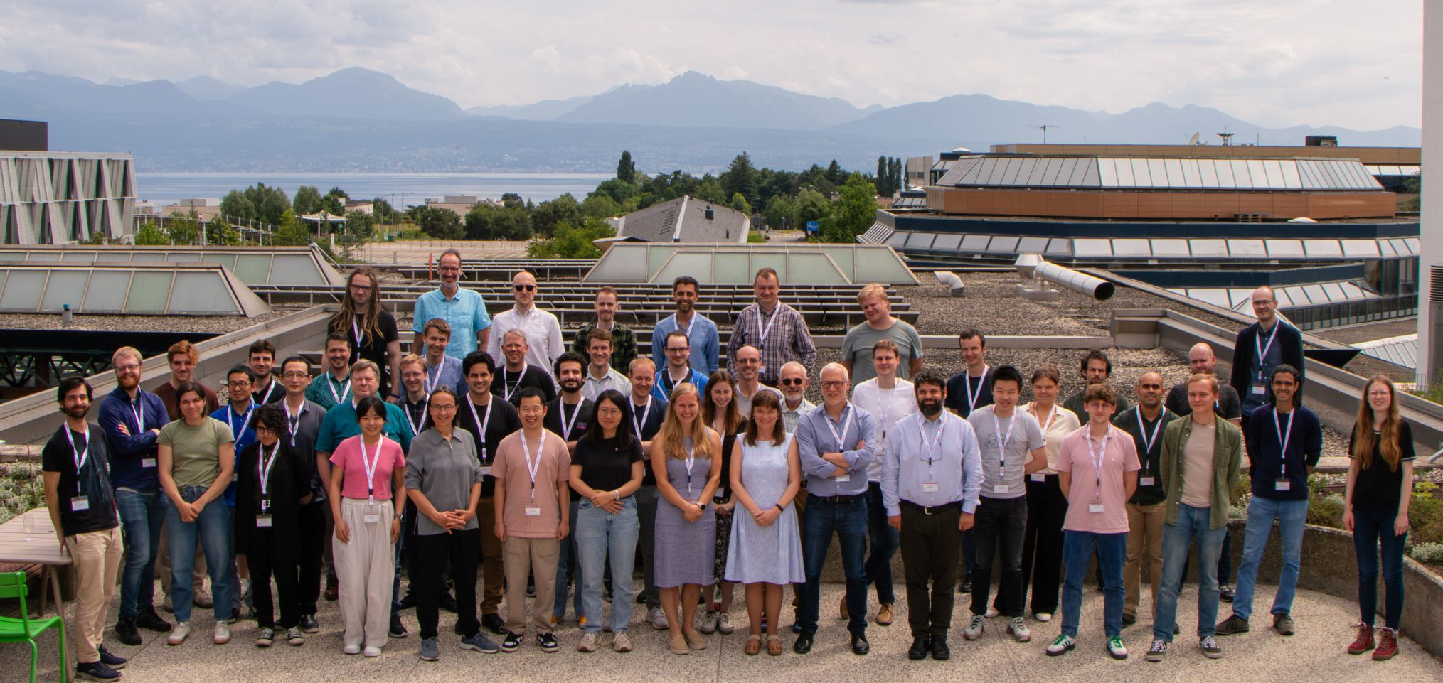
The TSVV 9 project
≈ 6 ppy/year over 2021-2025
Labs.: IRFM, Chalmers U., KTH, IPP Garching, EPFL, ACH VTT
≈ 15 funded contributors + many unfunded collaborators
Important synergies with TSVV 8, WPTE, ITER DMS Task Force, …
Group picture from the 12th Runaway Electron Modelling meeting, Lausanne, June 2025
E. Nardon | EUROfusion Science Meeting | 14 Jan. 2026 | Page 10

Slide 11


Simulation tools: 2 main ‘workhorses’
DREAM
Designed specifically to model REs during disruptions
1D (flux surface averaged, fixed geometry), 2P
Self-consistently evolves e⁻ distribution function using bounce-averaged kinetic equation
Different possible levels of description, from fully kinetic to fluid-like
JOREK
Originally an MHD code, later extended to model REs
2D or 3D, self-consistently evolved geometry
Fluid REs [Bandaru PRE 2019]
Kinetic REs [Bergström PPCF 2025] [Särkimäki NF 2022] [Sommariva NF 2018]
Good complementarity and synergy between the 2 codes
Simplifying a bit, DREAM is faster but contains less physics
[Hoppe CPC 2021]
[Hoelzl NF 2021]
E. Nardon | EUROfusion Science Meeting | 14 Jan. 2026 | Page 11

Slide 12
Model/code developments
Pellet models (essential to study disruption mitigation with SPI)
Self-consistent ablation plasmoid drift model [Vallhagen JPP 2023] implemented in DREAM
Physics of pellet ablation plasmoid drifts also investigated with JOREK [Kong NF 2025]
Ad hoc ablation plasmoid teleportation model in JOREK [Kong NF 2024]
Pellet rocket effect model [Guth PRL 2025] [Guth JPP accepted]
Kinetic REs in JOREK
Self-consistent coupling to the MHD equations via PiC method [Bergström PPCF 2025]
Hot tail (test particles) [Puel NF 2025]
Avalanche [Wouters EFTC 2025]
Effect of vertical plasma motion implemented in DREAM [Vallhagen JPP 2025] based on key input from JOREK [Wang NF 2025]
Reduced model to predict RE generation in activated tokamaks [Zaar JPP submitted]
Model for upper neutral pressure limit to access benign RE beam termination [Hoppe PPCF 2025]
E. Nardon | EUROfusion Science Meeting | 14 Jan. 2026 | Page 12

Slide 13
Validation
Validation of DREAM SPI simulations for ASDEX Upgrade [Halldestam JPP 2025] [Vallhagen PPCF 2025]
(Similar effort for JOREK SPI simulations on ASDEX Upgrade, JET, …, but mainly outside TSVV 9)
Validation and investigation of 3D MHD aspects of disruptions with JOREK
I_{p} spike, magnetic stochasticity, impurity mixing [Nardon PPCF 2021] [Nardon NF 2023]
Validation of RE beam formation simulations with JOREK and DREAM [Järvinen JPP 2022] [Nardon REM 2024]
Using Bayesian framework (ACH VTT)
RE benign termination
JOREK simulations for JET [Bergström PPCF 2025] [Singh REM 2024] [Sommariva NF 2024]
E. Nardon | EUROfusion Science Meeting | 14 Jan. 2026 | Page 13

Slide 14
Predictions
ITER
RE generation
Extensive predictions for SPI-mitigated disruptions with DREAM [Vallhagen NF 2024] [Vallhagen JPP 2025] [Votta, in prep.]
Compared fluid and kinetic DREAM predictions [Ekmark JPP 2024]
Optimised mitigation through Bayesian framework [Ekmark JPP 2024]
Started assessing hot tail generation with JOREK [Puel NF 2025]
Investigated 3D MHD effects during the CQ with JOREK [Särkimäki NF 2022] [Wang, in prep.]
RE termination
First predictions with JOREK [Bergström PPCF 2024] [Bandaru NF 2024]
Investigation of the role of background plasma resistivity [Nardon PoP 2023]
Other machines
Predicted RE beam generation and termination in EU-DEMO with JOREK [Vannini NF 2025]
Predicted RE generation in DTT with JOREK [Emanuelli FED 2026] [Emanuelli, submitted]
Predicted RE beam generation in ≈STEP with DREAM [Berger JPP 2022]
SPARC:
Predicted effect of REMC with DREAM [Tinguely PPCF 2023]
Predicted RE generation in MGI-mitigated disruptions with DREAM (w/o REMC) [Ekmark JPP 2025]
E. Nardon | EUROfusion Science Meeting | 14 Jan. 2026 | Page 14

Slide 15
Summary
DREAM and JOREK have been developed massively to improve the modelling of RE dynamics during tokamak disruptions
This is highly complex integrated modelling
Good complementarity and synergy between the 2 codes
Validation has progressed but is a complex task, to be pursued
Avalanche model partly validated using Bayesian framework
Other models (RE impact, hot tail) started but difficult
Avoiding RE beams in large future machines like ITER remains a major challenge
Enormous avalanche gain + nuclear seeds + possibly large hot tail seed
It is critical to capture the mechanisms that impact the avalanche gain (e.g. vertical motion during CQ, j profile flattening during TQ)
Some aspects of RE beam terminations have been modelled and understood, but a lot remains to be investigated
E. Nardon | EUROfusion Science Meeting | 14 Jan. 2026 | Page 15

Slide 16
Perspectives
Essential to maintain a strong activity
Partly covered by TSVV-F in 2026-2027
Key topics:
TQ physics (in particular in SPI-mitigated disruptions): trigger condition, transport, current density profile flattening, hot tail RE generation
Impact of 3D MHD activity during the CQ on RE beam dynamics
RE beam termination and PFC damage
Access conditions to benign terminations
⚠ Might be in conflict with current RE avoidance strategy in ITER
E. Nardon | EUROfusion Science Meeting | 14 Jan. 2026 | Page 16

Slide 17
E. Nardon | EUROfusion Science Meeting | 14 Jan. 2026 | Page 17

Slide 18
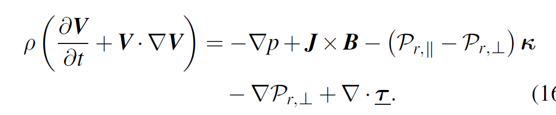
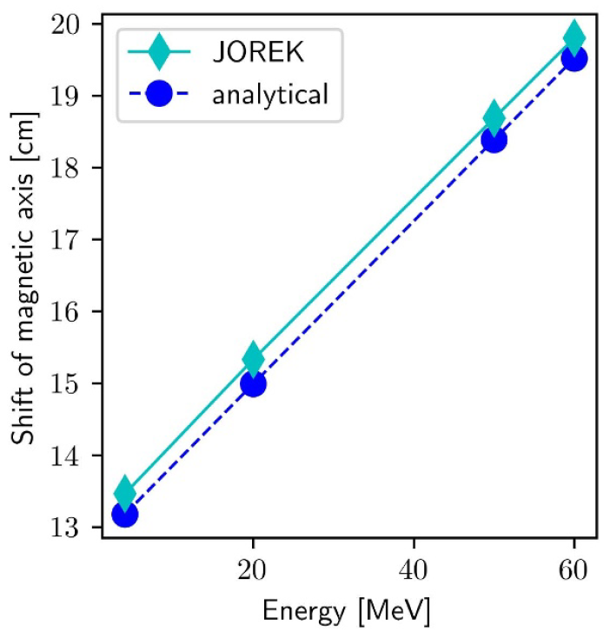
Self-consistent MHD + kinetic REs in JOREK
JOREK electron pusher evolves a population of kinetic electrons
Moments of this population used in the fluid equations
Pressure coupling scheme
[Bergström PPCF 2025]
Benchmarks on, e.g.:
Impact of RE energy on major radius of magnetic axis
Linear tearing mode growth rates
First applications to RE beam terminations
E. Nardon | EUROfusion Science Meeting | 14 Jan. 2026 | Page 18

Slide 19
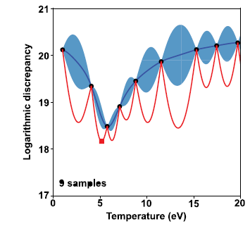
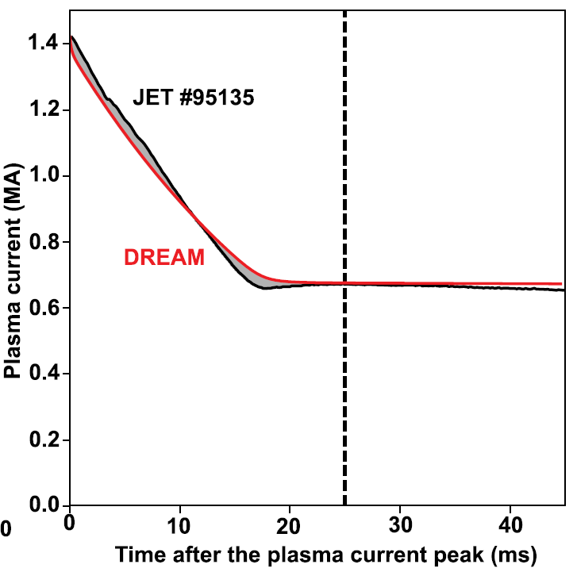
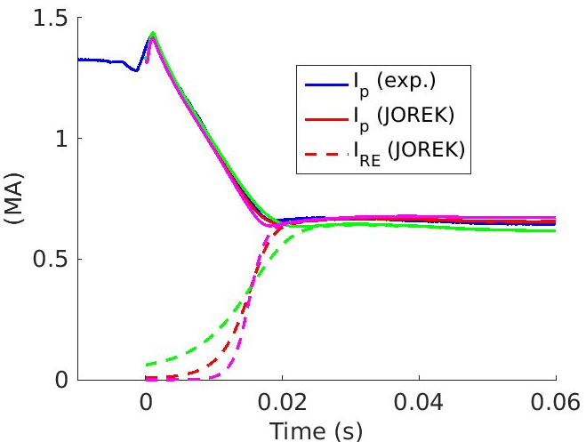
Validation of RE generation models
Validation is made difficult by the existence of “free parameters”
Typical example: validation of the avalanche model
Aim: reproduce the RE plateau current I_{RE}
Issue: RE seed is “free” → Can be used as a knob to match I_{RE} → “Fancy fitting” instead of validation
Solution?
1) Automatize fancy fitting through Bayesian optimisation framework → Speed, objectivity
2) Try to match more experimental observations, e.g.
synchrotron radiation, detailed shape of I_{p}(t) curve, …
3) Show that fancy fitting is not possible with
a falsified model
Falsifying Γ_{av}: true / x 2 / x 0.5
(JOREK data lost in Marconi flooding ☹)
[Järvinen JPP 2022]
[Nardon REM 2024]
E. Nardon | EUROfusion Science Meeting | 14 Jan. 2026 | Page 19

Slide 20
Predictions on RE avoidance in ITER
Extensive predictions for SPI-mitigated disruptions with DREAM [Vallhagen NF 2024] [Vallhagen JPP 2025] [Votta, in prep.]
Cover a wide range of plasma scenarios and SPI parameters
The model includes ‘ad hoc’ ingredients, informed e.g. by JOREK simulations
TQ: trigger condition, duration, transport, j profile flattening
Effect of vertical motion during CQ
Avoiding multi-MA RE beams in ITER disruptions is challenging
Enormous avalanche gain + unavoidable nuclear seeds
In addition, hot tail generation can also be a major concern
Strategy: use SPI to dilute the plasma as much as possible before the TQ
Suppresses hot tail generation by increasing the collisionality
(Moderately) reduces the avalanche gain G_{av} by raising E_{c}
E. Nardon | EUROfusion Science Meeting | 14 Jan. 2026 | Page 20

Slide 21
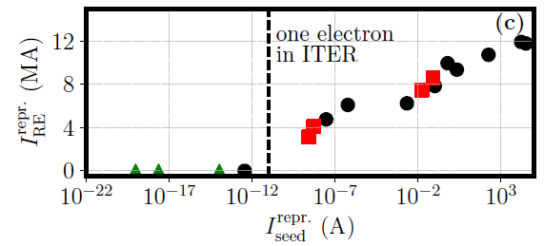
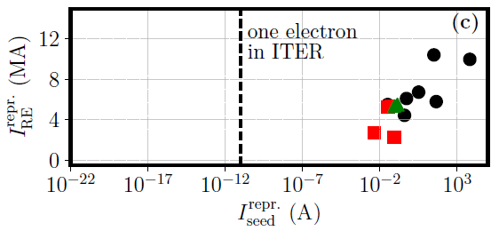
[Votta, in prep.]
15 MA L-mode plasma, no nuclear seeds
15 MA H-mode plasma, with nuclear seeds
RE beam can be avoided by suppressing the hot tail (+ Dreicer) seeds
Most effective method: staggered injection, i.e. pure H SPI followed by H+Ne SPI
Multi-MA RE beam cannot be avoided because of unavoidable nuclear seeds combined with very large avalanche gain
But these predictions may be pessimistic…
E. Nardon | EUROfusion Science Meeting | 14 Jan. 2026 | Page 21

Slide 22
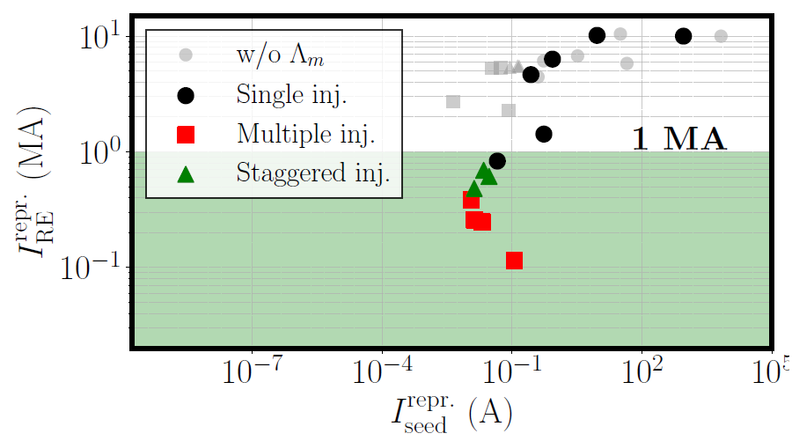
Including a j profile flattening during the TQ improves prospects
Related to the I_{p} spike – a common feature of disruptions
Modelled in DREAM through a hyper-resistivity term (Λ_{m})
Reduces the avalanche gain G_{av} by reducing Δψ
[Votta, in prep.]
15 MA H-mode plasma, with nuclear seeds
RE avoidance may not be hopeless, even with nuclear seeds
E. Nardon | EUROfusion Science Meeting | 14 Jan. 2026 | Page 22

Slide 23
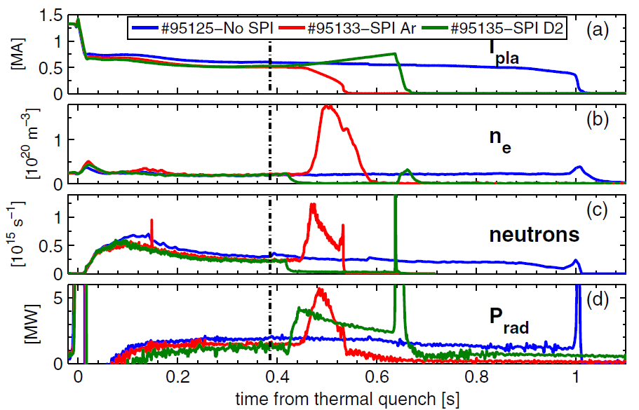
Trying to understand RE beam benign terminations
RE beam terminations in JET, including a benign one
[Reux PRL 2021]
Typical chronology of benign terminations:
1) Injection of D₂ into the RE beam → Recombination of the background plasma
2) At some point, violent instability → Complete loss of the REs
Background plasma recombination seems essential. Why?
Here, we propose a tentative partial interpretation, which certainly does not cover the whole story.
E. Nardon | EUROfusion Science Meeting | 14 Jan. 2026 | Page 23

Slide 24
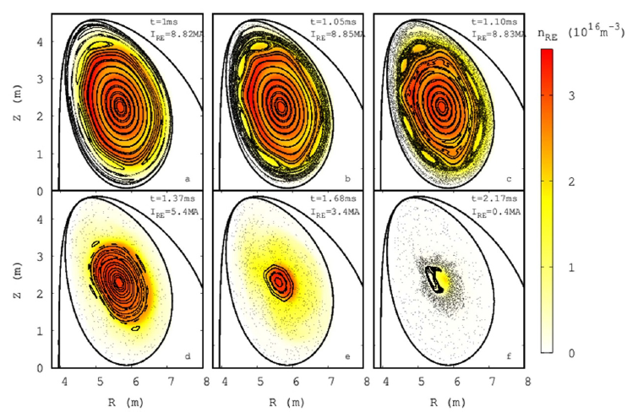
ITER simulation using JOREK with the RE fluid model
Poincaré plot (dots) + n_{RE} (color)
(Time progressing from left to right and top to bottom)
[Bandaru NF 2024]
Dominantly m/n = 2/1 instability related to q_{a} approaching 2
As the instability grows, magnetic stochasticity develops, deconfining the REs.
The stochastic region expands radially in time. Let’s call its radial extent Δr_{stoch}.
E. Nardon | EUROfusion Science Meeting | 14 Jan. 2026 | Page 24

Slide 25
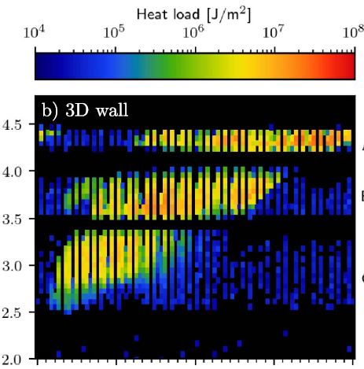
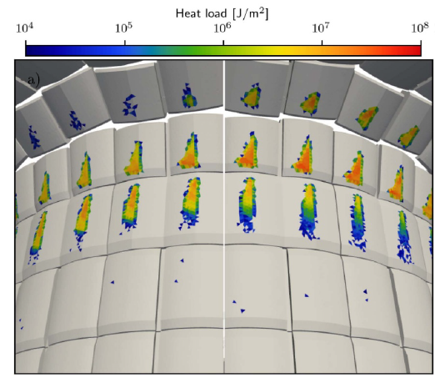


RE heat load on the wall in the previous ITER simulation
[Bergström PPCF 2024]
The deconfined REs distribute on the wall inside the “magnetic footprint”, whose area A_{footprint} increases in time.
A_{footprint} is largely determined by the amplitude of the dominant (i.e. 2/1) mode.
E. Nardon | EUROfusion Science Meeting | 14 Jan. 2026 | Page 25

Slide 26
Δr_{stoch}
a
Non-benign
Benign
0
A_{footprint}
A key factor determining the severity of the impact may be the ratio Δr_{stoch}/A_{footprint}.
Experimentally, benign impacts have a larger A_{footprint}. Why?
This may be related to the background plasma resistivity η.
Note: Instability dynamics largely determined by η, even though the current is initially fully carried by REs [Helander PoP 2007].
E. Nardon | EUROfusion Science Meeting | 14 Jan. 2026 | Page 26

Slide 27
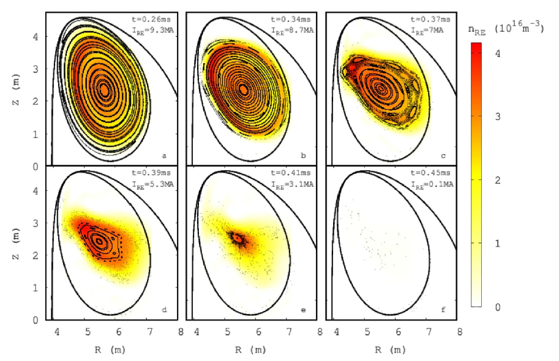
Comparing 2 simulations at different background plasma resistivity η
η = η₀
η = 10 η₀
[Bandaru NF 2024]
At lower η, Δr_{stoch} is larger for a given 2/1 mode amplitude.
This is because of stronger secondary modes, as detailed in [Nardon PoP 2023].
Since A_{footprint} is determined by the amplitude of the 2/1 mode, Δr_{stoch}/A_{footprint} is larger at lower η.
Low η promotes larger heat fluxes.
The increased η resulting from recombination may be a key factor in benign terminations.
E. Nardon | EUROfusion Science Meeting | 14 Jan. 2026 | Page 27

Slide 28
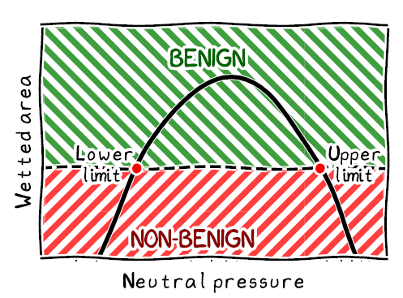
Some key open points:
JOREK simulations so far were initialized from an unstable state. How does the picture change when evolving across the instability boundary?
Kinetic + orbit shift effects? → Simulations with the JOREK kinetic RE model [Bergström PPCF 2025].
Self-consistent modelling of the (recombined) background plasma and its re-ionization during the termination
Access conditions to benign terminations
⚠ Might be in conflict with current RE avoidance
strategy in ITER
Model for upper neutral pressure limit [Hoppe PPCF 2025]
E. Nardon | EUROfusion Science Meeting | 14 Jan. 2026 | Page 28

