Slide 1






Interplay of electromagnetic turbulence, global MHD modes, fast particles, and Alfvénic instabilities in fusion plasmas
A. Mishchenko on behalf of E-TASC TSVV-10 team: Physics of Burning Plasmas

Slide 2
INTRODUCTION

Slide 3
TSVV-10: background
Several experiments worldwide will produce burning plasmas (ITER, BEST, SPARC, Infinity, GIGA, Stellaris …).
Energetic particles will be important for cross-couplings between micro- and macro-scales.
Turbulence and zonal structures cannot be considered separately from fast particles and Alfvénic modes.
MHD-type instabilities will also affect the plasma dynamics, turbulence, and transport in phase space.
Plasma profile evolution becomes a multi-scale nonlinear problem with global and kinetic contributions.
          TSVV-10 program:
Global nonlinear gyrokinetics as a minimal inclusive description addressing this problem within a single framework.
Lower fidelity (reduced models): hybrid particle-MHD codes, phase-space transport codes (quasilinear and PSZS).
Developing theory and codes for future burning-plasma fusion devices and dedicated ongoing experiments.

Slide 4

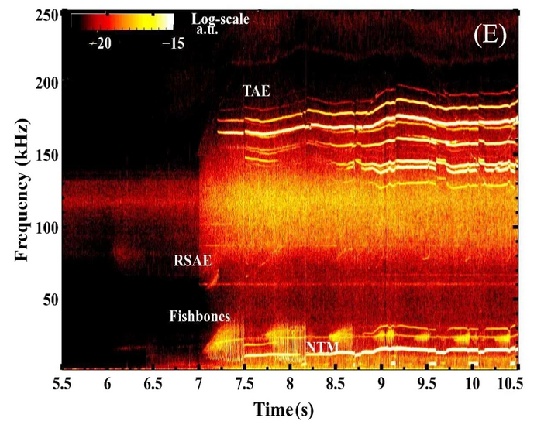
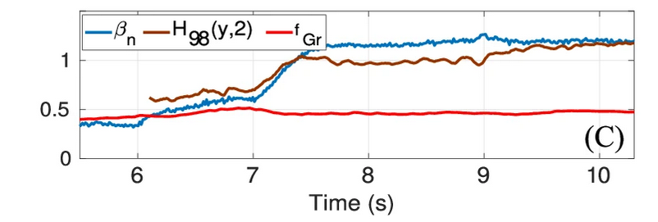
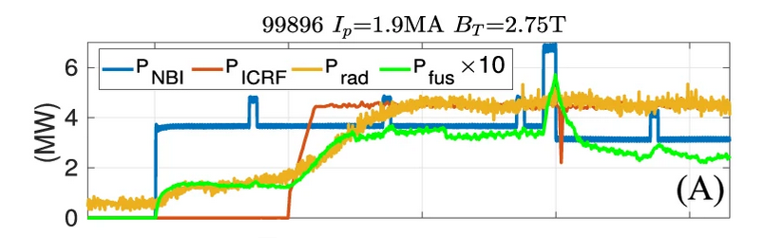
TSVV-G background: experiment (JET, Deuterium-Tritium campaign)
Alfvénic modes
Low-frequency Alfvénic modes
MHD-like modes
DT JET #99896: ICRF heating added at t ~ 7 s; confinement improvement and increased fusion reaction (fast ions).
Electromagnetic perturbations over a wide range of frequencies.
Heat transport significantly reduced because of the energetic-particle driven instabilities.
J. Garcia, Y. Kazakov, R. Coelho et al, Nature Communications [2024]

Slide 5
Synergies and couplings
Turbulence
(ITG, TEM, KBM …)
Zonal state
(coherent structures)
Profiles ; Transport
Fast particles
Alfvén Eigenmodes
(TAE, BAE, EPM …)
Ambient magnetic field
MHD modes (Sawteeth, fishbones, islands)

Slide 6
Synergies and couplings
Turbulence
(ITG, TEM, KBM …)
Zonal state
(coherent structures)
Profiles ; Transport
Fast particles
Alfvén Eigenmodes
(TAE, BAE, EPM …)
Ambient magnetic field
MHD modes (Sawteeth, fishbones, islands)

Slide 7
Synergies and couplings
Turbulence
(ITG, TEM, KBM …)
Zonal state
(coherent structures)
Profiles ; Transport
Fast particles
Alfvén Eigenmodes
(TAE, BAE, EPM …)
Ambient magnetic field
MHD modes (Sawteeth, fishbones, islands)
Sheared flows

Slide 8
Burning plasmas: complex interconnected system
Turbulence
(ITG, TEM, KBM …)
Zonal state
(coherent structures)
Profiles ; Transport
Fast particles
Alfvén Eigenmodes
(TAE, BAE, EPM …)
Ambient magnetic field
MHD modes (Sawteeth, fishbones, islands)
Sheared flows
Global NL gyrokinetic theory is a minimal inclusive description

Slide 9
GLOBAL GYROKINETIC CODES

Slide 10
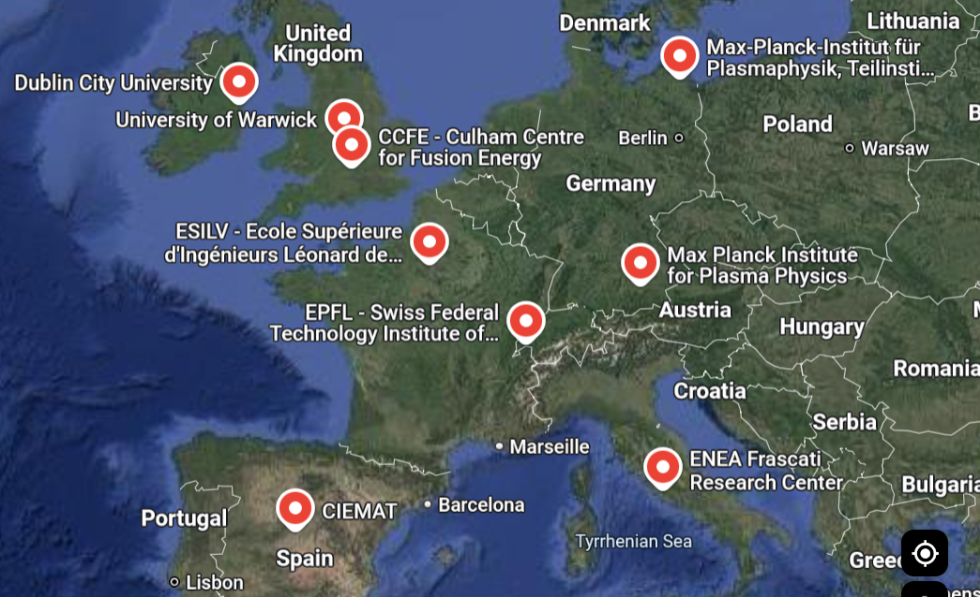
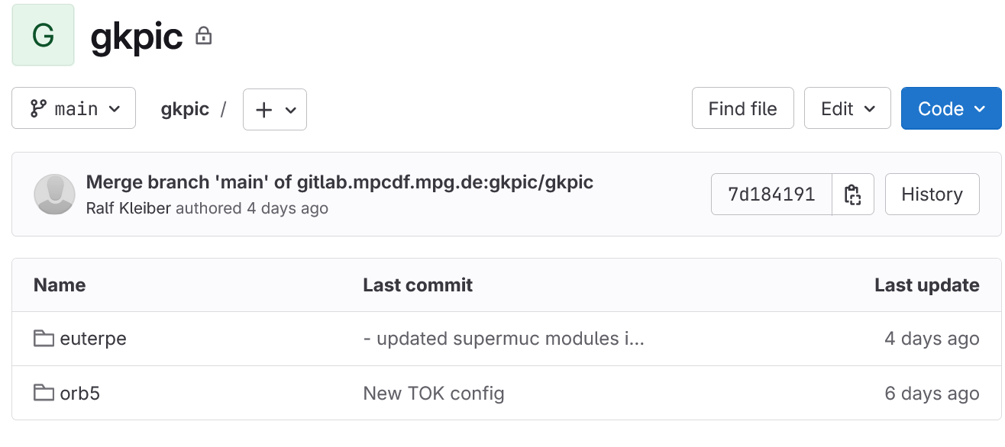
Gyrokinetic codes: ORB5 and EUTERPE codes
ORB5-EUTERPE community (EU)
Global nonlinear gyrokinetic particle-in-cell codes
Electromagnetic, kinetic electrons, collision operators
Arbitrary-wavelength solver, model for 𝛿𝐵|| available
Both codes started at SPC EPFL Lausanne, closely related
EUTERPE developed specifically for stellarator research
Codes are supported by EUROfusion (e.g. E-TASC)
Since June 2025: joint project, single repository
The codes can further converge to a single codebase
Developers and users in many EU fusion sites
Contributions from India (IPR) and Ukraine
Crucial role played by EUROfusion!
(ENR projects 2014-2024, TSVV-10)

Slide 11
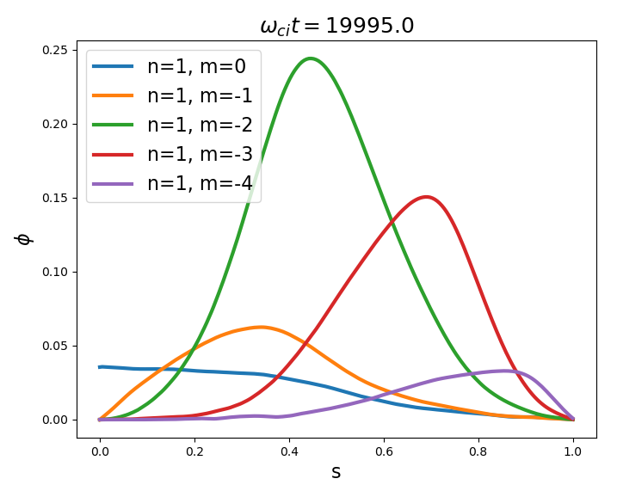
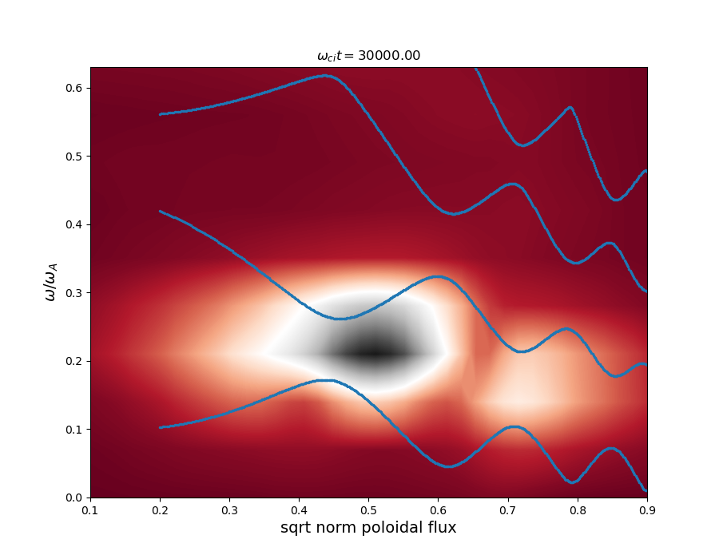
Gyrokinetic simulations of chirping instabilities: wave-particle nonlinearity
Poloidal harmonics (TAE mode)
FFT of electrostatic potential
ORB5
continuum
Energetic-particle driven TAE/EPM instabilities in TCV-shaped tokamak.
Coupled poloidal harmonics m = -2 and m = -3. Eigenmode frequency in the toroidal gap.
Electrostatic potential
Frequency of the TAE
TAE
Minor radius
Minor radius

Slide 12
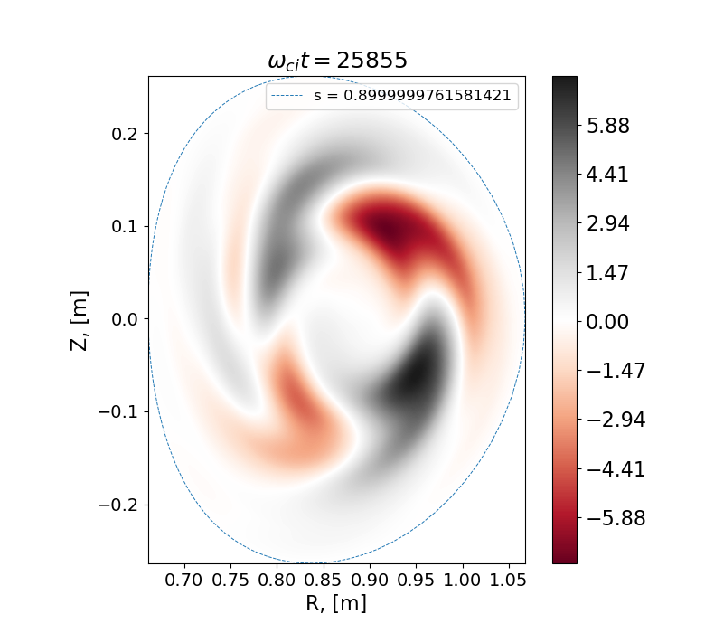
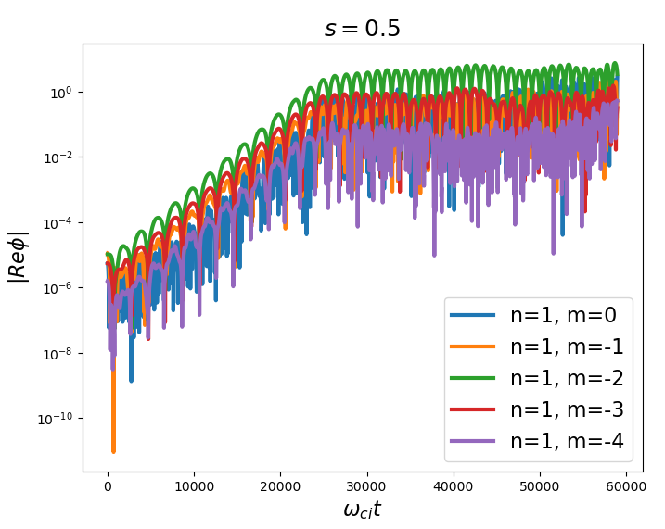
Gyrokinetic simulations of chirping instabilities: wave-particle nonlinearity
Poloidal harmonics (TAE mode)
FFT of electrostatic potential
ORB5
Energetic-particle driven TAE/EPM instabilities in TCV-shaped tokamak.
Coupled poloidal harmonics m = -2 and m = -3. Eigenmode frequency in the toroidal gap.
“Boomerang” shape of 2D mode structure caused by energetic-particle resonant response.
Saturation amplitude of the instability determines energetic-particle transport.
Electrostatic potential
Frequency of the TAE
TAE
Minor radius
Minor radius
Electrostatic potential
„Boomerang“ shape
Z
Electrostatic potential
R
Time

Slide 13
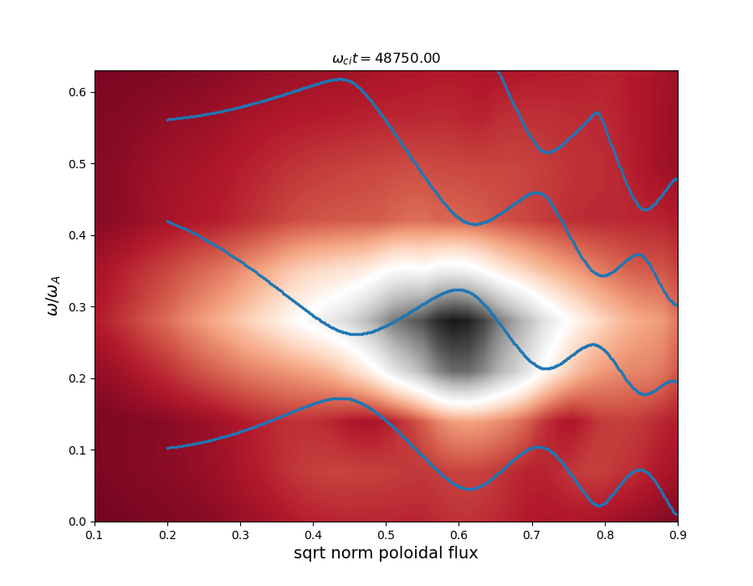
Gyrokinetic simulations of chirping instabilities: wave-particle nonlinearity
Poloidal harmonics (TAE mode)
FFT of electrostatic potential
FFT of electrostatic potential
ORB5
Electrostatic potential
Frequency of the TAE
Frequency of the TAE
TAE
chirp
TAE
chirp
Minor radius
Minor radius
Minor radius
Electrostatic potential
„Boomerang“ shape
Saturation amplitude of the instability determines energetic-particle transport.
Chirping dynamics is observed for mode frequency: phase-space structures.
Z
Electrostatic potential
R
Time

Slide 14
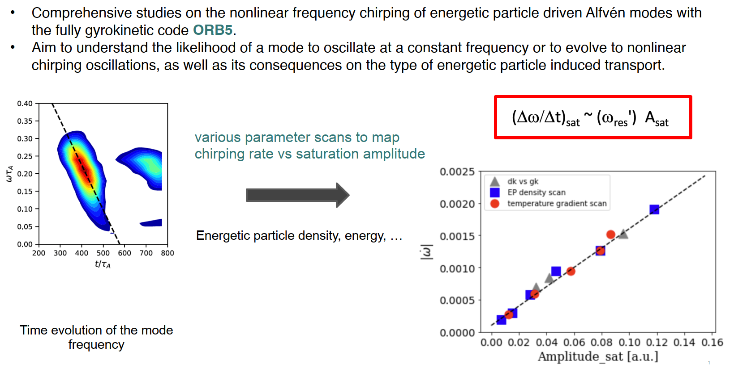
Gyrokinetic simulations of chirping instabilities: wave-particle nonlinearity
Comprehensive studies of the nonlinear frequency on Alfven modes driven by fast ions.
A large number of global gyrokinetic simulations performed with ORB5.
Plasma parameterers, energetic-particle parameters varied. Chirping rate follows universal dependency.
ORB5
Δω/Δt ~ A_{sat}
|Δω/Δt|
Time evolution of the mode frequency
Theory compared to simulations (verification): chirping modes in presence of energetic particles. Chirping rate from simulations is proportional to saturation amplitude (as predicted theoretically, [Zonca et al., Varenna Conf. 2024])

Slide 15
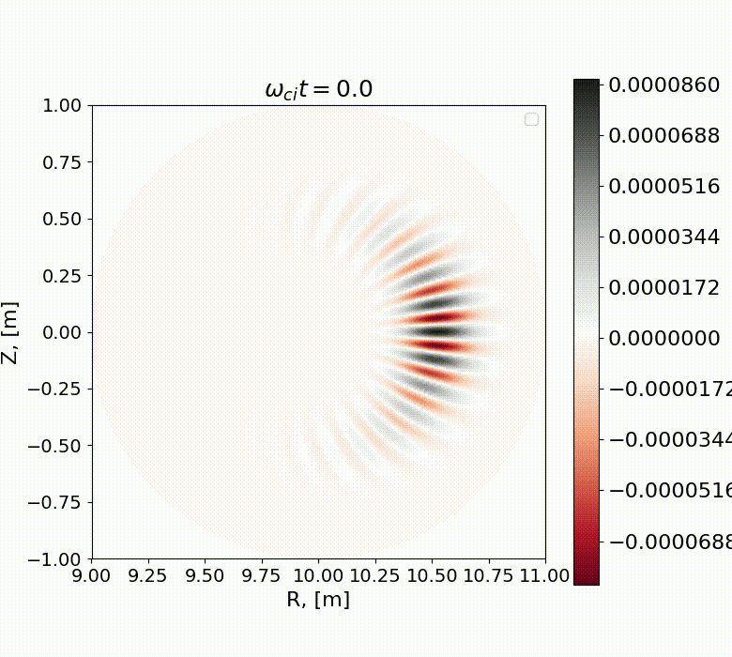
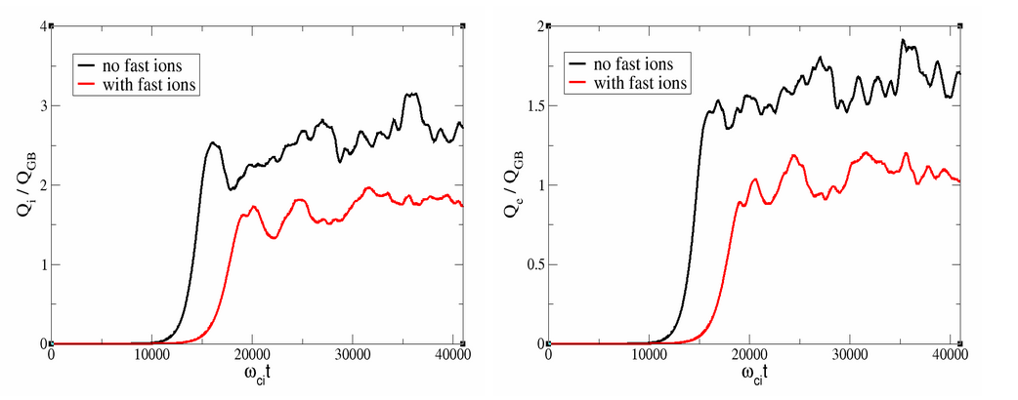
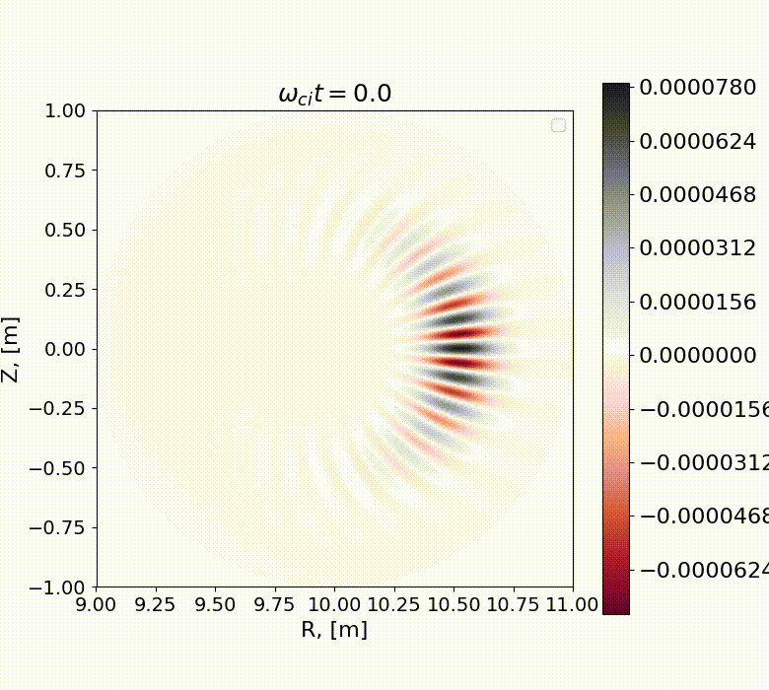
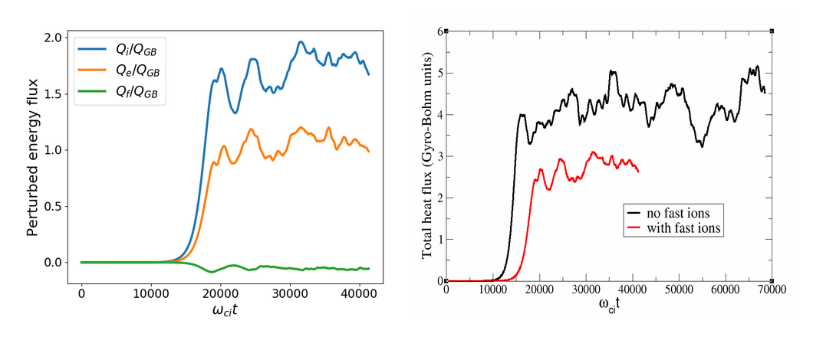
ORB5 code: effect of fast ions on core plasma confinement
Nonlinear gyrokinetic simulations with ORB5 code demonstrate clear reduction in the heat flux for both the bulk ions and the electrons
NO fast ions: sheared flow
For $β_{e}=0.1\%$, fast-ion heat flux is small. Total heat flux reduced by the fast ions!
Fast ions included: sheared flow
ORB5

Slide 16
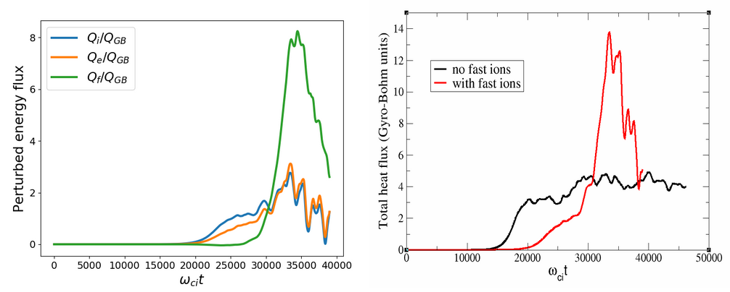

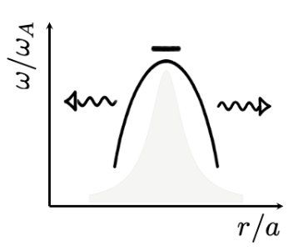
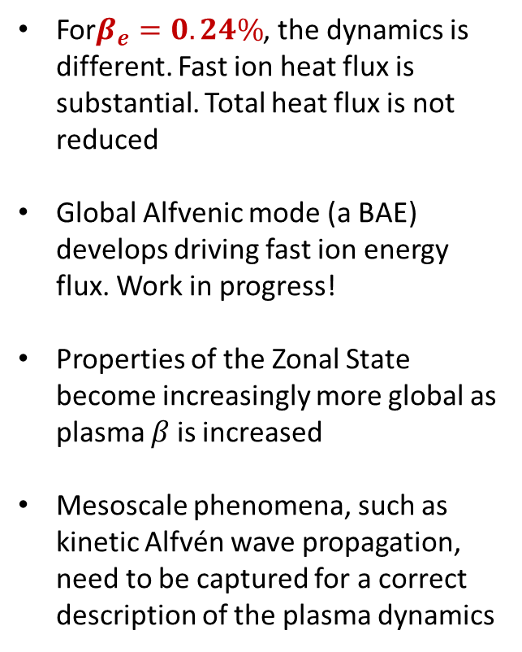
ORB5 code: effect of fast ions on core plasma confinement
For$β_{e}=0.24\%$, the dynamics is different. Fast ion heat flux is substantial. Total heat flux is not reduced
Global Alfvenic mode (a BAE) develops driving fast ion energy flux. Work in progress!
Properties of the Zonal State become increasingly more global as plasma 𝛽 is increased
Mesoscale phenomena, such as kinetic Alfvén wave propagation, need to be captured for a correct description of the plasma dynamics
ORB5
No fast ions: sheared flow
Fast ions included: global (BAE) mode

Slide 17
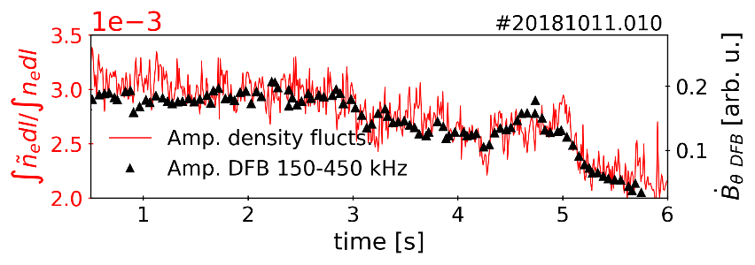
Experiment: Alfvénic Modes and Electromagnetic Turbulence in Wendelstein 7-X
Experimental Results:
• predominant ITG turbulence observed in W7-X
• distinctive Alfvénic frequency band is often seen
• temporal evolution of turbulence (PCI) and magnetic fluctuations (Mirnov) is very similar over entire discharges
• Alfvénic fluctuation amplitudes and turbulence level are correlated for many plasma discharges
Hypothesis: Alfvénic fluctuations are nonlinearly driven by ITG turbulence in W7-X.
Collaboration with TSVV-13

Slide 18
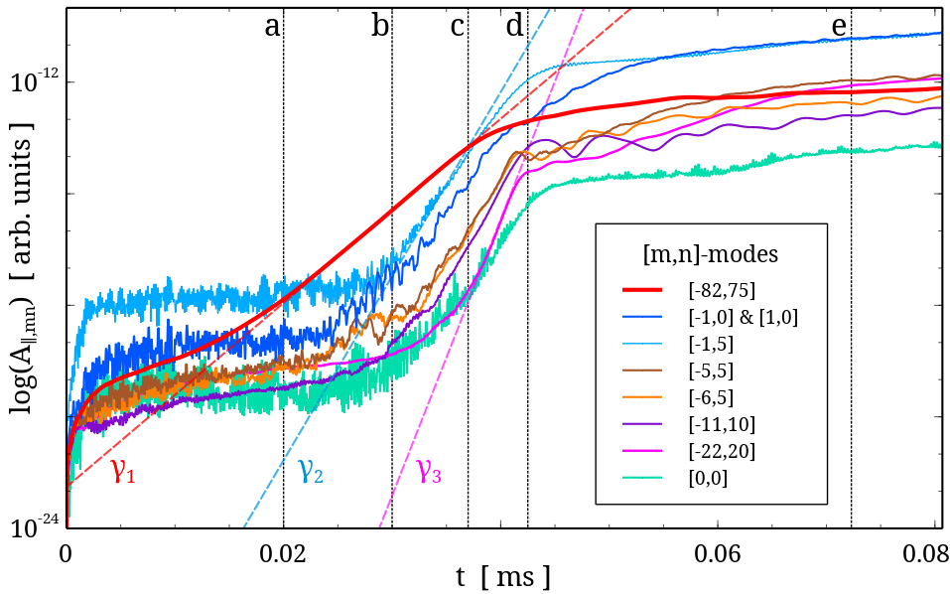
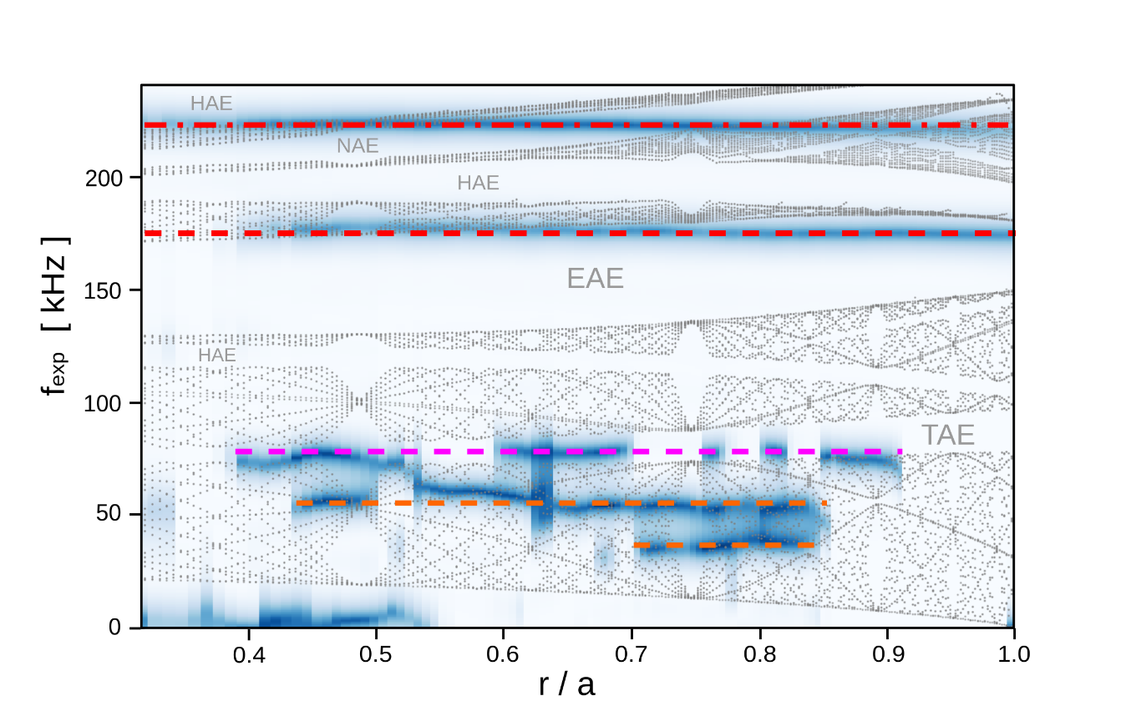
Simulations: Alfvénic Modes and Electromagnetic Turbulence in Wendelstein 7-X
Alfven
Simulation results:
EUTERPE
Experimental frequencies
ITG
Zonal flow
• early ITG (high-m) activity
• Zonal Flow & Alfvénic modes when ITG amplitude has passed threshold
• growth rate cascade γ₁ : γ₂ : γ₃ = γ : 2γ : 3γ (similar to “beat-driven” ZFs)
The role of ITG activity:
1. ITG modes included in simulations → low-m Alfvénic modes nonlinearly excited
2. ITG modes excluded from simulations → low-m modes remain stable
Gyrokinetic simulations recover experimental frequencies
Collaboration with TSVV-13

Slide 19
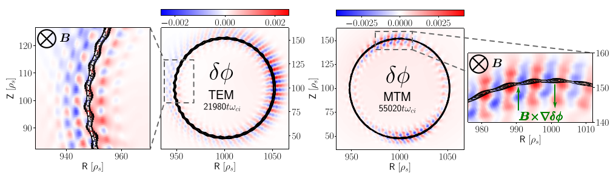
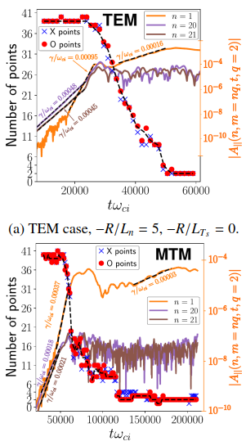
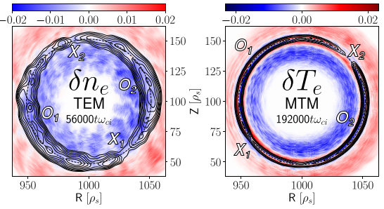
Turbulence-Driven Magnetic Islands in Toroidal Geometry
ORB5
Linearly stable tearing mode in toroidal geometry (collisionless).
Micro-instabilities generate an E × B flow that drives magnetic field line reconnection forming multiple small-scale islands along resonant surface.
The small-scale islands interact non-linearly and eventually coalesce into a large-scale magnetic island.
Collaboration with T-RECS ENR

Slide 20
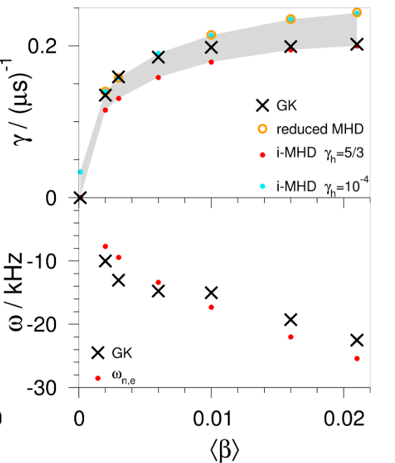
Gyrokinetic simulations of MHD-unstable stellarator configurations
EUTERPE
Consider 4-period stellarators:
  turning-ellipse configurations
Choice: Mercier-unstable at finite β (not a reactor candidate)
Perform full-torus GK simulations
Find good agreement with MHD (CAS3D, CKA) in linear phase.
First-ever benchmark of global MHD with global gyrokinetics in stellartors!
Collaboration with TSVV-11

Slide 21
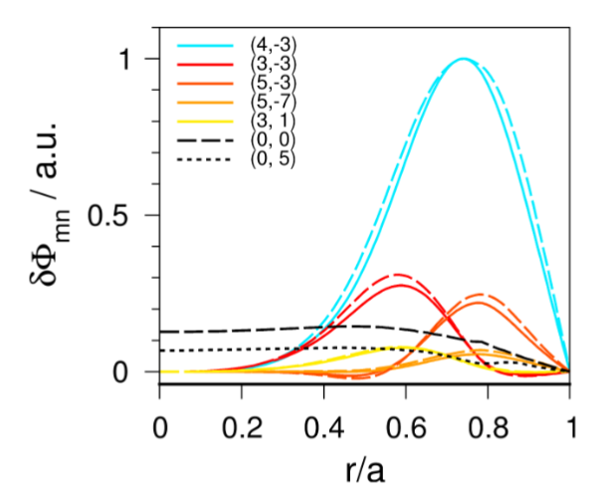
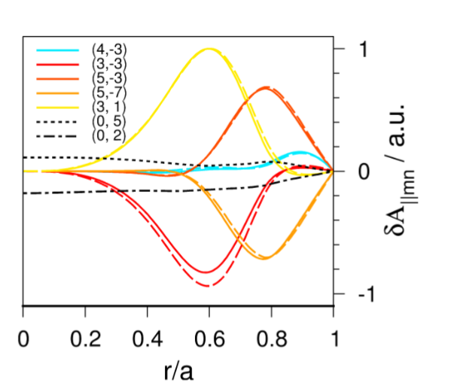
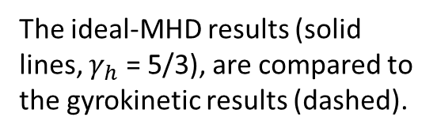
Gyrokinetic simulations of MHD-unstable stellarator configurations
EUTERPE
The ideal-MHD results (solid lines, $γ_{h}$ = 5/3), are compared to the gyrokinetic results (dashed).
Consider 4-period stellarators:
  turning-ellipse configurations
Choice: Mercier-unstable at finite β (not a reactor candidate)
Perform full-torus GK simulations
Find good agreement with MHD (CAS3D, CKA) in linear phase.
First-ever benchmark of global MHD with global gyrokinetics in stellartors!
Collaboration with TSVV-11
Very good agreement!

Slide 22
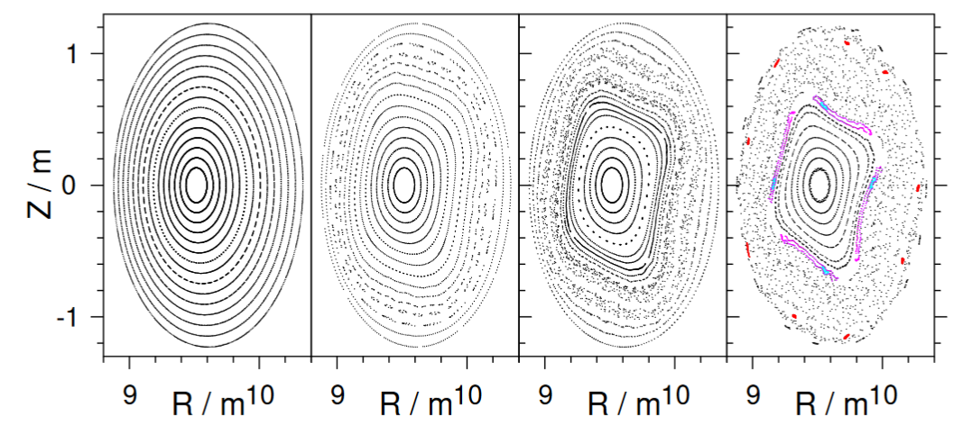
Gyrokinetic simulations of MHD-unstable stellarator configurations
Collaboration with TSVV-11
EUTERPE
Perturbed field-line tracing for GK magnetic field:
nonlinear growth of magnetic islands, ergodization
⟨β⟩ = 0.006
Consider 4-period stellarator
Choice: Mercier-unstable at finite β (not a reactor candidate)
Perform full-torus GK simulations
Find good agreement with MHD (CAS3D, CKA) in linear phase.
First-ever benchmark of global MHD with global gyrokinetics in stellartors!
t = 0
t = 32
t = 35.6
t = 40
Soft decay of magnetic surfaces.
No disruptive dynamics!
Soft beta limit in stellarators.
MHD instabilities in stellarator destroy flux surfaces. Magnetic configuration is affected.
First-ever fully gyrokinetic simulations of nonlinear MHD in stellarator plasmas!

Slide 23
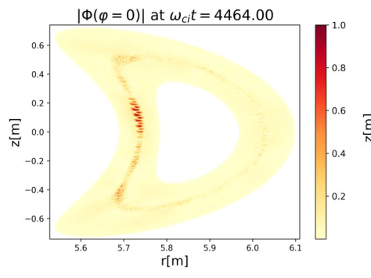
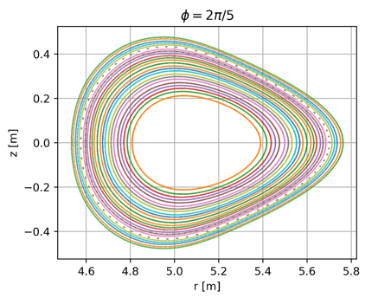
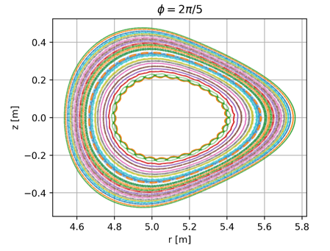
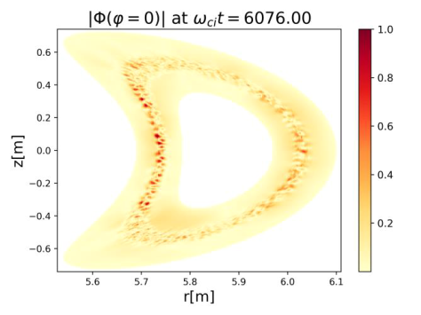
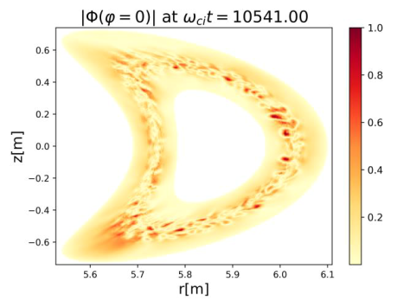
Gyrokinetic simulations of turbulence in W7-X: magnetic configuration affected
EM turbulence in Mercier-unstable W7-X configuration at β = 4%.
EUTERPE
Turbulent evolution of total magnetic field (flux surfaces).
Turbulence leads to ergodization of flux surface.
Magnetic configuration is affected by EM turbulence.
Linear phase
Noninear phase

Slide 24
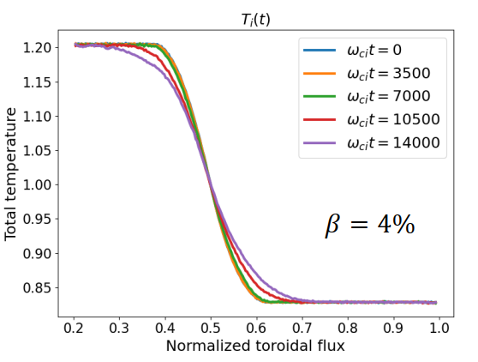
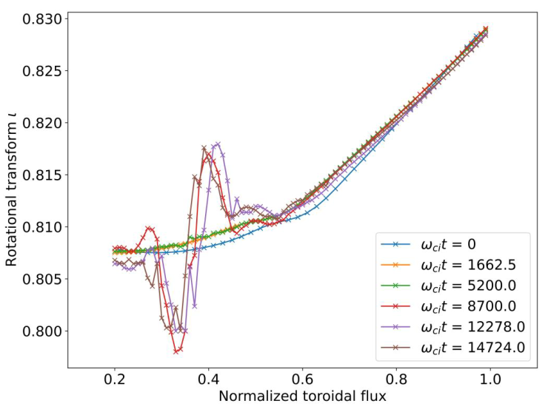
Gyrokinetic simulations of turbulence in W7-X: magnetic configuration affected
EM turbulence in Mercier-unstable W7-X configuration at β = 4%.
EUTERPE
Turbulent evolution of temperature and safety factor profiles
Turbulence modifies rotation transform (safety factor).
Magnetic configuration is affected by EM turbulence.

Slide 25
TSVV-G: future steps for gyrokinetic codes (ORB5/EUTERPE, GENE, GYSELA)
Eulerian code GENE and semi-Lagrangian full-f code GYSELA join TSVV-10 PIC codes ORB5/EUTERPE: verification and levereging each others strengths as elements of the overall E-TASC ecosystem
ORB5/EUTERPE applications:
  Saturation amplitude studies using ORB5: AEs + EPs (+ turbulence)
  Effect of EPs/AEs on turbulence (e.g. via ZF generation): ORB5
  Kink/fishbone instability; effect of ZFs, interaction with turbulence: ORB5 and GENE
  Tearing instability and turbulence in tokamaks (turbulent cascades, island merging vs. Island healing), in realistic geometry and including collisions: ORB5 and GENE
  Electromagnetic turbulence in stellarators, EP physics: EUTERPE
ORB5/EUTERPE development:
  adaptive control-variate in ORB5 (PSZS based, supported by neural networks)
  Field-aligned finite elements in EUTERPE (collaboration with TRIMEG)
  Further integration of the codes (already parts of a joint project; single git)
GENE and GYSELA development and applications
  AE + EP comparison (incl. performance) of GENE and GYSELA with PIC codes (ITPA, NL saturation, etc)
  Realistic CoM distribution functions in GYSELA (following XTOR CoM distribution functions)
  AE + EP + turbulence in ITER/DEMO: GENE

Slide 26
HYBRID MODELS (kinetic-fluid)

Slide 27
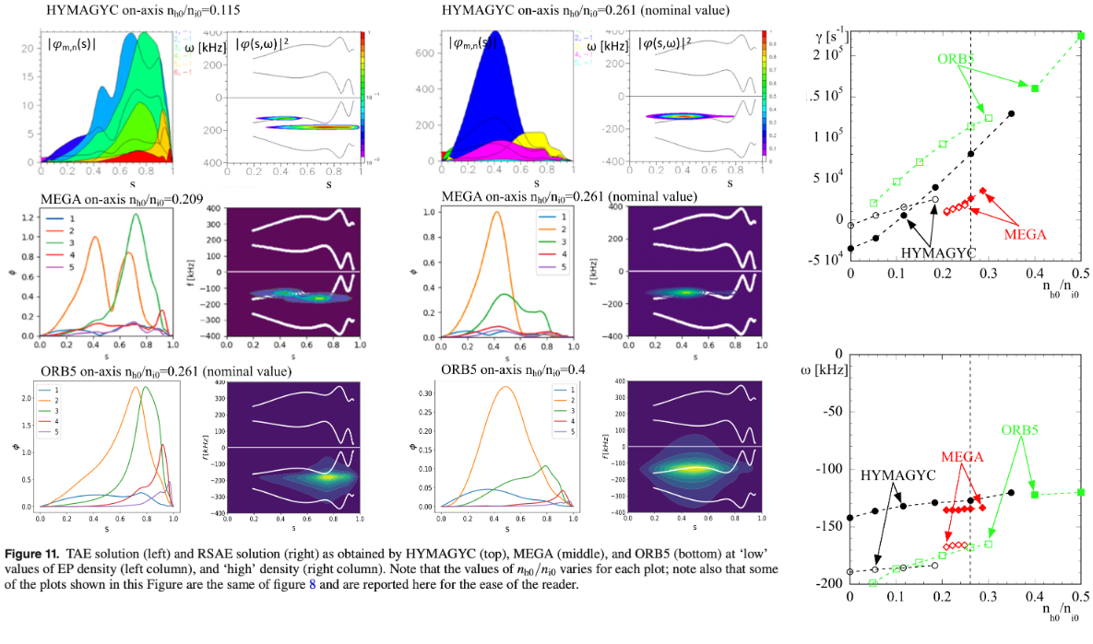

HYMAGYC
Nonlinear benchmark [G. Vlad, IAEA 2023]

Slide 28
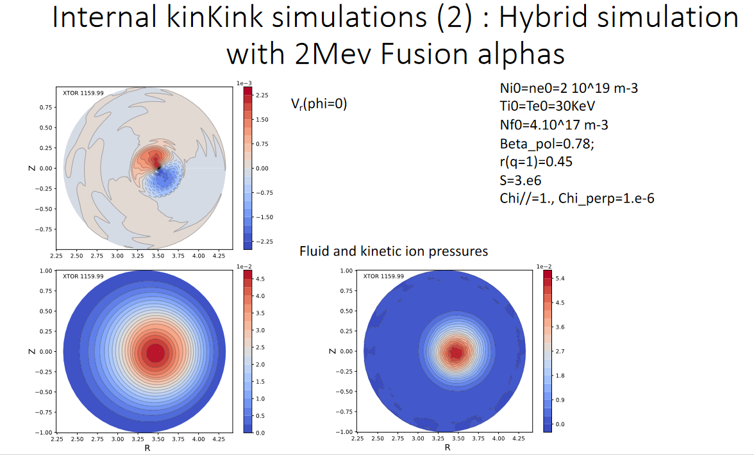
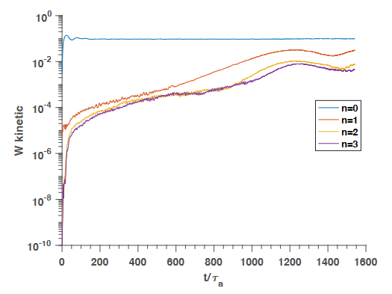
XTOR-K
saturated helical
equilibrium state
In progress: kink + fast ions + AEs

Slide 29
TSVV-G: future steps for hybrid fluid-kinetic codes (XTOR-K, HYMAGYC, STRUPHY)
XTOR-K: nonlinear MHD + nonlinear full-orbit EP; computationally intensive
HYMAGYC: linear MHD + nonlinear EP; less computationally challenging than XTOR-K
STRUPHY: various models + moderd math; pythonic
Fluid-kinetic codes as elements of the Digital-Twin eco-system
Goal: establishing „user comminuties“ for the codes (across WPs); interest has been expressed (Rui)
IMASification of XTOR-K (input: chease, profiles; output: mhd ids)
XTOR-K: performance optimization (GPU-enabling for solver; already enabled for particles)
STRUPHY: user training
Applications: nonlinear EP physics of AEs; kink/sawteeth in presence of EPs, kink (sawtooth)/tearing combinations, kink (sawtooth) / AE combinations, flux pumping (sawteethless reactor)

Slide 30
REDUCED MODELS (quasilinear, PSZS)

Slide 31
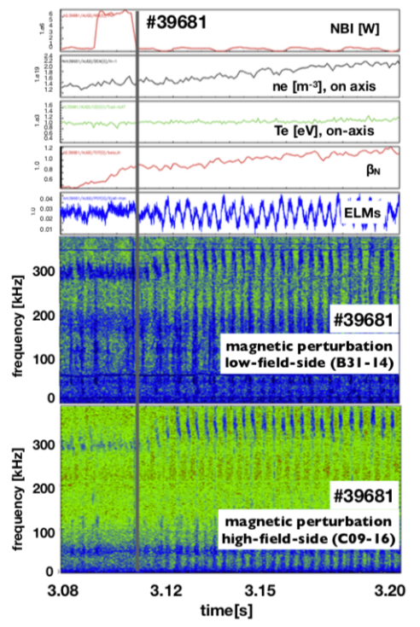
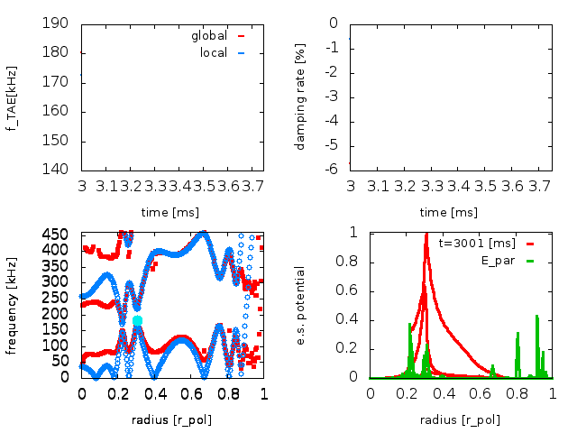
Theory-driven reduced models : Energetic-particle Workflow
Linear approximate gyrokinetic caluculations:
LIGKA and simpler models
slow L-H transition with constant heating power in the presence of strong EP activity
L-mode activity very similar to NLED base case (EGAM/BAE/TAE intermittent crashes, #31213) - but now in flat top phase with transport analysis possible!
automated analysis on Gateway now working using python EP-WF
Using time evolving experimental profiles (e.g. density) for LIGKA EP simulations
Hierarchy of models of varying fidelity available (from local models to full GK)

Slide 32
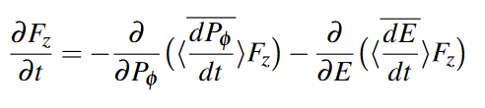


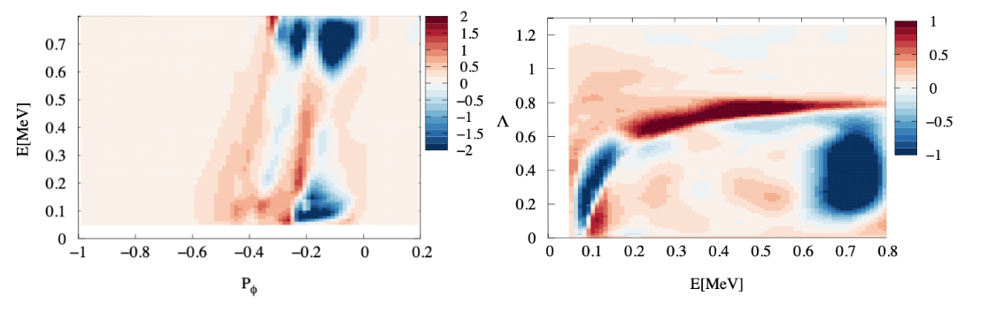
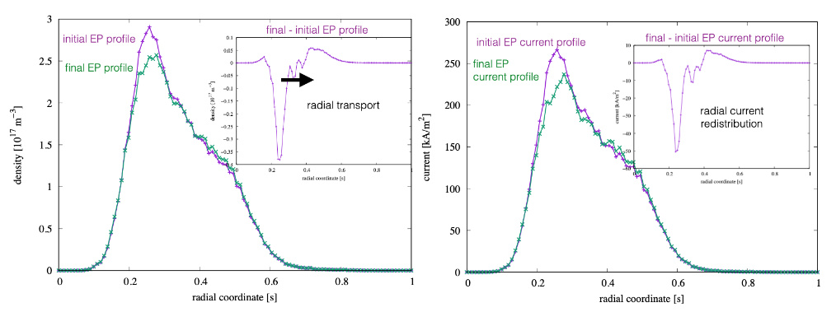
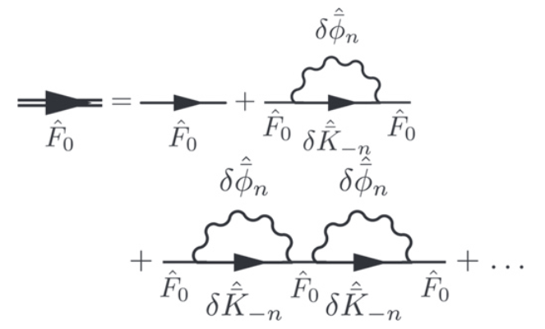
Theory-driven reduced models: transport code (ATEP)
+
=>
1. Compute linear wave (LIGKA)
2. Compute kinetic coefficients for this wave (HAGIS)
3. Solve PSZS kinetic equation (ATEP code)
4. Compute moments of the zonal state F0 (new density and current profilels)
5. Compute radial diffusion coefficient
(for a transport code)
PSZS compared with ORB5 (ITER)
Based on nonlinear theory:
phase space zonal structures and transport theory, Dyson-Schrödinger model …

Slide 33
TSVV-G: future steps for theory and reduced-model computing (ATEP, EP-WF)
THEORY:
Role of the amipolarity in Alfvenic mode saturation (fast-ion vs. bulk-plasma nonlinearities)
Analytic treatment of phase-space fluxes in nonlinear TAE dynamics, in presence of turbulence
Zonal flow generation by Alfven Eigenmodes (modulational vs. beat-driven regimes)
Chirping and saturation: scalings with the amplitude, zonal flow effects
REDUCED MODELS:
Extending models to transport time scales, zonal structures
Integration with EUROfusion tools (transport codes etc) via IMAS-IDS
Applications to optimization of burning-plasma regimes (collaboration with DEMO Central Team)
Applications to experiments (past, ongoing, and planned): JT60-SA, ASDEX-U, JET, ITER, BEST
Connecting TSVV-G activities (EP-WF/ATEP code) to burning-plasma operation planning

Slide 34
CONCLUSIONS

Slide 35
Conclusions
Turbulence, zonal flows, Alfvénic modes, energetic particles, MHD-like perturbations coexist and affect each other
Global nonlinear gyrokinetics is a minimal inclusive approach for this system
ORB5 and EUTERPE codes provide such a framework; enabled by numerous improvements in algorithms
First-in-kind simulations of nonlinear plasma evolution performed in tokamak and stellarator geometries
Hybrid models (kinetic-fluid) and reduced models (quasilinear, PSZS) have also been developed
E-TASC software ecosystem will make a qualitative difference for future fusion reactor projects (public and private)
https://indico.euro-fusion.org/category/283/
TSVV-G: continuation of TSVV Task 10
New contributors: GYSELA and GENE in addition to ORB5/EUTERPE – all major GK codes represented; cooperation between teams, exchange of experience, favourable environment for scientific discovery
Dissemination: small associations (Greece and Ukraine) included in TSVV-G
User communities for major codes (beyond TSVVs): XTOR-K, HYMAGYC, ORB5/EUTERPE, …

Slide 36
TSVV-10 => TSVV-G: Hierarchy of models
Theory
  deep insight into the physics
  predictions, ideas, limits for simulations
Low fidelity: theory-driven reduced models (EPWF, ATEP)
  quick execution
  full IMASification
  well-suited for integrated modeling and discharge planning
  able to address transport time scales
  sometimes based on parameters to be derived from higher fidelity or experiment
Intermediate fidelity: hybrid fluid-gyrokinetic models (XTOR-K, HYMAGYC + Struphy for TSVV-G)
  computationally more expensive but still very affordable (case-dependent)
  able to address resistive time scales and highly-nonlinear MHD
  IMASified (in some cases) and suited for integrated modeling
High fidelity: global gyrokinetic codes (ORB5/EUTERPE/TRIMEG + GENE and GYSELA for TSVV-G)
  computationally most expensive
  most accurate and realistic
  Fundamental for „lower fidelities“

Slide 37
TSVV-10 => TSVV-G: collaboration accross EUROfusion
TSVV-G + DCT/WPDES: reactor-relevant topics for burning plasmas (heating in Q>30 regimes for Power Plant)
TSVV-G + WPSA: collaboration on zonal flows and energetic particles
TSVV-G + WPTE,MOD: ADEX-U/TCV modelling
TSVV-G + WPW7X: collaboration on MHD and EP topics in the experiment
TSVV-G + ITPA-EP: leading benchmark joint activities (two topics)
TSVV-G + TSVV-H/TSVV-E/TSVV-F: integrated modelling with EP actors provided by TSVV-G,
TSVV-G + TSVV-I: collaboration on gyrokinetic modelling of nonlinear MHD activity in stellarator plasmas
TSVV-G + TSVV-J: collaboration on EM turbulence in stellarators
TSVV-G + ACH: ORB5/EUTERPE(MPG, EPFL), XTOR-K(CIEMAT, IPPLM)

Slide 38
BACKUP SLIDES

Slide 39
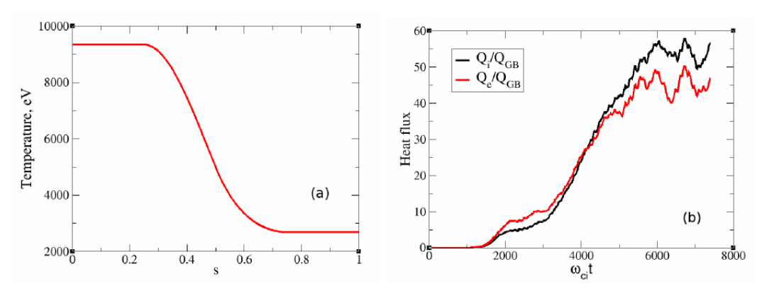
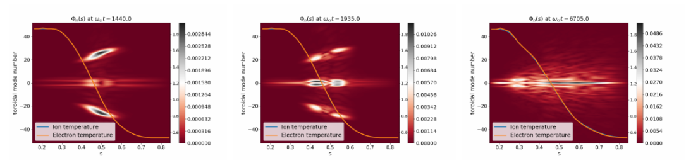
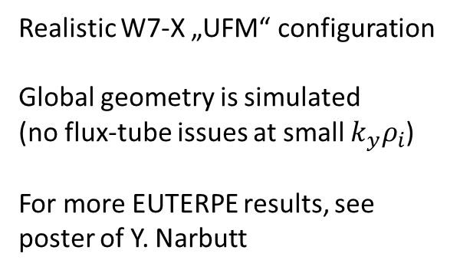
Global simulations of EM turbulence: EUTERPE
Realistic W7-X „UFM“ configuration
Global geometry is simulated
(no flux-tube issues at small $k_{y}ρ_{i}$)
For more EUTERPE results, see poster of Y. Narbutt
A. Mishchenko et al., Plasma Phys. Control. Fusion 64, 104009 (2022)

Slide 40
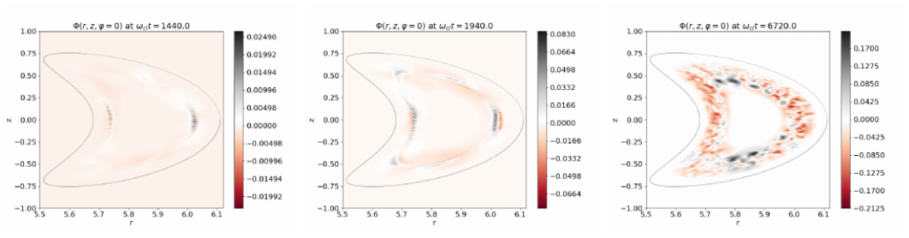
Global simulations of EM turbulence: EUTERPE
Realistic W7-X „UFM“ configuration
Global geometry is simulated
(no flux-tube issues at small $k_{y}ρ_{i}$)
For more EUTERPE results, see poster of Y. Narbutt
A. Mishchenko et al., Plasma Phys. Control. Fusion 64, 104009 (2022)

Slide 41
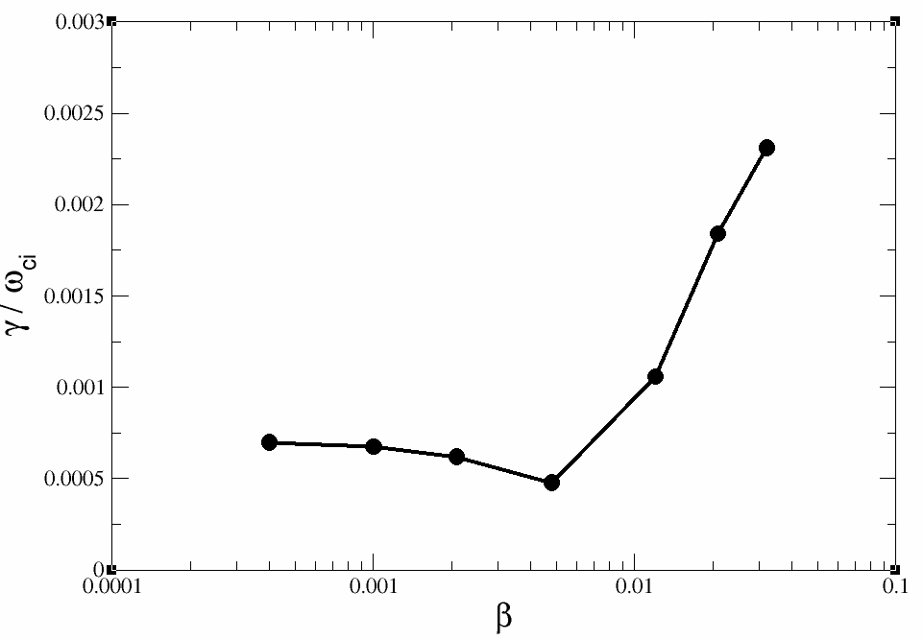

KBM saturation and profile relaxation
ITG-to-KBM transition
Plasma β increasing
KBM
ITG
Global simulations (ORB5)
No electromagnetic run-away in global setup!

Slide 42




KBM saturation and profile relaxation
Global simulations with adaptive control variate are needed to capture the profile relaxation

Slide 43



KBM saturation and profile relaxation
Global simulations with adaptive control variate are needed to capture the profile relaxation

Slide 44




Tearing instability, turbulence, effect on magnetic configuration
ORB5
Parallel current modified by the island
Safety factor modified by the island
Tearing instability generates islands
Islands generate flows
Flows become unstable (island saturation or healing).
Tearing instability and turbulence coexist and interact
Magnetic configuration is affected (evolution of q profile)
Islands perturb parallel current (zonal field).
Safety factor and local shear nonlinearly change.
Island growth is nonlinearly bound.

Slide 45

JET #92416: Toroidal Alfvén Eigenmodes seen in Deuterium-Deuterium experiment
afterglow
JET DD campaign, "afterglow experiment" shot #92416.
Experiment investigating plasma behavior after the main NBI heating pulse t > 6.1 s.
In this shot, TAEs were measured at the time 6.2 s of the discharge.
M. Fitzgerald, S.E. Sharapov, P. Siren, et al, Nuclear Fusion (2022)
TAEs

Slide 46





JET #92416: TAE simulations, beat-driven zonal flows
ORB5
TAE
TAE
Fast-ion destabilized TAE generates beat-driven zonal flow (double growth rate of TAE).
Radial location of zonal flow is determined by the TAE structure.

Slide 47



JET #92416: ITG simulations, TAE-driven zonal flows suppresses ITG (mode structure)
ORB5
No TAE-ZF
With TAE-ZF
w/o ZF
No TAE-ZF
with ZF
With TAE-ZF
TAE-driven zonal flows strongly affect mode structure of ITGs
Beat-driven zonal flow mitigates ITG instability
(antenna-emulated ZF)

Slide 48

XTOR-K

Slide 49
TSVV-G: background
Call for TSVV-G: Physics of Burning Plasmas
Develop a self-consistent description and corresponding simulation tools for the mutual
interaction of energetic particles, MHD modes, turbulence, and kinetic plasma profiles in both
tokamak and stellarator geometries.
Develop a theoretical understanding and validated interpretative/predictive capabilities
(including reduced models) of burning plasma physics in both tokamak and stellarator
geometries. The resulting reduced models are to be used in TSVV-H and TSVV-I.
Develop strategies to optimize the deposition of fusion alpha energy into the bulk plasma to
enhance reactor performance.

