Slide 1
TSVV15 Pulse Design Tools
F. Imbeaux, R. Coosemans, P. David, F. Jaulmes,
on behalf of TSVV15 contributors:
K. Adam, J.F. Artaud, T. Bolzonella, C. Boulbe, C. Contré, G.L. Derks, E. Fable, B. Faugeras, O. Février, A. Frank, G. Gros, R. Hazelhof, J. Hecko, C. Heiss, I. Ivanova-Stanik, H.T. Kim, L. Kripner, D. Kropackova, S. Marchioni, M. Marin, M. Mattei, A. Mele, A. Merle, R. Nouailletas, A. Panera, A. Pau, L. Pigatto, D. Ricci, L. Saccaro, O. Sauter, F. Solfronk, D. Terranova, G. De Tommasi, S. Van Mulders, S. Vorc

Slide 2
Context and Objectives
Lately born TSVV: started in October 2024, closed in December 2025
Pulse Design Tools (PDTs) are used to design and optimize plasma discharges within machine limits
Typical tool: self-consistently coupled free boundary equilibrium + 1D core transport solvers: plasma geometry, PF coil currents, heating and fueling scenario, plasma transport, SOL and wall conditions, plasma breakdown, …
To be effective for optimization, they must run quickly
At the beginning of the project, the state of the community was that Pulse Design Tools had been developed by some experiments and used mostly for that experiment.
Evolve to a more coordinated and harmonised landscape, by porting the existing tools to different experiments (task 1), develop interoperable components and framework that can benefit to all PDT prototypes (task 2 and 3), with a specific effort until the end of 2025 on transport+free boundary applications (task 4).
Maximise the mutualisation of modules (e.g. transport, fuelling, H&CD, equilibrium), coupling techniques and infrastructure solutions
Apply the tools to multiple experiments and benchmark them
Define a possible convergence strategy for the next period (2026-2027)
~35 people involved, 17 “activities” → highlights
IMAS interfaces

Slide 3
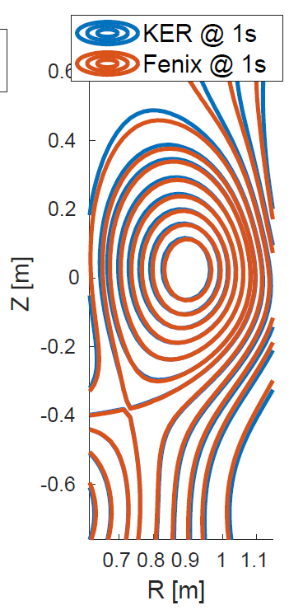
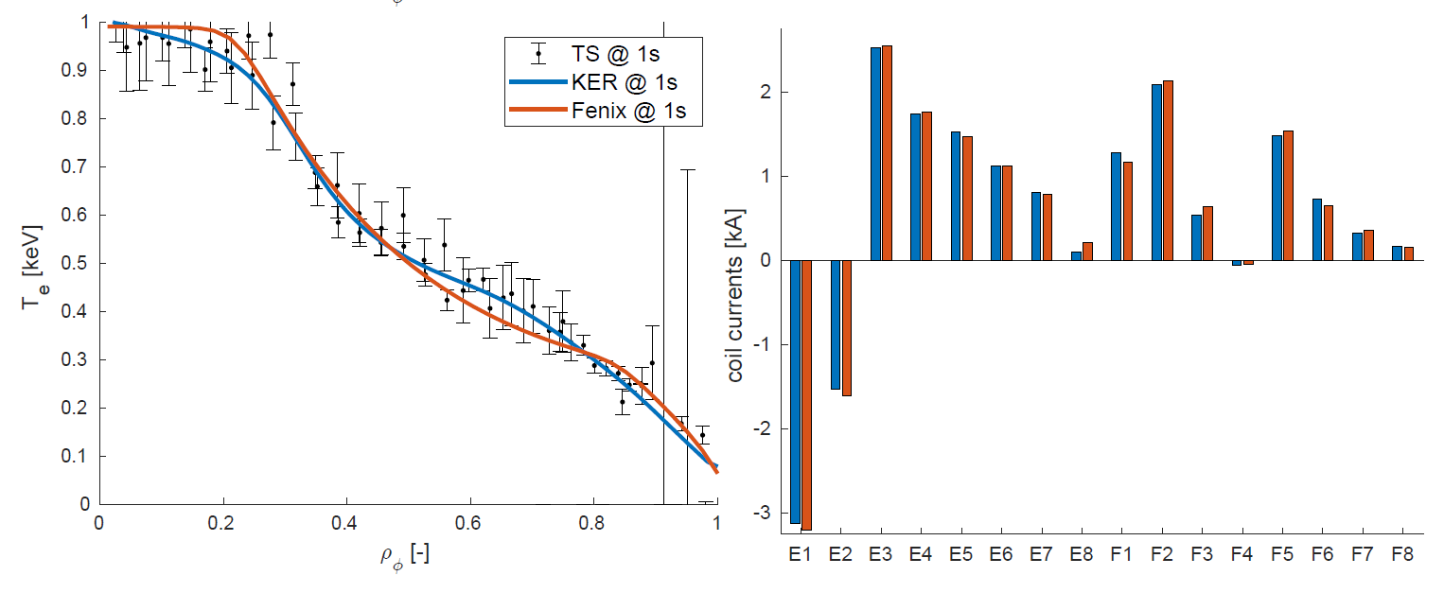
Task 1: Demonstration of PDT prototype (porting at existing machines): FENIX (AUG) applied to TCV
FENIX: Free boundary equilibrium (FGE) + transport (ASTRA) + TCV controllers
Very good match with TCV kinetic equilibrium reconstruction (KER)

Slide 4
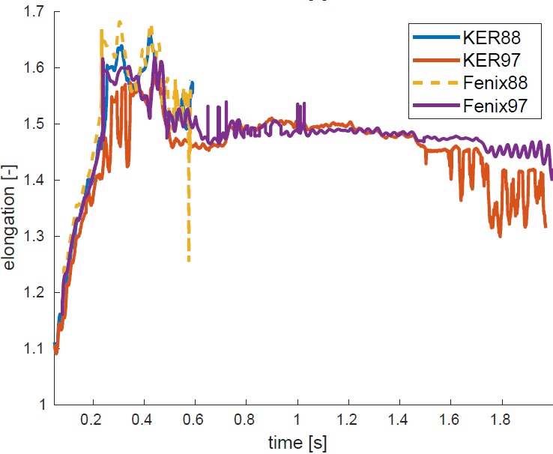
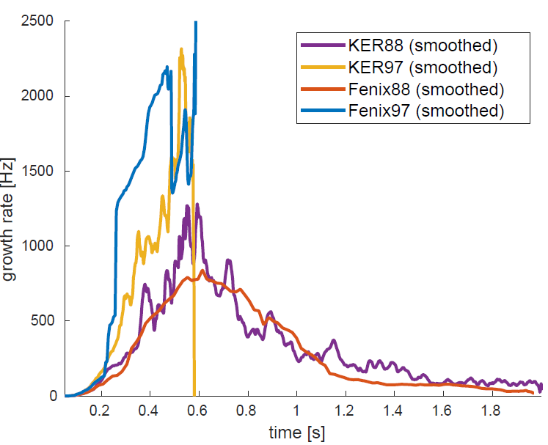
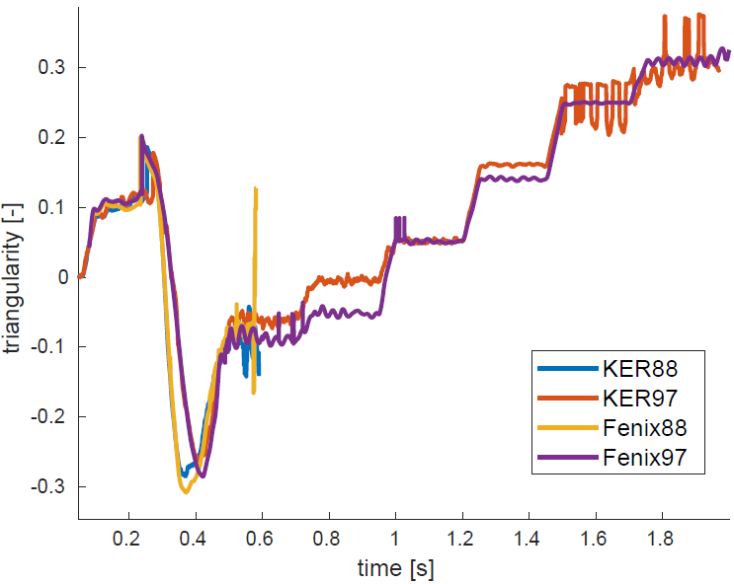
Task 1: Demonstration of PDT prototype (porting at existing machines): FENIX (AUG) applied to TCV
FENIX: Free boundary equilibrium (FGE) + current diffusion (ASTRA) + TCV controllers
Marginally stable triangularity scan: careful modelling allows to reproduce disruption in case 87688 vs lower elongation variation 87697 running through

Slide 5
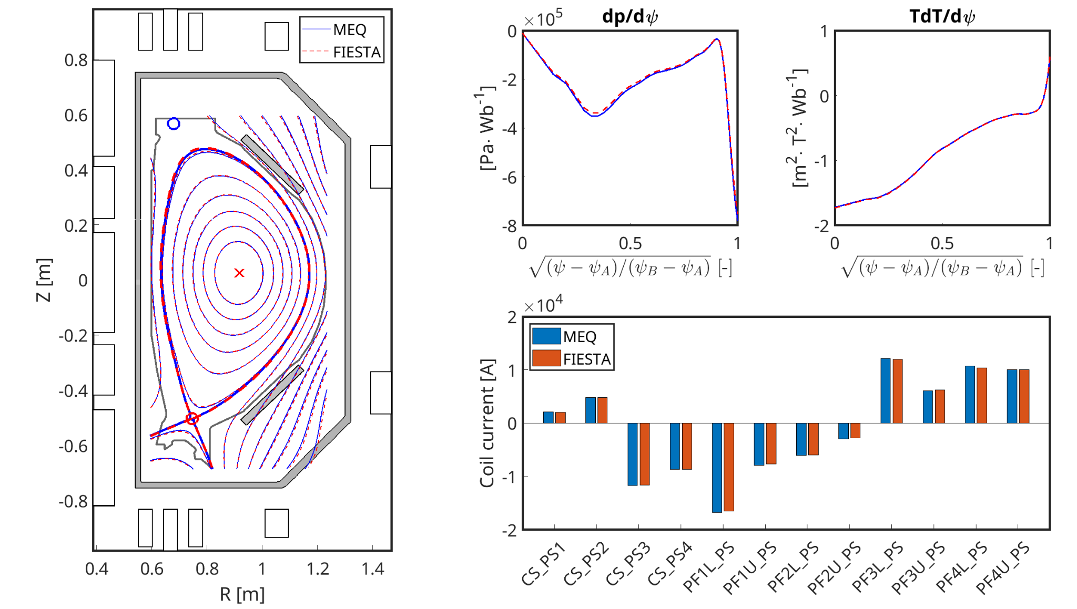
Task 1: Demonstration of PDT prototype (porting at existing machines): FBT (TCV) applied to COMPASS-U
FBT: inverse equilibrium for feedforward coil current preparation
Simulation with imposed p’ and TT’ benchmarked with FIESTA

Slide 6
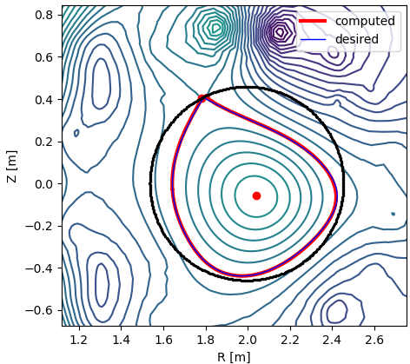
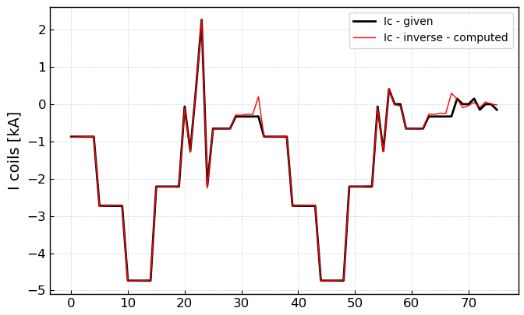
Task 1: Demonstration of PDT prototype (porting at existing machines): NICE (WEST) applied to RFX-MOD
NICE: inverse equilibrium reconstruction for #39122 of RFX-mod with imposed P’ and TT’ from the Inverse Equilibrium Tool (IET code).
Coil index
Comparison with measured currents and LCFS reconstructed from experimental data.

Slide 7
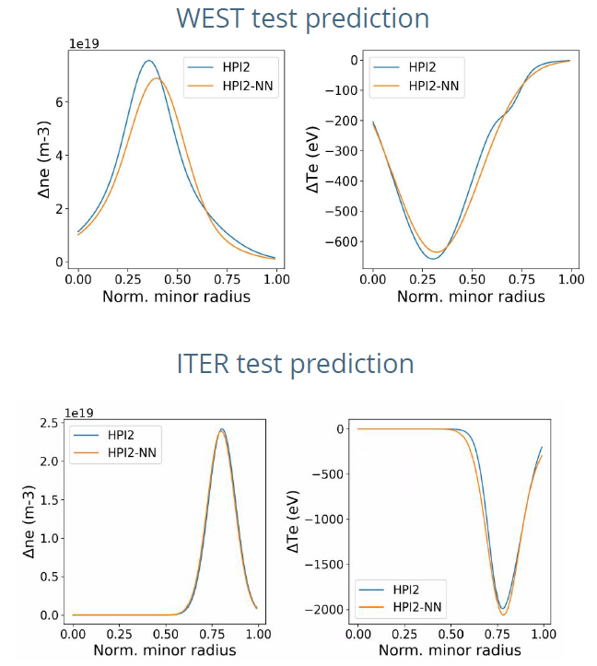
Task 2: Development of Reduced Models: HPI2-NN pellet surrogate
~10000 runs of HPI2 simulating pellet injection in WEST tokamak experimental data, and ITER simulation data.
Inputs: ne, Te, Ti/Te, q profiles, B0, pellet size and velocity
Output profiles:
Variation of electron density 𝚫𝒏𝒆 and 𝚫T𝒆
Ablation time
From ~15 min in HPI2 to ~10 ms in HPI2-NN
Average mean relative error on test of ~5-10 % (WEST) and ~3% (ITER) in both Δ𝑛𝑒 and Δ𝑇𝑒
Coupled to JINTRAC (and can be used for faster solvers)
The code is available Open Source here: https://github.com/DIFFER-NL/hpi2nn/

Slide 8
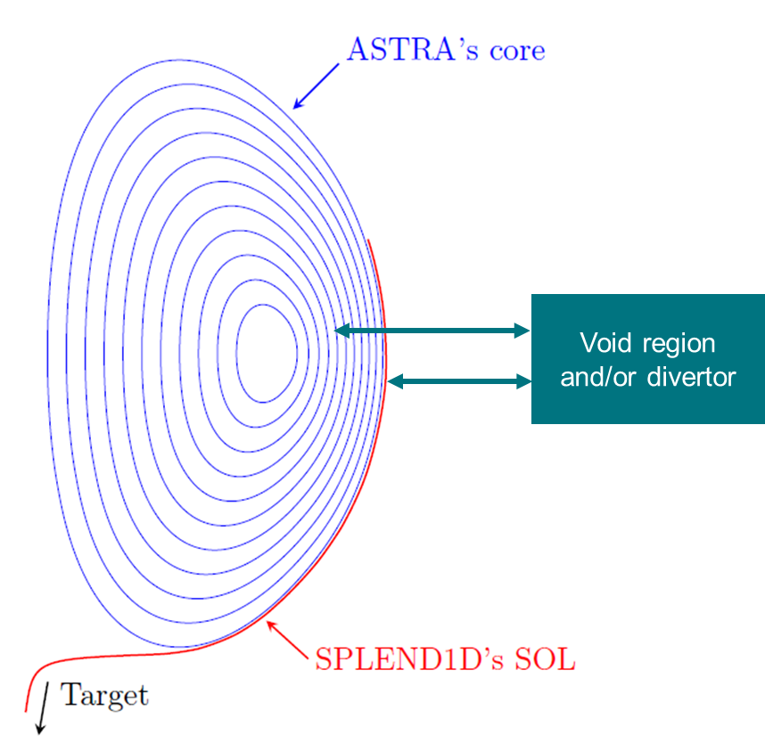
Task 2: ASTRA-SPLEND1D fueling model
Couple core model (ASTRA) to fast edge model (1D SOL code SPLEND1D)
Attempt proper fueling model from valve to plasma core by adding particle reservoirs
SPLEND1D [O. Février, Phys. Plasmas 31, 2024] available on https://gitlab.epfl.ch/fevrier/splend1d, can be shared after signing a license agreement

Slide 9
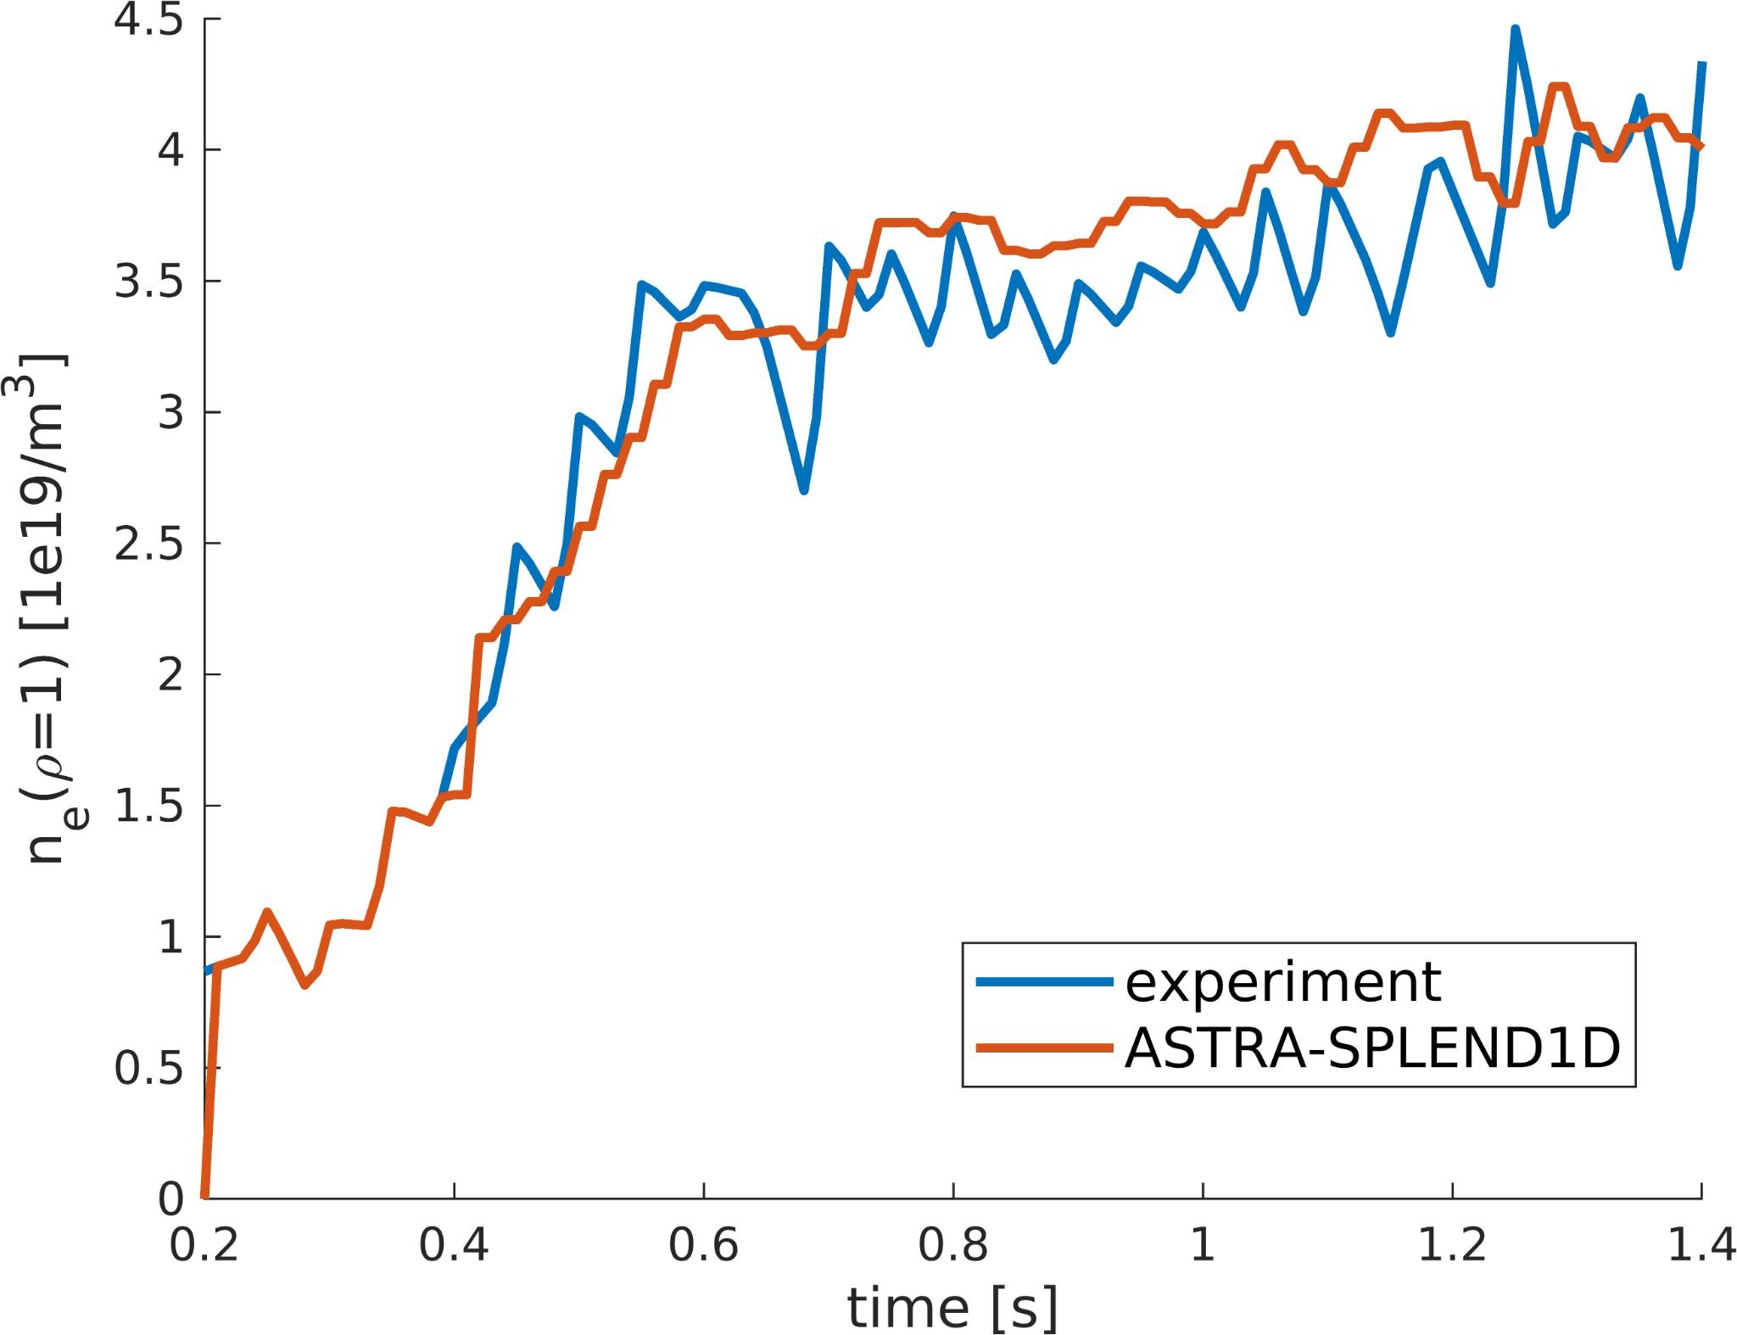
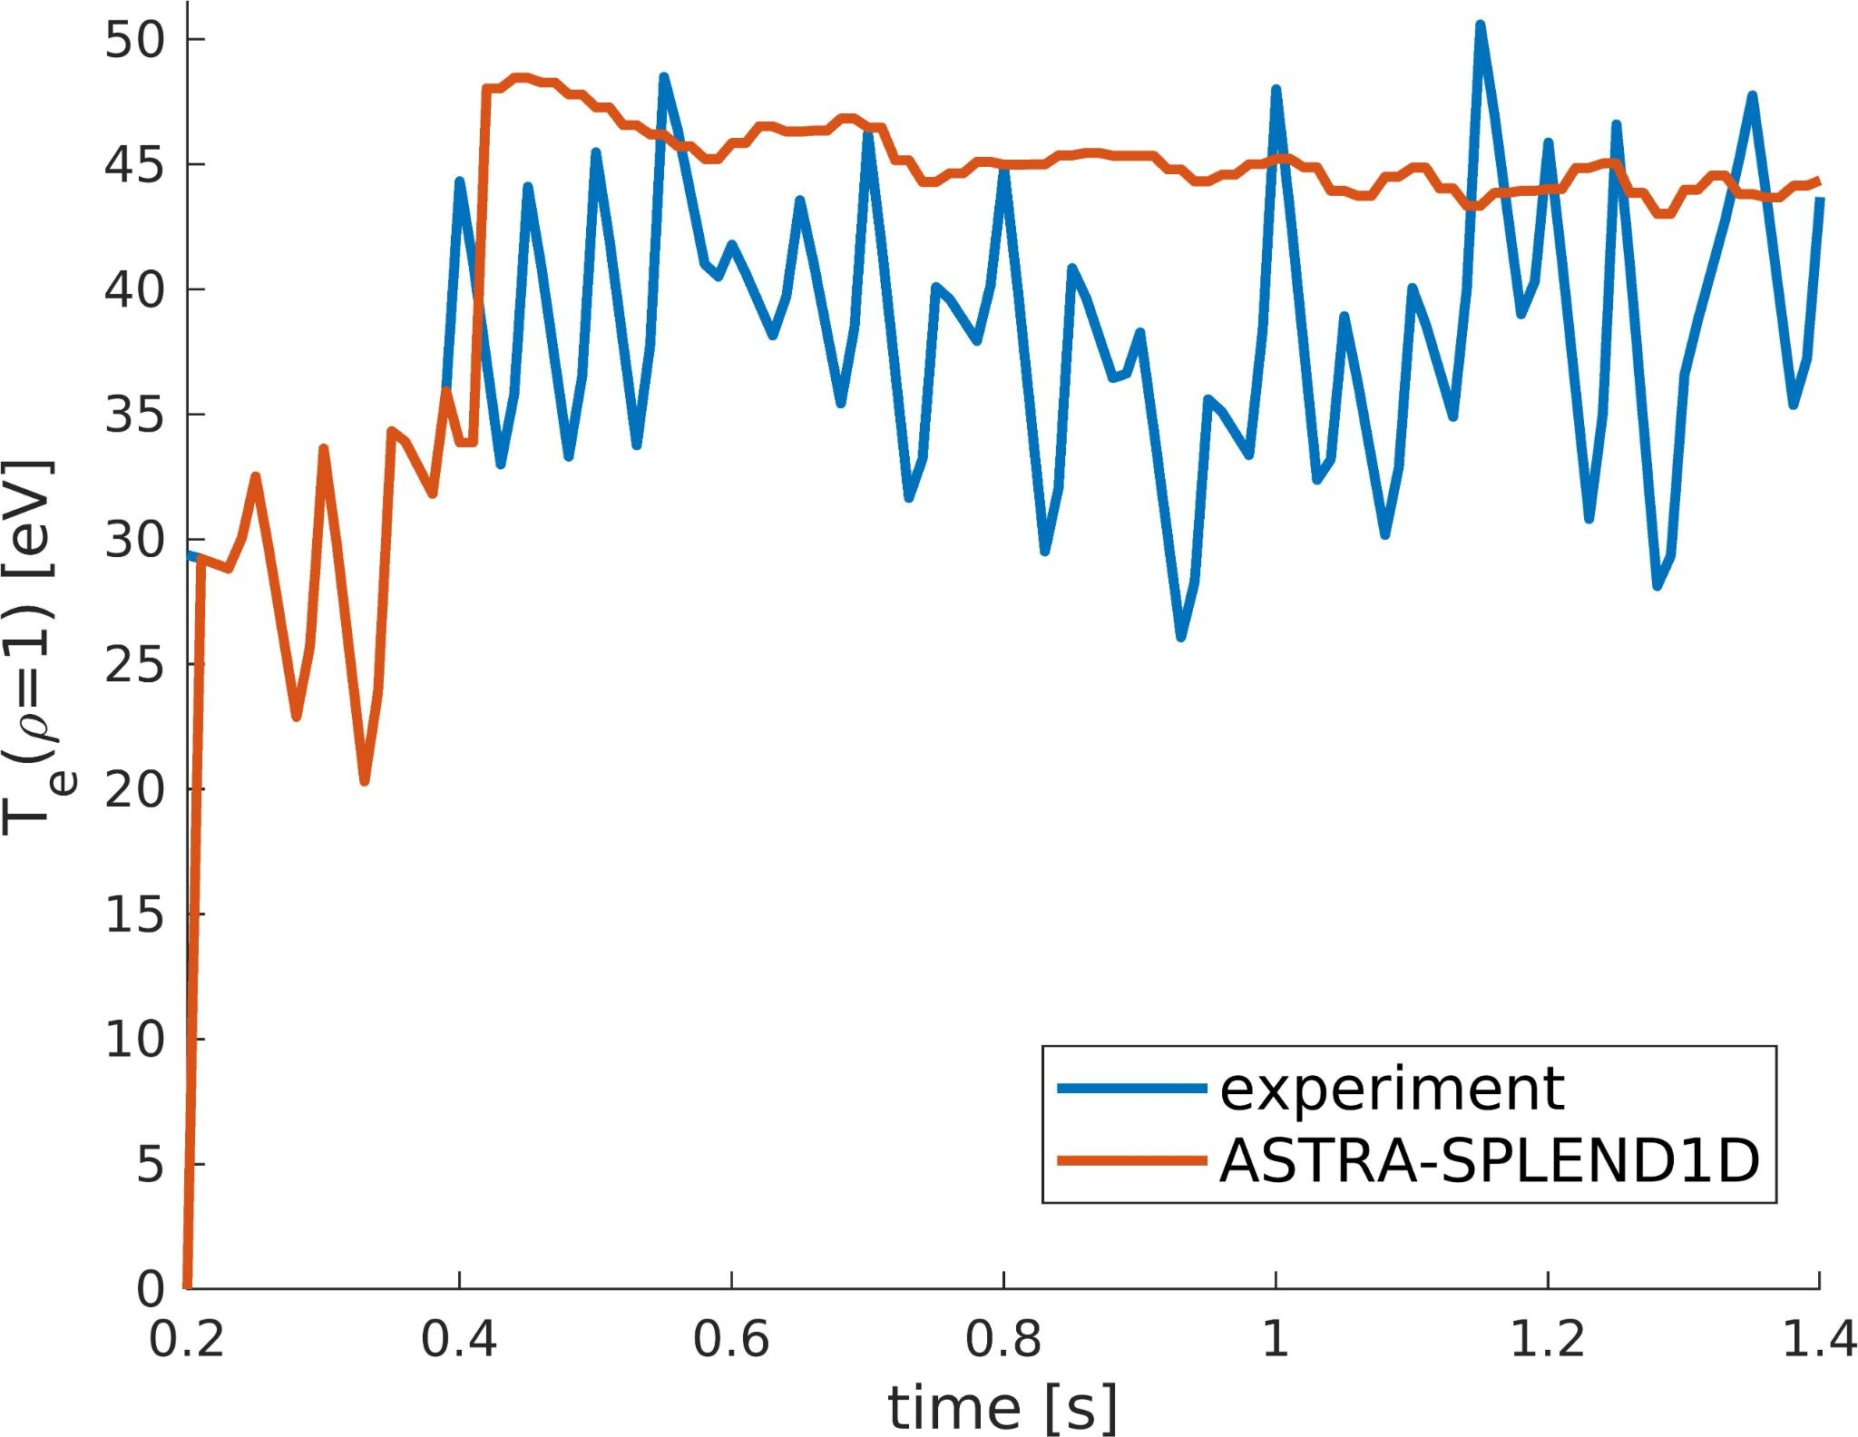
Task 2: ASTRA-SPLEND1D fueling model
Proof of concept for TCV #64965 Ohmic case
Ad hoc SPLEND1D parameters (e.g. neutral losses, recycling) tuned for flattop phase allow good prediction of density ramp as well
Remaining issues
Hard to find generic parameters working for multiple shots
SPLEND1D struggles in lower density regimes
Particle reservoirs still to be implemented

Slide 10
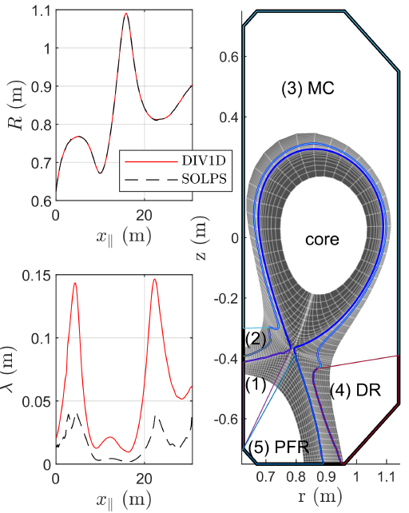
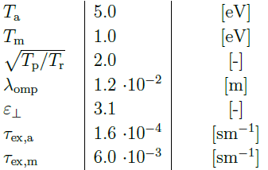
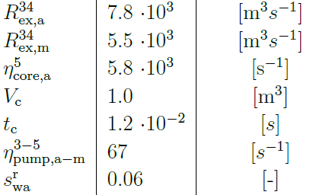
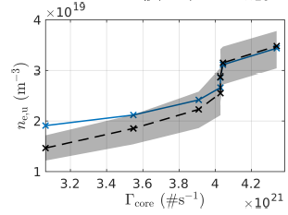
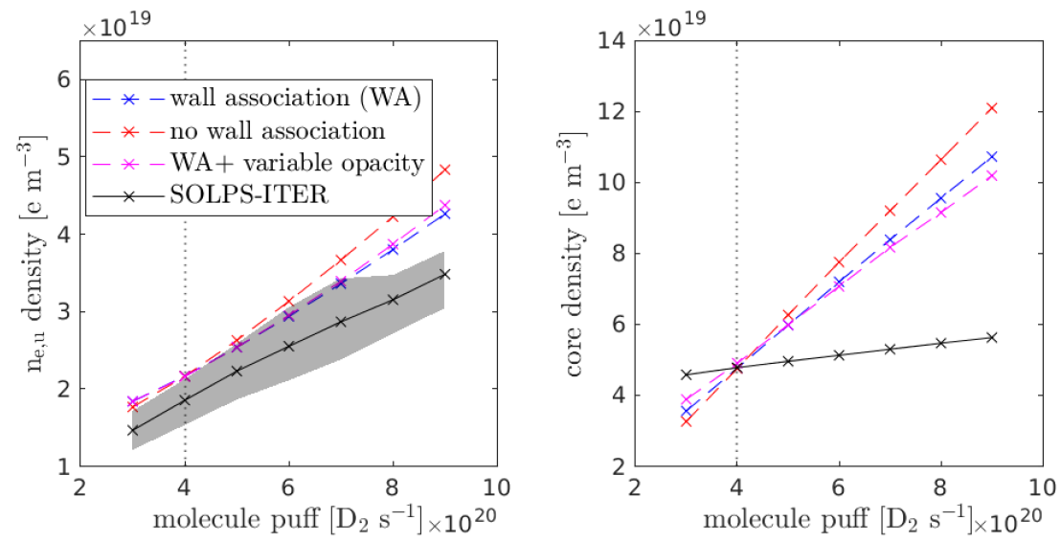
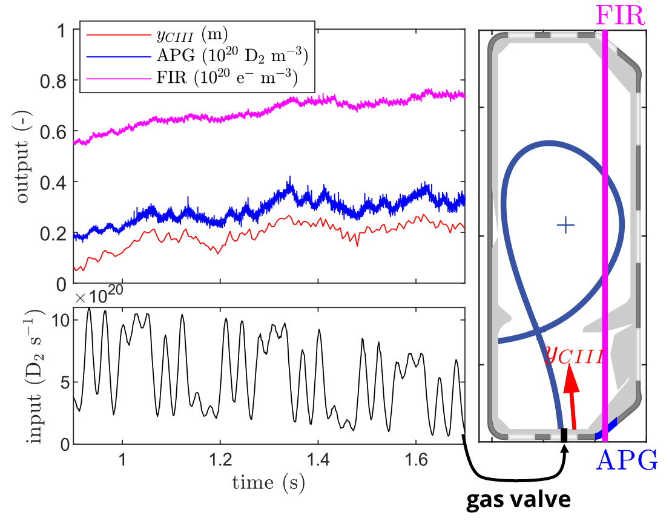
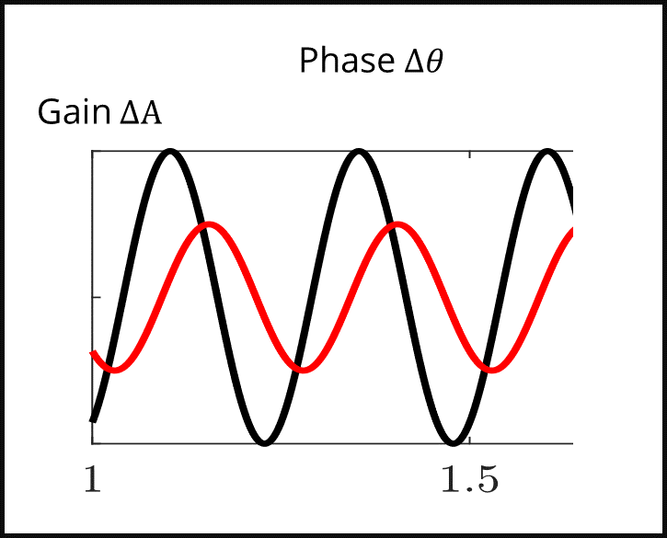
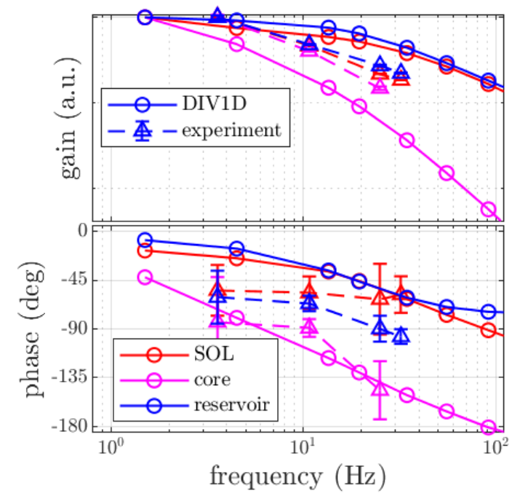
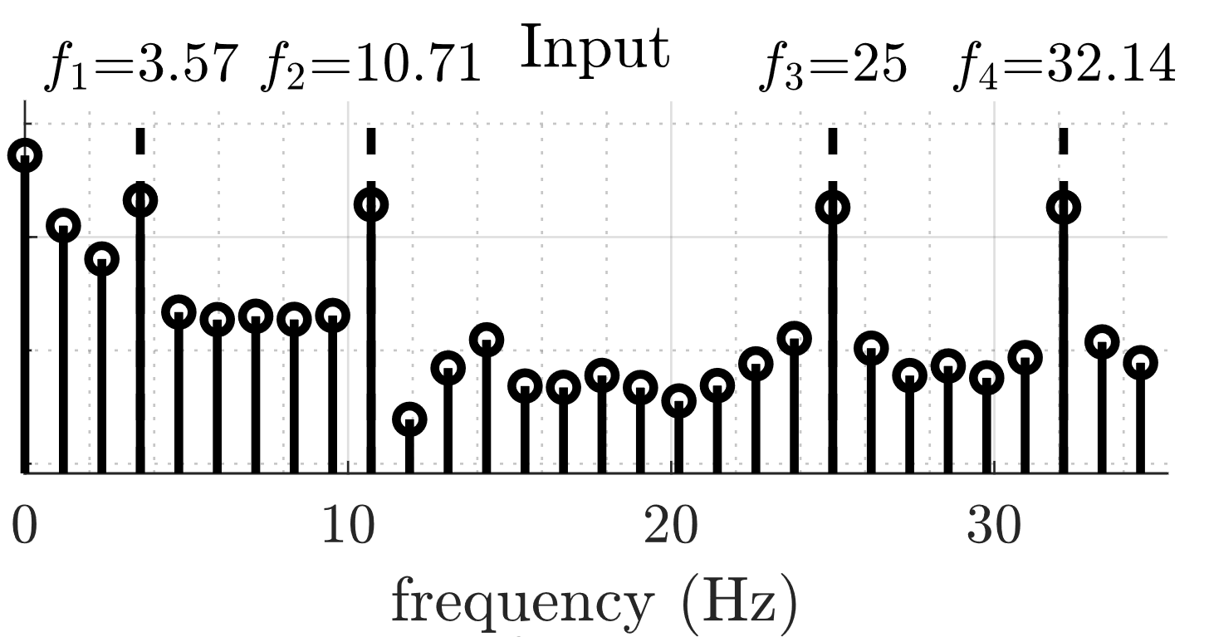


Task 2: Development of Reduced Models: Reduced Model for Neutral Density in the SOL: DIV-1D
Geometry
Calibration SOL
Closure reservoirs
Self-consistent global particle balance TCV
Reproduce density ramp as function of molecule puffing → settings suited to couple 1D core (could solve issue with ASTRA/AUG core coupling) (G L Derks et al 2025 Plasma Phys. Control. Fusion 67 105003)
Closure reservoirs to be automated
Global particle dynamics vs experiment TCV
Discrepancies remain with experiments (G L Derks inrev. 2025 NF)
parameters
parameters
upstream density
vs
core particle flux
upstream density vs molecule puffing
Dynamic experiment
Frequency domain
Comparison with DIV1D
But .. poor core model
Phase acceptable for initial controller design
F. Imbeaux et al | Science Meeting | January 2026

Slide 11

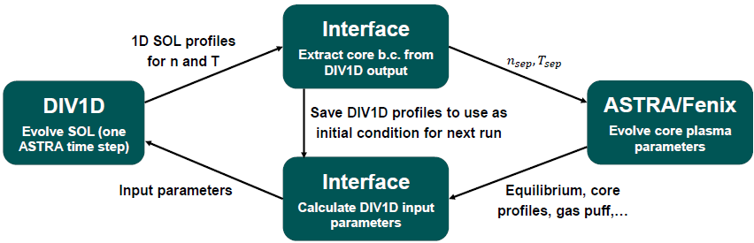
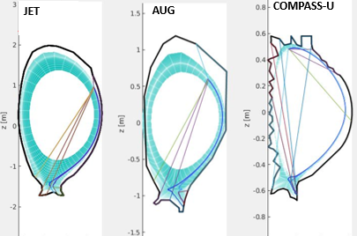
Task 2: Development of Reduced Models: DIV-1D coupling to ASTRA/FENIX (ongoing)
Porting to devices
Setup 1D geometry for: COMPASS-U, AUG, JET → (+ existing for TCV, MAST-U)
Automated calibration on SOLPS → better settings for TCV + AUG (R. Hazelhof et al. submitted to NF 2025)
Coupling to pulse simulators
Library in Matlab, C, Fortran nat.
Compiled/running in ASTRA → paused req. I/O + settings (F. Solfronk)
Code development
Writes to new IMAS 1D edge output (10%) (w. F. Imbeaux)
LGPL licensed on EUROfusion GitLab
Fortran native unit and integration tests + CI/CG (C. Donk)
Also on https://github.com/DIFFER-NL/DIV1D
ASTRA coupling
Geometry

Slide 12
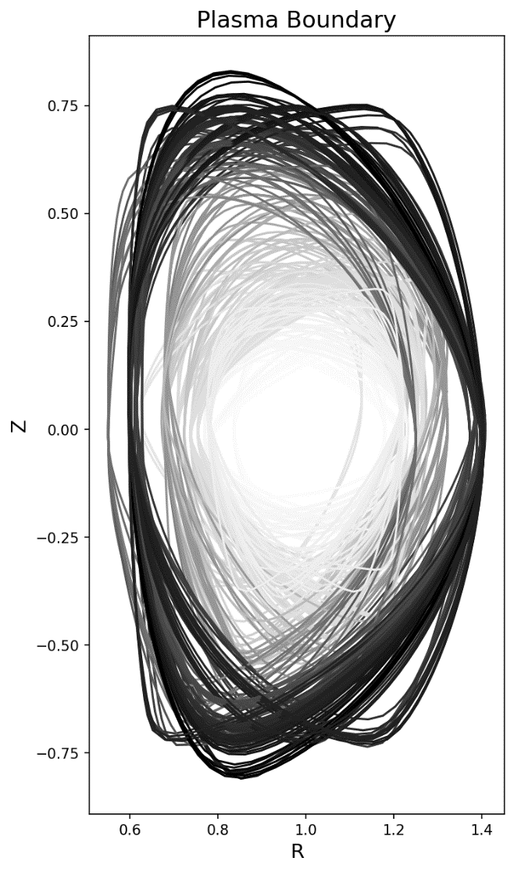
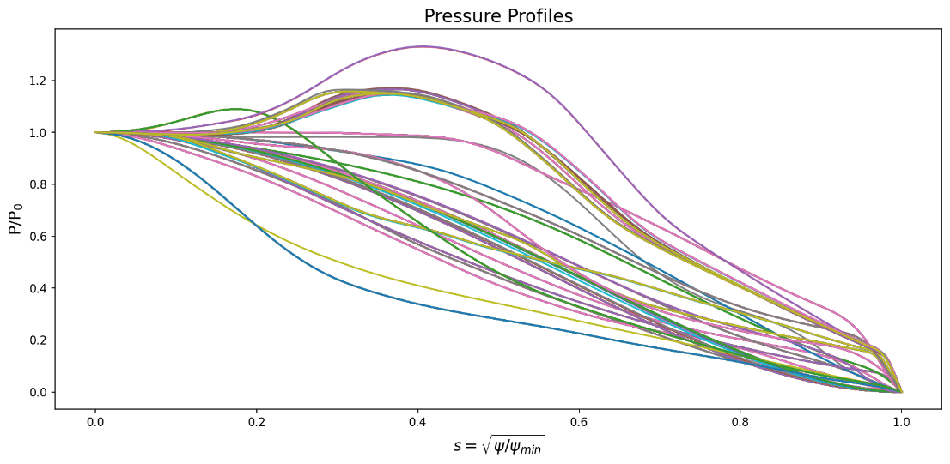
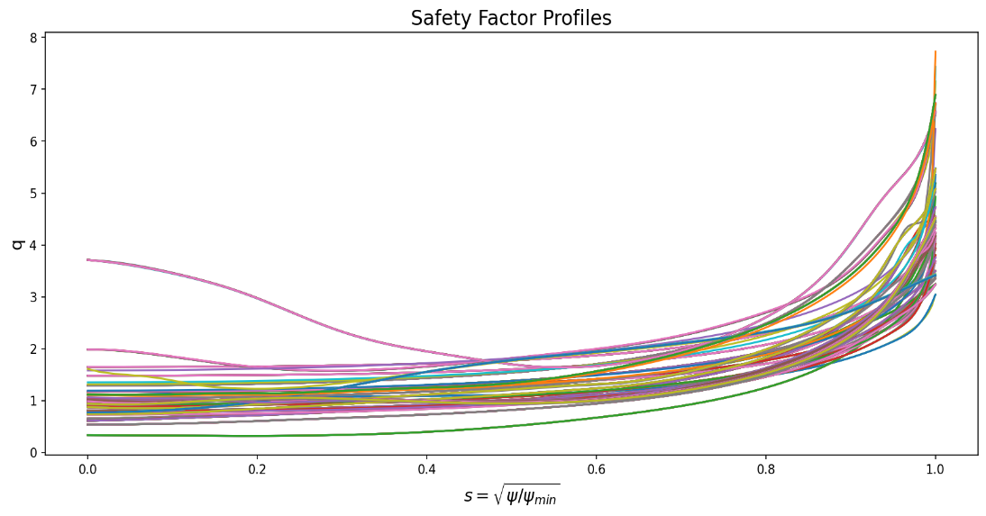
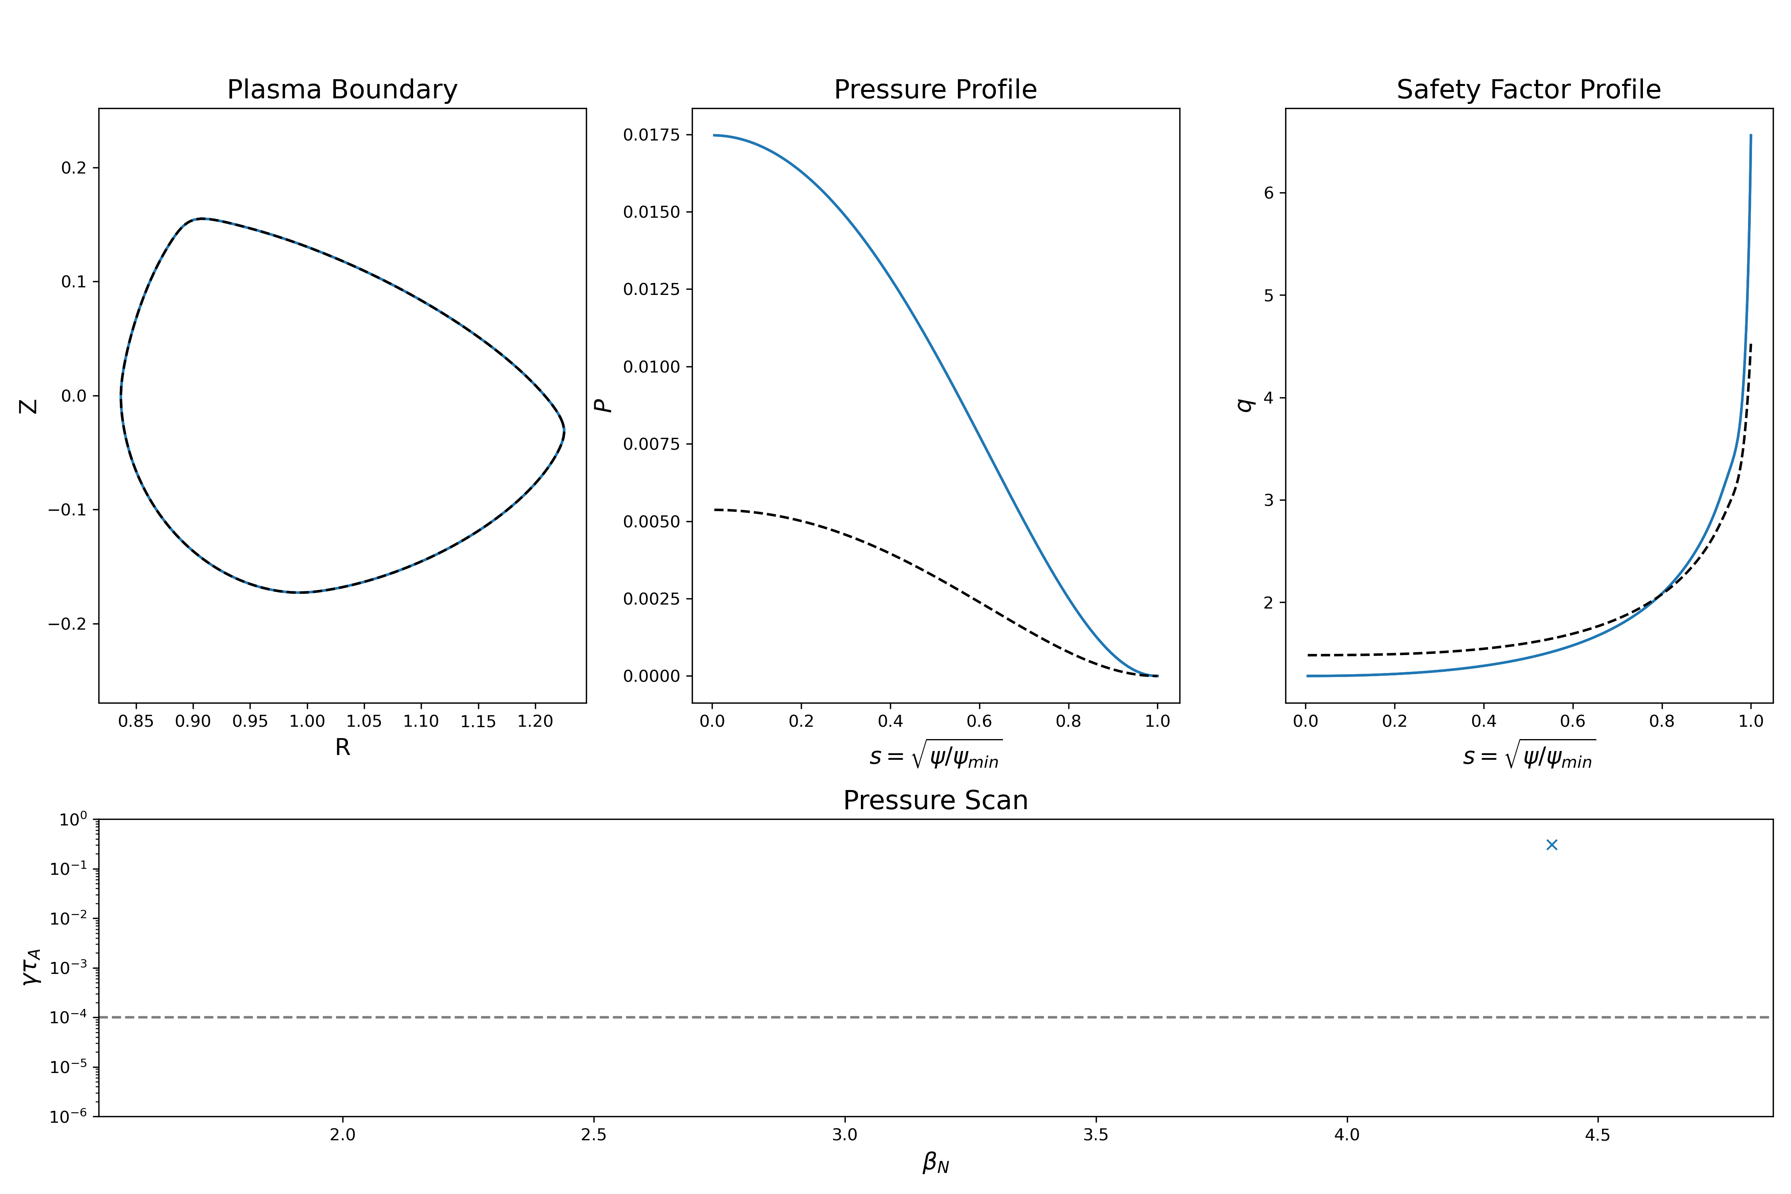
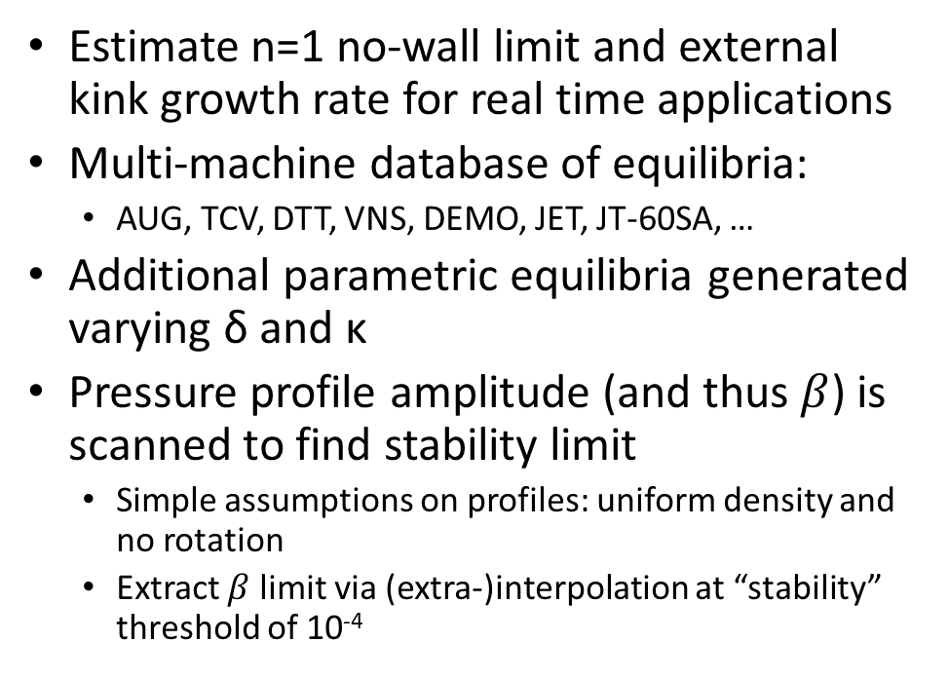
Task 2: MHD-reduced model based on Neural Networks
Estimate n=1 no-wall limit and external kink growth rate for real time applications
Multi-machine database of equilibria:
AUG, TCV, DTT, VNS, DEMO, JET, JT-60SA, …
Additional parametric equilibria generated varying δ and κ
Pressure profile amplitude (and thus $β$) is scanned to find stability limit
Simple assumptions on profiles: uniform density and no rotation
Extract $β$ limit via (extra-)interpolation at “stability” threshold of 10⁻⁴
CHEASE
MARS-F
γτ_{A}¹
β limit
γτ_{A}²
γτ_{A}^{n}

Slide 13
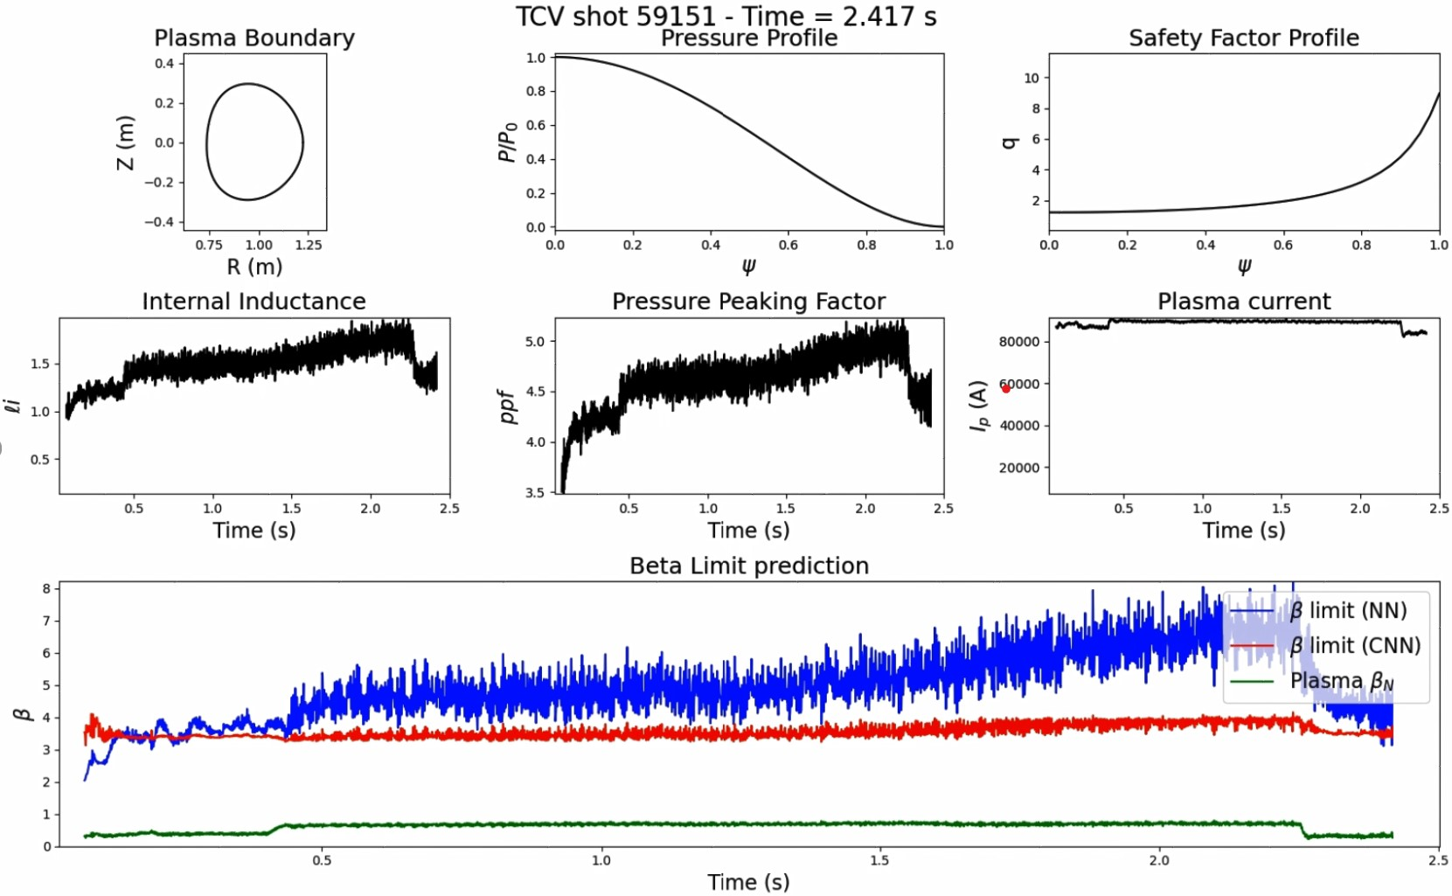
Example: prediction of β limit on entire discharge
0-D model (NN) prediction strongly affected by internal inductance: this is in agreement with theory and observations but perhaps optimistic
1-D model (CNN) prediction uses profiles and might be more realistic
Result to be verified with direct stability calculation

Slide 14
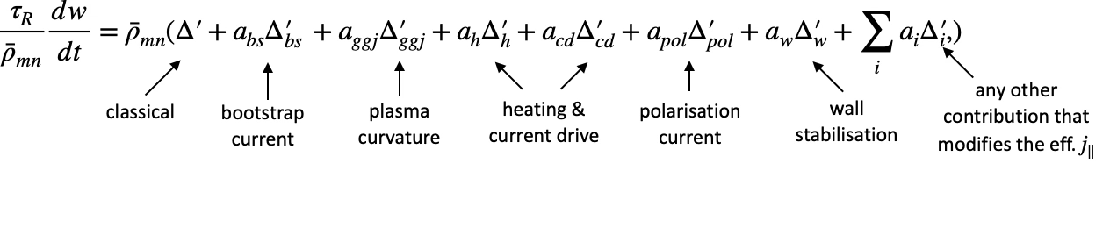
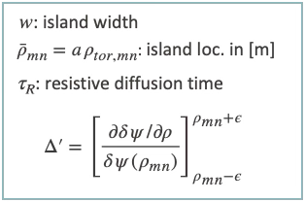
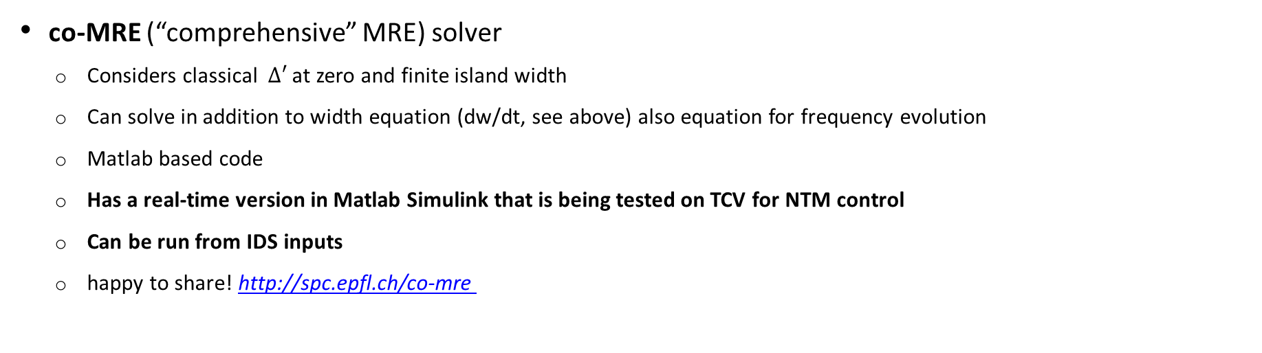
Task 2: Modeling neoclassical tearing modes (NTMs) with co-MRE
Modified Rutherford equation (MRE)
Main physics model to analyse/predict NTM dynamics in experiments and used for RT control applications
co-MRE (“comprehensive” MRE) solver
Considers classical $Δ′$ at zero and finite island width
Can solve in addition to width equation (dw/dt, see above) also equation for frequency evolution
Matlab based code
Has a real-time version in Matlab Simulink that is being tested on TCV for NTM control
Can be run from IDS inputs
happy to share! http://spc.epfl.ch/co-mre

Slide 15
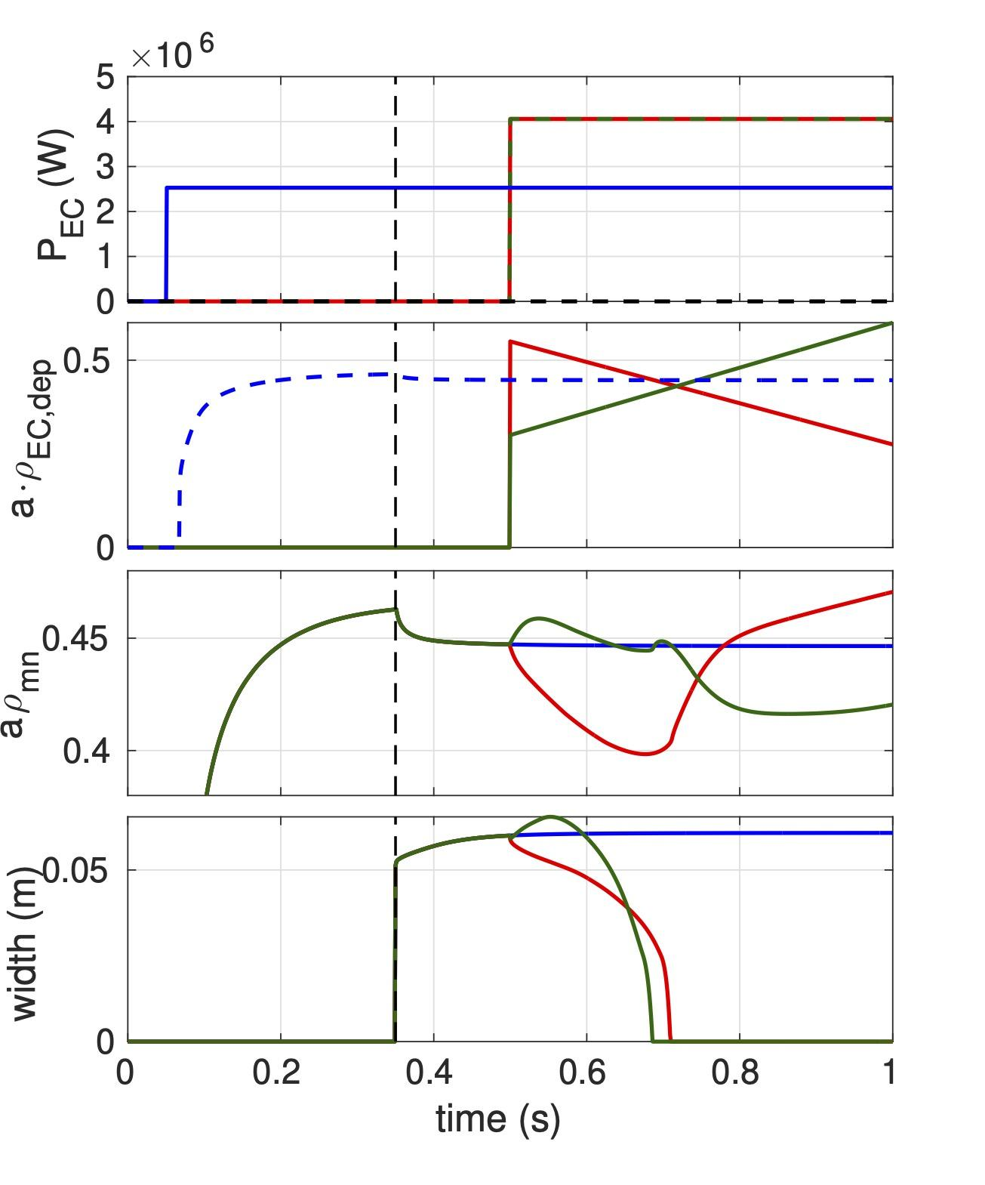
Coupling co-MRE and RAPTOR to model and optimise NTM control
off-axis control launcher
on-axis launcher
for scenario
Coupling with RAPTOR in testing phase
Revived the old/not up-to-date MRE model inside RAPTOR; replaced it with co-MRE
Each time step in RAPTOR we provide growth rate of the NTM by computing the MRE terms → modify electron heat conductivity with
Gaussian perturbation prop. to island width
Tested on constant equilibrium, n_{e} profile, etc. based on TCV discharge → only evolve current density and T_{e} with
different EC powers and deposition locations
seed island
move EC outwards
move EC inwards
island location
w/o control
island location

Slide 16
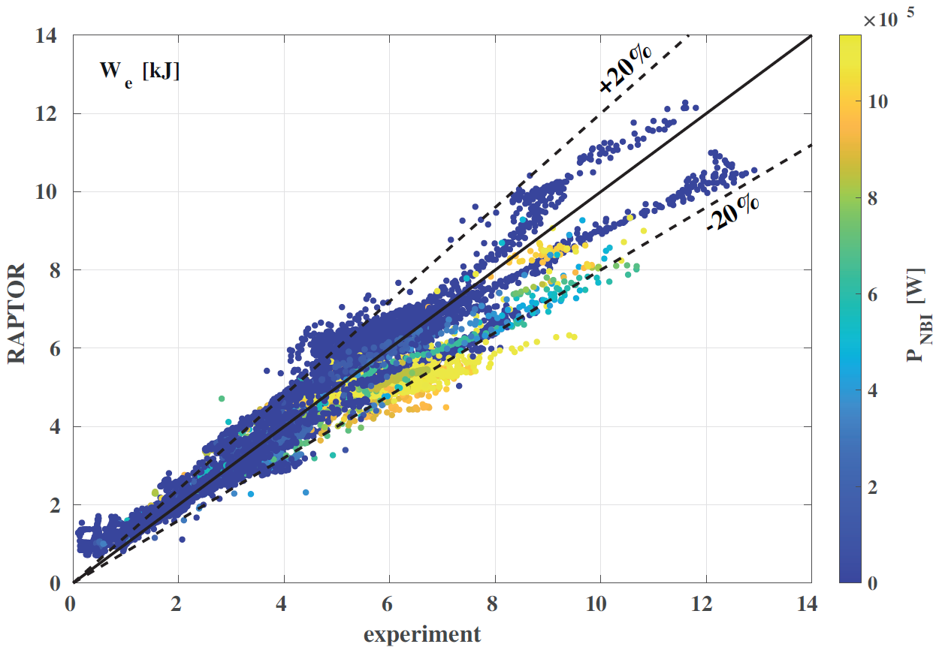
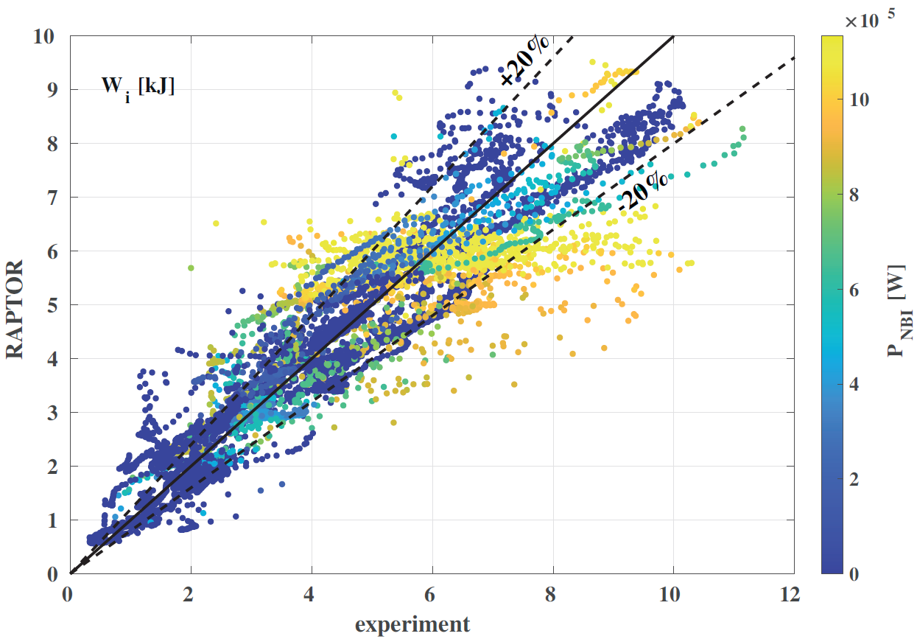
Task 2: RAPTOR-FBT pre-shot modelling
RAPTOR is available with a simple procedure at https://spc.epfl.ch/raptor
Developed fast predictive transport models for TCV including
gradient-based transport model and simple assumptions on confinement
geometry-dependent H-mode transition
Coupled with FBT inverse equilibrium calculation → feedforward coil trajectories to obtain desired plasma shape, including transport effects → shot preparation
Preliminary coupling achieved with Torbeam for EC deposition, validation pending
Good prediction accuracy for a database of 207 TCV shots
[C. Contré et al 2026, soon to be published]

Slide 17
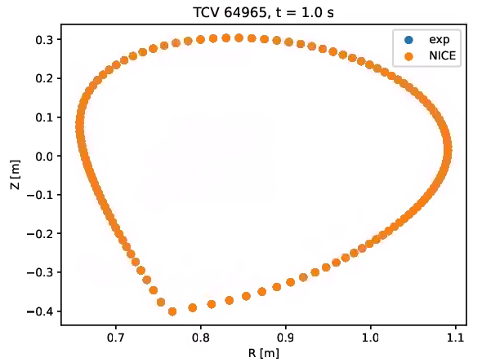
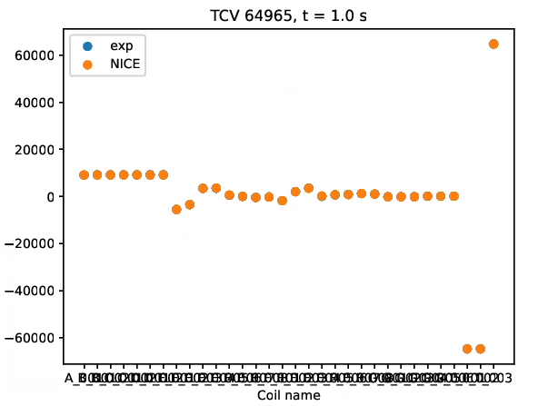
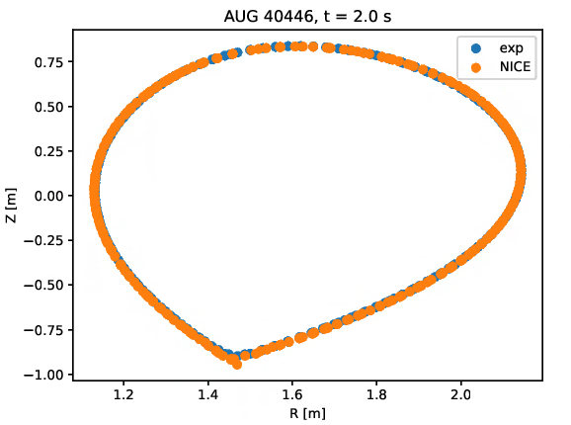
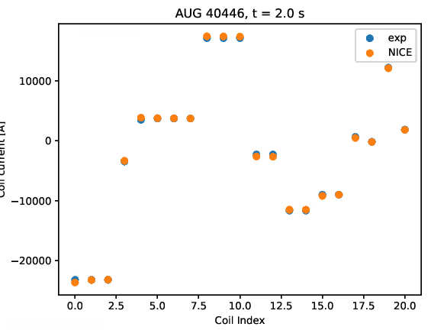
Task 3 : Design the PDT framework for integration of modules provided by other TSVVs
Has been focused on encouraging the use of IMAS interfaces and doing some benchmarks on different machines, different codes using the same input IMAS datasets
Example: NICE inverse (reconstruction of equilibrium and coil currents) applied to TCV and AUG

Slide 18
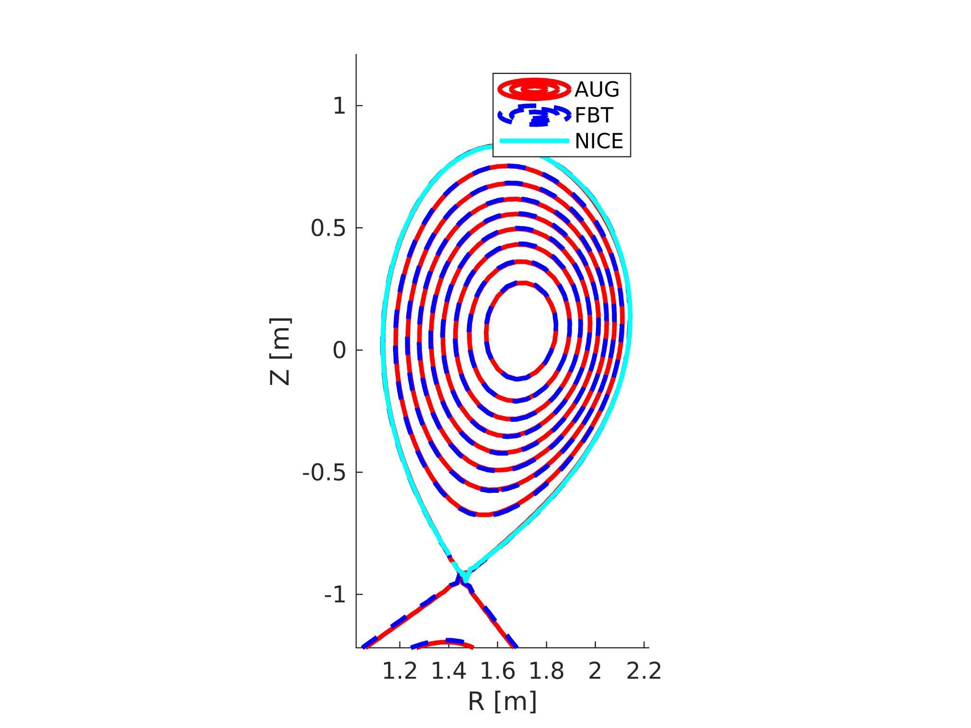
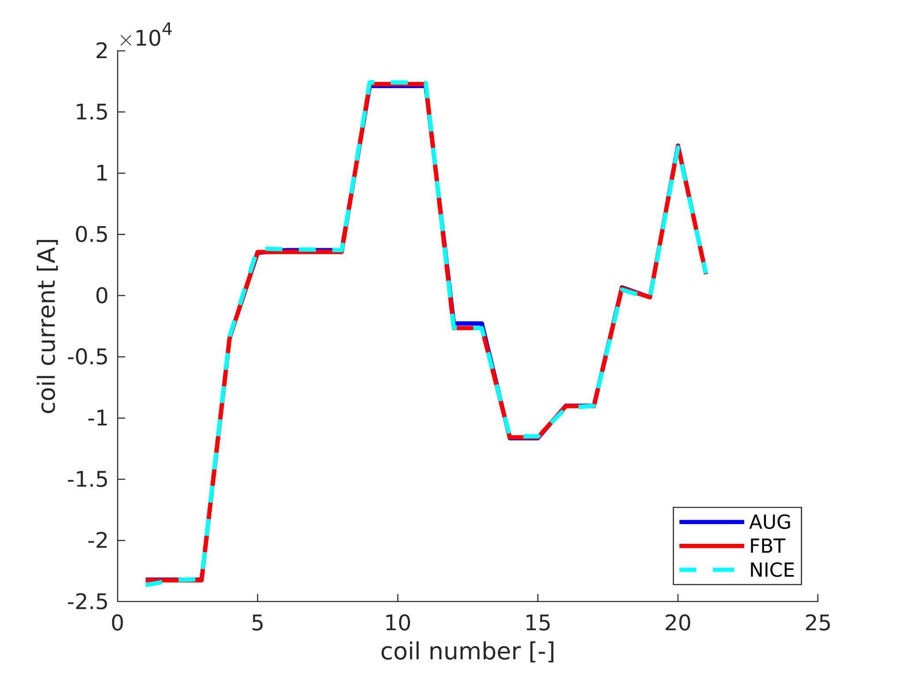
Task 3 : Design the PDT framework for integration of modules provided by other TSVVs
Using the same AUG IMAS dataset, benchmark between NICE and MEQ

Slide 19
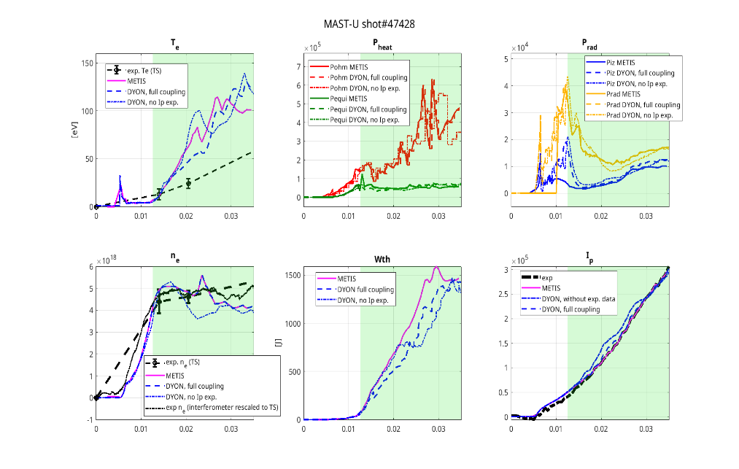
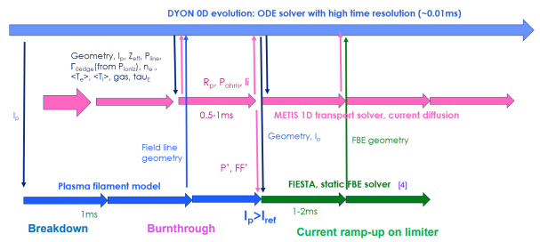
Task 4: Magnetic Equilibrium and Control for PDT: Coupled 1D transport equation of METIS with electromagnetic model for breakdown and burn-through of DYON
Self-consistent modelling of the initial ramp-up of tokamak plasma: integrated workflow of METIS (calculates current and pressure profiles) and FIESTA (equilibrium code) wrapped inside the DYON solver (0D model).
Validation on MAST Upgrade experimental data (MU03, burnthrough & Ip ramp-up shots).
In the future, we will apply the modelling to the TCV tokamak and run predictive simulations of the upcoming COMPASS Upgrade and ITER experiments.

Slide 20
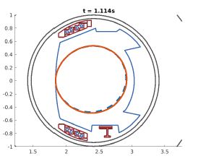
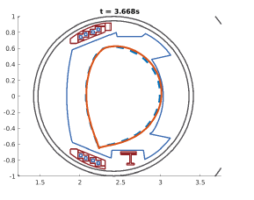
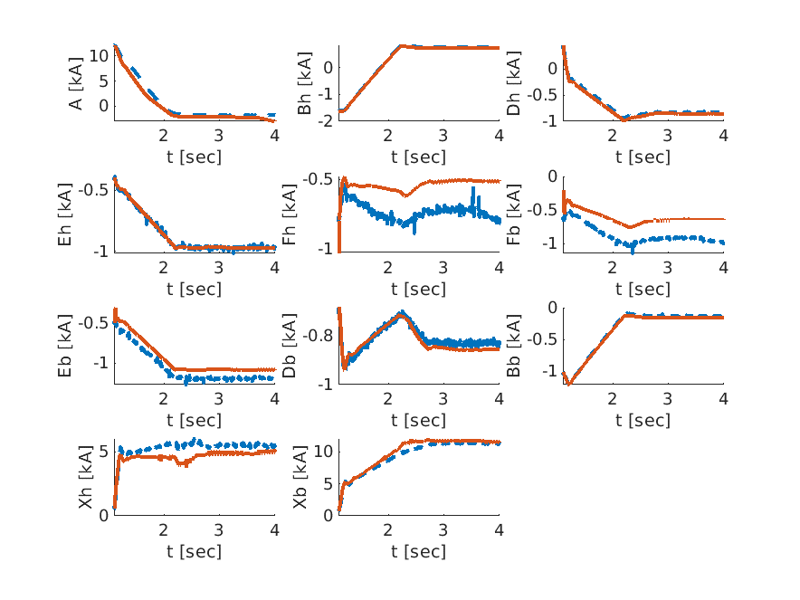
Task 4: Magnetic Equilibrium and Control for PDT: closed loop NICE + heat transport + controllers on WEST
On WEST, PDT and Flight Simulator development is carried out using the MUSCLE3 workflow framework, also used by ITER Org.
Coupling current diffusion and electron heat transport (NICE code) with the WEST shape controller in closed loop successfully simulated X-point formation, with very good agreement for coil currents and plasma shape
METIS and NICE with IMAS and MUSCLE3 coupling are used for the development of the ITER PDS
WEST #58089 Plasma boundary at two different time slices, simulation (red solid line) versus plasma reconstruction (blue dashed line).

Slide 21
Concluding remarks
Objectives in black, outcome in green
Maximise the mutualisation of modules (e.g. transport, fuelling, H&CD, equilibrium): task 2 developed several reduced models, they are usable by multiple PDTs although they are presently coupled to a single one. Frequent discussions with TSVV11 and joint activities on reduced models.
Coupling techniques and infrastructure solutions:
Only ITER Org. is trying to promote a generic infrastructure (IMAS Data Dictionary, MUSCLE3). CEA and DIFFER activities are aligned with this strategy.
Apply the tools to multiple experiments and benchmark them:
Some PDTs have been ported to some experiments, mostly by adapting to the local code and data ecosystem
Benchmark cases have been carried out, showing good agreement between equilibrium solvers. WEST cases require iron core capability, only few solvers handle that today.
Although TCV and AUG have processes to produce IMAS data, the dataset is often incomplete or sometimes the codes can’t use all the options covered by an IDS. A routine usage of IMAS datasets is necessary to improve the initial data mapping effort made for those machines.
Even an equilibrium code requires a minimal machine-specific configuration that is not automated yet, no easy user manual
Define a possible convergence strategy for the next period (2026-2027)
The community is happy to use multiple PDTs (ASTRA/Fenix, RAPTOR, METIS, …) and doesn’t see the need to converge to a single tool or framework
The community is happy to share models which can be adapted to various PDTs / frameworks. Sharing reduced models as Open Source starts to be a reality
TSVV15 has built bridges between the different groups, and there is a high scientific value to maintain them. Developments around PDTs will continue in EUROfusion under DTE, also in IO and various machines … it would be important to keep in touch

