Slide 1


Introduction to LID-QMS diagnostic on JET, including type of data available, progress on results
Joint LID-QMS/LIBS meeting, 9.12.2025, Frascati
Miroslaw Zlobinski et al.
Forschungszentrum Jülich GmbH, Institute of Fusion Energy
and Nuclear Waste Management – Plasma Physics,
Partner of the Trilateral Euregio Cluster (TEC), 52425 Jülich, Germany

Slide 2
Acknowledgements
Miroslaw Zlobinski¹*, A. Huber¹, G. Sergienko¹, I. Jepu², C. Rowley², A. Widdowson², R. Ellis², D. Kos², I. Coffey³, M. Fortune²,
D. Kinna², M. Beldishevski², L. Laguardia⁴, G. Gervasini⁴, A. Krimmer¹, H. T. Lambertz¹, A. Terra¹, S. Brezinsek^{1,5}, T. Dittmar¹,
M. Flebbe¹, R. Yi¹, R. Rayaprolu¹, J. Figueiredo^{6,7}, P. Blatchford², S. Silburn², E. Tsitrone⁸, E. Joffrin⁸, K. Krieger⁹, Y. Corre⁸,
A. Hakola¹⁰, J. Likonen¹⁰, THE EUROFUSION TOKAMAK EXPLOITATION TEAM¹⁷, THE JET CONTRIBUTORS¹⁸
¹ Forschungszentrum Jülich GmbH, Jülich, Germany
² United Kingdom Atomic Energy Authority, Culham Campus, Abingdon, United Kingdom
³ Queen’s University Belfast, Belfast, Northern Ireland, UK
⁵ Heinrich-Heine-Universität Düsseldorf, Düsseldorf, Germany
⁶ EUROfusion Programme Management Unit, Garching, Germany
⁷ Instituto de Plasmas e Fusão Nuclear, Instituto Superior Técnico, Universidade de Lisboa, Portugal
⁸ CEA, Institute for Research on Fusion by Magnetic confinement, St-Paul-lez-Durance, France
⁹ Max–Planck-Institut für Plasmaphysik, Garching, Germany
¹⁰ VTT Technical Research Centre of Finland Ltd, Espoo, Finland
¹⁷ See the author list of E. Joffrin et al., Nuclear Fusion 64 (2024) 112019 , doi:10.1088/1741-4326/ad2be4
¹⁸ See the author list of C.F. Maggi et al., Nuclear Fusion 64 (2024) 112012, doi:10.1088/1741-4326/ad3e16
*Email: m.zlobinski@fz-juelich.de

Slide 3
Outline
Motivation
The LID-QMS method
Diagnostic Setup at JET
QMS Calibration
Different Evaluation Methods
Open Issues
in situ Applications at JET
Comparison possibilities with LIBS

Slide 4

Motivation
Problem: Hydrogen isotope retention at the wall
Risk of high tritium release in case of large leak (e.g. ITER limit < 1kg T in the vacuum chamber)
Tritium losses in the fuel cycle
Wall material issues
…
(Joint European Torus)
tile 0
tile 1
75% of retention
in divertor
Ref: S. Brezinsek et al., Nucl. Fusion 55 (2015) 063021, doi:10.1088/0029-5515/55/6/063021
Ref: K. Heinola et al., J. Nucl. Mater. 463 (2015) 961-965, doi:10.1016/j.jnucmat.2014.12.098

Slide 5
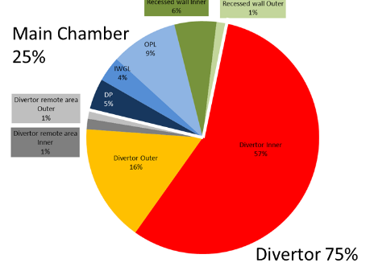
JET retention
JET
Inner Divertor
57%
Outer Divertor
16%
Divertor 75%
Widdowson et al., PFMC 2021, Phys. Scr, 2021

Slide 6
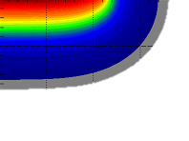

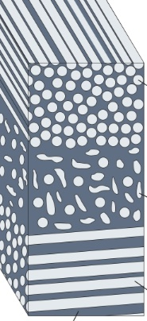

LID-QMS method
Laser-Induced Desorption (LID)
Laser only heats the surface,
no ablation, no crater formation,
no plasma needed
Possible surface modifications
due to heating :
roughening of surface
melting (only for high power)
minor evaporation
layer delamination due to
thermal stresses in short time
RGA
(Residual Gas Analysis) e.g. by QMS (Quadrupole Mass Spectrometry)
Example of calculated temperature
high energy laser (~20 J, 1 ms)
Be melting point
Laser spot
diameter ~3 mm
H₂, D₂, HD, DT,…
Be
Be
plasma deposit
W
Mo
W
Mo
substrate
CFC
CFC substrate
Be layer thickness in JET
is heated and thermally releases retained gases
vacuum chamber
Gas released by the laser heating is quantified
→ space resolved in situ diagnostic for fuel content

Slide 7
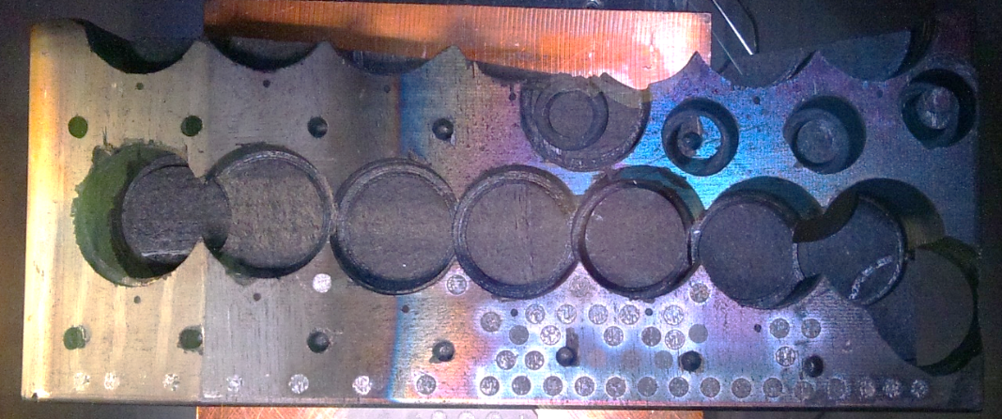
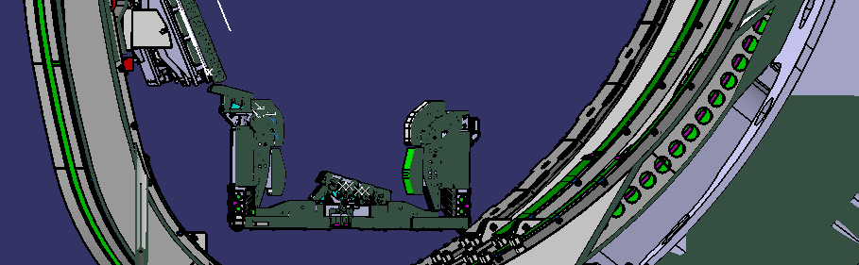

Ex situ LID-QMS of JET divertor tile 0
JET inner divertor tile 0 exposed in all plasmas of 2014-2016. Then ex situ LID-QMS performed in FZJ.
TDS of
cored
samples
LH14N
7c
6c
5c
5c
low
3c
low
1c
low
4c
3c
2c
1c
tile 0
LID-QMS:
Ø3 mm
laser
spots
tile 1
Good agreement of LID-QMS
with TDS (Thermal Desorption Spectroscopy)
except close to plasma heated side (due to D retention below laser heating depth)
here: Be:D layers, previously also proven for
bulk W, a-C:D layers and a-B:D layers
constant D inventory
Ref [1]: J. Likonen et al, Nuc. Mat. En. 19 (2019) 300-306 doi:10.1016/j.nme.2019.03.012

Slide 8
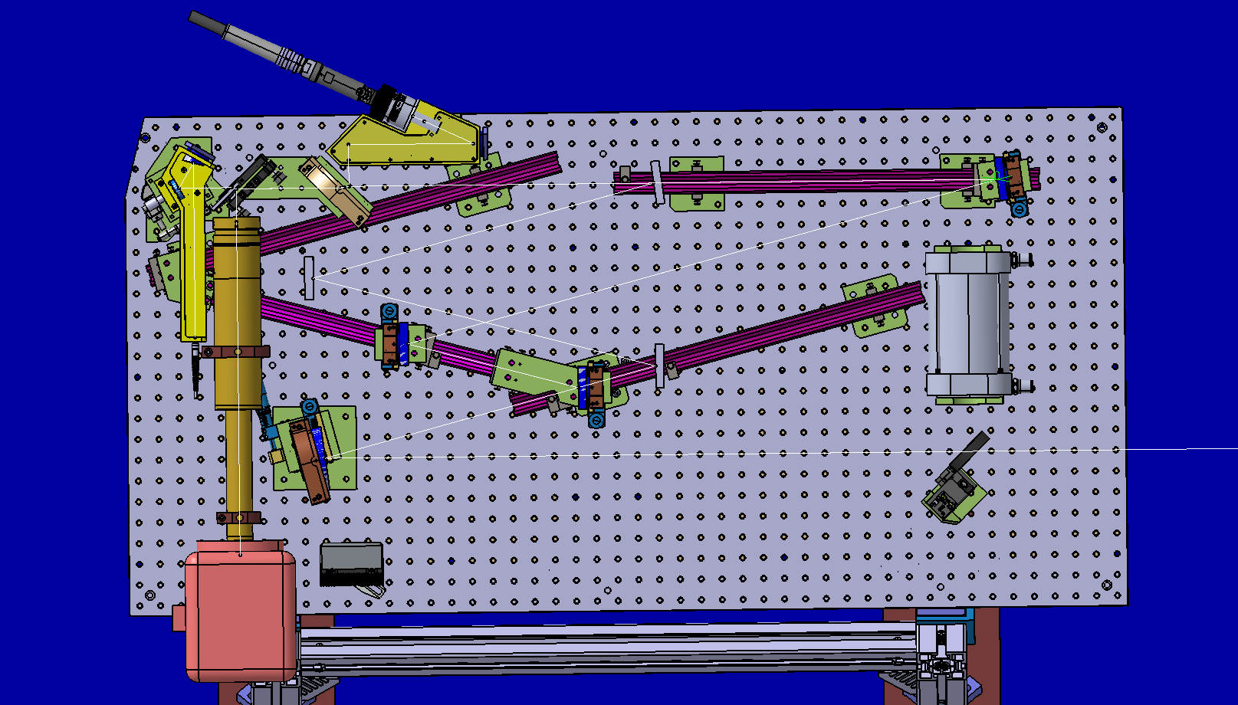
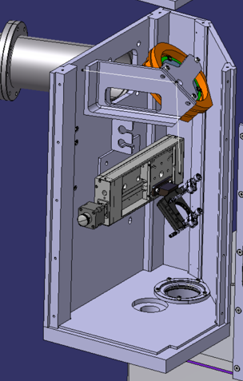
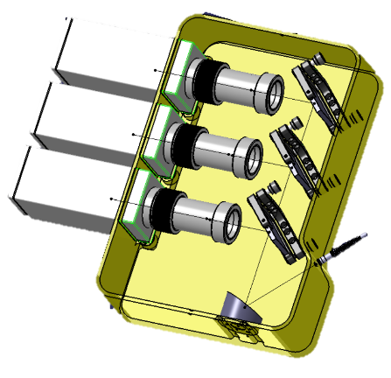
In situ LID-QMS setup at JET
Roof Lab
above Torus Hall
Diode-pumped Fibre Laser:
Ytterbium 1071 nm, 25 kW
(IPG YLS-25000)
Laser fibre
Optics Table
cooledBeam Dump
Ref: M. Zlobinski et al., Nucl. Fusion 64 (2024) 086031, doi:10.1088/1741-4326/ad52a5
Fibre to pyrometers
Field
Lens
passive Beam Dump
movable mirror
Torus
Hall:
Coaxial Camera
M4
3 cylindric mirrors squeeze laser beam
to be circular on the target
M1
Pyrometers
1
M3
M2
M5
Coaxial camera observation and temperature measurement of the laser spot
Total Transmission of Laser beam path: ~53%
Transmission of vacuum window: ~85%
Light reflection on surface: ~25%
Total laser power for heating: ~34%

Slide 9
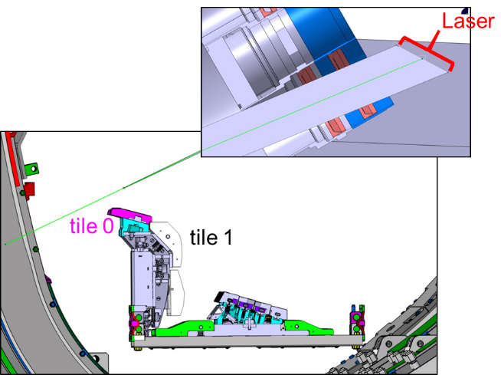
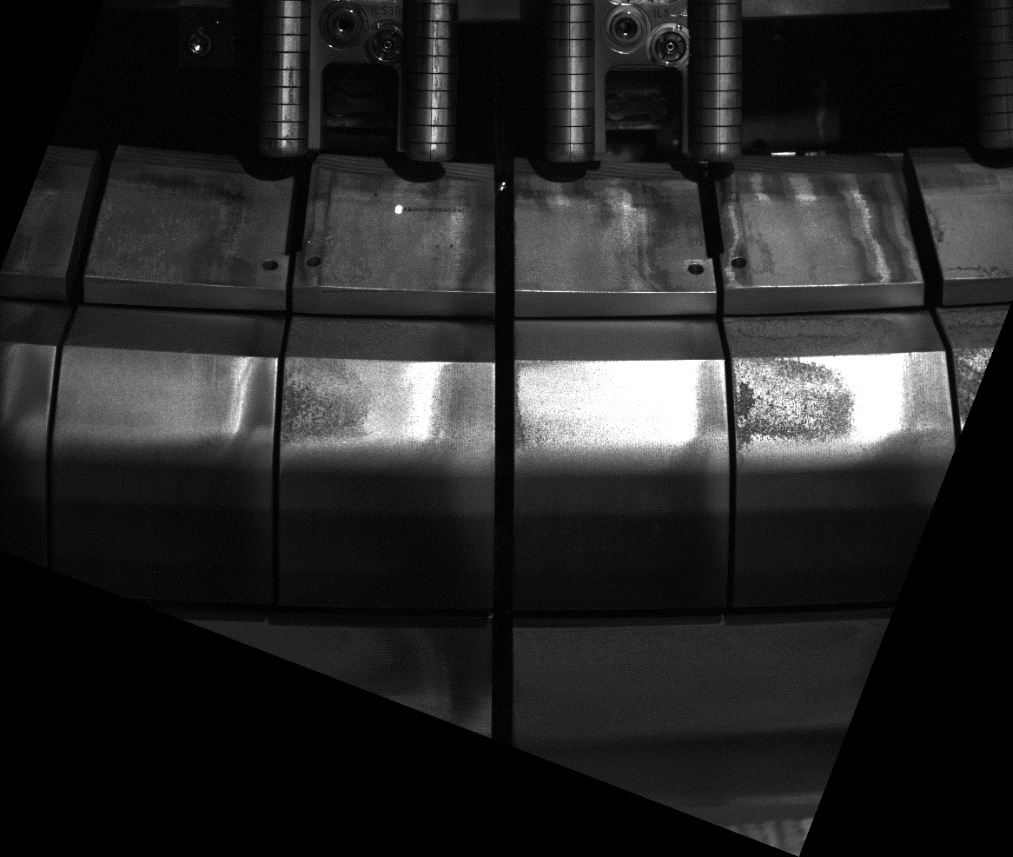

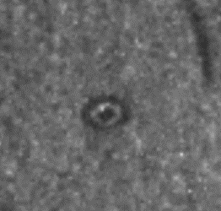
Laser accessible area
Vacuum window
upper inner divertor of JET
tile 0
laser angle ≈ 48°
(to surface normal)
tile 1
≈ 64°
≈ 13°
≈ 27°
Laser spot ellipticity show
on front of tile 1:
poloidal direction
142 mm
2.29 mm
toroidal direction
3.06 mm
with beam ellipticity settings
for tile 0, P_{Laser}=21.5 kW, 1 ms

Slide 10

Tritium Monitor Diagnostic at JET
Laser beam path length after laser fibre | 35.3 m | 27.8 m
Amount of Laser Mirrors | 12 + 1 beam splitter | 16 + 2 beam splitters
First mirror to target | 5.5 m | 5.8 m
Laser spot size on target | ∅ 3 mm | ∅ 5 mm
Laser power | 25 kW | 60 kW
Largest mirror dimension | ∅ 15 cm (M2, M3, M5) | 32 cm x 14 cm (M3)
In-vacuum/ex-vacuum | complete system ex-vessel | Mirrors M1-M6 in-vessel (in vacuum)
Scanning mirror to target | 5.5 m (M1) | 13.4 m (M7)
Neutron dose | ~ 10²¹ n (during last year of JET operation) | ~ 10²⁷ n (for whole ITER lifetime)
Remote Handling compatiblity | No | Yes
Fast scanning mirror | 50 Hz stop-and-go, 3 mm spot-to-spot | max. 64 Hz, 3.5 mm spot-to-spot
Camera Observation of target in VIS | coaxial and through separate window | coaxial
Temperature Measurement | 3 single color point pyrometer | 3 single color point pyrometer, IR camera, spectrometer
Target illumination | Broadband VIS light (IVIS) + halogen lamp | Lasers of a separate system (GL1)
Special features | Ellipticity correction (M8, M9, M10), Focus length compensation (M2, M3) | Shutter to Plasma, Remote optical surface inspection by ultra-sort laser pulses, Remote laser position sensors

Slide 11
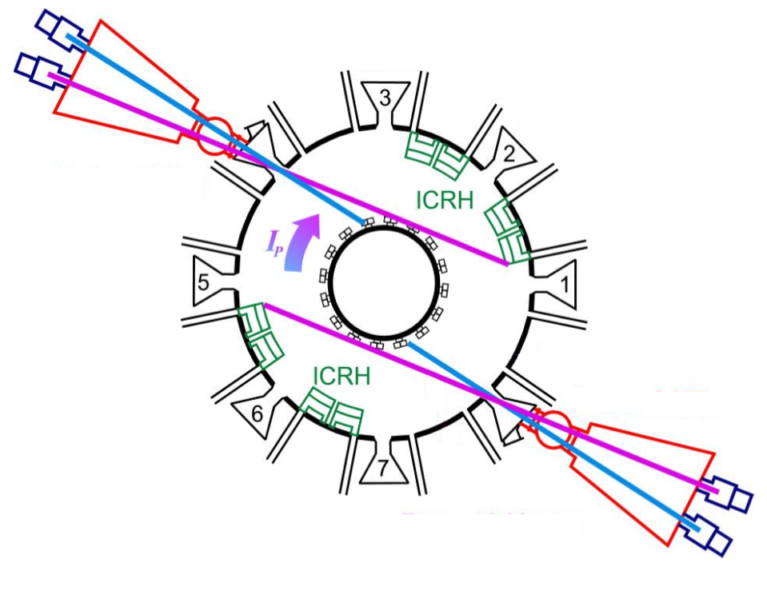

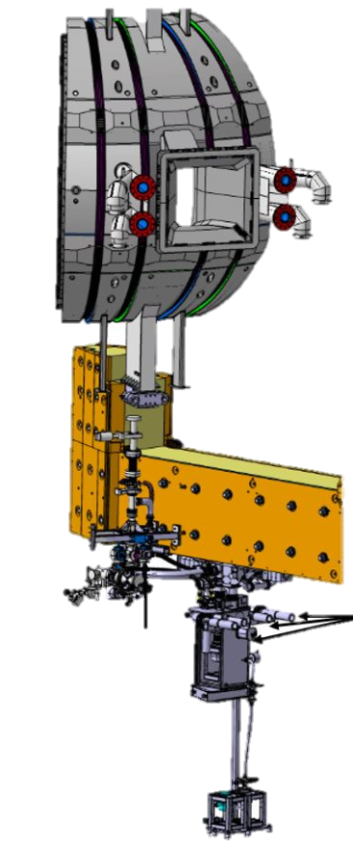
Detection System
Octant 8
The gases desorbed from the laser spot are
quantified by Residual Gas Analysis (RGA)
mainly by Quadrupole Mass Spectrometers (QMS):
3 QMS in the main torus
4 QMS in the sub-divertor
JET torus
Laser
QMS1=RGA10,QMS2=RGA11
sub-divertor
QMS5
QMS3=RGA3, QMS7=RGA7, …
Octant 8
LESSEONS LEARNED:
Detection of released gases by mass spectrometry in JET proven to be very sensitive
  if mass spectrometers are located close to the torus with good gas conductance (DT and T₂ mainly detected by QMS 5, 1, 2)
  if background partial pressures are low (low wall out-gasing) ⇒ waiting time after plasma needed (> 1 night)
  if torus pumping is reduced such that mass spectrometer repetition time << pump-out time

Slide 12
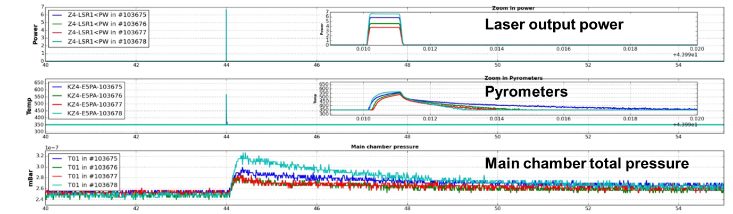
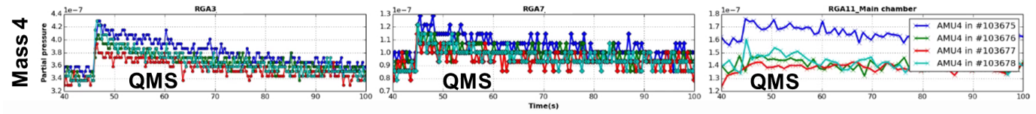
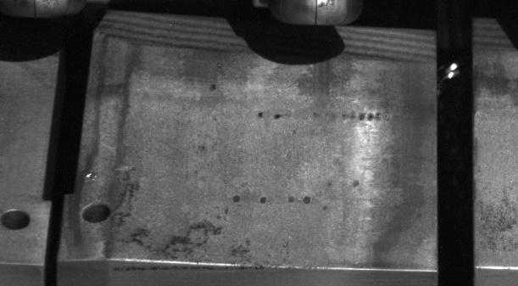

Laser power scan to confirm complete D desorption
21 kW
19 kW
Before this measurement: poloidal and toroidal scan to identify area of const. D retention (green rectangle)
Laser power scan to determine minimum power for complete fuel desorption: 19 kW for 1 ms
Ref: M. Zlobinski et al., Nucl. Fusion 64 (2024) 086031, doi:10.1088/1741-4326/ad52a5

Slide 13
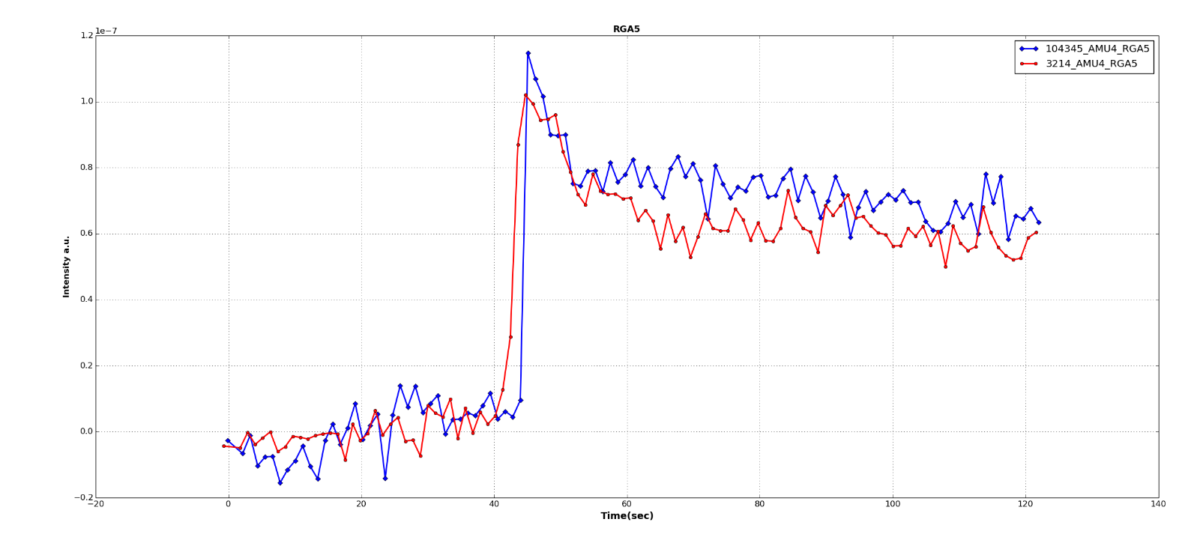
QMS Calibration
Quadrupole Mass Spectrometer calibration by short (~1 s) D₂ gas puff into the torus
Gas injection module volume V = 1.5 L
Pressure drop Δp in module after injection measured by baratron
N corresponds to the partial pressure jump in the mass spectrometer signal in the torus
Very low partial pressure jump is used, which is similar to the jump during the laser pulse
(~10¹⁸ D atoms)
repeated on each measurement day to account for different wall loading, pumping conditions,…
injected gas molecules N
QMS5 with laser pulse
QMS5 calibration gas puff
Mass 4 (D₂)
N_{calib}
N_{signal}
Background of partial pressure on
mass 4 subtracted from both
Time / s

Slide 14
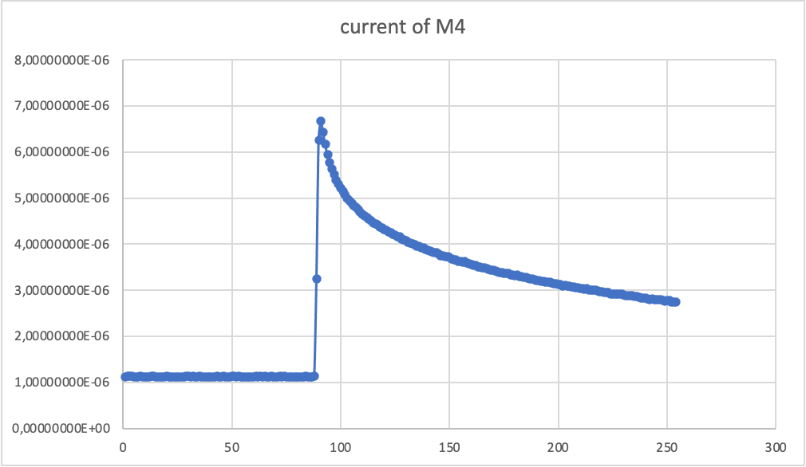
LID-QMS evaluation by different methods
Dynamic method (Gabriele Gervasini)
presentation on Thursday 9:25
“gas pumping method”:
Integral method
Integral of the
gas puff
Jump method
(Laura
Laguardia)
presentation on
Thursday 9:00:
∫
∫
Integral method was rejected because data do not go back to initial value
Dynamic method works for the case of many data points in a smooth decay, but not for low signals with high noise.
Jump method always works. So far the prime option for evaluation of LID-QMS measurements and calibration.

Slide 15
QMS Calibration
3 different D₂ gas amounts puffed into torus, each amount repeated with slightly different amount
→ 6 gas puffs on the same day
ΔI = K Δp V
Calibration factor K
QMS3
QMS7
Factor of 5 lower sensitivity
Linear fit
1σ = 1.6%
QMS signal jump ΔI / A
QMS signal jump ΔI / A
Linear fit
1σ = 1.7%
Δp V / mbar L
Δp V / mbar L
Amount of puffed gas
Amount of puffed gas
Very good detector linearity in the range of the laser-induced signal

Slide 16
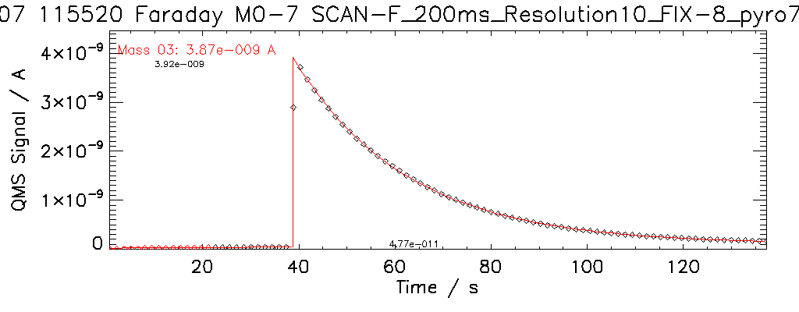
Small improvement of Jump Method
1.) fitting of signal before and after jump
2.) extrapolate both functions to the time of laser pulse
3.) use the difference at the laser pulse as jump
function 2
difference
function 1
laser pulse

Slide 17
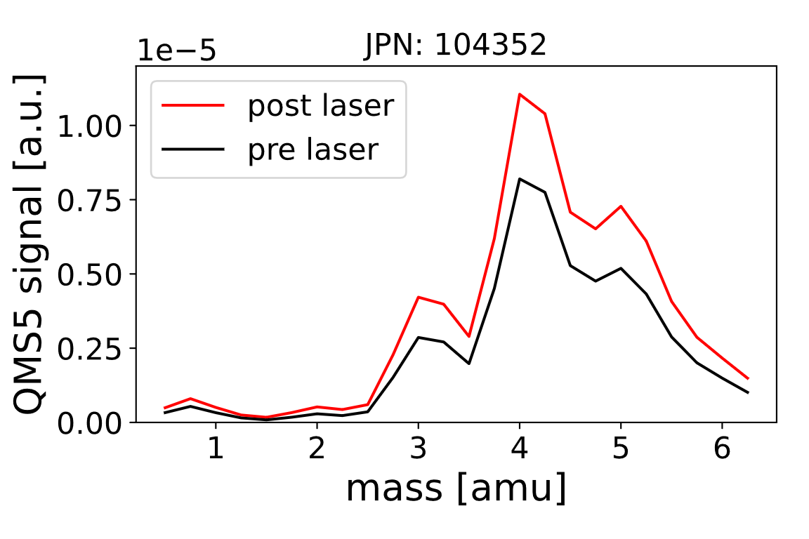
Open Issue 1: QMS Cracking Pattern and overlapping masses
Deconvolution of hydrogen isotopologues e.g. HT and D₂ both on mass 4.
Complication only if T present.
With H and D alone and a high-resolution QMS that can distinguish He from D2 there is no overlapping!
DT
D₂
He
HT
T₂
H
H₂
HD

Slide 18
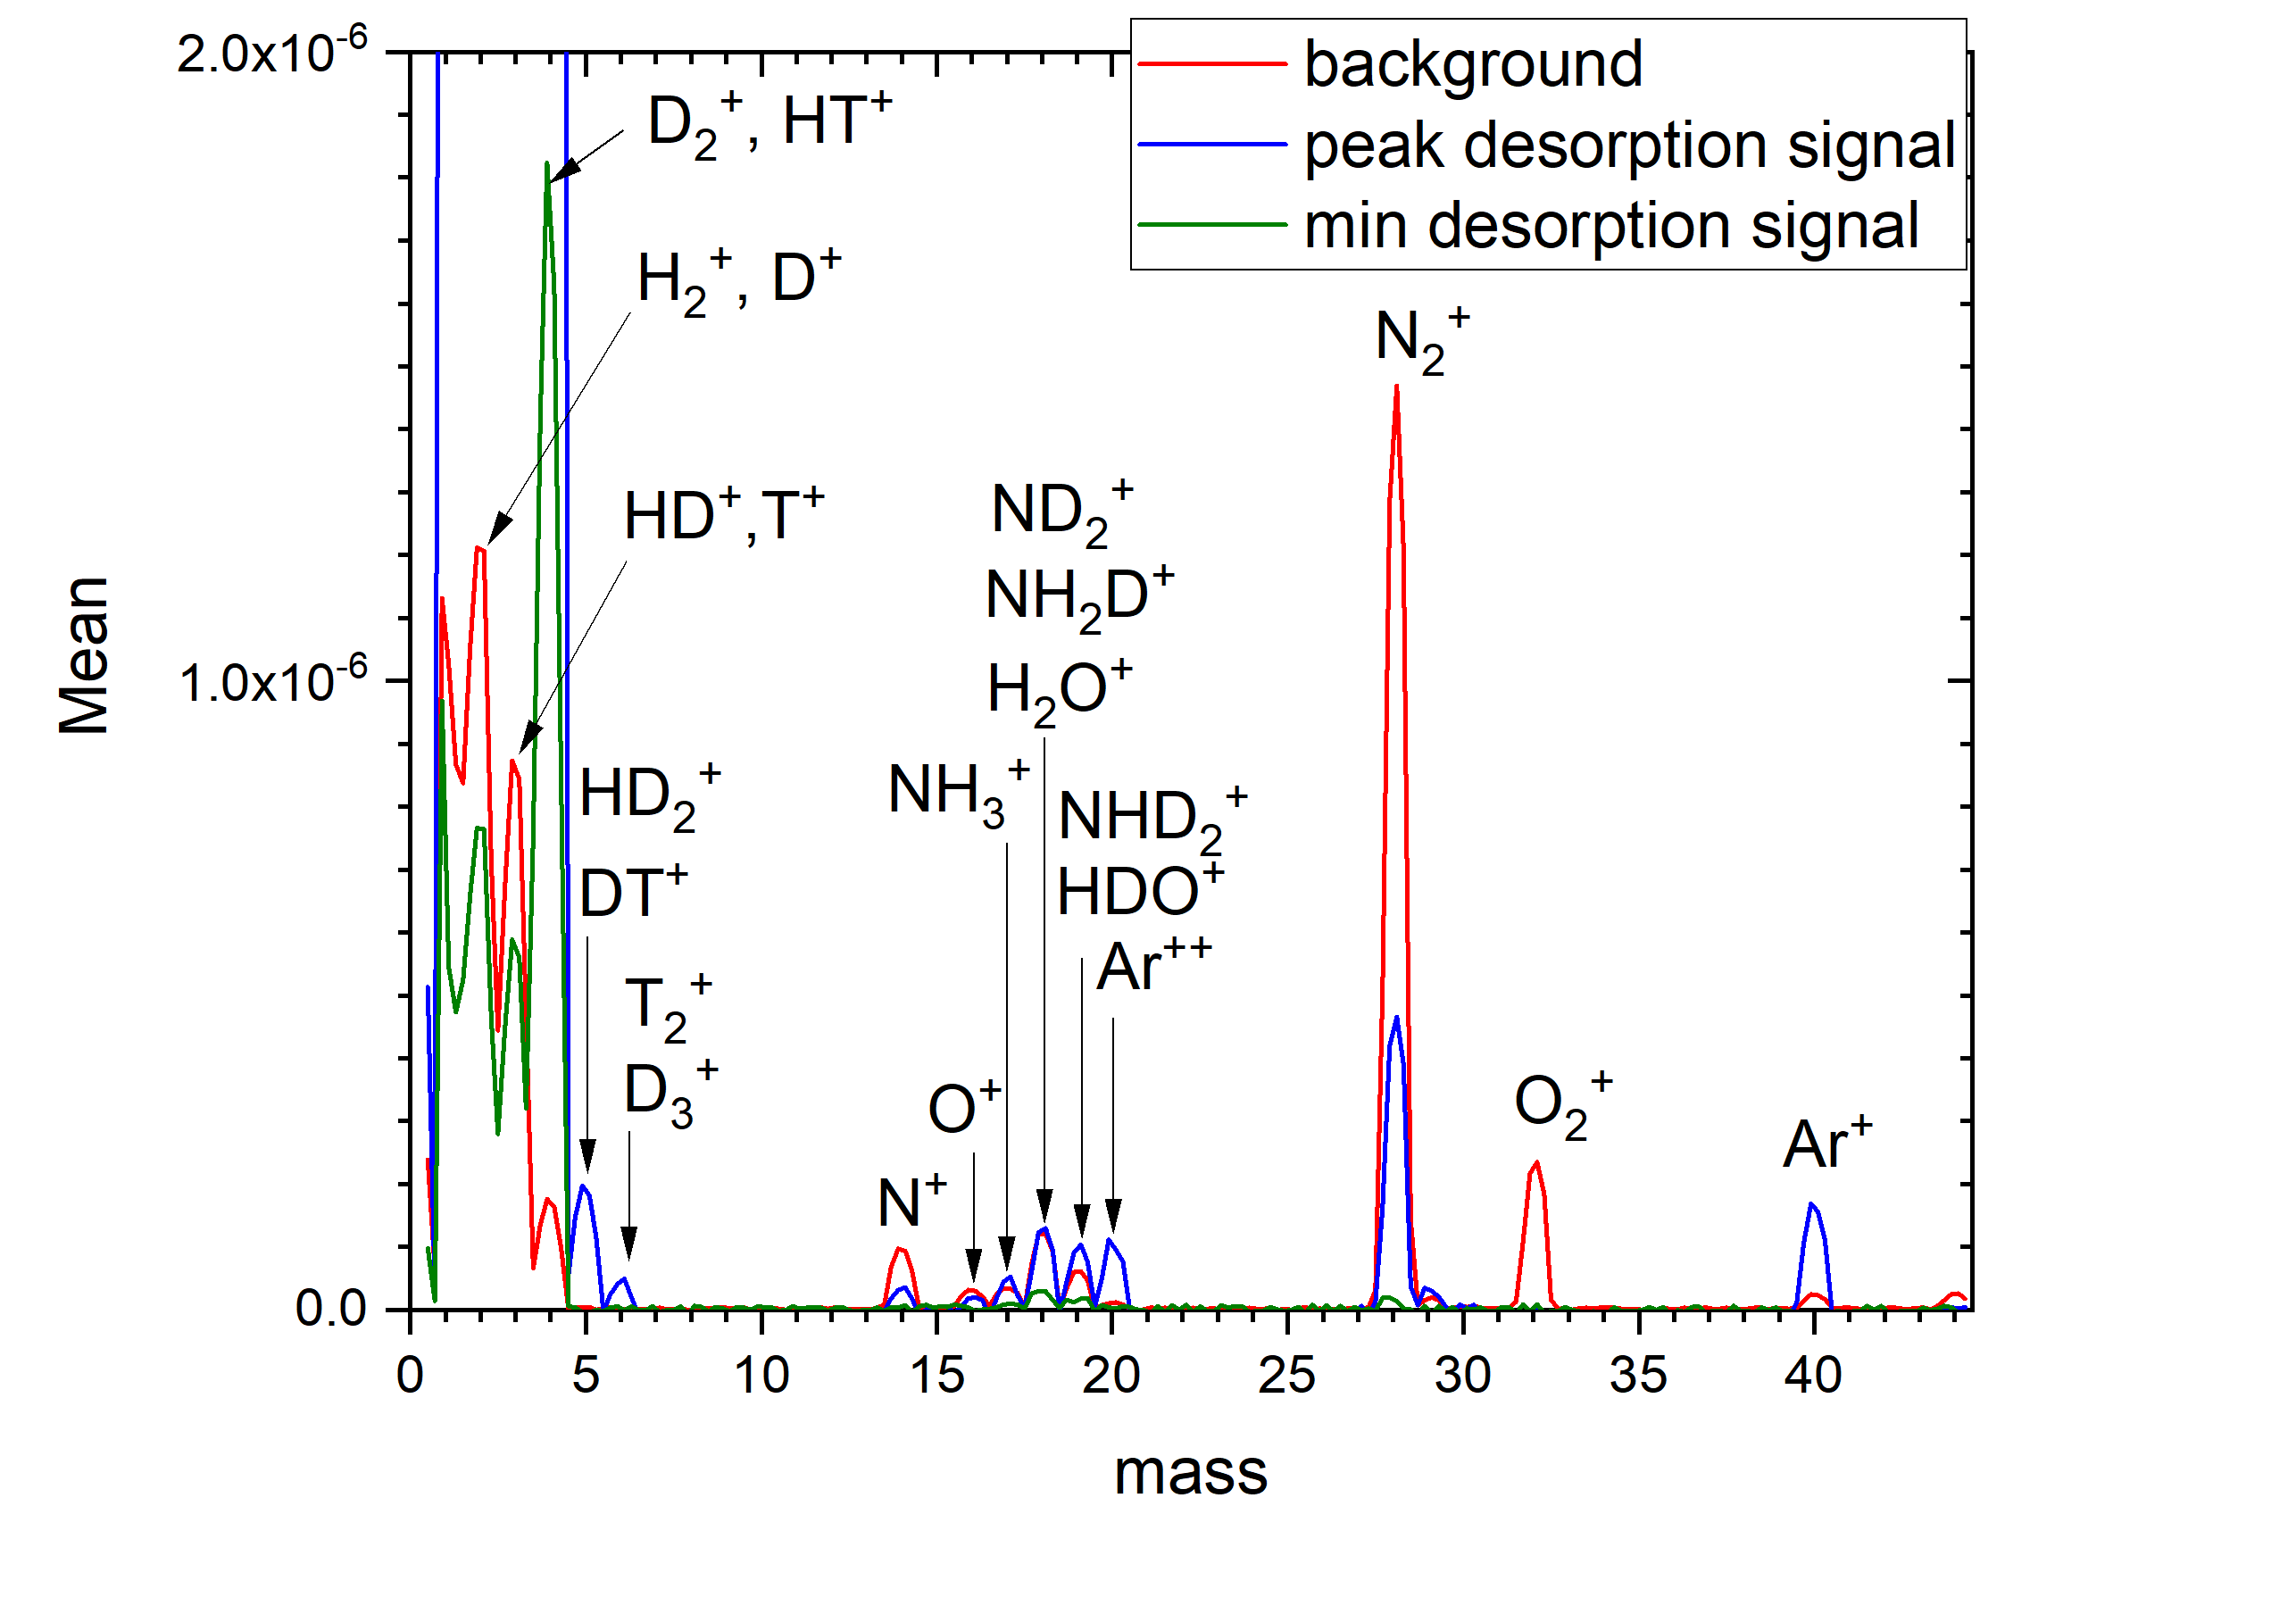
Open issue 1: QMS Cracking Pattern and overlapping masses
Open:
Deconvolution of cracking pattern inside QMS
(mainly mass 1-6)
And overlapping masses (e.g. HT and D₂)
Cracking of H2, D2 into atoms ~ few % only, thus negligible.
But overlapping masses still an issue.
=> Existing deconvolution programme (by Drenik)
to be understood
=> Take into account gas mixing due to species interaction time and calculate back with gas matrix (Sergienko, Matveev)
D₂O

Slide 19
Open Issue 2: LID-QMS calibration gas puffs: fractional injection
Calibration gas distribution in fractional volumes of the JET vessel
(main torus, 2 x pumping tower)
Gennady Sergienko (presentation on Thursday 10:30)
Laser in Oct 5
GIM4 used for calibration
gas injection
pumps
JET
main torus
Pumping
Tower Oct 6
Pumping
Tower Oct 1

Slide 20
Open Issue 3: calibration factors for mass 5 and 6
Deduction of calibration factor for mass 5 and 6 from mass 2 and 4
Measured QMS calibration factors
Expected from theory
Ks RGA sensitivities #104589 H₂, D₂, T₂ injections
Jump in current method Ks (A/mbar*L)
Mass Ks RGA3 (A/mbar*L) Ks RGA7 (A/mbar*L)
2 5.255419e-8 1.368379e-8
4 7.968536e-9 2.292932e-9
6 9.305809e-9 5.266764e-9
(G. Gervasini et al 2024 Nucl.Fusion64 126003)
Courtsey by D. Matveev

Slide 21
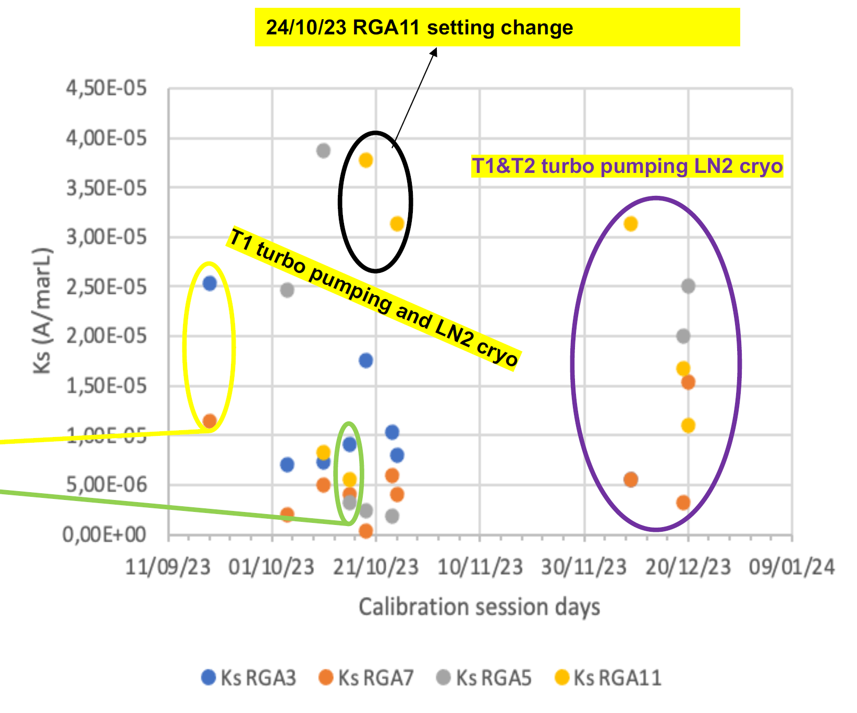
Open Issue 4: QMS Calibration Factor Variation
Several reasons for variation identified:
RGA settings change (understood)
JET pumping change (could be compensated with dynamic method?)
Background pressure change (reason: non-linearity of QMS? But within each day gas puffs show good linearity)
Open:
Do we need to systematically understand the different calibration factors on different days?
Or
Sufficient to use calibration factor of the same day as LID-QMS?
=> Maybe use first shot of each day (which was often in the same area) to find whether this is a variation only in calibration or also in LID-QMS.
Ref: Laguardia et al, PSI2024

Slide 22
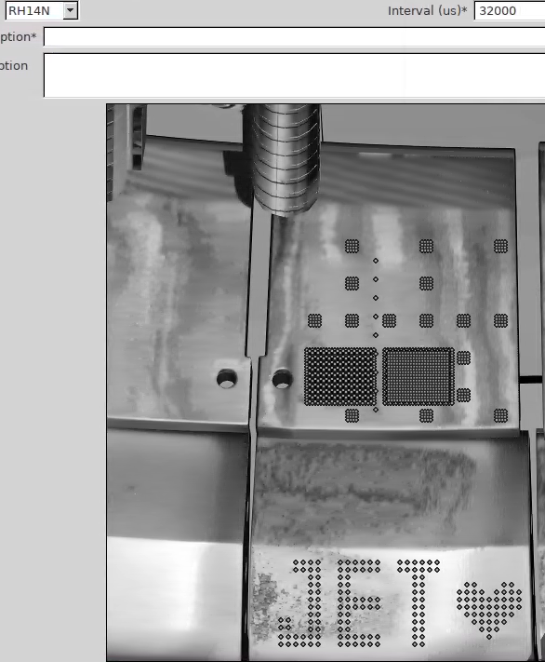
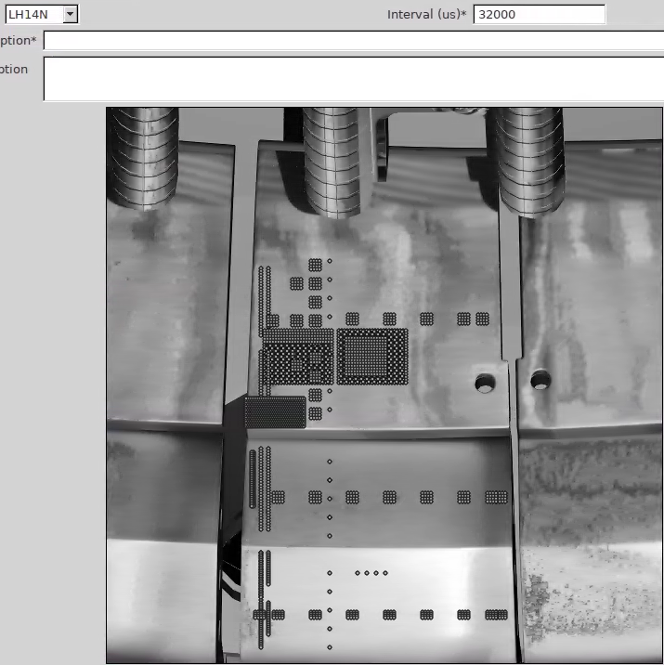
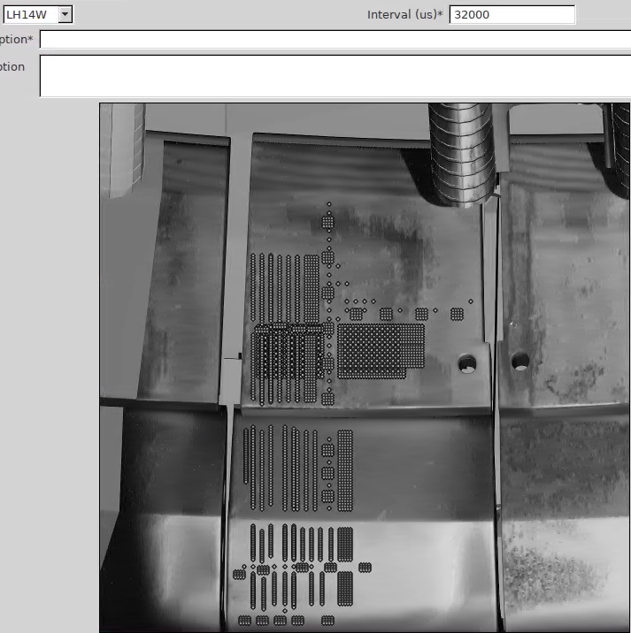
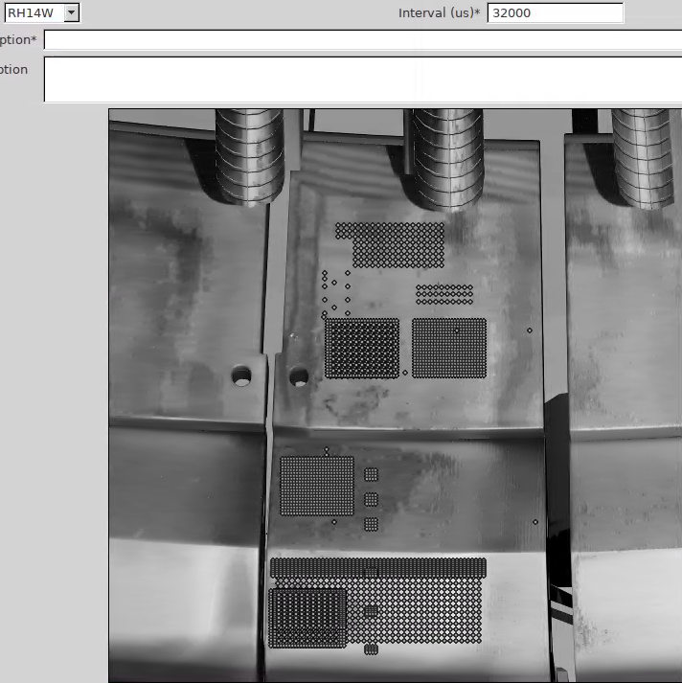
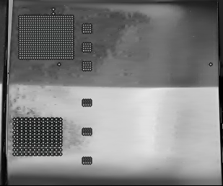
in situ Measurements with LID-QMS at JET inner upper divertor
Poloidal Scan with 1 laser pulse per position
25.9.2023
JPN 104423
-104441
cryo: LN₂ only Turbo1
surface coordinate s = 0
LH14W
2011-23
RH14N
2019-23
RH14W
2011-23
LH14N
2019-23
Tile 0:
9 laser pulses
14ING1C
2019-23
14ING1D
2011-23
14IWG1A
2019-23
14IWG1B
2011-23
Tile 1:

Slide 23
in situ Measurement of D by LID-QMS
Tile 0 (LH14N exposed 2019-2023), QMS 3
Assumptions:
mass 4 is D₂
mass 3 is HD
mass 5 is DT
(i.e. neglecting
possible HT on mass 4 (but improbable because little HD and H₂)
triple-ions like H₂D⁺ on mass 4 or
HD₂⁺ on mass 5, which are improbable due to low partial pressure p_{D2} < 7E-8 mbar)
using the calibration factor of mass 4 also for
mass 3 and mass 5
MEASUREMENT LIMIT for 20% uncertainty
2.6E18 D/cm², 1.9E17 D atoms for a single spot
Detection limit on mass 4 (i.e. 100% uncertainty):
1.1E18 D/cm², 8E16 D atoms for a single spot
for this QMS, for this day (this background, pumping conditions, wall-outgassing etc.)

Slide 24
Comparison to ex situ LID-QMS of JET divertor tile 0
JET inner divertor tile 0 (LH14N)
exposed in all plasmas of 2019-2023.
Then in situ LID-QMS performed in JET.
JET inner divertor tile 0 (LH14N)
exposed in all plasmas of 2014-2016.
Then ex situ LID-QMS performed in FZJ
factor 1.7
plasma side
Plausibility check:
qualitatively similar D profile (const. area + decrease towards plasma)
quantitatively:
4 years exposure with 41.9 h divertor plasma vs. 2 years exposure with 18.5 h divertor plasma (factor 2.4)
2.4^{0.5} = 1.5__
RE Recently shown by Zayachuk et al* that total retention roughly scales with square-root of plasma exposure time
ex situ expected to be lower than in situ due to outgassing and exposure to atmosphere
* Zayachuk et al., NME 42 (2025) 101872, doi:10.1016/j.nme.2025.101872

Slide 25
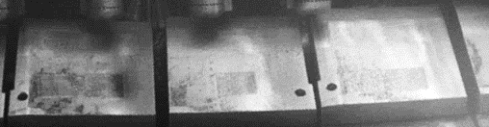
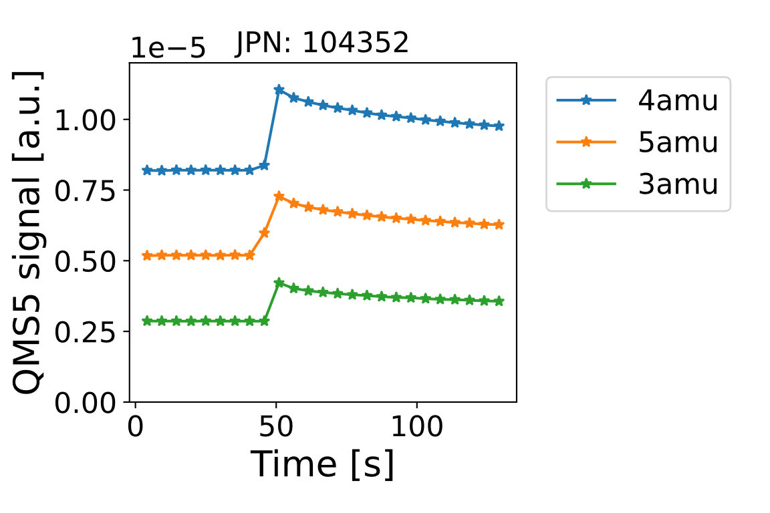
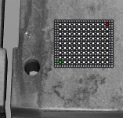
in situ Applications of LID-QMS in DT campaign
Monitoring of T retention growth due to plasma wall interaction
    4 x 3 cm² rectangles “cleaned” from fuel by overlapping laser spots before tritium operation
    one rectangle measured every week in
    “Raster mode”: 99 laser spots every 3 mm
    every 20 ms to increase the desorbed area
    Additional weekly measurement of rectangle 1
4 cm
4 cm
3 cm
  4 x 3 cm² “cleaned” rectangle
  overlapping with 1.5 mm
  spot-to-spot distance
Measurement after 1 week of JET operation:
D₂ , (TH)
DT, (HD₂)
HD
DT
D₂
T₂
HD
  99 laser spots
  with 3 mm spot-to-spot distance
Deconvolution of overlapping masses: Work ongoing
but in this case TH and HD₂ have probably negligible contribution to mass 4 and 5 as there is little H₂ (mass 2)
Ref: M. Zlobinski et al., Nucl. Fusion 64 (2024) 086031, doi:10.1088/1741-4326/ad52a5

Slide 26
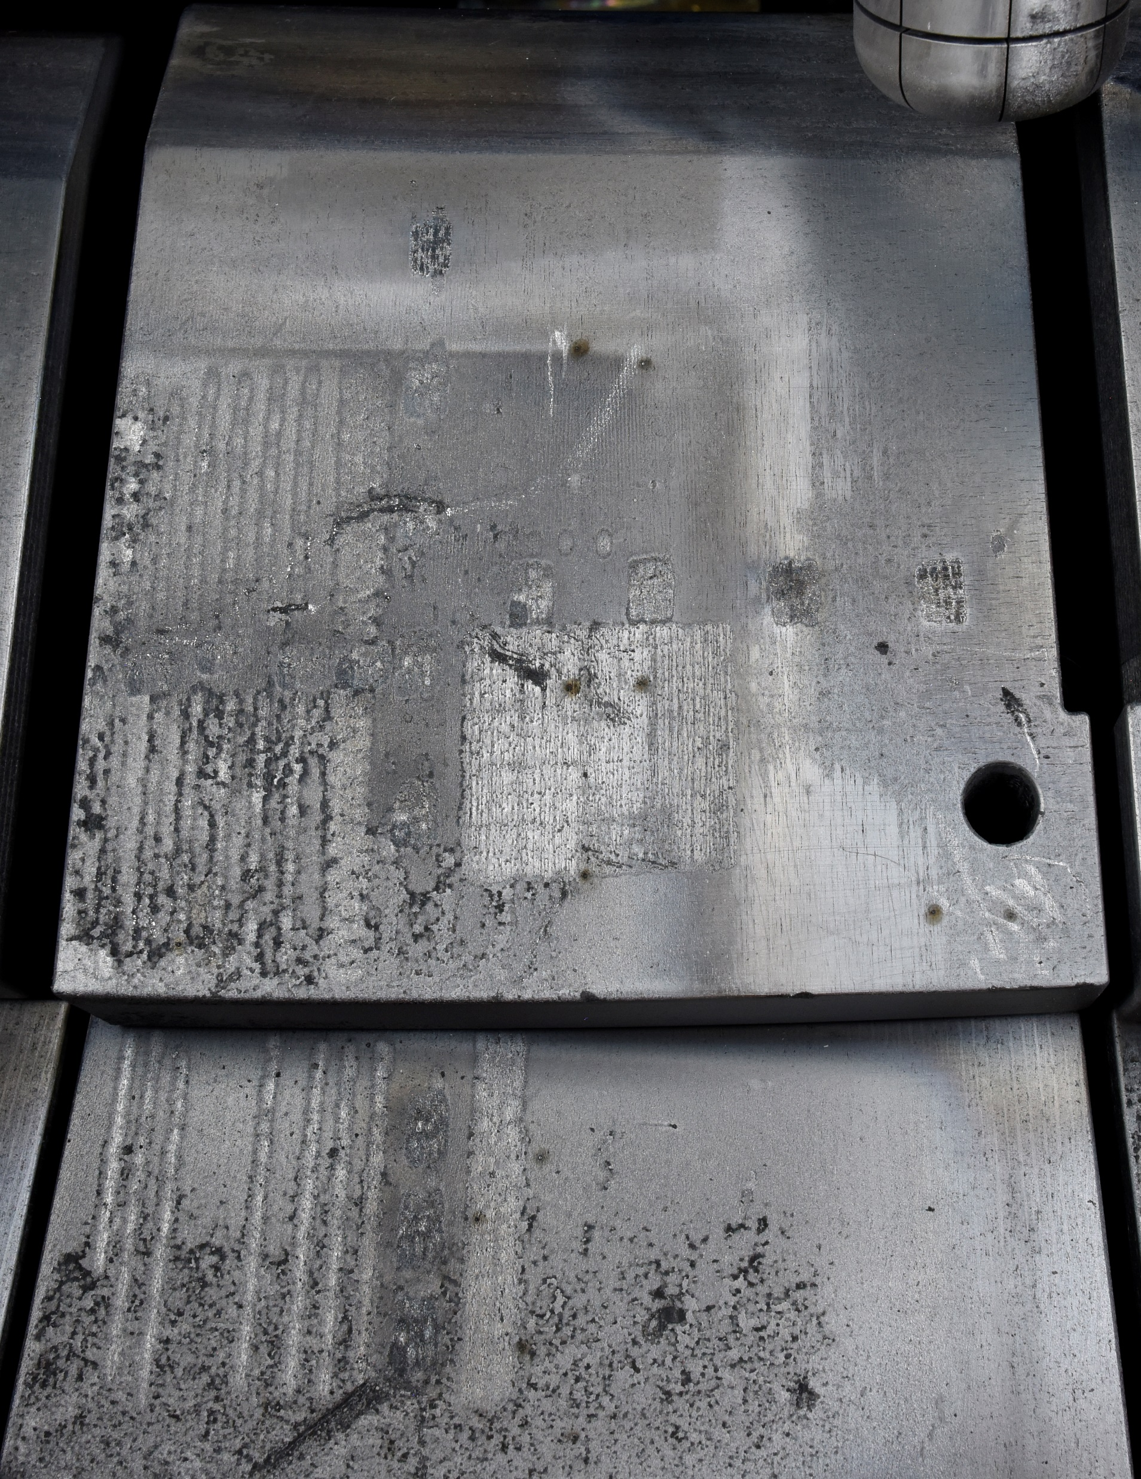
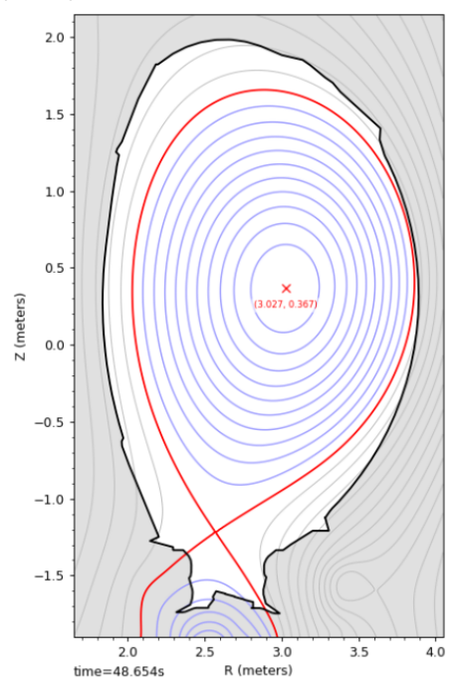
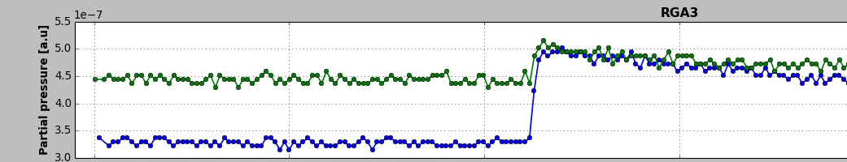
in situ Applications of LID-QMS after DT campaign
Monitoring of T depletion by detritiation methods / Assessment of detritiation methods (Effectiveness? Where?)
    Monitor the tritium content during different clean-up techniques:
      Backing to 320° C
      ICWC plasmas
      Raised Inner Strike Point plasmas (RISP)
      Glow discharge plasmas
    Measurement by repetition of a poloidal scan of the inner divertor
    with LID-QMS shifted by few mm after each cleaning method
Example Measurement: LID-QMS on top of tile 1 before and after RISP plasmas
Laser pulse
Mass 5 (DT)

Slide 27
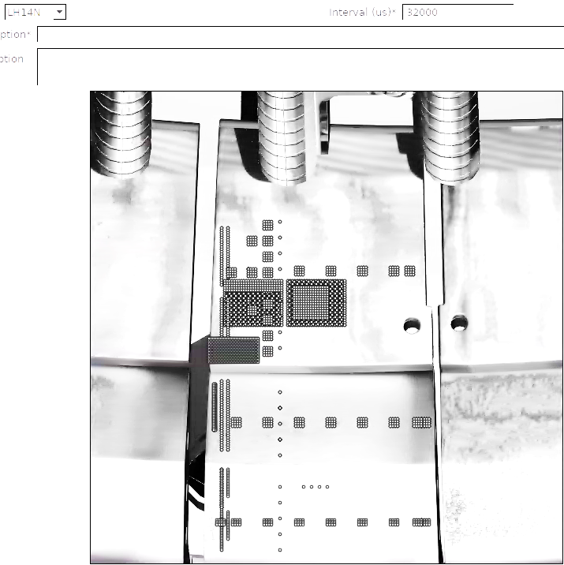
in situ Measurements with LID-QMS at JET
Final Measurements at JET after last plasma in December 2023:
Plan: direct comparison of ex situ to in situ LID-QMS in 70 positions ( ) on tiles retrieved from the torus and with LIBS
LH14W
2011-23
RH14N
2019-23
RH14W
2011-23
LH14N
2019-23
tile 0
(= HFGC)
tile 1
14ING1C
2019-23
14ING1D
2011-23
14IWG1A
2019-23
14IWG1B
2011-23

Slide 28
LID-QMS comparison tiles with LIBS
Orange: Direct comparison of in-situ LIBS and in-situ LID-QMS possible
Green Tiles: retrieved from JET for comparison of in-situ to ex-situ LID-QMS
Compare with 4x4 LID-QMS:
Masses available: 2-6, 20, 28, 40 (RGA3)
2-6, 19, 20 (RGA5, RGA11)
1-6, 19, 20, 28 (RGA7)
LH14W
2011-23
Tuesday
RH14N
2019-23
RH14W
2011-23
Friday
LH14N
2019-23
Tile 0:
or HFGC
14ING1C
2019-23
14ING1D
2011-23
14IWG1A
2019-23
Thursday
14IWG1B
2011/18?
-2023
Wednesday
Tile 1:

Slide 29
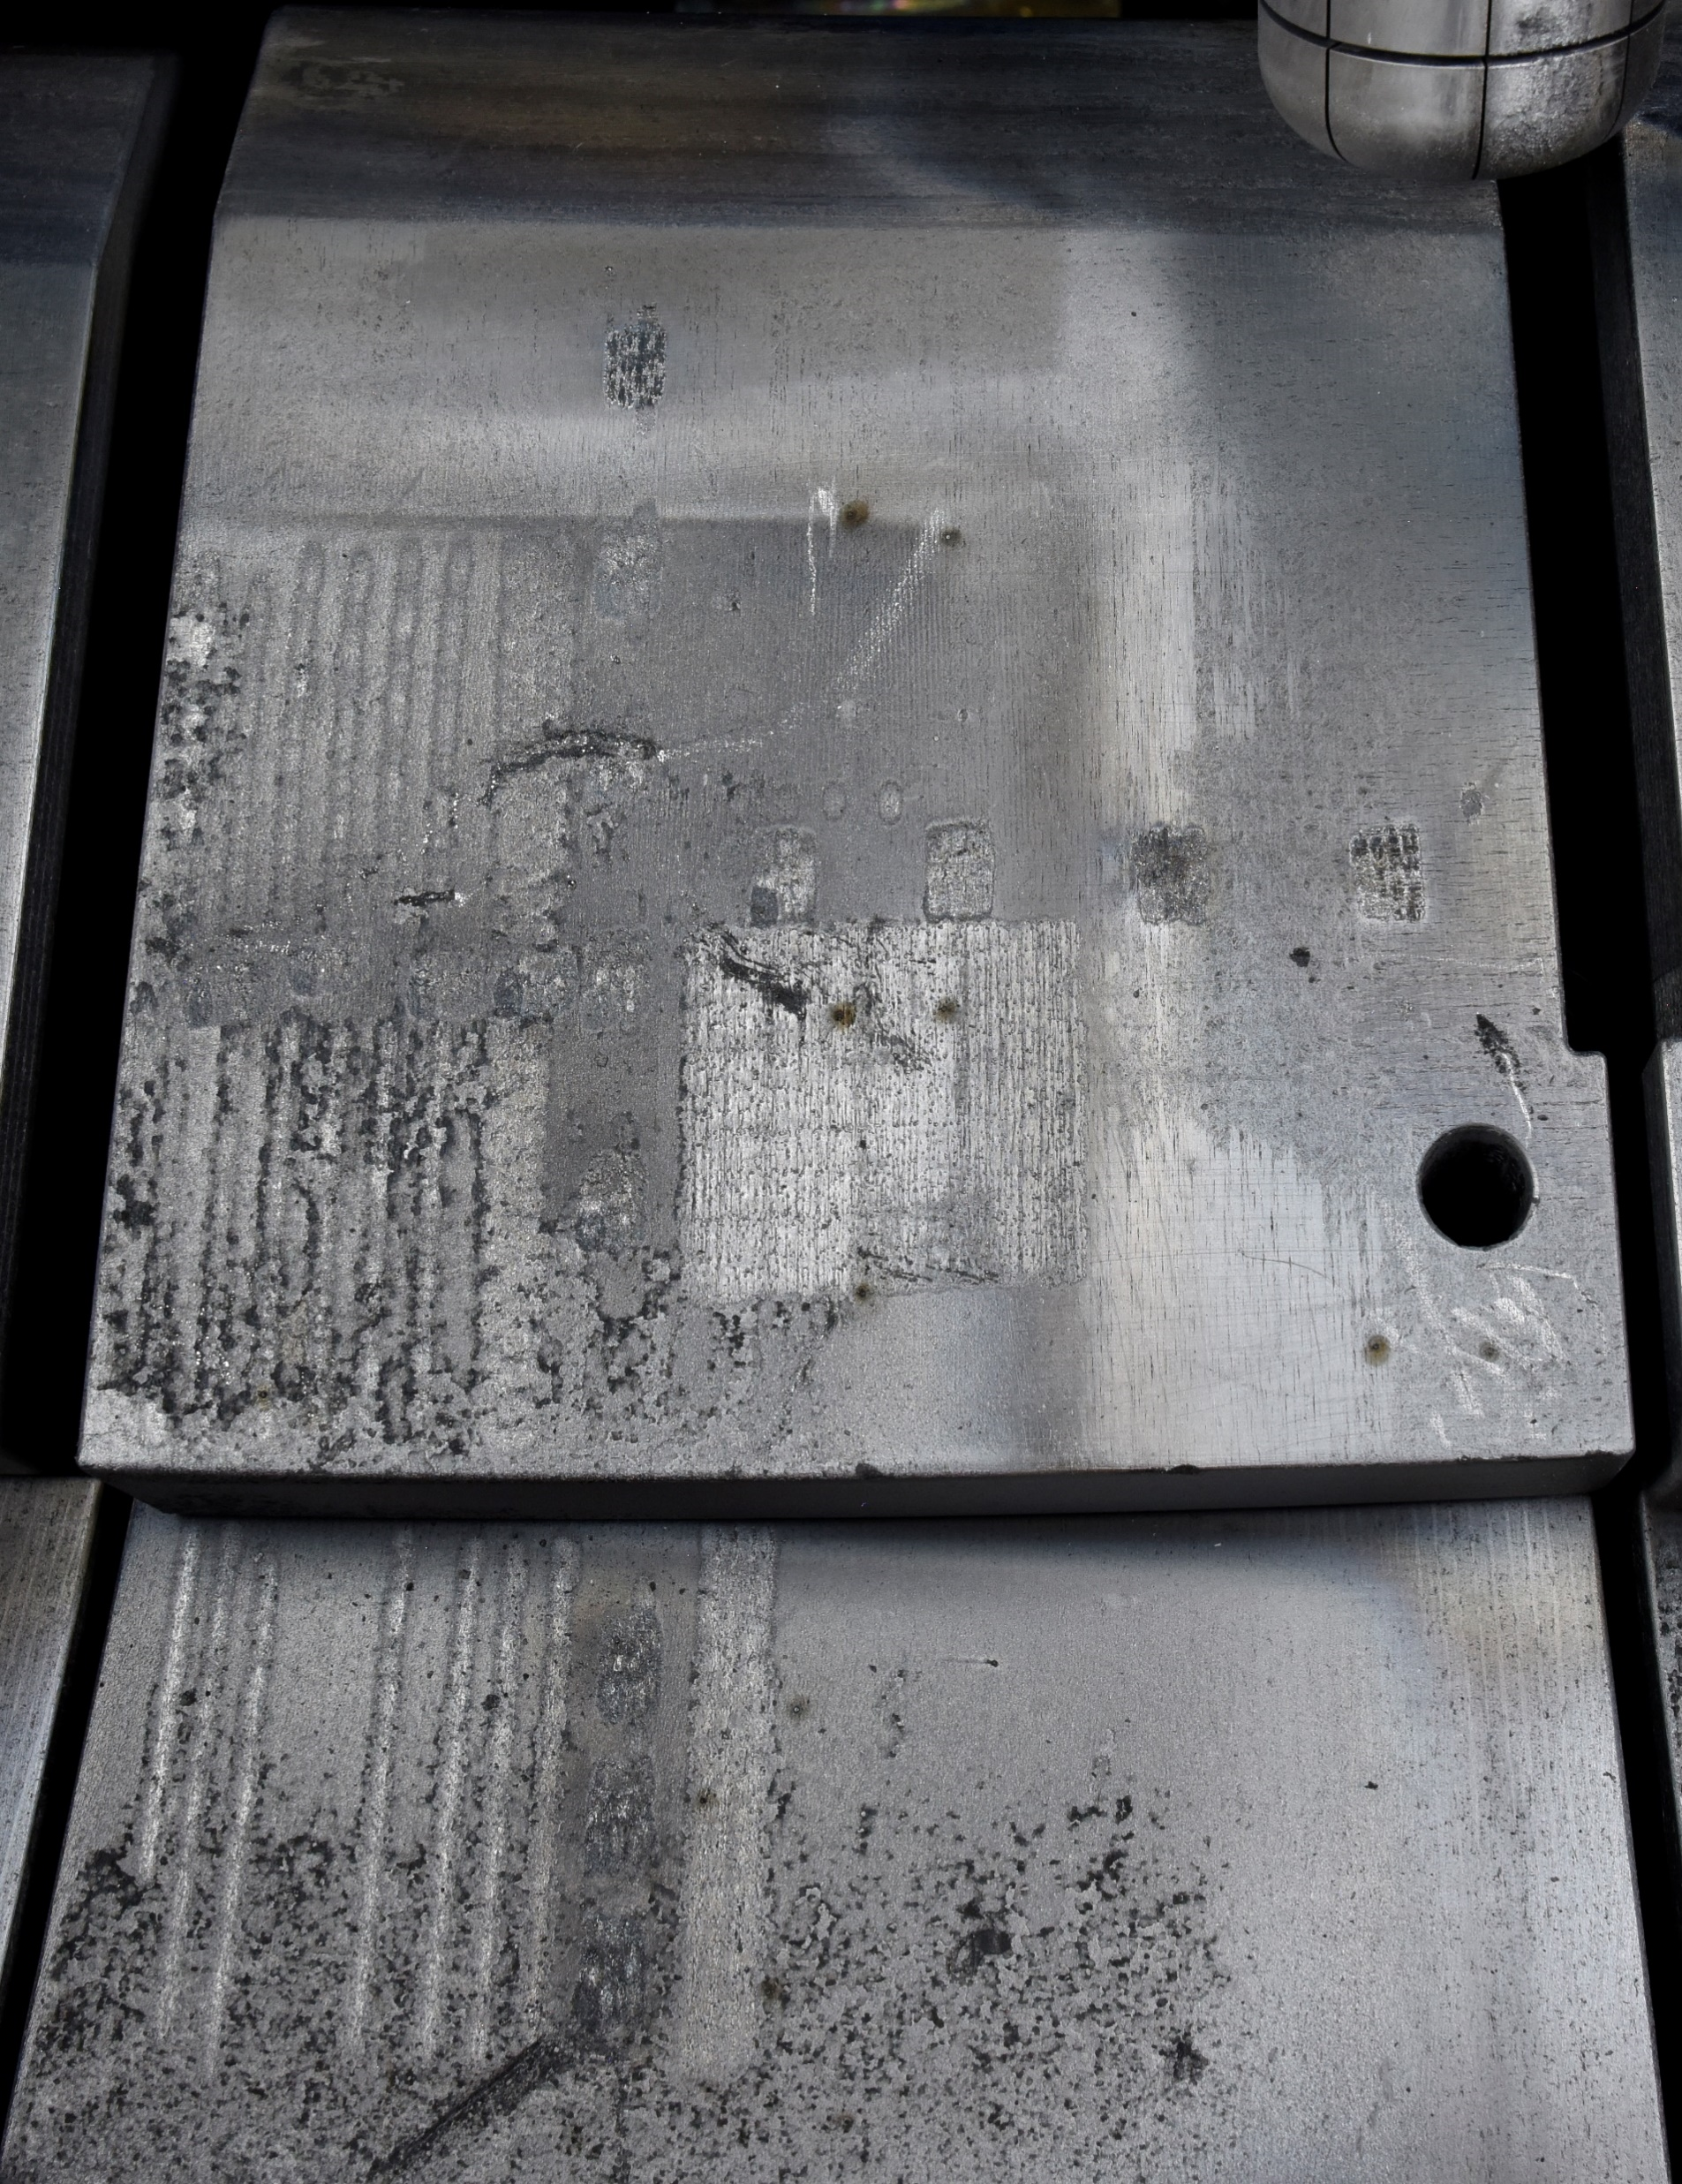
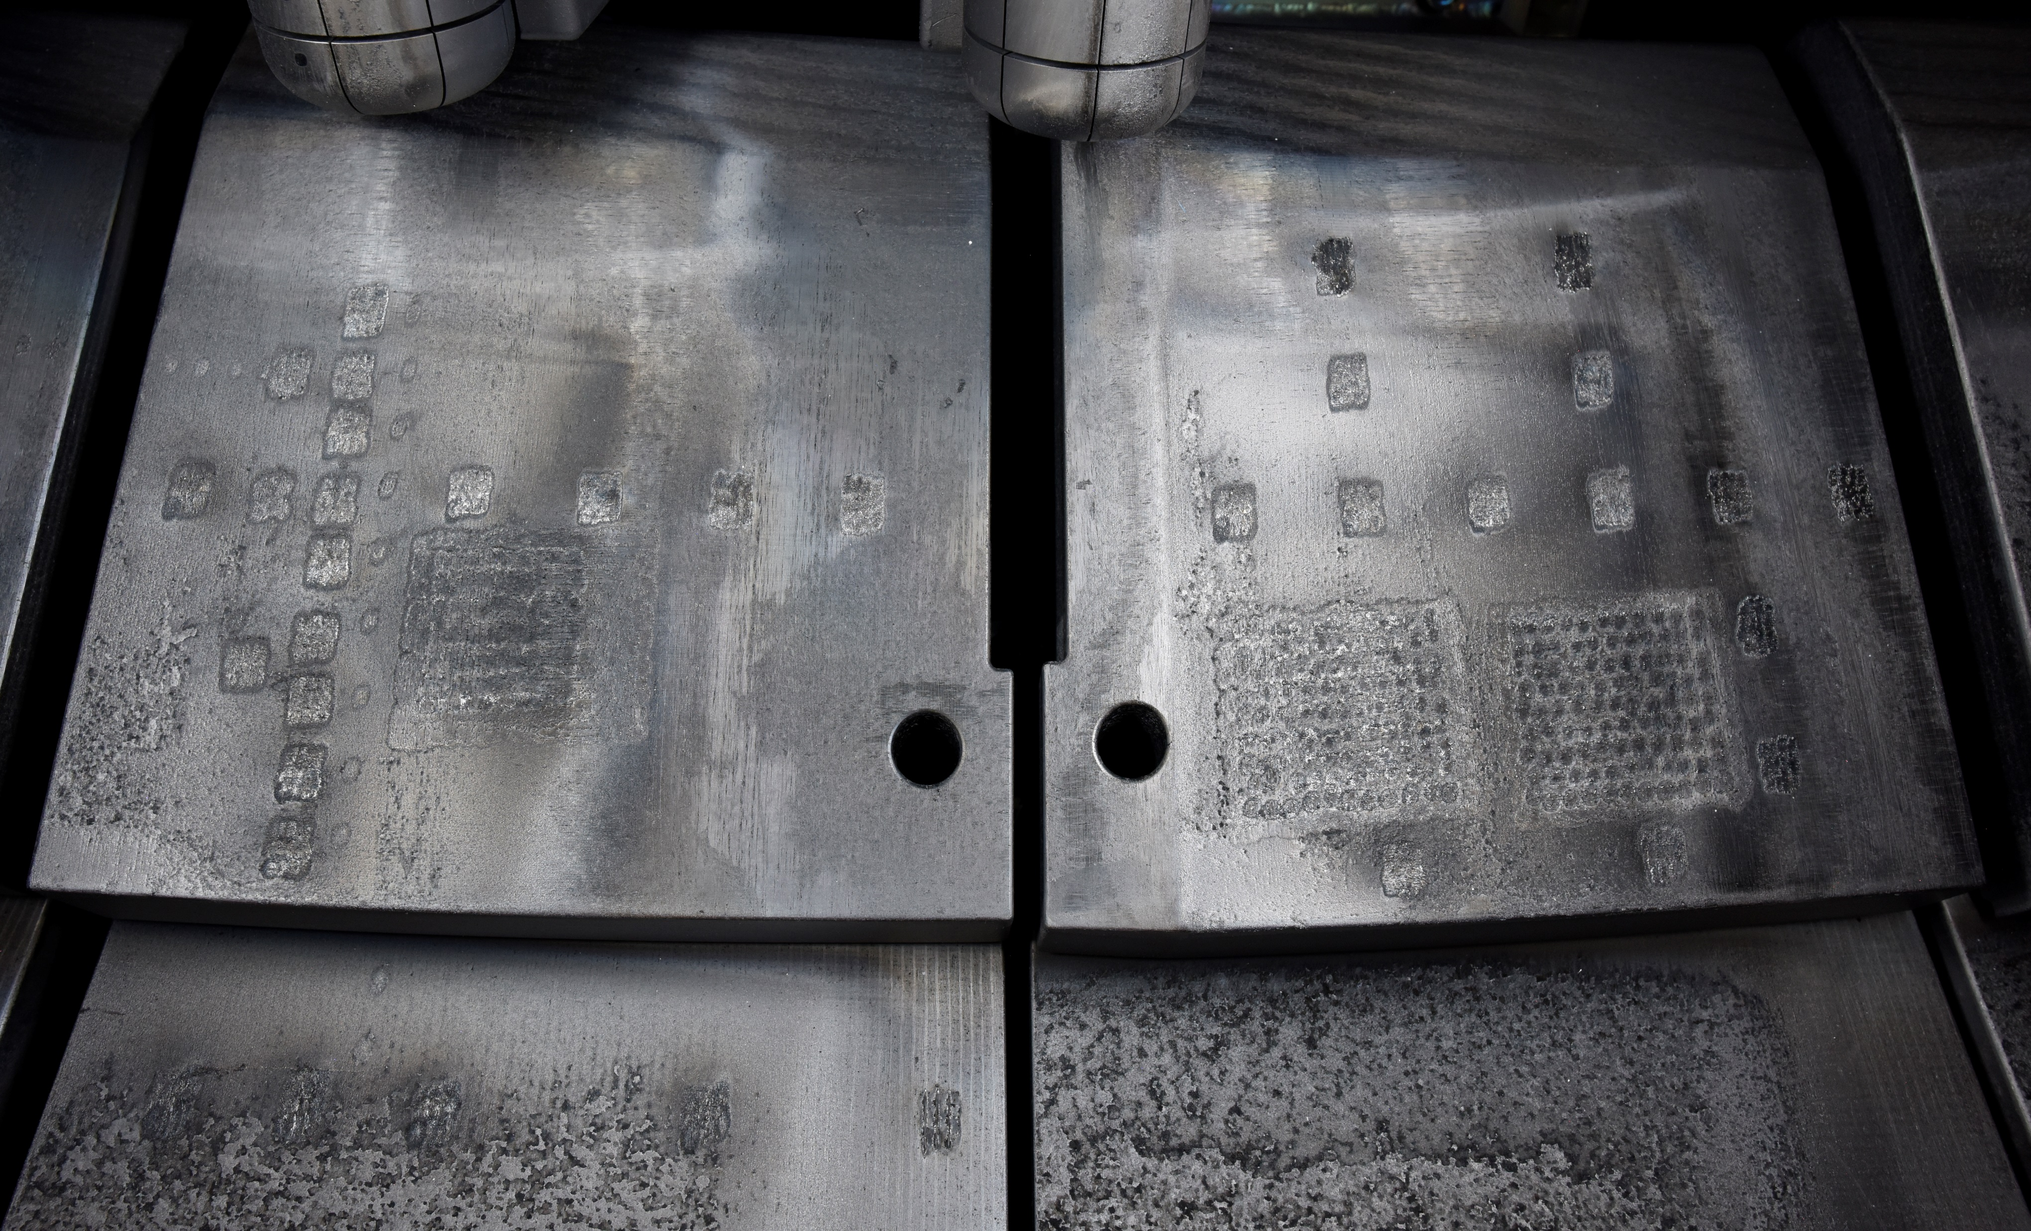
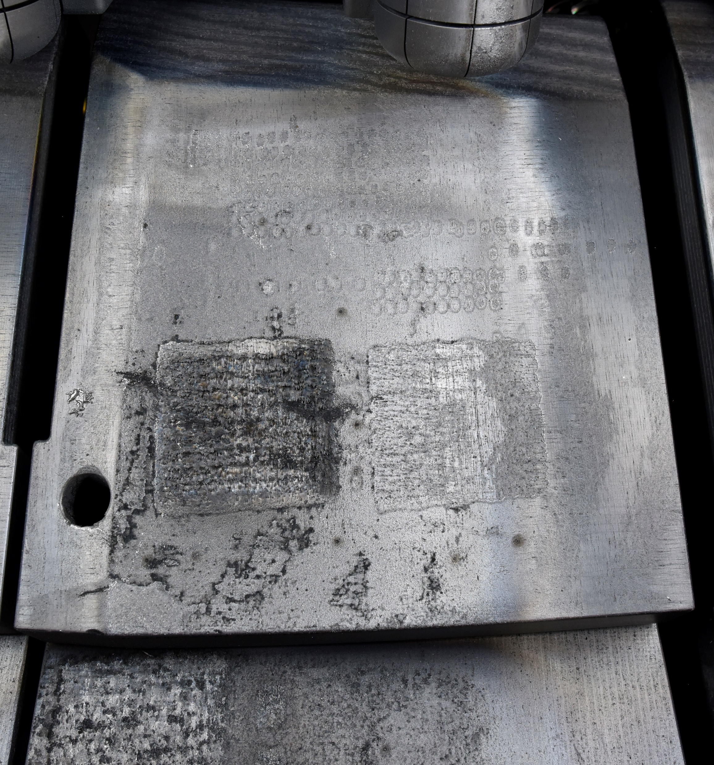
in situ Measurements with LID-QMS at JET
Laser Shot Plan
(old photo
overlaid
with
virtual laser spots):
LH14W
2011-23
RH14N
2019-23
RH14W
2011-23
LH14N
2019-23
tile 0
(= HFGC)
Hi-Resolution
photography
on
Mascot
robotic arm:
4 Tiles 0
retrieved
and being
disassembled
14ING1D
2011-23
tile 0
(= HFGC)
14IWG1A
2019-23
14IWG1B
2011-23
14ING1C
2019-23
tile 1

Slide 30
Backup-Slides

Slide 31
Poloidal Scan in situ on tile 0 (LH14N)
Absolute Calibration:
Calibration factor K_{m4} from D₂ puffs on the day of experiment
Take the same factor for mass 3 and 5 ?
Or interpolate result of T₂, D₂, H₂ puff ?
K_{s} RGA3 2.0185e-5 A/mbar*L
(± 7.142e-9)
ΔI₃, ΔI₄, ΔI₅
RGA3 jump / A
Assumption:
mass 3 is HD, mass 4 is D2, mass 5 is DT
(i.e. neglecting possible HT on mass 4
and triple-molecules like H₂D on mass 4 or
HD₂ on mass 5, which are improbable due to low partial pressure)
Total D = ΔI₃ * K_{m3} + 2 * K_{m4} * ΔI₄ + K_{m5} * ΔI₅
14ING1D
2011-23
K_{m3}
K_{m4}
K_{m5}

Slide 32
Extrapolation to JET and ITER
Fusion facility | Volume V [m³] | Pumping speed S [l/s] | Pump time t_{pump} [s] | Back-ground p_{D2} [mbar] | Inner surface A [m²] | D₂ outgasing rate D atoms /s | Lower detection limit D-atoms 10¹⁶
TEXTOR | 17.2 | 2100 | 8.2 | 1.6 10⁻⁷ | 38 | 1.6 ×10¹⁶ | 1.5
JET | 200 | 8000 (turbo) | 25 | 3 10⁻⁷ | 200 | 1.17× 10¹⁷ | 20
ITER | 1400 | 75000 | 18 | 1.3 10⁻⁷ | 1000 | 5 x10¹⁷ | 130
Strong dependence of the lower detection limit on the volume
Ref: A Huber et al 2001 Phys. Scr. 2001 102

Slide 33
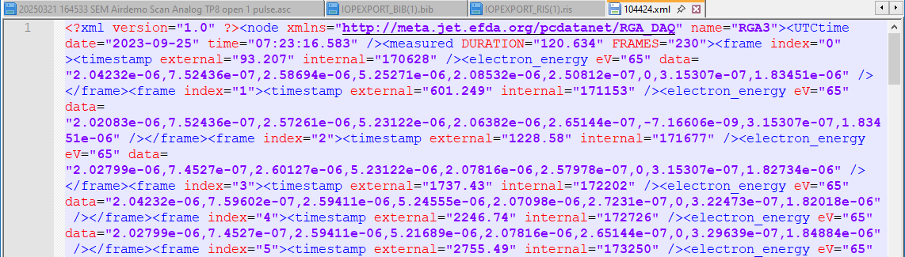
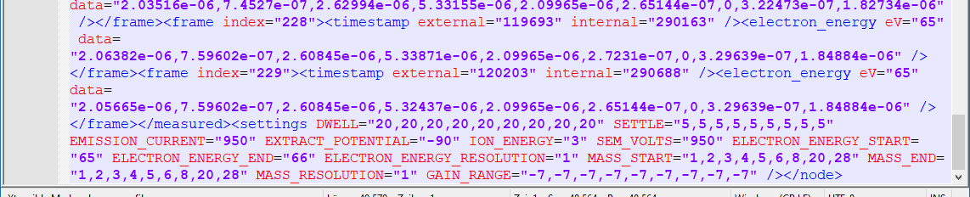
RGA 3 raw data

