Slide 1








Introduction to LIBS on JET, including type of data available, progress on results
Jari Likonen

Slide 2
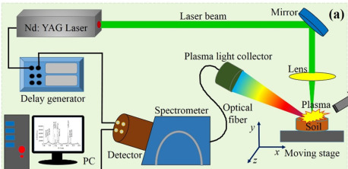
LIBS in fusion reactors
Laser-induced breakdown spectroscopy (LIBS) is a type of atomic emission spectroscopy which uses a highly energetic laser pulse as the excitation source
Laser is focused to form a plasma, which atomizes and excites species
These excited-state species emit light at unique wavelengths
This light can then be collected with a spectrometer
LIBS allows detailed inspection of vacuum vessel of fusion reactor
Particularly critical is to assess the amount of radioactive tritium retained in the layers
Also possible to determine thickness and elemental composition of the co-deposits
LIBS provides an (almost) unlimited access to different regions of reactor wall – without the need to remove wall components from the reactor
LIBS parameters can be tailored such that impact on wall structures is minimized →
no need for replacement after LIBS measurements

Slide 3
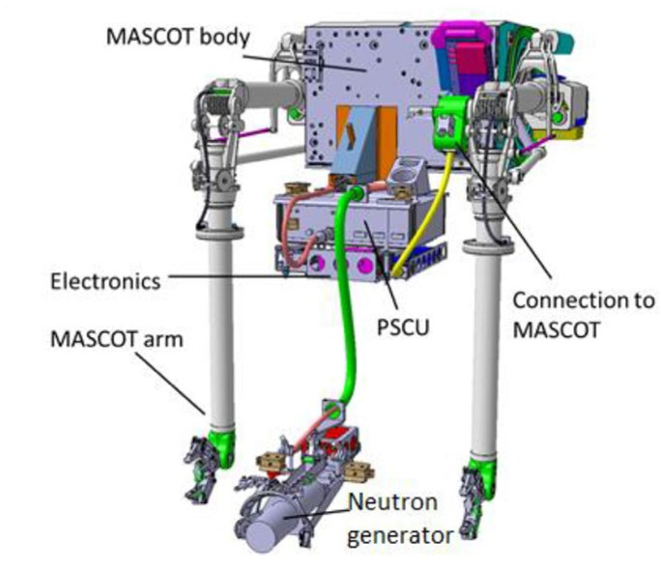

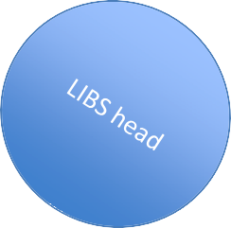
LIBS system at JET
LIBS enclosure developed by ENEA and optimised by FZJ
LIBS enclosure mounted on the JET MASCOT arm
RH boom moves LIBS tool close to the wall, outermost cone is in contact with tile to be investigated
Argon gas flux applied to increase signal to noise ratio
Optical fibre guides emitted light into spectrometers, located outside of the vessel

Slide 4
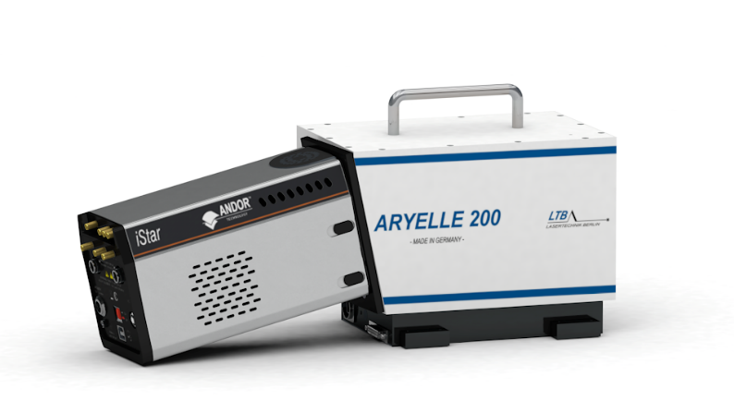
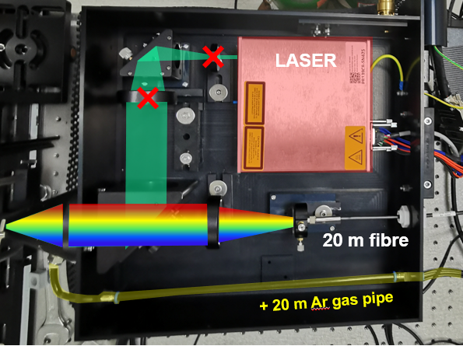
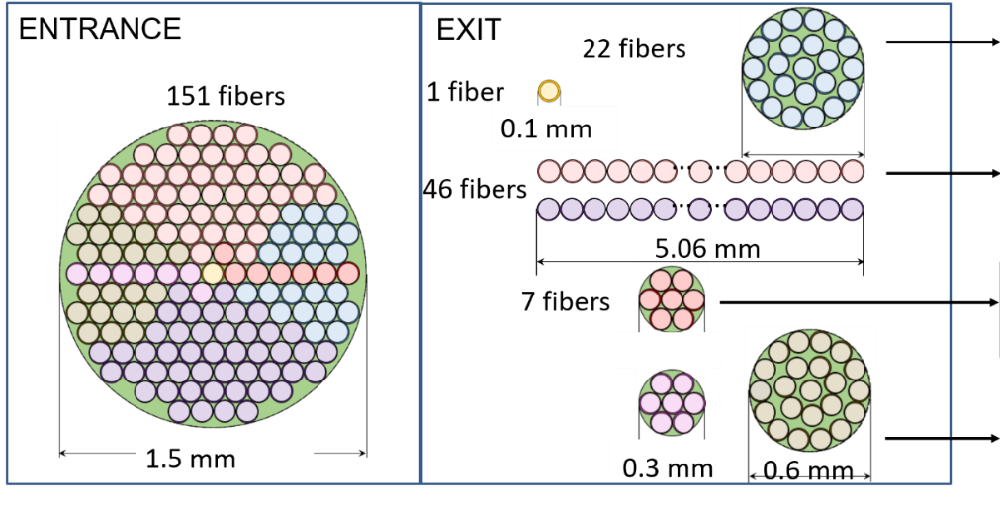
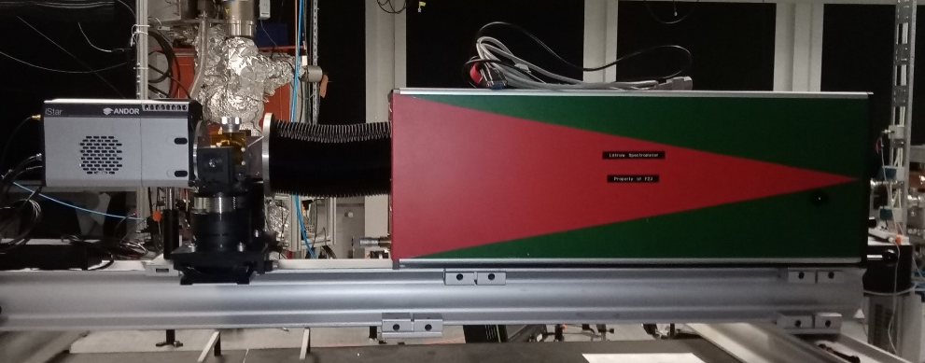
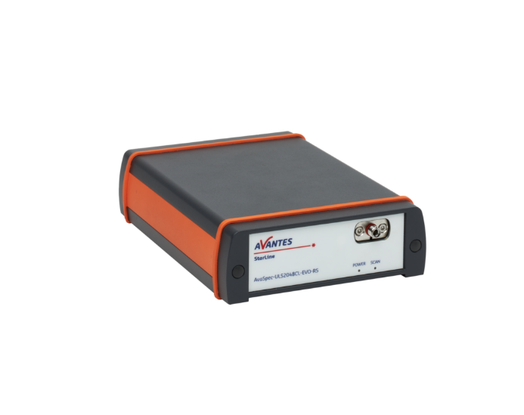
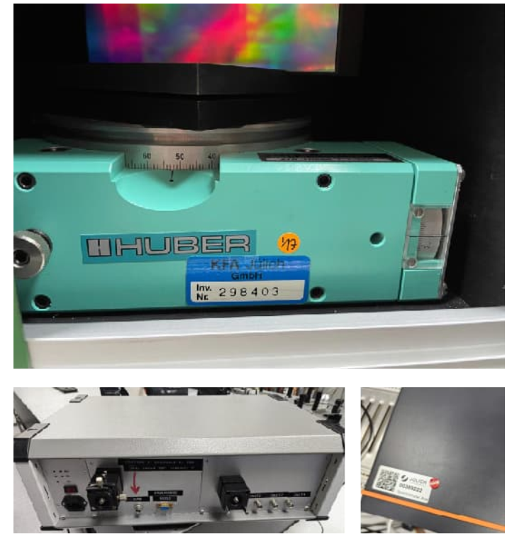
In-vessel LIBS applications at JET
JET-LIBS setup
Laser box
Fiber bundle
4 spectrometers
Optics Table
1
1
2
3
4
2
1. Echelle : F#10,resolution~70pm, 200-750 nm- T calculation
2.Littrow spectrometer: F#~4,resolution~30 pm(slit 100um), wavelength range 4 nm- H_{α} detection
3
3. Compact C-T spectrometer: resolution 0.5 nm, 300-1100 nm- Layer information
4. PMT :monochromator +3 different filters- H_{α} detection
4

Slide 5
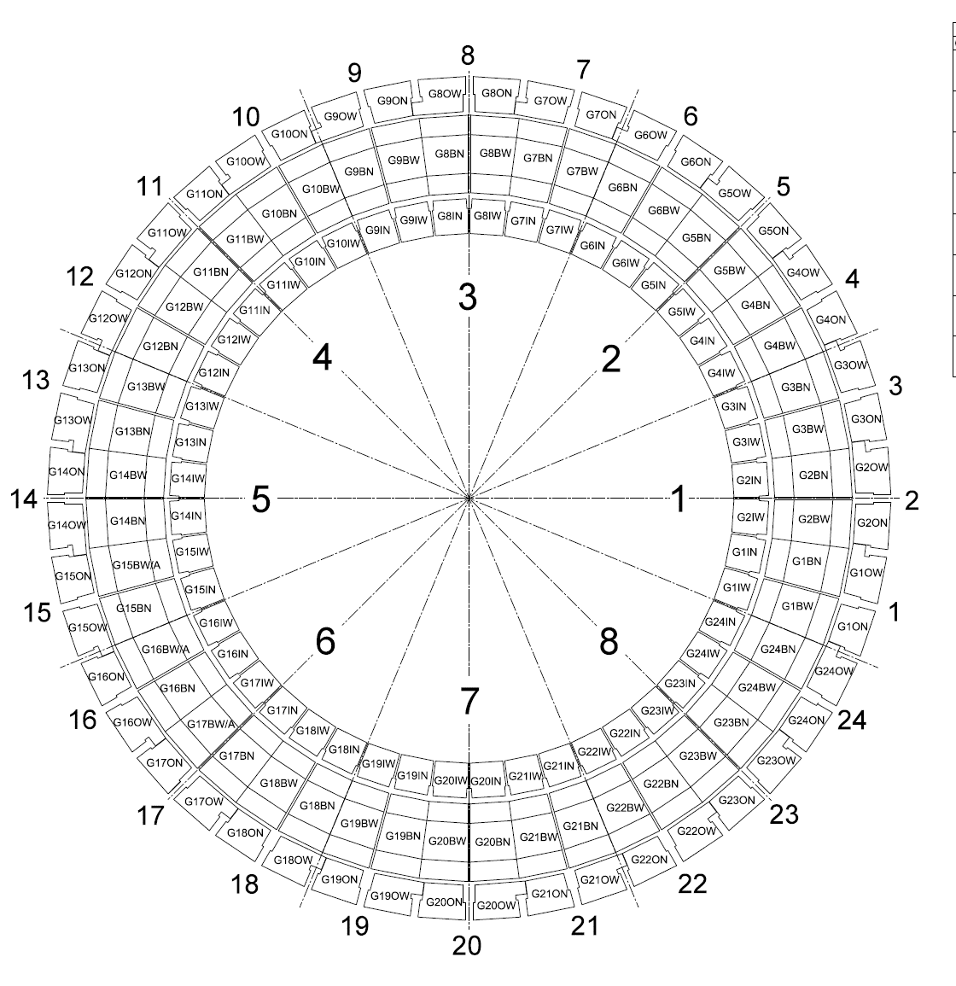
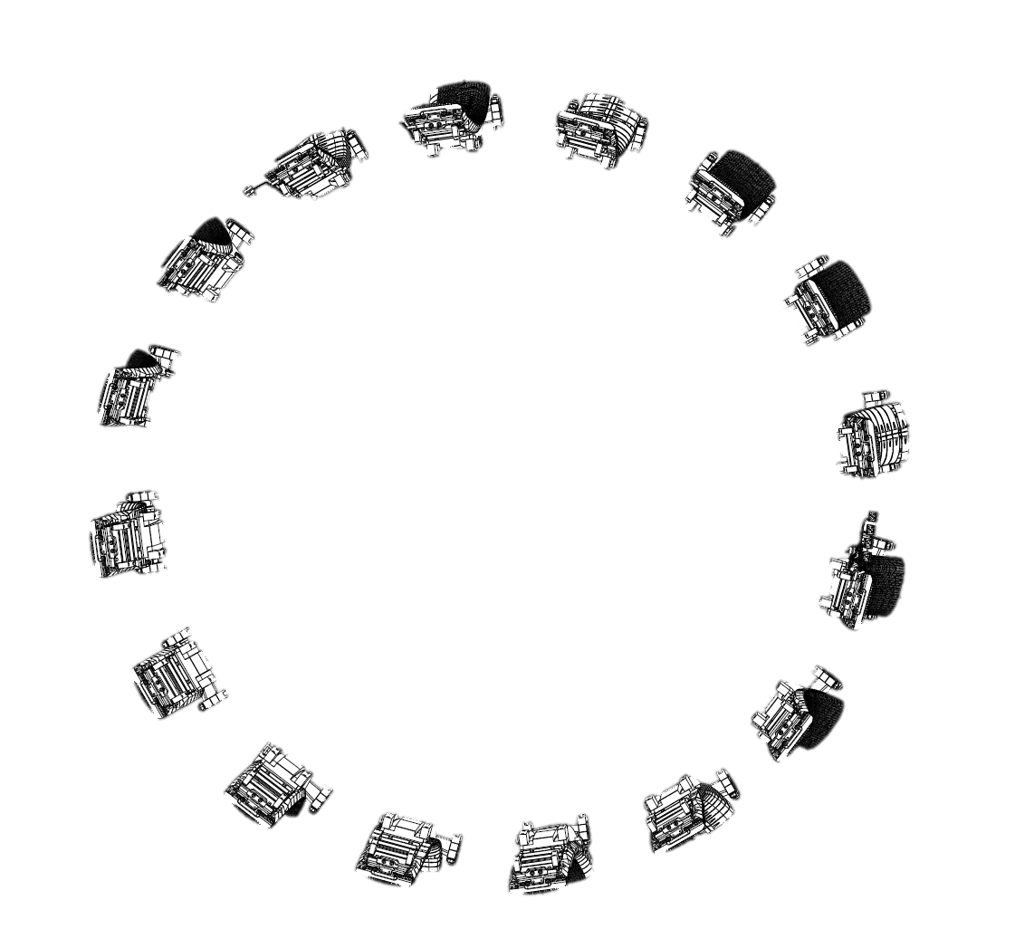
LIBS – Laser Induced Breakdown Spectroscopy – TOROIDAL MAP
4D
Z
X
VW
Oct5
X
Z
Z
X
X
Z
Z
X
X
Z
Z
X
VW
Oct1
X
Z
Bulk Be
W – coated CFC
Be coated inconel
Bulk W
Inconel (vacuum vessel)

Slide 6
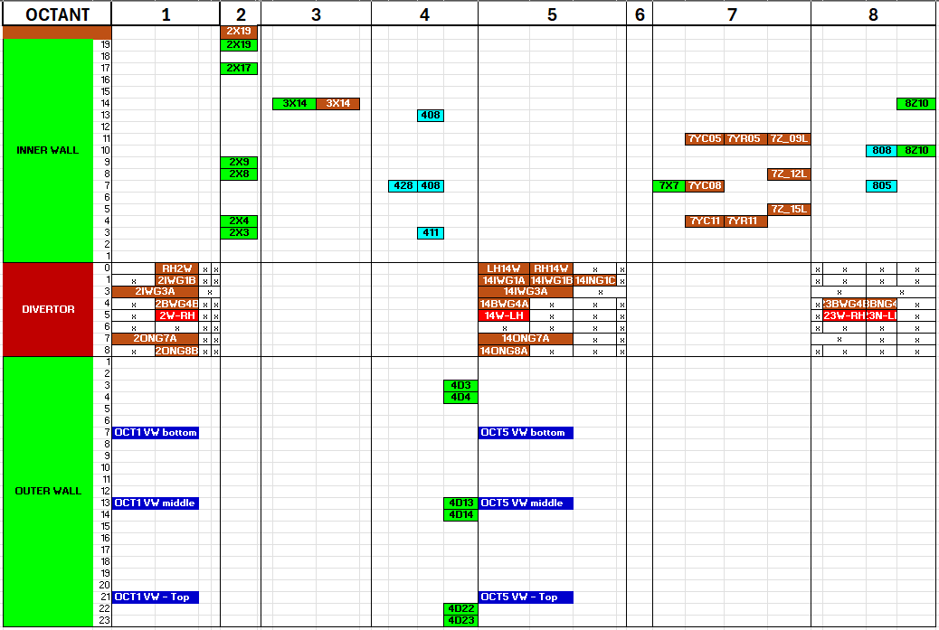
LIBS full distribution map
402
Poloidal direction
Bulk Be
W – coated CFC
Be coated inconel
Bulk W
Inconel (vacuum vessel)
Toroidal direction

Slide 7
LIBS at JET in 2025
1st Data analysis meeting (Feb 6th, FZJ)
Reported in March, PWIE meeting in Prague
PFMC
Several contributions (Likonen, Almaviva, Gasior, Yi)
Poloidal distributions of H isotopes, Be, W
11th Data analysis meeting (Oct 31st, Teams)
JET LIBS calibration pulses (pure materials)
Be calibration: 2XR8 pulse #492 (from C3 tile)
Inconel (vessel wall) OCT1 middle: pulse no. #357
Pure W (W-wedge – Lamellae): Stack A pulse #20 and repeated pulse (with setting changes) pulse #765
W-CFC Top of tile 8: pulse no. #51 (250 shots)
13th Data analysis meeting (Nov 28th, Teams)
Discussion on the joint LID/QMS-LIBS meeting

Slide 8

FZJ: Littrow results from Module 14(LID-QMS positions)
LID-QMS and LIBS analysis locations on tiles 0 and 1
LIBS pulses: #xy
LID-QMS pulses: #105abc

Slide 9
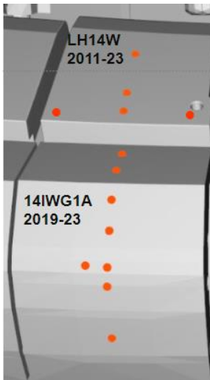
FZJ: Littrow results from Module 14 (LID-QMS positions)
2D map for (D+T)/(H+D+T)
HFGC
Tile 1
surface

Slide 10
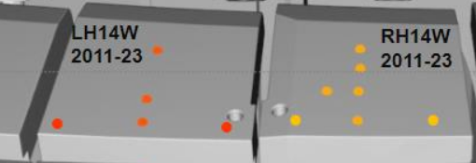
FZJ: Littrow results from Module 14 (LID-QMS positions)
2D map for (D+T)/(H+D+T)
HFGC LH14W
HFGC RH14W
D+T amount not constant toroidally
surface

Slide 11
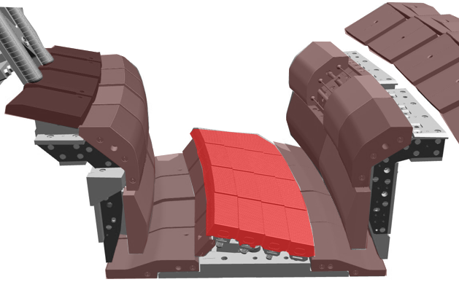
Aryelle: Be profile on divertor
Divertor module 14 with LIBS locations
14IWG1B
14ON G8A
0
1
1
8
HFGC_LH 14W
3
5
7
14IWG3A
4
6
14BWG4A
LBSRP_14W LH
C1 & C21
14ON G7A
Heaviest Be deposition on HFGC tile
and top part of tile 1
See Almaviva O1

Slide 12
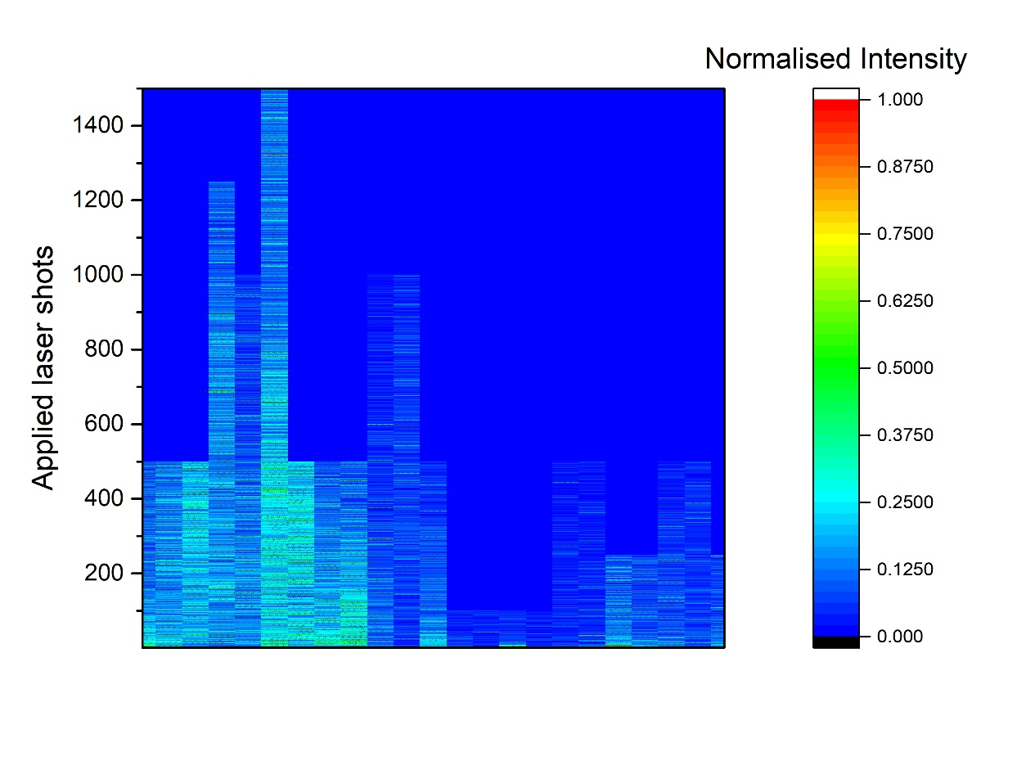
Aryelle: D profile on divertor
0
1
3
4
5
7
8
Divertor module 14 with LIBS locations
14IWG1B
14ON G8A
0
1
1
8
T-D-H slowly descreasing
HFGC_LH 14W
3
5
7
14IWG3A
4
6
14BWG4A
LBSRP_14W LH
C1 & C21
14ON G7A
H isotopes mainly retained on HFGC tile
and top part of tile 1
Co-deposition together with Be
See Almaviva O1

Slide 13
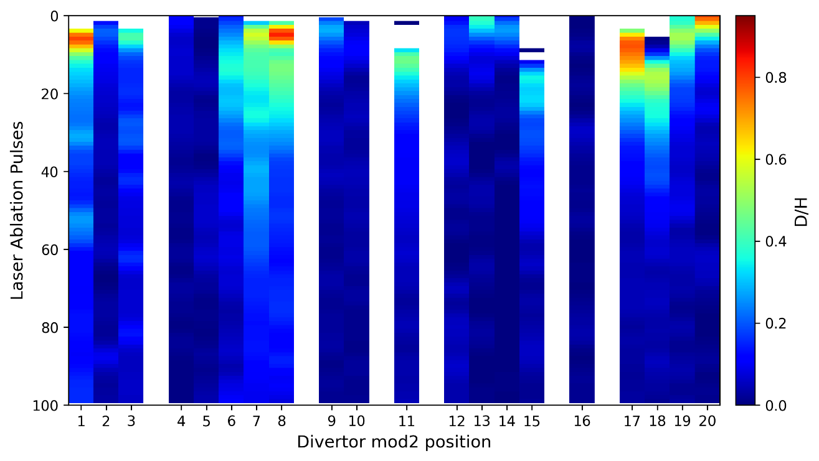
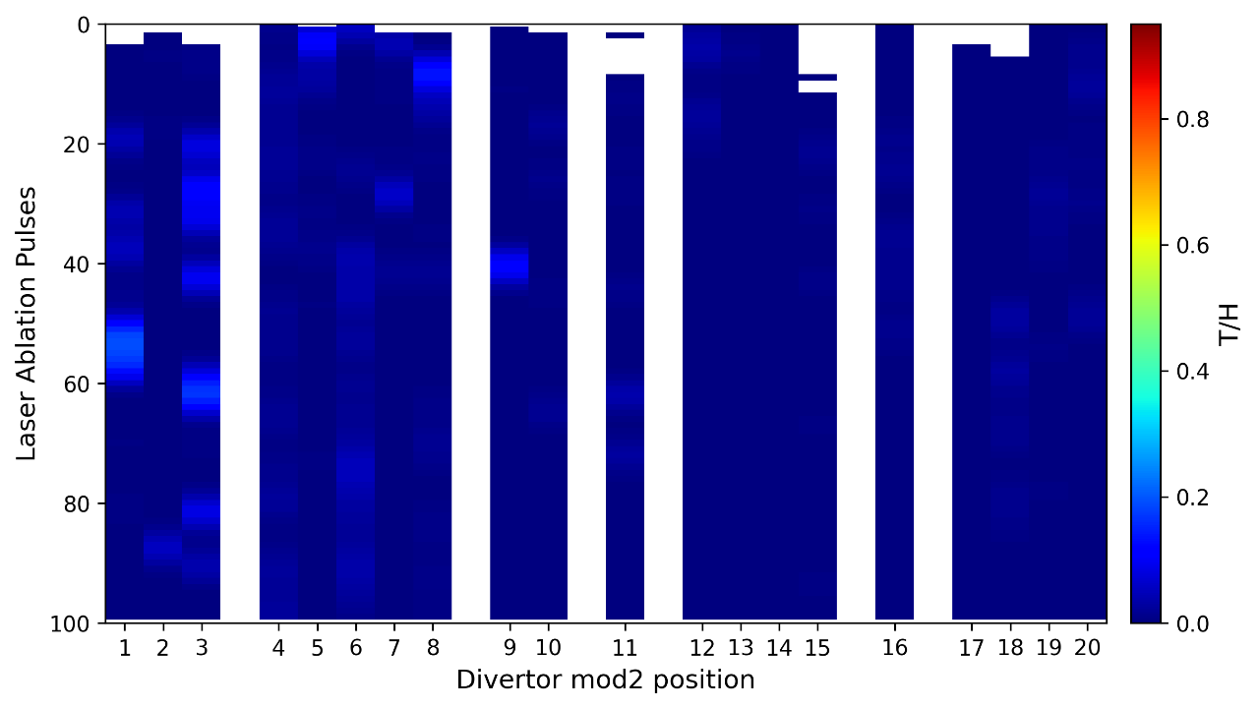
Littrow: D and T map for divertor
0
1
3
4
5
7
8
0
1
3
4
5
7
8
20
1
3
Overall T amount low along divertor tiles
See Yi 4889 POB-10, Thursday
4
17
8
9
12
16
10
15
11

Slide 14


Calibration free LIBS
CF procedure (A. Ciucci, Appl. Spec. 53(8), (1999), 960-964) aims to quantitatively estimate chemical elements detected in LIBS plasma.
CF will be applied to estimate the concentration of T+D+H with respect to W and Be.
CF is based on experimental intensities of the emission lines.
If LIBS plasma can be considered in local thermodynamic equilibrium (LTE) these intensities can be expressed as follows:
where, 𝐼^{ki}_{𝜆} = exp. intensity of the k→ i transition, N_{𝑠} = concentration of species, 𝐴_{𝑘𝑖} = transition probability for given line, g_{k} is k level degeneracy, 𝐸_{𝑘} the upper energy level of transition, 𝑘_{𝐵} Boltzmann constant, T is the plasma temperature, U_{s}(T ) is the partition function for emitting species at plasma temperature T_{e}.
Taking the logarithm of equation above we get (Boltzmann plot)
where

Slide 15
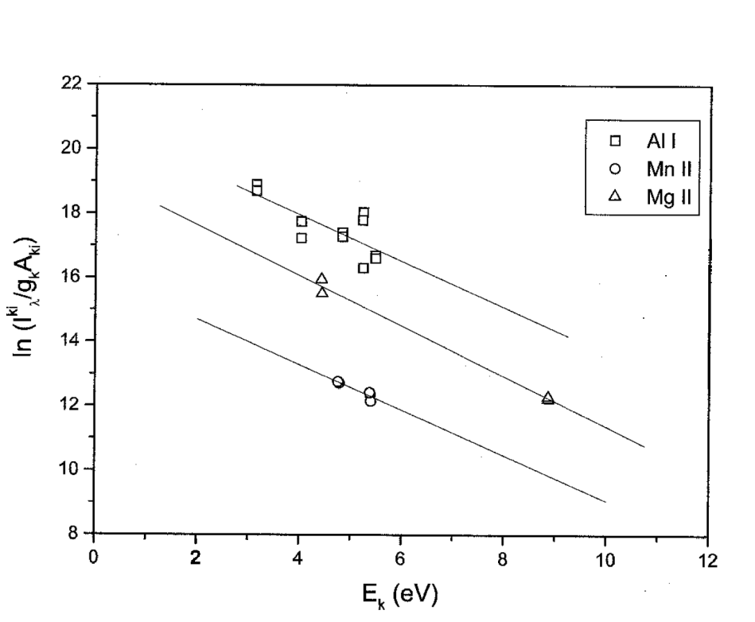
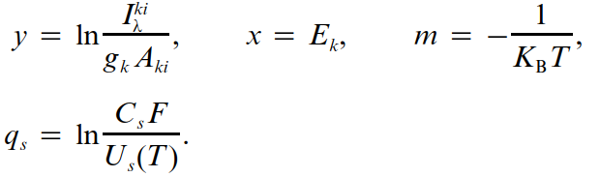
Calibration free LIBS
q_{s}(Al I)
q_{s}(Mg II)
q_{s}(Mn II)
Slope m of plots is related to plasma temperature, while the intercept q_{s} is proportional to logarithm of the species concentration.
Boltzmann plot method provides the temperature from only one ionization stage.
More general analysis is obtained using Saha-Boltzmann equation which provides relationships between transition line intensities from different ionization stages.

Slide 16
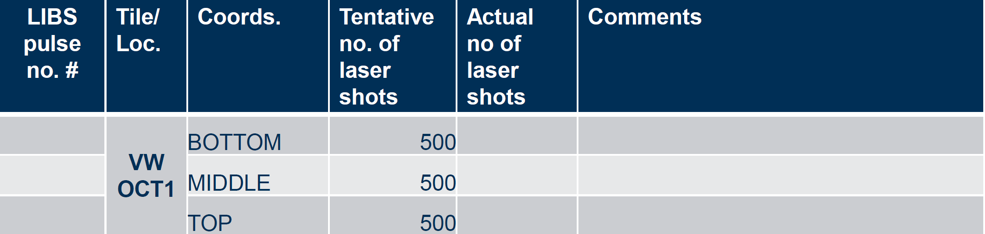
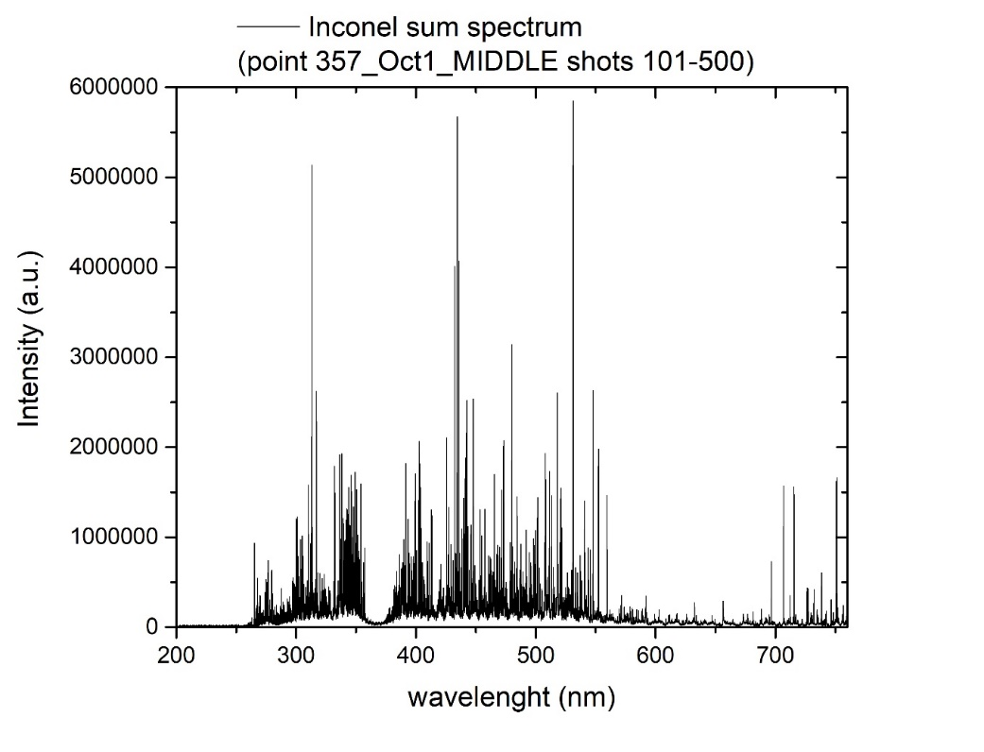
ENEA: Initial results of spectral analysis at JET, composition of co-deposited layers and fuel content: example: point 357 (Inconel reference). In-depth composition
500
LIBS spectrum of Inconel
Depth profiling of Be, W, Cr, Ni, T-D-H

Slide 17
ENEA: Initial results of spectral analysis at JET, composition of co-deposited layers and fuel content: example: point 357 (Inconel reference). Fuel content
500
Intensity ratio of the Balmer alpha band
(T+D+H) with respect to Cr I line at
425.44 nm and Ni line at 310.16 nm
Relative atomic concentration of Be, W, H, Ni,
C by applying the closure relation (sum of con-
centration = 100%)

Slide 18
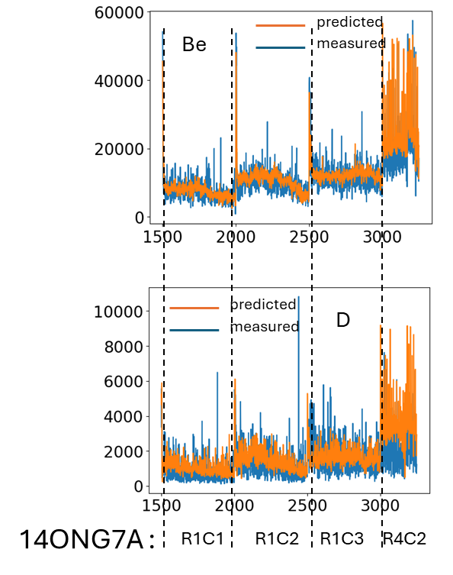
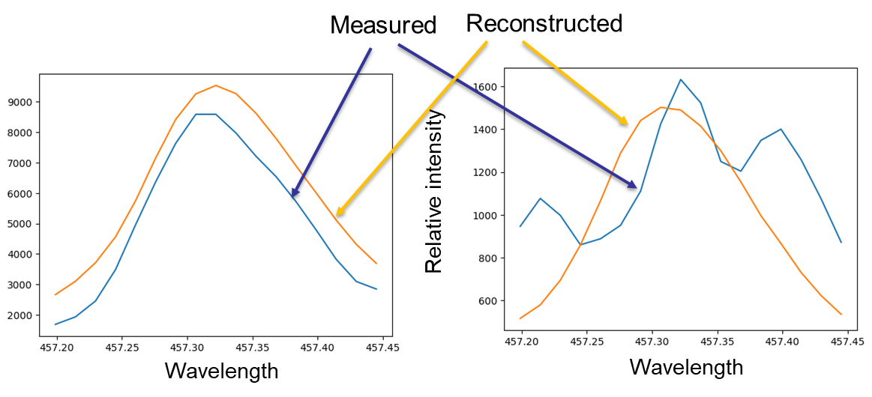
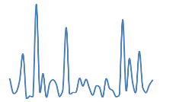
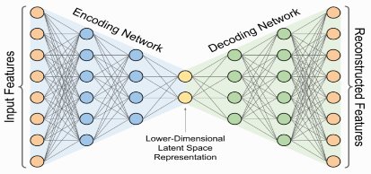
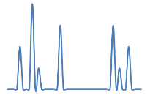
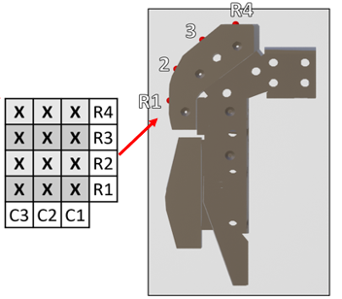
ML models development at the IPPLM – overview on results
Task and questions to be addressed
IPPLM specific: Implementation of machine learning and digital signal processing algorithms to facilitate data analysis
Approach
Application of digital data filtering for preliminary data engineering
Application of DNN-based autoenconer for dimensionality reduction and denoising
(DNN=Deep Neural Networks)
Application of DNN and CNN for data analysis (CNN=Convolutional Neural Networks)
Results
Profile reconstruction
Line reconstruction, Be I 457.3nm
Autoencoder
Input spectrum
Output spectrum
14ONG8A

Slide 19
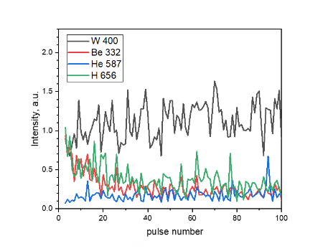
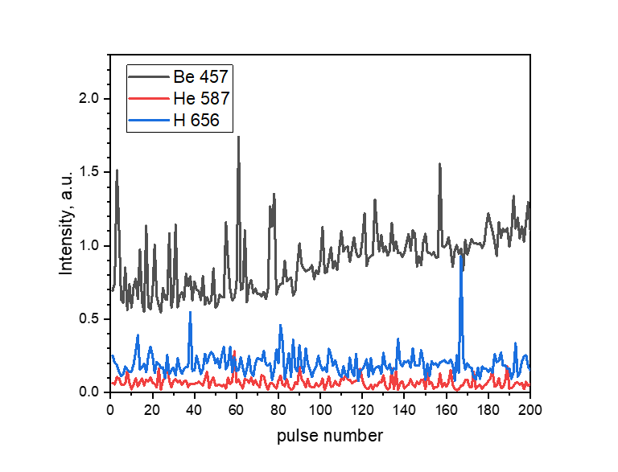
ISSP UL: Results of spectral analysis, composition of co-deposited layers and fuel content
Task and questions to be addressed
Spectral analysis of Aryelle data
Approach
CF-LIBS has been applied to the selected JET tiles (#492 Be ref. 2XR8; #20 W ref. 14WLH
AR3; #357 Inconel ref. Oct1 Middle)
Results
Transmission multiplier and echellogram correction have been applied to adjust
intensities of spectral lines
For calculation of electron temperatures, inverse line intensity (w_{i}=1/I_{i}, w_{i}=1/I_{i}²)
has been used as a weighting factor to reduce influence of self-absorbed spectral lines.
Weighted Boltzmann plots, in general, yielded slightly lower electron temperatures
Accuracy of relative atomic concentrations strongly depends on determination
of electron temperature.
Electron densities yielded 6…150 x 10²¹ m⁻³
Depth profiles and T_{e} for the selected JET tiles
Red: unweighted T_{e} , green: weighted T_{e}
W ref. 20 14WLH AR3 C1
D/H and Be signals appear up to the 40th pulse, exhibiting slow decay. He contamination to the surface is small
Be ref. 492 2X08 R7 C3 C7
No significant amount of impurities was detected on the surface

Slide 20
Relative concentrations on species in studied samples
Sample | Emitting species | Electron temperature, K | Relative concentration (averaged over all relevant lines), %
W (#20) | W I | 9573 (W I) | 99.0 ± 1.0
 | H I |  | 1.0 ± 1.0
Be (#492) | Be I | 11807 (Be I) | 98.5 ± 1.0
 | H I |  | 1.5 ± 1.0
Inconel (#357) | Ni I | 10267 (Ni I) | 56.27 ± 0.85
 | Cr I |  | 40.40 ± 0.65
 | Fe I |  | 3.32 ± 0.68
 | H I |  | (-1.43 ± 0.35)∙10⁻⁵
Notes:
Ielikt grafiku, kur nekas nemainās

Slide 21
UT: Analysis of data from LIBS JET campaign - reference samples
#357 Inconel OCT1 Middle
Shots 1-10: temperatures from W I, Ni I and Cr I lines are comparable
Shots 291-300: CF-LIBS Cr/Ni ratio 0.26 in the bulk sample is consistent with Inconel
Boltzmann plot
T_{e} = 0.57-0.63 eV
T_{e} = 0.83 eV

Slide 22
UT: Analysis of data from LIBS JET campaign - reference samples
#20 Pure W LBSRP 14WLH
Saha-Boltzmann plot (W,D+H)
Depth profiles are quite noisy and averaging of spectra over 10-15 LIBS shots gives more reliable results for CF-LIBS
Temperature from Boltzmann plot of W I lines and Saha-Boltzmann plot of W I and W II lines consistent
Electron density determined from Ar I and Be I lines consistent
H isotope quantification requires additional work

Slide 23
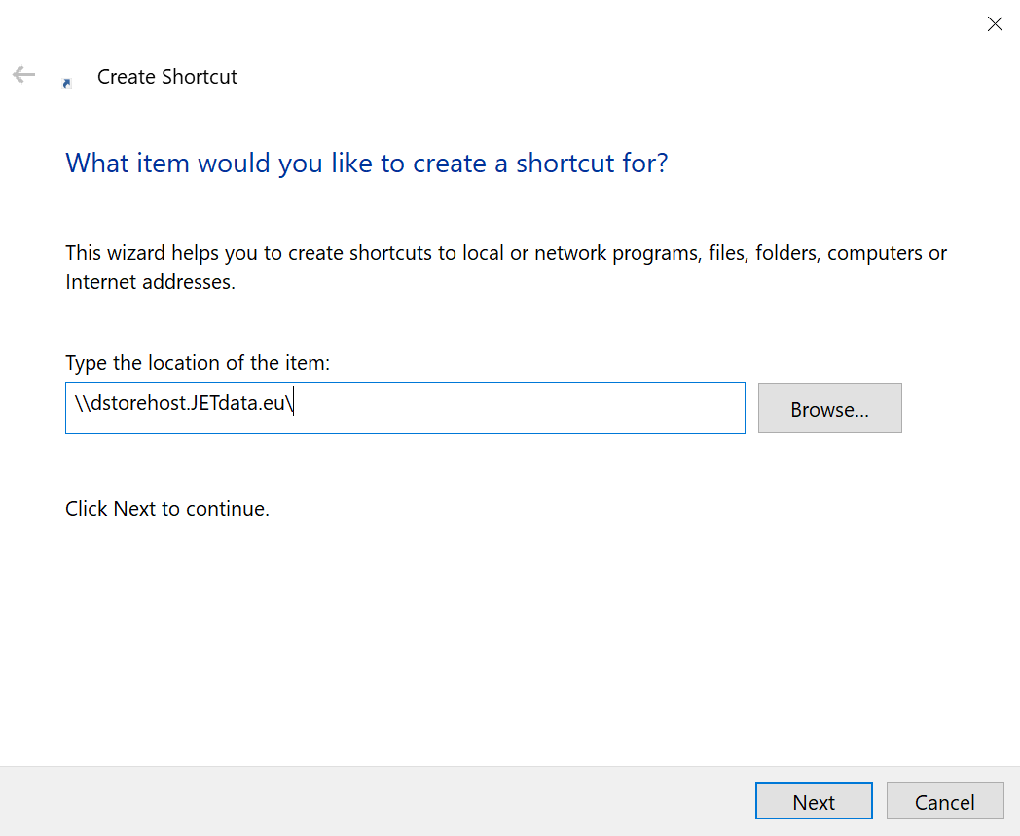
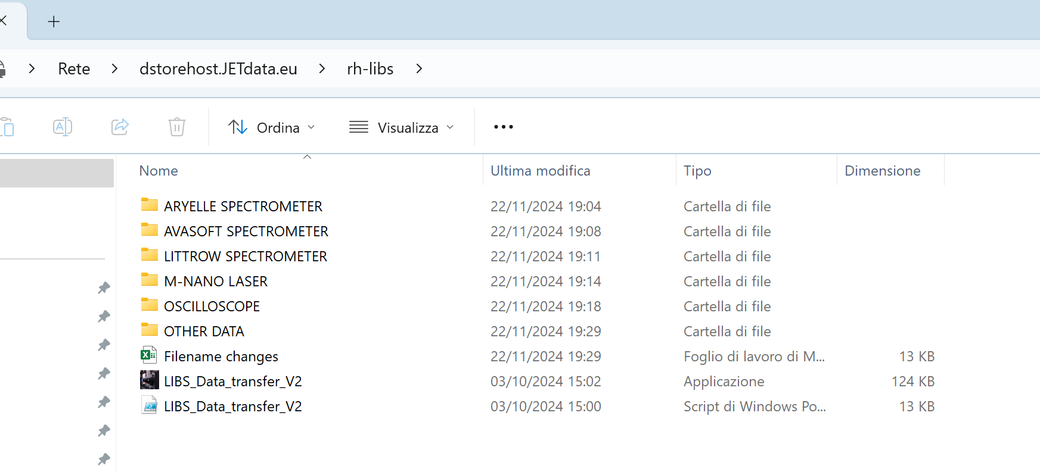
LIBS data access – STEP 4
On your PC/desktop create a shortcut folder:
For next prompt use:
Username: local\nobody
Password: <blank>(don't put any, leave empty)
\\dstorehost.JETdata\rh-libs

Slide 24
Concluding remarks
LIBS experiment at JET was successfully completed in October 2024 (840 locations)
LIBS data analysis progressing
Data analysis meetings on a monthly basis
Good progress in CF LIBS
Several contributions in PFMC
Additional reference LIBS measurements including some DTE3 samples to be made at VTT (~March-April 2026) depending on availability of Aryelle, Littrow and DEMON (LTB Lasertechnik Berlin GmbH) spectrometers.
Capabilities of DEMON spectrometer (not used at JET) will be tested (separation of D-T components) at VTT.

