Slide 1

LIBS vs LID-QMS @ JET
Analysis proposal for joint meeting
Ionuț Jepu, Anna Widdowson

Slide 2
Outlook
LID-QMS vs LIBS
Common area for comparison
Detailed pulse-based comparison plan

Slide 3
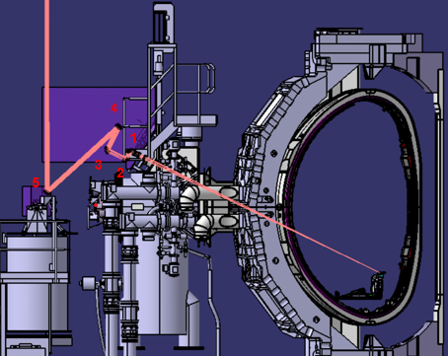
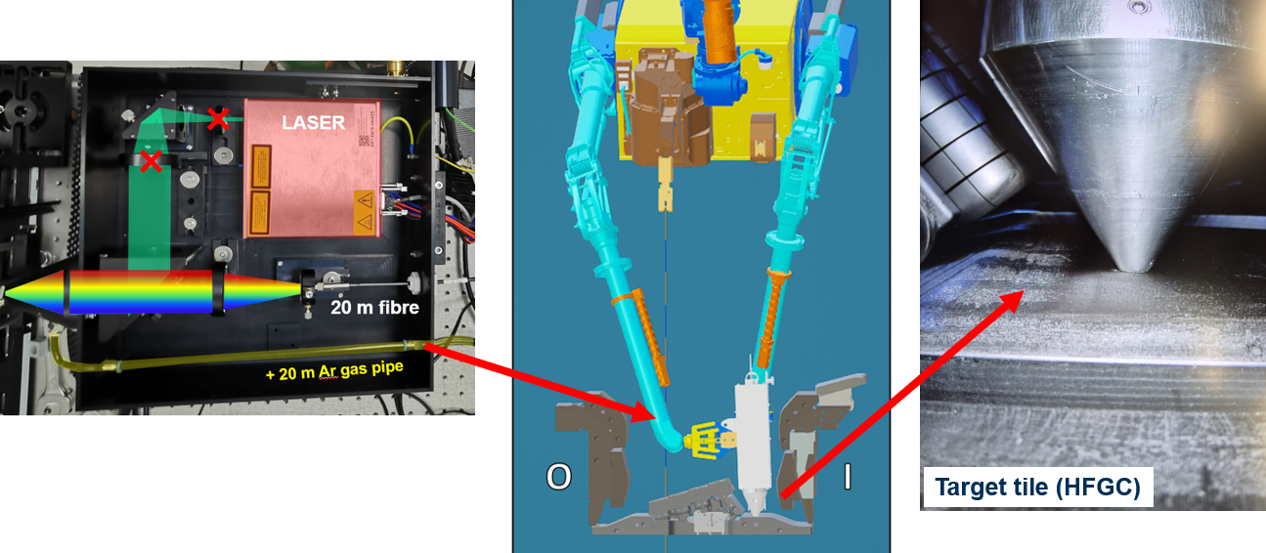
LIBS – Laser Induced Breakdown Spectroscopy
LID-QMS – Laser Induced Desorption via QMS
J. Likonen
M. Zlobinski
LIBS
Material composition
Fuel retention
LID-QMS
Fuel retention

Slide 4
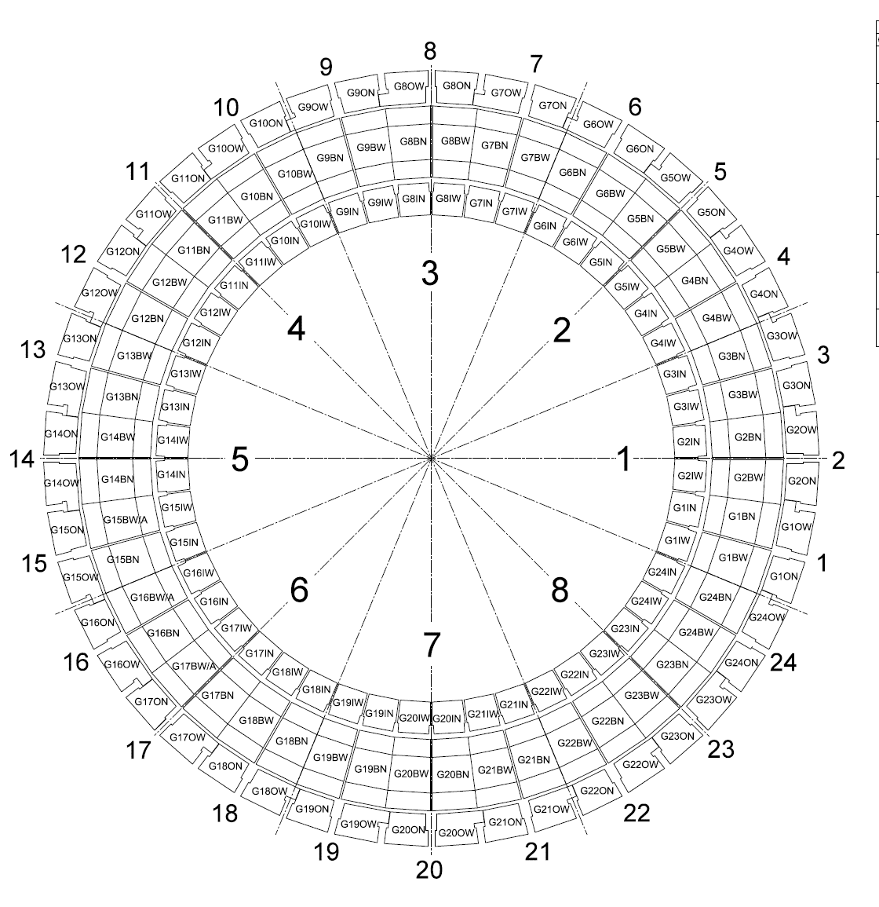
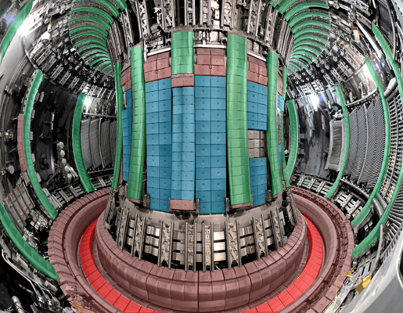
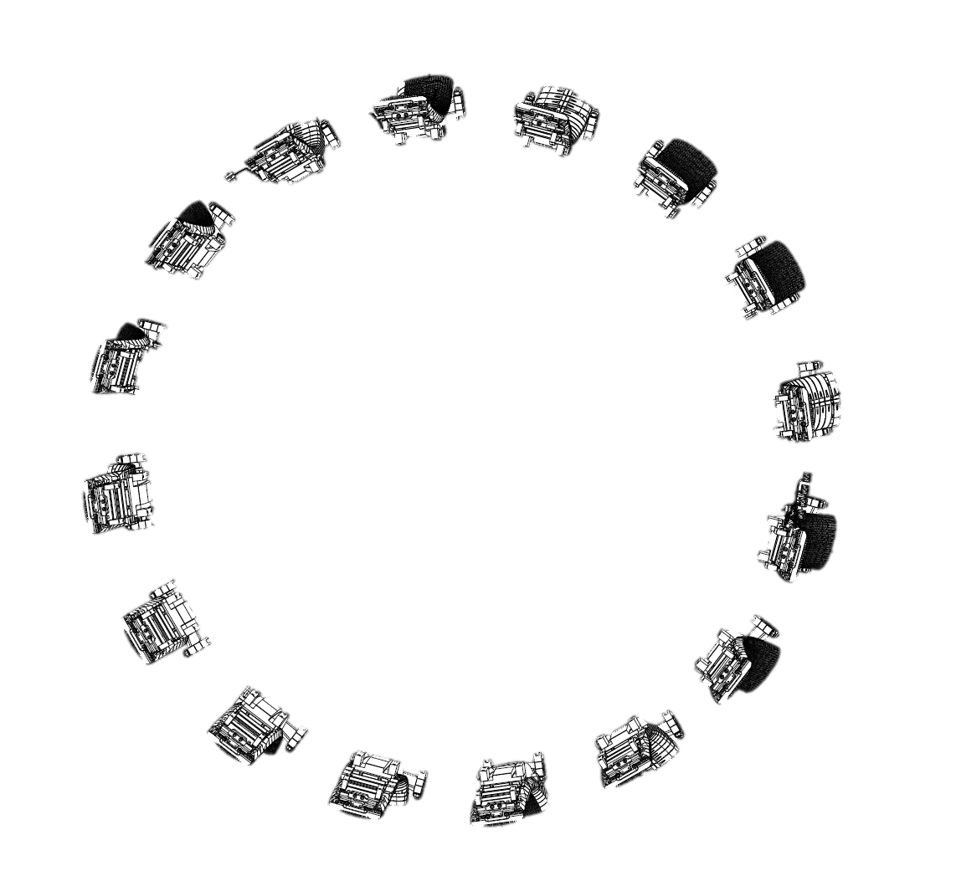
LIBS
4D
Z
X
VW
Oct5
X
Z
Z
X
X
Z
Z
X
X
Z
Bulk Be
X
VW
Oct1
W – coated CFC
Z
X
Z
Be coated inconel
Bulk W
Inconel (vacuum vessel)

Slide 5
LIBS and LID-QMS common target location – OCT 5 Mod 14
4D
Z
X
VW
Oct5
X
Z
Z
X
X
Z
Z
X
X
Z
Bulk Be
X
VW
Oct1
W – coated CFC
Z
X
Z
Be coated inconel
Bulk W
Inconel (vacuum vessel)

Slide 6
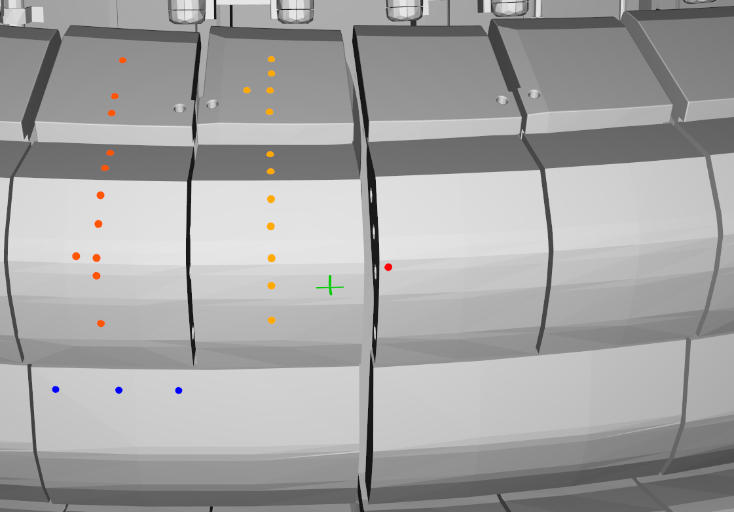
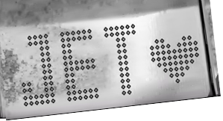
LIBS and LID-QMS common target location – OCT 5 Mod 14
LH14W 2011-23
RH14W 2011-23
LH14N 2019-23
RH14N 2019-23
LIBS spots
14ING1C
2019-23
RE damage
14ING1D
2011-23
14IWG1A
2019-23
14IWG1B
2011-23
14IWG3A
2011-23
6

Slide 7
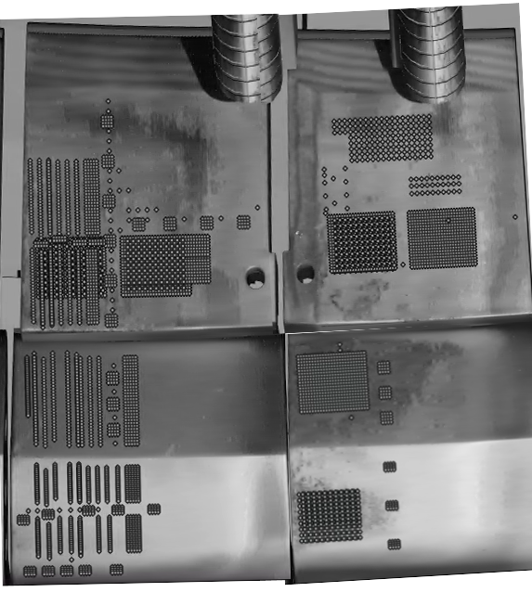
LIBS and LID-QMS common target location – OCT 5 Mod 14
LH14W 2011-23
RH14W 2011-23
LH14N 2019-23
RH14N 2019-23
LIBS spots
LH14W 2011-23
RH14W 2011-23
14IWG1A
2019-23
14IWG1B
2011-23
14IWG3A
2011-23
14IWG1A
2019-23
14IWG1B
2011-23
7

Slide 8

LIBS and LID-QMS common target location – OCT 5 Mod 14
LH14W 2011-23
RH14W 2011-23
LH14N 2019-23
RH14N 2019-23
Proposed LIDs for comparison
LIBS spots
LH14W 2011-23
RH14W 2011-23
14IWG1A
2019-23
14IWG1B
2011-23
14IWG3A
2011-23
14IWG1A
2019-23
14IWG1B
2011-23
8

Slide 9
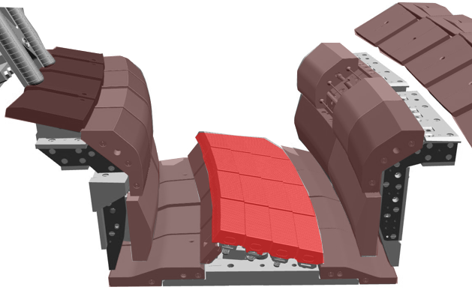
Divertor poloidal assessment (partially/fully completed)
part of PFMC contributions
Tile |  |  | Initial Pulse no. |  |  | Additional pulse no.(relatively same location)
HFGC (LH 14W) |  |  | 59 – 63 |  |  | 777 – 780
Tile 1 (14IW G1B) |  |  | 808; 12 – 15; 73 – 74 |  |  | 786 (a repeat of 74)
Tile 3 (14IW G3A) |  |  | 809 – 811 |  |  | Same as above
Tile 4 (14BW G4A) |  |  | 75 – 77 |  |  | 787 – 788
Tile 5 LBSRP_14WLH | C1 | Stack A | 20 |  | 20 | 765
 |  | Stack B | 23 |  | 23 | 766
 |  | Stack C | 26 |  | 26 | 768
 |  | Stack D | 29 |  | 29 | 769
 | C21 | Stack A | 40 |  | 40 | 770
 |  | Stack B | 43 |  | 43 | 771
 |  | Stack B (C12) |  |  | 34
 |  | Stack C | 46 |  | 46 | 773
 |  | Stack D | 49 |  | 49 | -
Tile 6 |  |  | NO LIBS on T6 | NO LIBS on T6 |  | NO LIBS on T6 | NO LIBS on T6
Tile 7 (14ON G7A) |  |  | 805 | 805 |  | - | -
Tile 8 (14ON G8A) |  |  | 802; 54; 57 | 802; 54; 57 |  | 775 (between 54 and 57) | 775 (between 54 and 57)
Tile 8 (2ON G8B) |  |  | 360 & 368 | 360 & 368 |  | No repeated pulses | No repeated pulses
Top of tile 8 (14ON G8A) |  |  | 51 | 51 |  | - | -
Common area with LID-QMS experiment
14IWG1B
14ON G8A
0
HFGC_LH 14W
1
1
8
3
5
7
14IWG3A
4
6
14BWG4A
LBSRP_14W LH
C1 & C21
14ON G7A

Slide 10
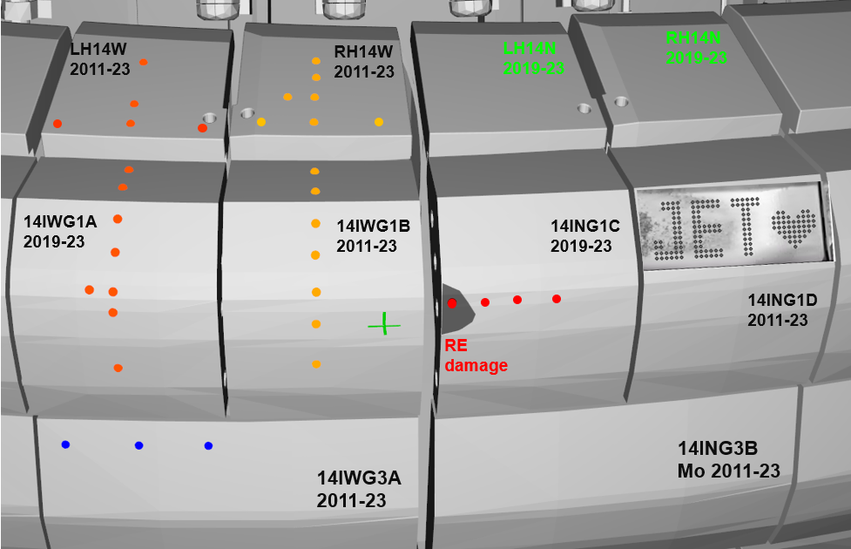
Divertor poloidal assessment (partially/fully completed)
part of PFMC contributions
14IWG1B
14ON G8A
0
HFGC_LH 14W
1
1
8
3
5
7
14IWG3A
4
6
14BWG4A
LBSRP_14W LH
C1 & C21
14ON G7A
+ T4, 5, 7 and 8
Previous LIBS assessment done

Slide 11
DETAILED PULSE comparison
LIBS vs LID-QMS

Slide 12
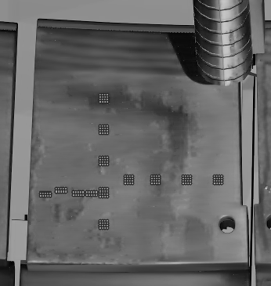
Proposal for LIBS vs LID-QMS joint analysis meeting
LIBS pulses: #xy
LIBS pulses completed from previous assessment
LID-QMS pulses: #105abc
HFGC
LH14W (2011-23)
HFGC LH14W (2011-23)
LID-QMS #no | LIBS #no | Comment
105852 | 63 | Poloidal assessment
105853
105854 | 62
105855
105856 | 60
105858 | 61 | Toroidal assessment
105859
105860
105855 | 60
105866
105865
105864
105867 | 59
852
63
Poloidal
853
854
866
865
864
867
859
861
858
855
860
62
856
61
60
59
Toroidal

Slide 13
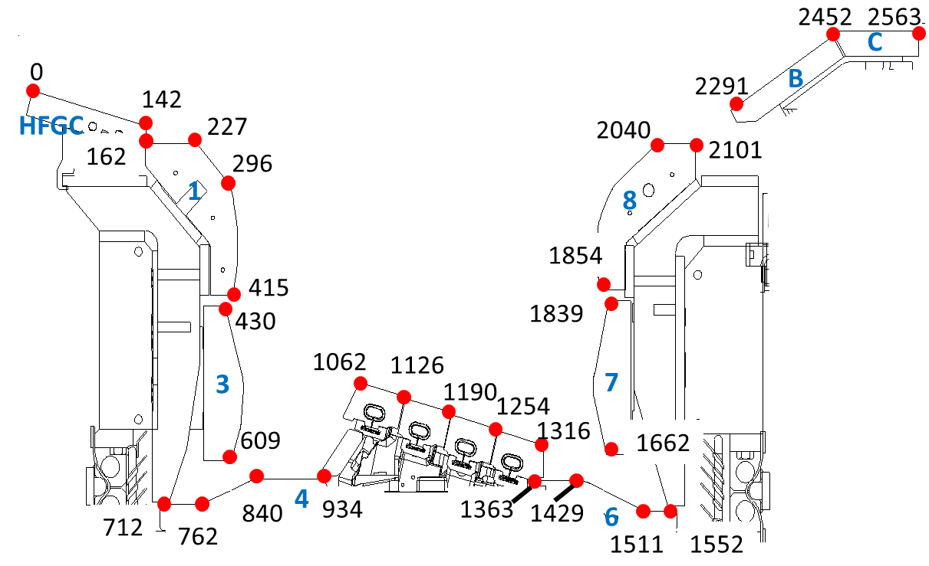
Proposal for LIBS vs LID-QMS joint analysis meeting
LIBS pulses: #xy
LIBS pulses completed from previous assessment
LID-QMS pulses: #105abc
HFGC
LH14W (2011-23)
S coordinates
JET – ILW
852
63
Poloidal
853
854
866
865
864
867
859
861
858
855
860
62
856
61
60
59
Toroidal

Slide 14
Proposal for LIBS vs LID-QMS joint analysis meeting
LIBS pulses: #xy
LIBS pulses completed from previous assessment
LID-QMS pulses: #105abc
HFGC
LH14W (2011-23)
0
HFGC LH14W (2011-23)
LID-QMS #no | S- coord | LIBS #no | S-coord | Comment
105852 | 40 | 63 | 52 | Poloidal assessment
105853 | 60
105854 | 80 | 62 | 102
105855 | 100
105856 | 120 | 60 | 130
105858 | -61 | 61 | -62 | Toroidal assessment
105859 | -50
105860 | -39
105855 | -22 | 60 | 0
105866 | -6
105865 | 11
105864 | 32
105867 | 53 | 59 | 54
852
40
63
Poloidal
S-coordinate
Poloidal
853
854
80
866
865
864
867
859
861
858
855
860
62
856
120
61
60
59
142
-60
0
50
S-coordinate
Toroidal
Toroidal

Slide 15
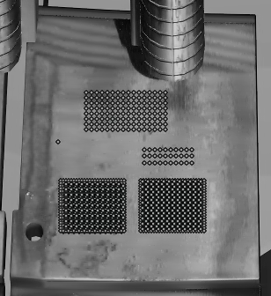
Proposal for LIBS vs LID-QMS joint analysis meeting
LIBS pulses completed from previous assessment
LIBS pulses: #xy
LID-QMS pulses: #105abc
HFGC
RH14W (2011-23)
0
HFGC RH14W (2011-23)
LID-QMS #no | LIBS #no | S-coord | Comment
NO LIDs | 70 | 50 | Poloidal assessment
NO LIDs | 69 | 73
NO LIDs | 67 | 98
NO LIDs | 65 | 125
NO LIDs | 67 | 0 | 1st Toroidal assessment Area 1 – fuel removed by LIDs
Area 1 | 68 | -21
NO LIDs | 64 | 54 | 2nd Toroidal assessment
NO LIDs | 65 | 0
NO LIDs | 66 | -62
35
70
Poloidal
S-coordinate
Poloidal
69
80
68
67
120
66
65
64
-60
0
50
142
LIBS trends comparison with LH14W (previous slide)
No LID-QMS data (4x4 squares) on this tile to compare
S-coordinate
Toroidal

Slide 16
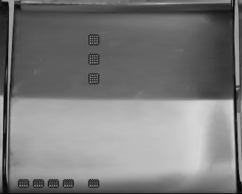
Proposal for LIBS vs LID-QMS joint analysis meeting
LIBS pulses completed from previous assessment
LIBS pulses: #xy
LID-QMS pulses: #105abc
14IW G1A (2019-23)
142
14IW G1A (2011-23)
LID-QMS #no | S-coord. | LIBS #no | S- coord. | Comment
105868 | 186 | 72 | 187 | Poloidal assessment
105869 | 200 | NO LIBS
105870 | 214 | 71 | 215
NO LIDs |  | 11 | 254
105871 | 301 | 10 | 290
NO LIDs |  | 8 | 306
NO LIDs |  | 7 | 340
NO LIDs |  | 807 | 395
105875 | -63 |  |  | Toroidal assessment
105874 | -53
105873 | -44 | 9 | -34
105872 | -34
105871 | -18 | 8 | -4
868
72
186
869
200
Poloidal
870
71
214
226
S-coordinate
Poloidal
11
874
872
10
875
873
871
301
9
8
Toroidal
7
807

Slide 17
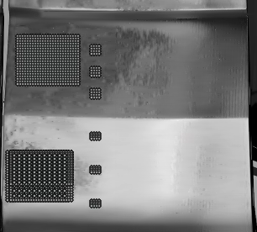
Proposal for LIBS vs LID-QMS joint analysis meeting
LIBS pulses completed from previous assessment
LIBS pulses: #xy
LID-QMS pulses: #105abc
14IW G1B (2011-23)
142
14IW G1B (2011-23)
LID-QMS #no | S-coordinate | LIBS #no | S-coordinate | Comment
105899 | 186 | 74 | 186 | Poloidal assessment
105900 | 200
105901 | 214 | 73 | 214
105923 | 240 | 15 | 253
105924 | 266
105925 | 294 | 14 | 280
 |  | 13 | 320
NO LIDs that low on the tile |  | 12 | 354
 |  | 808 | 407
899
74
186
900
200
Poloidal
901
73
214
226
S-coordinate
Poloidal
923
15
924
14
925
296
Toroidal
13
12
808

Slide 18
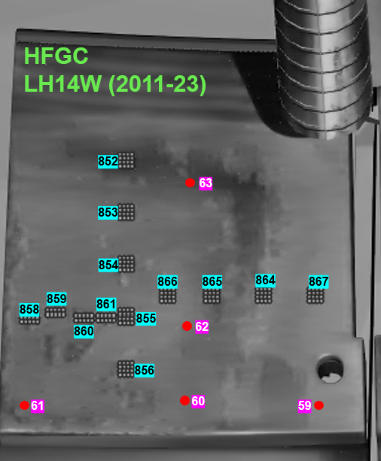
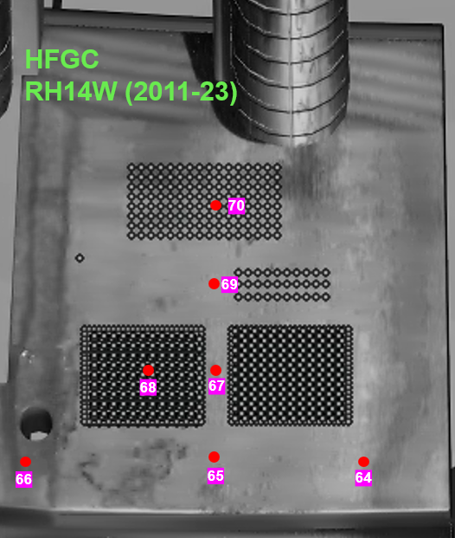
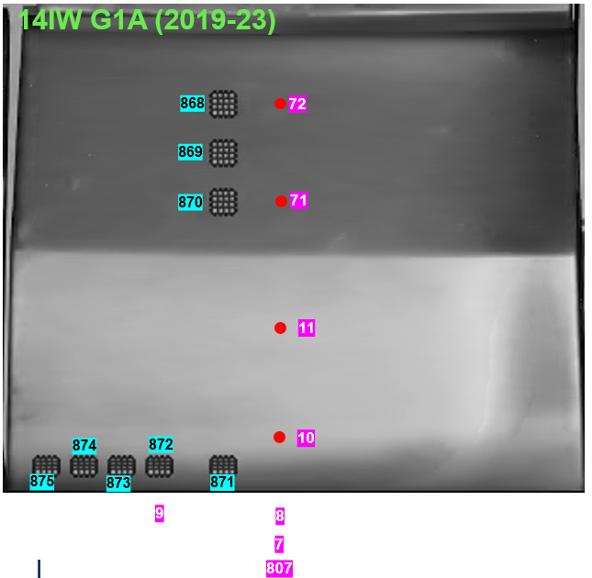
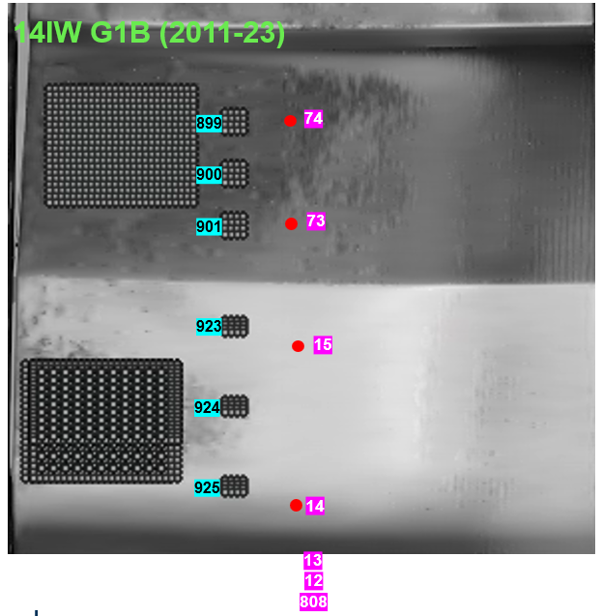
FULL pulse distribution MAP
LIBS pulses: #xy
LID-QMS pulses: #105abc
LIBS pulses completed from previous assessment

Slide 20
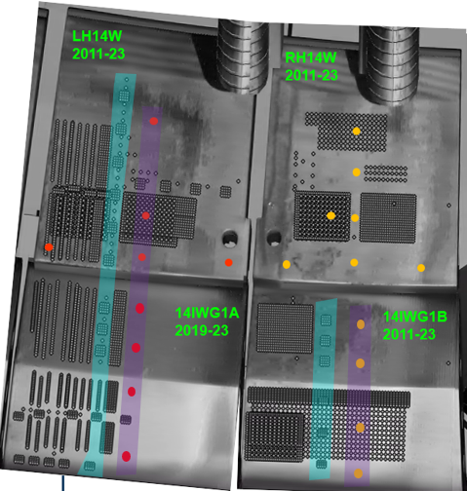
Proposal for LIBS vs LID-QMS joint analysis meeting
LID QMS area + LIBS pulse comparison
Proposed LIDs for comparison
LIBS points to compare
852
63
70
853
861
854
69
858
859
866
865
864
867
860
855
62
68
67
61
856
857(guide)
60
66
65
64
59
868
72
869
899
74
71
900
870
901
73
11
923
924
15
875
873
10
874
925
14
872
871

Slide 21
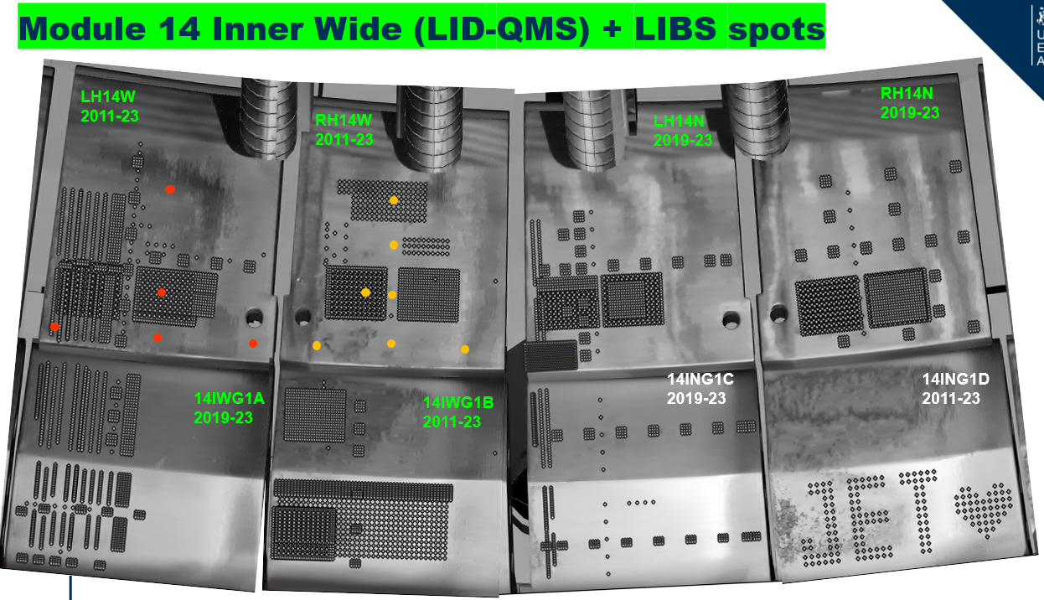
Proposal for LIBS vs LID-QMS joint analysis meeting
For the comparison purpose ( due to the LID-QMS limitation)
the selected tiles are: HFGC LH&RH 14W;
14IW G1A; 14IW G1B (marked with )
LID QMS area + LIBS spots
+ 4 extra points
+ 3 extra points
+ T4, 5, 7 and 8
Previous LIBS assessment done

Slide 22
Proposal for LIBS vs LID-QMS joint analysis meeting
LID QMS area + LIBS spots to be compared
Proposed LIDs for comparison
LIBS points to compare

Slide 23
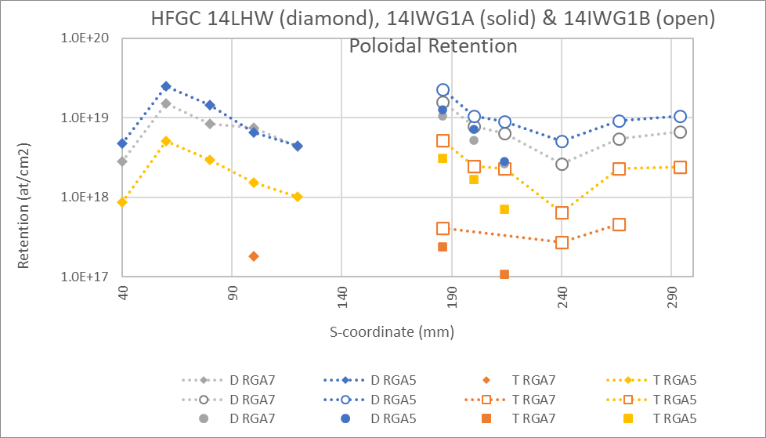
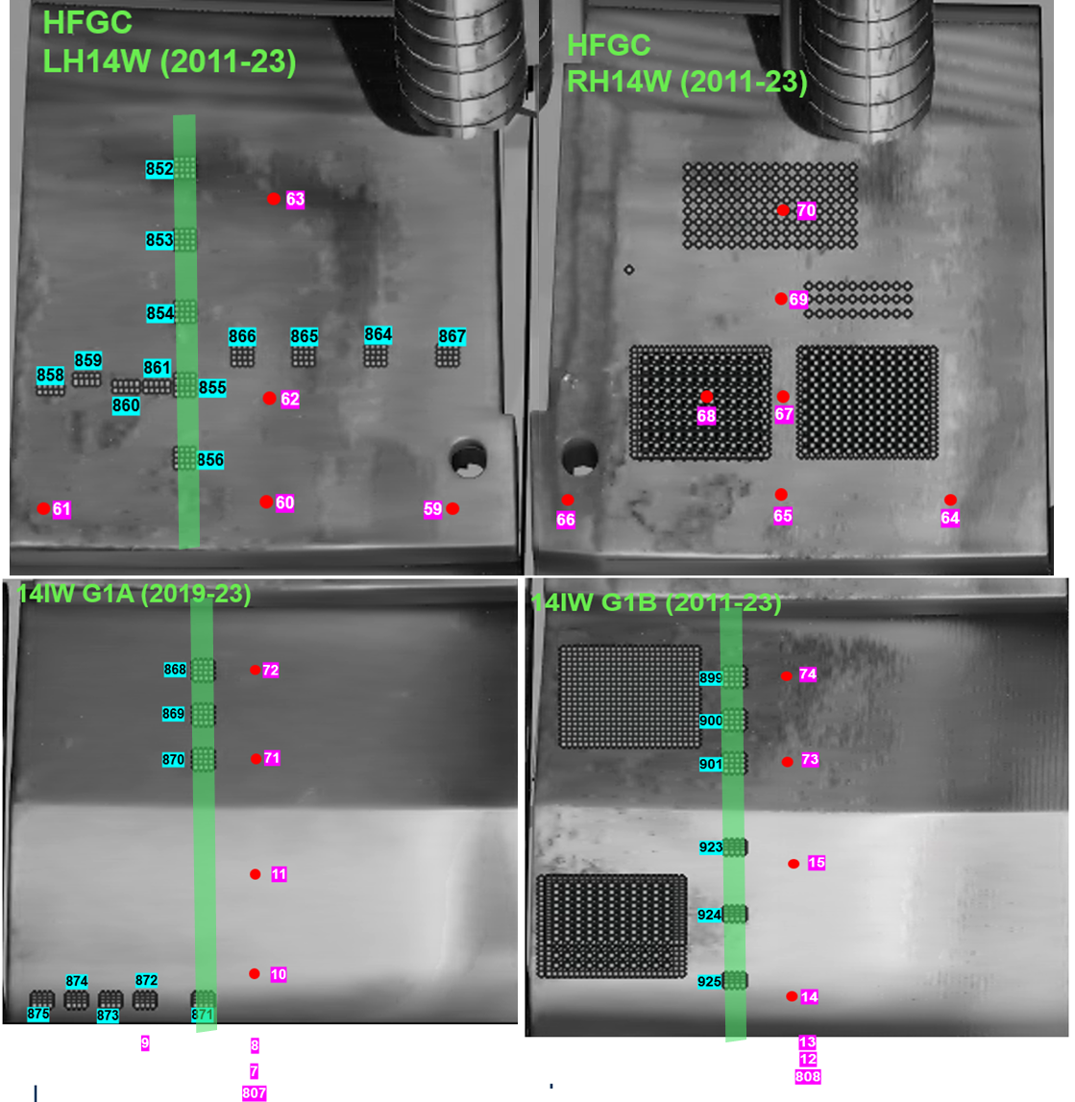
LID-QMS areal fuel retention at end of JET operations 19 & 20 December 2023
Assumptions:
AMU4 calibration factor used for AMUs
19/12/2023 AMU4 calibration factor used for 20/12/2023 data points
Calibration = Jump method

