Slide 1
Tile HFGC LH14W (2011-2023) LIBS retention (T, D, H, other)
Joint LID-QMS/LIBS meeting, ENEA-Frascati, 9-12 December 2025
Salvatore Almaviva
ENEA, Italian National Agency for New Technologies, Energy and Sustainable Economic Development

Slide 2
Summary
Wavelength and intensity calibration
Calibration free LIBS (CF) procedure JET reference points
CF-LIBS on JET tile HFGC LH14W (2011-2023)
Conclusions and next steps

Slide 3
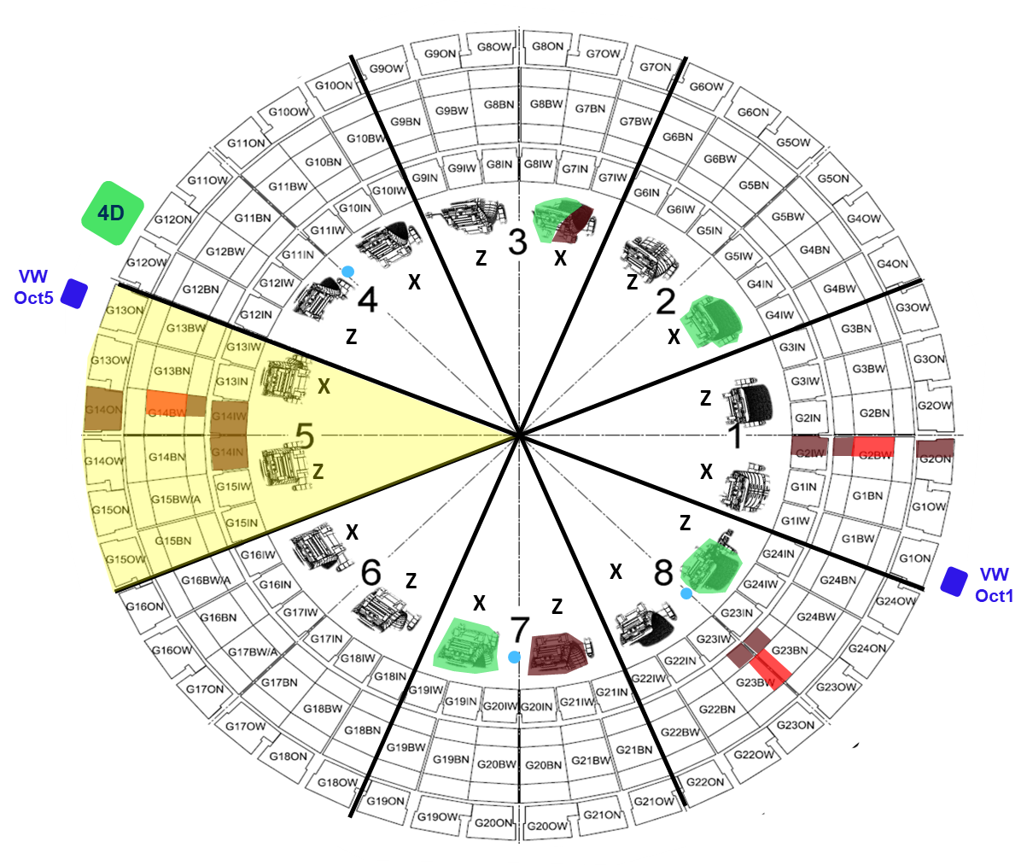
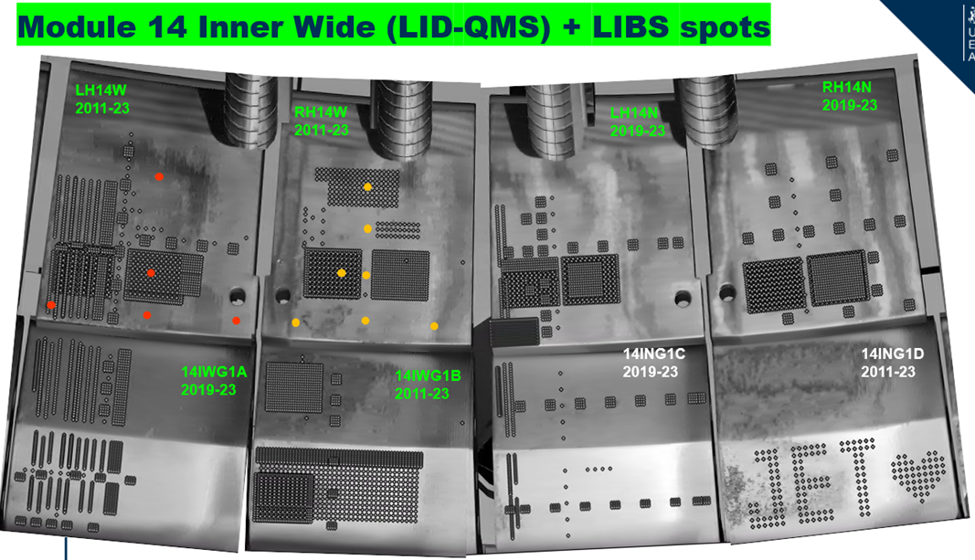
LIBS analysis of points 59-60-61-62 (HFGC LH14W)
The analysis area is located in octant 5 of JET and is composed of W - coated CFC PFCs
Bulk Be
W – coated CFC
Be coated inconel
Bulk W
Inconel (vacuum vessel)
Courtesy by UKAEA (I. Iepu)

Slide 4
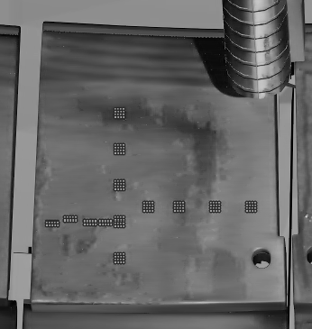
LIBS analysis of points 59-60-62-63 (HFGC LH14W)
HFGC LH14W (2011-23)
LID-QMS #no | LIBS #no | Comment
105852 | 63 | Poloidal assessment
105853
105854 | 62
105855
105856 | 60
105858 | 61 | Toroidal assessment
105859
105860
105855 | 60
105866
105865
105864
105867 | 59
HFGC
LH14W (2011-23)
852
63
Poloidal
853
854
866
865
864
867
858
859
861
855
62
860
856
61
60
59
Toroidal

Slide 5
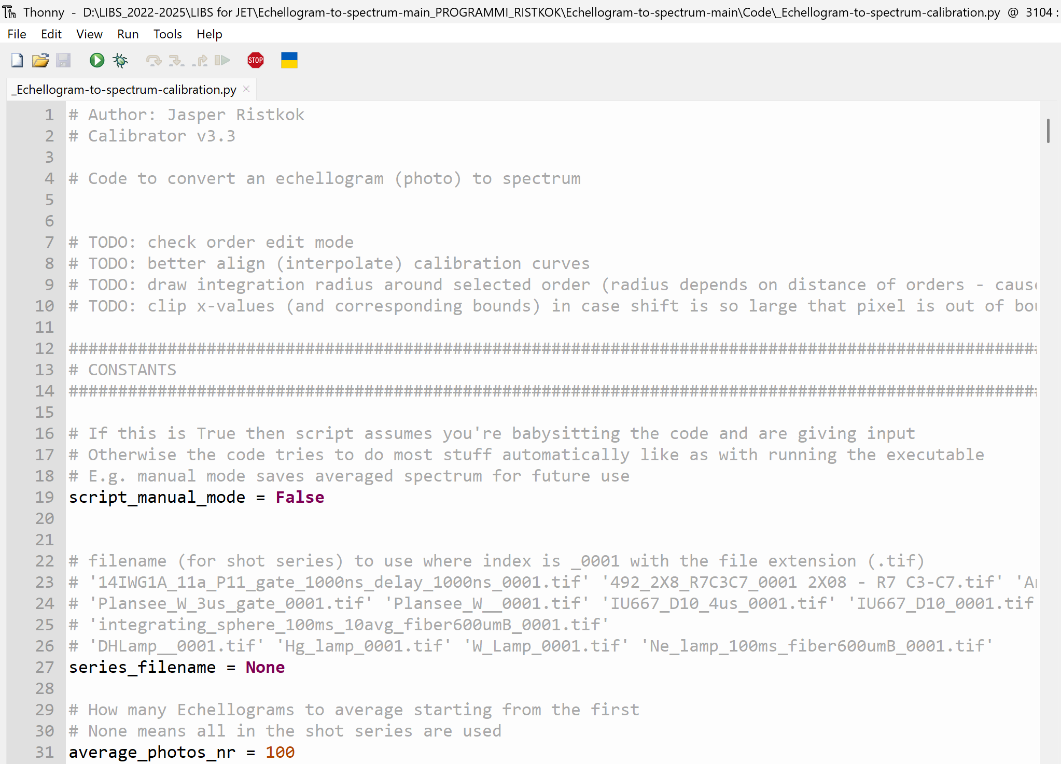
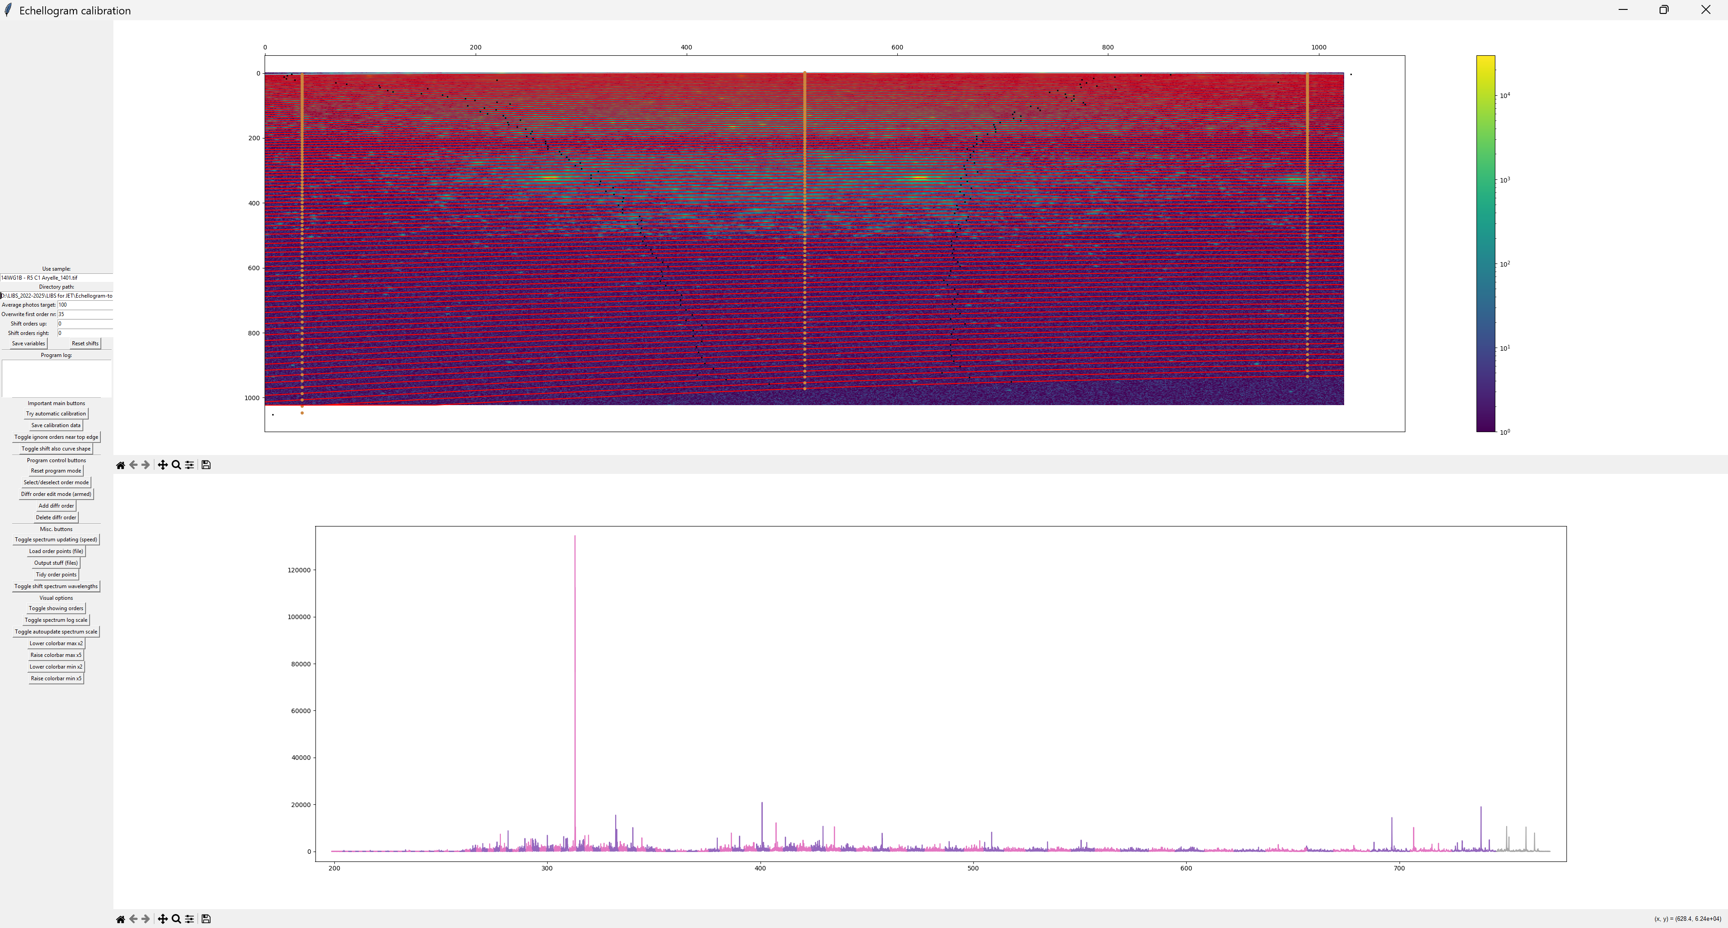
Wavelength calibration
The software package developed by UT was used to perform the wavelength calibration of the Echellograms acquired during the experimental campaign at JET.
The position of some emission lines has been checked after the calibration: residual shifts are in the range of few tenths of pm
Element | Wavelength (nm) | Element | Wavelength (nm)
Be II | 313.042 | Be I | 457.27
Be II | 313.1 | Ar I | 696.54
Be I | 332.1 | Ar I | 706.72
Be I | 332.13 | Ar I | 727.3
W I | 400.875 | Ar I | 738.4
W I | 407.44 | Ar I | 742.23

Slide 6
Intensity calibration
The optical transmission file was implemented to rescale the intensity of the LIBS spectra, by taking into account all the optical components of the LIBS system. The spectral region 344-385 nm was ignored because of the low signal related to the low optical transmission of the whole system
×
=

Slide 7
CF-LIBS procedure
The CF-LIBS algorithm was developed in a MATLAB environment following the next steps:
1) Automatic identification of the peaks in the experimental spectrum using the "findpeaks" function
2) Automatic assignment of the newly found peaks to the atomic and ionic emission lines of the chemical elements in the PFCs of JET (e.g., Be, W, Mo, Ni, Cr, Fe, C) based on the NIST database, comparing the relative position of the peaks.
3) Calculation of the electron density of the LIBS plasma from the line broadening of some reference lines of the above-mentioned chemical elements using the "peakfit" function
4) Calculation of the electron temperature of the LIBS plasma using the extended Boltzmann plot of the above-mentioned chemical elements
5) Calculation of the H-D-T band related to the Balmer alpha emission of the three H-isotopes
6) Application of the closure relation and calculation of the element concentrations in atomic %

Slide 8
CF-LIBS procedure: identification of the peaks in the spectrum
The “findpeaks” function returns a vector with the local maxima (peaks) of the input signal. The parameters needed to implement the function are:
1) minimum height of the peak (set as a fraction of the maximum signal).
2) prominence (reducing any possible interfering peak)
3) minimum spectral distance between the peaks (in nm).
4) peak width (in nm)

Slide 9
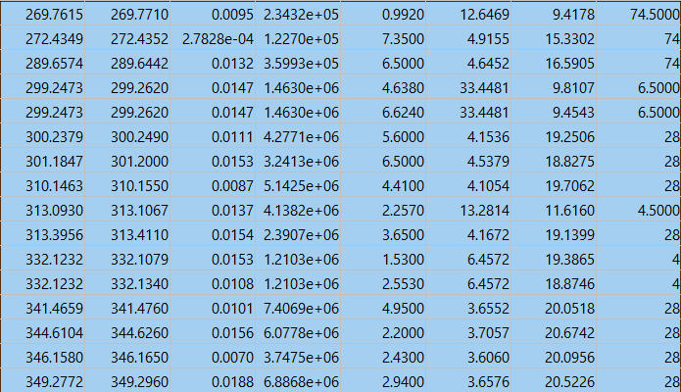
CF-LIBS procedure: identification of the peaks in the spectrum
The peaks identified in the spectrum are identified as atomic and ionic emission lines of the chemical elements of the PFCs of JET (e.g., Be, W, Mo, Ni, Cr, Fe, C) comparing their wavelength with those of the NIST database.
The spectroscopic parameters to apply the calibration free procedure (Energy of the upper level, Einstein’s coefficient, degeneracy of the transition) are the obtained by the NIST database.
Exp wv (nm)
NIST wv (nm)
Difference (nm)
Peak area
NIST g_{k}A_{ki}
E_{k} (+ E_{ion})
ln(Iλ/g_{k}A_{ki})
Atom/Ion
W Ion
W atom
C Ion
Ni atom
Be ion

Slide 10
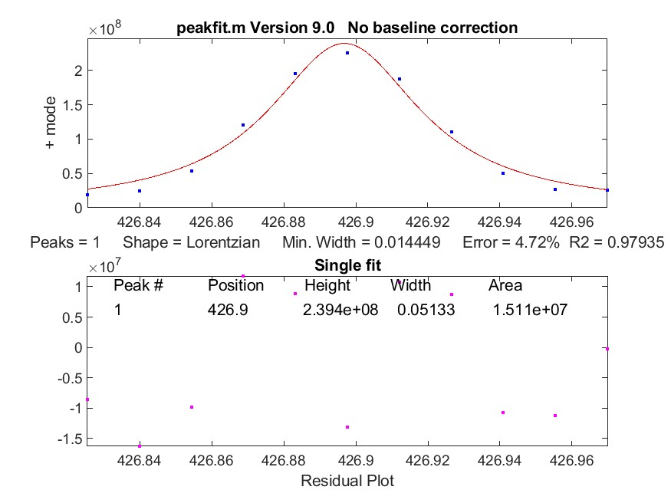
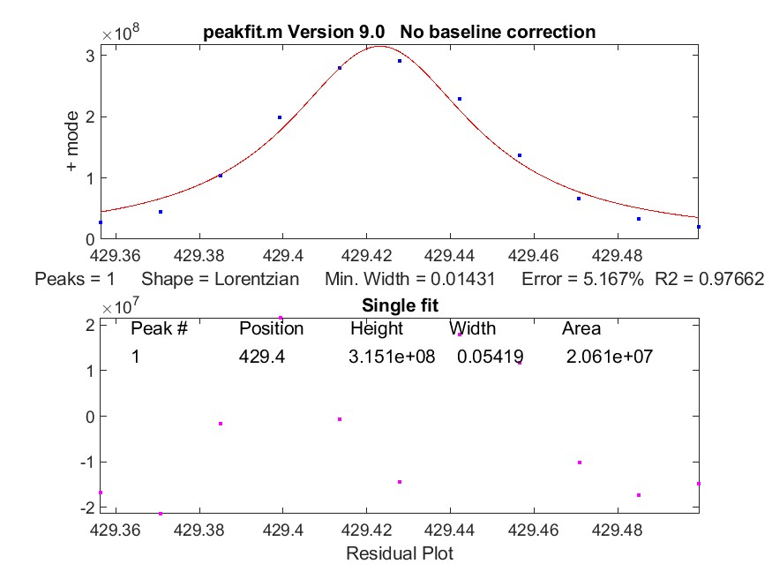
CF-LIBS procedure: calculation of the electron density
3) The plasma electron density is calculated by using the line broadening of some reference lines of the above-mentioned chemical elements using the “peakfit” function.
The peakfit function compute the Lorentz width of some reference lines useful for the electron density calculation.
Currently four lines are used in the peakfit function:
W I @ 426.94nm, W I @ 429.46nm, W I @ 430.21nm, Be I @ 457.27nm

Slide 11
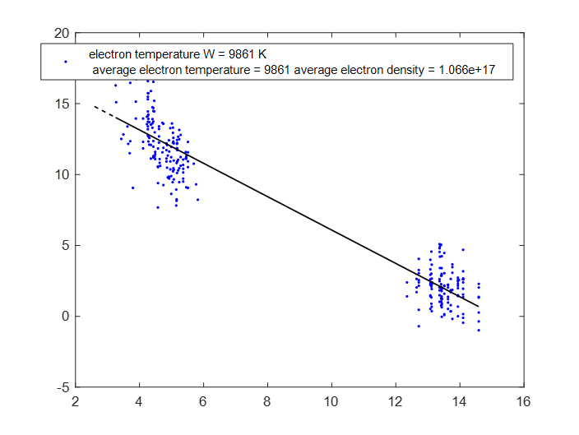
CF-LIBS procedure: calculation of the electron temperature
4) The electron temperature of the LIBS plasma is calculated by using the extended Boltzmann plot of the above-mentioned chemical elements: given the large number of atomic and ionic transitions the W I and W II atomic and ionic lines are generally used for the calculation of the electron temperature.

Slide 12
Determination of the signal of the H-D-T band (Hydrogen isotopes)
Calculation of the H-D-T band related to the Balmer alpha emission of the three H-isotopes: the intensity of the H-D-T band (considered as a unique emission band) is obtained by the experimental H-D-T integral signal between 655.9 – 656.4 nm subtracted by the nearby integral noise signal between 655.4 – 655.9 nm (no emission lines have been detected in that spectral region in the LIBS spectra). If the H-D-T signal is lower than the noise the H-D-T signal is assumed to be zero (no Hydrogen isotopes)

Slide 13
CF-LIBS procedure: test on reference points
Application of the closure relation and calculation of the element concentrations in atomic %: the CF-LIBS procedure and the closure relation is applied for each series of spectra.
492_2X8_R7C3C7_2X08 - R7 C3-C7 Be reference
357_VW1_M_Oct1_MIDDLE Inconel reference

Slide 14
CF-LIBS procedure: test on reference points
6) Application of the closure relation and calculation of the element concentrations in atomic %: the CF-LIBS procedure and the closure relation is applied for each series of spectra. Results for the reference points (T_{e} 15500 K, n_{e} = 3*10¹⁷)
360 - 02ONG8B - R4 C2 W_CFC_reference
20_14WLH_AR3C1 PURE W_reference

Slide 15
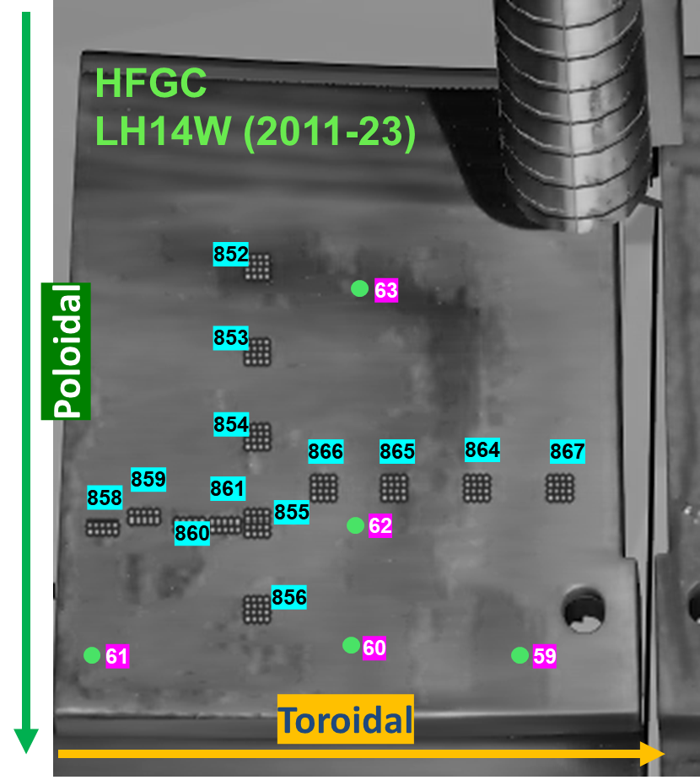
CF-LIBS procedure: LIBS points at JET 59-60-61-62-63
Application of the closure relation and calculation of the element concentrations in atomic %: points 59-60-61-62-63
59_LH14W_R1C1
60_LH14W_R1C2
60
59

Slide 16
CF-LIBS procedure: LIBS points at JET 59-60-61-62-63
Application of the closure relation and calculation of the element concentrations in atomic %: points 59-60-61-62-63
62 R1C4
63 R3C2
63
62
61
60
59
61 R1C3
60 R1C2
59 R1C1

Slide 17
CF-LIBS procedure: LIBS points at JET 59-60-61-62-63
Adjacent average over 5 points for W and T-D-H
Atomic conc. (%)
Atomic conc. (%)
Atomic conc. (%)

Slide 18
Conclusions and next steps
1) An automatize sw procedure is being developed to process the large number of spectra acquired in JET and apply the CF-LIBS in short times, giving the concentrations of the detected species in atomic %
2) First results for the Hydrogen isotopes, considered as a whole, suggest a residual atomic concentration of 5-10 % in the surface layer
3) Be is detected at very high concentration in the surface deposits
4) The thickness of the surface deposits depends on the position of the analysis point
5) Next steps:
update the procedure to include other elements (Ni, Cr, Mo…)
Optimize the number of emission lines included in the procedure retrieved from the NIST database

