Slide 1
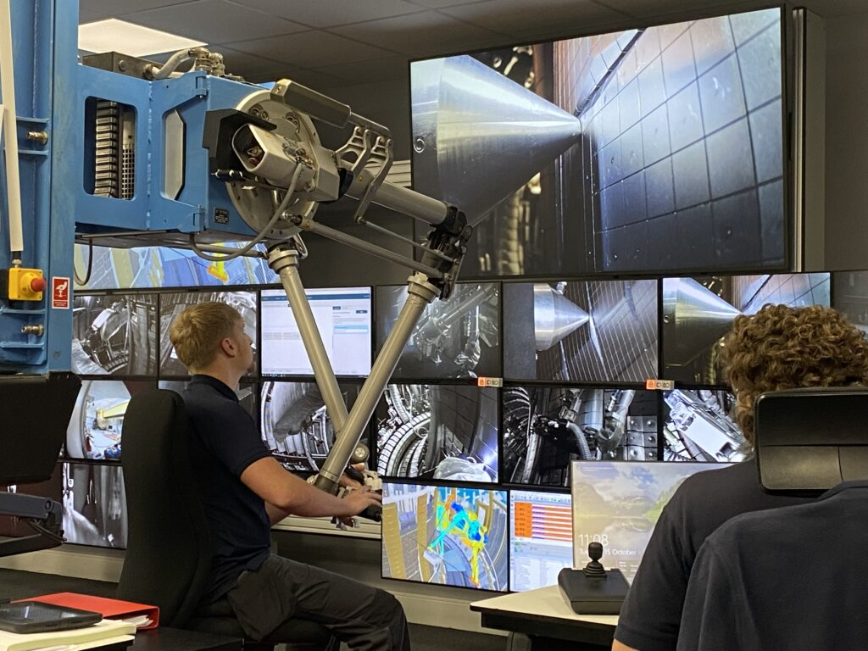


JET LIBS data in the QMS region-HFGC LH14W (2011-2023)
Rongxing Yi et al.
Forschungszentrum Jülich GmbH, Institute of Fusion Energy and Nuclear Waste Management – Plasma Physics, Partner of the Trilateral Euregio Cluster (TEC), 52425 Jülich, Germany

Slide 2
Outline
Fitting method
Results in the LID-QMS region(Module 14)
Conclusions

Slide 3
Fitting method
Spectral fitting
Problems:
Read spectral data, check if there is significant (6 times larger than noise)W line @ 657.39nm (pixel 840+-5)
T changed in 2 weeks experiment
yes
no
Wavelength 6 pixels deviation
Use the W line do calibration, pixel difference between H D T, other W lines and W 657.39 nm is solid
Do the fitting directly with H. Set the original value for H peak position(526-531) , get the fixed value,
No solid initial value for H
Give the pixel position to each peak and do voigt fitting(solid and shared gaussian part, Lorentz part only shared by HDT )
W line interference make it difficult to find the accurate wavelength for H
Save all data, but in red color when signal intensity <6N(only when signal >6N, it is regarded good signal)

Slide 4
Results in the LID-QMS region (Module 14)
Delay 4 us
Delay 8 us
Significant H signal in the first spectra
Weak H signal in the first spectra

Slide 5
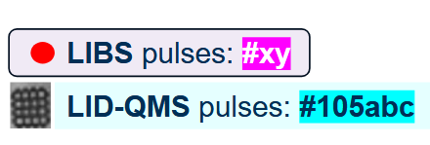
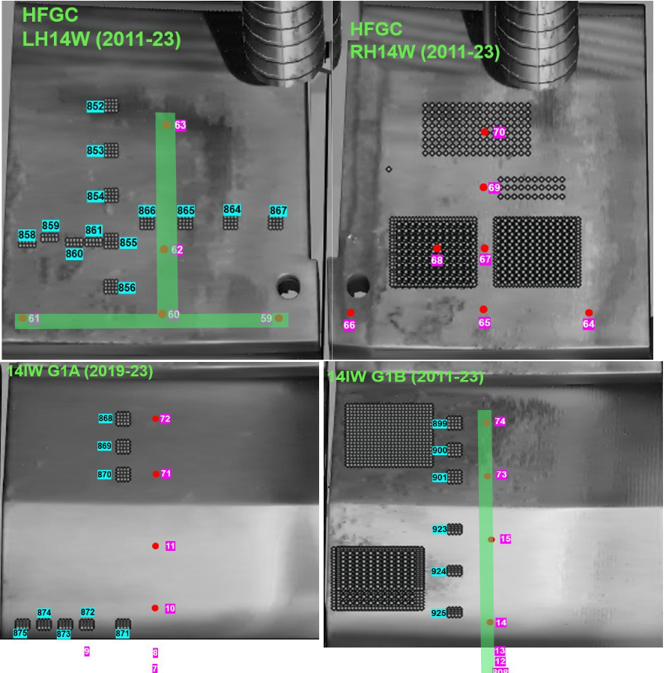
Results in the LID-QMS region (Module 14)
1
D empty position
10

Slide 6
Results in the LID-QMS region (Module 14)
1
6

Slide 7
Results in the LID-QMS region (Module 14)

Slide 8
Results in the LID-QMS region (Module 14)

Slide 9
Conclusions
Conclusions
Distribution of DT/HDT is different in different position. DT mainly exist in the initial 30 pulses
Quantitative results is on going, but ratio should be very accurate
Next
We can integrate all LIBS signal in 1 position to get the total ratio, but due to the matrix effect, it may be not very accurate(weight of each pulse is unsure)
We have several 8us spectra data, we can compare it if needed.

Slide 10
Thanks for your attention!

