Slide 1
14IWG1B LIBS Surface composition & fuel retention analysis
Joint LID-QMS/LIBS meeting as diagnostics for fusion
Lidia Baiamonte
ENEA, Italian National Agency for New Technologies, Energy and Sustainable Economic Development

Slide 2
Overview
Description of the data analysis methods
Results and discussion
Conclusions

Slide 3
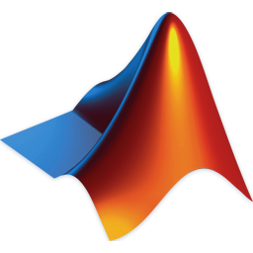

Depth profiling data analysis method
Due to the extensive volume of spectral data generated during the “LIBS for JET” experimental campaign, ENEA optimized the data-analysis workflow by developing dedicated scripts designed to efficiently process large spectral datasets within a reduced timeframe.
The scripts, implemented in a MATLAB® environment, automatically handle the sequential processing of the spectra acquired with the Aryelle spectrometer, following their preliminary conversion into “.txt” format.
The transformation of the raw data from the “.ary” format into “.txt” files was performed using the dedicated proprietary software Sophi nXt supplied with the Aryelle system.

Slide 4
Depth profiling data analysis method: MATLAB routine
Sequentially reading Aryelle .txt files
Searching for the the emission lines of chemical elements of interest
Computing the integral intensities of the emission lines
Storing and saving the lines’ integral intensities
Graphs:
Integral intensities Vs. number of laser shots
T-D-H/W or Be ratios Vs. number of laser shots

Slide 5
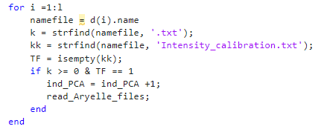
Depth profiling data analysis method: MATLAB routine
Sequentially reading Aryelle .txt files
The procedure performs depth profiling analysis on each acquired spectrum by searching for emission lines with high intensity and free of interference
The ‘for’ cycle looks for the .txt files in the folder

Slide 6
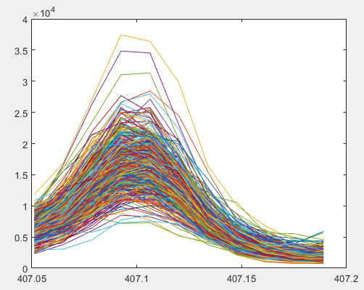
Depth profiling data analysis method: MATLAB routine
Searching for the the emission lines of chemical elements of interest
Atom/Ion | Wavelength [nm] | Motivation
Be I | 332.12 | Be deposits on the divertor area
 | 457.27
W I | 400.87 | W substrate and redeposited material from erosion
 | 407.06
T_{α}-D_{α}-H_{α} | 656.02-656.32 | Unburned or implanted fuel
Mo I | 550.65 | Mo interlayer (if present)
 | 553.3
 | 557.04
Cr I | 425.43 | Inconel structural material
 | 428.97
Ni I | 310.16
 | 338.06
 | 341.47
He I | 587.49 | Reaction product
C II | 426.7 | C in the CFC divertor base material
The selected emission lines are intended to have high intensity and be as interference-free as possible.
Computing the integral intensities of the emission lines
E.g., W I line at ~ 407 nm

Slide 7
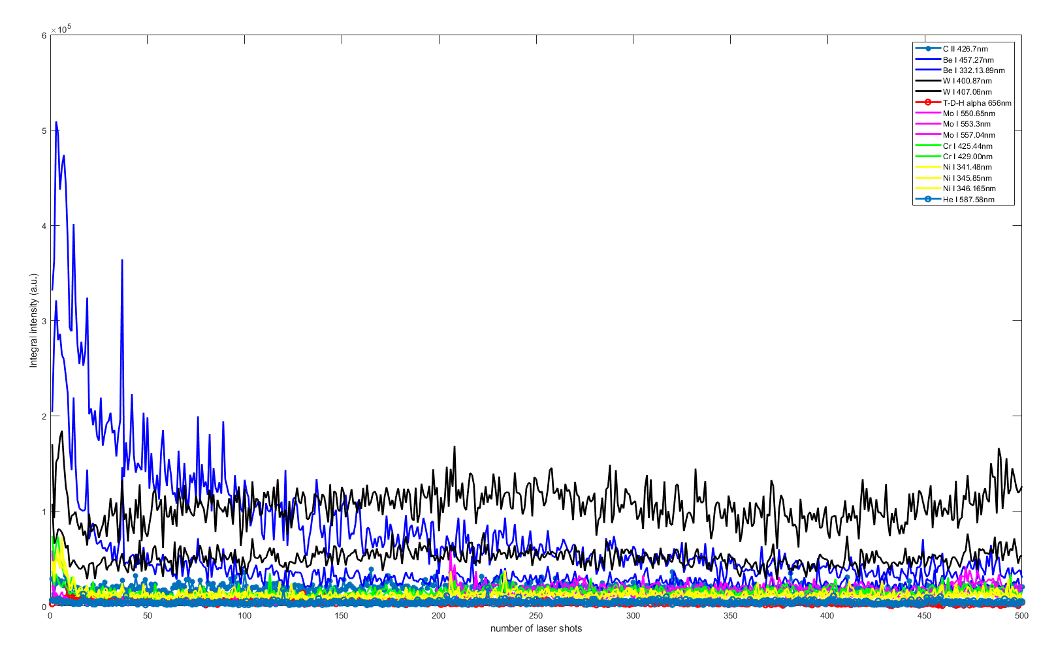
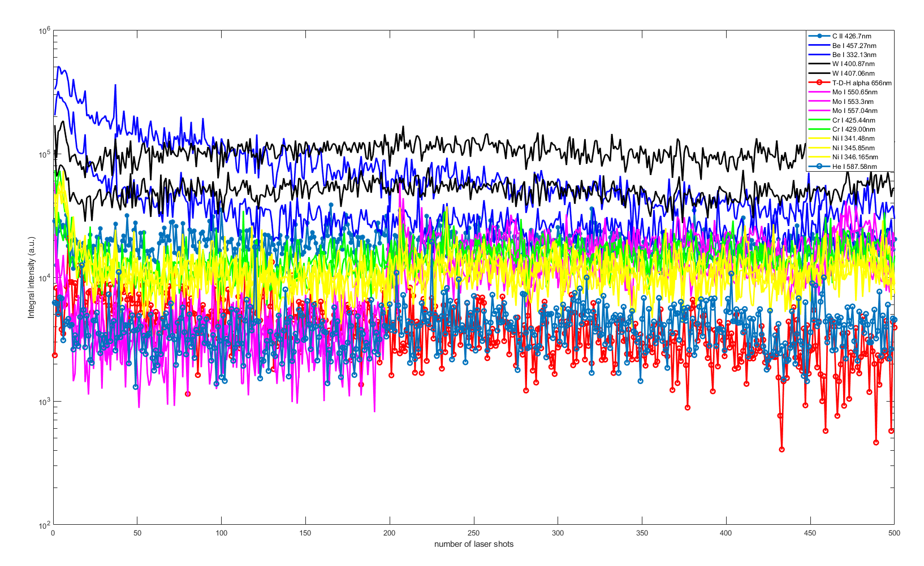
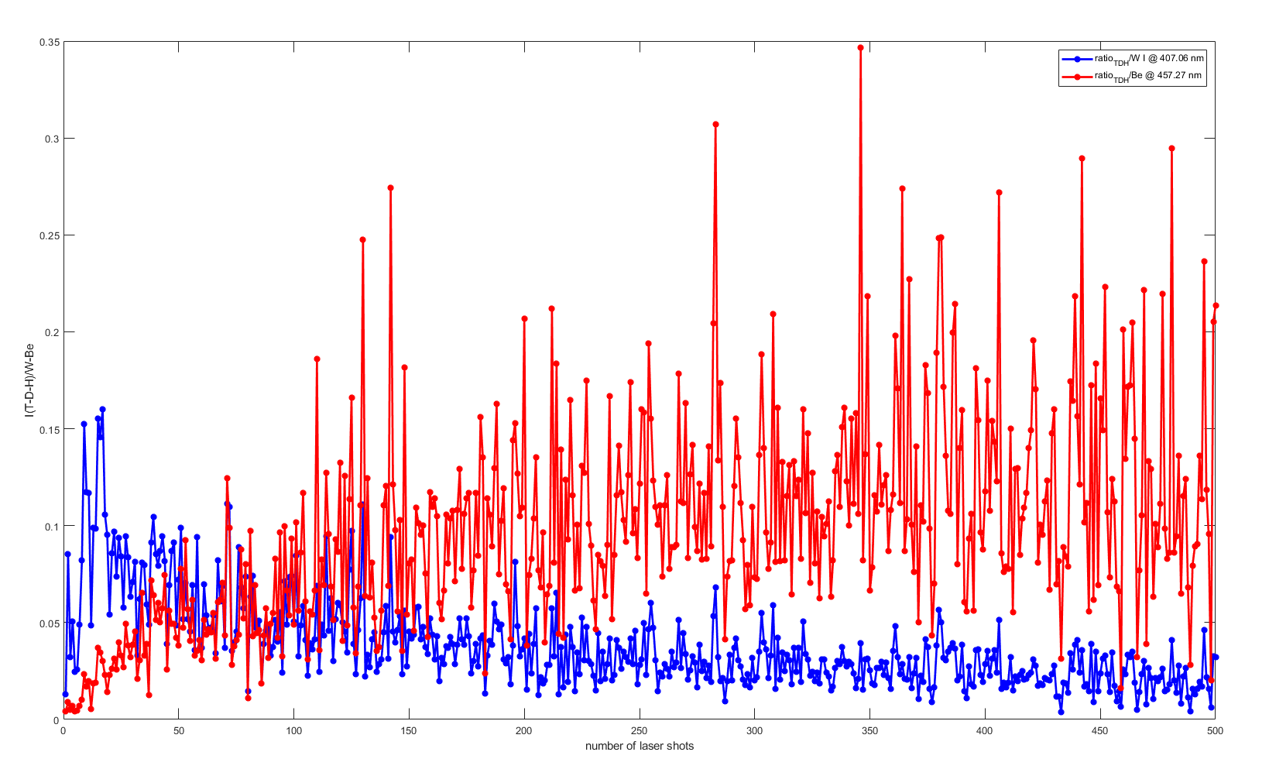
Depth profiling data analysis method: MATLAB routine
Linear scale
Storing and saving the lines’ integral intensities
Semi-logarithmic scale
Graphs:
Integral intensities Vs. number of laser shots
T-D-H/W or Be ratios Vs. number of laser shots
T-D-H ratios

Slide 8
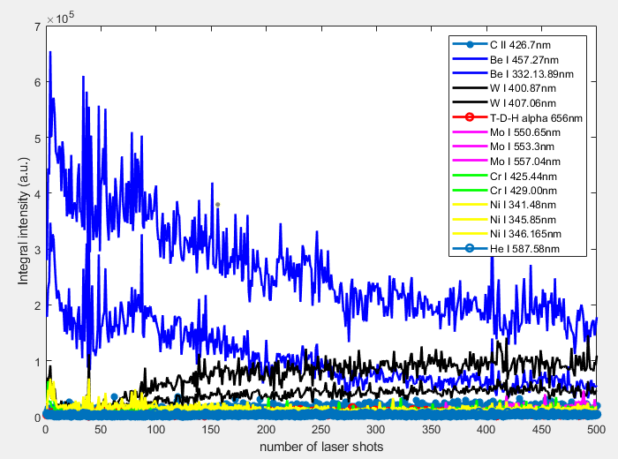
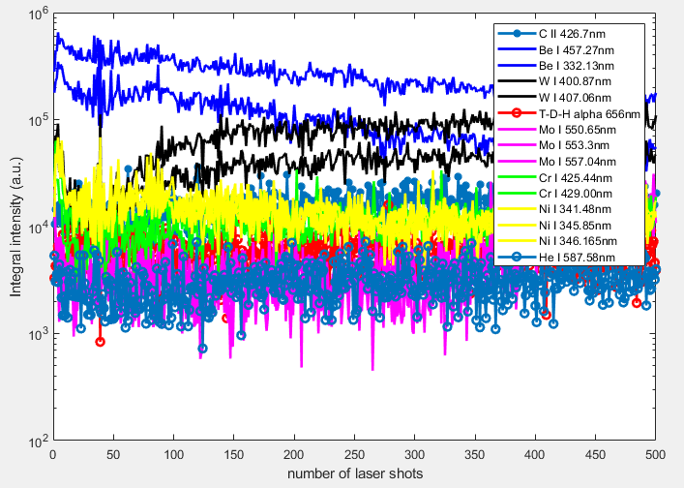
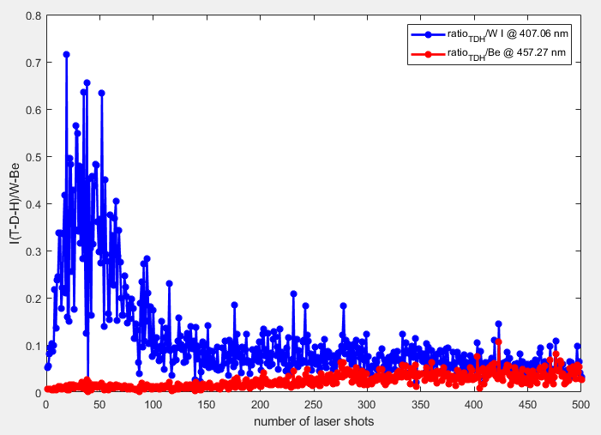
Depth profiling data analysis method: MATLAB routine
Interpretation of the output results
Thickness of the eroded & redeposited layers, in terms of number of laser shots (e.g., strong Be signal ⇒ Be layer deposited on the analyzed point of the divertor )
Presence of unburnt T-D-H fuel and its in-depth distribution
+
Traces of elements coming from the Inconel base superalloy (Ni, Cr)
Intensity ratios T-D-H/W and T-D-H/Be for qualitative in-depth distribution of unburnt T-D-H fuel
Be I
Cr
T-D-H/W
Ni
T-D-H

Slide 9
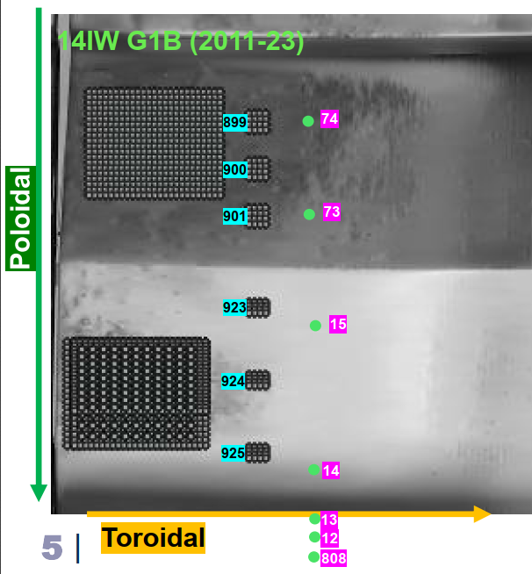
Analysis on 14IWG 1B
Analyzed pulses:
12_14IW G1B
13_14IW G1B
14_14IW G1B
15_14IW G1B
73_14IW G1B
74_14IW G1B
808_14IW G1B
All the Echellograms – except for 808_14IW G1B – underwent wavelength calibration using the TU software

Slide 10
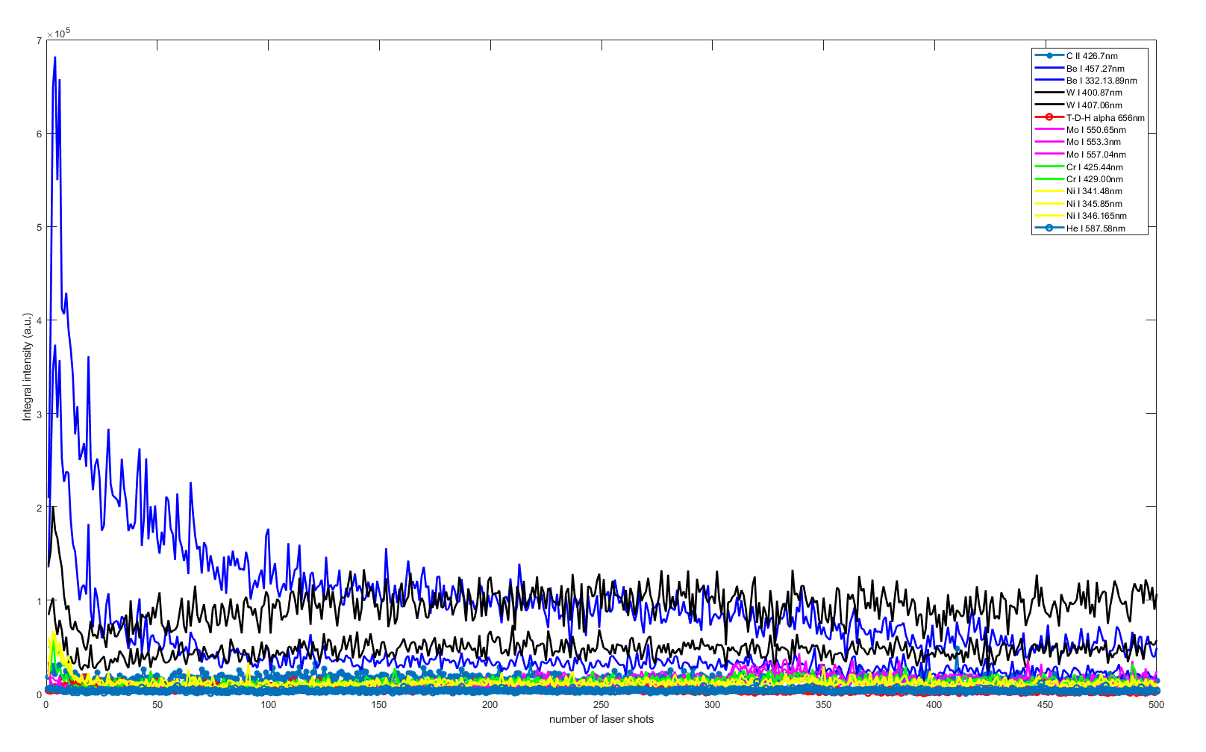
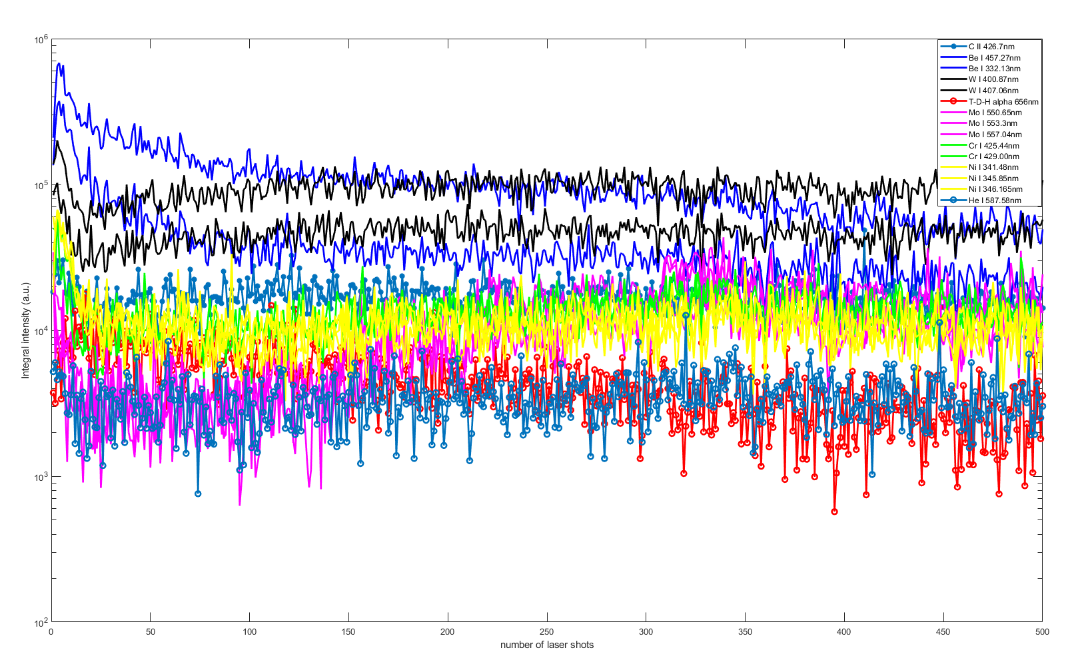
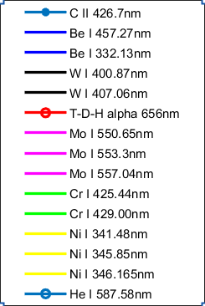
12_14IWG1B_R2C1
Linear scale
Logarithmic scale
Be I signals (blue) strongly decreasing after ~100 laser shots
Signals from the underlying W (black) gradually increasing, then almost homogeneous throughout the laser shots.

Slide 11
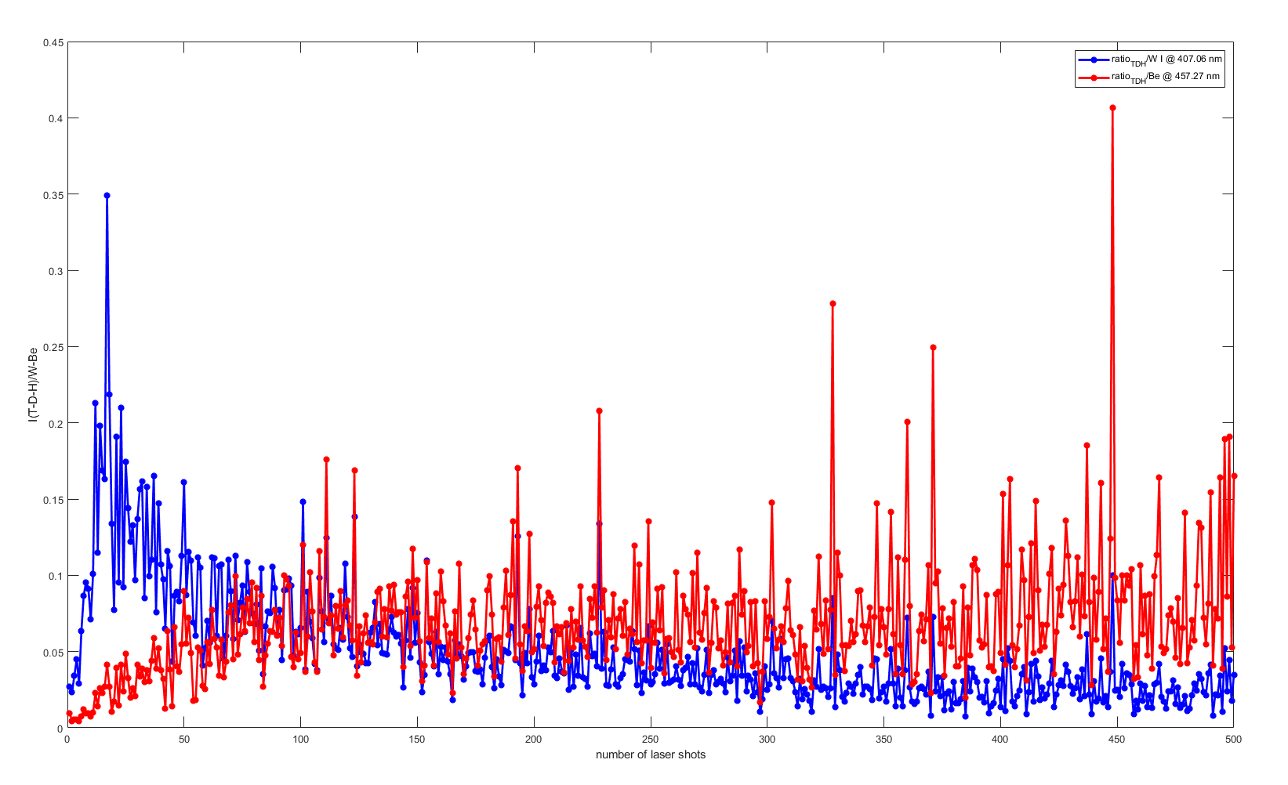
12_14IWG1B_R2C1
T-D-H in-depth distribution
T-D-H/W
T-D-H/Be
T-D-H/W ratio decreases as the W layer is progressively exposed shot by shot
T-D-H/Be increases as the Be residual layer is progressively removed by the laser shots

Slide 12
13_14IWG1B_R3C1
Linear scale
Logarithmic scale
Be I signals (blue) strongly decreasing after ~100 laser shots
Signals from the underlying W (black) gradually increasing.

Slide 13
13_14IWG1B_R3C1
T-D-H/Be
T-D-H in-depth distribution
T-D-H/W
T-D-H/Be
T-D-H/W ratio decreases as the W layer is progressively exposed shot by shot
T-D-H/Be increases as the Be residual layer is progressively removed by the laser shots
High noise in the T-D-H/Be graph due to the progressive intensity reduction of the other peaks
T-D-H/W

Slide 14
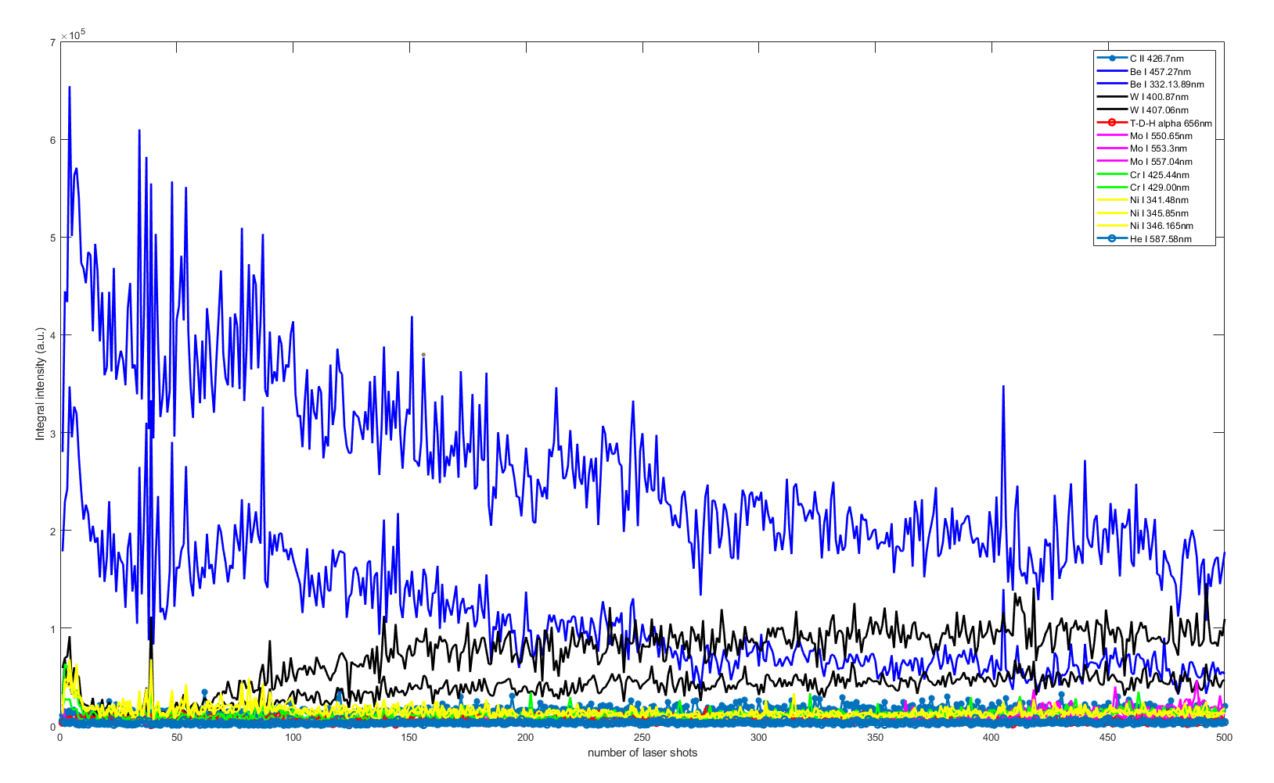
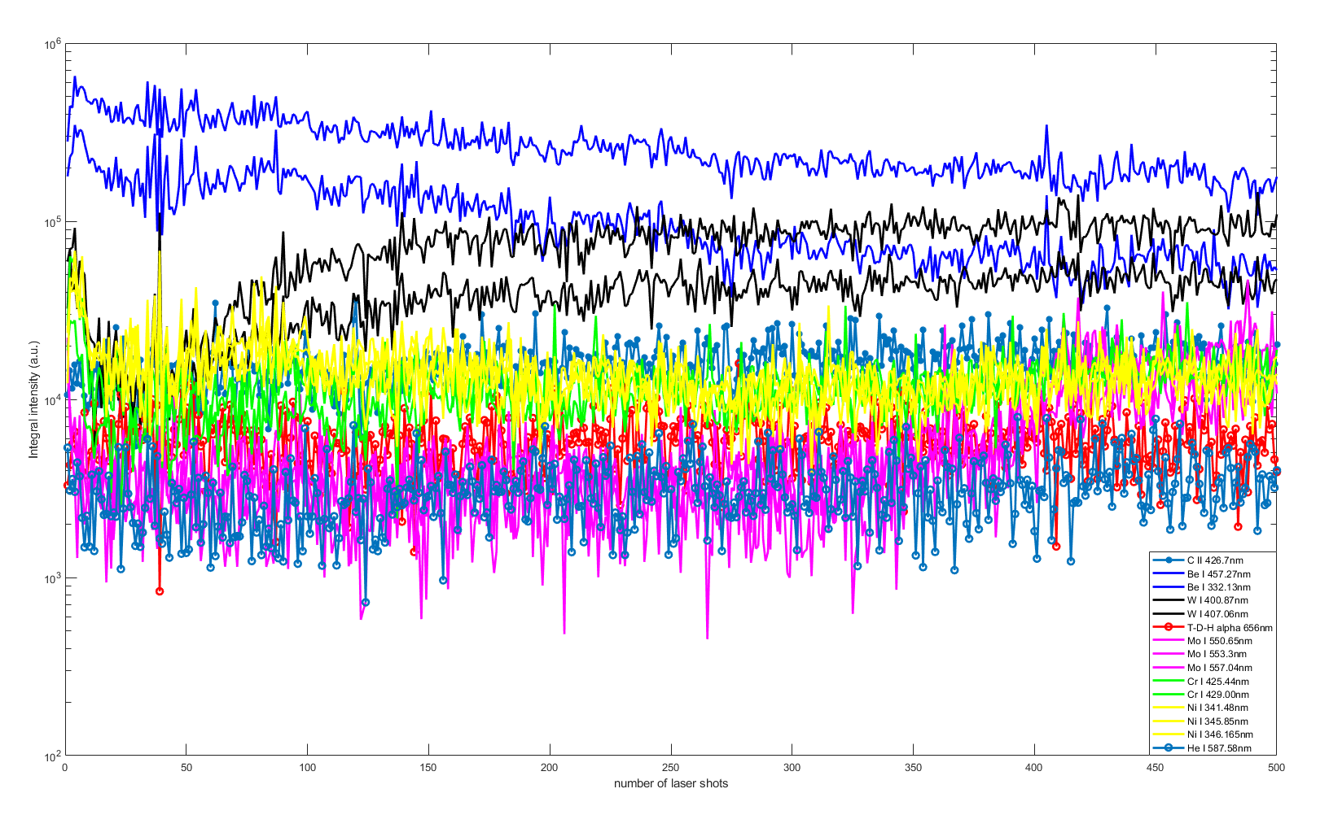
14_14IWG1B_R4C1
Linear scale
Strong Be I signals (blue), which decrease progressively with increasing number of laser shots ⇒ probably thick deposit of eroded Be
Signals from the underlying W (black) gradually increasing.
Logarithmic scale

Slide 15
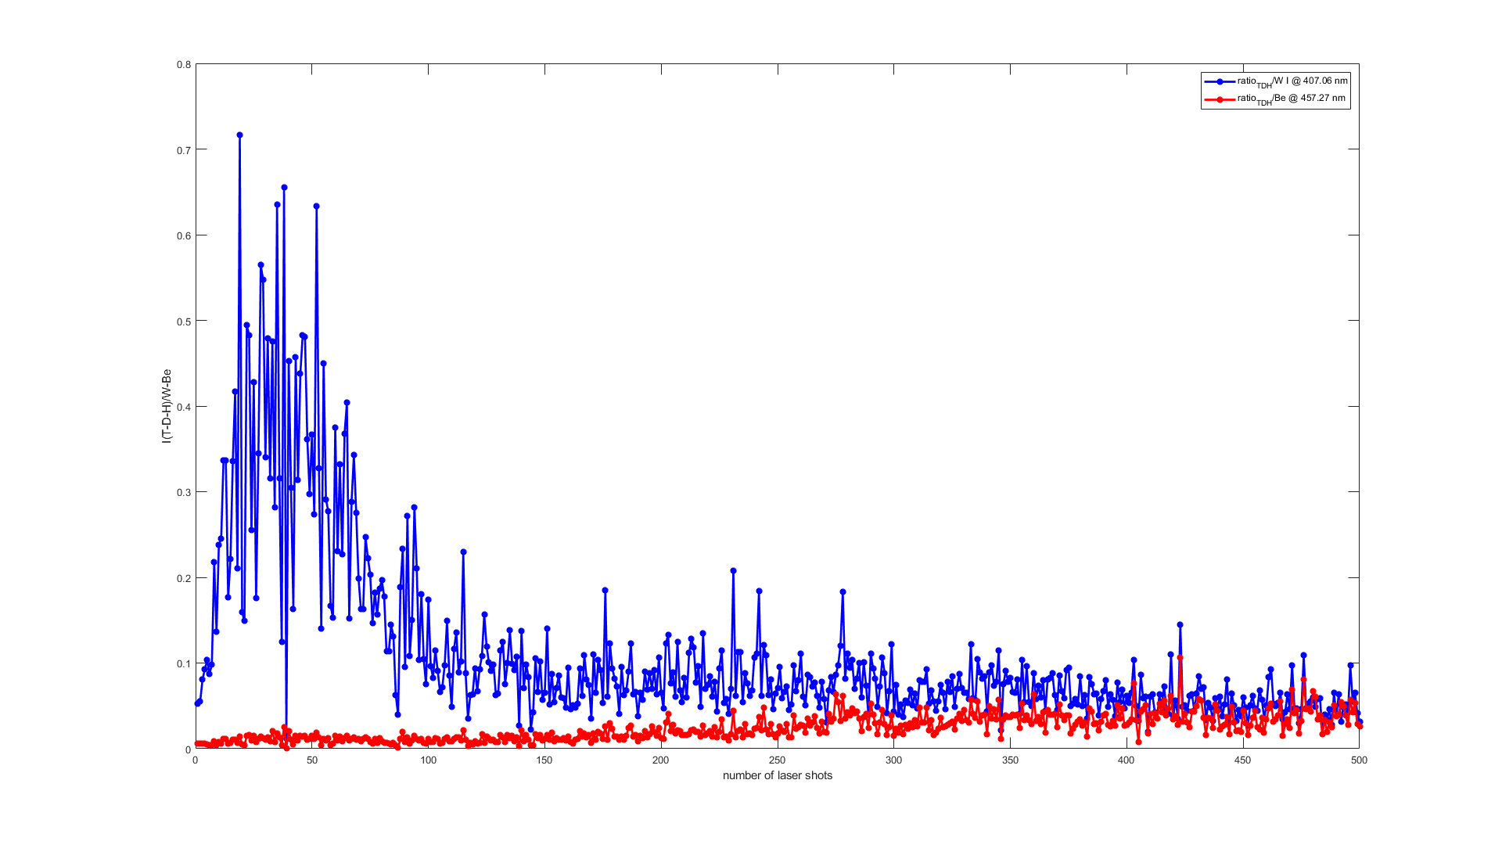
14_14IWG1B_R4C1
T-D-H/Be
T-D-H in-depth distribution
T-D-H/W
T-D-H/Be
T-D-H/W ratio decreases as the W layer is progressively exposed shot by shot
T-D-H/Be ratio remains overall low, as the thickness of the Be deposit remains high throughout the ablation
T-D-H/W
T-D-H/W
T-D-H/Be

Slide 16
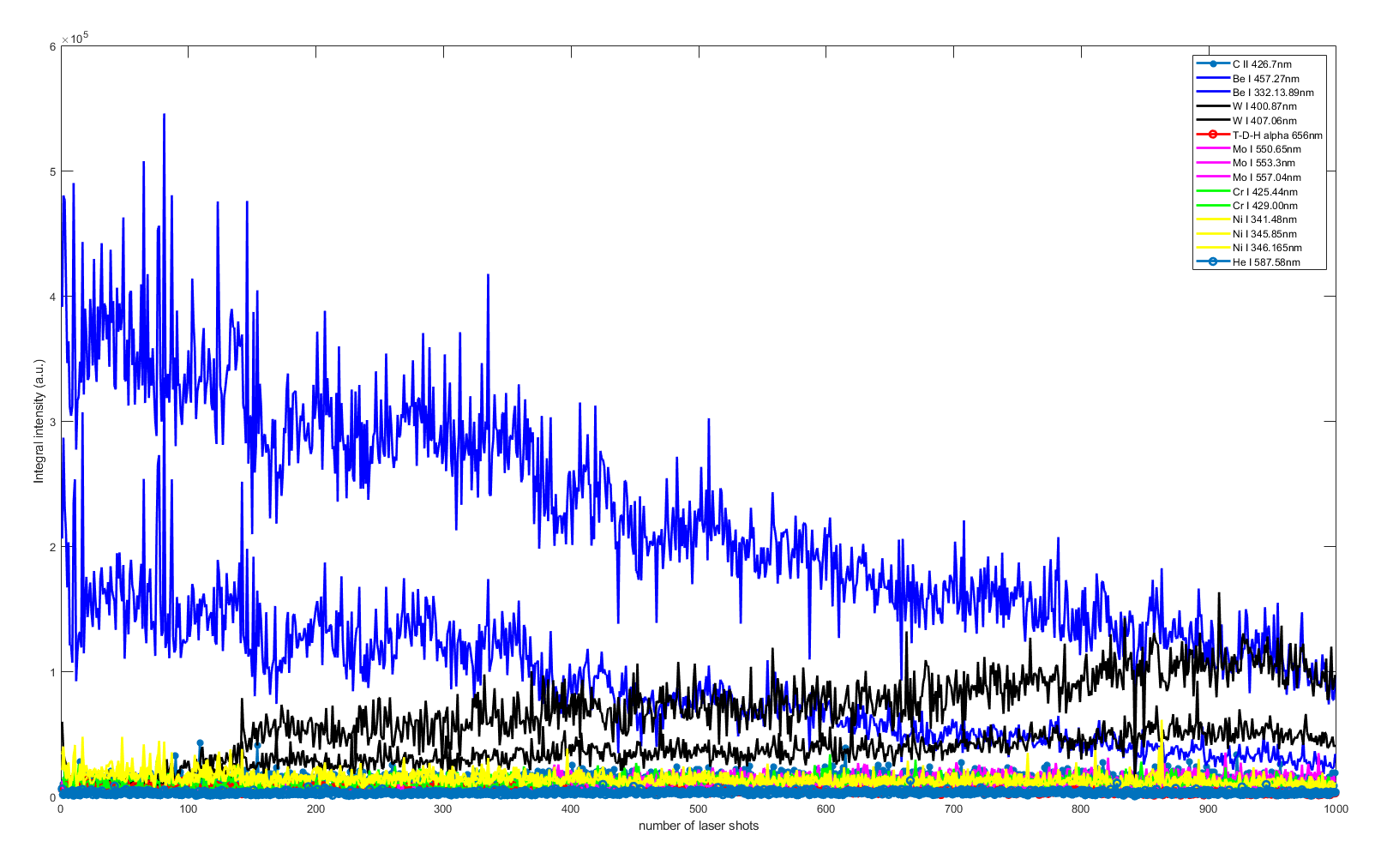
15_14IWG1B_R5C1
Linear scale
Strong Be I signals (blue), which decrease progressively with increasing number of laser shots ⇒ probably thick deposit of eroded Be
Signals from the underlying W (black) gradually increasing.
Logarithmic scale

Slide 17
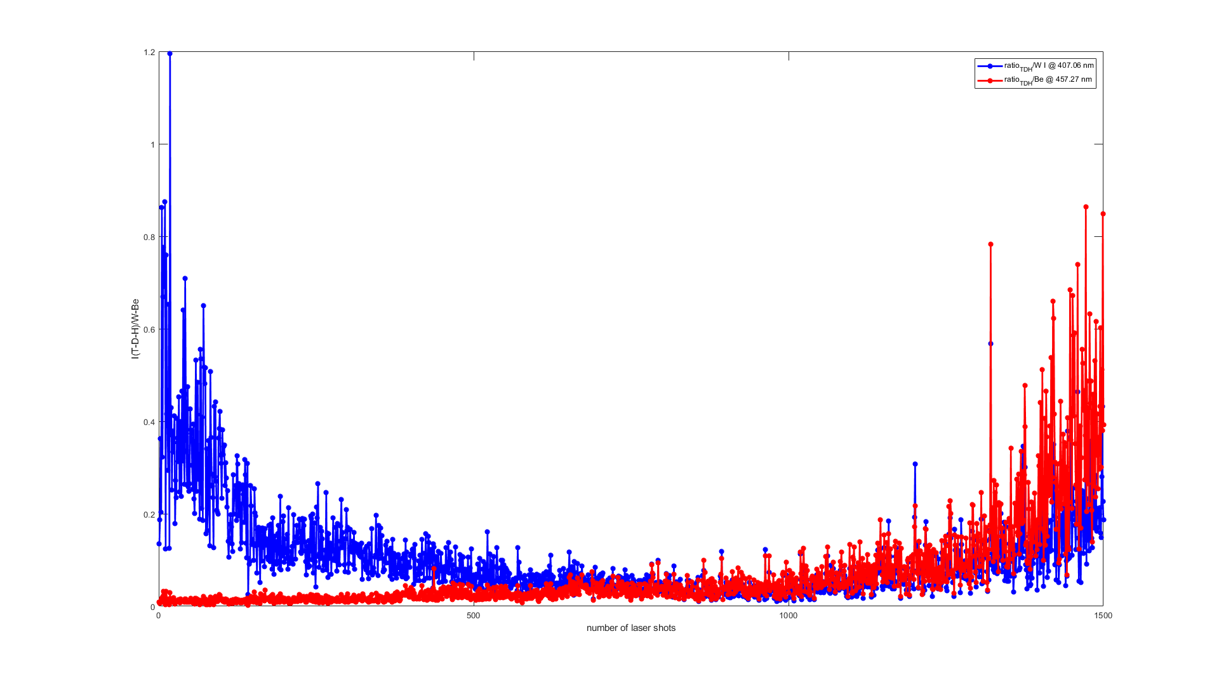
15_14IWG1B_R5C1
T-D-H in-depth distribution
T-D-H/W
T-D-H/Be
T-D-H/W ratio decreases as the W layer is progressively exposed shot by shot
T-D-H/Be ratio progressively increases with the shots as the Be layer is removed by the laser ablation
Low signal in the last shots -> not reliable

Slide 18
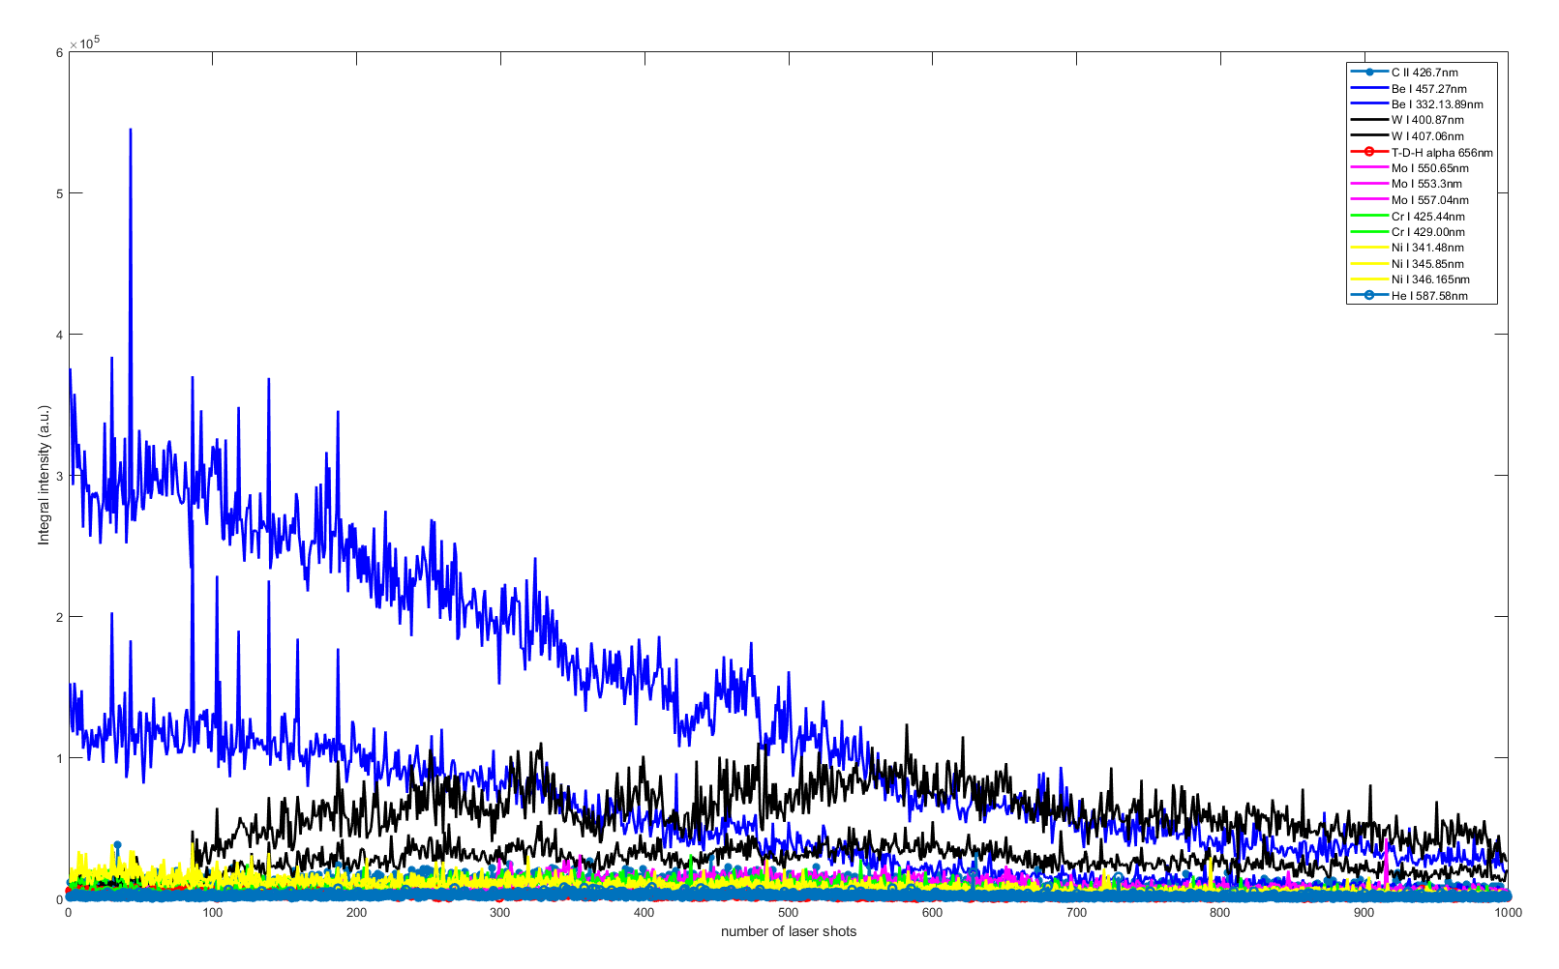
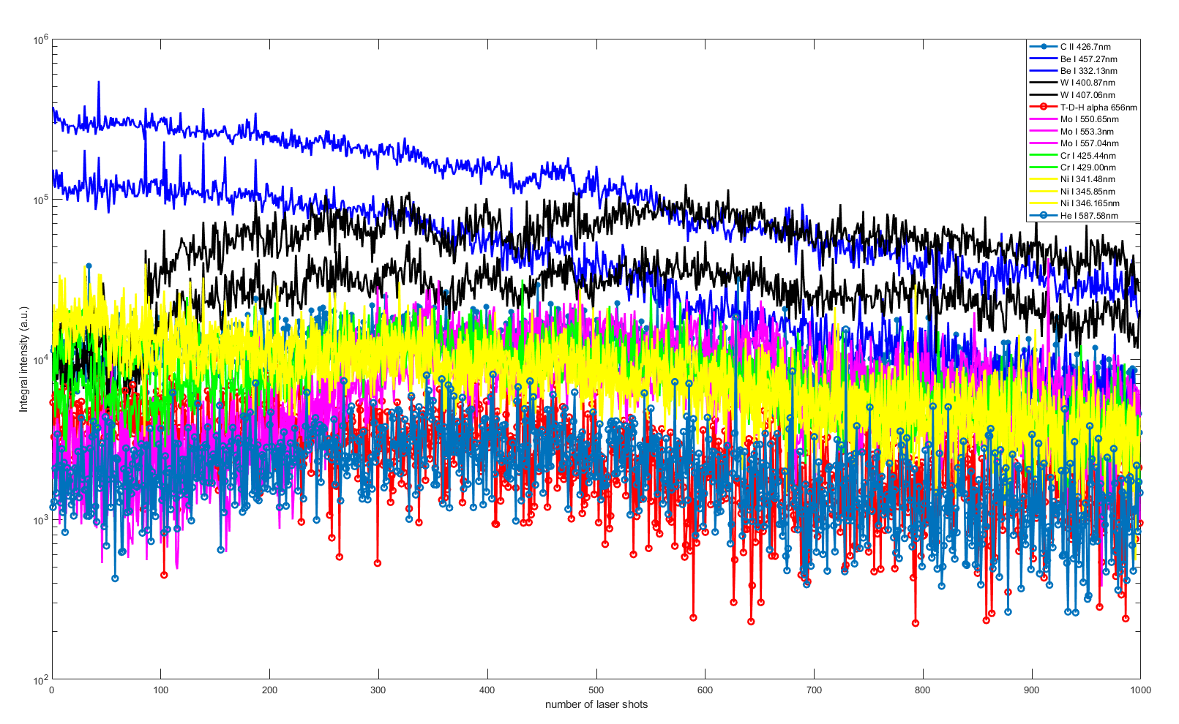
73_14IWG1B_R6C1
Linear scale
Logarithmic scale
Strong Be I signals (blue), which decrease progressively with increasing number of laser shots ⇒ probably thick deposit of eroded Be that is removed with the laser ablation
Signals from the underlying W (black) gradually increasing and emerging over the Be layer.

Slide 19
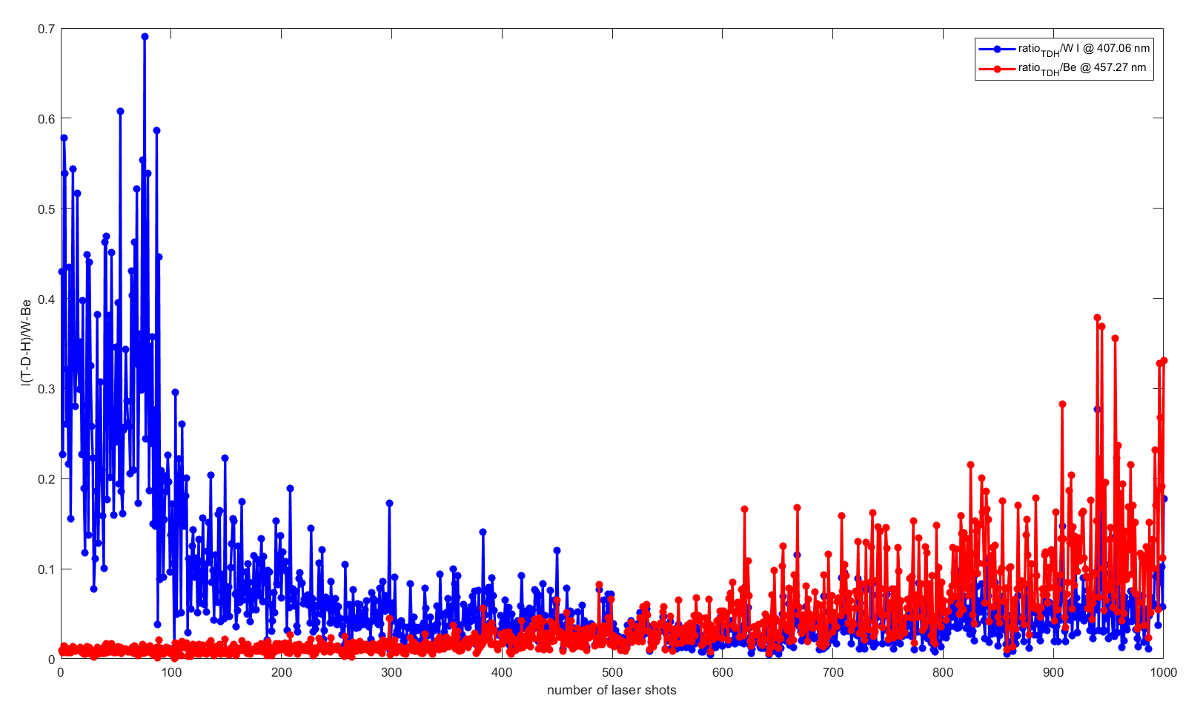
73_14IWG1B_R6C1
T-D-H in-depth distribution
T-D-H/W ratio decreases as the W layer is progressively exposed shot by shot
T-D-H/Be ratio progressively increases with the shots as the Be layer is removed by the laser ablation
T-D-H/W
T-D-H/Be

Slide 20
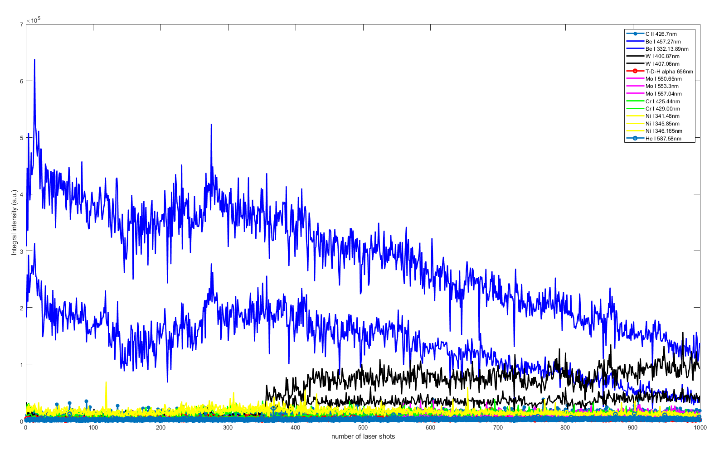
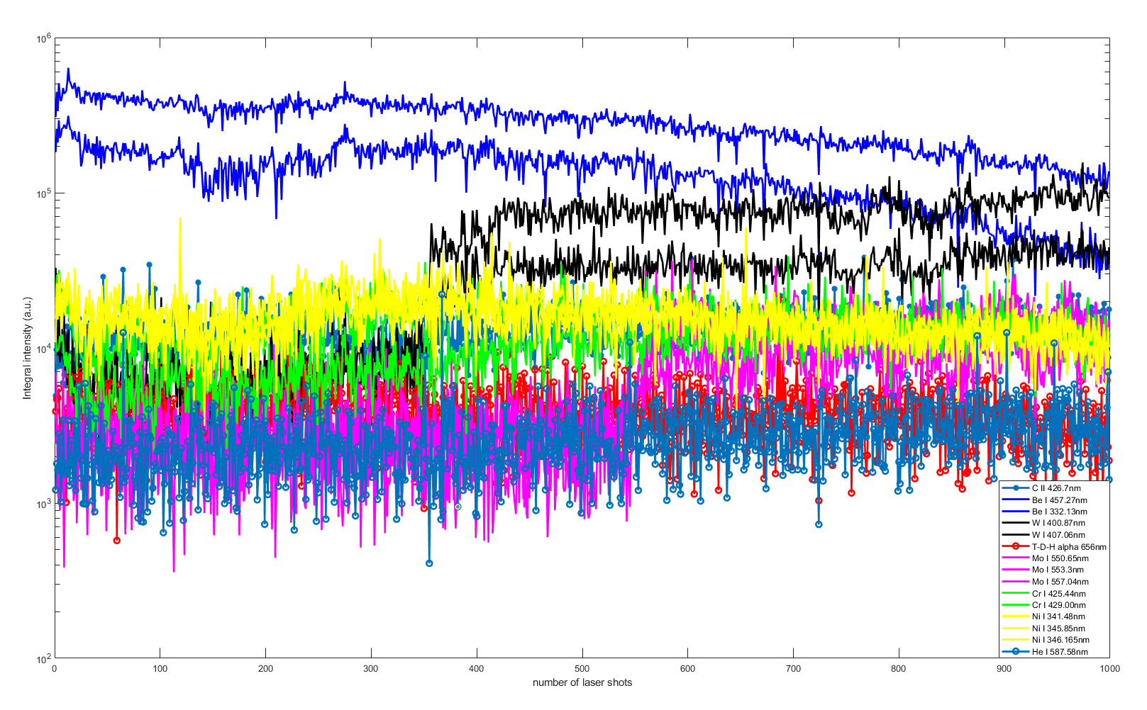
74_14IWG1B_R7C1
Linear scale
Strong Be I signals (blue), which decrease progressively with increasing number of laser shots ⇒ probably thick deposit of eroded Be
Signals from the underlying W (black) gradually increasing and emerging over the Be layer.
Logarithmic scale

Slide 21
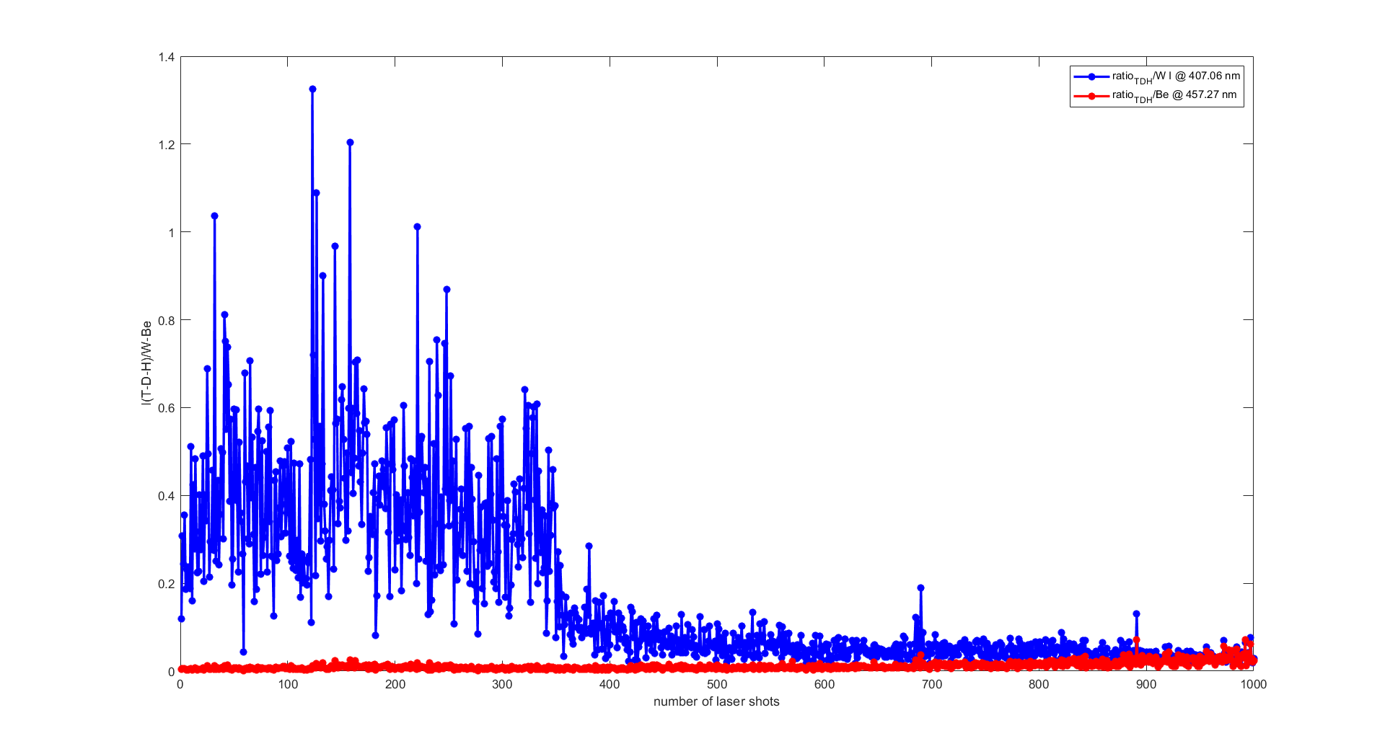
74_14IWG1B_R7C1
T-D-H in-depth distribution
T-D-H/W
T-D-H/W ratio decreases as the W layer is progressively exposed shot by shot
T-D-H/Be ratio slightly increases with the shots, remaining overall low
T-D-H/Be

Slide 22
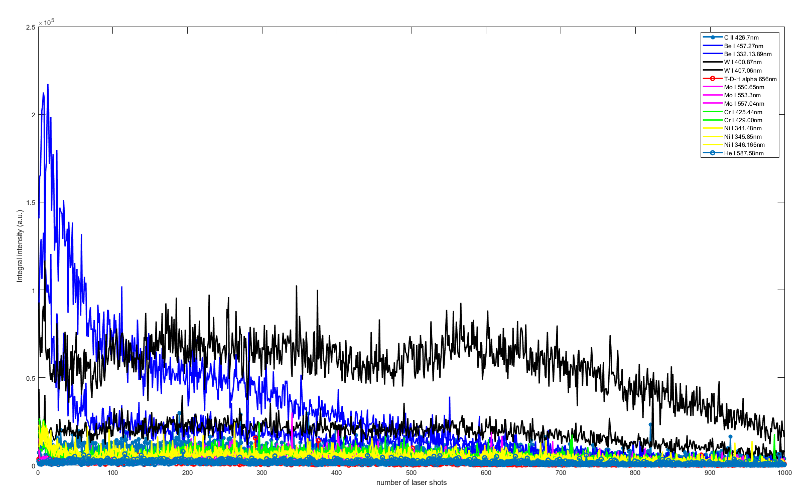
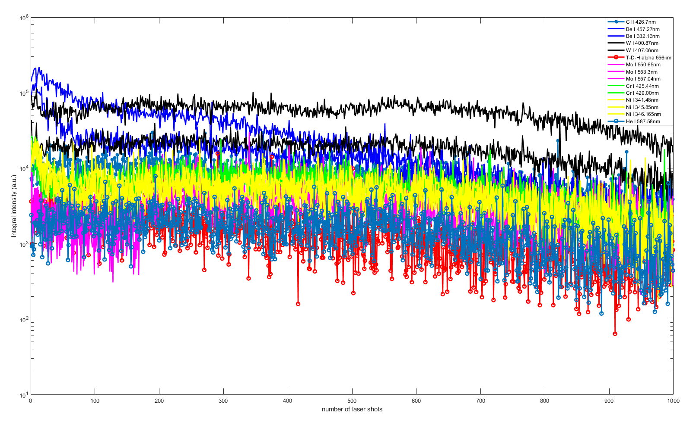
808_14IWG1B_R1C1
Linear scale
Logarithmic scale
Be I signals (blue) sharply decreases with increasing number of laser shots
W I signal (black) emerges over the Be layer, then gradually decreases

Slide 23
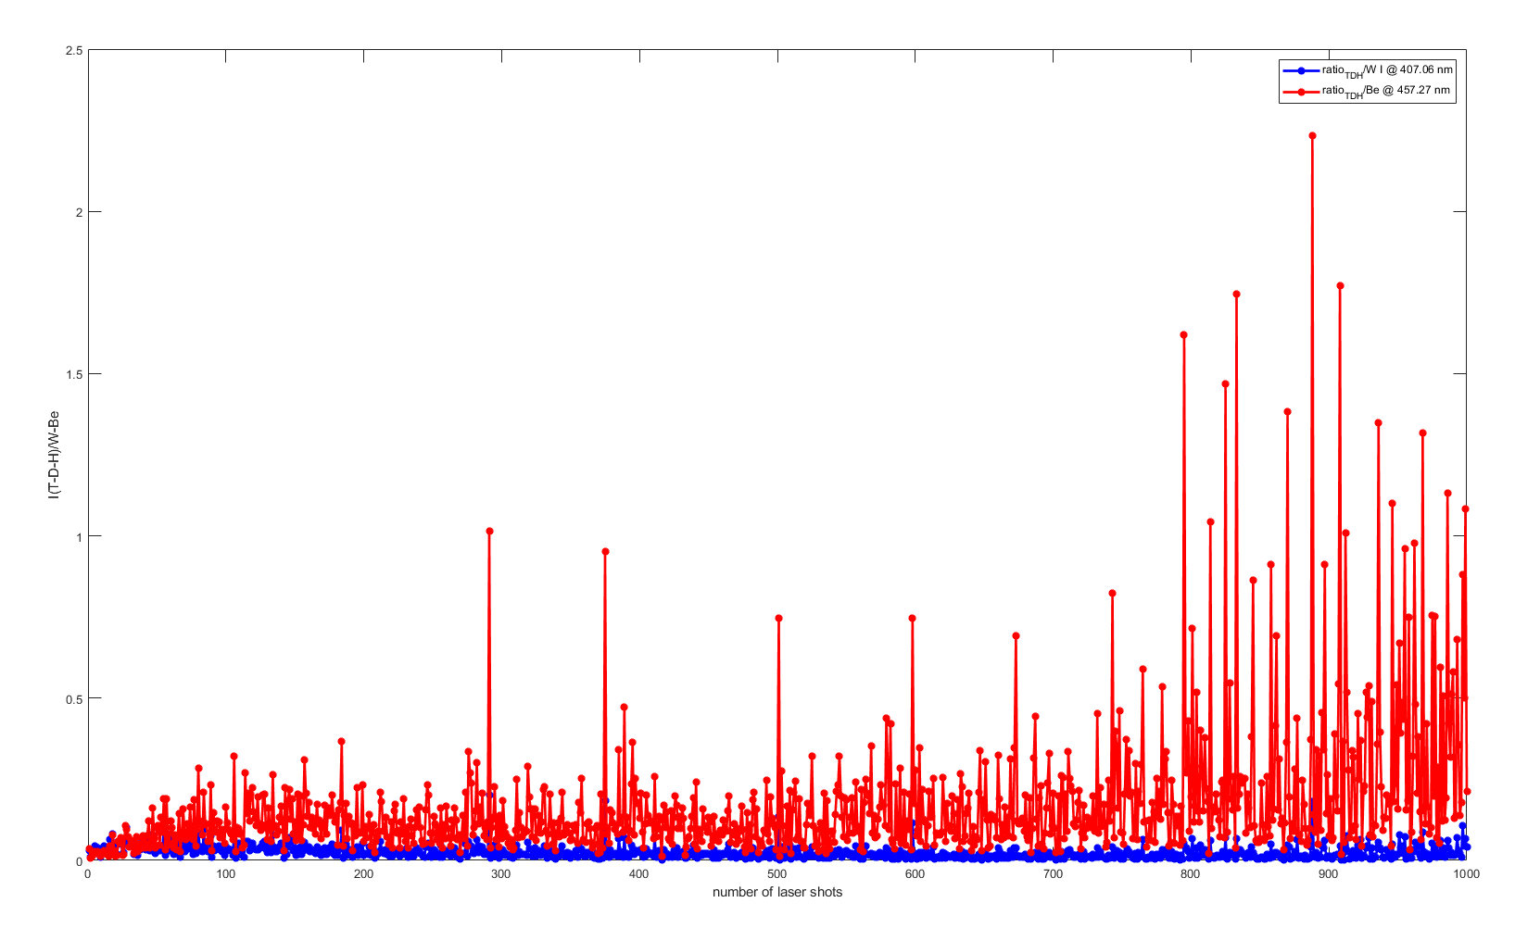
808_14IWG1B_R1C1
T-D-H in-depth distribution
Both ratios’ trends are not reliable because the Echellogram from pulse 808_14IWG1B_R1C1 was not calibrated with the method developed by TU, due to the lack of spectral images.
T-D-H/Be
T-D-H/W

Slide 24
Ablation rate
The ablation rate of the W layer was estimated
Knowing that the average thickness of the W layer is ~20 µm, the ablation rate was calculated by evaluating the laser shot number at which the W and the Mo lines emerge over the Be and the W coatings, respectively, thus calculating the number of shots needed to ablate 20 µm of W.
The resulting average ablation rate of the W layer for all the analyzed pulses is ~90 ± 18 nm/shot

Slide 25
Discussion and conclusions on depth profiling analysis
The processing of hundreds of spectral data in a short amount of time is able to provide a qualitative in-depth distribution of the elements of interest, including those contained in the base materials and any possible T-D-H residue
The presence of more spectral lines from the same element mostly following the same trends (e.g., Be I and W I lines), is an encouraging result as it contributes to proving the consistency of the method
In evaluating the W ablation rate, it is worth noticing that the W signal never sharply decreases because of the conic shape of the ablation crater that keeps the W always detectable.

Slide 26

Calibration-free data analysis method
A calibration-free data analysis method was developed in ENEA with the same idea of processing a large spectral dataset with one script, and implemented in a MATLAB® environment.
The development of this script is still in progress, so the results are intended to be preliminary.
Relative concentrations of T-D-H, W, Be Vs. number of laser shots were analyzed.

Slide 27
Results
12_14IWG1B_R2C1
W
The resulting graphs were too noisy to provide a clear trend of the elements’ concentration
Since the script development is still ongoing, the data were not averaged ⇒ high noise
Be
H

Slide 28

Conclusions
The MATLAB® procedure on the calibration-free data analysis needs to be further developed, introducing the averaging of the spectral data to reduce noise.
The T-D-H retention will be evaluated once the script is updated with the new procedures.

