Slide 1
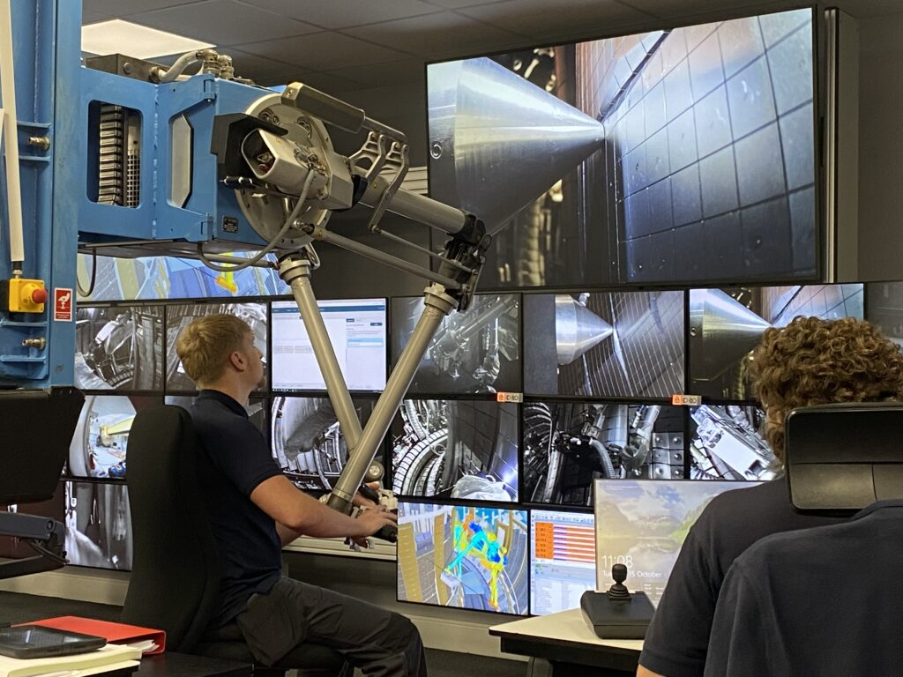


JET LIBS data in the QMS region-14IW G1B(2011-2023)
PWIE, Juelich
Rongxing Yi et al.
Forschungszentrum Jülich GmbH, Institute of Fusion Energy and Nuclear Waste Management – Plasma Physics, Partner of the Trilateral Euregio Cluster (TEC), 52425 Jülich, Germany

Slide 2
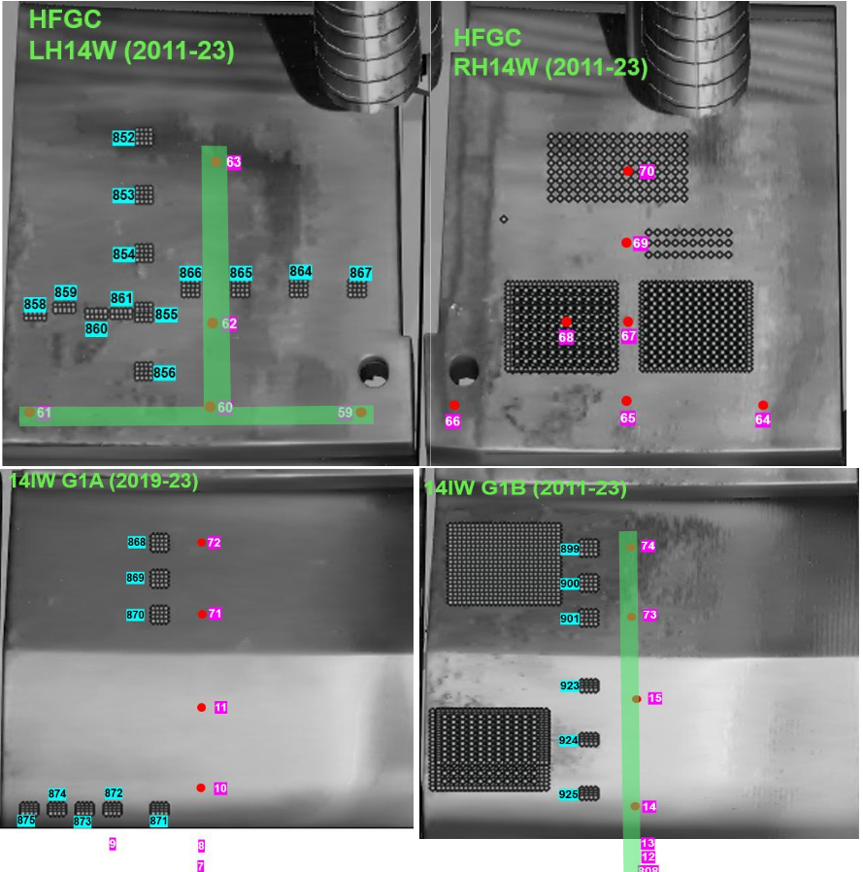
Results in the LID-QMS region (Module 14)
1
Highest D ratio
1
2
3
4

Slide 3
Outlook and Conclusions
1
2
3
4

Slide 4
Results in the LID-QMS region (Module 14)
1
2
3
4

Slide 5
Outlooks and Conclusions
Conclusions
Top of G1B shows the highest DT ratio
The middle part of G1B shows a dip of DT ratio

Slide 6
Thanks for your attention!

