Slide 1








Update on plans for ex-vessel LIBS for calibration
Jari Likonen

Slide 2
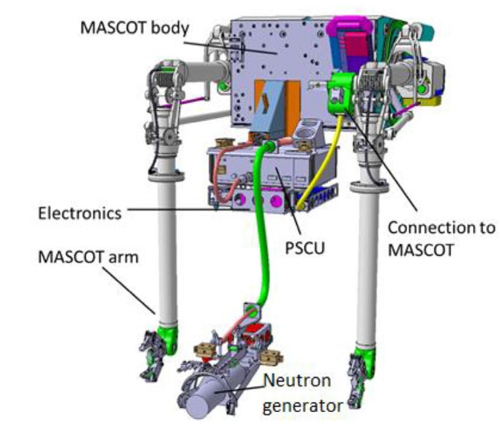

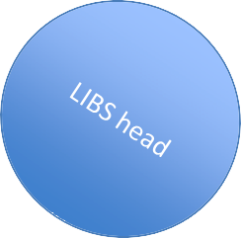
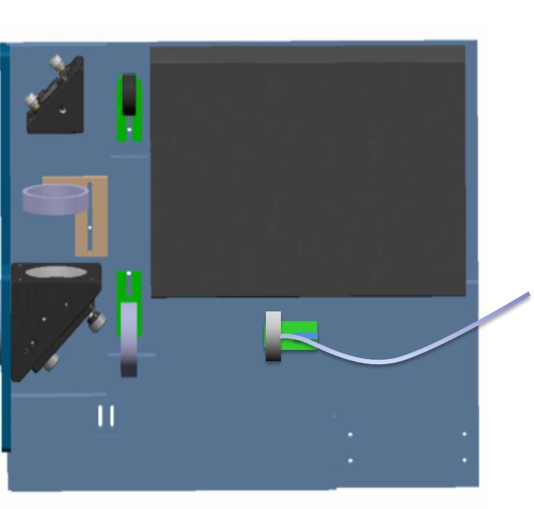












LIBS at VTT and at JET
Aim
The aim is to repeat the LIBS experiment at VTT
LIBS setup optimized after the first VTT experiment
Littrow spectrometer was not available at VTT in 2024
First experiments at VTT
Commissioning of LIBS system (February 18th – 24th, 2024)
Measurement campaign March 11th – 22nd, 2024)
LIBS at JET
Commissioning of LIBS system (April 29th – May 10th, June 17th – 21st, August 5th – 23rd, September 23rd – October 2nd)
Experiment dates: October 2nd – 18th, 2024
Results
LIBS experiment was completed successfully
840 locations were analysed
JET wall
component
Laser
Plasma light
Laser beam

Slide 3
LIBS experiment at VTT in 2026
1st planning meeting (Dec18th, Teams)
Tentative time schedules
Availabilities of spectrometers
Shipment of spectrometers
Samples
Team?
VTT experiment
Cleaning of LIBS tool and optical fibre before the experiment
Reanalysis of samples measured in 2024 at VTT
Analysis of DTE3 samples (at least W lamellae)
Optimization of DEMON parameters
Data analysis meetings after the experiment (e.g. for PSI)?
Post-mortem analyses
Post-mortem results (IBA, SIMS, TDS…) for DTE3 samples available later in 2026

Slide 4
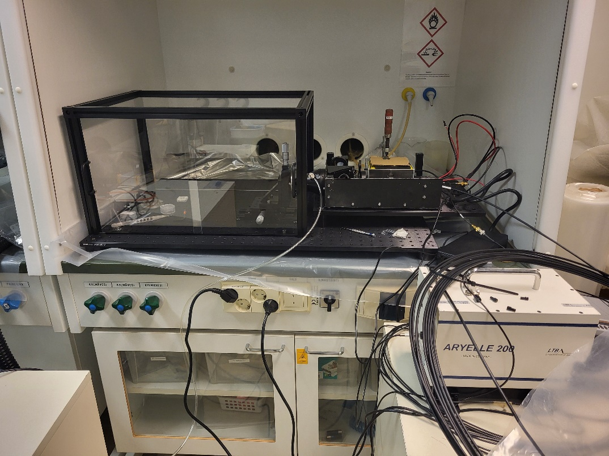
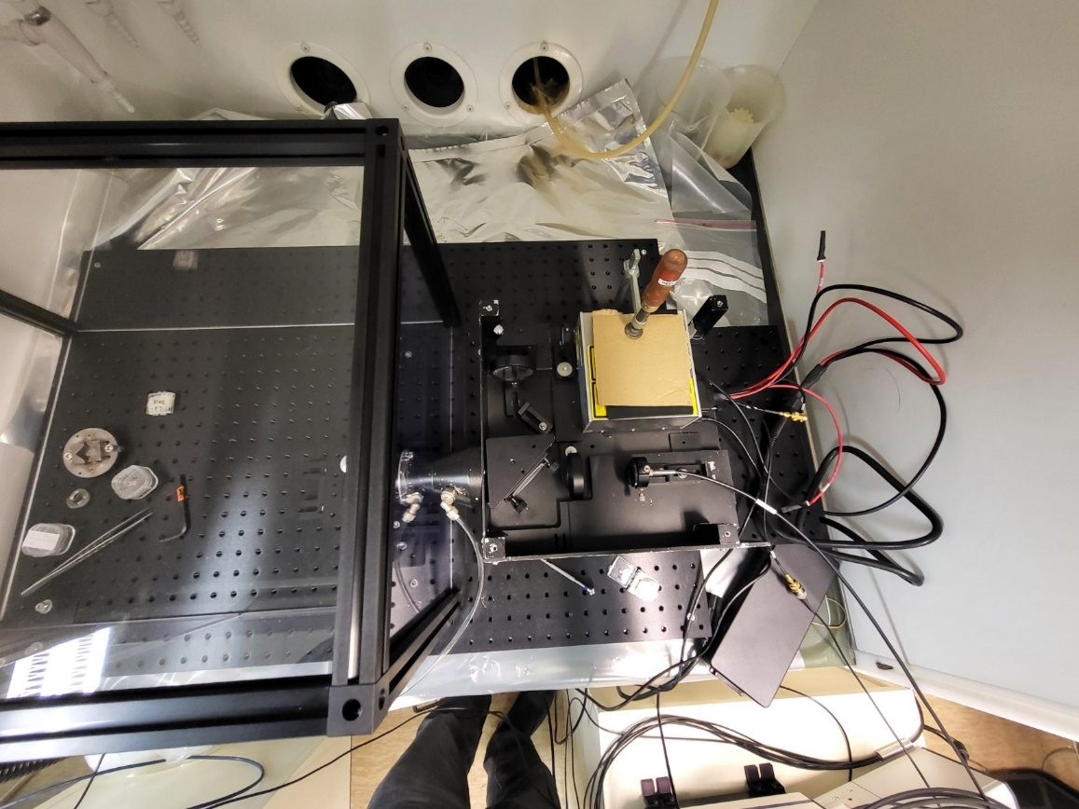
LIBS measurements at VTT in 2024
ps-laser
sample
20m long
optical fibre
Montfort Laser M-Nano laser (1064nm, 0.8ns, 10mJ)
Aryelle 200 spectrometer (resolution 0.07 nm @600nm)
Andor iStar DH334T-18U-E3 ICCD camera
Calibration (D and Hg lamps)
Ar gas
Jari Likonen | LIBS PB meeting | VC | 27 March 2024 | Page 4

Slide 5
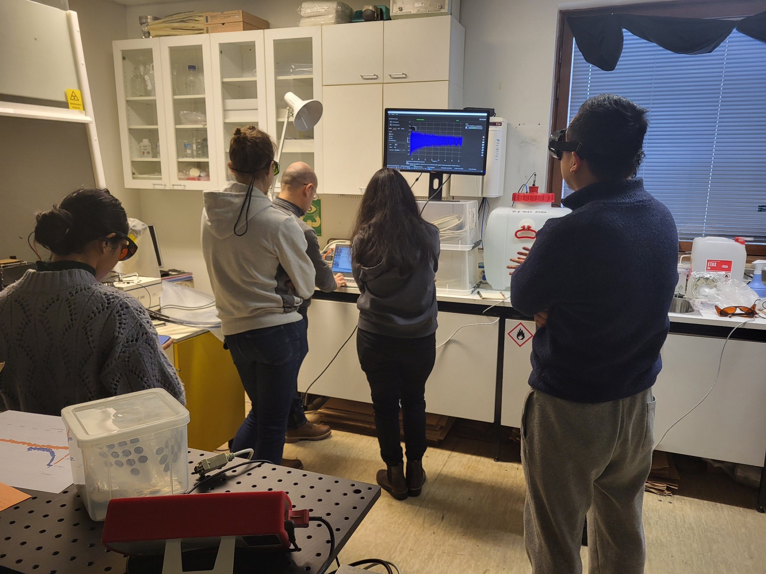
LIBS measurements at VTT in 2024
Old lab at VTT
Jari Likonen | LIBS PB meeting | VC | 27 March 2024 | Page 5

Slide 6
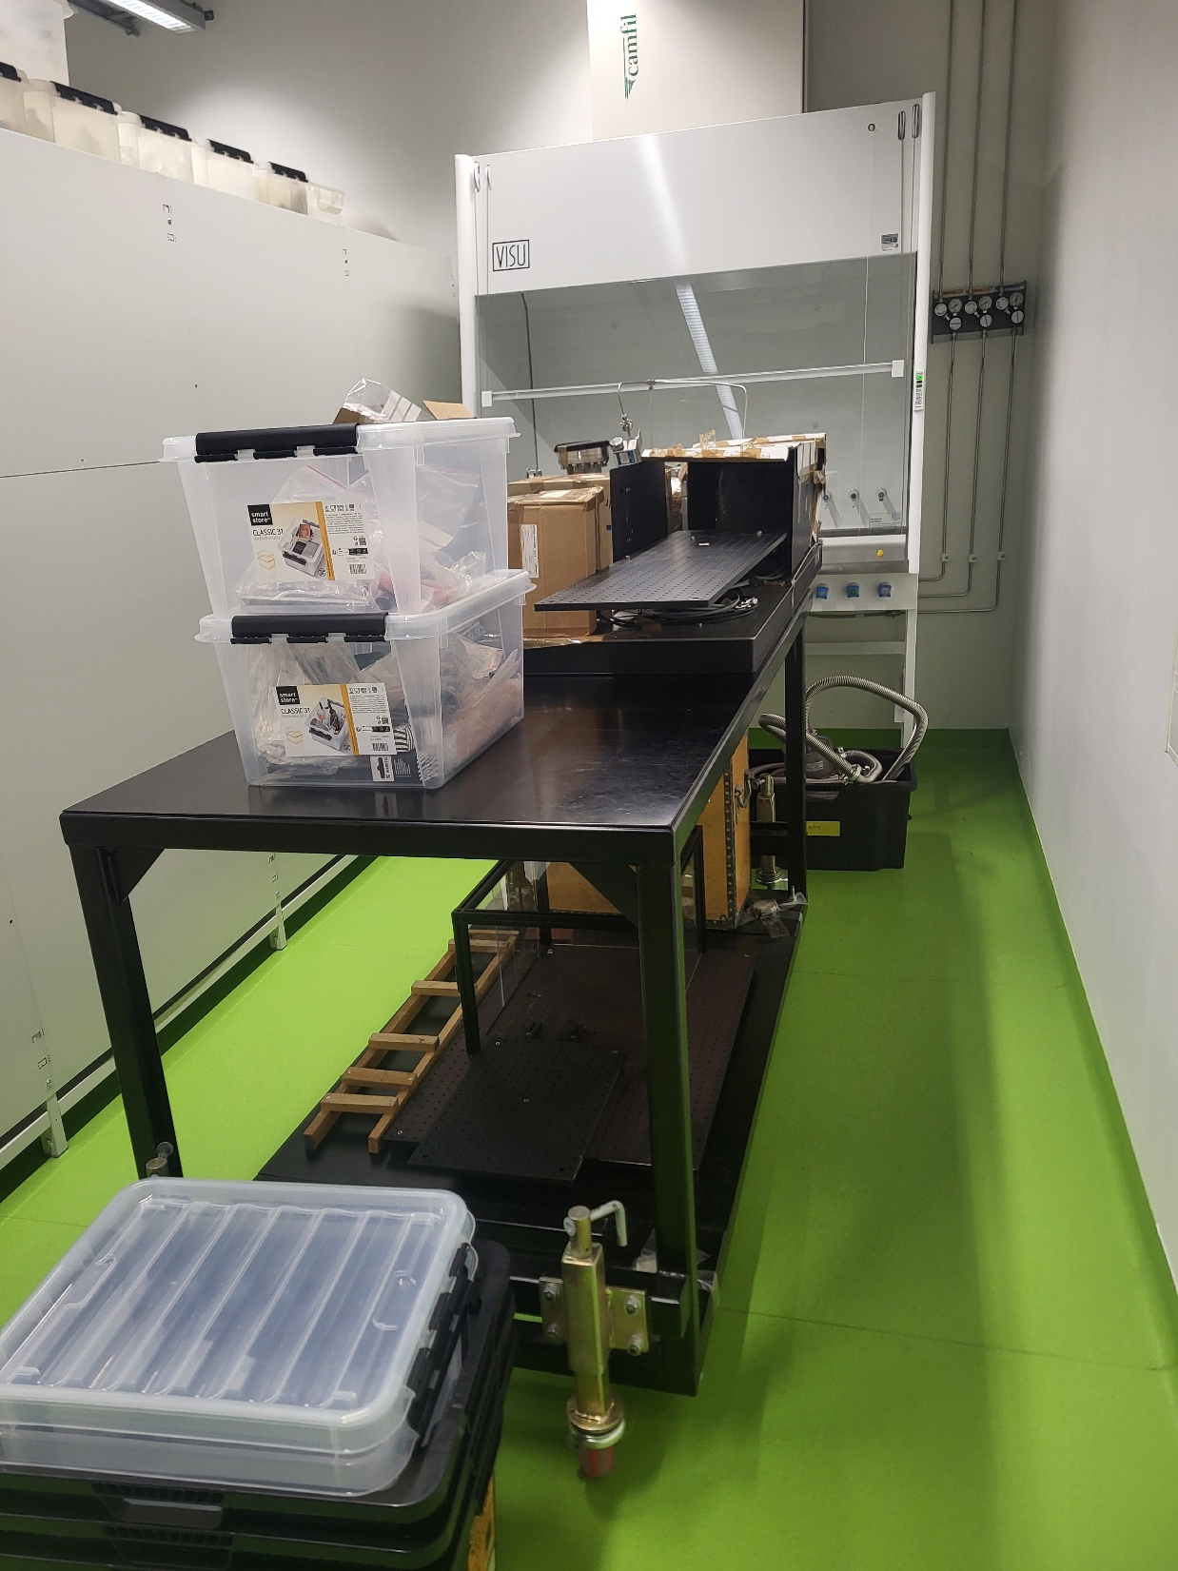
LIBS measurements at VTT in 2026
Part of the new lab at VTT
Smaller than the old lab
Old LIBS system needs to be moved to the corridor during
the new VTT experiment
Jari Likonen | LIBS PB meeting | VC | 27 March 2024 | Page 6

Slide 7
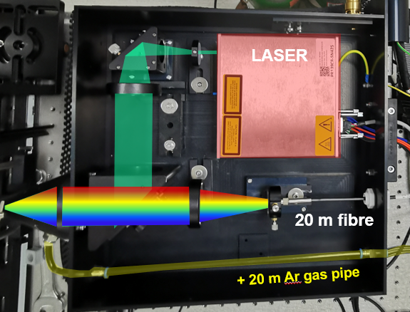
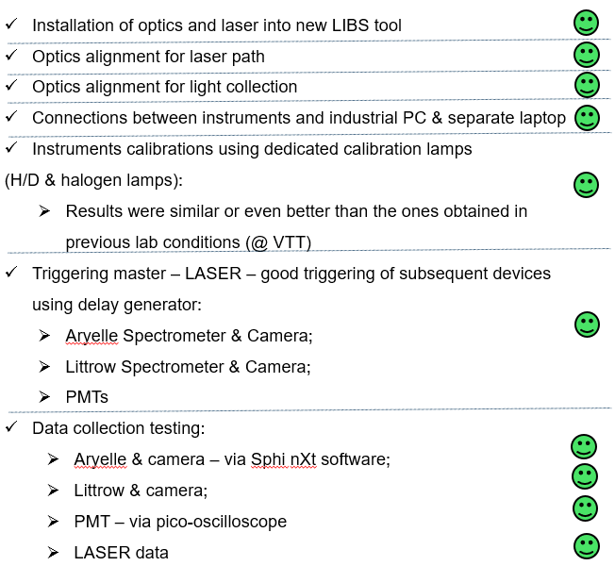
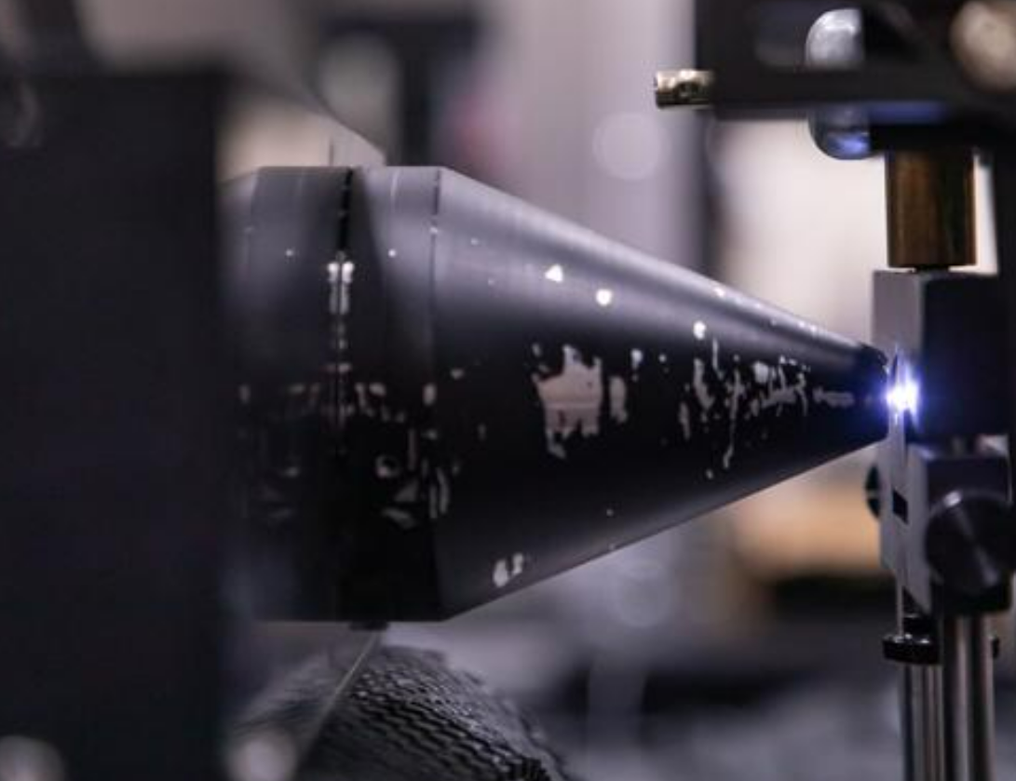
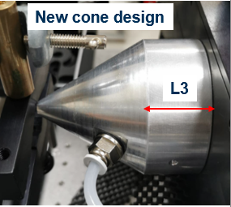


SPE.E1 Participation in the LIBS experiment at VTT and at JET using RH, and in the data analysis of CF LIBS (UKAEA)
Initial beam set-up & cone
Final beam set-up & cone
LIBS tool lab commissioning @ JET (made three
times)

Slide 8
LIBS system at JET
LIBS enclosure developed by ENEA and optimised by FZJ
LIBS enclosure mounted on the JET MASCOT arm
RH boom moves LIBS tool close to the wall, outermost cone is in contact with tile to be investigated
Argon gas flux applied to increase signal to noise ratio
Optical fibre guides emitted light into spectrometers, located outside of the vessel

Slide 9
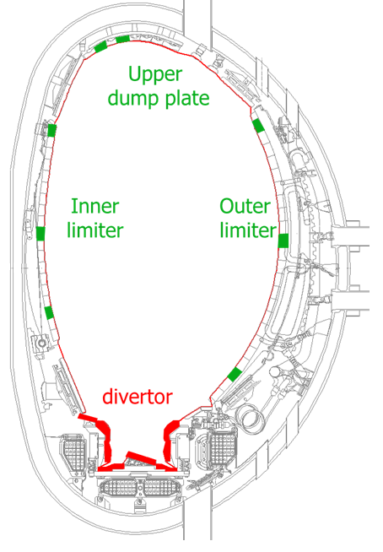
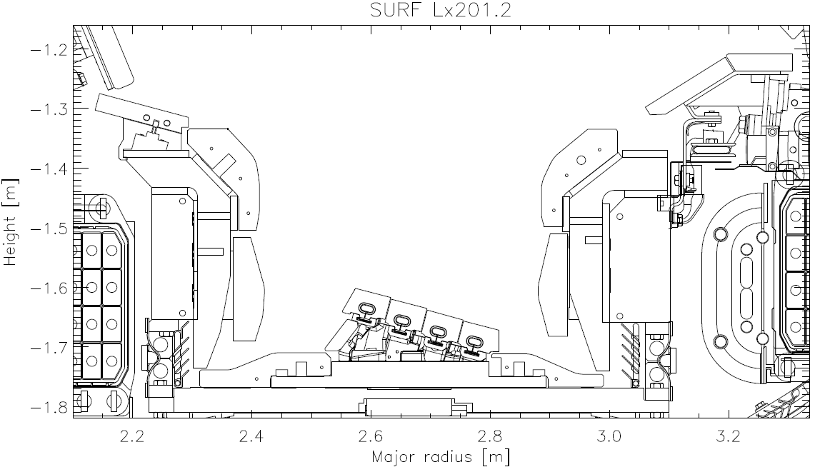
Analysed JET samples at VTT in 2024
C
B
0
3c
1c
12a
11a
11b
8a
7b
1
8
3a
7
4D15_623
4D15_703
6a
3
B12_167
5
7
2XR11_623
2XR11_641
2XR11_668
4
6
9
Jari Likonen | LIBS PB meeting | VC | 27 March 2024 | Page 9

Slide 10
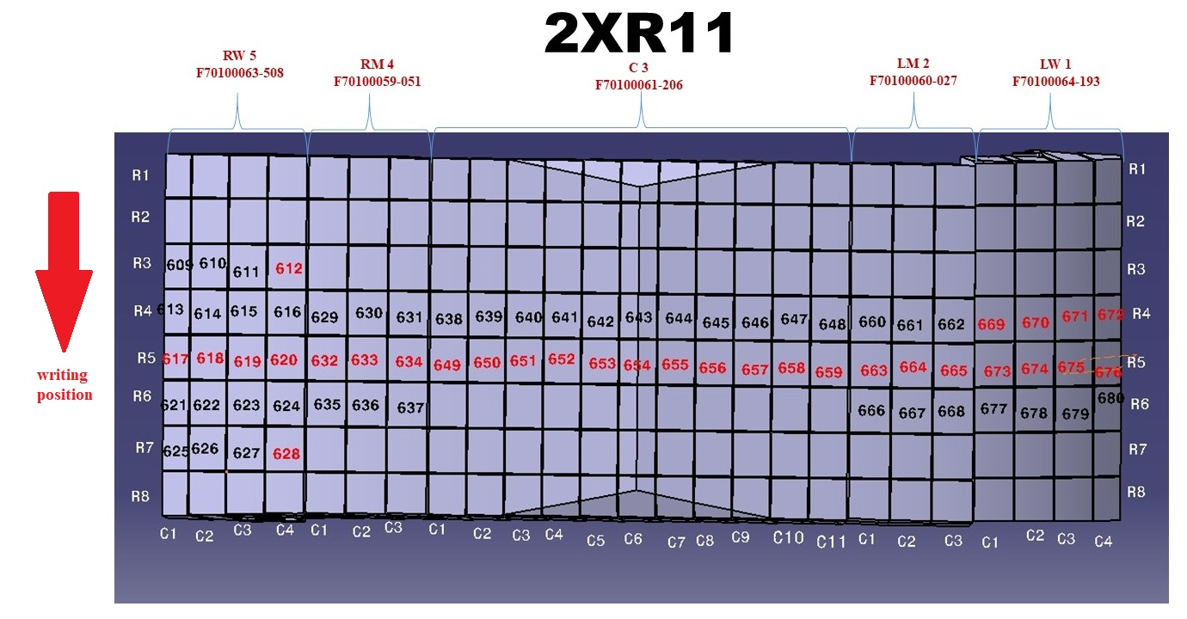
2XR11 (2011-2016)
10
Jari Likonen | LIBS PB meeting | VC | 27 March 2024 | Page 10

Slide 11
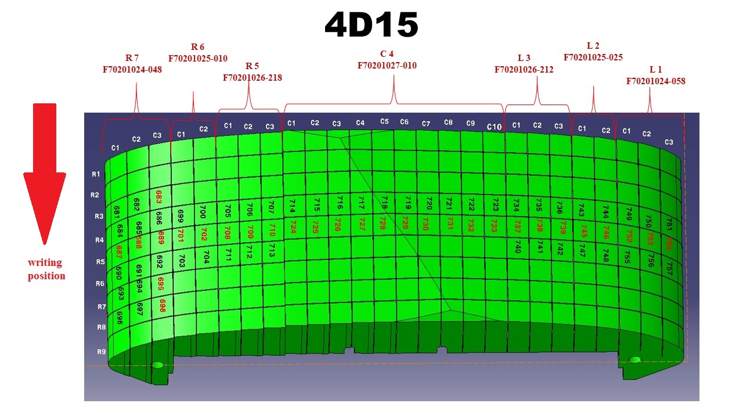
4D15 (2011-2016)
11
Jari Likonen | LIBS PB meeting | VC | 27 March 2024 | Page 11

Slide 12
Analysed JET samples at VTT in 2024
”Clean” samples
Mo217, 0dpa, D implantation 40eV, 5 hrs at ambient temperature (VTT)
Mo218, 1dpa (1 MeV Mo+), D implantation 40eV, 5 hrs at ambient temperature (VTT)
Plansee W- annealed at 1000degreeC for 1h (FZJ)
IAP 60181002, Be+D (10at%), 10 um, Si (VTT)
IAP 60220201, Be+D(20%), Bias -150V, 5um, W 5_7 (VTT)
IAP 6019017_1_3, Be+He(5%)+D(5%) (VTT)
WEST C3 34iK (possibly lost at JET)
WEST C4-200J (VTT?)
JET samples (at VTT)
2XR11 (2011-2016): 623, 641, 668
4D15 (2011-2016): 686, 703
HFGC (2011-2016): 1c, 3c
14IWG1A(2011-2016): 3a, 8a, 11a, 12a
2IWG3A (2014-2016) : 6a
2ONG7A(2014-2016) : 7
2ONG8B(2014-2016) : 7b, 11b
W lamellae
IWC-2
12
Jari Likonen | LIBS PB meeting | VC | 27 March 2024 | Page 12

Slide 13
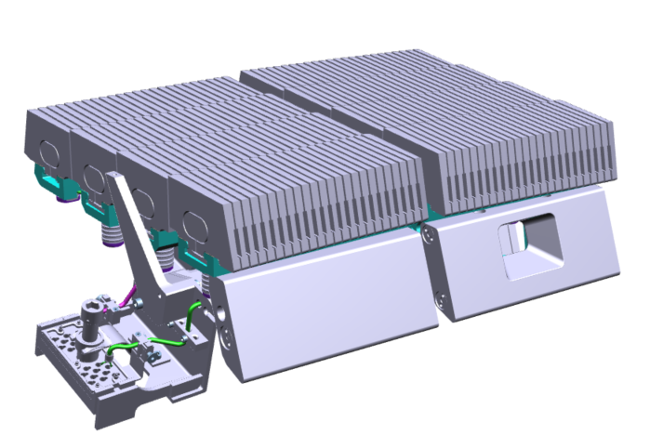
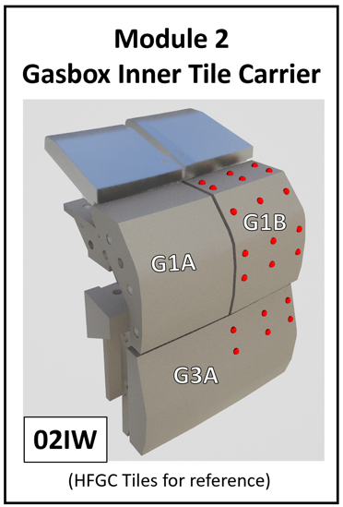
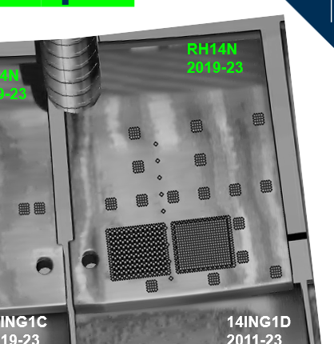
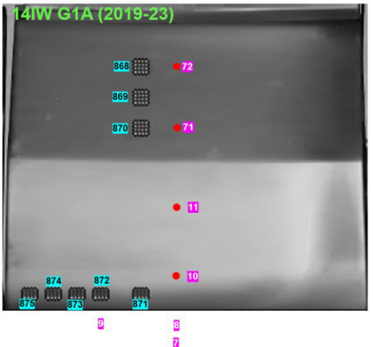
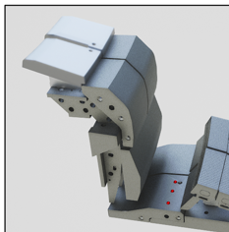
DTE3 samples and tiles
1
LH
D
C
RH
B
24
A
JET tiles and samples
Shipping from UKAEA to VTT in 2025-2026
W lamellae: A12 LH, C12 LH, D12 LH
2IW G1B (2010-2023)
HFGC RH14N (2019-2023)
14IW G1A (20219-2023)
14BW G4C (2010-2023)
Limited number of DTE3 samples may be available during LIBS
experiment at VTT
Tritiated W sample from IAP?
To be discussed on Dec 18th
Deposition
monitor
13
14BWG4C
Jari Likonen | LIBS PB meeting | VC | 27 March 2024 | Page 13

Slide 14
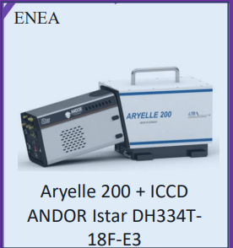
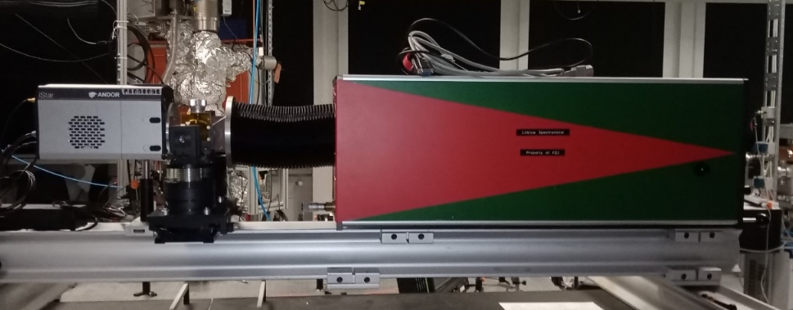
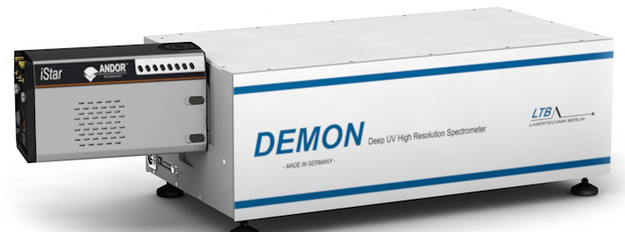
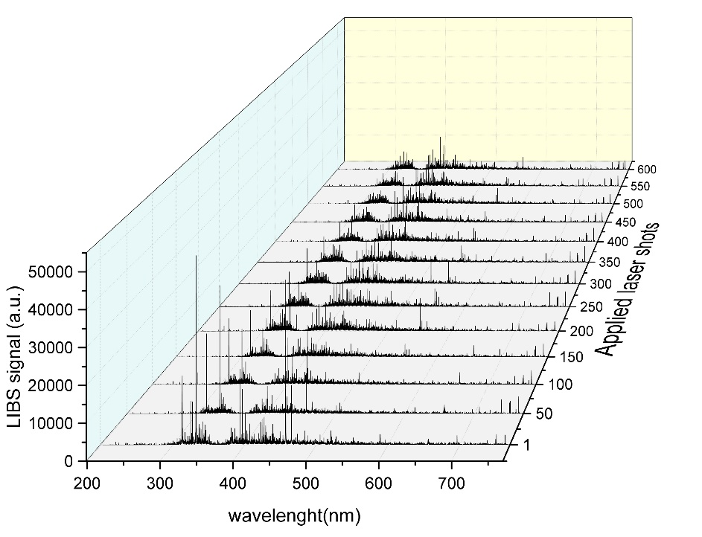
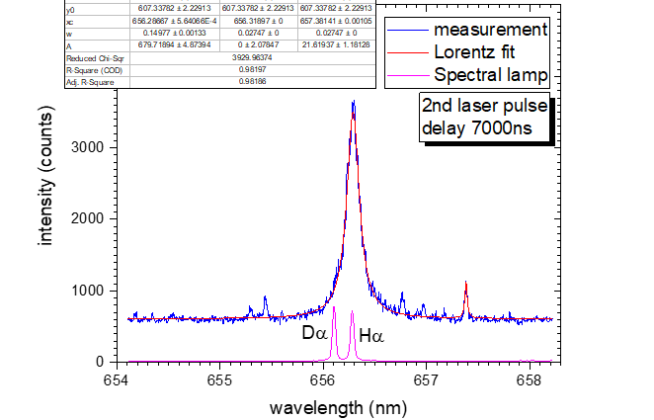
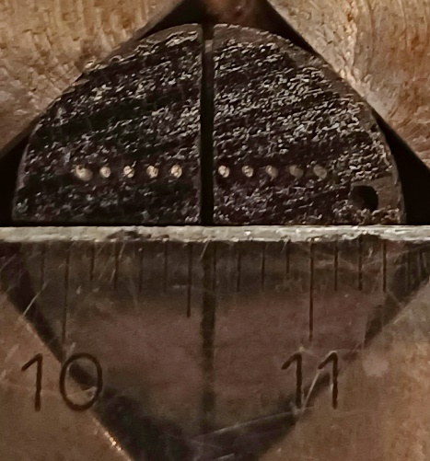
LIBS measurements at VTT
Aryelle 200 (ENEA)
-UV-VIS-IR (250-750 nm)
spectrometer
Littrow spectrometer (FZJ)
-High resolution (0.03 nm @ 500 nm)
spectrometer
DEMON spectrometer (LTB)
-High resolution (0.0025-0.012nm)
spectrometer
W lines
JET sample 2IWG3A_6a
Be lines
0
1
Mo lines
6a
3
H_{α}-D_{α}: 0.18 nm
D_{α} -T_{α}: 0.06 nm
4
Jari Likonen | LIBS PB meeting | VC | 27 March 2024 | Page 14

Slide 15
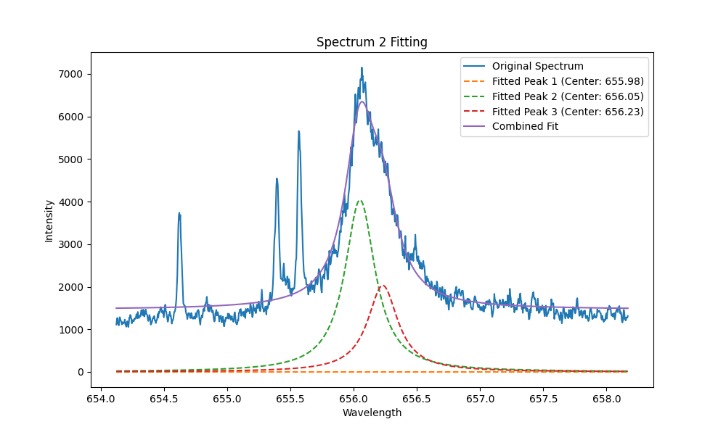
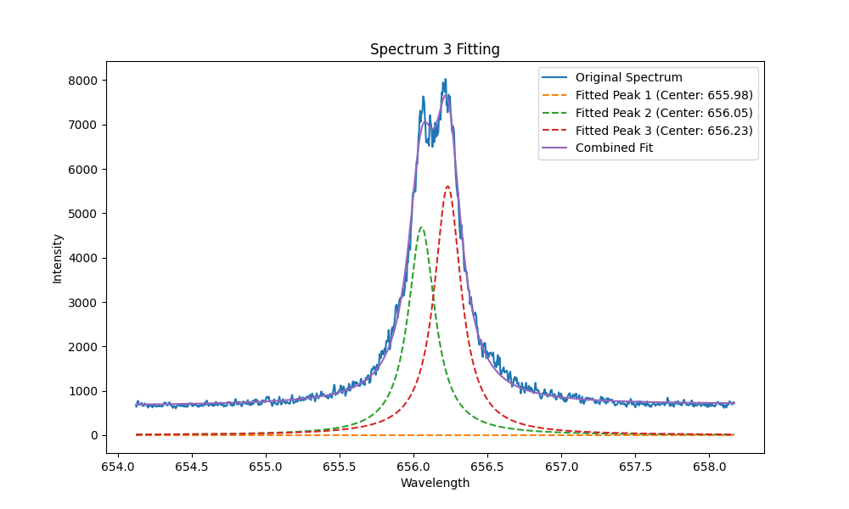
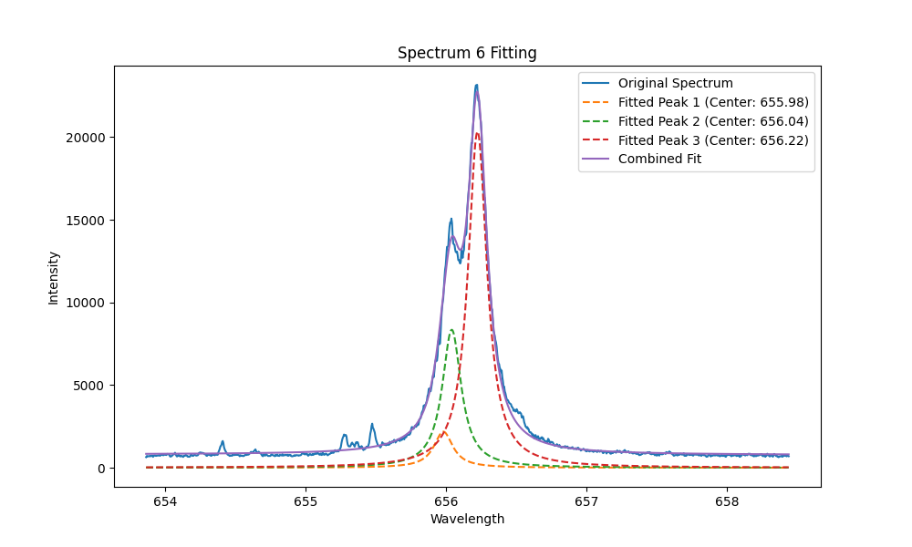
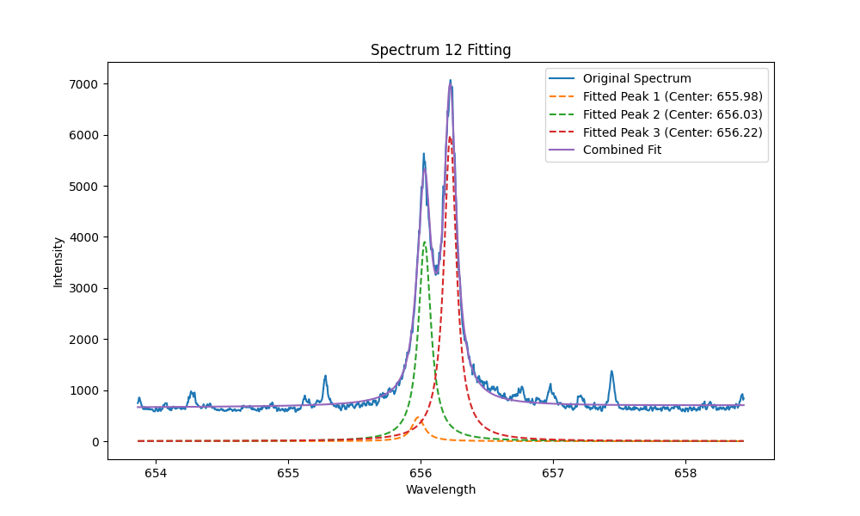
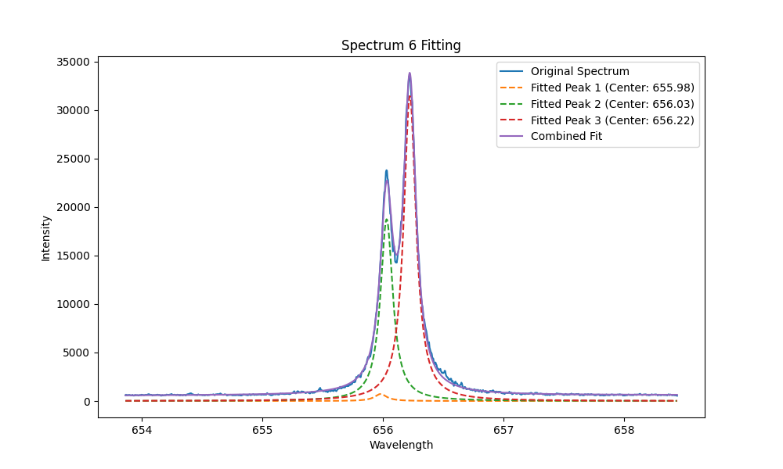
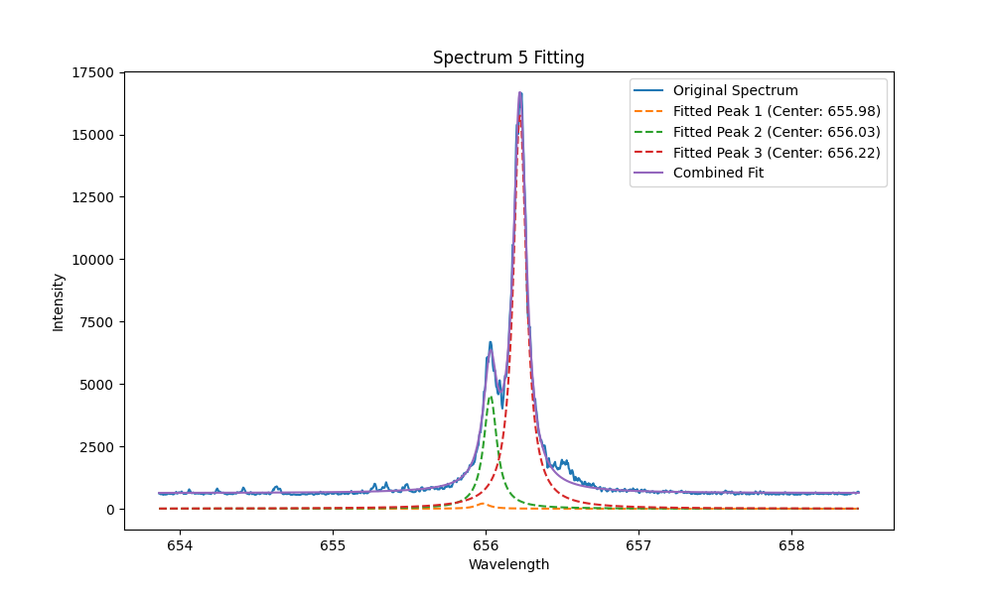
2. Results-Ha spectrum optimization
Different delay time in-vessel @JET
4us
8us
10us
12us
14us
18us
8us mostly used at JET
In additional measurements: 2-20us
15

Slide 16
2. Results-Ha spectrum optimization
FWHM of H_{α} is narrow enough to separate H/D after 8 us. After 18us it reaches to 0.1 nm, which is still higher than the gap between T/D.
However, we can use Voigt fitting to resolve them.
But there is still a trade off between delay and SNR.
Different delay time
H/D 0.18 nm
T/D 0.07 nm
FWHM
SNR
Fitting quality
16

Slide 17
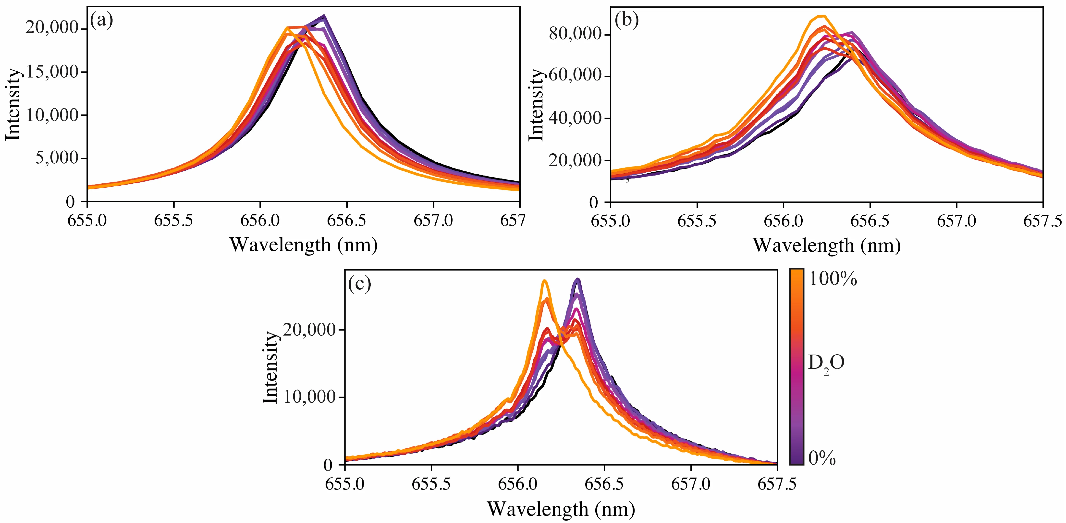
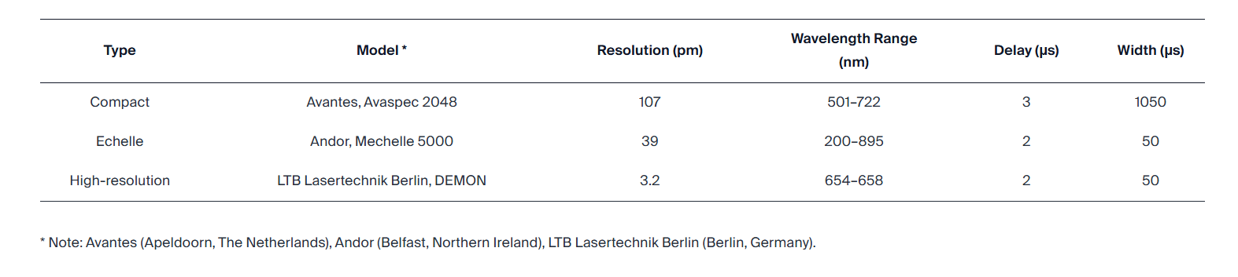
DEMON spectrometer
Compact
Echelle
DEMON spectrometer
-High resolution (0.0025-0.012nm)
spectrometer
DEMON
H.B. Andrews, J. McFarlane, Sensors 9797 (2023), 23(24)
Jari Likonen | LIBS PB meeting | VC | 27 March 2024 | Page 17

Slide 18
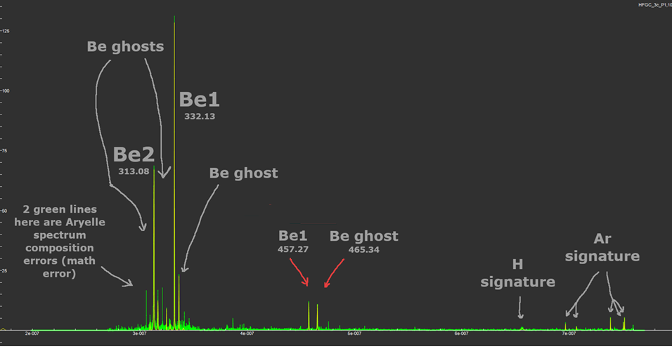
LIBS measurements at VTT in 2024
0
3c
1
3
4
370 spectral lines were detected
60 lines were reliable and usable for LIBS analysis
ghost lines are artifacts caused during process of compiling spectrum in Echelle-type spectrometer
If a spectral line has high intensity, then light from spectrometer output will appear on adjacent diffraction orders on the camera matrix
Jari Likonen | LIBS PB meeting | VC | 27 March 2024 | Page 18

Slide 19
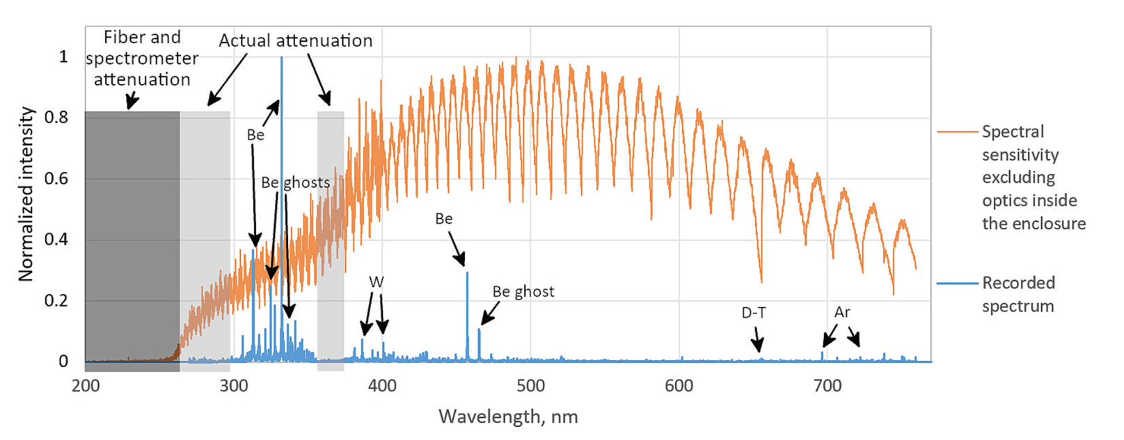
LIBS measurements at VTT in 2024
Ristkok et al., NME 44 (2025) 101968
Signal attenuation below 300 nm and around 350–370 nm.
Spectral sensitivity curve determined from halogen and deuterium calibration lamp outputs, excluding the LIBS
enclosure optics
The sensitivity modulation arises from the way the Aryelle spectrometer compiles the spectrum.
Jari Likonen | LIBS PB meeting | VC | 27 March 2024 | Page 19

Slide 20
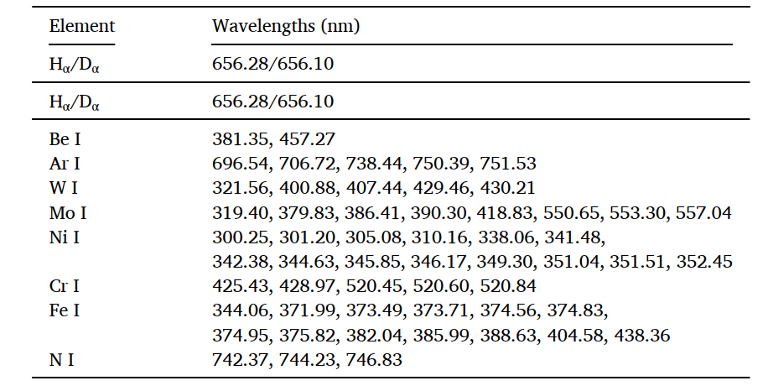
LIBS measurements at VTT
Reliable lines of neutrals identified for each detected element.
Jari Likonen | LIBS PB meeting | VC | 27 March 2024 | Page 20

Slide 21
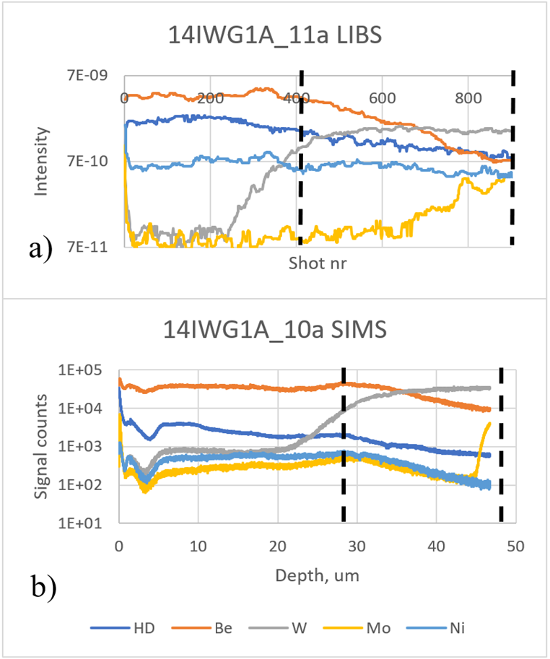
LIBS measurements at VTT in 2024, depth profiles
Comparison between LIBS and SIMS depth profiles
SIMS: thickness of co-deposited Be-layer ~28 µm
To construct the LIBS depth profiles, intensities of multiple lines for each element were summed to improve the signal-to-noise ratio.
LIBS: 15-480 shots required for ablating through Be-layer (average 120 shots)
LIBS and SIMS depth profiles rather similar
0
11a
10a
1
3
4
Jari Likonen | LIBS PB meeting | VC | 27 March 2024 | Page 21

Slide 22
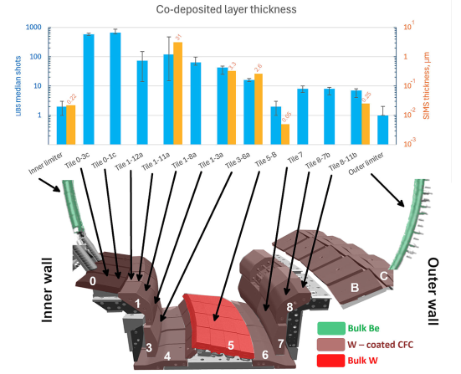
LIBS measurements at VTT in 2024, depth profiles
Median number of laser shots required to ablate through the co-deposited layers in samples from different parts of divertor along poloidal direction. This is complemented by the SIMS estimates for the co-deposited layer thicknesses.

Slide 23
Conclusions
LIBS system designed and commissioned for investigating composition and tritium content of co-deposited layers and plasma facing surfaces at JET
Testing of LIBS system at VTT and at JET
Real JET samples (from divertor and limiters) analysed
A new LIBS experiment at VTT required because LIBS setup was modified and optimized after experiments at VTT and at JET
JET experiment consisted of a sub-ns laser, necessary optics, photomultipliers and three spectrometers
840 locations analysed successfully during the measurement campaign (October 2024, ~2 weeks, 16h/day)
Overall 2 orders of magnitude reduction in 14 MeV neutron production (T content %) from start to end of clean-up
Low T signal in LIBS spectra and D and T peaks not completely separated
Heaviest Be and H isotope deposition on inner divertor tiles 0 and 1
Data analysis on-going
Fuel retention, composition of layers, calibration free LIBS, machine learning

