Slide 1
Progress in analysis of large scale datasets (AI)
LIBS Data Processing of JET data
Paweł GĄSIOR
Damian SOKULSKI, Pavel VEIS, Sanath SHETTY, Matej VEIS, Rongxing YI, Sebastijan BREZINSEK
IPPLM, CU, FZJ
All LIBS @JET contributors

Slide 2
OUTLINE
AI in 2025
Pipeline of JET LIBS data processing
  Data preparation
  Data preprocessing
  Training optimisation
  Signal reconstruction
  Performance assessment
Results of the profile reconstruction
Results of fitting of LITROW spectra
Summary + Conclusion

Slide 3

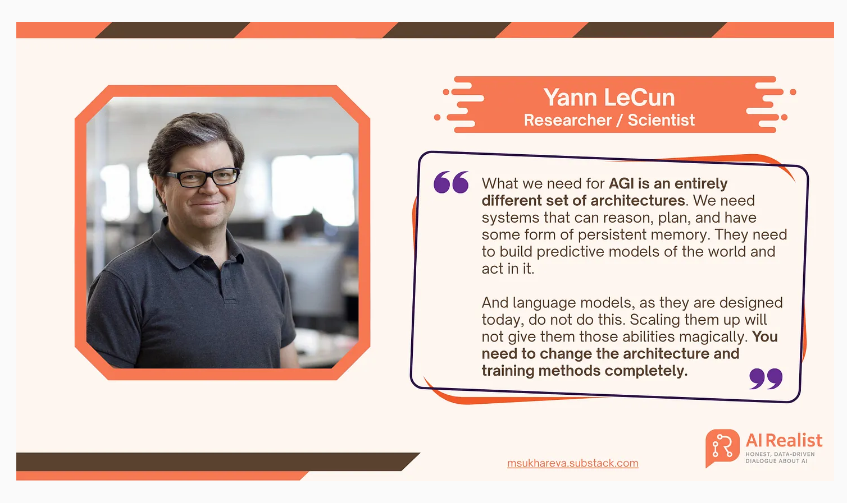

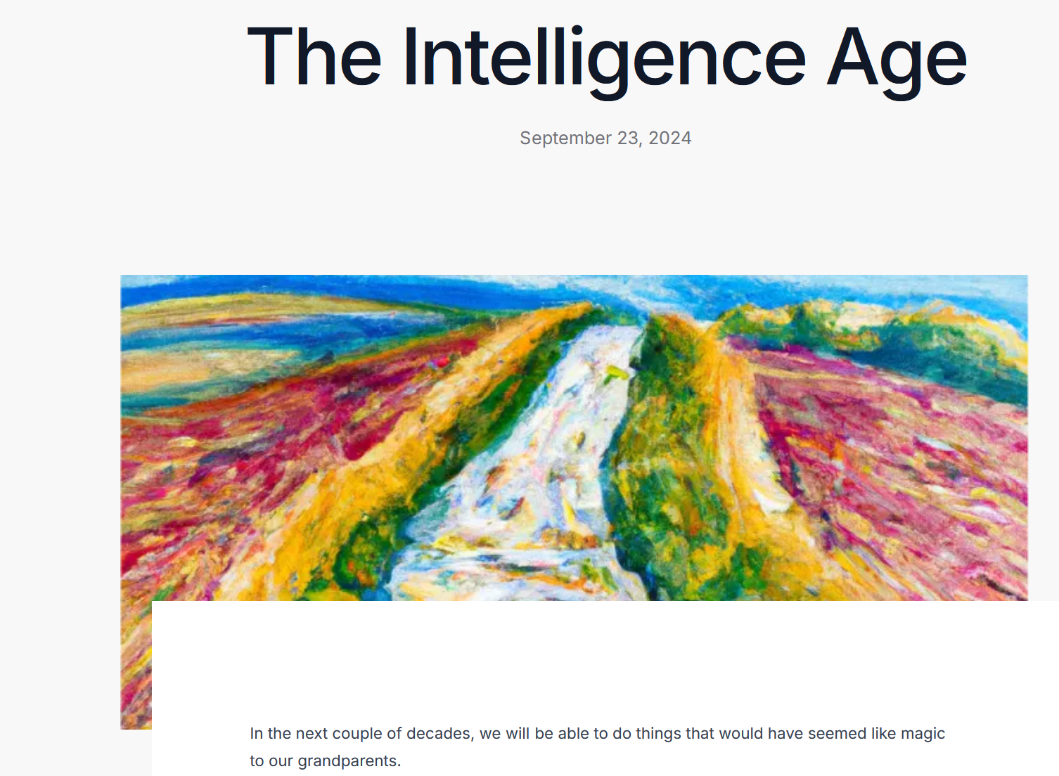

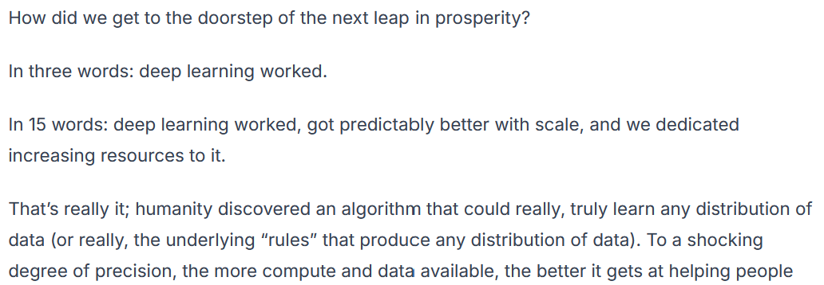
Meanwhile…
"people understand very little about how LLMs actually work, so they still think LLMs are very different from us. But actually, it's very important for people to understand that they're very like us." LLMs don’t just generate words, but also meaning.

Slide 4


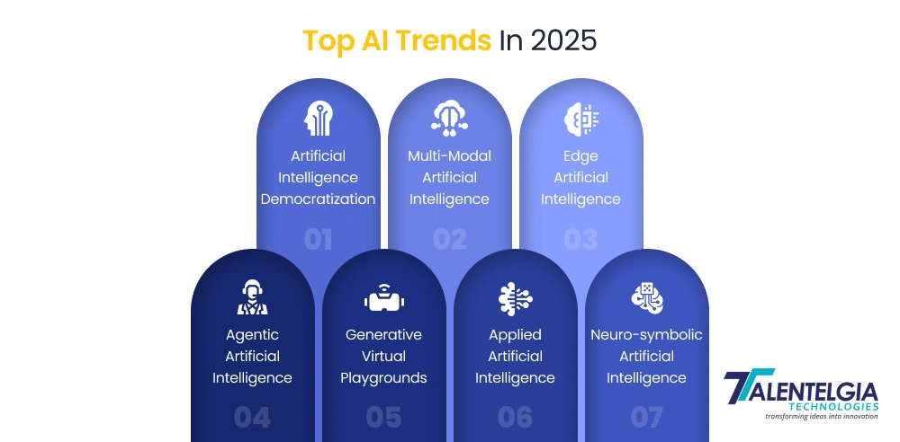
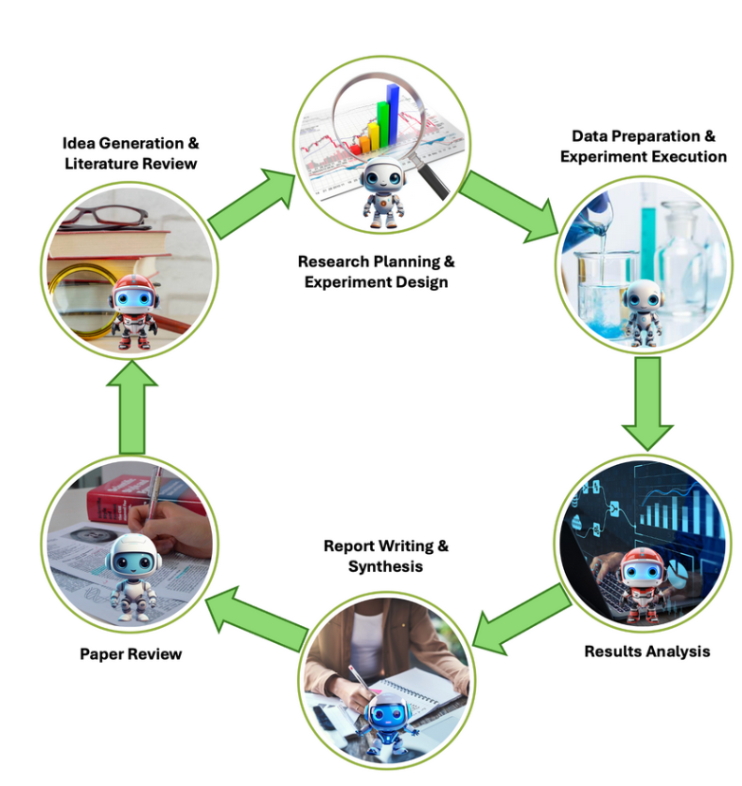
What happend in AI in 2025?

Slide 5
Experiments with AI for LIBS at the IPPLM, CU and FZJ in 2025
Preprocessing of (huge amounts) experimental data
Selection of data format for storing the data
Selection of examples for training models
Training with huge amounts
First level anomaly detection before training
Hyperparameter tuning with evolutionary algorithms
Reconstruction and data analysis
Extraction of datasets for reconstruction and visualisation
Second step of anomaly detection
Selection of features for data representation
Hyperparameter tuning with AI tools
Integration with chemical contents analysis
5

Slide 6
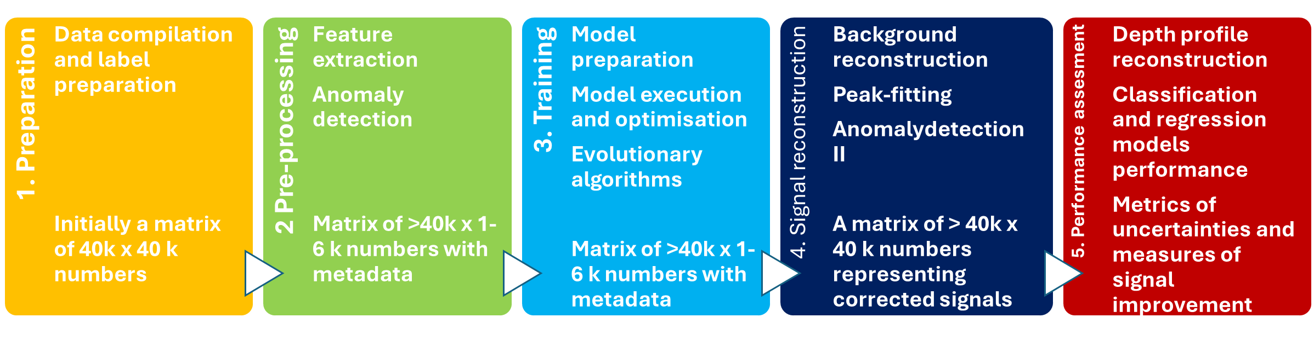
Typical workflow
Preparation
Original data is in the spectrometer native format, thus it needs to be converted to digital arrays. Since there are tens of thousands files it requires batch conversion and multi-processing algorithms.
2. Pre-processing
Although it is considered that deep learning performs feature selection automatically, it is important to feed it with meaningful which means that non-informative fragments of spectra need to be removed. It is realized by automatic peak extraction.
First step of anomaly detection is implemented here: algorithm checks if the spectrum contains unexpected peaks and gives their coordinates.
3. Model preparation and training
Data needs to be divided into training, validation and test sets. Instead of standard division in which most of data is taken for training, here 50 % of data serves for test to simulate real time data processing on previously trained model.
Data processing engine is based on autoencoders and model optimisation is performed on genetic algorithms.
4. Signal reconstruction
After the models are optimised and tested they need to be used to predict selected data-sets. First step is inference of data for all the measured spectra, however, the raw result of this operation are extracted figures which yet have to be arranged in spectra waveforms by complementing by previously removed fragments and curve fitting.
Second step of anomaly detection is implemented here: the algorithm checks if the reconstructed signals differs from the input signals more than by 3 * standard deviations and gives their coordinates.
5. Performance assessment
Based on the reconstructed signals depth profiles can be calculated and compared with those original.
The processed data can server for quantification and classification models which can be verified based on the results obtained by other techniques as e.g. SIMS.
The performance of all the models may be assessed by means of various metrics available in Scikit-learn.

Slide 7
Typical workflow
Preparation
Original data is in the spectrometer native format, thus it needs to be converted to digital arrays. Since there are tens of thousands files it requires batch conversion and multi-processing algorithms.
7

Slide 8
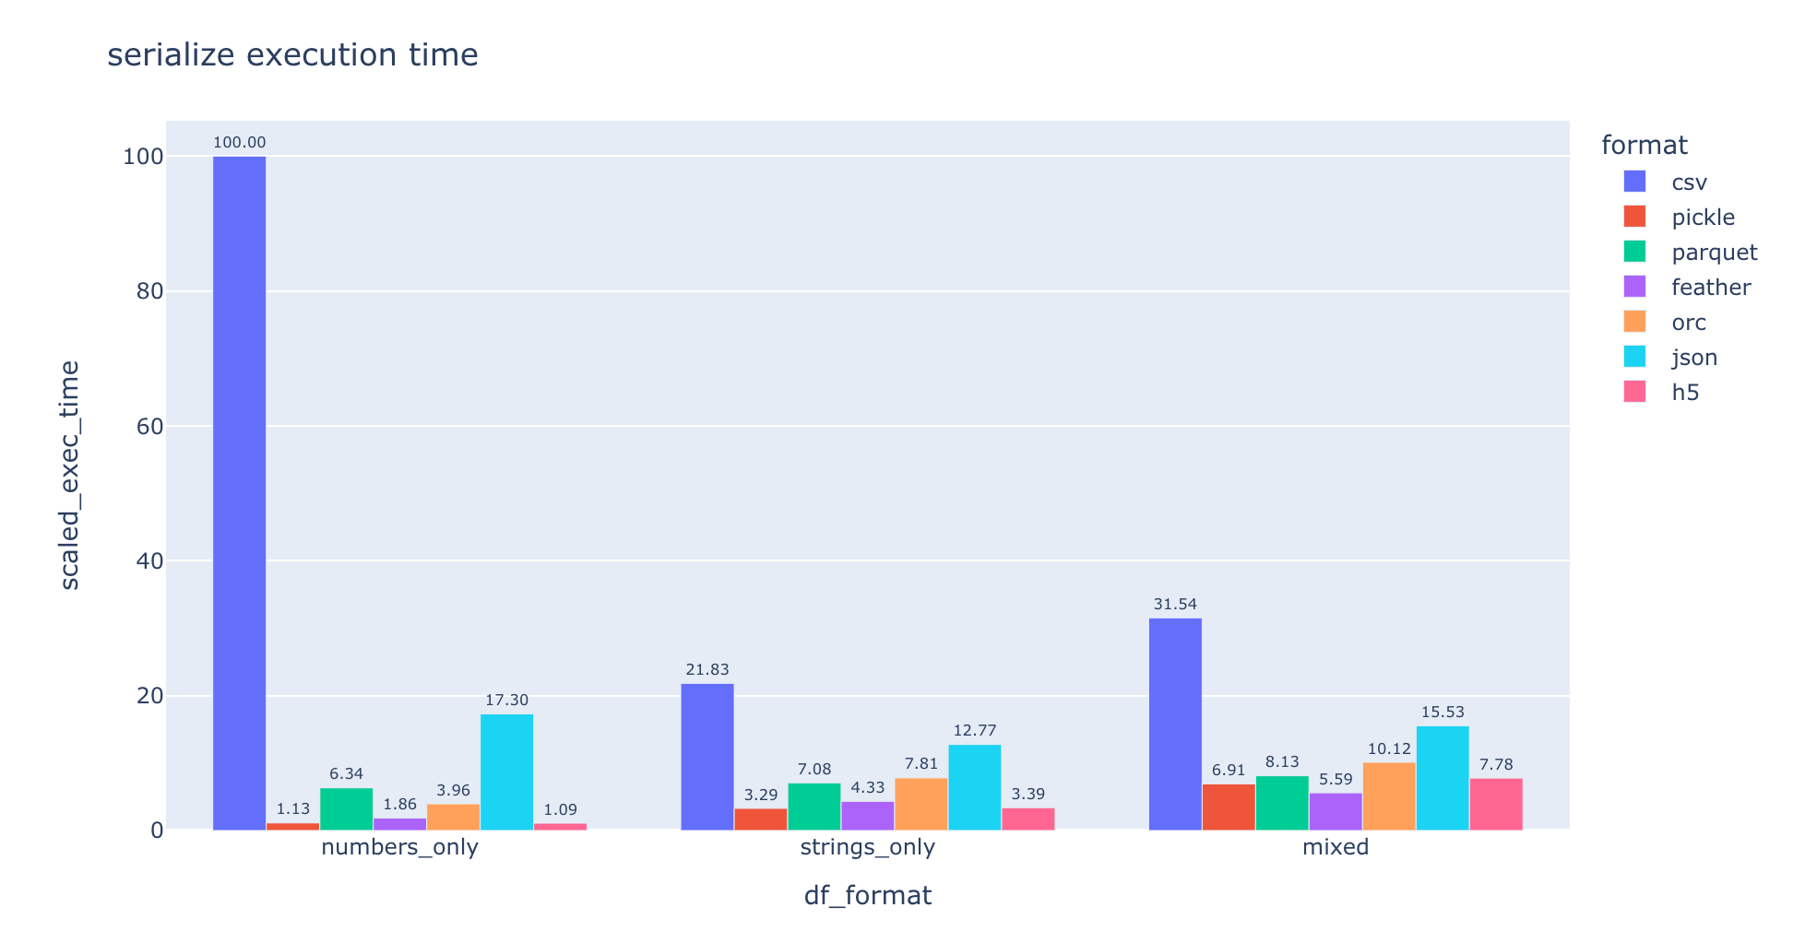
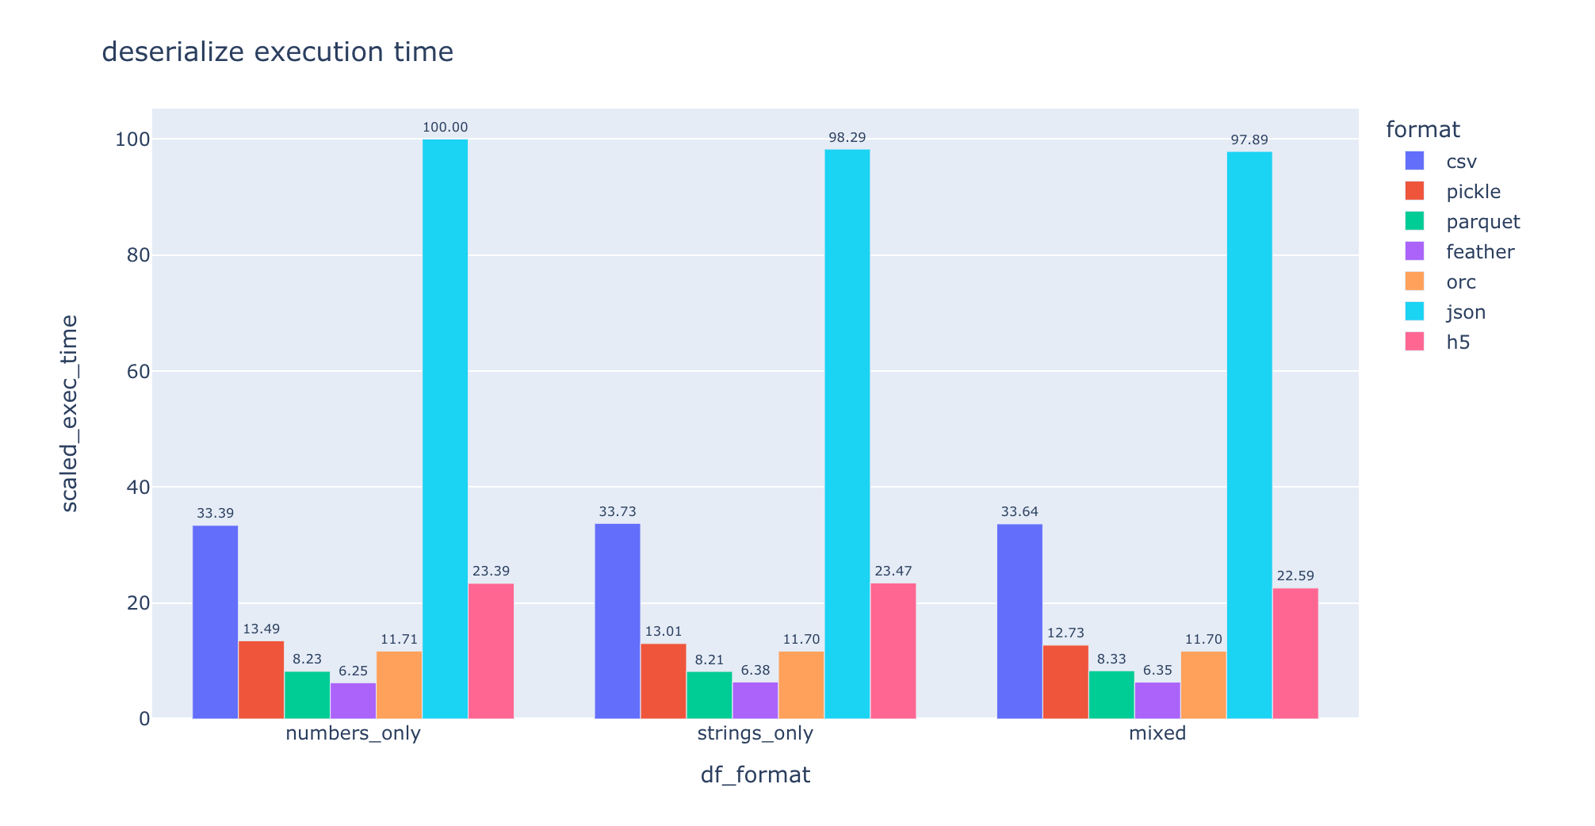
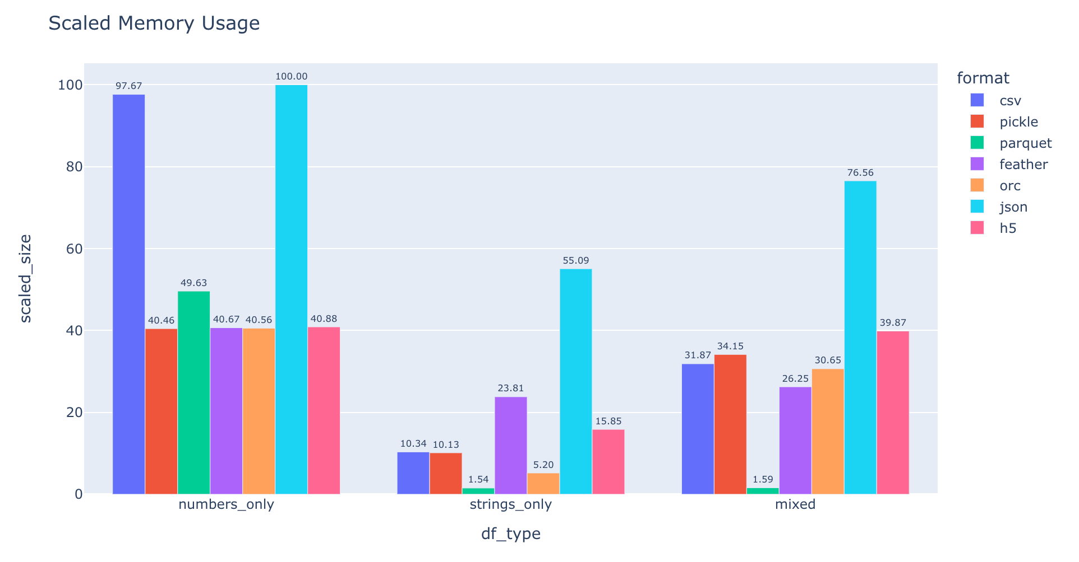
Preparation
Batch conversion of Aryelle files to .csv (Python script employing multiprocessing)
Selection of the files contibuted to given locations
Extracting data from the files to a single data frame whiLe parsing the filenames to produce metadata.
Saving data in hdf5 format

Slide 9
Typical workflow
2. Pre-processing
Although it is considered that deep learning performs feature selection automatically, it is important to feed it with meaningful which means that non-informative fragments of spectra need to be removed. It is realized by automatic peak extraction.
First step of anomaly detection is implemented here: algorithm checks if the spectrum contains unexpected peaks and gives their coordinates.
9

Slide 10
Preprocessing – feature extraction and verification
Averaging
(representative)
Extracting peaks of given parameters
(SciPy)
Confirmation of the presence of substantial features
1st level anomaly detection
Saving data in hdf5 format

Slide 11
Typical workflow
3. Model preparation and training
Data needs to be divided into training, validation and test sets.
Instead of standard division in which most of data is taken for training, here less than 50 % of data serves for test to simulate real time data processing on previously trained model.
Data processing engine is based on autoencoders and model optimization is performed on genetic algorithms and novel AI based tools.
11

Slide 12
Model preparation and training
Preparation of the environment
Reading the data
Splitting the data for training, validation and test (the rest)
Saving the data
Prearation of the optimisation method and environment
Cycles of training and validation for different optiimisation methods (Evolutionary, Automatic (Keras Tuner))
Saving models in hdf5 format

Slide 13
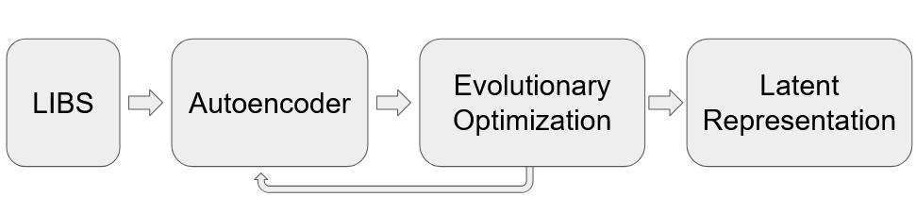
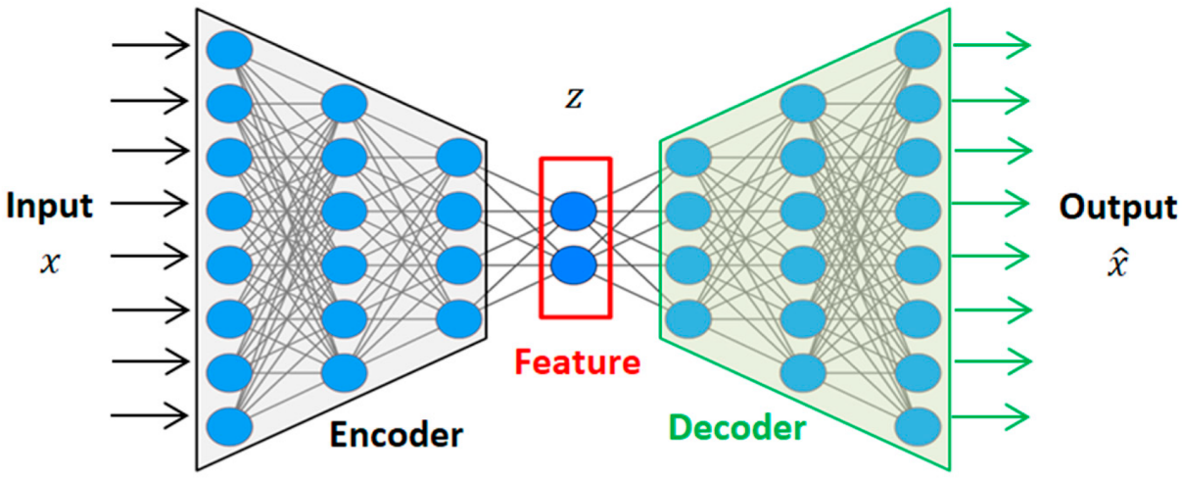
Hyper parameter tuning (A smoother example)
Spectra provided by Rongxing Yi, FZJ Juelich
Nd:YAG laser (5 ns, 50 mJ, 1064 nm)
Pure elemental samples of Al, Cr, Fe, Mo, Ni, W, and Zn
200 - 900 nm range, 26 000 wavelengths sampled
Linear combination of spectra simulating varying composition

Slide 14
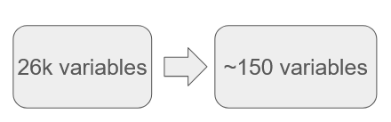
Autoencoder advantage
Compression ration of 170
For reference:
zip: 2-10
JPEG: 10-20
MP4: 50
Hidden | Latent | Regularizer | Activation | MSE | CosSim | Relative Error
1621 | 195 | 0.0 | leaky ReLU | 0.021 | 0.23 | 6.4%
1377 | 136 | 0.0012 | tanh | 0.20 | 0.041 | 11%
There are different hyperparameters for minimizing
the error and the cosine similarity, which can have
Advantages when taking into account different goals.

Slide 15
Typical workflow
4. Signal reconstruction
After the models are optimised and tested they need to be used to predict selected data-sets. First step is inference of data for all the measured spectra, however, the raw result of this operation are extracted figures which yet have to be arranged in spectra waveforms by complementing by previously removed fragments and curve fitting.
Second step of anomaly detection is implemented here: the algorithm checks if the reconstructed signals differs from the input signals more than by 3 * standard deviations and gives their coordinates.
15

Slide 16
Signal reconstruction and analysis preparation
Reading the model
Inference of data from the given part of the test set.
Saving the data
Reconstruction of the lines (fitting)
Reconstruction of the profiles.
Saving data in hdf5 format
2 nd level anomaly detection (Based on the prediction error)
Preparation of analysis, statistics, graphs, etc.

Slide 17
Typical workflow
5. Performance assessment
Based on the reconstructed signals depth profiles can be calculated and compared with those original.
The processed data can server for quantification and classification models which can be verified based on the results obtained by other techniques as e.g. SIMS.
The performance of all the models may be assessed by means of various metrics available in Scikit-learn.
17

Slide 18
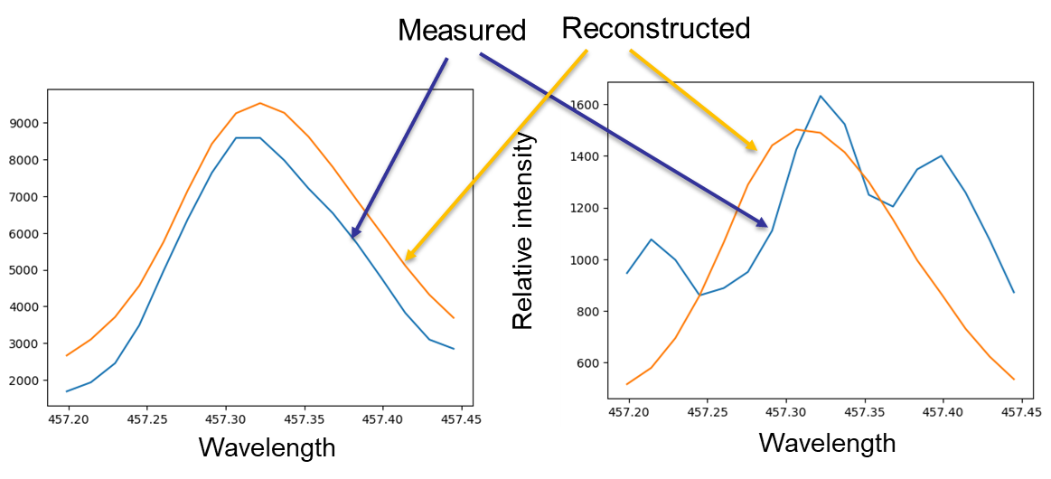
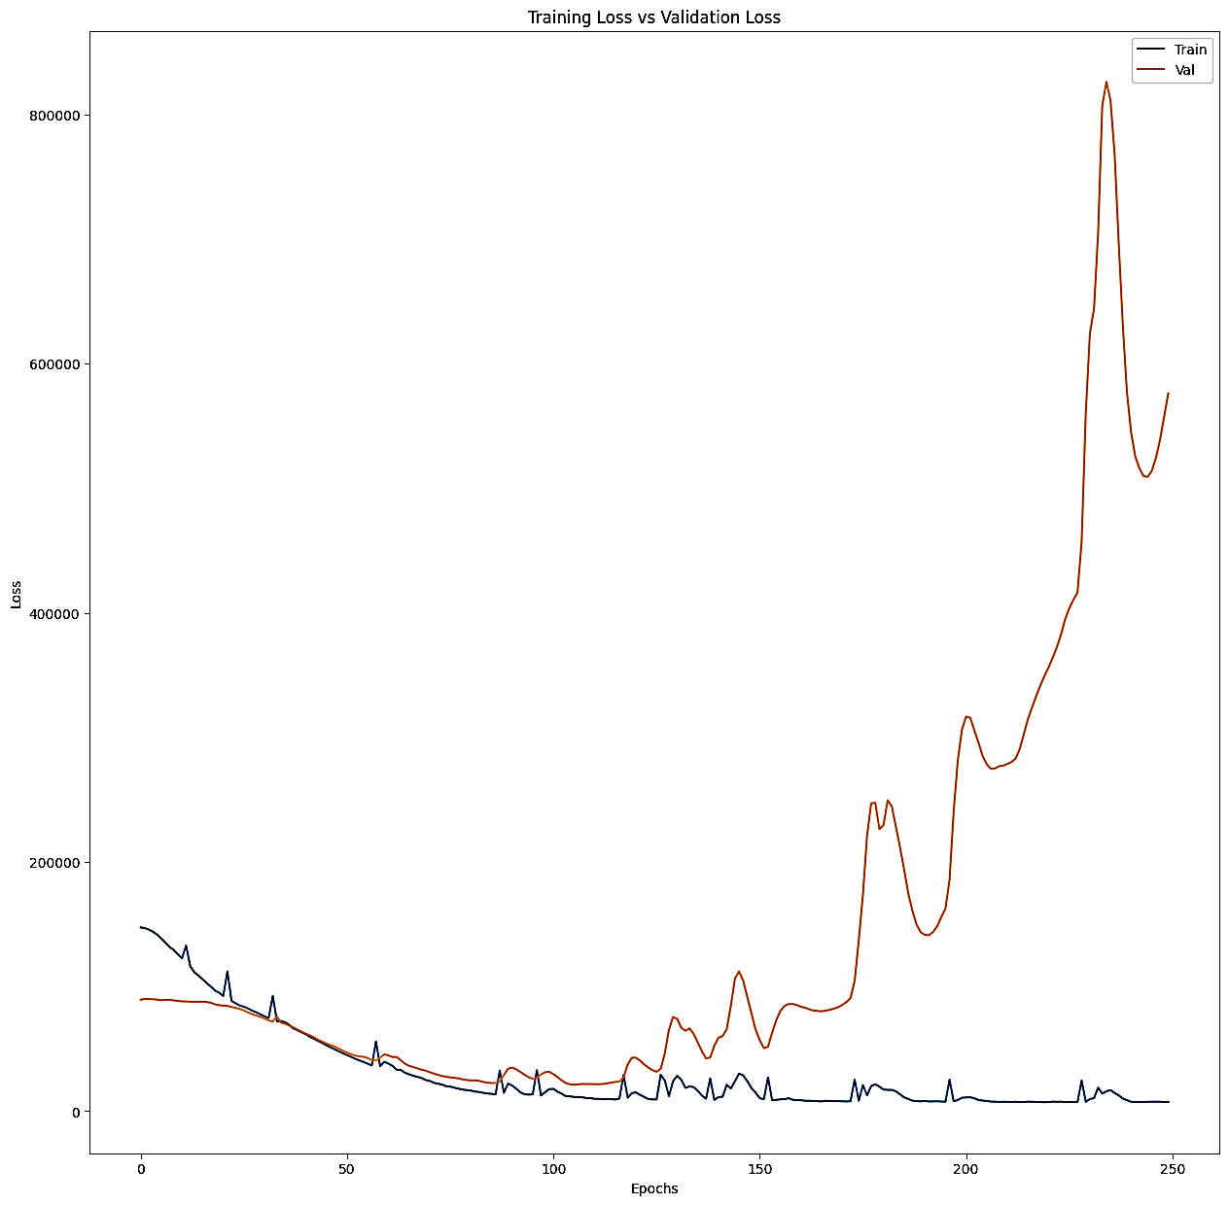
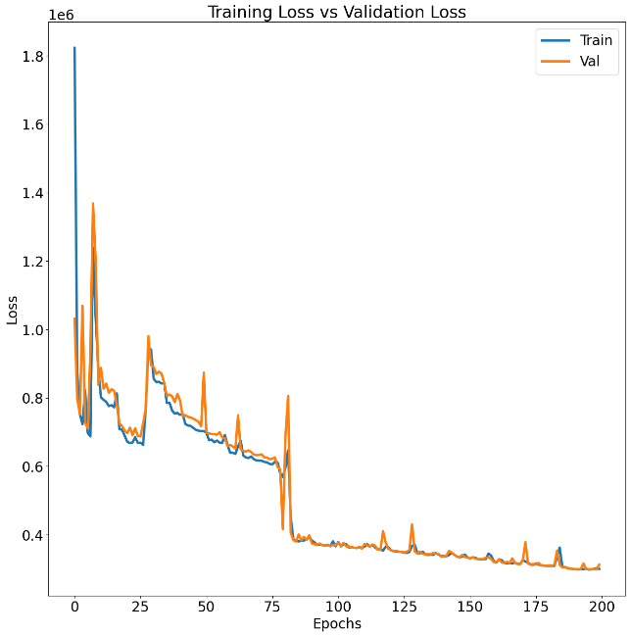
Line reconstruction and why we think it works
Memorisation
vs
Generalisation
Reconstructed lines have shape more similar to theoretical, the influence of fluctuations is decreased, on the other hand, the anomaly detection algorithm checks if the discrepancy is not questionable.
When fitting a model with millions of parameter there is a risk of overfitting in which the model „remembers” the noise.
In the learning curves it is manifested by divergent training and validation curves.

Slide 19
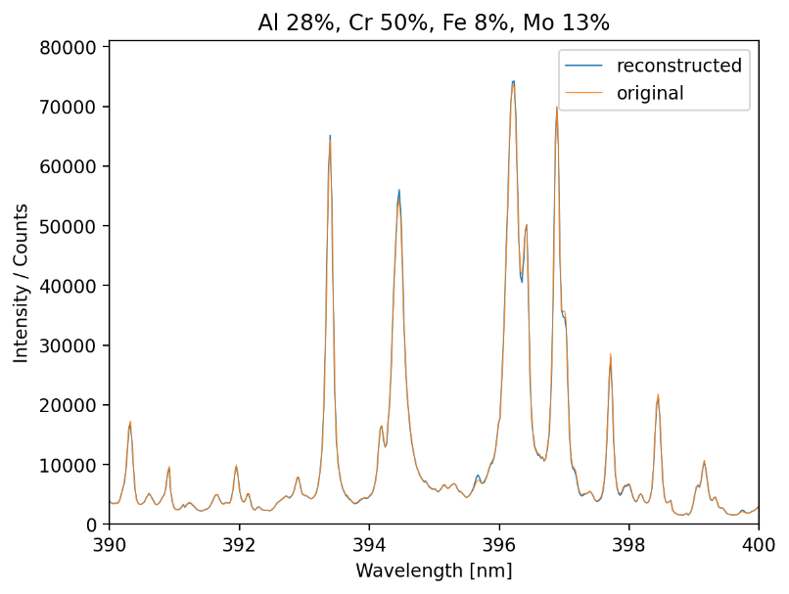
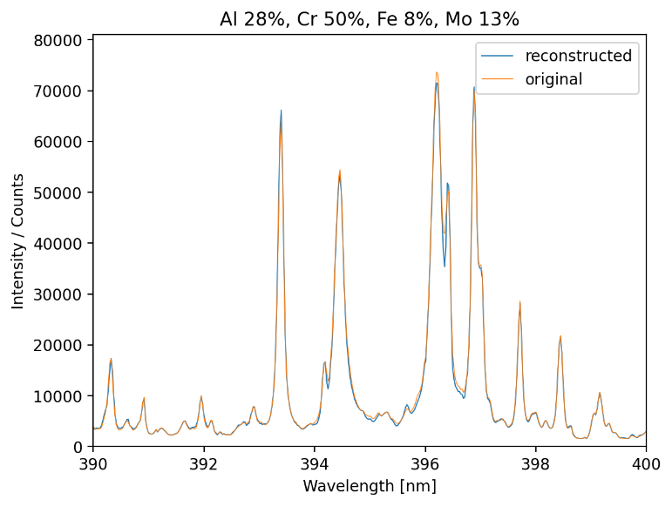
Performance of reconstruction
Reconstruction
Without autoencoder:
MSE = 1.7 x 10⁻⁵
RMSE = 0.27%
R² = 0.9993
Training time = 20 min
With autoencoder:
MSE = 2.3 x 10⁻⁵
RMSE = 0.31%
R² = 0.9993
Training time = 30 s
With the autoencoders the accuracy is insignificantly lower, but still excellent and the computative cost is substantially lower.

Slide 20
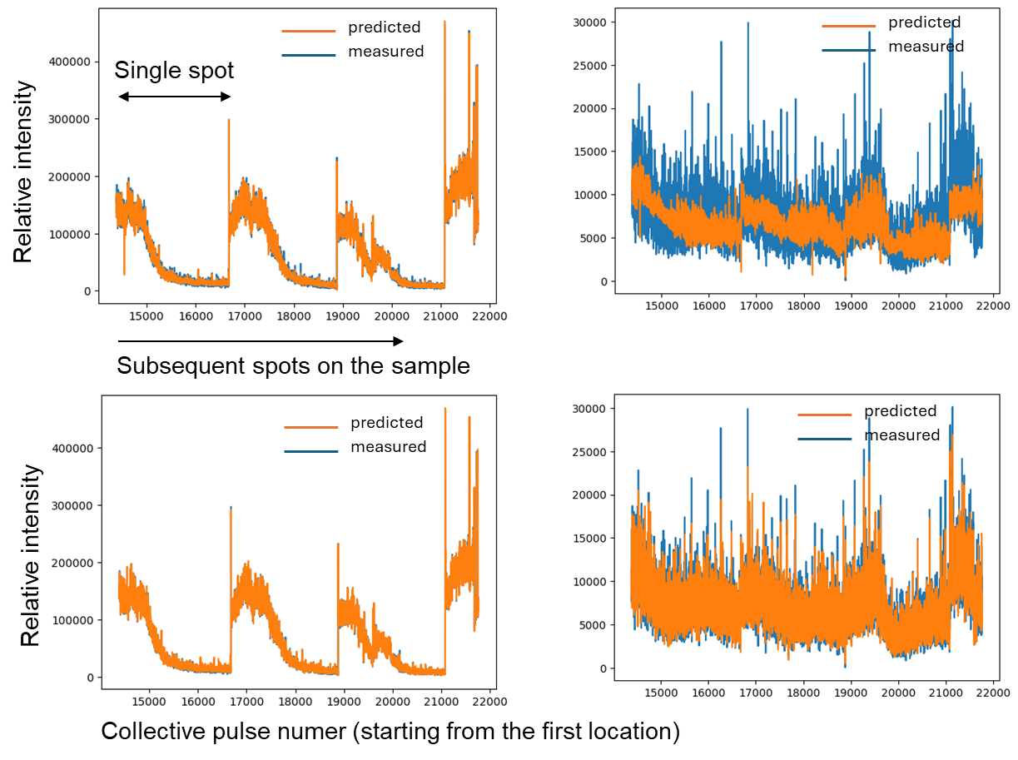
Profile reconstruction
Diagrams show collective profiles for Be and H for HGFC_1c sample through subsequent locations. The difference between the upper and lower models are in the number of parameters in the latent layer.
Both models are capable of tracking changes in Be, however, the upper model is not sufficient to track H due to its lower representation in training data.
The models with sufficient number of parameters are capable of tracking fluctuations of the major lines filter out the stochastic parts of the signals.

Slide 21
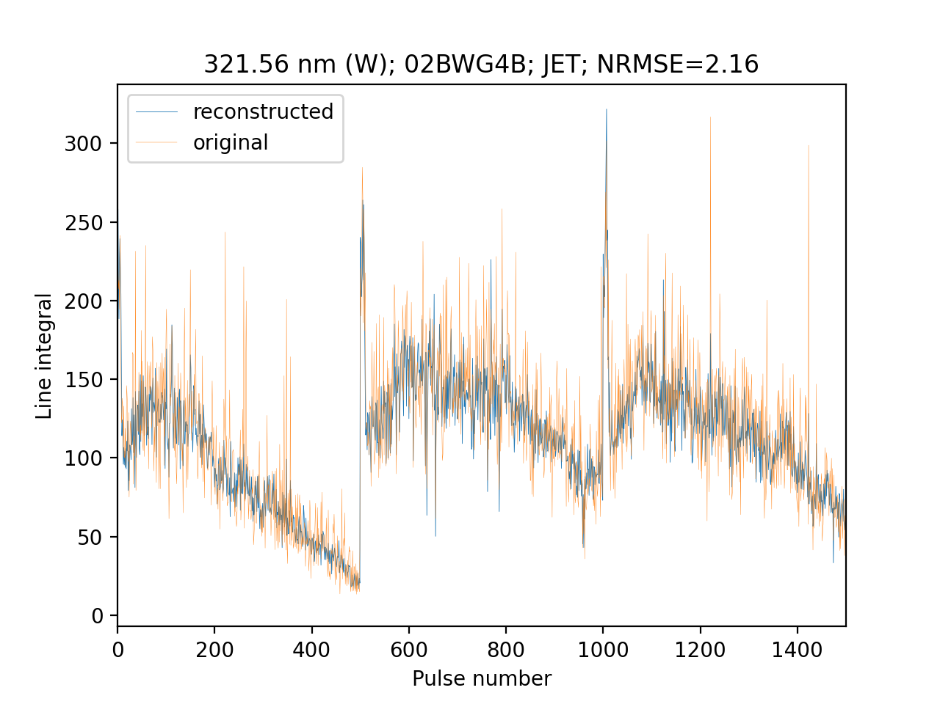
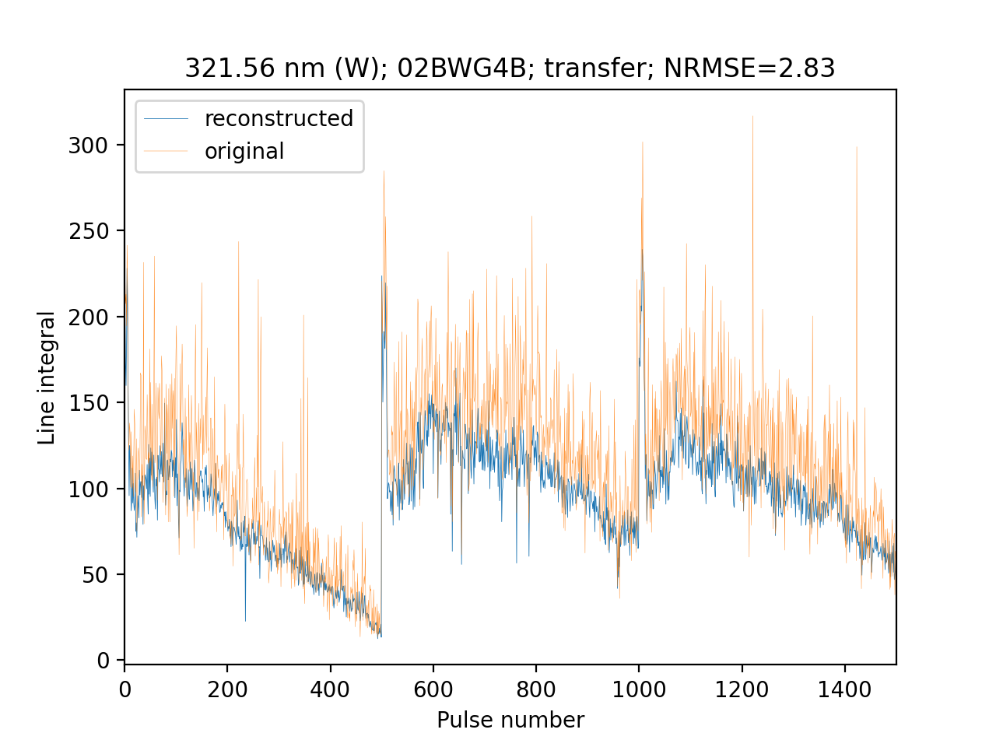
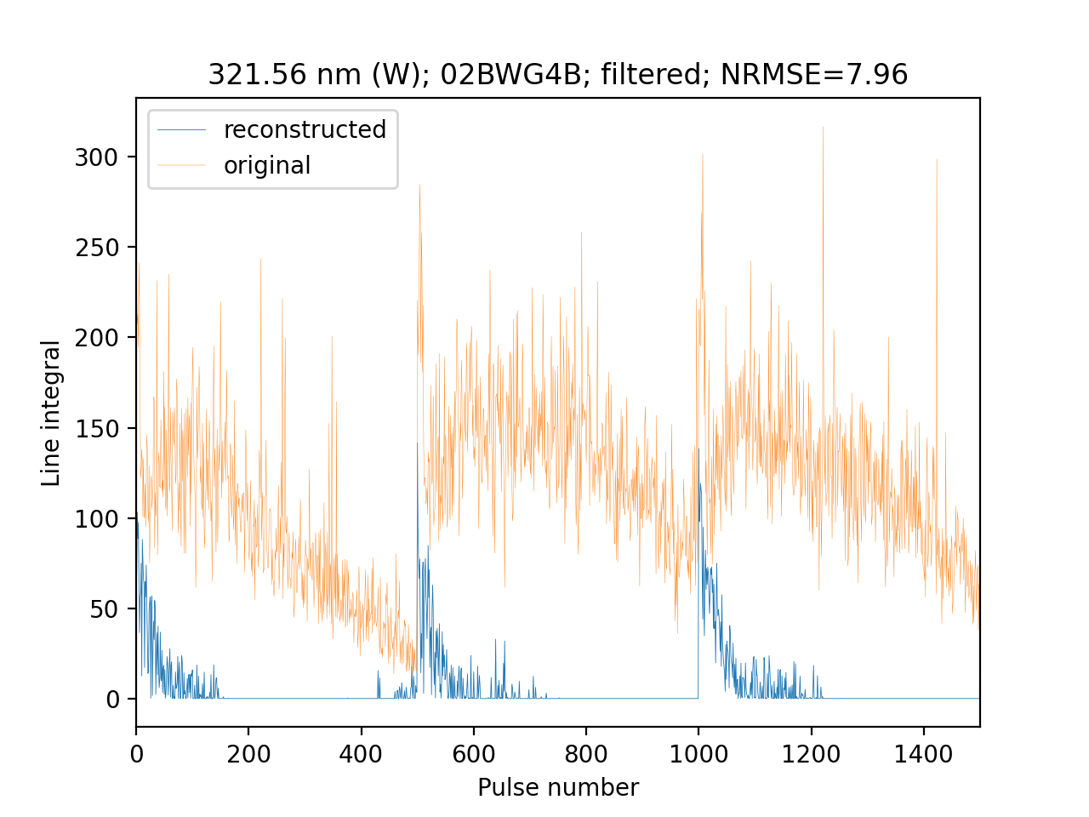
Reconstruction of profiles for JET data (I)

Slide 22
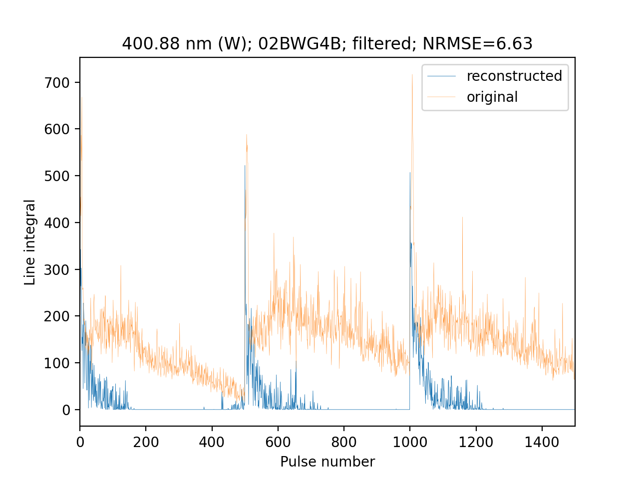
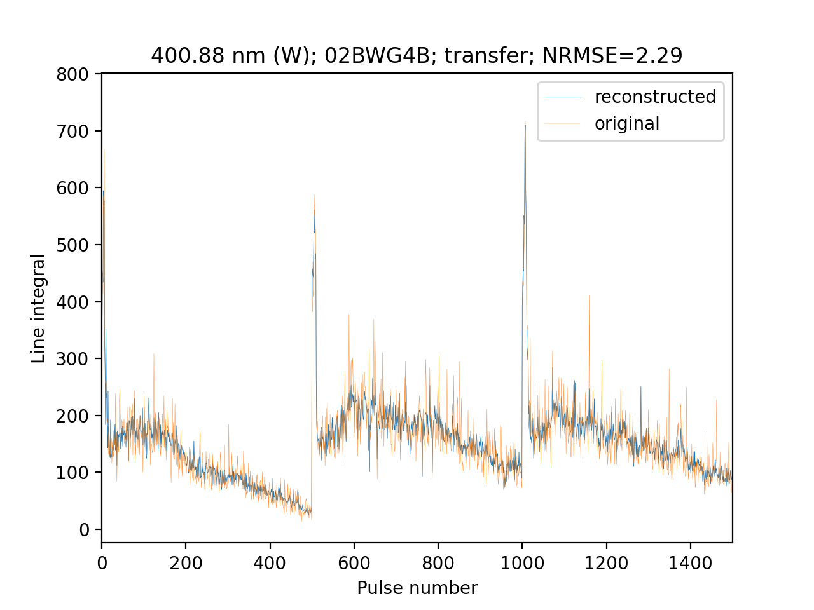
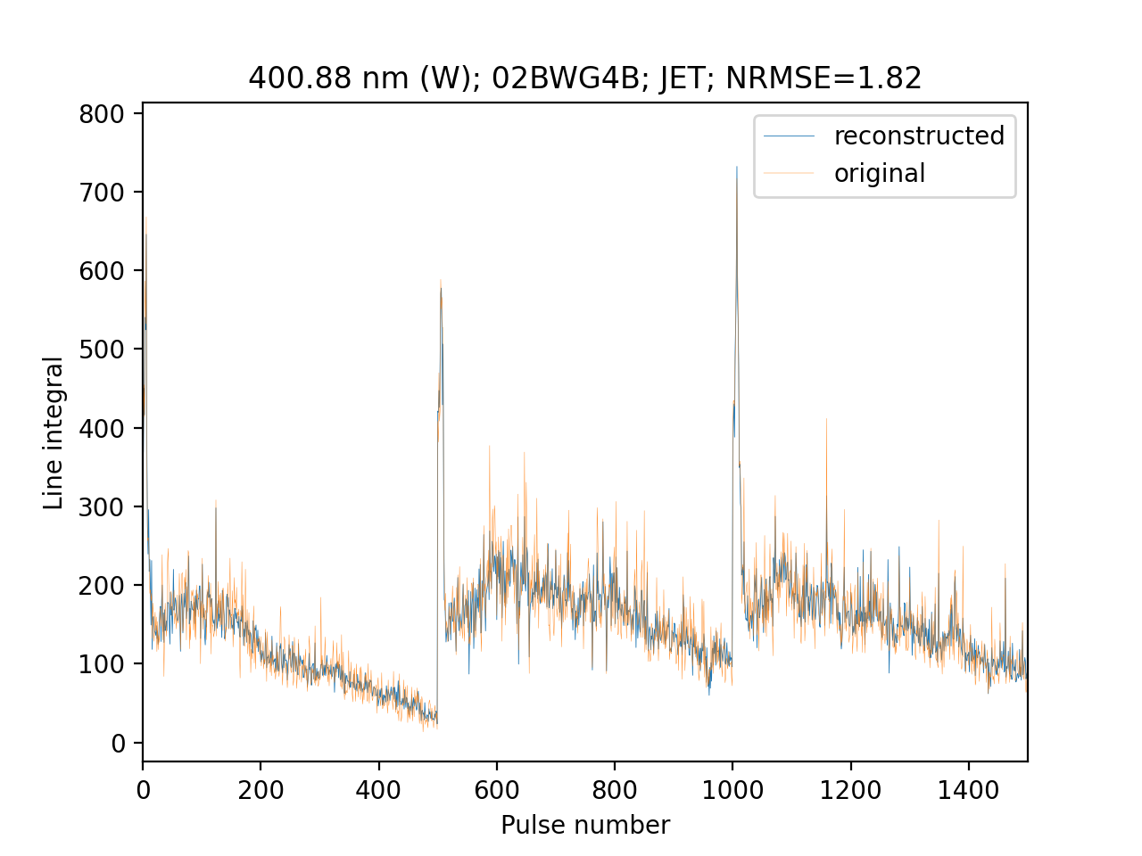
Comparison of tungsten lines

Slide 23
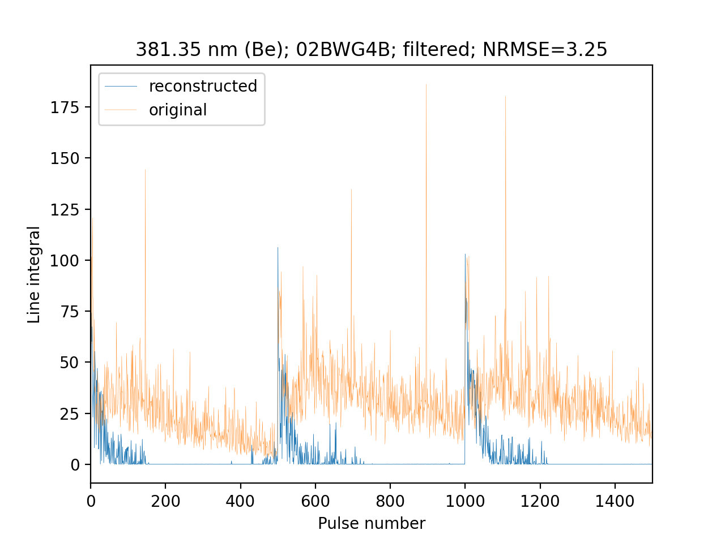
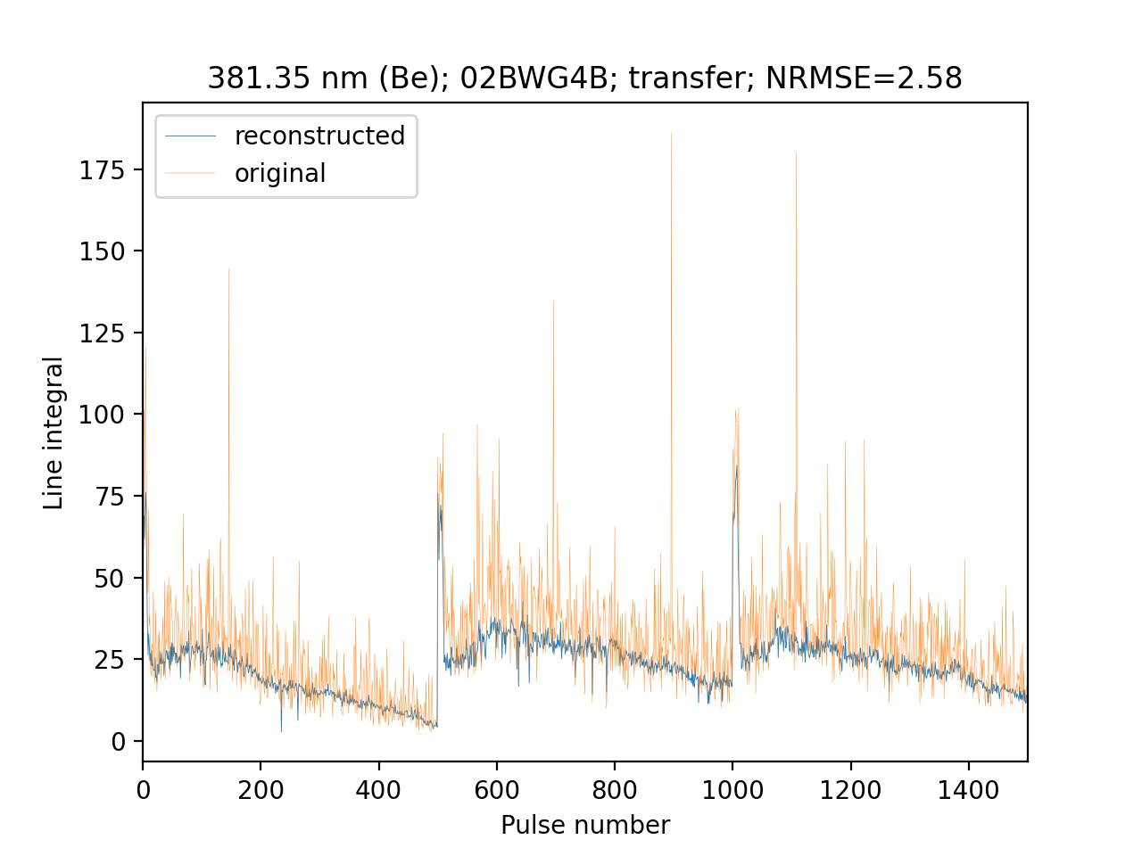
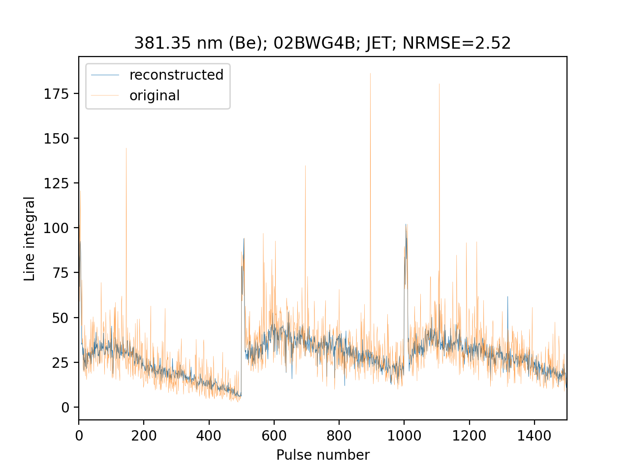
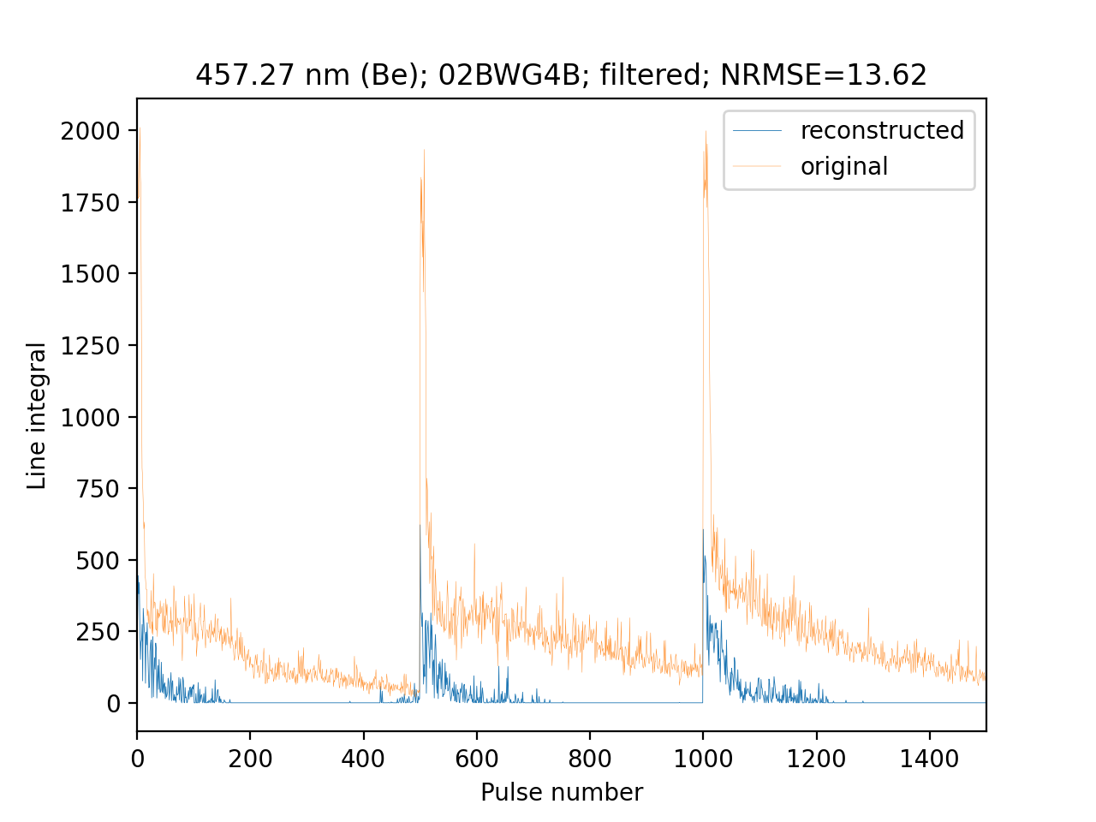
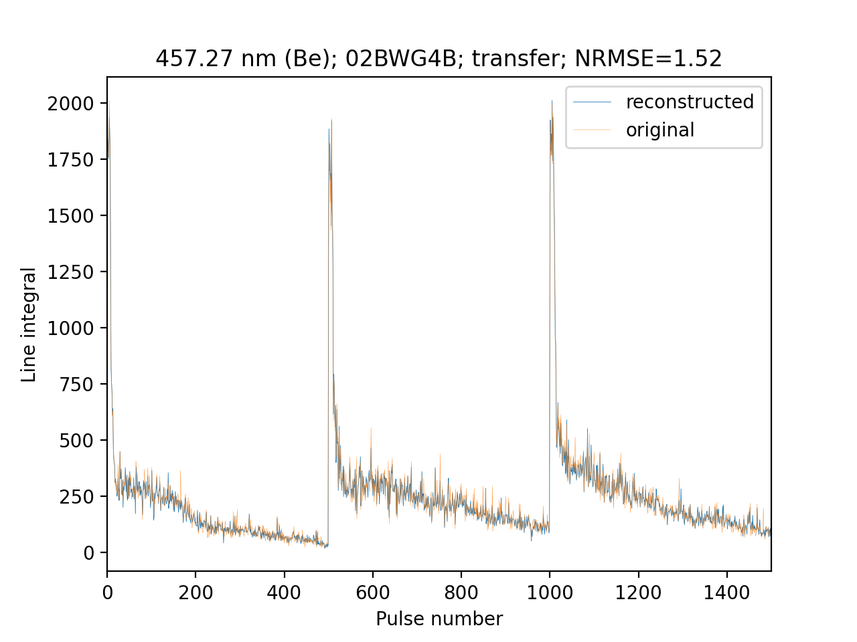
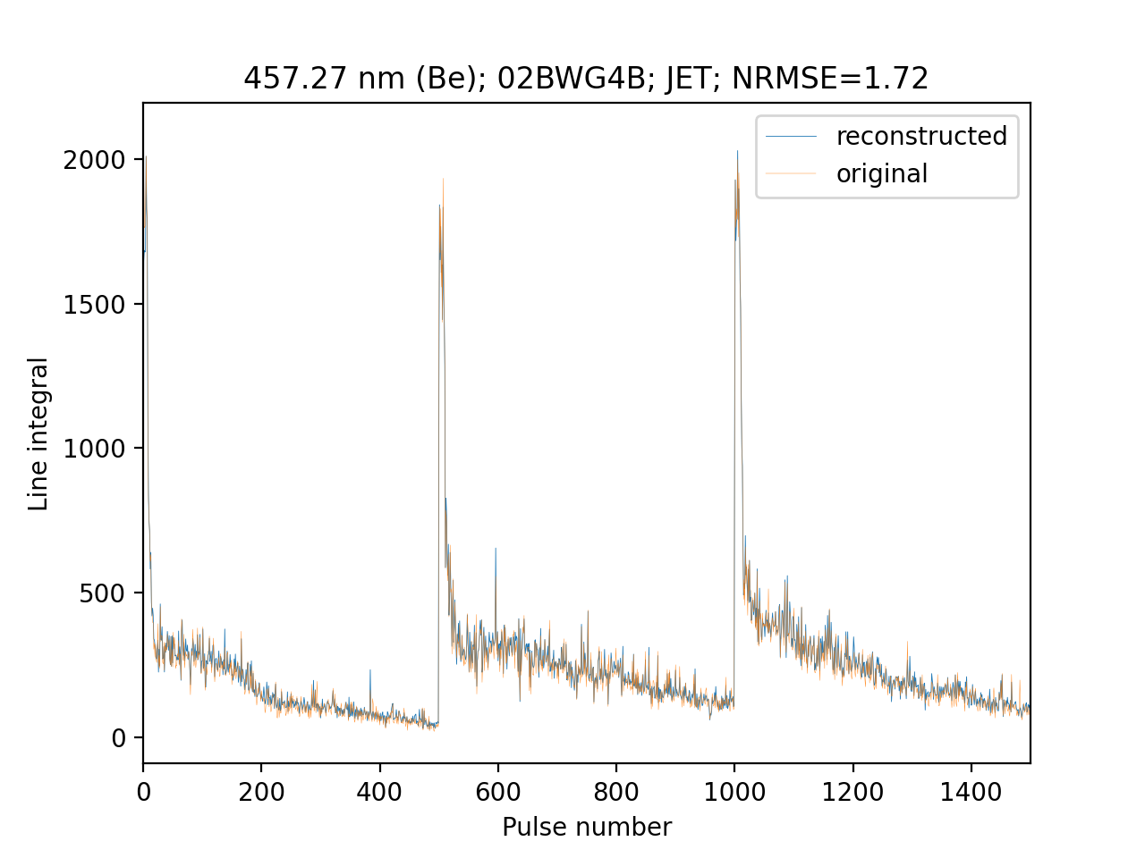
Comparison of Be lines

Slide 24
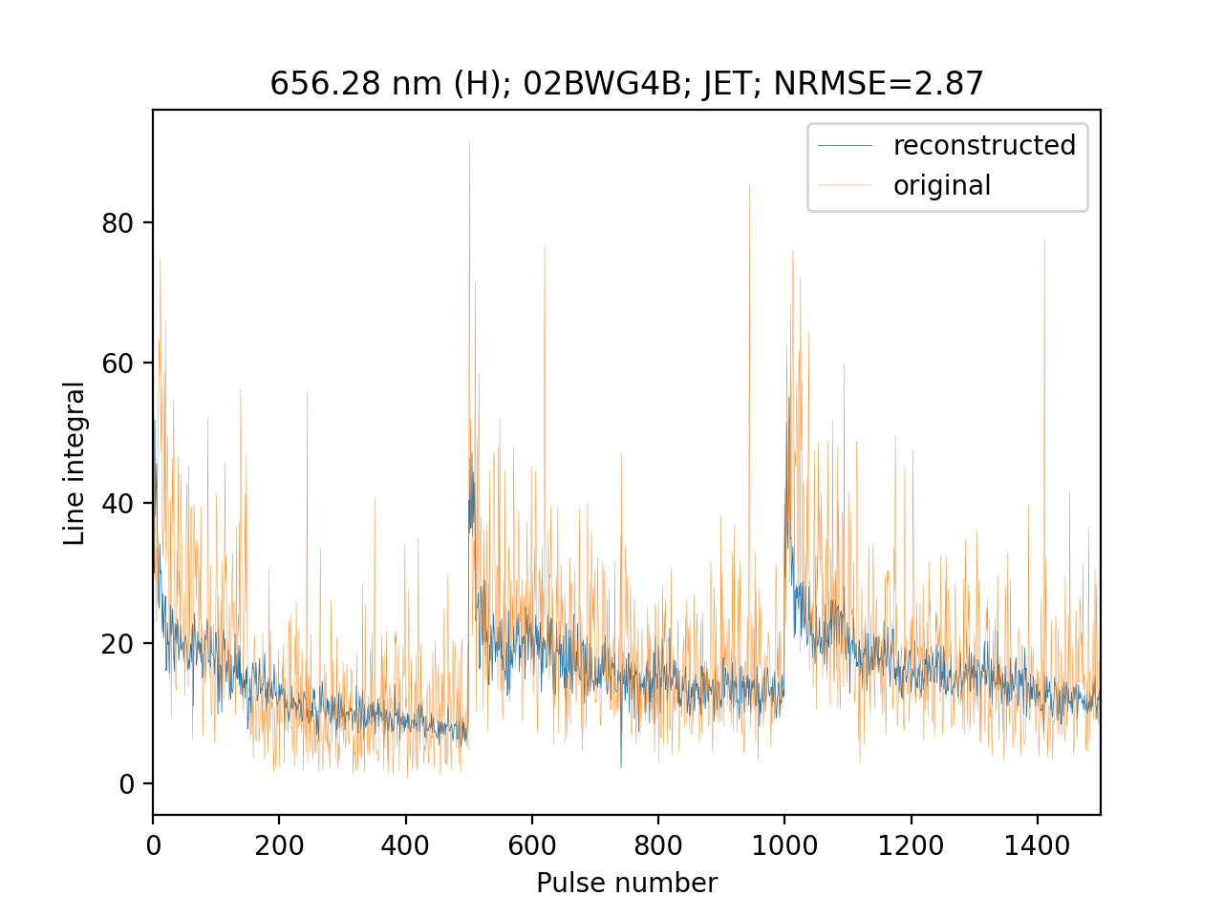
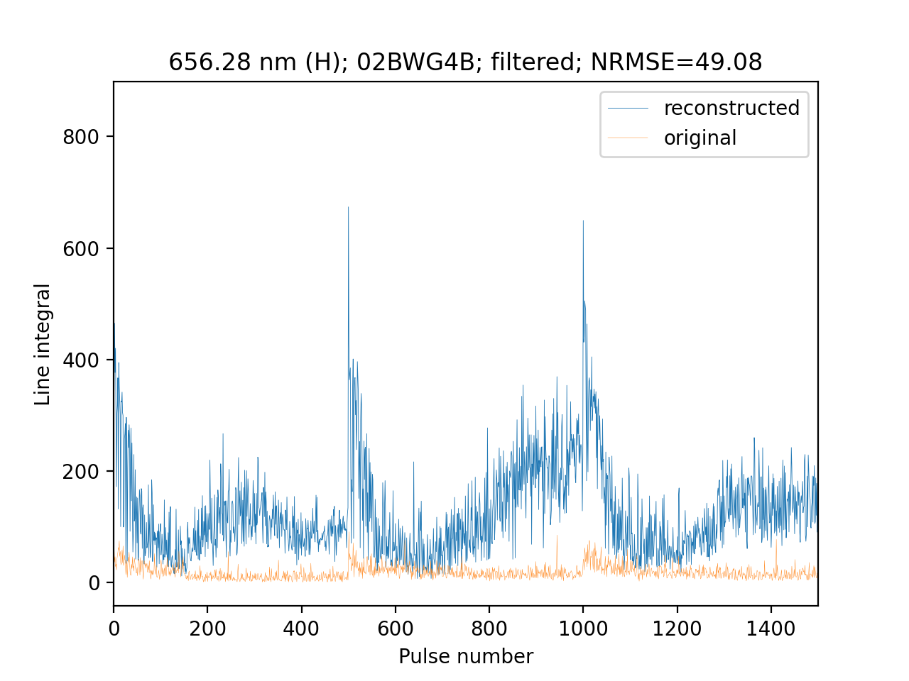
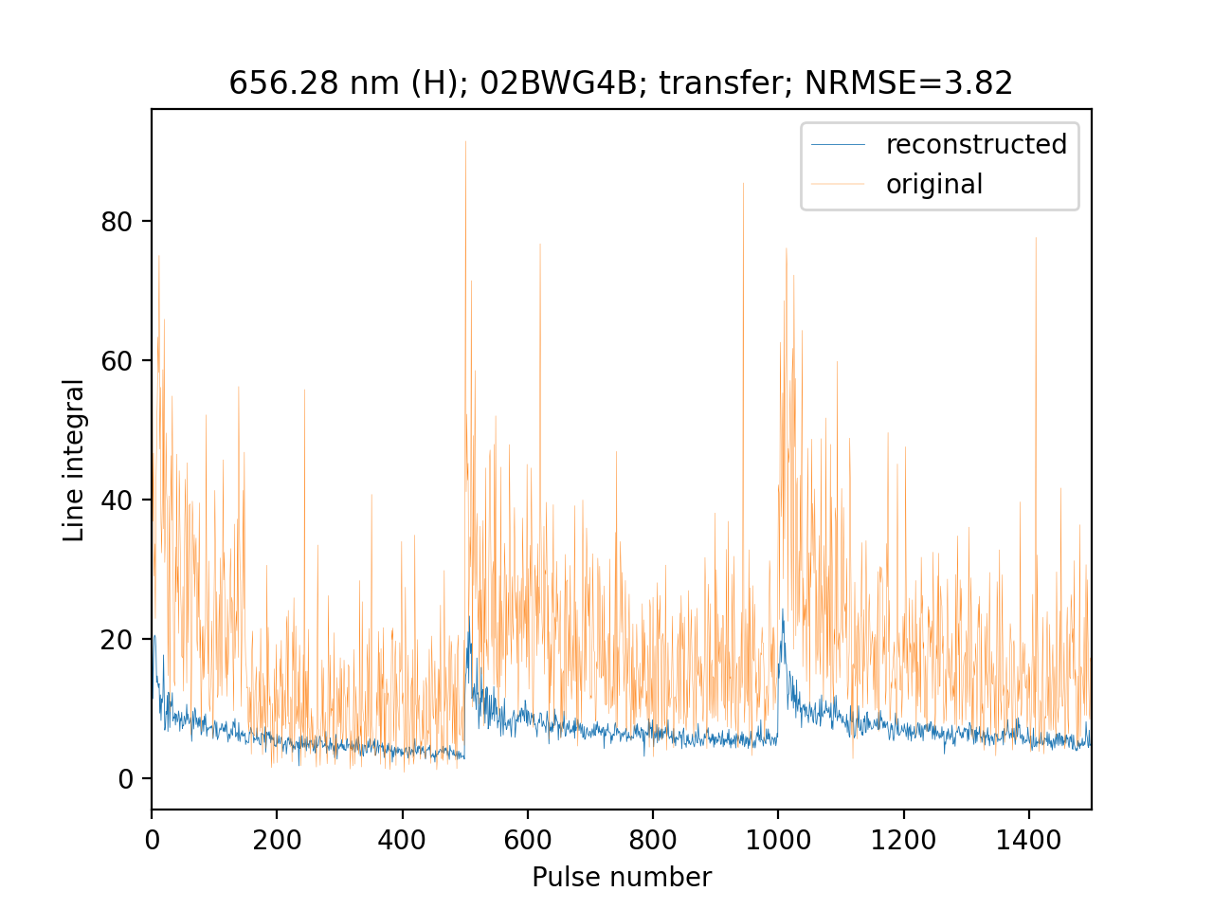
Comparison of H lines reconstruction

Slide 25
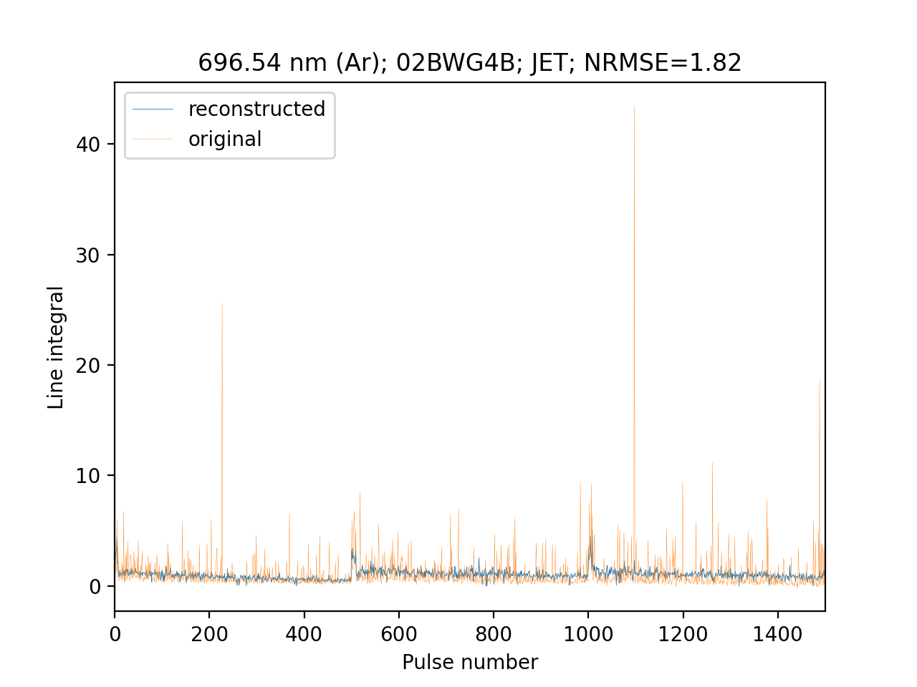
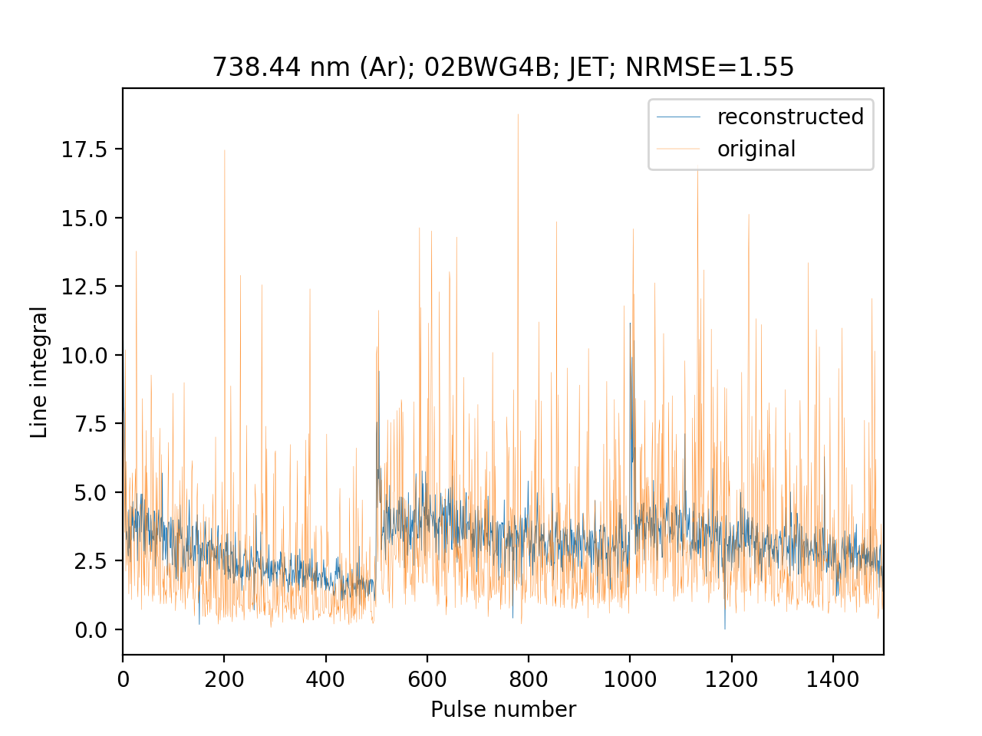
Argon lines

Slide 26
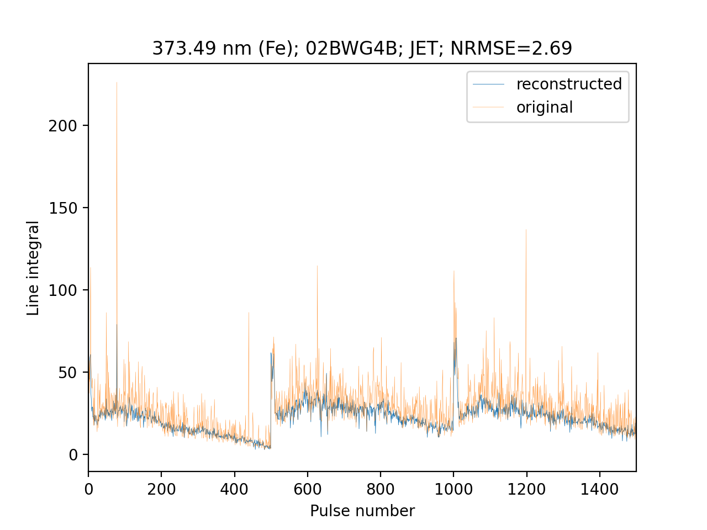
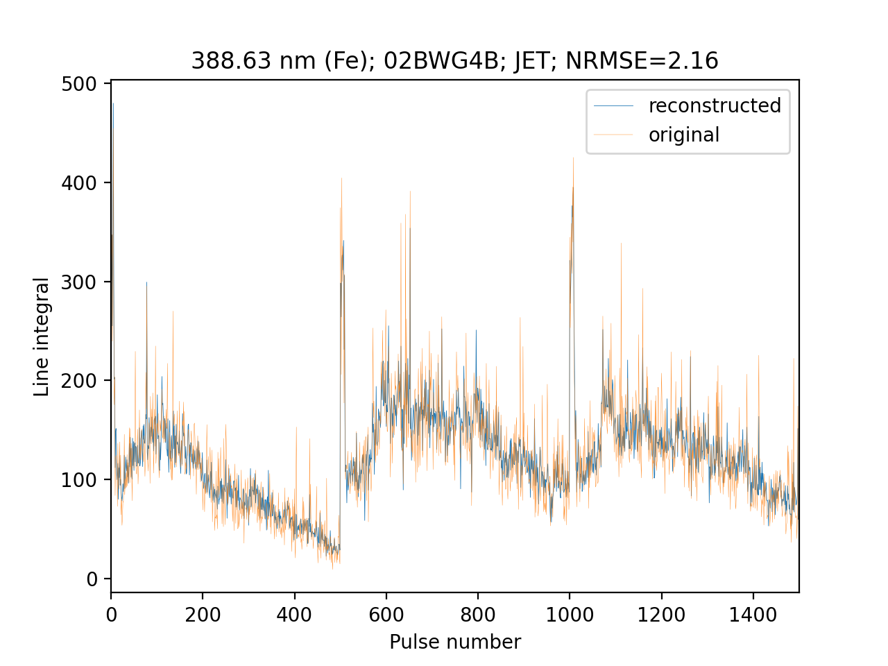
Fe lines

Slide 27
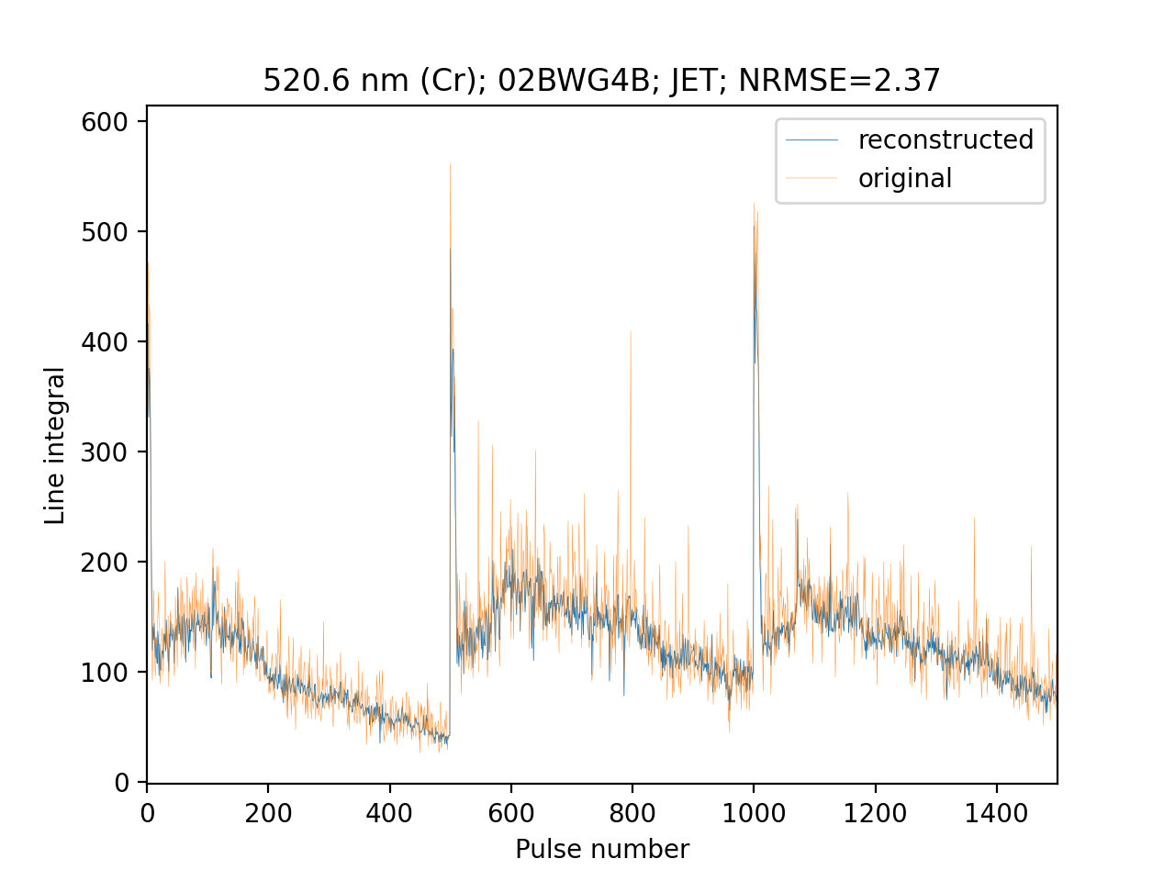
Cr lines vs Fe lines

Slide 28
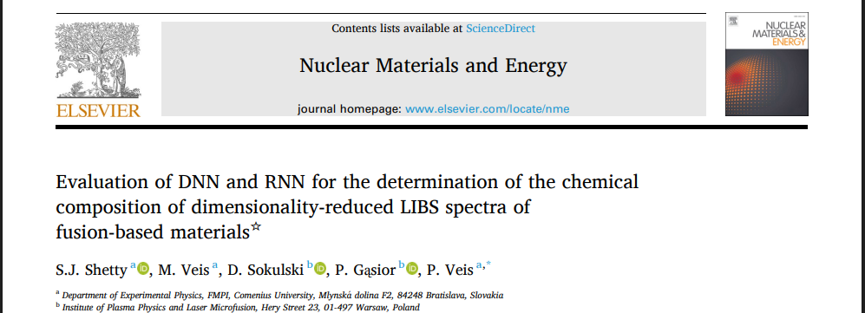
AI - Preparation and validation of deep learning models for pre-processing experimental data (CU)
Work done in 2025:
A comparative study was carried out on DNN and RNN methods for the analysis of simulated LIBS spectra of fusion-relevant elements derived from the NIST database.
A dataset consisting of 7400 spectra with a spectral resolution λ/Δλ=4000 was generated for training and testing.
The dimensionality of the data was reduced from 41730 to 1024 points using encoder style architecture and the reduced dataset (latent) was trained using DNN, GRU and Bi-LSTM.
Model hyperparameters were optimized using the Polar Bear Optimization Algorithm, a population-based heuristic optimization technique.
10 target elements (which one ) and T_{e} (from to) were quantified using DNN and RNN algorithms with R² of 0.96 and 1.00 (for W and T_{e} respectively.

Slide 29
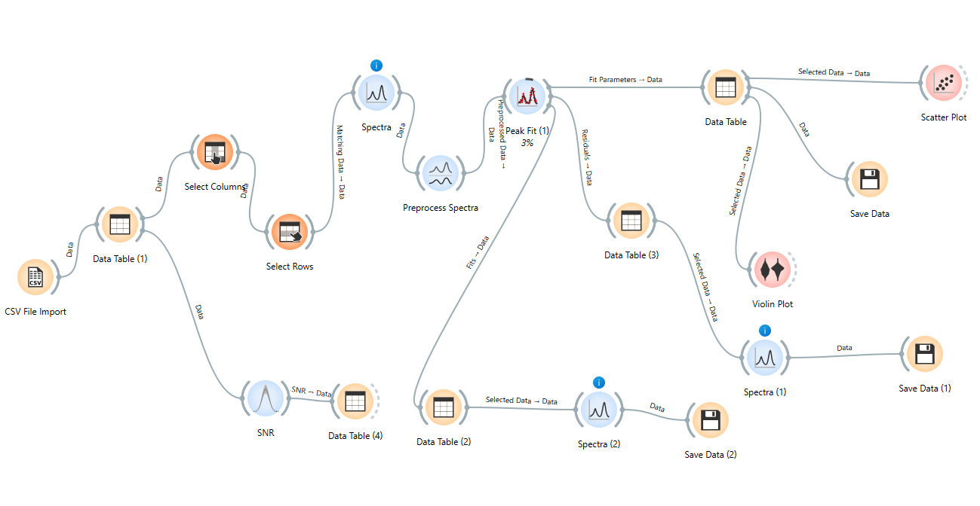
Analysis of high resolution data with Orange framework

Slide 30
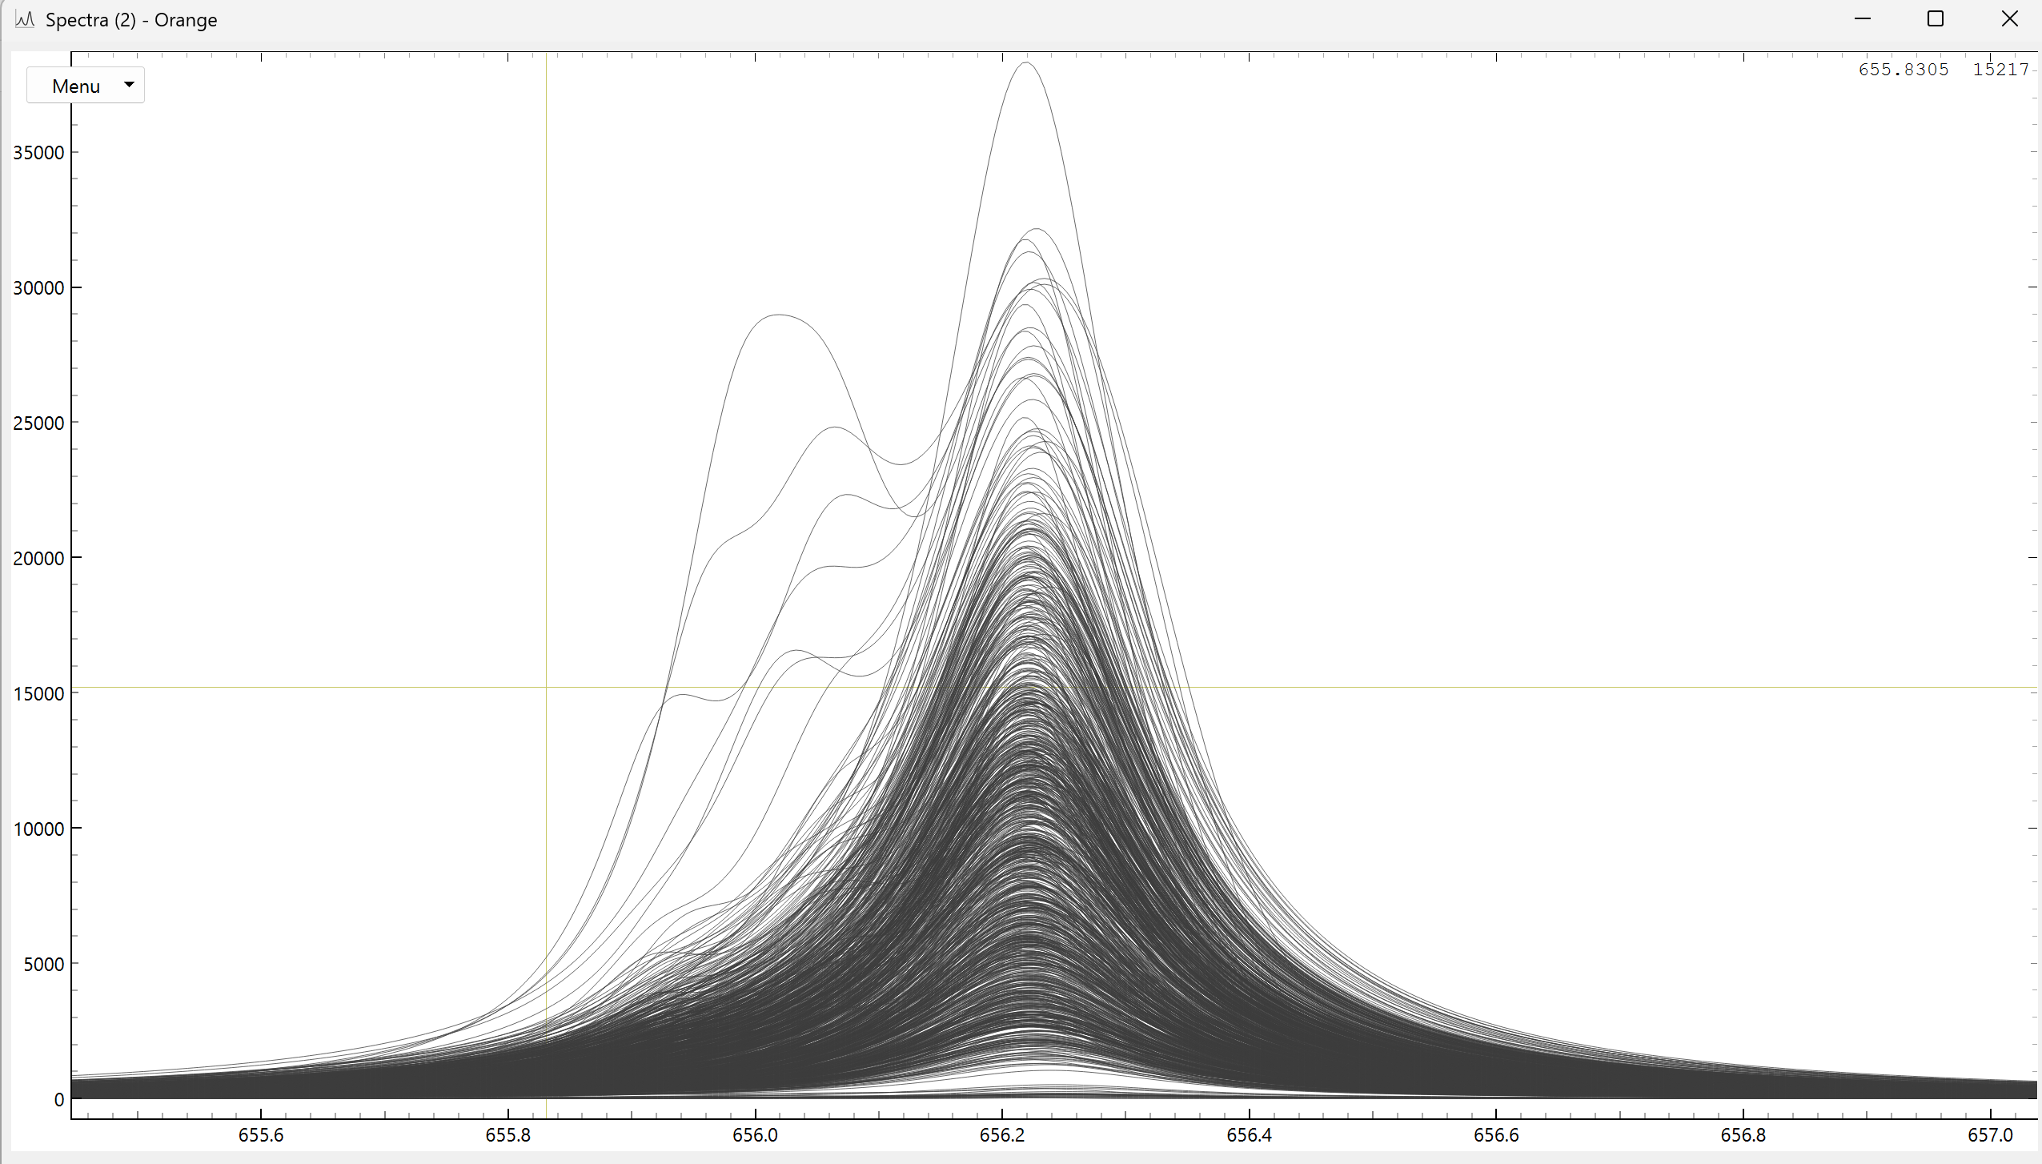
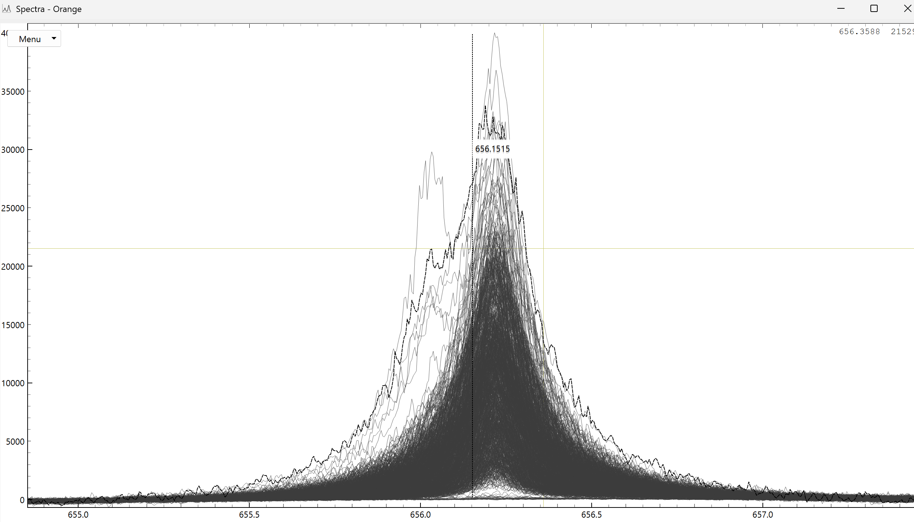
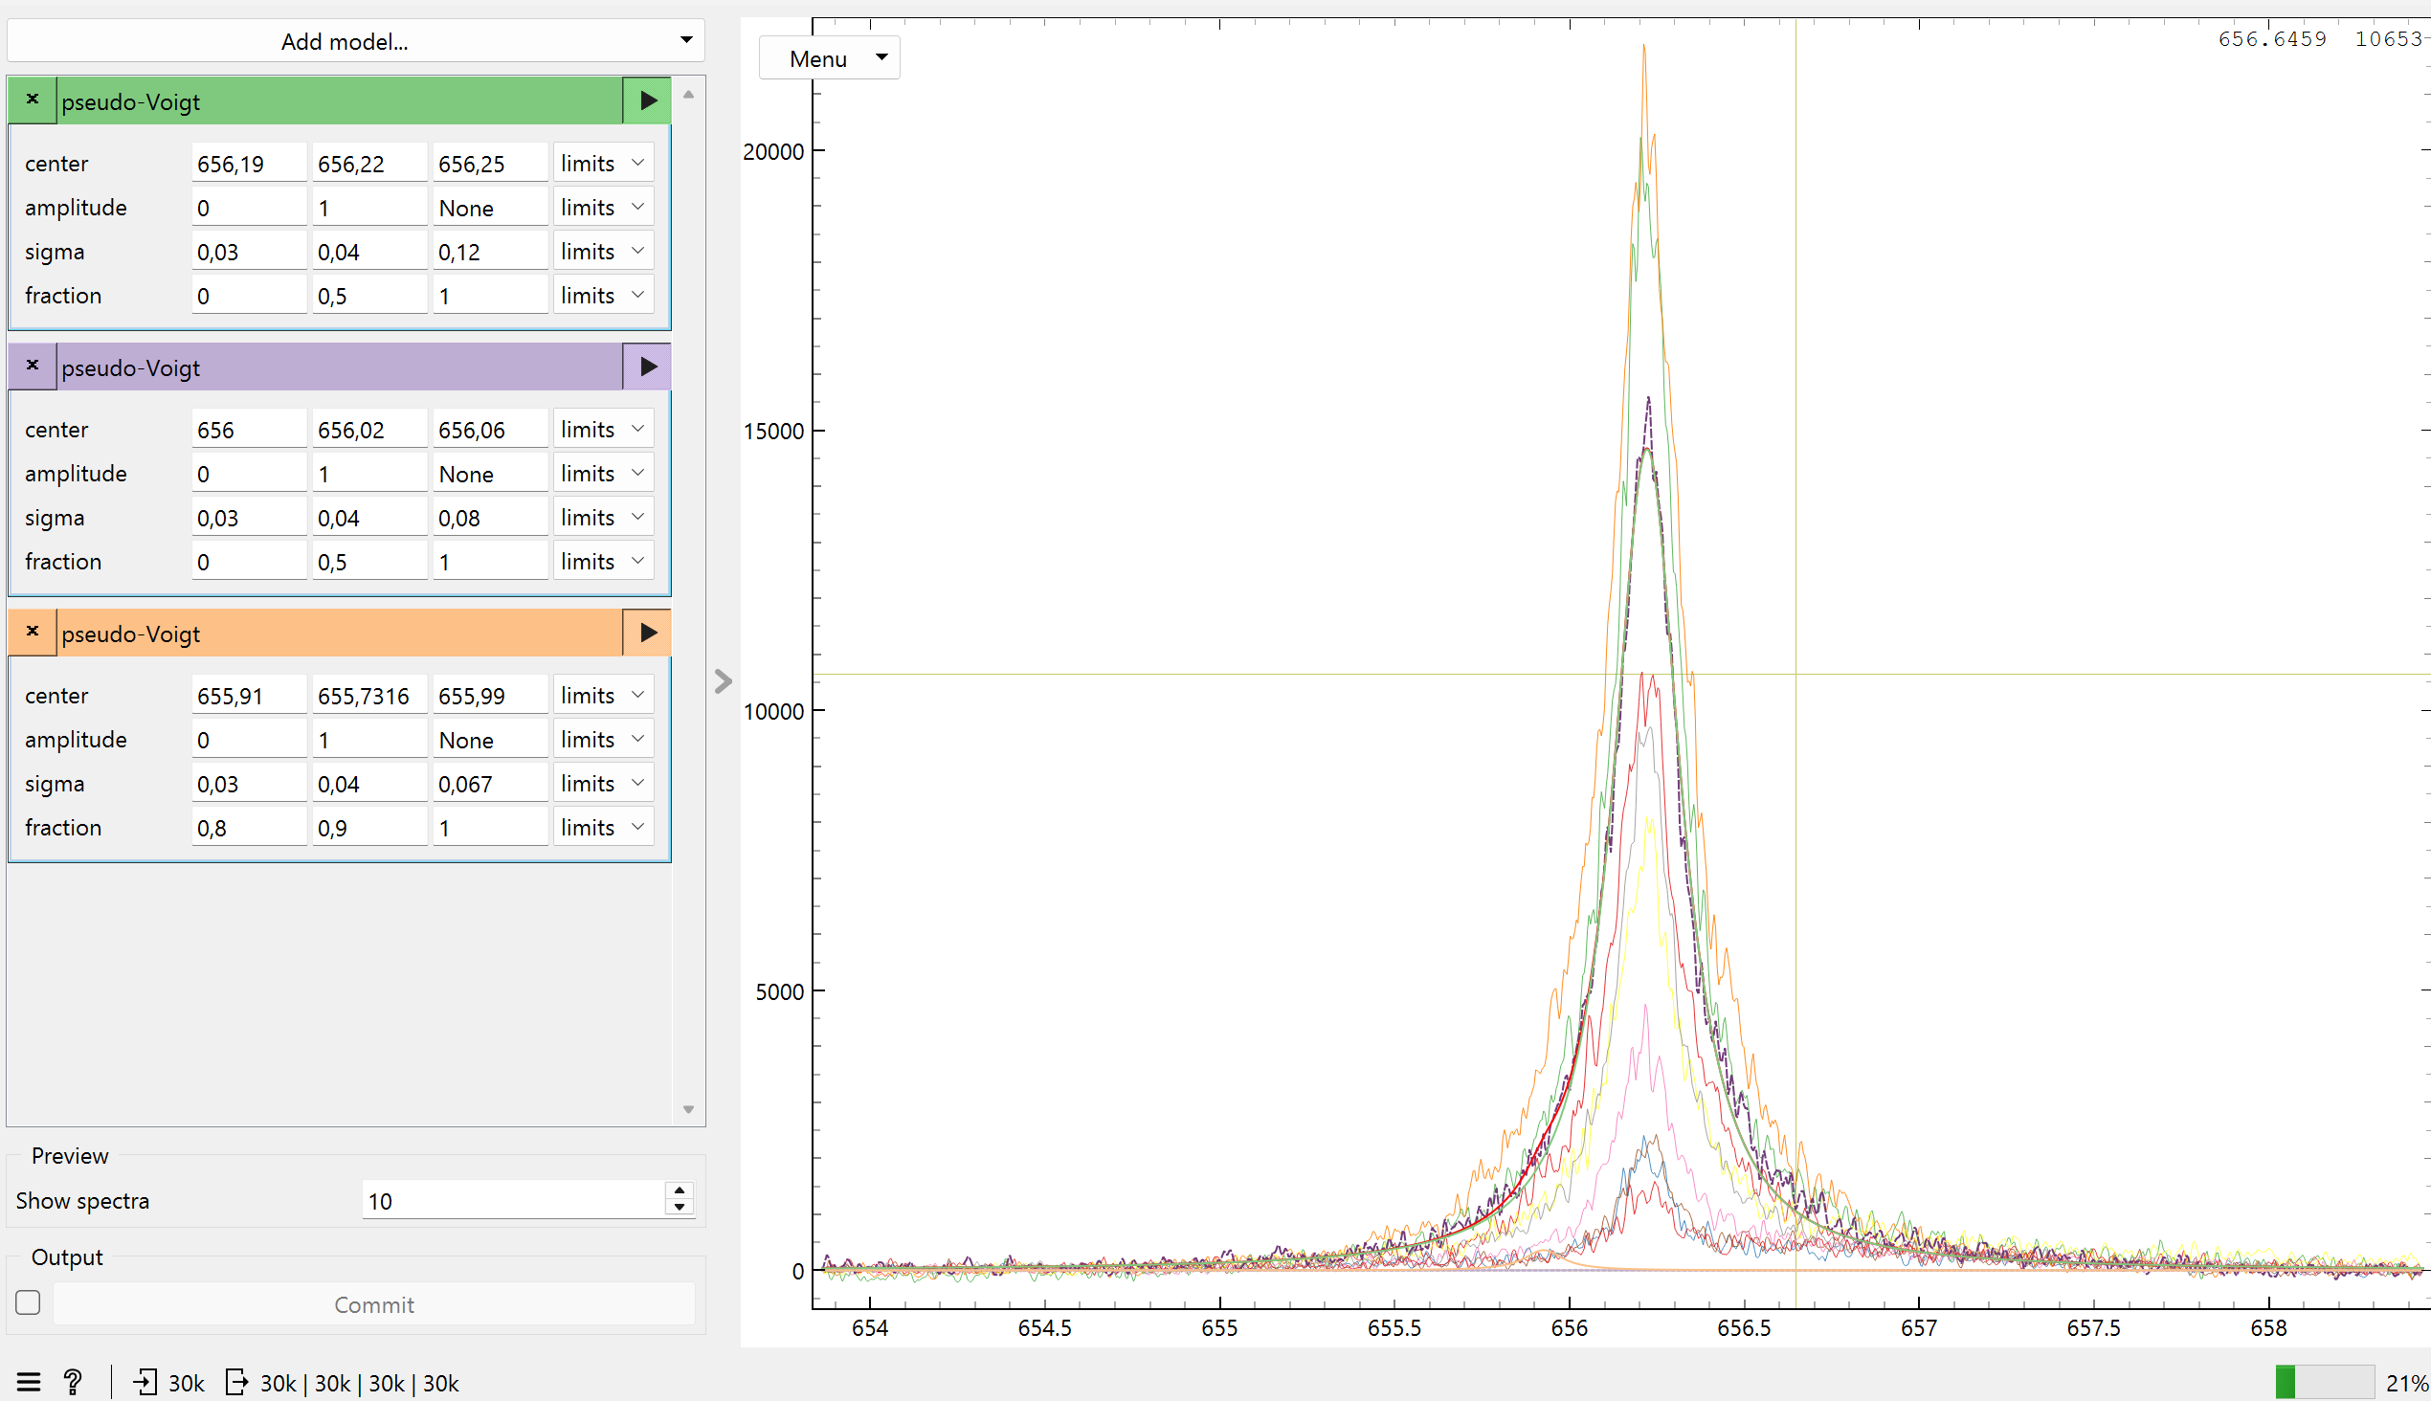
Fitting spectra
1000 of 30000
processed spectra
Uses lmfit method (PyPI)
Processing speed is ~7000 spectra/hr
(Intel(R) Core(TM) i9-14900HX (2.20 GHz), 32 GB RAM)

Slide 31
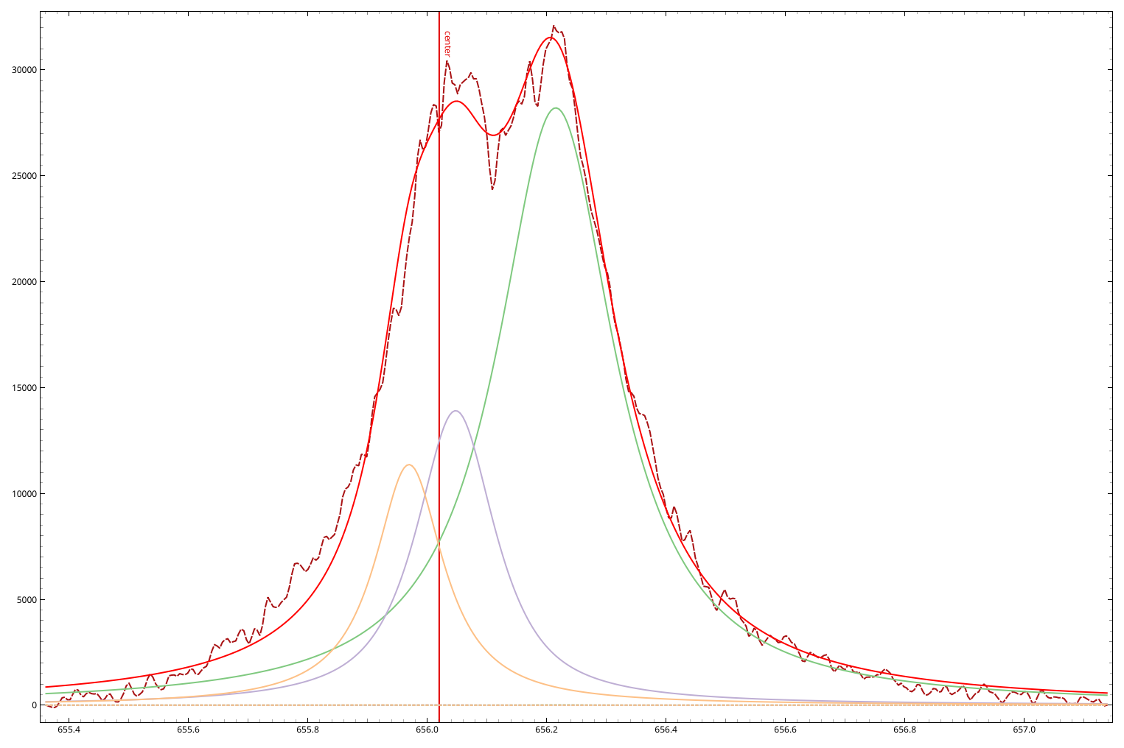
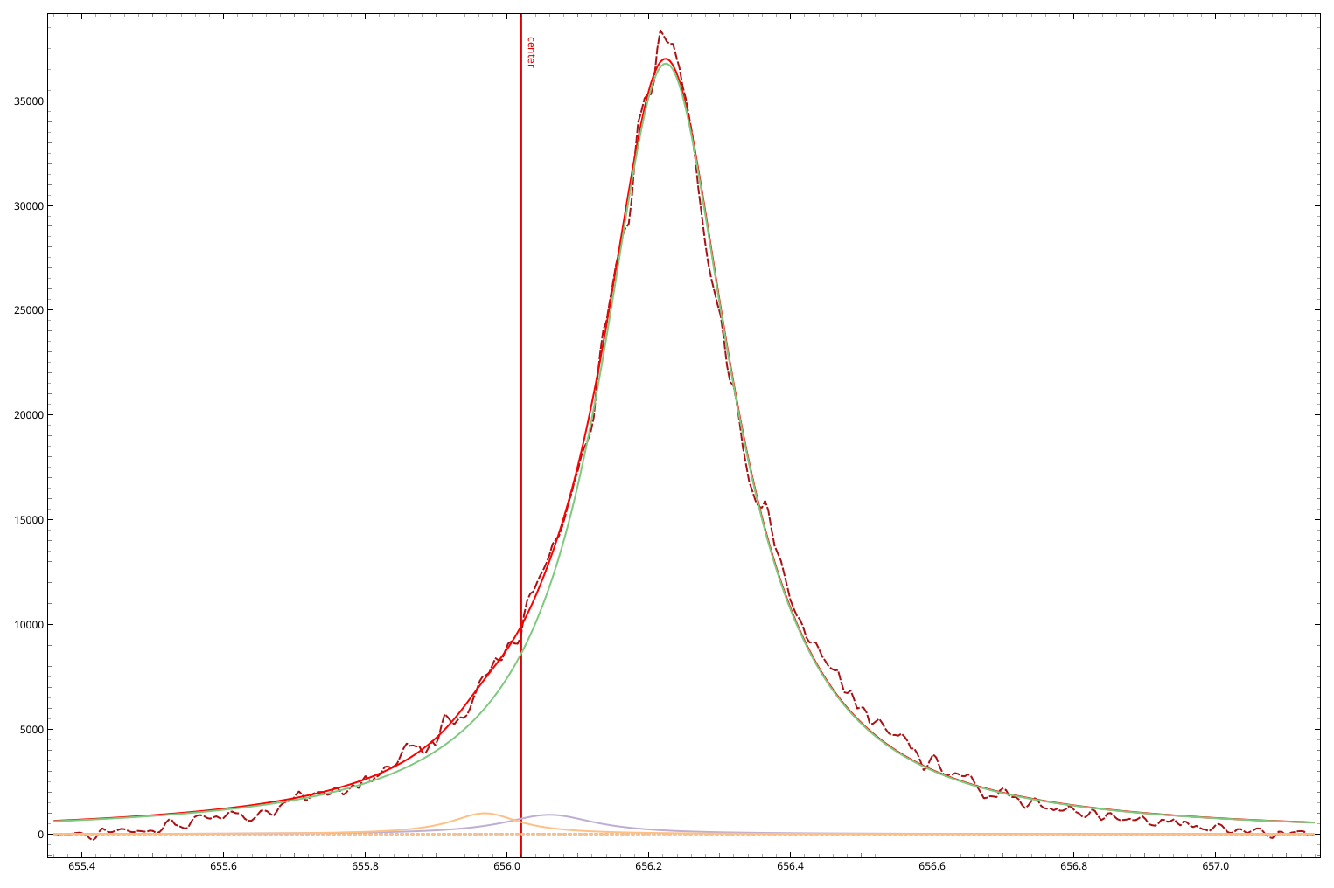
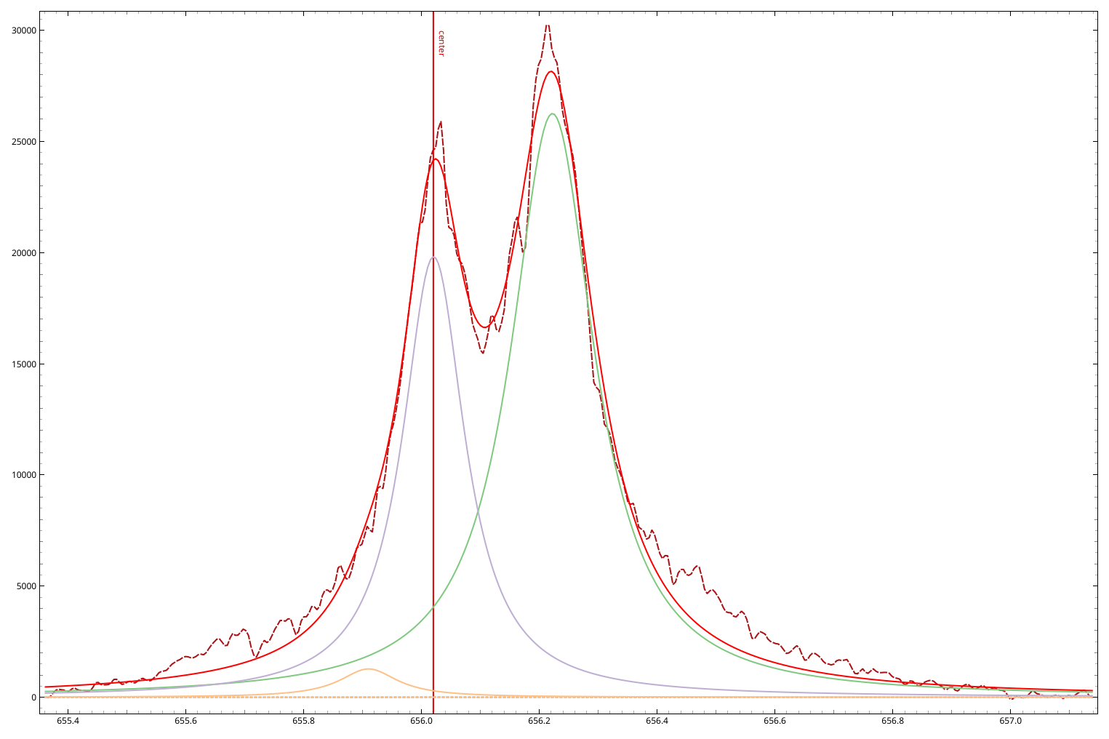
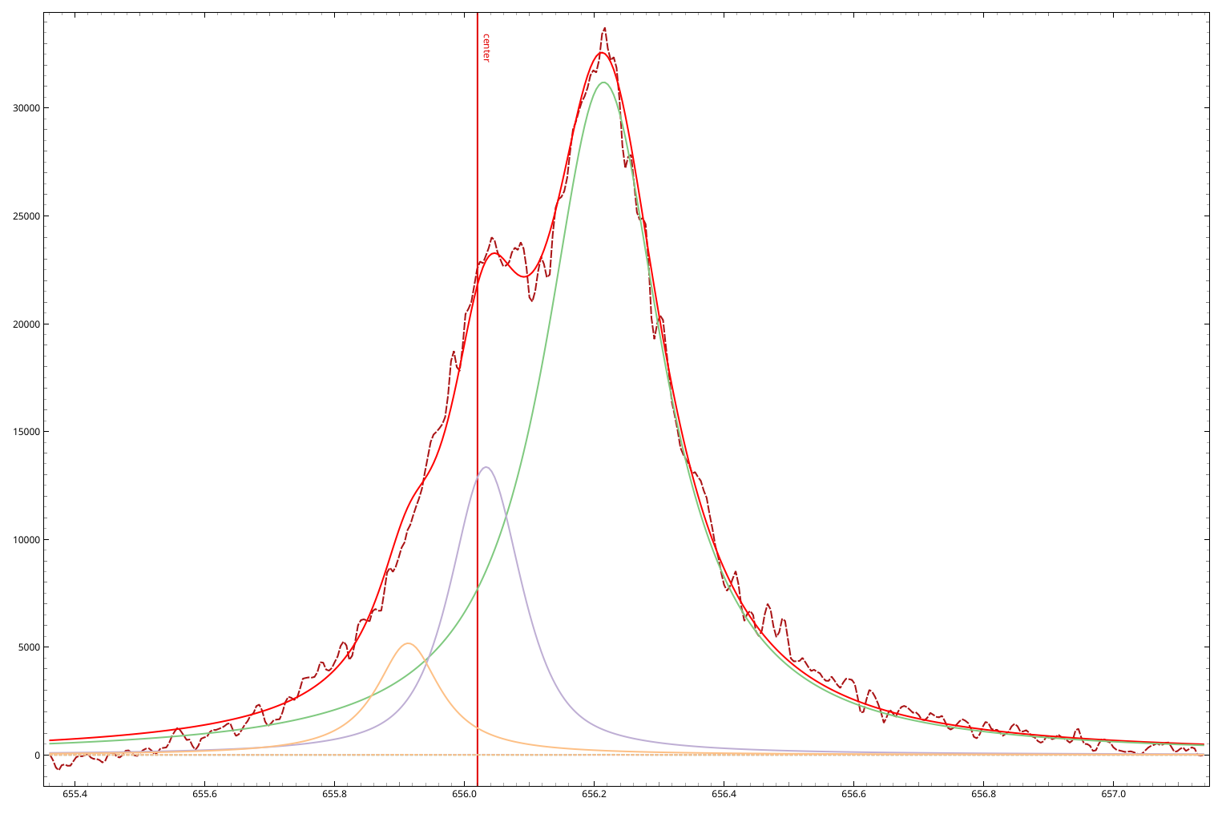
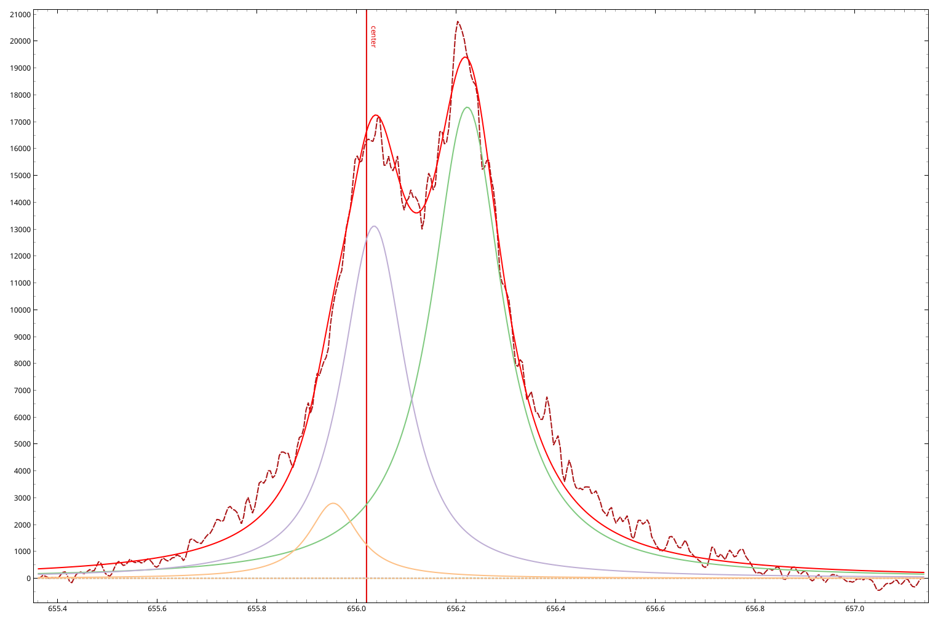
Isotopic separation
530_2X9_R2LW1C3_Mon Oct 14 2024_19
559_2X9_R6LW1C2_Tue Oct 14 2024_06
605_2X9_R8LW1C3_Tue Oct15 2024_12
584_2X9_R8RW5C3_Tue Oct 15 2024_09
514_2X9_R2C3C2_Mon Oct 14 2024_18

Slide 32
Summary, conclusion, plans
AI worked.
Reconstruction is suprisingly good for signals which look really bad, showing that they are deterministic and their information can be deconvoluted
Application of autoencoders can substantially reduce the amount of data and initial preprocessing may reduce the training time, there are some advantages of transfer learning, but it is inferior for lines with lower representation
Still need precise measurements to accurately predict chemical concentration (may be obtained thank to experiment at VTT)
Plans for 2026
  Test machine learning algorithms with experimental LIBS spectra from the new VTT experiment as well as from measurements from CU and FZJ in order to determine electron density and plasma parameters
  Use of Conditional Generative Adversarial Network (cGAN) and VAE (Variational Autoencoder) to create experimental like spectra for better model training.
  Find the optimal normalisation techniques based on the correlations in the latent layer of autoencoders

Slide 33
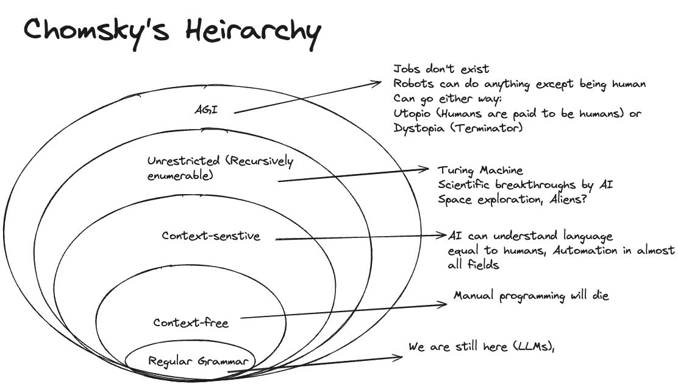
Thank you for your attention

