Slide 1
Time evolution of gas injection calibration data - "jump method"
Joint LID-QMS/LIBS meeting as diagnostics for fusion
Frascati December 9 to 12 2025
L. Laguardia, G. Gervasini, I. Jepu, M. Zlobinski , A. Widdowson

Slide 2
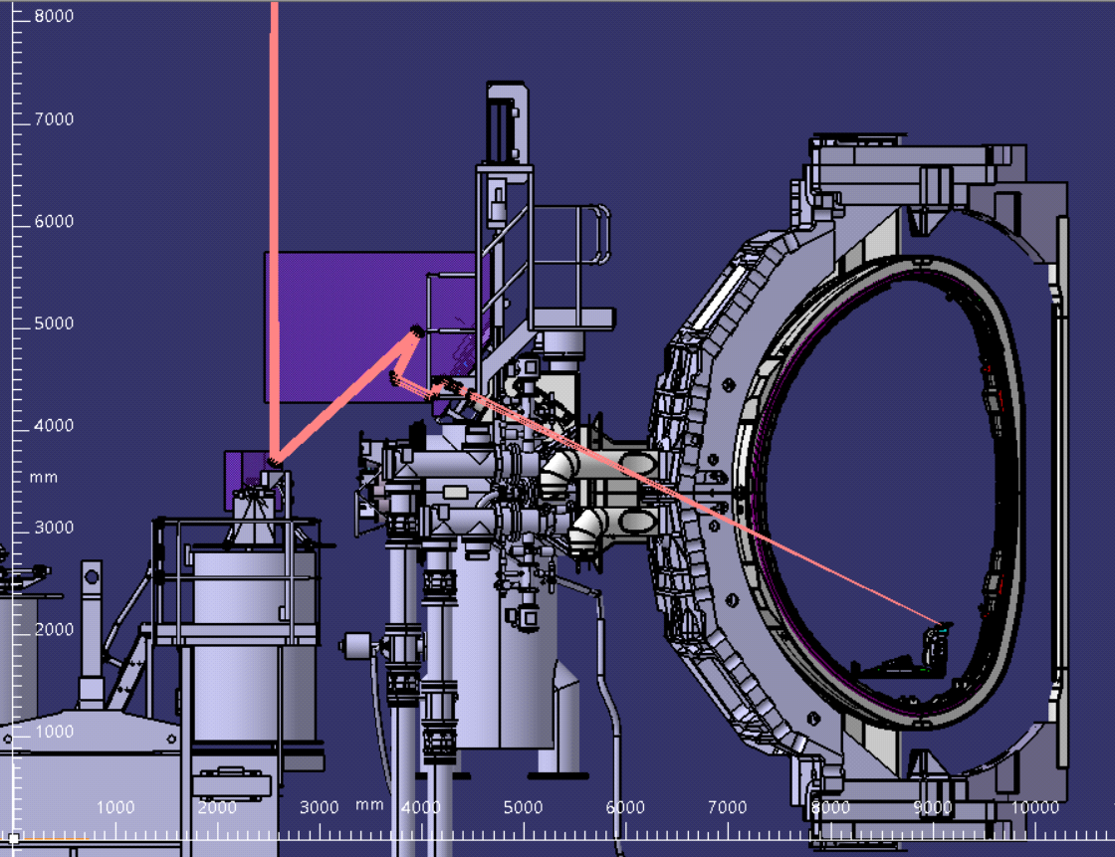
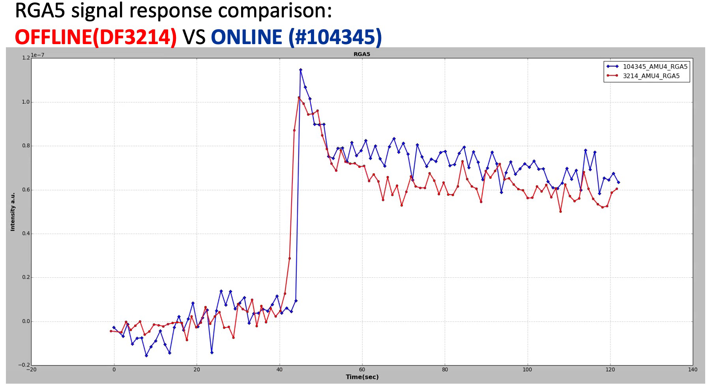
Motivation
During the DTE3 campaign in JET, fuel retention was investigated using LID-QMS (Laser Induced Desorption via Quadrupole Mass Spectrometry).
LID-QMS is a cutting-edge technique that employs a laser to heat the tile surface, inducing fuel desorption.
The gases desorbed from the laser spot are then quantified by a Residual Gas Analyzer (RGA).
4
1
3
2
Accurate quantification of gas release from the tiles following a laser pulse, requires determining the RGA's sensitivity (calibration factor) for each desorbed gas species.
5

Slide 3
Gas puffs – offline pulses for LID-QMS calibration
22 Dedicated injection session 180 offline pulses with gas injections performed
Each LID-QMS session had its own gas calibration puffs via offline pulsing;
GIM4, single puff, voltage control was used;
Injections performed with D₂ and H₂;
No dedicated T₂ gas puffs for LID-QMS sessions, because TIM bottle cannot make small gas injection
Different pumping conditions investigated

Slide 4
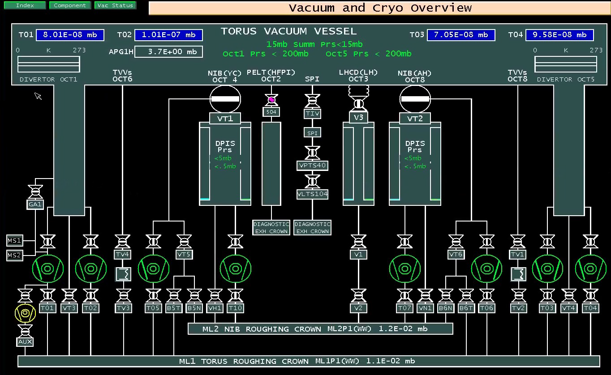
Pumping conditions during calibration gas injection
p
Cryo pumps at LN2
RVs closed
T03-04 closed
T02 normally closed
T01 always open
T01
T02
T03
T04
RGAs main chamber (5,11) in Farady mode
KT5 RGAs divertor (RGA3 and RGA7) in SEM mode

Slide 5
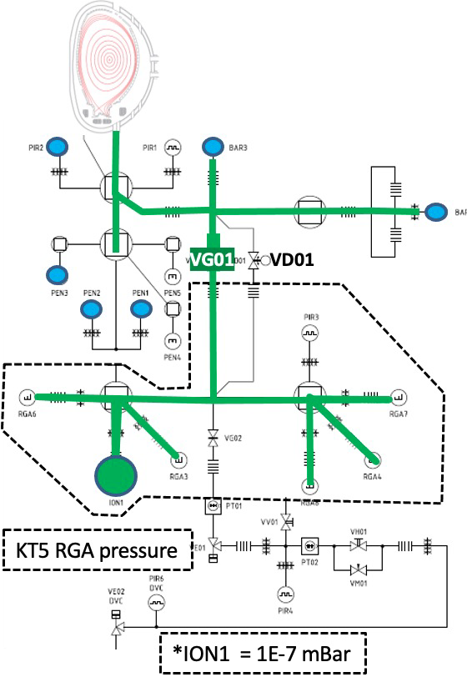
KT5 overview – LIDS-QMS set-up
To ensure optimal signal acquisition during LIDS-QMS, the main valve (VG01) is kept open, to allow for the entire gas flow
Since very low gas is releases during LID-QMS experiments, very tiny gas quantity were injected during calibrations pulses

Slide 6
RGAs calibration procedure
Each calibration session was performed a the end of the LID-QMS experiments by the following procedure:
4 or 5 gas different (in quantity) gas injections in main chamber by GIM4, performed at constant pumping speed (the same used during the LID-QMS experiments) and registration of the drop in pressure in GIM4 (VC offline data)
2. Registration of the RGAs response to gas injections (DF offline data)
3. Registration of the pressure evolution both in main chamber and in RGAs
The RGAs response (increase of the current from the background due to increase of the the gas pressure P (single gas injection) is given by:
ΔI = Ks ΔP
(P is the partial pressure of gas and Ks is the RGA gas sensitivity for gas (A/mbar)

Slide 7
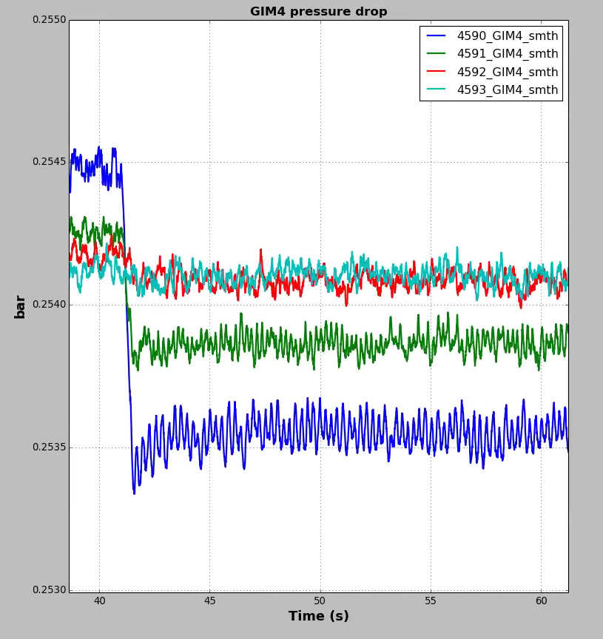
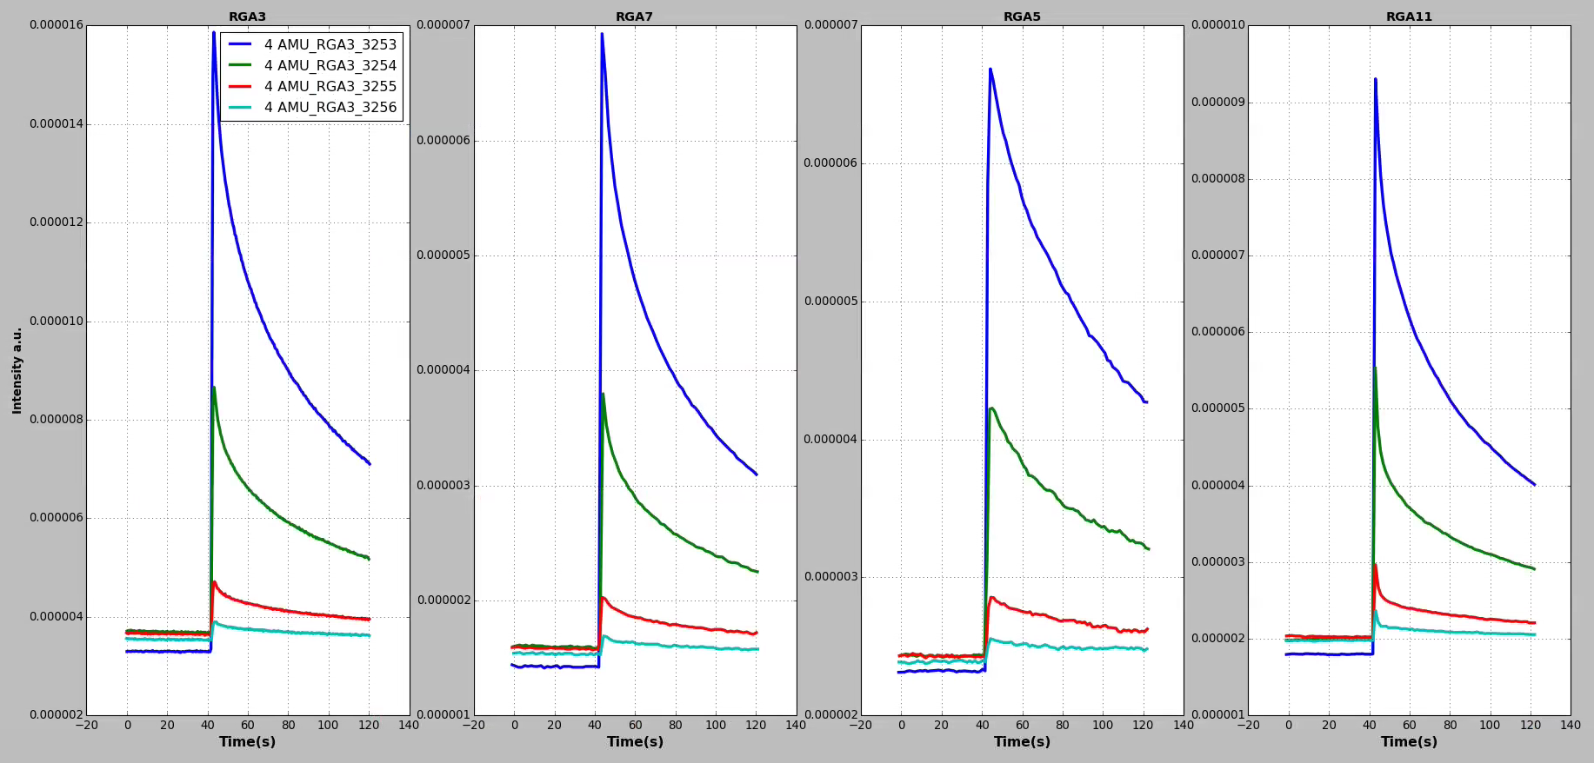
Gas injections in main chamber by GIM4 and RGAs response
1. GIM4 pressure drop
2. RGAs response to gas injections
Even when only a very small amount of gas was injected, resulting in a slight, often challenging-to-determine, pressure drop in GIM4, the spectrometer still detected an observable signal.

Slide 8
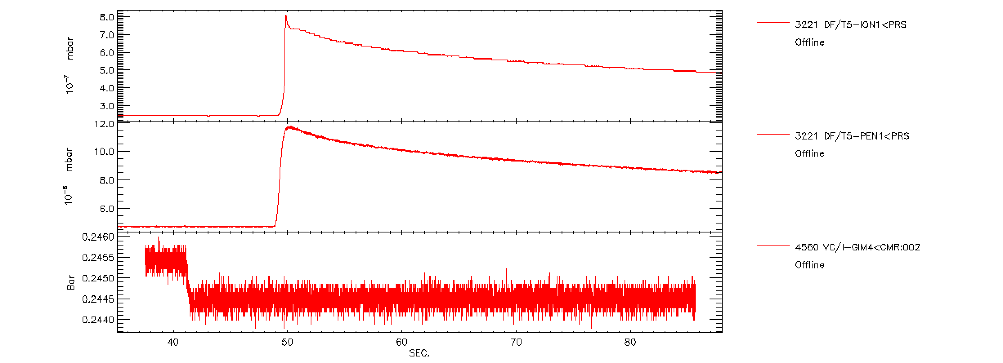
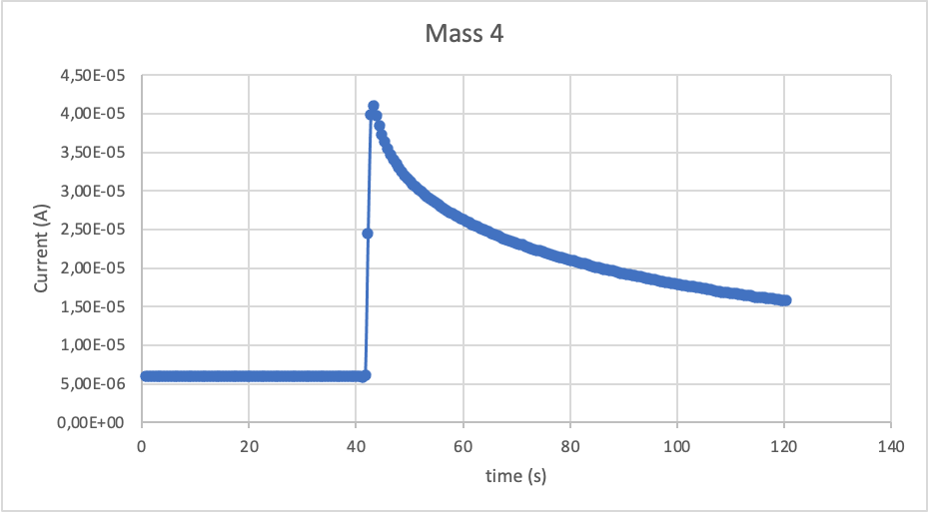
3. Registration of the pressure evolution both in main chamber and in RGAs
RGA response
Pressure increase in KT5 system
Pressure increase in main chamber
Pressure drop in GIM4

Slide 9
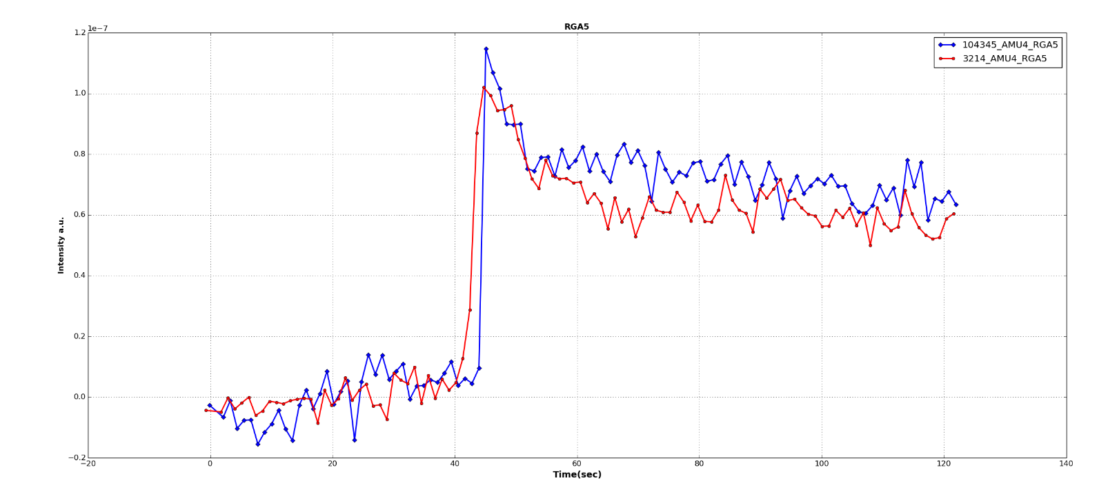
QMS Calibration by jump method
Quadrupole Mass Spectrometer calibration by short (~1 s) D₂ gas puff into the torus
Gas injection module volume V = 1.5 L
Pressure drop Δp in module after injection measured by baratron
N corresponds to the partial pressure jump in the mass spectrometer signal in the torus
Very low partial pressure jump is used, which is similar to the jump during the laser pulse
(~10¹⁸ D atoms)
repeated on each measurement day to account for different wall loading, pumping conditions,…
injected gas molecules N
QMS5 with laser pulse
QMS5 calibration gas puff
Mass 4 (D₂)
N_{calib}
N_{signal}
Background of partial pressure on
mass 4 subtracted from both
Time / s

Slide 10
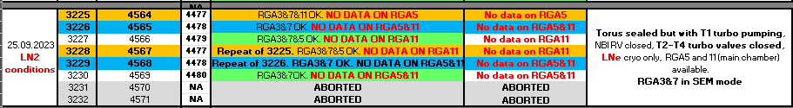
Ks of RGAs during the 25_09_2023 D₂ injection
Laguardia et al | Joint LID-QMS/LIBS meeting as diagnostics for fusion, Frascati December 9-12 2025

Slide 11
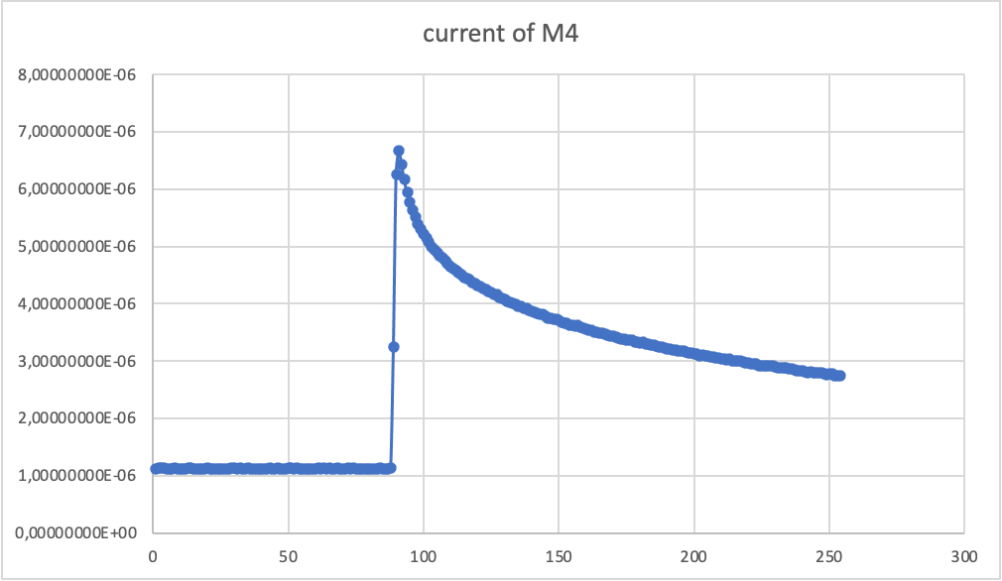
Jump in current method only for AMU4
ΔI=MAX Current- AVERAGE of low currents
Laguardia et al | Joint LID-QMS/LIBS meeting as diagnostics for fusion, Frascati December 9-12 2025

Slide 12
Drop in pressure calculations by using sigmoid function

Slide 13
Results
VC DF DP [mbar] DP [mbar*L] DI RGA7[A] Ks RGA7 [A/mbar*L] DI RGA3 [A] Ks RGA3 [A/mbar*L]
4564 3225 0.93810 1.37901 5.545300e-6 4.021227e-6 2.732782e-5 1.981703e-5
4565 3226 0.34149 0.50199 1.794570e-6 3.574910e-6 9.029764e-6 1.798793e-5
4566 3227 0.07384 0.10854 4.034200e-7 3.716773e-6 1.996878e-6 1.839756e-5
4567 3228 0.96248 1.41485 5.888950e-6 4.162256e-6 2.919102e-5 2.063195e-5
4568 3229 0.43544 0.64010 2.440200e-6 3.812236e-6 1.216259e-5 1.900118e-5
4698 3230 0.02774 0.04078 1.007240e-7 2.470159e-6 5.199400e-7 1.275102e-5
For each RGA and injection, the results were obtained by a procedure that first determined the pressure drop and then the jump current for mass 4

Slide 14
KS trend observed for each injection during each session
Same trend for both RGA3 and RGA7
Imprecision in determining the pressure drop for very small gas injections inevitably results in a corresponding imprecision in KS determination
Laguardia et al | Joint LID-QMS/LIBS meeting as diagnostics for fusion, Frascati December 9-12 2025

Slide 15
Ks = Δ I/Δ P V (A/mbar*L)
For each series of gas injections following LID-QMS experiments, the RGA sensitivity is the slope of the linear regression of points derived from the DI/AP*V ratio for each injection.
Ks RGA5 = 5E-05 A/mbar*L
Ks RGA3 2.0185e-5 A/mbar*L
Ks RGA7 4.082e-6 A/mbar*L
Ks RGA11 5.967e-5 A/mbar*L
Typically, RGA3 exhibits a higher KS value than RGA7
Laguardia et al | Joint LID-QMS/LIBS meeting as diagnostics for fusion, Frascati December 9-12 2025

Slide 16
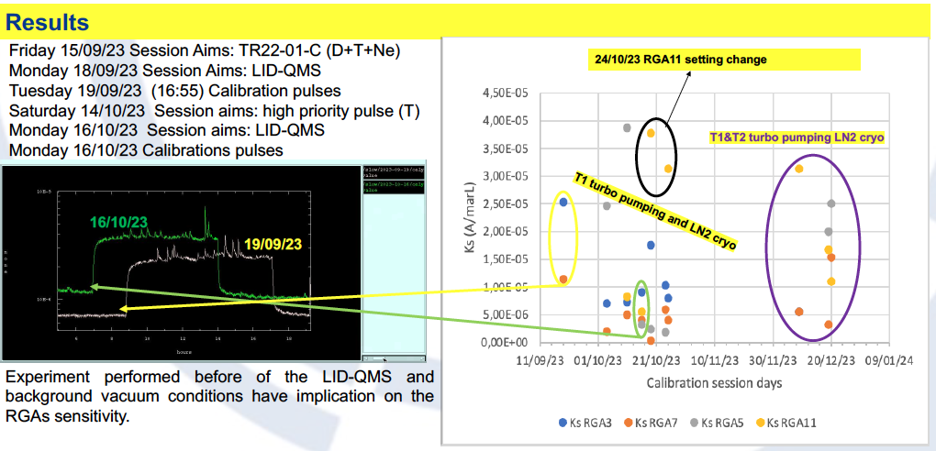
RGA sensitivity is influenced by experiments performed before LID-QMS and by background vacuum conditions

Slide 17
RGA sensitivity data from the 19 and 20 December 2023 calibration injections
Date | KsRGA3 | KsRGA7 | KsRGA5 | KsRGA11
19.12.23 | 6,60E-06 | 3,341E–6 | 6,00E-05 | 7,00E-05
20.12.23 | no data | 1,6884E–6 | 2,7486E–5 | 1,2259E–5
RGA5 and RGA11 data are in continuous mode ( more accurate determination of the current jump is needed).

Slide 18
NEXT STEPS
Complete the analysis of all acquired data for each session
Identify/develop a method to determine the sensitivity of the RGAs for other masses.

Slide 19
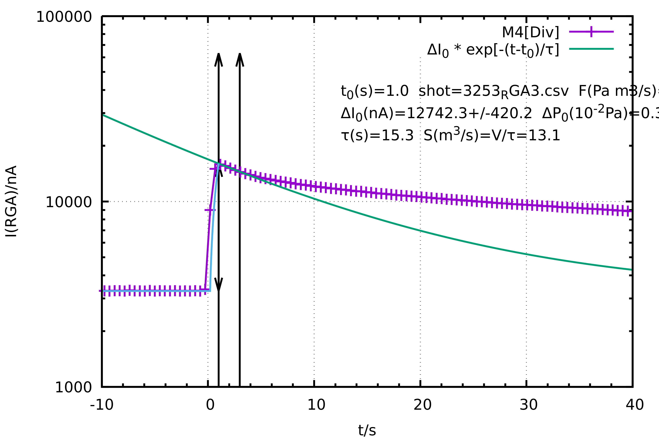
Comment/question
log I(t) )/(linear time t) curve shows two distinct slopes. In the region where volumetric pumping is active, the slope of the linear fit is 1/τ, allowing for the calculation of the pumping speed S. If this derived S is consistent with the known, nominal pumping speed, it validates the Ks factor obtained from this curve
Is it possible to use this method to evaluate the RGA sensitivities derived from the current jump technique?

Slide 21
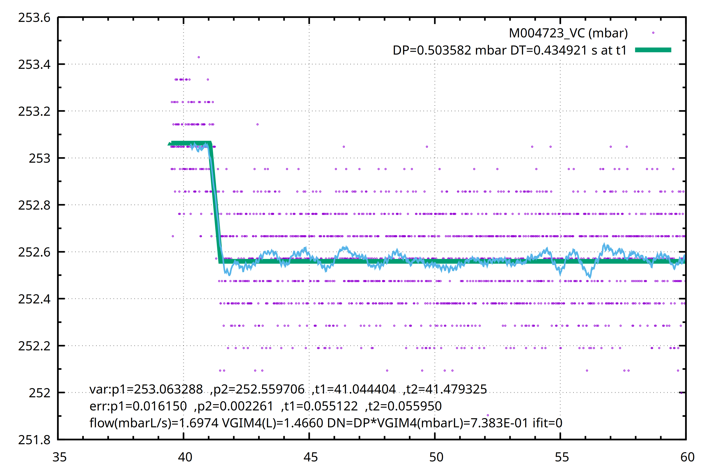
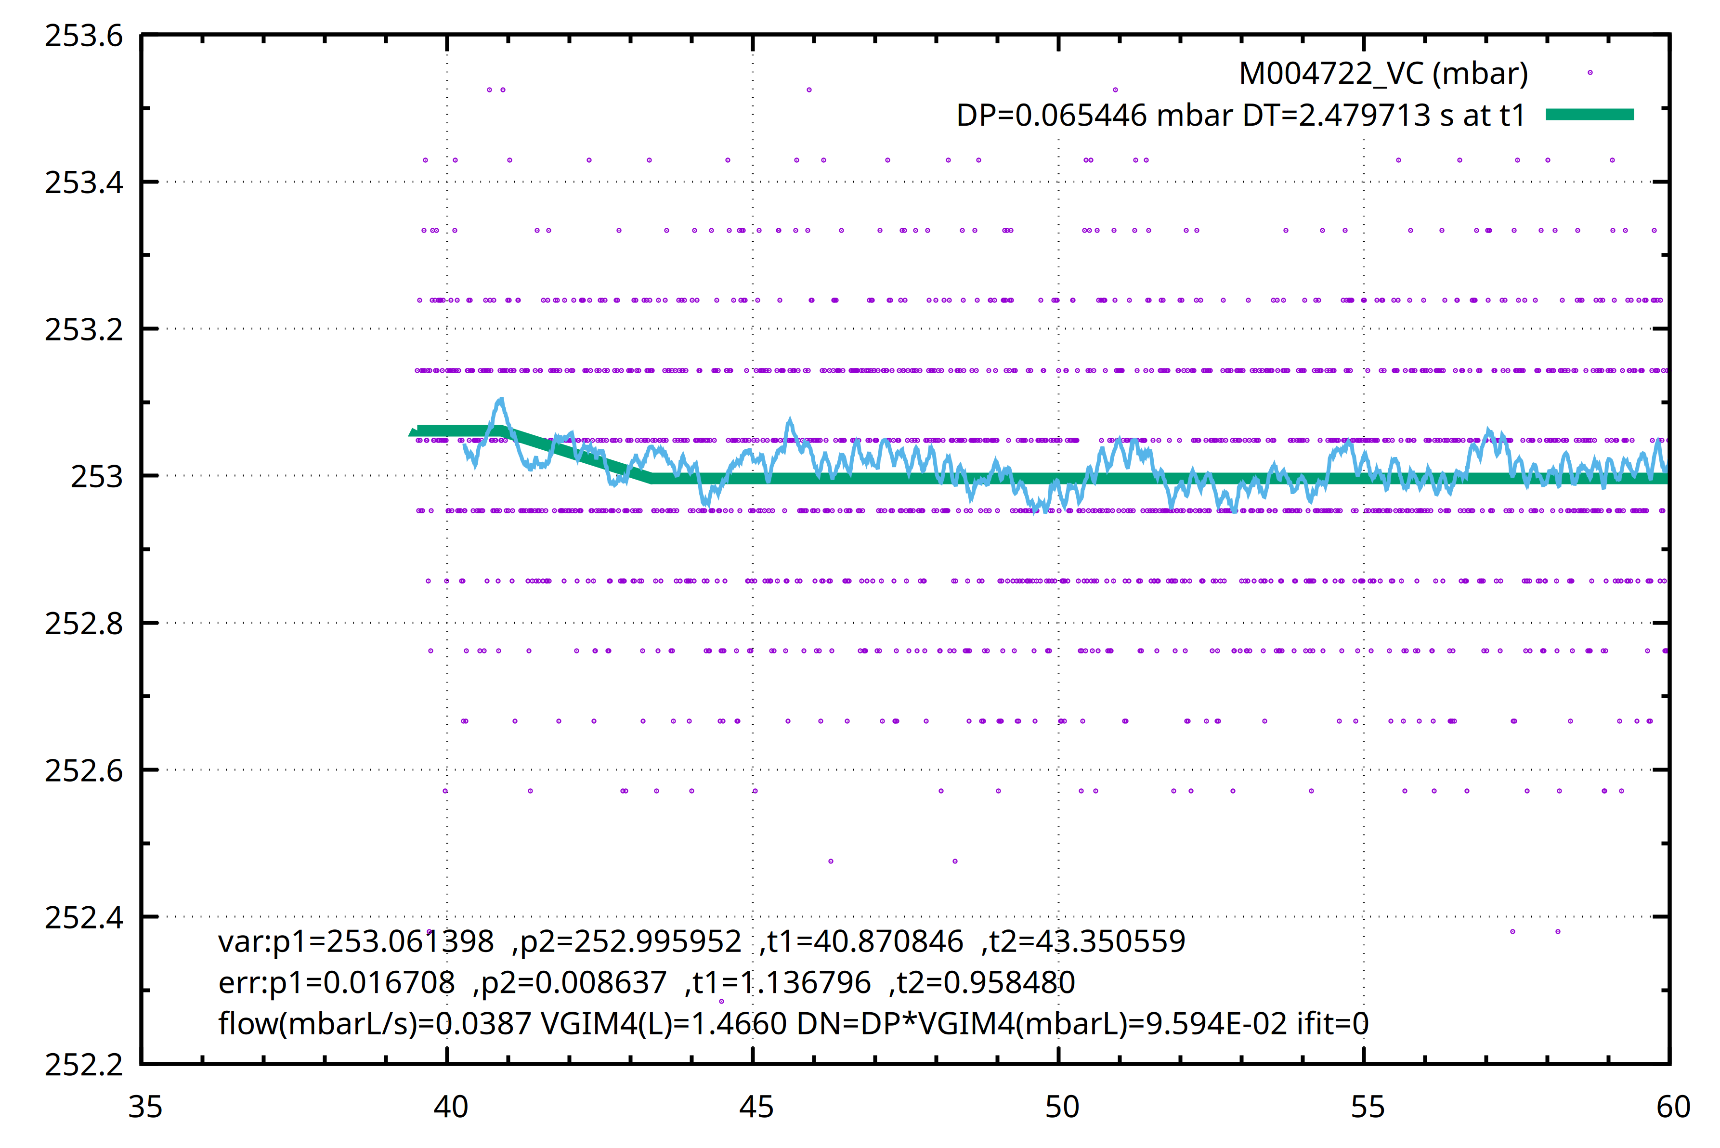
Gabriele DP calculations

Slide 22
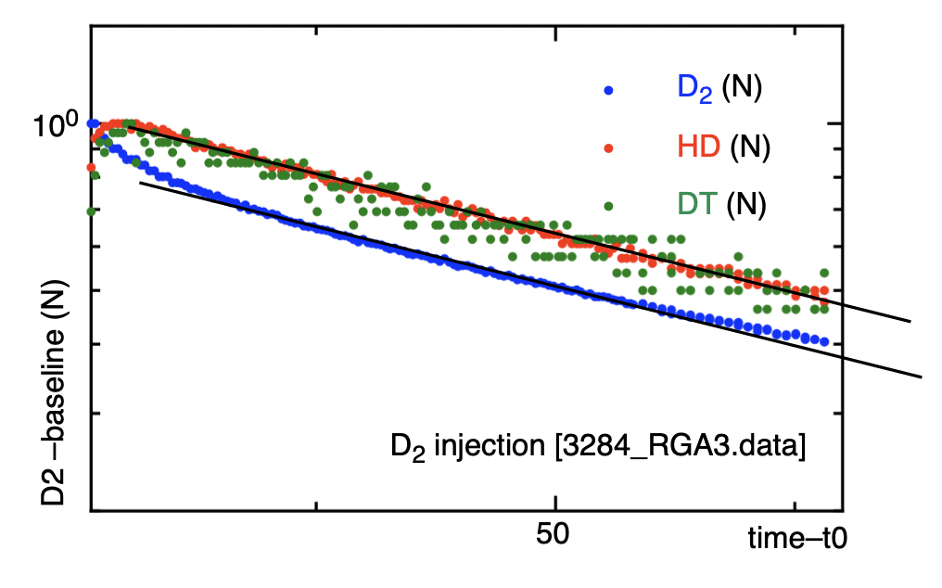
#off line 3284
OBSERVATIONs
MS signals for different mass values exhibit different baseline
once the baseline is subtracted to the signals different masses have the same temporal decay (first derivative)
EXPERIMENT
HYPOTESIS
the baseline signal is related to the chemical species adsorbed at the surface before the gas injection and progressively released in the gas phase
the signals at different masses, corresponding to isotopic variants of the hydrogen molecule, result from the heterogeneous recombination/desorption dynamics
(left) data for the different isotopes (the baseline has been subtracted) as a function of time from t0, i.e. the maximum of the injected species (D₂)
(right) data with baseline subtraction and normalized (N) i.e. divided by the maximum, all show the same derivative (slope lines drawn)
For D₂ the initial decay is determined by the kinetics of formation of the other isotopic variants by recombination on the surface.
MODELLING
model for D₂ injection with guesses for rates
MODELLING
simple kinetic modelling based on the solution of a system of differential master equations for the temporal evolution of molecules (isotopic variants)
input data: recombination probability at the W surface from ab initio investigations (from the literature)
OUTPUT
synthetic MS signals for all the isotopic variants of hydrogen molecule
appropriate tuning with experiments for quantitative analysis
L. Laguardia RT06 JET Analysis and Modelling week 2-6 December 2024

