Slide 1
LIBS JET meeting 12.12.2025 Frascati
University of Tartu
Indrek Jõgi

Slide 2
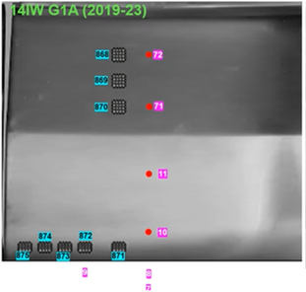
Investigated pulses

Slide 3
# 10 14IWG1A – R4 C1 (averaging and temperature)
Depth profile (0.3xBe for scaling)
Spectra averaged over 20 shots
Be temperature overestimated (self absorption)
W temperature most suitable

Slide 4
# 10 14IWG1A – R4 C1 (H+D line)
Spectra averaged over 20 shots
1-10 shot average

Slide 5
# 10 14IWG1A – R4 C1 (CF-LIBS concentration)
Depth profile
Spectra averaged over 20 shots
Spectra averaged over 10 shots
Averaging over 20 shots gives smoother concentration profiles
For next pulses, averaging over 20 shots

Slide 6
#11 14IWG1A – R5 C1
Depth profile
Spectra averaged over 20 shots
Tempeartures quite similar (except Be)

Slide 7
#71 14IWG1A – R6 C1
Depth profile
Spectra averaged over 20 shots
W temperature smoothest

Slide 8
#72 14IWG1A – R7 C1
Depth profile
Spectra averaged over 20 shots
Ni temperature smoother!

Slide 9
D+T from Littrow spectrometer
# 10 14IWG1A – R4 C1
#11 14IWG1A – R5 C1

