Slide 1
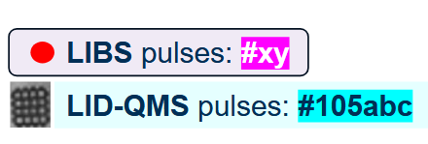
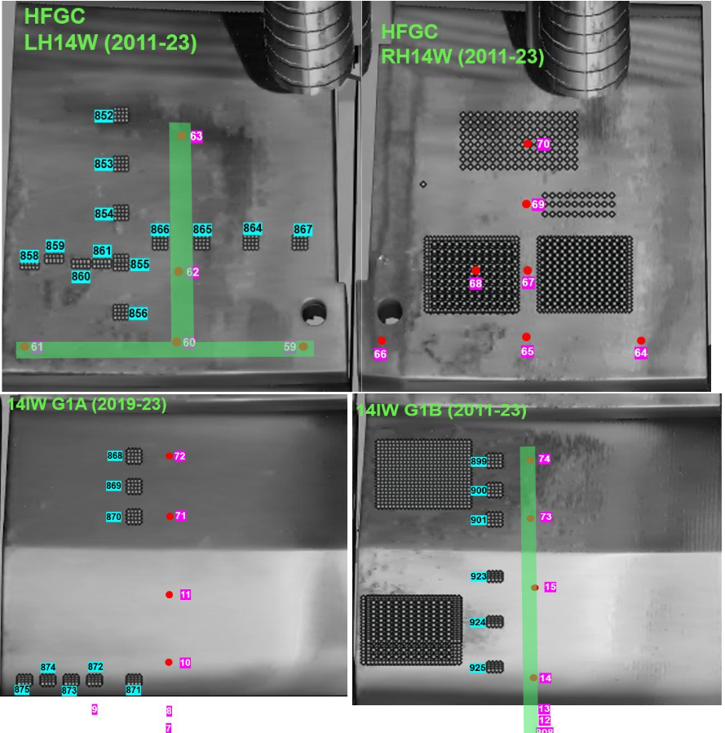
LIBS retention (T, D, H) measured at tile HFGC RH14W (2011-2023)
64_HFGC_RH14W - R1 C1
65_HFGC_RH14W - R1 C2
66_HFGC_RH14W - R1 C4
67_HFGC_RH14W - R2 C2
68_HFGC_RH14W - R2 C3
69_HFGC_RH14W - R3 C2
70_HFGC_RH14W - R4 C2

Slide 2
LIBS retention (T, D, H) measured at tile HFGC RH14W (2011-2023)
1
Highest D ratio
11

Slide 3
LIBS retention (T, D, H) measured at tile HFGC RH14W (2011-2023)
1
6

Slide 4
Depth profiling of W and Ti by Littrow spectrometer

