Slide 1

Erosion studies on W-B layers in laboratories
R. Gurschl, M. Fellinger, B. Burazor Domazet, J. Brötzner, G. Nagy, R.A. Wilhelm and F. Aumayr
WPPWIE SP B Monitoring Meeting
10.10.2025
Deliverable 2025: Erosion rates of co-deposited W-and B-based model systems following exposure to controlled ion beams

Slide 2
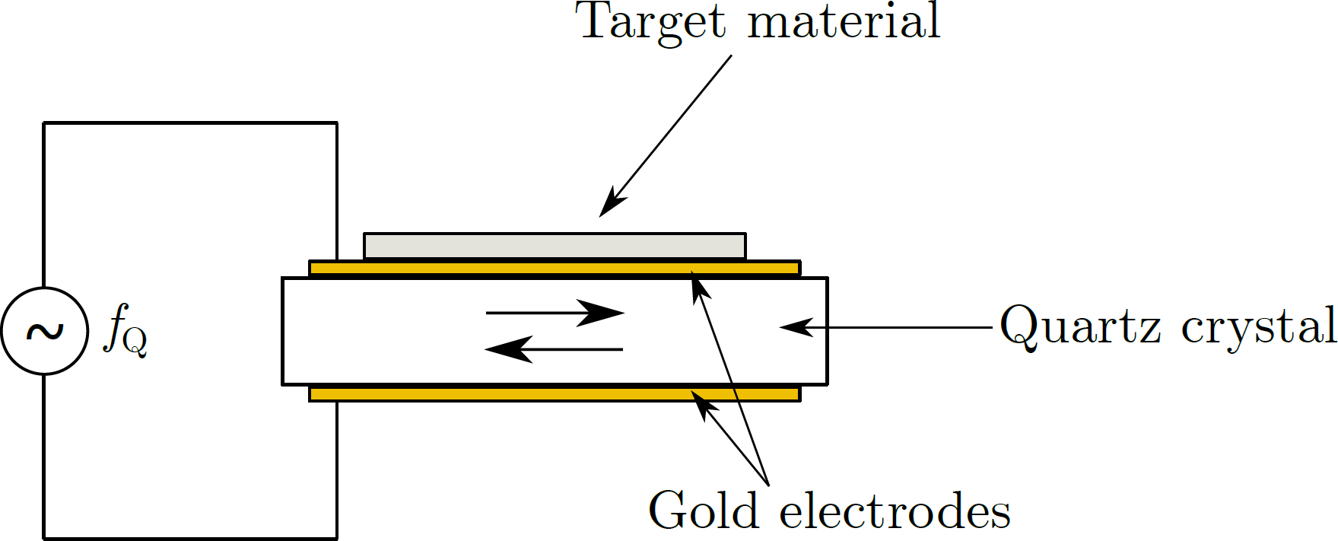
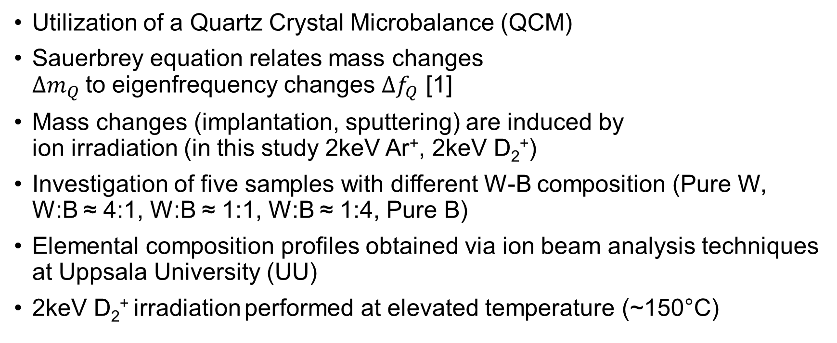
Experimental method
Ions
α
Utilization of a Quartz Crystal Microbalance (QCM)
Sauerbrey equation relates mass changes $∆m_{Q}$to eigenfrequency changes $∆f_{Q}$ [1]
Mass changes (implantation, sputtering) are induced by ion irradiation (in this study 2keV Ar⁺, 2keV D₂⁺)
Investigation of five samples with different W-B composition (Pure W, W:B ≈ 4:1, W:B ≈ 1:1, W:B ≈ 1:4, Pure B)
Elemental composition profiles obtained via ion beam analysis techniques at Uppsala University (UU)
2keV D₂⁺ irradiation performed at elevated temperature (~150°C)
[1] G.Sauerbrey, Zeitschrift f. Physik 155 (1959)

Slide 3
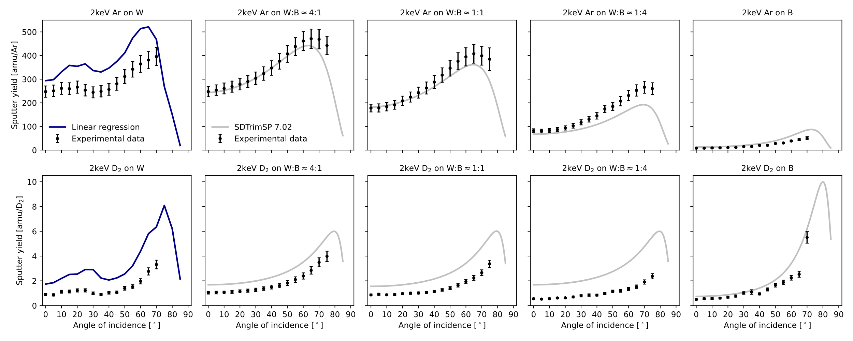
Results – 2keV Ar⁺ and D₂⁺ irradiation

Slide 4
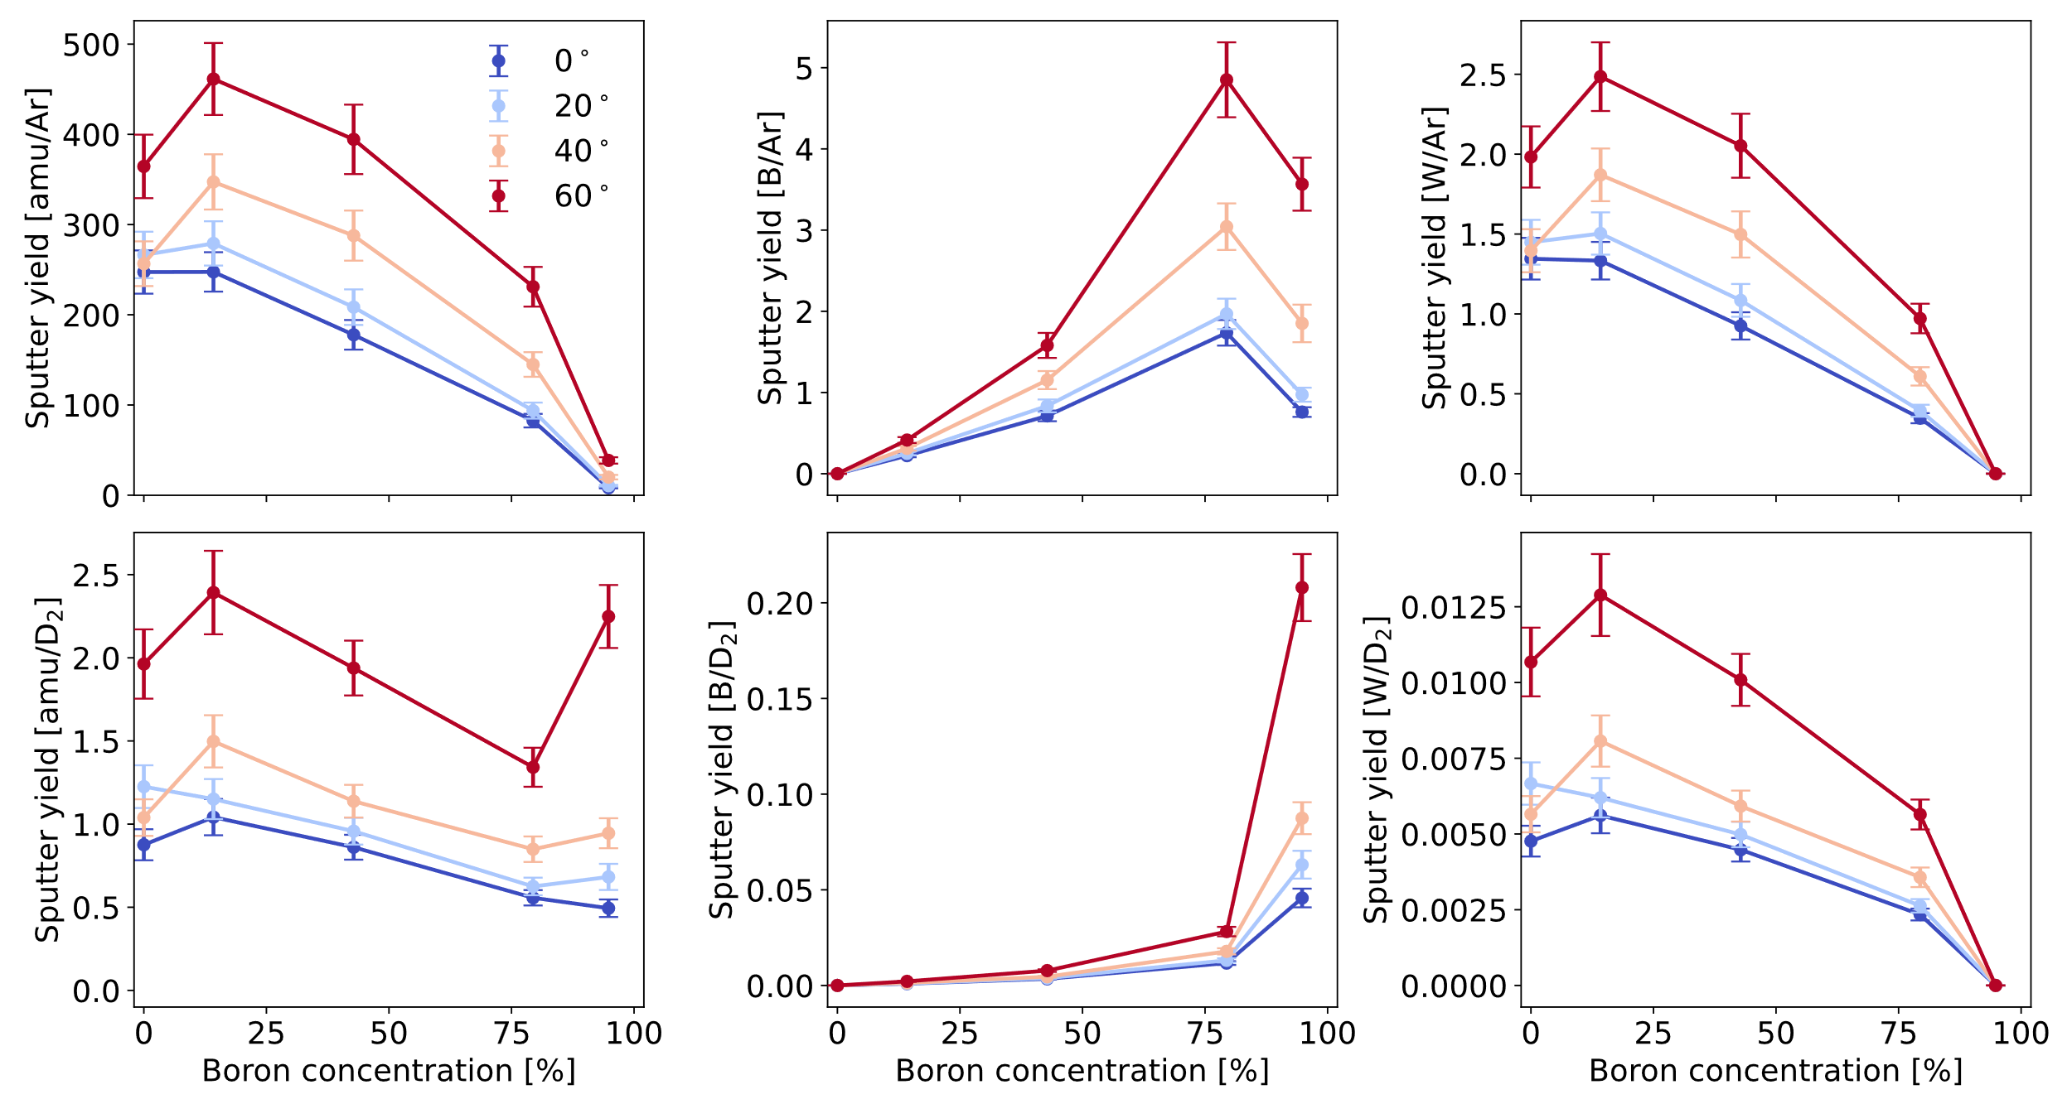

Results – 2keV Ar⁺ and D₂⁺ irradiation
Conversion from amu/ion into atoms/ion possible with assumption
$$\frac{Y_{W,at}}{Y_{B,at}}=\frac{q_{W}}{q_{B}}$$

Slide 5
Conclusions & open questions
Conclusions:
Amount of sputtered tungsten particles decreases with increasing boron concentration
Beneficial for a fusion reactor because influx of high-Z impurities is reduced
Open questions:
Investigation of temperature dependence of sputter yield
Investigation of remaining disagreement between SDTrimSP data and experimental results

Slide 6
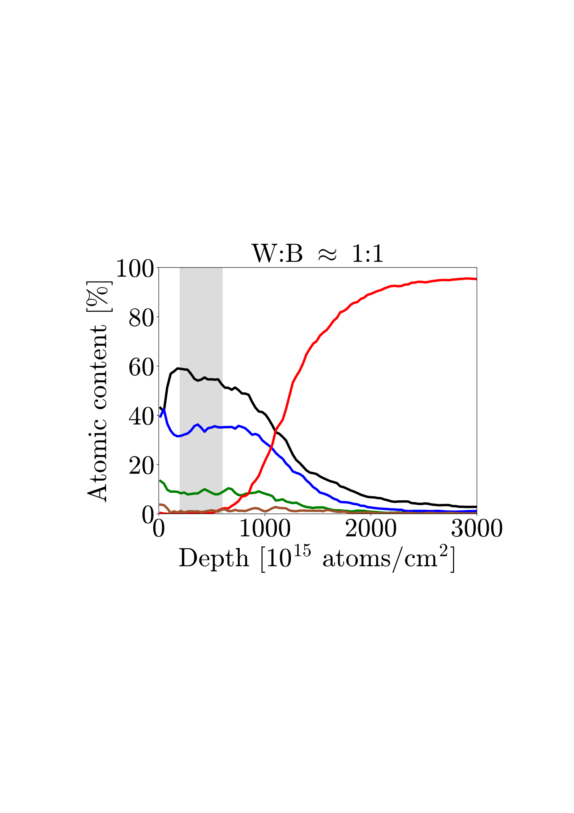
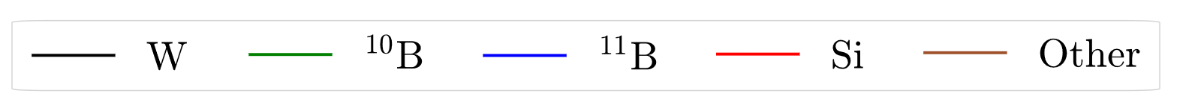
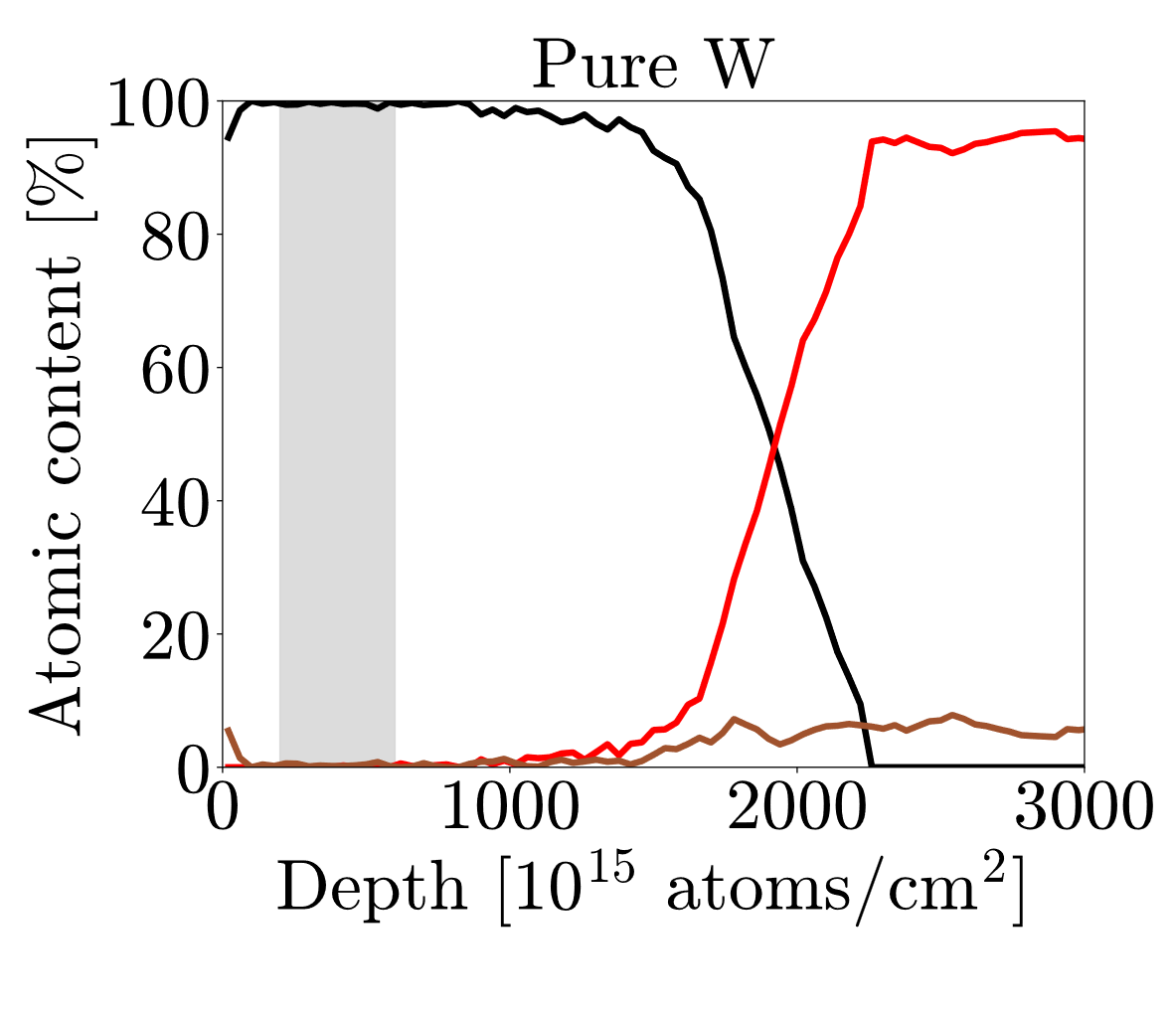
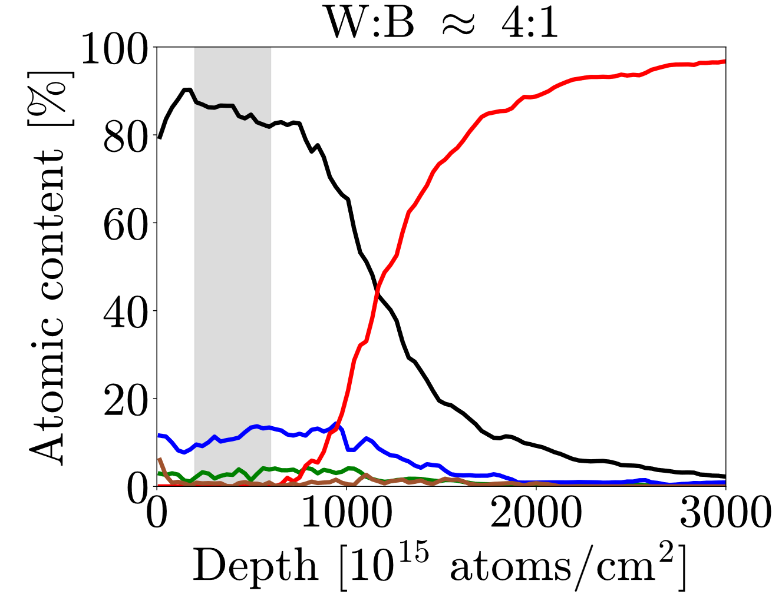
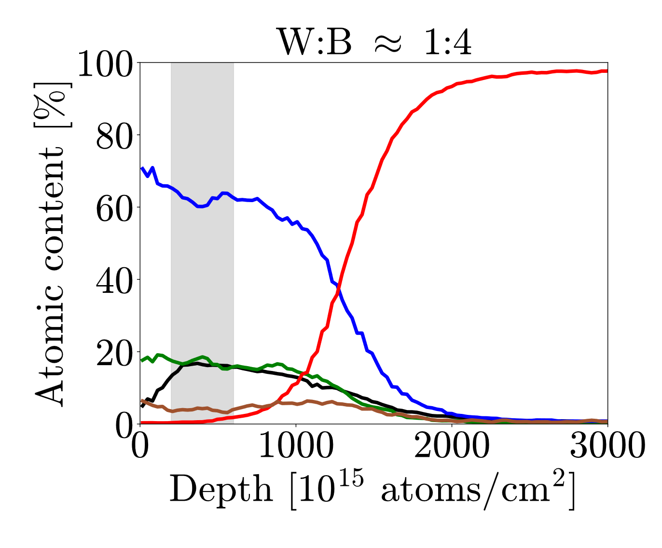
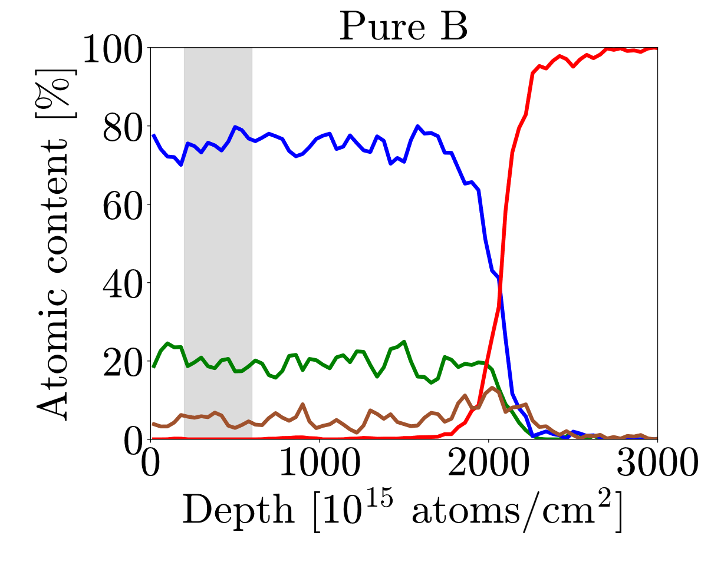
Elemental depth profiles

Slide 7
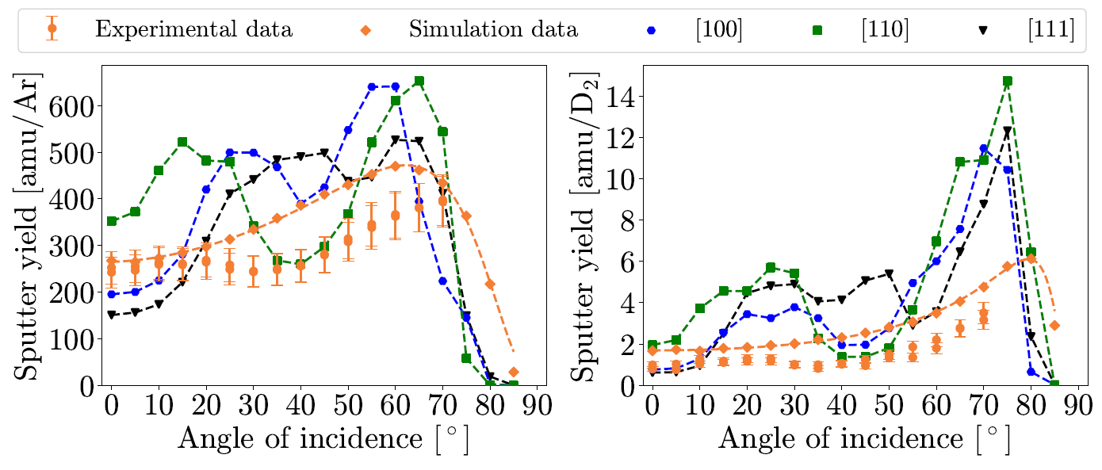
Pure W

Slide 8
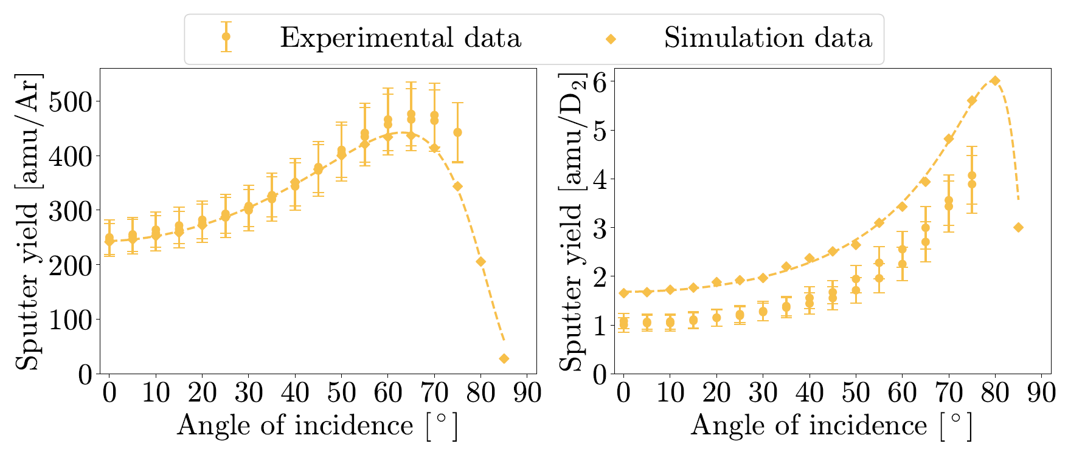
W:B ≈ 4:1

Slide 9
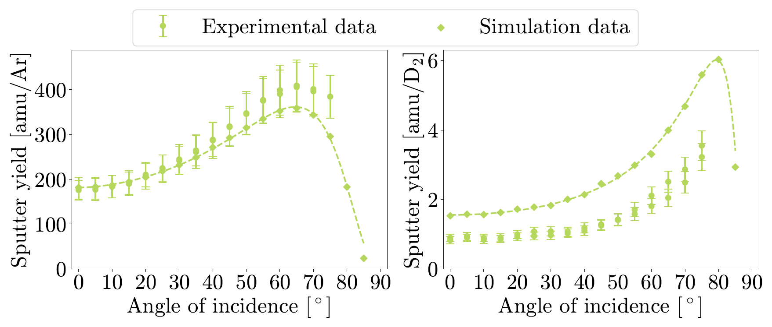
W:B ≈ 1:1

Slide 10
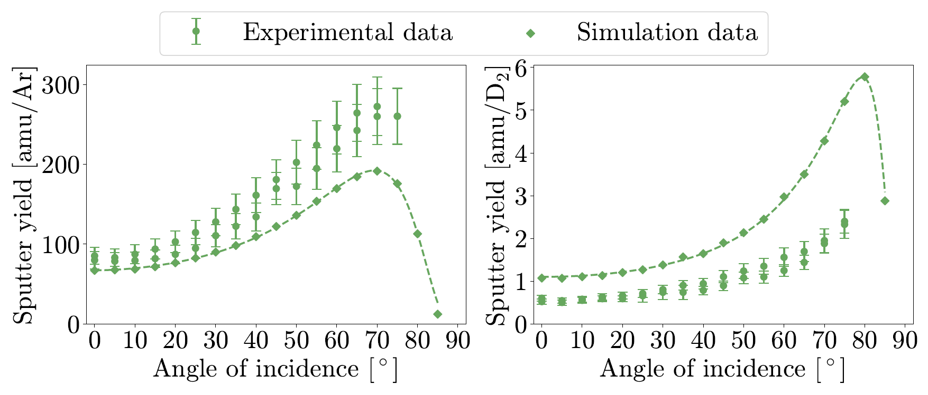
W:B ≈ 1:4

Slide 11
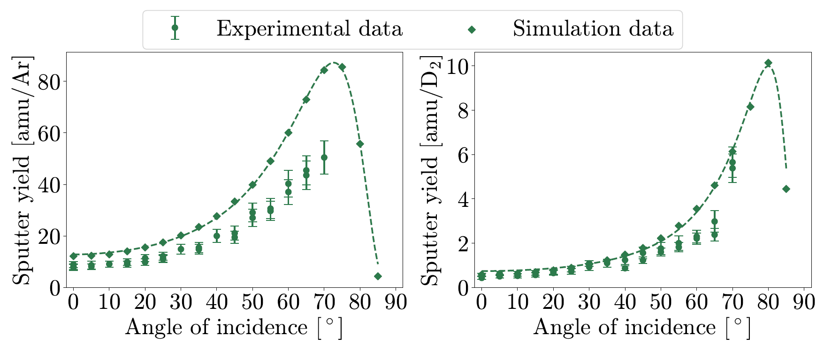
Pure B

Slide 12
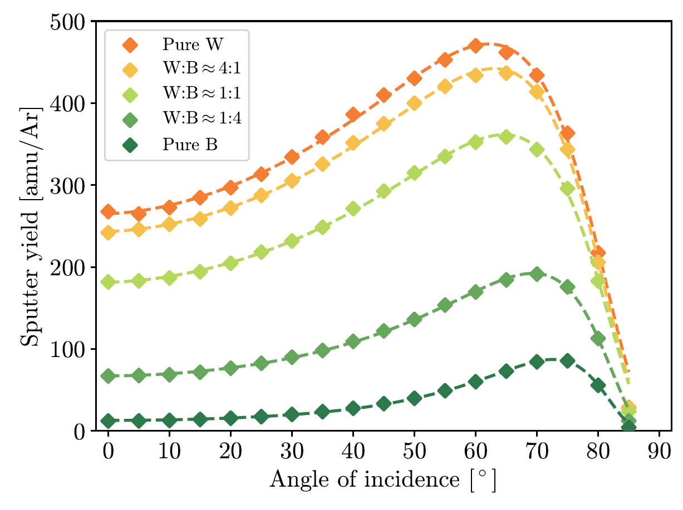
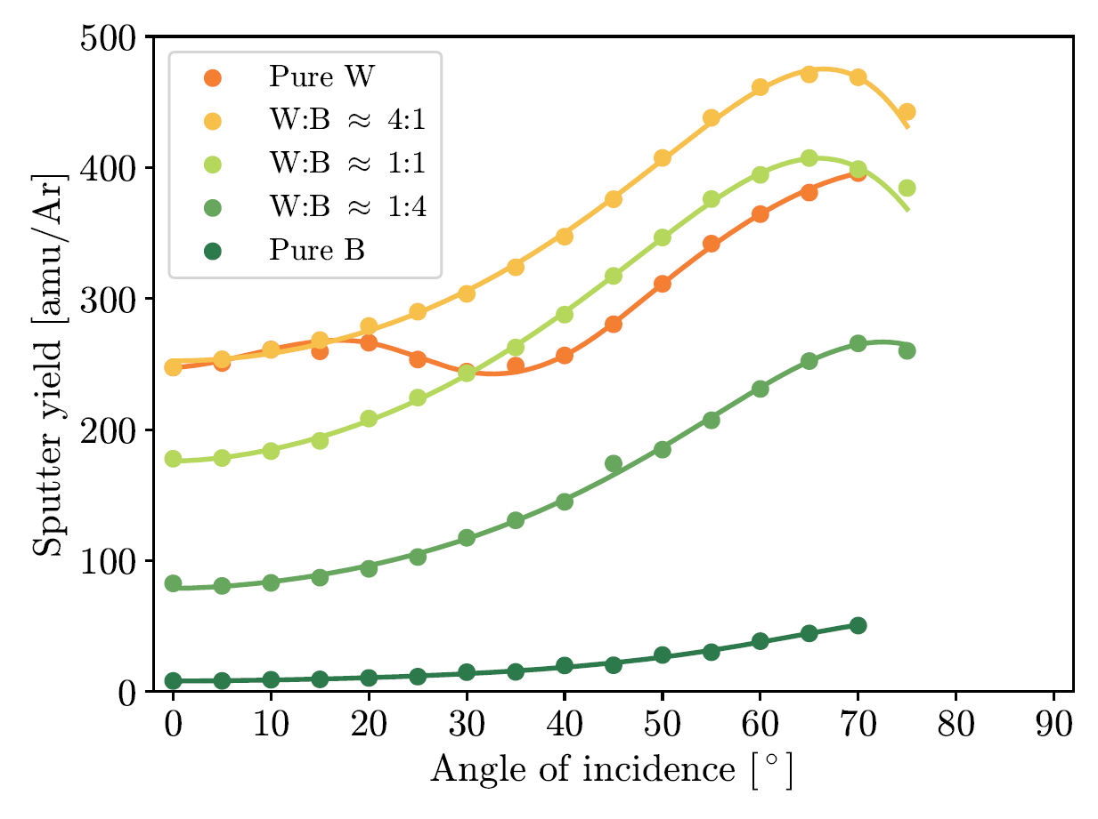
Comparison – Ar

Slide 13
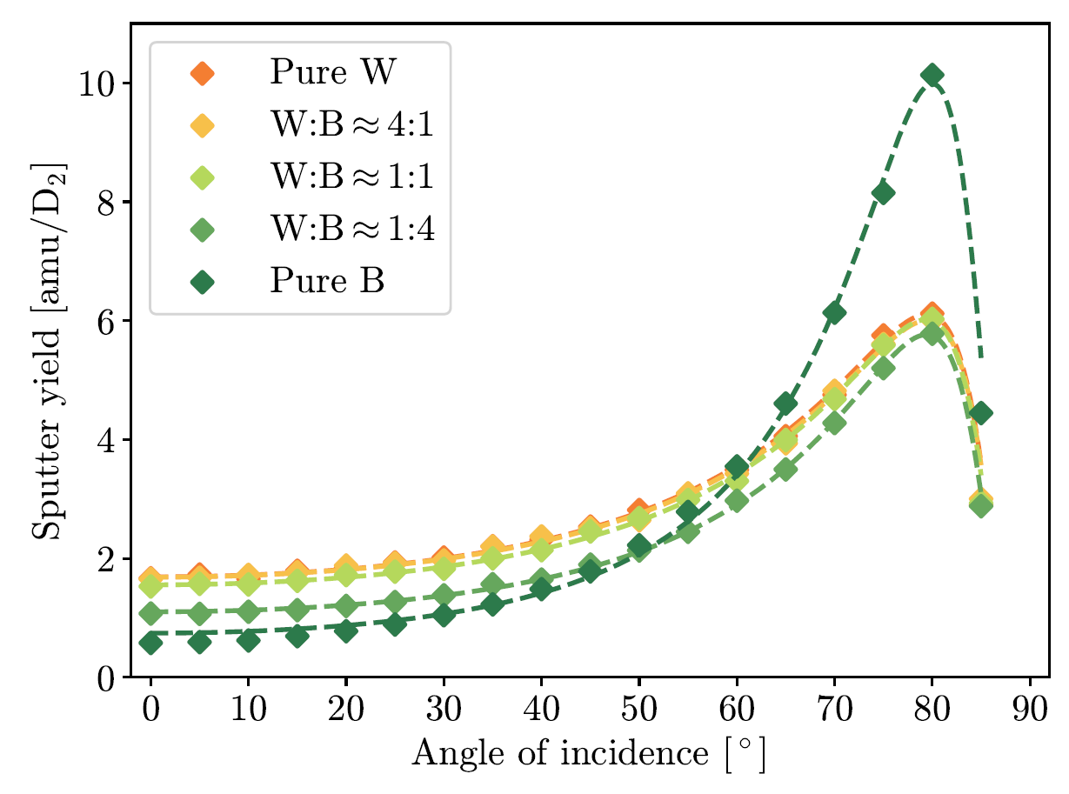
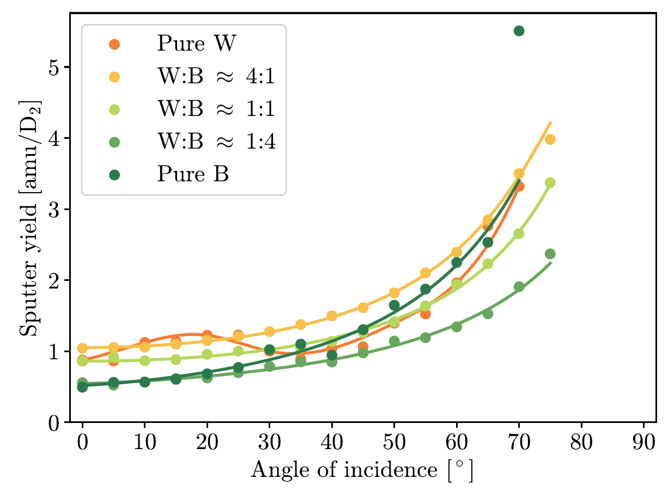
Comparison – D₂

