Slide 1
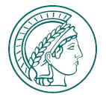


W erosion and redeposition in AUG Ne seeded experiment
M. Rasinski, Ch. Baumann, K. Krieger, R. Dux, A. Hakola, J. Karhunen, V. Rohde, S. Samuli

Slide 2
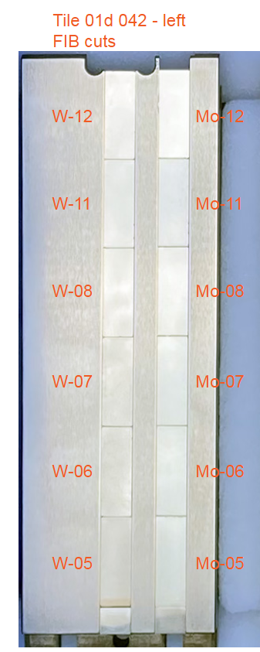
FIB cross-section preparation
2
17mm
On each sample 2-4 FIB cross-sections with line marking were prepared
Cross-section examined after AUG Ne campaign to determine the erosion and redeposition
Results will be used for ERO 2.0 modeling
AUG exposure
H-mode and L-mode D plasma with Ne seeding
Set of W and Mo samples for each experiment
1
2.5mm
6 mm

Slide 3
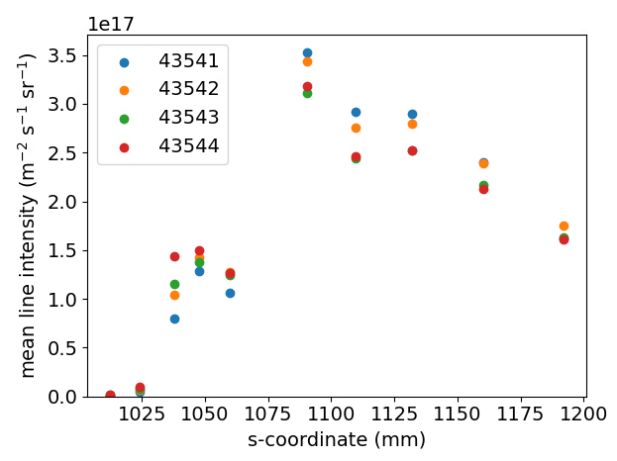
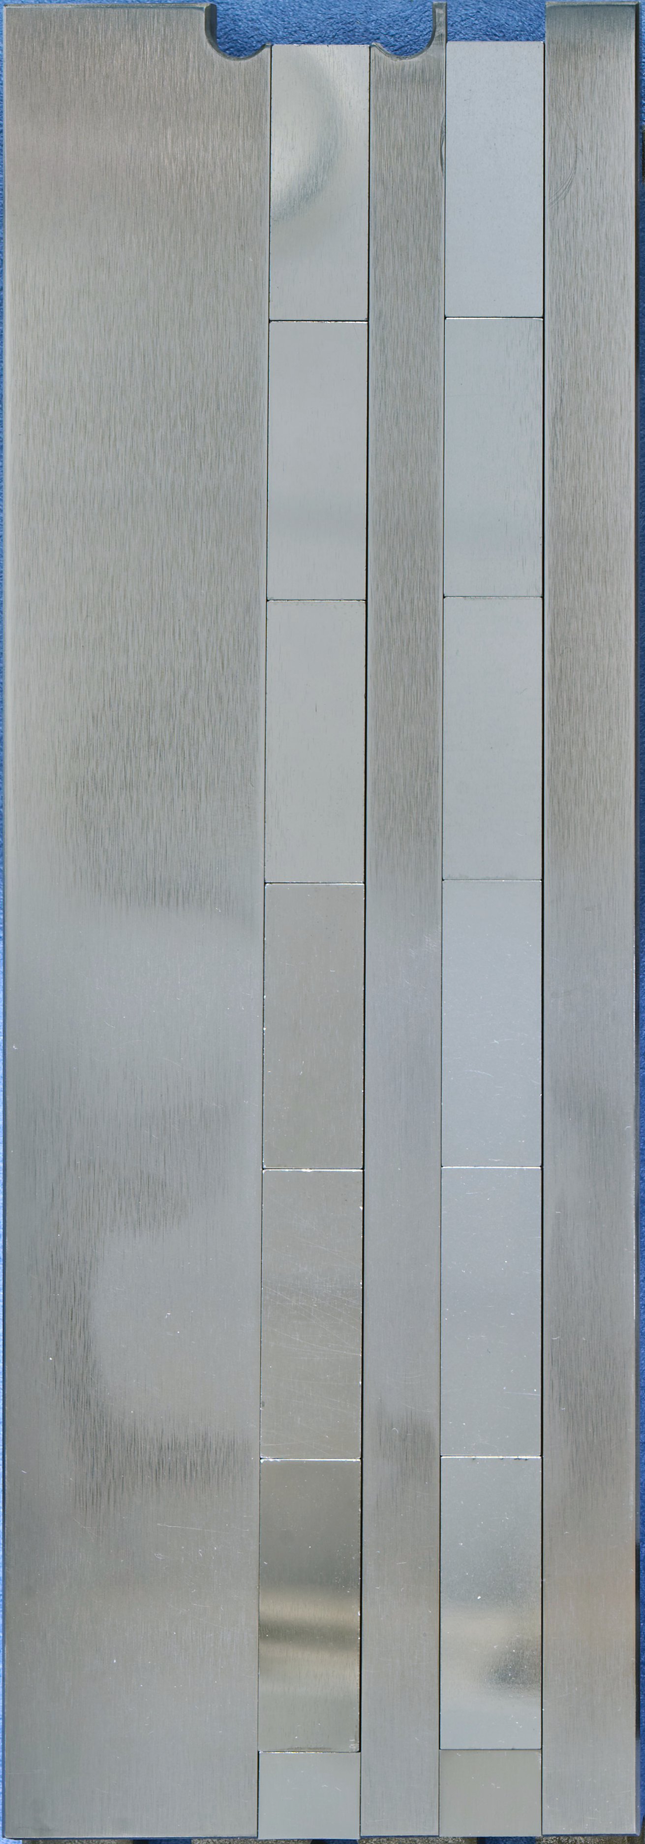
W
Mo
H-mode series – Mo I line intensity (5528 A)
VIS
x
x
OSP
OSP

Slide 4
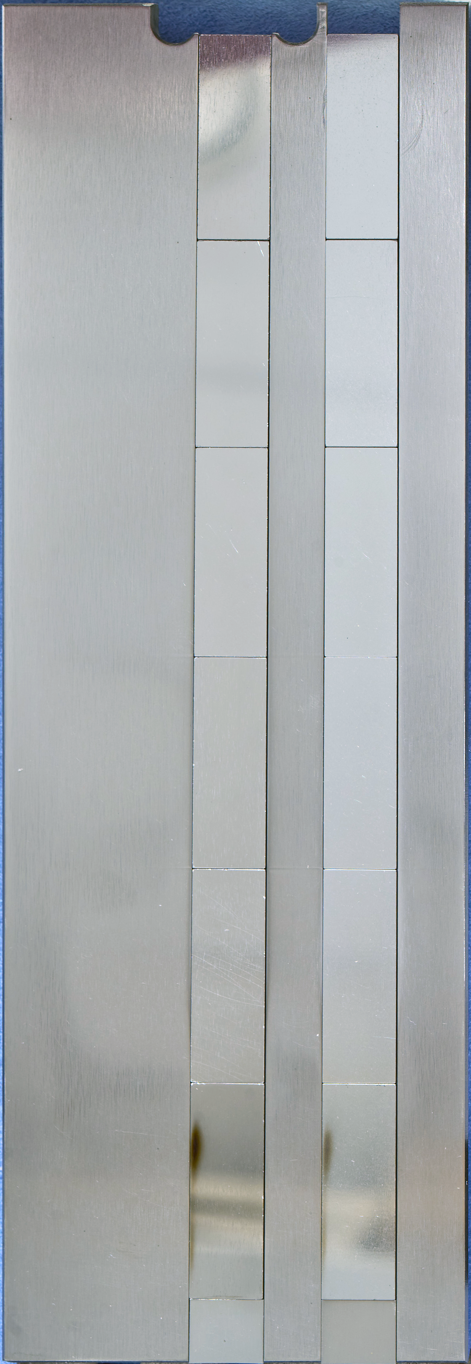
Results
before
after
W
Mo
W
W
Erosion below 50 nm – not possible to measure due to technique sensitivity
Mo
Erosion ~ 50 nm
Deposition – if present to thin to be measured by FIB cross-sections. TEM required on selected location
Mo
x
x
50 nm
H-mode

Slide 5

Sp B.1 Exposure of W-nano samples to PSI-2 plasmas
O. Marchuk, M. Sackers, M. Rasinski, S. Brezinsek, A. Houben, M. Klein and A. Kreter
Forschungszentrum Jülich GmbH – Institute of Fusion Energy and Nuclear Waste Management - Plasmaphysik,
Partner of the Trilateral Euregio Cluster (TEC), 52425 Jülich, Germany

Slide 6
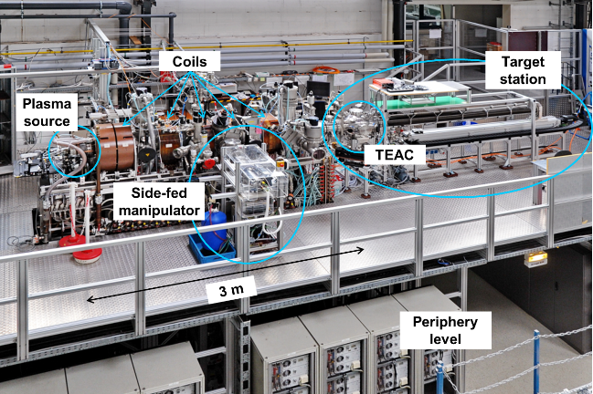
Setup of Psi-2

Slide 7
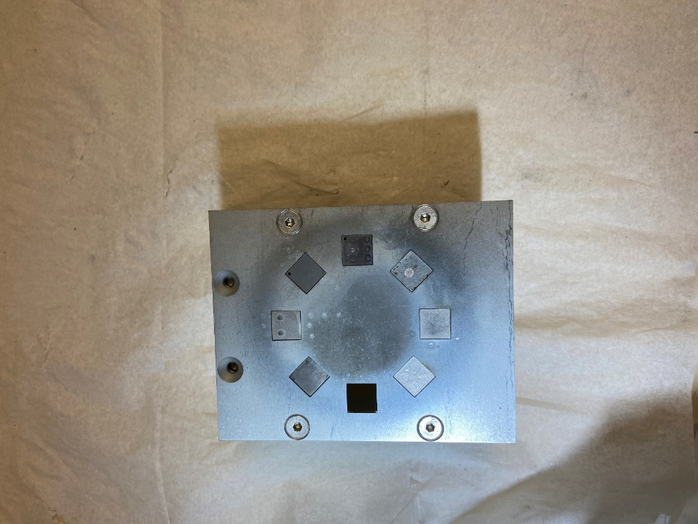
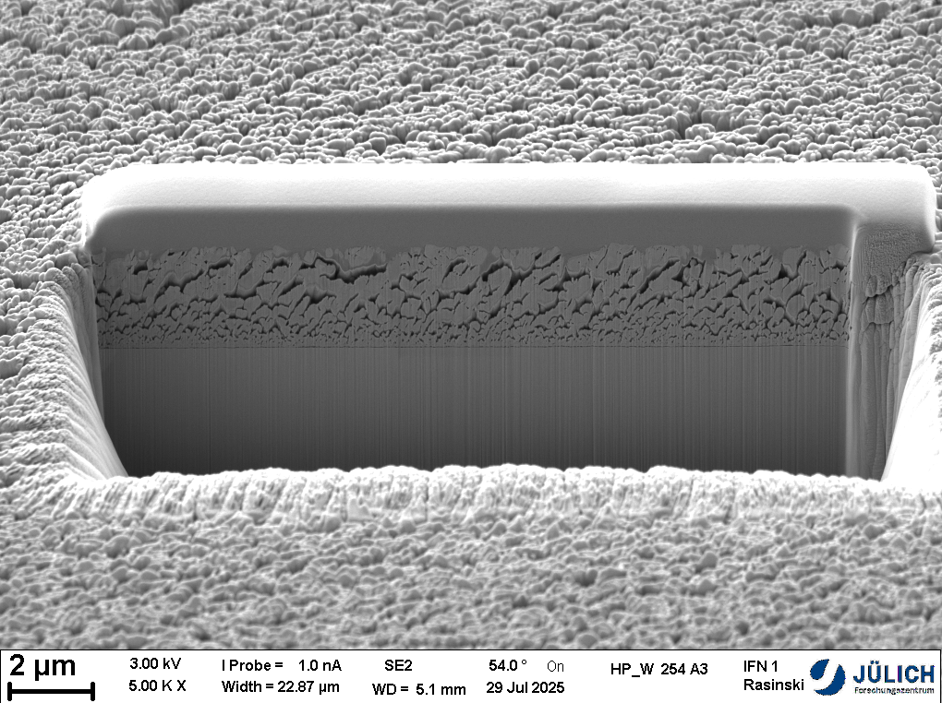
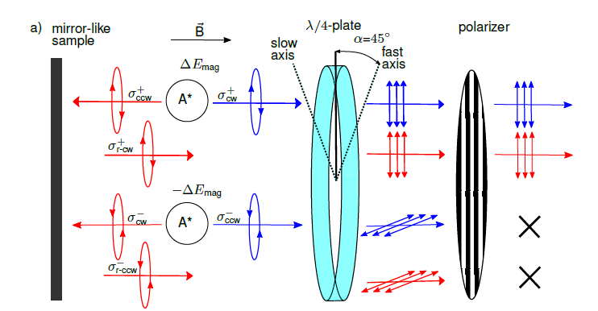
Spectroscopic studies on W-nano in PSI-2
A3 sample was put to the top
5
The A3 sample was exposed to 25 minutes in Ar
Front optics of the LOS (#5, along the normal to the target) :
Two type of lines:
Direct photons
reflected photons

Slide 8
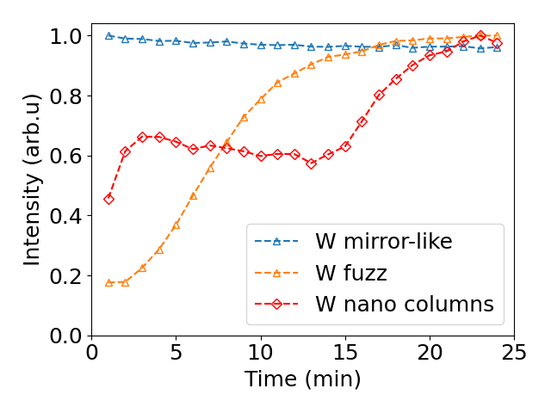
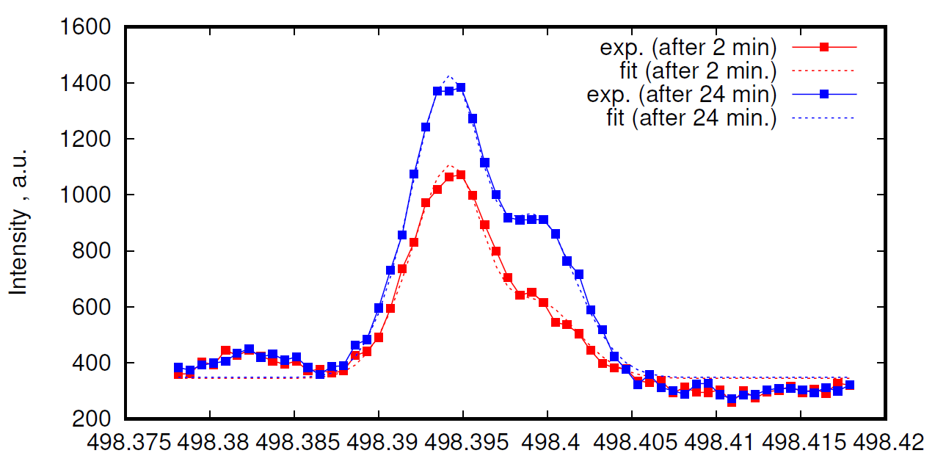
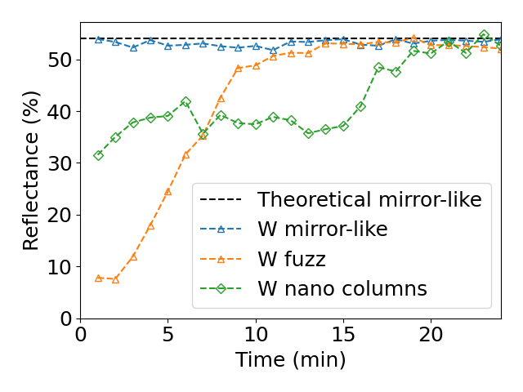
First results (A3)
Variation in intensity /Sputtering yield
Variation in reflectance /optical properties
Wavelength, nm
Some mistakes in the optical set-up were done for other targets. No data

