Slide 1
Analyses of Monoblock 28 and boronized samples from WEST
P. Tsavalas¹, K. Mergia¹, A. Lagoyannis¹, M. Axiotis¹, D. Papadakis¹, M. Diez², A. Benmoumen³, C. Martin³, I. Bogdanovic Radovic⁴, Z. Siketic⁴, E. Fortuna – Zaleśna⁵, M. Spychalski⁵, A. Hakola⁶
¹National Center for Scientific Research “Demokritos”, Athens, Greece
²CEA, IRFM, F-13108 Saint-Paul-Lez-Durance, France
³Aix Marseille University, CNRS, PIIM, Marseille
⁴Ruđer Bošković Institute, Bijenička 54, 10000 Zagreb, Croatia
⁵Faculty of Materials Science and Engineering, Warsaw University of Technology, Woloska 141, Warsaw, 02-507, Poland
⁶VTT Technical Research Centre of Finland Ltd, Espoo, Finland

Slide 2
ITER-like W-monoblock 28 from WEST divertor (Phase I)

Slide 3
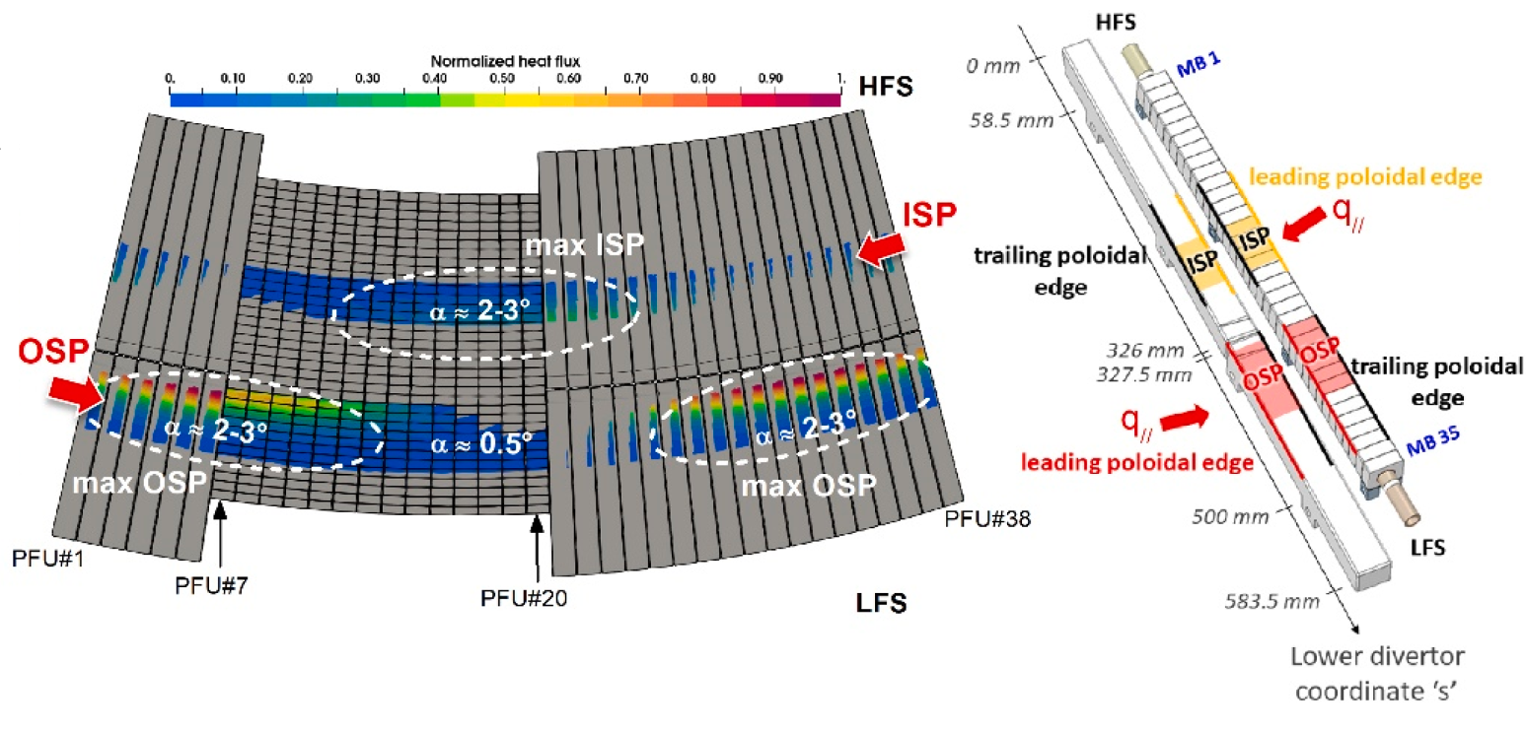
ITER-like actively cooled PFUs - MB 28
PFU#13
30.7 mm
plasma
Leading edge (LE)
Plasma-exposed
Trailing edge (TE)
6 mm
MB28
26 mm
12 mm
vertically misaligned of ~+0.3 mm
PFU#13

Slide 4
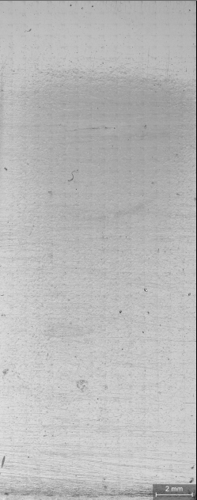






Experimental Methods
NRA/RBS (1.6 MeV D beam)
SEM with EDX
Optical profilometry
Tof ERDA (23 MeV ¹²⁷I⁸⁺ )
Optical microscopy
FIB - SEM
National Center for Scientific Research “Demokritos”
Ruđer Bošković Institute
Aix Marseille University
2 mm
Warsaw University of Technology
Toroidal direction
Analysis along the toroidal direction
Leading edge
Trailing edge

Slide 5
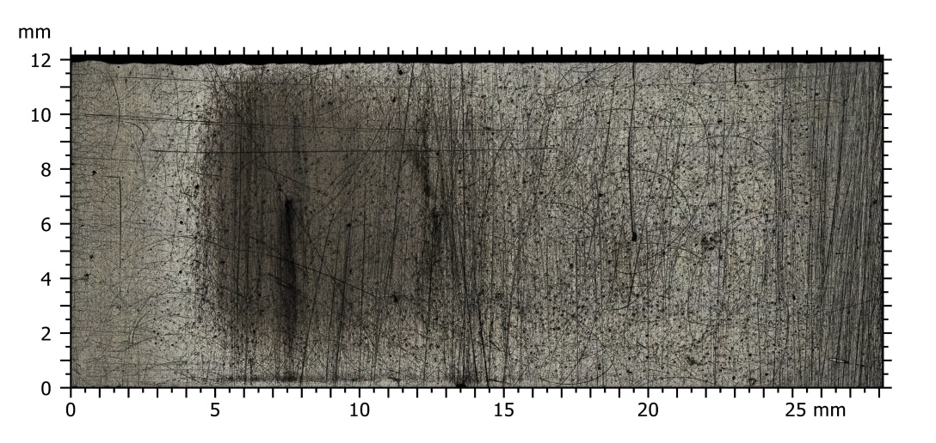
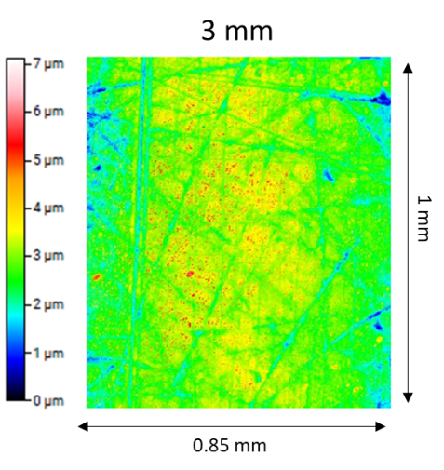
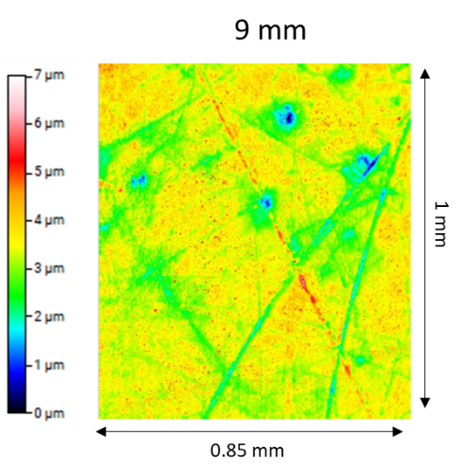
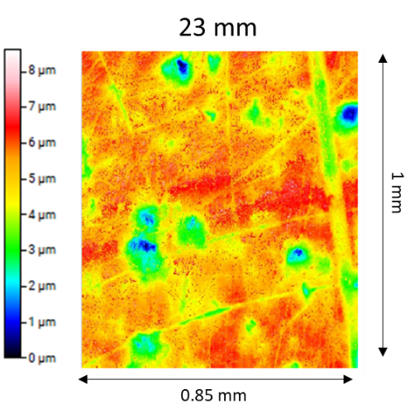
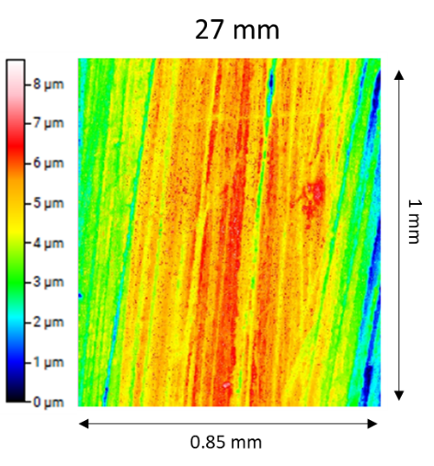
Optical image & Roughness
Toroidal direction
LE
TE
Optical microscopy
4 Different zones observed optically (gray dotted lines)
Roughness
From LE to 17 mm: lower than non-exposed (smooth surface)
From 19 to 23 mm: similar to non – exposed (surface depressions)
Near TE: highest values (scratches)
Zone 1
Zone 2
Zone 3
Zone 4
LE
TE

Slide 6
Fuel retention & material deposition
Zone 1
Zone 2
Zone 3
Zone 4
Zone 1
Low D and He retention
Low B, N, Cu and Fe deposition
Highest C deposition near LE
High W concentration
Zone 2
Highest fuel (D and He) retention
Highest B, N, Cu and Fe deposition
Zone 3
D & He retention decreases
B, N, Cu and Fe deposition decreases
Zone 4
Near TE: C & H deposition increase
Material deposition further decreases
fuel retention almost constant
Oxygen: large fluctuations

Slide 7
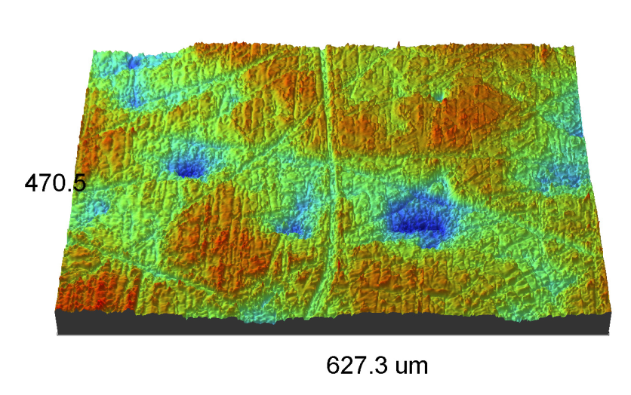
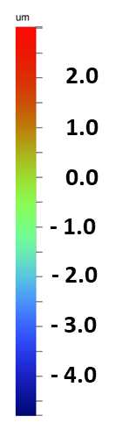
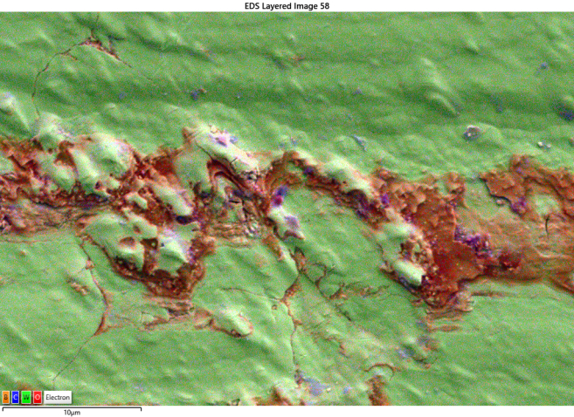
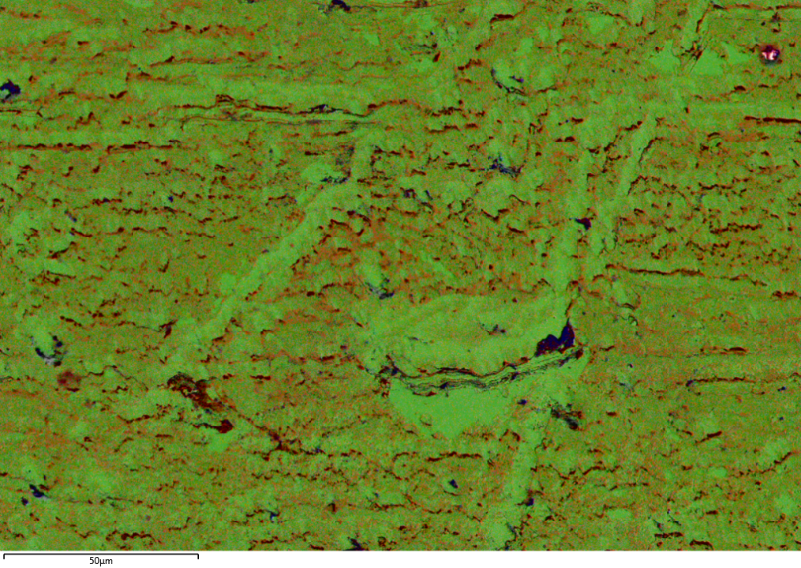
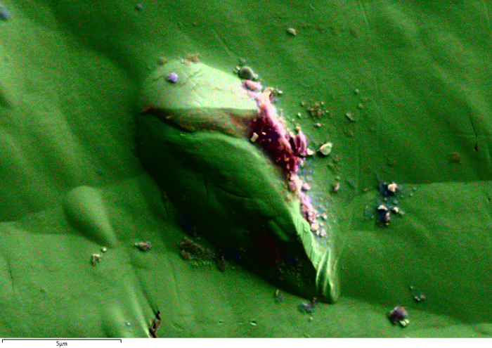
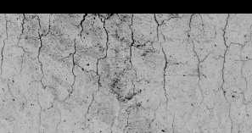
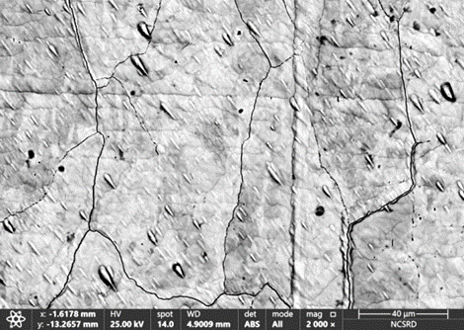
Surface Morphology
Formation of deposition areas
TE
LE
Zone 2
Zone 3
Near TE
Zone 3
50 μm
B
C
O
W
300 µm
10 μm
Elongated pointy objects
Formation of deposition areas
Zone 2: Mainly covered by B, N, O and Cu rich areas
Zones 3: Deposition concentrated along linear grooves and depressions
Near TE: linear deposition parallel to TE
TE
~58º
Artificial W coating
LE
5 μm
Pointy objects (observed all over the surface)
Oriented: 50º - 60º angle between the long axis and the LE/TE
Max length of 25 μm
Length-to-width ratio from 2 to 4
Stratified structures with, in some cases, embedded dust particles
Cracks
TE
Near LE
~700 μm
Zone 1
250-300 μm
Cracks
Perpendicular to LE: length ~ 700 μm
Along grain boundaries, visible where there is no deposition
Erosion observed in Zone 1
LE
P. Tsavalas et al Nuclear Fusion (submitted)

Slide 8
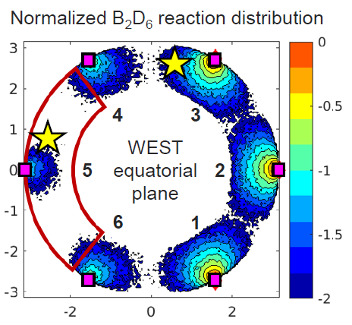
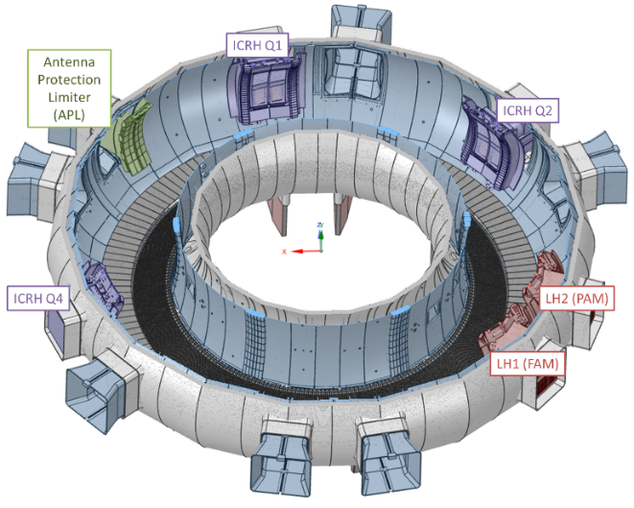
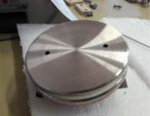
Motivation: In initial phase of ITER operations (SRO), the boronization will be toroidally non-symmetric
Recent simulations suggest strongly non-uniform B₂D₆
Aim: how (non-)uniform is B layer formation?
A. Gallo, PFMC 2025
Non uniform boronization performed in WEST
Q2
Spatially non-uniform boronization tested in WEST:
6 glow electrodes (anodes) on top LFS
3 (out of 6) diborane (B₂D₆) feed locations
bottom LFS Q1, Q2, Q3 (half of the torus)
Q3
Q3
Q4
A. Gallo, PFMC 2025
Q1
Q4
Q6
Q5
Glow electrode

Slide 9
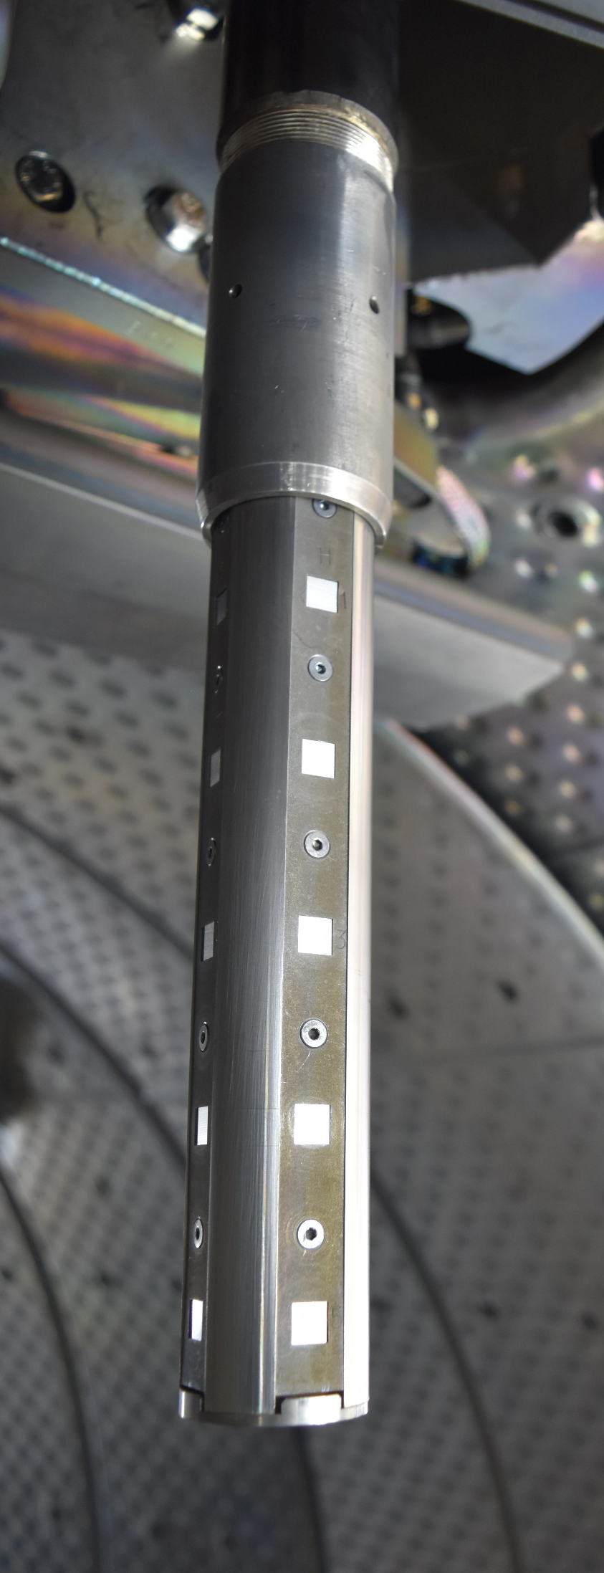

Boronized Samples
Sample holder | Pos | Side | Composition
Q3 | Pos 2 | A | Bulk W coated with Au
 |  | B
 |  | C
 |  | D
 | Pos 5 | A
 |  | B
 |  | C
 |  | D
 | bottom | Y
Q4B | Pos 2 | E
 |  | F
 |  | G
 |  | H
 | Pos 5 | E
 |  | F
 |  | G
 |  | H
 | bottom | Z
 | Pos 3 | F | Bulk Al coated with Au
Reference W |  |  | Bulk W coated with Au
Collector Probes
Q3
Q4
Q3
Q4
1
2
3
4
5
1
2
3
4
5
W
Pos 2
W
Pos 3
Al
    Q3 (B-rich region)
    Q4 (B-depleted region)
W
Pos 5
W
W
W
Side Y
Side Z

Slide 10
Methodology – Spectra
RBS/NRA measurements:
Beam: deuteron
Energy: 1.4 ΜeV
12.5 μm Kapton between the sample and the detector
Sample Q4 pos 2 side H was measured exactly after the air exposure and 22 days later
Representative W sample spectra
Al sample spectra
¹¹B(d,α₂)
B
¹⁰B(d,p_{4,5})
¹¹B(d,α₀)
¹⁰B(d,p₂)

Slide 11
Elemental Amount
Boron
Deuterium
Carbon
Pos 2
Bottom sides
Pos 5
Pos 3 (Al)
Pos 5
Pos 5
Bottom side Y
22 days later
Bottom side Z
Pos 2
Pos 5
H2 after 22 days
22 days later
Pos 2
Reference
Pos 2
Average pos 2
Average pos 5
Boron
No dependence on probe & side; dependence on vertical position
~3.5 × more B in pos 5 than in pos 2
Bottom sides present similar & the highest values
Pos 3 (Al) similar with pos 2
Same amount after 22 days air expose
Carbon
W samples: similar amount with reference one
high C amount Pos 3 (Al)
Deuterium
Dependence on probe; dependence on vertical position only for Q3
Q3: ~3.5 × more D in pos 5 than in pos 2
Q3 bottom side Y: the highest amount
Low values for Q4 presenting max. variation by factor of 5
Oxygen
Q3: similar amount with reference independent on position
Q4: pos 5 & bottom side present 3 times more than pos 2 & reference
Oxygen
Pos 5
Pos 2

Slide 12
D/B ratio & Conclusions
Q2
D/B ratio
Q3
Q1
Q4
Q6
Pos 2
Pos 5
Q5
Bottom
Bottom
The non-symmetric feed locations B₂D₆ and symmetric glow elecrodes result in (Q3 & Q4 results):
Boron
Uniform deposition regarding side & region (probe)
Dependence on vertical position
No change after 22 days air exposure
Deuterium
Non-uniform deposition for different regions (probes)
Q3: No dependence on side; dependence on vertical position
Q4: small dependence on side; small variation with vertical position
22% decrease after 22 days air exposure
D/B ratio:
Q3: no dependence on side & position (~0.23)
Q4:
  almost no dependence on side
  dependence on position (pos 2 ~ 0.14 & pos 5 ~ 0.05)

Slide 13
Thank you for your attention

