Slide 1

WPPWIE SP B: Monitoring meeting, 10 October, 2025
Production of B reference layers
C. Porosnicu, P. Dinca, B. Butoi, O. G. Pompilian, C. Staicu, B. Solomonea, C. P. Lungu
IAP-Romania

Slide 2
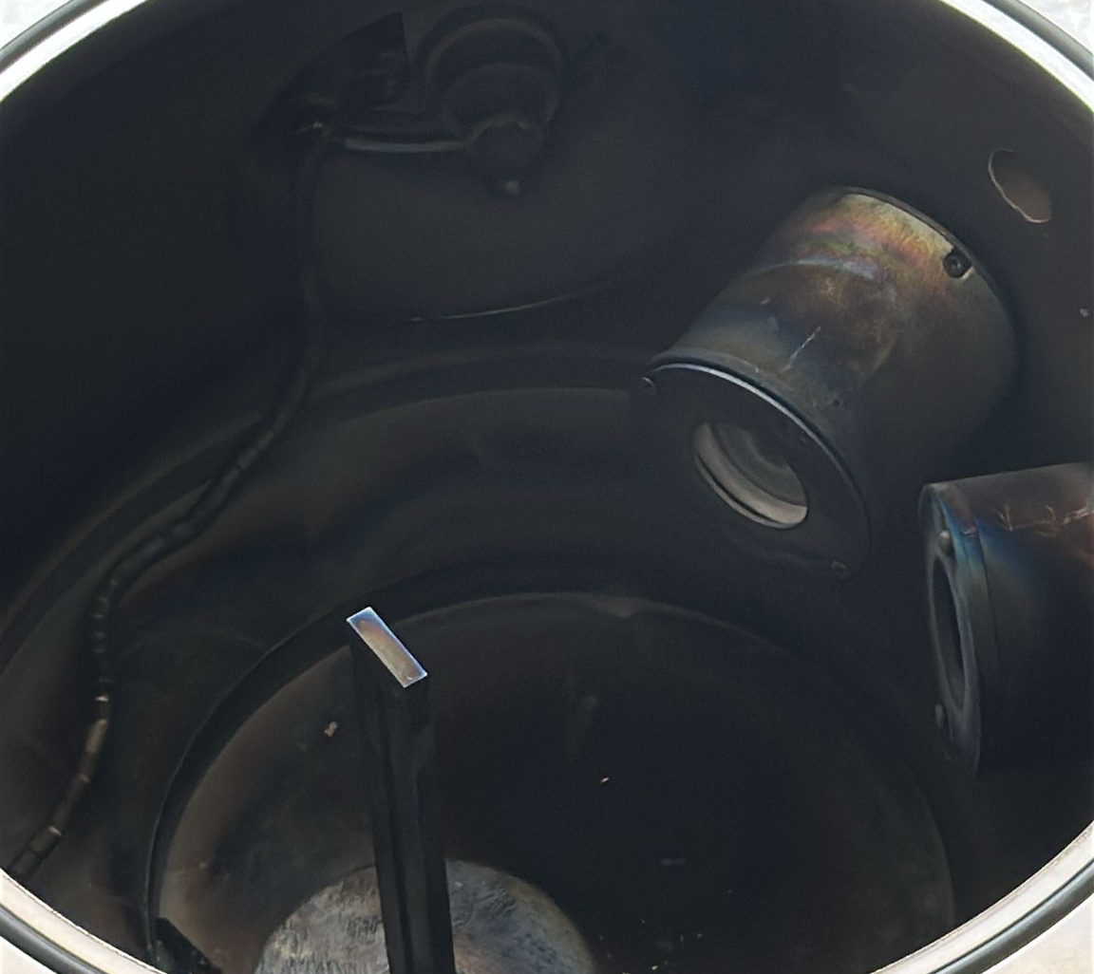
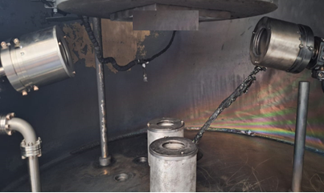
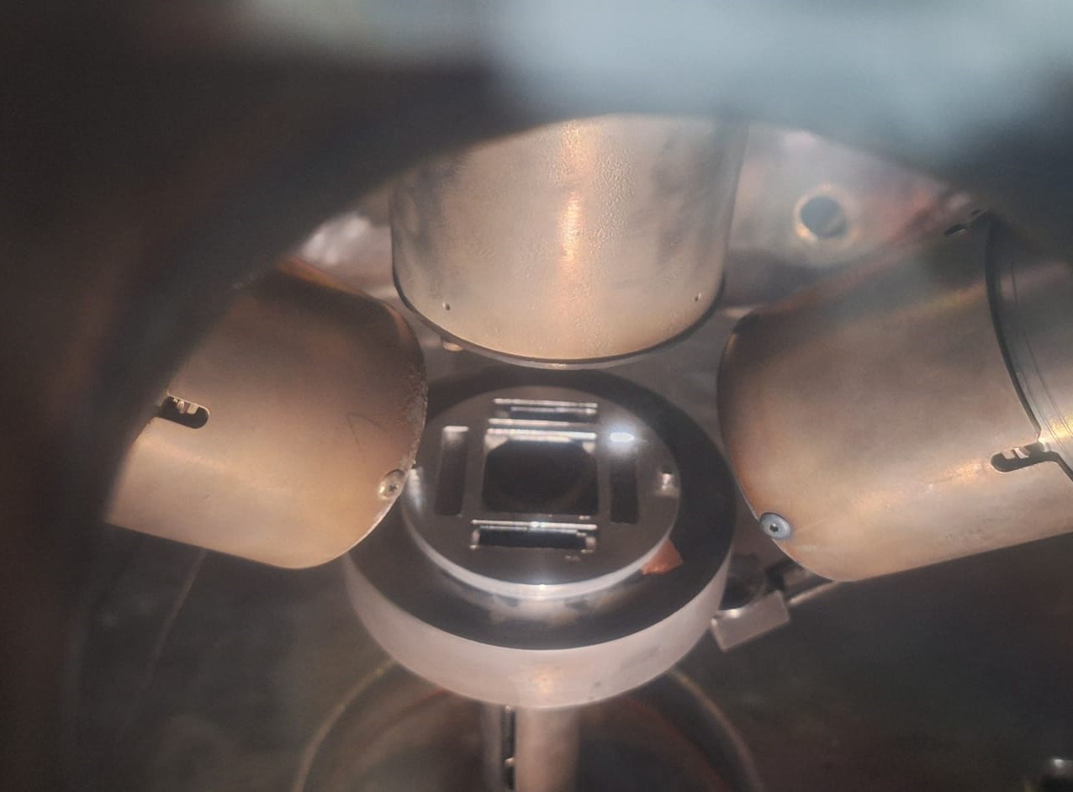
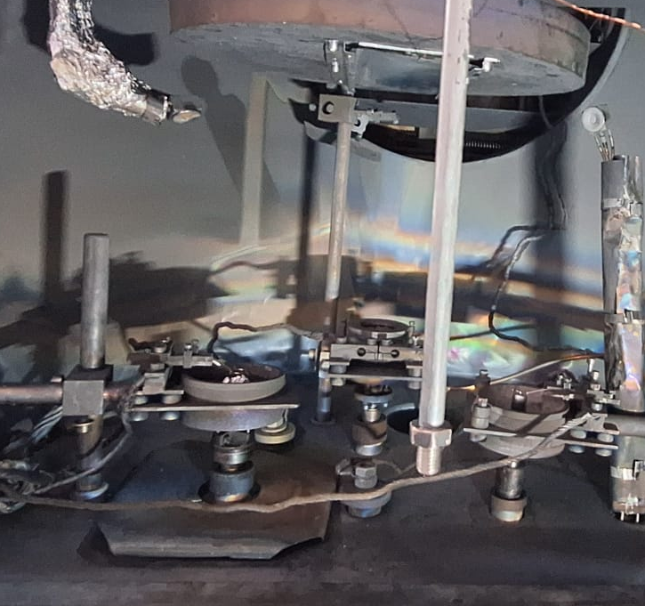
B/D coating process – available setups
2024 was dedicated in setup and coating recipe development and plasma charactherisation methods
Previous expertise used for coatings within the facility was redirected to B
Picture of the coating system used for B-D (Ne, N, He) layer deposition
Picture of the coating system used for B(/W)-D (Ne, N, He) layer deposition
Picture of deposition system used for obtaining B (-W)-D/H/etc. layers
TVA Deposition system used for obtaining B (/W,etc). layers
Magnetron systems (1-5 available): RF, DC, HiPIMS, mp- HiPIMS, BP-HiPIMS
Thermionic vacuum arc

Slide 3
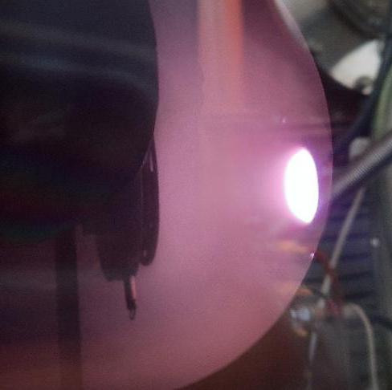
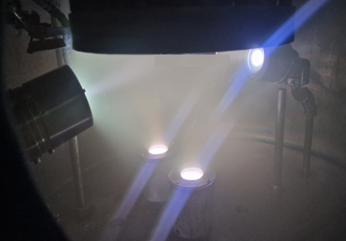
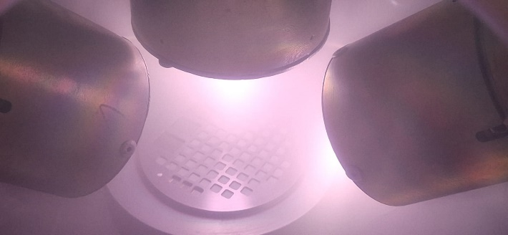
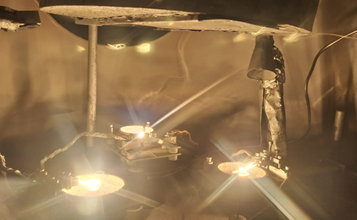
B/D coating process – available setups
2024 was dedicated in setup and coating recipe development and plasma charactherisation methods
Previous expertise used for coatings within the facility was redirected to B
Picture of the coating system used for B-D (Ne, N, He) layer deposition
Picture of the coating system used for B(/W)-D (Ne, N, He) layer deposition
Picture of deposition system used for obtaining B (-W)-D/H/etc. layers
TVA Deposition system used for obtaining B (/W). layers
Magnetron systems (1-5 available): RF, DC, HiPIMS, mp- HiPIMS, BP-HiPIMS
Thermionic vacuum arc

Slide 4
Plasma characterisation - Ion energy measurements
2024 was dedicated in setup and coating recipe development and plasma charactherisation methods
RF plasma, Ion energy DF
RF plasma, Ion energy overview
Parameters varied
Ar/D ratio
RF Power
Pressure
BIAS Voltage

Slide 5
Plasma characterisation - Ion energy measurements
2024 was dedicated in setup and coating recipe development and plasma charactherisation methods
RF plasma, Ion energy DF
RF plasma, Ion energy overview
Parameters varied
Ar/D ratio
RF Power
Pressure
BIAS Voltage

Slide 6
Plasma characterisation - Ion energy measurements
2024 was dedicated in setup and coating recipe development and plasma charactherisation methods
HiPIMS Monopulse, Frequency, Voltage, Pulse duration
B+Ar+D, Ar/D: 1/1,
Bipolar HiPIMS,
Positive pulse duration varried
Positive pulse voltage varried
RF+HiPIMS+DC = ~90 types of plasmas
For each one we know:
Ion energy
Coating rate (Particle flux)
D/B ratio by TDS
Useful for recipe development and future production

Slide 7
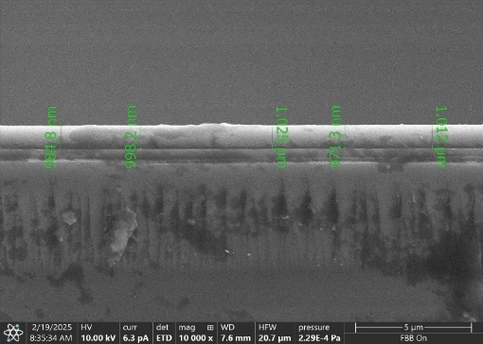
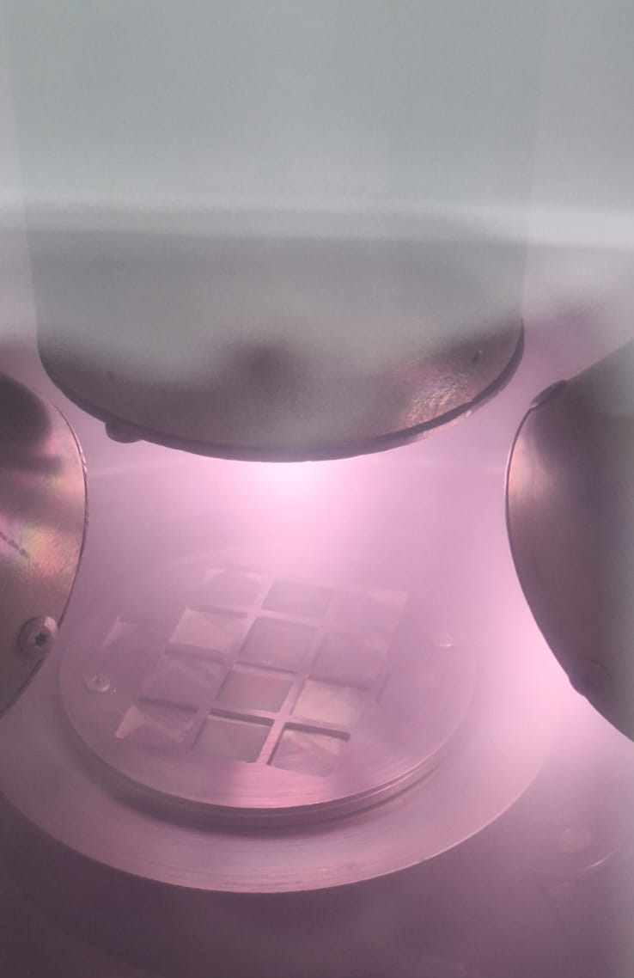
Results form the B layers production task in 2025 under SBP4
Pre-deposition. Calibration
Coating parameters
4x Si substrates
2 RF sources opperated at 100W each
Working pressure: 1x10⁻²mbar
Ar flow= 20sccm
D₂ flow= 20 sccm
Measurements
SEM cross-section
TDS
In situ photo of the deposition
TDS results (D concentration and quantity)
Cross-section-SEM results

Slide 8
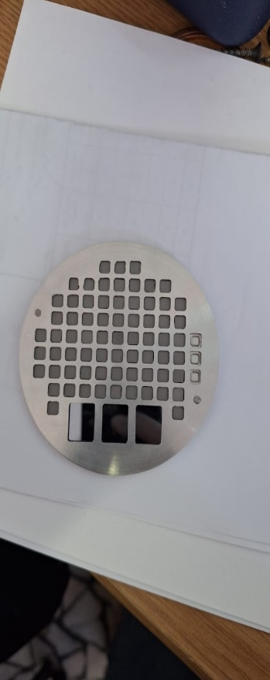
Results form the B layers production taskin 2025 under SBP4
Boron+D2(10%) 5μm
Thermal Treatment- 50ºC- 500ºC_Ramp 5ºC/min
TDS measurement during Thermal Treatment
Preparation of 5x5 mm² W samples coated with B+D₂(10%)
Subject to thermal treatment post-coating
Deuterium quantity as a function of the thermal treatment
60 tungsten substrates 5x5 mm
2 RF sources opperated at 100W each
Working pressure: 1x10⁻²mbar
Ar flow= 20sccm
D₂ flow= 20 sccm
Temperature (ºC) | D released (at/cm²⁾ | D released during the TT (%)
50 | 7.45E+14 | 0.01
100 | 8.25E+15 | 0.08
150 | 2.21E+16 | 0.22
200 | 2.98E+16 | 0.29
250 | 2.82E+17 | 2.76
300 | 1.06E+18 | 10.39
350 | 2.22E+18 | 21.76
400 | 3.24E+18 | 31.76
450 | 4.95E+18 | 48.53
500 | 6.45E+18 | 63.24
1050 | 1.02E+19 | 100.00
TDS result on B+D2_1050ºC
Sample holder
In situ photo of the deposition

Slide 9
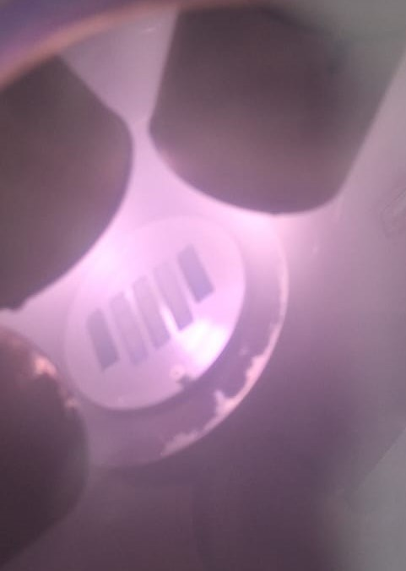
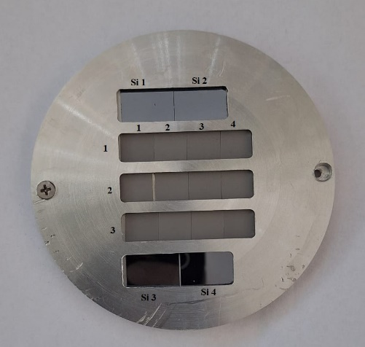

Results form the B layers production taskin 2025 under SBP4
Boron deposition (100nm)
Boron deposition (5μm) with and without D
12 tungsten substrates 10x10 mm
2 RF sources opperated at 100W each
Working pressure: 1x10⁻²mbar
Ar flow= 20sccm
D₂ flow= 20 sccm
8 tungsten substrates
Eurofer φ 40 mm - for permeation studies
2 RF sources opperated at 100W each
Working pressure: 1x10⁻²mbar
Ar flow= 20sccm
D₂ flow= 20 sccm
In situ photo of the deposition
Sample holder
Analisys (TDS, XRD,SEM, etc.) was be performed.
Samples sent - sealed bags in vacuum
All samples were stable after the deposition (at least before shipping)
In situ photo of the deposition

Slide 10
XPS on tungsten-boride formation
Request for tungsten boride layers from Penn State University (A. Marin) under a PSU - WEST collaboration.
Samples coated by TVA – task performed.
TVA parameters variation- W/B coatings with and without boride formation
Elemental relative concentrations (at. %)
Si2-6_340 nm | B1s | C1s | O1s | W4f | B/W
0.0 min sputtering | 15.1 | 45.3 | 32.9 | 6.7 | 2.3
0.5 min sputtering | 45.9 | - | 38.8 | 15.3 | 3.0
1.0 min sputtering | 58.3 | - | 15.8 | 25.9 | 2.3
5.0 min sputtering | 63.0 | - | 13.5 | 23.5 | 2.7
10.0 min sputtering | 63.3 | - | 13.1 | 23.6 | 2.7

Slide 11
2025 Status report of the B coatings at IAP under SBP4
1. Boron coatings with controlled deuterium inclusions (10 at%) - Completed : End of February 2025
B+D₂ (10 at%) with a nominal thickness of 5 um deposited on W (5x5 mm). Exposure to distinct temperatures 50 – 500 ºC
Measurements performed on the samples: TDS and SEM
Sample sent to: CEA_France (10 pieces), JSI_Slovenia (10 piece), NCSRD_Greece (10 pieces), RBI_Croatia (10 pieces), VTT_Finland (10 piece)
2. Boron Layers with a nominal thickness of 100 nm - Completed : End of February 2025
100 nm boron layers deposited on W (10x10 mm ) and Si substrates (2025
Measurements performed on the samples: SEM
Sample sent to: DIFFER_The Netherlands (1 piece Si, 1 piece W), CEA_France (1 piece), FZJ_Germany (1 piece), IPPLM_Poland (1 piece), IST_Portugal (1 piece), JSI_Slovenia (1 piece), NCSRD_Greece (1 piece), VR_Sweden (1 piece), VTT_Finland (1 piece), CIEMAT_Sapin (1 piece)
3. Boron Layers with a nominal thickness of 5 um - Completed : March 2025
5um boron layer deposited on Ø 40 Eurofer substrate, W(10 x10 mm) and Si substrate
Measurements performed on the samples: SEM
Samples sent to : JSI_Slovenia (1 piece Eurofer ), CEA_France (1 piece Si),JSI_Slovenia (5 pieces W), IST_Portugal (1 piece W), CIEMAT_Spain (1 piece W)
4. Boron Layers with controlled D ratio (10 at%) - Completed : March 2025
5um B+D (10 at%) layer deposited on Ø 40 Eurofer substrate, W(10 x10 mm) and Si substrate
Measurements performed on the samples: SEM
Samples sent to : JSI_Slovenia (1 piece Eurofer ), CEA_France (1 piece Si),JSI_Slovenia (5 pieces W), IST_Portugal (1 piece W), CIEMAT_Spain (1 piece W)

Slide 12
2025 Status report of the B coatings at IAP under SBP4
Planned until the end of 2025
Deposition of pure boron layers with a nominal thickness of 100 nm and 5 um on W(12 x 15 mm) substrates – (Deadline: September 2025) substrates to be received from Rodrigo
Deposition of B+D₂ (10 at%) with a nominal thickness of 100 nm and 5 um on W(12 x 15 mm) (Deadline: September 2025) - ongoing
Deposition of B (5 µm) on Mo (⌀30 mm, 3 pcs) (Deadline : September 2025)- Mo substrates just received
Boron coatings with controlled deuterium inclusions (10 at%). Exposure to distinct temperatures 50 – 500 ºC. (Deadline: January 2026)
Problems:
Two turbo-pumps failures in August and September. One was replaced, activity re-started.
The remaining tasks planned until the end of 2025 are on track, there are no issues to report concerning the sample production. Some delays due to substrates delivery delay and pump failure(see above) but nothing to be worried.

Slide 13
Prospects for studying B layers under SPF
Proposal of an experimental plan - Example and ideas:
  Different aproach than under SPB: Focus on plasma parameters instead of coating properties.
  For each set of parameters, very well defined plasma characterization
  Ionisation degree (Langmuir probe), Ion energy (IEDF), species identification (MS, OES), etc.
  Sistematic study
  Fixed plasma parameters – well characterized plasma => what will we obtain??
  stability, morphology, composition, adhesion, hardness, fuel retention
  Work plan has to be established by SP Leaders under SPB, SPC, SP D, SPX and SPF since the need of a “database of artificial B layers for physics studies: stability, fuel content, and release”
Parameters to be varied:
RF-MS parameters (Input power) |  | Pressure (1e-03 – 1e-01 mbar)
HiPIMS MP and BP plasma parameters (Pulse duration and frequency, voltage for negative and positive pulse) |  | Acceleration voltage (0 to-200V for MS;-700V for TVA),
TVA parameters (voltage and current) |  | D/Ar ratio (1/20 – 1/1)

