Slide 1

WPPWIE SP B: Monitoring Meeting, 10 October 2025
Ion-beam measurements of B layers and other samples at IST
Rodrigo Mateus, Norberto Catarino,
Rui Silva, Sérgio Magalhães, Eduardo Alves
Notes:
Please Indicate your subproject

Slide 2
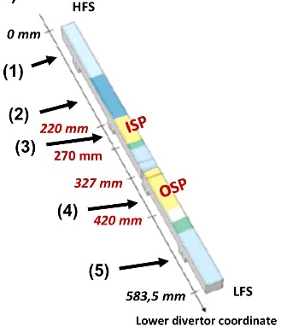


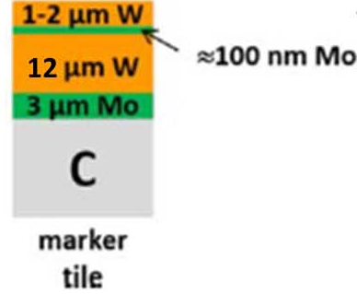
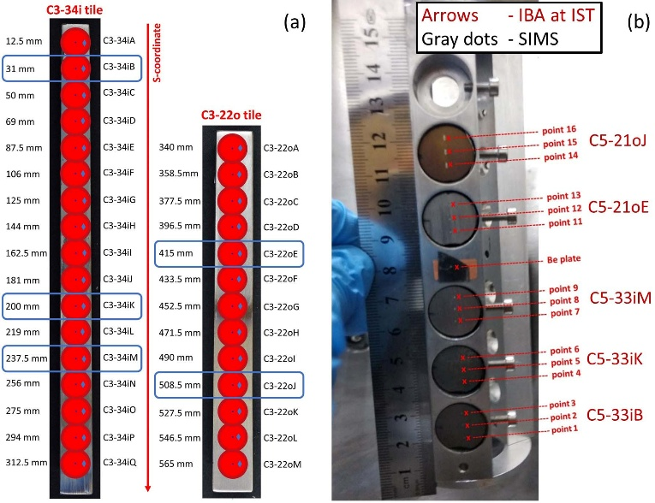
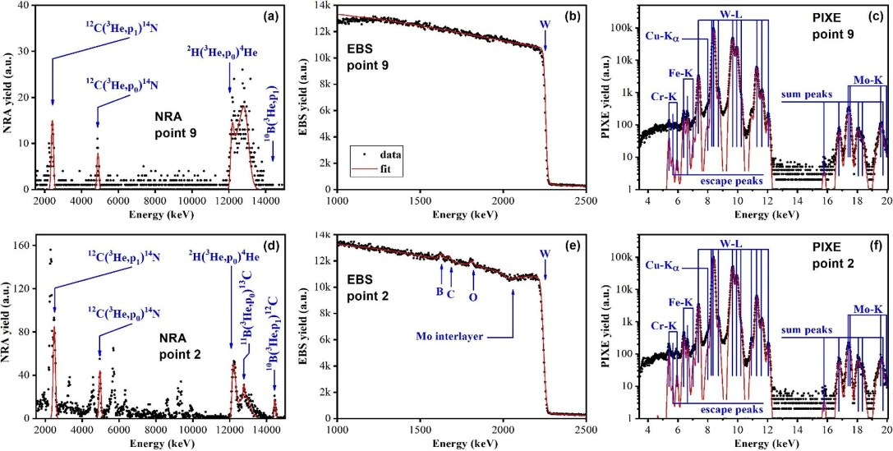
Analysis of WEST samples: core disks retrieved from lower marker tiles exposed along C3, C4, C5
Locations of the EM tiles at the lower divertor of WEST
SIMS analysis at VTT
IBA experiment at IST following the SIMS points ;
simultaneous:
EBS + PIXE / 2.3 MeV ¹H⁺ incident ion beams
RBS + NRA / 2.3 MeV ³He⁺ incident ion beams
Selected core disks:
C3-34iB , C3-34iK , C3-34iM , C3-22oE , C3-22oJ
C4-32iB , C4-32iK , C4-32iM , C4-20oE , C4-20oJ
C5-33iB , C5-33iK , C5-33iM , C5-21oE , C5-21oJ
(1) (2) (3) (4) (5)
Erosion-deposition net
along the S-coordinate
after the C3 campaign
Erosion
Marker (EM)
tile
M. Diez et al. Nucl. Mater. Energy 12 (2017) 559
M. Balden et al. Phys. Scripta 96 (2021) 124020
Selected
core disks:
THIS WORK
- Zone (5)
- Zone (4)
S ∼ 242 mm / erosion-ISP
- Zone (3)
- Zone (2)
- Zone (1)
S ∼ 31 mm / thin deposition
nearby HFS

Slide 3
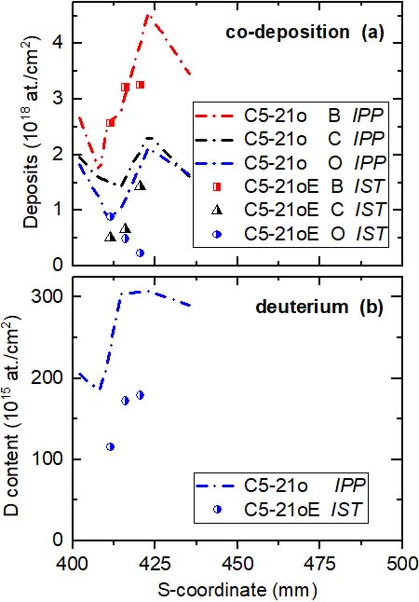
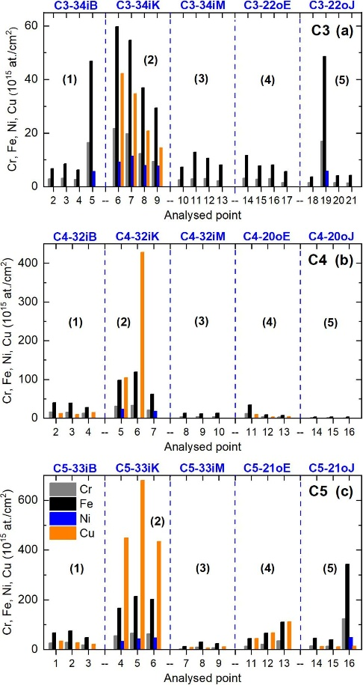
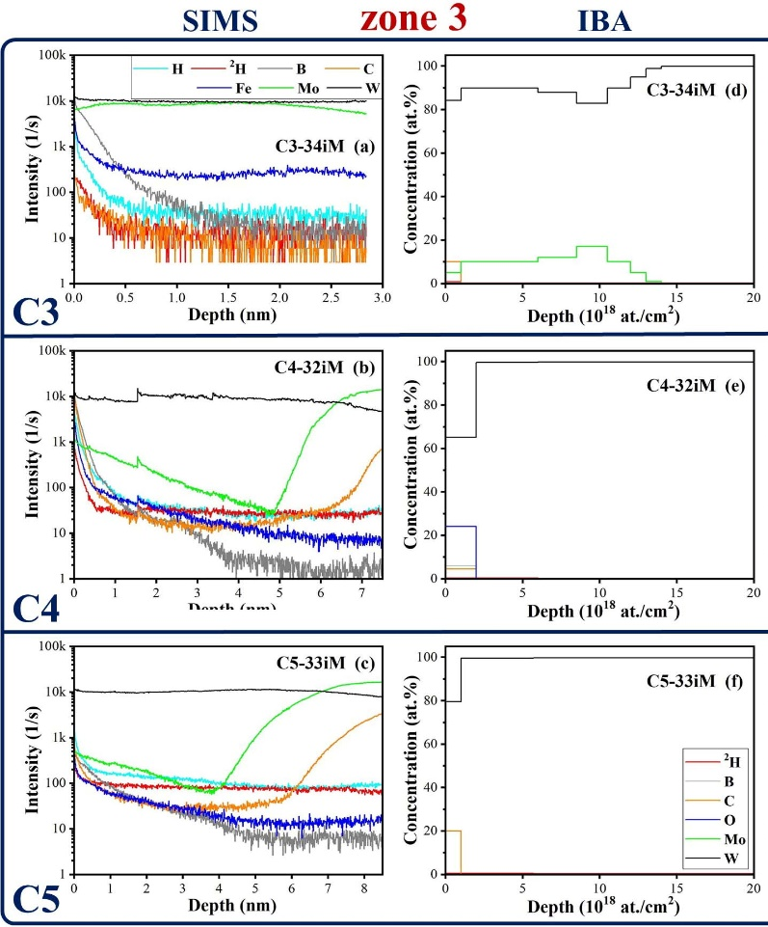
Analysis of WEST samples: core disks retrieved from lower marker tiles exposed along C3, C4, C5
Zone (4) , after C5
IBA quantification for D, B, C, O after C5 nearby OSP:
from the entire C5-21o tile
from the C5-21oE core disk
PFMC-20 conference:
IST et al.,
Elemental analysis of divertor marker tiles
exposed during the 2018 (C3), 2019 (C4)
and 2020 (C5) WEST campaigns
PIXE analysis:
superposition of Ni-K_{α} and W-L_{L} peaks
evidence of Ni deposition
Fe:Cr:Ni contents ➔ stainless steel
SIMS + EBS :
C5-33iM core disk (ISP)
erosion rate after C5 ∼ 0.2-0.3 nm/s (∼7.3 h oper. in Phase 1)
Notes:
Ni-K_{α} (7.48 keV) and W-L_{L} (7.39 keV)

Slide 4
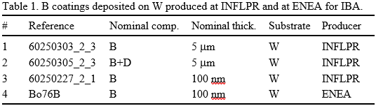
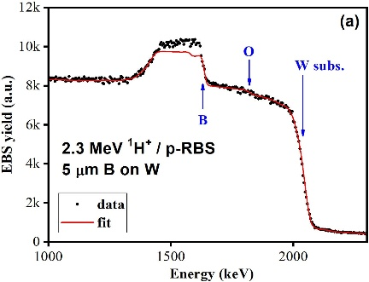
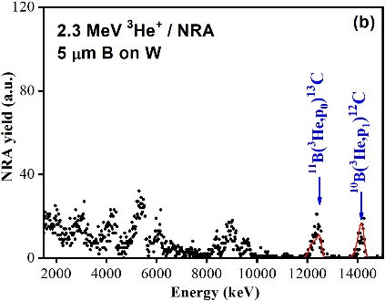
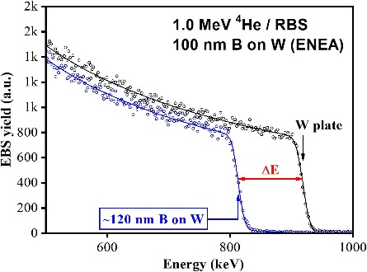
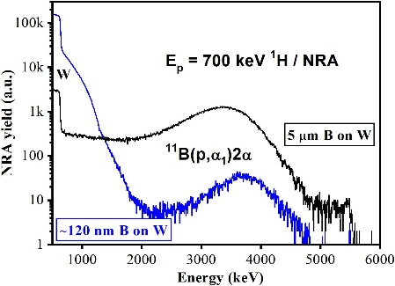
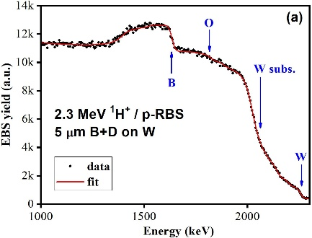
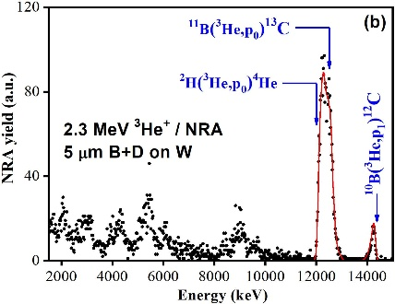
Reference B-based coatings for ITER and DEMO
PhD student - scholarship from the Portuguese foundation
Fundação para a Ciência e a Técnologia (FCT)
Title of the thesis:
Oxidation behaviour of boron coatings for nuclear fusion applications
(collaboration with INFLPR)
Any evidence of fast oxidation of the B layers over time at RT

Slide 5
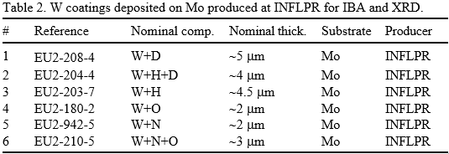
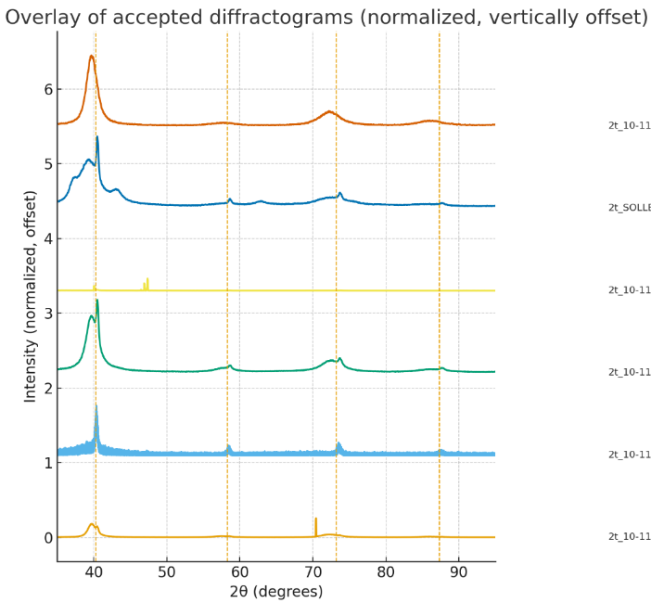
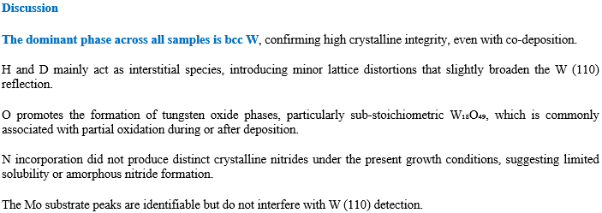
Reference W-based coatings for ITER and DEMO
IBA experiment :
simultaneous ERDA + RBS / 2.0 MeV ⁴He⁺ incident beams
EBS / 1.75 MeV , 2.15 MeV ¹H⁺ incident beams
simultaneous RBS + NRA / 1.75 MeV ³He⁺ incident beams
IBA spectra under analysis
W-N
W-N-O
W-O
W-H-D
W-H
(110)
W-D
(200)
(211)
(220)

