Slide 1



Report and Plans PoliTo
WPPRD-LMD 2025 Final Meeting
F. Subba¹, E. Bray¹, A. Villa¹, E. Agus¹, C. Marchetto^{1,2}, H. Wu¹, R. Zanino¹
¹NEMO group, Dipartimento Energia, Politecnico di Torino, Italy
²ISC-CNR, Dipartimento Energia, Politecnico di Torino, Italy
With thanks to G.F. Nallo for many valuable contributions

Slide 2
Outline
Task Objectives:
  Develop and use the coupled SOLPS-ITER ASTRA-STRAHL formulation to evaluate different LM candidates and LMD divertor configurations
  Implement different LM options in the above framework
  Evaluate different LMD configurations using same
Implementation:
  Including kinetic neutrals
    The starting point
    What was done in 2025
    Preliminary results
  Sn transport in the core plasma (SOLPS-ASTRA, one way only)
    The starting point
    What was done in 2025
    Current results
Overview of 2026-2027: Compass-U modeling

Slide 3
SOLPS-ITER Simulations for DEMO Including Kinetic Neutrals
Take an available SOLPS-ITER scenario with Ar seeding as reference (F. Subba et al 2021 Nucl. Fusion 61 106013).
Implement the LM puffing in front of the outer divertor target (Sn considered).
Adopt a kinetic approach (B2.5-EIRENE coupling) to reproduce neutral particle behavior.
Make a comparison between the DEMO reference scenario to investigate the LM effect.
WARNING:
Computational power was disrupted by a number of events:
  MARCONI had a flooding event, lasting early 2025
  GATEWAY was dismissed and substituted late 2025, time is required to have SOLPS-ITER fully functional on the new machine
Full convergence is not yet obtained: following results are indicative, but not yet quantitative.
Data shown correspond to the status in the first 10 days of Dec. 2025

Slide 4
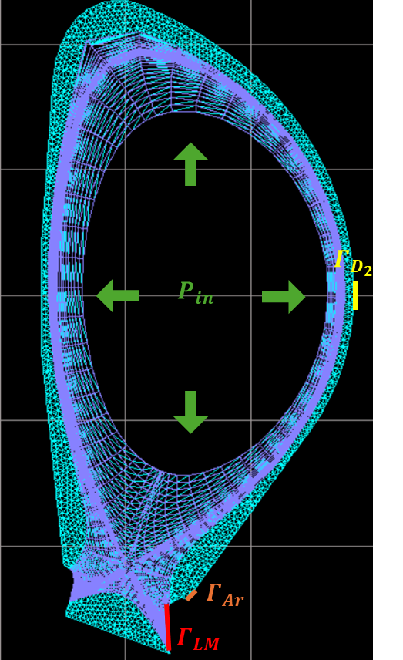
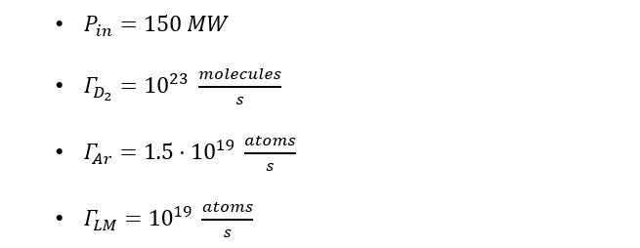
SOLPS-ITER Simulations Setup for DEMO Including Kinetic Neutrals
Species: D, He, Ar and Sn
Pumping in the PFR region

Slide 5
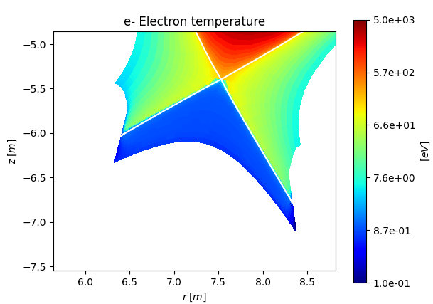
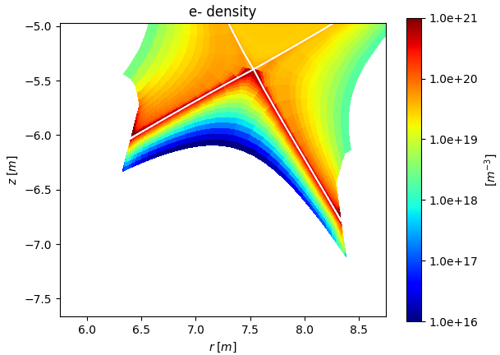
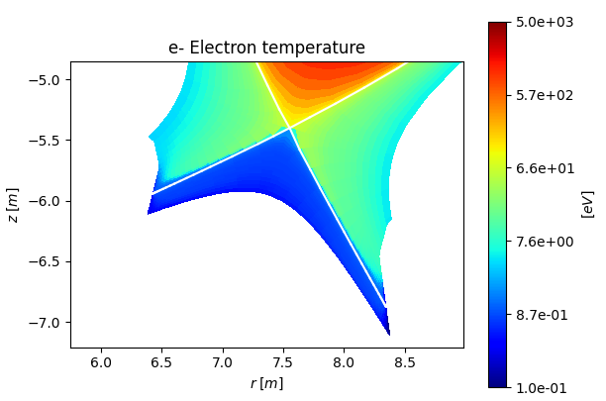
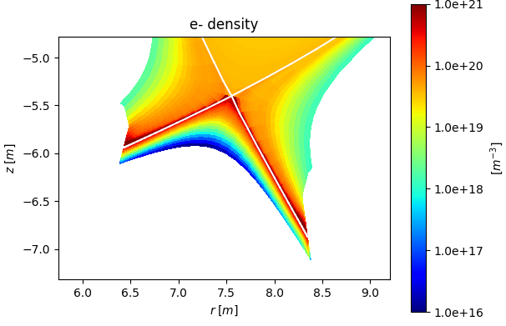
SOLPS-ITER Simulations for DEMO Including Kinetic Neutrals – Electron Temperature and Density
Reference case
Reference case + Sn puff

Slide 6
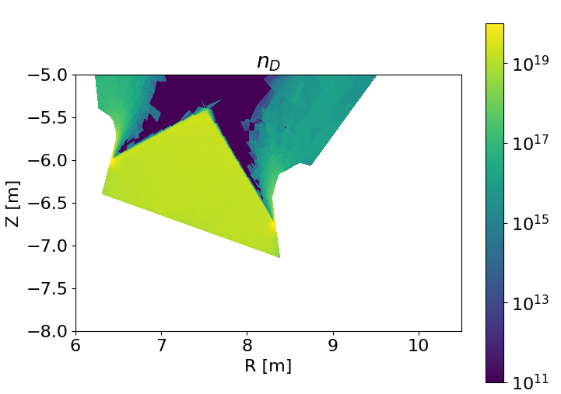
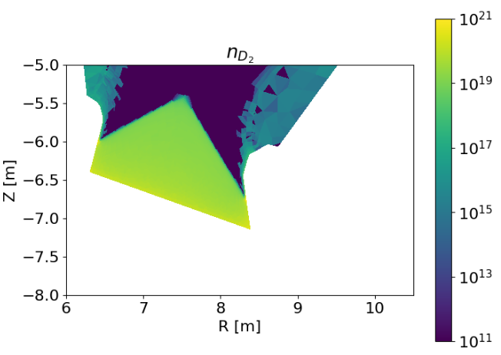
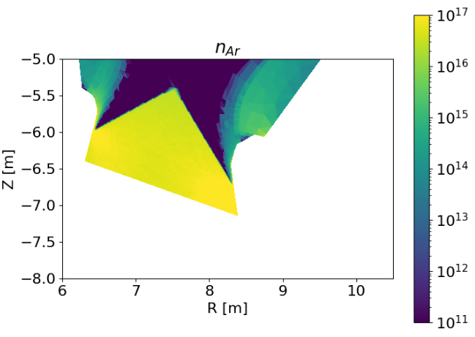

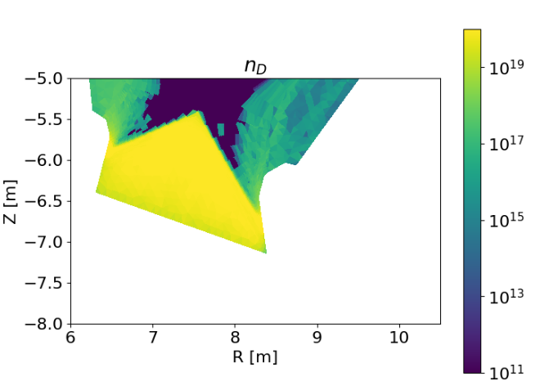
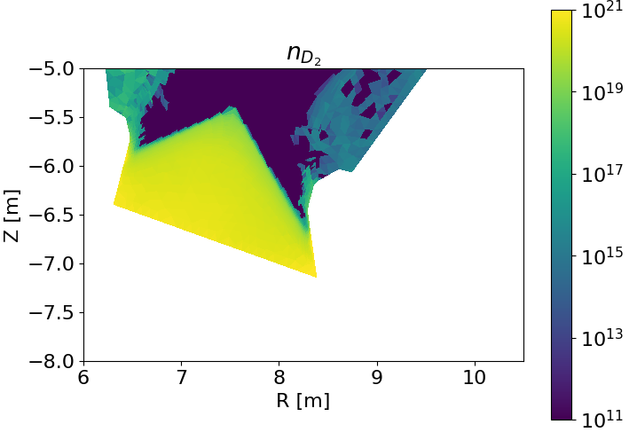
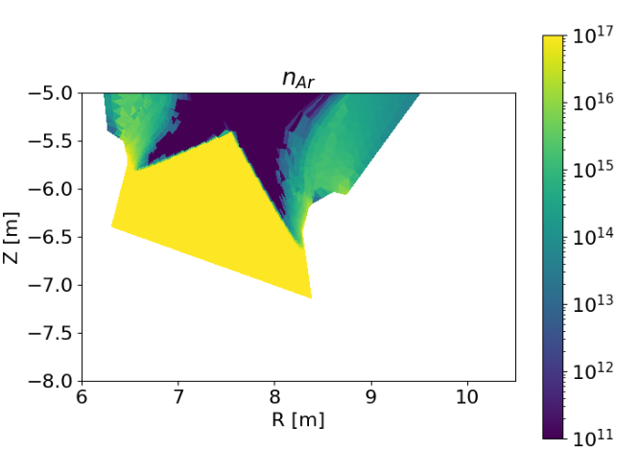
SOLPS-ITER Simulations Including Kinetic Neutrals – Neutral Particle Density
Reference case
Reference case + Sn puff

Slide 7
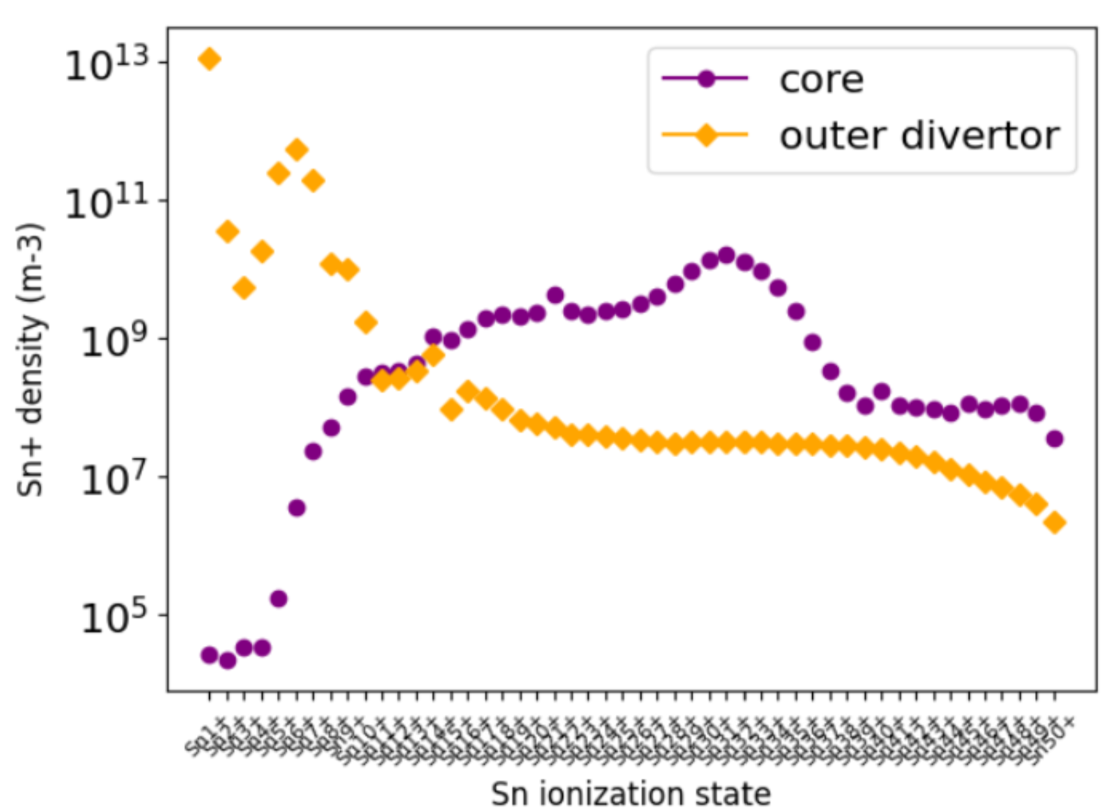
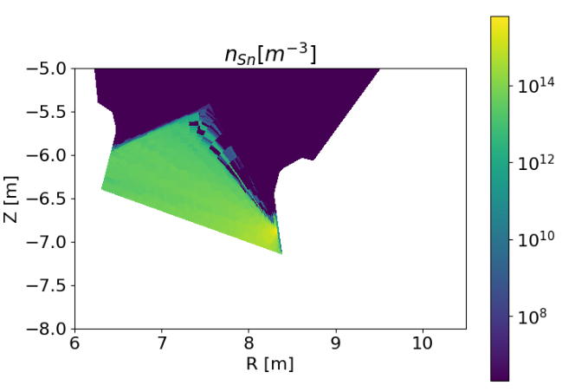
SOLPS-ITER Simulations for DEMO Including Kinetic Neutrals – Sn density
Tin transport toward the core appears to be moderate --> resulting in a low Sn density in this region.
In the core, higher charge states dominate, with a peak around Sn³⁰⁺.
In the outer divertor, Sn is mainly present in low charge states (up to Sn¹⁰⁺).
The neutral Sn density is strongly localized in the lower PFR, close to the outer divertor target where the puffing is located.
Moving away from the divertor plates and upward toward the separatrix, the Sn neutral density rapidly decreases by several orders of magnitude, indicating limited penetration of neutrals into hotter plasma regions.

Slide 8
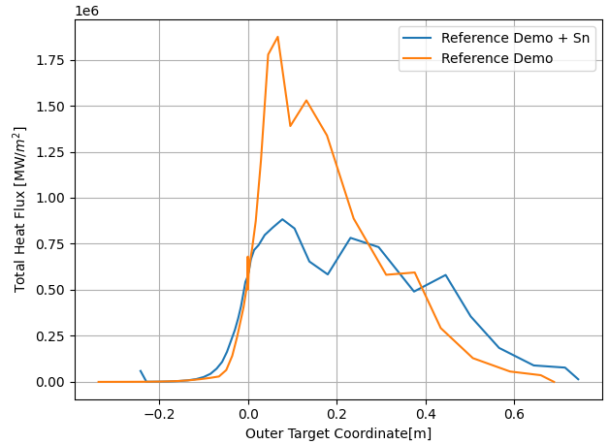
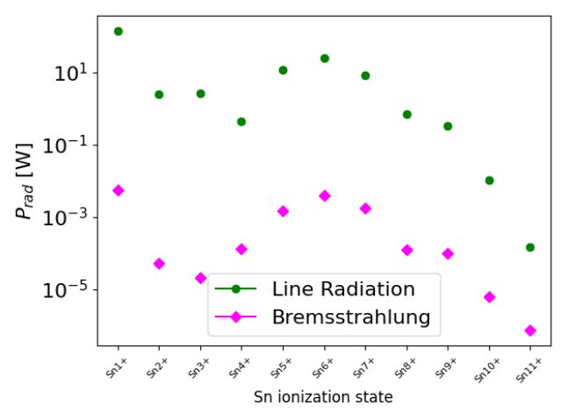
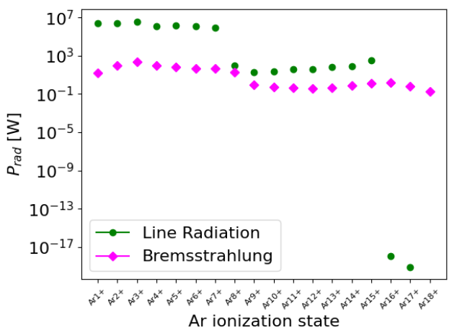
SOLPS-ITER Simulations for DEMO Including Kinetic Neutrals – Heat Flux and Radiated Power
The presence of Sn appears to significantly reduce the heat flux reaching the outer target (about 50%).
However, when examining the radiated power in the SOL region, Sn shows a very weak contribution (negligible compared with Argon).
What processes might be responsible for this behavior? Could the energy spent ionizing Sn be the only explanation for the lower heat flux?
A deeper understanding of the underlying mechanisms is therefore required.
*Sn ion species are limited to Sn10+ in the plot, as higher charge states exhibit even lower radiated power.

Slide 9
SOLPS-ITER Simulations for DEMO Including Kinetic Neutrals - Conclusions
Compared with the reference case, the presence of Sn appears to significantly lower the heat flux reaching the divertor target.
Only a regime with detachment already induced by Ar was explored so far. Testing additional combinations (more Sn, less Ar) would also be interesting. So far:
  Divertor protection effects are visible
  Significant influence on overall energy balance (radiation) still missing

Slide 10
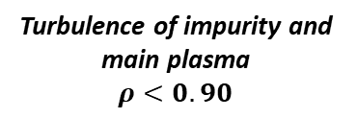
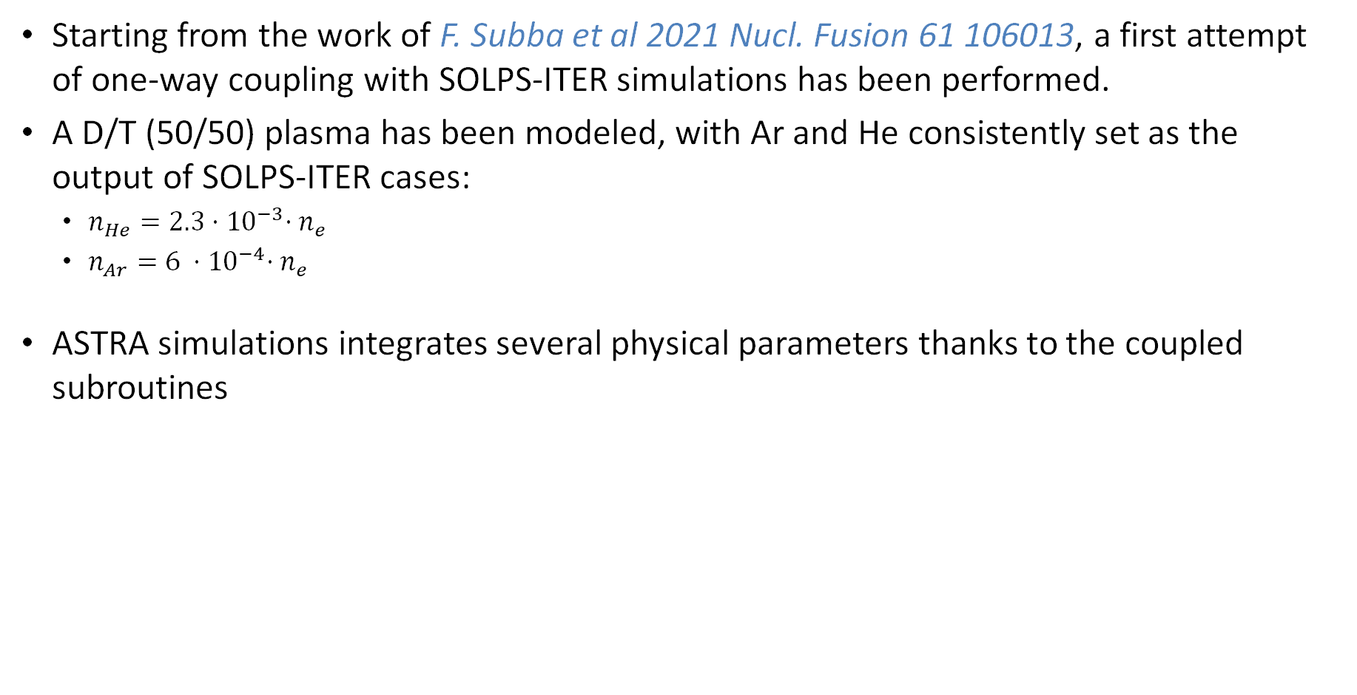
ASTRA simulation – Reference case with one-way coupling
Starting from the work of F. Subba et al 2021 Nucl. Fusion 61 106013, a first attempt of one-way coupling with SOLPS-ITER simulations has been performed.
A D/T (50/50) plasma has been modeled, with Ar and He consistently set as the output of SOLPS-ITER cases:
  $n_{He}=2.3{⋅10}^{−3}⋅n_{e}$
  $n_{Ar}=6 {⋅10}^{−4}⋅n_{e}$
ASTRA simulations integrates several physical parameters thanks to the coupled subroutines
ASTRA
TGLF-sat2
FACIT
NEUT
RABBIT
Turbulence of impurity and main plasma
$ρ<0.90$
Neoclassical transport of Sn
Neutral particles from atomic processes
NBI power and particles deposition

Slide 11
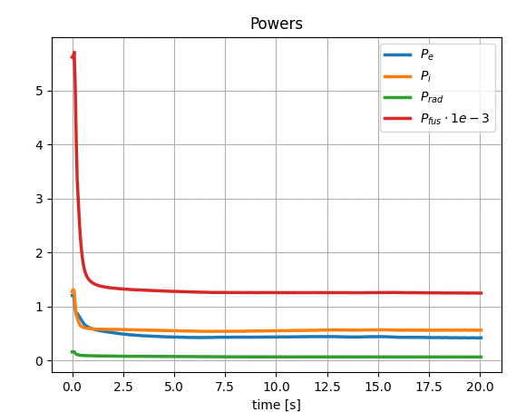
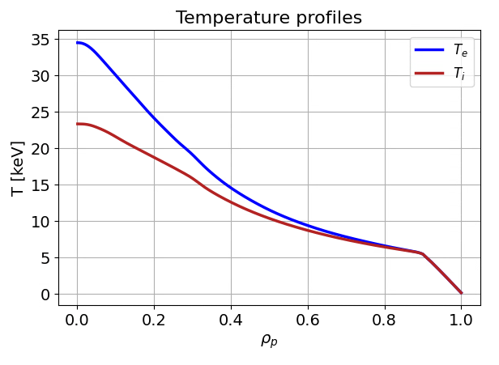
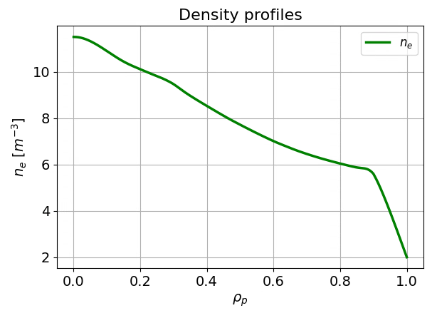

ASTRA simulations – EU-DEMO reference case
Reference case of EU-DEMO with D, T, - (50/50) - He, Ar
Pedestal profiles remain constant, while core transport is self-consistent evolved.
Final profiles at convergence, leading to a fusion power of around 1.3 GW
$$P_{fus}≈1,3 GW$$

Slide 12
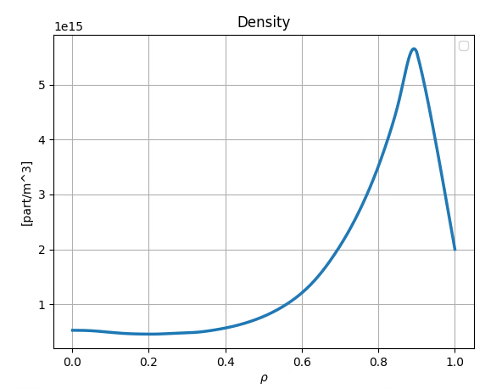
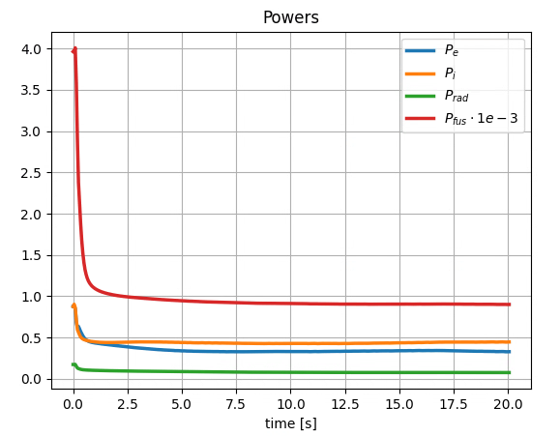
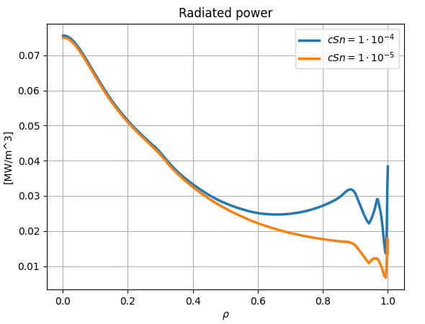


ASTRA simulation – Sn source
The addition of Sn in the simulation does not impact significanlty the core transport.
Sn accumulates mainly in the edge, where its radiations are not harmful.
Nevertheless, it does impact the power balance, leading to a decrease of around 30 % in fusion power with a source of $n_{Sn}=n_{e}⋅{10}^{−5}$ (and also with $n_{Sn}=n_{e}⋅{10}^{−4})$
Sn density
$$P_{fus}≈0,9 GW$$

Slide 13
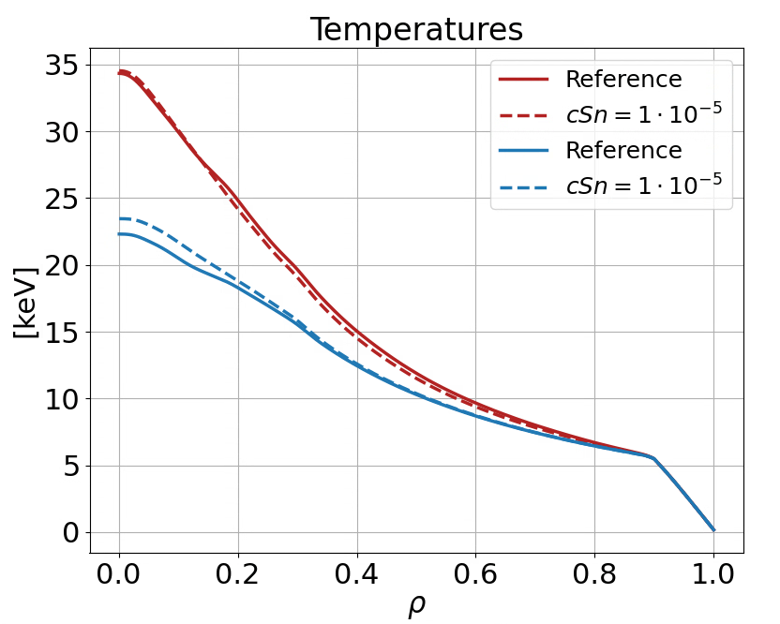
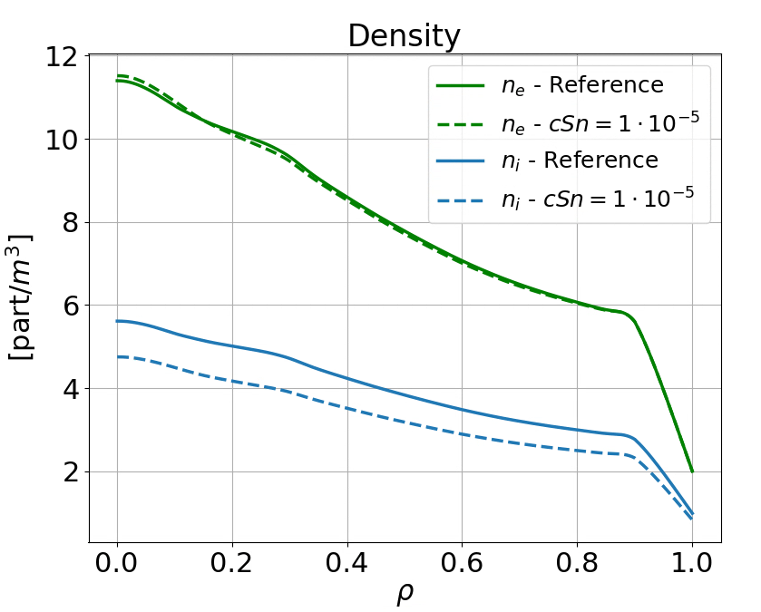
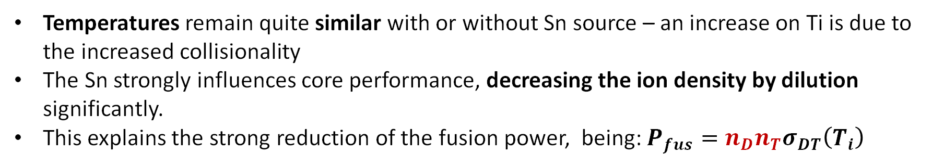
ASTRA simulations – core dilution
Temperatures remain quite similar with or without Sn source – an increase on Ti is due to the increased collisionality
The Sn strongly influences core performance, decreasing the ion density by dilution significantly.
This explains the strong reduction of the fusion power, being: $P_{fus}=n_{D}n_{T}σ_{DT}\left(T_{i}\right)$
T_{e}
T_{i}

Slide 14
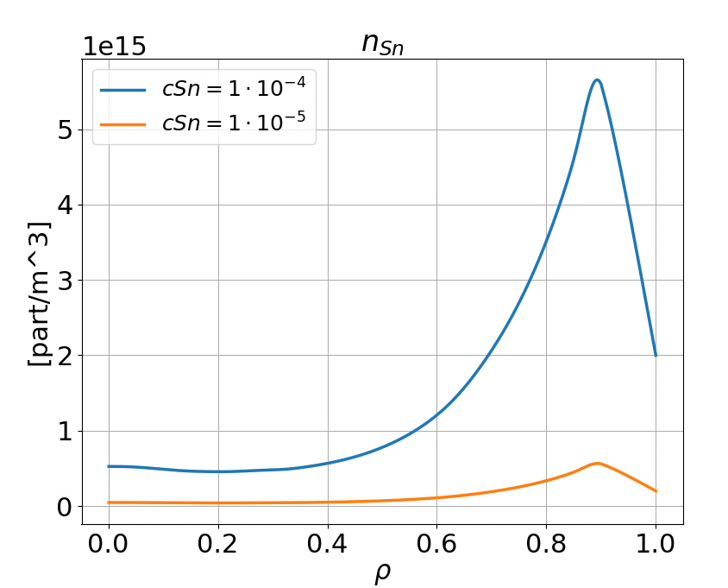
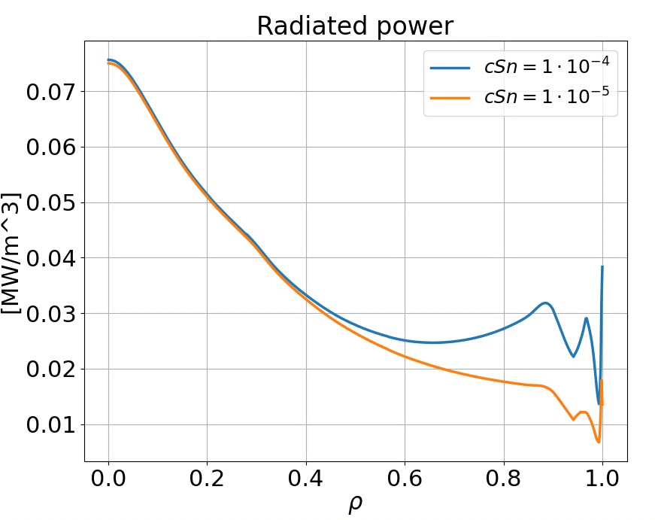
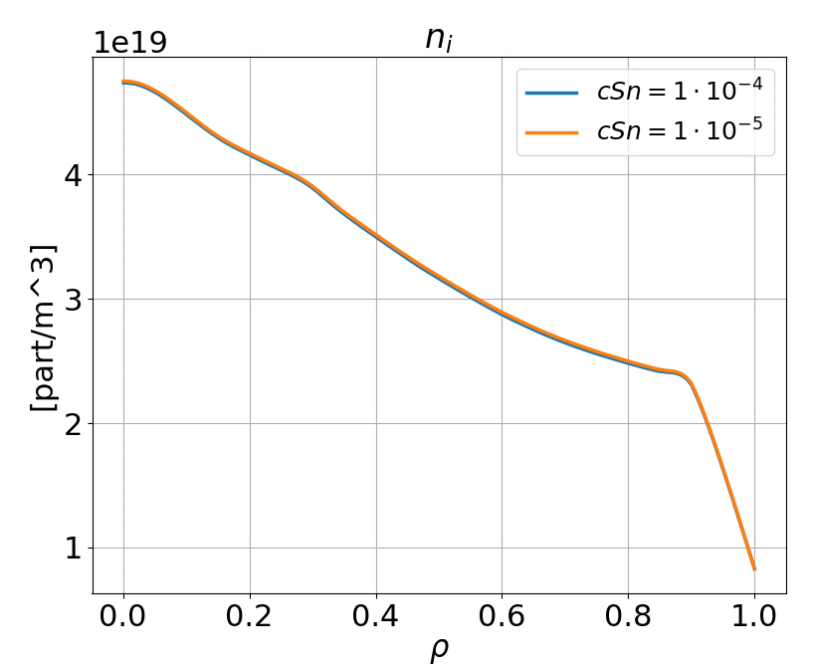
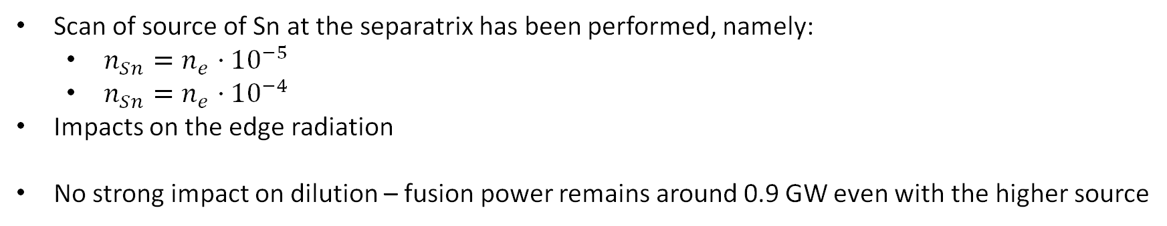
ASTRA simulation – scan of source of Sn
Scan of source of Sn at the separatrix has been performed, namely:
  $n_{Sn}=n_{e}⋅{10}^{−5}$
  $n_{Sn}=n_{e}⋅{10}^{−4}$
Impacts on the edge radiation
No strong impact on dilution – fusion power remains around 0.9 GW even with the higher source

Slide 15
Conclusions
First attempt at modeling LM transport in the core was performed with SOLPS+ASTRA
At the moment, one-way coupling only
Sn does not seem to deeply penetrate within the core, but rather accumulates at the edge
Impact on the overall fusion power seems to be significant (at least for the Sn level considered)

Slide 16
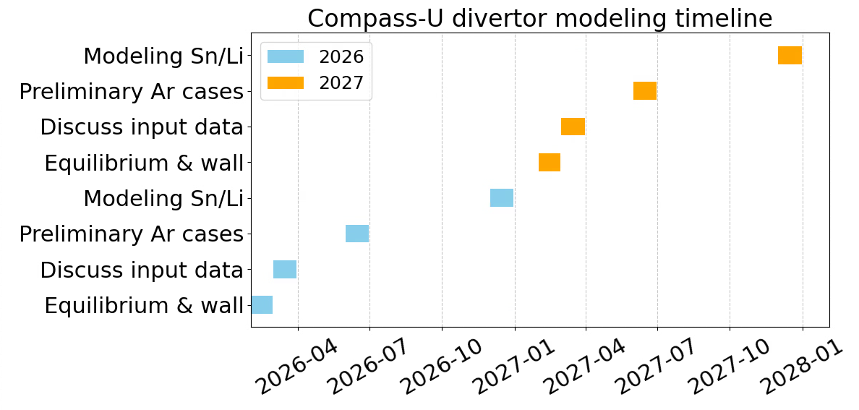
Plans for 2026/2027 – Compass-U
Open divertor
Closed divertor

Slide 17
Thank you for your attention

Slide 18
Plans for 2026 – 2027 – Compass-U
Get equilibrium and wall for open divertor: Feb 2026
Discuss input data with Compass-U staff (density level, impurity, power, fueling, …). Prepare first cases: March 2026
Preliminary cases with Ar completed: June 2026
Modeling with Sn and Li completed: Dec 2026
Get equilibrium and wall for closed divertor: Feb 2027
Discuss input data with Compass-U staff (density level, impurity, power, fueling, …). Prepare first cases: March 2027
Preliminary cases with Ar completed: June 2027
Modeling with Sn and Li completed: Dec 2027

