Slide 1
Suppression of helium clustering in bcc W across temperature via dilute V alloying
Guanying Wei
14th Nov.2025

Slide 2
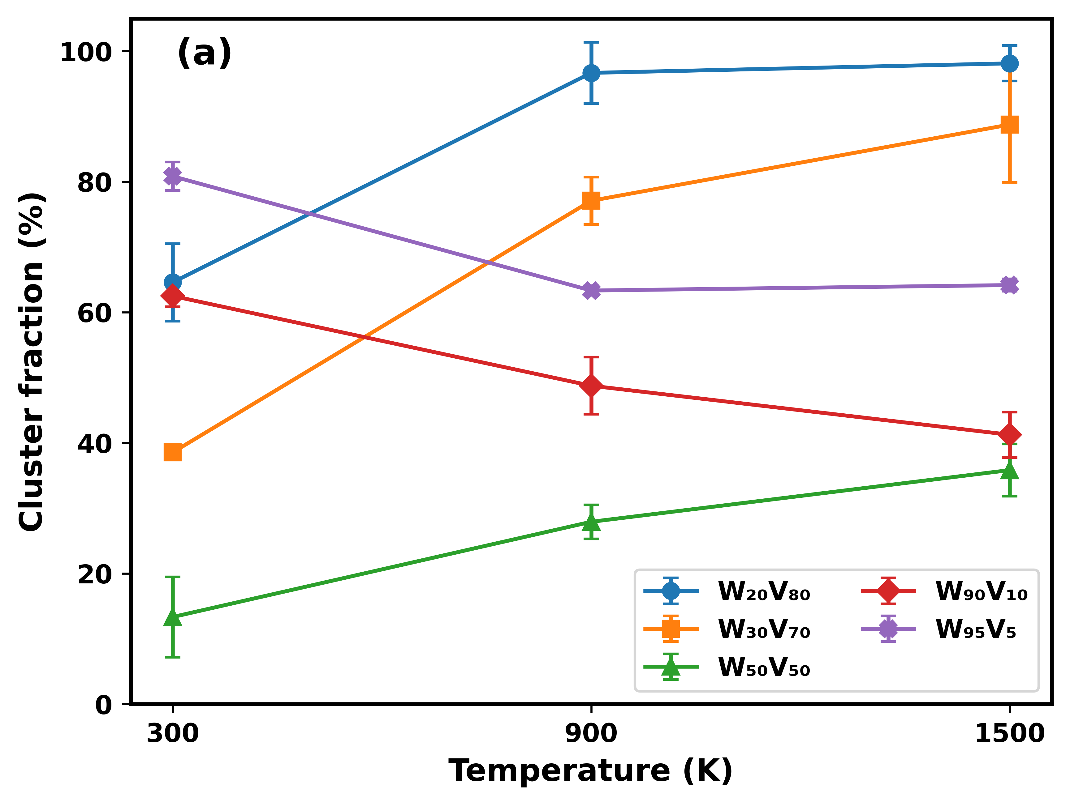
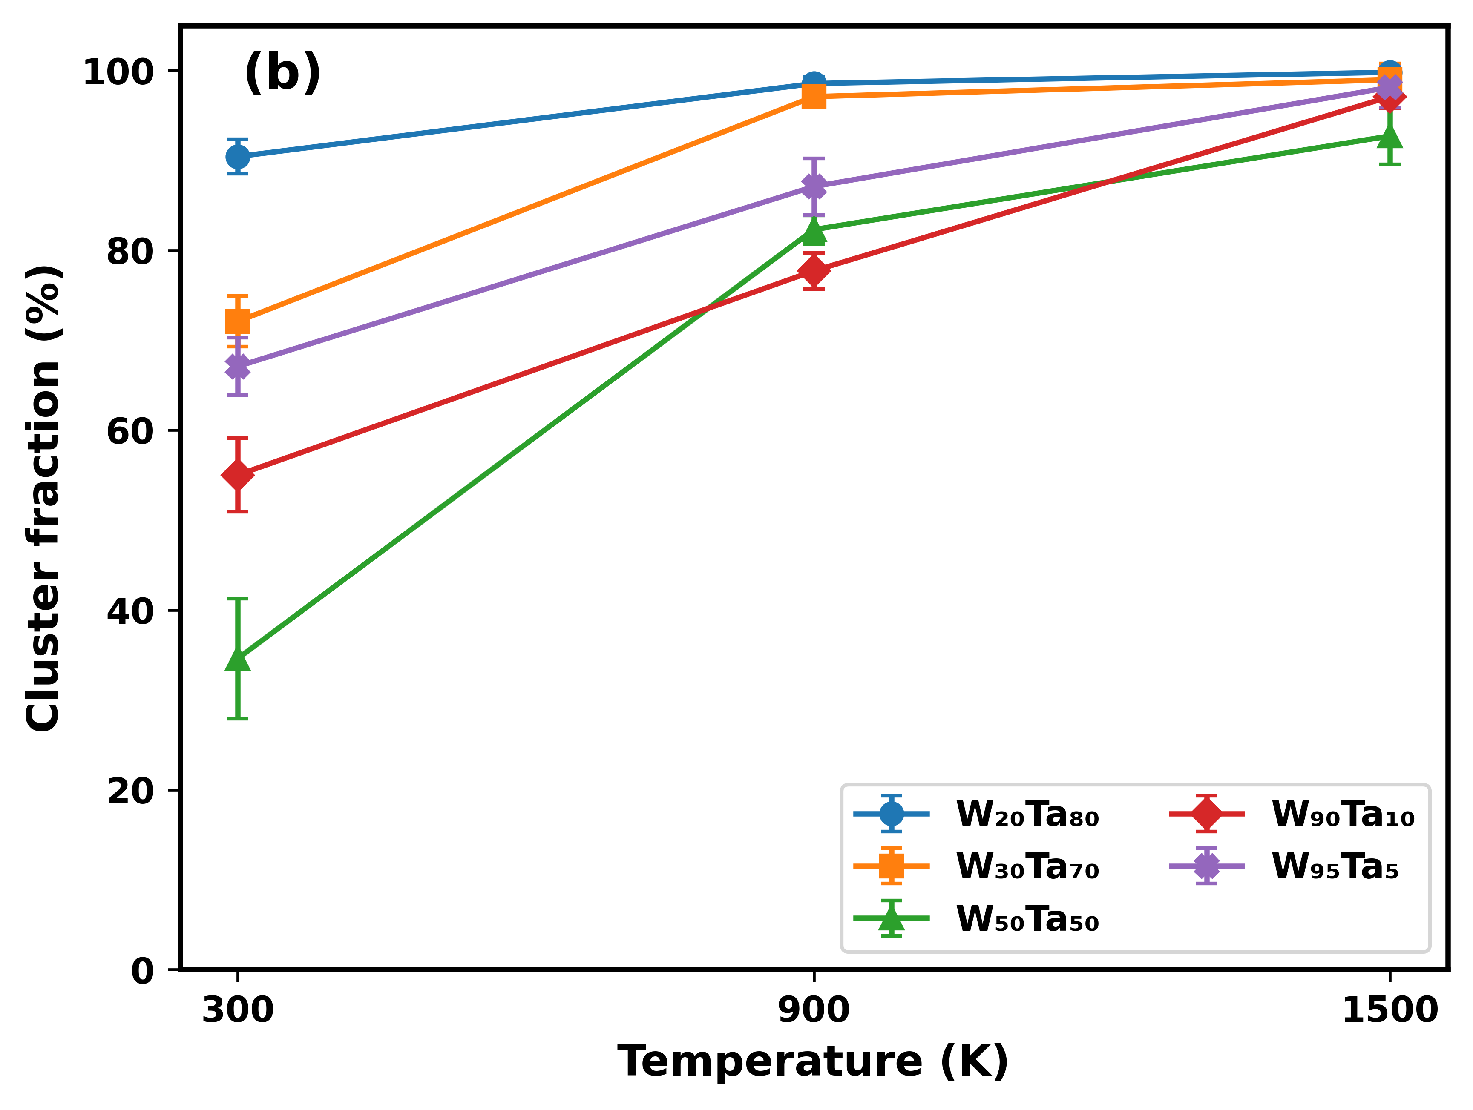
He cluster fraction in Wvx and WTax

Slide 3
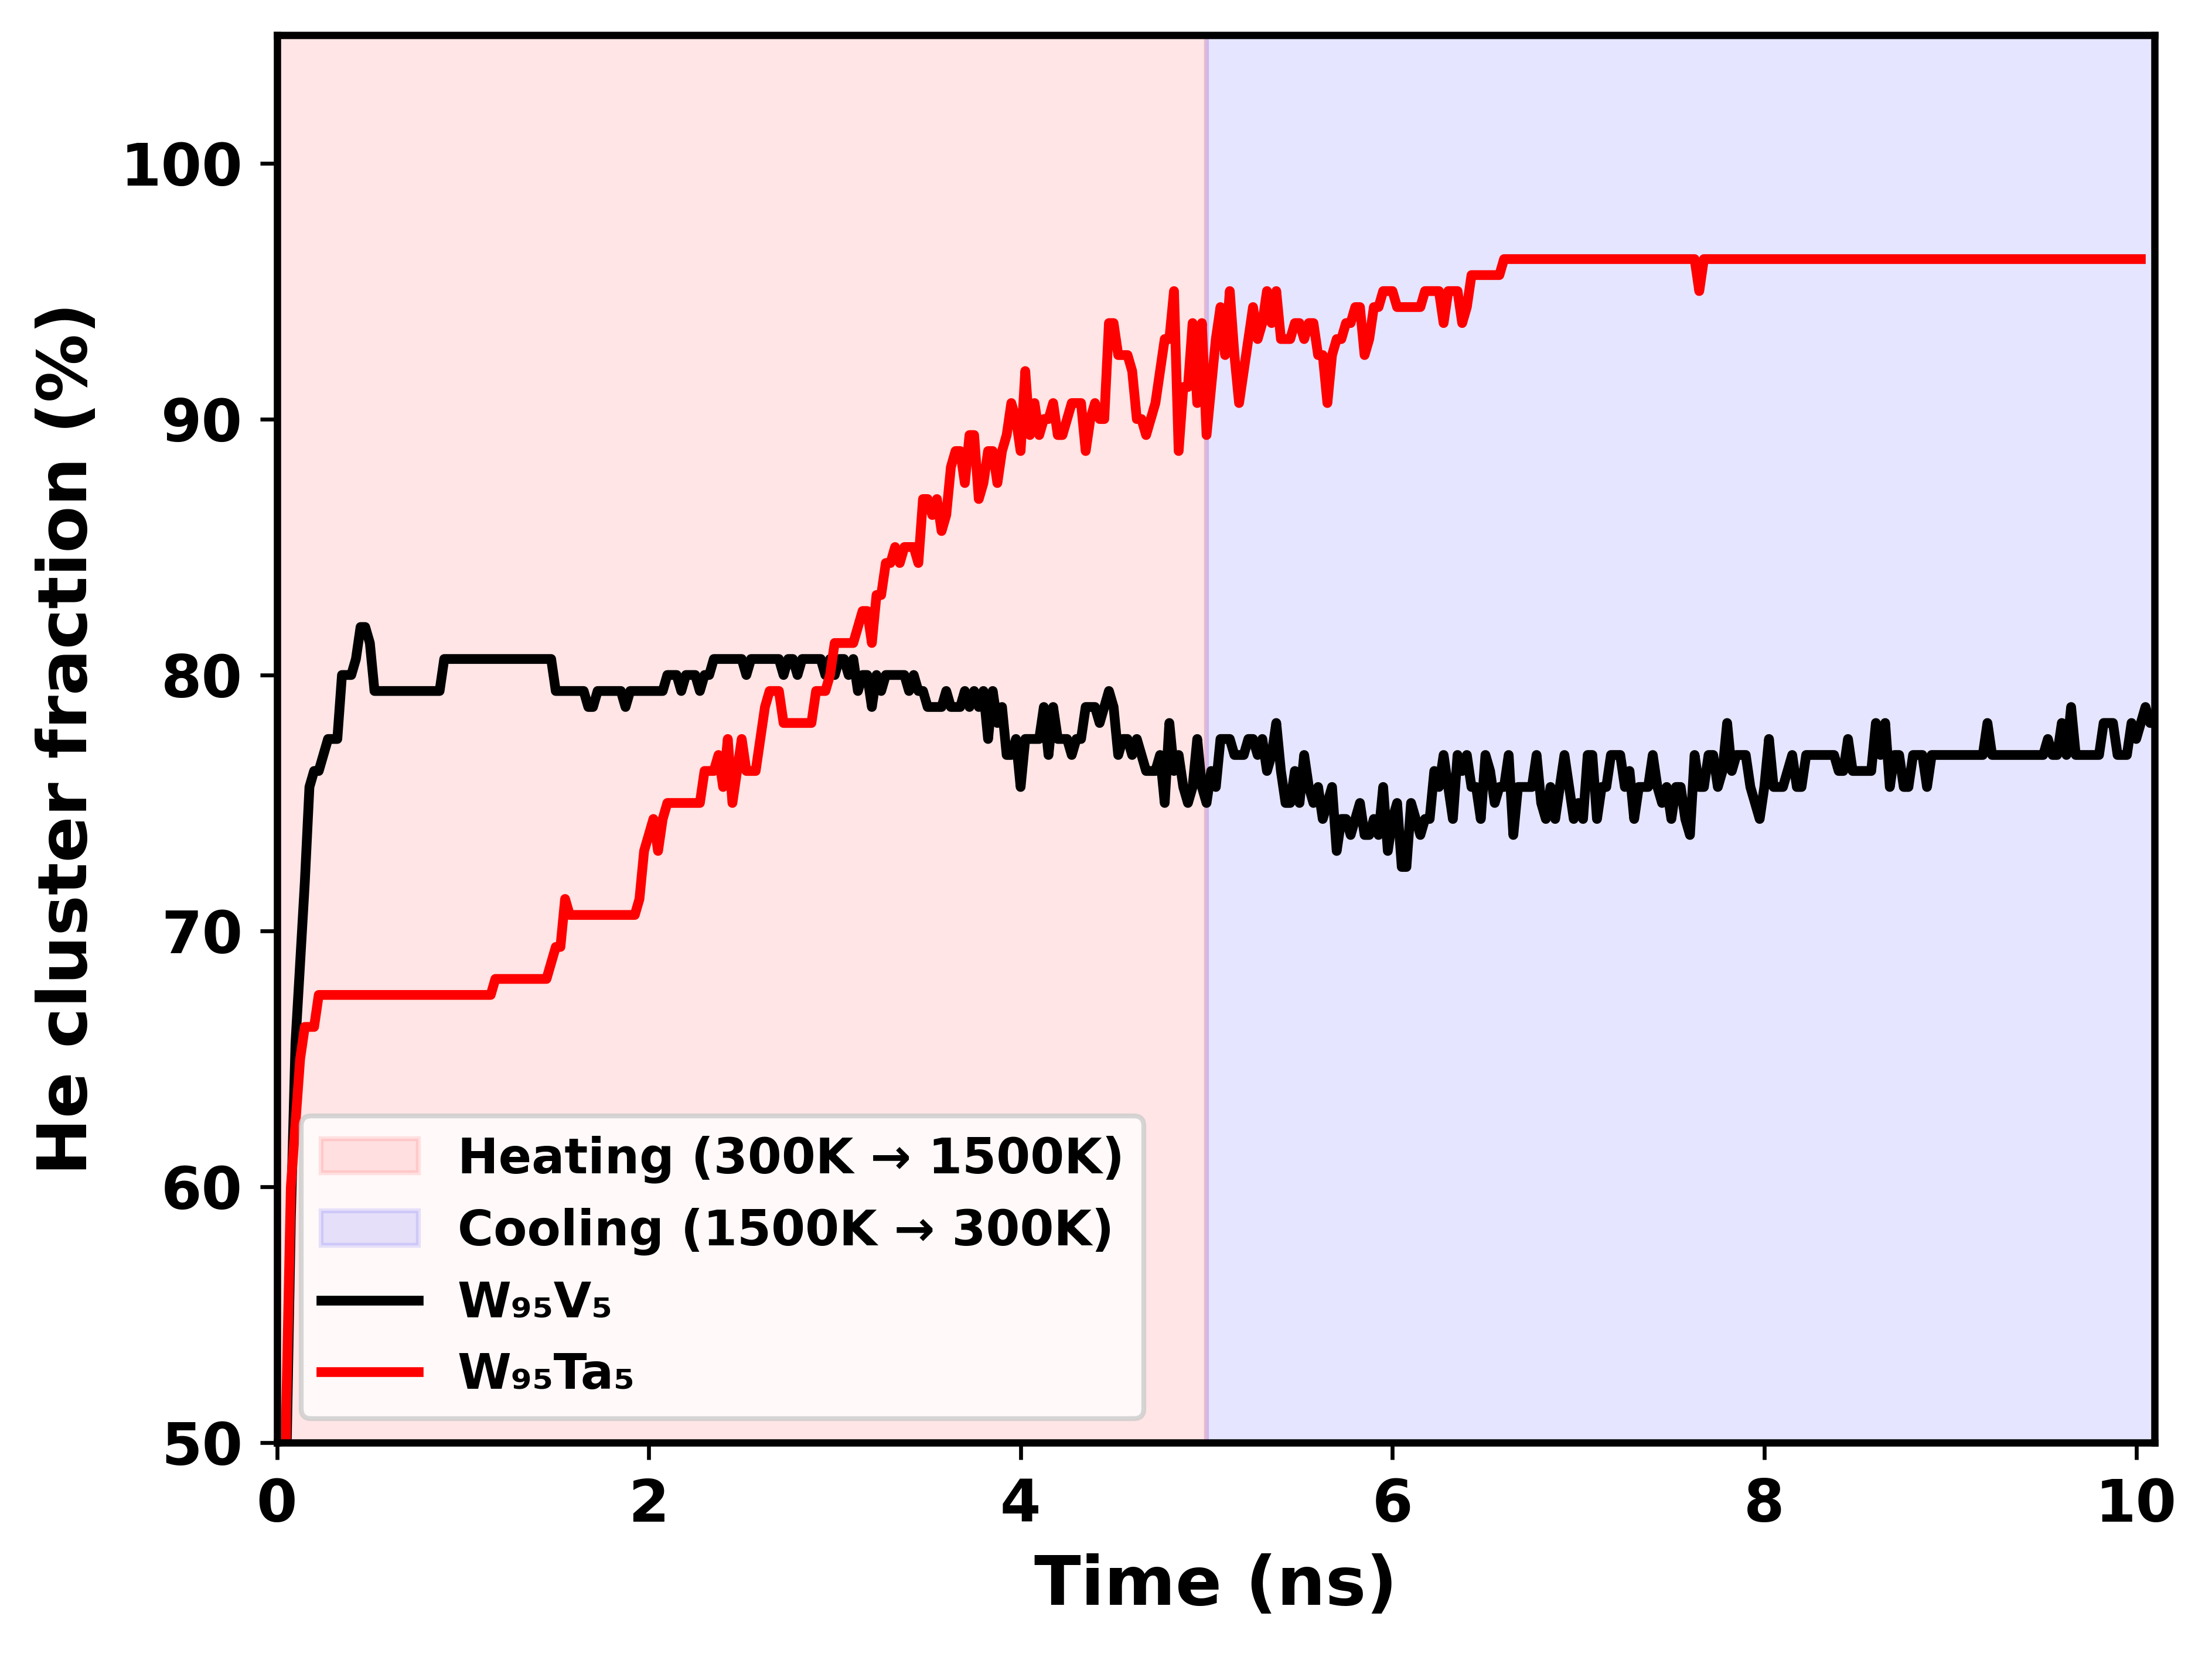
Further verification

Slide 4
He cluster distribution

Slide 5
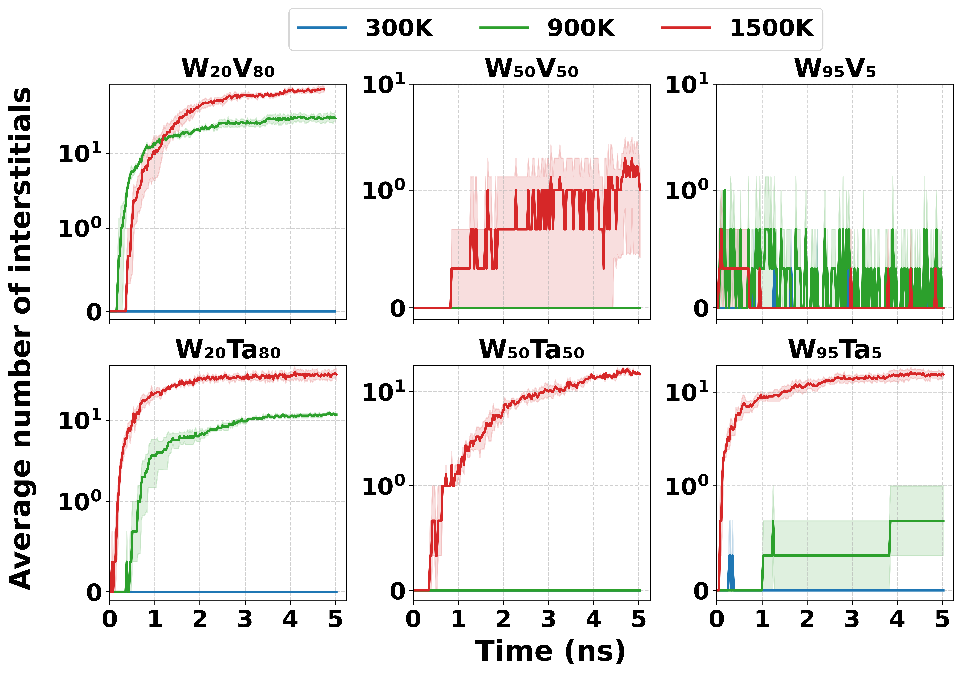
Self trapping

Slide 6
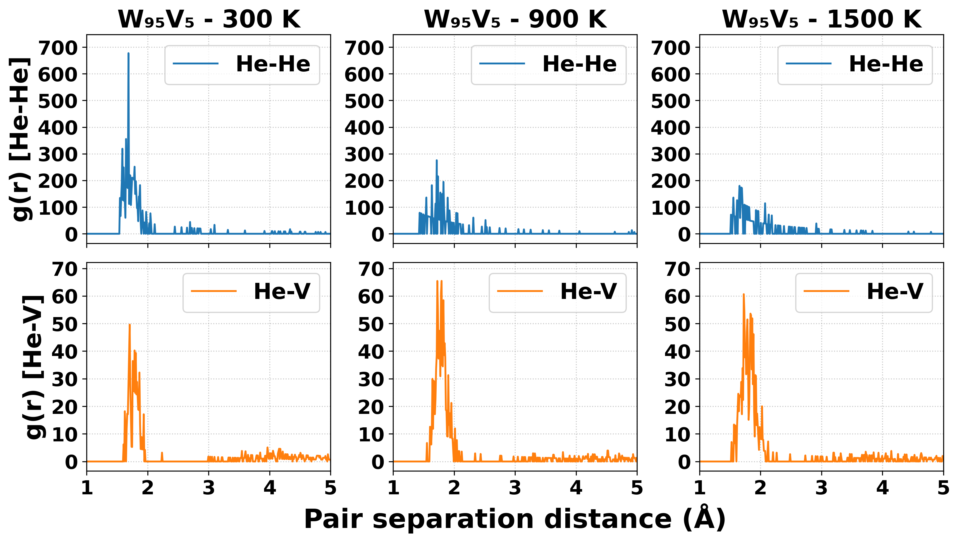
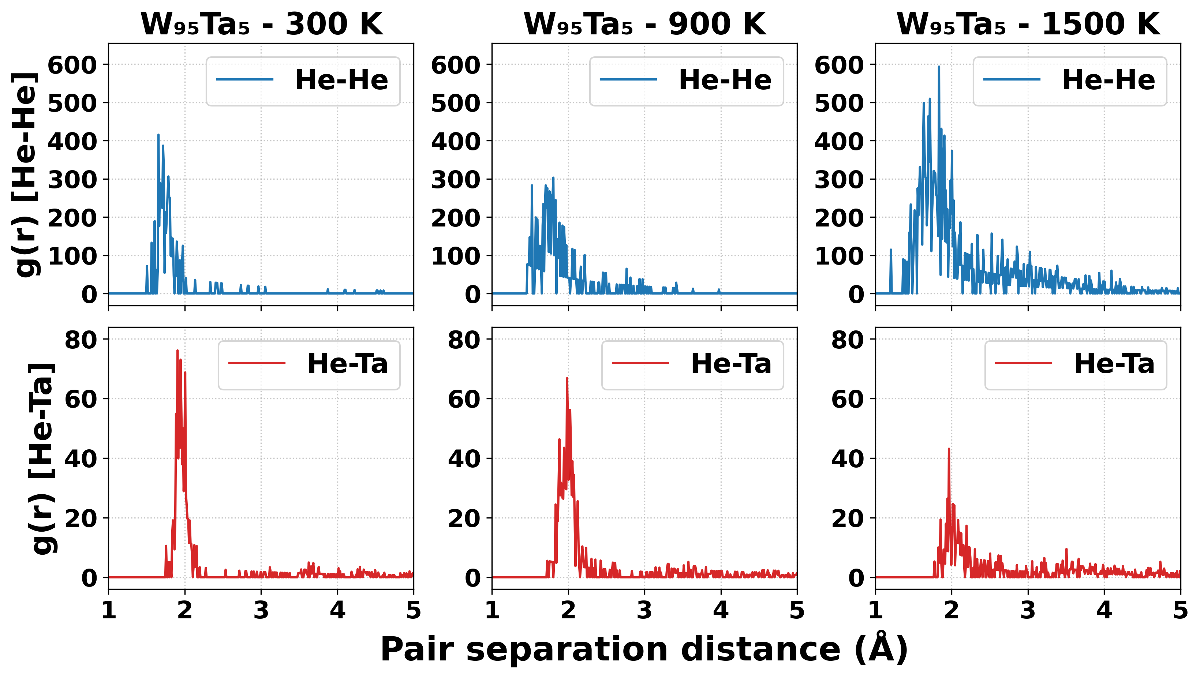
Interaction between He-He and He-V/Ta

Slide 7
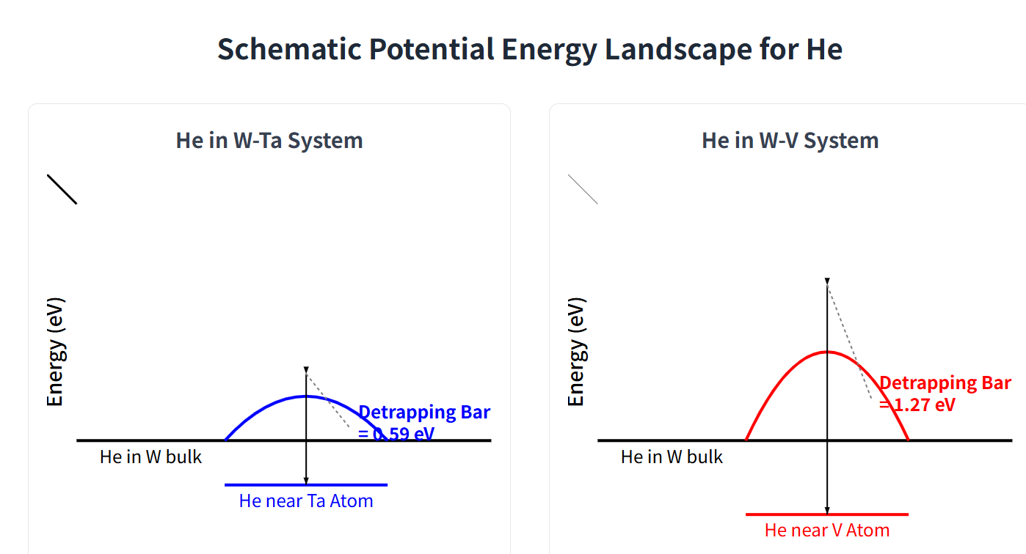
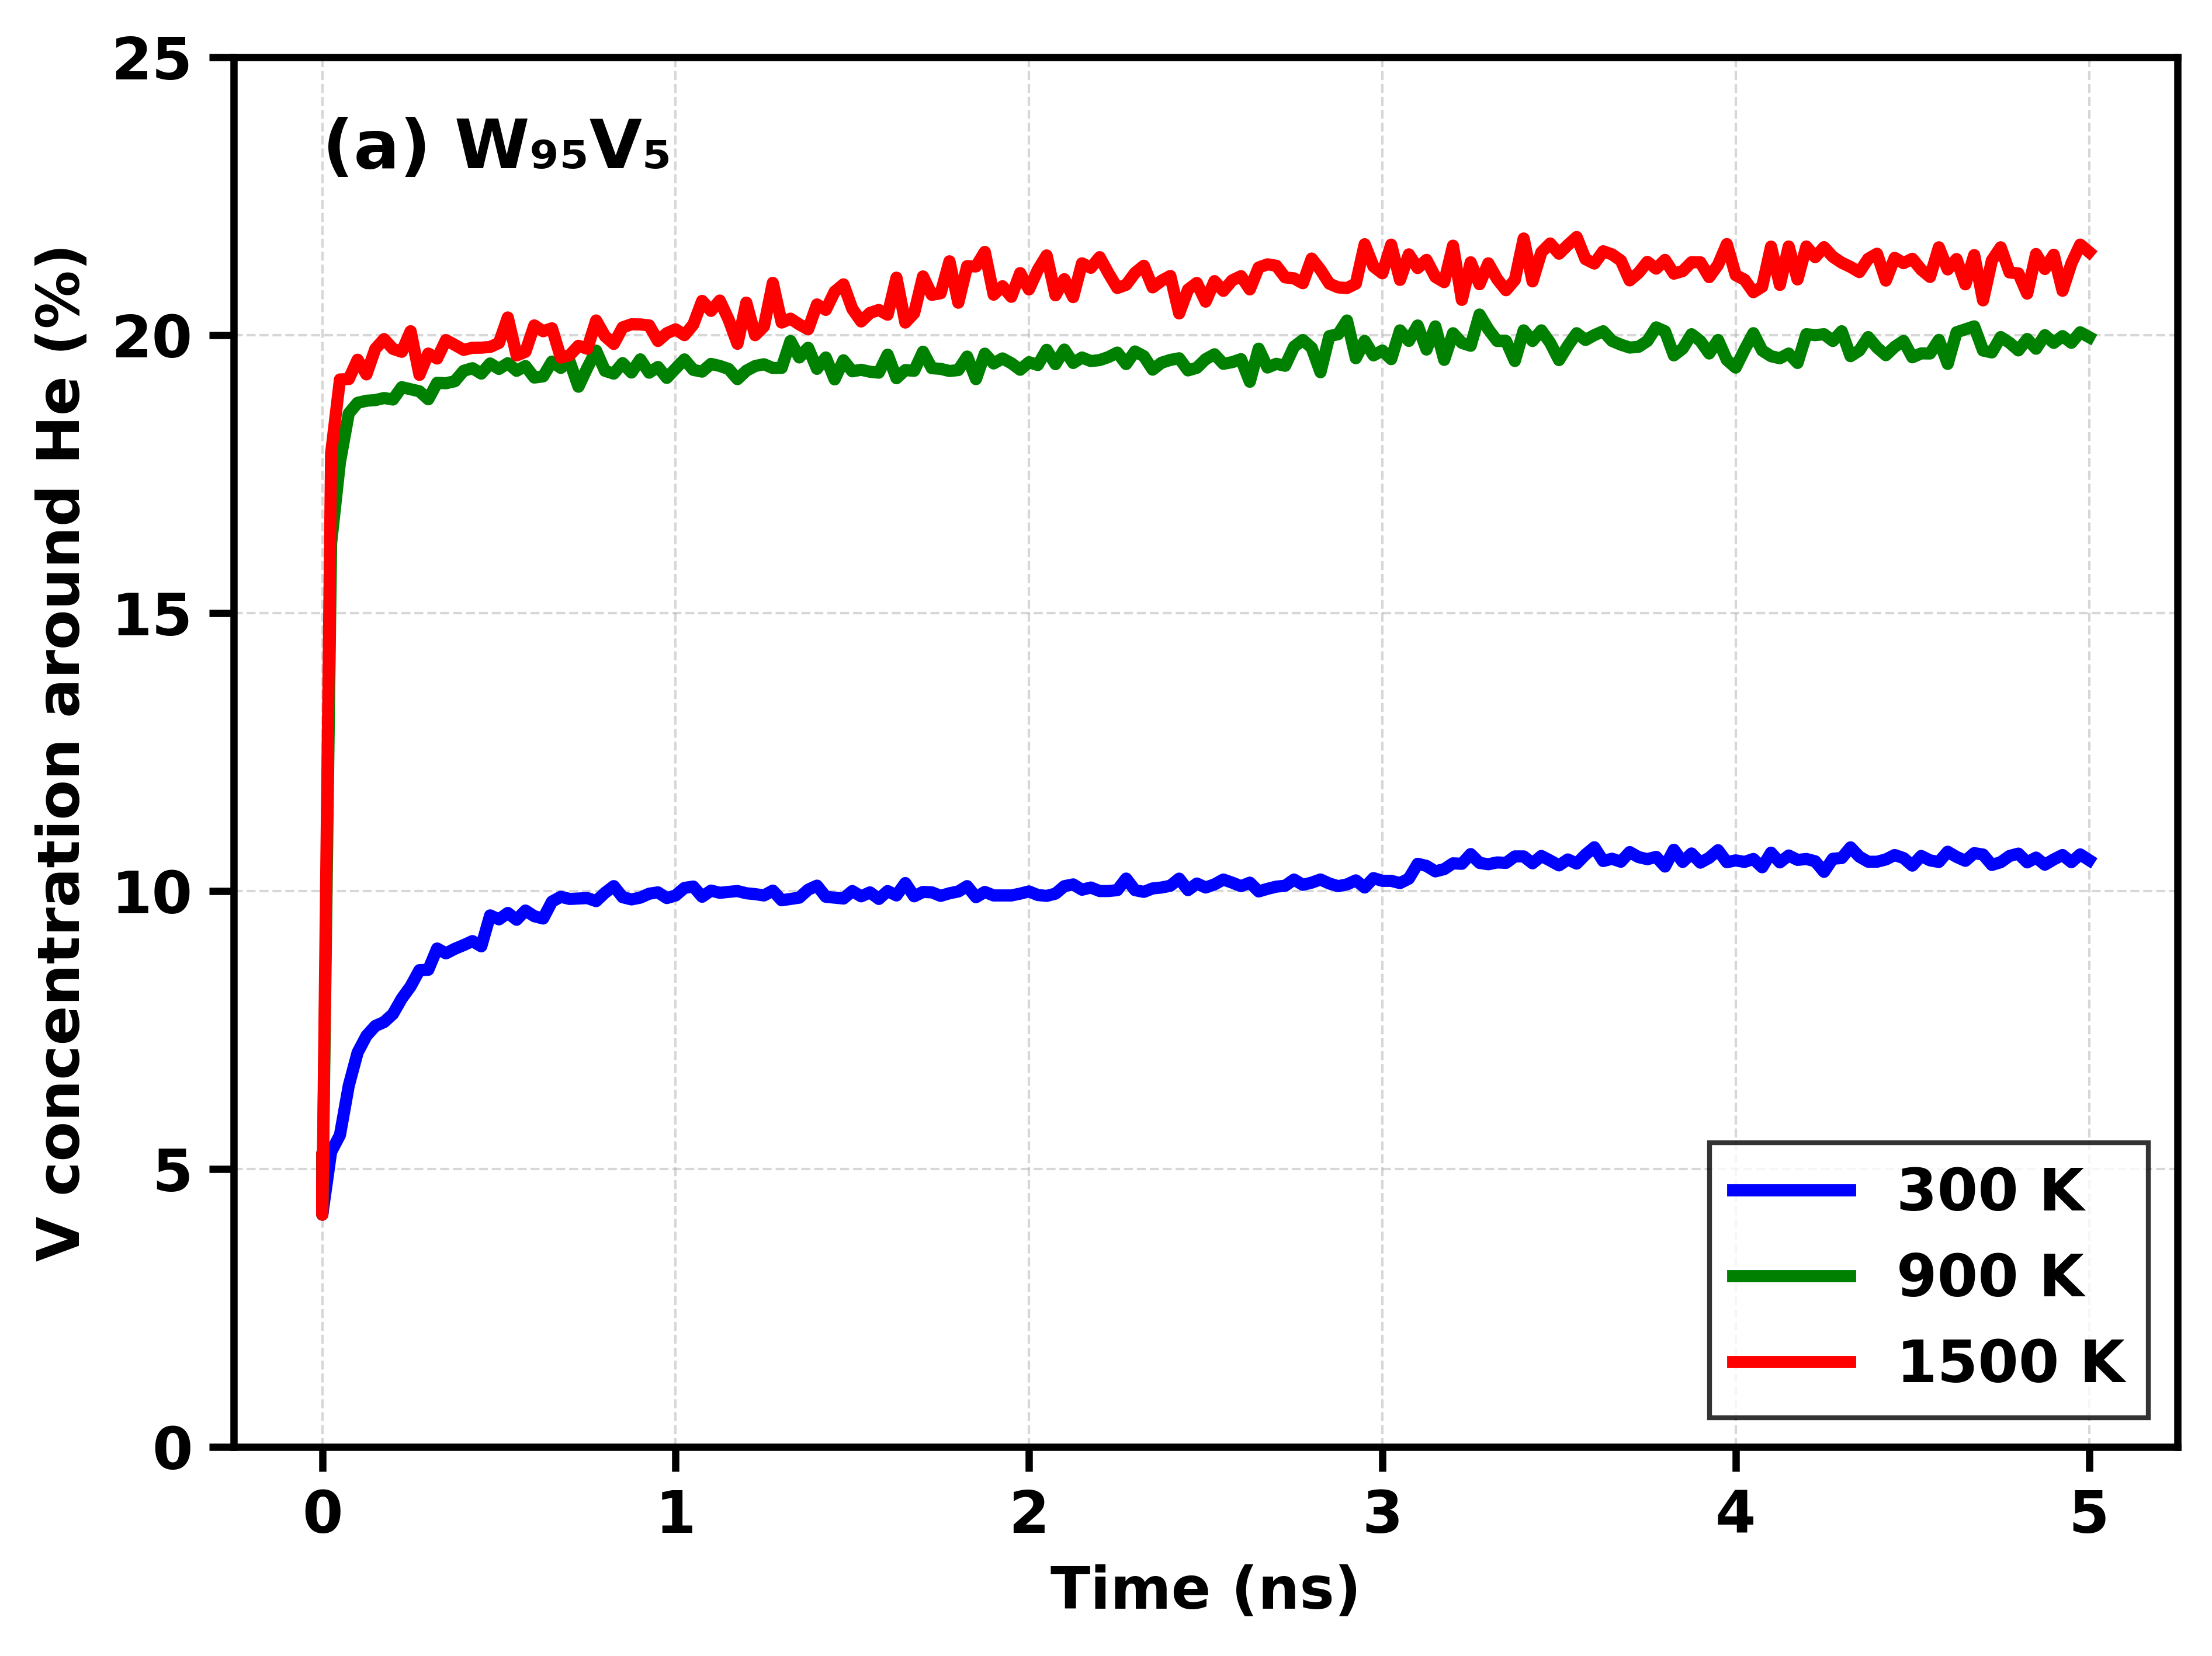
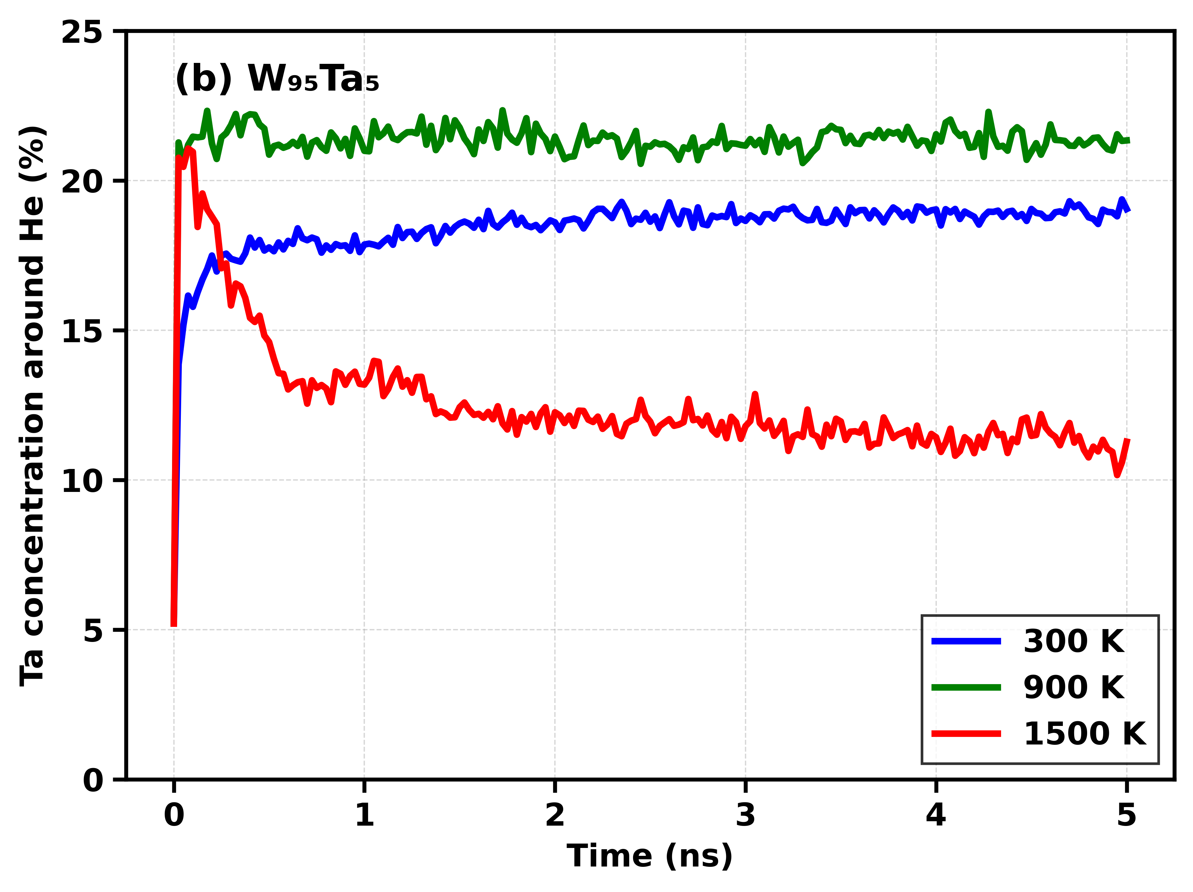
Element around He

Slide 8
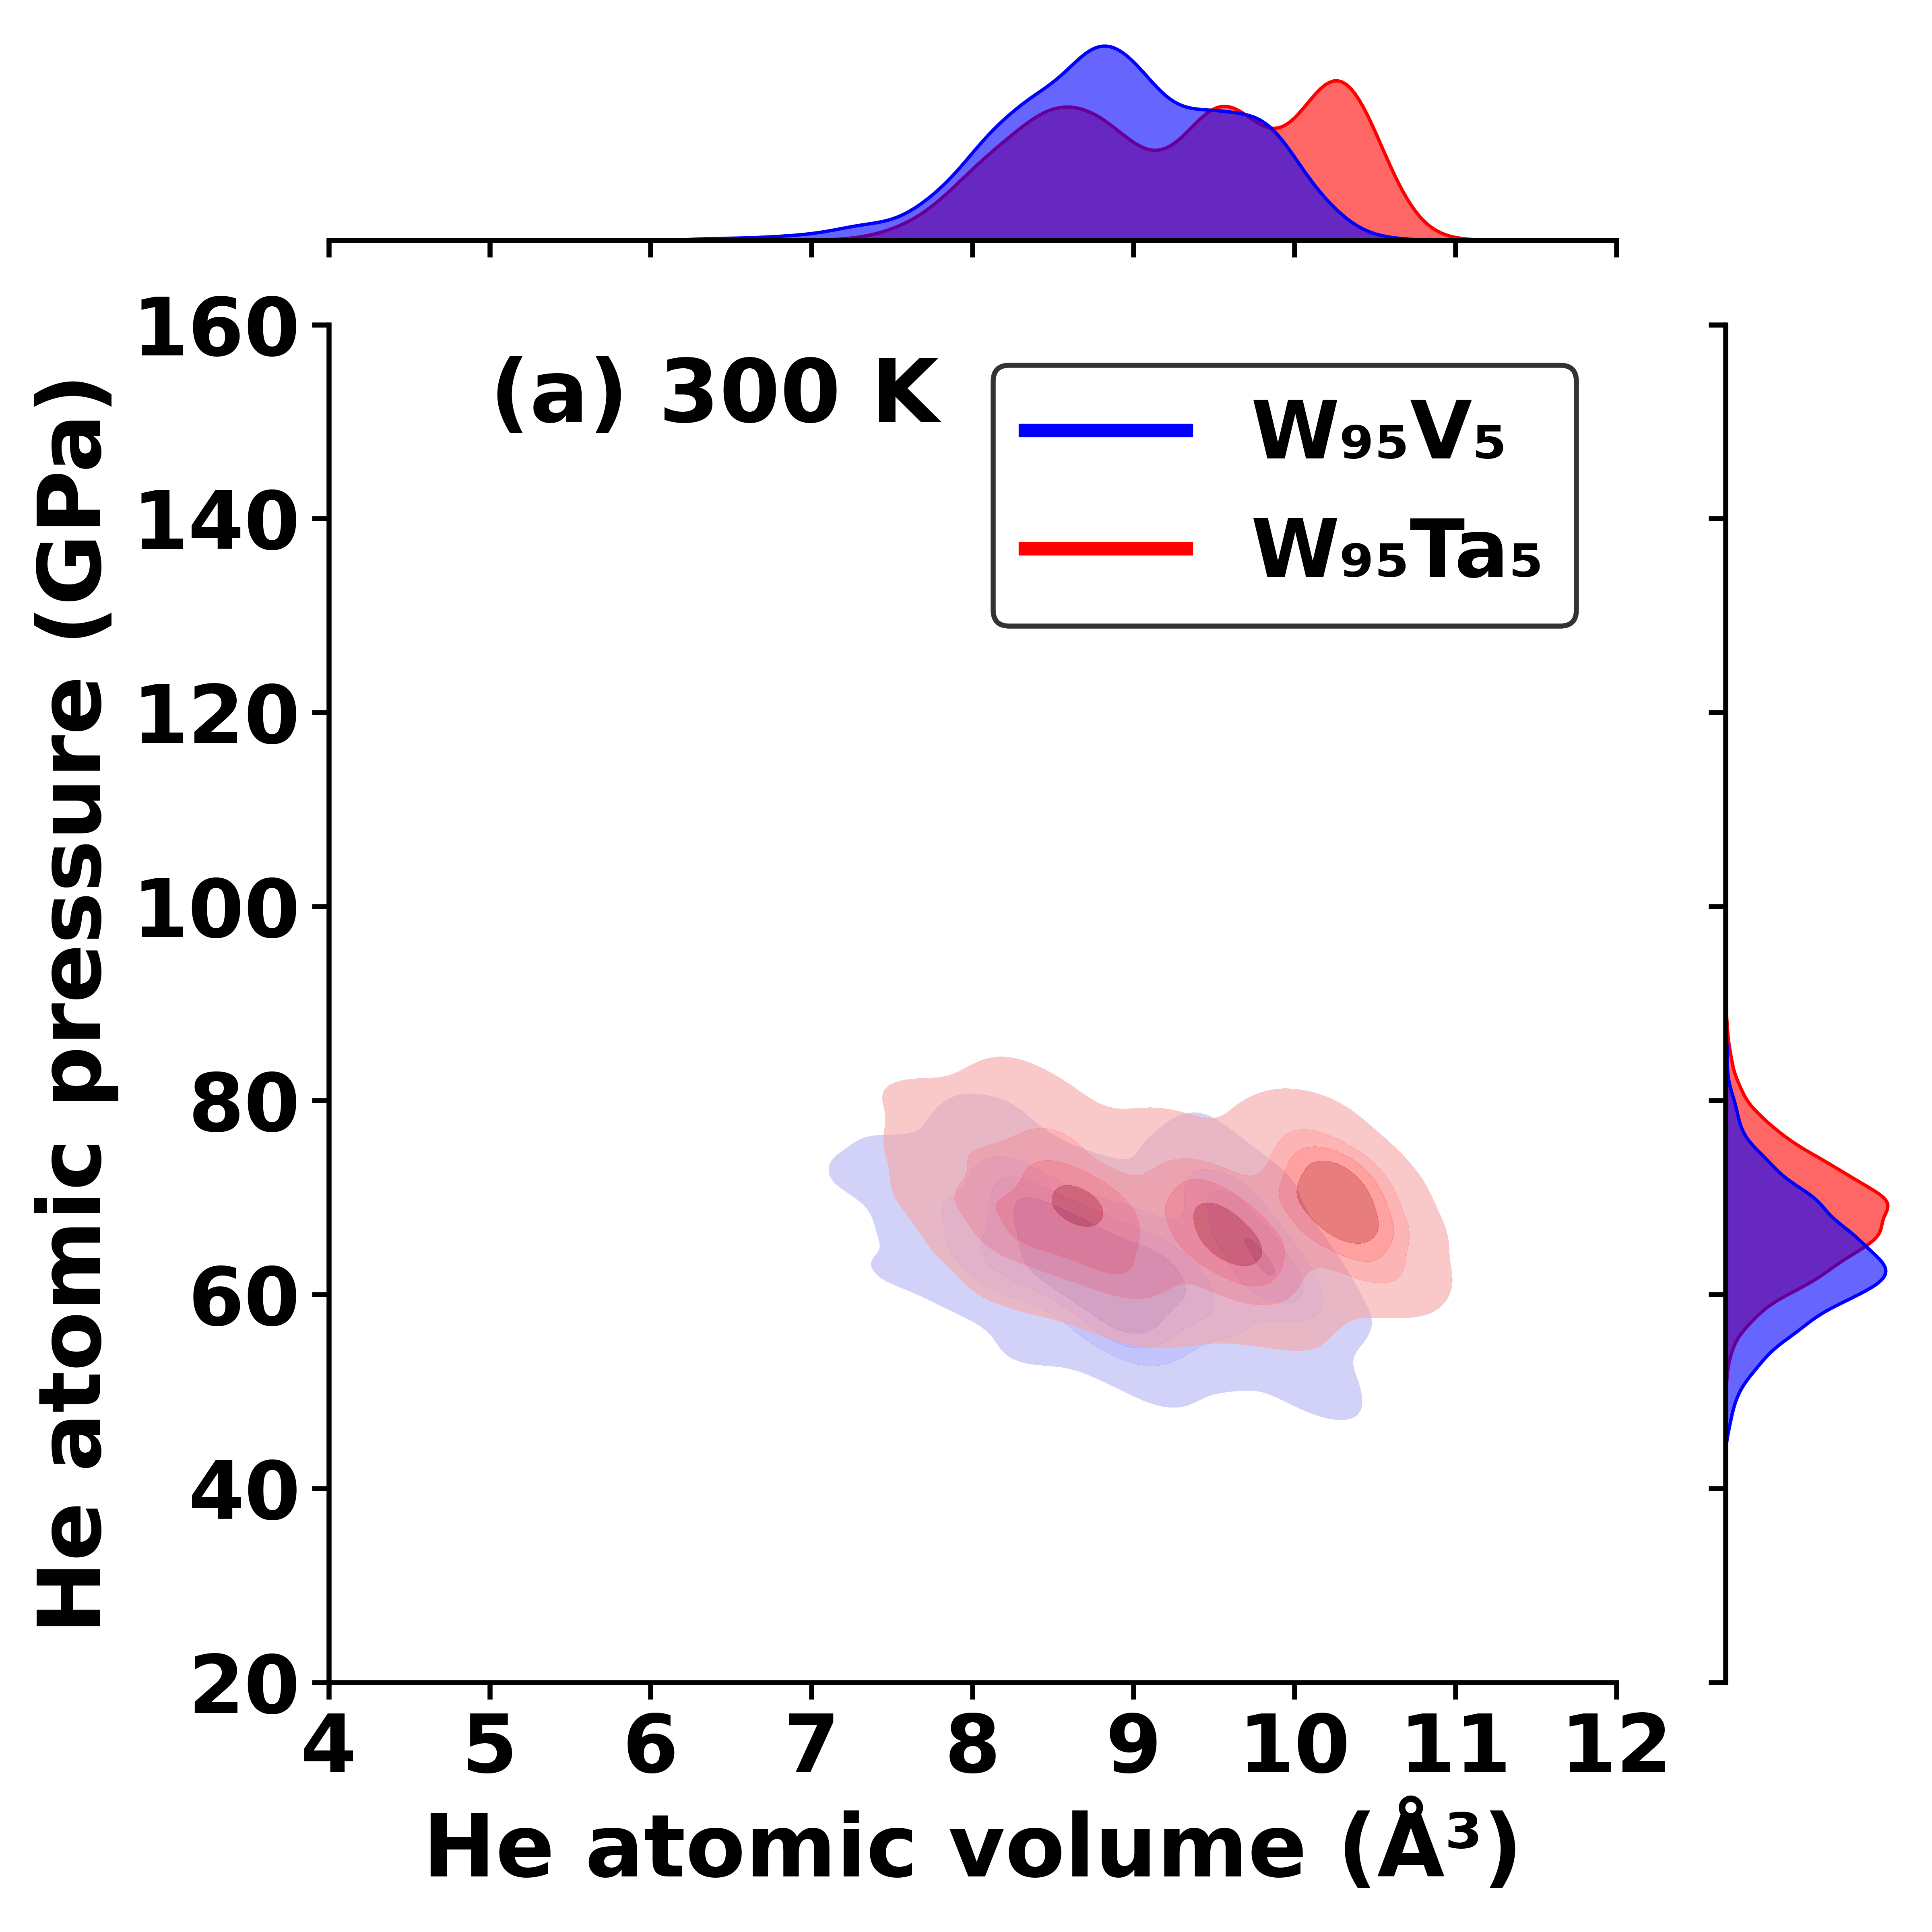
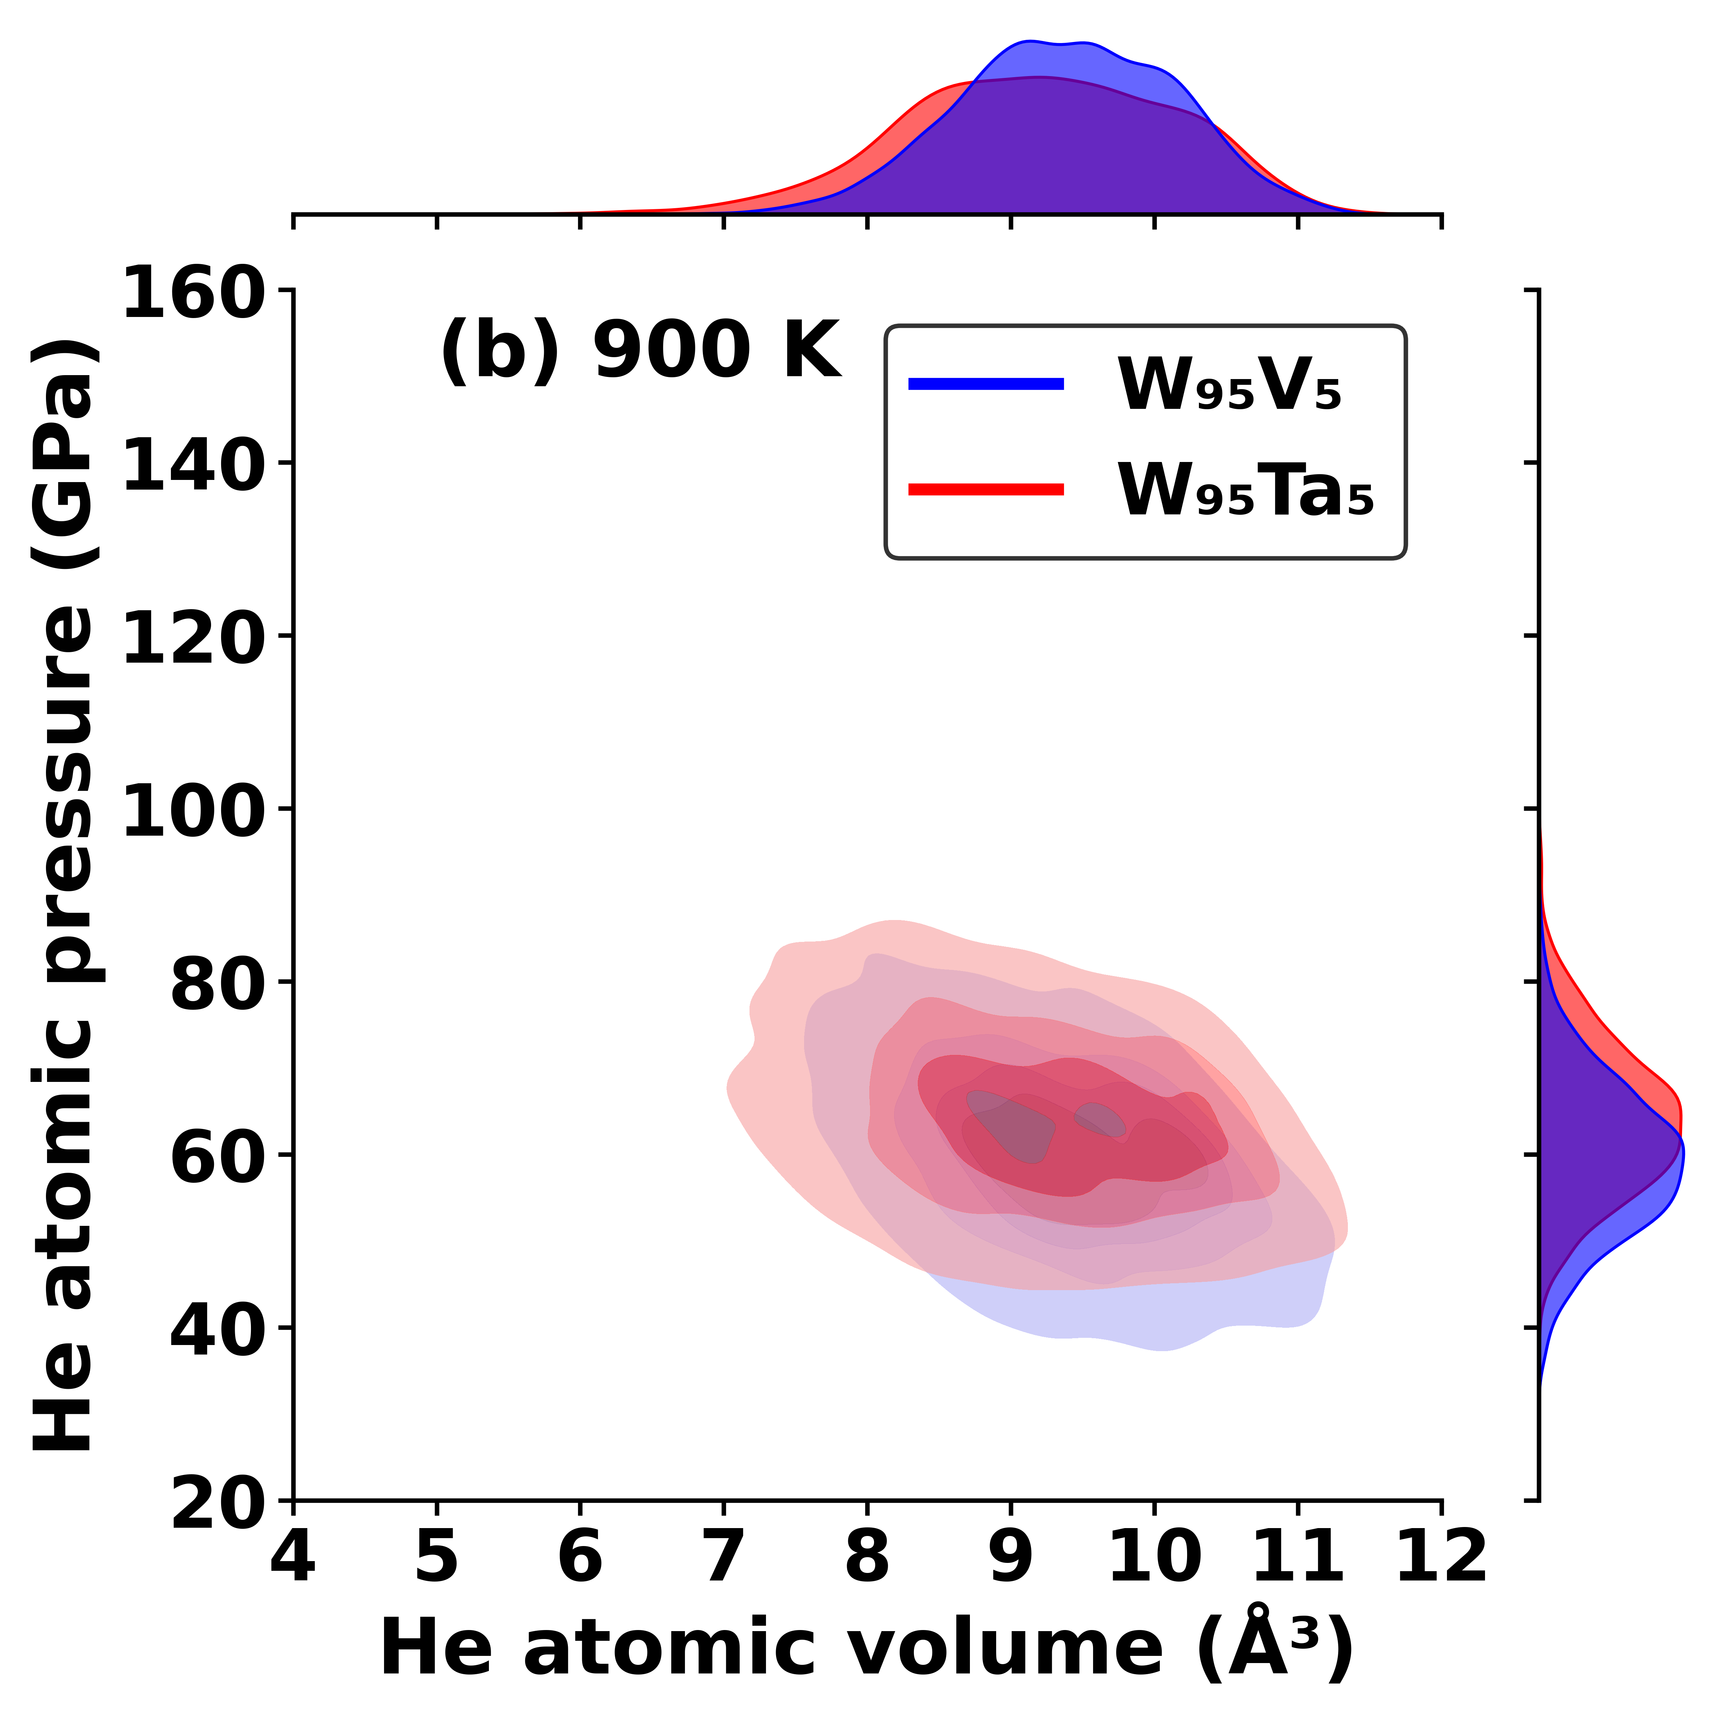
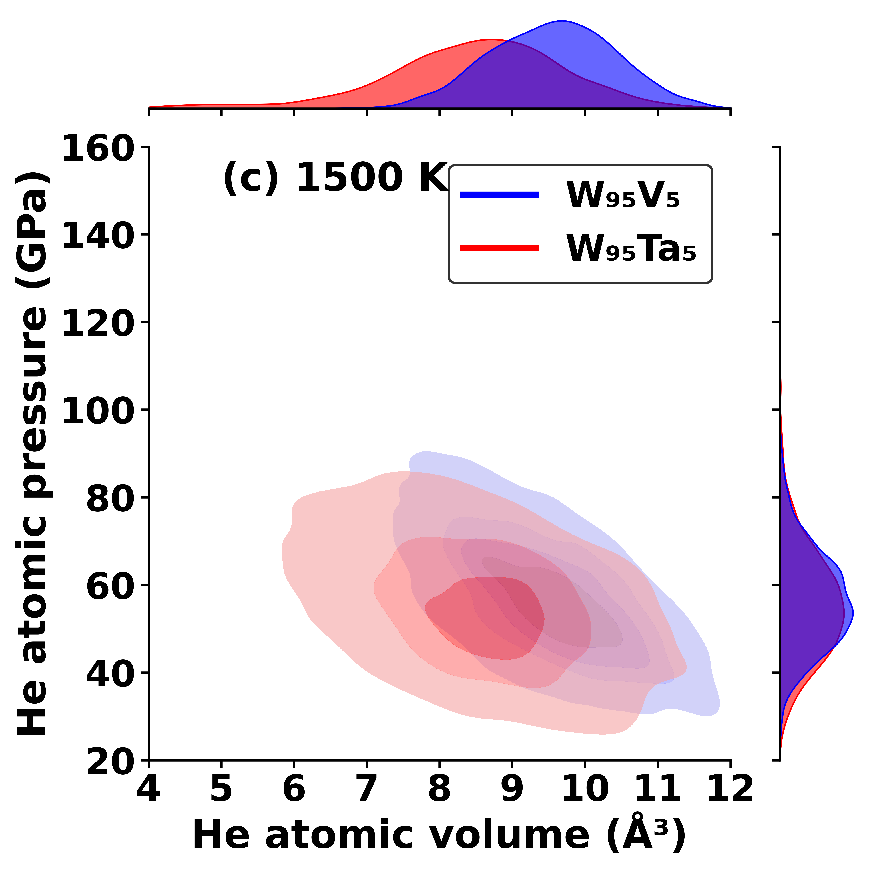
Pressure-volume

Slide 9
The presence of a small amount of V : 1.Suppresses He clustering at high temperatures (900-1500 K). 2. Inhibits He self-trapping and the creation of vacancy traps (Frenkel pairs). 3. Acts as a potent trapping site for mobile He atoms. 4. Creates stable, low-pressure "comfort sites" via elastic strain compensation.
Summary

Slide 10
He release
Simulation setup
Cell: 40 × 40 × 60 bcc unit cells (~192,000 metal atoms)
He loading: 1,152 He atoms randomly placed within the central 60% of the box height (z-axis)
Vacuum: 3 lattice constants at the bottom, 20 at the top
Boundaries: non-periodic along z (open surfaces), periodic in x and y
Thermal protocol: ramp from room temperature to 850 °C over 50 ps (NVT), then anneal at 850 °C
Relaxation time: 2,200 ps for W; 1,750 ps for W–V
Results
W: He largely forms clusters; 23 He atoms are released to vacuum.
W–V: He atoms mostly vibrate near their initial positions; none are released.

Slide 11
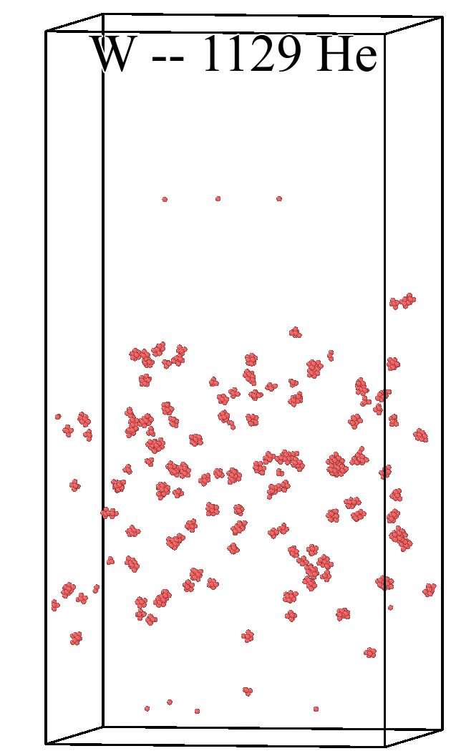
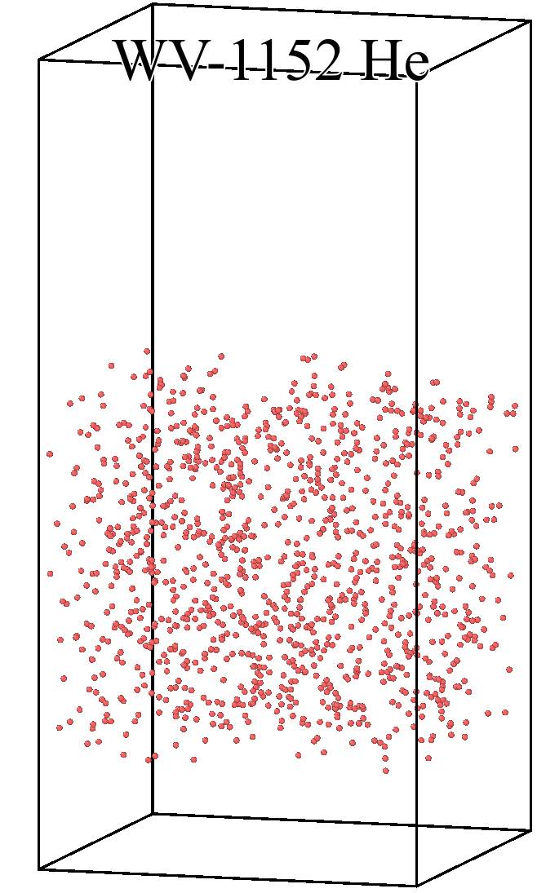
Screenshots

