Slide 1



Transmission Electron Microscopy of He ion implanted W-based HEA at IJCLab
Stéphanie Jublot-Leclerc, Antoine Combrisson, Florian Pallier, Aurélie Gentils
Université Paris-Saclay, CNRS/IN2P3, IJCLab, Orsay, France
14th November, 2025
HerHEA project, EUROfusion, ENR-MAT.02.VTT-T001
2024-2025
Contact: aurelie.gentils@ijclab.in2p3.fr

Slide 2
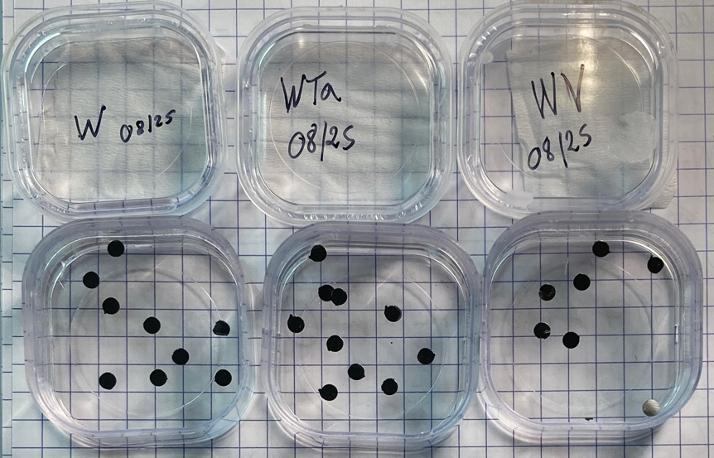
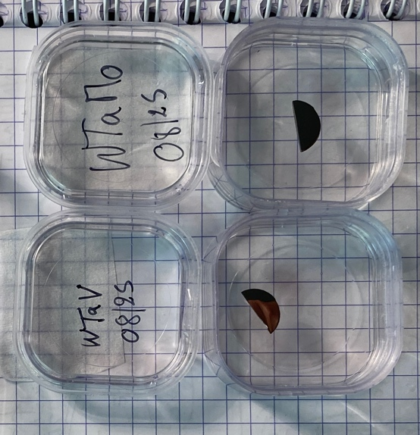
Updated status on HerHEA work at CNRS-IJCLab (14th Nov. 2025)
Materials sent to CNRS-CEMHTI and UHEL for ex situ ion implantation and characterizations
Material fabrication at VTT
Cutting of the bulk as-fabricated material
subcontractor in France for EDM cutting
squares
Available material(s) to be studied
W, W-Ta, W-Mo, W-V
Quick SEM-EDX characterization
of binary alloys
Surface mechanical polishing
Electrical Discharge Machining
3 mm diameter discs
Other materials from Portugal
W-Ta-V, W-Ta-Mo
half discs
Polishing performed on W, W-V, W-Ta and the ternary alloys
WTaV, WTaMo
Mirror-polished samples (mid August / Sept.)
HerHEA project, EUROfusion, ENR-MAT.02.VTT-T001, 2024-2025

Slide 3
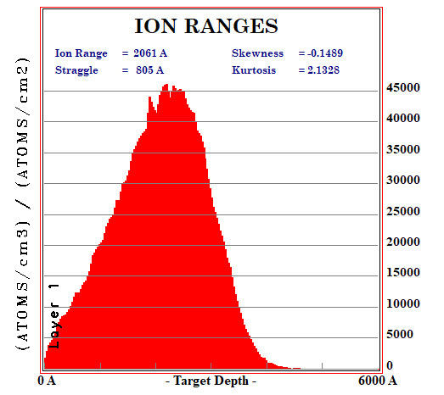
Updated status on HerHEA work at CNRS-IJCLab (14th Nov. 2025)
Materials sent to CNRS-CEMHTI and UHEL for ex situ ion implantation and characterizations
Material fabrication at VTT
Cutting of the bulk as-fabricated material
subcontractor in France for EDM cutting
squares
Available material(s) to be studied
W, W-Ta, W-Mo, W-V
Quick SEM-EDX characterization
of binary alloys
Surface mechanical polishing
Electrical Discharge Machining
3 mm diameter discs
Other materials from Portugal
W-Ta-V, W-Ta-Mo
half discs
Selection of conditions and performing He implantation
High T°C (500°C), one high fluence (1x10¹⁷ He.cm⁻²)
Energy 100 keV
SRIM calculations using average E_{d} = 44 eV, see J. Byggmästar, F. Djurabekova, and K. Nordlund, Phys. Rev. Materials 8 (2024) 115406, https://doi.org/10.1103/PhysRevMaterials.8.115406
From literature: should be enough He to see bubbles in W → He bubbles observed in W by TEM starting 5x10¹⁵ cm⁻² fluence (12 keV, 600°C), see F. Luo et al, Fusion Engineering and Design 125 (2017) 463, dx.doi.org/10.1016/j.fusengdes.2017.04.014
HerHEA project, EUROfusion, ENR-MAT.02.VTT-T001, 2024-2025
Notes:
J. Byggmästar, F. Djurabekova, and K. Nordlund, Threshold displacement energies in refractory high-entropy alloys, Phys. Rev. Materials 8 (2024) 115406
https://doi.org/10.1103/PhysRevMaterials.8.115406

Slide 4


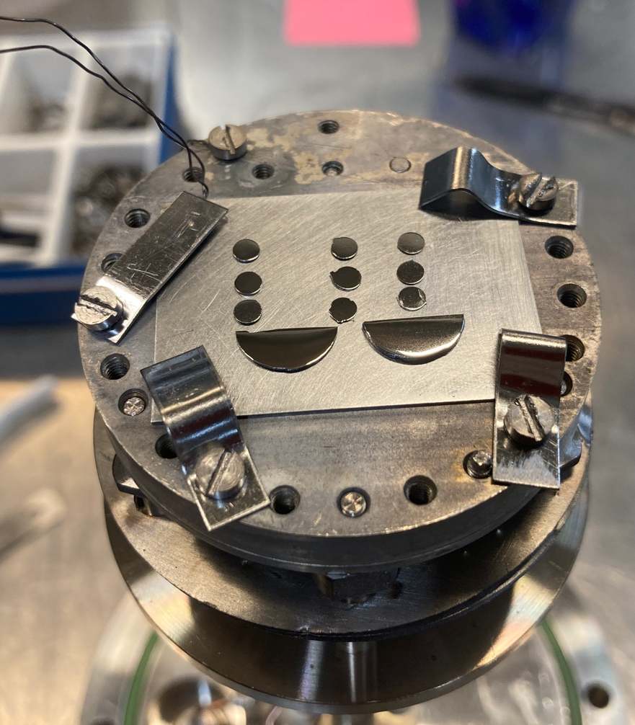
Updated status on HerHEA work at CNRS-IJCLab (14th Nov. 2025)
Ion implantation performed
in Sept. 2025 using 190 kV IRMA ion implanter
He energy: 100 keV
He fluence : 1x10¹⁷ cm⁻²
Temperature of the samples: 500°C
Material fabrication at VTT
Cutting of the bulk as-fabricated material
subcontractor in France for EDM cutting
Orsay
https://mosaic.ijclab.in2p3.fr
squares
Available material(s) to be studied
W, W-Ta, W-Mo, W-V
Quick SEM-EDX characterization
of binary alloys
Surface mechanical polishing
3 mm disc
Electrical Discharge Machining
3 mm diameter discs
Other materials from Portugal
W-Ta-V, W-Ta-Mo
half discs
Selection of conditions and performing He implantation
High T°C (500°C), one high fluence (1x10¹⁷ He.cm⁻²)
Energy 100 keV
W
WTa
WV
WTaV
WTaMo
From literature: should be enough He to see bubbles in W → He bubbles observed in W by TEM starting 5x10¹⁵ cm⁻² fluence (12 keV, 600°C), see F. Luo et al, Fusion Engineering and Design 125 (2017) 463, dx.doi.org/10.1016/j.fusengdes.2017.04.014
Samples attached on the implantation sample holder
HerHEA project, EUROfusion, ENR-MAT.02.VTT-T001, 2024-2025

Slide 5
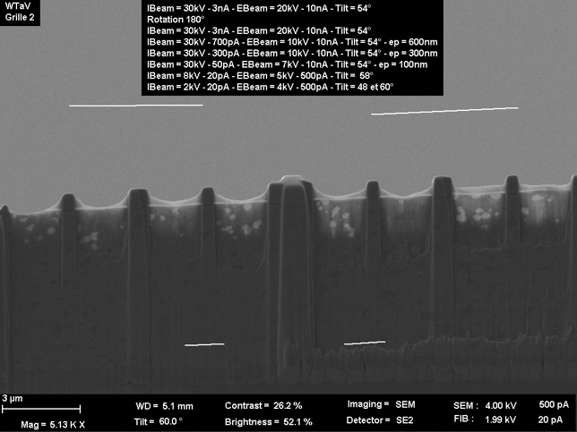
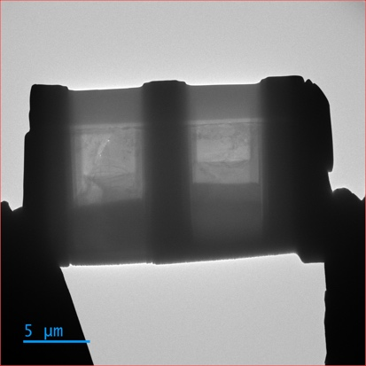
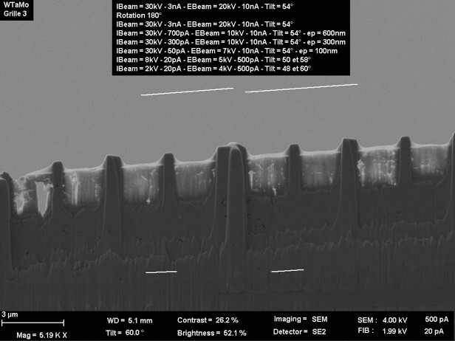
Updated status on HerHEA work at CNRS-IJCLab (14th Nov. 2025)
Materials sent to CNRS-CEMHTI and UHEL for ex situ ion implantation and characterizations
Material fabrication at VTT
Cutting of the bulk as-fabricated material
subcontractor in France for EDM cutting
squares
Available material(s) to be studied
W, W-Ta, W-Mo, W-V
Quick SEM-EDX characterization
of binary alloys
Surface mechanical polishing
Electrical Discharge Machining
3 mm diameter discs
Other materials from Portugal
W-Ta-V, W-Ta-Mo
half discs
He ions
Selection of conditions and performing He implantation
High T°C (500°C), one high fluence (1x10¹⁷ He.cm⁻²)
Energy 100 keV
Pt protective layer
surface
depth
250924_1016_WTaV_G2
4C_W_1700X_0091
TEM thin foils
preparation by FIB
(end Sept./Oct., IEMN and NCBJ)
FIB lift-out performed
at IEMN (D. Troadec) and NCBJ (D. Kalita)
250924_1015_WTaMo_G3
HerHEA project, EUROfusion, ENR-MAT.02.VTT-T001, 2024-2025

Slide 6
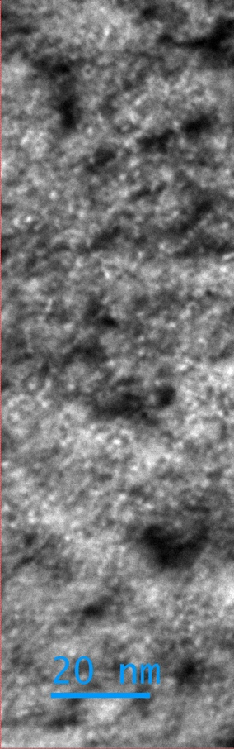
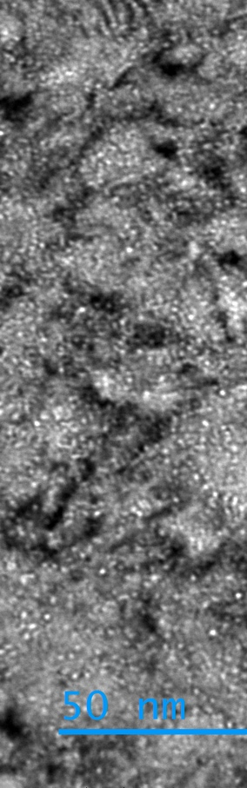
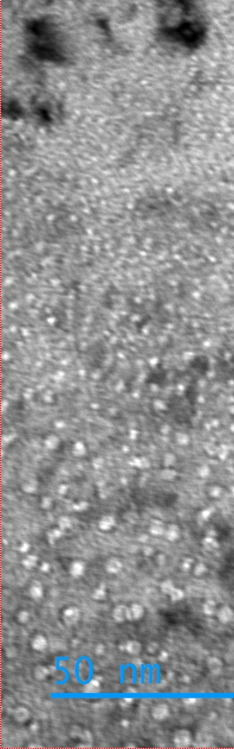
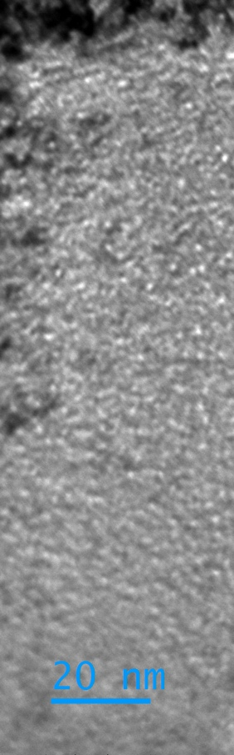
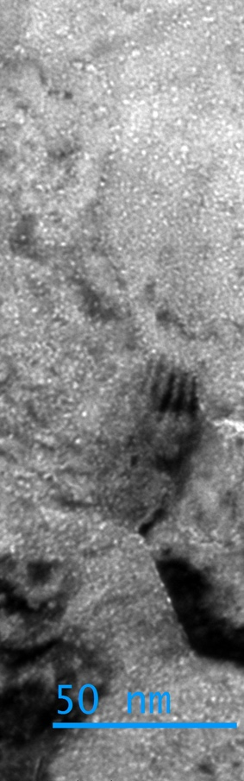
Updated status on HerHEA work at CNRS-IJCLab (14th Nov. 2025)
Beware ! Not the same scale (to be updated ;-) )
W
WTa
WV
WTaV
WTaMo
Materials sent to CNRS-CEMHTI and UHEL for ex situ ion implantation and characterizations
Material fabrication at VTT
Material fabrication at VTT
Cutting of the bulk as-fabricated material
subcontractor in France for EDM cutting
Cutting of the bulk as-fabricated material
subcontractor in France for EDM cutting
squares
squares
Available material(s) to be studied
W, W-Ta, W-Mo, W-V
Available material(s) to be studied
W, W-Ta, W-Mo, W-V
Quick SEM-EDX characterization
of binary alloys
Surface mechanical polishing
Electrical Discharge Machining
3 mm diameter discs
Electrical Discharge Machining
Other materials from Portugal
W-Ta-V, W-Ta-Mo
Other materials from Portugal
W-Ta-V, W-Ta-Mo
half discs
half discs
Selection of conditions and performing He implantation
High T°C (500°C), one high fluence (1x10¹⁷ He.cm⁻²)
Energy 100 keV
Through focus series of bright field images showing bubbles
See details next slides
Observation if any He bubbles are seen
Transmission Electron Microscopy
ex situ (in October/November)
TEM thin foils
preparation by FIB
(end Sept./Oct., IEMN and NCBJ)
HerHEA project, EUROfusion, ENR-MAT.02.VTT-T001, 2024-2025

Slide 7
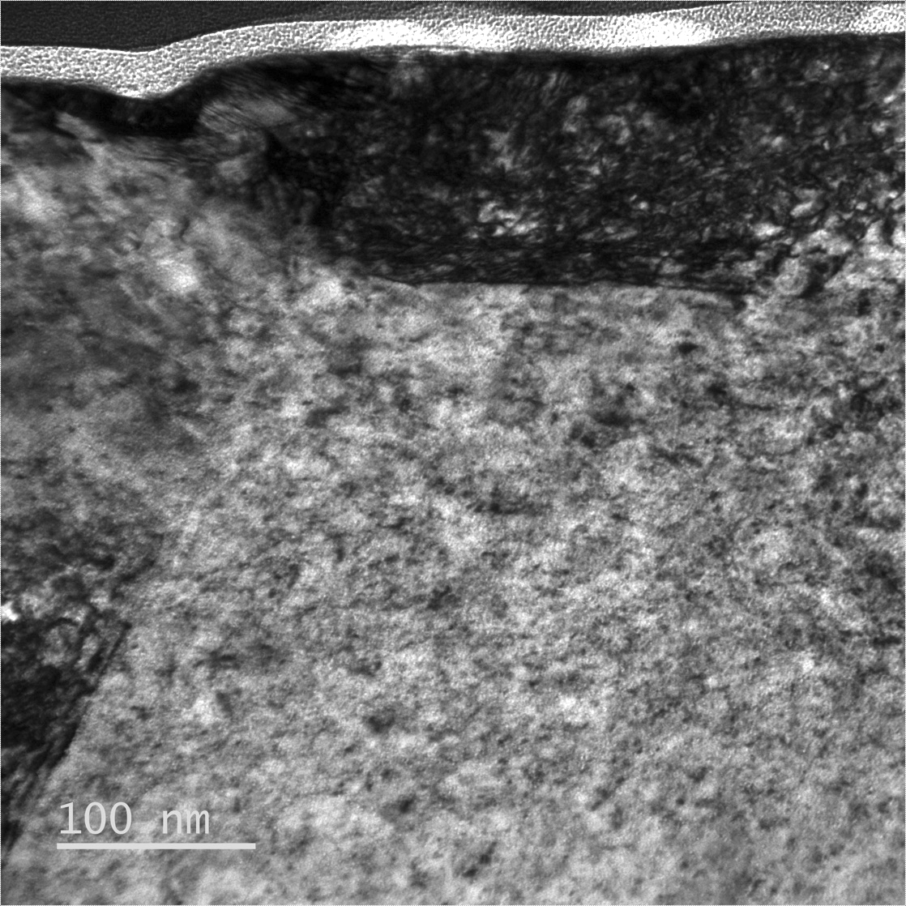

Bright field TEM images of He-implanted W
! very thick foil – need further study
Pt protective layer
surface
surface
underfocus
4C_W_100kX_0082 -500nm
overfocus
4C_W_100kX_0080 +500nm
HerHEA project, EUROfusion, ENR-MAT.02.VTT-T001, 2024-2025

Slide 8

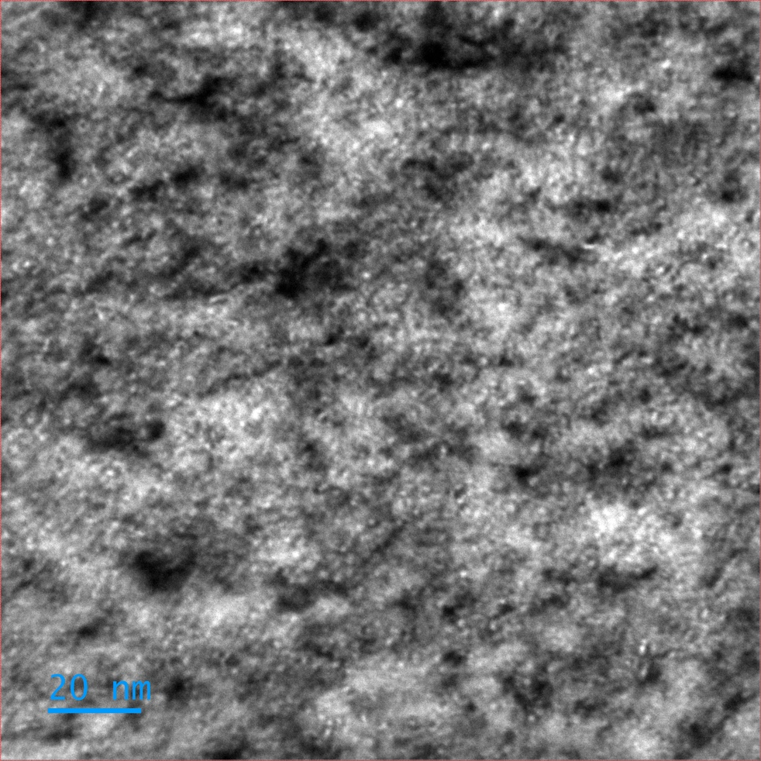

Bright field TEM images of He-implanted W
surface
underfocus
overfocus
4C_W_280kX_0060 -500nm
4C_W_280kX_0062 +500nm
HerHEA project, EUROfusion, ENR-MAT.02.VTT-T001, 2024-2025

Slide 9
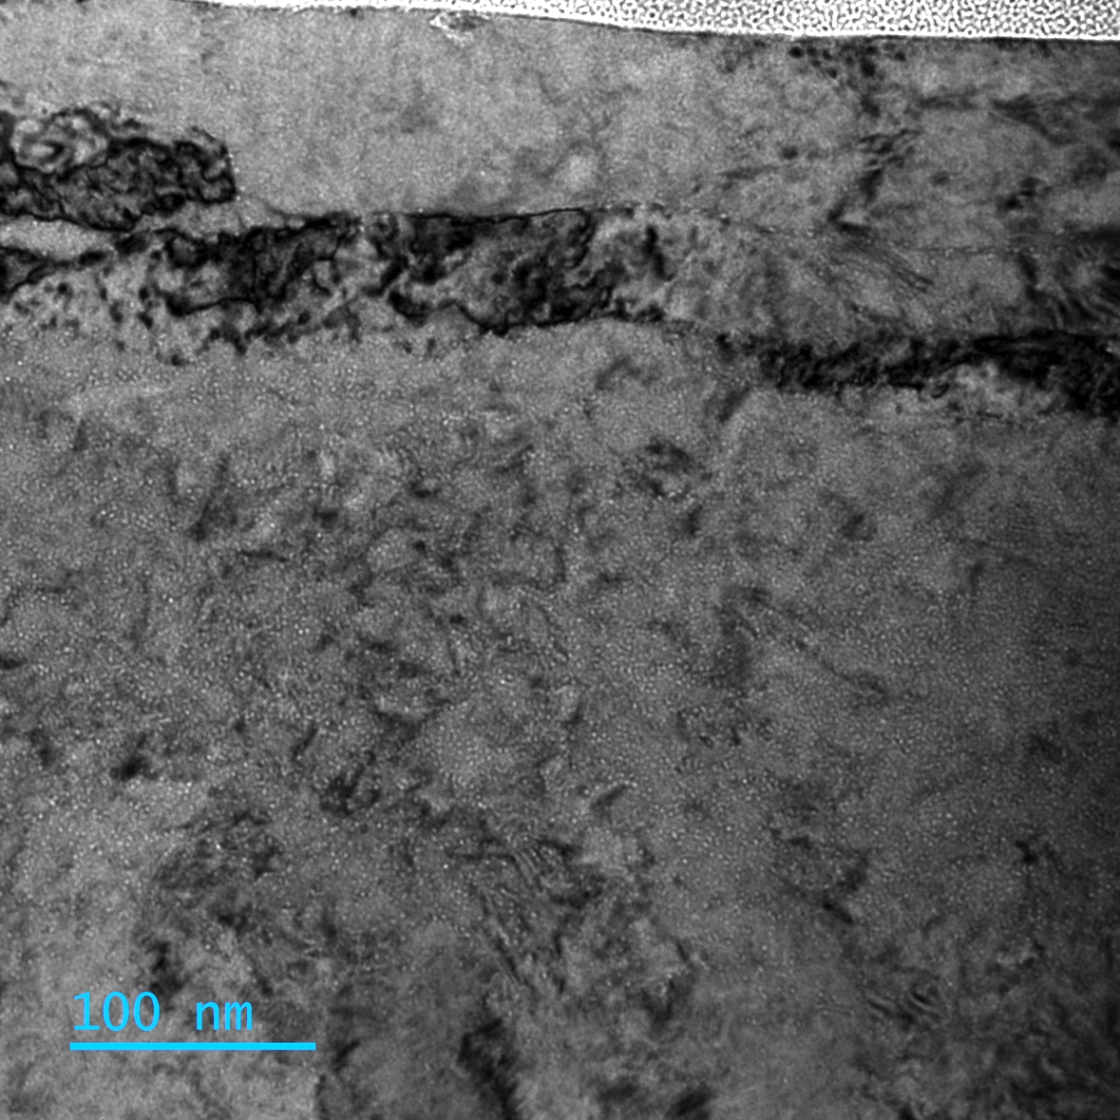
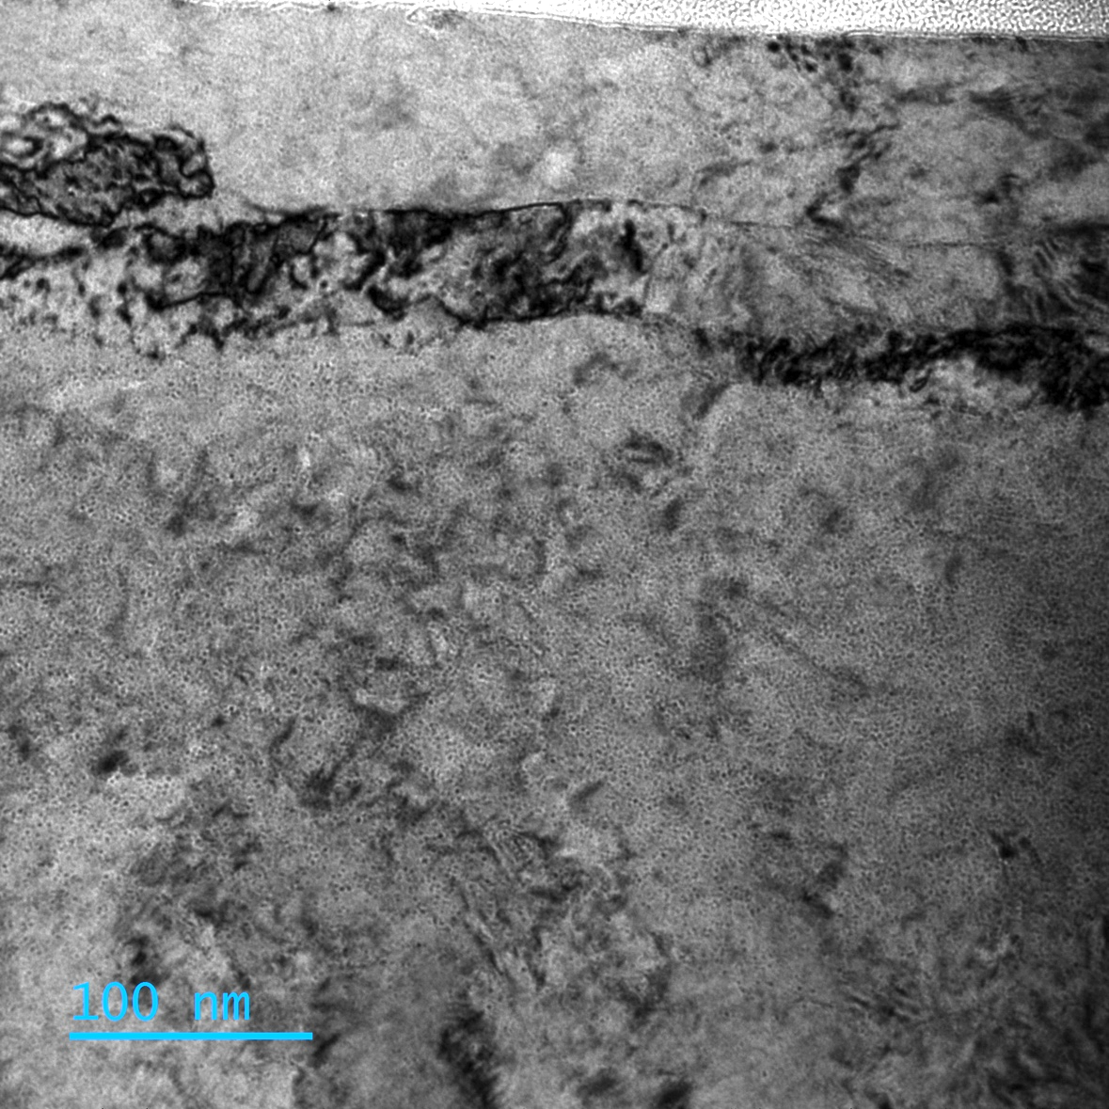
Bright field TEM images of He-implanted WTa
Pt protective layer
surface
surface
underfocus
G4_WTa_100kX_0081 -1.5 um
overfocus
G4_WTa_100kX_0085 +1.5 um
HerHEA project, EUROfusion, ENR-MAT.02.VTT-T001, 2024-2025

Slide 10

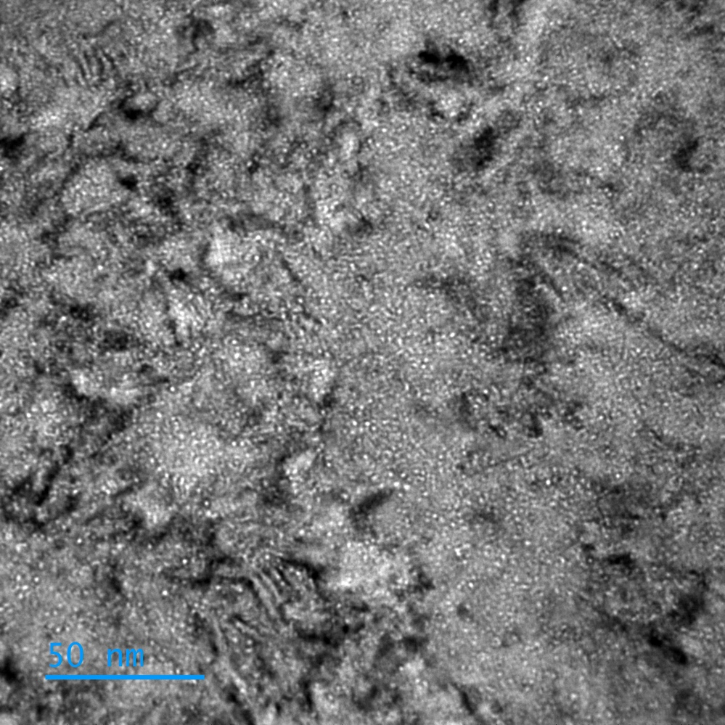
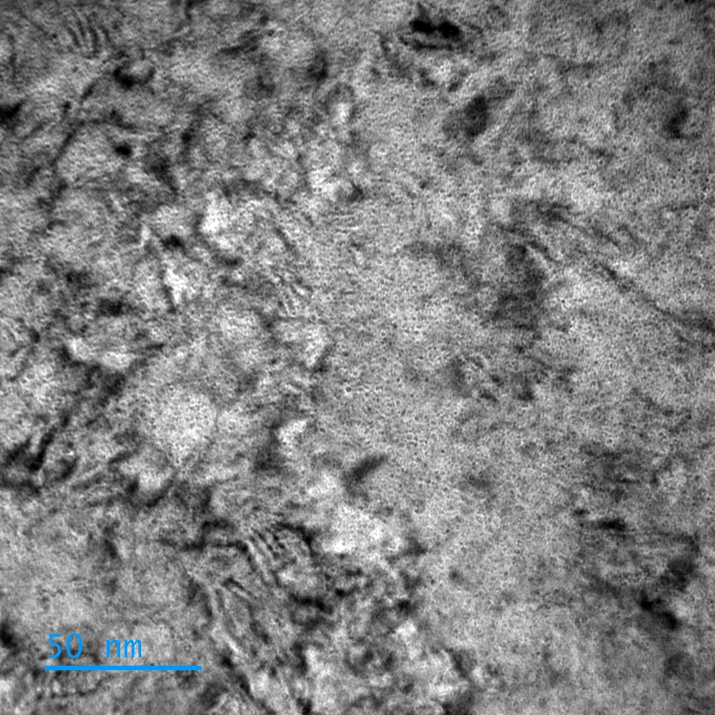
Bright field TEM images of He-implanted WTa
surface
underfocus
overfocus
G4_WTa_200kX_0091 -500nm
G4_WTa_200kX_0093 +735nm
HerHEA project, EUROfusion, ENR-MAT.02.VTT-T001, 2024-2025

Slide 11
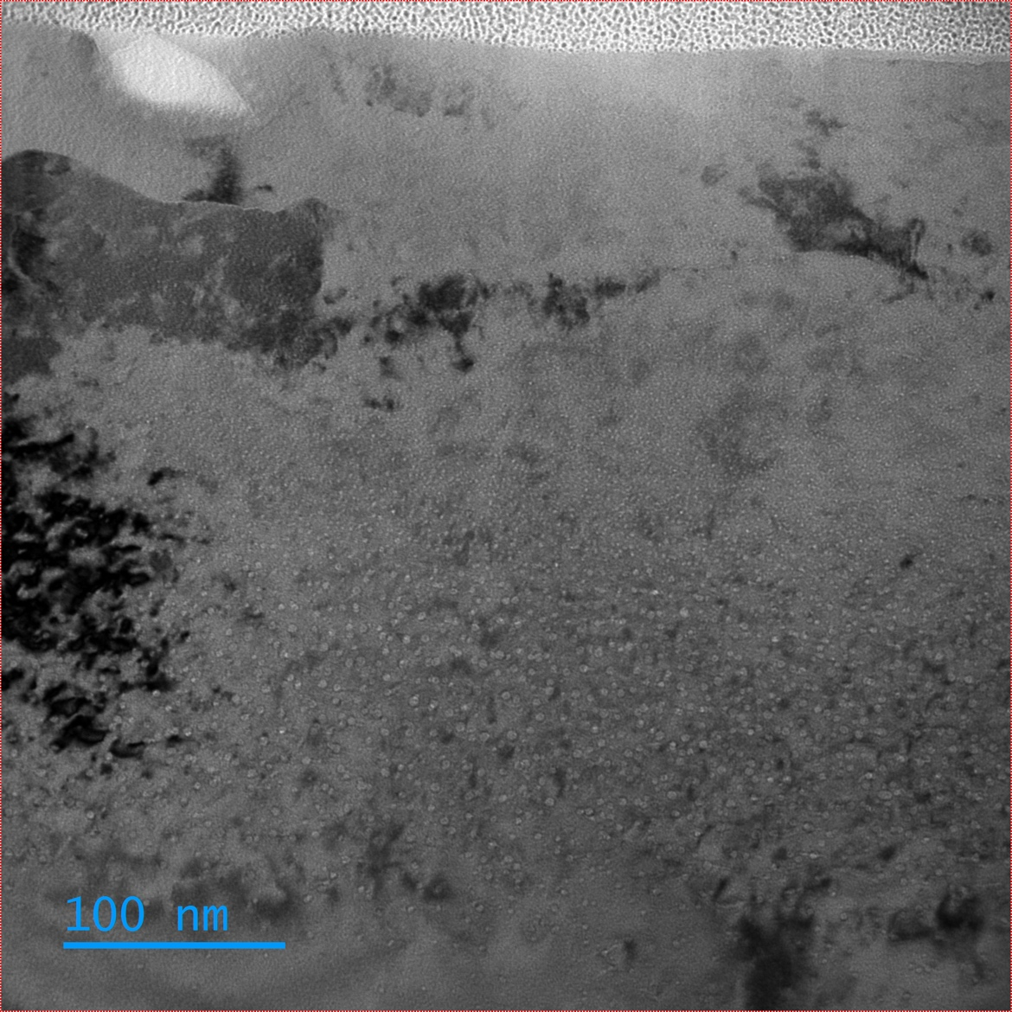
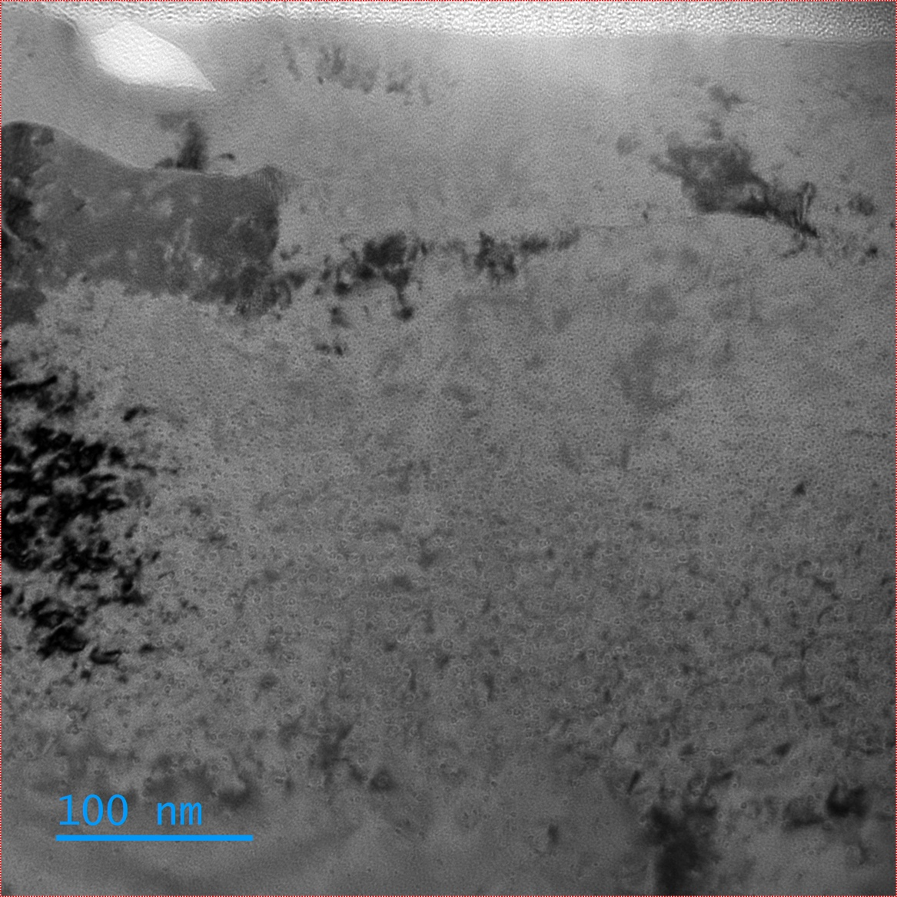
Bright field TEM images of He-implanted WV
Pt protective layer
surface
surface
underfocus
G5_WV_100kX_0109 -735nm
overfocus
G5_WV_100kX_0110 +735nm
HerHEA project, EUROfusion, ENR-MAT.02.VTT-T001, 2024-2025

Slide 12
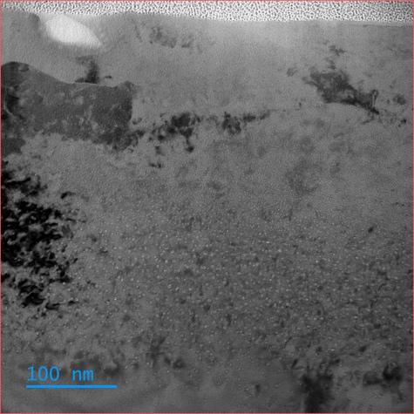
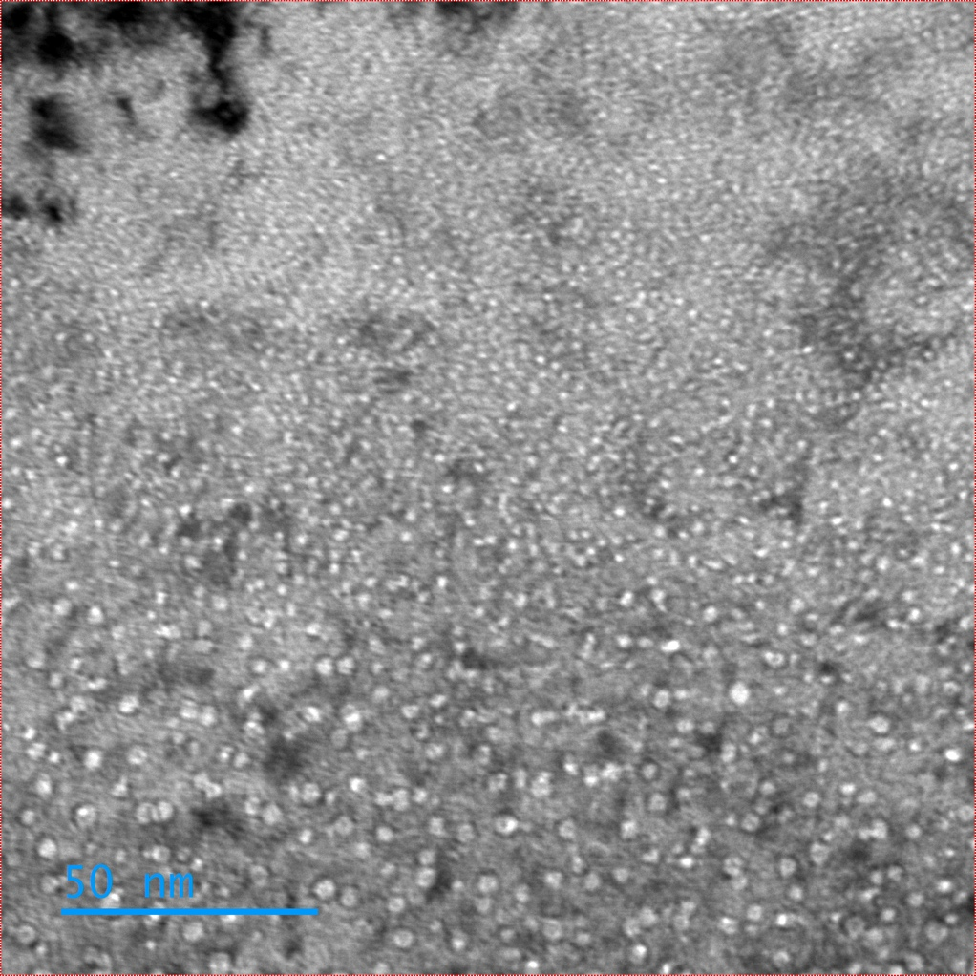
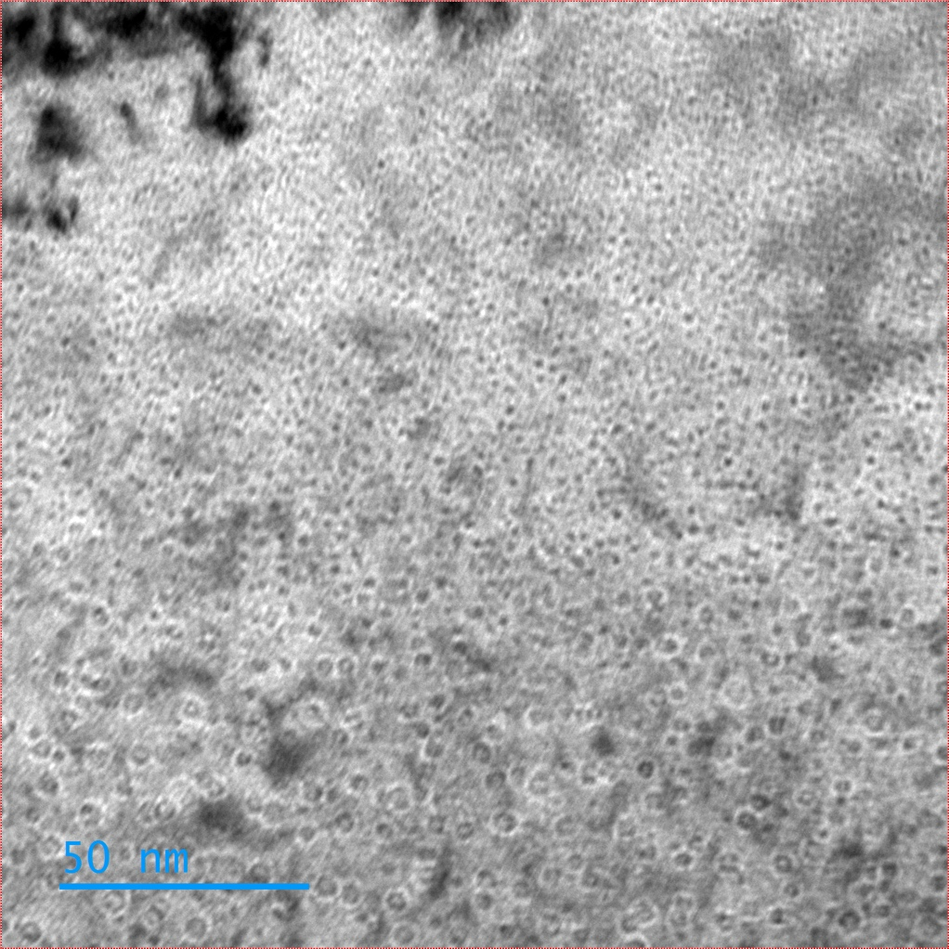
Bright field TEM images of He-implanted WV
surface
underfocus
overfocus
V homogeneity
to be checked later
G5_WV_240kX_0120 -1.04nm
G5_WV_240kX_0118 +735nm
HerHEA project, EUROfusion, ENR-MAT.02.VTT-T001, 2024-2025

Slide 13
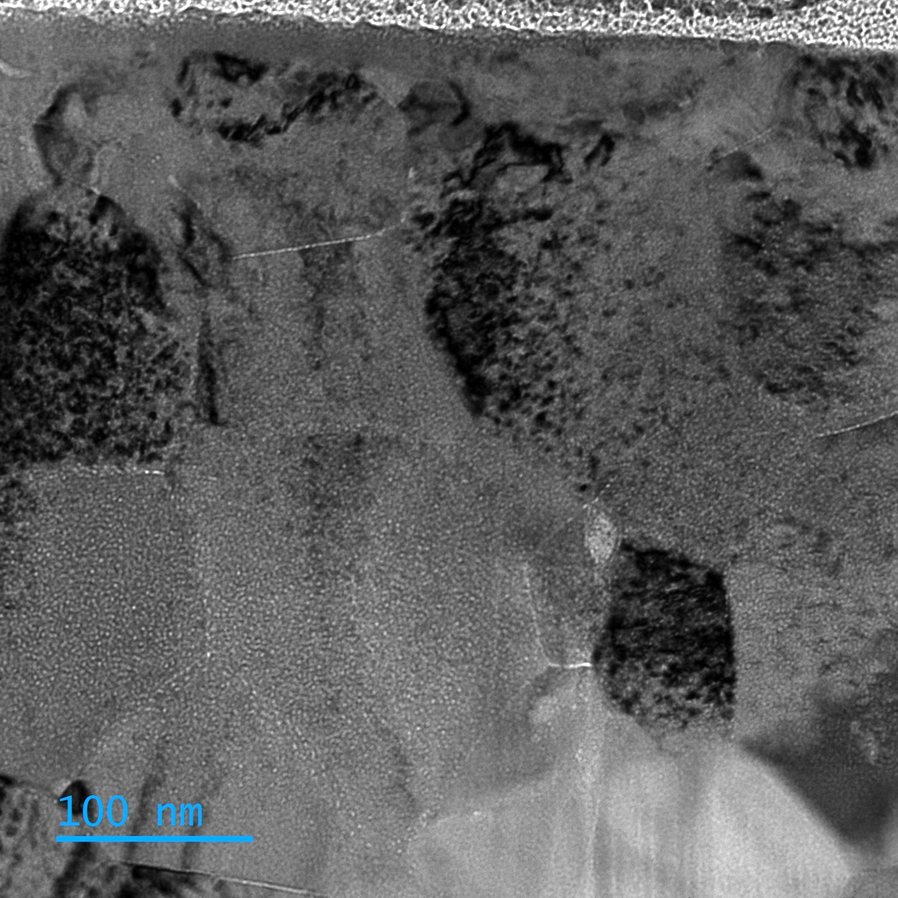
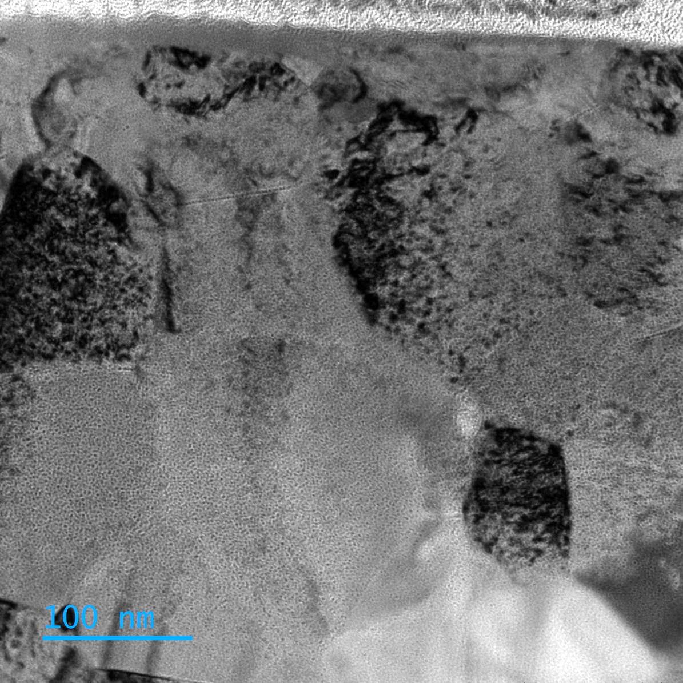
Bright field TEM images of He-implanted WTaV
Pt protective layer
surface
surface
underfocus
G2_WTaV_100kX_0032 -1.59 um
overfocus
G2_WTaV_100kX_0030 +1.59 um
HerHEA project, EUROfusion, ENR-MAT.02.VTT-T001, 2024-2025

Slide 14

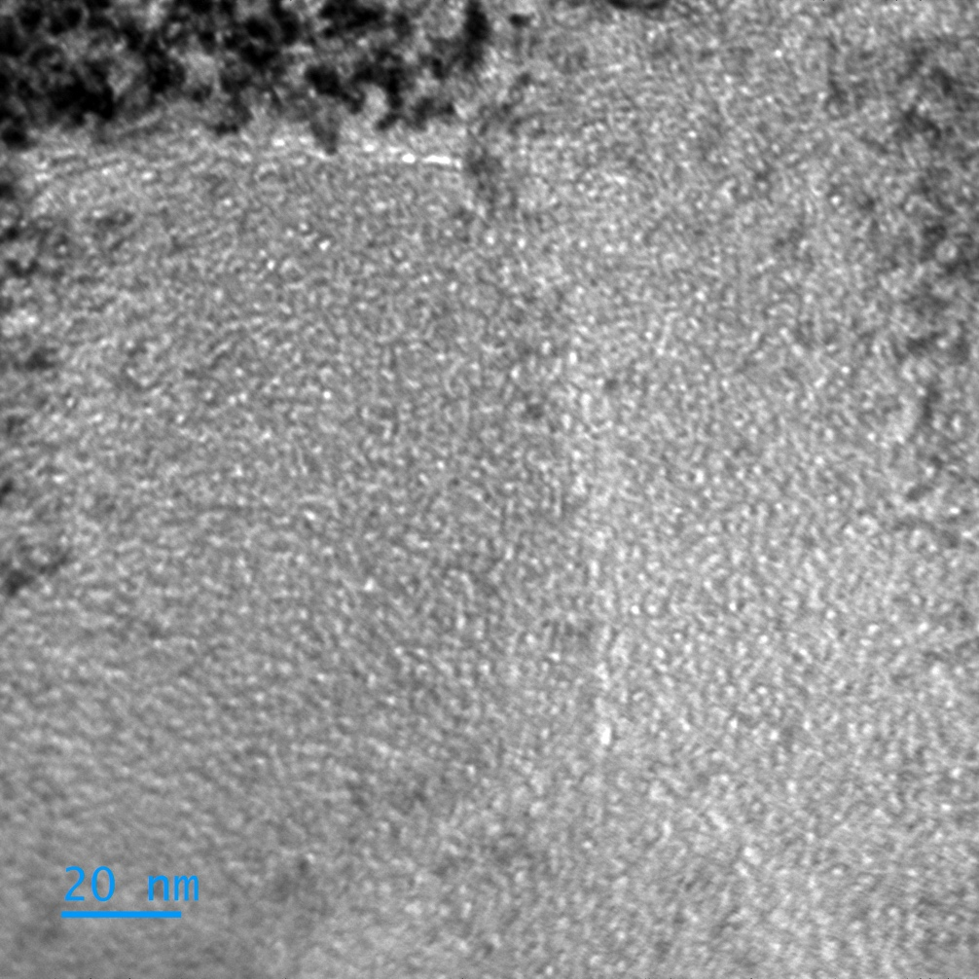
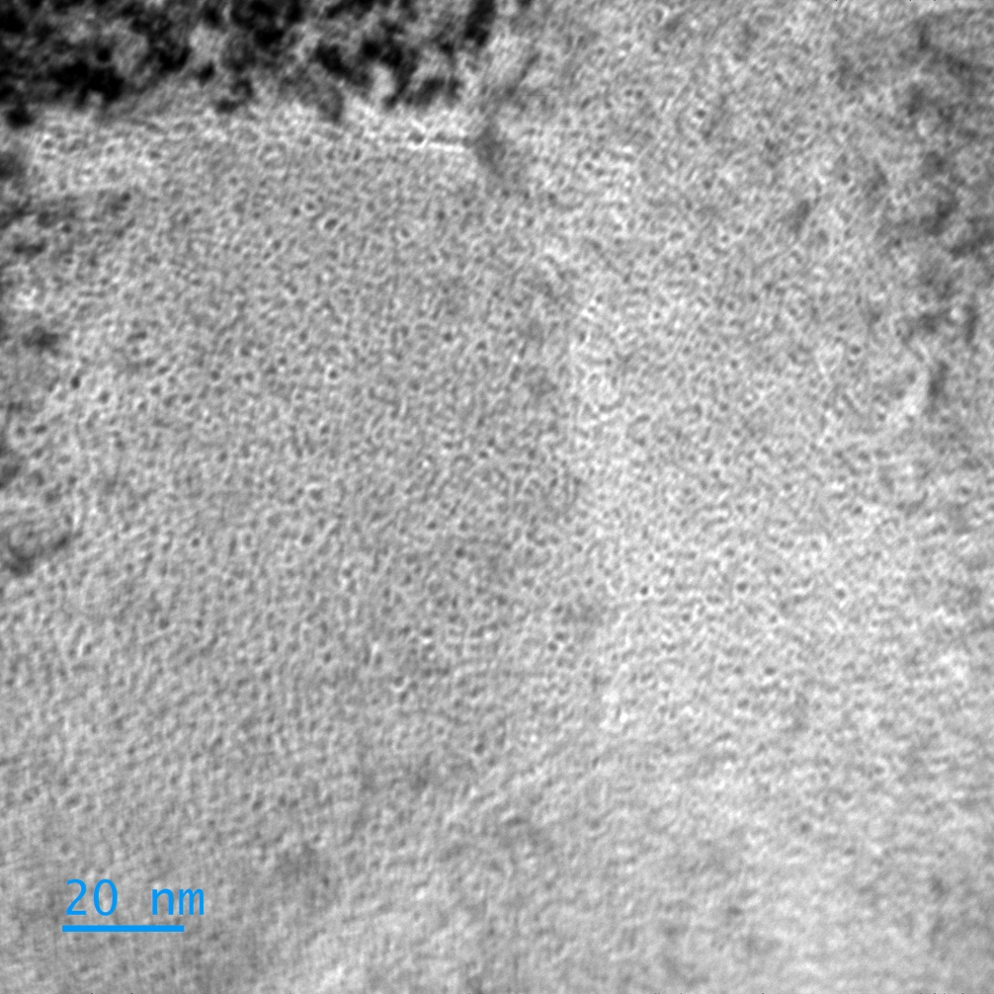
Bright field TEM images of He-implanted WTaV
surface
underfocus
overfocus
G2_WTaV_280kX_0041 -750nm
G2_WTaV_280kX_0042 +750nm
HerHEA project, EUROfusion, ENR-MAT.02.VTT-T001, 2024-2025

Slide 15
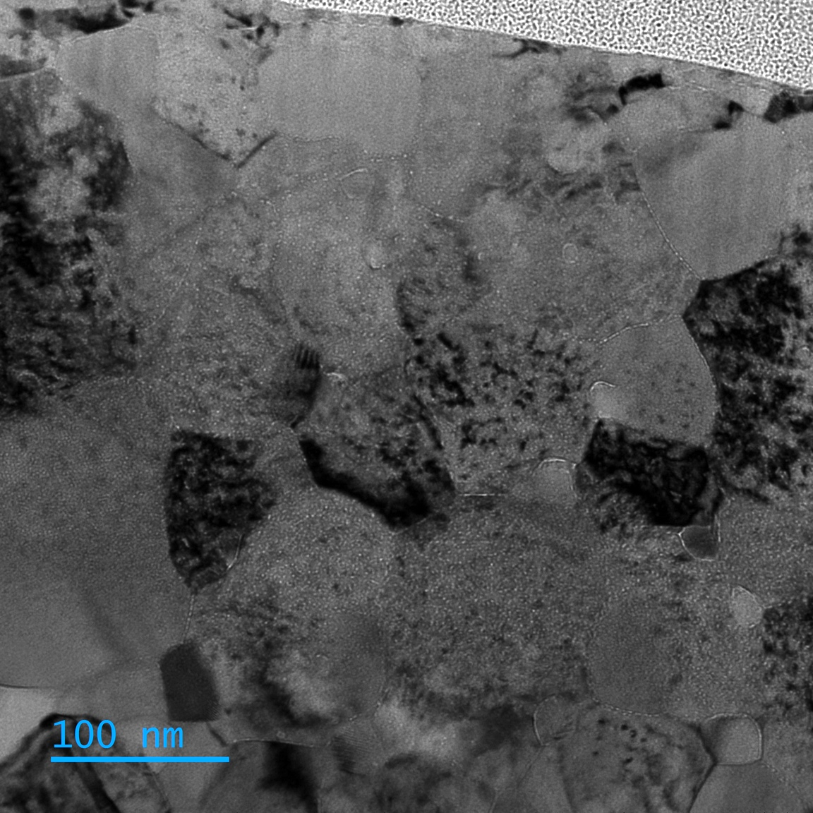
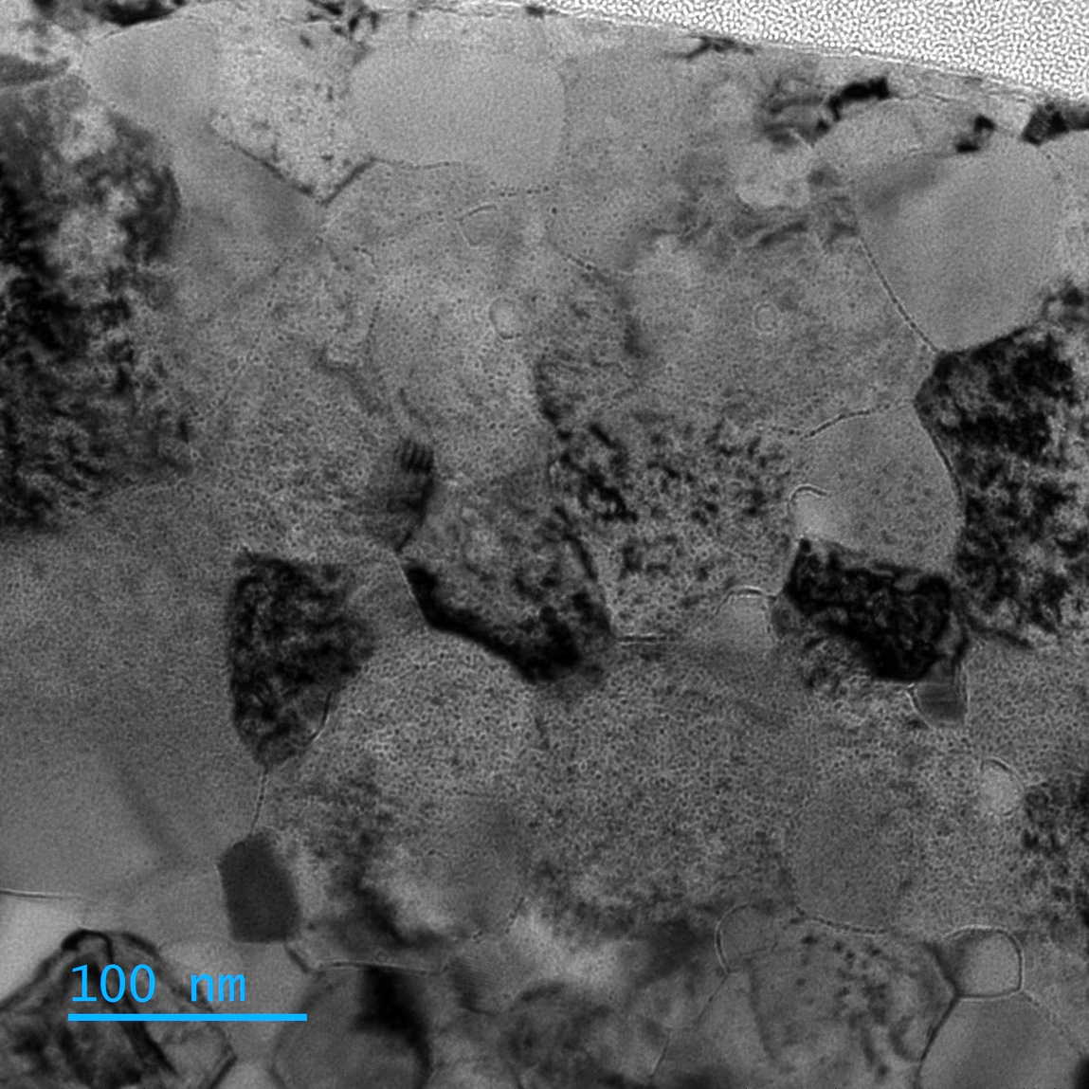
Bright field TEM images of He-implanted WTaMo
Pt protective layer
surface
surface
underfocus
G3_WTaMo_100kX_0056 -1.4um
overfocus
G3_WTaMo_100kX_0058 +1.4um
HerHEA project, EUROfusion, ENR-MAT.02.VTT-T001, 2024-2025

Slide 16
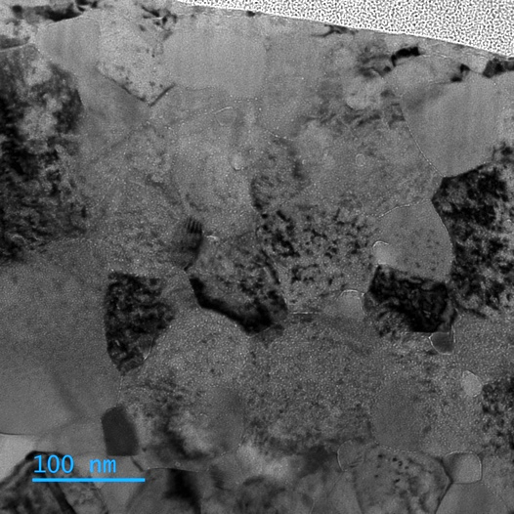
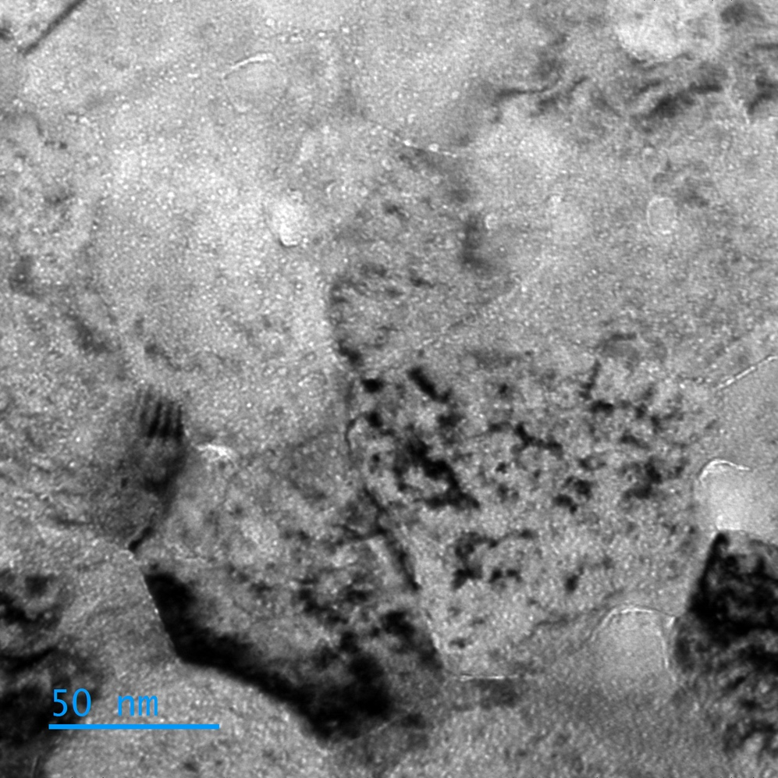
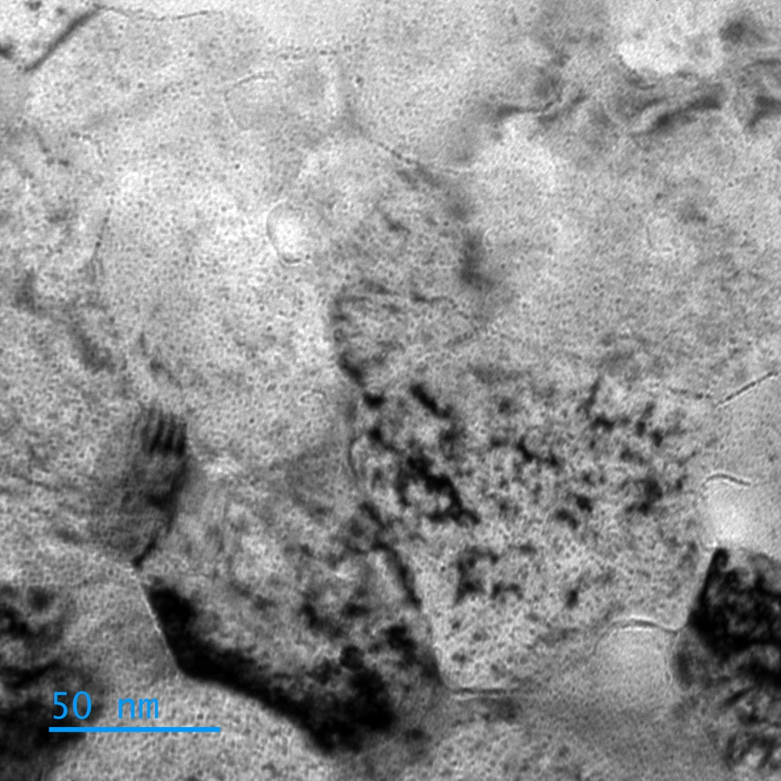
Bright field TEM images of He-implanted WTaMo
surface
underfocus
overfocus
G3_WTaMo_200kX_0065 -735nm
G3_WTaMo_200kX_0064 +735nm
HerHEA project, EUROfusion, ENR-MAT.02.VTT-T001, 2024-2025

Slide 17
Updated status on HerHEA work at CNRS-IJCLab (14th Nov. 2025)
Materials sent to CNRS-CEMHTI and UHEL for ex situ ion implantation and characterizations
Material fabrication at VTT
Cutting of the bulk as-fabricated material
subcontractor in France for EDM cutting
squares
Available material(s) to be studied
W, W-Ta, W-Mo, W-V
Quick SEM-EDX characterization
of binary alloys
Surface mechanical polishing
Electrical Discharge Machining
3 mm diameter discs
Other materials from Portugal
W-Ta-V, W-Ta-Mo
half discs
Selection of conditions and performing He implantation
High T°C (500°C), one high fluence (1x10¹⁷ He.cm⁻²)
Energy 100 keV
https://mosaic.ijclab.in2p3.fr
M3.1 → delayed to early 2026 ?
Orsay
Analyse the experimental data
Interpretation / Comparison with other HerHEA results / Publication
TEM observation of
He bubbles
TEM thin foils preparation
by FIB
Still lot of work to be done !
HerHEA project, EUROfusion, ENR-MAT.02.VTT-T001, 2024-2025

