Slide 1
Work-Package Theory and Modelling (WPTM) 2026-2027
Xavier LITAUDON* (Project Leader), Gloria FALCHETTO (Project Support)
Special thanks to the E-TASC Scientific Board, Frank Jenko and Denis Kalupin
CEA lead lab. for WPTM
*xavier.litaudon@cea.fr

Slide 2
Work-Package Theory and Modelling (WPTM)
A key focus is the development and application of validated predictive tools that enable reliable extrapolations to unexplored parameter regimes
This objective is critical due to significant knowledge gaps on the path to ITER and fusion power plant – gaps that cannot be addressed solely through direct experiments in existing fusion facilities over the next decade
Bridging these gaps requires robust, validated simulations based on first-principles models or the best available extrapolation methods
Activities implemented through the set of 11 Theory, Simulation, Verification and Validation (TSVV) projects, each one focusing on a specific topic as outlined in the WP 2026-2027.

Slide 3
High-level objectives
Focus on first-principle and multi-fidelity modelling, from high-fidelity physics to reduced models for whole-device and future real-time applications
Strong emphasis on:
Verification, validation, and uncertainty quantification
Integrated modelling from plasma core to (metallic) wall, from the start to the end
Systematic validation using advanced diagnostics experimental data and synthetic diagnostics with WPs TE, STEL, PWIE
Extension of tools to non-axisymmetric geometries: tokamaks & stellarators
Embedded in the E-TASC ecosystem, with:
Close links to experimental WPs, WP AC (DMP, HPC, Advanced Computing Hubs)
Collaboration with IO and international partners
Transform research codes into widely used, validated predictive tools
Leverage EUROfusion experimental strengths, e.g.
Access to multi-machine databases (tokamak & stellarator) including metallic wall devices
Access to the unique DT JET database and isotopes (H, D, DT) physics
Enable confident, simulation-driven preparation of experiments and future fusion facilities, reducing reliance on empirical approaches

Slide 4
Overall process and timeline
The overall budget for TSVVs in the 2026/27 extension is approximately 30% lower than previously
Reduced number of TSVVs compared to 2021-2025 and focused scope keeping similar size in terms of manpower
June-Sept. 2025: Call for Proposals for TSVVs with 5-6 PPY/Y in 2026-2027
Sept. : Appointment of the new E-TASC Scientific Board with new remit
“The Scientific Board will work in close collaboration with the Plasma Science Department, the Digital Solutions for Fusion Office (DSO), and the Scientific and Technical Advisory Committee (STAC).
To ensure coherence across the different Work Packages, the Board will be jointly chaired by the Head of the DSO, and the Project Leader of the Theory and Modelling Work Package”
23-24 October 2025: E-TASC Scientific Board meeting to review the TSVV proposals
Jan. 2026 : Resource loaded Work Plan approved by the EUROfusion General Assembly

Slide 5
11 comprehensive, well-elaborated, and high-quality multi-beneficiary projects led by a Principal Investigator (PI)
 | TSVV titles | Principal Investigator | Lead Beneficiary | Other Beneficiaries involved
A | H-Mode and Small/No-ELM Pedestals | Tobias Görler | MPG | CEA, DIFFER, ENEA, EPFL
B | Plasma Particle/Heat Exhaust – Fluid Simulations | Patrick Tamain | CEA | DTU, EPFL, IPP.CR, LPP-ERM-KMS, MPG
C | Plasma Particle/Heat Exhaust – Gyrokinetic Simulations | Daniel Told | MPG | CEA, DIFFER, EPFL, IPP.CR, JSI
D | Plasma-Wall Interactions with Metallic Plasma-Facing Components | Dmitry Matveev | FZJ | CEA, DIFFER, IPP.CR, MPG, VR, VTT
E | Impurity Sources, Transport, and Screening | Guido CIRAOLO | CEA | EPFL, FZJ, IPP.CR, IPPLM, VTT
F | Tokamak Disruptions and Runaway Electrons | Matthias Hoelzl | MPG | CEA, ENEA, EPFL, VR
G | Physics of Burning Plasmas | Oleksiy Mishchenko | MPG | CEA, ENEA, EPFL, KIPT, NCSRD, UKAEA
H | Reliable Prediction of Plasma Performance and Operational Limits in Tokamaks | Michele Marin | EPFL | CEA, DIFFER, ENEA, EPFL, IPP.CR, IST, LPP-ERM-KMS, MPG, UKAEA, VR
I | Stellarator Optimization | Joaquim Loizu | EPFL | CIEMAT, EPFL, MPG, OEAW
J | Stellarator core turbulence | José Manuel García-Regaña | CIEMAT | DIFFER, EPFL, MPG, UKAEA
K | Neutral Particle Models | Dmitriy V. Borodin | FZJ | CEA, DIFFER, ENEA, EPFL, FZJ, LPP-ERM-KMS, VTT

Slide 6
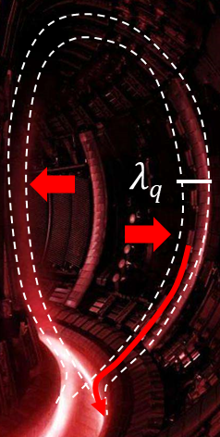
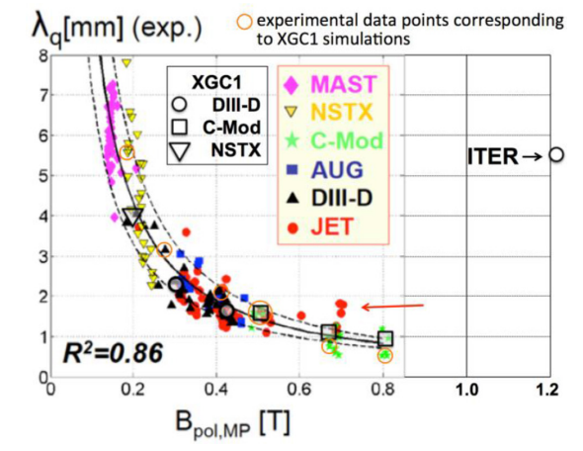
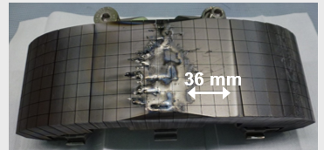
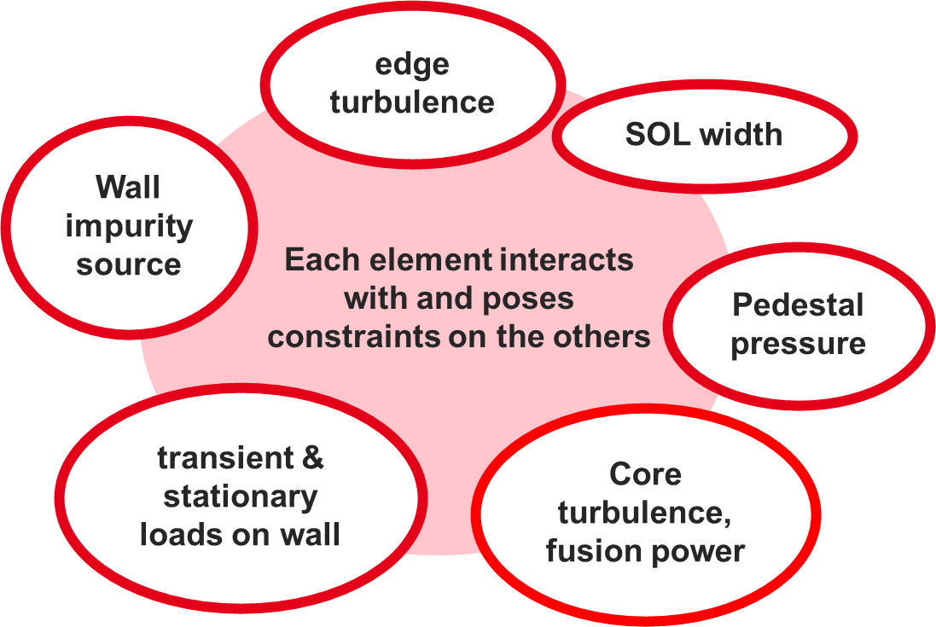
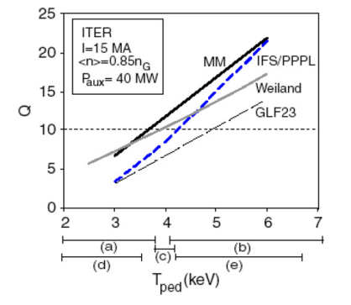
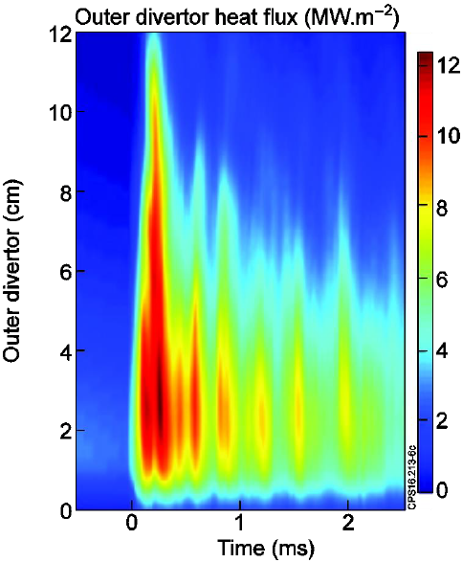
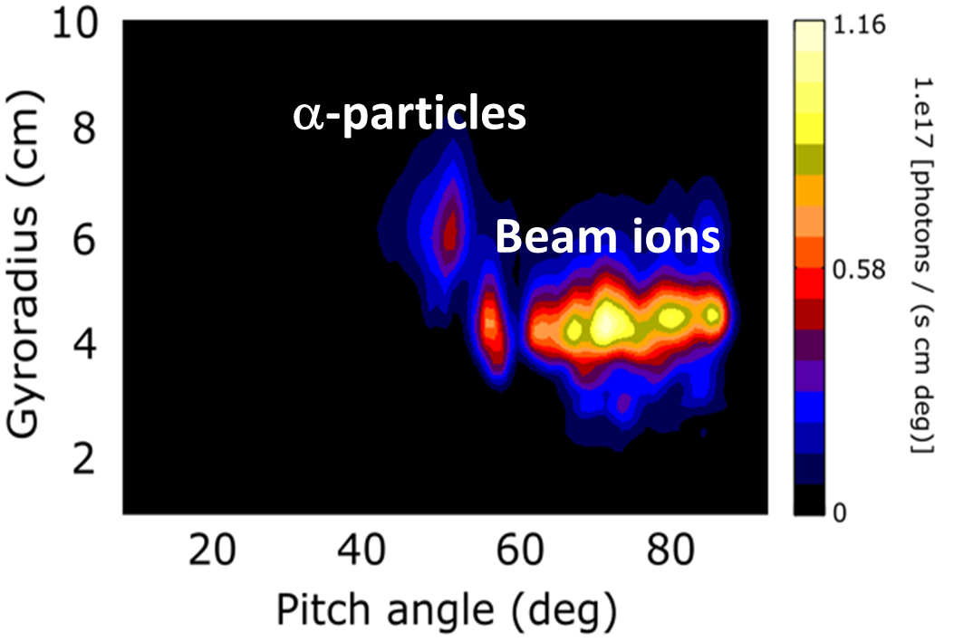

TSVVs to address Core-Edge-Wall integration
SOL
Synthetic Infra-Red diagnostic
$${ P}_{wall}∝1/{λ_{q}}$$
Wall
Pedestal
Core

Slide 7
Grant Deliverables and Milestones
Grant Deliverables
Report on code dissemination, model validation, and comparison with experimental data (for both tokamaks and stellarators)
Report on TSVV Research Software Compliance with EUROfusion Standards (Priority 1 and 2 Criteria)
Grant milestones
Formal coordination established with experimental WPs for model validation and requirement capture for data comparison
Formal coordination established with ACHs in support to TSVV Research Software compliance with EUROfusion standards.

Slide 8
Description of work
TSVVs: network of coordinated EUROfusion teams, working collaboratively and leveraging synergies
between tokamak and stellarator, burning plasmas, neutral physics, synthetic diagnostics, neutral codes, sheath boundary physics, impurity transport, database …
Code Development and Validation :
fostering advances in code verification, validation, and uncertainty quantification to enhance predictive capabilities for preparing future experiments, ITER operation, and the design of a fusion pilot plant
promoting evolution of research software towards EUROfusion Standard Software
Simulation Integration, Interpretive & Predictive Modelling
Integrating validated codes into simulation frameworks
Validating them for interpretive and predictive simulations
Provide workflows and support for the preparation and analyses of fusion experiments.
In addition, creation of reduced models for integrated modelling is of major importance, e.g. :
TSVV-A through TSVV-G will address these area and maintain close collaboration with TSVV-H.
TSVV-J is expected to contribute relevant physics modules that can be utilised within TSVV-I

Slide 9
Resource considerations
The call was issued for 5-6 PPY/ Y for TSVVA- to J and 3 PPY/Y for TSVVVK.
Following the initial replies we were 45% overbudgeted.
Within one week all the TSSV PIs went down to the minimum limit of the call: 5PPY/Y and 3 PPY/Y for TSVVK for 2026-2027 (without UKAEA).
PIs have revised the deliverables & PPY/Y following recommendations from the E-TASC board.
Calculations with the actual salary/per research unit for 2026 & 2027, budget is above the WPTM ceiling in consortium cost (732k€)
With the agreement of the E-TASC board, it has been decided to provide the requested resources in 2026 and to reduce by 28 % the 2027 resources (uniformly across all TSSVs)
Mismatch between the deliverables and the allocated resources in 2027
Mission budget is 97k€ / year (direct cost) is deemed barely sufficient for allowing to hold at least one in person meeting per TSVV per year
In 2026, Project Change Requests will be presented for approval ( project boards & General Assembly)

Slide 10
WPTE Building Synergies Across EUROfusion Projects
Integrating Theory & Modelling with Experimental and Design Activities
Fusion Science Department – WP TE: Tokamak Exploitation & WPSA
Access to experimental data from AUG, MAST-U, TCV, WEST, JET, JT-60SA
Support interpretative/predictive modelling and code validation
Fusion Science Department – WP PWIE: Plasma Wall Interaction and Exhaust
Physics of plasma-wall interaction with tungsten first wall
Strong links with SP D (plasma-edge & plasma-wall modelling)
Fusion Science Department – WP STEL: Stellarator Activities
Collaborative modelling and experiments to advance stellarator physics
Fusion Science Department –WP ENR: Enabling Research
Supports blue-sky theory and modelling projects to explore novel ideas
Design & Integration Department – WPDES: Design Activities
Provides validated, user-friendly simulation tools essential for design workflows
Digital Solutions for Fusion Office – WP AC (cf next slide)

Slide 11
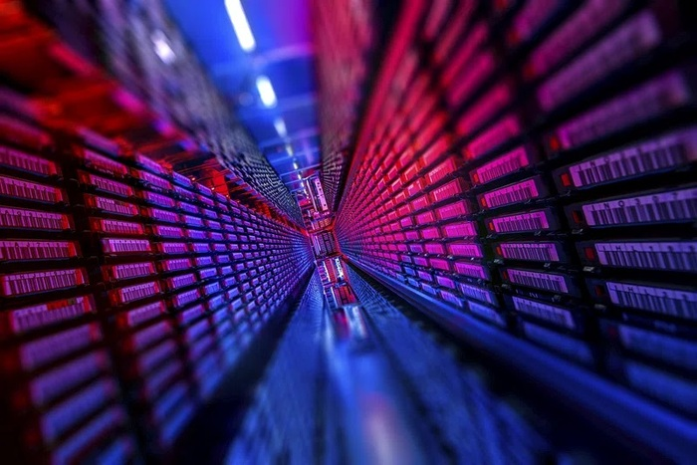

Focus on Coordination with WP Advanced Computing within DSO
Leveraging Advanced Computing effort to Strengthen Theory & Modelling
Two Interlinked Structures should work “Hands in Hands”
TSVV Tasks within W PTM
Advanced Computing Hubs (ACH): expertise in computer science, scientific computing, data management, code integration, and software engineering support
Digital Twin Environment and TSVV Projects: shared models
Pulse Design Tool
synthetic diagnostics
Databases
Integrated multi-physics fusion power plants simulation frameworks
Advanced visualization techniques
Infrastructures
HPC and Gateway
Long Term Data Storage Facility
[Jenko 2025 Nature Reviews Physics]

Slide 12
Management of WP Theory & Modelling
Ensuring Effective Coordination and Progress
Strengthen Coordination and cross-fertilisation of ideas among TSVVs & relevant WPs
Regular coordination meetings with Principal Investigators
Liaise with the exp. WPs TE, STEL, PWIE, SA and fusion pilot plant design activities
Annual In-Person Meetings
Review progress, strategy (next Framework programme preparation), and align goals
Reporting
Annual grant deliverable and technical reports
Regular updates at Fusion Science Department meetings
Bi-annual Project Board meetings
Stakeholder Engagement
Close coordination to address issues proactively
Transparent communication channels within EUROfusion
Develop collaboration with International Partners & Private sectors

Slide 13
International Collaboration
ITER-IO
Participation in the ITER Integrated Modelling Expert Group (IMEG) meetings at IO: review progress in the IMAS software infrastructure and plasma simulators developed at IO, within ITER Members’ programs
USA - General Atomics
TSVV-E: Assess tungsten sputtering, transport and deposition in characteristic DIII-D plasma scenarios in preparation of the DIII-D transition to W.
TSVV-A- F: Validation of models against DIII-D experimental data
USA - Princeton Plasma Physics Laboratory
TSVV-J: transport and profile prediction in stellarators and cross-code verification
University of Wisconsin, Madison
TSVV-B: validation of plasma edge turbulence in the Helical Stellarator eXperiment (HSX) stellarator

Slide 14
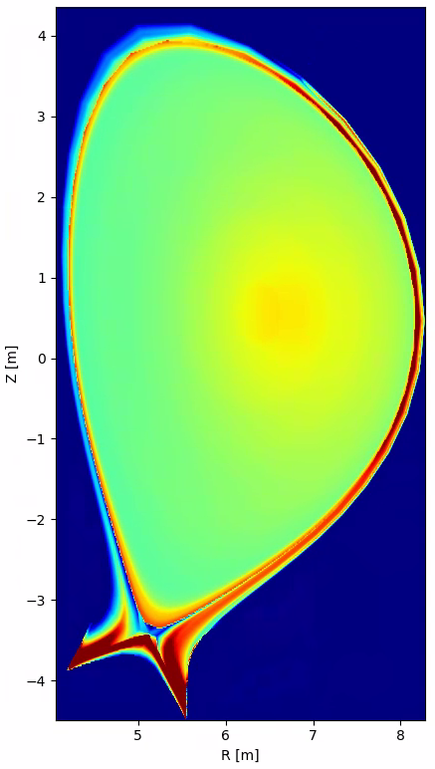
ITER Research Plan (IRP) and collaboration to be discussed
Close Collaboration Essential – EUROfusion-IO agreement
“Successful implementation & execution of the IRP relies on close collaborations between the IO and the fusion research institutes in both the experimental and theory/modelling areas”
Examples of focused Physics R&D for ITER to be supported by TSVVs
An integrated vision from W-wall sources, SOL, H-mode, pedestal and core transport, from the start to the end
H-mode access, ELM control, no-ELM scenarios and fusion performance with W-wall
Disruption prediction, mitigation, and avoidance
Focus on extensive Validation & Application
Wide range of tools must be validated on existing experiments prior to ITER exploitation
Development of multi-diagnostics analysis workflows and validation on experimental data in IMAS
[A. Loarte et al. ]

Slide 15
Parallel session #2 on Tuesday afternoon TSVV Community (self-organisation) – Proposals of Topics for discussion ?
Synthetic diagnostics
Coordination & Synergy with DTE projects (under DSO)
Support to ITER Research Plan
Model validation with experimental WPs & UQ
Reduced models development
Training sessions & code dissemination
Private sector involvement
International collaboration
Brainstorming on FP-10 -scientific topics
WPTM management/organization

Slide 17
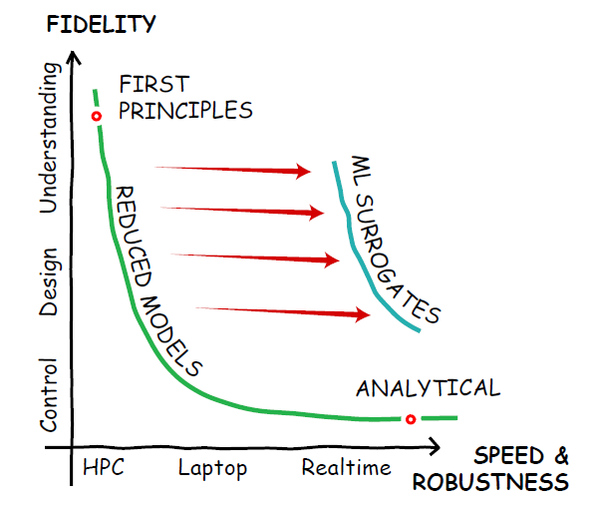
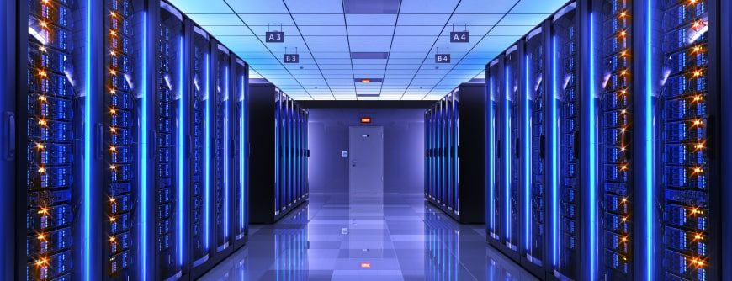
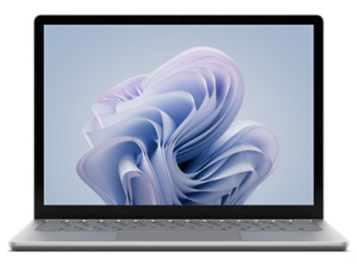
Multi-Fidelity Modelling Approach
Balancing Accuracy and Efficiency
High-Fidelity Models
Provide detailed, first-principle physics
Deliver reliable and accurate predictions
Suitable for in-depth analysis of key phenomena
Lower-Fidelity Models
Enable high-throughput computing
Facilitate rapid scenario exploration and operational support
real-time control and design optimization
Synergistic Use
Both levels are essential and must be developed/used in parallel
Allow seamless transition between fidelity levels depending on use case and computational resources
[O. Meneghini]

