Slide 1
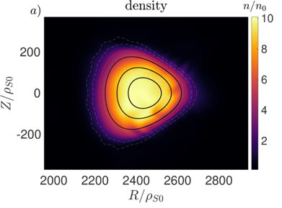
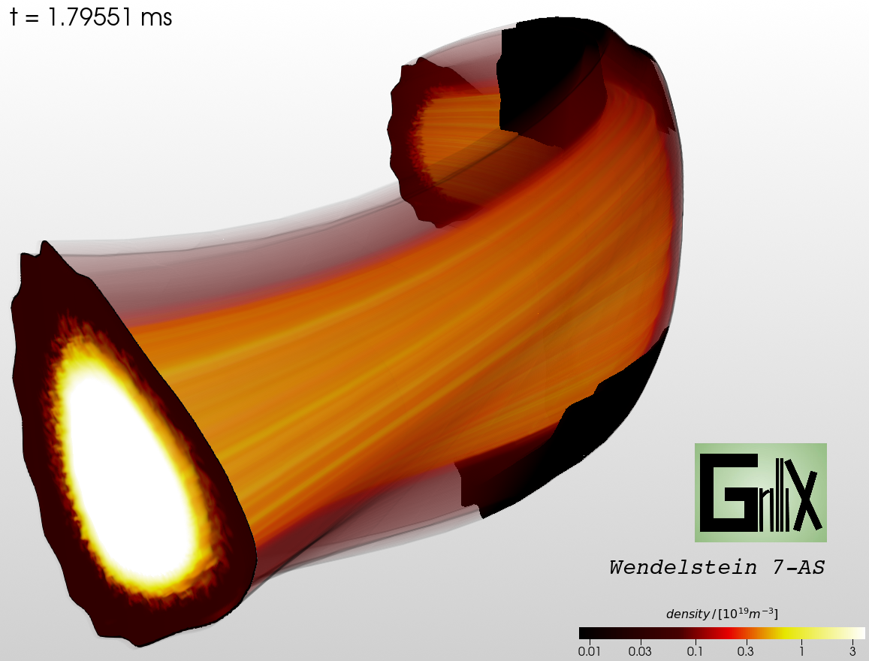
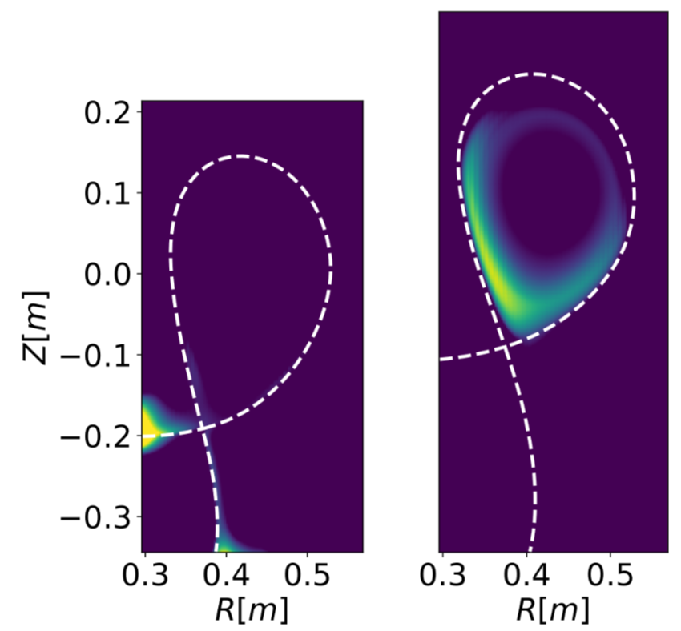
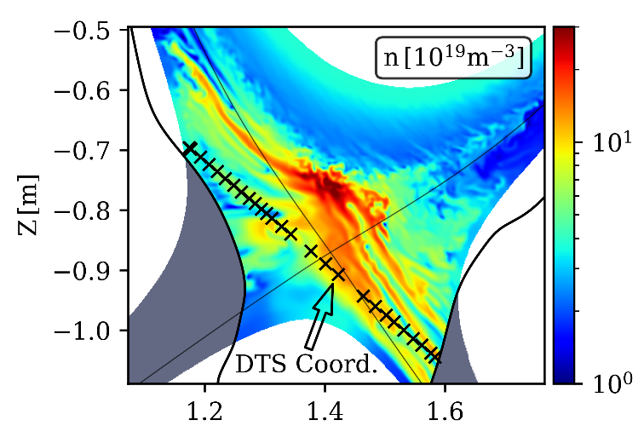
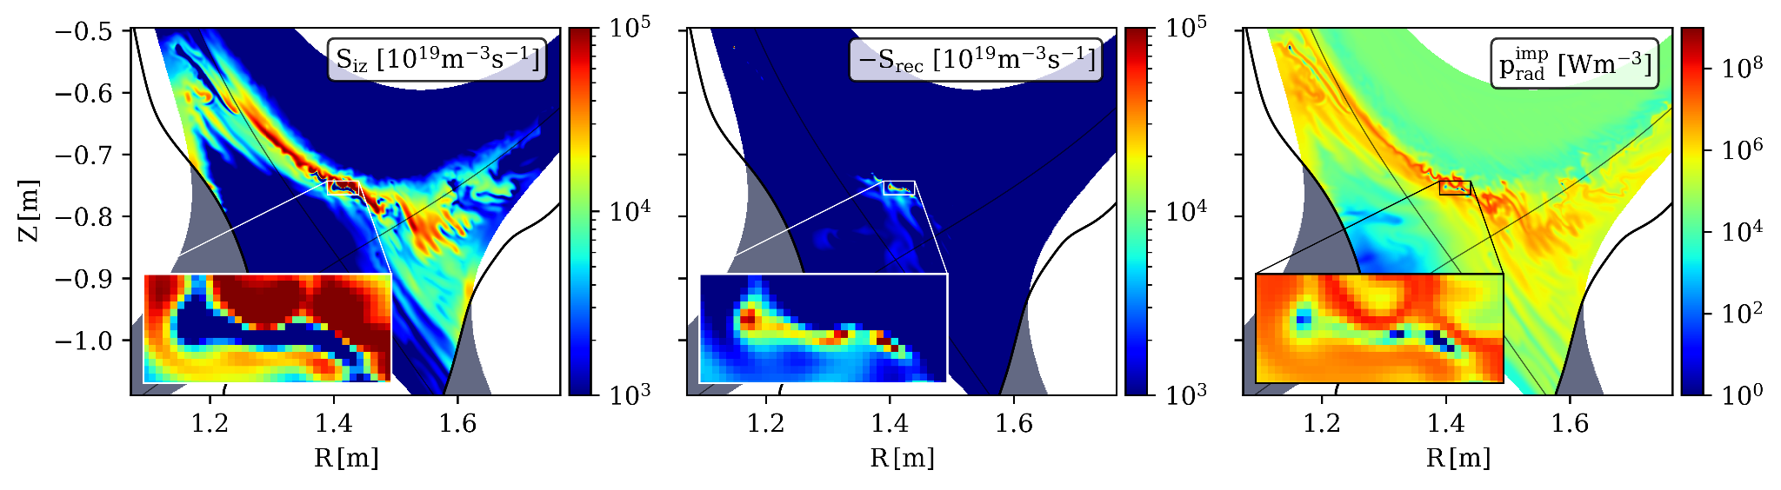
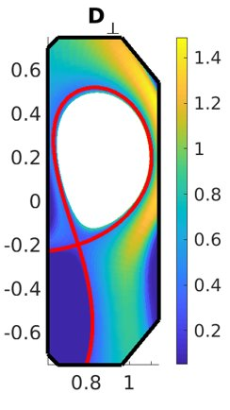
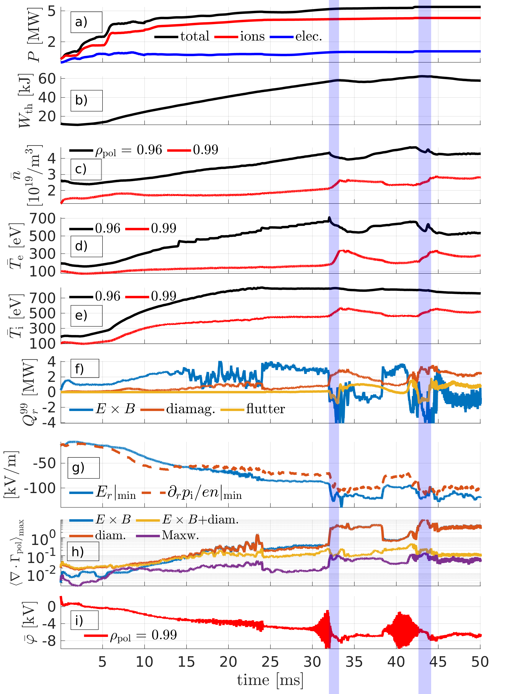
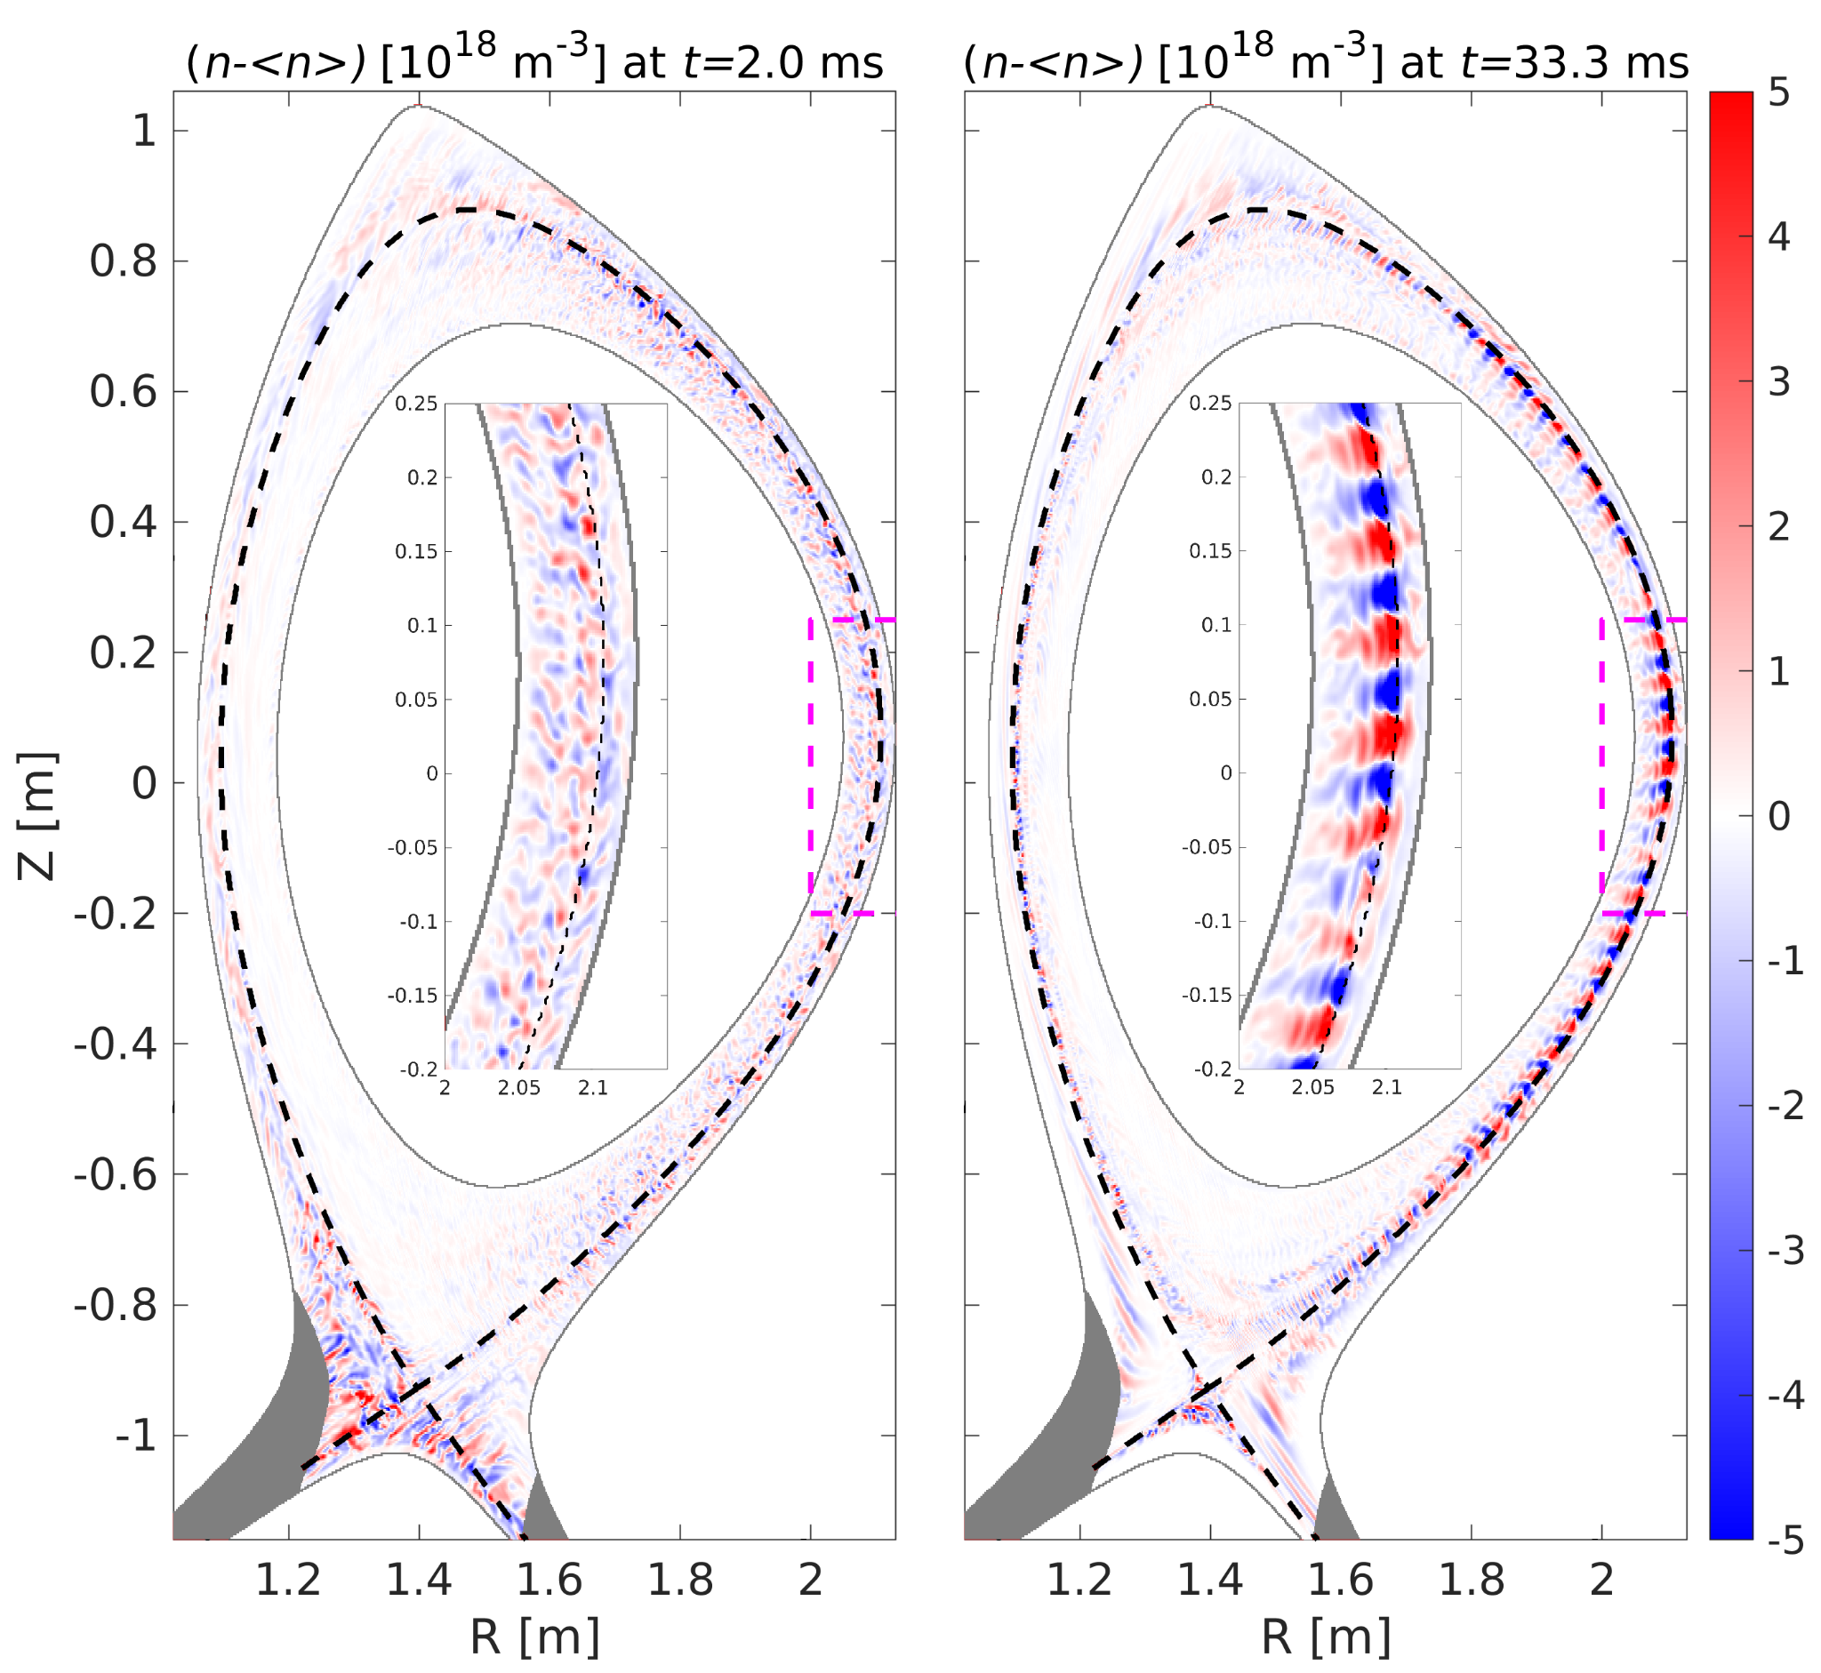
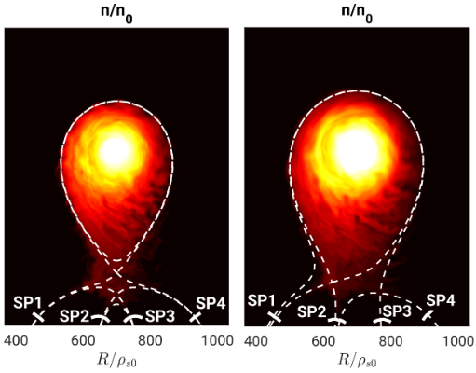
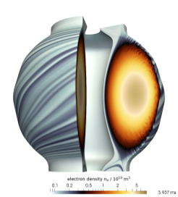




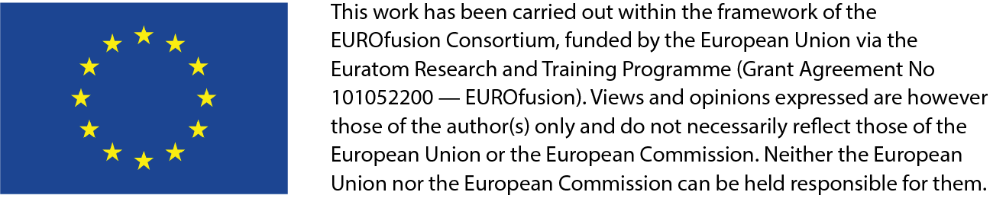




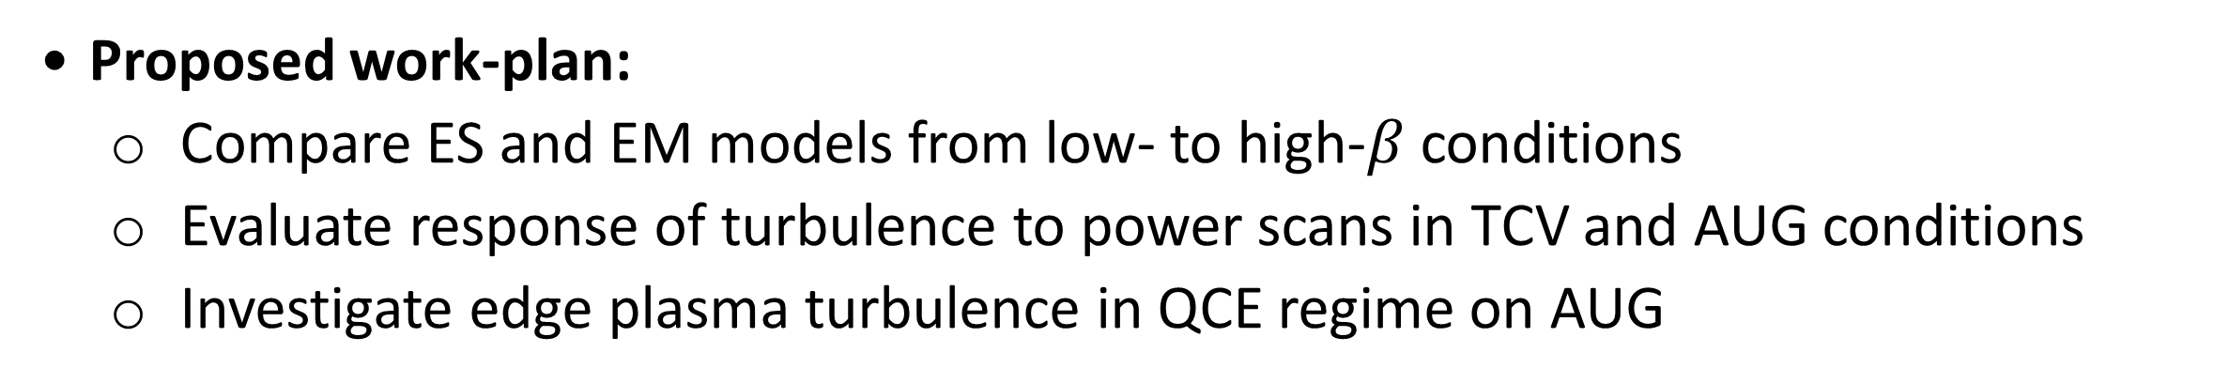

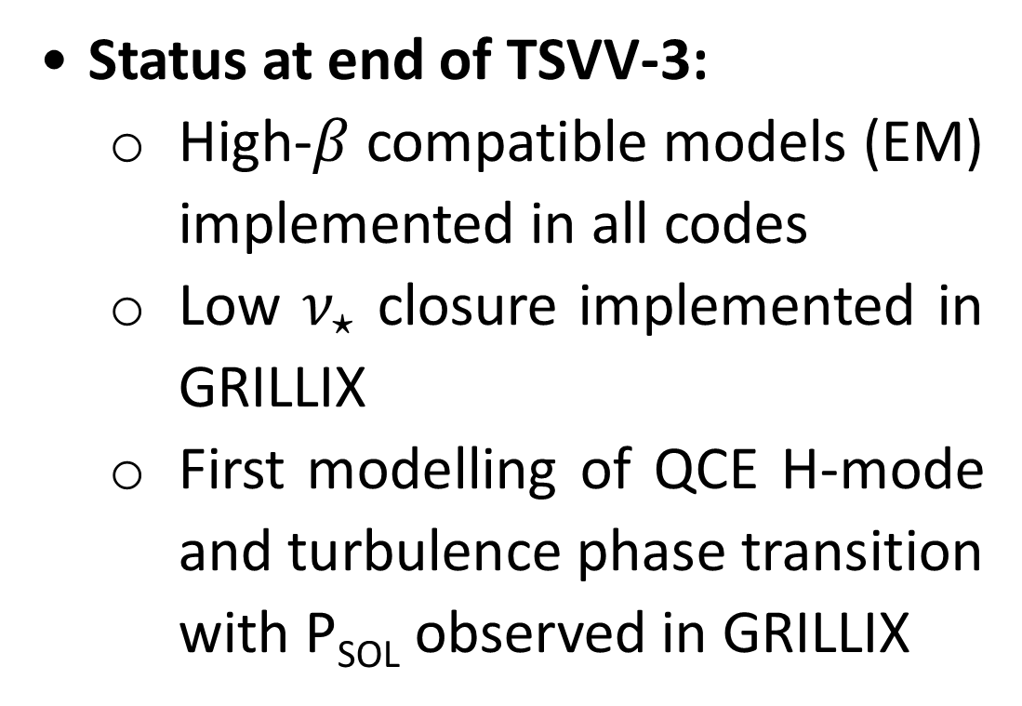
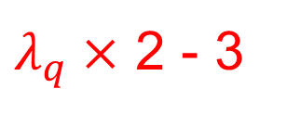
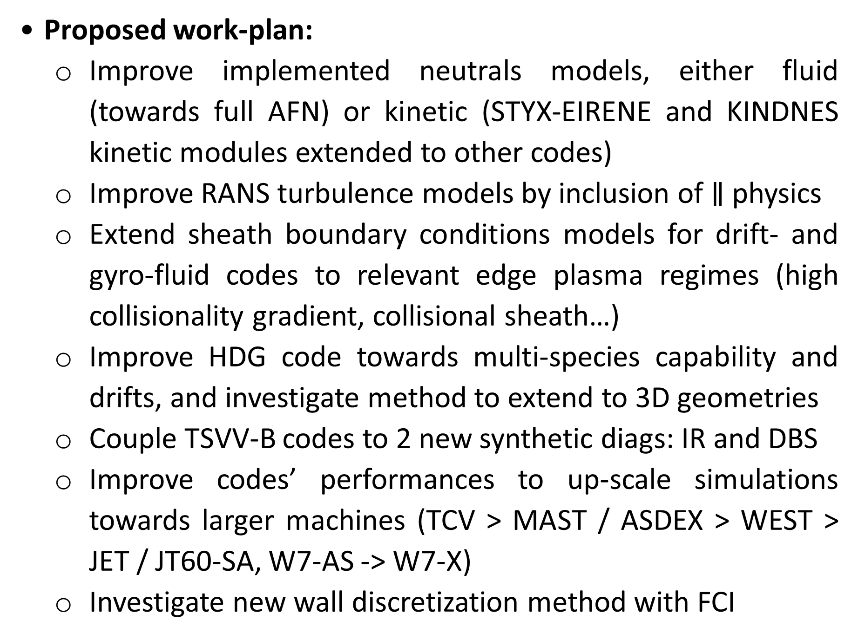

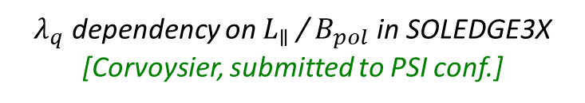
TSVV-B: Plasma Particle/Heat Exhaust – Fluid Simulations
Current status and 2026-2027 workplan
¹P. Tamain*, ¹H. Bufferand, ²W. Dekeyser, ³S. Garcia Herreros, ²D. Hens, ⁴I. Kudashev, ³D. Mancini, ⁴A. Medvedeva, ⁵A.H. Nielsen, ²O. Renders, ³P. Ricci, ⁶A. Stegmeir, ³Z. Tecchiolli, ⁵A. Thrysøe, ⁷T. Tork, ⁸D. Tskhakaya, ⁵M. Wiesenberger, ⁶W. Zholobenko
¹CEA, IRFM, Saint-Paul-lez-Durance, France
²KU Leuven, Department of Mechanical Engineering, Leuven, Belgium
³EPFL, SPC, Lausanne, Switzerland
⁴Aix-Marseille Univ, CNRS, Centrale Marseille, M2P2, Marseille, France
⁵Department of Physics, Technical University of Denmark (DTU), Denmark
⁶Max-Planck-Institut für Plasmaphysik, Garching, Germany
⁷Max-Planck-Institut für Plasmaphysik, Greifswald, Germany
⁸Institute of Plasma Physics of the CAS, Prague, Czech Republic
* E-mail: patrick.tamain@cea.fr
Legend:
Contributors funded by TSVV-B project
Contributors funded by other means
FRAMEWORK & OBJECTIVES
Proposed workplan:
Confrontation to WPTE machines in non-standard plasma configurations: MAST-U, TCV with long leg or XPTr, and ADCs in AUG
Evaluation of plasma conditions at the WEST FW with SOLEDGE-HDG focusing on start-up phase
Framework: TSVV-B = extension of TSVV-3 project in 2026-2027
Project objective: self-consistent fluid modelling (including turbulence) of the edge plasma in fusion power plant - relevant conditions
1 new mission vs TSVV-3: non-axisymmetric configurations
4 edge turbulence codes involved: FELTOR, GBS, GRILLIX, SOLEDGE3X
Following outcome of TSVV-3:
Move from development- to application-centered plan (Tasks 1 to 5)
Carry on progress on models and technical gaps (Tasks 6 to 8)
TASK 4: EDGE TURBULENCE IN STELLARATORS
Status at end of TSVV-3:
First stellarator turbulence simulations demonstrated with GBS and GRILLIX
Some limitations concerning the ability to handle complex edge configurations
TASK 1: EDGE TURBULENCE IN RELEVANT DIVERTOR REGIME
Proposed workplan:
Prepare FELTOR and GRILLIX to handle stellarator relevant geometries
Analyse edge plasma turbulence in selected stellarators cases: W7-AS → W7-X + other MS machines (HSX, LHD)
W7-AS (GRILLIX) [Stegmeir, submitted to CPP]
Status at end of TSVV-3:
Different flavors of neutrals models implemented in turbulence codes
Turbulence simulations in detached and XPR regime demonstrated
Significant impact observed on turbulent transport
Only proof-of-principle multi-species turbulent simulations
W7-AS (GBS) [Tecchioli, in prep]
[Mancini, NF 2023; Mancini, EPS 2025
$$q_{∥} (W.m^{−2})$$
TASK 5: VALIDATION AGAINST SCALING LAWS AND EXTRAPOLATION
Detached
$$λ_{q}^{near}=4.3mm$$
$$λ_{q}^{far}=17mm$$
Status at end of TSVV-3:
little systematic study yet, mainly because of numerical cost of parameter scans
Attached
$$λ_{q}^{near}=2.6mm$$
$$λ_{q}^{far}=6.3mm$$
$λ_{q}×$ 2 - 3
Proposed workplan:
Evaluate SOL width dependency with key parameters (B_{pol}, B_{tor}, P_{heat}…) and compare with experimental scaling laws
Evaluate response of RANS turbulence model to similar parameter scans (KUL)
[Quadri NME 2025; Tamain, EPS 2025]
[Eder, NF 2025]
$λ_{q}$ dependency on $L_{∥}$ / $B_{pol}$ in SOLEDGE3X [Corvoysier, submitted to PSI conf.]
Proposed work-plan:
Analysis of turbulence in detached regime in TCV-X23 experiment, both with direct numerical simulations of turbulence and reduced turbulence models.
Perform first evaluation of light impurity turbulent transport
Investigate the modelling of 2 majority species D-T plasmas in mean-field as well as turbulence simulations
TASKS 6 & 7: IMPROVING MODELS’ FIDELITY & CODE CAPABILITIES
Proposed work-plan:
Improve implemented neutrals models, either fluid (towards full AFN) or kinetic (STYX-EIRENE and KINDNES kinetic modules extended to other codes)
Improve RANS turbulence models by inclusion of $∥$ physics
Extend sheath boundary conditions models for drift- and gyro-fluid codes to relevant edge plasma regimes (high collisionality gradient, collisional sheath…)
Improve HDG code towards multi-species capability and drifts, and investigate method to extend to 3D geometries
Couple TSVV-B codes to 2 new synthetic diags: IR and DBS
Improve codes’ performances to up-scale simulations towards larger machines (TCV > MAST / ASDEX > WEST > JET / JT60-SA, W7-AS -> W7-X)
Investigate new wall discretization method with FCI
TASK 2: EDGE TURBULENCE IN ADVANCED CONFINEMENT REGIME
Status at end of TSVV-3:
High-$β$ compatible models (EM) implemented in all codes
Low $ν_{⋆}$ closure implemented in GRILLIX
First modelling of QCE H-mode and turbulence phase transition with P_{SOL} observed in GRILLIX
L-H transition?
[Zholobenko, PRL accepted]
Proposed work-plan:
Compare ES and EM models from low- to high-$β$ conditions
Evaluate response of turbulence to power scans in TCV and AUG conditions
Investigate edge plasma turbulence in QCE regime on AUG
Perpendicular transport coefficient map from reduced turbulence model in TCV
[Dekeyser, CPP 2022; Carli, PET 2025]
TASK 3: CONFRONTATION TO EXPERIMENT IN ADVANCED GEOM.
TASK 8: BUILDING SIMULATIONS TOOLS FOR THE COMMUNITY
Status at end of TSVV-3:
Turbulence codes now able to address non-standard divertor configurations
Time-dependent PWI in full geometry demonstrated with HDG
MAST-U (FELTOR)
[Nielsen AAPPS-DPP, 2025]
Status at end of TSVV-3:
All codes compliant with 1st level of EUROfusion standard software
Partial IMAS-ification of outputs
Coding and documentation standards have been enforced
Proposed workplan:
Complete IMAS-ification of outputs
Invest permanent effort in code maintenance and documentation
Provide effective user support and organize training for new users
TCV ADC (GBS)
[Giacomin, NF, 2020]

