Slide 1
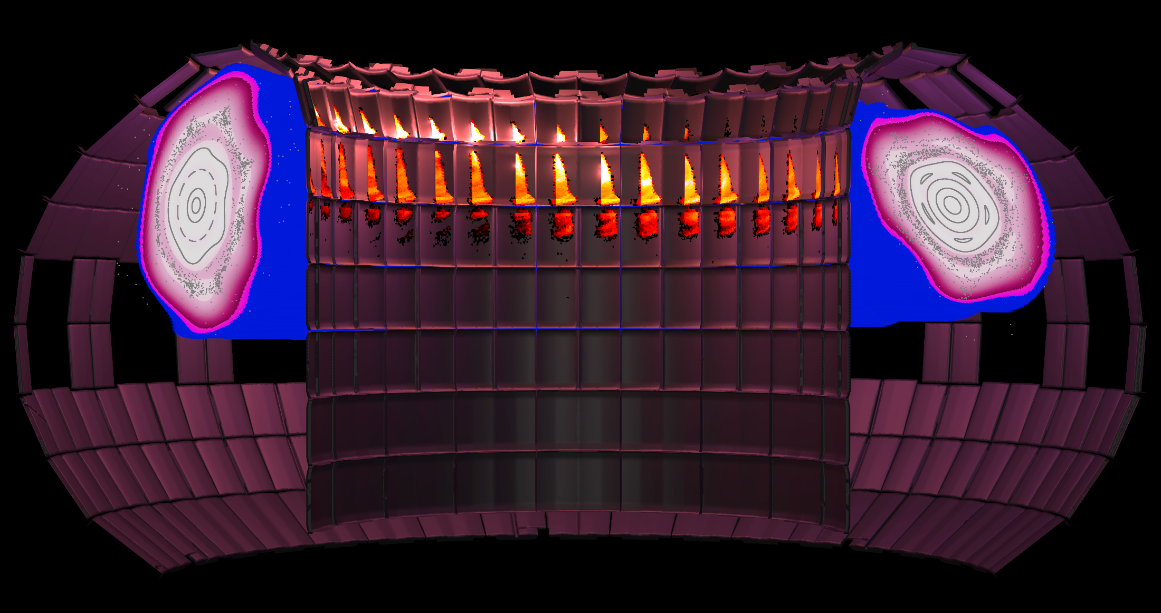


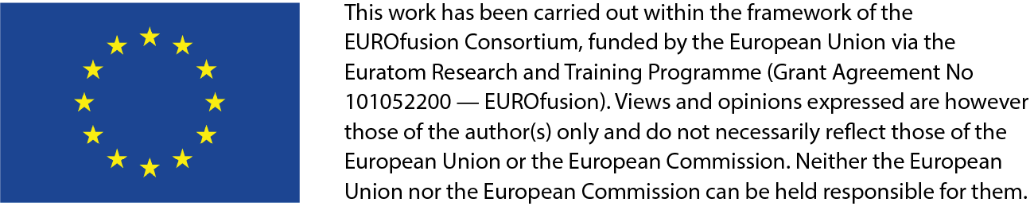
TSVV-F: Disruptions and Runaway Electrons
M. Hoelzl (PI), M. Hoppe, N. Schwarz, T. Fülöp, L. Votta, D. Bonfiglio, S. Guinchard, M. Kong, J. Decker, N. Isernia, G. Rubinacci, G. Papp, F. Wouters, E. Nardon, C. Wang, B. Zaar, F. Cipolletta, and the entire Disruption & RE & and Code Communities.
Advance predictive simulations and practical mitigation strategies for tokamak disruptions and runaway electrons to enable safe operation of ITER and future European fusion power plants.
Context & Motivation
Future fusion devices (ITER, EU-FPP) face disruptions with extreme heat loads, electromagnetic forces, and runaway electrons (REs) that can severely damage the machine.​
Disruption avoidance will never be perfect; robust, well-validated mitigation of all disruption phases is essential for safe operation.​
RE avalanching scales exponentially with plasma current, making complete RE avoidance in ITER-like devices virtually impossible and demanding reliable mitigation and benign termination strategies.​
A multi-fidelity approach is needed with higher and lower-dimensional models complementing each other.
What the project does
Develop an integrated multi-physics, multi-scale simulation framework combining JOREK, DREAM, CARIDDI, and LUKE for tokamak disruptions and REs (strong and weak coupling depending on the needs) to establish a hierarchy of predictive models.
Perform high-fidelity 2D/3D global simulations plus reduced and surrogate models to cover full disruption dynamics and fast parameter scans.​
Closely link modeling with experiments (AUG, DIII-D, WEST, TCV, JET, ITER) for validation.
Support model exploitation for experiment interpretation in the experimental EUROfusion work packages.
Support ITER and EU-FPP predictive applications for scenario and mitigation design.​
Broaden the user basis and expertise.
Key scientific goals
Improve understanding of RE generation, transport, and benign termination under ITER-relevant conditions and tungsten-wall environments.​
Clarify how MHD activity during the current quench affects RE avalanching, vertical motion, and electromagnetic forces on the vessel.​
Quantify the role of intrinsic and injected impurities, pellet assimilation, and pre-disruption plasma conditions for successful disruption mitigation.​
Main modeling & code goals
Achieve deep integration and direct coupling between JOREK and DREAM, including exchange of RE distribution functions and transport coefficients.​ Allow to switch seamlessly between different model fidelities (2D JOREK + 1D2V DREAM ↔ 3D2V JOREK).
Enhance JOREK and DREAM companion plasma and RE models, including impurities, neutrals, and RE-induced effects on charge states.​
Implement self-consistent ExB boundary conditions and accurate plasma–wall coupling via CARIDDI for electromagnetic force evaluation.​
Use LUKE to model kinetic instabilities and wave effects (ECRH, helicon) and to provide non-Maxwellian distributions for DREAM and JOREK.​
Synthetic diagnostics & data
Develop synthetic diagnostics for high-energy Bremsstrahlung, thermography, and RE impact signatures for direct comparison to experiments.​
Derive improved large-angle collision cross sections for partially ionized impurities and implement them in DREAM and LUKE.​
Use synthetic diagnostics to validate models, interpret experiments, and support control scheme design for future devices.​
Surrogate and reduced models
Build reduced-order and surrogate models for rapid RE risk assessment and disruption consequence prediction.​
Provide simple criteria for RE generation in activated devices and models for RE-induced wall heating and damage thresholds.​
Deliver effective RE transport coefficients for use in “flight simulators” and real-time plasma control tools.​
Expected impact
Provide validated tools to predict natural and mitigated disruptions and to design robust mitigation and control strategies for ITER and EU-FPP.​
Reduce the risk of severe disruption-related damage, supporting safe, reliable fusion power plant operation.​
Strengthen the European and international disruption/RE modeling community, by training young researchers and promoting open, shared software and data.​
Collaboration & community
Build on and unify the JOREK and DREAM code communities within the EUROfusion software suite with strong ties to LUKE and CARIDDI.​
Maintain close collaboration with WP TE, WP DES, ITER Organization, and international programs, including coordination via regular meetings and workshops.​
Ensure open governance with representatives from all partners, open seminars, and publicly accessible codes, publications, and data sets where possible.
Strengthen the European disruption and runaway electron community beyond the official list of project contributors.
LUKE
CARIDDI

