Slide 1
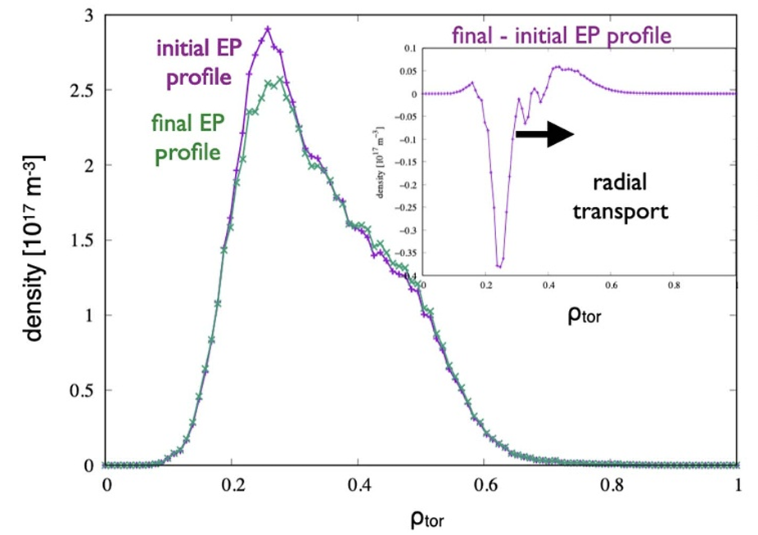
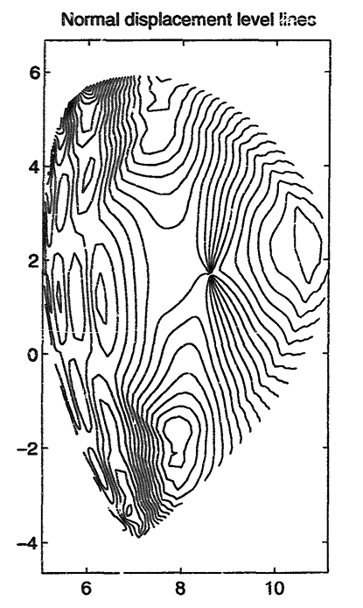
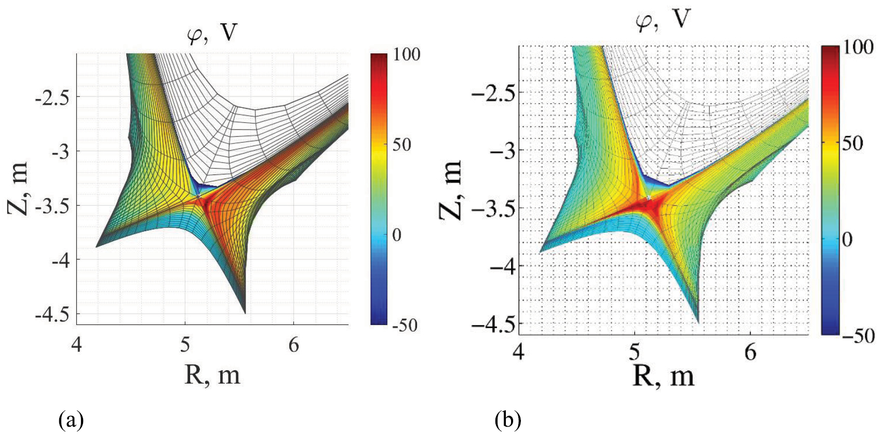
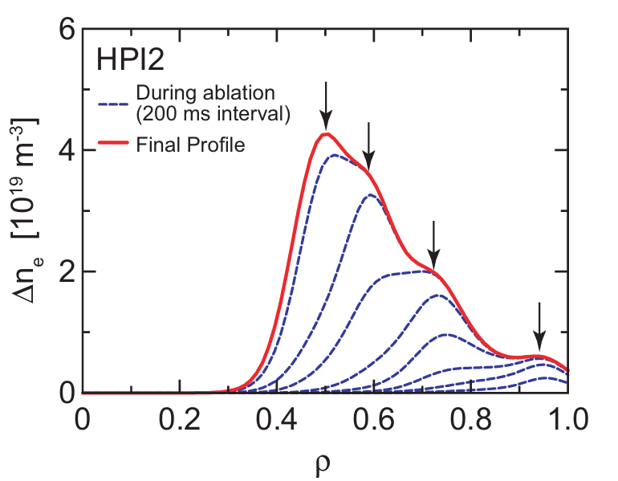
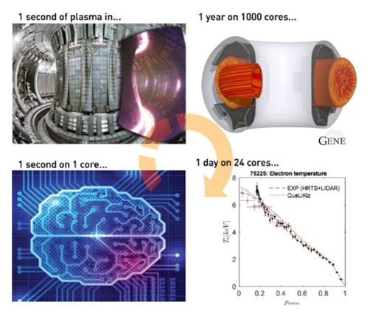
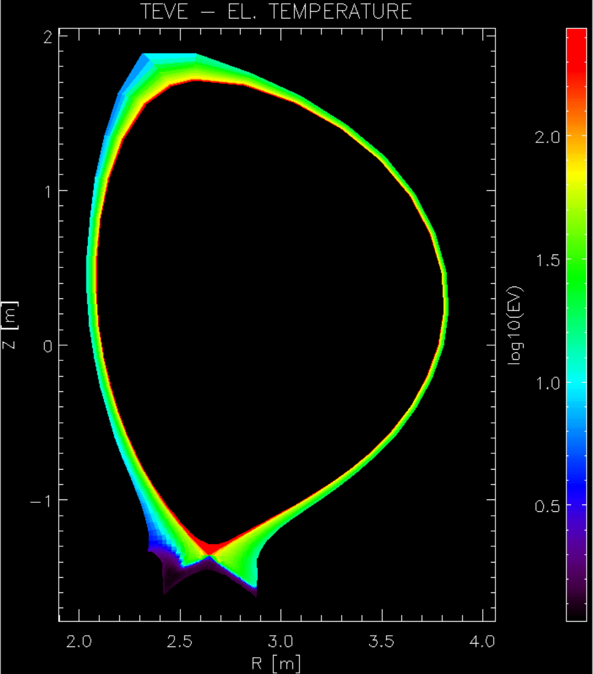
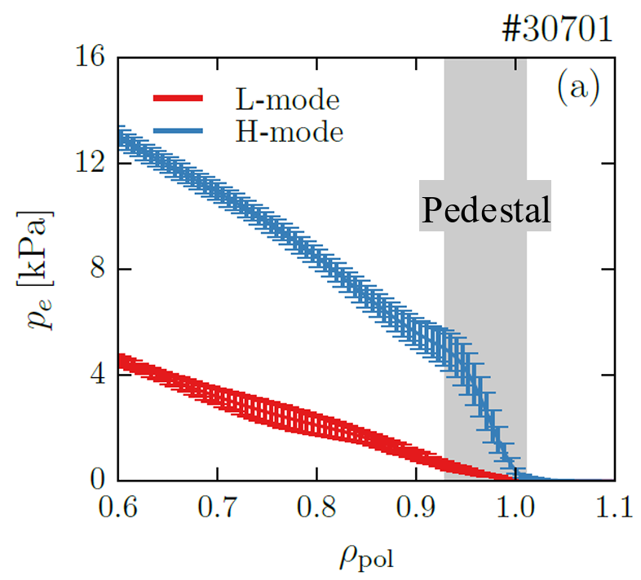
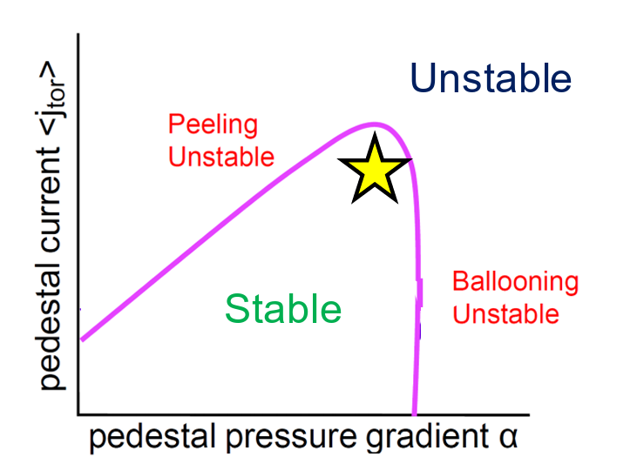
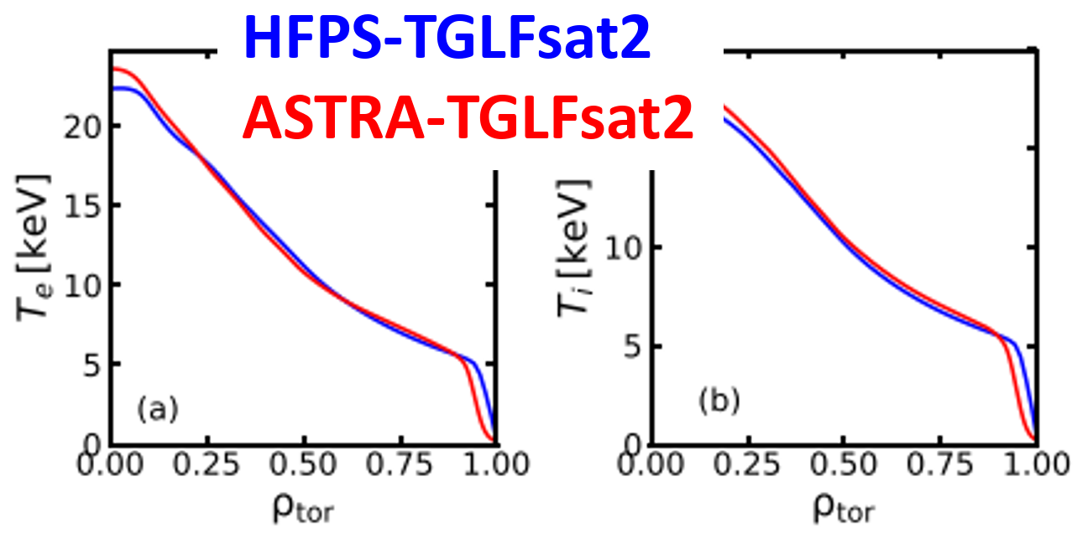
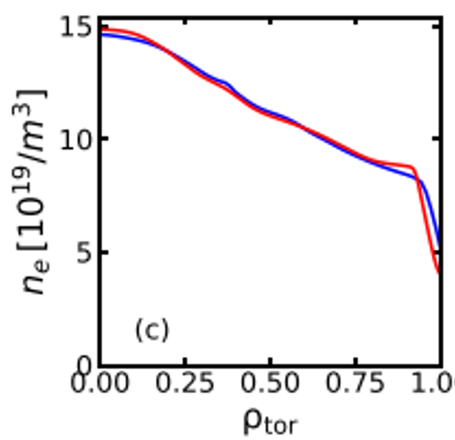
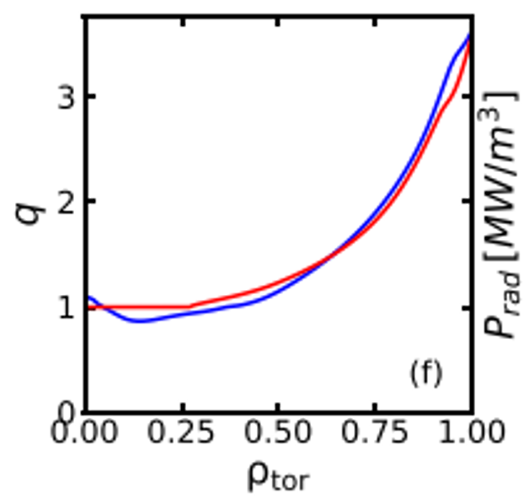





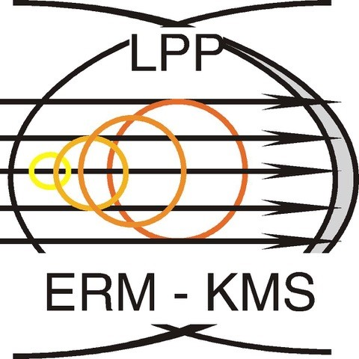

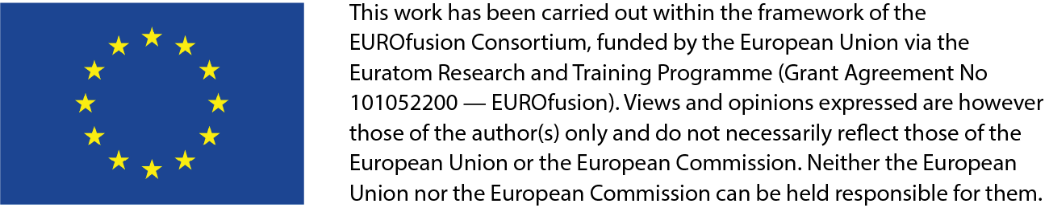





TSVV-H
Reliable Prediction of Plasma Performance and Operational Limits in Tokamaks
¹M. Marin, ²C. Bourdelle, ²E. Vergnaud, ²P. Manas, ³P. Maget, ³Y. Camenen, ⁴D. Yadykin, ⁴P. Strand, ⁴A. Guillevic, ⁴B. Brandstrom, ⁴M. M. Skyllas, ⁵L. Frassinetti, ⁵A. Lafay, ⁵O. Sundberg, ⁶G. Tardini, ⁶A. Popa, ⁷R. Gatto,, ⁸S. Wiesen, ⁸A. P. Alvarez, ⁸B. Liu, ⁹P. Mantica, ¹⁰P. Lamalle, ¹¹F. J. Casson, ¹¹P. Fox, N. ¹¹Cummings, ¹¹E. Tholerus, ¹¹A. Snodin, ¹¹S. Gabriellini, ¹¹G. S. Lopez, ¹O. Sauter, ¹R. Coosemans, ¹A. Balestri, ¹J-P. Svantner
¹SPC, Swiss Plasma Center, Ecole Polytechnique Fédérale de Lausanne, Station 13, Lausanne 1015, Switzerland
²CEA, IRFM, F-13108 Saint-Paul-lez-Durance, France
³ CNRS, Aix-Marseille University, PIIM UMR7345, Marseille, France
⁴Chalmers University of Technology, Gothenburg, Sweden
⁵Department of Electromagnetics and Plasma Physics, KTH Royal Institute of Technology, Stockholm, Sweden
⁶Max-Planck-Institut für Plasmaphysik, D-85748 Garching, Germany
⁷Sapienza University of Rome, Rome, Italy
⁸DIFFER—Dutch Institute for Fundamental Energy Research, De Zaale 20, 5612 AJ Eindhoven, Netherlands
⁹Institute of Plasma Science and Technology, CNR, Milano, Italy
¹⁰Laboratory for Plasma Physics, ERM/KMS, Brussels, Belgium
¹¹CCFE, Culham Science Centre, Abingdon OX14 3DB, United Kingdom of Great Britain and Northern Ireland
Motivation and objectives TSVV11 → TSVVH
WP2: key physics modules validation
Physics understanding
Fidelity
High beta and energetic particle impact on transport
Prepare operation
System codes
Validate
High β H-modes
1^st principle codes
High fidelity IM
Pulse Design Tools
System codes
Predict
EP MHD and transport in JT60-SA and ITER
Full pulse
Validation against tokamak experiments
Full radius
Validate
High β H-modes + fast ions
WP1: Integrating Modelling Workflow orchestration and module coupling framework
[P. Lauber Nucl. Fusion 2024]
New models being coupled
[L. Degtyarev, CPC 1997]
[E. Kaveeva, Nucl. Fusion 2020]
Extending simulation capabilities
Integrate and test fast surrogate modules
[R. Sakamoto, Nucl. Fusion 2013]
Validate
Negative triangularity
Perform JET NT simulations with HFPS and ASTRA
Validate
Tungsten modelling
Perform WEST W dust simulations, check stability with EQSTABIL
Validate
Pellets modelling
Perform WEST pellet injection simulations with HPI2NN and TGLF
QLKNN
HPI2NN
TGLFNN
SOLPSNN
Support
HFPS
Pipelines
SOL-Core integration
Integrate and test IMASsified workflows
Validate
Core-edge with multiple isotopes
Perform JET simulations with COCONUT, multiple isotopes, BgB
Test
fast surrogate or simplified modules
Perform JET simulations with COCONUT, QuaLiKiz / TGLF
EQSTABIL
ATEP
PLIKES
[A. Ho, Nucl. Fusion 2023]
WP3: Physics driven benchmarks
Pedestal modelling
JET D and DT
Steady state Validation
GENE-TANGO
Fidelity
Run
Test
ideal MHD calculations on JET discharges
Perform JET simulations with MISHKA
Test
resistive MHD calculations on JET discharges
Perform JET simulations with CASTOR
AUG ECRH-heated discharge
Dynamic evolution Validation
Catalogue
HFPS
TRANSP
ITER 15MA baseline scenario
Steady state Extrapolation
Verify
ASTRA
ETS
Share
RAPTOR
TORAX
WP4: Large scale validation
Demonstrate
Proof of concept
TCV and WEST tens of discharges, with automatic workflow for launch and analysis
Demonstrate
Large scale automated execution, storage and Validation
100s discharges from TCV, WEST and possibly JET
Machine
imas
Post Process
IMAS IDSs INPUT
IMAS IDSs OUTPUT
HFPS – JINTRAC
jetto-tools
Gateway Eurofusion
Reports
Wiki pages
Trainings
Mattermost
Impact
Increased modelling speed and capability through surrogates and new physics
Multiple fidelity levels easily allows for verification
Quickly identify workflow failures thanks to benchmarks
Move towards full radius with the inclusion of edge and pedestal
Move towards full pulse by studying transients and dynamical evolution
Quantify agreement robustly through large scale validation
In person meetings
Project management
Remote meetings
ACH
DMP
WPTE
TSVVs
IO

