Slide 1
Beyond ITER DEMO A=2.8: physics uncertainties and mitigation actions
E-TASC General Meeting #2, 11/02/2026
Clarisse Bourdelle for the Plasma System Division in DEMO Central team
CEA, IRFM, F-13108 Saint Paul-lez-Durance, France

Slide 2
Context and Acknowledgements
DEMO: DEMOnstration Fusion Power Plant (…) aims of demonstrating the production of few hundred MWs of net electricity, the feasibility of operation with a closed tritium fuel cycle, and maintenance systems capable of achieving adequate plant availability [Federici NF 2019]
In 2020, G1 Gate Review which identified integration issues.
Since 2021, to address integration issues DEMO central team started in Garching [Federici FED 2021].
**
Plasma System Division team: Philipp Lauber, Francesco Maviglia, Andrea Quartararo, Mattia Siccinio, Sven Wiesen, Pasquale Zumbolo
& former lead (until Dec 2024): Hartmut Zohm, former member: Florian Koechl
WPDES support: Mike Dunne, Alessandro Di Siena, Matteo Falessi, Teobaldo Luda, Leonardo Pigatto
**
November 17-20 2025, DEMO status was reviewed at the G2 Gate.
I presented results on physics uncertainties impact and on high fidelity integrated modelling.
Two reports, two talks and one publication in preparation.

Slide 3
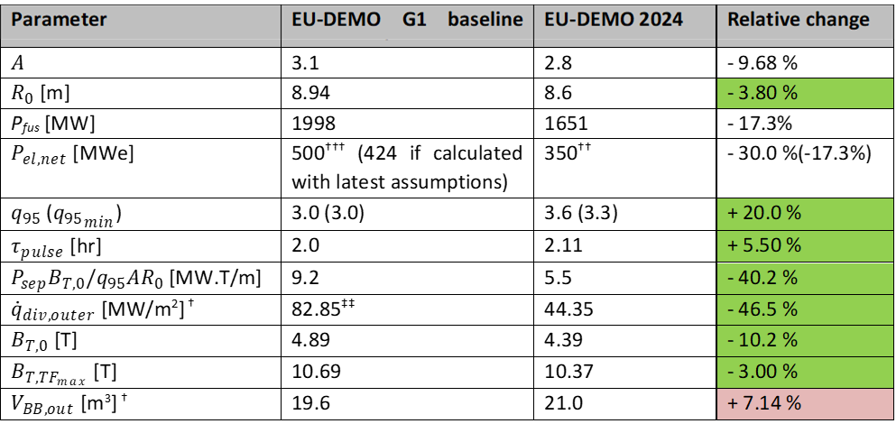
DEMO revised baseline proposed [Coleman NF 2025]
A lower aspect ratio, allowing for lower B, easing defined criterium on exhaust
More margin on q₉₅ vs MHD limit of 3

Slide 4
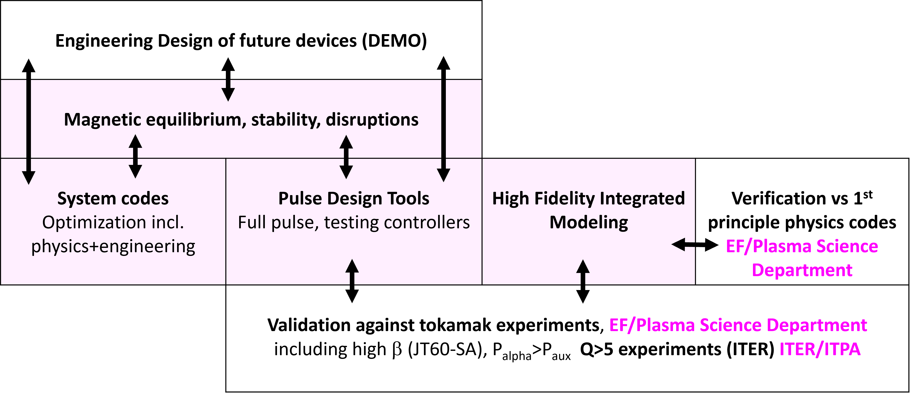
Various fidelity levels for plasma physics in the Plasma System Division

Slide 5
Table of Content
Physics assumptions used in the system code to design DEMO A=2.8
Motivation/Context for high fidelity physics based DEMO plasma modelling
Preparing a High fidelity integrated modelling of DEMO burning plasma
High fidelity integrated modelling results
Lessons learnt, way forward

Slide 6
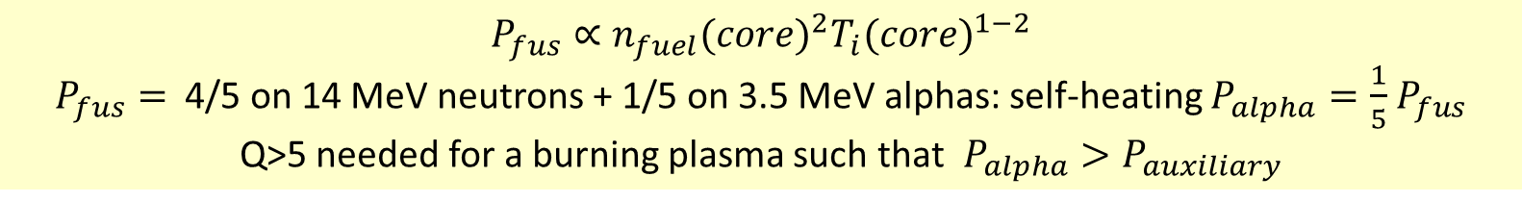
Plasma physics in system code for DEMO design
In system code, 3 quantities from plasma physics needed:
Fusion power, P_{fus} , key quantity, summarizing the plasma output for DEMO design by system code that is then converted in electric power
Power crossing the separatrix, P_{sep} , constrained to a max value for divertor protection
Plasma resistivity to compute the pulse length
How are these 3 quantities estimated?
$$P_{fus}∝{n_{fuel}(core)}^{2}{T_{i}(core)}^{1−2}$$
$P_{fus}=$4/5 on 14 MeV neutrons + 1/5 on 3.5 MeV alphas: self-heating $P_{alpha}=\frac{1}{5}$ $P_{fus}$
Q>5 needed for a burning plasma such that $P_{alpha}>P_{auxiliary}$
Thanks to [Matti Coleman NF 2025] & Andrea Quartararo for expertise on PROCESS physics parameters

Slide 7
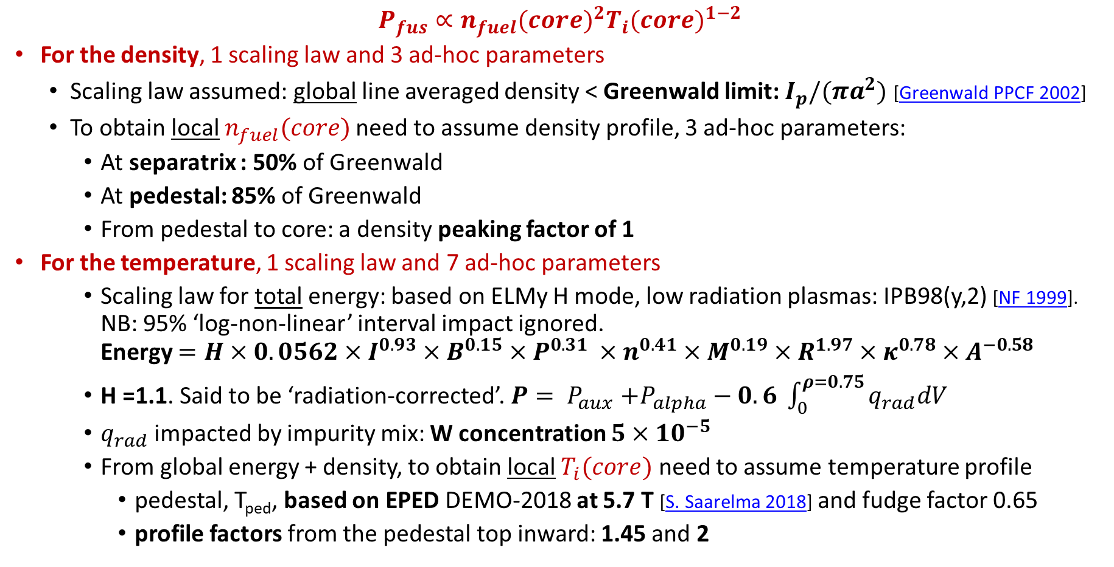
Plasma physics in system code: fusion power estimation
$P_{fus}∝{n_{fuel}(core)}^{2}{T_{i}(core)}^{1−2}$
For the density, 1 scaling law and 3 ad-hoc parameters
Scaling law assumed: global line averaged density < Greenwald limit: $I_{p}/(πa^{2})$ [Greenwald PPCF 2002]
To obtain local $n_{fuel}(core)$need to assume density profile, 3 ad-hoc parameters:
At separatrix : 50% of Greenwald
At pedestal: 85% of Greenwald
From pedestal to core: a density peaking factor of 1
For the temperature, 1 scaling law and 7 ad-hoc parameters
Scaling law for total energy: based on ELMy H mode, low radiation plasmas: IPB98(y,2) [NF 1999]. NB: 95% ‘log-non-linear’ interval impact ignored. Energy $=H×0.0562×I^{0.93}×B^{0.15}×P^{0.31} ×n^{0.41}×M^{0.19}×R^{1.97}×κ^{0.78}×A^{−0.58}$
H =1.1. Said to be ‘radiation-corrected’.$P{= P}_{aux}+P_{alpha}−0.6 \int_{0}^{ρ=0.75}{q_{rad}dV}$
$q_{rad}$ impacted by impurity mix: W concentration $5×{10}^{−5}$
From global energy + density, to obtain local $T_{i}(core)$ need to assume temperature profile
pedestal, T_{ped}, based on EPED DEMO-2018 at 5.7 T [S. Saarelma 2018] and fudge factor 0.65
profile factors from the pedestal top inward: 1.45 and 2

Slide 8
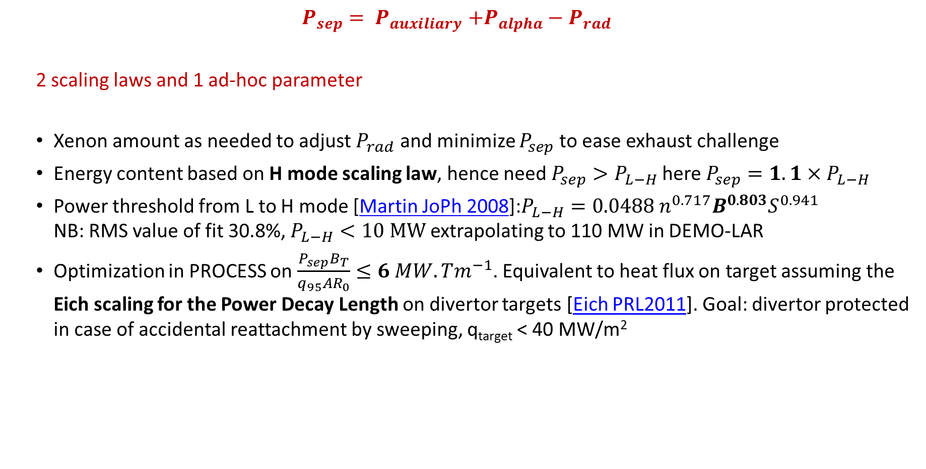
Plasma physics in system code: power crossing the separatrix
$$P_{sep}{= P}_{auxiliary}+P_{alpha}−P_{rad}$$
2 scaling laws and 1 ad-hoc parameter
Xenon amount as needed to adjust $P_{rad}$and minimize $P_{sep}$ to ease exhaust challenge
Energy content based on H mode scaling law, hence need $P_{sep}>P_{L−H}$here $P_{sep}=1.1×P_{L−H}$
Power threshold from L to H mode [Martin JoPh 2008]:$P_{L−H}=0.0488 n^{0.717}B^{0.803}S^{0.941}$ NB: RMS value of fit 30.8%, $P_{L−H}<10 MW$ extrapolating to 110 MW in DEMO-LAR
Optimization in PROCESS on $\frac{P_{sep}B_{T}}{q_{95}AR_{0}}≤6 MW.Tm^{−1}$. Equivalent to heat flux on target assuming the Eich scaling for the Power Decay Length on divertor targets [Eich PRL2011]. Goal: divertor protected in case of accidental reattachment by sweeping, q_{target} < 40 MW/m²

Slide 9
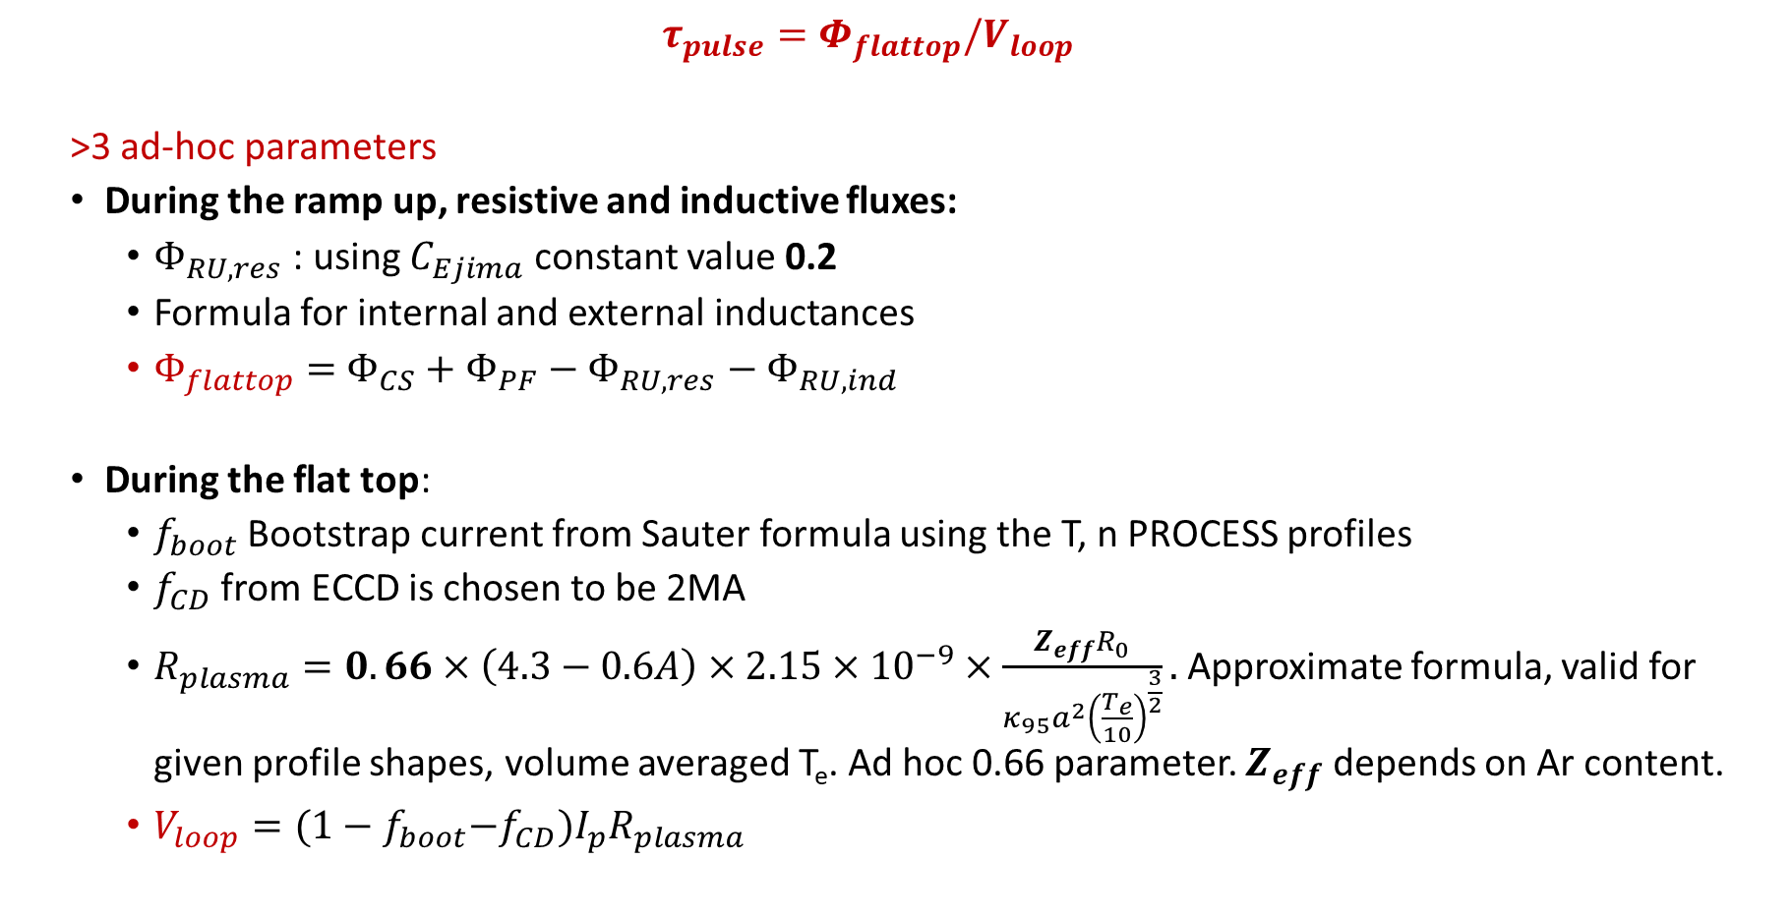
Plasma physics in system code: pulse length
$$τ_{pulse}=Φ_{flattop}/V_{loop}$$
>3 ad-hoc parameters
During the ramp up, resistive and inductive fluxes:
$Φ_{RU,res}$: using $C_{Ejima}$ constant value 0.2
Formula for internal and external inductances
$Φ_{flattop}=$ $Φ_{CS}+$ $Φ_{PF}−$ $Φ_{RU,res}$ $−$ $Φ_{RU,ind}$
During the flat top:
$f_{boot}$ Bootstrap current from Sauter formula using the T, n PROCESS profiles
$f_{CD}$ from ECCD is chosen to be 2MA
$R_{plasma}=0.66×\left(4.3−0.6A\right)×2.15×{10}^{−9}×\frac{Z_{eff}R_{0}}{κ_{95}a^{2}{\left(\frac{T_{e}}{10}\right)}^{\frac{3}{2}}}.$Approximate formula, valid for given profile shapes, volume averaged T_{e}. Ad hoc 0.66 parameter. $Z_{eff}$ depends on Ar content.
$V_{loop}={(1−f}_{boot}−f_{CD})I_{p}R_{plasma}$
More in Appendix D [Coleman et al NF 2025]
[Kovari FED 2014]

Slide 10
In summary, physics parameters in PROCESS:
14 ad-hoc parameters and 4 scaling laws used in PROCESS to determine the fusion power , pulse length and constrain power crossing separatrix

Slide 11
Table of Content
Physics assumptions used in the system code to design DEMO A=2.8
Motivation/Context for high fidelity physics based DEMO plasma modelling
Preparing a High fidelity integrated modelling of DEMO burning plasma
High fidelity integrated modelling results
Lessons learnt, way forward

Slide 12

To reduce uncertainty on ad-hoc parameters: Need high fidelity integrated modelling
Integrated modelling provides :
self-consistent physics based modelling of transport and sources using
verified and validated reduced models
Sources: ECRH, fusion power
Sinks: radiation
Turbulent transport fluxes
reduced models: TGLFsat2
transport PDE solver $t→t+∆t$
Predicted T_{i}, density, profiles up to ρ=1
Initial profiles
2D magnetic eq and stability
Current diffusion
ASTRA, HFPS…

Slide 13
High fidelity integrated modelling vs system codes
 | System code (PROCESS) | 0.5D integrated modelling (ASTRA-0.5D, METIS) | High fidelity integrated modelling (ASTRA, HFPS)
Density profile | ad-hoc parameters |  | Turbulent transport reduced model + Pedestal model
Temperature profile | Ad-hoc profile shape T_{i}=T_{e} | Ad-hoc pedestal + heat diffusion shape + power balance | Turbulent reduced model
 | Constrained by energy scaling law
Heat sources | Not self-consistent | Self-consistently iterated with T profile, incl. heat-exchange, fusion
Radiated power | Not iterated | self-consistently iterated with T profiles
Current profile, equilibrium | Not calculated | Self-consistent 1D current diffusion and 2D equilibrium inside LCFS
Flux consumption | Formula + ad-hoc factor | V_{loop} self-consistent with profiles
CPU time | ~ sec. per operation point | ~ minute per operation point | ~1000 CPUh (~ 1 day on 48 procs)

Slide 14
The challenge of the gaps between today’s tokamaks and ITER/DEMO
 | P_{fus}= 5xP_{alpha} MW | P_{alpha}/P_{aux} | Q= P_{fus/}P_{aux} | Kinetic/magnetic Pressure β_{core} | Larmor radius ρ* | P_{rad} / P_{alpha}+P_{aux} ρ<1
JET DT [NF2023] | 12.5 | 8 % | 0.4 | 2.2 % | 0.034 | ~20%
ITER 15 MA [NF2024] | 500 | 200 % | 10 | 4-4.2 % | 0.021 | 4%
DEMO A=2.8 | 1600 | 640 % | 32 | 4.9 % | 0.016 | ~60-70%
Very large gaps between JET DT and ITER/DEMO
In terms of P_{alpha}/P_{aux}, β
But ITER/DEMO have similar β and power density!
Due to different plasma volumes: 2700 m³ ~ 3 x ITER

Slide 15
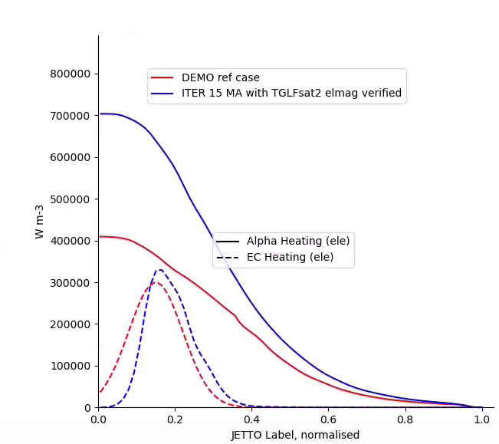
The challenge of the gaps between today’s tokamaks and ITER/DEMO
 | P_{fus}= 5xP_{alpha} MW | P_{alpha}/P_{aux} | Q= P_{fus/}P_{aux} | Kinetic/magnetic Pressure β_{core} | Larmor radius ρ* | P_{rad} / P_{alpha}+P_{aux} ρ<1
JET DT [NF2023] | 12.5 | 8 % | 0.4 | 2.2 % | 0.034 | ~20%
ITER 15 MA [NF2024] | 500 | 200 % | 10 | 4-4.2 % | 0.021 | 4%
DEMO A=2.8 | 1600 | 640 % | 32 | 4.9 % | 0.016 | ~60-70%
DEMO A=2.8
ITER 15 MA
Alpha heating on electrons
ECRH
Very large gaps between JET DT and ITER/DEMO
In terms of P_{alpha}/P_{aux}, β
But ITER/DEMO have similar β and power density!
Due to different plasma volumes: 2700 m³ ~ 3 x ITER
Synergy: preparing ITER operation / designing DEMO

Slide 16
Table of Content
Physics assumptions used in the system code to design DEMO A=2.8
Motivation/Context for high fidelity physics based DEMO plasma modelling
Preparing a High fidelity integrated modelling of DEMO burning plasma
High fidelity integrated modelling results
Lessons learnt, way forward

Slide 17
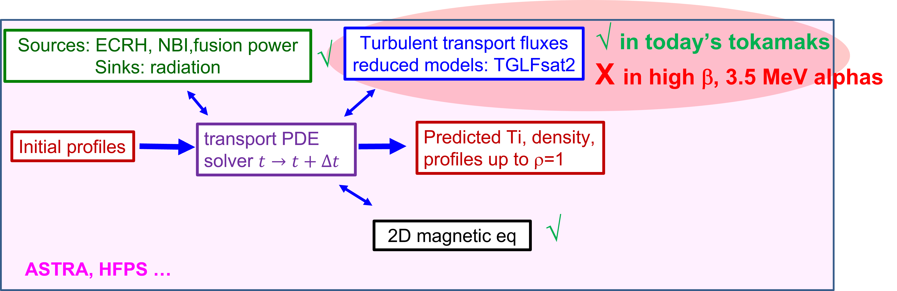
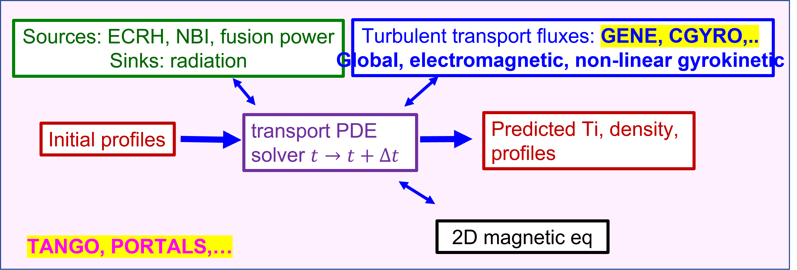
Given the gaps in β and alpha power: verification before extrapolation of reduced turbulent transport in burning plasma context
Reduced turbulent transport model: TGLFsat2 in HFPS integrated modelling framework: settings optimized for electromagnetic turbulence tested on JET high β plasma [Najlaoui PPCF 2025] ~1000 CPUh, ~1 day on 48 processors
VS
Higher fidelity turbulent transport model, frontier of achievable calculations: GENE global, electromagnetic, nonlinear, coupled in Tango framework. 8 million CPUh for convergence tests + 70k node hours on GPU [A. Di Siena NF2026] ~ year work needed

Slide 18
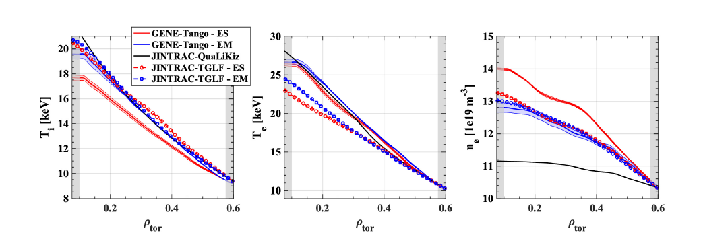
Verification of reduced model against First global gyrokinetic profile predictions of ITER burning plasma
TGLFsat2 in HFPS framework verified against GENE in Tango framework
1st time reduced turbulent transport model verified in burning plasma conditions. ITER 15 MA burning plasma used, for ρ<0.6
Good agreement between GENE-Tango electromagnetic and TGLFsat2-HFPS electromagnetic
DEMO prediction in HFPS: using TGLFsat2 verified electromagnetic settings
[A. Di Siena NF2026]
GENE-Tango - ES
GENE-Tango – EM
QuaLiKiz-HFPS
TGLFsat2-HFPS – ES
TGLFsat2-HFPS - EM

Slide 19
Table of Content
Physics assumptions used in the system code to design DEMO A=2.8
Motivation/Context for high fidelity physics based DEMO plasma modelling
Preparing a High fidelity integrated modelling of DEMO burning plasma
High fidelity integrated modelling results
Lessons learnt, way forward

Slide 20
High fidelity integrated modelling, main settings, ref. case
Turbulent transport: verified electromagnetic TGLFsat2 for heat and particle (D, T, Ar, Xe, W )
Pedestal: ITER-EPED with fudge factor, pedestal top at ρ_{tor}=0.93 to match stand alone ideal MHD P_{ped}
Plasma composition:
D and T 50/50
Helium ashes produced by fusion reactions. No 3.5 MeV alpha at this stage.
Initial Z_{eff} of 1.5, W concentration at separatrix 5x10⁻⁵. Xe content feedback to have P_{sep} ~170 MW
He escape velocity at separatrix of 25 cm/s, Xe of 10 cm/s while Ar and W have no escape velocities.
ECRH power 50 MW, gaussian centred at ρ_{tor}=0.15. ECCD ~ 1 MA.
Particle source by ‘continuous pellet model’, which provides 50/50 D/T, feedback on electron density at pedestal top of 5.7x10¹⁹m⁻³, i.e. 90% of the Greenwald density
Continuous sawtooth model inside q=1, adding an additional transport of 0.3 m²/s.
Toroidal rotation not evolved, at 0 at all radii.

Slide 21
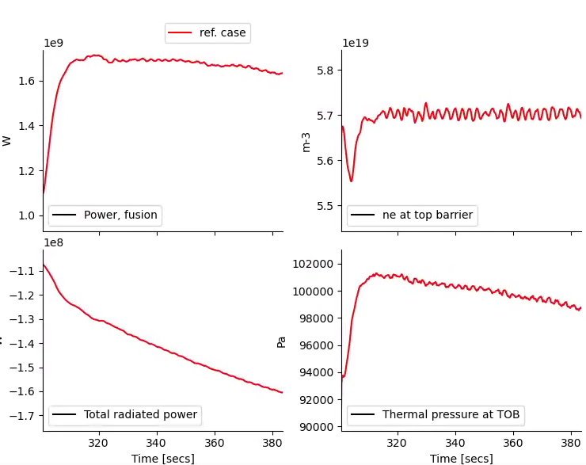
Reference case for high fidelity integrated modelling
Fusion power 1.7 GW, reached ~ t₀+10 s
Power crossing the separatrix, feedback using Xe content, slowly leading to larger P_{rad}
Density at the pedestal matching reference in ~ t₀+8 s
Pedestal pressure 8% higher than IMEP / ideal MHD stand alone prediction
NB: here no self-consistent pedestal, on-going now ASTRA-TGLFsat2-IMEP T. Luda

Slide 22
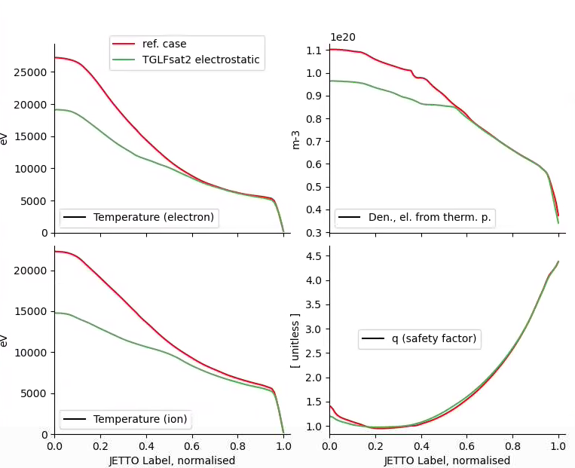
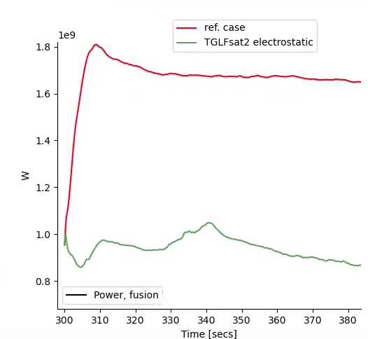
Impact of the reduced turbulent model settings fusion power reduced by 700 MW
TGLFsat2 | Electrostatic, ‘default’ | Electromagnetic, ‘verified’
Strong impact on T_{i} and density for ρ<0.6
Hence on P_{fus}…
-~40%, - ~700 MW!

Slide 23
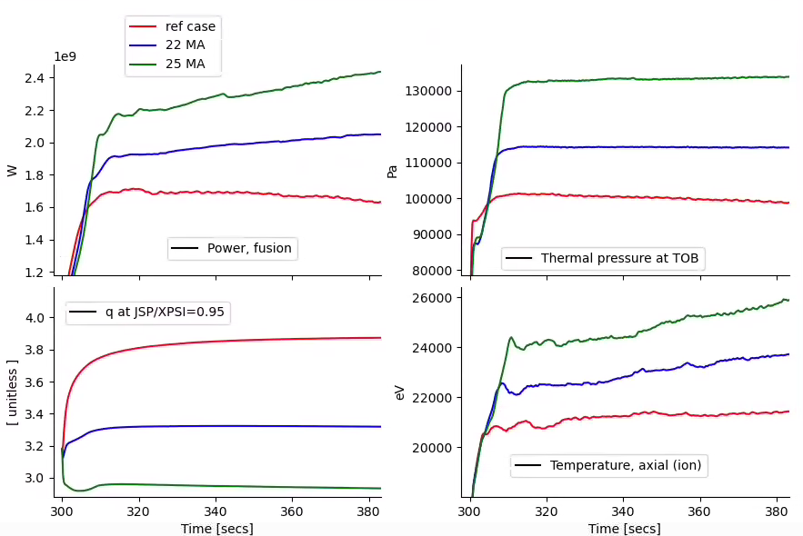
Given uncertainties, can a larger I_{p} recover potential confinement quality loss?
‘forced’ pedestal pressure increase guided by stand-alone IMEP. to be confirmed by self-consistent modelling (on-going)
Increasing I_{p} by 33% leads to +40%, + 700MW on P_{fus}
For 25 MA, q₉₅ ~<3, would need ideal MHD stability checks
25 MA
22 MA
18.8 MA

Slide 24
Table of Content
Physics assumptions used in the system code to design DEMO A=2.8
Motivation/Context for high fidelity physics based DEMO plasma modelling
Preparing a High fidelity integrated modelling of DEMO burning plasma
High fidelity integrated modelling results
Lessons learnt, way forward

Slide 25
Conclusions
In system code, physics in 14 ad-hoc parameters and 4 scaling laws
Need guidance from higher fidelity burning plasma modelling
Given the gaps between todays devices and ITER/DEMO mandatory:
Verification of physics based reduced models against frontier modelling capability (done from turbulent transport, and energetic particle physics)
Validation on Q>5 ITER plasmas as soon as possible
Integrate verified reduced physics models and predict DEMO burning plasmas
Done in HFPS using TGLFsat2 for turbulent transport including electromagnetic modes, P_{fus} 1.7 GW, + 700 MW if I_{p} increased by 30%. TGLF electrostatic ‘default’ leads P_{fus} - 700 MW!
CPU time: 1000 h ~1 day/48 procs, can be used to test uncertainties, prepare control schemes
Self-consistent pedestal stability coupling done, simulations on-going (ASTRA/IMEP/TGLFsat2) including QCE compatible n_{sep}, SOLPS informed T_{sep}
Workflow for energetic particle (ATEP) in ~h/256 procs, IMAS out/in. Self-consistent coupling on-going (TSVV-H and G)
Pellet, ECRH self-consistent planned in the coming year
SOLPSNN coupling in the coming year

Slide 26
Verification and/or validation mandatory before extrapolation
Engineering Design of future devices (DEMO/VNS)
Magnetic equilibrium, stability see F. Maviglia Gate 2
System codes See A. Quartararo Gate 2 More expertise to guide parameters+range & physics based scaling | Pulse Design Tools Full pulse, testing controllers Some physics models & Surrogate models* See M. Siccinio Gate 2 | High Fidelity Integrated Modeling More physics models Pellet, pedestal, Alpha, SOL S. Wiesen Gate 2 | More Verification vs 1st principle physics codes Turbulence + alpha High beta / flat q Pedestal transport Turb. SOL incl. imp.
 | More Validation against tokamak experiments, including high β (JT60-SA), density limit, L-H transition threshold scaling, QCE and detachment, SOL impurity ‘compressibility’, P_{alpha}>P_{aux} Q>5 experiments (ITER)
* Control schemes impact strongly DEMO design: actuators/sensors

Slide 27
Thank you

Slide 28
High fidelity integrated modelling vs system code
 | 0.5D integrated modelling (ASTRA-0.5D, METIS) | High fidelity integrated modelling (ASTRA, HFPS)
Density profile | ad-hoc parameters | Turbulent transport reduced model + Pedestal model
Temperature profile | Ad-hoc pedestal + heat diffusion shape + power balance | Turbulent reduced model
 | Constrained by energy scaling law
Heat sources | Self-consistently iterated with T profile, incl. heat-exchange, fusion
Radiated power | self-consistently iterated with T profiles
Current profile, equilibrium | Self-consistent 1D current diffusion and 2D equilibrium inside LCFS
Flux consumption | V_{loop} self-consistent with profiles
CPU time | ~ minute per operation point | ~1000 CPUh (~ 1 day on 48 procs)

Slide 29
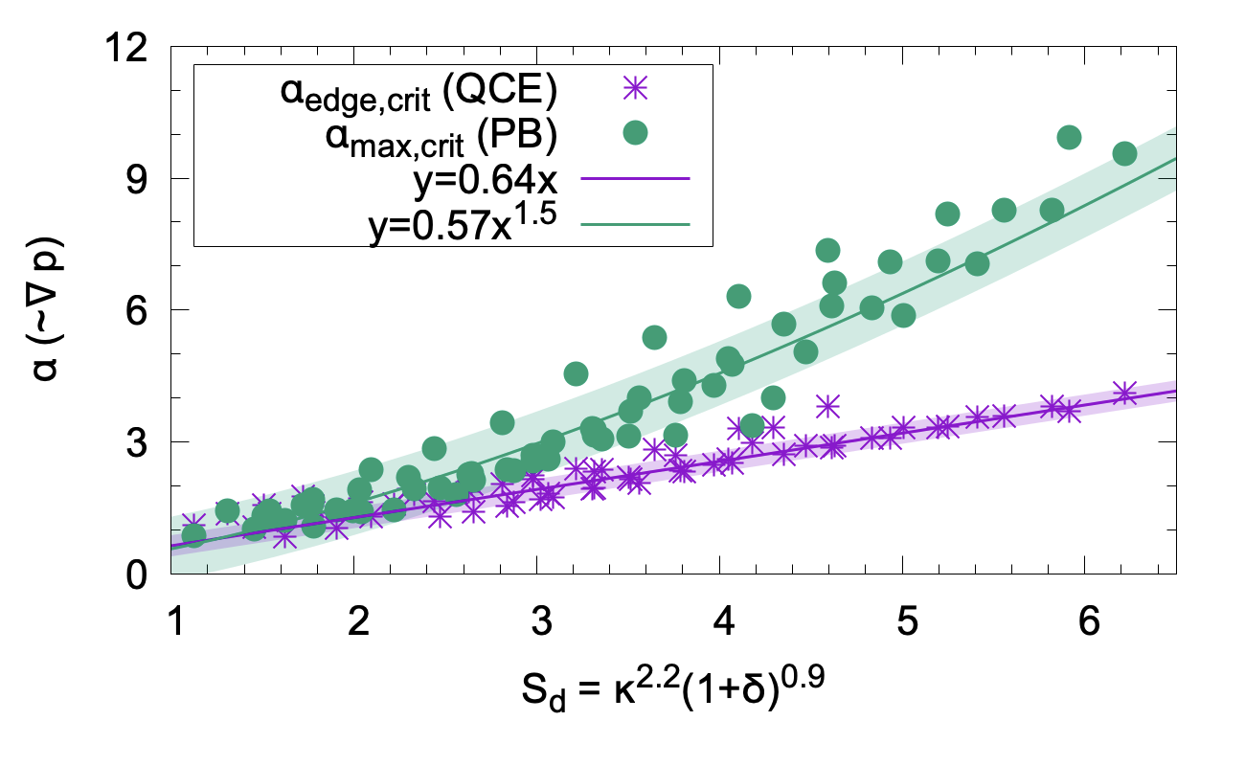
Quasi-Continuous Exhaust (QCE) regime foreseen for DEMO
ELM free regime required compatible with detached plasma in SOL
Quasi-Continuous Exhaust (QCE) regime [Faitsch 2021] observed on AUG, TCV and JET DT
Combines no ELMs with high density at separatrix and broader power decay length SOL
n_{sep} values expected to be reachable in both ITER and DEMO [Dunne 2024]
Operational window larger at high plasma shaping S_{d} = κ²(1+δ)=5 in DEMO-LAR
Ongoing experiments to assess QCE compatibility with detachment/X point radiator, results expected in next 1-2 years
ELM free
[Dunne 2024]
At this stage no physics based reduced model for heat/particle transport in pedestal. Hence no QCE pedestal predictive capability as yet…

Slide 30
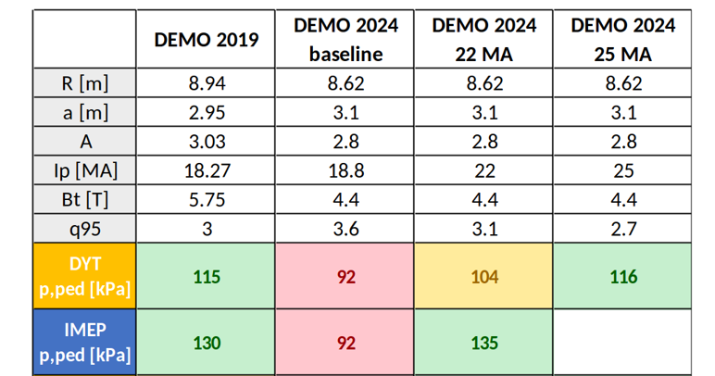
DEMO pedestal pressure guided by ideal MHD limits
Stand-alone predicted pedestal top pressure using ideal MHD peeling/ballooning limit:
EPED/IPED family [Snyder 2009, Dunne 2017], relying on parameterisation of the transport in pedestal. DYT [Puchmayr, 2020], derived from IPED database and the H98 scaling for the global energy content
IMEP model [Luda NF2025] relying on ETG-like heat transport and D/χ ratio in the pedestal
For now, in HFPS, tuned an ITER EPED based model [Polevoi NF 2015] to IMEP/DYT stand-alone results (fudge factor 0.55). Pedestal top chosen at ρ=0.93. Found a posteriori too narrow, unstable with respect to ideal MHD using MARS-F. Self-consistent pedestal modeling on-going.

Slide 31
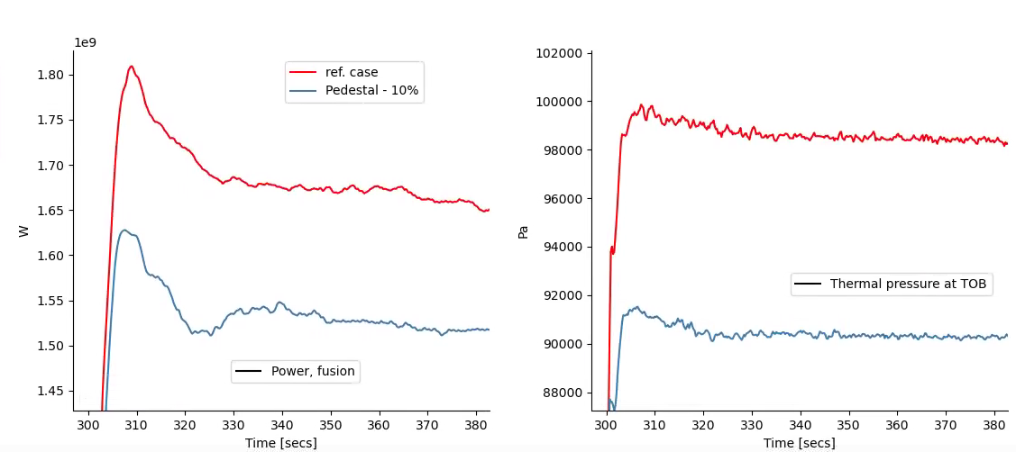
Impact of the pedestal height, here stiff profiles, hence as expected lower pedestal means lower fusion power
Fusion power in W
Pedestal pressure in Pa
-~10%
-~10%, - ~150 MW
IMEP

Slide 32
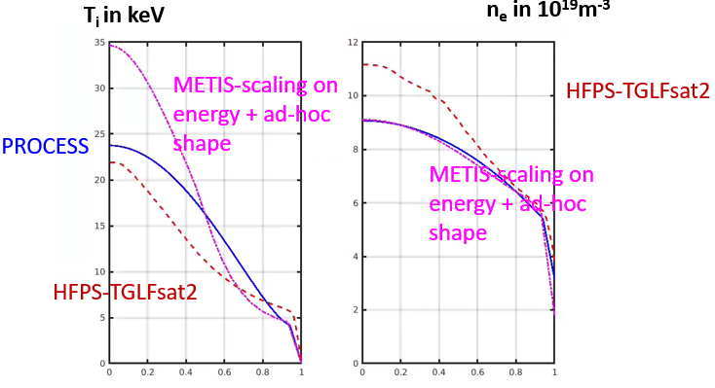
High fidelity modelling vs 0.5D and System code profiles
Similar fusion power by ‘chance’
Very different profiles for T and density
But now can explore physics based plasma response to changes of input data, boundary/initial conditions, etc
 | W_{th} (MJ) | I_{p} (MA)/B_{T}(T) | V_{loop} (mV) | li | P_{fus} (GW) | q₉₅ | β_{N} | Z_{eff} | W_{fast/}W_{tot} | f_{boot} | P_{ped} (kPa) | Pulse length estimate
METIS | 1113 | 18.4/4.4 | 40 | 0.86 | 1.7 | 3.8 | 3.1 | 2.8 | 16% | 38% | 71 | 1h38min
HFPS | 1055 | 18.8/4.4 | ~50 | 0.71 | 1.6 | 3.9 | 2.6 | 1.7 | 9% | 40% | 99 | 1h22min

Slide 33
assessment of energetic particle dynamics: status and plans
first quasi-linear assessment of alpha particle dynamics for DEMO LAR parameters shows:
weakly unstable toroidal Alfvén eigenmodes - similar to ITER
linearly unstable KBM/ATIG branches - driven by both thermal and alpha particle gradients
physics gaps that need to be addressed:
how are they coupled non-linearly? role of q=1 dynamics: sawteeth/flux pumping
effect on self-consistent profiles in presence of non-linear alpha production rate?
understanding/models for non-linear interaction with turbulence and EP-driven modes ongoing [TSVV-G]; important role of non-linearly generated zonal flows and currents [Chen et al, NF 2024]
phase space resolved reduced models/codes (e.g. ATEP) need be improved further and integrated in modelling chains
considerable uncertainty: sensitivity to be scanned for optimisation/control
extrapolating to reactor conditions needs to remain an important driver, together with validation efforts (high-beta JT-60SA cases)

Slide 34
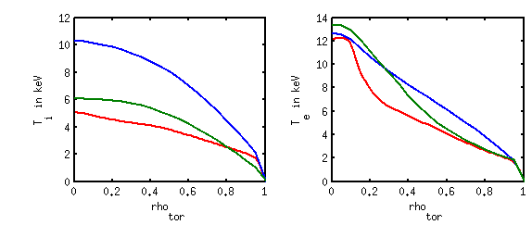
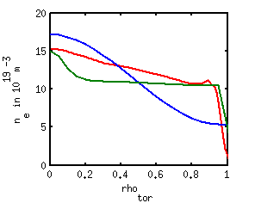
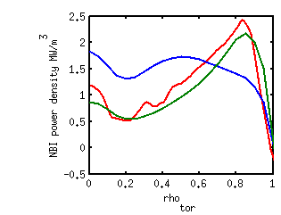
Impact of various modelling fidelity levels on VNS performances
ASTRA-TGLF
P_{fus} =37 MW
P_{fus} =25 MW
P_{fus} =17 MW
METIS – ref settings
METIS – JET based
 | 0.5D integrated modelling (ASTRA-0.5D, METIS) | High fidelity integrated modelling (ASTRA, HFPS)
Density profile | ad-hoc parameters | Physics based: Turbulent transport reduced model & Pedestal model
Temperature profile | Ad-hoc pedestal & heat diffusion shape | Turbulent reduced model
 | Constrained by energy scaling law
CPU time | ~ minute per operation point | ~ 1 day on 48 procs for 100s of plasma
To maximize P_{fus}: Key role of NBI absorption and T_{e}

