Slide 1

Enabling Data-Driven Fusion Science: Platforms, Federation, and AI-Ready Workflows
presented by
Brian Sammuli
General Atomics
PI, Fusion Data Platform
Brian Sammuli¹, Raffi Nazikian¹, Mitchell Clark¹, Erik Olofsson¹, Tom Neiser¹, David Orozco¹, Cihan Akcay¹, Javier Hernandez Nicolau², Fabio Andrijauskas², Annmary Justine Koomthanam³, Aalap Tripathy³, Rishabh Sharma³, Matthew Waller⁴, Ruqi Pei⁴, Zeyu Li¹, Amitava Majumdar², Rose Yu², Sicun Gao², Frank Wuerthwein², Martin Foltin³, Craig Michoski⁴, David Schissel¹, Sterling Smith¹, Xi Chen¹, Ilkay Altintas², Shweta Purawat²
¹General Atomics
²University of California, San Diego
³Hewlett Packard Enterprise
⁴Sophelio
Presented at the
2nd E-TASC General Meeting
9-13 February, 2026
Work supported by the U.S. Department of Energy under Award No. DE-FC02-04ER54698 and Award No. DE-SC0024426

Slide 2





Overview: US fusion program is developing data infrastructure to support science and technology development
Support for Tokamak Research, FIRE collaboratives, broader fusion community, data science research
Fusion Data Platform (FDP) → Under development now
Development environment for fusion data-driven applications with fusion-specific data tools
Uses distributed version control semantics for code, metadata, generated artifacts
Provides federated access to data via the Open Science Data Federation
Fusion Energy Data Ecosystem and Repository (FEDER) → Starting Soon
Expansion of FDP capabilities
Materials databases, engineering data and workflows

Slide 3
Motivation: Why do we need an updated data ecosystem?
Need
FDP/FEDER Solution
Data Distribution
No community-wide broad distribution of fusion data
Use Open Science Data Federation software stack (HEP tested)
Data Curation
No standard tools for curating fusion data
Equip with fusion-specific data curation tools
Standardization
MDSplus commonly used, but no unified schema
Use IMAS schema for curated data
Reproducibility and Provenance
ML models often published with insufficient info to reproduce results
Use HPE's Common Metadata Framework for workflows, with complete provenance tracking of data, models, and metadata
Discoverability
No standard repository of curated data, no ability to search existing models/data
Provide metadata database with web portal and search interfaces

Slide 4


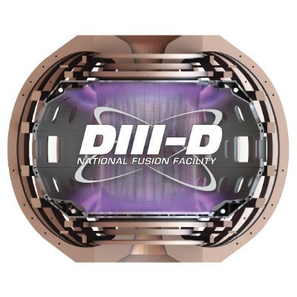



FDP provides framework for FAIR (Findable, Accessible, Interoperable, Reproducible) usage of fusion data
Search
Explore
Users
Data
Code
Models
Findable
MetaHub Web Portal
Common Metadata Framework: Track Workflows
Reproducible
User Defined Workflows
FDP Tools
Third Party Tools
Interoperable
Data Processing
Data Curation
Model Lifecycle
Fusion Data
Cache
Accessible
Open Science Data Federation
Common Namespace

Slide 5
FDP uses the Pelican stack and the Open Science Data Federation for storage efficient data distribution
Search
Explore
Users
Data
Code
Models
MetaHub Web Portal
Common Metadata Framework: Track Workflows
User Defined Workflows
FDP Tools
Third Party Tools
Data Processing
Data Curation
Model Lifecycle
Future
KSTAR
Fusion Data
Cache
WEST
Open Science Data Federation
Common Namespace

Slide 6
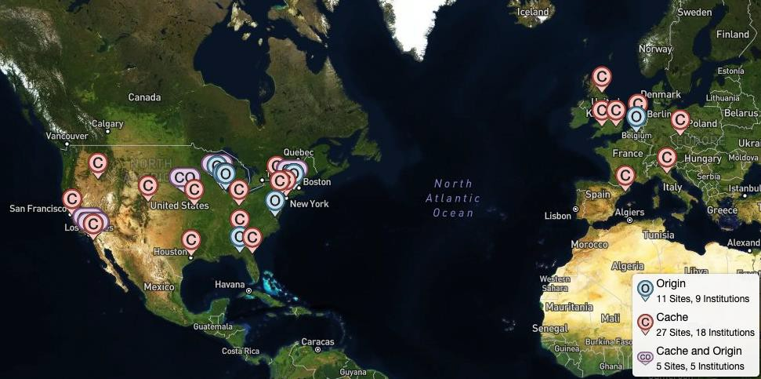
OSDF acts as a content delivery network for scientific data with global reach
Access control via SciTokens
Short-lived, OAuth2/JWT capability tokens for scientific cyberinfrastructure
Enables least-privilege, federated access to data and compute without long-lived credentials
Issuance tied to institutional data usage agreement
FDP
Currently Deployed at SDSC
Aim to deploy at...
→ ...all US DOE leadership class computing sites
→ ...additional experimental sites, funded under US DOE TR program (KSTAR, WEST)

Slide 7
FDP provides tools for tracking provenance and reproducibility via the Common Metadata Framework
Search
Explore
Users
Data
Code
Models
MetaHub Web Portal
Common Metadata Framework: Track Workflows
User Defined Workflows
FDP Tools
Third Party Tools
Data Processing
Data Curation
Model Lifecycle
Fusion Data
Cache
Open Science Data Federation
Common Namespace

Slide 8

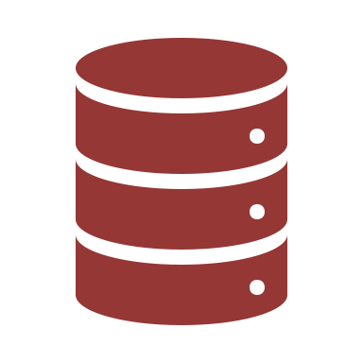
Workflows are represented as directed graphs that capture the relationship between code, data, generated artifacts, and metadata
Working Directory
Git Commit
Push
Load and Preprocess Data
Label Data
Train ML Model
Evaluate
Github
Unlabeled Dataset
Labeled Dataset
Model
Signals Used
Labels
Hyperparameters
Metrics
Shots Used
Train/Test Split
Data
Archive
Archive Version
Typical Usage Pattern – Just version the code
Code and model can diverge
Stage
Lineage
Metadata
Data/Artifact
Metadata

Slide 9
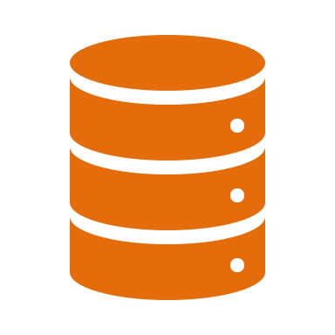
Workflows are represented as directed graphs that capture the relationship between code, data, generated artifacts, and metadata
Working Directory
CMF Commit v0
Load and Preprocess Data
Label Data
Train ML Model
Evaluate
Push
Unlabeled Dataset
Labeled Dataset
Model
Signals Used
Labels
Hyperparameters
Metrics
Shots Used
Train/Test Split
CMF Remote
Repo
Data
Archive
Archive Version
CMF bundles entire workflow in a single atomic unit, allowing for consistent snapshots
Enables provenance tracking, reproducibility, and sharing
Stage
Lineage
Metadata
Data/Artifact
Metadata

Slide 10

The FDP uses distributed version control semantics, allowing for collaborative development and workflow sharing
Working Directory
CMF Commit v1
User A
Load and Preprocess Data
Label Data
Train ML Model
Evaluate
Push v1
Unlabeled Dataset
Labeled Dataset
Model
Signals Used
Labels
Hyperparameters
Metrics
Shots Used
Train/Test Split
CMF Remote
Repo
Data
Archive
Archive Version
Train Additional ML Model
Evaluate Additional Model
Stage
Model
Lineage
Metadata
Hyperparameters
Metrics
Train/Test Split
Data/Artifact
Metadata

Slide 11
Quick poll: How many of you have written something like this?
results = []
for shot in shots:
data = read_data(shot)
processed_data = process_data(data)
if meets_some_criteria(processed_data):
results.append(processed_data)
TokSearch accelerates this type of processing pipeline!

Slide 12
FDP facilitates data ingestion and processing via the TokSearch framework
Search
Explore
Users
Data
Code
Models
MetaHub Web Portal
Common Metadata Framework: Track Workflows
User Defined Workflows
FDP Tools
Third Party Tools
Data Processing
Data Curation
Model Lifecycle
Fusion Data
Cache
Open Science Data Federation
Common Namespace

Slide 13
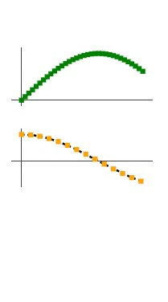
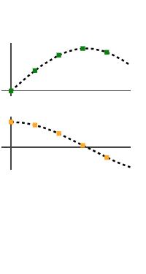
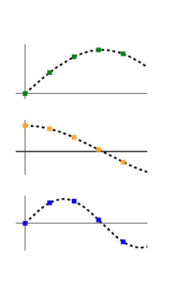
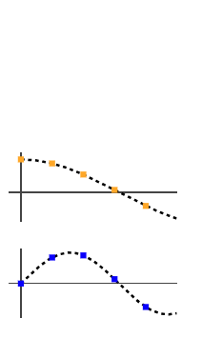
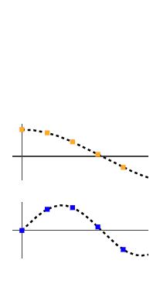
TokSearch composes built-in and user-defined functions into a pipeline
Align:
Put signals onto a common timebase
Keep:
Only preserve selected data
S1
Shot No.
Output
S2
✅
S3
PIPELINE
Fetch:
Pull signals
from archives
(0D, 1D, 2D, ...)
Map:
Apply an arbitrary function to the data
(S3 = S1 * S2)
Where:
Only allow data
matching user-defined criteria to continue

Slide 14
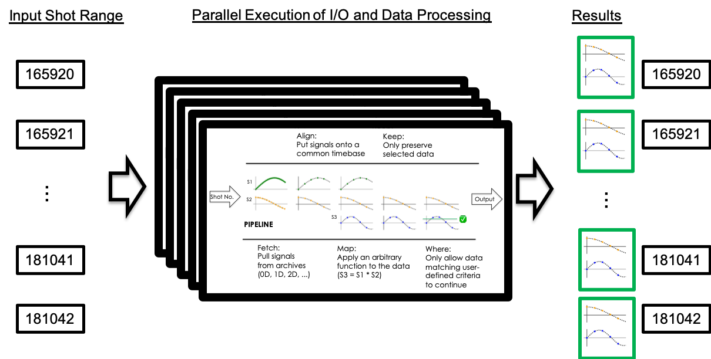
TokSearch pipelines can be executed in parallel for high throughput processing
TokSearch Docs
Access to ~1PB of DIII-D data at high throughput
Load and process O(10,000) shots in minutes instead of days
Compatible with IMAS schema

Slide 15
FDP data access is flexible
Data fetching can be done via tools besides TokSearch
MDSplus patched to allow direct access to OSDF-hosted data
Same for PTDATA (DIII-D specific)
Pelican provides multiple access methods/APIs (POSIX, REST, C++, Go, Python FSSPEC)
TokSearch can be extended to additional data formats
Example: MAST team at UKAEA incorporated Zarr file access into the codebase with a few day’s effort
Allows FDP to access FAIR MAST datasets

Slide 16
FDP is equipped with tools for data exploration and curation
Search
Explore
Users
Data
Code
Models
MetaHub Web Portal
Common Metadata Framework: Track Workflows
User Defined Workflows
FDP Tools
Third Party Tools
Data Processing
Data Curation
Model Lifecycle
Fusion Data
Cache
Open Science Data Federation
Common Namespace

Slide 17
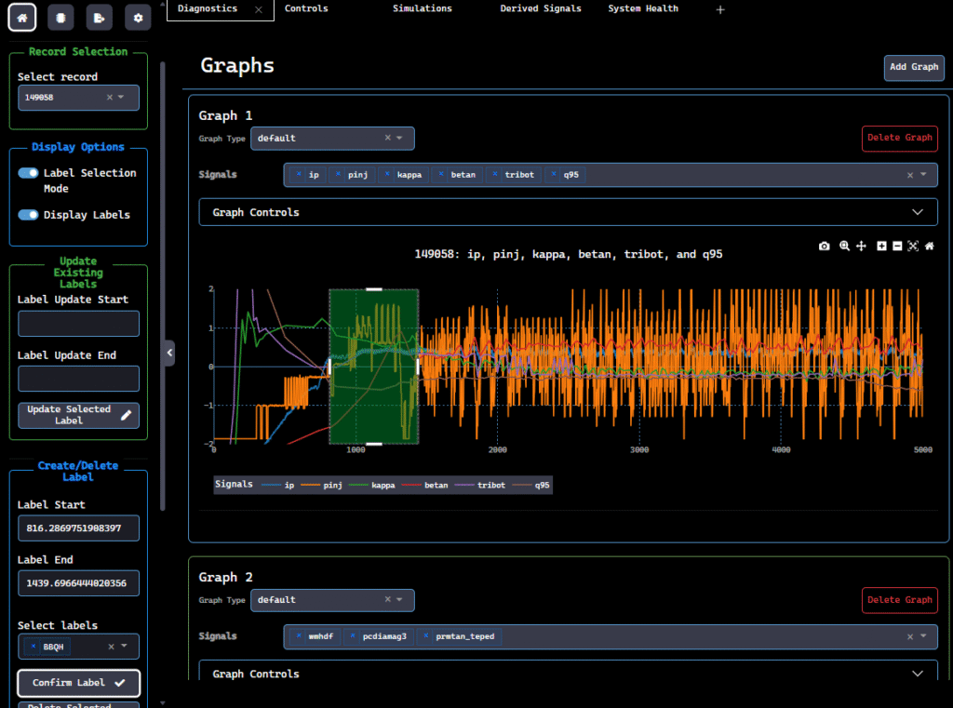
FDP installations provide the Data Fusion Labeler (dFL) for rich data processing and labeling functionality
Initially applied to generation of database for high-confinement DIII-D discharges
Labels:
Edge-localized-mode (ELMy)
Standard quiescent-H mode (QH)
Wide pedestal quiescent-H mode (WPQH)
Broadband quiescent-H mode (BBQH)
Labeling throughput increased ~5-8x compared with previous ad hoc method
 | Shots | Time Spent | Speed up
Previous database | 145 | ~2-3 weeks | -
New Database | 400 | 1 week | ~5-8x

Slide 18
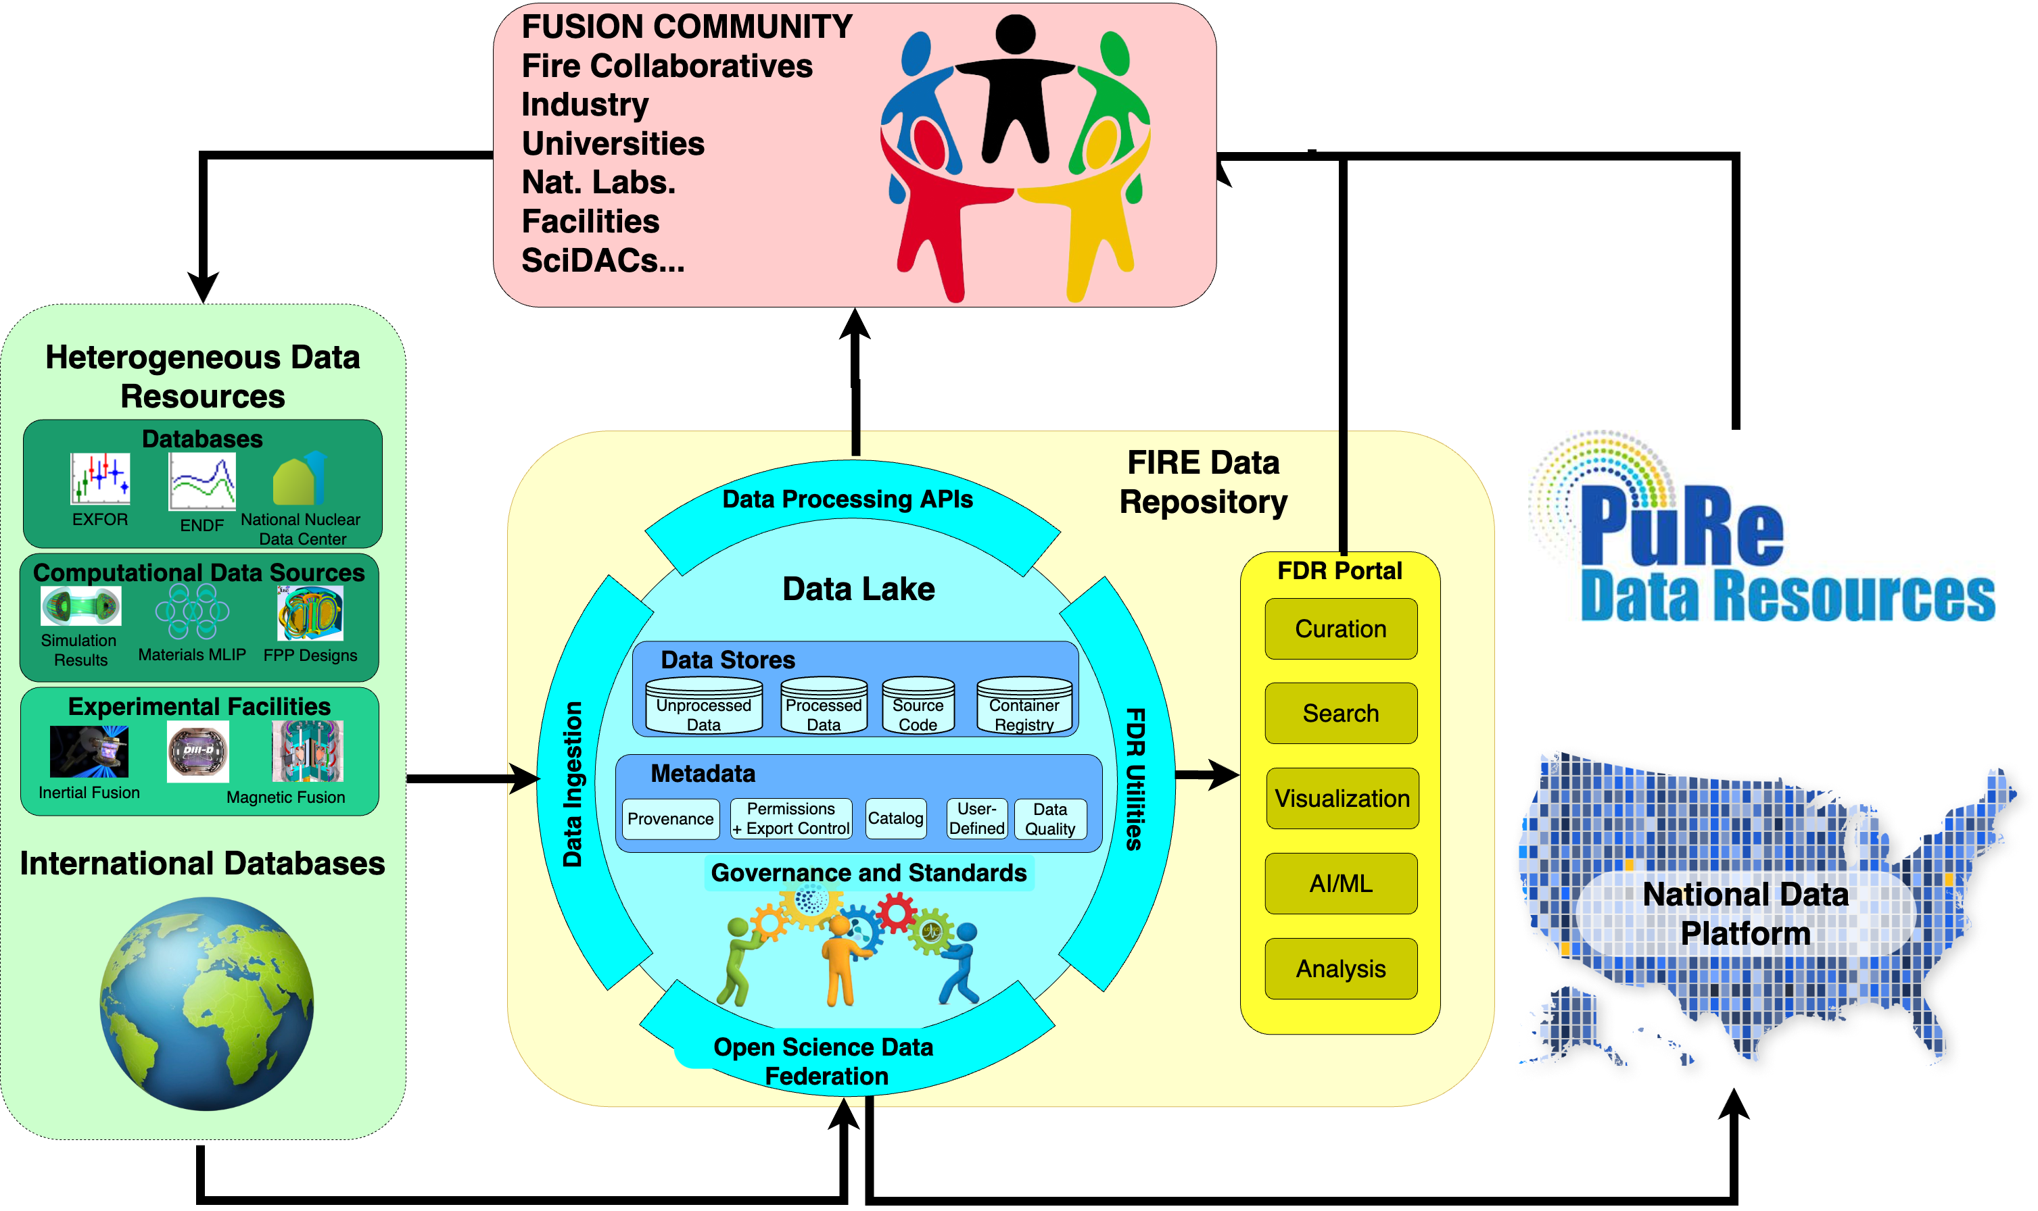
Fusion Energy Data Ecosystem & Repository (FEDER) uses FDP, expands it to incorporate additional sources of data from FIRE collaboratives
Federated data lake
Logically centralized
Physically distributed
Scalable infrastructure for heterogeneous fusion data
Metadata standards and LLMs for data discoverability
User-friendly tools for multi-source data integrated analysis
Reusable analysis pipelines integrating models and data
→ Aims to be largest knowledge fusion knowledge base ever created to accelerate development of fusion energy

Slide 19







What FEDER delivers
• Common ontologies, standardized interfaces for transferable research products, without bespoke data workflows, across IFE and MFE
→ IMAS ontology for all inputs and outputs, expand with the community
• Accessible data and workflows with end-to-end provenance for traceability & reproducibility
• Scalability through integration with the DOE IRI and HPDF infrastructure (inc. AmSC)

Slide 20
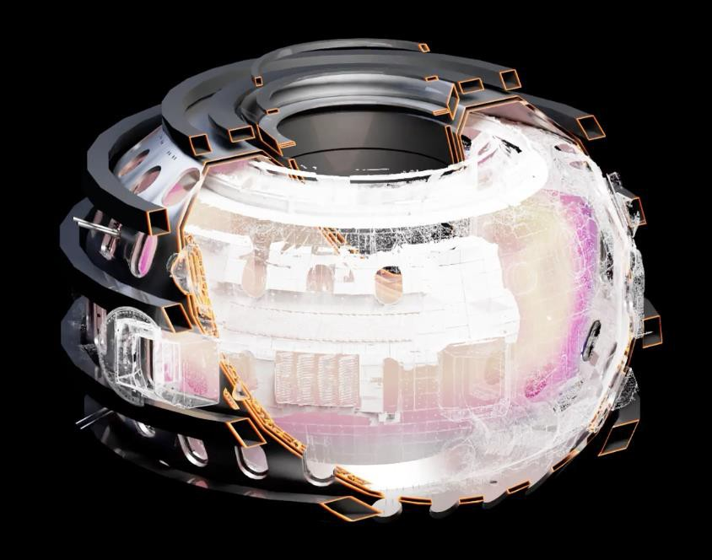
FEDER Exemplar: Enabling community-driven digital twins, integrating materials and system-scale models
FEDER will provide the data substrate needed for integrating multiscale whole device digital twin development
DIII-D digital twin currently under development (part of AmSC program)

Slide 21



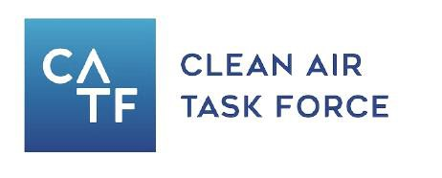

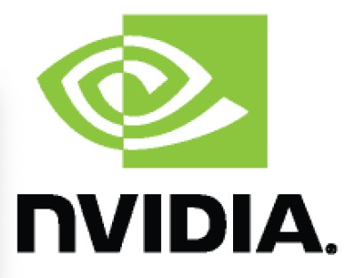


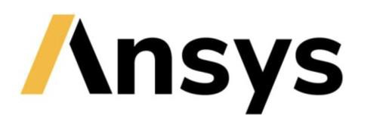








FEDER builds on strong community & industry engagement

Slide 22
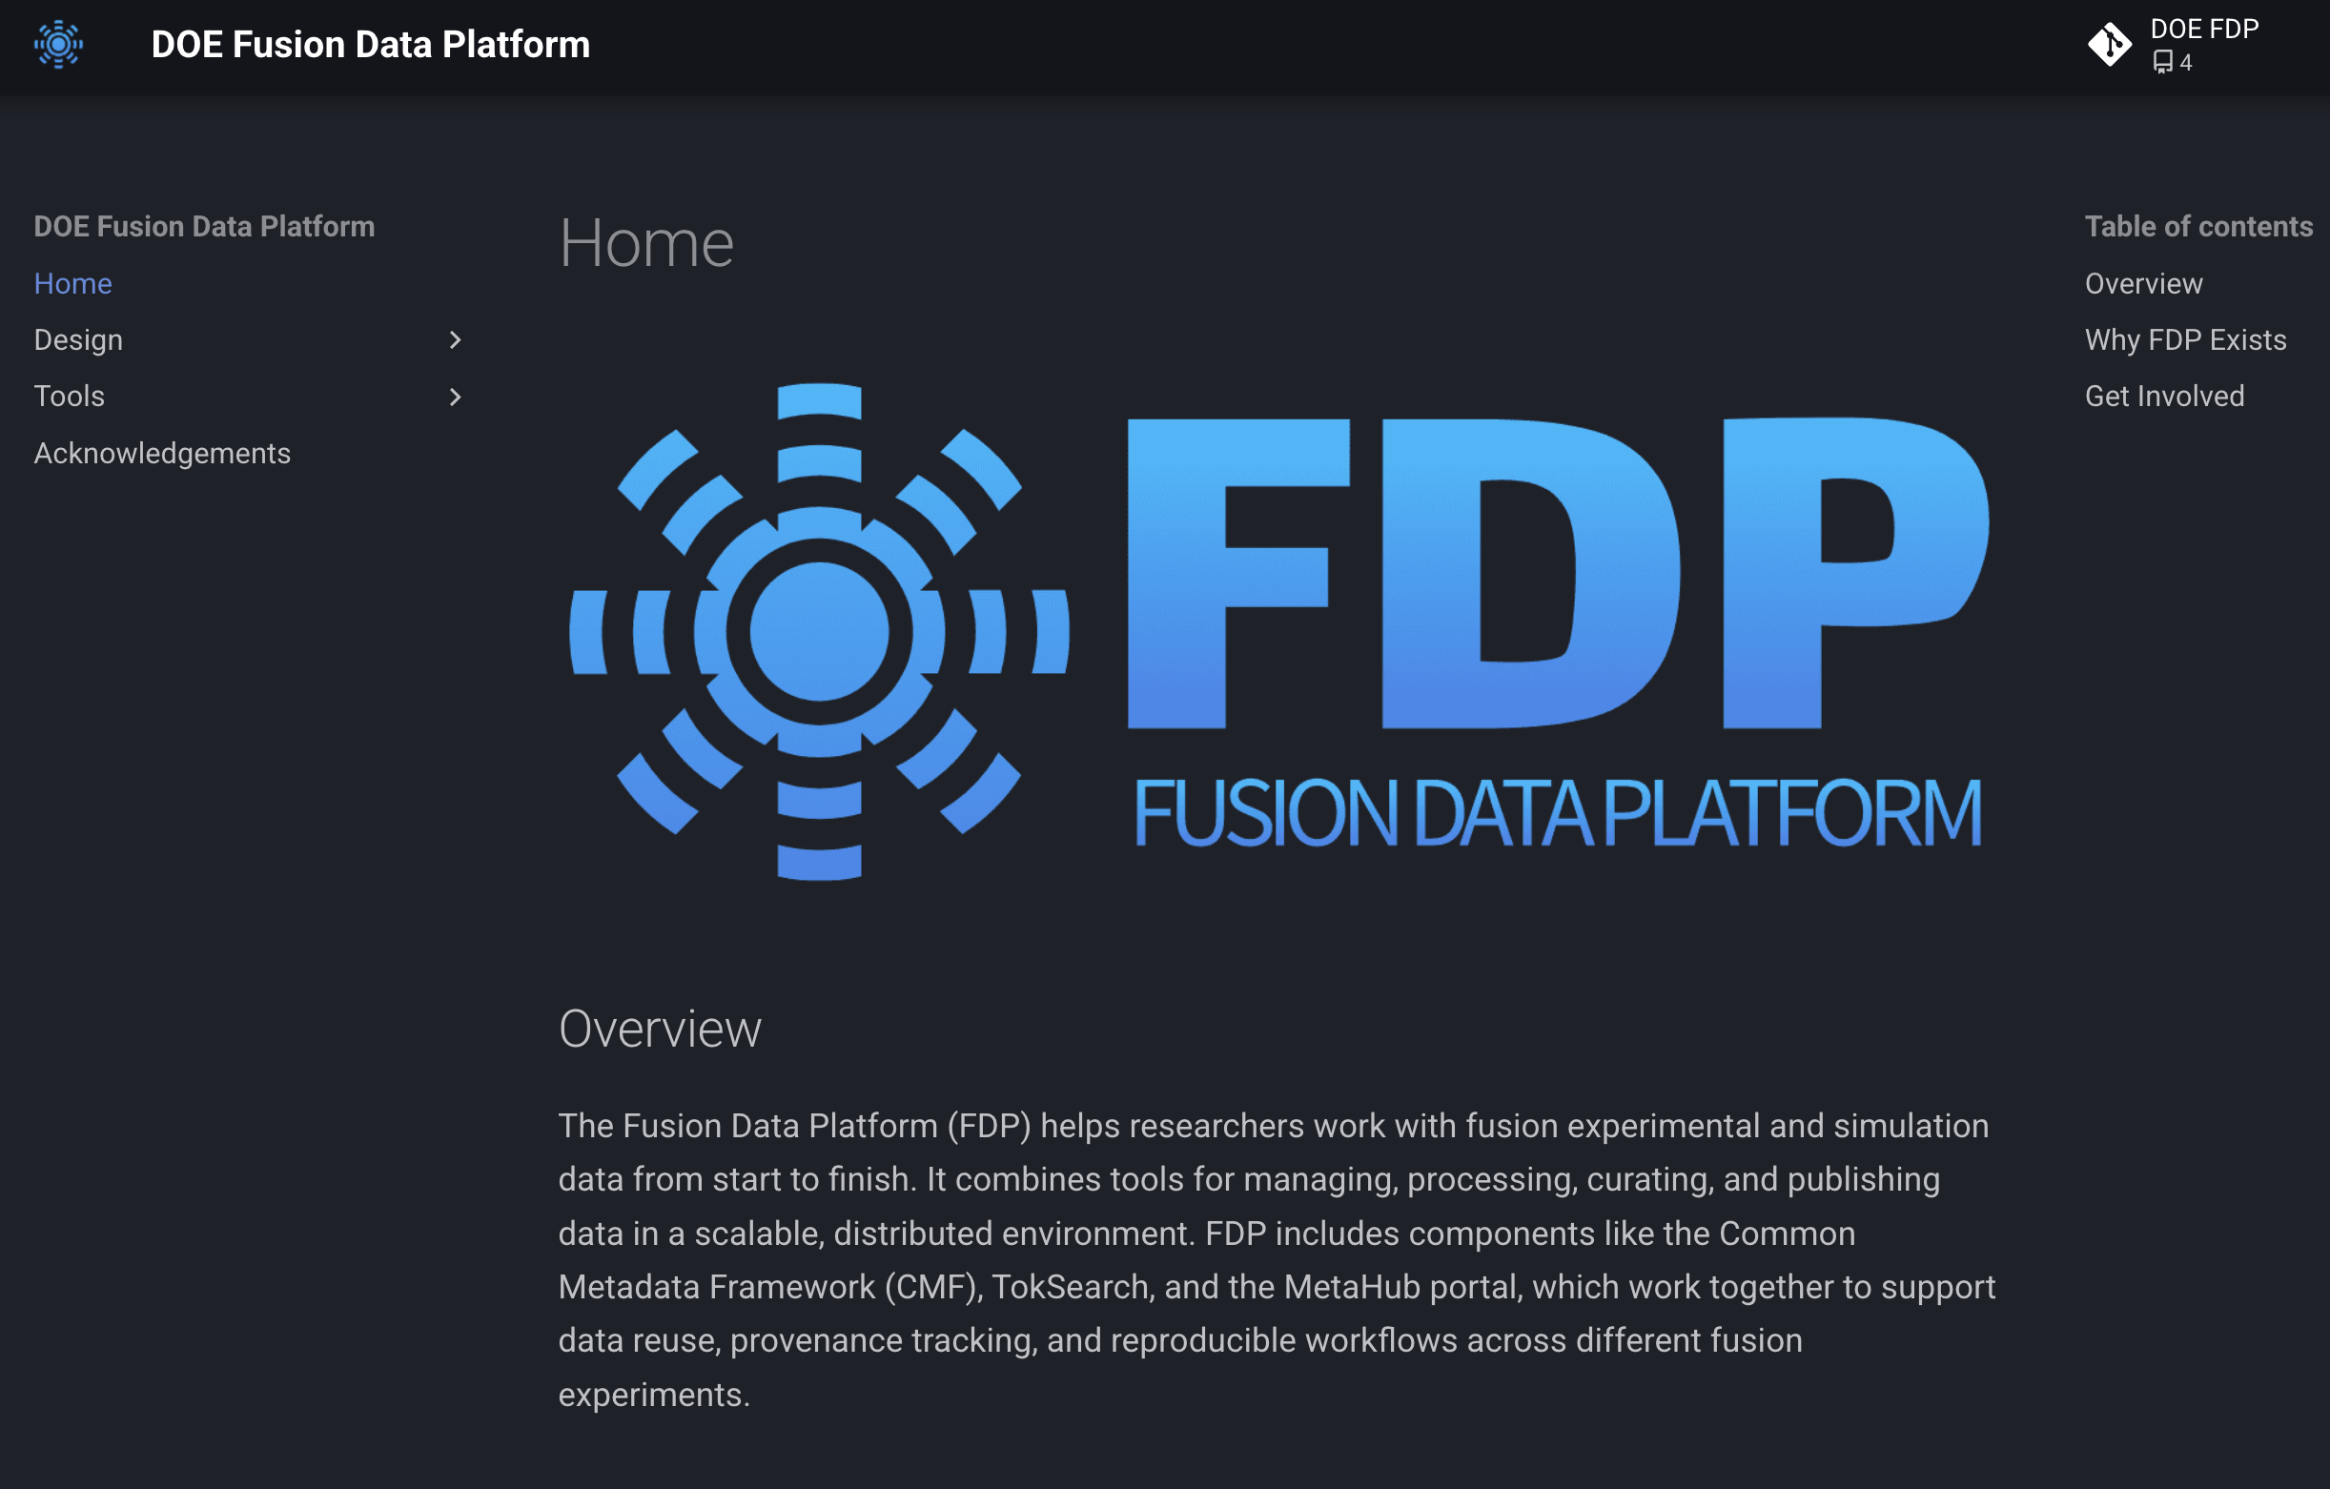

Users Welcome!
Interested in getting access?
Reach out to:
sammuli@fusion.gat.com
clarkm@fusion.gat.com
Questions?

