Slide 1
Engineering modelling tool
E-TASC General Meeting #2
Max Planck IPP, Garching, 09-13/02/2026
Session: Community demand for theory and modelling
I. Moscato on behalf of EUROfusion Design Central Team
Design & Integration Department
Acknowledgment and main contributors: P. Pereslavtsev, M. Molinari and Safety Office

Slide 2
Outline
Framing and integration needs
Case study #1: Neutronics (Monte Carlo)
Case study #2: Safety modelling
Take-away: what engineering needs from the plasma modelling community

Slide 3
Why engineering modelling is central in fusion
Fusion design is multi-physics and multi-scale
From plasma-facing components to plant-level behaviour
Normal + off-normal + accident scenarios
Experiments are limited and expensive
Need predictive capability and quantified uncertainty
Modelling enables rapid design loops
Requirements → CAD → analyses → optimisation → updates
Take-away: Engineering value comes from trustworthy, integrated workflows.

Slide 4
Mature engineering tools A landscape of software largely transferable to fusion
What already works well (industry-standard)
What is fusion-specific (around the solver)
FEA / thermo-mechanics (e.g., Abaqus, ANSYS Mechanical)
CFD / thermal-hydraulics (e.g., ANSYS CFD/Fluent, STAR-CCM+)
HPC, meshing and QA workflows; solver verification
Fusion-relevant loads and boundary conditions (pulses, transients)
Material data under irradiation / high heat flux / cryogenics
Multi-physics coupling (neutronics ↔ Thermal/Hydraulics ↔ mechanics)
Qualification: V&V + UQ for credible design margins
Take-away: Often the bottleneck is inputs, data and coupling—not the solver.

Slide 5
Engineering modelling toolchain Selected examples
Neutronics
Monte Carlo transport (MCNP, …)
Activation/decay heat, shutdown dose, nuclear loads
Structural & fluids
Thermo-mechanics (FEA) and thermal-hydraulics (CFD & System Codes)
Safety toolchain
System codes
Source terms → release → consequences
Sensitivity/UQ frameworks
Workflow integration
CAD conversion, configuration control, automation, reproducibility
Take-away: The chain matters -> consistent interfaces and traceability across tools.

Slide 6
Integration challenge From plasma scenarios to engineering Key Performance Indicators
Plasma scenarios
CAD/config
Engineering analyses
V&V + UQ
Design & safety
Typical bottlenecks
CAD → analysis conversion and geometry QA
Configuration/version control across models and data
Uncertainty propagation into design margins
Reproducibility and automation of workflows
Take-away: Integration and traceability turn modelling outputs into design decisions.

Slide 7
Cross-cutting gaps & required developments
Qualification (V&V)
Reference experiments + code-to-code benchmarks
Long-term maintenance and governance
Uncertainty quantification (UQ)
Nuclear data + modelling simplifications + numerical/statistical errors
Propagate to margins and safety arguments
Coupling & workflows
Neutronics ↔ thermal-hydraulics ↔ mechanics ↔ safety
Standard interfaces, co-simulation, automation
Fusion-specific data/models
Working fluids and chemistry; tritium and dust source terms; irradiation data
Take-away: Priority → qualified data, coupling, and uncertainty-aware workflows.

Slide 8
Monte Carlo neutronic simulations
Monte Carlo simulations
Computer Code
Geometry model
Nuclear data
Calculations
Verification
Validation
Version control
Engineering CAD models
Preprocessing
Automated conversion
Geometry check
International library
Microscopic check
Integral benchmark
Geometry control
Check of results
Variance reduction
Uncertainty analyses
Visualization

Slide 9
I. Monte Carlo computer code. General info.
MCNP (Monte Carlo N-Particle) code, developed by Los Alamos National Laboratory (LANL) since the 1950s, it was officially formed in 1977. It evolved from a specialized code to a general-purpose, internationally distributed tool (MCNP6) supporting extensive particle transport simulations for nuclear applications.
Key Historical Developments of MCNP:
1940s-1960s (Origins): Originates from early Monte Carlo work at Los Alamos
1977 (Formation): MCNP is formed by merging separate Neutron and Photon codes.
1983 (MCNP3): First public release
1990s (Expansion): MCNP4 added electron transport and many-particle capabilities
2000s (Modernization): MCNP5 (2001-2002) was rewritten for improved parallelism
2010s-Present (MCNP6): Offers complete, multi-particle (n,γ, e, d, t, α, ions) transport, with latest versions 6.3
MCNP is used for reactor physics, radiation shielding, and medical dosimetry, with over 20,000 copies distributed worldwide (throughout personal licenses).

Slide 10
I. Monte Carlo computer code. Verification and Validation
Each MCNP version goes through a strict formal verification procedure:
A suit of ~ 50 code checks elaborated over 50 years
Geometry processing
Calculation procedure
Output checks
Each MCNP version goes through a strict validation procedure:
International set of the criticality benchmarks (120 cases)
Experimental data base of 26 cases for heavy ions
Numerous international benchmarks for different experimental setups
Each MCNP version follows strict version control
Any modifications are included into the source code first upon request and justification
The new modifications are reported to the developers
The modifications are justified by developers
The full verification and validation procedure is repeated before a release and included in the significant updates in necessary.

Slide 11
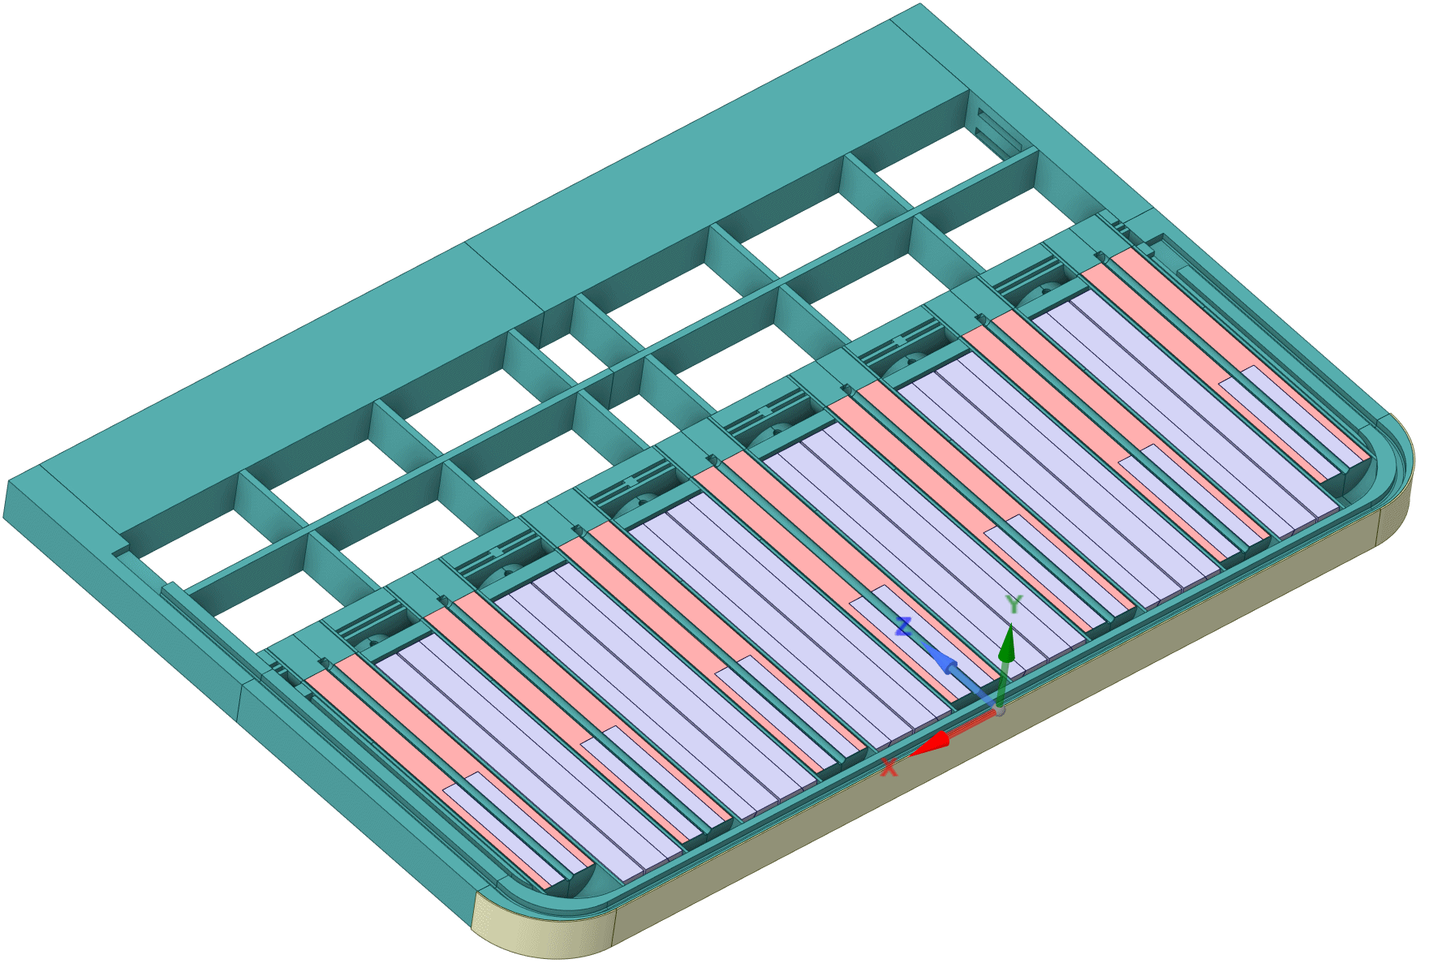
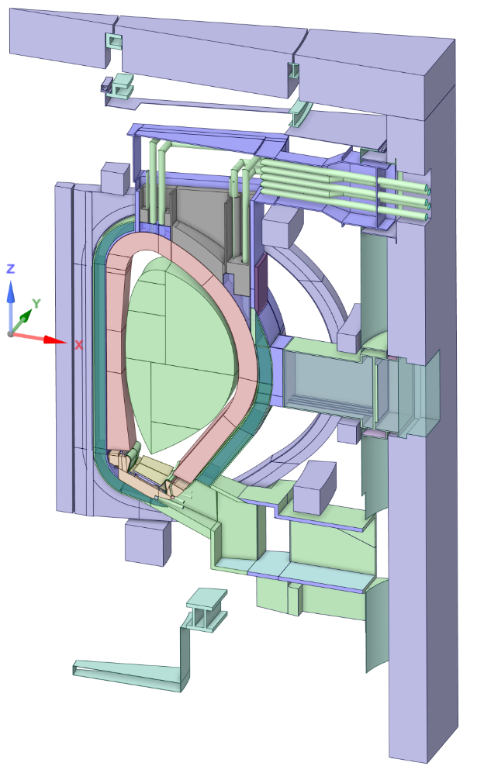
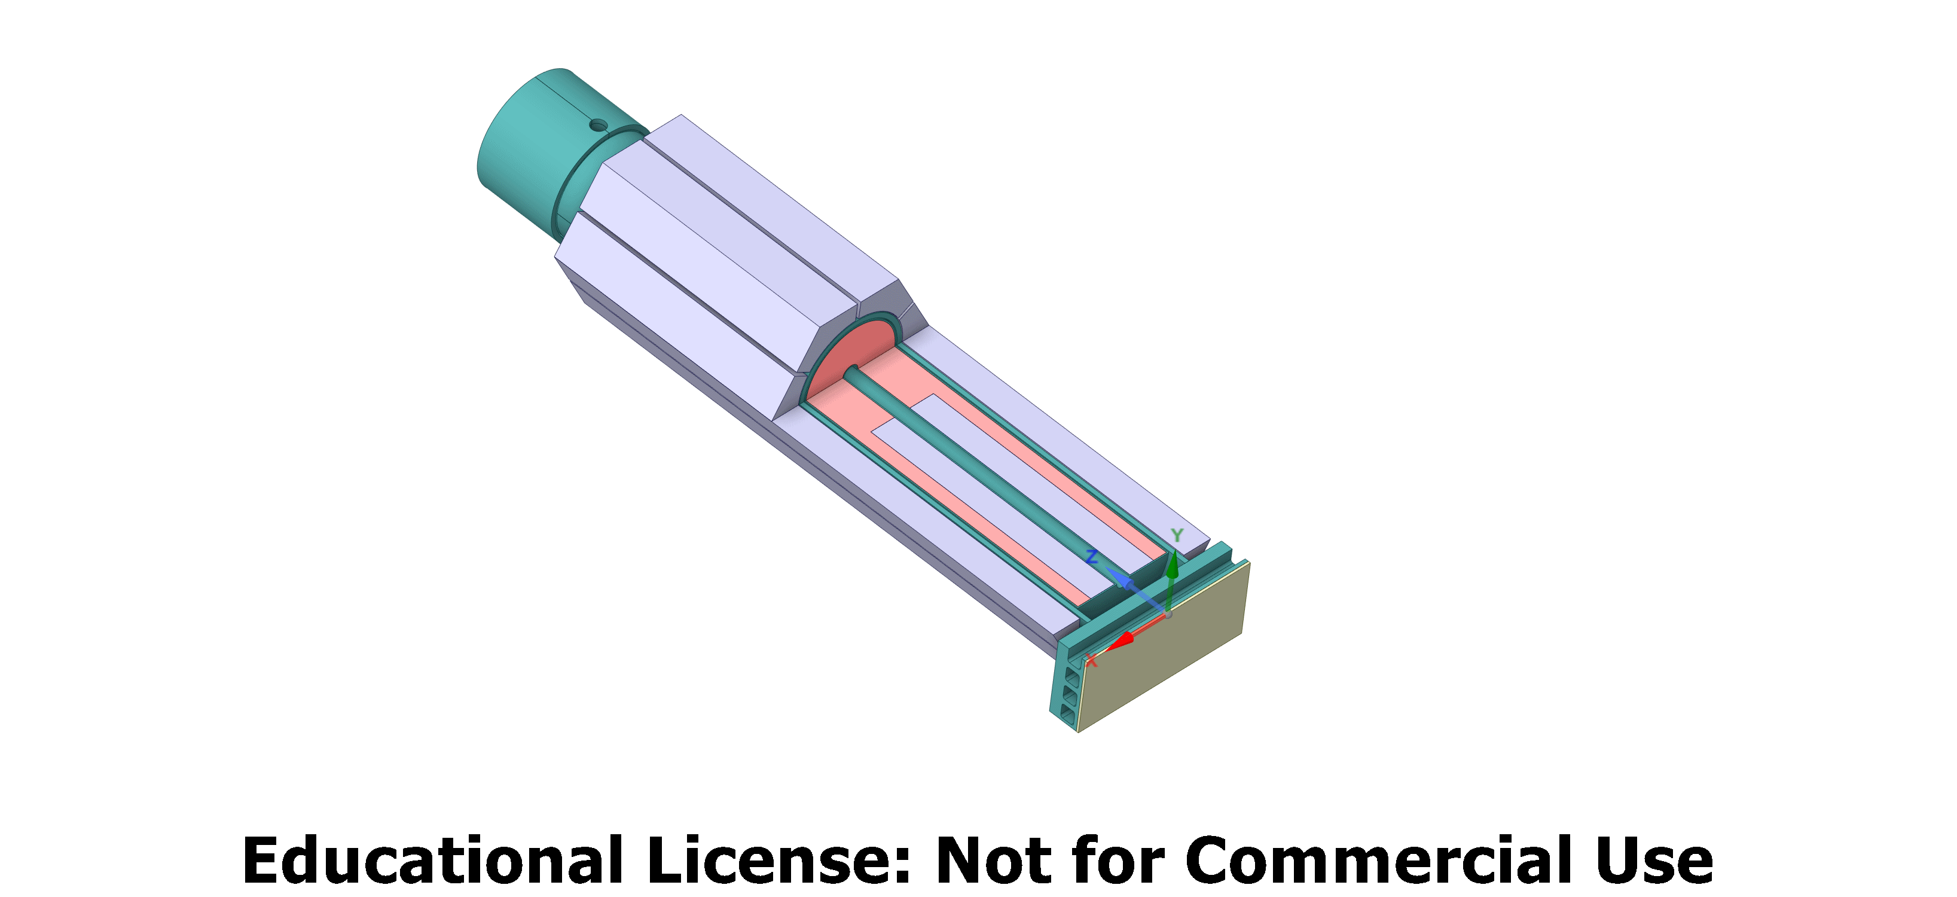
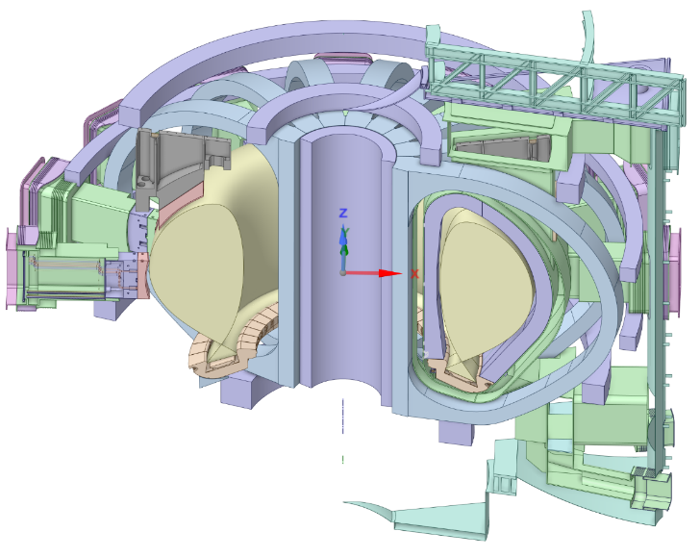
II. MCNP geometry model
DEMO toroidal segment
DEMO blanket
The model uses a CAD design
Modular based
Almost arbitrary complexity
DEMO
DEMO
“fuel pin”

Slide 12
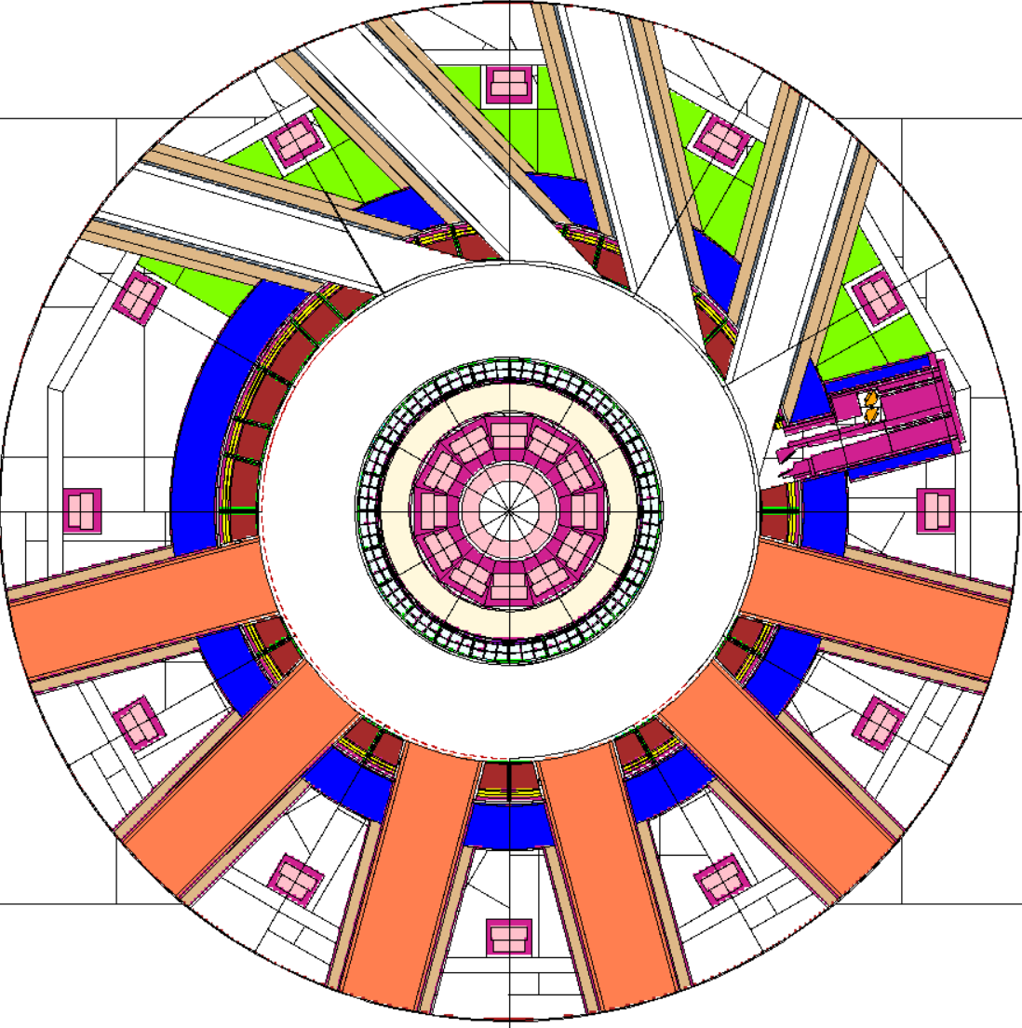
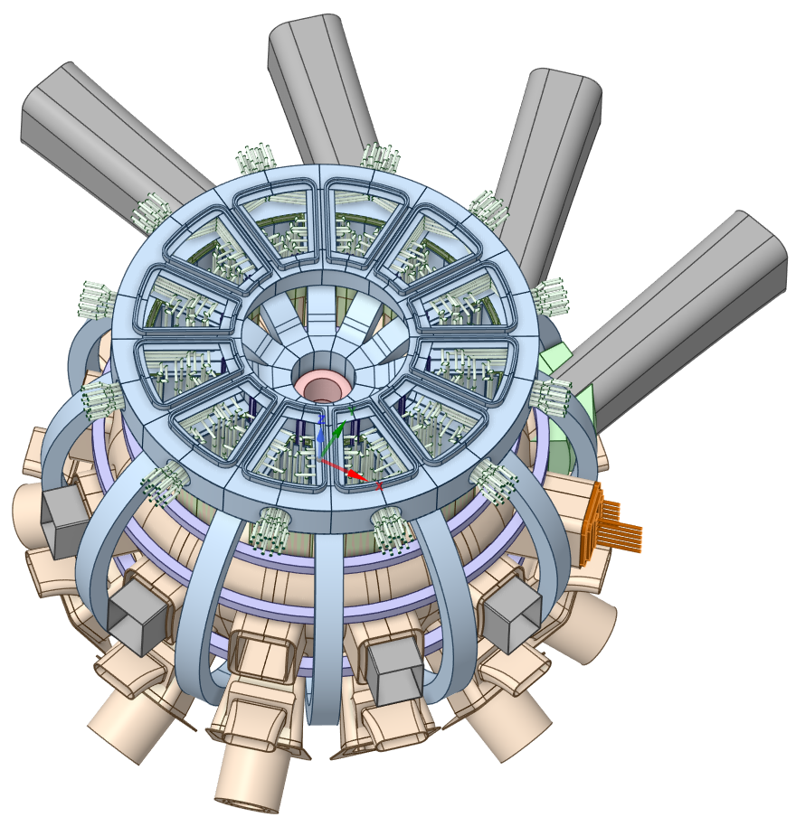
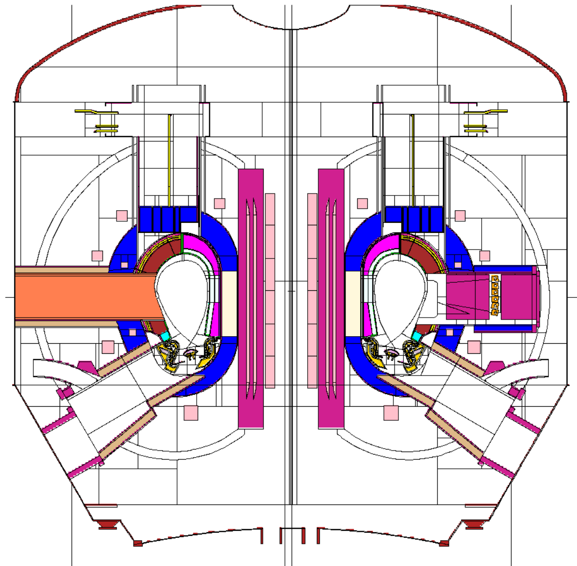
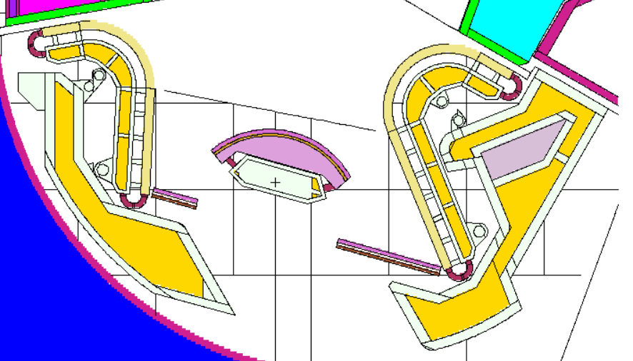
II. MCNP geometry model. Model generation
European
automated
conversion
CAD
MCNP

Slide 13
III. Nuclear data
The data used in the MCNP calculations:
Neutron induced reaction data from the latest European data library JEFF-4.0 (Joint European Fission Fusion), 2025
Big community of the developers (~100 people), well validated against microscopic and integral measurements, permanent quality and version control, continuous improvements towards high quality
Reaction cross sections (E_{n} ≤ 200 MeV)
Secondary particle distributions (energy and angle)
Gamma induced reactions
Photo-atomic (E_{γ} ≤ 1000 MeV), from Los-Alamos Laboratory
Gamma-nucleus (E_{γ} ≤ 200 MeV), from JEFF-4.0
Electron-atomic data
Uncertainty data for nuclear reactions (specially dedicated European project):
Variance data: estimated uncertainty due to experimental data and nuclear modelling uncertainty
Covariance data: estimated uncertainty of data variation due to interaction of different reaction channels

Slide 14
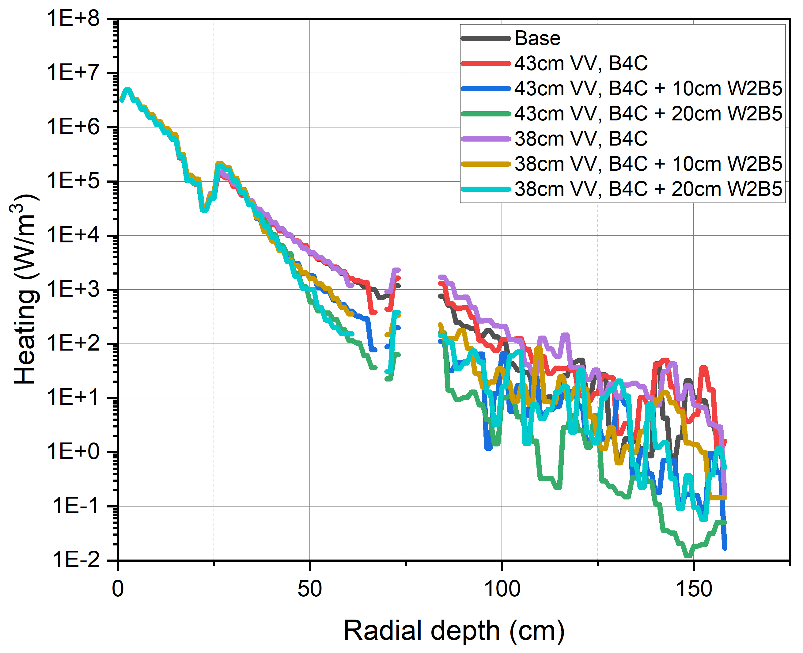
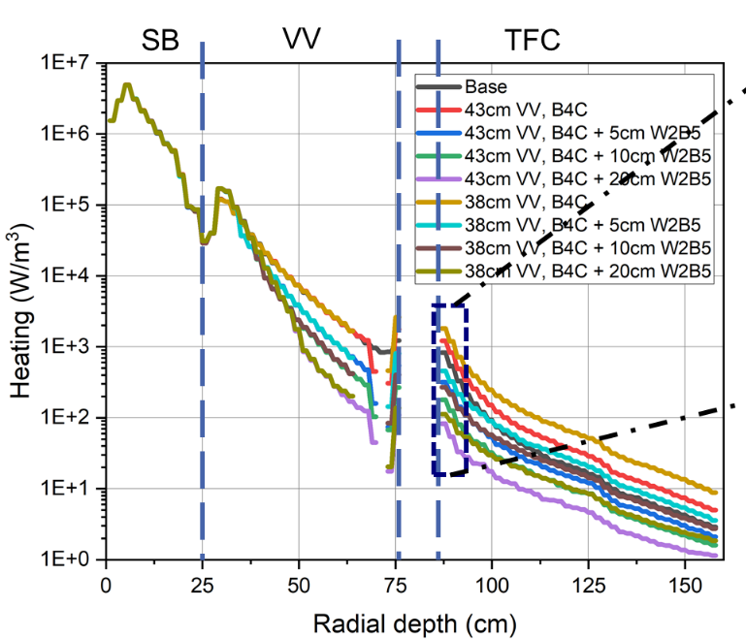
IV. Monte Carlo calculations
“MCNP code is not intended to be used as a “black box”.
MCNP simulation setup includes:
The geometry specification (geometry model)
The description of problem materials and selection of nuclear data
The location and definition of the particle source
The type of answers requested (various nuclear responses)
Variance reduction technique.
To assure the quality of the Monte Carlo calculations:
The number of histories (initiated source particles) is not indicative of the quality of the response
Variance reduction technique is applied to reduce the statistical uncertainty
The convergence of the results should be questioned
The statistical (Monte Carlo) uncertainty of the results should be below acceptable limit:
10% as a rough estimate
~ 1% accepted for simulations in EUROfusion VNS project
Wrong result
Correct result

Slide 15
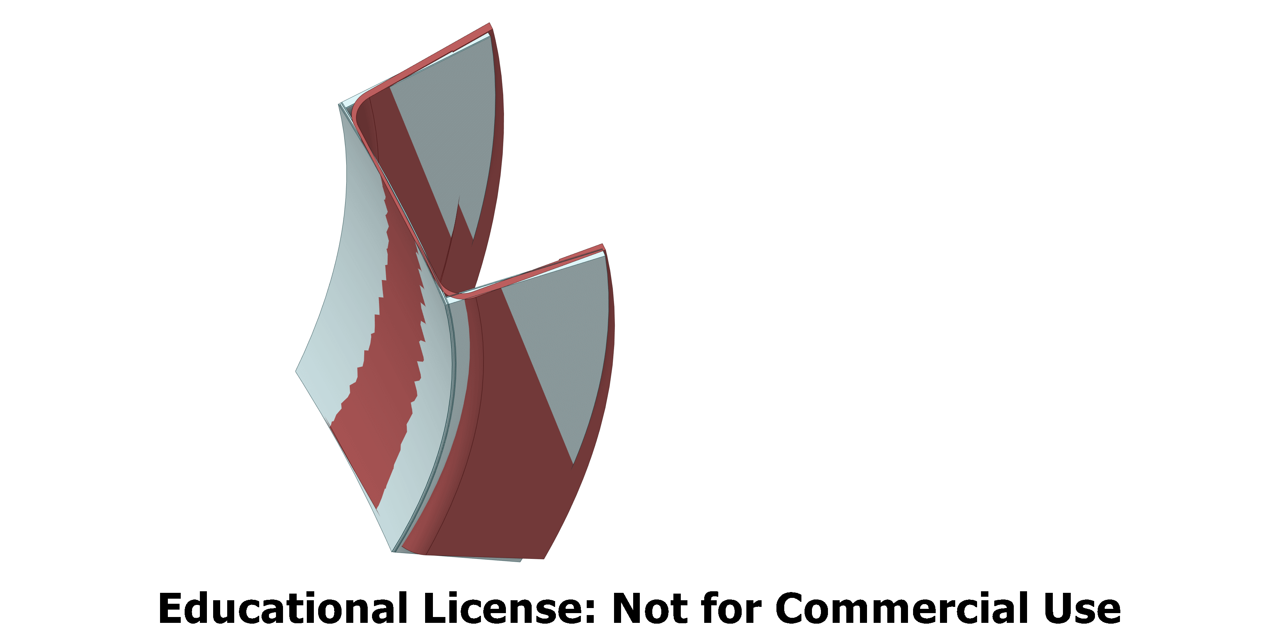
IV. Monte Carlo calculations. Uncertainty analyses
The reasons of the Monte Carlo results uncertainties:
Uncertainties due to geometry modelling
Depended on specific geometry
Sensitivity analyses are carried out for every project
Sensitivity to geometry simplifications (CAD level)
Sensitivity to geometry modelling (MCNP level)
Sensitivity to materials definitions
Uncertainties due to Monte Carlo technique
Results should be check on convergence
Accepted statistical uncertainty should be adequate the response: Tritium Breeding Ratio → ≤ 0.1%, TFC nuclear loads → ≤ 2%
Uncertainty due to nuclear data
The results are produced trough a time-consuming Total Monte Carlo simulations with thousands of the randomly prepared nuclear data files
Simplified
Original

Slide 16
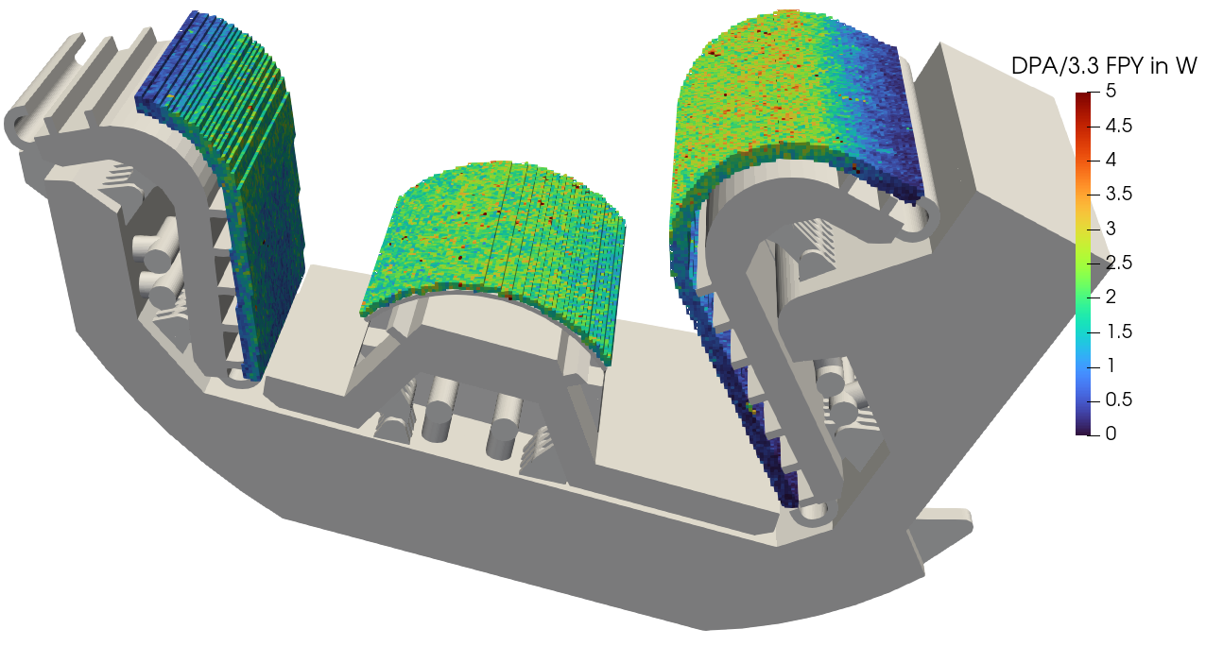
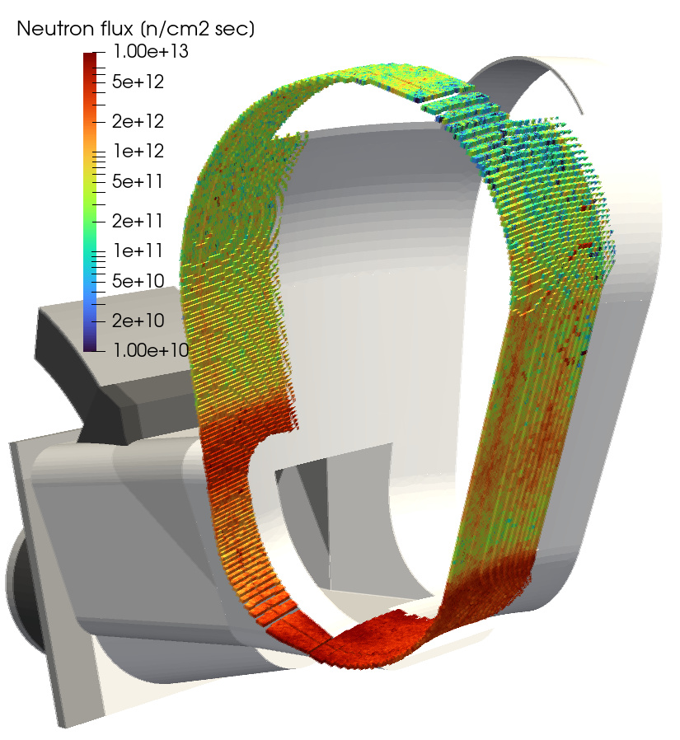
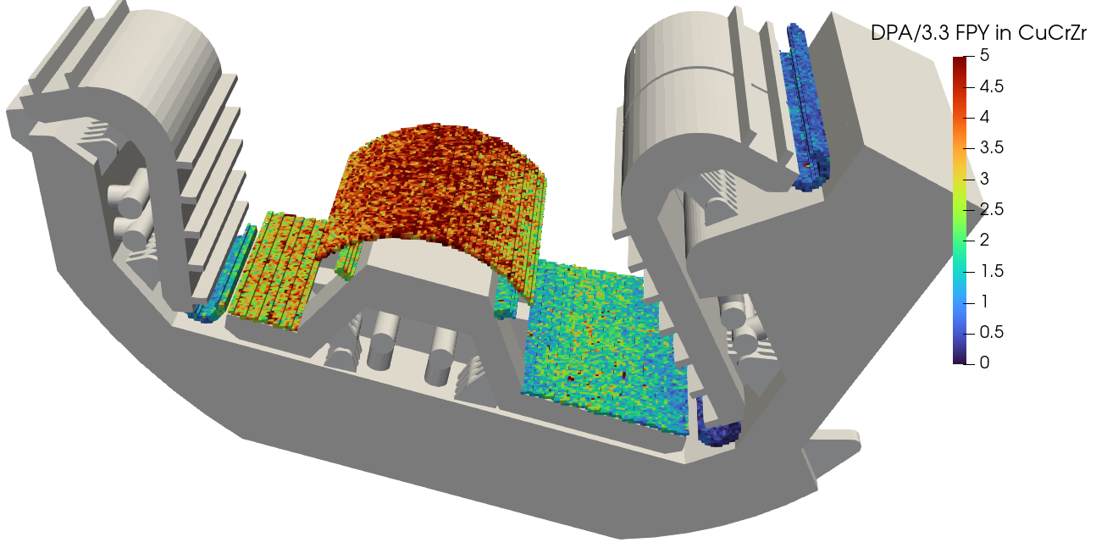
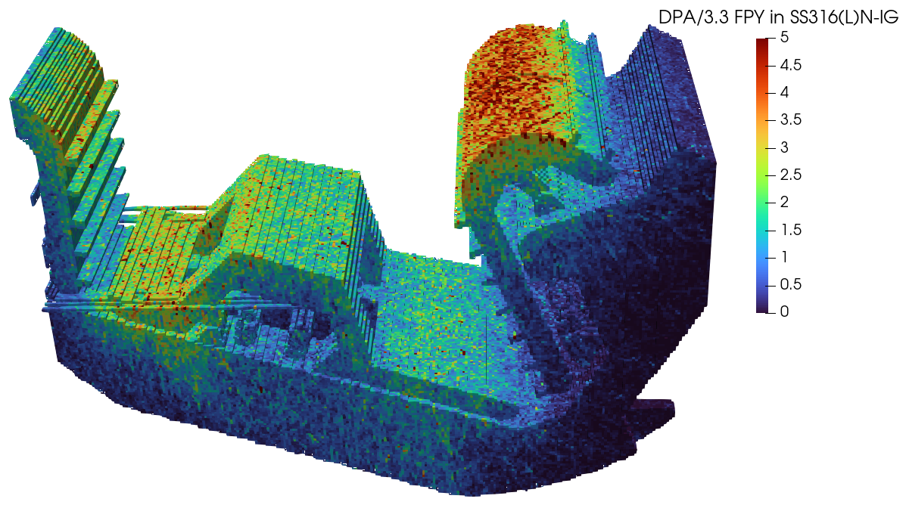
IV. Monte Carlo calculations. Visualization of results
Neutron flux
Nuclear damage

Slide 17
Safety modelling: current status and key gaps
Status: a toolchain exists
System codes (MELCOR, ASTEC, RELAP5-3D, …)
Containment (COCOSYS) and CFD/structural support
Source term & consequence tools (activation, tritium, ACP, dust, release)
Main fusion-specific gaps
Multiple working fluids (water, He, PbLi, molten salts, cryogens, H-isotopes)
New materials/impurities and chemistry
Source terms behaviour: W dust, tritium, activated products
Need
Qualification plan: verification/validation + long-term maintenance
Take-away: Safety requires a qualified chain and credible uncertainties.

Slide 18
Safety codes (examples) and integration needs
System / containment
MELCOR (fusion), ASTEC, RELAP5-3D, …; COCOSYS
Source terms
FISPACT-II, ACAB, TMAP, OSCAR-Fusion, …
Release / consequences
JRODOS, MACCS, COSYMA, …
Sensitivity / UQ
RAVEN, SUSA, …
Integration focus
Consistent interfaces, shared assumptions, V&V + UQ across the chain
Take-away: Integration and governance are as important as the codes themselves.

Slide 19
What engineering needs from the plasma theory/modelling community
Shareable plasma scenario definitions
Standardised pulses/transients/off-normal events + metadata
Clear mapping to engineering load cases
Boundary conditions with uncertainty
Heat/particle flux, ELM/disruption statistics, radiation spectra
Uncertainty envelopes usable for design margins
Coupling interfaces
APIs / data formats to feed the digital thread
Configuration control and traceability
Joint benchmarks
Integrated benchmarks (plasma → PFC → plant) and agreed KPIs
Experiments that reduce dominant engineering uncertainties
Take-away: Co-design standards, UQ and benchmarks to make models actionable for design and licensing.

Slide 20
Thank you for your attentions

