Slide 1

WP Plasma-Wall Interactions and Exhaust
WPTM Meeting TSVVs
Sebastijan Brezinsek (PL)
Forschungszentrum Jülich
Heinrich-Heine-Universität Düsseldorf
J.W. Coenen (FZJ), A. Hakola (VTT), K. Schmid (MPG),
A. Kirschner (FZJ), A. Goriaev (ERM/KMS), J. Likonen (VTT), I. Classen (DIFFER) M. Reinhart (FZJ, PSO) and D. Douai (CEA, DPL)

Slide 2
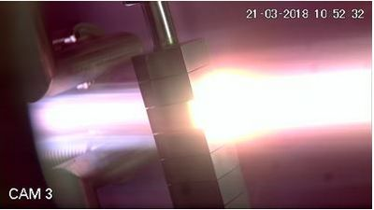
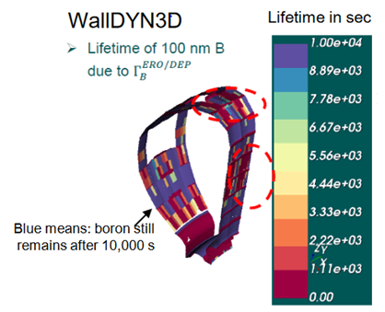
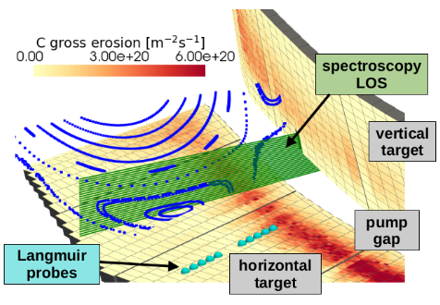
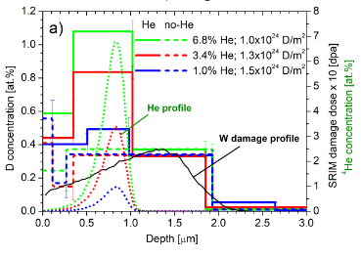
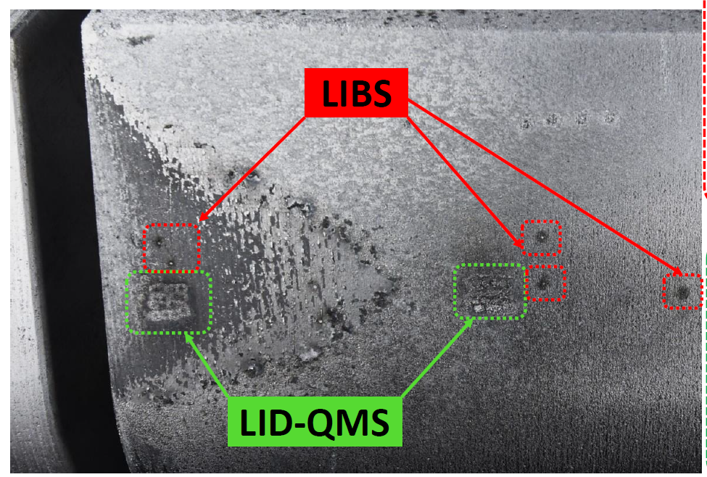
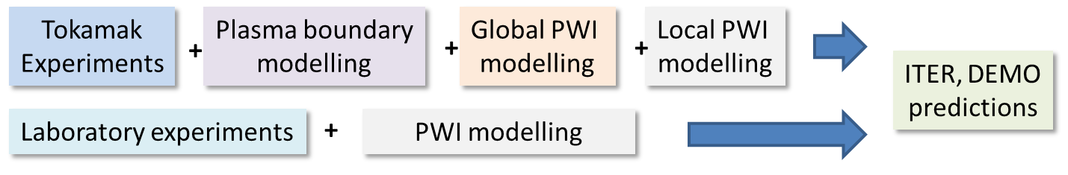
Work Package Plasma-Wall Interactions and Exhaust
Focus on ITER and PFP materials, H and isotopes, He, seeding gases, and impurities
Particle and heat flux
Tungsten + Deuterium
In linear devices
Runaway beam damage
of PFCs analysis and interpretative simulation
Support in WPTE exploitation
In AUG, WEST and JET in PWIE
area with metallic PFCs
Goal: steady-state operation
MAGNUM
Support in WPW7X exploitation
operating with C towards W
ITER
[T. Morgan]
[I. Jepu]
[K. Schmid]
[J. Romazanov]
[S. Markelj]
Synergistic effects by heat flux and plasma loading of W materials
3D erosion & deposition modelling
Tungsten and Boron
Fuel retention in steel and tungsten
Neutrons + Deuterium/Helium
Surface analysis (D,T) by
Laser-based techniques
Recombining H,D plasmas in PSI-2 and MAGNUM-PSI (CRMs)
Wall conditioning in TOMAS and boronization assessment

Slide 3
Main Objectives for 2026/2027 I
WPPWIE covers high priority activities for ITER (new baseline), supports pilot power plant and reactor-class devices, supports tokamak and stellarator exploration, and addresses open physics questions in are of plasma-wall interactions, plasma boundary and particle exhaust
WPPWIE core program of 2025 continues in 2026 and 2027 addressing these priority items
Support program for ITER: W sources, transport, influx, and deposition at the first wall and divertor |T retention, quantification, and removal from B | (temporary) first wall material qualification
Support program for pilot and fusion plant activities: (novel) material qualification | transients and high fluence | PWIE simulations (e.g. lifetime) | retention/diffusion/permeation in PFCs/blanket (W/steel)
Support program for JT-60SA/Wendelstein7-X: transfer from C towards W PFCs | power handling | material migration | divertor functionality optimization| long-pulse PWI operation aspects

Slide 4
Main Objectives for 2026/2027 II
PFC qualification and lifetime: synergistic effects in loading and operation beyond damage | RE beam damage analysis / interpretative modelling / predictions
PWIE code development and benchmark experiments: pedestal⬄ plasma-wall interface ⬄ material using linear machines, laboratory experiments, reference experiments in full-W devices (ASDEX Upgrade, WEST and incl. EAST collaboration for CXN)
PWIE simulations for novel tokamak scenarios QCE, XPR| first wall vs. divertor W sources | material migration studies | benchmark experiments
Completion of JET components analysis: tungsten, steel, RE-damaged PFCs, T and He retention
Benchmark of CRM with A&M data for H, D, T (atoms and molecules) | W collisional-radiative models | B chemistry, MD calculations
In-operando diagnostics optimisation for material composition and retention | lessons learned from LIBS and LID-QMS at JET towards next step devices |analysis stations in hot cells | simulation and fast analysis tools
Support in surface analysis for toroidal devices and linear plasma experiments
First exploration of PEX JUDITH-3/PSI-2 with tungsten samples (end of 2027)

Slide 5
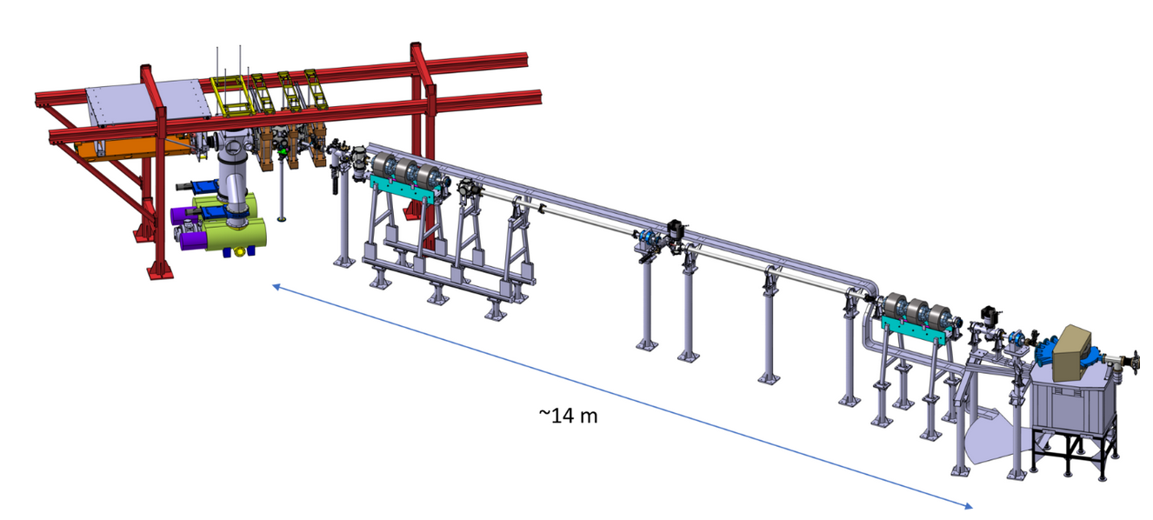
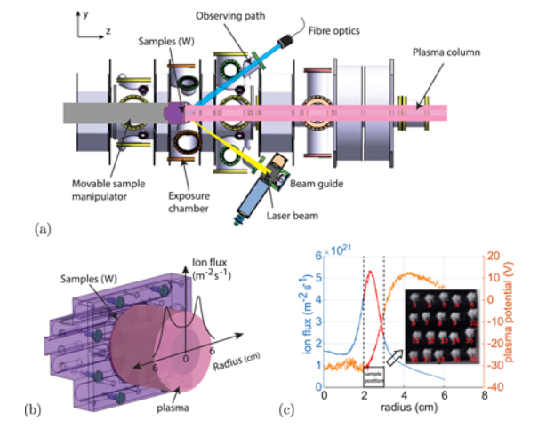
Improved in-situ/vacuo fuel retention and recovery capabilties
SP C + SP F + SP X (in-vacuo) + SP D
Fuel retention and release properties of B layers exposed to fuel species and build with fuel
Simulation related to fuel trapping and release
Ion-damage W material studies
SP C + SP F + SP X (in-operando) + SP D
Fuel retention and release properties of B layers exposed to fuel species and build with fuel
Simulation related to fuel trapping and release
Recycling-studies on surface for W, B, layers
H. van Eeck et al.
DIFFER
Modelling of linear plasma experiments:
Plasma and neutrals
Plasma-Wall Interaction modelling and retention
Validate codes, atomic and molecular data, materials data

Slide 6
General WPPWIE view on TSVVs (status)
Good direct interaction between WPPWIE subproject D and former TSVV-5, TSVV-6, TSVV-7 members
WPPWIE provides input in atomic and molecular data, plasma backgrounds, reference experiments in
linear devices, post-mortem analysis from tokamaks and stellarators to benchmark, complementary
simulations, validation of code packages in laboratory experiments, etc.
Interaction benefits from personal involved in both packages. common meetings, code camps etc.
General WPPWIE view on TSVVs (future)
TSVV-C,-D, and-K provides code packages, which are still und development, but parts and modules are
- usable for predictive modelling for full-metallic devices within EUROfusion portfolio or beyond
- usable for interpretative modelling of plasma-edge, plasma-wall interaction, and exhaust as benchmark
Main missing points from WPPWIE perspective
  real PWI-plasma coupling (iterative loop with plasma cooling by impurities)
  time-resolved plasma boundary simulation capability (transients and fuelling)
  plasma flows and drifts in 3D boundary codes
  turbulence code - PWI code coupling to assess the impact of turbulence on impurity sources
  Footprint of damage (RE beam) from modelling
Clarification where dust formation, conversion, transport in plasma and recessed areas is covered

Slide 7
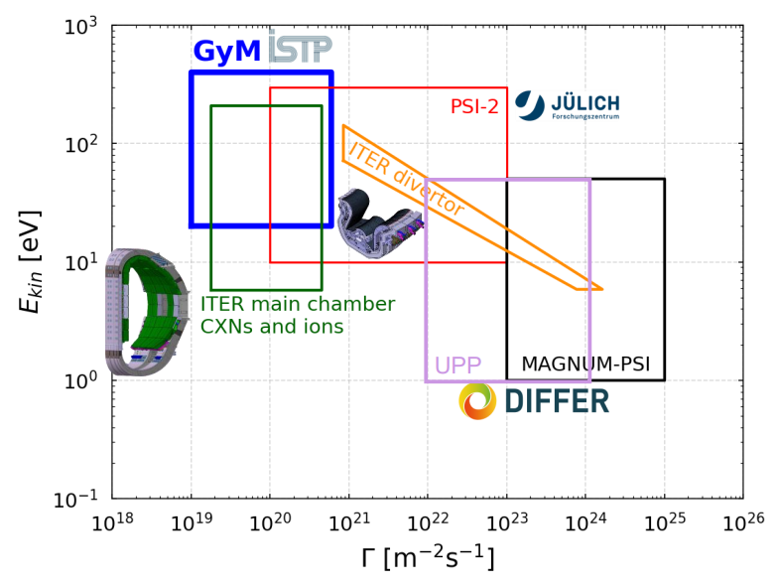
Operational space of linear devices: Impact energy vs. flux
Steady-state devices and can
reach fluences up to 10³⁰Dm⁻²
per operational day
Link to WEST experiments
Relevant fluence for ITER
JULE-PSI space as PSI-2,
but in controlled area suitable
for T, activated and toxic materials

