Slide 1

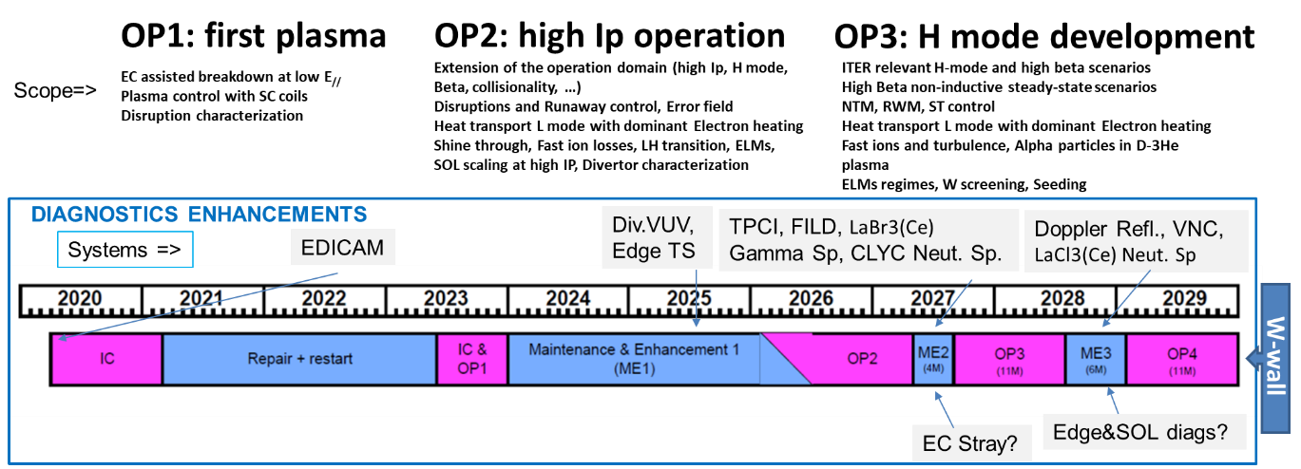
WPSA objectives in 2026-27
The overall objective of WPSA is to support the scientific exploitation of JT-60SA through the development of machine enhancements, operational tools and operational expertise in cooperation with the EU implementing agency F4E.
This work is being performed in close connection with the JT-60SA Experiment Team for the assignment of priorities in the enhancements program
Most of 2026: JT-60SA through Machine Enhancements 1
Most of 2027 dedicated to OP2:
significant participation expected (running diagnostics and related data processing and validation)
Grant Milestone | Commissioning of the Edge Thomson Scattering diagnostics in JT-60SA completed | 31.12.2026
Grant Deliverable | Report on first measurement of the pedestal density and temperature at sub-cm spatial resolution in JT-60SA | 31.12.2027

Slide 2
ENHANCEMENT and OPERATION activities in 2026 - 2027
Thomson Scattering System
Installation, system commissioning and exploitation of the edge TS system (2026)
Exploitation and support to operation in OP2, OP3 (partially on site) (2027)
Divertor VUV
Installation, development of the analysis software (synthetic diagnostics), commissioning and evaluation/validation of the first spectra against noise, support to the Experiment Team for scientific exploitation in OP2
Commissioning of the MGI system and first operation with plasma (2026)
Support for the operation of EDICAM and data interpretation; in particular, assisting the development of high current scenarios
Support to neutronics calculation for diagnostics shielding and for the development of the collimator of the Gamma Rays Spectrometer and of the Compact Neutron Spectrometer (2026)
Installation, commissioning and support to operation of the Runaway Electron Monitor (tbc)
2027
Installation and commissioning of FILD
Installation and commissioning of TPCI – validation of the synthetic diagnostics
Installation and commissioning of LaBr₃(Ce) Gamma Spectrometer
Support to the development of the Pellet Launching System (Sources development and integration with the launcher)
Procurement and characterization of the LaCl₃(Ce) Compact Neutron Spectrometer
Finalize the design of Doppler Reflectometry
Finalize the design of the Vertical Neutron Camera
Support the selected Edge and SOL diagnostics

Slide 3
Code Management activities in 2026 (~1ppy)
G Falchetto - Area Coordinator
Main objective: consolidation, test and provision of operational tools for use in Naka “control-room” in support to the scientific exploitation :
JT-60SA PDS : PDS optimised and applied to JT-60SA hybrid scenario
Magnetic control integrated tools demonstrated on a relevant scenario
Intrashot data visualization and analysis tools adapted to OP-2 (eg automated profile fitting tool)
Consolidation of EC HCD and ECE modelling tools
Consolidation of tools in support of OP-2 magnets operation
TPCI synthetic diagnostics tested on a relevant scenario
Training for users on the Pulse Design Simulator, ATEP workflow, MHD chain

Slide 4
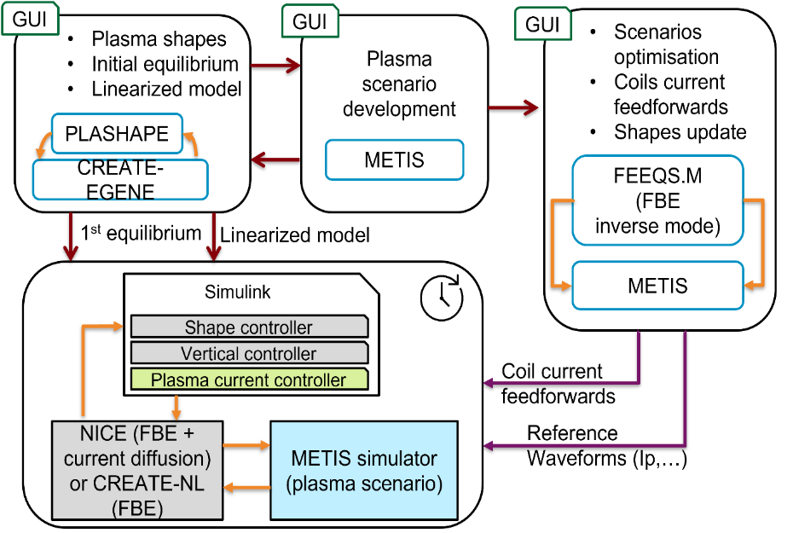
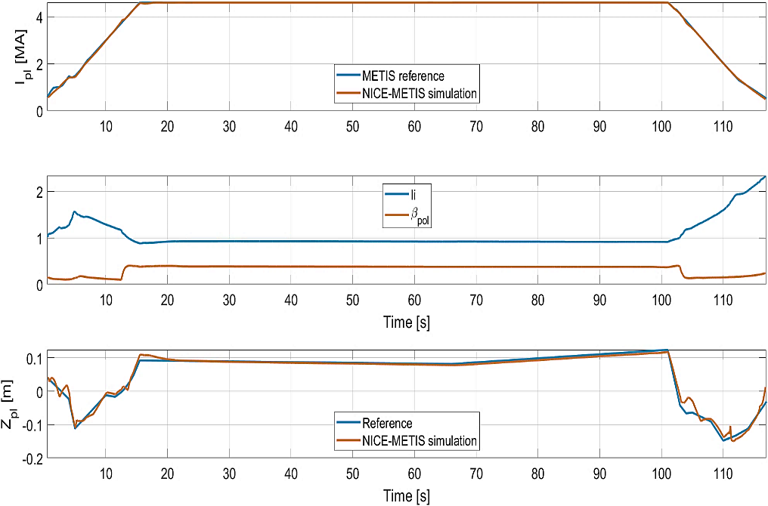
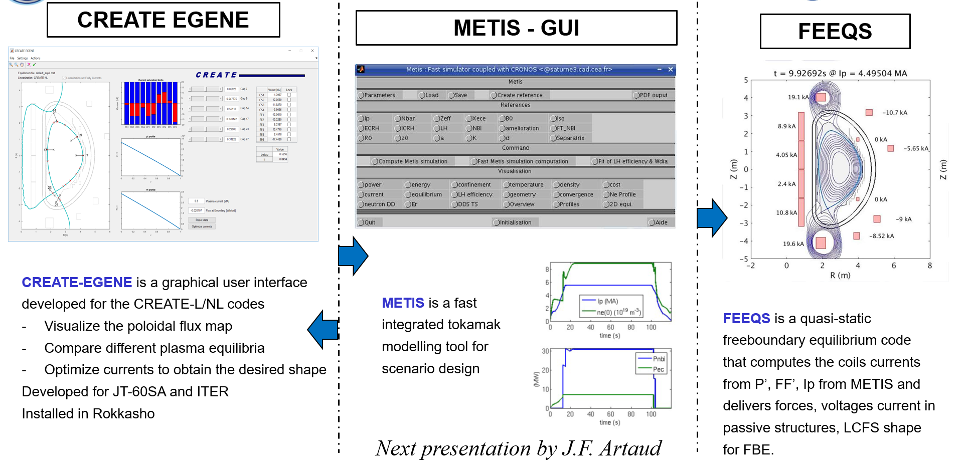
Pulse Design Simulator for JT-60SA
[E. Joffrin et al 2026 Submitted to Nuclear Fusion ]
PDS full discharge simulation of JT-60SA 4.6MA/2.25T scenario
Caveat: JT-60SA PDS is not yet routine, nor “press button code”; hence, a training is required to get familiar with the various components.
A training is being prepared and will be offered in 2026:
to users willing to gain experience in scenario design, in view of proposing an experiment or becoming a plasma operator;
although target will be JT-60SA it can be valuable in view of PDS development for other devices, like WEST and ITER, which are using similar tools.

Slide 5

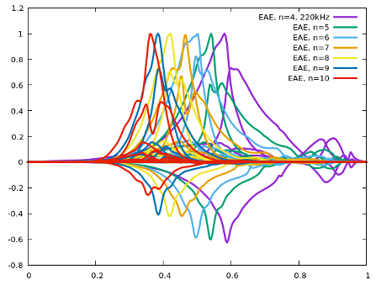
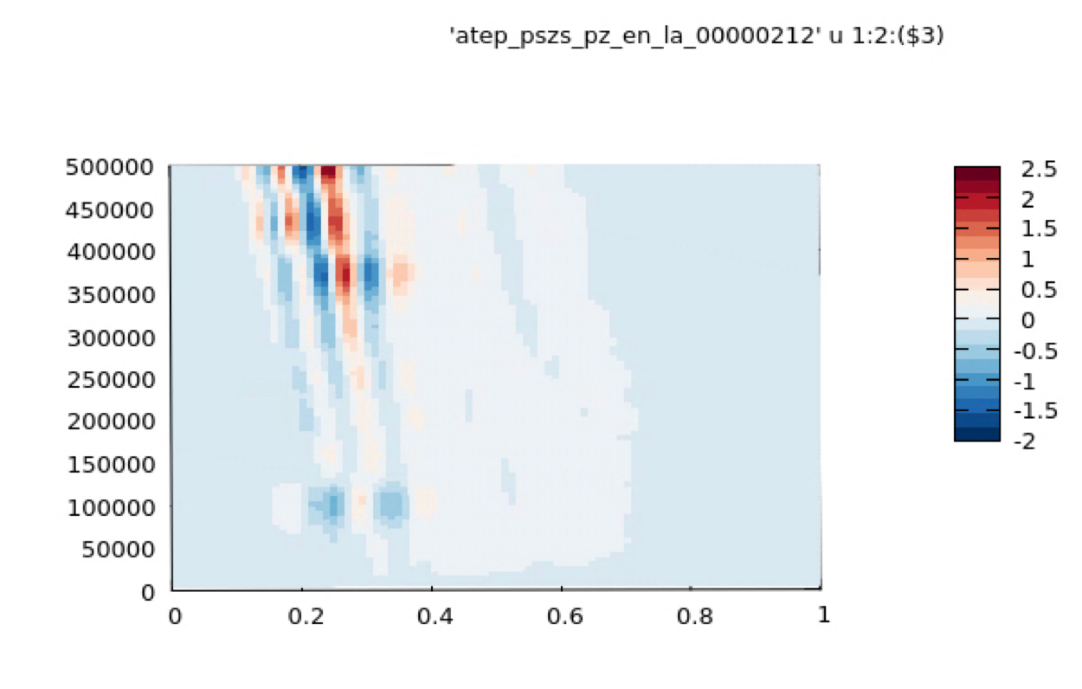
EP-Stability Workflow
[courtesy Ph. Lauber]
new versions of EP-Stability Workflow available on ITER SDCC and new Gateway (thx T. Hayward-Schneider & V.-A. Popa)
docker image in preparation (thx to B. Pogodziński, ACH Poznan)
open source in preparation
soon: use ATEP and/or EPCOM transformed NBI data (CoM IDSs) for EP-WF
waiting reference JT-60SA cases in IMAS format - the training course should be built on updated SA equilibria
training course (July 2023) can be repeated with updated WF versions (https://indico.euro-fusion.org/event/2729/)
JT-60SA: EAEs
e.s. potential
radius
phase space zonal structure
energy [eV]
radial coordinate |Pz|

