Slide 1
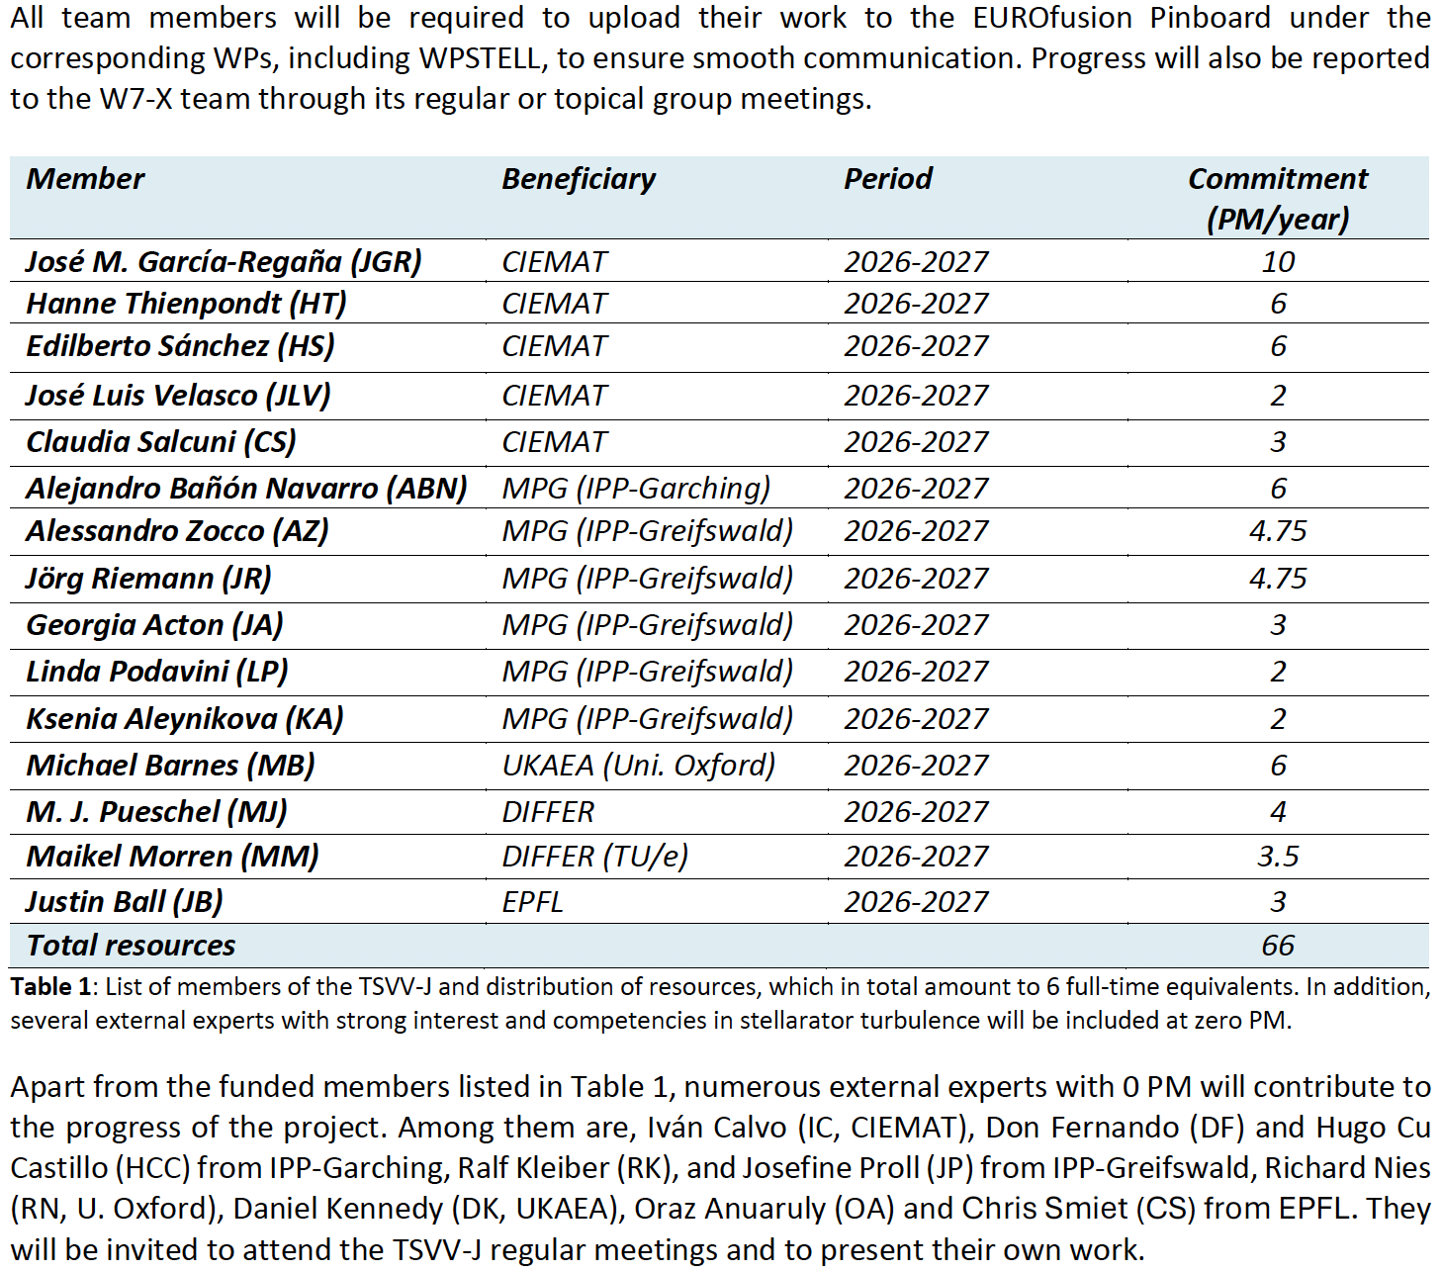
TSVV#13 → TSVV-J
TSVV#13 Stellarator turbulence simulation → TSVV-J Stellarator Core Turbulence
If there is anyone else you would like to keep in the loop, please let me know.
J. M. García Regaña | TSVV-13 Meeting 27 | Zoom | 15/12/2025 | Page 1

Slide 2
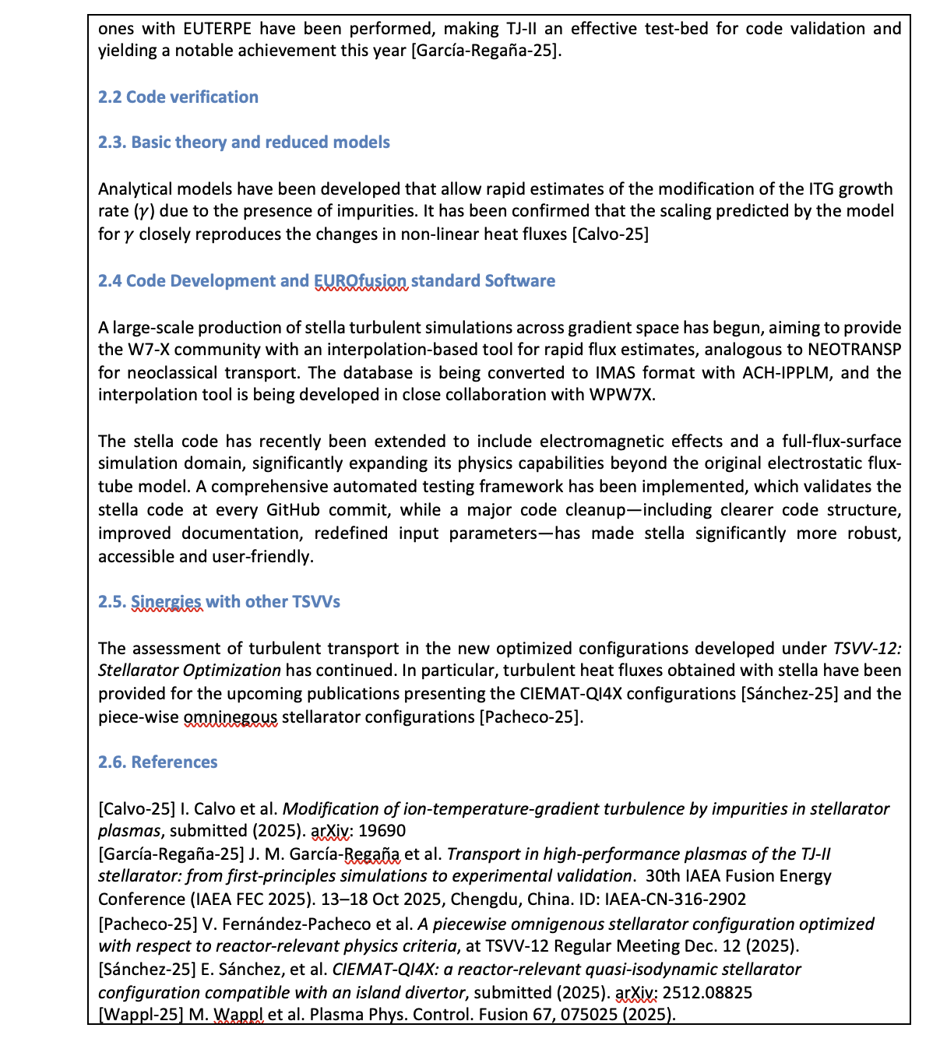
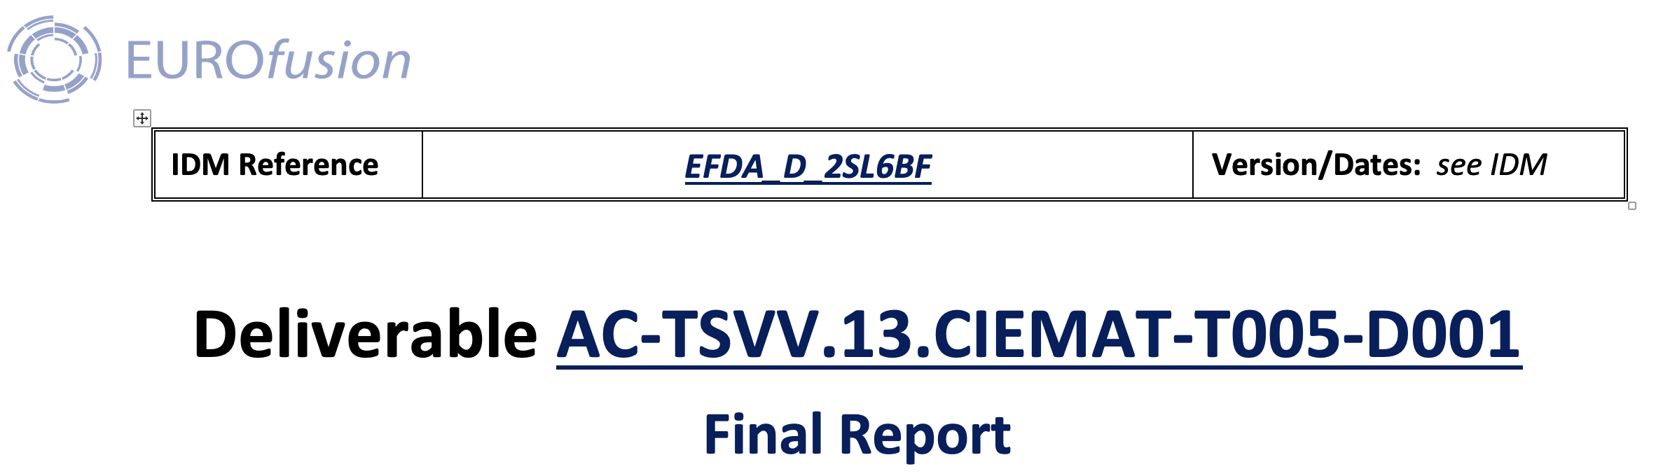
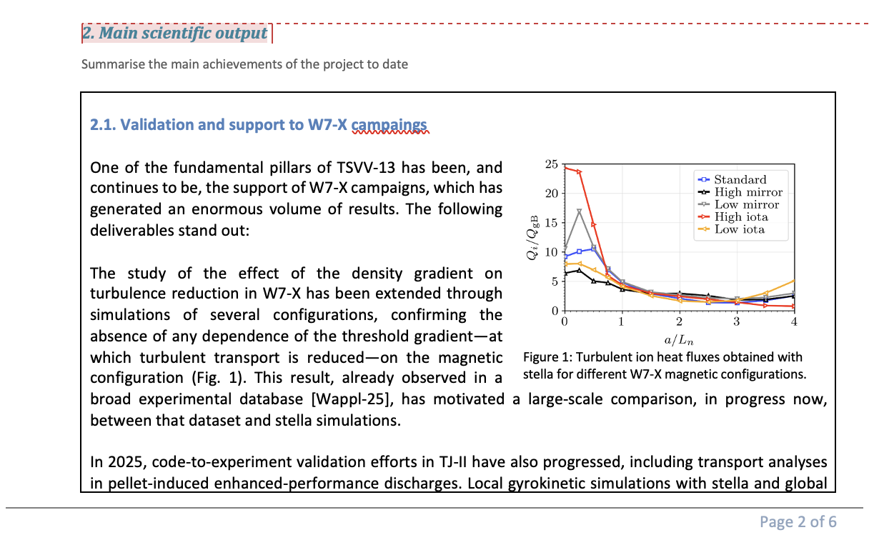
Feedback from TSVV#13: Final report
Please, send me your feedback by Thursday Dec. 18
J. M. García Regaña | TSVV-13 Meeting 27 | Zoom | 15/12/2025 | Page 2

Slide 3

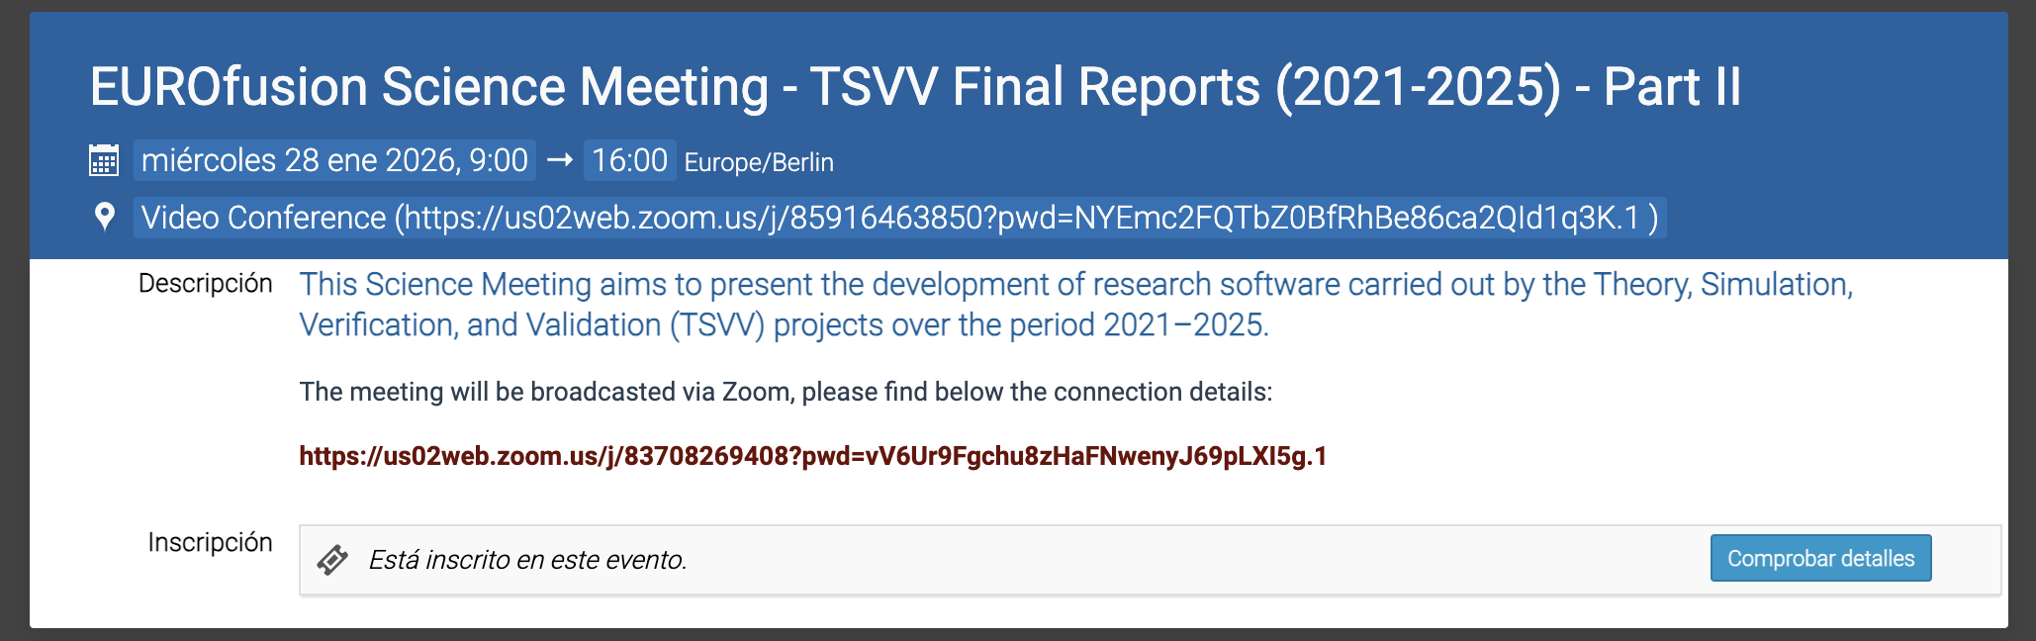
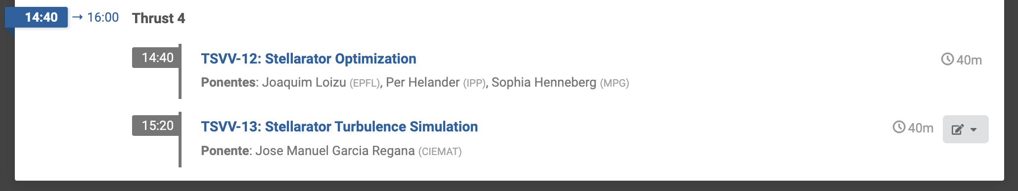
Feedback from TSVV#13: Science Meeting
J. M. García Regaña | TSVV-13 Meeting 27 | Zoom | 15/12/2025 | Page 3

Slide 4
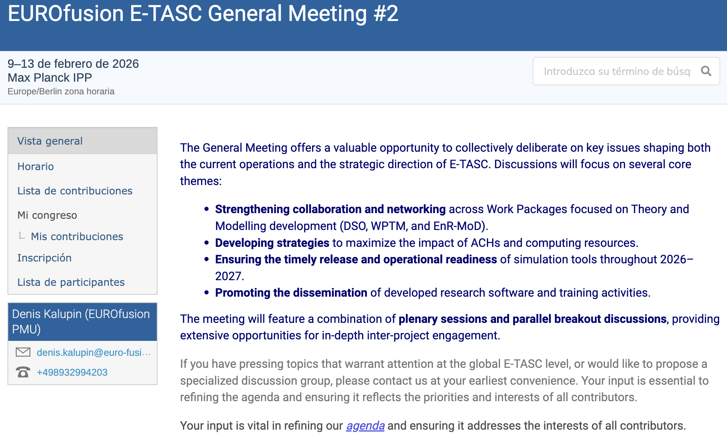
E-TASC General Meeting II (Feb. 9-13)
Poster session on Tuesday: Status and plans of activities by projects (TSVVs, DTEs, DATA, EnRs)
J. M. García Regaña | TSVV-13 Meeting 27 | Zoom | 15/12/2025 | Page 4

Slide 5
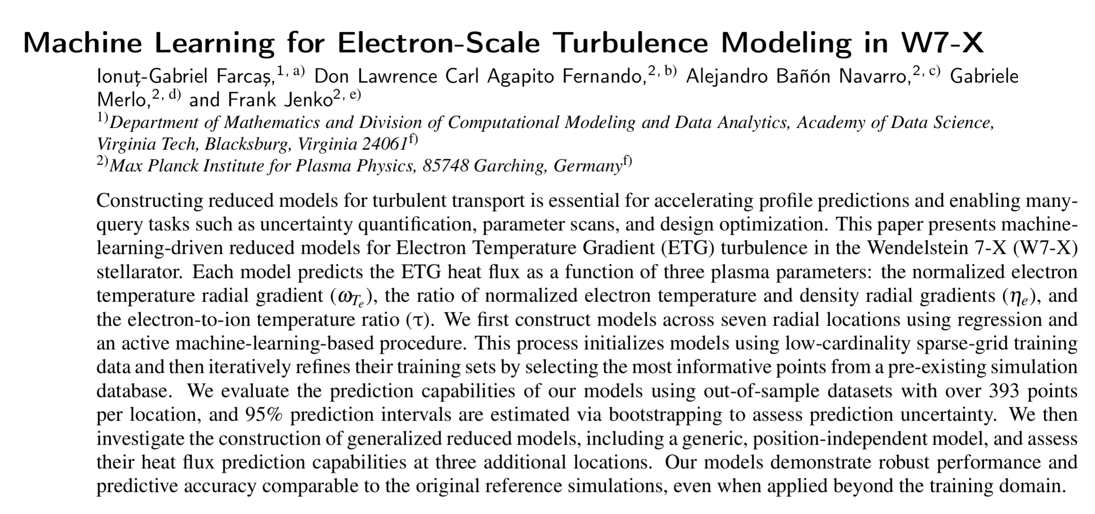
Agenda
# | Title of contribution | Speaker
1 | TSVV13 updates (reporting, E-TASC general meeting) | J. M. García Regaña (CIEMAT)
2 | Machine Learning for Electron-Scale Turbulence Modeling in W7-X | Don Fernando(IPP-Garching)
Next meeting:
January 12 at 11:00 CET (10:00 UK)
J. M. García Regaña | TSVV-13 Meeting 27 | Zoom | 16/12/2024 | Page 5

