Slide 1
Contributions from Aalto University
TSVV-5 : Report 2025
Ray Chandra, Timo Kiviniemi, Mathias Groth
Aalto University, Espoo, Finland
Dec 12, 2025

Slide 2
TSVV-5 deliverables 2025: development and application of EIRENE photon model & EIRENE validation in JET
Full photon-gas-plasma coupling enabled in SOLPS-ITER and validation with JET-ILW Ohmic plasmas
Evaluation of isotope effect on (H,D,T) gas pumping with time-dependent EIRENE simulations of JET-ILW

Slide 3
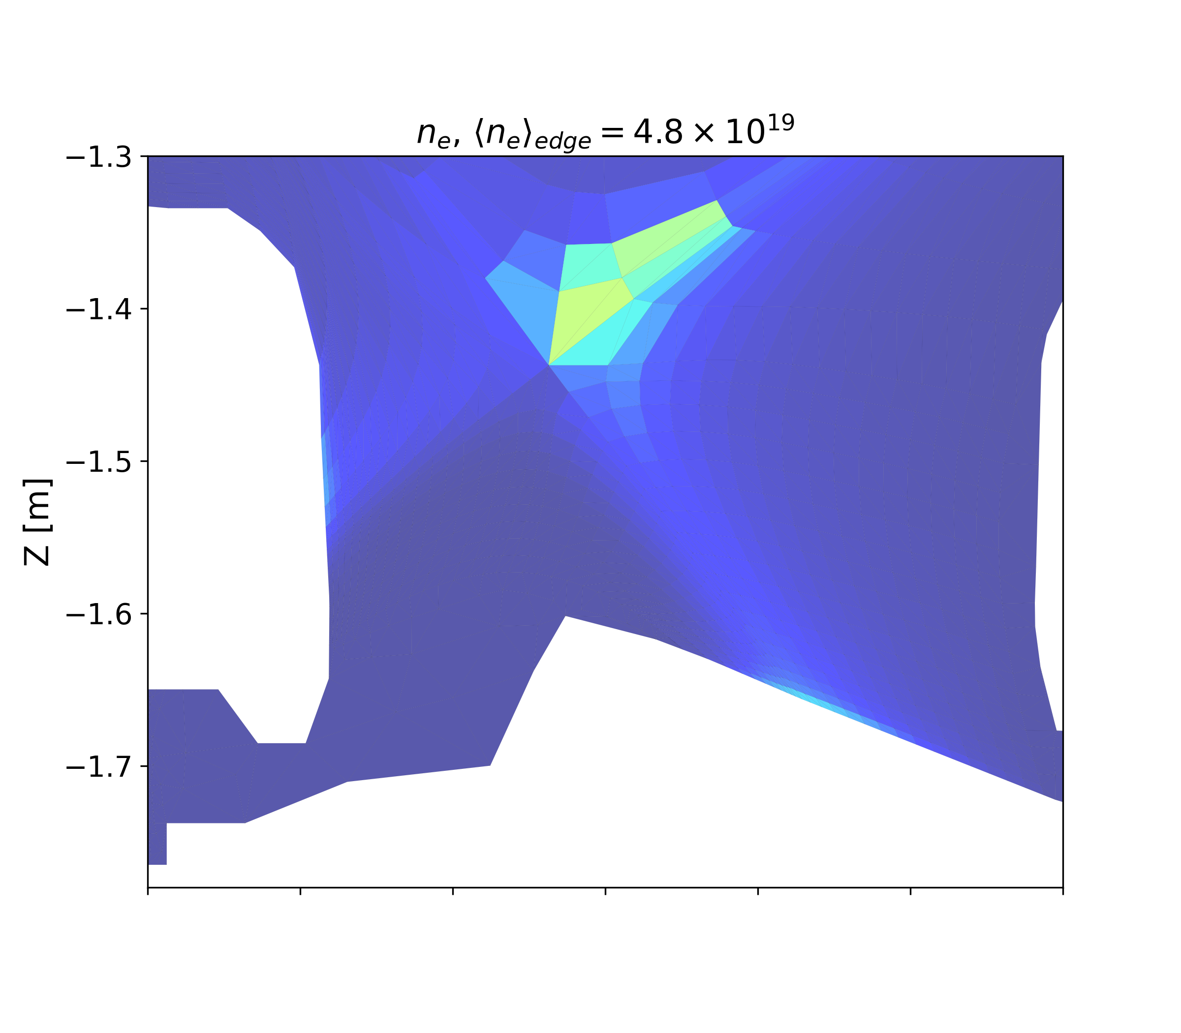
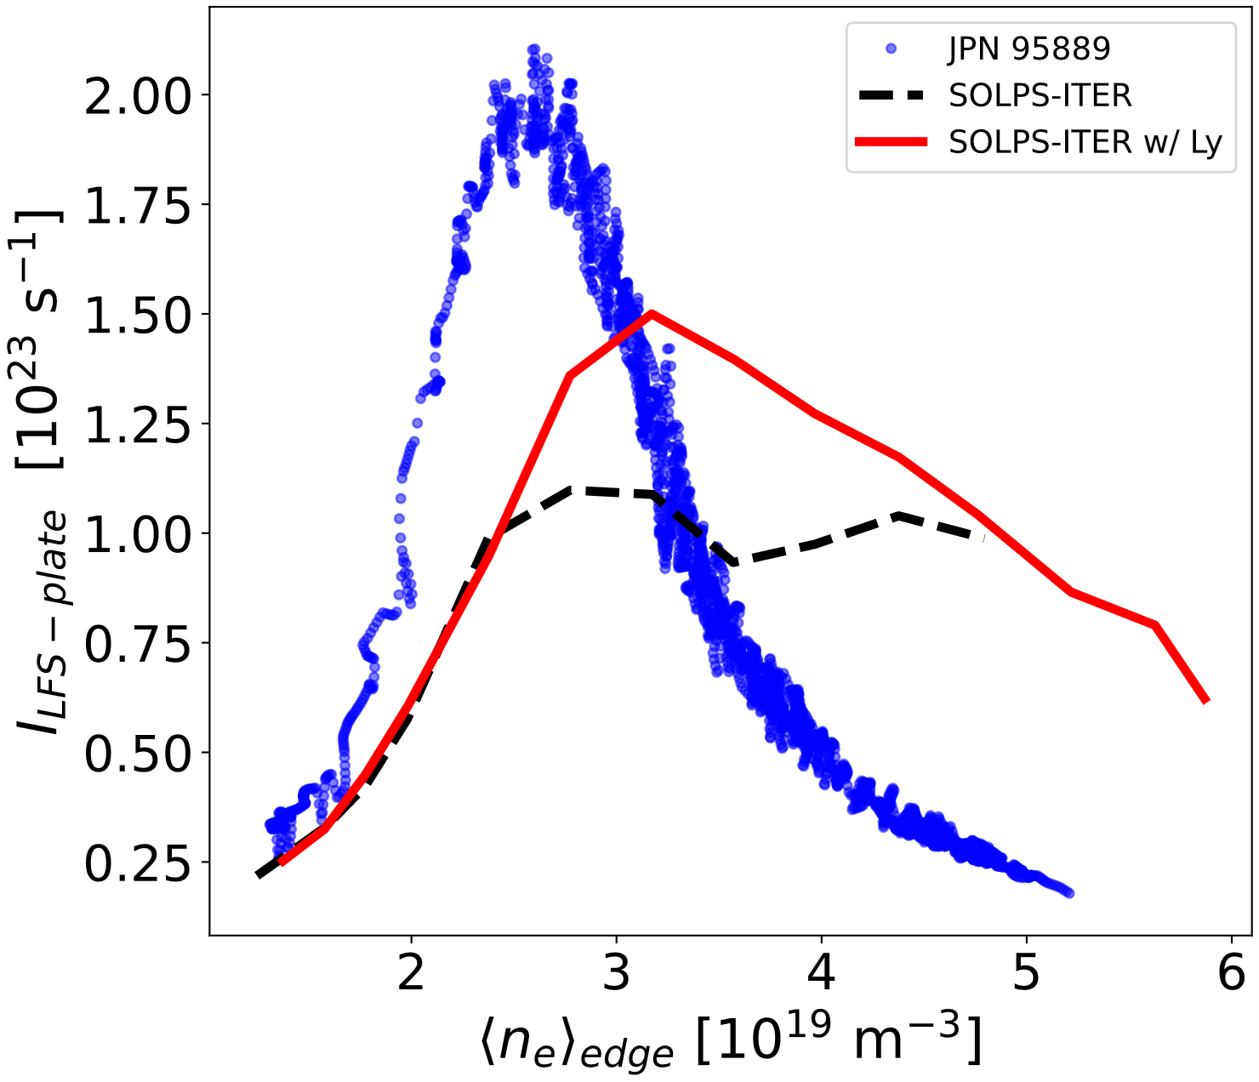
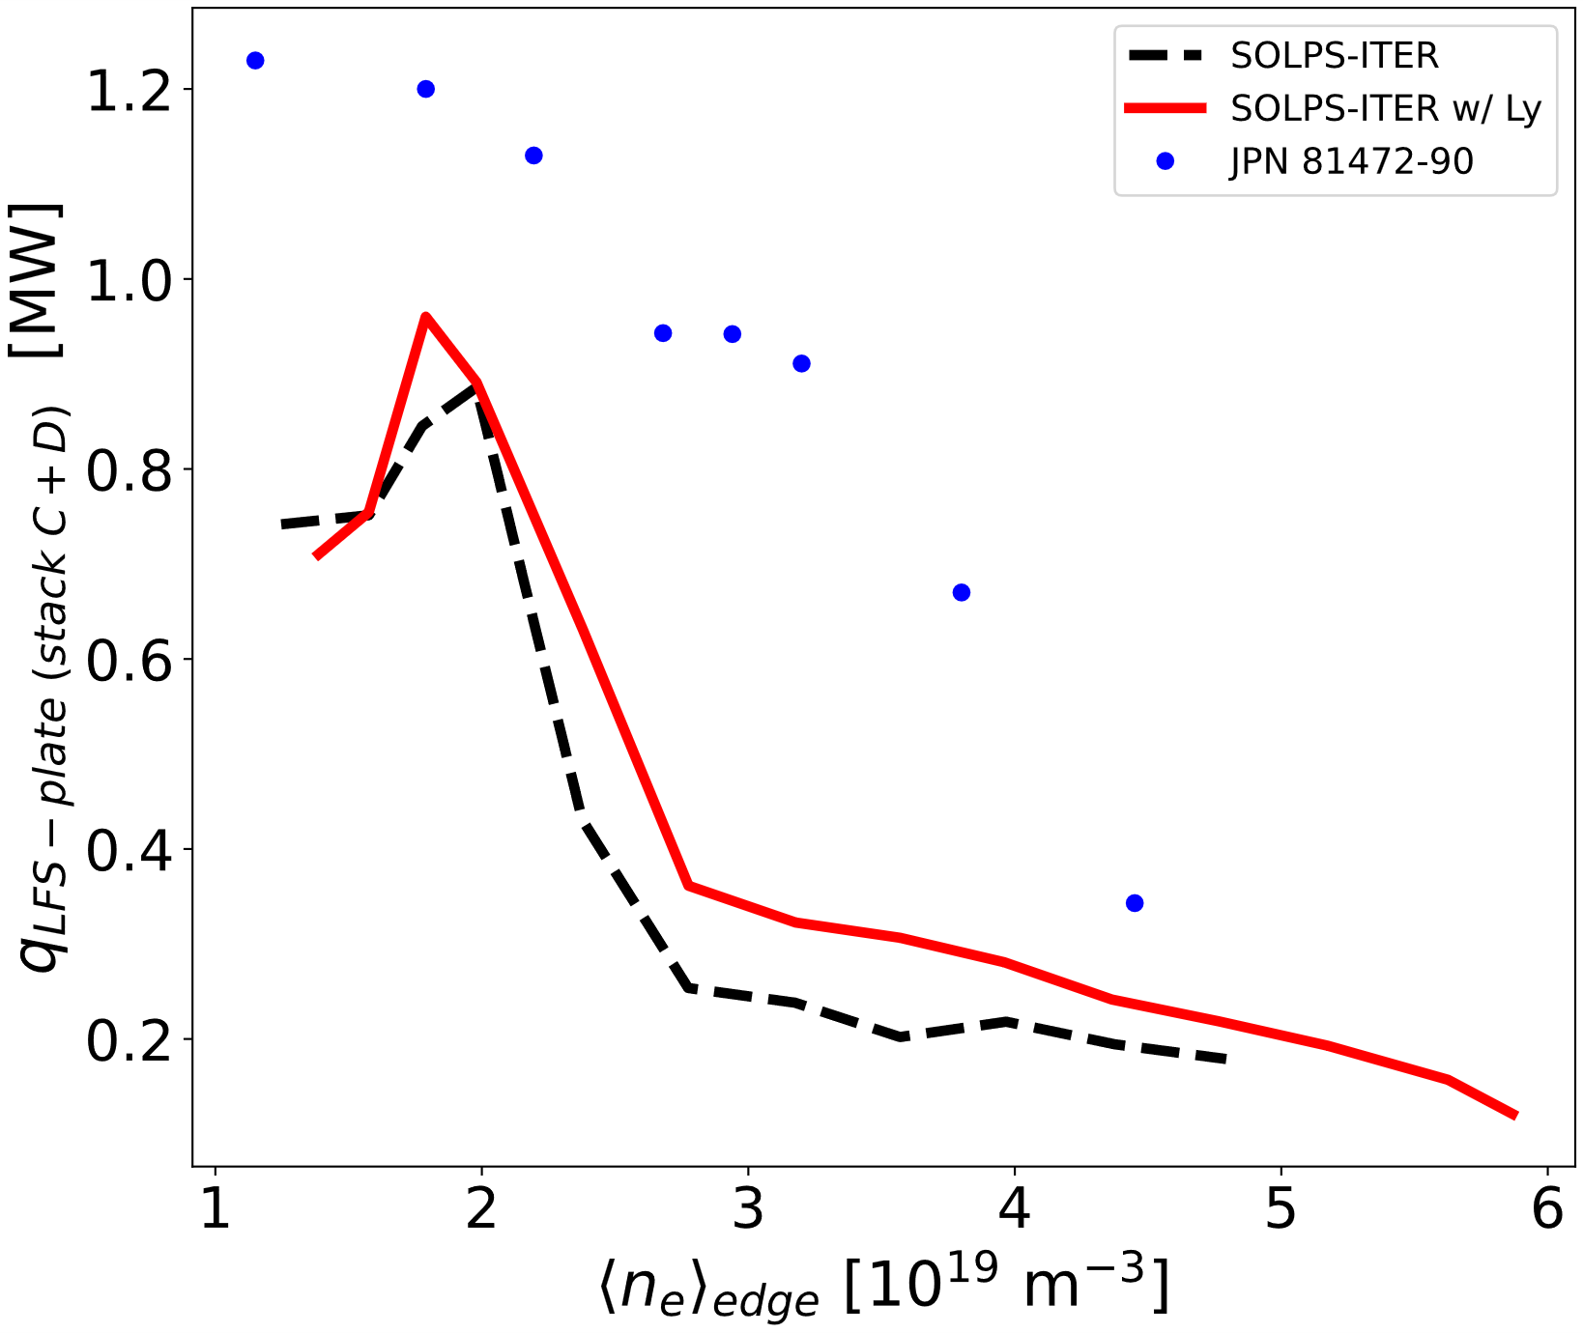
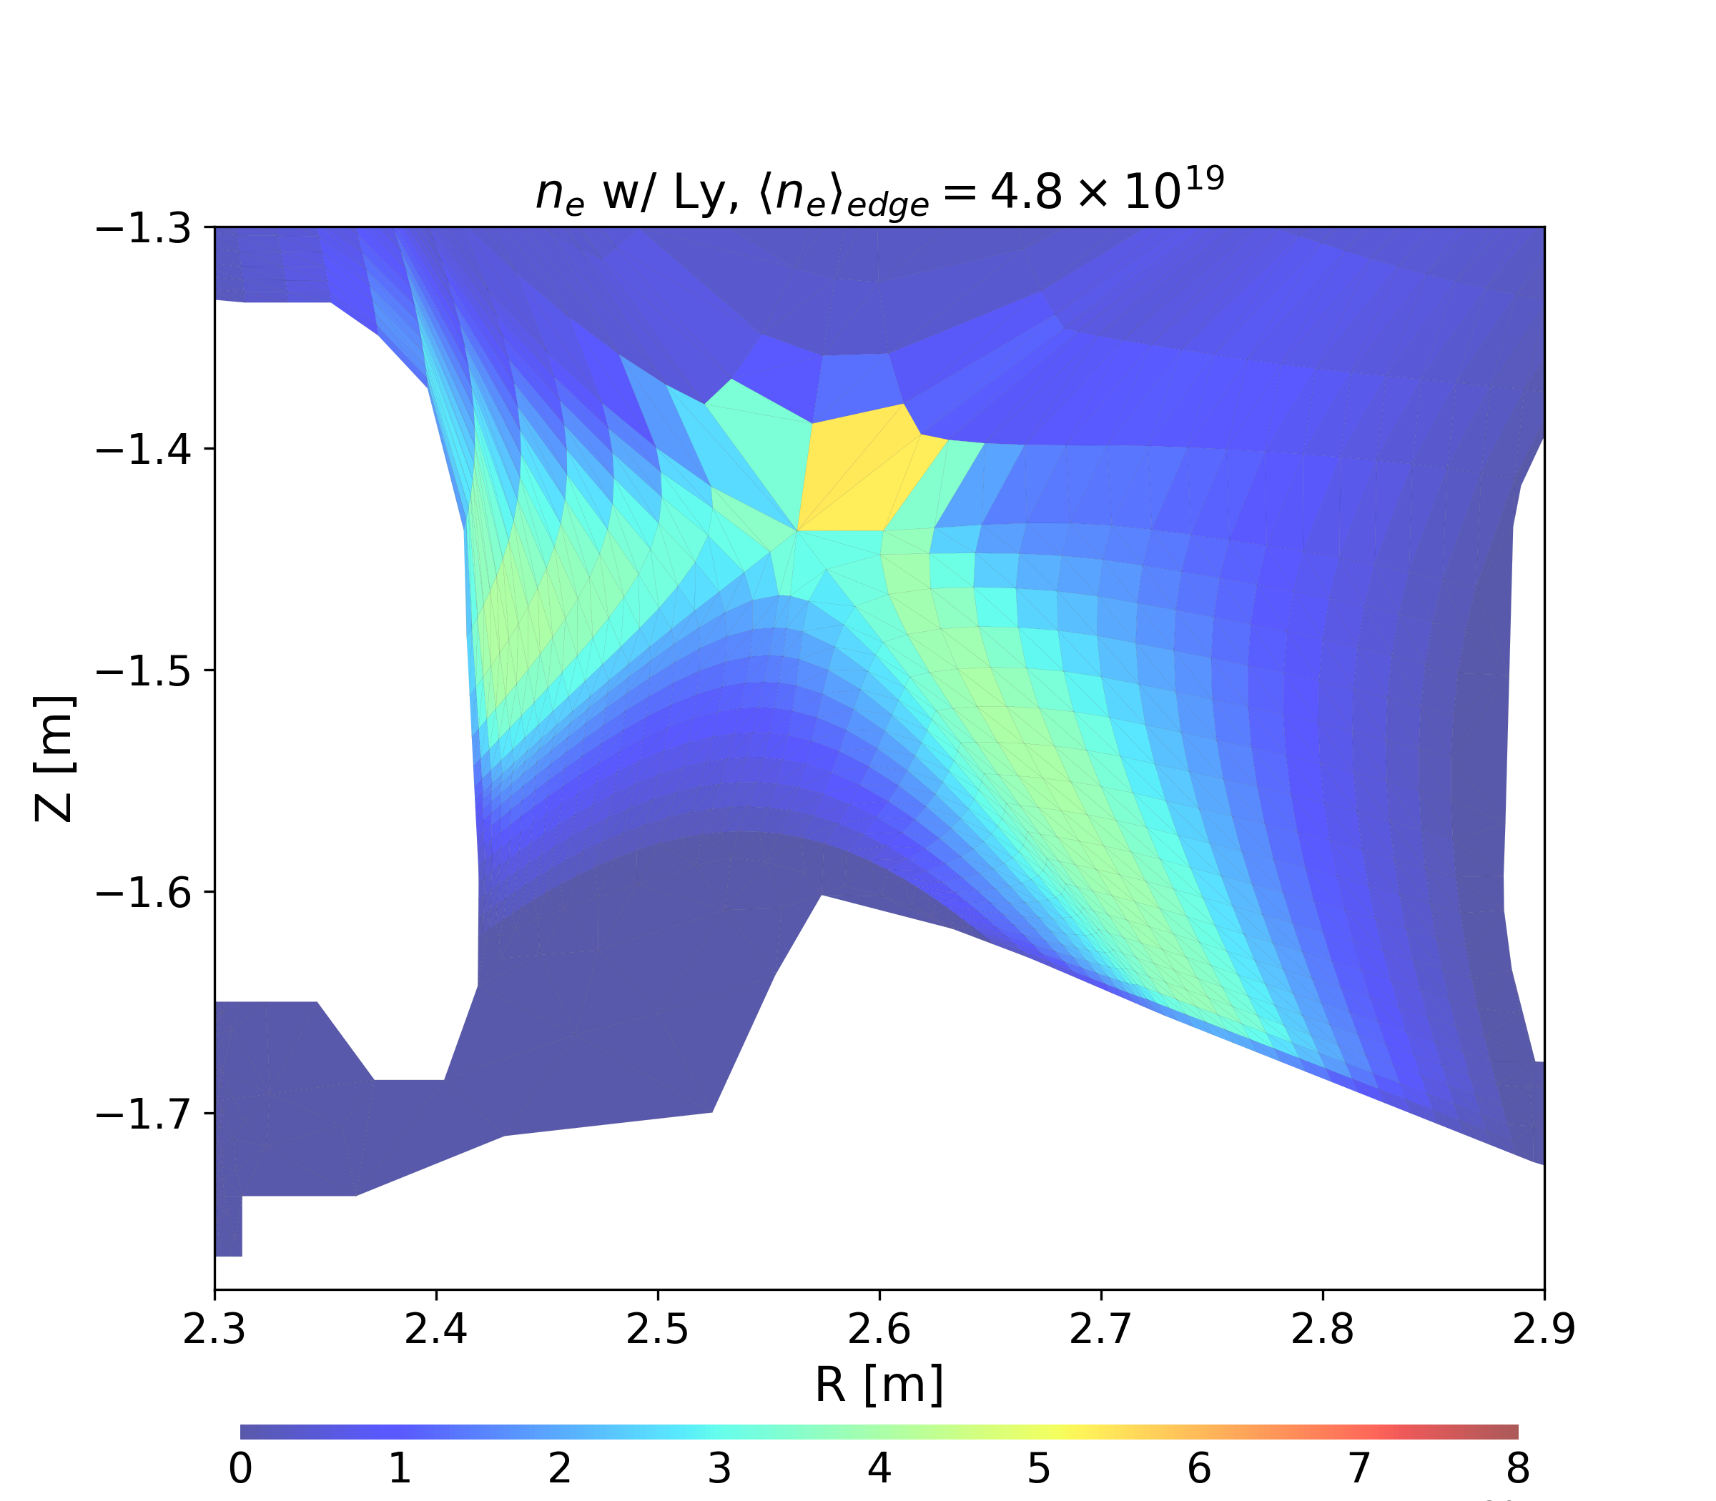
Full photon-gas-plasma coupling enabled in SOLPS-ITER and used for JET-ILW Ohmic plasma simulations
Feature in the SOLPS-ITER/EIRENE git branch feature/photon_transport
Applied to SOLPS-ITER JET-ILW Ohmic D plasma in varying midplane separatrix density → Prediction of I_{LFS-plate} peak values improved by ~30% and increased q_{LFS-plate} by 10-80% at high-recycling
R. Chandra et al., PET 2025

Slide 4
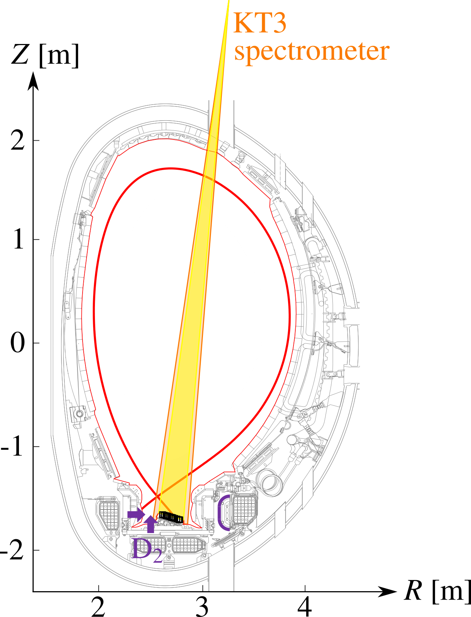
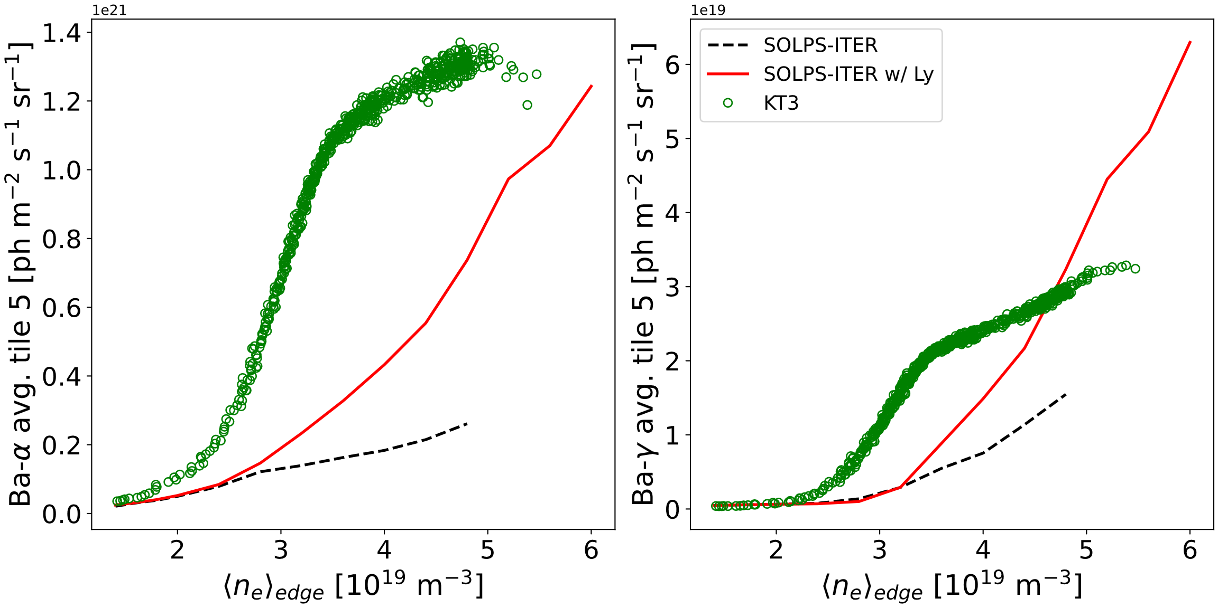
Full photon-gas-plasma coupling enabled in SOLPS-ITER and used for JET-ILW Ohmic plasma simulations
R. Chandra et al., PET 2025
Use PESDT-Cherab on SOLPS-ITER result to produce synthetic diagnostic
Increased Ba-α emission by 3x with Lyman trapping but Ba-γ overestimated at deep detachment → not the complete picture
Current results summarized to a Nuclear Fusion publication

Slide 5
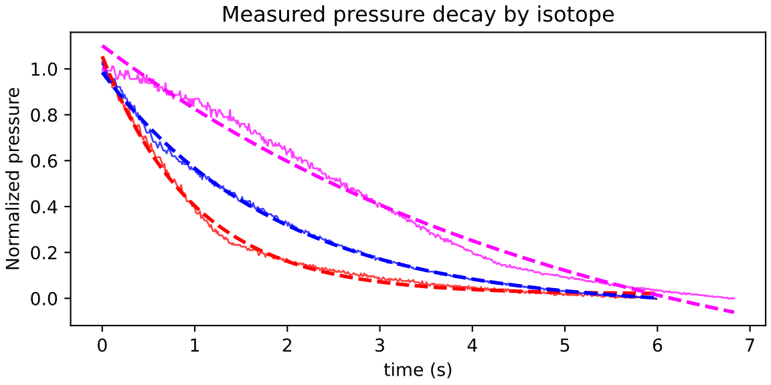
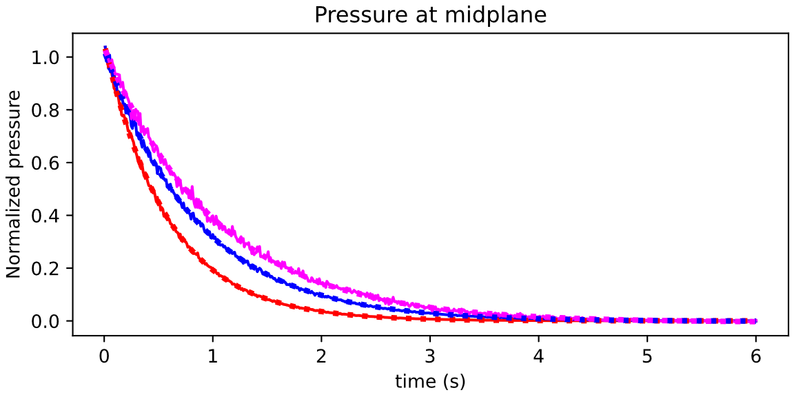
Evaluation of isotope effect on (H,D,T) gas pumping with time-dependent EIRENE simulations of JET-ILW
Pumping speeds as measured by the subdivertor Baratron pressure gauge
The differences between isotopes are caused by their masses and sticking coefficients
Sticking coefficients [1]: α(H₂) = 0.6, α(D₂) = 0.9 and α(T₂) = 1.0
JPN 104589
S_{eff} (H2) = 192 m³/s
(prior to 2D geometry calibration)
S_{eff} (H2) = 216 m³/s
S_{eff} (D2) = 112 m³/s
S_{eff} (D2) = 150 m³/s
S_{eff} (T2) = 124 m³/s
S_{eff} (T2) = 66 m³/s
KT5P Bar. 1
EIRENE
[1] C. Day, Fusion Sci. Technol., 2005

Slide 6
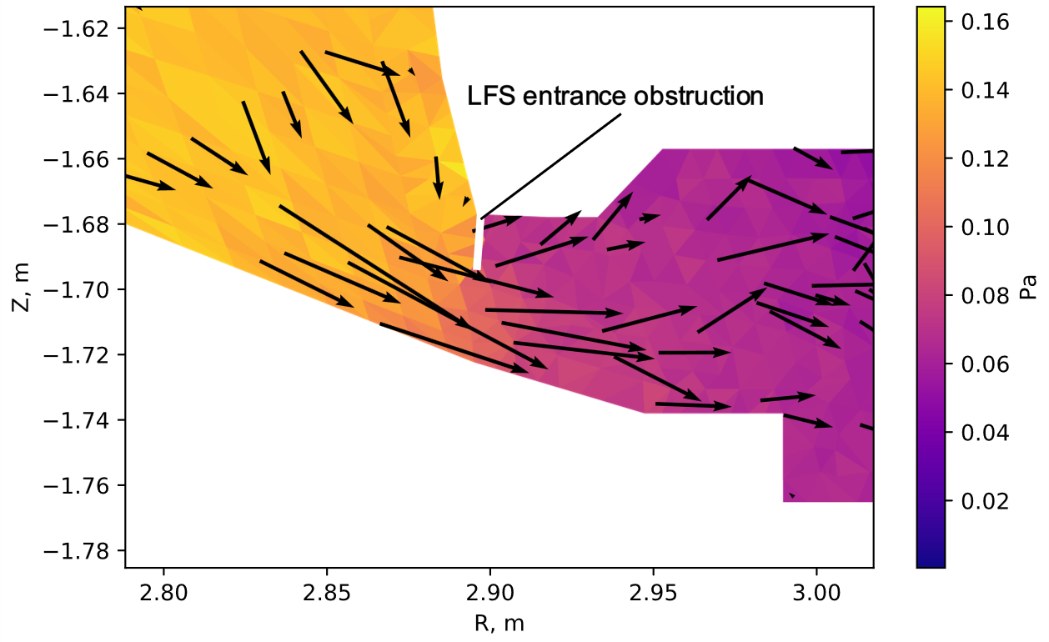
Evaluation of isotope effect on (H,D,T) gas pumping with time-dependent EIRENE simulations of JET-ILW
Adjustment on the LFS entrance obstruction matched measured and simulated effective pumping speeds of D₂ (112 m³/s vs. 119 m³/s)
Matching all isotopes simultaneously requires modifying sticking coefficients [similarly as in A.Scarabosio & A. Zito works]
Isotope | Measured S_{eff} | Simulated S_{eff} (unobstructed) | Simulated S_{eff} (obstructed)
Protium (H₂) | 192 m³/s | 216 m³/s | 160 m³/s
Deuterium (D₂) | 112 m³/s | 150 m³/s | 119 m³/s
Tritium (T₂) | 66 m³/s | 124 m³/s | 98 m³/s

