Slide 1

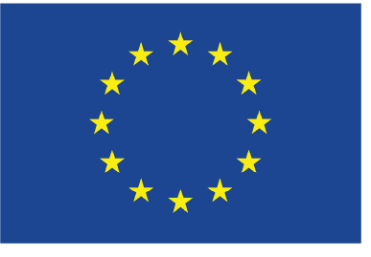
TSVV-5 final reporting (for 2025)
FZJ report
D. Borodin
This work has been carried out within the framework of the EUROfusion Consortium, funded by the European Union via the Euratom Research and Training Programme (Grant Agreement No 101052200 — EUROfusion). Views and opinions expressed are however those of the author(s) only and do not necessarily reflect those of the European Union or the European Commission, neither of the ITER organisation. Neither the European Union nor the European Commission can be held responsible for them.

Slide 2
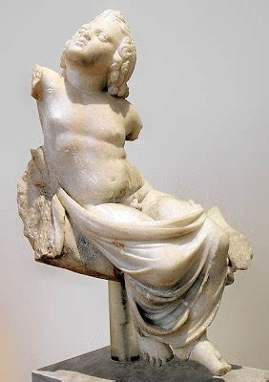
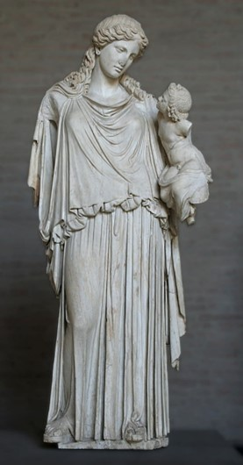
PLOUTOS can be used to
www.eirene.de
to import/export data (JSON, tabular, etc.)
to produce input data for EIRENE and for other codes with CRMs
  ➔ load/improve/save the developed configuration (selected reactions and parameters) including starting from the standard pre-sets
to check data for consistency and abnormal features
do sensitivity studies:
  ➔ understand A&M side of the problem and identify the most significant processes (among the selected ones)
The table contains data sources and type(s), ”generation”, other info …
➔ we plan adding simulation case references.
Both statues are at
Glyptothek, Munich.
EIRENE

Slide 3
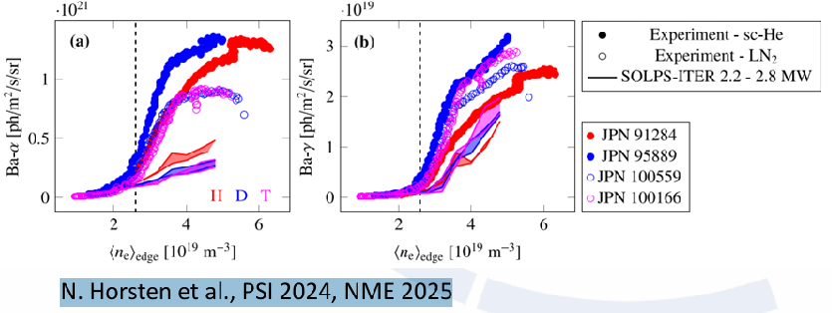
Ploutos
Ploutos is a useful tool, but not evolving last 2 years. We should put new datasets into it.
Also format of PLOUTOS needs to be updated to follow up with the ModCR development.
ModCR should replace with time (end of next year?..) the legacy solver (Perl) in Ploutos
Discrepancy in Ba-alpha emission for H vs D,T suggests MAR underestimated in simulations for D and T R. Chandra et al., PET 2025 N. Horsten et al., PSI 2024, NME 2025 𝐻₂(𝑣)+𝐻⁺→𝐻₂+H{H, D, Т}
We need a subgroup working on new datasets:
F.Cianfrani, R. Chandra, P.W. Groen, M.Gordon, D.V.Borodin
Do clear “code requirements” for ODE/LTE solution in ModCR
Do CI and visualisation cases for solvers convergence and accuracy estimations.
Do new datasets
Introduce data generations

Slide 4
Policy proposal on management of AMNS data
Policy proposal formulated as it spinned off from the decennial IAEA meeting on Atomic, Molecular and surface data in 2024.
+3 additional events at FZJ and IAEA
(F.A.I.R data and metadata)
https://conferences.iaea.org/event/442/contributions/37745/
GitHub: https://github.com/D-V-Borodin/AMDPolicyDoc (public for the time being. We count on change requests to be submitted as “pull requests”)
git clone https://github.com/D-V-Borodin/AMDPolicyDoc.git
or git clone git@github.com:D-V-Borodin/AMDPolicyDoc.git

Slide 5
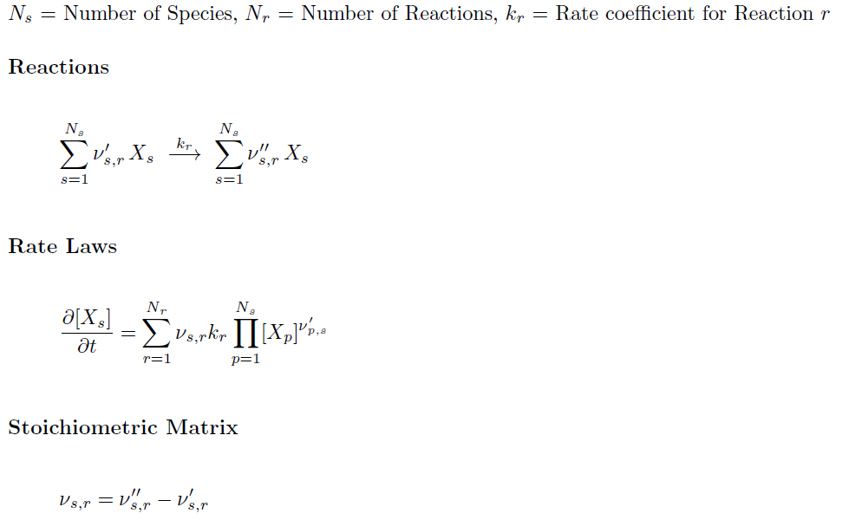
‘StoichioMatr’ approach for balance equations
Reiser, D., von Keudell, A. & Urbanietz, T.
Determining Chemical Reaction Systems in Plasma-Assisted Conversion of Methane Using Genetic Algorithms.
Plasma Chem Plasma Process 41, 793–813 (2021).
Very good fits with the Ploutous-like CRM files
General and abstract (no problem to treat e, p, e-e etc. driven transitions inside single matrix – “reservoirs”)
  Abstractisation of reactions in the main loop of EIRENE is one of the ModCR goals. Aim: minimise branching by reaction type
Extra step with “StoichioMatr’” will allow keeping the basic database on particular solver run (can be several even by single ModCR start)
No linearity is implied

Slide 6

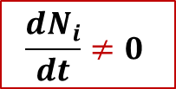
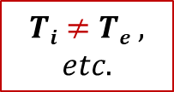

New CRM Solver for EIRENE – “ModCR”
This CRM is aimed to precompute rate coefficients accounting for all parametric dependences (n_{e}, T_{e}, but also T_{i}, …) in contrast with currently used polynomial fits (AMJUEL, …) + add a number of levels/processes not accounted for at this time
The internal states (e.g. rovibrational states in molecular species) are to be tracked with a flexible a flexible control over this resolution (as separate specie or variable).
The nonstationary solution for balance equations should be the default one
(with the stationary only as a useful option).
The solver should be modular, thus usable standalone or even in various codes.
The improved A&M data input (encapsulated data - JSON, potentially also HDF5). We need tools for visualisation and testing.
  Meet the exploding amounts of data for molecules
  (with resolution by rovibrational states)
$$Ti≠Te ,$$
$$etc.$$
$$\frac{dN_{i}}{dt}≠0$$
$$Why not$$
$$also ERO?..$$
Not only performance and reliability, but additional physics can be provided!
➔ For instance, what if detachment is caused by non-stationary effects?!..

Slide 7
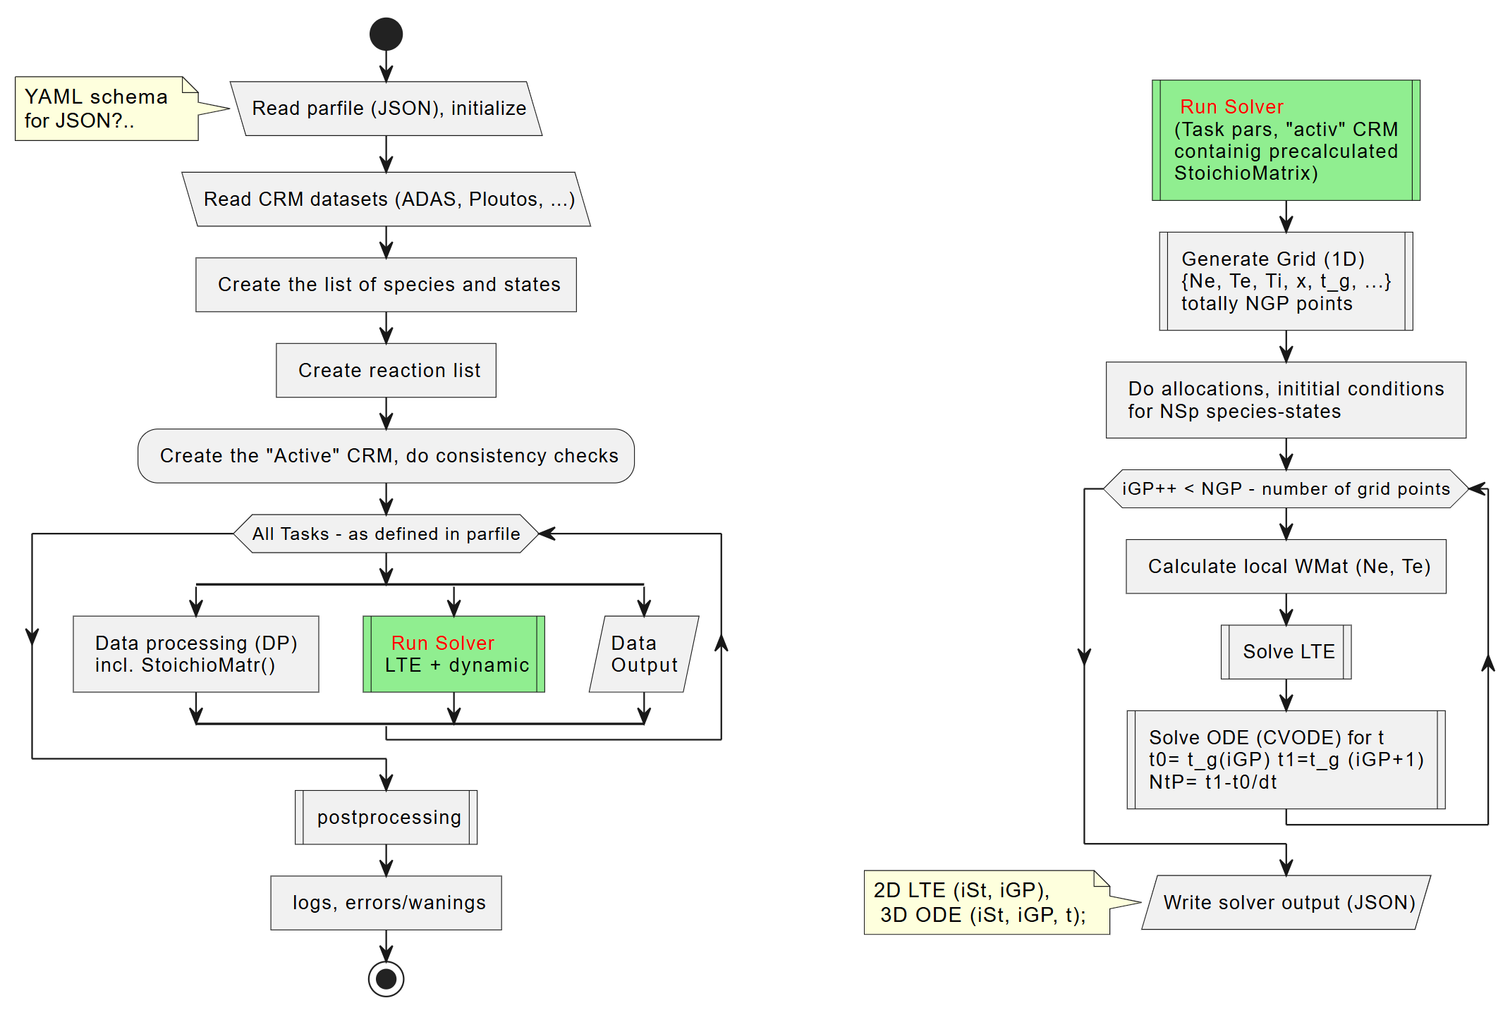
UML for ModCR –crude version of “action diagram”
Other diagrams (e.g. “class diagram”) allow optimisation of workflow and data structure…

Slide 8
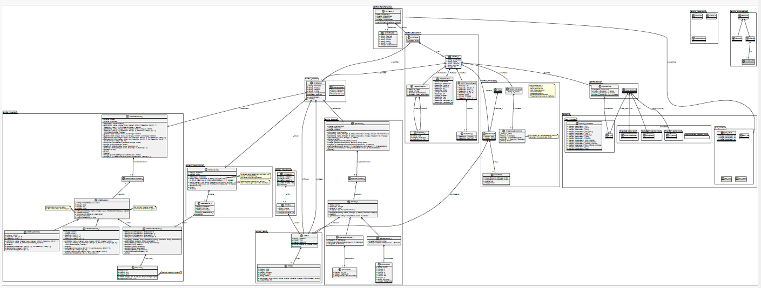
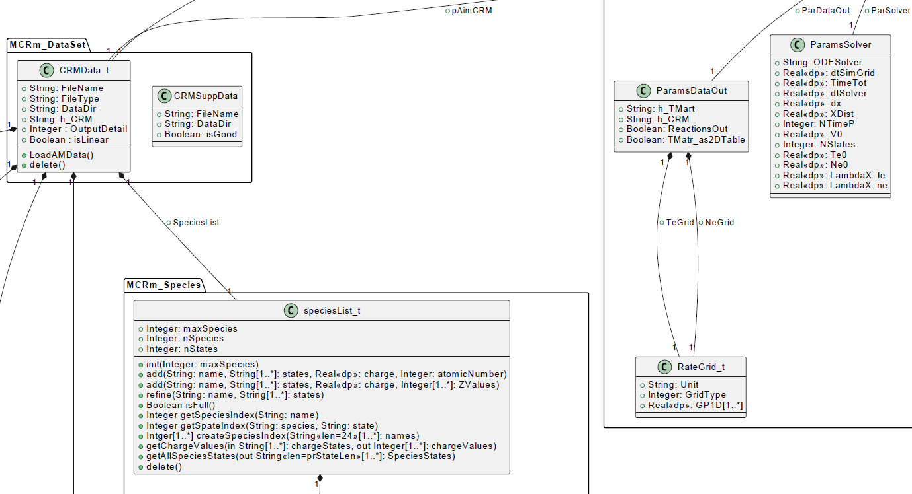
UML Class Diagramm of ModCR

Slide 9
Transport code variations and commons: CRMs
Property | EIRENE | ERO, ERO2.0
Ab initio | Yes (iterations with fluid code, e.g. with B2.5 → “SOLPS-ITER”) | No, test-particle approximation on a given plasma BG (e.g. from SOLPS)
Gyro-motion | Guiding centre approximation | Full-resolved, detailed 3D wall elements, surface sheath
Plasma-wall interaction | Less detailed locally, often no 3D | More detailed: 3D, sheath, etc.
PWI impact on plasma | Yes, also “advanced fluid neutrals”, “wall reservoirs” etc. | In general NO (certain effects were introduced…)
Both approaches have clear advantages and range of appropriate tasks, both packages are highly demanded by ITER, EU-DEMO and other fusion-relevant devices!
➔ Moreover, they often support each other (plasma BGs from various CFD-EIRENE used and tested in ERO)
However, the subtasks for treatment of atomic and molecular processes in plasma are very similar!
Break-up of the molecular species in plasma
Ionisation and other processes affecting charge and energy, thus transport
Synthetic spectroscopy for comparison with diagnostics
Similar A&M process treatment challenges!

Slide 10
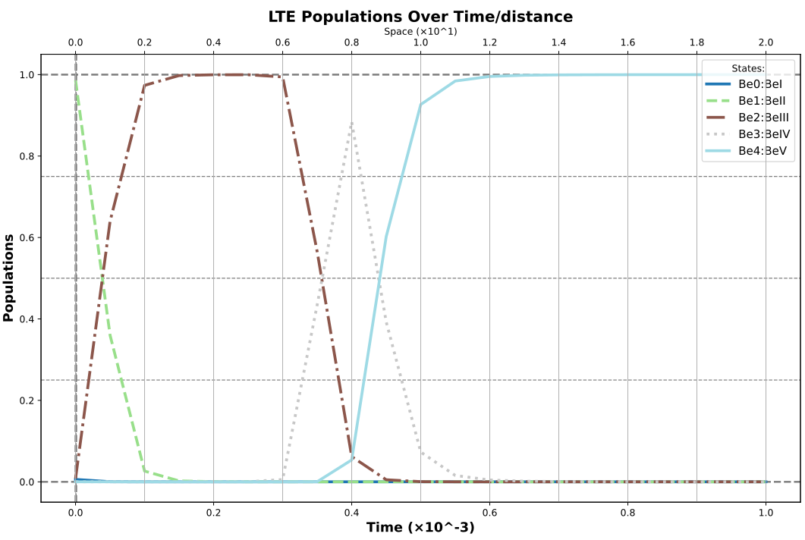
ModCR (standalone, LTE) results
ModCR works for LTE (stationary) approach
ODE (various solvers, as well as 1D MC are in yet in progress
MS resolved version and molecular processes (Ploutos files) in progress
ADAS “GCR”
approach
(adf11)

Slide 11
Summary and conclusion
CRMs are essential part of EIRENE and similar transport codes
  They pose both performance and data amount challenges
The MC approach for species should be combined with flexible tracking of external state calculated by ODE solution – we expect large performance boost!
  New tools (Plutous, ModCR) are in development
  Flexible border between MC and ODE solution will allow performance optimisation and error estimations.
  Universal module ModCR usable both in transport codes and standalone is under development.
  New IT technologies are used (e.g. UML).

Slide 12
Thanks for the attention!

Slide 13
IMS – items for 2025
Perform demonstrative runs for ITER and DEMO including checks for sufficient performance and stability of the code. Document for all other “portfolio” cases utilized in TSVV-5.
Finalize EIRENE-NGM documentation. Optionally: provide training for collaborations and porting on GateWay.
Joint papers (or reports/preprints) on the a) HPC ready EIRENE-NGM with interfaces for the IM b) improved AMNS and CRMs c) EIRENE-NGM validation with extrapolations for ITER and DEMO.
Significant progress is reached along main lines of the project – physics (FKH and CRMs) as well as code refactoring and infrastructure improvement (the license “EPL”, IMASification, webpages, CI and version merging, documentation etc.). Some unplanned additional developments (EIRON toy-model for testing of parallelization and domain composition concepts, new universal CRM module “ModCR” etc.) were started. In 2025 the project will focus on the following tasks. Final merge of the existing code branches, finalize the list of CI cases, final profiling and optimization of the core for performance, universal framework and particular interfaces to other codes employed in related TSVVs. Perform predictive runs for ITER and DEMO (utilizing the improved CRMs and A&M data basis as well as the FKH) demonstrating new capabilities. Demonstrate a meaningful simulation case with ~1 billion volume cells. ACH HPC support is expected. Writing joint papers (or reports/preprints) on the a) HPC ready modular EIRENE-NGM with interfaces for the IM and its performance optimization from by parallelization as well as algorithmic improvement b) improved AMNS and CRMs c) EIRENE-NGM validation, UQ and predictive power.

Slide 14
Summary: TSVV-5 progress and plans
Physics
  Fluid-kinetic hybridisation (FKH) development successfully continues – incl. new branches (KDMC)
  A&M CRM extension and refinement (Ploutos + ModCR, photon tracing - opacity)
  Establishing simulation cases (validation at JET, Magnum-PSI, verification at ITER and EU-DEMO scales with realistic geometry) – in progress incl. with new features - FKH etc.
Code development
  Parallelisation: OpenMP-MPI hybrid (related code refactoring done; EIRON “toy”-model (ACH-VTT) allows testing CPU loading and domain decomposition approaches so as new FKH options)
  Code streamlining (Segregation of the numeric core, etc.) –new big changes (e.g. ModCR substituting CRM part in the inner loop) – concepted and progressing.
  Merging all existing versions into first milestone one (MsV) – released in Nov 2024
  Improved I/O (JSON/HDF5), visualisation, IMASification, etc. – done or in good progress (with ACH)
Organisational and techical items
  New EIRENE license, “infectious open source”, Coding guidelines, ChangeLog, improved CI - available at www.Eirene.de and as part of EIRENE Git repo, good progress
  Regular VCs and annual Code Camps, also strong and regular communication with ITER, IAEA and neighbour TSVVs (mostly 3 and 7, but also others).

Slide 15
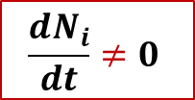
New code (also library for EIRENE): “ModCR”
Should provide BOTH standalone and build-in CRM for EIRENE
  Therefore written in modern Fortran
  Linked with Ploutos (uses the same JSON files for I/O)
  Non-stationary approach utilising up-to-date Sundails solver (CVODE++) for stiff ODE systems (algebraic stationary option also available for control)
The whole specie-state and reaction basis is inside, however the code should form the list of “active states”
  Provide different resolution on states being tracked
  Provide flexible border for tracking of MC species and internal state populations as variables
  Provide data processing pipe lines (easy to reproduce with updates)
All functionality available in EIRENE (e.g, photon tracing) must be preserved!
The code should be modular (library, API) for use in EIRENE, EIRON (toy model for parallelisation), ERO…
ModCR should be used as a test bed for serialisation and other new tech.
$$\frac{dN_{i}}{dt}≠0$$
This
is unique and justifies creation of the new code

Slide 16
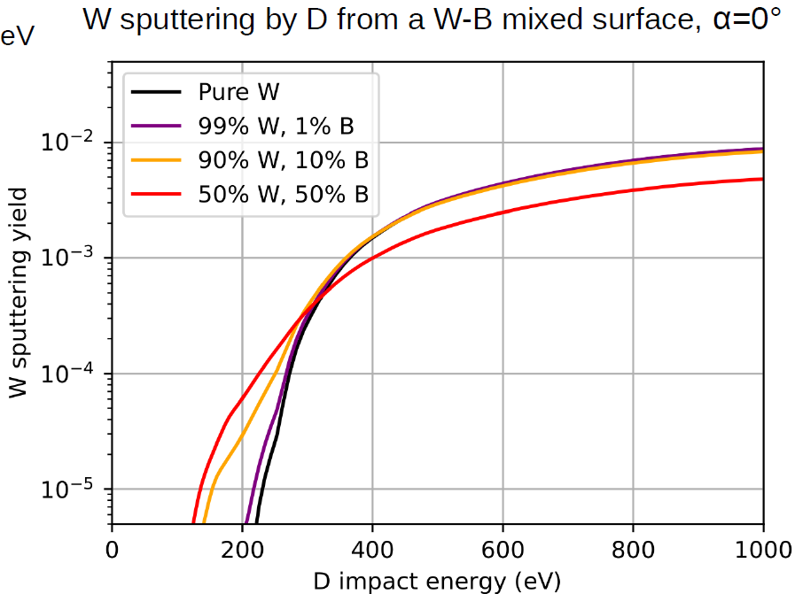
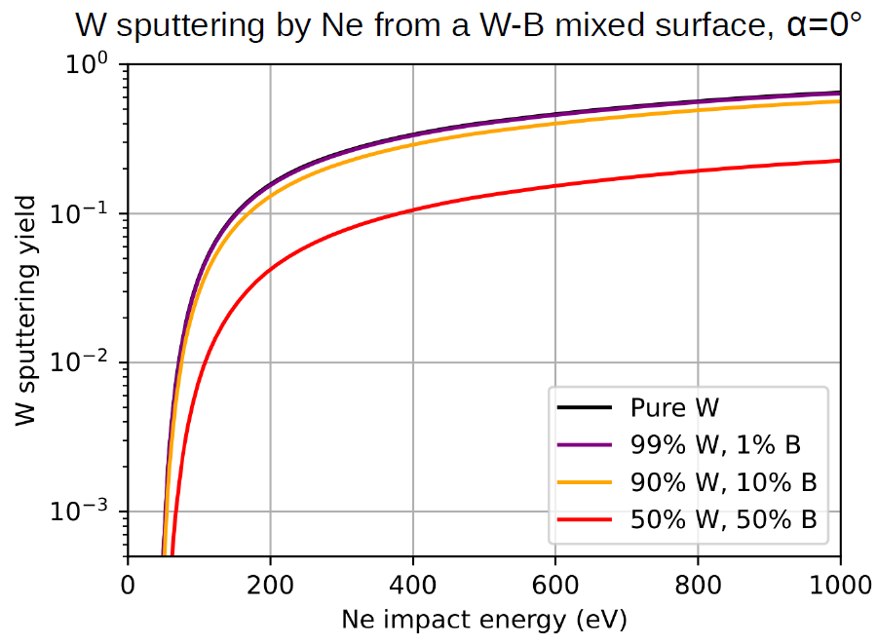
W sputtering with B admix (SDTrimSP)
Recent updates in ERO data for PSI
H.Kumpulainen, PSI-2025
W←Ne is reduced!
Boosts W←D at low E_{in}
A. Mutzke et al. SDTrimSP Version 6.00, IPP-Report 2019-02
Recent Be CAPS data (MolDyn)
N.F.Mofrad, J.Romazanov, et al.
JNM 609 (2025) 155758

