Slide 1
DIFFER TSVV-5 2025
Overview of activities
P.W.C. Groen and E. Westerhof

Slide 2
Work done
Add scoring of processes B2.5-EIRENE (PWG)
ModCR (PWG)
Coupling FreeFEM to SOLPS-ITER (continued, PWG)
Modelling of Magnum-PSI with vibrationally resolved molecular distribution (EW)

Slide 3
Add scoring of processes B2.5-EIRENE
Receive a code snippet from Nicolas Rivals (CEA) for scoring processes
Implemented this in solps-iter/modules/Eirene/src/user-routines/user_iter (local branch)
eirmod_upcusr.f
eirmod_uptusr.f
However, this only concerns a subset of processes (i.e. tracked particle energy dependent)
Implement the scoring of other processes in these user routines would duplicate code (inefficient and error-prone), because it is spread over existing multiple parts of the code
This demands a much larger effort than anticipated (discontinued)

Slide 4
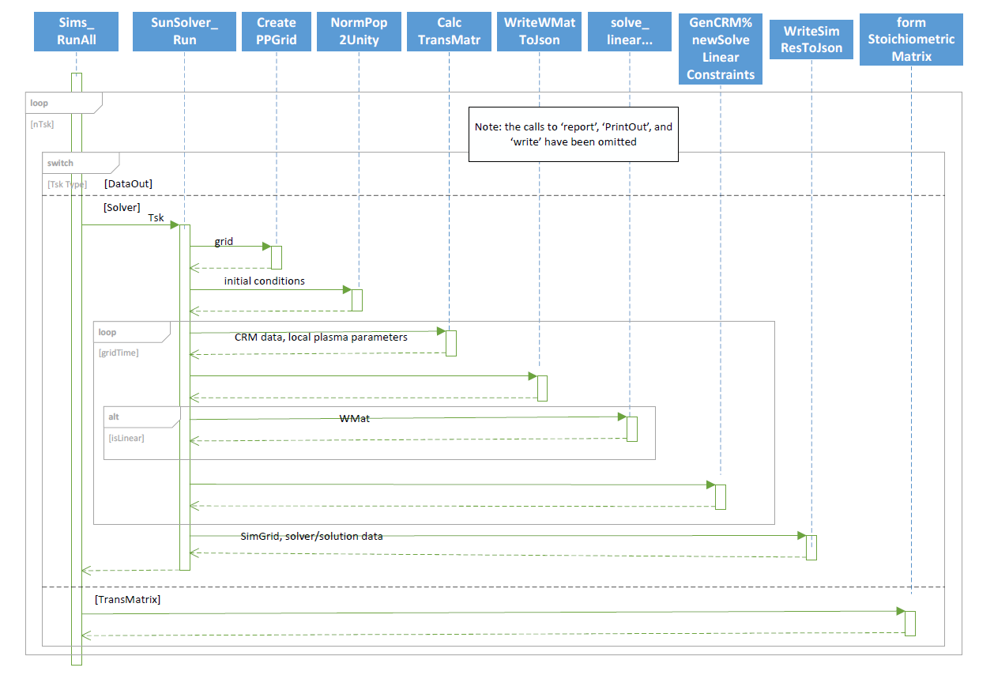
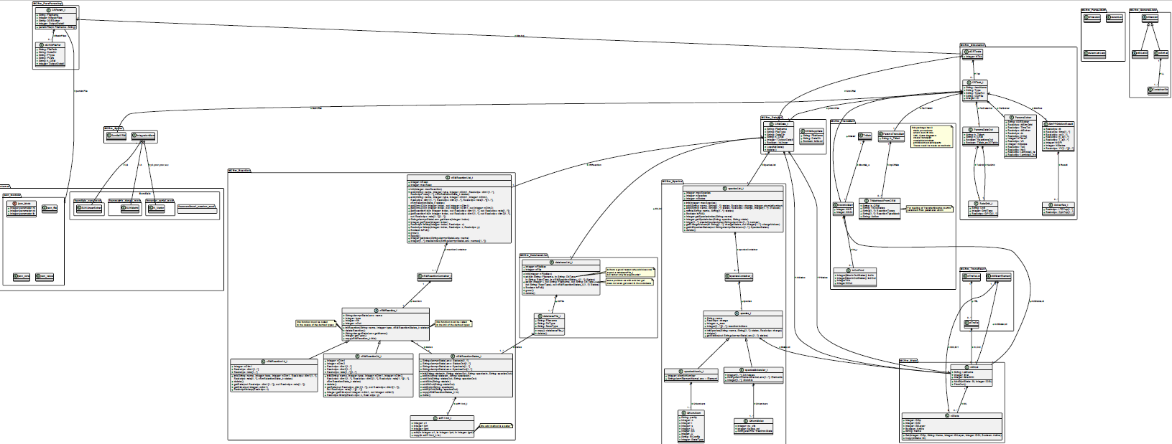
ModCR
A standalone CRM code, with the intention to be coupled to EIRENE
In close collaboration with M. Gordon, and Dmitriy Borodin (FZJ)
Analysing, documenting, redesigning and refactoring code, add features (e.g. line intensity calculation)
M. Gordon, FZJ
P.W.C. Groen, DIFFER

Slide 5
Coupling FreeFEM to SOLPS-ITER (continued)
Simulation of plasma heat flux on (linear device) Magnum-PSI target, calculating the target’s temperature
Coupling SOLPS-ITER, i.e. B2.5 with FreeFEM [1] code describing the target, as done by J. Gonzalez [2] and G.F. Nallo [3]
The coupling still needs to be implemented thoroughly, and we have contact with Politecnico di Torino to address the still open questions that are reported, e.g.
documentation (routines, input files, switches, equations solved, mesh creation, etc.)
FreeFEM installation and details
deployment setup (bringing it to the users)
[1] freefem.org (Finite Element Method code)
[2] J. Gonzalez et al., Plasma Phys. Control. Fusion 65 (2023) 045009
[3] G.F. Nallo et al., Journal of Fusion Energy (2023) 42:41
Target temperature output

Slide 6
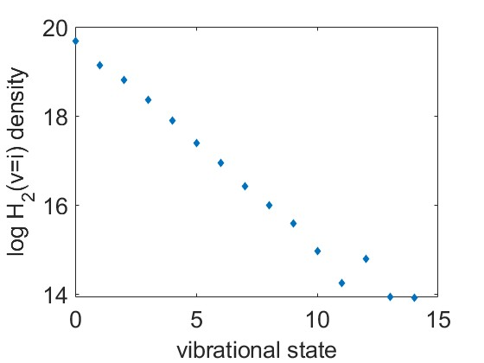
Modelling of Magnum-PSI with vibrationally resolved molecular distribution
A Magnum-PSI case has been set up in SOLPS-ITER including all vibrational states of H₂ molecules
Analysis and comparison to standard case is still ongoing
Can serve as benchmark for future ModCR implementation in EIRENE
H₂ vibrational distribution

