Slide 1
WP STEL News 15.01.2026

Slide 2
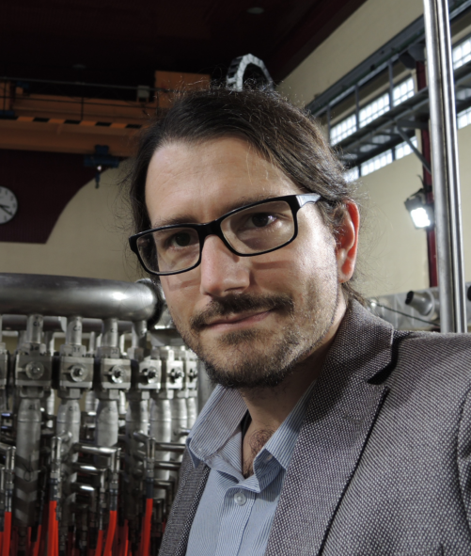
News from WP STEL
New revision of PMP for 2026/2027 submitted after STAC recommendations.
26 reports (out of 40) uploaded already to IDM
We are working on formulating all the tasks and deliverables from last year call for participation. In total more than 90 activities, which is time consuming. Especially that there is quite a few new ones, which need to be thoroughly discussed.
We are starting to prepare call for campaign participation in the campaigns 2026/2027. The new set of Research Topics and Campaign Objectives will be prepare jointly with TFLs from W7-X.
New DTFL Daniel Carralero (CIEMAT) accepted by GA, replacing Arturo Alonso (CIEMAT)

Slide 3
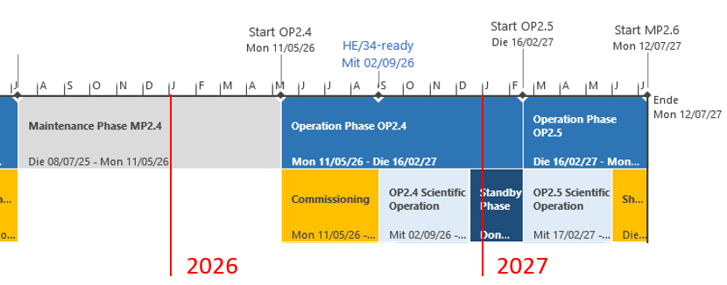
W7-X Experimental Campaigns in 2026/2027
Schedule of OP2.4 and OP2.5 campaigns:
New task forces at IPP to organize the experimental campaigns:
TF1: Core Scenario Development (Golo Fuchert, Neha Chaudhary)
TF2: Edge Scenario Development (Victoria Winters, Matt Kriete)
TF3: Physics Integration and Exploration (Adrian von Stechow, Ksenia Aleynikova)

Slide 4
New divertor for W7-X
IPP is preparing a staged upgrade approach for W7‑X divertor to enable rapid, lower-risk testing of new geometries and plasma-facing materials.
Scope: Develop a flexible, three-dimensional, fully metallic high heat flux divertor geometry suited for next-generation stellarator reactors. Present open design accommodates many configs, but lacks good particle exhaust and due to design flaws limits the operational window.
Initial step: replace three divertors as a practical test towards a flexible, reactor-relevant metallic divertor
Early modifications prioritize flexibility and minimize operational downtime
Supports validation of 3D divertor modeling and development
~€500k hardware investment for first stage; long-term personnel commitment for ongoing R&D. Also an additional staff will be required for installation and setup.
The proposal for PCR for co-financing of human resources in preparation.

