Slide 1
Study of fast ions confinement in QH-mode in DEMO
FINAL Meeting - KDII#8/PMI Physics 2020
Guillermo Bustos, Cristian Sommariva, Jonathan Graves
July the 1st, 2020

Slide 2
Contents
Introduction
Description of the project
Results
DEMO QH-mode Baseline
VMEC QH-mode equilibria
Fast ions in QH-mode equilibria with EHO
Conclusions and future work

Slide 3
Introduction
In the Quiescent High confinement mode (QH-mode) ELMs are suppressed at similar plasma performance as in H-mode [Burrell, K. H. 2005].
Instead of ELMs, a low-n MHD instability (called Edge Harmonic Oscillation, EHO) saturates and provides necessary transport to sustain high pedestal.
Low collisionality + Pressure gradient = strong bootstrap current → Region of low magnetic shear at the pedestal region.
Key elements to access QH mode:
Pressure pedestal
Low edge collisionality
ExB flow shear
Trigger EHOs
Avoid ELMs
EHO might deteriorate the confinement of fast ions such as highly energetic NBI or alpha particles decreasing the expected DEMO performance → Assessment of fast ions confinement in DEMO.

Slide 4
Description of the project
QH-mode equilibrium for DEMO (Provided externally)
Reproduction QH-mode equilibrium with the VMEC code
STEP 1
STEP 2
Obtain edge corrugations (EHO) within the QH-mode baseline with Free-Boundary VMEC
Study of fast ions confinement in QH-mode in DEMO with VENUS-LEVIS
STEP 3

Slide 5
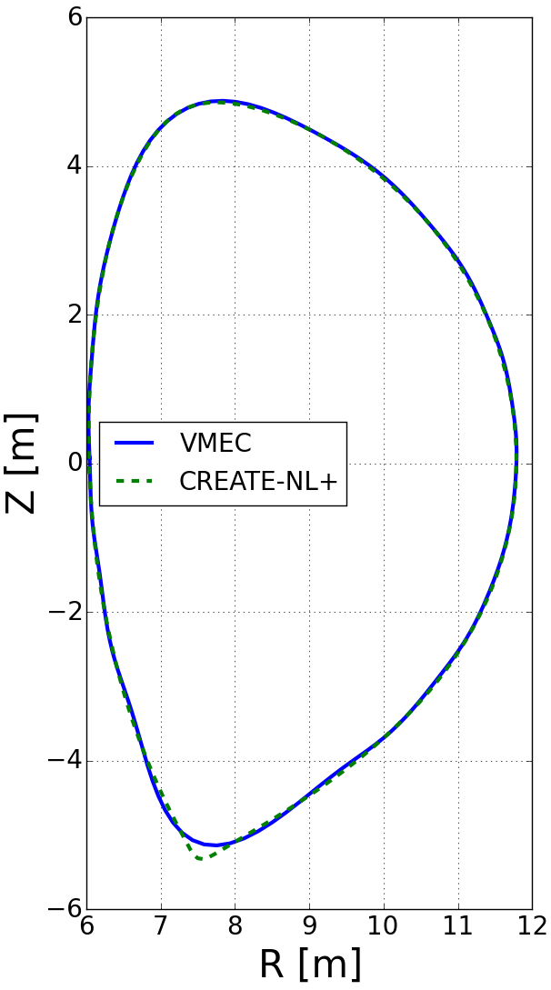
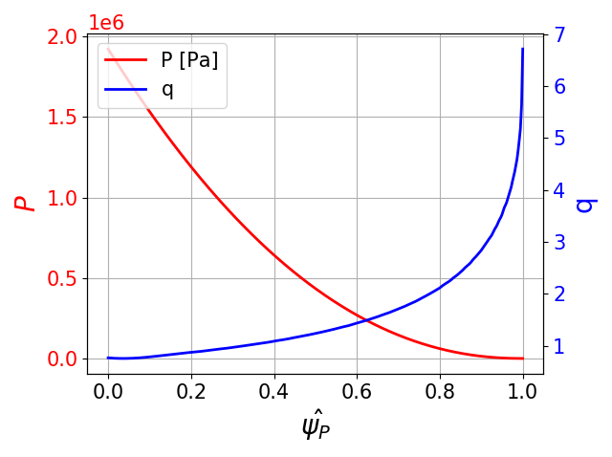
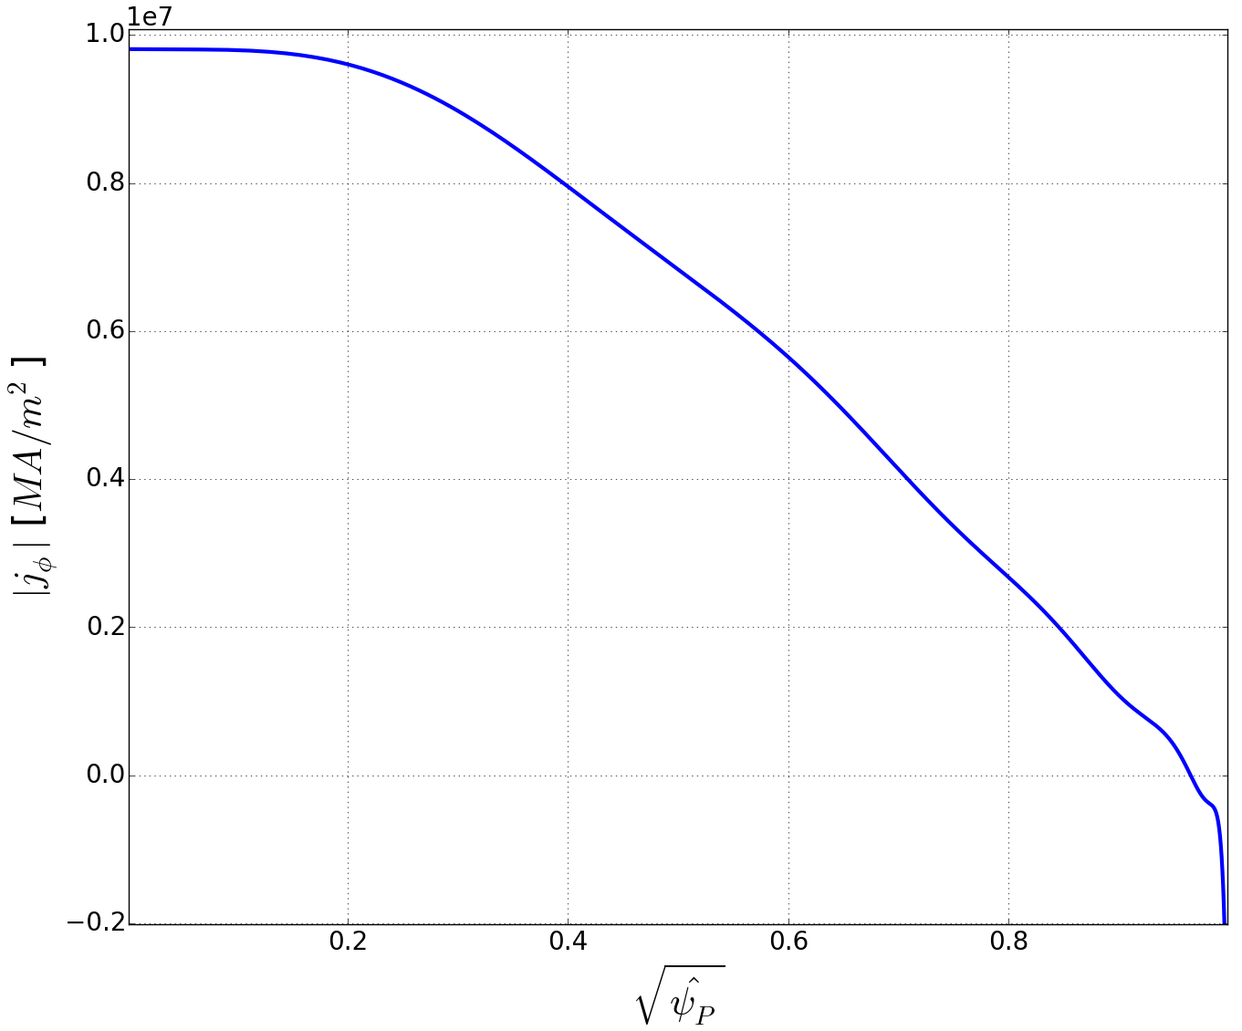
VMEC DEMO 2019 QH-mode baseline reproduction
The DEMO 2019 QH-mode baseline has been reproduced using the VMEC fixed-boundary code
Pressure and safety factor profiles obtained directly from the provided equilibrium.
Last Closed Flux Surface approximated by 16 Fourier modes.
Main physical parameters:
$β_{Total}$ = 0.029
$β_{Pol}$ = 1.03 (1.03 CREATE-NL+ reference)
$B_{0}$ = 5.30 T (5.69 CREATE-NL+ reference)
$V_{P}$ = 2343.35 $m^{3}$ (2448 CREATE-NL+ reference)
$I_{Tor}$ = -17.0 MA (-18.2 CREATE-NL+ reference)
Current density profile does not present the typical spike at the edge observed in QH-mode experiments!

Slide 6
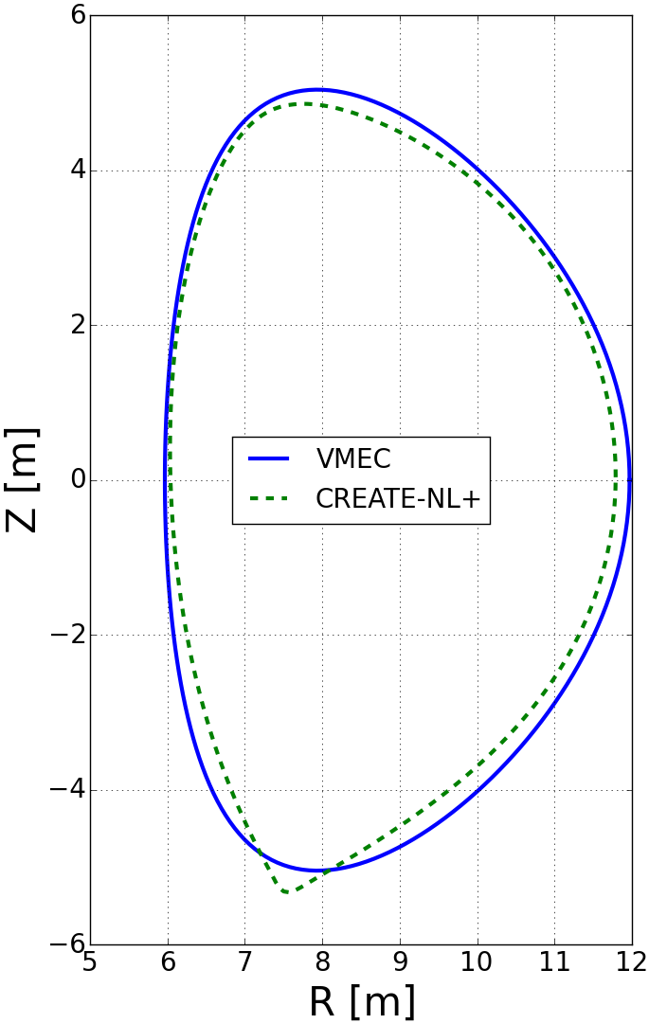
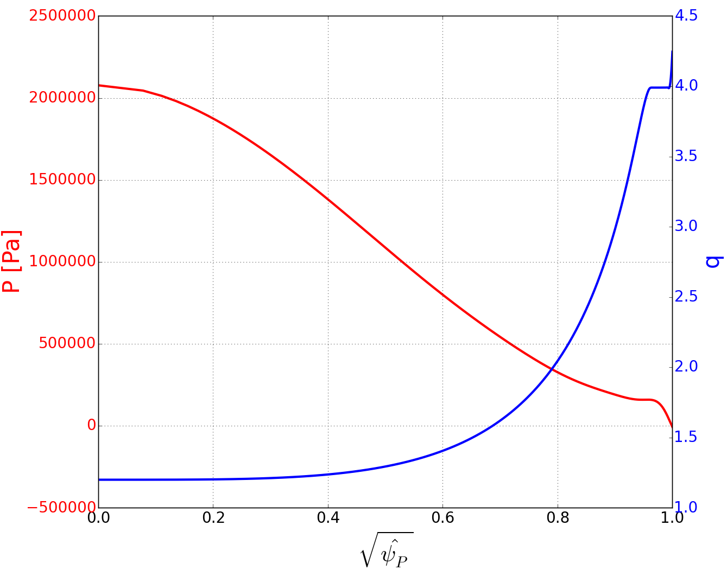
VMEC QH-mode equilibria
A few parameters has been modified in VMEC free-boundary simulations in order to obtain EHO:
Shape: Modified to be up-down symmetric.
Up-down asymmetries of magnetic surfaces are not expected to significantly affect the confinement of fast particles in 3D equilibria with EHO.
Pressure profile: A pressure pedestal that lifts the entire pressure profile has been added at the edge.
Safety factor profile: Set to be flat within the region $0.95≤{\hat{ψ}}_{T}≤0.99$, with $q_{p}$ just below the rational surface n=1,m=4.

Slide 7
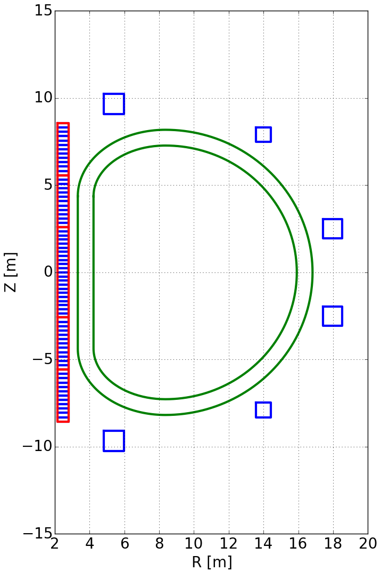
Calculation of vacuum field
EHO are external modes → Free-boundary simulations in VMEC are required → A description of the vacuum magnetic field must be provided as input.
Coil description modified to be up-down symmetric.
Current in the coils calculated by the FreeGS code [B. Dudson,2020].
Fixed-Boundary VMEC
FREEGS
Coil Currents
Free-Boundary VMEC
DEMO coil set

Slide 8
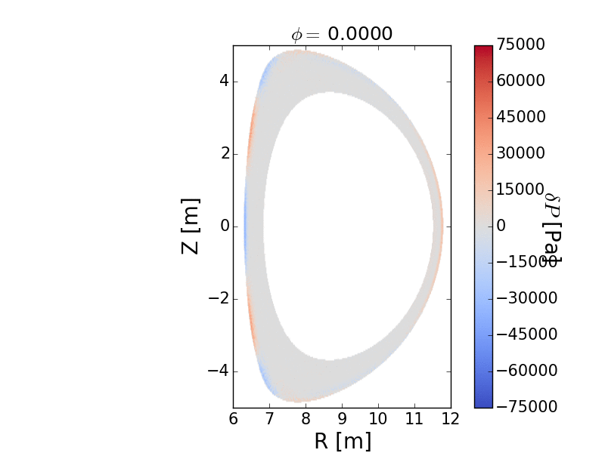
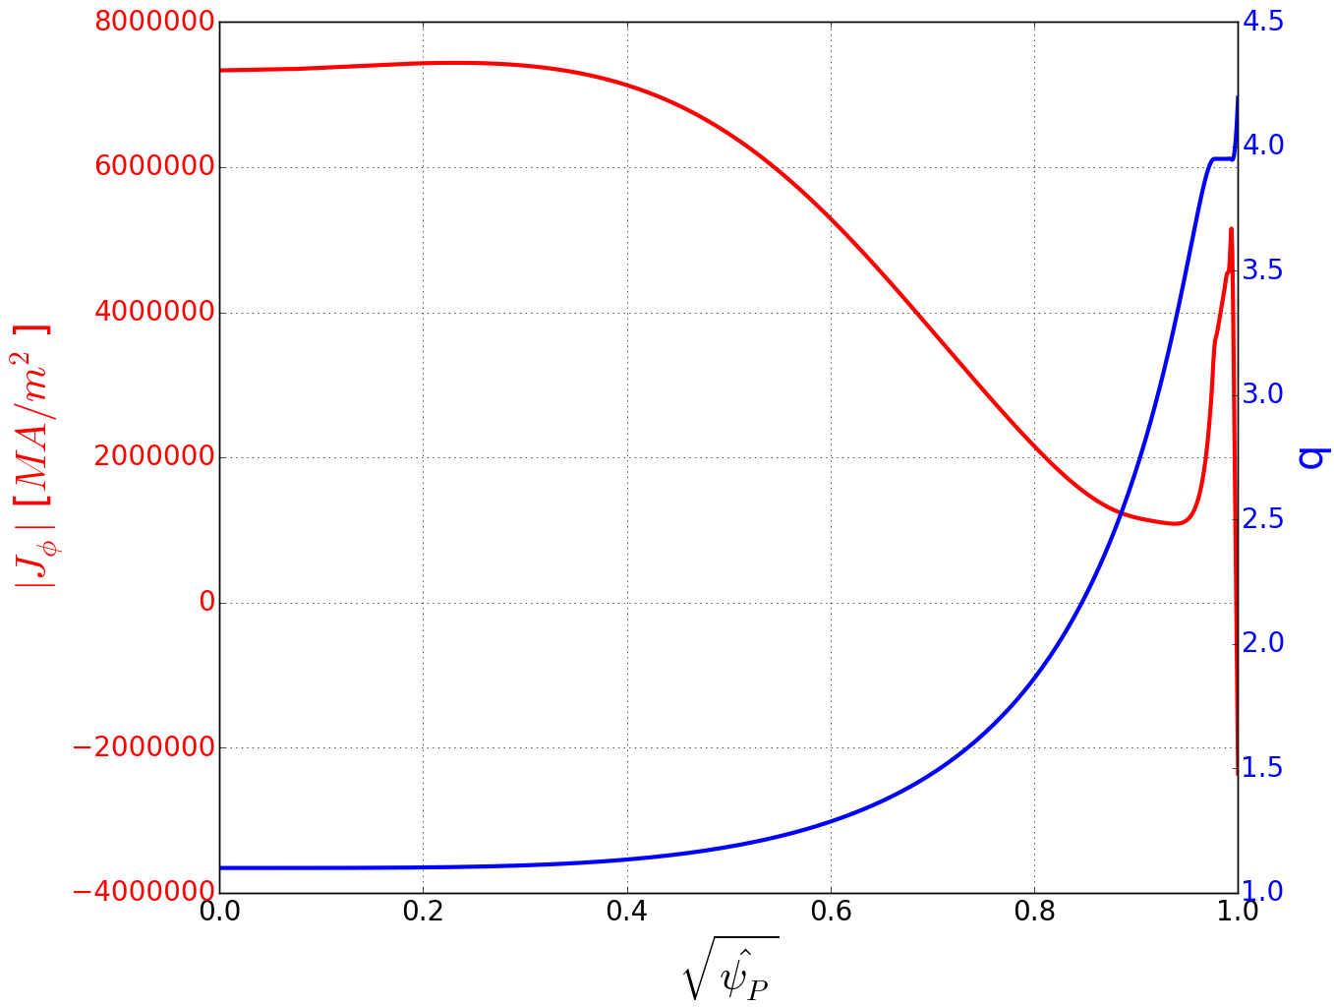
EHO in VMEC equilibria
Free-boundary VMEC simulations has been performed within the DEMO QH-mode baseline.
Main physical parameters:
$β_{Total}$ = 0.035
$β_{Pol}$ = 1.72 (1.03 CREATE-NL+ reference)
$B_{0}$ = 5.85 T (5.69 CREATE-NL+ reference)
$V_{P}$ = 2317.29 $m^{3}$ (2448 CREATE-NL+ reference)
$I_{Tor}$ = -20.26 MA (-18.2 CREATE-NL+ reference)
3D → EHO
2D → NO EHO
$$δP=P_{3D}−P_{2D}$$

Slide 9
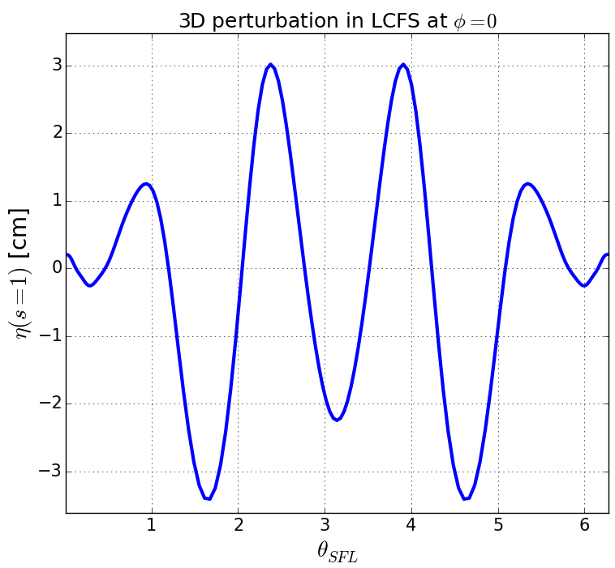
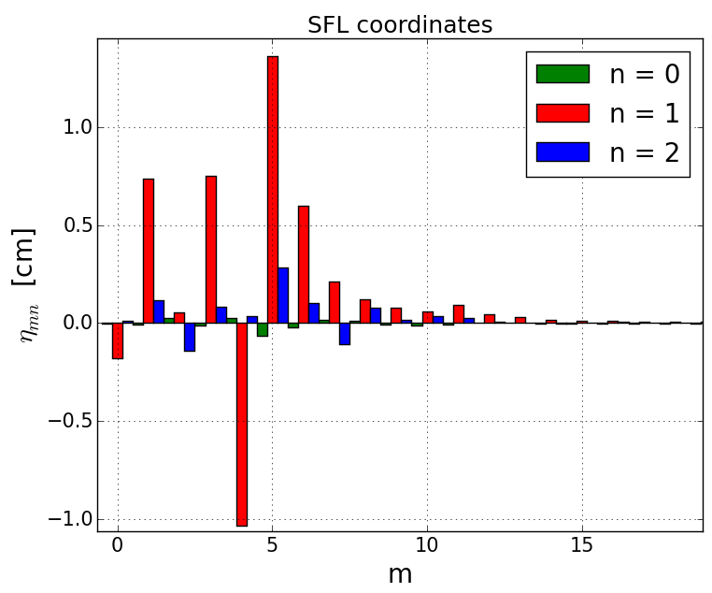
EHO in VMEC equilibria
Analysis of the MHD perturbation has been performed in order to confirm that EHO are exfernal modes
We define the normal nonlinear plasma displacement ($η$) as the distance between the 3D and 2D surface in the direction normal to the 2D surface [A. Kleiner, 2019]:
$η\left(s,θ,φ\right)N\left(θ,φ\right)=S_{3D}\left(s,θ_{3D},φ\right)−S_{2D}\left(s,θ,φ\right)$,
Nonlinear normal perturbation in LCFS can be of ~3.5 cm, or 1.3% of minor radius.
(Not a DEMO equilibrium)
Dominant (n=1, m=5) mode.

Slide 10
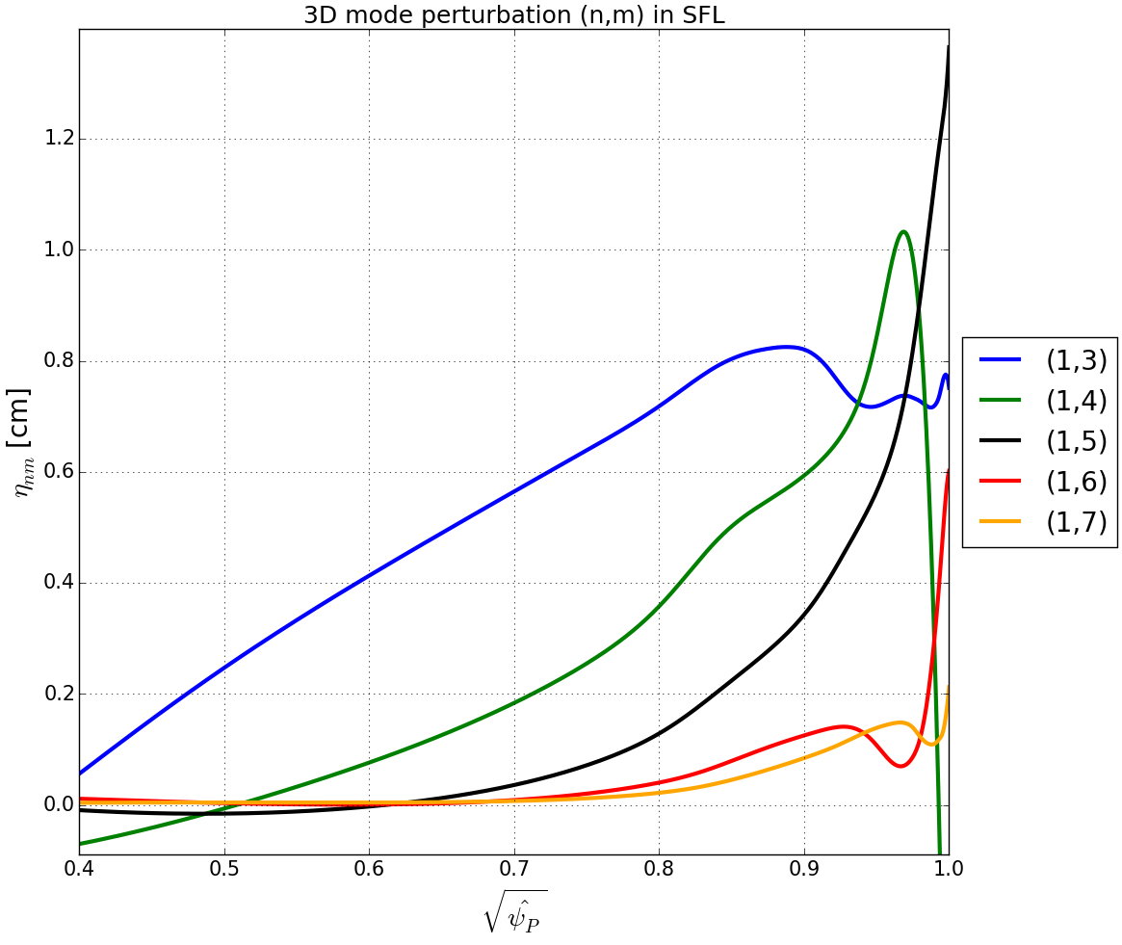
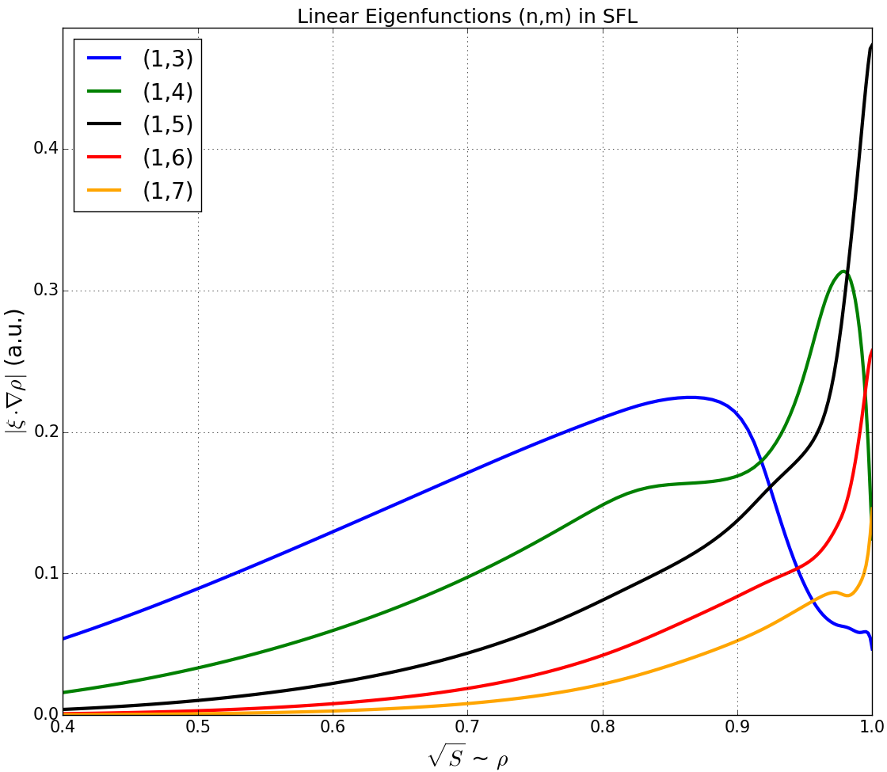
EHO in VMEC equilibria
By calculating the nonlinear normal plasma displacement at every flux surface, it is possible to reconstruct the radial perturbation amplitude profiles for all modes.
The 2D equivalent axisymmetric equilibrium has been tested for instability using the KINX code.
Ideal unstable to MHD instabilities with ${\hat{γ}}^{2}=0.004$
Both profiles exhibit a (n=1,m=4) mode localized at the pedestal, and a (n=1,m=5) perturbing the plasma edge. These would correspond to the dominant exfernal mode and its upper sideband.
→In good agreement with the exfernal mode theory [D. Brunetti, 2019]

Slide 11
Fast ions in QH-mode DEMO with EHO
Motivations:
EHO have the effect of deforming the plasma last close flux surface with 3D-corrugations:
they may degrade the confinement of fast ions
Localised orbit loss patterns might increase the heat flux on the DEMO first wall
The fast ion confinement properties of DEMO 2019 equilibria have to be assessed
Objectives:
Analyse the possible increase of ions first orbit losses in 3D DEMO 2019 QH-mode equilibrium
Identify possible loss particle pattern modifications due to EHO
Procedure:
576000 fast ions are initialised in DEMO 2019 QH-mode 2D and 3D equilibria and tracked for 1 ms:
Both NBI deuterons and fusion product (alphas) confinement properties are studied
Particle obits are computed using the VENUS-LEVIS code in VMEC Free-boundary equilibria
Both orbit and coulomb collision physics is taken into account
The increase of ion first orbit losses is identified as the difference between the number of lost particles between VENUS-LEVIS simulations in 2D and 3D equilibria

Slide 12
Fast ions in QH-mode DEMO with EHO
Simulation set-up:
Plasma radial density and temperature profiles have been obtained from [PROCESS 2019]
Interpolated over VMEC radial grid via cubic splines
Assumed deuterium and tritium temperature equal to the plasma ion temperature
Fusion products initialisation:
Fully ionised Helium-4 particles at 3.5MeV
Particle uniformly distributed on the poloidal, toroidal and pitch angle coordinates
Radial distribution as function of the [H.-S. Bosch and G, Hale] fusion cross-sections
Neutral Beam Injected deuterons initialisation:
NBI composed of 3 beamlets with an injection energy of 1MeV and of a total power of 50MW
NBI geometry and characteristics kindly provided by P. Agostinetti
Planar and poloidal view of the DEMO NBI initial particle distribution (in blue). Red lines correspond to the equilibrium LCFS

Slide 13
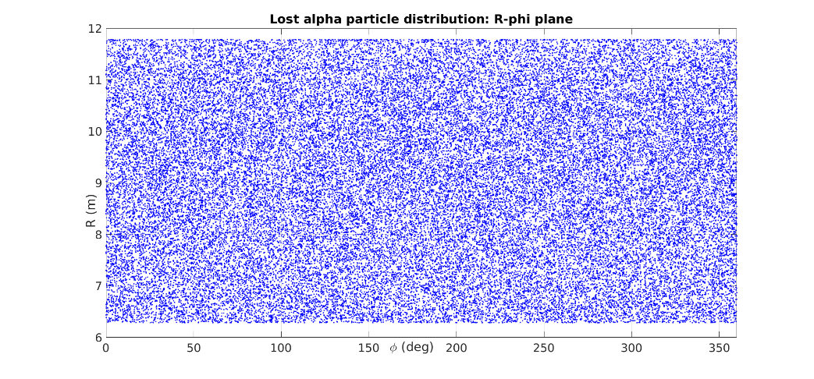
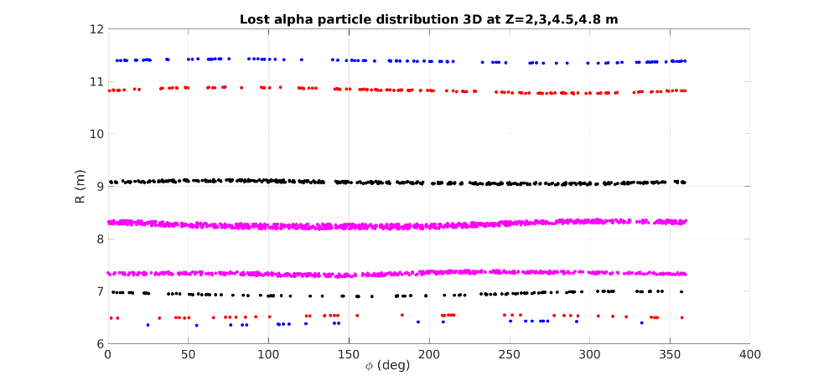
Alpha losses in DEMO QH
First orbit losses of alphas in DEMO-QH:
Approximately 10% of the total particle population is lost due to orbit effects
An increase of the 0.69% of the particle losses is attributed to EHO
Particle losses are uniformly distributed on the LCFS in 2D equilibria
3D edge corrugations modifies the alpha particle loss patterns accordingly
it may locally increase the heat flux on the DEMO first wall
Type of equilibrium | Total number of lost particles | % of lost particles
2D DEMO QH-mode | 53498 | 9.29%
3D DEMO QH-mode | 57506 | 9.98%
Fraction of lost alphas in 2D and 3D DEMO QH-mode equilibria
Lost alphas poloidal Poincaré plots in 2D and 3D DEMO QH-mode eq.
Lost alphas toroidal Poincaré plots in 2D (left) and 3D (right) DEMO QH-mode equilibria

Slide 14
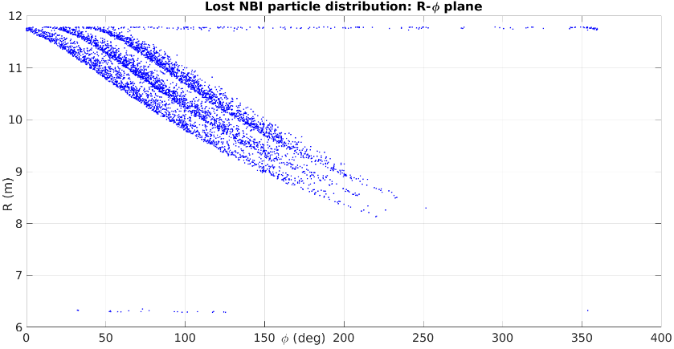
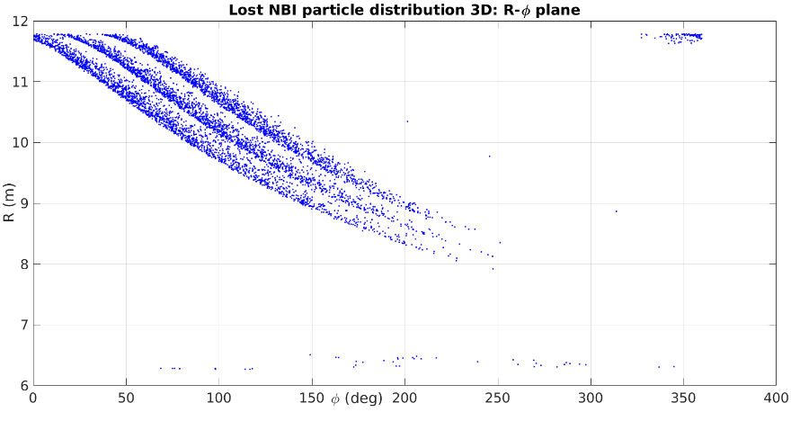
NBI losses in DEMO QH
First orbit losses of the DEMO NBI ions:
Approximately 1% of the initial NBI population is lost due to orbit effects
3D EHO increases the number of losses of approximately 0.15%
Particle loss patterns are weakly perturbed by the presence of plasma edge corrugations.
Spatial localization of losses might be possible
Type of equilibrium | Total number of lost particles | % of lost particles
2D DEMO QH-mode | 5198 | 0.9%
3D DEMO QH-mode | 6079 | 1.05%
Fraction of lost NBI in 2D and 3D DEMO QH-mode equilibria
Integrated particle position on the poloidal plane for 2D (left) and 3D (right) DEMO QH-Mode equilibria
Integrated particle position on the toroidal plane for 2D (left) and 3D (right) DEMO QH-Mode equilibria

Slide 15
Conclusions and future work
Conclusions
The DEMO 2019 QH-mode baseline has been slightly modified in VMEC free-boundary simulations to obtain 3D edge corrugations (identified in this work as EHOs)
The nonlinear amplitude of the perturbation is of approximate 3.5 cm at the LCFS, corresponding to 1.3% of the minor radius.
A systematic analysis of the resulting equilibrium suggest that obtained 3D corrugations can be identified as the nonlinear saturated state of exfernal modes, which present characteristic features of the EHOs observed in QH-mode experiments.
Simulations of fast ion orbit losses in DEMO 2D and 3D QH-mode equilibria have been performed
EHO accounts for an increase of the 0.69% and of the 0.15% of the particle losses for respectively the alpha and NBI particle populations
Simulations suggest that the edge corrugations modify the ion loss patterns with possible spatial localisation.
Future work:
Evaluation of the full parameter space in which is possible to obtain saturated EHOs
Exploration of the possibility to increase the amplitude of the obtained edge corrugations.
Investigate the effect of EHO on different fast ion transport mechanisms (collisional transport, charge exchange, etc …)
Further studies on the possibility of having spatial heat flux localisation due to EHO.

Slide 16
References
Burrell, K. H., West, W. P., Doyle, E. J., Austin, M. E., Casper, T. A., Gohil, P., … Zeng, L. (2005). Advances in understanding quiescent H-mode plasmas in DIII-D. In Physics of Plasmas (Vol. 12, pp. 1–10). American Institute of Physics. https://doi.org/10.1063/1.1894745
Brunetti, D., Graves, J. P., Lazzaro, E., Mariani, A., Nowak, S., Cooper, W. A., & Wahlberg, C. (2018). Analytic stability criteria for edge MHD oscillations in high performance ELM free tokamak regimes. Nuclear Fusion, 58(1), 014002. https://doi.org/10.1088/1741-4326/aa9456
Brunetti, D., Graves, J. P., Lazzaro, E., Mariani, A., Nowak, S., Cooper, W. A., & Wahlberg, C. (2019). Excitation Mechanism of Low- <math display="inline"> <mrow> <mi>n</mi> </mrow> </math> Edge Harmonic Oscillations in Edge Localized Mode-Free, High Performance, Tokamak Plasmas. Physical Review Letters, 122(15), 155003. https://doi.org/10.1103/PhysRevLett.122.155003
Hirshman, S. P., van RIJ, W. I., & Merkel, P. (1986). Three-dimensional free boundary calculations using a spectral Green’s function method. Computer Physics Communications, 43(1), 143–155. https://doi.org/10.1016/0010-4655(86)90058-5
Kleiner, A., Graves, J. P., Cooper, W. A., Nicolas, T., & Wahlberg, C. (2018). Free boundary 3D ideal MHD equilibrium calculations for non-linearly saturated current driven external kink modes in tokamaks. Nuclear Fusion, 58(7), 074001. https://doi.org/10.1088/1741-4326/aac607
Cooper, W. A., Brunetti, D., Faustin, J. M., Graves, J. P., Pfefferlé, D., Raghunathan, M., … Aiba, N. (2015). Free boundary equilibrium in 3D tokamaks with toroidal rotation. Nuclear Fusion, 55(6), 063032. https://doi.org/10.1088/0029-5515/55/6/063032
Kleiner, A., Graves, J. P., Brunetti, D., Cooper, W. A., Medvedev, S., Merle, A., & Wahlberg, C. (2019). Current and pressure gradient triggering and nonlinear saturation of low- n edge harmonic oscillations in tokamaks. Plasma Physics and Controlled Fusion, 61(8), 084005. https://doi.org/10.1088/1361-6587/ab2444
D. Pfefferlé, W.A. Cooper, J.P. Graves, C. Misev, (2014) VENUS-LEVIS and its spline-Fourier interpolation of 3D toroidal magnetic field representation for guiding-centre and full-orbit simulations of charged energetic particles, Computer Physics Communications, Volume 185, Issue 12, 2014, Pages 3127-3140.

Slide 17
References
Degtyarev, L., Martynov, A., Medvedev, S., Troyon, F., Villard,L., and Gruber, R. (1997).The KINX ideal MHD stability code for axisymmetric plasmas with separatrix.Computer Physics Communications, 103(1):10–27.
Dudson, Ben. “FreeGS: Free Boundary Grad Shafranov Solver” https://github.com/bendudson/freegs
PROCESS title ‘baseline 2019 qh-mode’ , produced the 26/03/19 at 16:32. User: morrisj
H.-S. Bosch and G, Hale, Nucl. Fusion 32, 611, (1992), DOI: 10.1088/0029-5515/32/4/I07

Slide 18
Description of the project (EXTRA)
Goals of the project:
Identify equilibrium conditions leading to the formation of EHOs within the DEMO 2019 QH-mode baseline.
Analyse the transport of fast ions in DEMO QH-mode equilibria with EHOs.
The VENUS-LEVIS code [Pfefferle et al., 2014] simulates the distribution of marker particles in a background equilibrium. Particularly needed is the magnetic geometry decomposed in Fourier components.
For a plasma with EHO, we need a full 3D equilibrium containing edge corrugations. In this first principle study, the VMEC free-boundary code [Hirshman and Whitson, 1983] is used to produce a QH-mode-like equilibrium featuring EHOs
VMEC PROS
Fast calculation of fully nonlinear 3D saturated states.
Saturated states corresponding to known instabilities have been obtained before:
External Kink [Kleiner, A. 2018],[Cooper, W. A.]
Exfernal modes (identified as EHO) [Kleiner, A. 2019]
VMEC CONS
Equilibrium code only: No guarantee that the final solution is physically accessible.
No flow: Assume that EHO can exist without flow, as low-n modes are only weakly affected by it

Slide 19
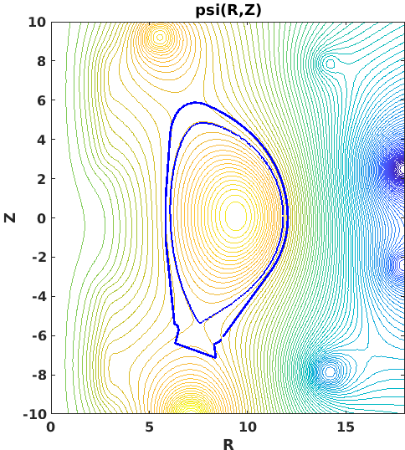
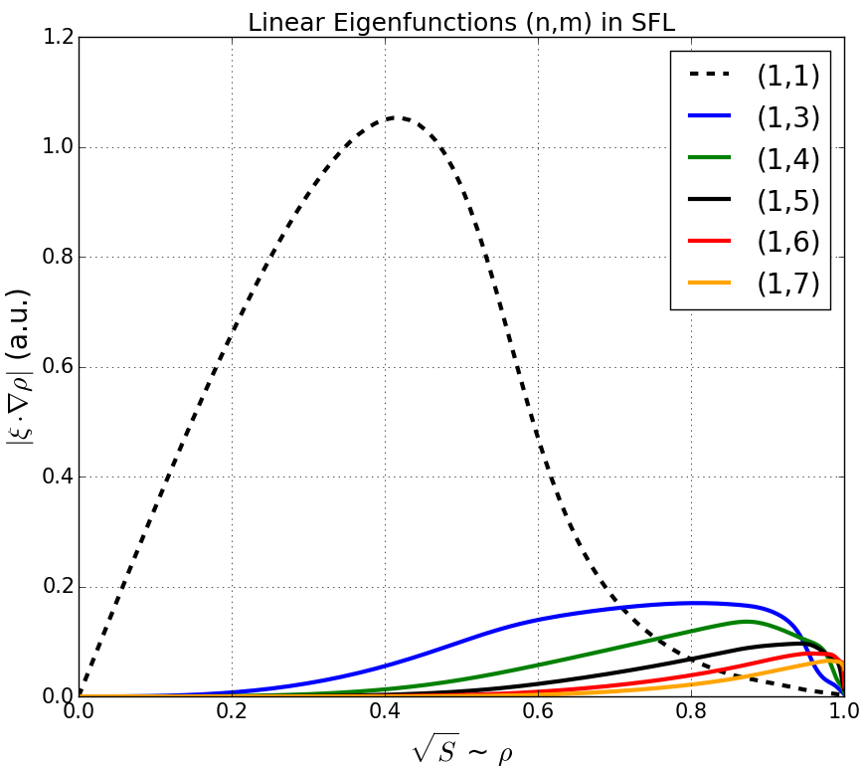
DEMO 2019 QH-mode baseline (EXTRA)
The reference flat-top equilibrium for the DEMO 2019 QH-mode baseline was provided externally [1].
The equilibrium was tested for stability using the KINX code [Degtyarev et al., 1997] .
Ideal unstable, with normalized growth rate of
$${\hat{γ}}^{2}=0.006451$$
Dominant mode (n=1,m=1), probably excited by $q_{axis}<1$.

Slide 20
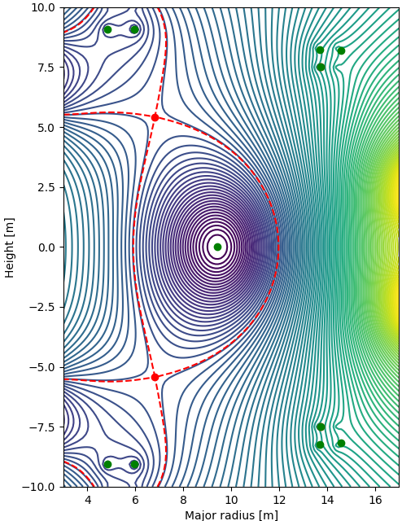
Calculation of vacuum field (EXTRA)
In order to obtain currents in the coils that agree with the ones used for obtaining the CREATE equilibrium [1], we set the current in one coil to be constant and let FreeGS calculate the currents in the remaining coils through feedback control.
Coil label | FreeGS | CREATE (SOF) | CREATE (EOF)
CS3U [MAt] | -41.56 | 13.63 | -5.94
CS2U [MAt] | 5.40 | -1.42 | -29.11
CS1 [MAt] | 9.6 | -9.6 | -58.23
CS2L [MAt] | 5.40 | -7.17 | -29.11
CS3L [MAt] | -41.56 | 25.14 | -12.44
PF1 [MAt] | -7.095 | 14.19 | 2.32
PF2 [MAt] | 1.316 | -5.22 | -5.89
PF3 [MAt] | 7.486 | -5.12 | -6.08
PF4 [MAt] | -7.095 | -3.98 | -3.64
PF5 [MAt] | 1.316 | -7.76 | -8.98
PF6 [MAt] | 7.486 | 15.46 | 10.25

Slide 21
VMEC DEMO 2019 QH-mode baseline reproduction (EXTRA)
The VMEC code also requires the total enclosed toroidal flux, which is calculated using the safety factor through the following formula:
$$ψ_{T}\left(s\right)−ψ_{T}\left(axis\right)=\left[ψ_{P}\left(edge\right)−ψ_{P}\left(axis\right)\right]\int_{0}^{{\hat{ψ}}_{p}}{d{{\hat{ψ}}_{p}}^{′}q\left({{\hat{ψ}}_{p}}^{′}\right)}$$
$$ψ_{T}\left(edge\right)−ψ_{T}\left(axis\right)=261.39 \left[Wb\right]$$
The fixed-boundary VMEC simulations hav been performed using 500 enclosed flux surfaces and a mode spectrum of $0≤m<16$ poloidal and $−4≤n≤4$ toroidal modes. The simulation converged with a residual radial force smaller than ${10}^{−10}N$.
The free-boundary VMEC simulations have been performed using 289 enclosed flux surfaces and a mode spectrum of $0≤m<16$ poloidal and $−6≤n≤6$ toroidal modes. The simulation converged with a residual radial force smaller than ${10}^{−10}N$.

Slide 22
VMEC QH-mode equilibria (EXTRA)
Simple up-down symmetric model for the guess of the Last Closed Flux Surface in free-boundary VMEC simulations
$$R \left(θ\right) =R_{0}+r_{0}cos\left(θ\right)−D−Ecos\left(θ\right)+Tcos\left(2θ\right)$$
$$Z\left(θ\right)=r_{0}cos\left(θ\right)+Ecos\left(θ\right)−Tcos\left(2θ\right)$$
With $R_{0}=8.938$ is the major radius, $r_{0}=4.0$ is the minor radius, $D=0.3$ is the Shafranov shift, $E=1.0$ is the elongation and $T=0.33$ is the triangularity.
Pressure profile in the CREATE equilibrium has been lifted to approximately 150 kPa, which corresponds to ~2.5% of the pressure on axis. The pedestal is modelled by a Gaussian from the pedestal top to the plasma edge.
A small spike at the edge that places $q_{a}$ just above the rational surface has been added to suppress the saturated external kink modes in VMEC free-boundary simulations.

Slide 23
VMEC QH-mode equilibria (EXTRA)
FreeGS takes as input the plasma profiles, vacuum $RB_{φ}$ at the magnetic axis, shape constrains, and a set of coils.
The plasma profiles are used to determine the toroidal current density $J_{φ}$. In this work, we specify the pressure in the axis and the total toroidal current. Then FreeGS calculates $J_{φ}$ as:
$$J_{φ}\left(R,Z\right)=L\left[β_{0}R+{\left(1−β_{0}\right)}/R\right]{\left(1−{\hat{ψ}}_{p}^{α_{n}}\right)}^{α_{m}}$$
Where $L$ and $β_{0}$ are calculated using the constrains which follows:
$$p_{axis}=−Lβ_{0}\int_{axis}^{boundary}{{\left(1−{\hat{ψ}}_{p}^{α_{n}}\right)}^{α_{m}}dψ_{p}}$$
$$I_{p}=Lβ_{0}\iint{R{\left(1−{\hat{ψ}}_{p}^{α_{n}}\right)}^{α_{m}}dRdZ+L\left(1−β_{0}\right)\iint{\frac{{\left(1−{\hat{ψ}}_{p}^{α_{n}}\right)}^{α_{m}}}{R}dRdZ}}$$

Slide 24
