Slide 1
KDII#8 Final Meeting Solps DEMO Simulations
F. Subba

Slide 2
Outline
Task specification/status
Low/density attached case
Scans towards high density/detachment
Current status: target loads, sputtering, pumping
Future developments

Slide 3
Task Specifications
Deliverable | Status
Strongly attached case (no evidence of momentum loss in the plasma flow to the target)
Barely detached case (evidence of momentum loss but electron temperature still above 5 eV on the divertor plate)
Fully detached case (electron temperature below 5 eV and heat flux below 10 MW/m2 on the divertor plate)
Overly detached case (larger impurity concentration than in case 3 – radiation front moving towards the X-point)
The first two objectives are available now, the last two are still to be completed

Slide 4
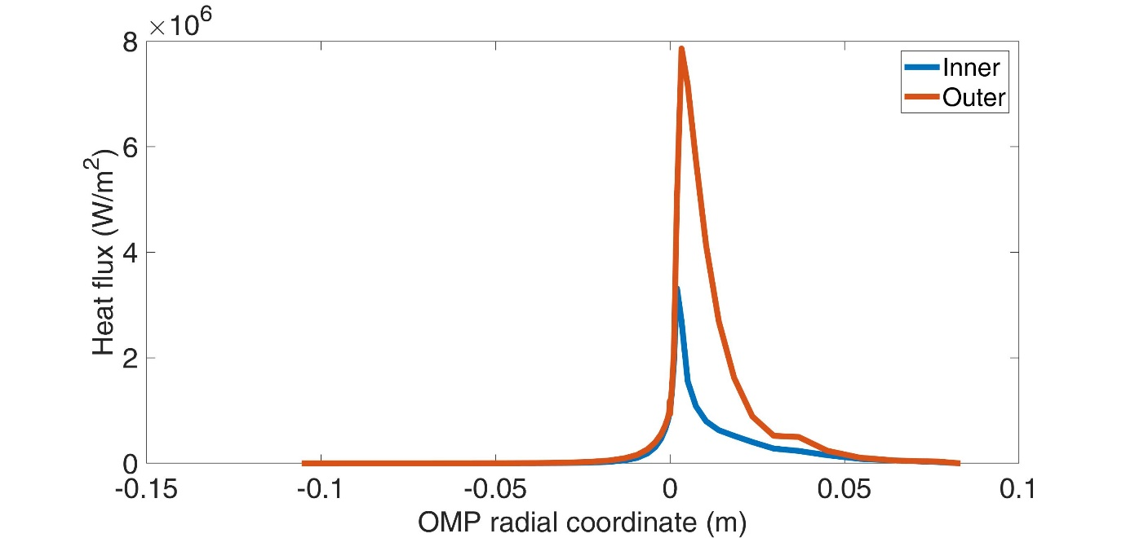
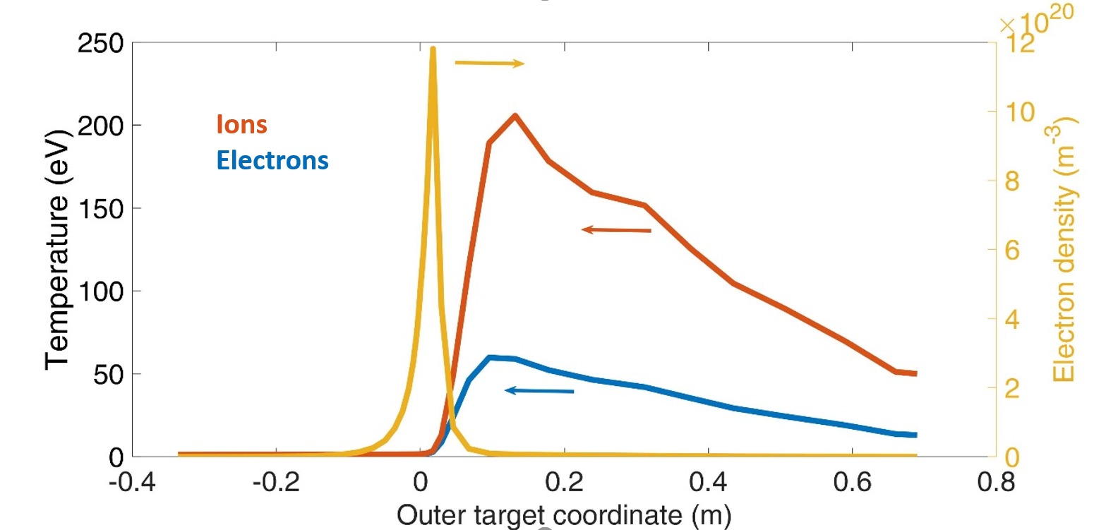
Attached Case
First attached case: end 2019
Target heat flux barely tolerable
BUT
Temperature unrealistic
Upstream density: < 2e19 m-3
Heat flux density
P_{in} = 150 MW
Particles:
D Pellet = 3.0e22 s-1
D puff = 4.6e21 s-1
Ar puff = 3.0e19 s-1
He 7.1e20 s-1
Density and temperature

Slide 5
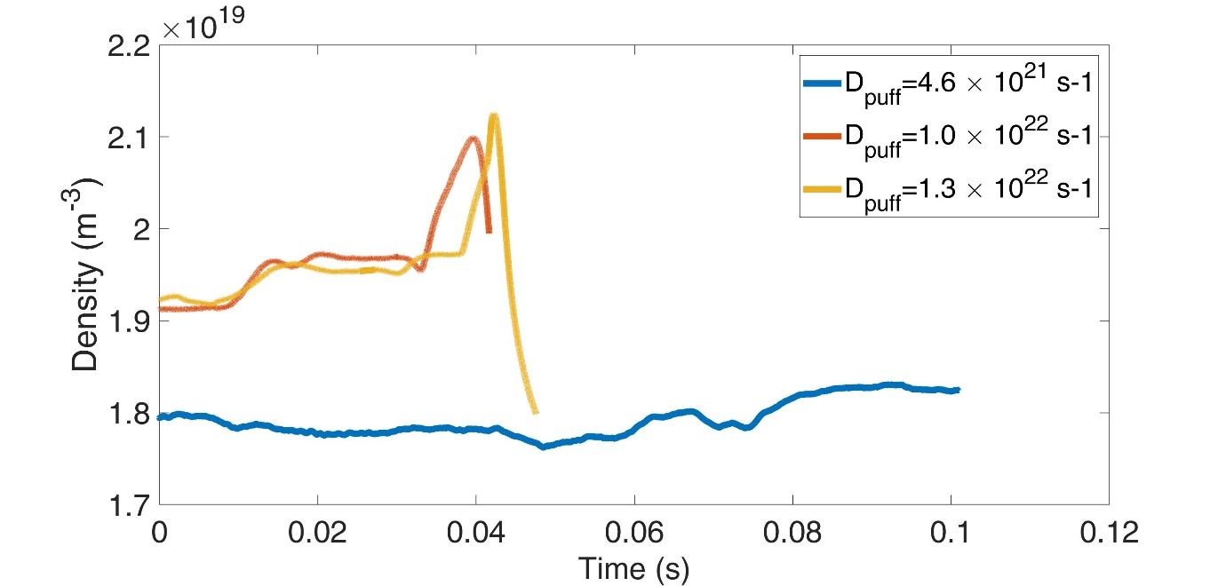
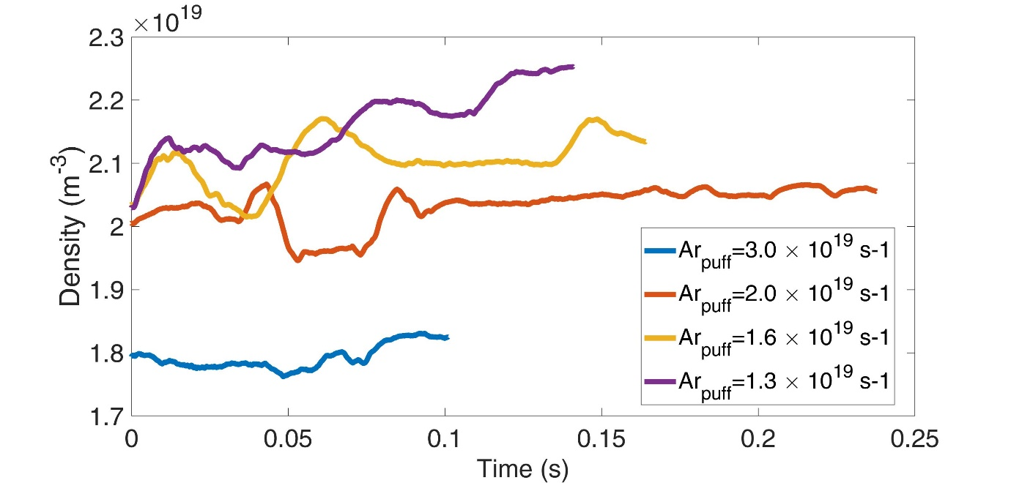
Increase Upstream Density: Dead End?
Increase D_{puff} shows little effect
Probably need (at least) to be more aggressive
But puff would be no more a “correction”
Decrease Ar puff has more significant effect
Possible explanation from S. Krasheninnikov, Phys. of Plasmas, 2016
But we still want a high-radiative divertor
Upstream density
Pull D puff up
Upstream density
Push Ar Puff down
Try both ways together!

Slide 6
Explore a Different Setup (Pilot Case)
Change substantially the setup
Particle fuelling:
D_{puff}: 1e23 s-1
Pellets: 7e21 s-1
Ar_{puff}: 1.5e19 s-1
P_{core}: 150 MW (unchanged)
Consequences:
Worsen the T burn-up
Put more stress on the fuel recycle system
Still doable

Slide 7
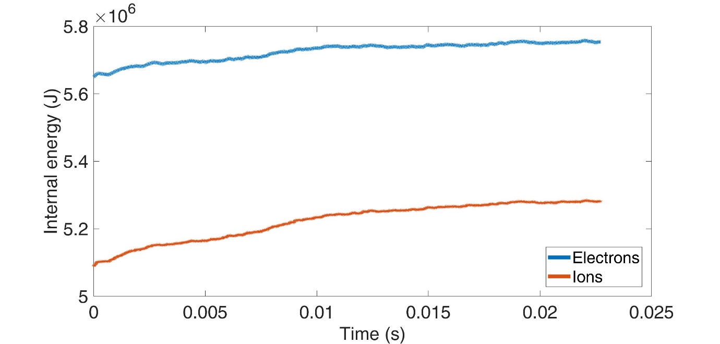
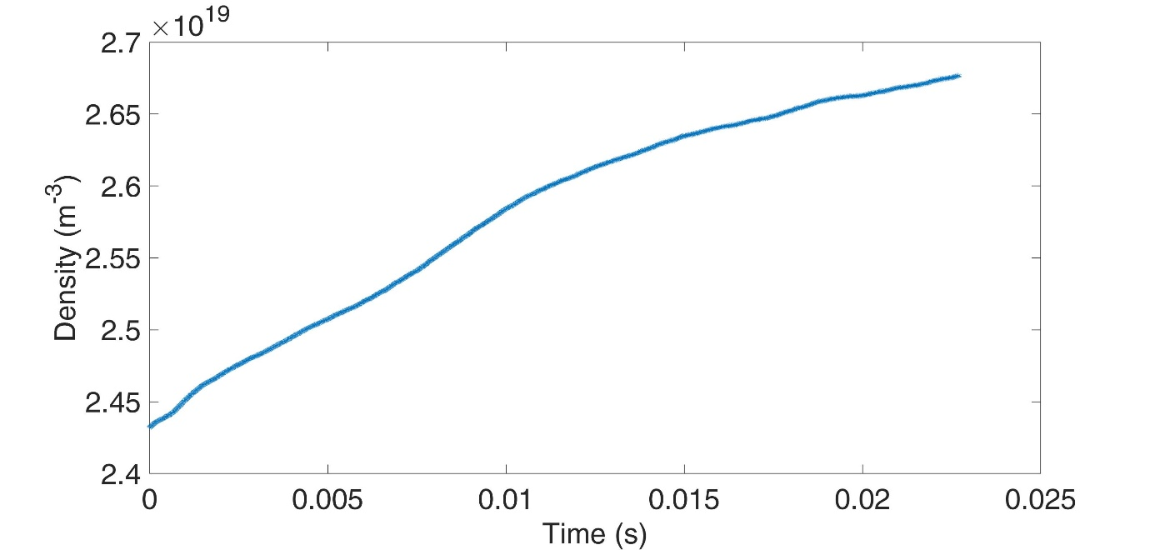
Approach to Steady State
Pilot case not steady state yet, but not terribly far
Energy content: increase rate ~4 MW (vs. 150 P_{in})
Electron content increase rate: ~4e22 s-1 (vs. D_{puff} 1.e23 s-1)
Int. energy content
Upstream density
Range of “acceptable” upstream densities: 3-4 e19 m-3
Probably still more room to improve target conditions
n_{up} → ~3e19 m-3?

Slide 8
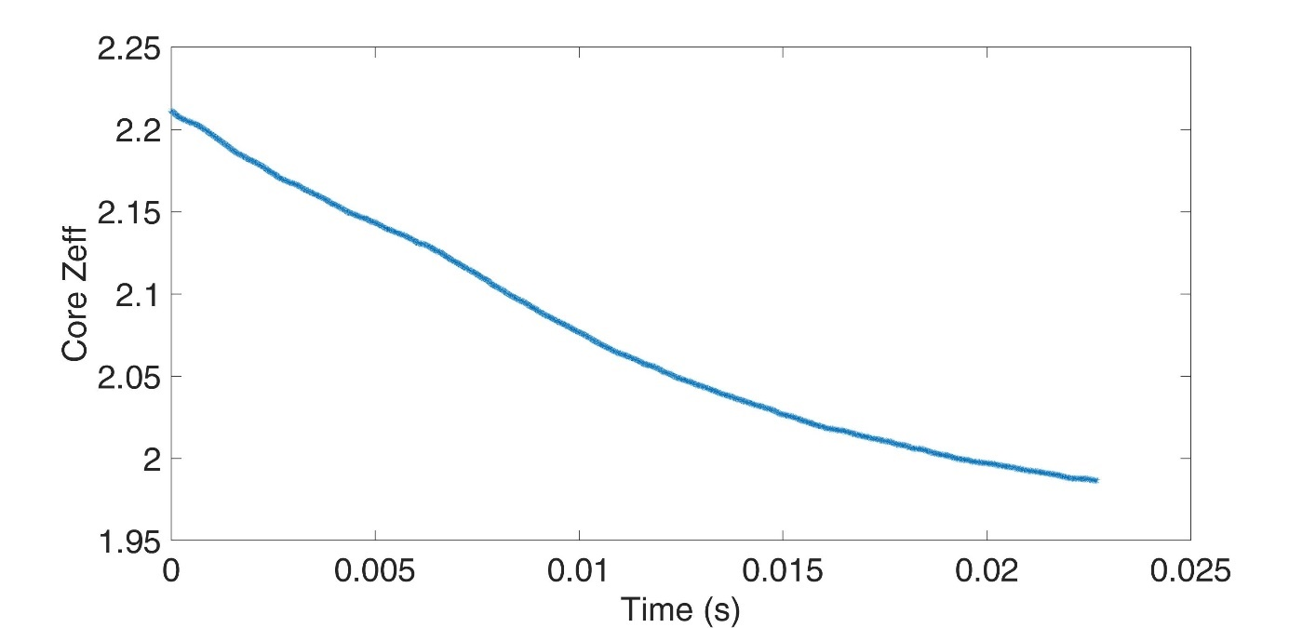
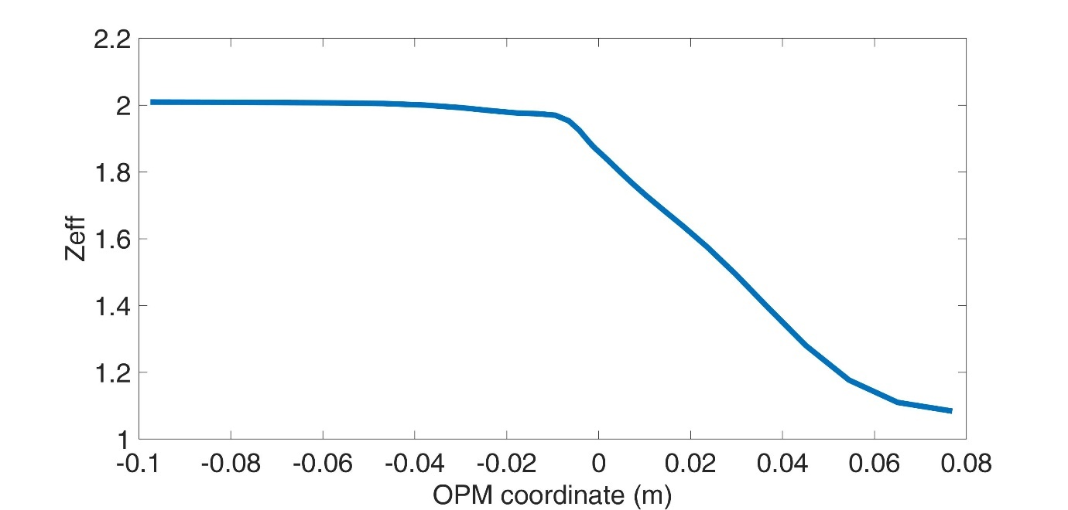
Core Plasma Pollution
Core Zeff decreasing noticeably
Now slightly les than 2 at the separatrix
Large changes no more expected
Almost uniform across the core
Core Zeff
Zeff profile

Slide 9
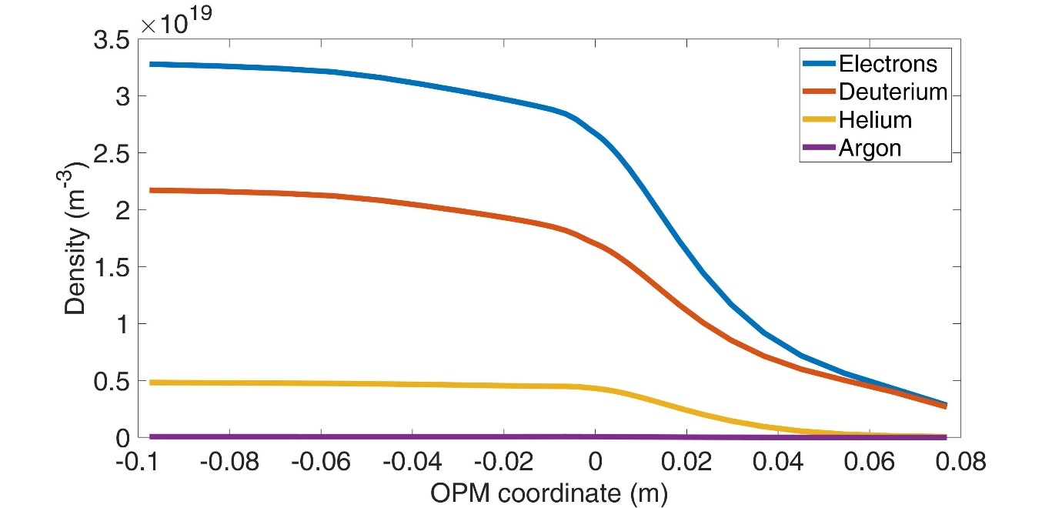
Core Plasma Pollution
Core Zeff decreasing noticeably
Now slightly les than 2 at the separatrix
Large changes no more expected
Almost uniform across the core
Helium core content
Measure concentration as c_{He} = n_{He}/n_{D}
At the moment c_{He} = 20%-25%
Space for improvement if n_{up} can increase further
Ionic species profiles
Zeff profile

Slide 10
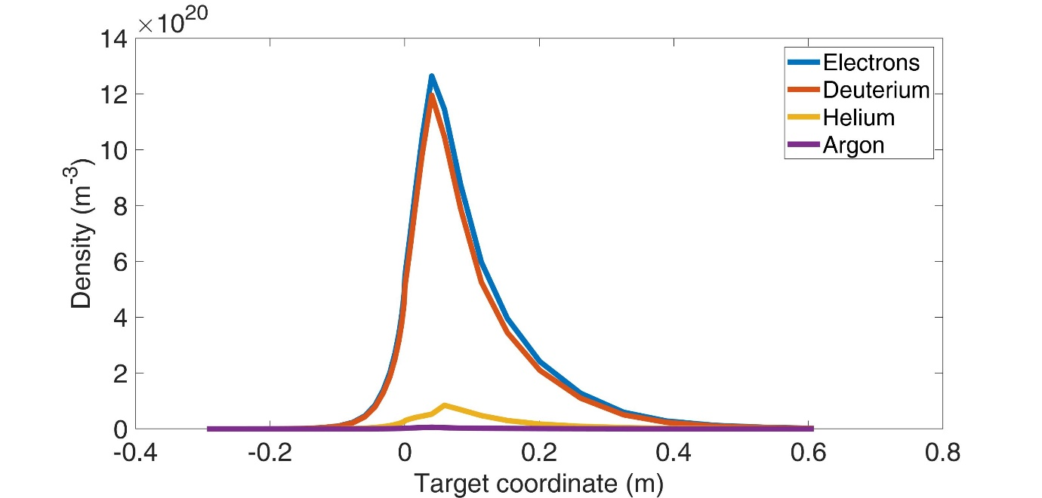
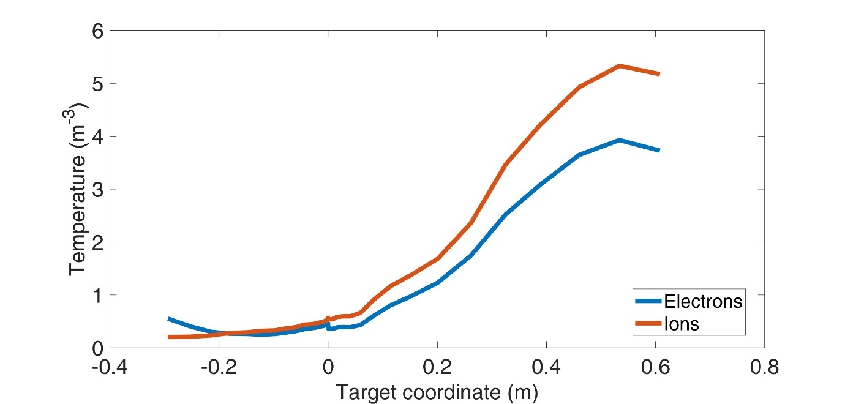
Target Profiles: HFS
HFS target is markedly high-recycling / detached
Large max. density: ~1.3e21
T_{sep} < 1 eV
P_{targ}/P_{up} ~ 0.3
T increases away from strike point but:
Max value still ~5 eV
About 0.5 m far from strike point
Target density
Target temperature
Not a big surprise on the HFS

Slide 11
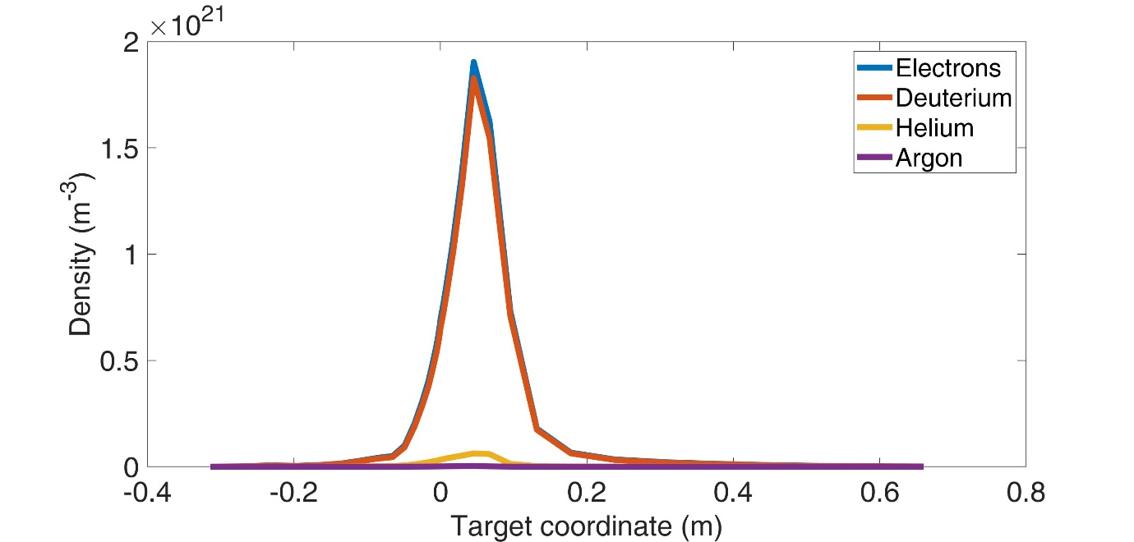
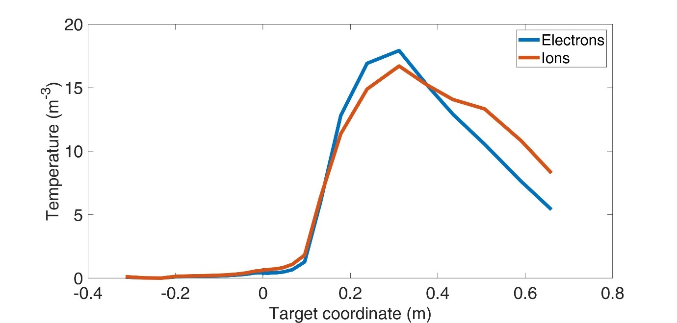
Target Profiles: LFS
LFS more critical
Higher density: ~2e21
Reduced pressure drop: P_{targ}/P_{up}~0.6
Higher max temperature: ~19 eV
Target density
Target temperature

Slide 12
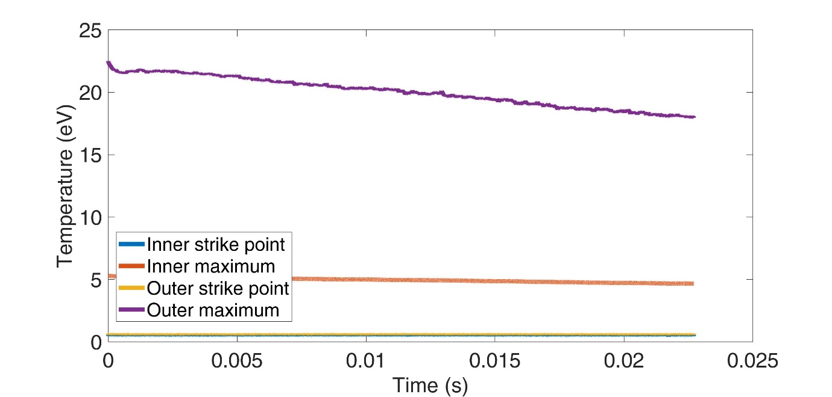
Target Profiles: LFS
LFS more critical
Higher density: ~2e21
Reduced pressure drop: P_{targ}/P_{up}~0.6
Higher max temperature: ~19 eV
Luckily enough Tmax is still going down...
Target density
Target temperature

Slide 13
Target Profiles: LFS
LFS more critical
Higher density: ~2e21
Reduced pressure drop: P_{targ}/P_{up}~0.6
Higher max temperature: ~19 eV
Luckily enough Tmax is still going down...
Now check:
Heat flux
Sputtering
Neutrals in the divertor
Target density
Target temperature

Slide 14
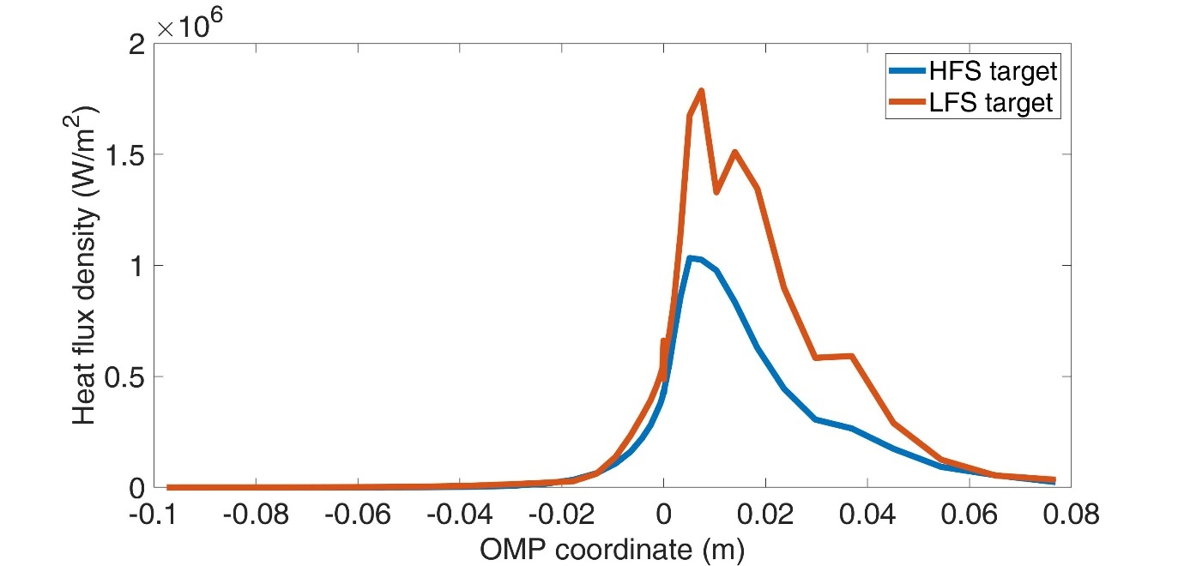
Target Heat Flux
Peak heat flux less than 2 MW m-2
Does not include radiation, but no dramatic changes expected
Heat flux density

Slide 15
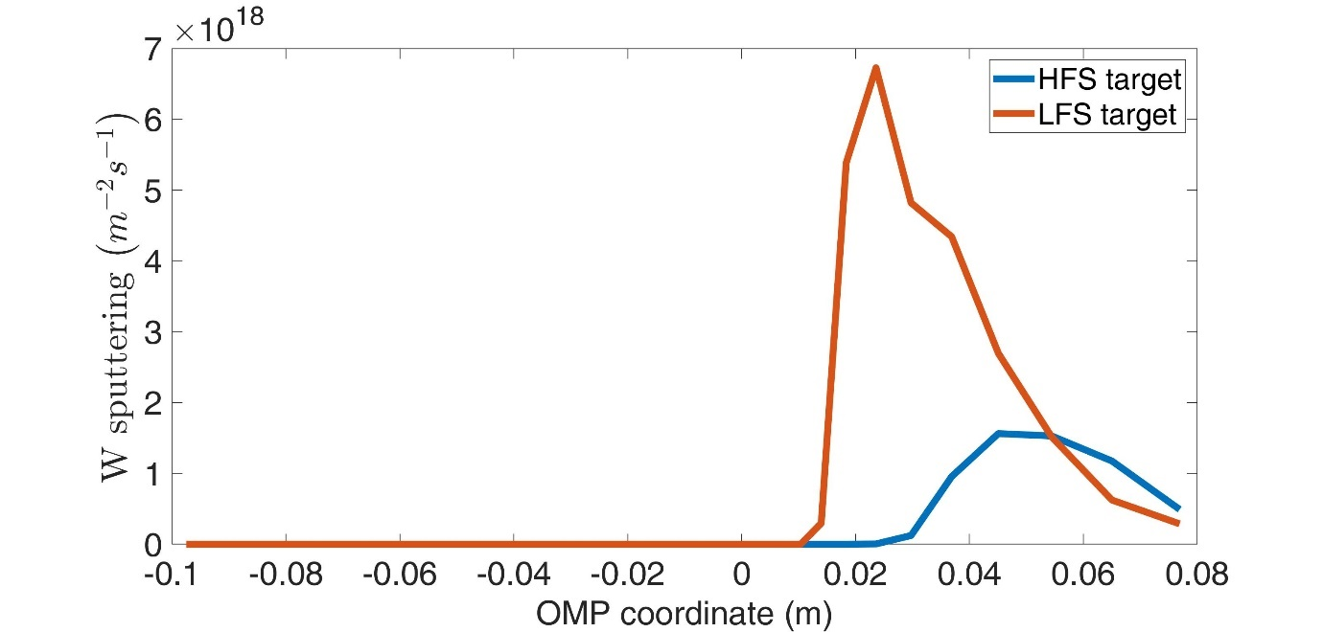
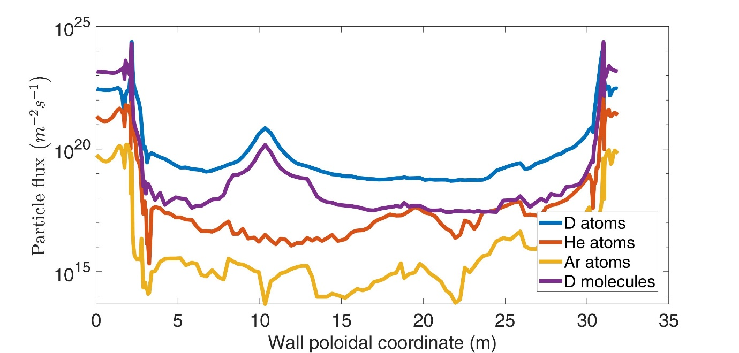
Sputtering
Preliminary estimate of target W sputtering
Use TRIM database
Python routines courtesy of D. Coster
Literature reported limit: 1.5e19 m2s-1 (R. Wenninger, Nuclear Fusion, 2014)
Wall damage also to be evaluated
Input can be given to other codes (e.g. ERO)
Sputtered flux density
Wall neutral flux

Slide 16
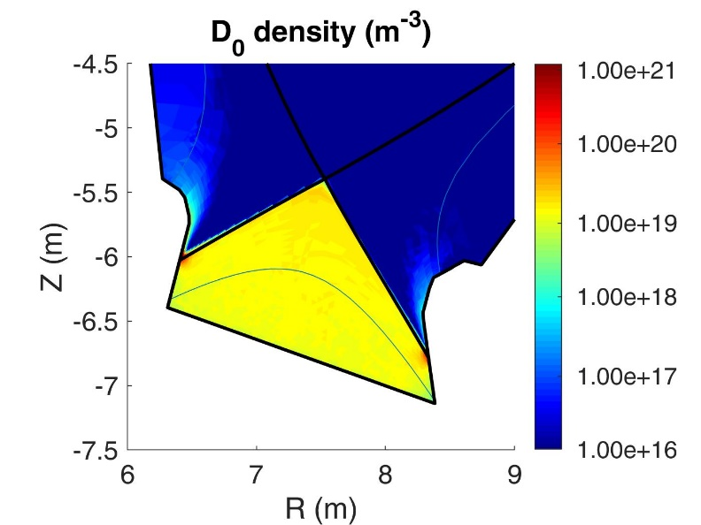
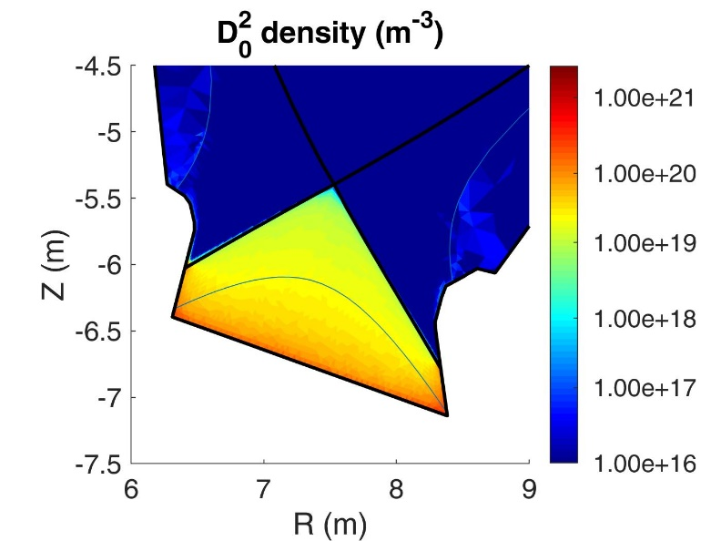
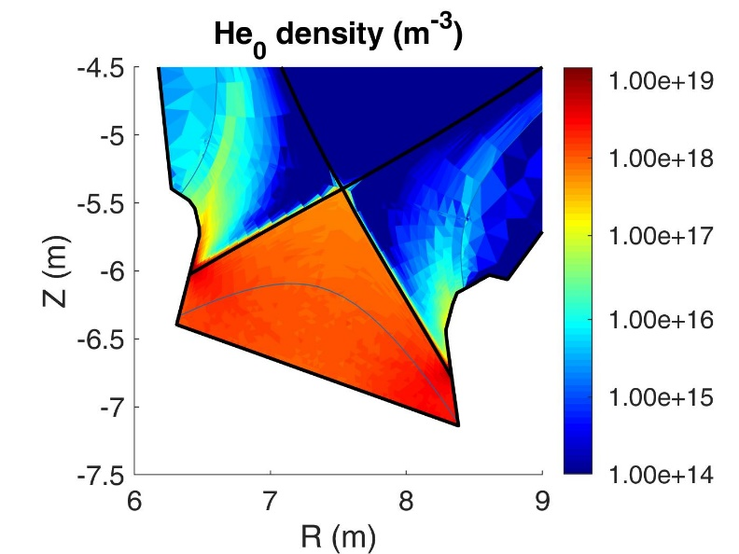
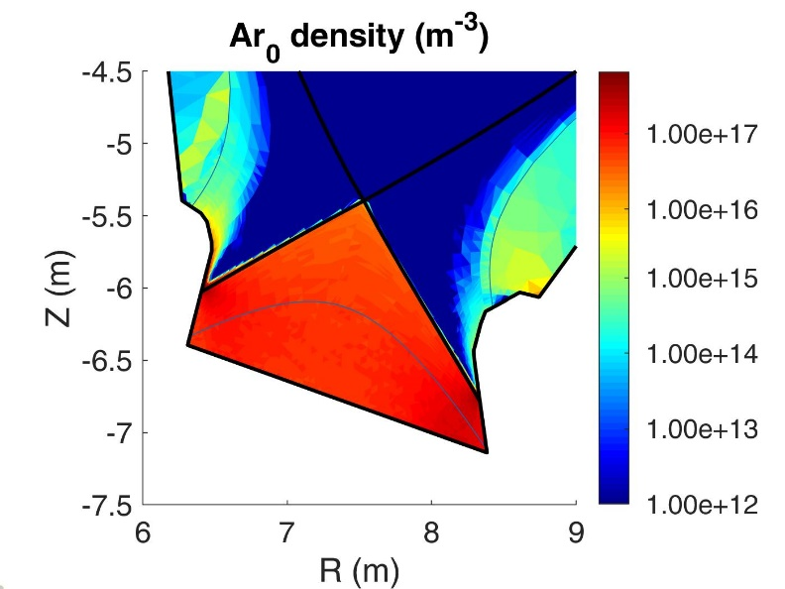
Neutrals in the Divertor
Pump
Pump
Pump
Pump
Neutrals accumulate close to the pump ... But not so much!

Slide 17
Neutrals in the Divertor
Neutral species | Pressure close to pump opening (Pa) | Density close to pump opening (m⁻³)
$$D^{0}$$ | 1.2 | 1.3×10¹⁹
$$D_{2}^{0}$$ | 2.8 | 3.8×10¹⁹
$${He}^{0}$$ | 0.26 | 1.3×10¹⁸
$${Ar}^{0}$$ | 0.025 | 9.6×10¹⁶
Estimated pumping speed: several 1e3 m3s-1 ➔ too much

Slide 18
Improving Neutral / Divertor Conditions
At a first look, neutral conditions in the divertor seems the most critical parameter feature
Possible mitigating actions:
Explore higher upstream density
Should we include the liner in our modeling?

Slide 19
Future Developments (Proposal)
Higher upstream density
Always beneficial
Complete the desired detachment scan
Include the liner in simulations
More accurate divertor description
Hope for better pumping conditions
Consider species-dependent albedos
Not sure if a major difference might arise
But it could improve the simulation accuracy/reliability
Code upgrade: from 3.0.6 to 3.0.7
New version just released
Second half of 2020 seems a reasonable time to upgrade

Slide 20
Thank you For Attention

