Slide 1
Improved feedback control of the radiated power in Wendelstein 7-X using system identification
A. Tsikouras, F. Reimold, G. Partesotti, M. Krychowiak, M. van Berkel, and the W7-X Team

Slide 2
Content
Motivation
Control approach
Perturbative experiments
Frequency Analysis
Results
Summary
Future Work
System Identification

Slide 3
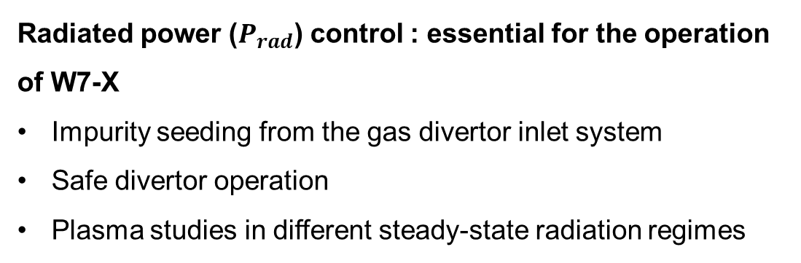
Motivation
Radiated power ($P_{rad}$) control : essential for the operation of W7-X
Impurity seeding from the gas divertor inlet system
Safe divertor operation
Plasma studies in different steady-state radiation regimes

Slide 4
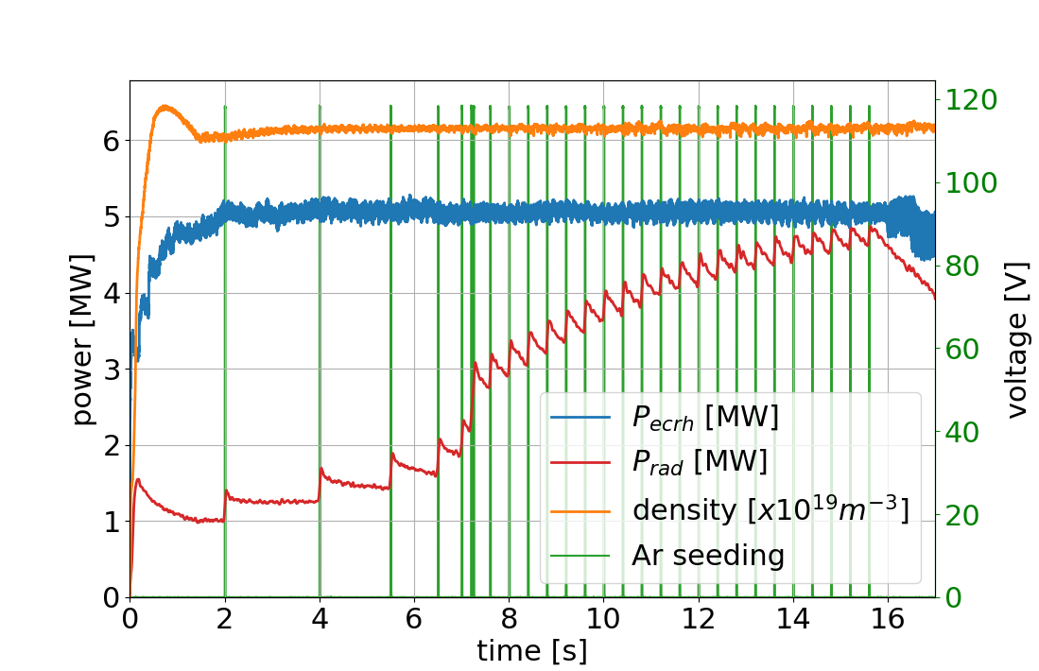
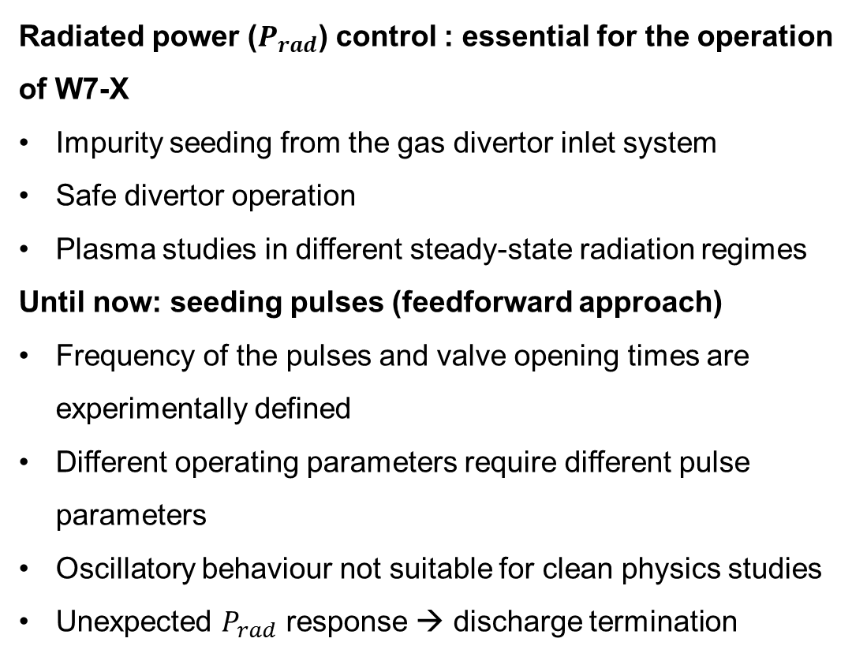
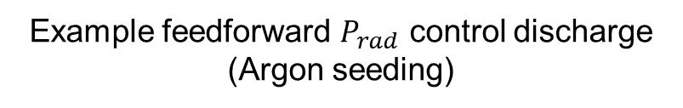
Motivation
Radiated power ($P_{rad}$) control : essential for the operation of W7-X
Impurity seeding from the gas divertor inlet system
Safe divertor operation
Plasma studies in different steady-state radiation regimes
Until now: seeding pulses (feedforward approach)
Frequency of the pulses and valve opening times are experimentally defined
Different operating parameters require different pulse parameters
Oscillatory behaviour not suitable for clean physics studies
Unexpected $P_{rad}$ response → discharge termination
Example feedforward $P_{rad}$ control discharge (Argon seeding)

Slide 5
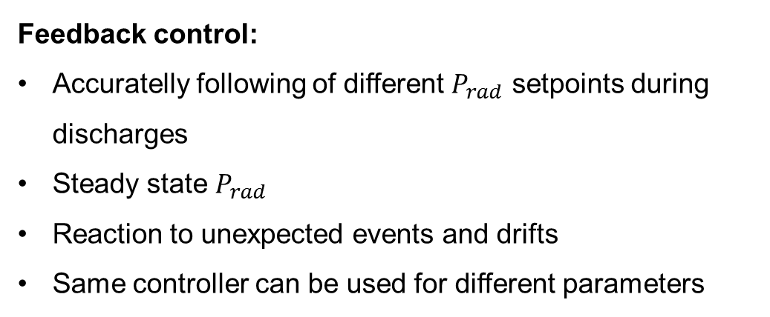
Motivation
Feedback control:
Accuratelly following of different $P_{rad}$ setpoints during discharges
Steady state $P_{rad}$
Reaction to unexpected events and drifts
Same controller can be used for different parameters

Slide 6
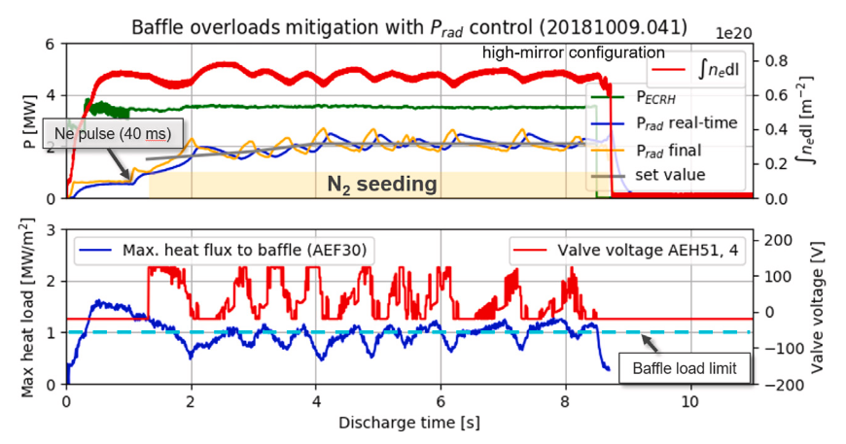
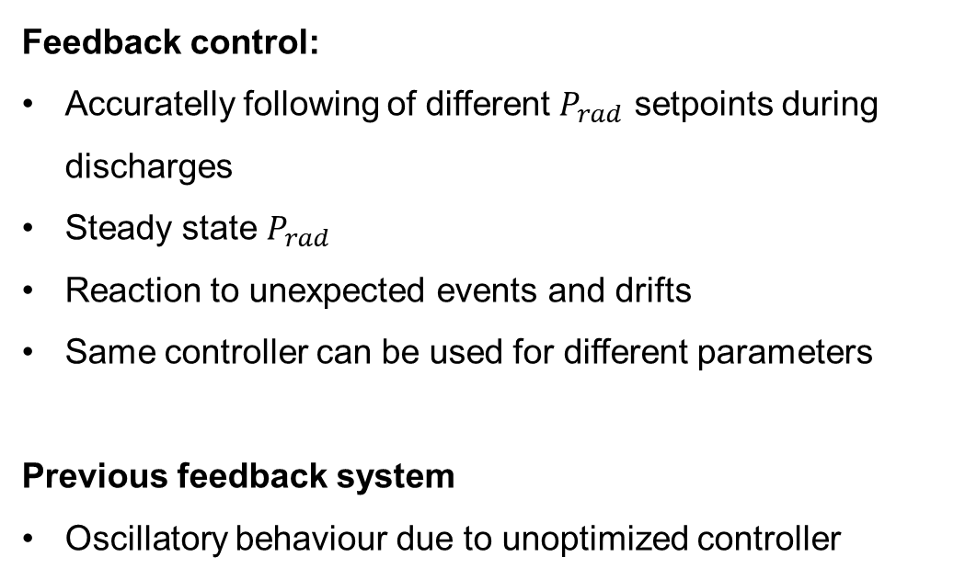
Motivation
Feedback control:
Accuratelly following of different $P_{rad}$ setpoints during discharges
Steady state $P_{rad}$
Reaction to unexpected events and drifts
Same controller can be used for different parameters
Previous feedback system
Oscillatory behaviour due to unoptimized controller
M. Krychowiak et al. Nuclear Materials and Energy 34 (2023)

Slide 7
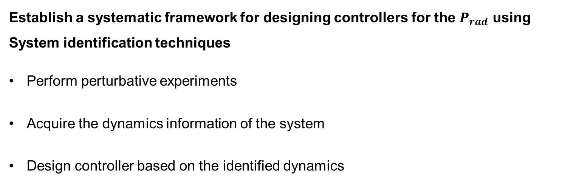
Motivation
Establish a systematic framework for designing controllers for the $P_{rad}$ using System identification techniques
Perform perturbative experiments
Acquire the dynamics information of the system
Design controller based on the identified dynamics

Slide 8
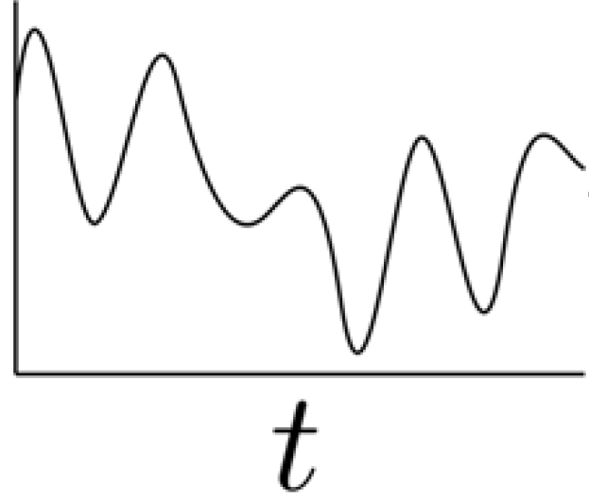
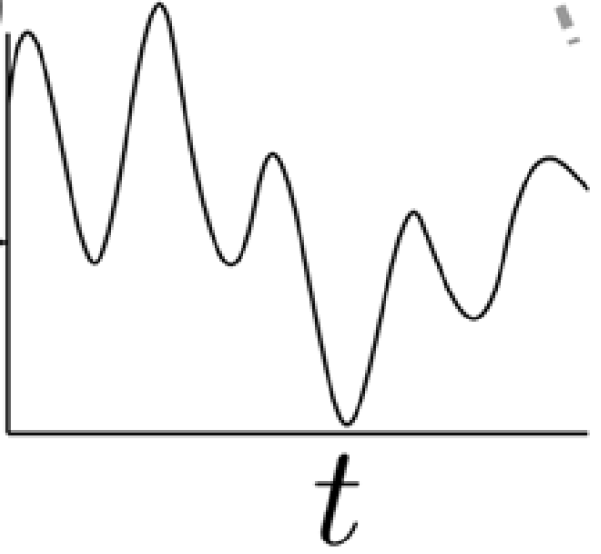


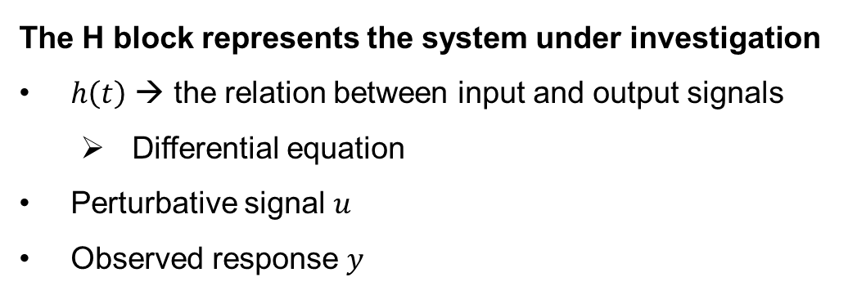

Control approach
The H block represents the system under investigation
$h\left(t\right)$ → the relation between input and output signals
Differential equation
Perturbative signal $u$
Observed response $y$
$$u$$
$$y$$
H
Τ. Ravensberger, et al. Nature communications 12 (2021)
$$y\left(t\right)=h\left(t\right)∗x\left(t\right)$$
R. Pintelon et al. System Identification: a frequency domain approach (2012)

Slide 9
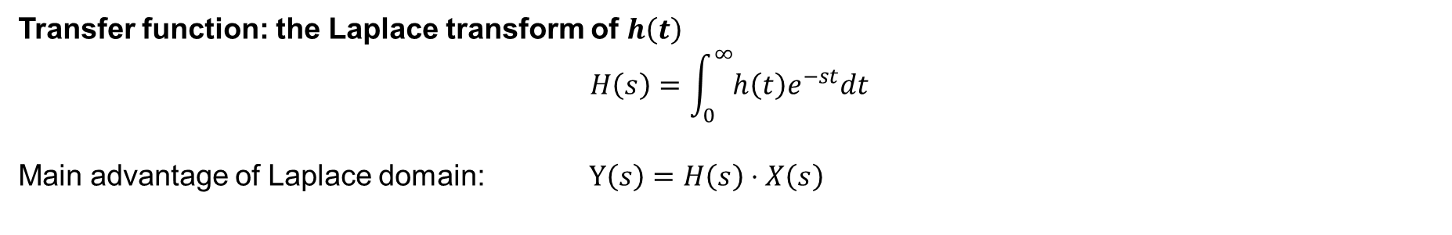
Control approach
The H block represents the system under investigation
$h\left(t\right)$ → the relation between input and output signals
Differential equation
Perturbative signal $u$
Observed response $y$
$$u$$
$$y$$
H
Τ. Ravensberger, et al. Nature communications 12 (2021)
$$y\left(t\right)=h\left(t\right)∗x\left(t\right)$$
Transfer function: the Laplace transform of $h\left(t\right)$
$$H\left(s\right)=\int_{0}^{∞}{h\left(t\right)e^{−st}dt}$$
Main advantage of Laplace domain: $Y\left(s\right)=H\left(s\right)⋅X\left(s\right)$
R. Pintelon et al. System Identification: a frequency domain approach (2012)

Slide 10
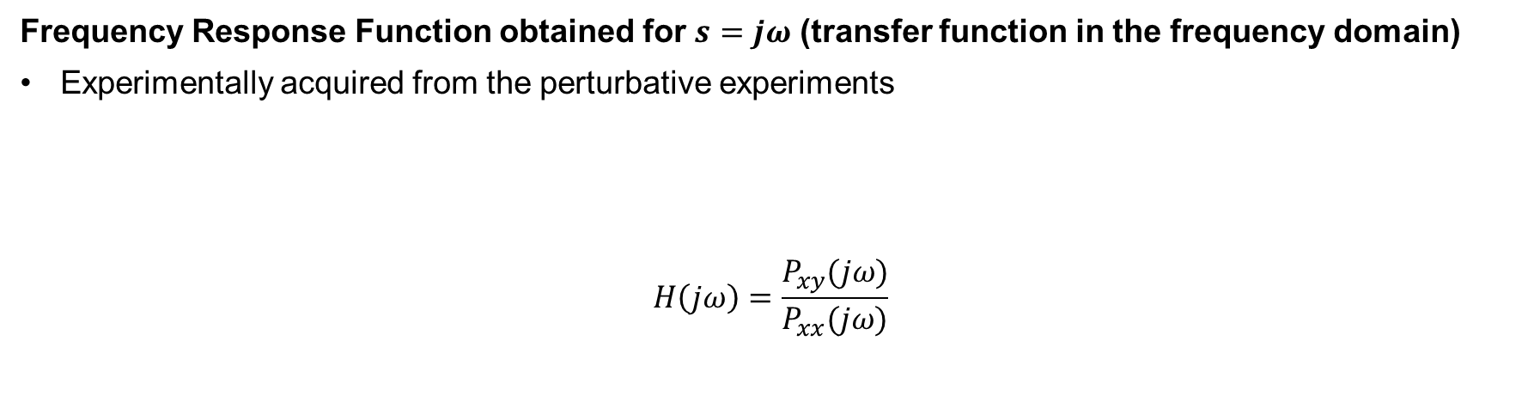
Control approach
Frequency Response Function obtained for $s=jω$ (transfer function in the frequency domain)
Experimentally acquired from the perturbative experiments
$$H\left(jω\right)=\frac{P_{xy}(jω)}{P_{xx}(jω)}$$
Cross-power spectral density
Auto power spectral density
R. Pintelon et al. System Identification: a frequency domain approach (2012)

Slide 11
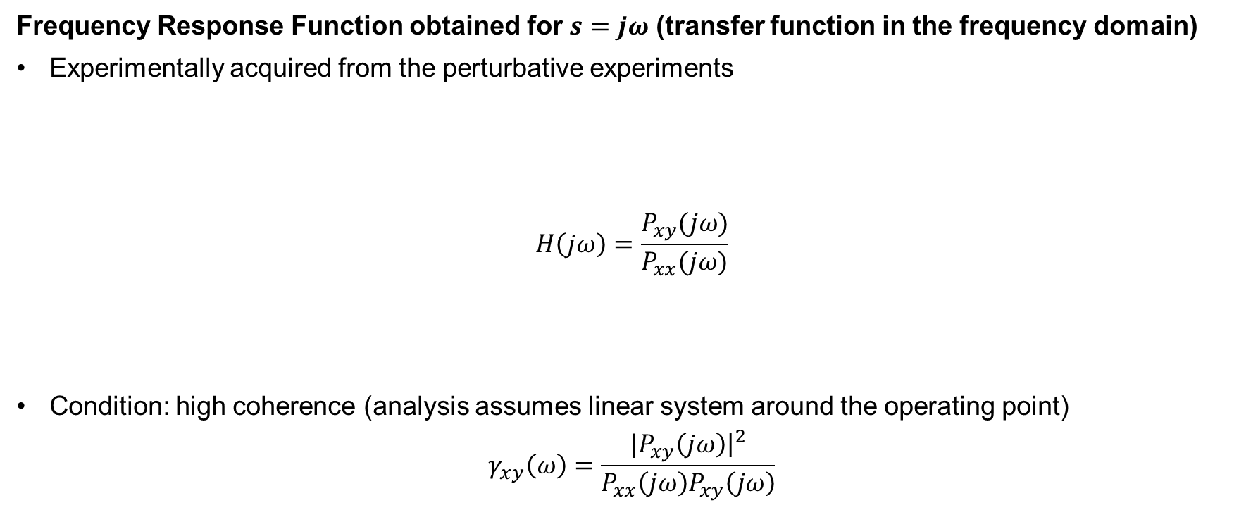
Control approach
Frequency Response Function obtained for $s=jω$ (transfer function in the frequency domain)
Experimentally acquired from the perturbative experiments
$$H\left(jω\right)=\frac{P_{xy}(jω)}{P_{xx}(jω)}$$
Condition: high coherence (analysis assumes linear system around the operating point)
$$γ_{xy}\left(ω\right)=\frac{{|P}_{xy}\left(jω\right){\left.​\right|}^{2}}{P_{xx}\left(jω\right)P_{xy}\left(jω\right)}$$
Cross-power spectral density
Auto power spectral density
R. Pintelon et al. System Identification: a frequency domain approach (2012)

Slide 12
Control approach
input
Actuator (gas valves)
W7-X
Sensor (bolometer camera)
output
H

Slide 13
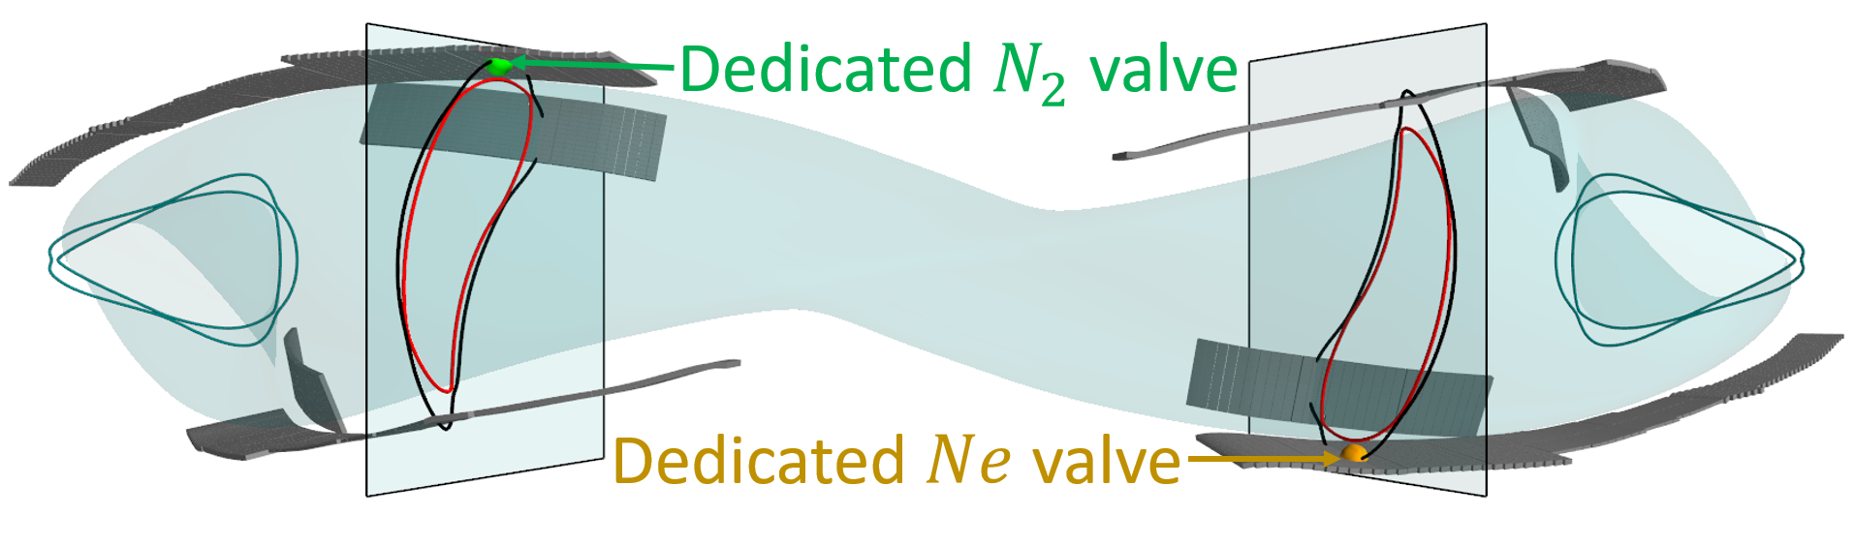
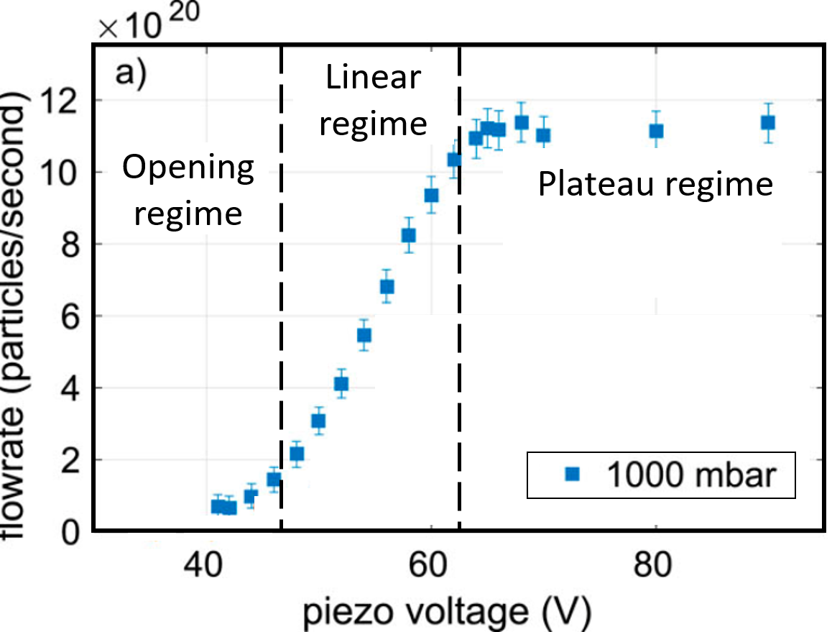

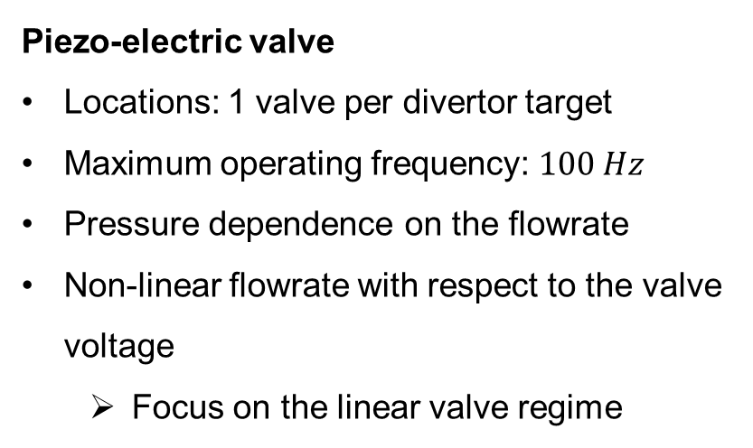
Actuator (input)
Piezo-electric valve
Locations: 1 valve per divertor target
Maximum operating frequency: $100 Hz$
Pressure dependence on the flowrate
Non-linear flowrate with respect to the valve voltage
Focus on the linear valve regime
upper divertor location
lower divertor location
input ($u$) → valve voltage
M. Griener et al. Rev. Of Scientific Instrumements 87 (2017)

Slide 14
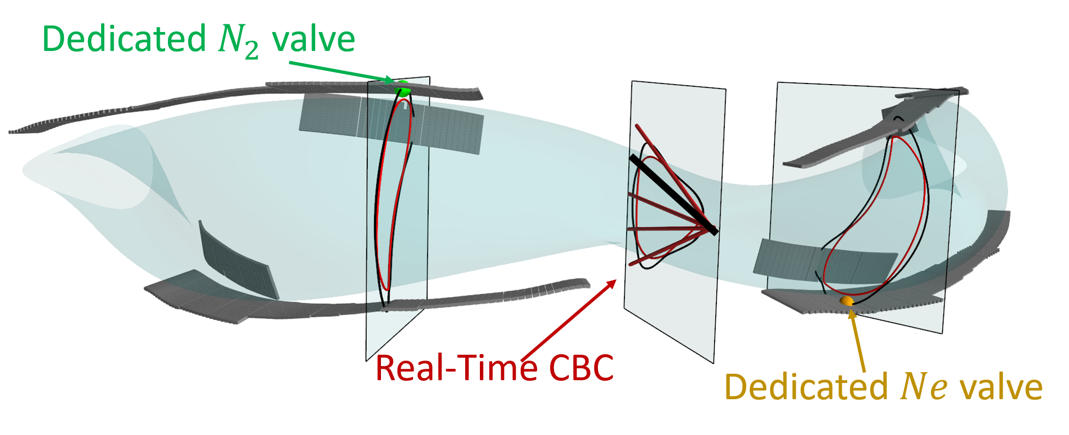
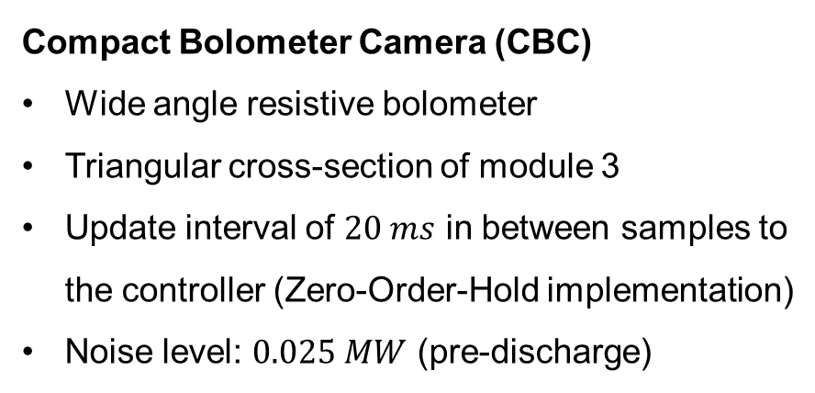
Sensor (output)
Compact Bolometer Camera (CBC)
Wide angle resistive bolometer
Triangular cross-section of module 3
Update interval of $20 ms$ in between samples to the controller (Zero-Order-Hold implementation)
Noise level: $0.025 MW$ (pre-discharge)
output ($y$) → calculated $P_{rad}$ proxy from CBC
G. Partesotti et al. Rev. Of Scientific Instrumements 95 (2024)

Slide 15
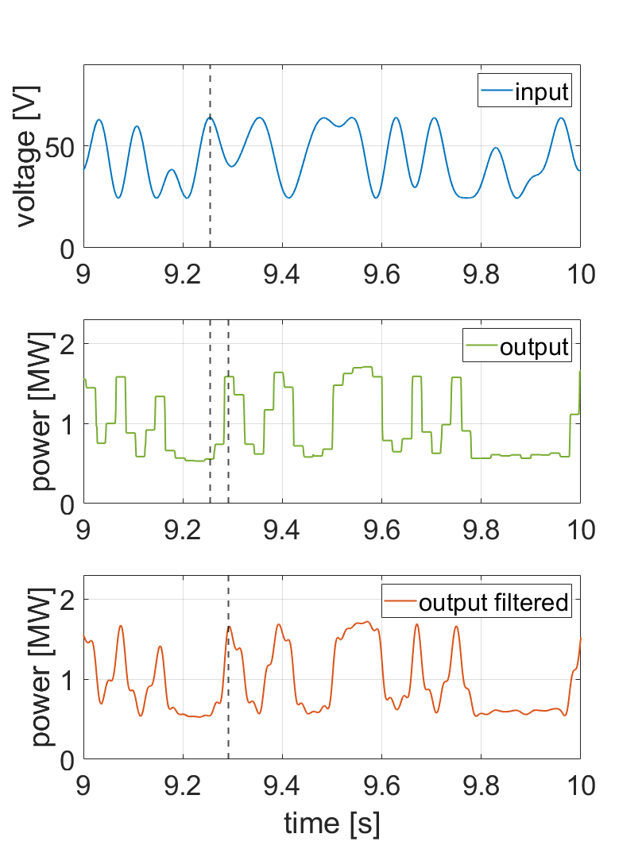
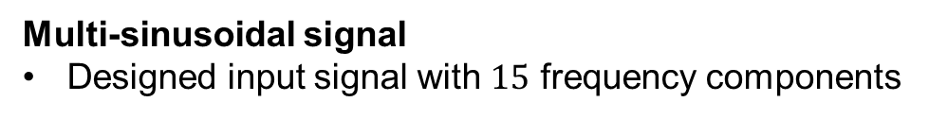
Perturbative experiment
Multi-sinusoidal signal
Designed input signal with $15$ frequency components

Slide 16
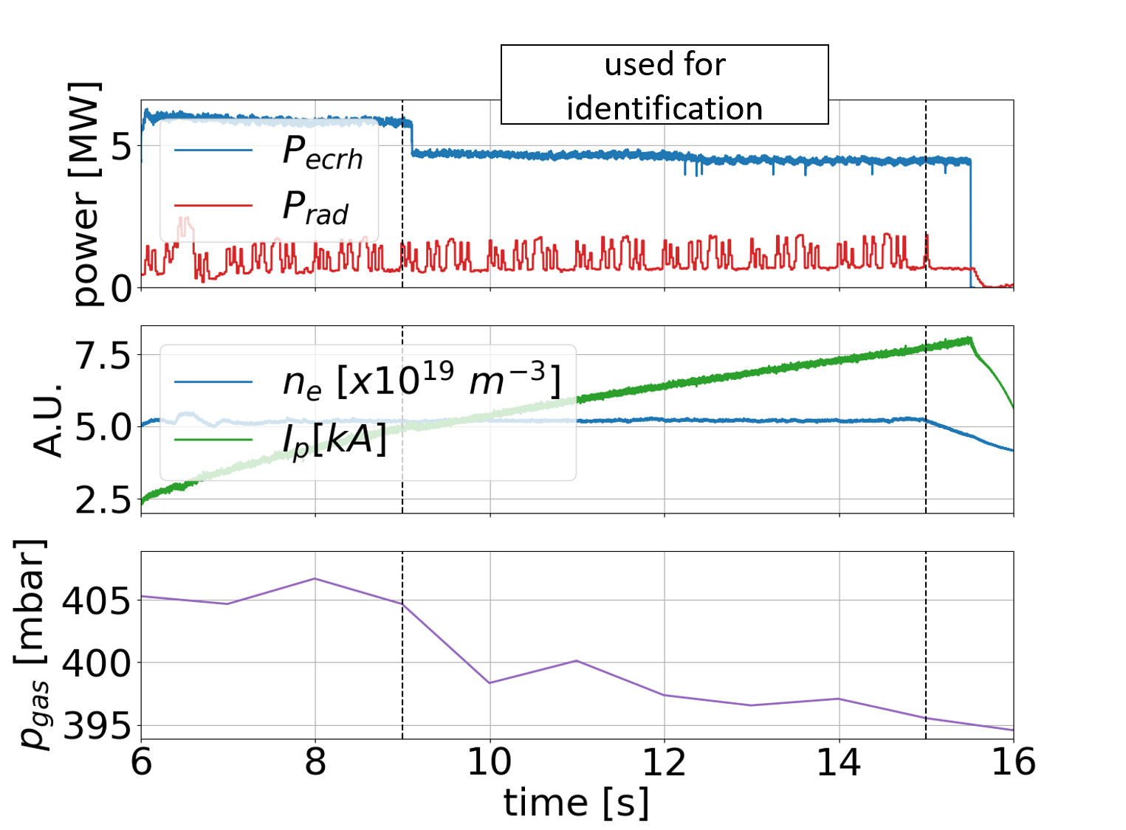
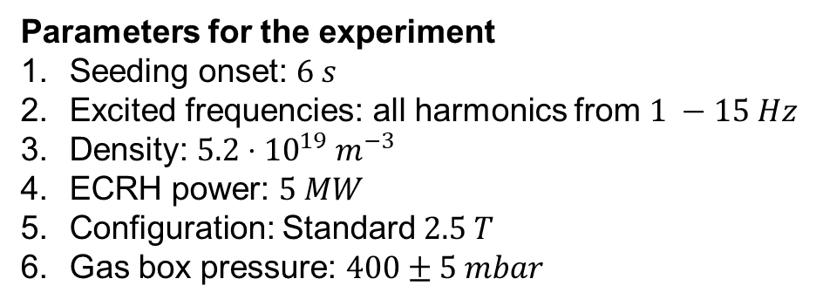
Perturbative experiment
Parameters for the experiment
Seeding onset: $6 s$
Excited frequencies: all harmonics from $1 −15 Hz$
Density: $5.2⋅{10}^{19} m^{−3}$
ECRH power: $5 MW$
Configuration: Standard $2.5 T$
Gas box pressure: $400±5 mbar$

Slide 17
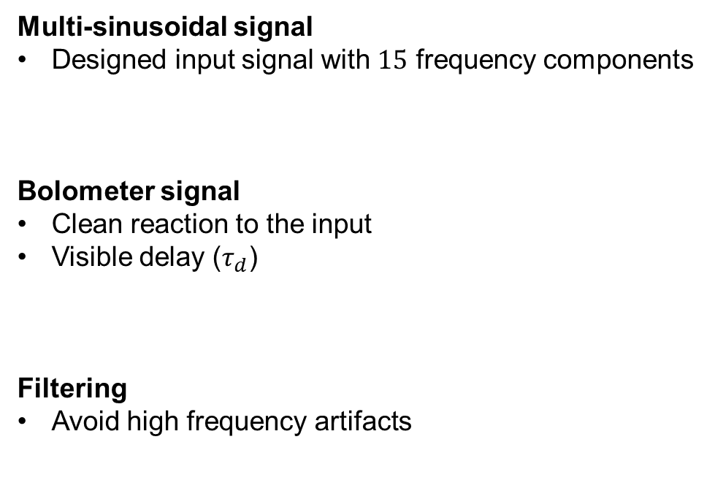

Perturbative experiment
Multi-sinusoidal signal
Designed input signal with $15$ frequency components
Bolometer signal
Clean reaction to the input
Visible delay ($τ_{d}$)
Filtering
Avoid high frequency artifacts
$$τ_{d}$$

Slide 18
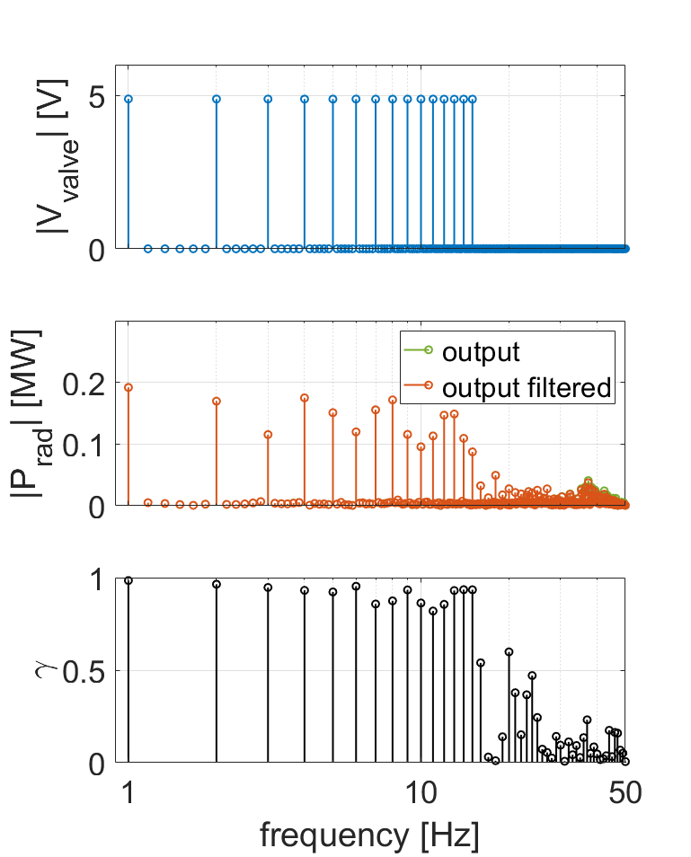
Frequency domain analysis
Discrete Fourier Transform (excitation quality)
Dominant excitation of the input frequencies
High coherence for the input frequencies

Slide 19
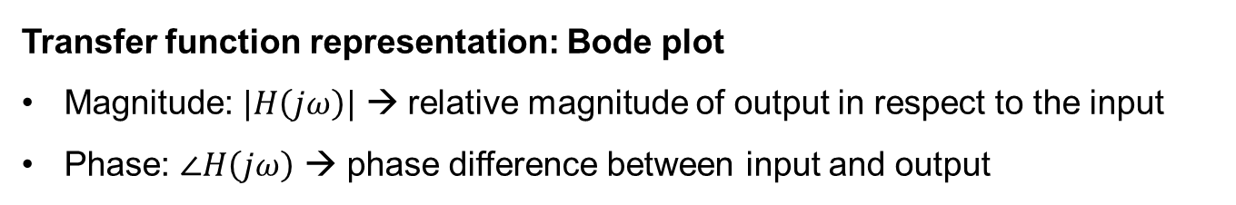
Frequency domain analysis
Transfer function representation: Bode plot
Magnitude: $|H\left(jω\right)|$ → relative magnitude of output in respect to the input
Phase: $∠H\left(jω\right)$ → phase difference between input and output

Slide 20
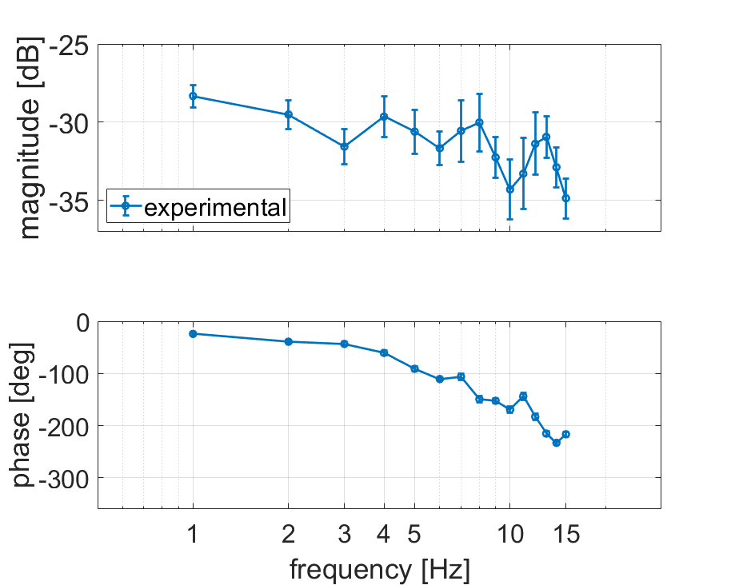
Frequency domain analysis
Transfer function representation: Bode plot
Magnitude: $|H\left(jω\right)|$ → relative magnitude of output in respect to the input
Phase: $∠H\left(jω\right)$ → phase difference between input and output
System exhibits pure delay behaviour
Characteristics of pure delay
Constant magnitude
Descending phase as frequency increases
Expected a frequency-dependent behaviour

Slide 21
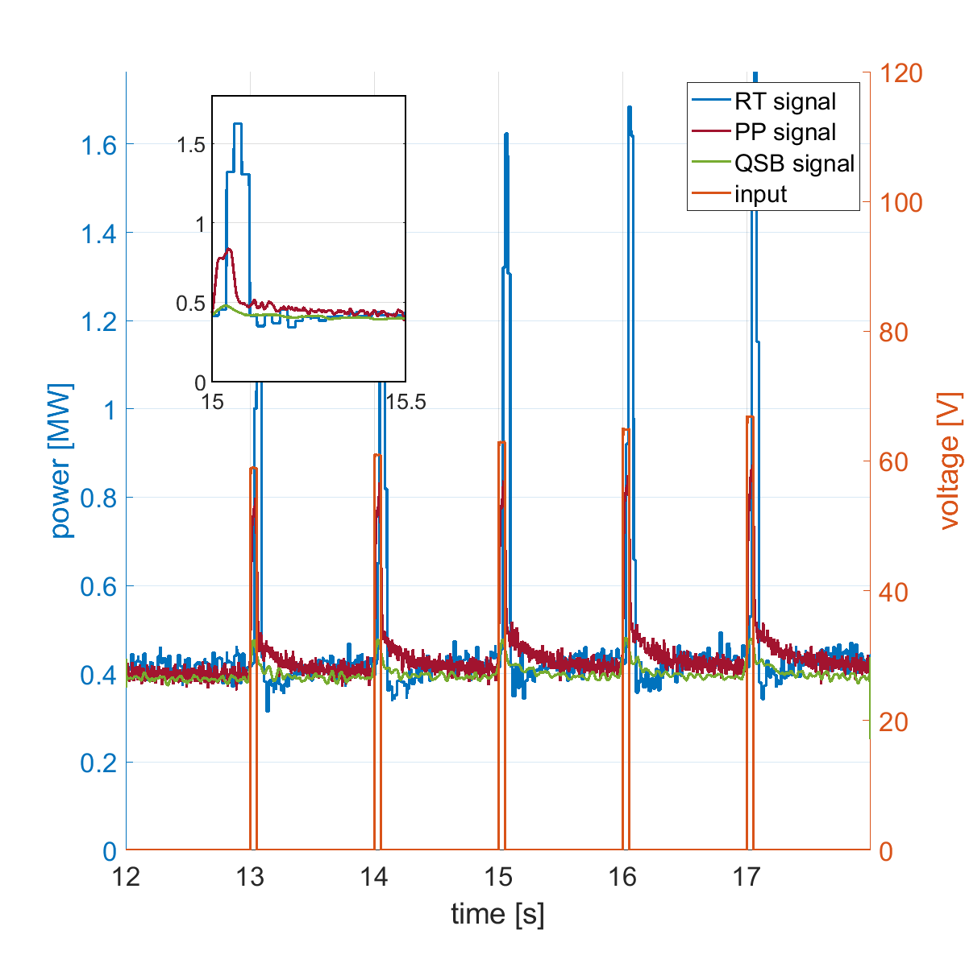
Frequency domain analysis
Investigation of pure delay behaviour
Impulse-like experiment under investigation
3 different bolometer signals
Real-Time CBC signal (RT)
Post-Processed CBC signal (PP)
Core Bolometer signal (QSB)

Slide 22
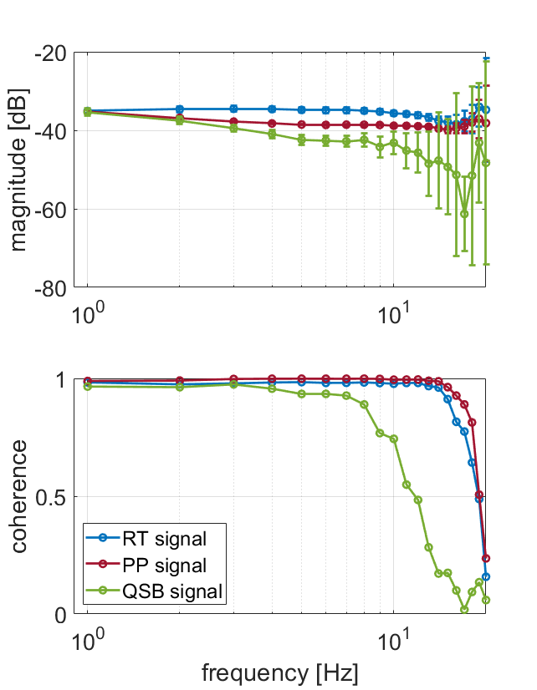
Frequency domain analysis
Investigation of pure delay behaviour
Impulse-like experiment under investigation
3 different bolometer signals
Real-Time CBC signal (RT)
Post-Processed CBC signal (PP)
Core Bolometer signal (QSB)
All signals exhibit similar amplitude behaviour
Small amplitude change for the high coherence frequencies
Low coherence
Low coherence
Transfer function behaviour → part of the system

Slide 23
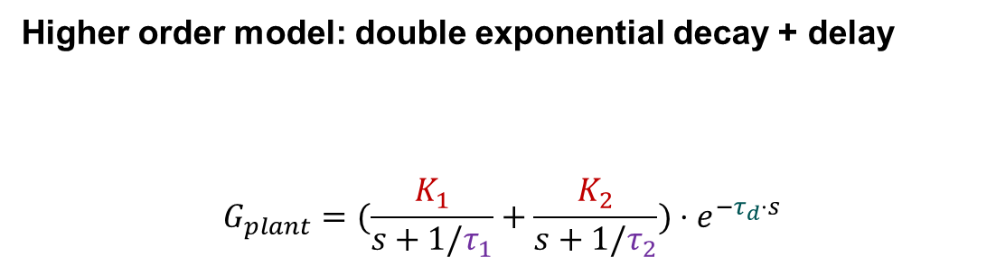
Transfer function modelling
Modelling of experimental transfer function
Different models can exhibit the same behaviour for a specified frequency region
Simplest model able to match the experimental data: pure delay
Higher order model: double exponential decay + delay
$$G_{plant}=(\frac{K_{1}}{s+1/τ_{1}}+\frac{K_{2}}{s+1/τ_{2}})⋅e^{−τ_{d}⋅s}$$
how strong the output will respond to an input
delay
how fast the decay is

Slide 24
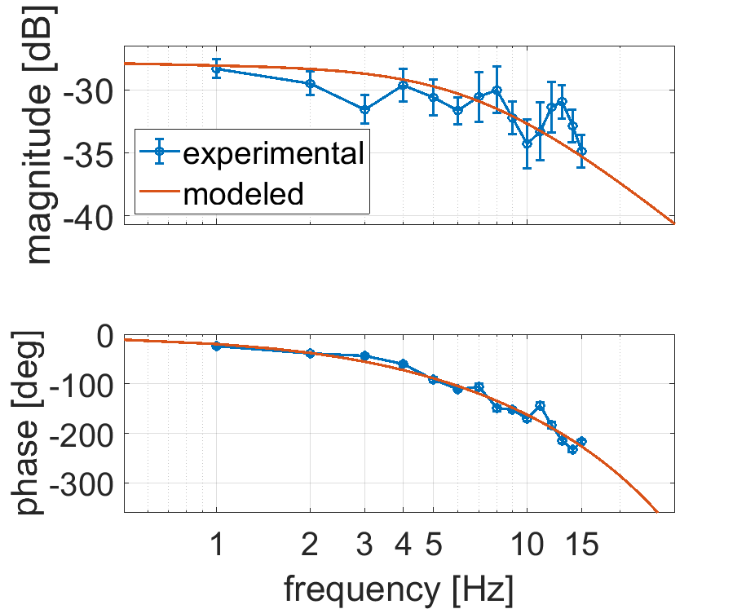
Transfer function modelling
Modelling of experimental transfer function
Different models can exhibit the same behaviour for a specified frequency region
Simplest model able to match the experimental data: pure delay
Higher order model: double exponential decay + delay
$$G_{plant}=(\frac{K_{1}}{s+1/τ_{1}}+\frac{K_{2}}{s+1/τ_{2}})⋅e^{−τ_{d}⋅s}$$
how strong the output will respond to an input
delay
how fast the decay is

Slide 25
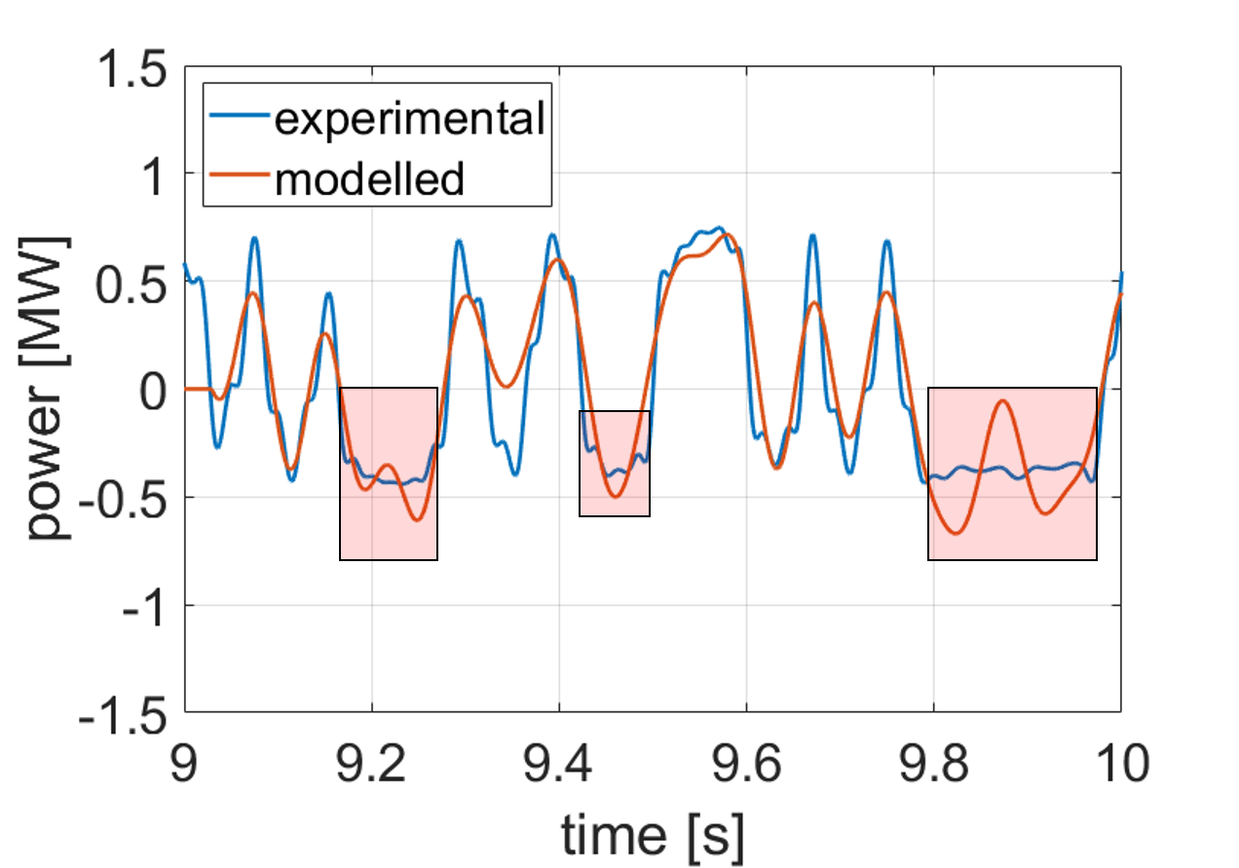
Transfer function modelling
Modelling of experimental transfer function (time domain)
Behaviour is captured by model
Missmatches in the amplitude due to non-linearities (valve operating in non-linear regimes)
Non-linearities

Slide 26
Transfer function modelling
Modelling of experimental transfer function (time domain)
Behaviour is captured by model
Missmatches in the amplitude due to non-linearities (valve operating in non-linear regimes)
Correlation with the amplitude decreases in the bode plot
Non-linearities

Slide 27
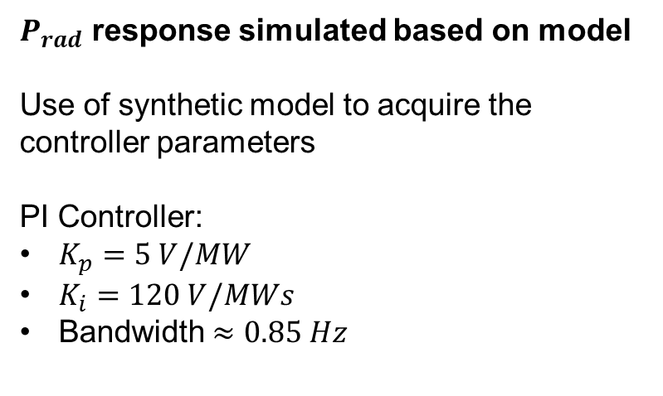
Controller designed: $N_{2}$
$P_{rad}$ response simulated based on model
Use of synthetic model to acquire the controller parameters
PI Controller:
$K_{p}=5 V/MW$
$K_{i}=120 V/MWs$
Bandwidth $≈0.85 Hz$
Satisfactory synthetic response

Slide 28
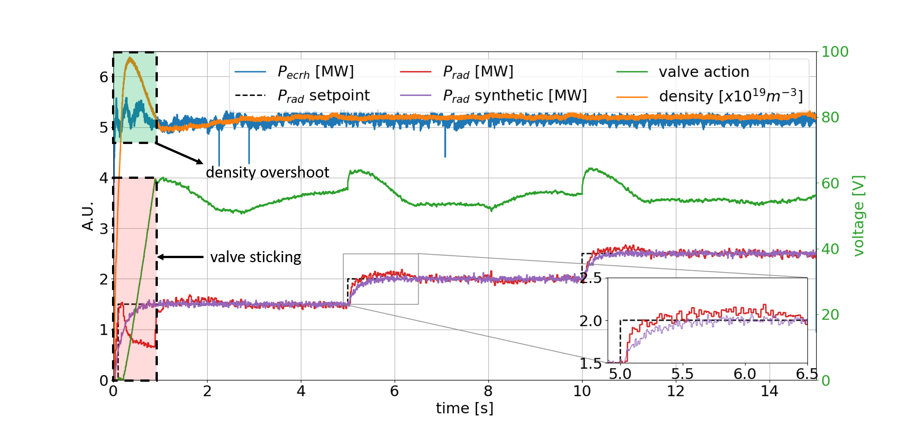
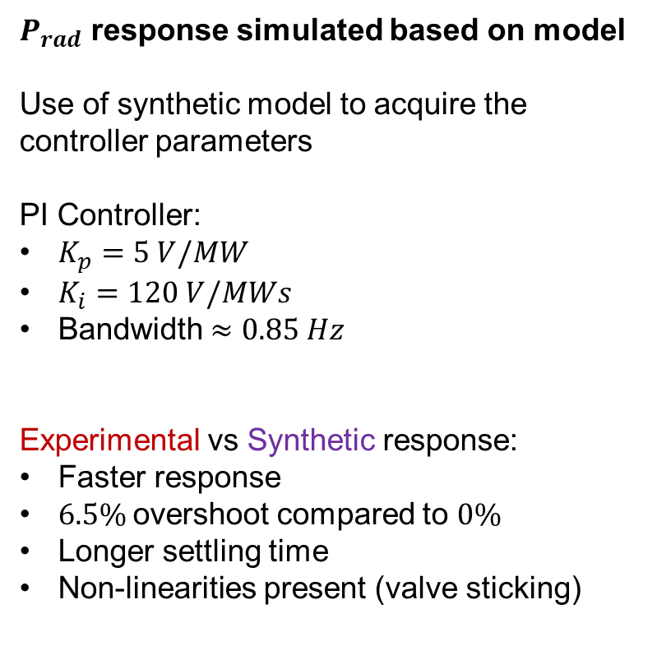
Controller designed: $N_{2}$
$P_{rad}$ response simulated based on model
Use of synthetic model to acquire the controller parameters
PI Controller:
$K_{p}=5 V/MW$
$K_{i}=120 V/MWs$
Bandwidth $≈0.85 Hz$
Experimental vs Synthetic response:
Faster response
$6.5\%$overshoot compared to $0\%$
Longer settling time
Non-linearities present (valve sticking)
Satisfactory synthetic response

Slide 29
Summary
Established framework for identifying the dynamics of the system
Perturbative experiments provide with the dynamics of the system
Multisinusoidal and impulse-like signals provide with transfer function estimations
Pure delay behaviour for the investigated frequency regime: only the steady state of the system is captured
Modelling of the experimental transfer function is possible with simple models
PI gains can be further optimized
Main obstacle: the delay of the system

Slide 30
Future work
Optimize perturbative experiment
Smaller voltage span: operate only at the linear regime of the valve
Include higher frequency components to investigate higher frequency dynamics
Optimize modeling of the transfer function for performing simulations
Physics based transfer function model
Identify dynamics using as an input the seeding rate and not the valve voltage
Controller independent of the gas box pressure
Include feedforward part for faster response

