Slide 1
Budget Requests 2026-2027
Summary

Slide 2
WPSTEL - 2027 budget requests and priorities
Topic | Required resources (PM, hardware, facilities, …) | Associated CC budget* [k€] | Associated EC budget* [k€] | WP priority (Low, Medium, High) | PSD priority TBD | PSD comments
Extension of PNBI from 4 to 6 sources to reach Ptotal > 20 MW | 24 PM | 102 | 113 | high | 3 | High scientific importance but only MPG
Stellarator reactor: Remote handling in 3D environment of FOAK | 12 PM | 51 | 56 | high | 2 | Critical system for FOAK, low TRL, important for feasibility
Stellarator reactor: Preparation of design space using system studies for FOAK stellarator | 6 PM | 26 | 28 | high | 1 | Allows more EU participation
Stellarator reactor: Mechanical stress analysis of 3D inter-coil support towards FOAK | 12 PM | 51 | 56 | medium | 4
Stellarator reactor: Initial assessment of a FOAK particle exhaust and fuel cycle | 6 PM | 26 | 28 | medium | 4
Stellarator reactor: Transfer of novel technologies towards 3D first wall and blanket | 6 PM | 26 | 28 | medium | 4

Slide 3
WPTM - 2027 budget requests and priorities
Topic | Required resources in PM | Associated CC budget* [k€] | Associated EC budget* [k€] | WP priority | PSD priority TBD | PSD comments
TM0. WPTM Management PL/PSO (12PM CEA 82 k€ CC) + Missions 15 k€ (Actual cost) | 19 | 95 | 100 | H | 1 (PCR!) | Not originally budgeted, resources of the TSVVs had to be used
TM1. SOL heat flux decay length, pedestal and L-H transition (TSVVs: A, B, C, H, K) | 28 | 120 | 132 | H | ? | First the reduced scope needs to be identified based on existing budget (as discussed in the Premeeting)
TM2. Robust simulation of advanced regimes without ELMs by integrating missing elements (TSVVs A, B, C, H, K ) | 24 | 103 | 113 | H | ?
TM3. Core-pedestal-SOL-wall workflow including 3-D effects (TSVVs: D, E, J, K) | 25 | 107 | 118 | H | ?
TM4. Disruption, RE and impact on the W wall at high current (TSVVs: D, F) | 21 | 90 | 99 | H | ?
TM5. Simulation of high beta plasmas and fast particle effect on confinement/stability (TSVVs: G, H, I , J ) | 21 | 90 | 99 | H | ?
TM6. Stellarator core turbulence and optimization: Divertor and alpha losses (TSVVs: G, I, J) | 22 | 94 | 104 | H | ?
TM7. Development and test of reduced models for integrated workflows (TSVVs: A, B, C, D, E, F, G, H, J, K ) | 29 | 125 | 138 | H | ?
TM8. Validation and UQ (TSVVs: A, B, C, D, E, F, G, H, J ) | 22 | 93 | 103 | H | ?

Slide 4
WPTM - 2027 budget requests and priorities (break-down of resources)

Slide 5
WPPWIE - 2027 budget requests and priorities
Topic | Required resources (PM, hardware, facilities, …) | Associated CC budget* [k€] | Associated EC budget* [k€] | WP priority | PSD priority TBD | PSD comments
Area 1: Tritium | 23PM HW: 30k€ | 98.17 HW:15 | 108.1 HW:21 | High | 2
Area 2: Dust | 24PM 30 days IBA 3k€/day | 102.4 Fac.: 45 | 112.1 Fac.: 63 | High | 3/4 | Its importance for safety case recognised
Area 3: JET post-mortem analysis (+ conversion of 1 container into PM) | 12 PM Fac. : 20k€ (accelerator) Eq/OGS 10k€ | PM: 42.8 Fac.: 10 Eq/OGS: 5 | PM: 47 Fac.: 14 Eq/OGS: 7 | High | 1
Area 4: RE-induced PFC damage | 8PM | 34,2 | 37,6 | High | ? | Are there TE activities on the subject? (see ITER Tech spec doc)

Slide 6
Background 2026-2027 for WP TE
Topic | Required resources (PM, hardware, facilities, …) (in average 82 k salary) | Associated CC budget* [k€] | Associated EC budget* [k€] | WP priority (Low, Medium, High) | PSD priority | PSD comments
Scientific exploitation of TE devices : machine operation |  | tbd |  | High/medium | 2 (30%) 3 (35%) 5 (40%) | Scenarios see next slide
Scientific exploitation of TE devices : staffing (pm) | 149PM; 309k€ missions | 636; 309 |  | high | 4
JT-60SA scientific exploitation : staffing | 420PM; 3900man-days missions; 5 staff sec for lim. period | 1794; 1160; 234 |  | high | 1
JT-60SA scientific exploitation : HMI training (2026) |  | tbd |  | high (under SA?) | 1 (low budget) | To be clarified once the budget need is clear (April?) Could be from present resources

Slide 7
Increase of machine operation – CC k€
SCENARIOS | ASDEX-U | WEST | TCV | W-7X | MAST-U | Total CC [k€]
Current plan | 4 696 | 3 967 | 2 315 | 7 633 | 0 | 18 611
Scenario I: All machines 30% | 5 120 | 4 323 | 2 527 | 8 325 | 0 | 20 295
Increase of op. cost for Sc. I | 424 | 356 | 212 | 692 | 0 | 1 684
Scenario II: AUG+WEST 35%; others 30% | 5 973 | 5 044 | 2 527 | 8 325 | 0 | 21 869
Increase of op. cost for Sc. II | 1 277 | 1 077 | 212 | 692 | 0 | 3 258
Scenario III: AUG+WEST 40%; others 30% | 6 827 | 5 764 | 2 527 | 8 325 | 0 | 23 443
Increase of op. cost for Sc. III | 2 131 | 1 797 | 212 | 692 | 0 | 4 832
Scenario IV: AUG+WEST 40%; TCV 35%; others 30% | 6 827 | 5 764 | 2 948 | 8 325 | 0 | 23 864
Increase of op. cost for Sc. III | 2 131 | 1 797 | 633 | 692 | 0 | 5 253

Slide 8
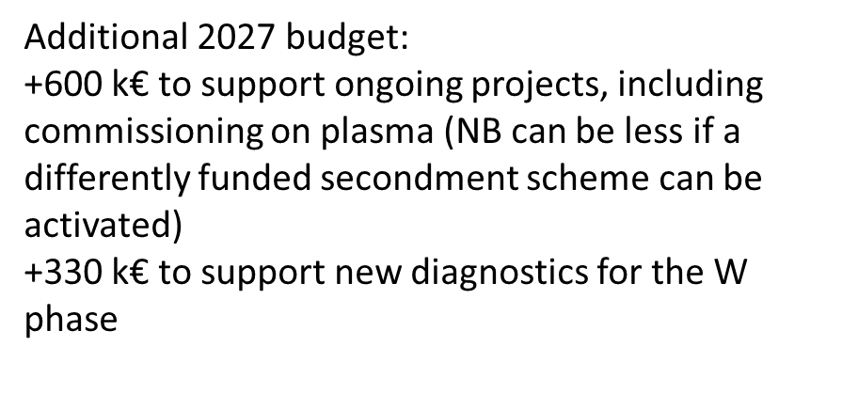
WPSA - 2027 budget requests and priorities
Topic | Required resources (PM, hardware, facilities, …) | Associated CC budget* [k€] | Associated EC budget* [k€] | WP priority | PSD priority TBD | PSD comments
Support ongoing projects and diagnostics for W phase | 50PM Missions – 900ppd Secondment – 20 ppms | 213.54 267.75 116.67 | 234.9 210.38 64.17 | High | TBD | Requires split by Diagn
Total resources - 926.25k€ |  | 597.96 | 509.45
*Conversion: Numbers provided in PB preemeting presentation were used in the table above

Slide 9
Enhancements WPTE - 2026 budget requests
Topic | Required resources (PM, hardware, facilities, …) | Associated CC budget* [k€] | Associated EC budget* [k€] | WP priority (Low, Medium, High) | PSD priority TBD
WEST Retarding Field Analyzer - Equipment | 17k€ | 8.5k€ | 11.7k€ | Low | 3
TCV LHPI (LH Parametric Instability) antenna - Missions | 6k€ | 5.3k€ | 4.1k€ | High | 1
Fast Ion Research Enhancements and Gamma-ray Observations [at AUG] - Missions | 6k€ | 5.3k€ | 4.1k€ | High | 1
Ultra-fast-swept profile reflectometer on AUG - Missions | 9k€ | 7.9k€ | 6.2k€ | High | 1
Total | 38k€ | 27k€ | 26.1k€
Priorities applicable only if 2021-25 budget can be used!
*Conversion: 4.7k€ CC/ PM (@average); 5.2k€ EC/PM; HW/facility CC= 0.5*direct cost; HW/facility EC=0.7*direct cost

