Slide 1
21/01/2026 – TSVV-B kick-off Project news
TSVV-B – Regular advancement meeting
P. Tamain

Slide 2
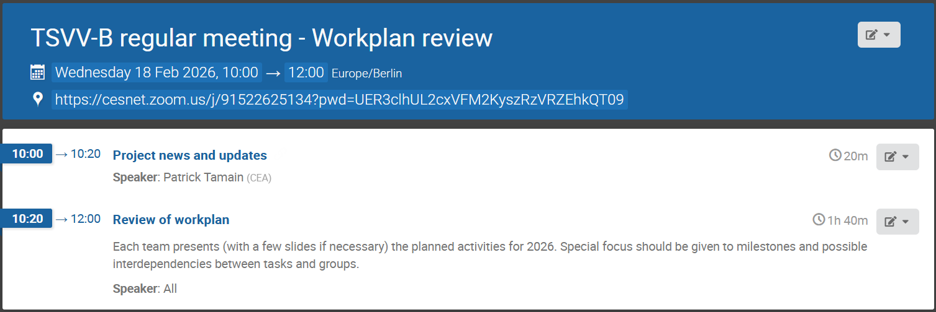
Today’s meeting agenda

Slide 3
Feedback from ETASC general meeting
Again many discussions on code standards and to which point this should become compelling
Scientific feedback? (Andreas to detail)
Discussion with M. Giacomin on reduced turbulence models (PI of dedicated ENR project) => contact made afterwards
Tense discussion about IMAS compliance of our codes
Budget issue for 2027 confirmed (see next slide)

Slide 4
Scientific rationales to recover 2027 budget cuts
-30% budget cut in 2027 if no additional money found
Request from Xavier Litaudon:
To prepare a strong rationale for getting extra resources, please, provide us by February 25th for each TSVV, a “high level” list of:
Deliverables / activities that are at risk due to the reduced budget in 2027, in particular focusing on the impacts for EUROfusion and other FSD WP where the models are used for the experiments preparation/analysis;
“New activities” that could be performed with extra resources in 2027.

Slide 5
Annual meeting
When? June or September?
Where? Garching, Marseille, elsewhere?

Slide 6
Pitagora allocation
Requested:
 | HDG | BIT1 | FELTOR | GBS | GRILLIX | SOLEDGE3X | ACH | TOTAL
CPU |  | 115 000 |  | 235 000 | 399 000 | 248 000 | 5 000 | 1 002 000
GPU |  |  | 40 000 |  |  | 29 000 | 1 000 | 70 000
Allocated (proportional to allocation / request):
80%
 | HDG | BIT1 | FELTOR | GBS | GRILLIX | SOLEDGE3X | ACH | TOTAL
CPU | - | 91 816 | - | 187 625 | 318 563 | 198 004 | 3 992 | 800 000
GPU | - | - | 40 000 | - | - | 29 000 | 1 000 | 70 000
100%
New project names: FUPA2_TSVVB (CPU) and FUPB2_TSVVB (GPU)
Please send me updated list of users for each project

Slide 7
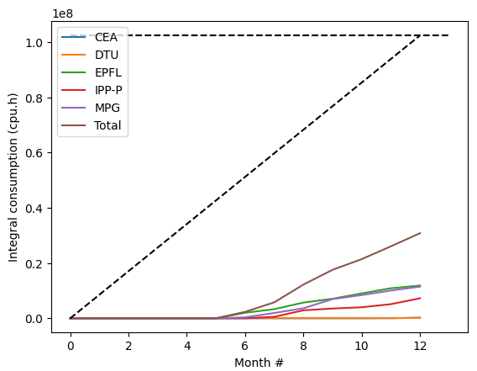
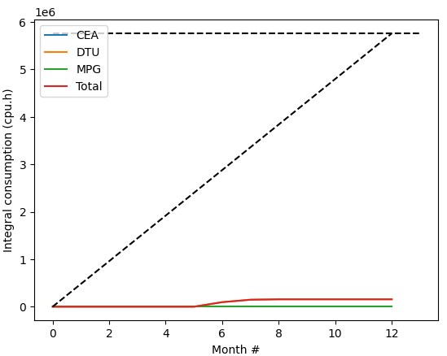
Pitagora consumption
CPU
GPU
30%
3%
Reason for under-consumption?

Slide 8
Latest publications (1)
Please use from now on WPTM-TSVV-B-CEA
Turbulence in QCE
K Zhang et al : 12th February 2026 | DocumentID : 42177
: Turbulent Nature of the Quasicontinuous Exhaust Regime for Fusion Plasmas
Journal : Physical Review Letters, .
Turbulence in detached regime (TCVX23)
V Quadri et al : 6th January 2026 | DocumentID : 41751
: 3D turbulence simulations in detached conditions and their implications for the mean-field modelling of divertor regimes
Journal : Nuclear Fusion, .

Slide 9
Latest publications (2)
EPS abstracts
M Bassanini et al : 13th February 2026 | DocumentID : 42206
: Implicit-Explicit time integration scheme with Physics-based precondition for the two-fluid plasma model of tokamak edge turbulence
Conference : 52nd EPS Conference on Plasma Physics (EPS 2026), Edinburgh, Scotland, Edinburgh, Scotland, 29th June 2026.
D Mancini et al : 9th February 2026 | DocumentID : 42115
: Impact of negative upper triangularity on SOL width in self-consistent turbulence and plasma–neutral simulations
Conference : 52nd EPS Conference on Plasma Physics (EPS 2026), Edinburgh, Scotland, Edinburgh, Scotland, 29th June 2026.
B Csillag et al : 6th February 2026 | DocumentID : 42105
: Simulating turbulence in island divertors
Conference : 52nd EPS Conference on Plasma Physics (EPS 2026), Edinburgh, Scotland, Edinburgh, Scotland, 29th June 2026.

Slide 10
Today’s meeting agenda
Please upload materials to https://indico.euro-fusion.org/event/3911/

