Slide 1
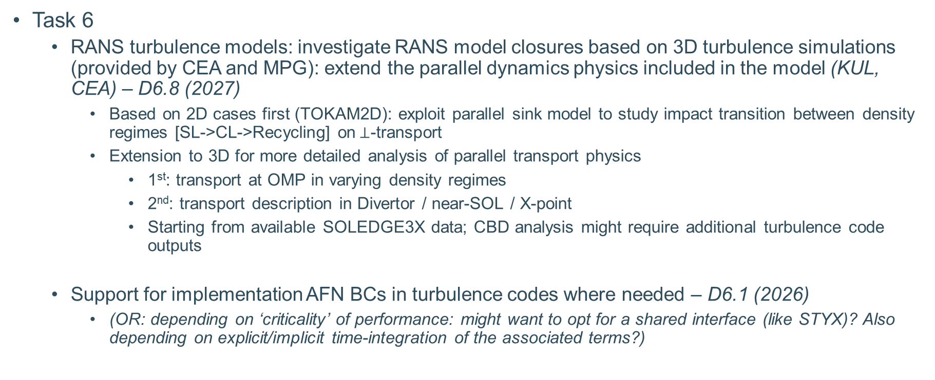
Work plan 2026
Task 6
  RANS turbulence models: investigate RANS model closures based on 3D turbulence simulations (provided by CEA and MPG): extend the parallel dynamics physics included in the model (KUL, CEA) – D6.8 (2027)
    Based on 2D cases first (TOKAM2D): exploit parallel sink model to study impact transition between density regimes [SL->CL->Recycling] on$⊥$-transport
    Extension to 3D for more detailed analysis of parallel transport physics
      1st: transport at OMP in varying density regimes
      2nd: transport description in Divertor / near-SOL / X-point
      Starting from available SOLEDGE3X data; CBD analysis might require additional turbulence code outputs
  Support for implementation AFN BCs in turbulence codes where needed – D6.1 (2026)
    (OR: depending on ‘criticality’ of performance: might want to opt for a shared interface (like STYX)? Also depending on explicit/implicit time-integration of the associated terms?)

Slide 2
Work plan 2026
Task 1 & 5
  Analysis of turbulence in detached regime in the frame of the TCV-X23 experiment, both with direct numerical simulations of turbulence and reduced turbulence models. Comparison will be made between pulses without and with baffle. For the latter, comparison with mean-field simulations using the SOLEDGE-HDG code are envisaged (CEA, EPFL, MPG, DTU, KUL) – D1.2 (2027)
  Evaluate SOL width dependency with key plasma parameters using RANS turbulence model (KUL) – D5.2 (2027)
  Starting from TCV-X21/23 simulations of S.Carli
    Analyse impact of RANS model constants on transport predictions
    Perform density / power / field scans to analyse predicted power decay length scalings and compare with experimental scaling laws
    Investigate updated parallel transport descriptions and sheath boundary conditions based on k

Slide 3
Activities at risk in case of budget cut 2027
Task 6
  RANS turbulence models: we propose to continue investigating RANS model closures based on 3D turbulence simulations (provided by CEA and MPG). In details, this includes:
    Extend the parallel dynamics physics included in the model (KUL, CEA)
    Extend the closure effort to full SOL, with focus on divertor and separatrix regions (KUL)
    Investigate alternative transport descriptions, such as convective-diffusive descriptions. One possible method for analysis is through the correlation-based diffusion method s (KUL)
  D6.8 Updated RANS model description applicable to SOL in variety of L-mode regimes (KUL) (Report / presentation / paper)
Impact on EUROfusion:
  Delayed availability of reduced model in SOLPS-ITER for application to edge model validation and scenario preparation within the other WPs (TE)

