Slide 1
Instabilities at the edge of NT TCV plasmas and geometric proxies to predict the impact of plasma shaping on turbulence
TSVV-A annual workshop07.10.2026
A. Balestri^{1,2}, J. Ball¹, S. Coda¹, O. Sauter¹, A. Mariani³, P. Mantica³ ,B. Vanovac⁴,B. Labit¹
¹Ecole Polytechnique Fédérale de Lausanne (EPFL), Swiss Plasma Center (SPC), 1015 Lausanne, Switzerland,
²Max-Planck-Institut für Plasmaphysik, Garching, Germany
³Istituto per la Scienza e la Tecnologia dei Plasmi, CNR, Milan, Italy
⁴Plasma Science and Fusion Center, Massachusetts Institute of Technology, Cambridge, MA 02139, United States ofAmerica

Slide 2
Negative Triangularity plasmas: H-mode performance without H-mode
[1] A. Merle et al., 2017 PPCF 59 104001
[2] A. O. Nelson et al., 2024 PPCF 66 105014
[3] O. Sauter et al., 66th APS 2024
[4] A. Marinoni et al., 2009 PPCF 51 055016
[5] G. Merlo et al, 2023 PoP 30 102302
[7] A. Balestri et al., 2024 PPCF 66 075012
[6] G. Di Giannatale et al., 2024 PPCF 66 095003
[8] A. Mariani et al., 2024 NF 64 106024
[9] M. Bécoulet et al., 2026 PPCF 68 035031
[10] L. De Gianni et al., 2026 PPCF 64 106024
Experiments (TCV, DIII-D, AUG) and simulations showed that Negative Triangularity (NT):
Robustly inhibits access to H-mode [1,2,3]
Intrinsically ELM-free
Reduction of turbulent transport [4,5,6,7,8,9,10]
Recover H-mode performance

Slide 3
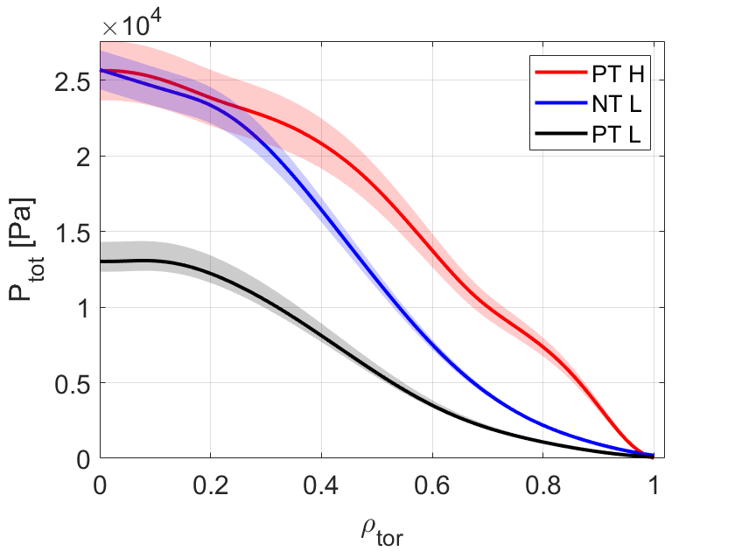
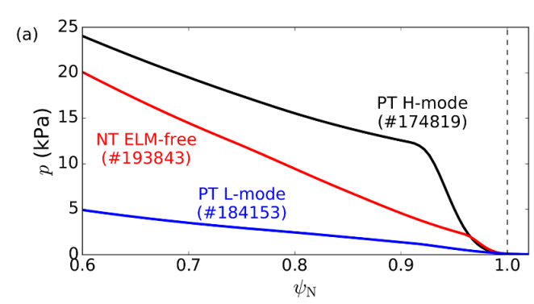
Negative Triangularity plasmas: H-mode performance without H-mode
[1] A. Merle et al., 2017 PPCF 59 104001
[2] A. O. Nelson et al., 2024 PPCF 66 105014
[3] O. Sauter et al., 66th APS 2024
[4] A. Marinoni et al., 2009 PPCF 51 055016
[5] G. Merlo et al, 2023 PoP 30 102302
[7] A. Balestri et al., 2024 PPCF 66 075012
[6] G. Di Giannatale et al., 2024 PPCF 66 095003
[8] A. Mariani et al., 2024 NF 64 106024
[9] M. Bécoulet et al., 2026 PPCF 68 035031
[10] L. De Gianni et al., 2026 PPCF 64 106024
Experiments (TCV, DIII-D, AUG) and simulations showed that Negative Triangularity (NT):
TCV
DIII-D
Robustly inhibits access to H-mode [1,2,3]
Intrinsically ELM-free
[2] A. O. Nelson et al., 2024 PPCF 66 105014
Reduction of turbulent transport [4,5,6,7,8]
Recover H-mode performance
[7] A. Balestri et al., 2024 PPCF 66 065031

Slide 4
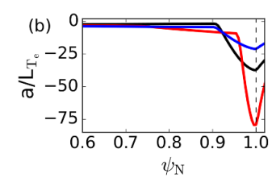
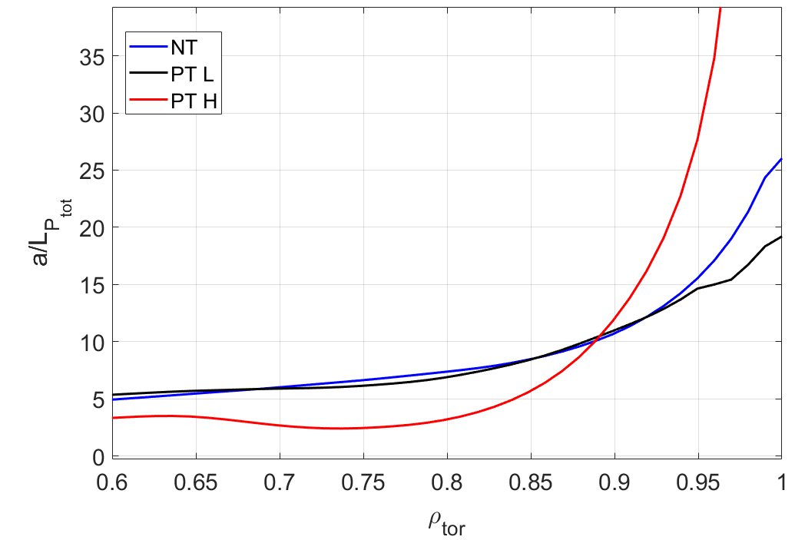
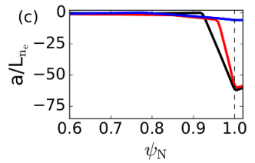
Reduction of turbulence at the edge plays a crucial role in NT plasmas
[1] A. O. Nelson et al., 2024 PPCF 66 105014
[2] A. Balestri et al., 2024 PPCF 66 065031
[2]
DIII-D
[1]
TCV
Steepening of pressure logarithmic gradients is observed at the very edge of NT plasmas in TCV and DIII-D
Clear sign of turbulence stabilization

Slide 5
H-mode-like performance in NT only if turbulence is reduced
[1] A. Balestri et al., 2025 PPCF 67 105025
[2] A. Balestri et al., 2024 PPCF 66 075012
[3] G. Merlo et al, 2023 PoP 30 102302
Understanding how geometry plays a role in this reduction of turbulent transport is key to design and optimize a NT scenario
NT beneficial effect might change depending on turbulence regime [1,2]
Important to characterize the dominant type of microinstabilities that dominate the NT edge
NT beneficial effect might change depending on other geometrical parameters [1-3]
Can we find metrics that describe well the effect of shaping on turbulence and go beyond the definition of elongation, triangularity, etc.?

Slide 6
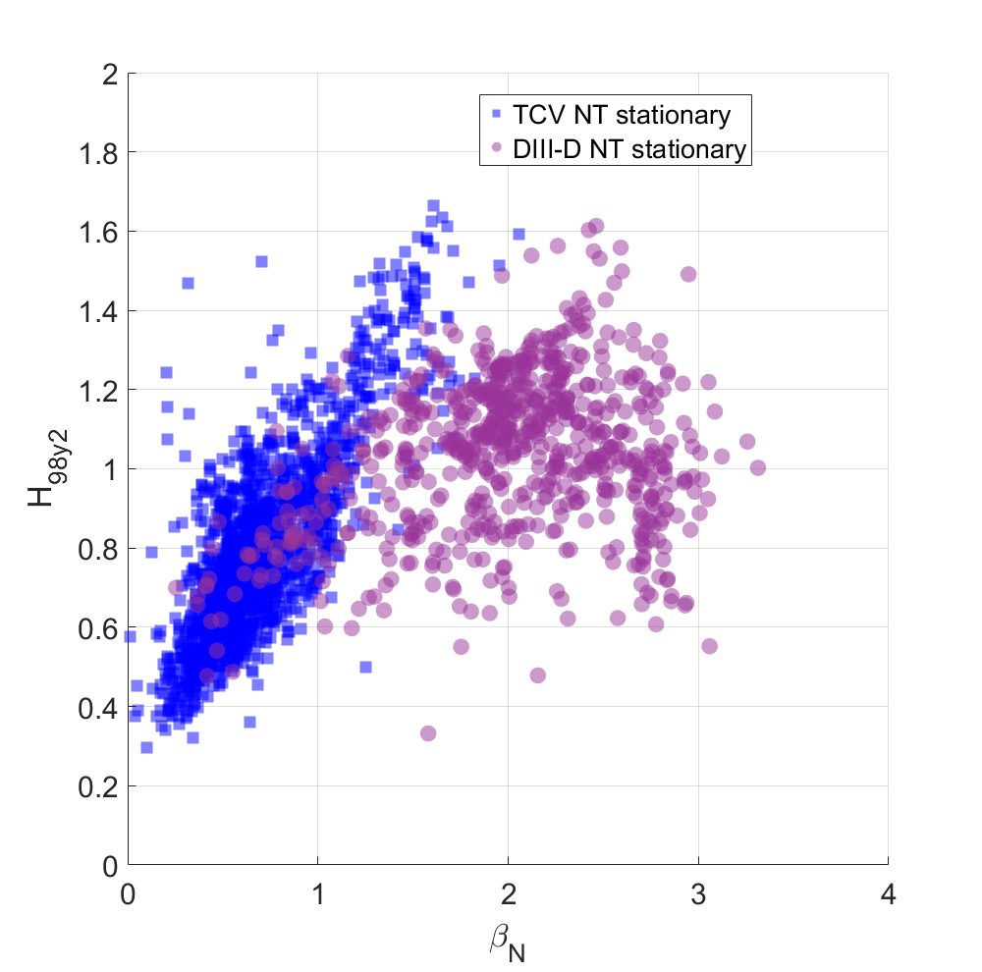
Database of TCV and DIIID [1] NT shots
All the NT datasets consist of ELM-free diverted NT scenarios.
[1] DIIID data courtesy of A. O. Nelson

Slide 7
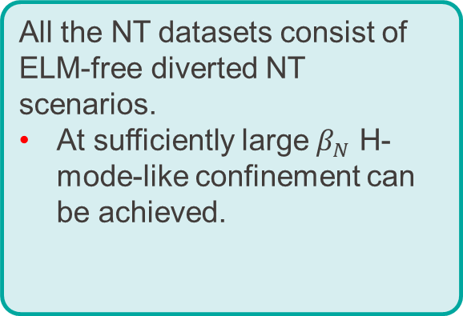
Database of TCV and DIIID [1] NT shots
All the NT datasets consist of ELM-free diverted NT scenarios.
At sufficiently large $β_{N}$ H-mode-like confinement can be achieved.
[1] DIIID data courtesy of A. O. Nelson

Slide 8
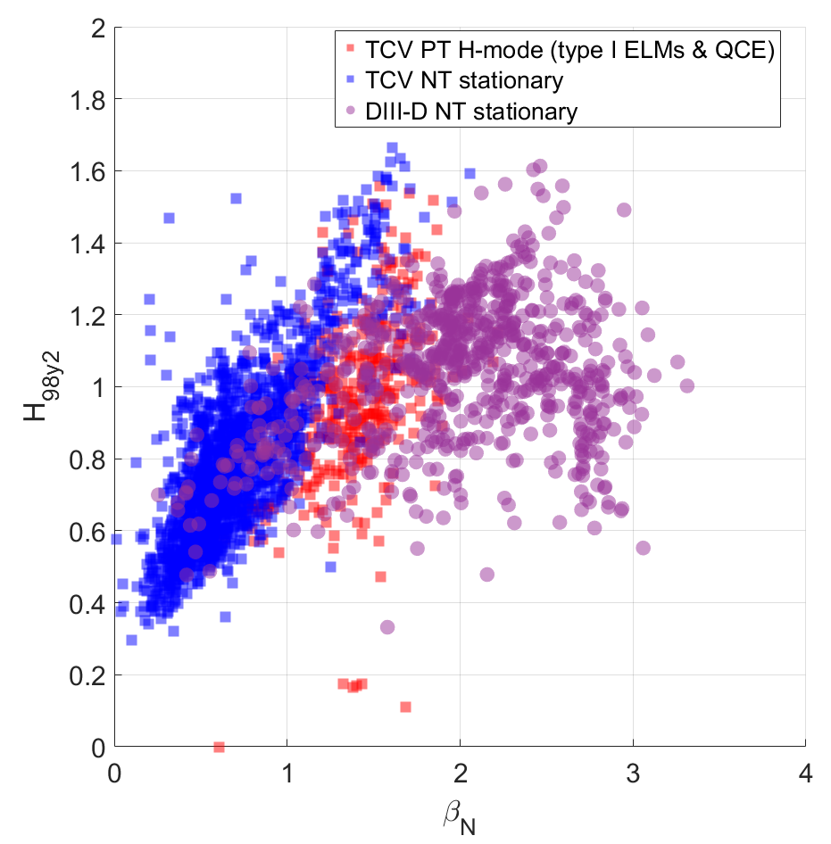
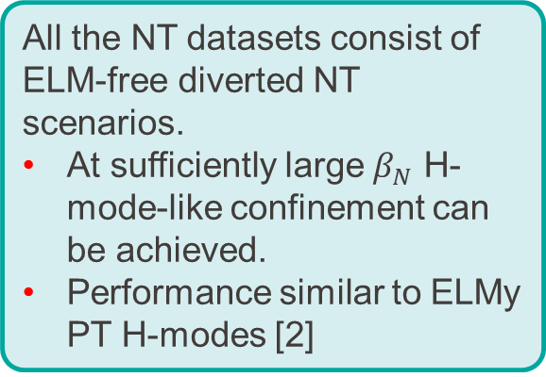
Database of TCV and DIIID [1] NT shots
All the NT datasets consist of ELM-free diverted NT scenarios.
At sufficiently large $β_{N}$ H-mode-like confinement can be achieved.
Performance similar to ELMy PT H-modes [2]
[1] DIIID data courtesy of A. O. Nelson
[2] B. Labit et al.,2020 28th IAEA FEC

Slide 9
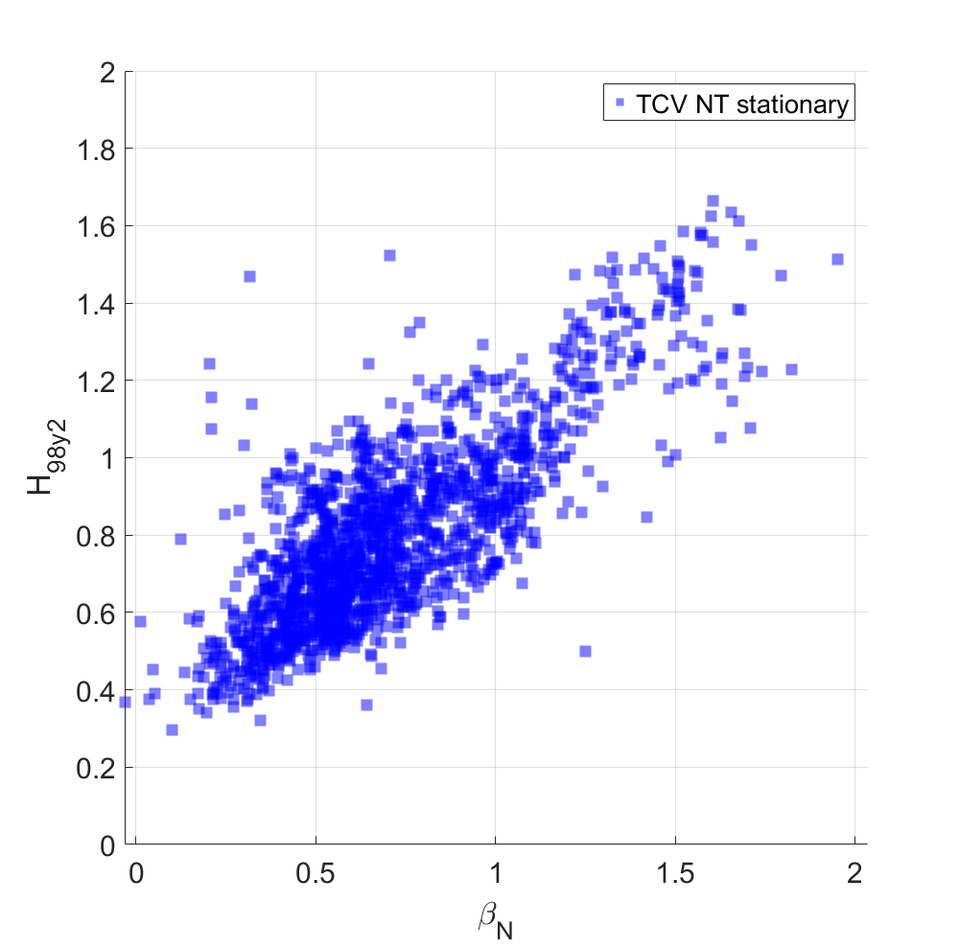
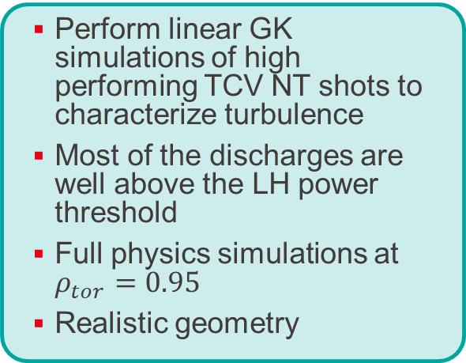
Database of TCV and DIIID [1] NT shots
Perform linear GK simulations of high performing TCV NT shots to characterize turbulence
Most of the discharges are well above the LH power threshold
Full physics simulations at $ρ_{tor}=0.95$
Realistic geometry

Slide 10
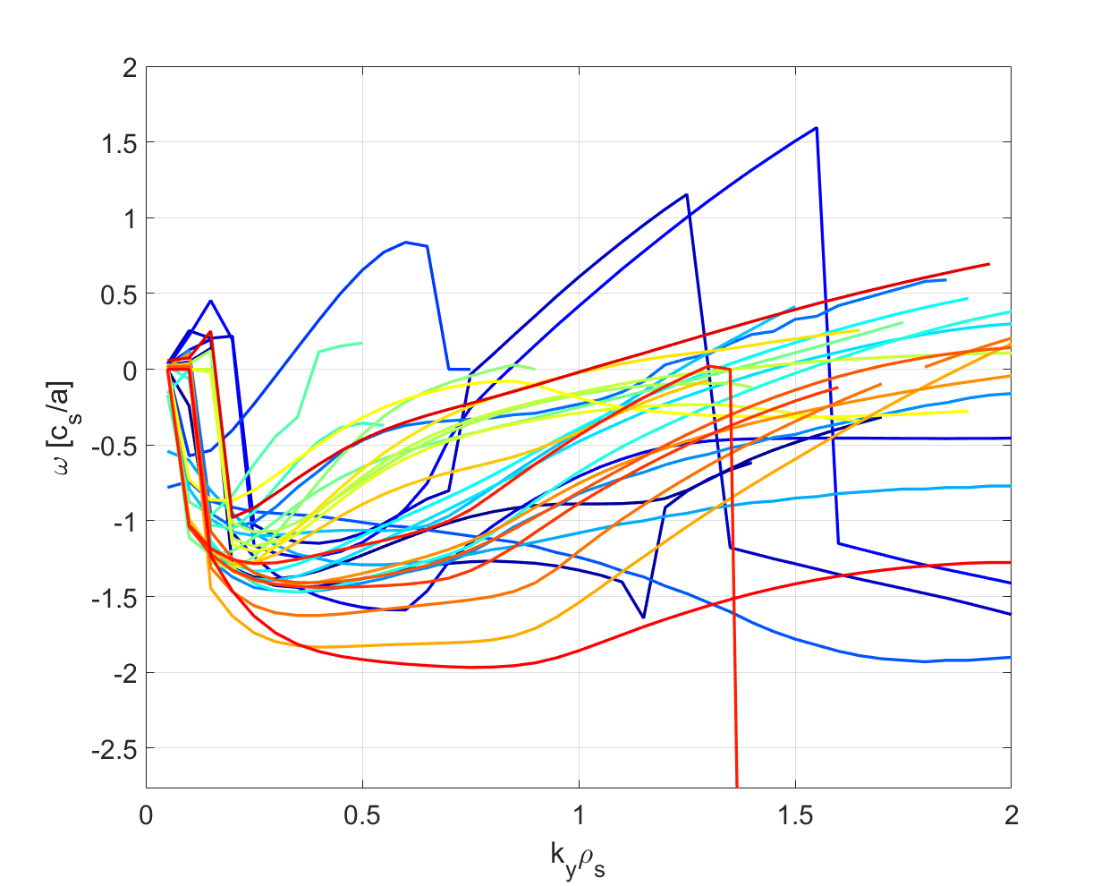
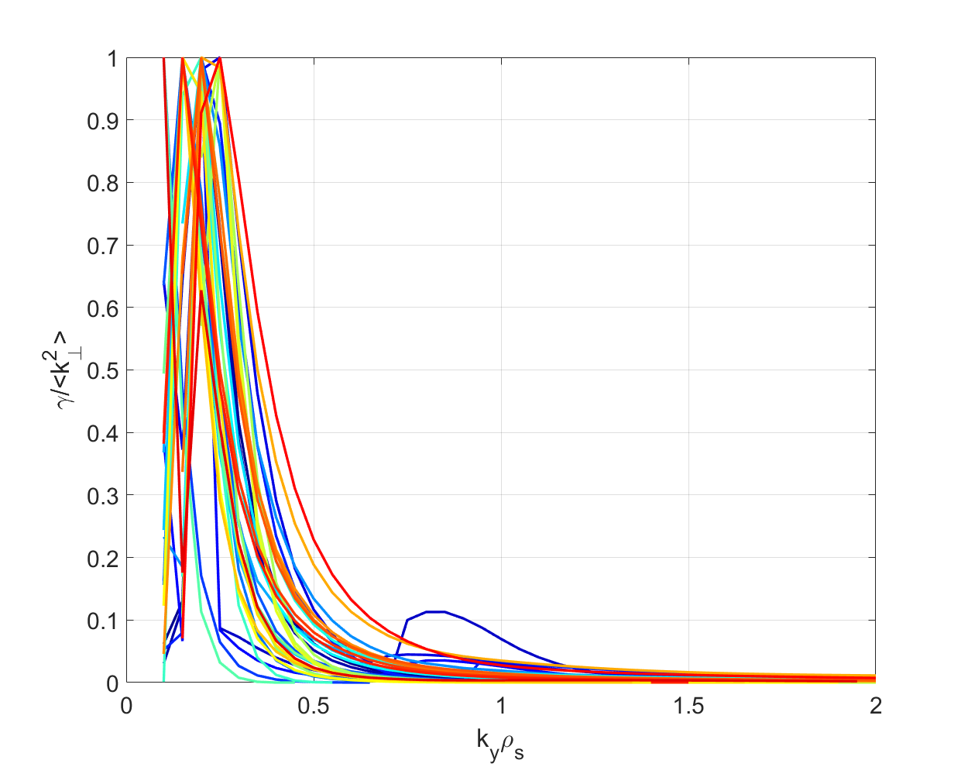
GK linear simulations of TCV NT database
Simulations of 35 TCV NT discharges show “standard” TEMs dominating transport
QL estimate predict maximum contribution to NL fluxes around $k_{y}ρ_{i}=[0.15,0.35]$

Slide 11
GK linear simulations of TCV NT database
Simulations of 35 TCV NT discharges show “standard” TEMs dominating transport
QL estimate predict maximum contribution to NL fluxes around $k_{y}ρ_{i}=[0.15,0.35]$
Turbulence seems standard, so we can try to apply and extend a previously developed model that predicts the impact of shaping on turbulence [1]
[1] A. Balestri et al., 2024 PPCF 66 075012

Slide 12
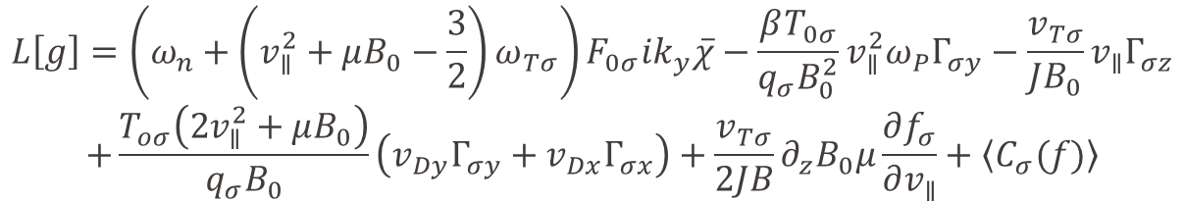



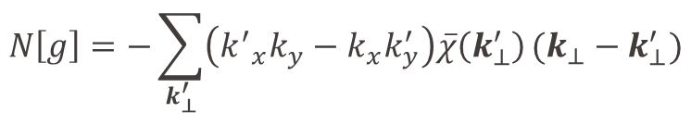
Where does geometry enter the gyrokinetic equation?
$$\frac{∂g}{∂t}=L\left[g\right]+N[g]$$
$+$ GK Maxwell’s equations
Pressure term
Parallel advection term
Drive term
$$L\left[g\right]=\left(ω_{n}+\left(v_{∥}^{2}+μB_{0}−\frac{3}{2}\right)ω_{Tσ}\right)F_{0σ}ik_{y}\overline{χ}−\frac{βT_{0σ}}{q_{σ}B_{0}^{2}}v_{∥}^{2}ω_{P}Γ_{σy}−\frac{v_{Tσ}}{JB_{0}}v_{∥}Γ_{σz}$$
$$+\frac{T_{oσ}\left(2v_{∥}^{2}+μB_{0}\right)}{q_{σ}B_{0}}\left(v_{Dy}Γ_{σy}+v_{Dx}Γ_{σx}\right)+\frac{v_{Tσ}}{2JB}∂_{z}B_{0}μ\frac{∂f_{σ}}{∂v_{∥}}+\left\langle C_{σ}(f)\right\rangle$$
Curvature terms
$$N\left[g\right]=−\sum_{k_{⊥}^{′}}{\left({k^{′}}_{x}k_{y}−k_{x}k_{y}^{′}\right)\overline{χ}\left(k_{⊥}^{′}\right)}(k_{⊥}−k_{⊥}^{′})$$
Trapping term
Collisions
FLR effects from gyroaverage operator
$$\overline{χ}=J_{0}\left(k_{⊥}ρ_{i}\right)χ$$
$$k_{⊥}=(∇x∙∇x{)k}_{x}^{2}+2(∇x∙∇y)k_{x}k_{y}+(∇y∙∇y)k_{y}^{2}$$

Slide 13
Where does geometry enter the gyrokinetic equation?
$$\frac{∂g}{∂t}=L\left[g\right]+N[g]$$
$+$ GK Maxwell’s equations
$$L\left[g\right]=\left(ω_{n}+\left(v_{∥}^{2}+μB_{0}−\frac{3}{2}\right)ω_{Tσ}\right)F_{0σ}ik_{y}\overline{χ}−\frac{βT_{0σ}}{q_{σ}B_{0}^{2}}v_{∥}^{2}ω_{P}Γ_{σy}−\frac{v_{Tσ}}{JB_{0}}v_{∥}Γ_{σz}$$
$$+\frac{T_{oσ}\left(2v_{∥}^{2}+μB_{0}\right)}{q_{σ}B_{0}}\left(v_{Dy}Γ_{σy}+v_{Dx}Γ_{σx}\right)+\frac{v_{Tσ}}{2JB}∂_{z}B_{0}μ\frac{∂f_{σ}}{∂v_{∥}}+\left\langle C_{σ}(f)\right\rangle$$
Curvature terms
$$N\left[g\right]=−\sum_{k_{⊥}^{′}}{\left({k^{′}}_{x}k_{y}−k_{x}k_{y}^{′}\right)\overline{χ}\left(k_{⊥}^{′}\right)}(k_{⊥}−k_{⊥}^{′})$$
FLR effects from gyroaverage operator
$$\overline{χ}=J_{0}\left(k_{⊥}ρ_{i}\right)χ$$
$$k_{⊥}=(∇x∙∇x{)k}_{x}^{2}+2(∇x∙∇y)k_{x}k_{y}+(∇y∙∇y)k_{y}^{2}$$

Slide 14
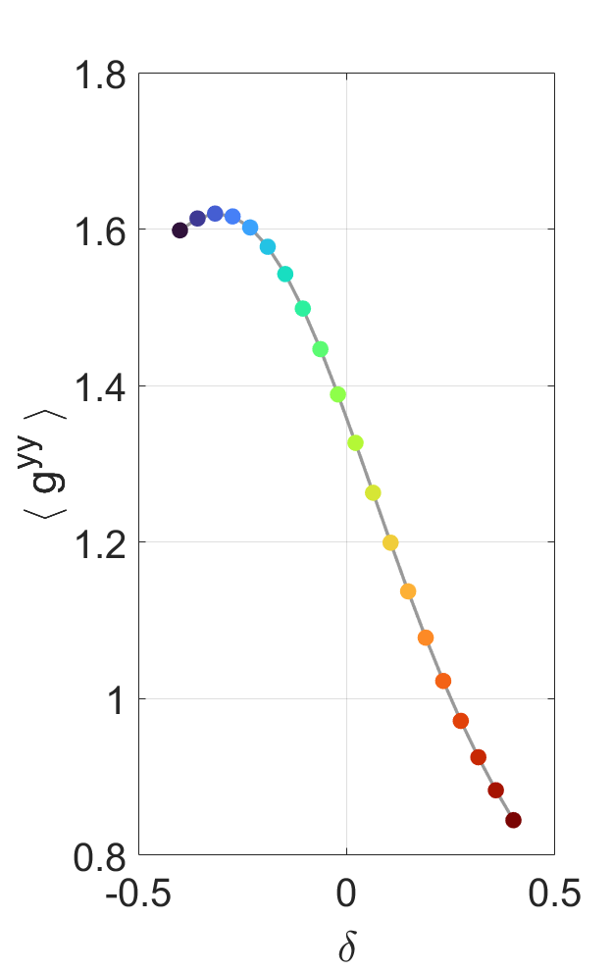
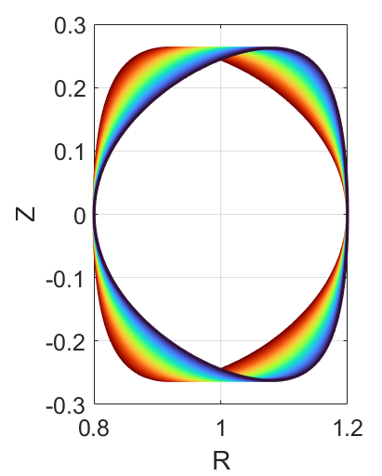
Geometric dependence of magnetic drifts and FLR effects
FLR effects
[1] A. Balestri et al., 2024 PPCF 66 075012
NT makes the FLR effects stronger
Weaker turbulence [1]

Slide 15
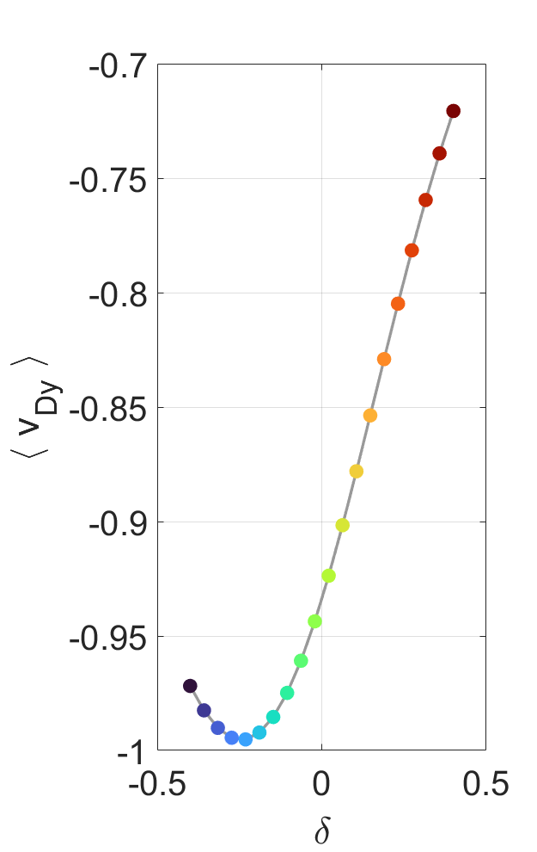
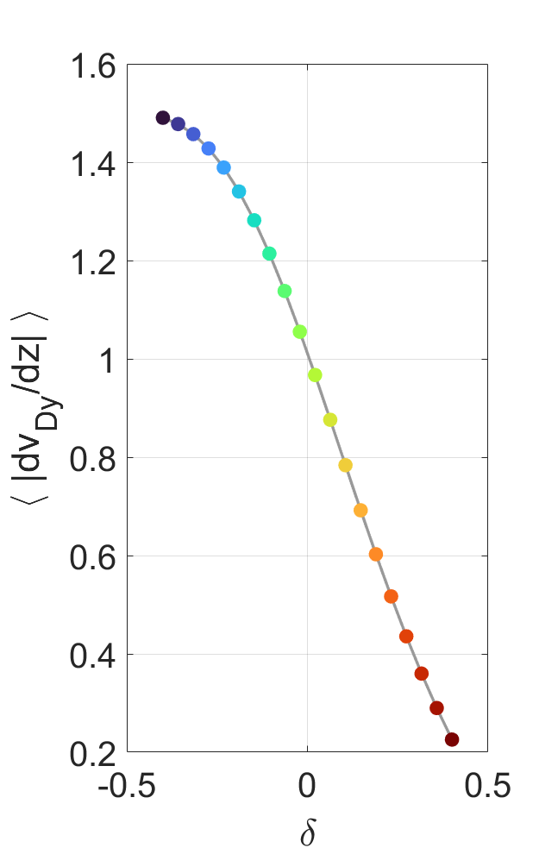
Geometric dependence of magnetic drifts and FLR effects
Magnetic drift
Poloidal variation of magnetic drift
NT causes faster magnetic drifts that change more rapidly along the poloidal angle
Weaker turbulence [1] [1]
[1] A. Balestri et al., 2024 PPCF 66 075012

Slide 16
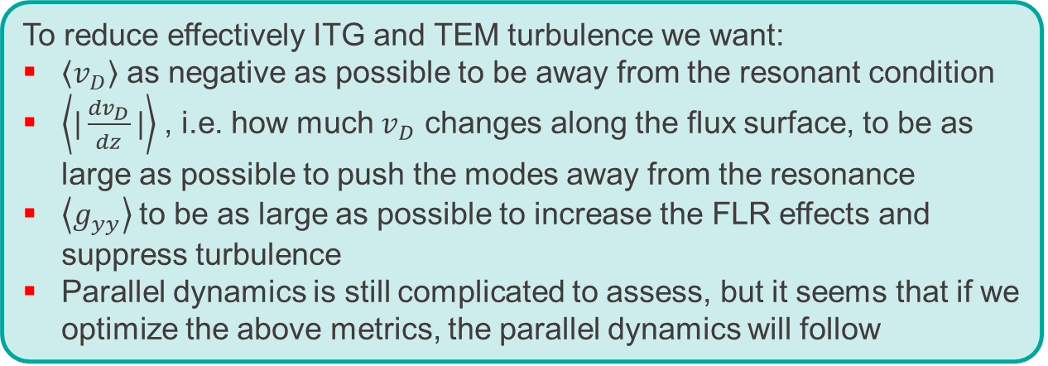
I know, it was a lot to digest… let me summarize
To reduce effectively ITG and TEM turbulence we want:
$\left\langle v_{D}\right\rangle$ as negative as possible to be away from the resonant condition
$\left\langle |\frac{{dv}_{D}}{dz}|\right\rangle$, i.e. how much $v_{D}$ changes along the flux surface, to be as large as possible to push the modes away from the resonance
$\left\langle g_{yy}\right\rangle$to be as large as possible to increase the FLR effects and suppress turbulence
Parallel dynamics is still complicated to assess, but it seems that if we optimize the above metrics, the parallel dynamics will follow
Tested on simplified scenarios [1]. We can test it on more realistic scenarios
[1] A. Balestri et al., 2024 PPCF 66 075012

Slide 17
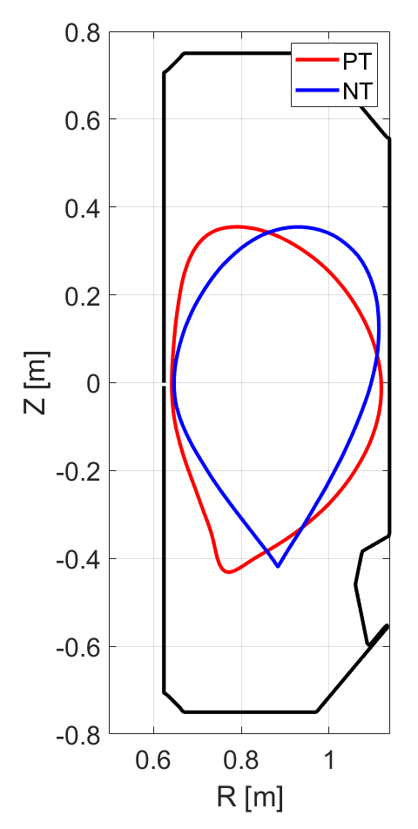
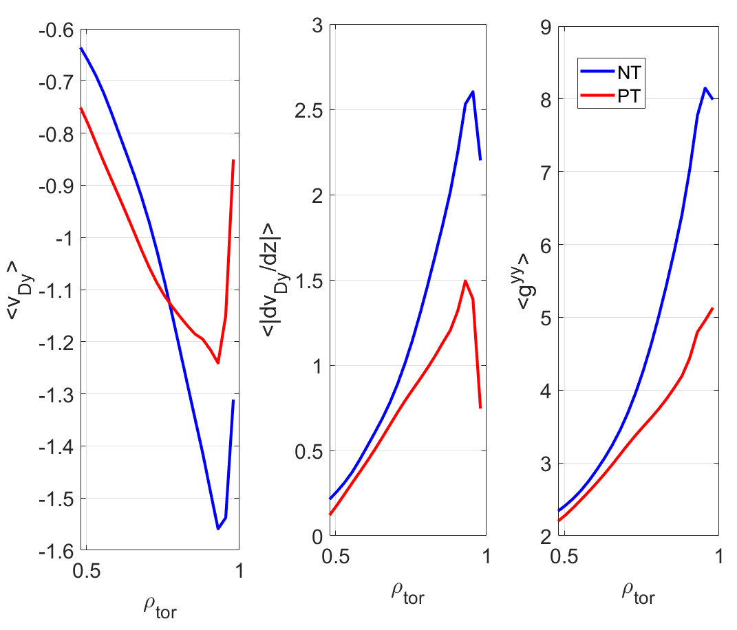
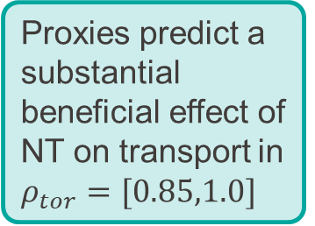
Testing importance of magnetic drift and FLR effects
[1] A. Balestri et al., 2024 PPCF 66 065031
[2] A. Mariani et al., 2024 NF 64 106024
Let’s consider an experimental NT/PT couple from TCV [1,2]
Proxies predict a substantial beneficial effect of NT on transport in $ρ_{tor}=[0.85,1.0]$

Slide 18
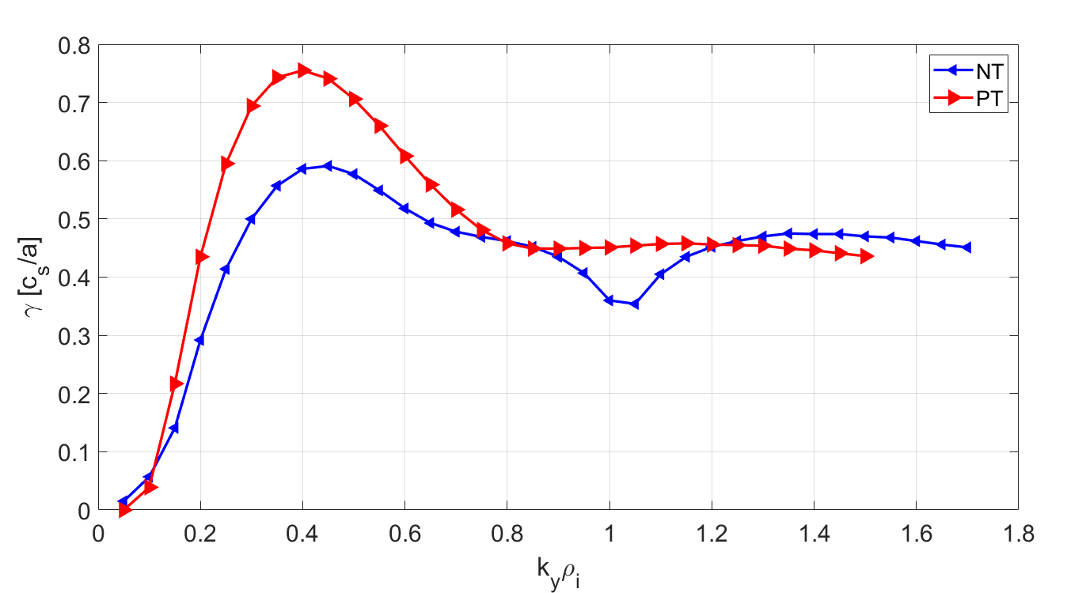
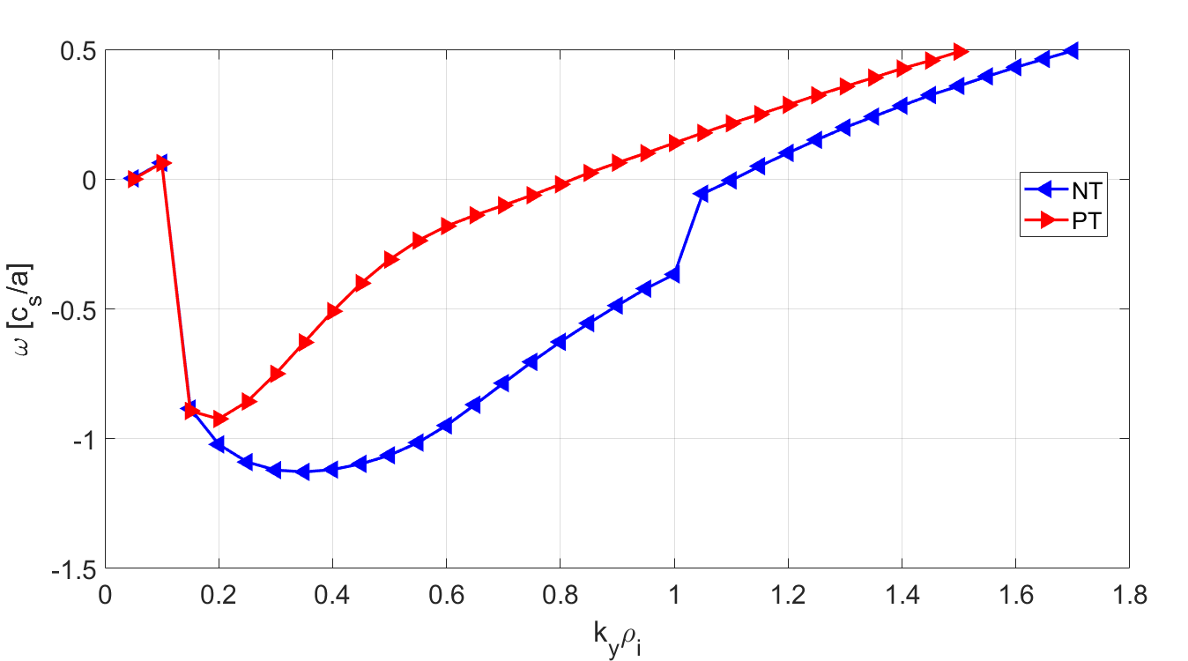
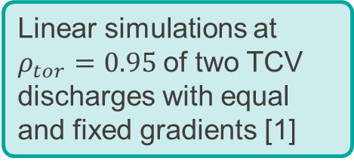
Testing importance of magnetic drift and FLR effects
[1] A. Balestri et al., 2024 PPCF 66 065031
[2] A. Mariani et al., 2024 NF 64 106024
Linear simulations at $ρ_{tor}=0.95$of two TCV discharges with equal and fixed gradients [1]
Consistently with previous results, we have TEM dominated regimes.
NT shows the usual linear stabilization of modes wrt PT

Slide 19
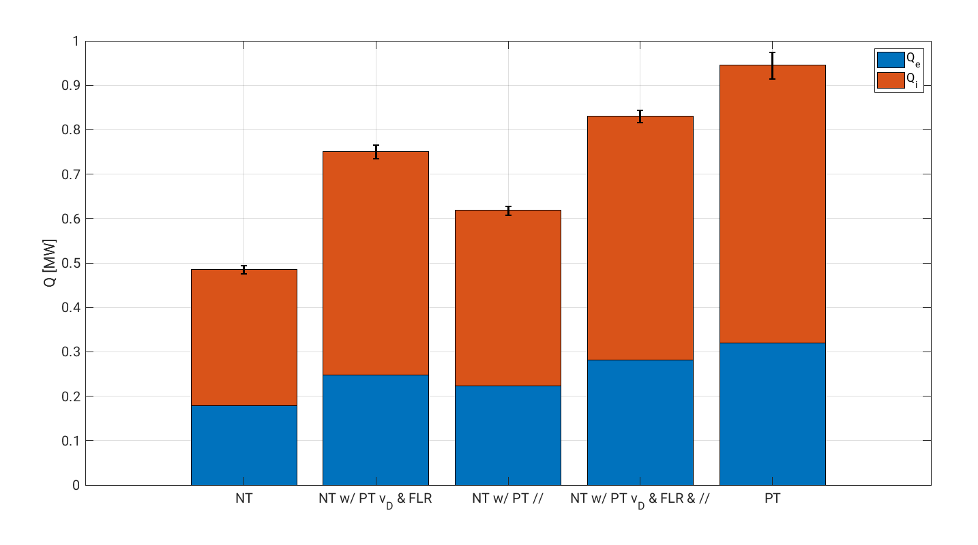
Testing importance of magnetic drift and FLR effects
Adapted from A. Mariani et al. (submitted to PPCF)
Nonlinear simulations show substantial reduction of turbulence from PT to NT shape.
Swapping magnetic drift velocity and FLR effects between geometry allows to recover a good part of the difference between NT and PT.

Slide 20
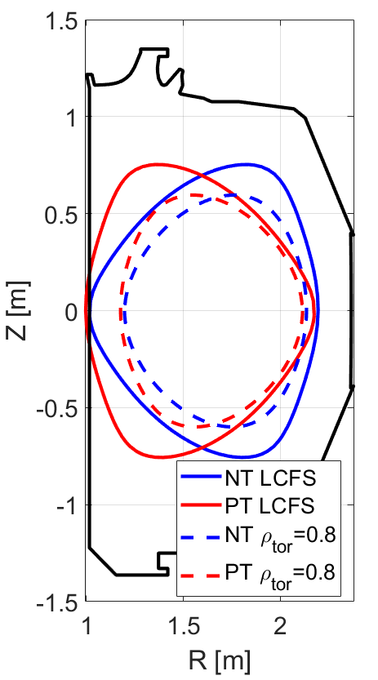
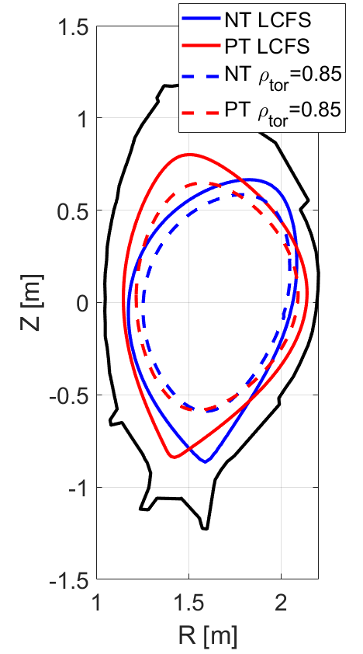
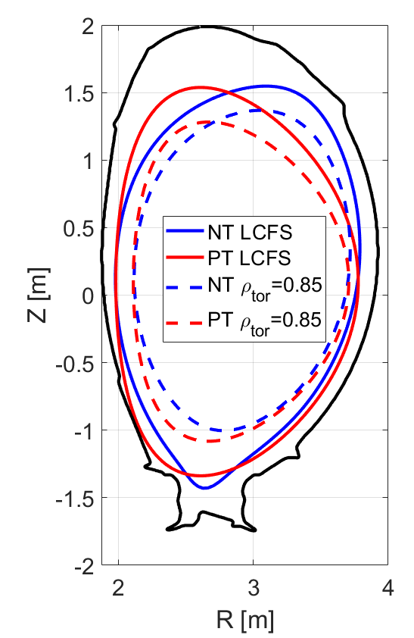
Further validation in realistic ITG scenarios from different tokamaks (DIII-D, AUG, JET)
DIII-D
NT shot #171241 [1]
PT produced with CHEASE flipping LCFS
DIII-D
AUG
NT shot #43493 [2]
PT shot #36157 [3]
JET
NT shot #105835 [4]
PT produced with CHEASE flipping LCFS
AUG
JET
[1] A. Marinoni et al., 2024 NF 64 086045
[2] B. Vanovac et al., 2026 NF, 66 106040
[3] L. Aucone et al., 2024 PPCF 66 075013
[4] O. Sauter et al., 2024 APS-DPP meeting

Slide 21
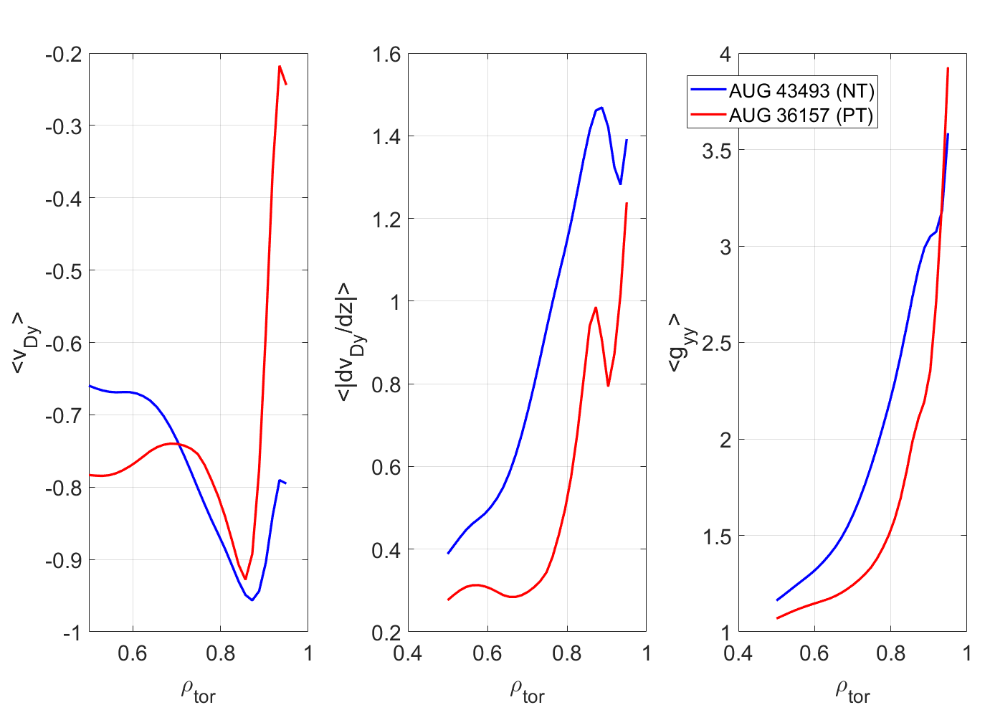
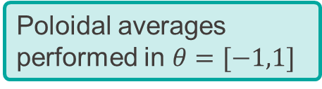

Proxies predict stabilization of turbulence in AUG-NT scenario at $ρ_{tor}=0.9$
Poloidal averages performed in $θ=[−1,1]$
Similar trends observed for DIII-D and JET
Proxies predict a substantial beneficial effect of NT on transport

Slide 22
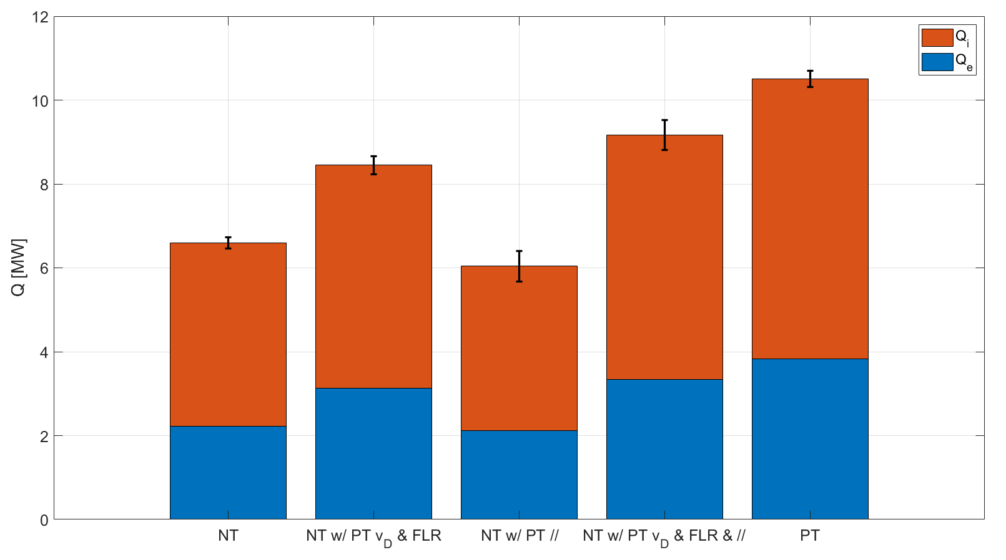
Importance of magnetic drift and FLR effects confirmed in realistic ITG scenarios
Nonlinear simulations show substantial reduction of turbulence from PT to NT shape.
Swapping magnetic drift velocity and FLR effects between geometry allows to recover most of the difference between NT and PT.

Slide 23
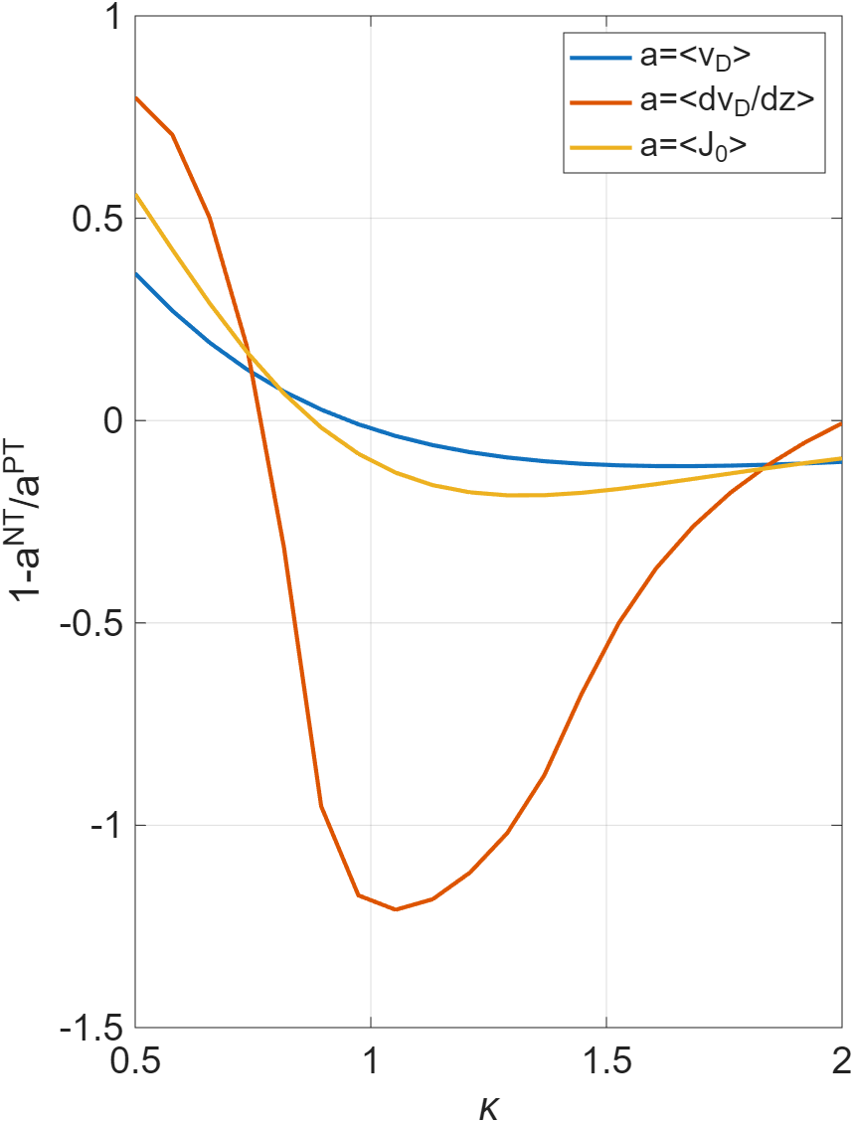
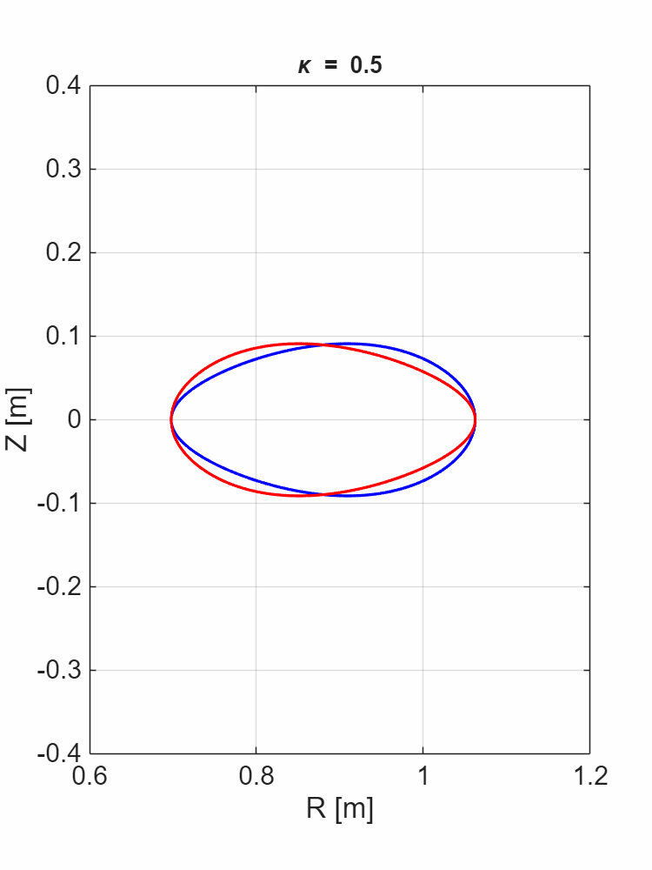

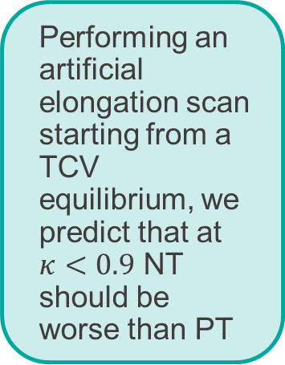
Can we find a scenario where the proxies predict NT to be worse than PT?
$$\left\langle g^{yy}\right\rangle$$
NT bad
Performing an artificial elongation scan starting from a TCV equilibrium, we predict that at $κ<0.9$ NT should be worse than PT
NT good

Slide 24
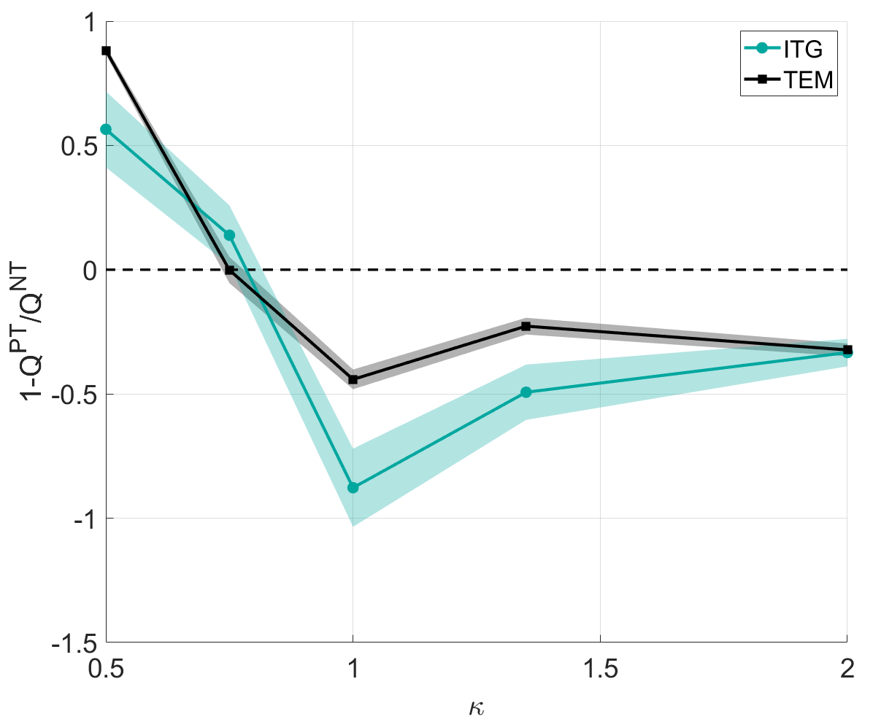
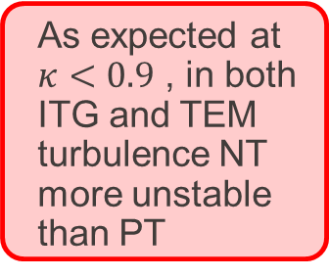
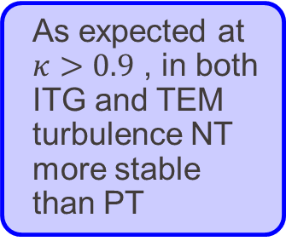

Gyrokinetic simulations seem to confirm this prediction
Local gradient-driven gyrokinetic simulations of TCV
Elongation $(κ)$ artificially changed
As expected at $κ>0.9$ , in both ITG and TEM turbulence NT more stable than PT
As expected at $κ<0.9$ , in both ITG and TEM turbulence NT more unstable than PT

Slide 25
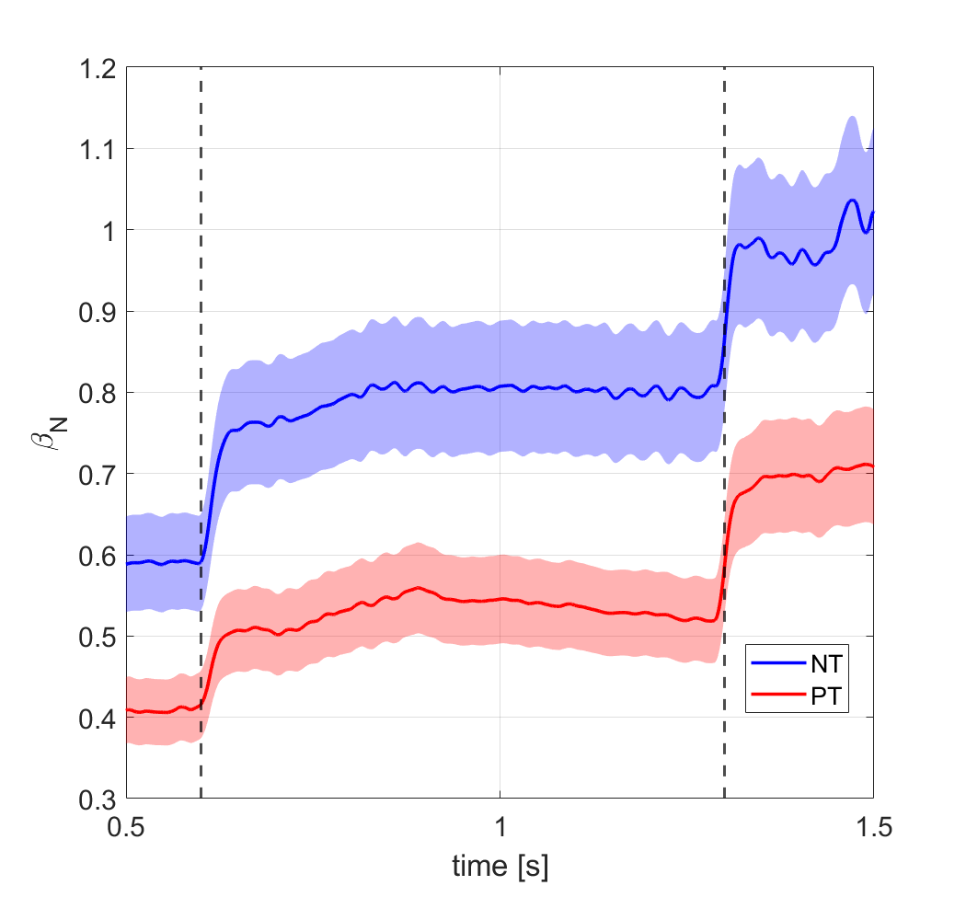
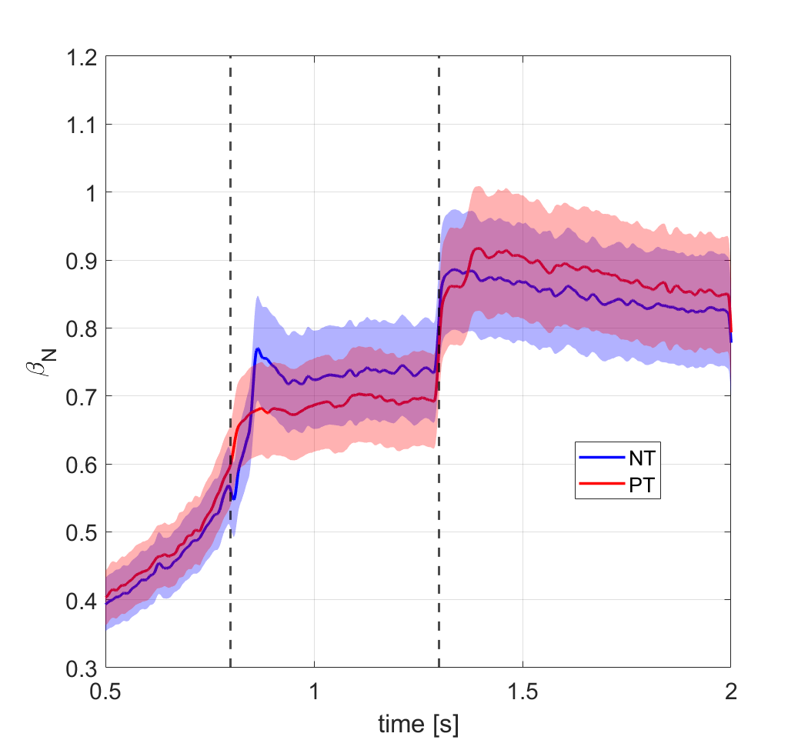






Experimental results on TCV confirm predictions
Inner limited NT and PT discharges with same magnitude of triangularity and heated with different levels of ECRH power
$$κ=1.5$$
$$κ=0.95$$
$$P_{ECH}=1.0MW$$
Ohmic
Ohmic
$$P_{ECH}=1.0MW$$
$$P_{ECH}=0.5MW$$
$$P_{ECH}=0.5MW$$

Slide 26
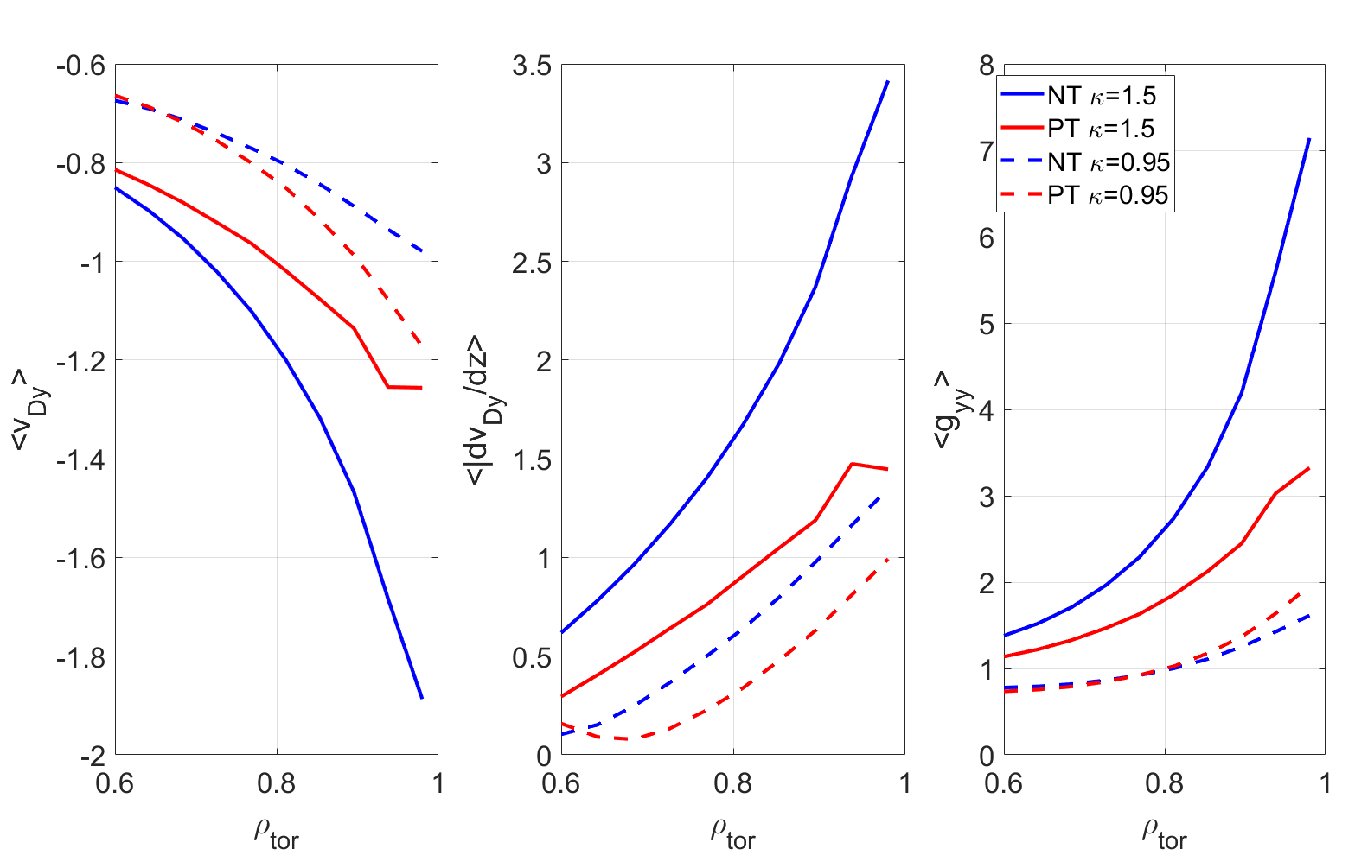


Experimental results on TCV confirm predictions
$$κ=1.5$$
The experimental results is well captured by the proxies
$$κ=0.95$$

Slide 27
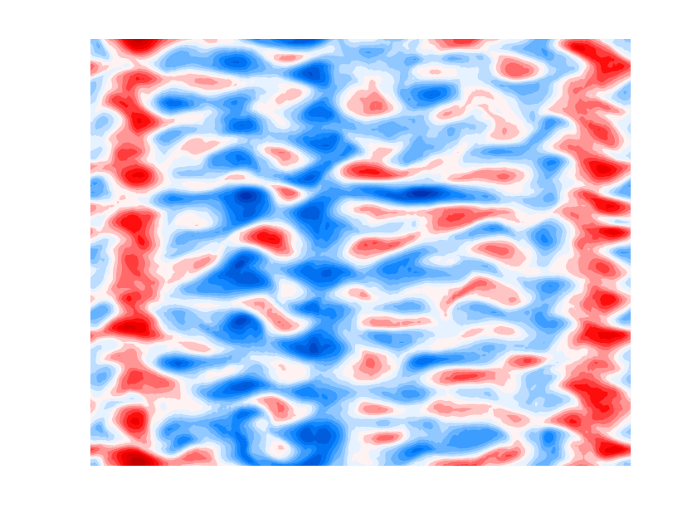
Conclusions

Slide 28
Summary
Edge linear simulations of the NT-TCV database show standard TEM dominating transport
Developed and extended simple model based on geometry dependence of magnetic drift velocity and FLR effects to predict impact of shaping on turbulence
The model seems to hold well for edge simulations of TCV TEM-dominated scenarios
The model seems to hold well for simulations of ITG-dominated scenarios in different machines (DIII-D, JET and AUG)
Predictive capabilities of geometric proxies successfully tested experimentally on TCV with and elongation scan

Slide 29
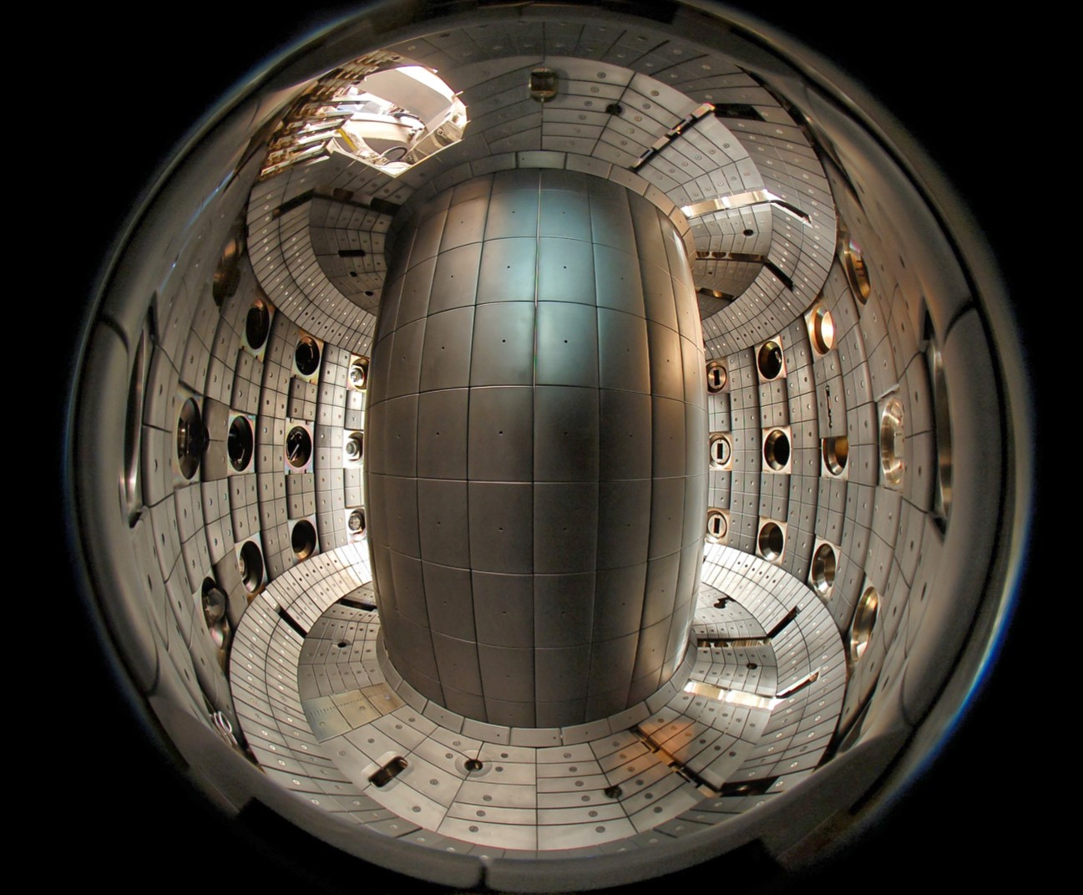

Thank you!

Slide 30
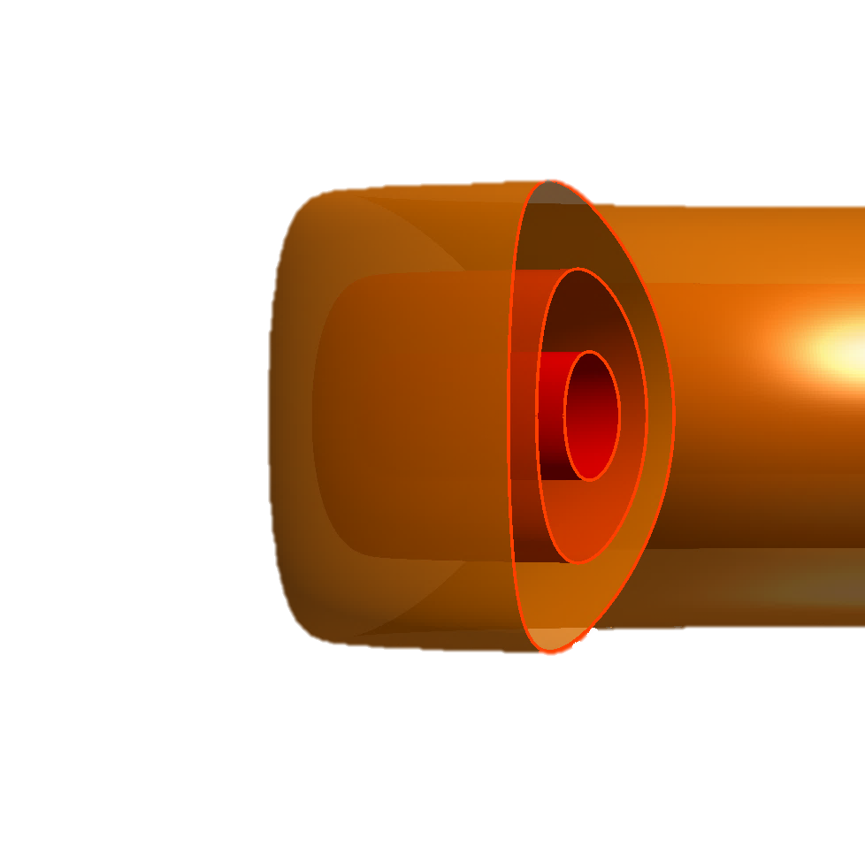
Backup

Slide 31
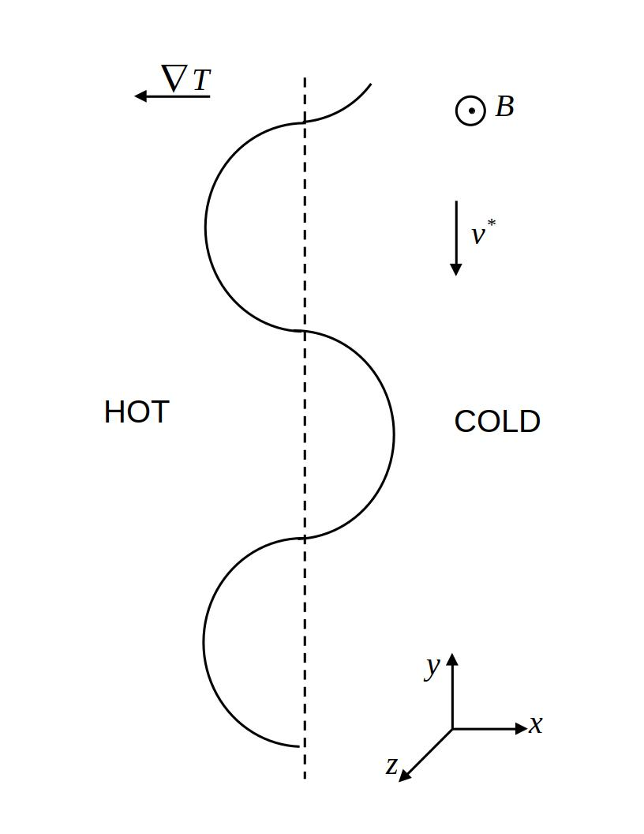
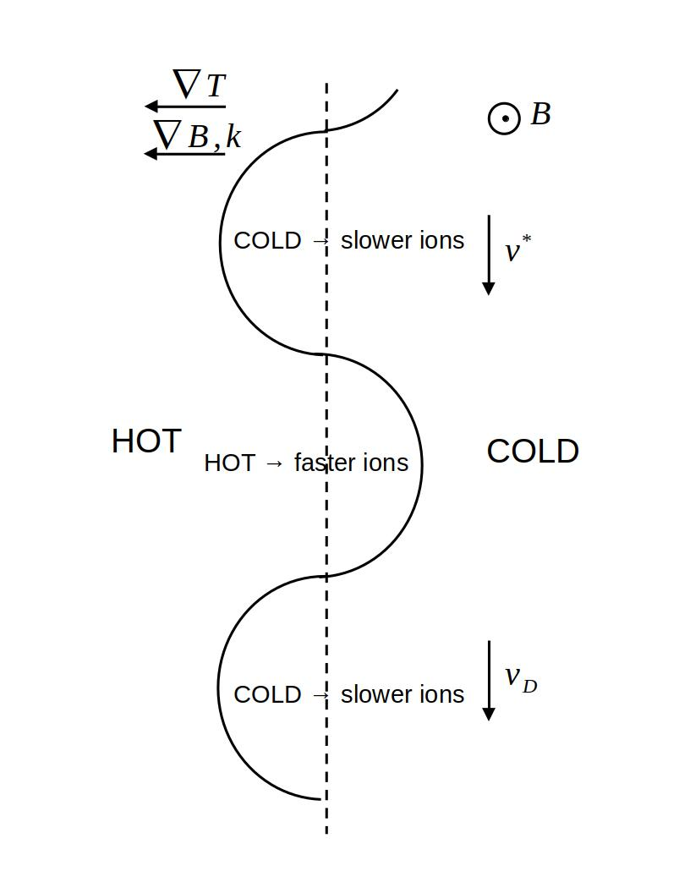
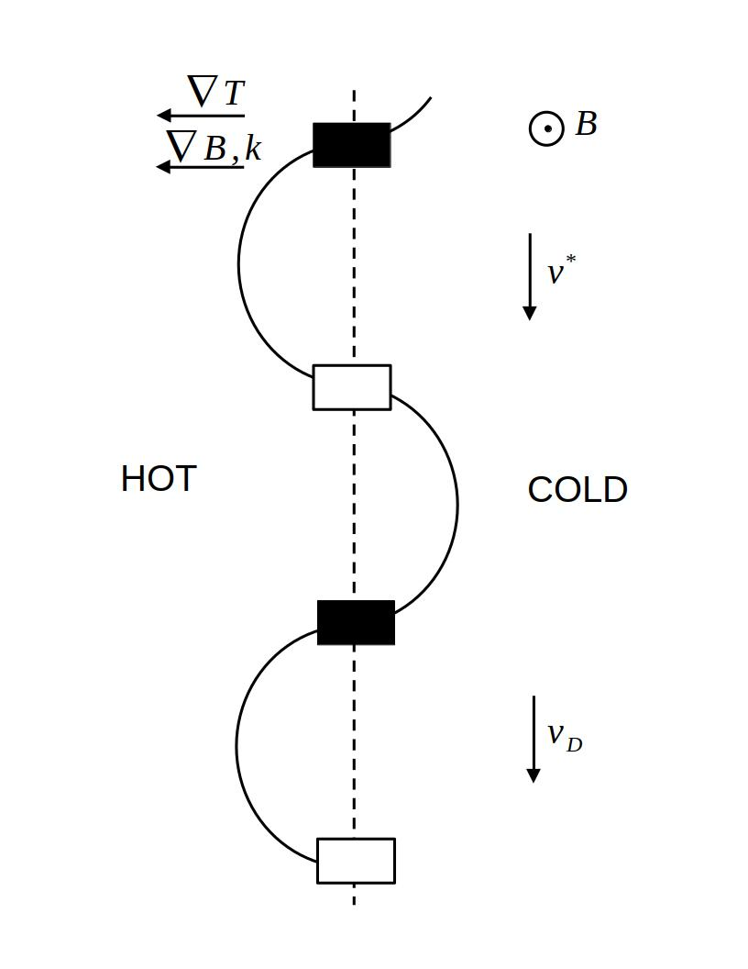
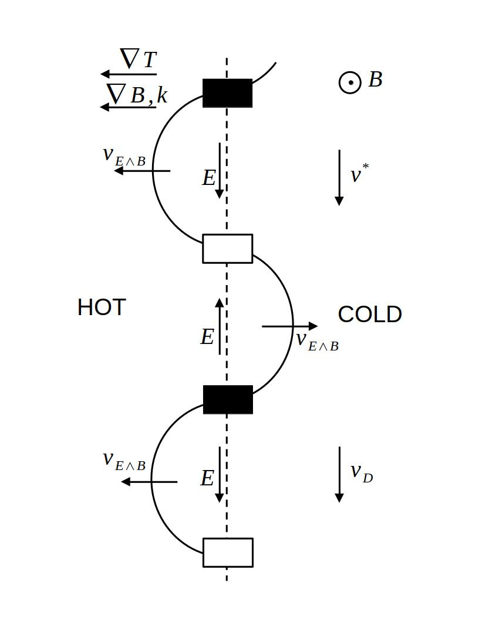

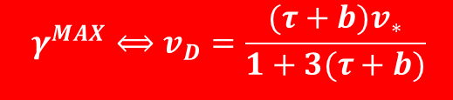



ITG linear theory
The wave travels with a velocity:
$$v_{∗}∝B∧∇P$$
When we add curvature and gradient of B, the ions will also drift with a velocity:
$$v_{D}∝T_{i}(B∧∇B)$$
Because of different temperatures, the ions will drift at different speed. This cause an accumulation/depletion of charge
An electric field is consequently generated. This causes the appearance of a ExB drift that makes the wave’s amplitude grow
This is a resonant process.
From [1], we found that the optimal point for the growth of ITG is:
[1] M. Beer, Gyrofluid models of turbulent transport in tokamaks”, Ph.D. Thesis (1994)
$$γ^{MAX}⟺v_{D}=\frac{(τ+b)v_{∗}}{1+3(τ+b)}$$
where $\frac{r}{R}≪1, τ=\frac{T_{i}}{T_{e}}, b=k_{⊥}^{2}ρ_{i}^{2}$
$$γ^{MAX}⟺v_{D}=\frac{v_{∗}}{4}$$
If $τ=1,b=$0

Slide 32


Magnetic drift scan (methodology)
To understand the impact of magnetic drifts, we have modified artificially the original NT magnetic drift profile:
$$v_{Dy}\left(z\right)={σv}_{Dy}^{NT}\left(z\right)+v_{Dy0}$$

Slide 33





Magnetic drift scan in pure-ITG regime
[1] M. Beer, Ph.D. Thesis (1994)
Existence of a “rollover” point.
Growth rates decrease with increasing variation of $v_{Dy}$.
$$v_{D}\sim \frac{v_{∗}}{13}$$
Faster magnetic drifts wrt. the rollover point imply more stable modes
$$σ$$
In agreement with [1], where the maximum growth rate can be found when:
$$γ^{MAX}⟺v_{D}=\frac{v_{∗}}{4}$$

Slide 34



Magnetic drift scan in pITG regime
Resonant condition
$$v_{∗}/13$$
NT makes the ions drift faster, causing a mismatch between $v_{D}$ and $v_{∗}$. This pushes the ITG away from the resonant condition

Slide 35
Nonlinear simulations at conventional A in pure-ITG
We can try to see what role faster magnetic drifts and stronger FLR effects play in a conventional A case. In this context, the physical processes involved could be more complex.

Slide 36

Nonlinear simulations at conventional A in pure-ITG
The same picture holds for the conventional A case. However, depending on the scenario, parallel dynamics could play some role

Slide 37

We tested the same physical picture in a pure-TEM scenario
In a TEM scenario, the same physical picture holds, but parallel dynamics and geometry/dependent terms in collisional operator become more important
Heat flux [gB]

