Slide 1

2025 Final Summary / 2026 Plans
Project Meeting
Plasma-Wall Interactions and Exhaust
Sebastijan Brezinsek
Forschungszentrum Jülich
S. Brezinsek (PL), J.W. Coenen, A. Hakola, K. Schmid, A. Kirschner, J. Likonen, I. Classen, A. Goriaev, and D. Douai (DPL)

Slide 2
2025 Final Summary WPPWIE
WPPWIE contributed significantly to the EUROfusion output in 2025
First contributions to urgent ITER questions in view of the new baseline
and first wall material choice were achieved: PWIE with tungsten and boron /
fuel retention and removal aspects / wall conditioning / predictive simulations
Advances in material qualification and support of tokamak experiments
Advances in simulations and validation of key PWIE and plasma boundary codes
Exploration of laser-based surface techniques in laboratory and tokamak environment
Reference experiments to benchmark atomic and molecular data with novel diagnostics
Strong collaboration with WPTE, WPW7X, WPAC: experiments and modelling
Successful collaboration with WPDES, WPMAT, WPDIV in specific areas
All deliverables and milestones apart from (i) “ITER”-mirror cleaning from B and (b) JET post-DT analysis were completed and achieved in time.
Level 3 reporting has been completed and accepted!
23 Grant Deliverables Report for the period 2021-2025 close to completion!
Technical Report of WPPWIE in progress!
Thank you all for your contributions!
Special thank to the Subproject Leaders and the Project Science Officer!

Slide 3
EUROfusion Prolongation 2026-2027
2021-2025 EUROfusion had significant underspending (e.g. delay of large projects e.g. PEX, DONES, DTT etc.)
European Commission requests adaption of EUROfusion structure, program, budget for the two-years-prolongation considering the underspending in the first five years
European Commission required a “new” proposal and foresees a full evaluation
EUROfusion Consortium submitted new program fit to the new boundary conditions (external panel evaluation)
European Commission is demanding a strict separation of phase 2021-2025 from phase 2026-2027
Physics content: distinguishable from previous years
Publications: separate WPPWIE pinboard entry for 2026-2027 for new activities and papers submitted
Transfer only limited to few areas requested in 2025 and separate reporting
Delayed or unused budget from 2021-2025 returned to EUROfusion central budget
Increase in complexity in comparison to first EUROfusion prolongation in 2019-2020
Impact on reporting, preparation, interaction, parallel bookkeeping, speed for preparation
Rise in uncertainty reflected in the time needed for preparation and available funding preparation
Note: the budget is preliminary until the European Commissions agrees to the proposal

Slide 4
EUROfusion Prolongation 2026-2027
What are the consequences for WPPWIE?
WPPWIE remained an independent WP and was not closed/combined/integrated!
WPPWIE budget increased substantially from 2021 until 2025 by about a factor 2
WPPWIE budget of 2026 is about 40% below the budget of 2025, but only 7% below the five-years-average
Refocus WPPWIE on the main PWIE activities
Reduce the number of Activities and Deliverables in subprojects
Adapt the support of plasma facilities and analysis devices
Prioritization of science topics and ensure remaining projects have critical mass to provide significant scientific output
Skip activities with T operation in Saclay (high cost) in 2026 and 2027
Skip activities with metallic tokamak dust and safety assessment (mainly WEST) in 2026 and 2027
Skip activities at QSPA facilities (challenge to operate) => Additional funding by the EUROfusion PM obtained
PL and Subproject Leaders prepared a best as possible programme under the given boundary conditions
Still final adaptations are ongoing considering feedback from laboratories

Slide 5
WPPWIE Structure 2026-2027
WPPWIE
PL S. Brezinsek [FZJ]
DPL D. Douai [CEA]
SPA
J.W. Coenen [FZJ]
SPC
K. Schmid [MPG]
SPD
A. Kirschner [FZJ]
SPB
A. Hakola [VTT]
SPE
J. Likonen [VTT]
SPF
A. Goriaev [ERM/KMS]
SPX
I. Classen [DIFFER]
SPA: Particle and heat load studies in preparation of the exploitation of ITER and fusion power plant
SPB: Experiments on erosion, deposition, and material migration
SPX: Plasma characterization and laser-based diagnostic development
SPC: Fuel retention and release
SPD: Plasma-edge and plasma-wall interaction modelling
SPE: JET post-mortem analysis, LIBS and associated interpretation
SPF: Wall conditioning and boronization physics

Slide 6
Objectives I
The long-term goals of WPPWIE are to provide information related to Plasma-Wall Interaction and Exhaust (PWIE) physics and associated technological aspects, which are crucial for the completion of ITER with first wall components made of tungsten (W), for the successful and safe operation of ITER in the SRO (Scientific Research Operation [Pitts 2025]) and DT-1 (Deuterium-Tritium Operation [Loarte 2025]) phase, and to provide viable information regarding PWIE aspects for a reactor-class device exposed to high neutron fluxes such as DEMO or a fusion pilot plant. The objectives of WPPWIE in 2026-27 are to a large extend in-line with the 2025 objectives, which have - in comparison to the original objectives of 2021 - already been shifted towards the new ITER needs associated with the new research baseline and exchange of the first wall material from Be to W in the main chamber.
Support ITER plasma-facing components (PFC) qualification, performance assessment, and lifetime estimations regarding limiter start-up, L-mode plasmas (SRO) and H-mode burning plasma conditions (DT-1)
Support ITER regarding the usage of boronization, its impact on fuel retention, and explore ways of efficient fuel removal
Support ITER regarding tungsten migration (erosion, transport, deposition, screening) and boron migration (erosion, transport, deposition, mixing)
[All three in strong collaboration with WPTE an WPTM]
Note: Collaboration Agreements between EUROfusion and ITER in four areas are in signature process:
ITER is also a key European Device!

Slide 7
Objectives II
Support DEMO (or fusion power plant) plasma-facing material qualification under plasma or combined plasma and heat load
Support DEMO (or fusion power plant) lifetime (erosion and deposition) and safety estimates (tritium retention and dust)
Support of W-based divertor and first wall solutions and their qualifications
[All three in strong collaboration with WPMAT, WPDIV, WPDES, WPBB and WPTE, WPW7X]
Support of tokamak and stellarator experiments in area of PWIE
Provision of surface sputtering data by molecular dynamics simulations and beyond
Completion of JET LIBS and post-mortem analysis (nuclear environment)
Benchmark of collisional-radiative models, atomic and molecular data with novel experiments and diagnostics
Optimization of laser-based surface analysis techniques
Advanced PWIE code development and benchmark experiments for the far-scrape-off layer

Slide 8
Human Resources WPPWIE in AWP 2026-2027
Selection made and human resources balanced in different subprojects and tasks to be carried out
Detailed Task Specification is done in consultation with the RUs to include priorities of labs (in agreement with local programme) and available personal (avoiding overbooking of human resources)
Delay in set-up of 2026-2027 tasks specification
Input into IMS etc. will start after this meeting
(temporary PSO in FZJ: D. Alyassin)
Note:
WPPWIE prepared one program for two years.
But 2027 is still subject to changes and adapations and depends on GA approval.

Slide 9
Facilities WPPWIE in AWP 2026-2027
Selection made by PL and SPLs considering needs for WPPWIE tasks
Machine usage similar to 2024
Machine costs preliminary updated with RUs input in cause of evaluation
LPD resources slightly reduced
Accelerator resources constant
Internal flexibility required if delays appear in this period.
Transfer of tasks beyond 2027 likely not possible as structure in
FP10 might be different.
Note:
WPPWIE prepared one program for two years.
But 2027 is still subject to changes and adapations and depends on GA approval.

Slide 10
Resource allocation summary AWP 2026
WBS ID | Manpower [PM] | E&GS (incl. use of facilities) [k€] | Missions (actual) [k€] | CC resources [k€] | Total resources [k€] | Related GD/GM | Involved Beneficiary(ies) / Affiliated Entities
PM | 29.6 | - | 85 | 250.7 | 397 |  | FZJ, VTT, MPG, FZJ, VTT, LPP-ERM-KMS, DIFFER, FZJ, Not all
FOp | (114.2) | 75+697 | - | 1095.7 | 1946 |  | FZJ, DIFFER, MPG, KIPT, CIEMAT, ENEA, DIFFER, IST, NCSRD, VR, VTT, RBI, CEA, JSI
SPA | 100 | - | - | 345.6 | 691 |  | CEA, CIEMAT, DIFFER, DTU, FZJ, KIPT, LPP-ERM-KMS, MPG, VR, UKAEA
SPB | 111 | - | - | 427.6 | 855 |  | CEA, CIEMAT, CU, DIFFER, ENEA, FZJ, IAP, IPP.CR, IPPLM, IST, JSI, MPG, NCSRD, OEAW, RBI, UT, VR, VTT, UKAEA
SPC | 84 | - | - | 346.7 | 693 |  | CEA, DIFFER, ENEA, FZJ, IPPLM, ISSP-UL, JSI, KIT, MPG, OEAW, VR, UKAEA
SPD | 91 | - | - | 362.3 | 725 |  | CEA, CIEMAT, DIFFER, ENEA, FZJ, IPP.CR, IPPLM, MPG, OEAW, VTT, UKAEA
SPE | 83 | - | - | 197.1 | 394 |  | CU, ENEA, FZJ, IAP, IPPLM, ISSP-UL, IST, NCSRD, UT, VR, VTT, UKAEA
SPF | 45 | - | - | 198.4 | 397 |  | CEA, ENEA, FZJ, IAP, KIPT, LPP-ERM-KMS, MPG, VR
SPX | 56 | - | - | 231.3 | 463 |  | CEA, CU, DIFFER, FZJ, IPPLM, ISSP-UL, MPG, UT, VTT
2026 Total | 599.6 (+ 114.2 UoF) | 75 (+ 697 UoF) | 85 | 3455.4 | 6561

Slide 11
Resource allocation summary AWP 2027
WBS ID | Manpower [PM] | E&GS (incl. use of facilities) [k€] | Missions (actual) [k€] | CC resources [k€] | Total resources [k€] | Related GD/GM | Involved Beneficiary(ies) / Affiliated Entities
PM | 29.6 | - | 84 | 252.8 | 400 |  | VTT, FZJ, MPG, LPP-ERM-KMS, DIFFER, Not all.
FOp | (112.8) | 48+695 | - | 1082.5 | 1913 |  | VTT, JSI, CEA, ENEA, NCSRD, CIEMAT, FZJ, RBI, IST, KIPT, VR, DIFFER, MPG
SPA | 100 | - | - | 350.8 | 702 |  | LPP-ERM-KMS, CIEMAT, DTU, KIPT, CEA, MPG, VR, FZJ, DIFFER, UKAEA
SPB | 110 | - | - | 429.2 | 858 |  | UT, IPP.CR, CU, CIEMAT, IST, IPPLM, RBI, NCSRD, JSI, OEAW, IAP, VR, VTT, ENEA, DIFFER, CEA, FZJ, MPG, UKAEA
SPC | 84 | - | - | 351.9 | 704 |  | IPPLM, ENEA, VR, OEAW, ISSP-UL, DIFFER, KIT, JSI, FZJ, MPG, CEA, UKAEA
SPD | 91 | - | - | 367.9 | 736 |  | CIEMAT, OEAW, DIFFER, IPPLM, IPP.CR, MPG, CEA, ENEA, VTT, FZJ, UKAEA
SPE | 67 | - | - | 152.3 | 305 |  | IPPLM, NCSRD, VR, IST, IAP, ISSP-UL, VTT, FZJ, UKAEA
SPF | 45 | - | - | 201.4 | 403 |  | KIPT, IAP, VR, ENEA, CEA, MPG, FZJ, LPP-ERM-KMS
SPX | 61 | - | - | 250.1 | 500 |  | ISSP-UL, VTT, ENEA, IPPLM, CU, UT, CEA, MPG, DIFFER, FZJ
2027 Total | 587.6 (+ 112.8 UoF) | 48 (+ 695 UoF) | 84 | 3438.9 | 6521

Slide 12
Accompanied Research and UKAEA
Accompanied Research
Request from IAP obtained and will be fully supported
Request from IPPLM obtained and will be fully supported
UKAEA activities integrated in WPPWIE work programme
SPA (including HIVES)
SPC (retention modelling)
SPD (MD simulation)
SPE (JET activities)
Inclusion into IMS where appropriate

Slide 13
Missions
EU-related missions
Resources for joint experiments (TOMAS, PSI-2, MAGNUM, etc.) reserved
Resources for LIBS campaign at VTT to mimic JET experiment reserved
Resources for in-person Annual Meeting in autumn reserved
Resources for joint meetings like Tervaniemi Modelling Week reserved
Resources for in-person midterm and progress meetings on request
Other visits on request
International missions
International mission budget for WPPWIE available (preliminary selection covers EAST experiments, DIII-D experiments, Rokasho and Japanese laboratories)
Other visits on request
Note:
Mission budget reduced with respect to previous years, but requests are welcome and we try to accommodate what is possible for the success of WPPWIE.
Contact: PL, SPL and PSO

Slide 14
Focus: PWIE topics of relevance for ITER‘s new baseline with W and B
PWI finally determines the lifetime of first wall components => armour thickness, melting and recrystallisation, heat exhaust capabilities of damaged PFCs (W)
PWI has vital impact on machine and nuclear safety => license limits on fuel retention (B, T) and dust formation (B, W)
PWI can negatively impact confinement and plasma performance => impurity influx and radiation (W, O, seed)
PWI impacts the duty cycle of the device => frequency of boronisations (B, W, O) and fuel removal activities (T, B)
PWI in steady-state conditions (with fluence) and during transient events (with energy and flux) to be controlled
Oxygen impurity
fuel retention
Boron
seed species
Tungsten PFC
dust formation
dust formation
erosion
pollution
erosion
Key areas for ITER to be addressed by experiments, testing, and/or simulations:
Tungsten: Required W PFC armour thickness? Maximal tolerable tungsten influx form W wall for Q=10? High-Z dust?
Boron: Which frequency of boronization and which layer thickness and homogeneity is required? Low-Z dust?
Tritium: How to monitor, quantify, and if required remove it under controlled conditions? Frequency?

Slide 15
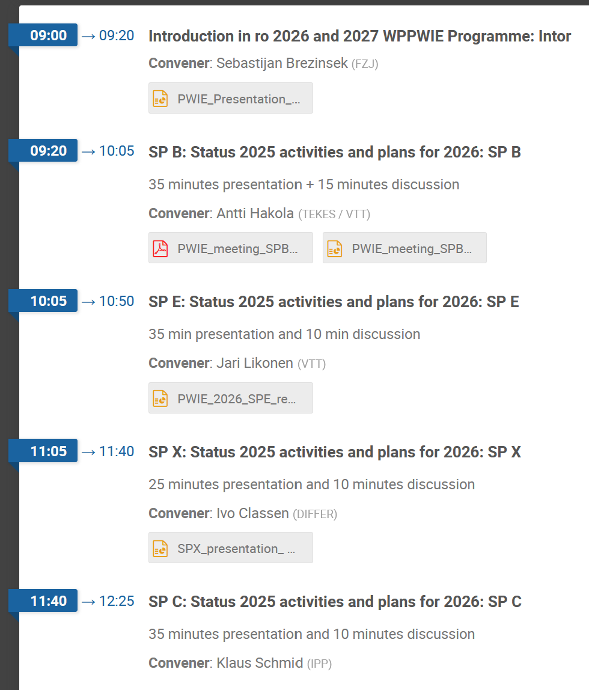
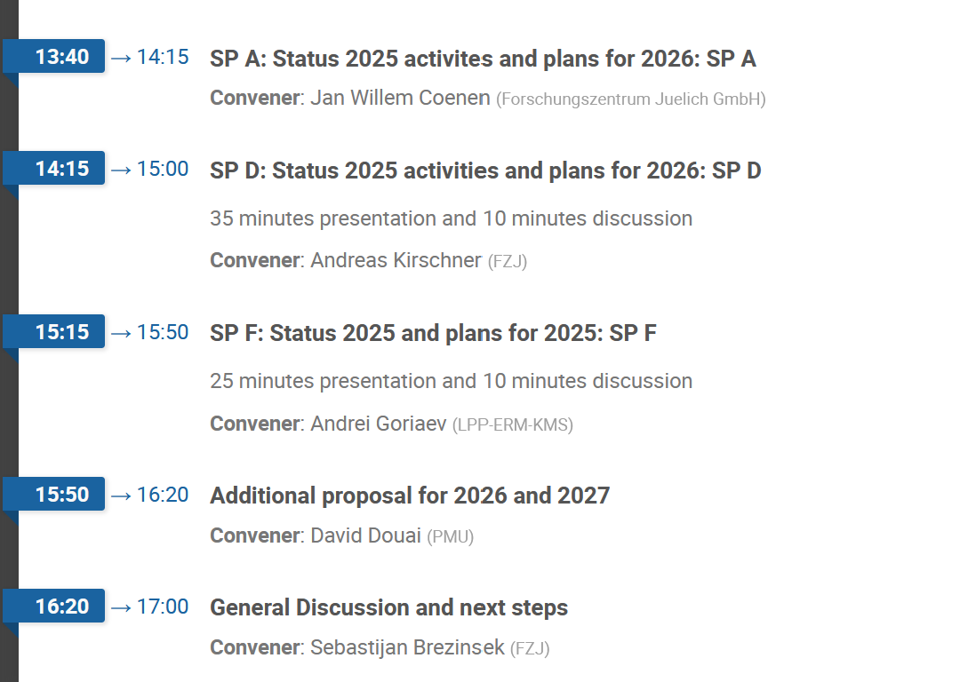
Agenda

Slide 16
Next steps: 2026 activities
Activity sheets for each subproject activity in final iteration
Upload to IDM into WPPWIE area for ACPs and SCPs as PMP_ANNEX2
PMP will be updated with integral information in the next weeks and uploaded by EASTER
Upload of Tasks, Deliverables and

Slide 17
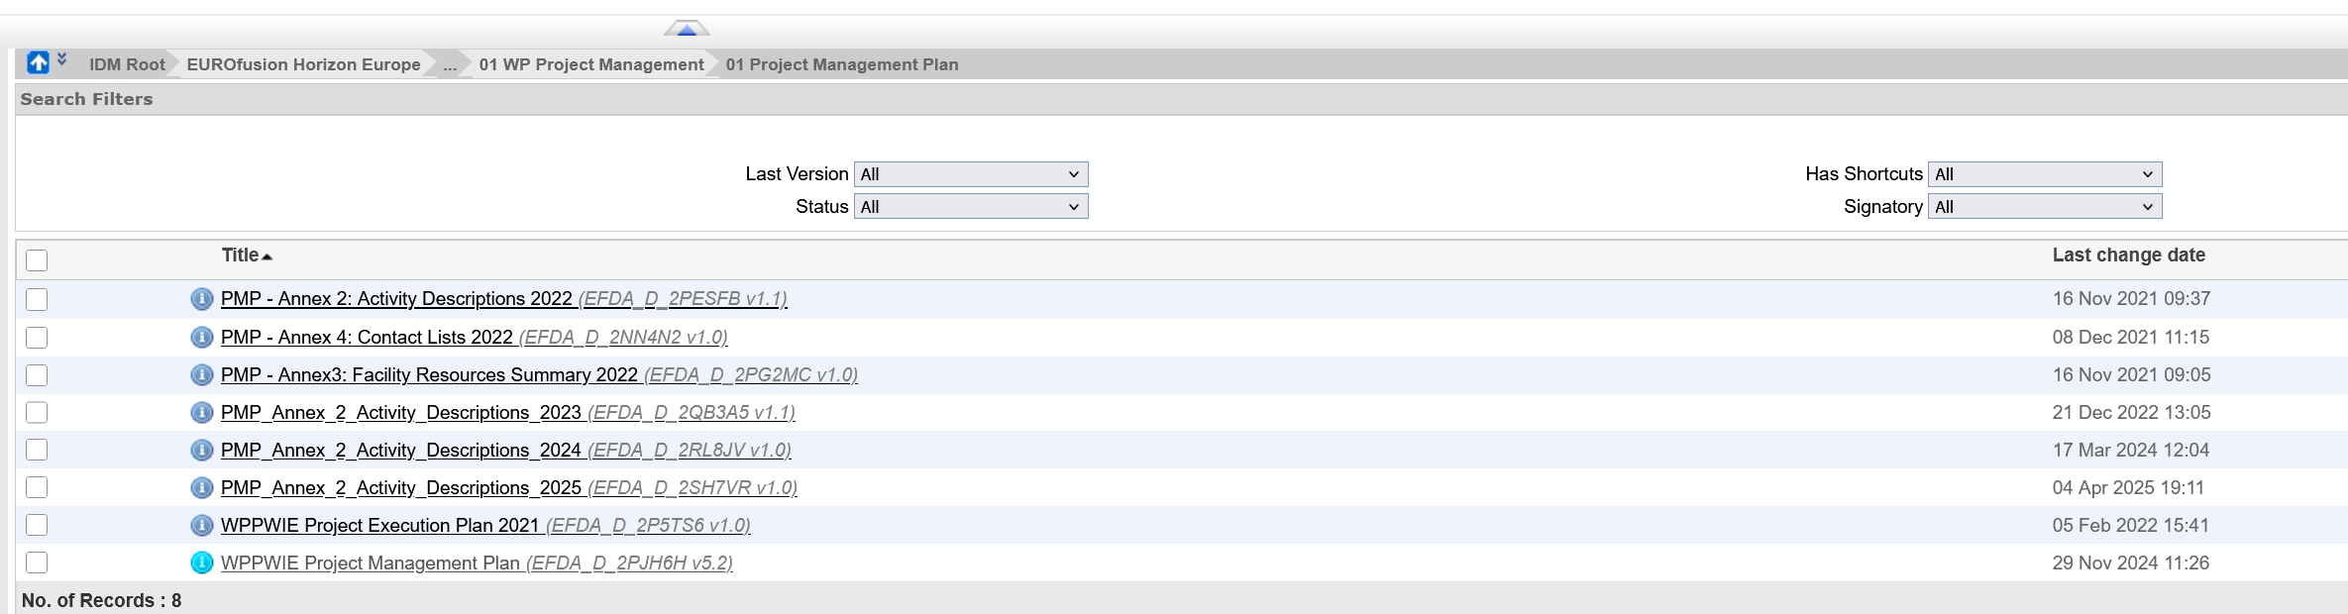
Next steps: 2026 activities info in IDM
Activity sheets for each subproject activity in final iteration
Upload to IDM into WPPWIE area for ACPs and SCPs as PMP_ANNEX2
PMP will be updated with integral information in the next weeks and uploaded by EASTER
Update of Contact List from RUs required! Current list from 2022 outdated.
List organized by PMU is on level of SCP and ACP provided January 2026, but some complaints when inviting
SCP and ACP to this meeting (large RUs with multiple partners)

Slide 18
Next steps: 2026 activities info in IMS
Same procedure as in previous years
Content of activity sheets for each subproject activity will be transferred into IMS
Tasks and Deliverables will be transferred into IMS
Deliverable Owner AND Scientific Contact Person of each participating RU must recommend
We hope to have all SP activities implemented next week and completed with all signature in two weeks
If you have questions or comments, please send it to me, David,
and the corresponding SPL as soon as possible.

Slide 20
Next steps

Slide 23
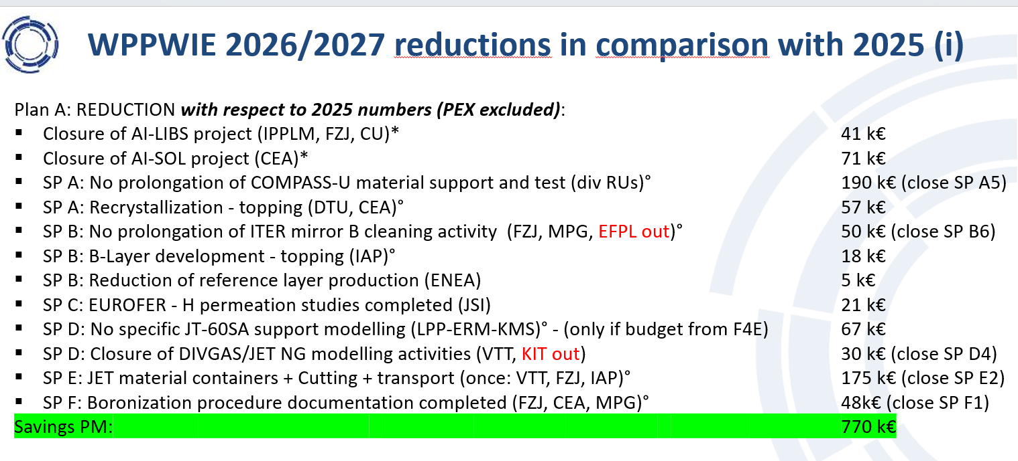
Resources in WPPWIE in AWP 2026-2027
Resources in AWP 2026/2027 for PWIE are reduced by ~40% with respect to the average of 2021-2025
About 33% reduction with respect to 2025 (WPPWIE resource profile and extra tasks in 2024/2025)
Refocus and closure of different activities with extra budget in 2024/2025 for 2026-2027
Remaining reduction by closure/pause of a few physics areas (prioritisation including Program Manager)
Closure or strong reduction of all T-lab studies [risk to lose labs is high]
Closure of dust related studies (tokamak analysis, predictions, modelling) [risk to lose labs is high]
QSPA studies limited [budget to rebuild facilities from other area]

