Slide 1

2025 Final Summary / 2026 Plans Subproject: SP B Experiments on erosion, deposition, and material migration
Project Meeting
Plasma-Wall Interactions and Exhaust
Antti Hakola
VTT
S. Brezinsek (PL), J.W. Coenen, A. Hakola, K. Schmid, A. Kirschner, J. Likonen, I. Classen, A. Goriaev, and D. Douai (DPL)

Slide 2
2025 Final Summary of SP B

Slide 3
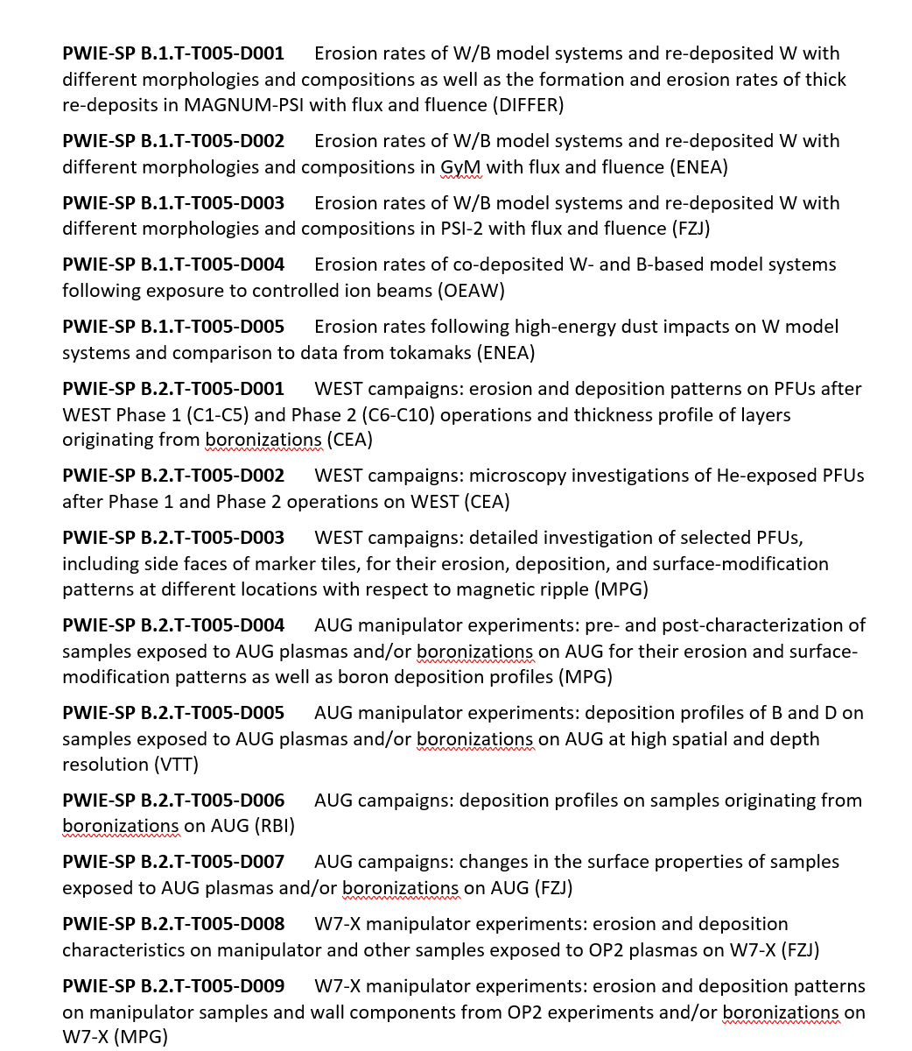
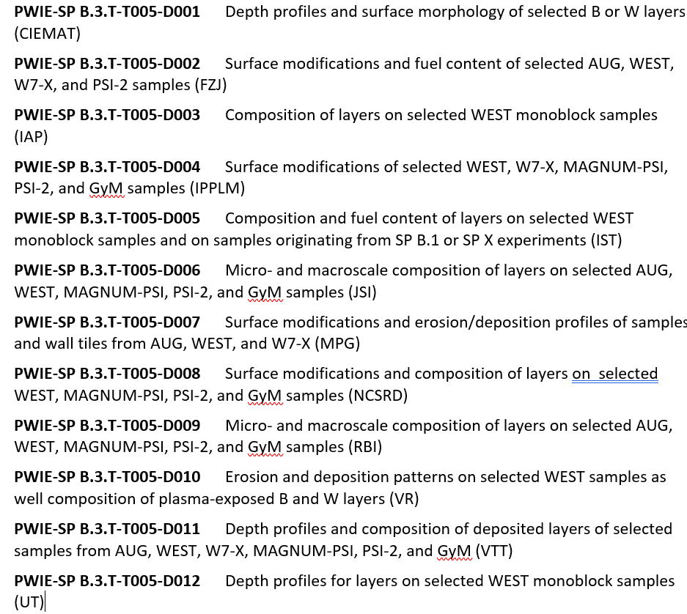
Status 2025 Tasks and Deliverables SP B.1 & SP B.2 & SPB.3
PWIE-SPB.1.T-T005-D005 Erosion rates following high-energy dust impacts on W model systems and comparison to data from tokamaks (ENEA)
All corresponding deliverables achieved and reported
All corresponding deliverables achieved and reported except for the one for RBI (D006, delayed)
All corresponding deliverables achieved and reported except for the one for RBI (D009, delayed)

Slide 4
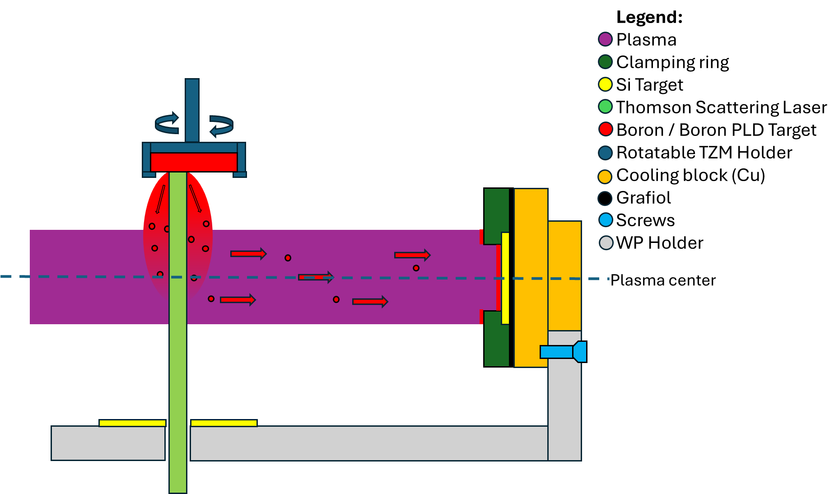
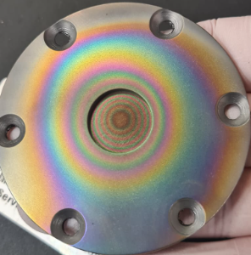
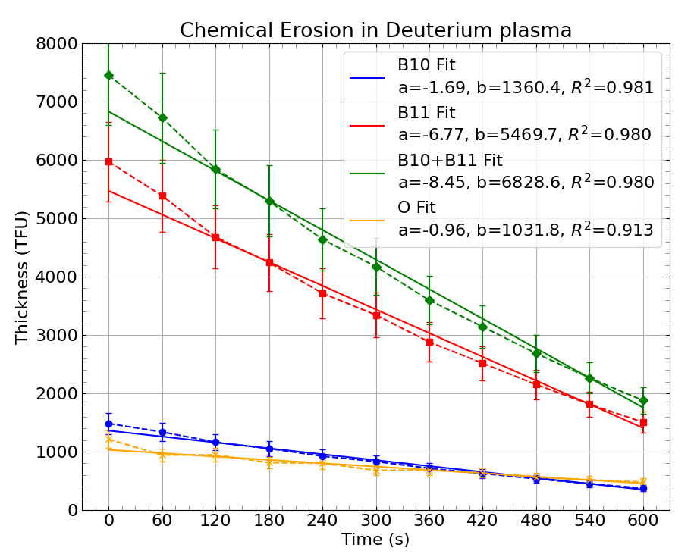
Example of SP B activities SP B.1 - Production and erosion of thick re-deposition layers (DIFFER)
Task and questions to be addressed
Production of thick re-deposited B-containing layers as expected in ITER
Investigate chemical erosion of B
Approach
Use in-house developed plasma-assisted pulsed laser deposition (PLD) to grow thick B layers
Use lab-grown (PoliMo) 1-um thick B layers to study chemical erosion
Results
Using He plasma demonstrated for growing thick (~1 μm) B layers
Studied as a function of the deposition energy, pressure, and B-field
Impurity content ~20% O, some C and N
Chemical erosion dominant at low E_{ion}
Erosion rate for E_{ion} = 5 eV determined as 0.75 nm/s, Y=2.34×10⁻³
Erosion as function of ion energy experiments Nov 2025
Deliverable: PWIE-SP B.B1.T-T005-D001
Status: completed
Facilities: Magnum-PSI 6 days, UPP 3 days (0 granted), Accelerator 13 days
Linked WP or TSVV: SP B.4
T.W. Morgan, J.G.A. van Kesteren, C.J.D. Robben, B. Tyburska-Pueschel

Slide 5
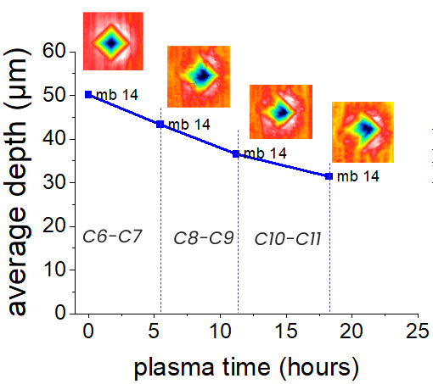
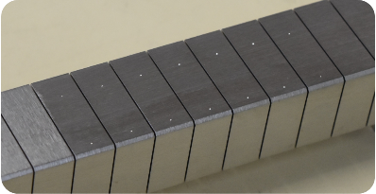
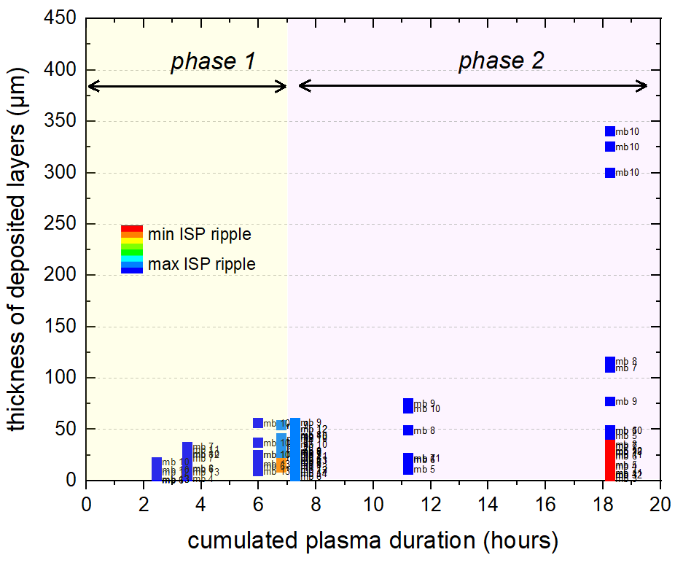
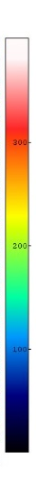
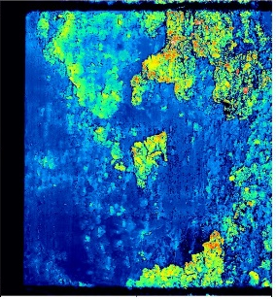
Example of SP B activities SP B.2 - WEST analysis: erosion and deposition patterns on PFUs (CEA)
Task and questions to be addressed
Assess erosion of divertor PFUs phase 2
Approach
Fiducials on the surface of 4 PFUs (CEA)
Measurement of their depth using confocal microscopy – monitoring after each campaign (CEA)
FIB analyses of the fiducials (MPG)
Results
Fiducials clearly modified by plasma (change of depth, change of shape)
Erosion might reach 20 µm at ISP after 18h of plasma
Task and questions to be addressed
Evaluate deposition behaviour on PFUs during phase 2
Approach
Confocal microscopy on PFUs after C9 and C11 to determine thickness of deposited layers
Results
Layers > 100 µm during phase 2
If no cleaning is carried out, layers can even grow up to 350 µm
Deliverable: PWIE-SP B2.T-T005-D001
Status: completed
Facilities: 20 k€ consumables
Linked WP or TSVV: WPTE
M. Diez et al.

Slide 6
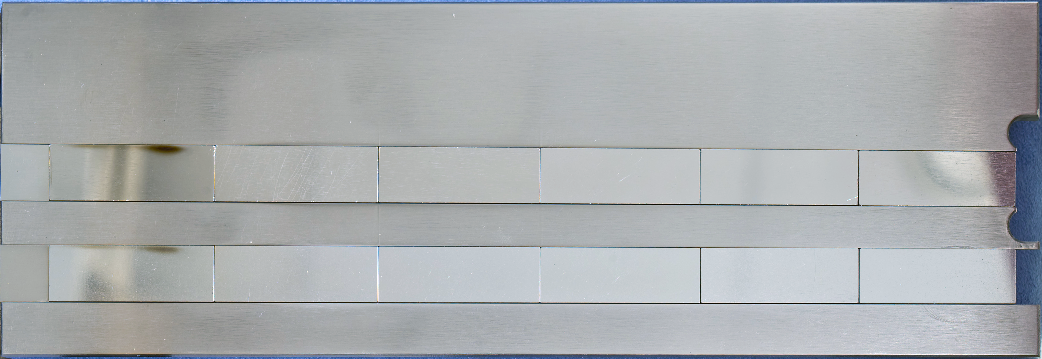
Example of SP B activities SP B.2 - Changes in the surface properties of samples exposed on AUG (FZJ)
Task and questions to be addressed
Analysis of W and Mo samples exposed in AUG to L-mode and H-mode plasmas with Ne seeding
Approach
Set of samples were pre-characterized and prepared for the AUG exposure (FIB cross-sections for erosion/deposition studies)
After AUG exposures samples were characterized by means of electron microscopy techniques
Results
Low erosion spotted for Mo samples exposed to H-mode AUG plasma (at most 50 nm).
Erosion below 50 nm of W samples exposed to H-mode AUG plasmas
No visible erosion of both Mo and W exposed to L-mode AUG plasmas
before
after
W
Mo
50 nm
W
Mo
Deliverable: PWIE-SP B.B2.T-T005-D007
Status: completed
Facilities: -
Linked WP or TSVV: WPTE
x
x
H-mode
M. Rasinski

Slide 7
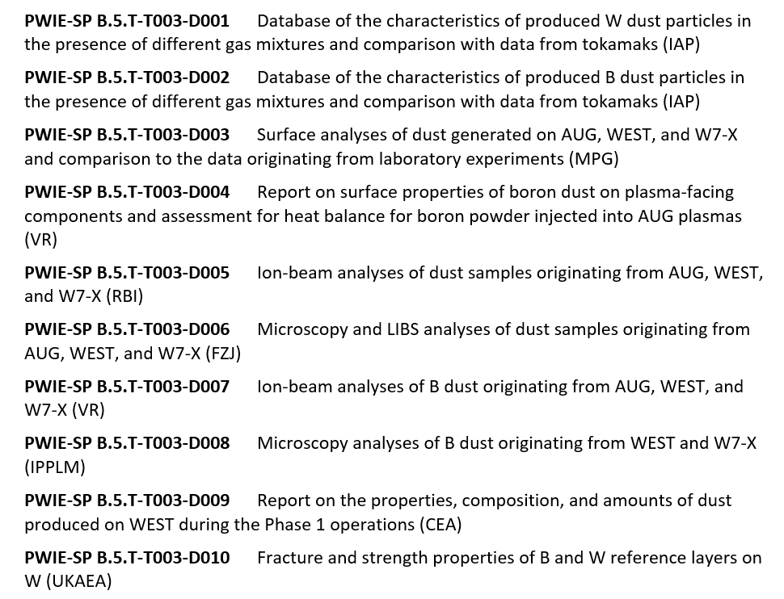
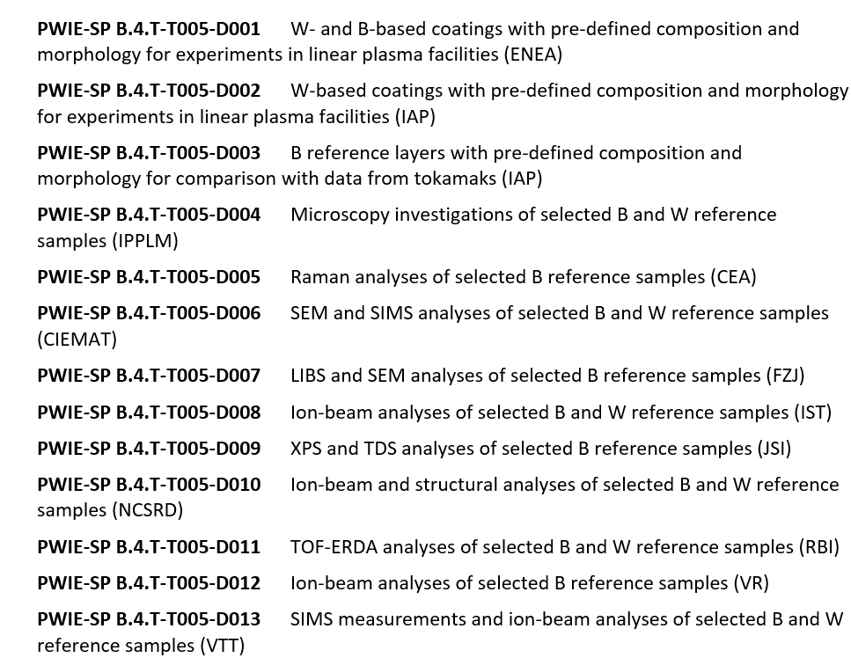
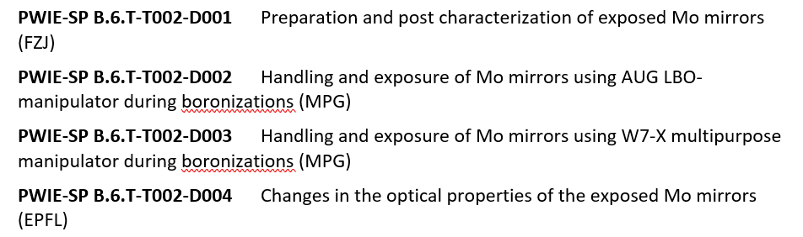
Status of 2025 Tasks and Deliverables SP B.4 & SP B.5 & SP B.6
All corresponding deliverables achieved and reported
All corresponding deliverables achieved and reported
All corresponding deliverables achieved and reported
including PWIE-SP B6.T-T002-D004

Slide 8
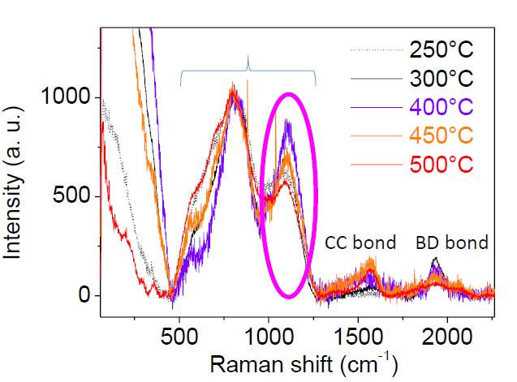
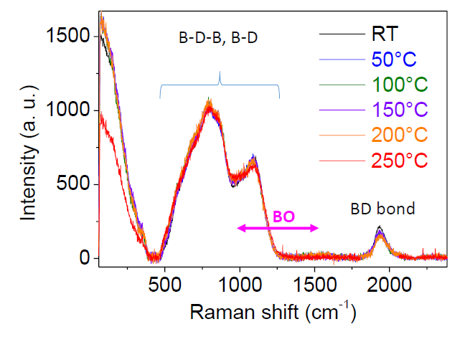
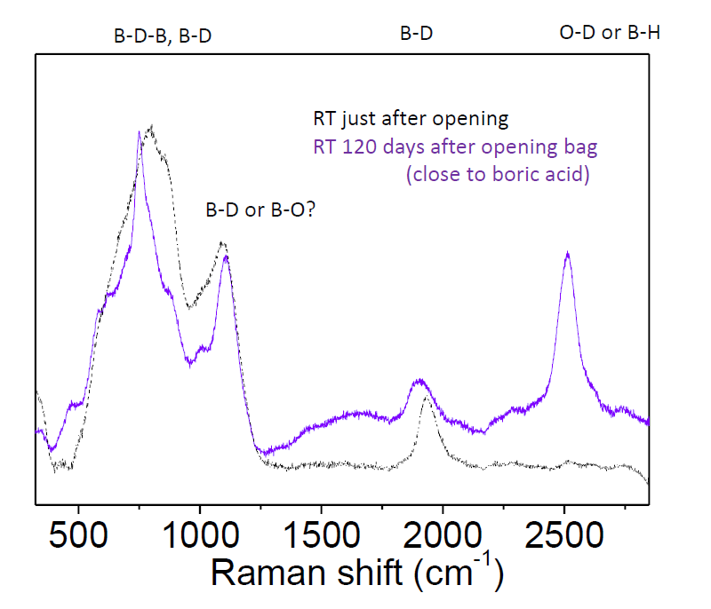
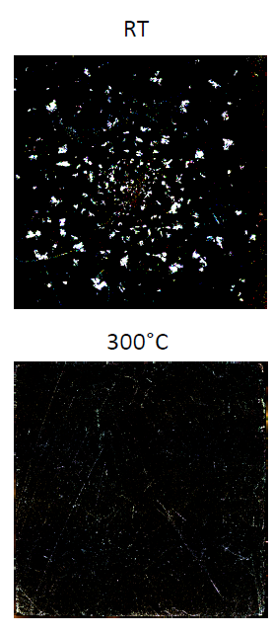
Example of SP B activities SP B.4 - Raman analyses of different B reference layers (CEA)
This task covers Raman measurements for B layers provided by IAP, ENEA, and VR (supplemented by optical microscopy)
Results
B layers annealed at different temperatures (IAP)
White crystals found when T_{ann} < 200°C upon exposure to air → appear to be B(OH)₃
Outside of the crystals: boron structure remains stable when T_{ann} < 250°C but evolves above 250°C → due to contamination? Due to oxidization?
Outside of the crystals: strong changes in spectrum after exposure to air → formation of BO or BH compounds?
Thin B layers (100 nm) (ENEA and VR) show a-B-like spectra but are generally thin and require further investigations
Examples of white crystals (RT) and more homogeneous surface (300°C) of the B+D₂(10%) , samples from IAP
Deliverable: PWIE-SP B.B4.T-T005-D004
Status: completed
Facilities: -
Linked WP or TSVV: -
C. Pardanaud, C. Martin, G. Giacommetti

Slide 9
Example of SP B activities SP B.6 - Changes in the optical properties of the exposed Mo mirrors (EPFL)
Results
Complete removal of boron films confirmed by XPS after plasma cleaning
Recovery of the reflectivity after plasma cleaning. Diffuse reflectivity increases by a few percent after cleaning
Deliverable: PWIE-SP B.6.T-T002-D004
Status: completed
Facilities: -
Linked WP or TSVV: WPTE, WPW7X
L. Marot

Slide 10
2026 Plans of SP B

Slide 11
PWIE Structure in 2026 and 2027
Project Leader: S. Brezinsek
Deputy Leader: D. Douai
PSO: D. Alyassin / NN
Project | Titel | Leader
SP A | Particle and heat load studies in preparation of the exploitation of ITER and a fusion power plant | J.W. Coenen
SP B | Experiments on erosion, deposition, and material migration | A. Hakola
SP C | Fuel retention and release | K. Schmid
SP D | Plasma-edge and plasma-wall interaction modelling | A. Kirschner
SP E | JET post-mortem analysis, LIBS and associated interpretation | J. Likonen
SP F | Wall conditioning and boronization physics | A. Goriaev
SP X | Plasma characterization and laser-based diagnostic development | I. Classen
In general: Tasks and Deliverables are prepared for 2026 and 2027
IMS entry of tasks and deliverables shall be completed by first week of March

Slide 12
2026 Tasks and Deliverables
SP B.1 Determine differences in erosion patterns on re-deposited vs. virgin W and W-B based co-deposits in high-flux and/or high-fluence conditions in linear devices and tokamaks
Deliverable ID | Deliverable Title
D001 | Report on erosion rates for B reference layers on MAGNUM-PSI as a function of their ion energy and temperature (DIFFER)
D002 | Report on erosion rates for selected W and B reference layers on GyM/BiGyM as a function of the sample composition (ENEA)
D003 | Report on erosion and re-deposition rates for selected W and B reference layers on PSI-2 as a function of sample composition (FZJ)
D004 | Preliminary report on effective sputtering yields of 2D/3D microstructures exposed on MAGNUM-PSI (IPP.CR)
D005 | Comparison between erosion rates of selected W and B reference layers in ion-beam exposures at different temperatures (ÖAW)
The work will be based on corresponding activities in 2025 but now the focus will be set on higher fluxes or fluences than was the case in the period 2021-2025 to reach conditions relevant for ITER and pilot plants
In addition, systematic studies on the impact of sample composition, structure, morphology, and surface temperature will be carried out – these were only superficially addressed in 2021-2025
In many deliverables the work in 2026 will be summarized in a preliminary or interim report while the final report with more detailed experimental data and full set of experiments will be provided in 2027

Slide 13
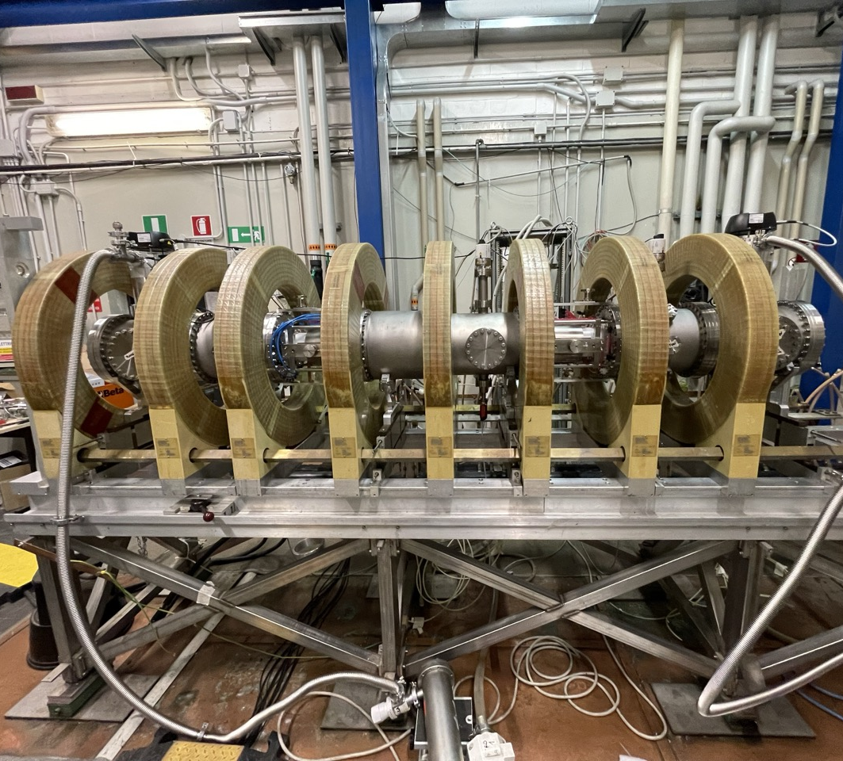
Example of SP B.1 Activities D002: Exposure of W and B reference layers to the upgraded BiGyM device
GyM upgrade – BiGyM Status and Outlook:
Leak tests of the vacuum vessel are ongoing after its rearrangement to accommodate new vacuum sectors for the two 13.56 MHz, 10 kW birdcage helicon antennas
(in collaboration with SPC-EPFL).
First plasma is expected by June 2026, with PMI experiments planned for the second half of 2026
First plasma campaign will focus on characterization of plasma parameters and their spatial profiles using Langmuir probes and optical emission spectroscopy, with particular emphasis on particle flux measurements
First BiGyM PMI experiments on W/B reference layers like those exposed in GyM → in late 2026?
Further BiGyM PMI experiments on W/B reference layers with varying compositions, such as B–O, B–O–N, and B–W → potentially in 2027
New vacuum sectors for the two 13.56 MHz, 10 kW birdcage helicon antennas
ENEA

Slide 14
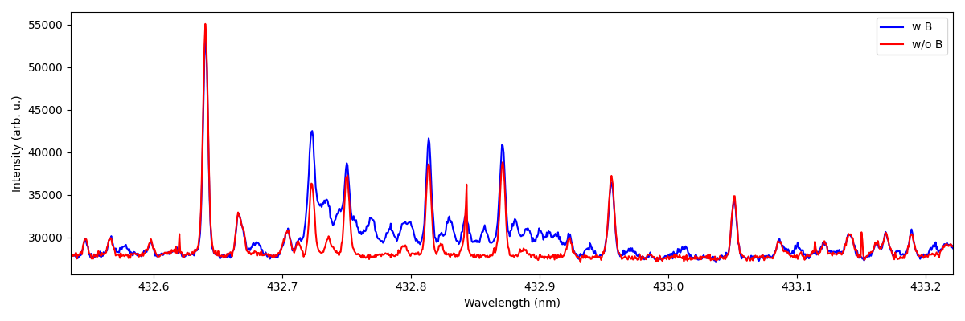
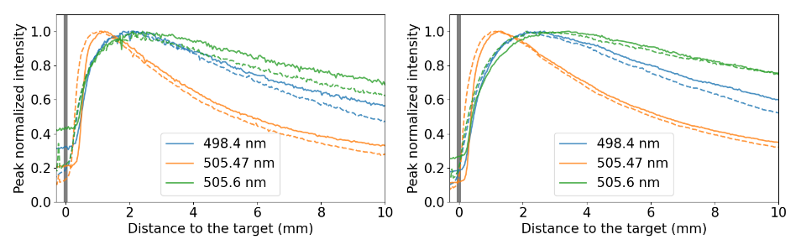
Example of SP B.1 Activities D003: Erosion and re-deposition rates for W and B reference layers on PSI-2
Emission of BD molecules @ PSI-2
High resolution (HRS) and imaging spectroscopy (IS) to be applied for bulk and re-deposited W and B layers on PSI-2
Determining sputtering rates of W+B layers in PSI-2
Analysis of B I and BD lines in UV/VIS at different D fluxes
Discrimination between chemical and physical erosion
Measurements of energy and angular distribution of B I lines
Erosion rates of W in linear cross machine comparison study by impact of different gases such as Ar or Ne
Time-of-Flight Experiments @PSI-2
Sputtering of W(poly) (solid lines) and W(111) (dashed lines) by Ne ions.
Emission of spectral lines from different excited levels will be analyzed
FZJ

Slide 15
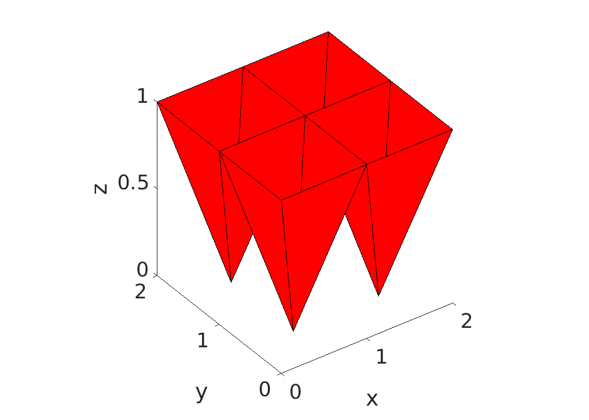
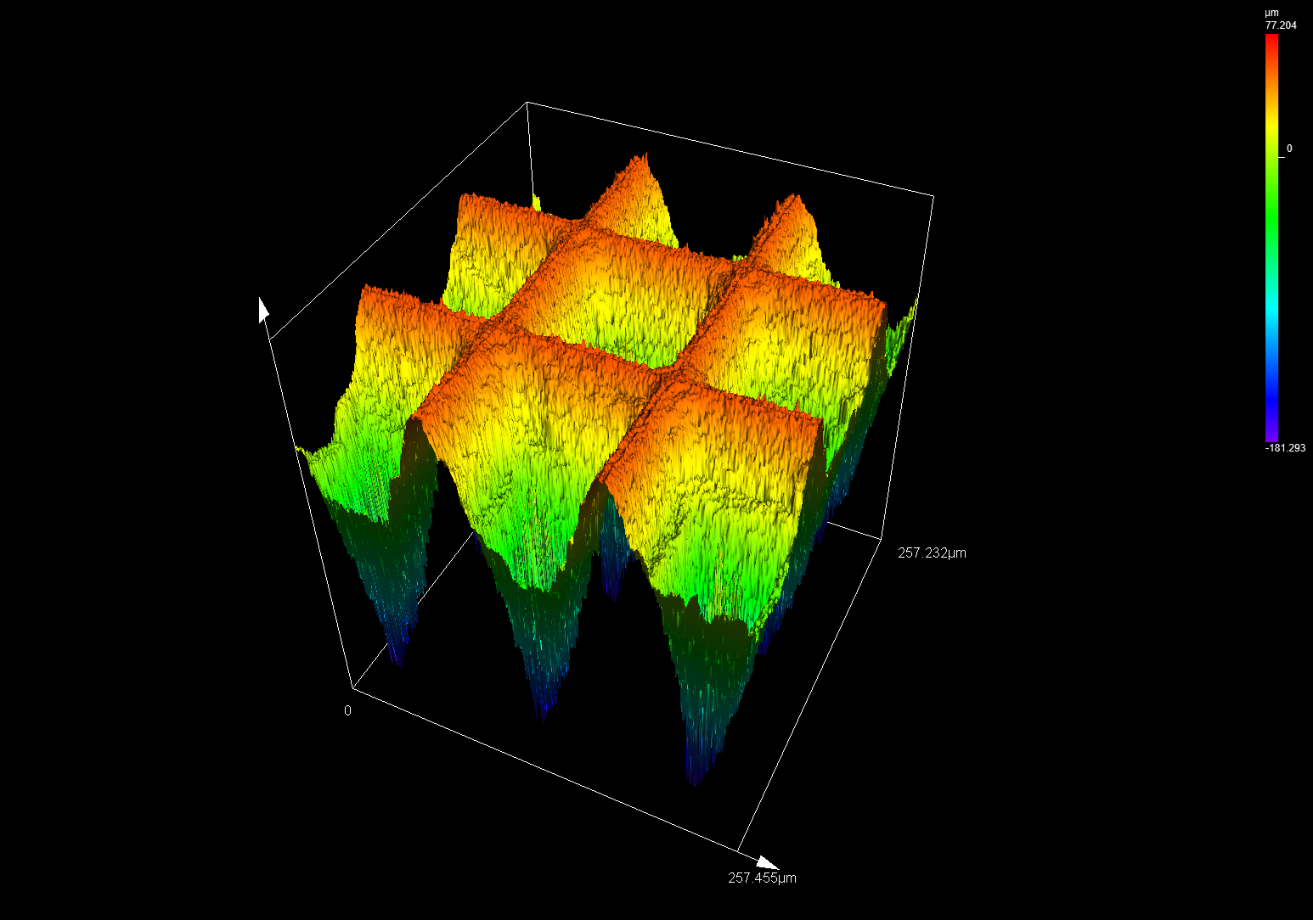
Example of SP B.1 Activities D004: Effective sputtering yields of 2D/3D microstructures exposed on MAGNUM-PSI
Tungsten impurity is a major threat for future reactors – efficient cooler for fusion-relevant plasma core temperatures. It can prevent reaching desired values of Q or e.g. high confinement mode
Sputtering from plasma-wetted areas (e.g. divertor strike points) is often not the main problem - W gets ionized close to the surface and then transported back onto the PFC
Tungsten PFCs with poor contact with plasma (low T_{e}, n_{e}) allow the neutral W to travel far before it gets ionized → can be transported in the confined plasma. This was identified e.g. for JET [Kumpulainen NME 2022], where energetic neutrals originating from CX collisions were a major driver of the tungsten impurity. Simulations for CEFTR also suggest that first wall will be the main source of tungsten [Xu PST 2025]
Most PFCs are currently optimised for power loading – small gaps, bevels etc. However, the components with poor plasma contact may be instead optimized for low sputtering
Recent paper [Eksaeva NME 2019] suggest that rough surface can reduce sputtering by a factor 4-6x!
Idea: let’s manufacture a tungsten surface which would significantly reduce the effective sputtering yield and test it in Magnum PSI
Morphology: array of inverted pyramids 0.1 mm wide and 0.2 mm deep
First samples are expected to be ready for experiments by the end of March 2026
Morphology concept
First sample produced by laser ablation at HiLASE facility
IPP.CR

Slide 16
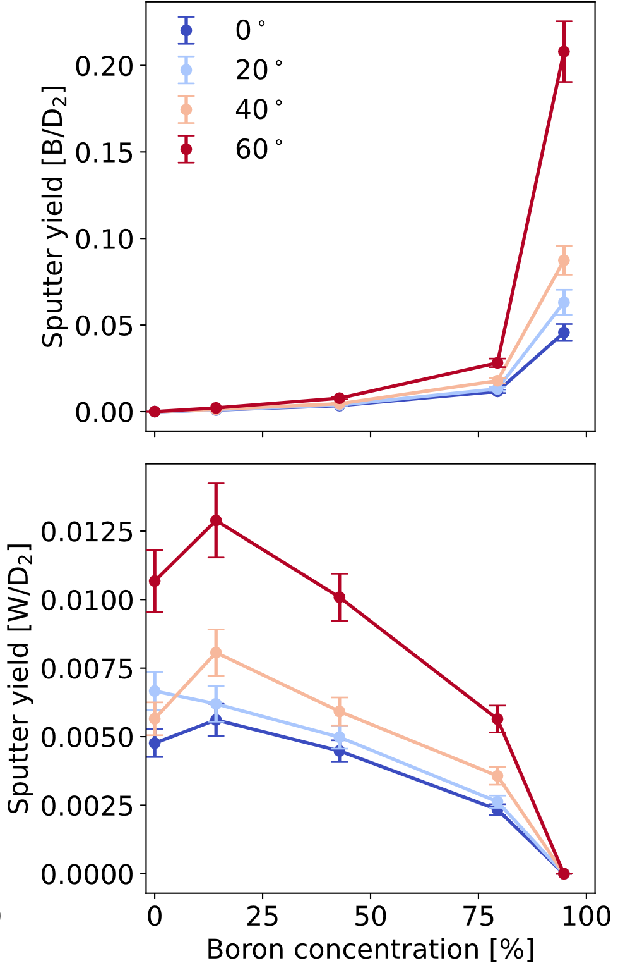
Example of SP B.1 Activities D005: Temperature dependence for sputtering of W and B layers by ion beams
Sputter yields of 2 keV D₂⁺ irradiation on W – B reference layers as a function of boron concentration (preliminary results)
Motivation
Wall conditioning via boronization will lead to locally different wall compositions ranging from W to B, thereby influencing the erosion properties of the first wall.
The determined erosion rates of W and B reference layers measured in 2025 were found to be temperature dependent, especially for 2 keV D₂⁺ irradiation on pure B.
Approach
Utilization of a Quartz Crystal Microbalance (QCM) to perform angle dependent sputter yield measurements of samples with different tungsten-boron mixing ratio under 2 keV Ar⁺ and 2 keV D₂⁺ irradiation at different sample temperatures.
Human Resources (2026)
R. Gurschl, B. Burazor Domazet, M. Fellinger, J. Brötzner, G. Nagy, R.A. Wilhelm, F. Aumayr
ÖAW

Slide 17
2026 Tasks and Deliverables
SP B.2 Characterize samples coming from PWIE experiments (under WPTE) in full-W devices (AUG, WEST): interpret results, assess changes in their surface state, erosion, and deposition patterns on them. Provide benchmarking data for modelling (SP D) and boron studies (SP F)
Deliverable ID | Deliverable Title
D001 | Erosion and deposition patterns extracted for PFUs removed from WEST after C6-C12 campaigns (CEA)
D002 | Interim report on microscopy investigations for various B-containing layers and ITER-like monoblocks removed from WEST after C6-C12 campaigns (CEA)
D003 | Report on the feasibility of applying picosecond and top-hat laser beam profiles for analyses of WEST Phase 2 samples (CU)
D004 | Composition of deposited layers on selected WEST PFUs from Phase 2 operations (IST)
D005 | Interim report on erosion, deposition, and surface-modification patterns on selected WEST Phase 2 samples (MPG)
D006 | Compositional and structural properties of selected samples following boronizations and high-fluence operations on WEST (NCSRD)
D007 | LIBS elemental depth profiles for marker-tile samples from WEST Phase 1 operations (UT)
D008 | Deposition patterns of B, D, and plasma impurities on the surface layers of different PFUs from WEST Phase 2 operations (VR)
D009 | High-resolution depth profiles on WEST PFUs and samples removed after Phase 2 operations during C6-C12 campaigns (VTT)
D010 | Interim report on the erosion properties of probes and marker samples exposed to specific AUG plasmas (FZJ)
D011 | Interim report on erosion and deposition patterns on samples exposed to specific AUG plasmas and boronizations (MPG)
Deliverable ID | Deliverable Title
D012 | Gross and net erosion patterns for marker-samples exposed to specific AUG plasmas (VTT)
D013 | Comparative report on broad-beam and microbeam analyses for detailed elemental composition on selected WEST samples (JSI)
D014 | Interim report on elemental concentrations on the surfaces of marker samples exposed to specific AUG plasmas at high spatial resolution (RBI)
D015 | Erosion and deposition patterns on W7-X samples exposed during specific OP2 experiments (FZJ)
D016 | Interim report of erosion and deposition patterns on W7-X samples exposed during OP2 (MPG)
D017 | Interim report on surface changes on selected W7-X and WEST wall components and samples exposed to boronizations (IPPLM)
D018 | Elemental depth profiles for B-containing samples from GyM/BiGyM experiments (CIEMAT)
D019 | Erosion patterns on specific B- and W-containing samples from MAGNUM-PSI/UPP experiments (DIFFER)
D020 | Interim report on changes in the surfaces of B- and W-containing samples during GyM/BiGyM experiments (ENEA)
D021 | Erosion patterns on specific B- and W-containing samples from PSI-2 experiments (FZJ)

Slide 18
2026 Tasks and Deliverables
SP B.2 Characterize samples coming from PWIE experiments (under WPTE) in full-W devices (AUG, WEST): interpret results, assess changes in their surface state, erosion, and deposition patterns on them. Provide benchmarking data for modelling (SP D) and boron studies (SP F)
SP B.2 is the largest of the three Tasks under SP B, addressing surface analyses of components coming from various experiments in tokamaks/stellarators (AUG, WEST, W7-X) and linear devices (experiments under SP B.1)
Large part of the work will deal with samples from WEST with the focus set on the Phase 2 operations (only started in 2021-2025), in particular to the samples originating from the different high-fluence campaigns (in C7 and C12)
The AUG work will be on detailed surface characterization of exposed marker samples (only erosion was investigated in 2025) and other samples becoming available after the 2025 campaign (incl. boronization samples)
Concerning W7-X, there is an extensive set of tiles + samples removed after the OP 2.3 campaign – all pending for assessing their erosion and deposition patterns and to be compared with the OP 2.1/OP 2.2 data (in 2021-2025)
Analyses of samples from SP B.1 will be a service task feeding back the information to planning additional experiments
Boronization samples will be studied jointly with SP F: under SP B we will concentrate on the co-deposits and aspects related to material migration
All the data can be used as benchmarking cases for SP D activities, up to the point of data validation

Slide 19
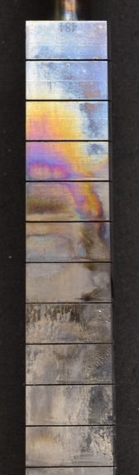
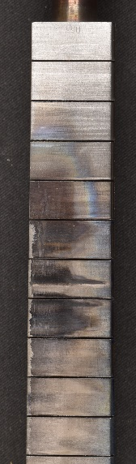
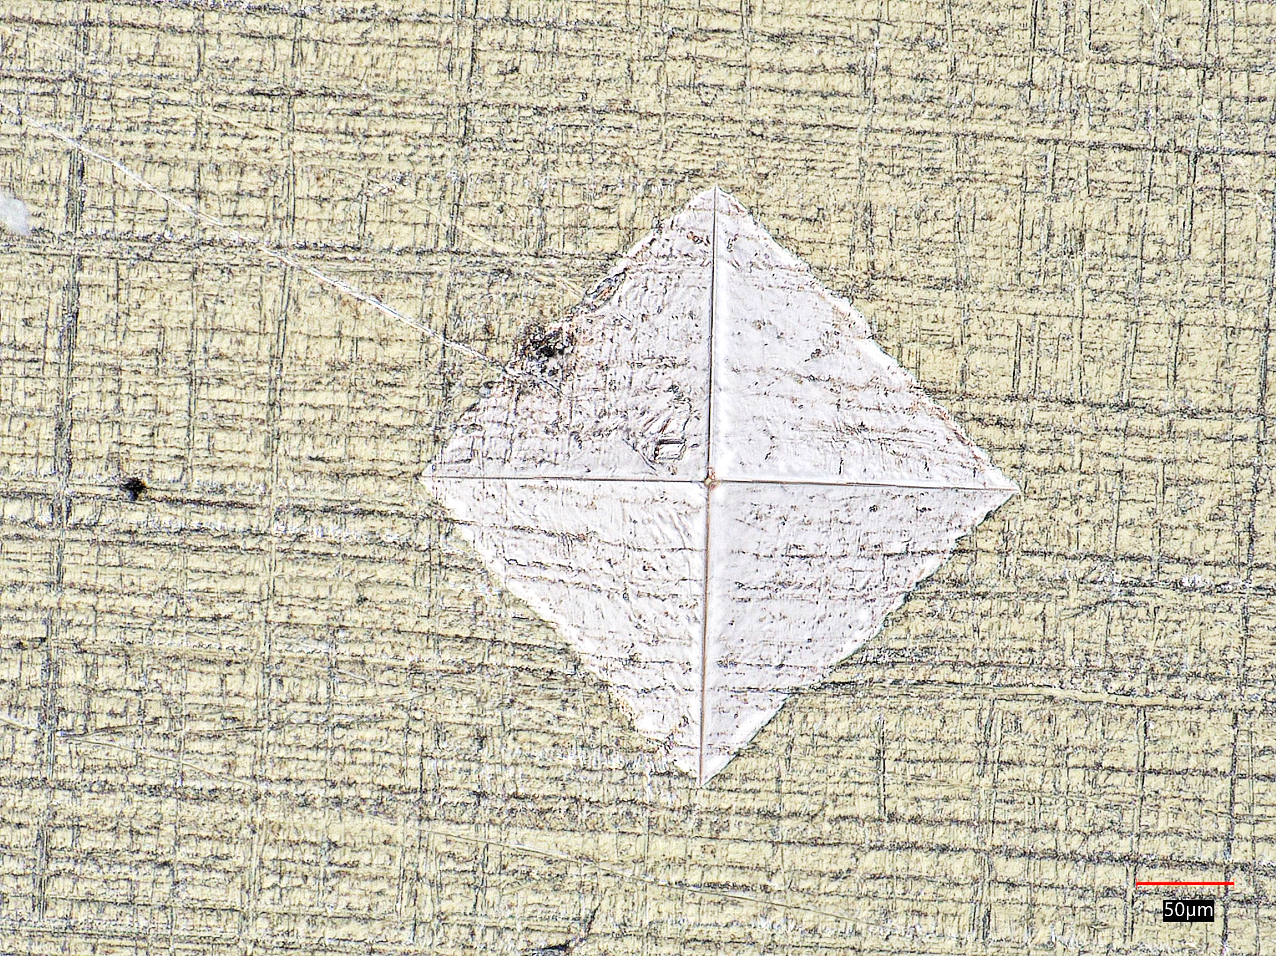
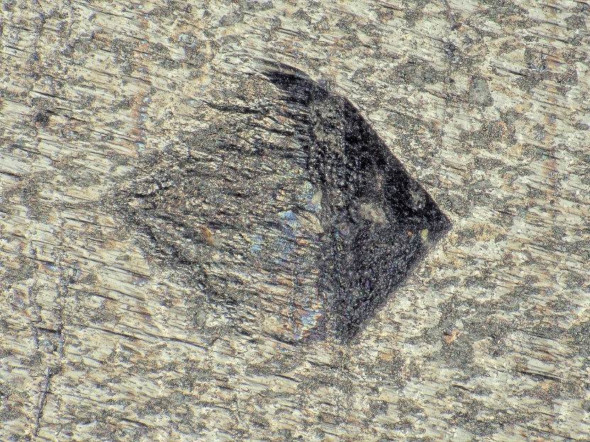
Example of SP B.2 Activities D001: WEST analyses programme for 2026 and beyond
Priority#1 : high fluence campaigns and impact on divertor erosion/redeposition/fuel retention
2 high fluence campaigns in WEST :
C7 (2023) : attached plasma, 3h30 → 1 PFU selected (max outer) for characterization
C12 (2025) : XPR scenario, detached plasma, 4h30 → 1 PFU selected (max outer) for characterization
Priority#2 : evaluation of divertor erosion (5 PFUs with erosion indents)
Continue work on erosion PFU 357 exposed to C6-C9 (SEM, FIB @MPG)
Start characterization on erosion PFU 356 exposed to C6-C12 (confocal @CEA)
Start characterization on erosion PFU 091 exposed to C12 only (confocal @CEA)
Priority#3 (2027)
Evaluate thermal properties of deposited layers (flash method @IUSTI)
Characterization of W emissivity (@IUSTI)
C7
C12
PFU | Cutting | Fuel retention | Fuel retention | Thickness of deposited layers | Thickness of deposited layers | Change of surface morphology | Change of surface morphology | Composition of deposited layers
PFU High fluence C7 | done | IBA@IST | on going | Manual removal of layers + confocal | scheduled in 2026 | Roughness @Aix-Mar Uni. | X | XRF ? LIBS ? XPS ? TOF-SIMS??
PFU High fluence C12 | scheduled for summer 2026 |  | scheduled end of 2026+2027 |  | scheduled in april 2026 |  | on going
Erosion indent before plasma exposure
Erosion indent after plasma exposure
Work in 2026 :
purchase of a new cutting machine (25kEur)
new cutting campaign foreseen in the summer (erosion PFU, high fluence C12 PFU,...)
CEA

Slide 20
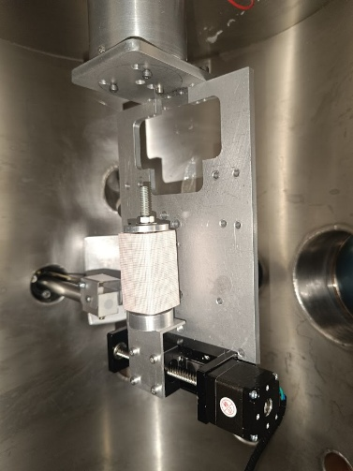
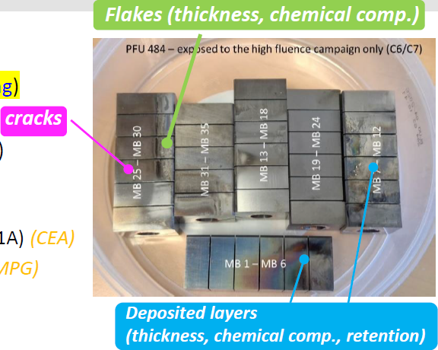
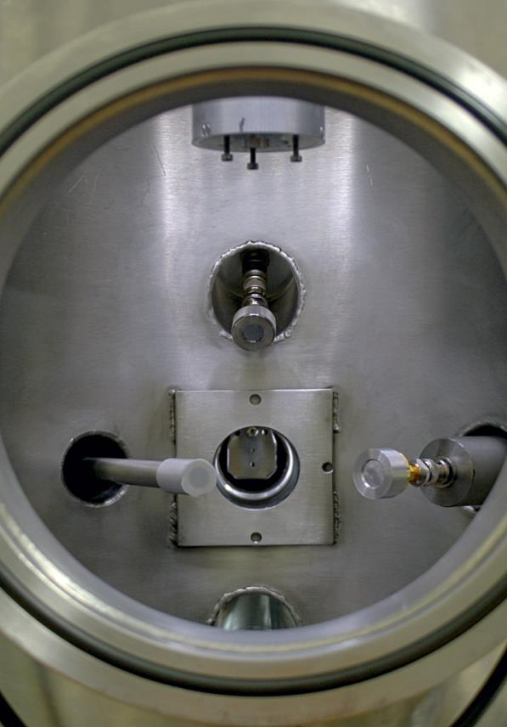

Example of SP B.2 Activities D004: Characterization of WEST PFUs after high-fluence campaigns
PFU 484 – exposed to C6/C7 (prepared for IBA at IST)
Experimental JET chamber
prepared for the analysis:
new horizontal stage (50 mm)
installed and tested
IBA over selected points:
Incident beam of 1 mm diameter
Simultaneous RBS-NRA (³He⁺ beams)
Simultaneous EBS-RBS (¹H⁺ beams)
EBS-RBS
PIXE
NRA
IST

Slide 21
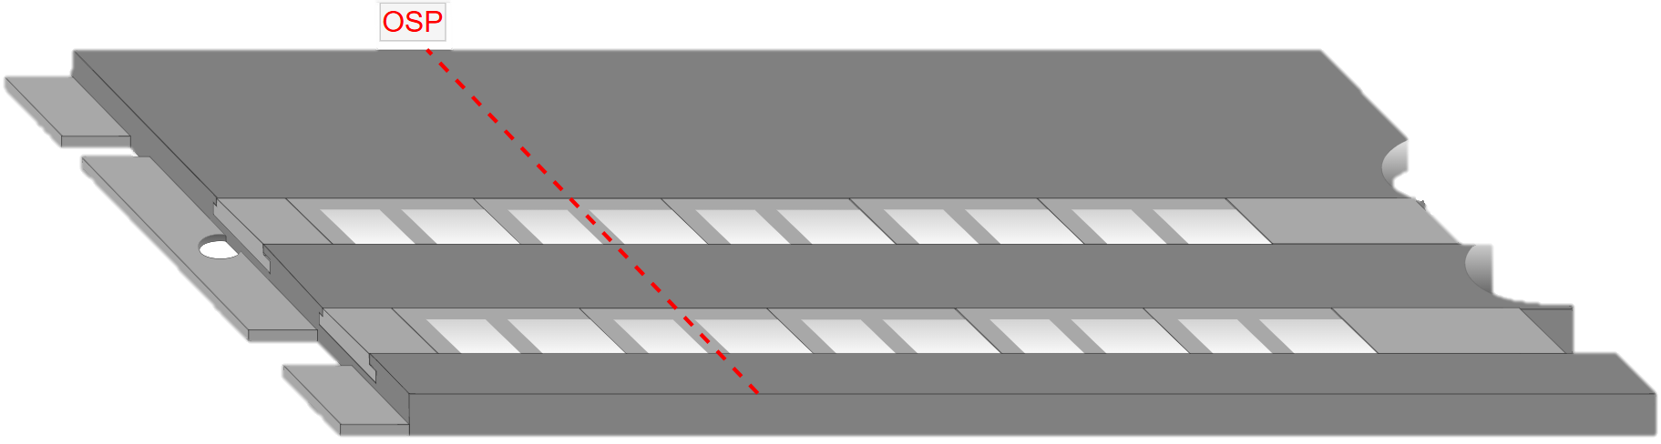
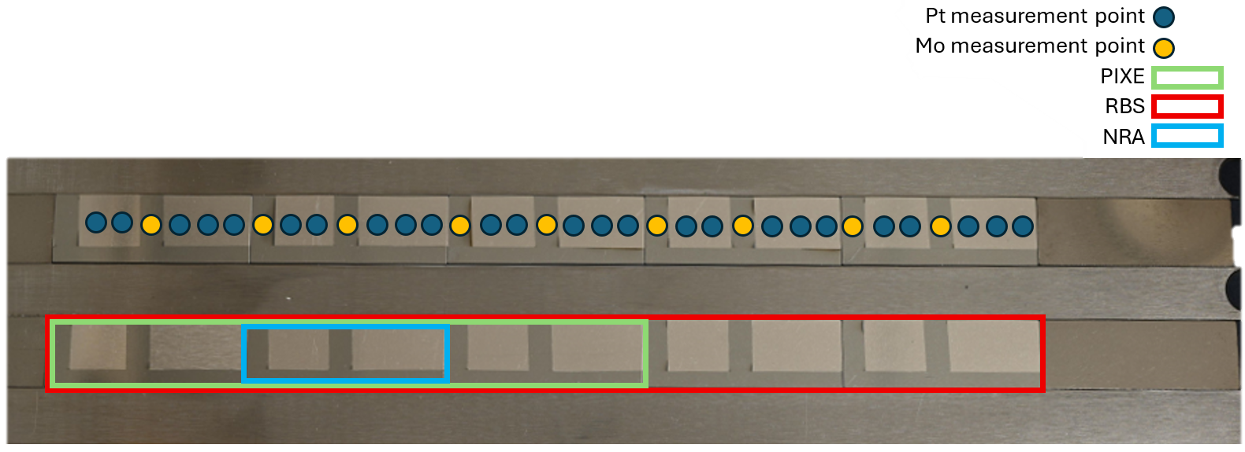
Example of SP B.2 Activities D012: Gross and net erosion patterns for marker-samples exposed to AUG plasmas
Erosion at the outer strike point of AUG studied by using Pt marker layers on Mo substrates as proxies for W
Several ion-beam analyses performed – in 2026 much more in-depth analysis of the samples scheduled including
Analysis of the measured RBS, NRA, and PIXE data (VTT)
Micro-beam measurements for the samples (RBI)
Microscopy measurements on the areas of interest (MPG)
TOF-SIMS measurements for the surface layers (VTT)
W
Pt
Mo
Initial results collected so far
No notable deposition of light elements observed
Small erosion but in line with predicted values
Little W being deposited on areas in between the markers!? → to be confirmed
VTT

Slide 22
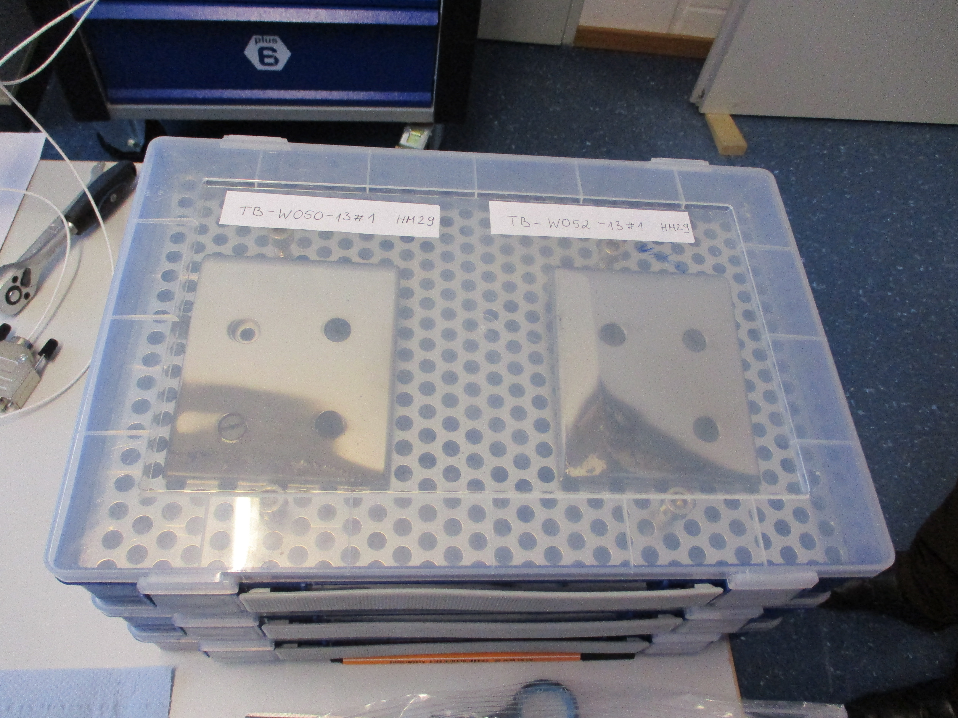
Example of SP B.2 Activities D016: Erosion and deposition patterns on W7-X samples exposed during OP2
Aim: Determine Erosion/deposition areas in W7-X
33 tiles dismounted after OP 2.3 - Inner wall tiles (graphite, W-coated graphite) - Baffle tiles (W, tungsten heavy alloys)
Erosion at inner wall (W-marker layers)
Deposition of boron, carbon at inner wall
Deposition of boron, carbon on baffle tiles
Analysis by ion beam analysis methods → Analysis just started and ongoing → Results will be presented at PSI 05/2026
MPG

Slide 23
Example of SP B.2 Activities D016: Erosion and deposition patterns on W7-X samples exposed during OP2
Charge exchange (CX) fluxes measurements
H⁺ (fast) + H⁰ (slow) → H⁰ (fast) + H⁺ (slow)
1st experimental approach: Collector probes
Implantation of neutrals on suitable materials (amorphous Carbon samples)
Number of implanted neutrals provides the total CX flux
Depth profile of implanted neutrals provides flux energy distribution
High-resolution TOF-ERDA able to provide the required depth resolution
2nd experimental approach: Layered samples
Implantation of neutrals on special multi-layered samples
Barrier layer: Al₂O₃, varying layer thickness allows the determination of the CX flux energy distribution
Diffusion layer: Fe, separation of surface-barrier and getter layer signals
Getter layer: Zr, thickness tens of nm to avoid possible saturation
H. Verbeek et al., Nuclear Fusion 38 (1998) 1789
Gas
W7-X sample Analysis
Slow CX
Exposure of samples to boronization processes and plasma conditions using the multi-purpose manipulator (MPM)
multiple types of material (C, Al, Tungsten alloys, stainless steel,…)
polished and unpolished samples
Fast CX
Barrier
layer
Al₂O₃
Diffusion
layer
Fe
Getter
layer
Zr
Substrate
MPG

Slide 24
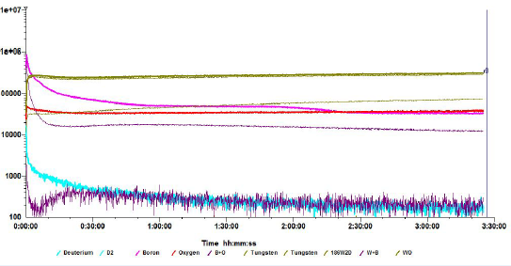
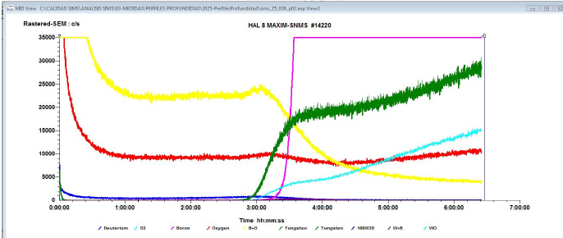
Example of SP B.2 Activities D018: Elemental depth profiles on B samples exposed in GyM
Task and questions to be addressed
Check the layer has the desired composition and properties using SIMS – comparison to VTT results
2025 results summary
Boron signals have a strong matrix behaviour in our SIMS: B+O in pure boron layers, B in B+D films
No effect of air storage: B-related signals were practically the same after 1 or three months.
B+D on W: main signal is B (pink).
Pure B on W: main signal is B-O (yellow).
Pure B discs: main signal is B-O (yellow).
Results need to be put into perspective against new findings and data by other methods!
CIEMAT

Slide 25
2026 Tasks and Deliverables
SP B.3 Provision of reference layers (B layers with D, W+B layers etc.) and compare with layers obtained from tokamak experiments with focus on the composition and structure
Deliverable ID | Deliverable Title
D001 | Characterized W and B reference coatings for laboratory and linear-machine experiments – initial batches (ENEA)
D002 | Characterized B coatings for linear-machine experiments – initial batches (FZJ)
D003 | Characterized W reference coatings for laboratory and linear-machine experiments – initial batches (IAP)
D004 | Characterized B reference coatings for laboratory and linear-machine experiments and for permeation studies – initial batches (IAP)
D005 | Characterized B reference coatings for linear-machine experiments and oxidization studies – initial batches (VR)
D006 | Interim report on the characteristics of different B reference coatings with focus on retention and compositional properties (VTT)
D007 | Interim report on Raman characterization of the produced B and W reference layers with focus on their structural and chemical properties (CEA)
D008 | Interim report on microscopy investigations of the produced W and B reference layers with focus on their surface morphology (IPPLM)
D009 | Interim report on the characteristics of the produced B and W reference layers with focus on their retention and permeation properties (JSI)
D010 | Interim report on the characteristics of the produced B and W reference layers with focus on mechanical and compositional properties (NCSRD)
D011 | Elemental composition for the produced B and W reference layers – interim report (RBI)
In 2026, several W- and B-based reference layers will be produced and characterized for their properties – to be further provided in experiments under SP B.1/SP B.2 as well as SP A, SP C, SP F, and SP X
Different from 2021-2025, the B layers will exhibit more complex compositions (mixed W+B layers, D and seeding impurity inclusions)
Concerning the W layers, the focus will be on layers simulating re-deposits – in 2021-2025, virgin W coatings as well as W co-deposits were produced

Slide 26
Example of SP B.3 Activities D001: Production of B and W reference layers for SP B.1 experiments
Production plan for 2026:
Compact B, B-O, B-O-N and B-W coatings produced via nanosecond Pulsed Laser Deposition (PLD), from 100 nm/s to µm/s
Thin compact B produced by RF-MS
Porous B and B-W coatings ranging from rough to dusty with thicknesses from 100s nm to several µm/s via femtosecond Pulsed Laser Deposition
Possibility to grow multilayer systems
Different kinds of W (Nanocolumnar W, compact W and porous W-O) to support LIBS studies (SP X)
Boron coatings can be used in LPDs to study erosion yield as a function of morphology, porosity and composition. There is also the interest in thick B coatings for permeation studies (JSI)
800 nm
500 nm
Example of a boron coating
ENEA

Slide 27
Example of SP B.3 Activities D003: Production of W reference layers by different methods
Production of W coatings (5 µm) on Mo substrate for experiments in linear plasma facilities
Use of different deposition methods (DC magnetron sputtering DCMS, HiPIMS, CMSII etc) at different deposition parameters to produce W coatings
Preliminary experiments showed a different crystallographic structure for coatings deposited by different deposition methods
What we know by now:
CMSII coatings: strong reflection along (211) direction of the W phase
DCMS coatings: strong reflection along (211) direction of the W phase
HiPIMS coatings: strong reflection along (110) direction of the W phase
XRD pattern for W coating deposited by CMSII
XRD pattern for W coating deposited by DCMS
XRD pattern for W coating deposited by HiPIMS
Possible retention capabilities or other properties are influenced by crystallographic orientation?
IAP

Slide 28
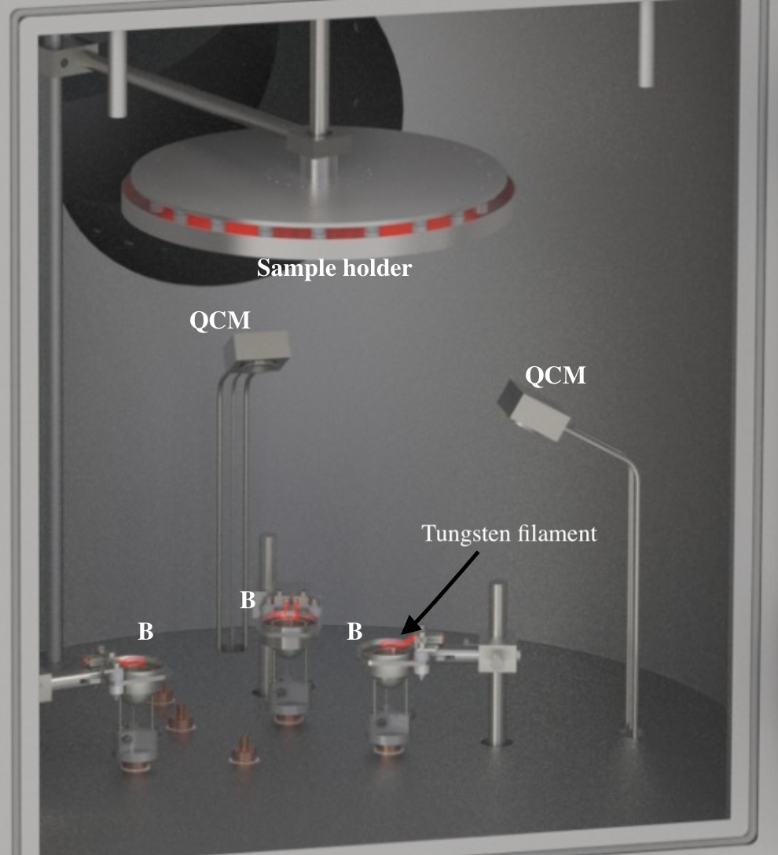
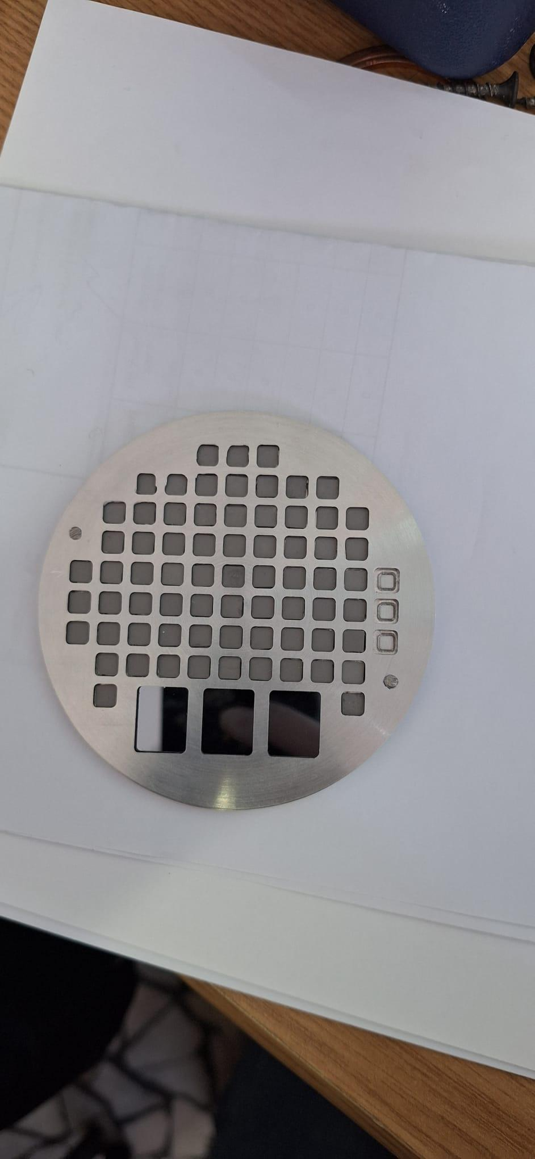
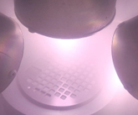
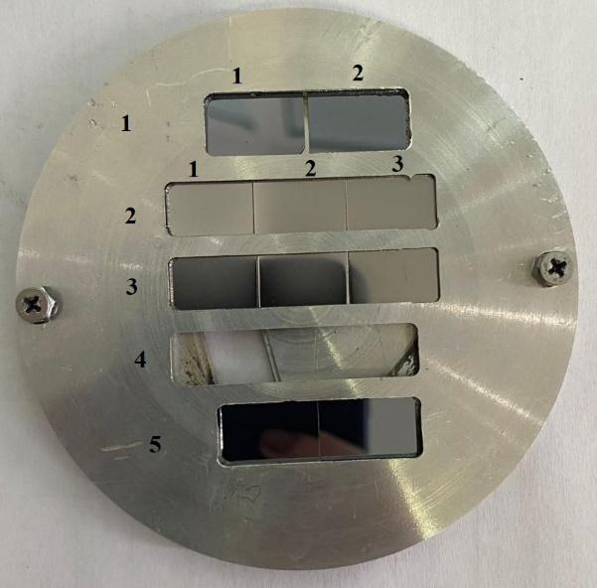
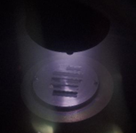
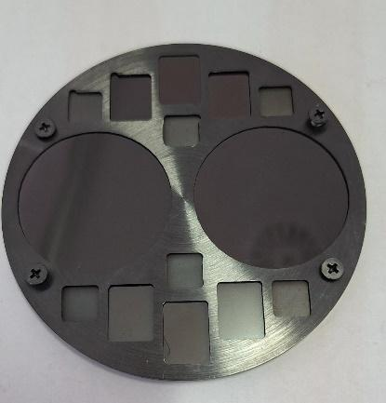
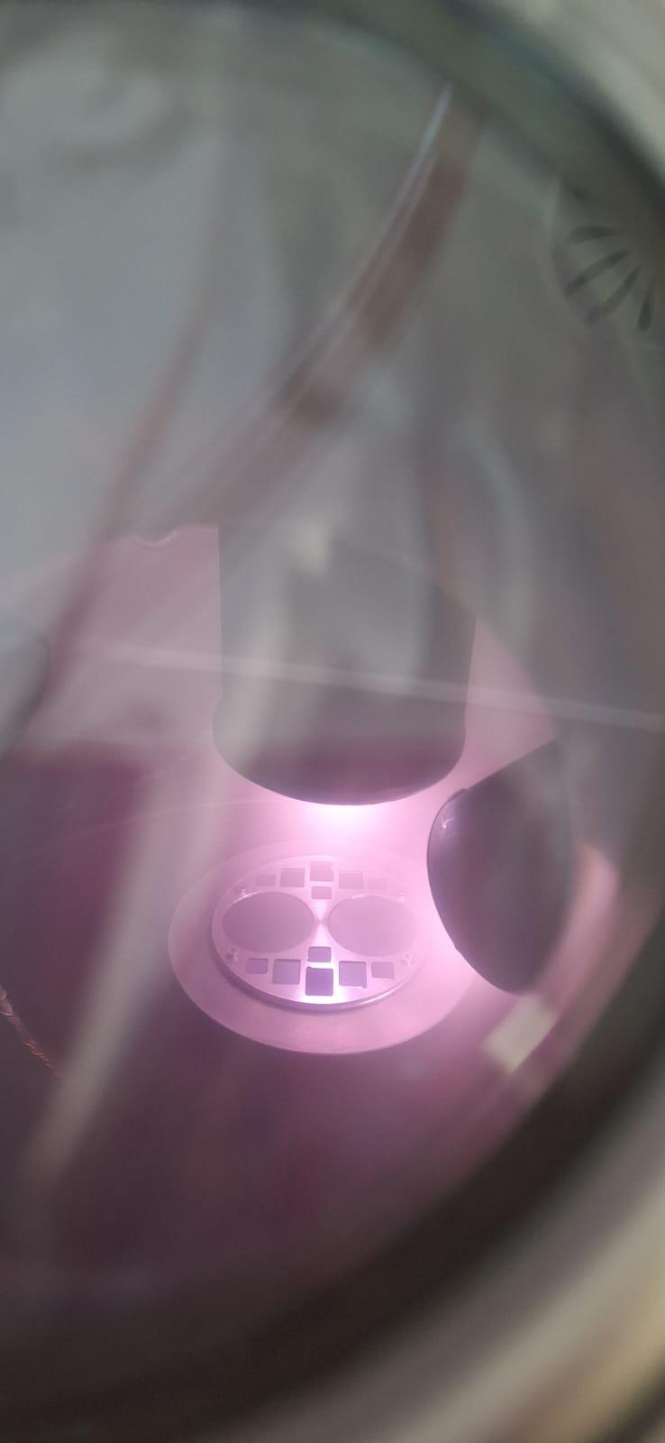
Example of SP B.3 Activities D004: Production of B reference layers and multilayer coatings
Coatings to be produced for SP B.1 and SP X:
Deposition of B (5 µm) on Mo - study the impact of roughness on erosion characteristics and LIBS spectra
Coatings to be produced for SP C (permeation studies):
Up to 5 μm B layers (pure and with D) on Eurofer and W (and Si) → V. Nemanic @JSI
Experiments agreed with colleagues under SP B:
B coatings with D inclusions (10 at.%) and annealed at 50–500°C → C. Pardanaud @CEA
Oxidation under controlled thermal conditions for B layers on W → R. Mateus @IST
Vary O₂ partial pressure (10⁻²-10 mbar), surface T (100-1000 °C), and D ion energy (40-200 eV)
Micromechanical studies on W-B layers with and without D → Y. Zayachuk @UKAEA
LIA-LIBS-QMS and detection and separation of H isotopes in B-D samples using laser ablation and MW-plasma, collaboration with Institute of Physics Belgrad [1]
Other samples to be discussed later in 2026
[1] Vujadinović, N. et. al, Detection of hydrogen isotopes in fusion-relevant targets using laser ablation and microwave-induced plasma. Eur. Phys. J. Plus 141, 157 (2026). https://doi.org/10.1140/epjp/s13360-026-07406-0
IAP

Slide 29
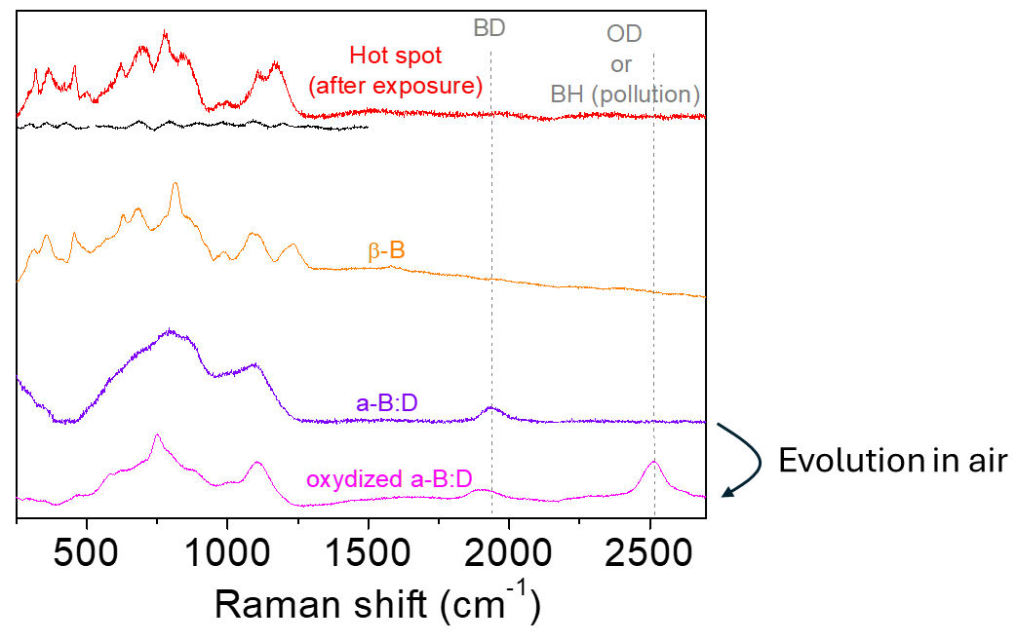
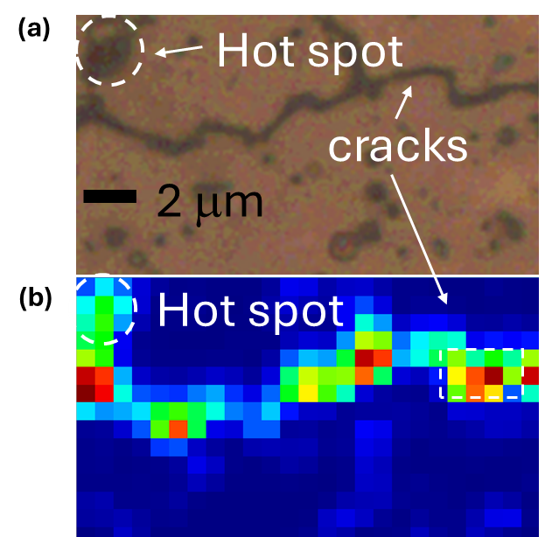
Example of SP B.3 Activities D007: Formation of B compounds in different reference samples
Raman analyses to be performed for as-produced B reference samples as well as following their exposure to GyM/BiGyM plasmas
Main results so far
Non exposed samples: amorphous boron
Exposed samples: amorphous + presence of hot spots (<10%) and no BD chemical bonds
Exposed samples: no BD chemical bonds observed
Hotspots crystalline in boron beta-phase
Plans for 2026
Study the origin for the formation of the crystalline phase in hotspots
Detailed investigations of the Raman spectra to control oxidation of H/D-containing B samples produced at different temperatures
Disentangle structural and chemical influence on local organization and oxidation of B samples
CEA

Slide 30
Concluding remarks
SP B will continue with 3 different activity areas during the period 2026-2027:
SP B.1: Erosion and re-deposition experiments in linear plasma devices and laboratory conditions
SP B.2: Surface analyses of samples from tokamaks/stellarators and linear plasma devices and identifying material migration pathways in W machines
SP B.3: Production of B and W reference layers
SP B.1 will put the focus on higher fluxes and fluences and broader varying of sample and exposure parameters than in 2021-2025
In SP B.2, concentrate on the outcomes of high-fluence campaigns on WEST, detailed characterization of samples originating from specific AUG experiments, and studying B-based co-deposits from AUG, WEST, and W7-X
SP B.3 will produce B samples resembling co-deposits and W samples simulating re-deposits together with reference layers for dedicated experiments

