Slide 1

2025 Final Summary / 2026 Plans
Subproject: SP X
Project Meeting
Plasma-Wall Interactions and Exhaust
Ivo Classen
DIFFER
S. Brezinsek (PL), J.W. Coenen, A. Hakola, K. Schmid, A. Kirschner, J. Likonen, I. Classen, A. Goriaev, and D. Douai (DPL)

Slide 2
2025 Final Summary of SP X
In 2025 SP X consisted of 2 parts:
SP X.1: Atomic and molecular processes in attached/detached plasmas
SP X.2: Optimization of laser-based surface analysis diagnostics

Slide 3
Status 2025 Tasks and Deliverables SP X.1
PWIE-SP X.1.T-T005-D001 CARS results in Magnum-PSI. Flow velocity measurements with CIS and multispectral imaging using MANTIS on Magnum-PSI/UPP. (DIFFER)
PWIE-SP X.1.T-T005-D002 VIS/VUV molecular and atomic spectroscopy on H and D in PSI-2. Comparison of MANTIS to hyperspectral camera in UPP. (FZJ)
PWIE-SP X.1.T-T005-D003 VUV OES measurements in MAGNUM-PSI/UPP with focus on H/H2 (CU)
PWIE-SP X.1.T-T005-D004 Interpretation spectroscopy results using spectra simulation and (CR) modelling with YACORA and development VUV-OES (MPG)
All corresponding deliverables achieved and reported

Slide 4



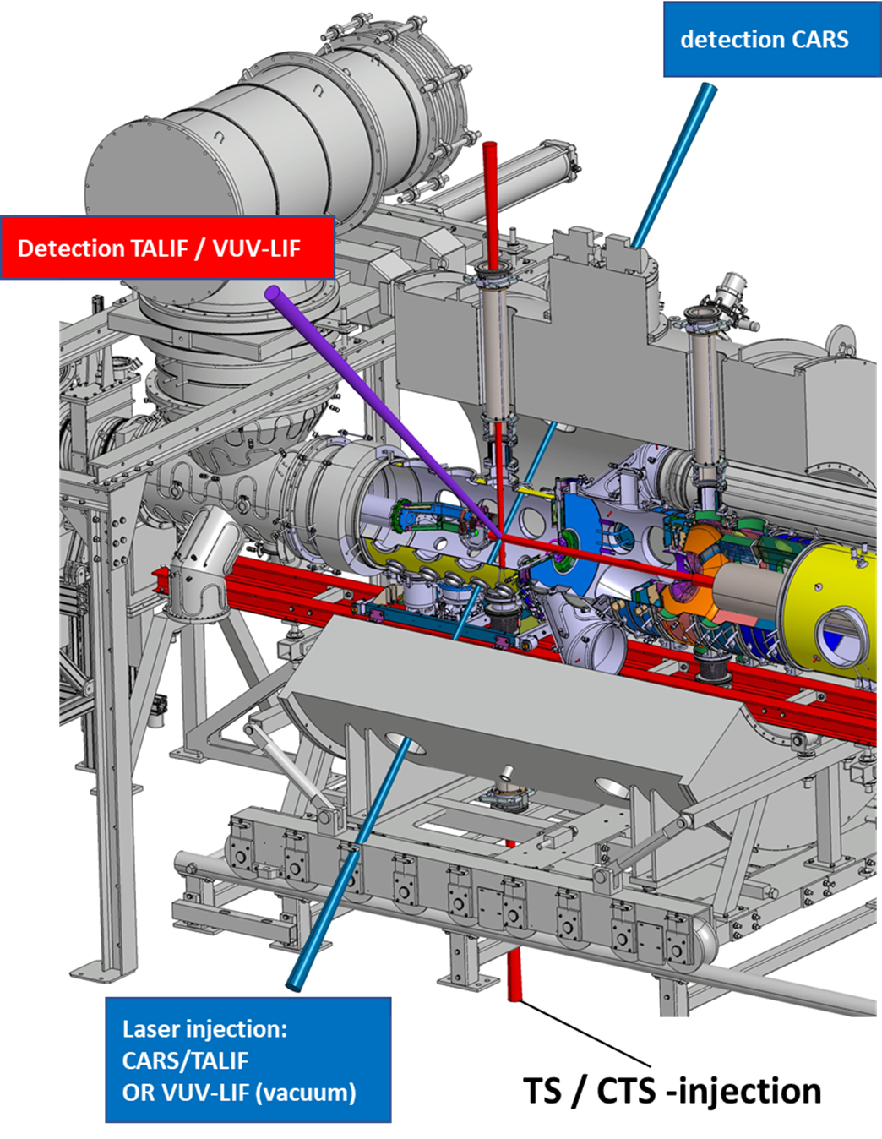
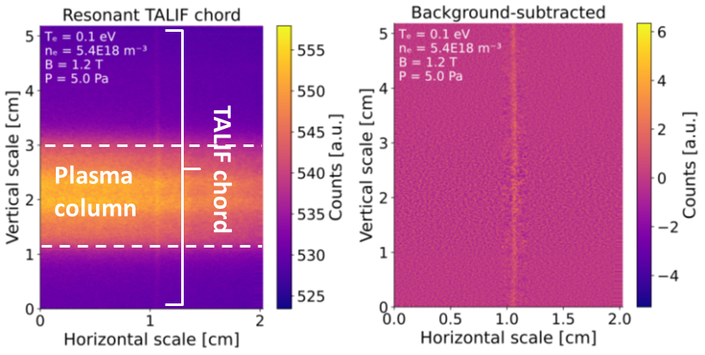
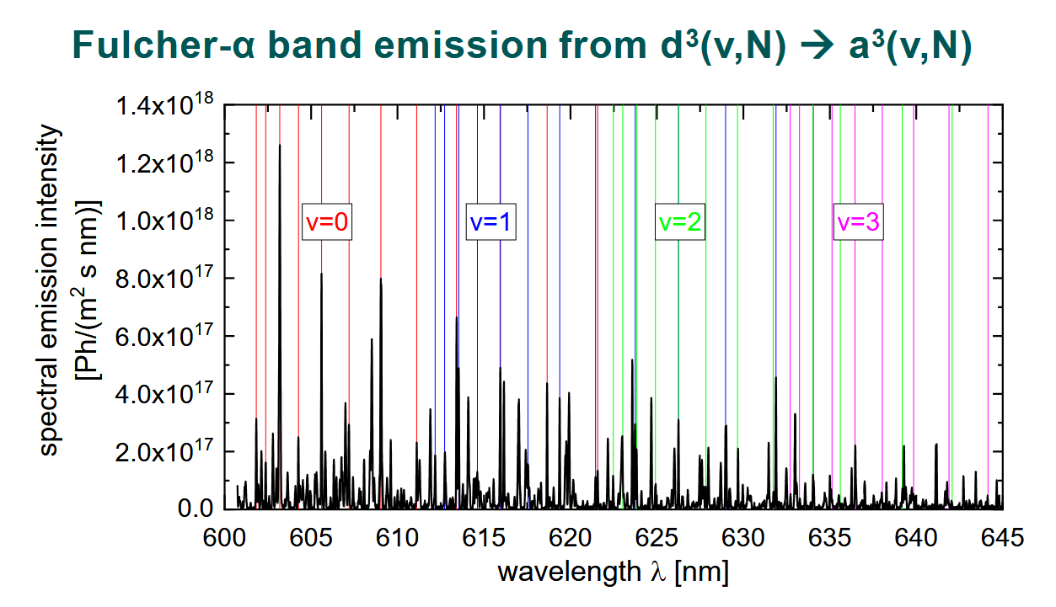
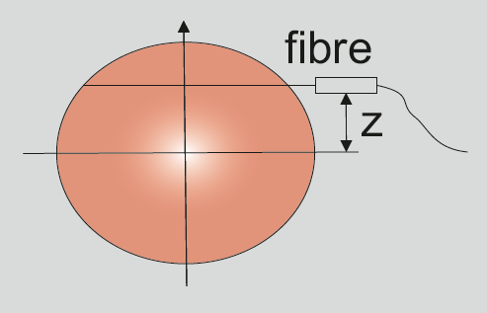
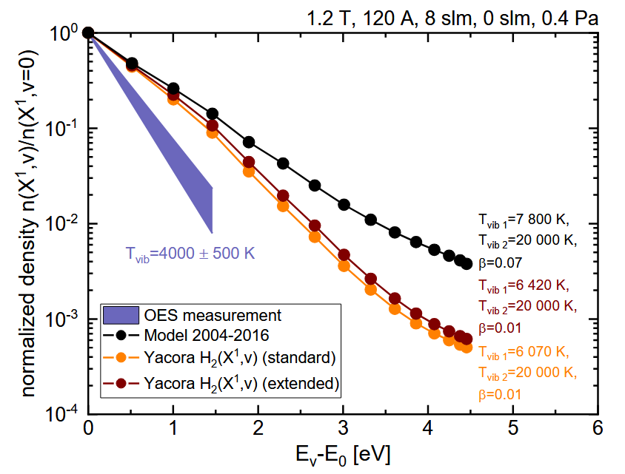
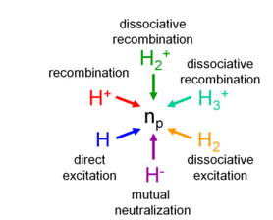
Highlight SP X.1
Active and passive spectroscopy as input for modelling
D001: TALIF on Magnum-PSI
D004: Fulcher-band measurements and Yacora CR modelling
D002: High-resolution OES on PSI-2

Slide 5
Status of 2025 Tasks and Deliverables SP X.2
PWIE-SP X.2.T-T005-D001 Comparison of ps vs. ns LIBS: absolute content and composition. Comparison SP vs. DP LIBS, or alternative LIBS signal enhancement methods: absolute fuel content in W samples and composition (CEA)
PWIE-SP X.2.T-T005-D002 In-situ LIBS and NRA in Magnum-PSI. Reference measurements of outgassing and retention after D plasma loading: absolute content and composition in W and reference samples (DIFFER)
PWIE-SP X.2.T-T005-D003 Comparison SP vs. DP LIBS, or alternative LIBS signal enhancement methods: absolute fuel content in W samples and composition / (CF)-LIBS results on H-D loaded samples. Investigation of the possibility to detect He with LIBS (ENEA)
PWIE-SP X.2.T-T005-D004 Comparison of ps vs. ns LIBS / Comparison SP vs. DP LIBS / Reference measurements of outgassing, recycling, and retention / LAMIS measurements / Explore TALIF and LIBS for H isotope identification (FZJ)
PWIE-SP X.2.T-T005-D005 Report on LIBS analysis by application of machine learning algorithm: focus on development of the models for chemical contents estimation and reconstruction of experimental signals. (IPPLM)
PWIE-SP X.2.T-T005-D006 ps/ns LIBS analysis of B, W, (Be) containing coatings. CF quantification and depth profile analysis. DP LIBS. Analysis of JET and ITER related samples. He-loaded and deuterium-exposed coatings. Ablation rate analysis. (CU)
PWIE-SP X.2.T-T005-D007 Analysis of B containing coatings and/or W coatings with (CF)-LIBS / (CF)-LIBS results He loaded samples / In-situ LIBS and NRA in Magnum-PSI: Reference measurements of (LIBS induced and natural) outgassing and retention after D plasma loading (UT)
PWIE-SP X.2.T-T005-D008 Comparison of ps vs. ns LIBS: absolute content and composition / Analysis of B containing coatings and/or W coatings with (CF)-LIBS: absolute content and composition (ISSP-UL)
PWIE-SP X.2.T-T005-D009 LIBS measurements on W and Be containing reference layers in support of the SP E.1 activities (VTT)
All corresponding deliverables achieved and reported

Slide 6

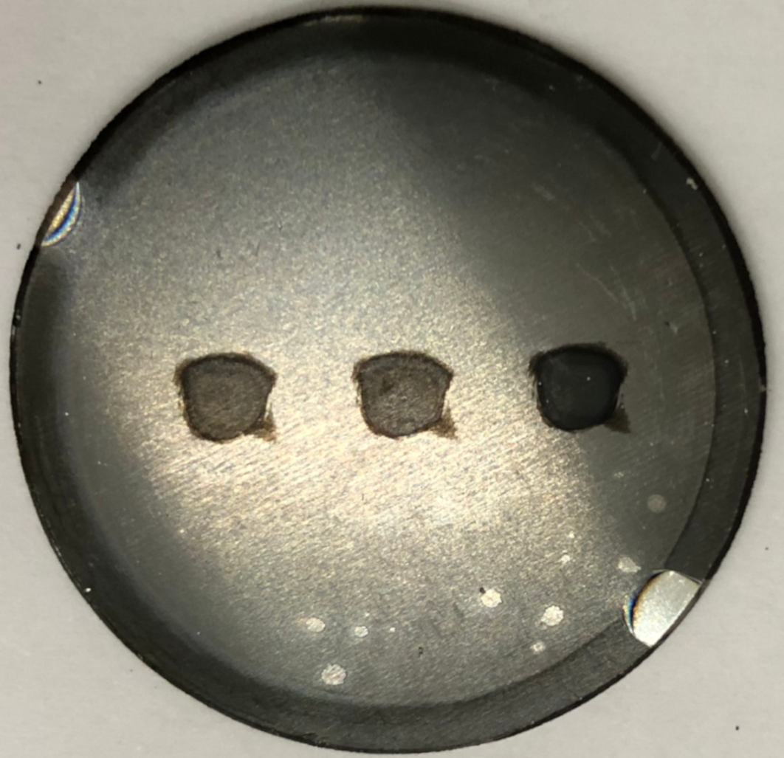
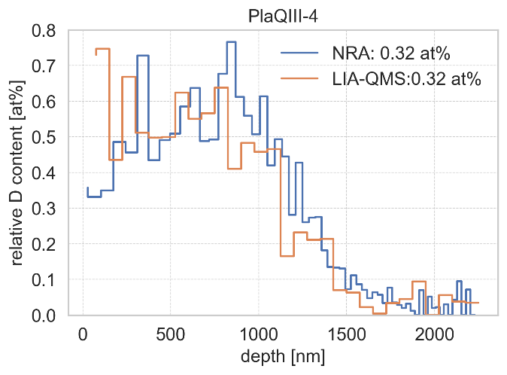
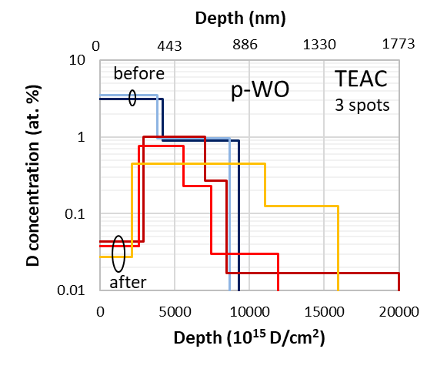
Highlight SP X.2
Comparing laser-techniques to NRA
D002/7: ns LIBS vs NRA
Laser pulses cause outgassing and diffusion of D
NRA is non-perturbative reference for LIBS or LIA-QMS
Long (ns) pulses: big effect of outgassing / diffusion of D
Short (ps) pulse: D depth profile is well reproduced
Large LIBS crater to fit NRA!
LIBS crater
D004: ps LIA-QMS vs NRA
NRA area

Slide 7
2026 Plans of SP X
In 2026 SP X (still) consists of 2 parts:
SP X.1: Characterizing the atomic and molecular properties of H and D in reactor-relevant detaching conditions (Magnum-PSI, PSI-2) using advanced (active) spectroscopy, as a benchmark for advanced CR models (EIRENE, YACORA)
SP X.2: Optimizing laser-based techniques for in-operando quantification of fuel content in PFCs and determination of their limit of detection in W

Slide 8
PWIE Structure in 2026 and 2027
Project Leader: S. Brezinsek
Deputy Leader: D. Douai
PSO: D. Alyassin / NN
Project | Titel | Leader
SP A | Particle and heat load studies in preparation of the exploitation of ITER and a fusion power plant | J.W. Coenen
SP B | Experiments on erosion, deposition, and material migration | A. Hakola
SP C | Fuel retention and release | K. Schmid
SP D | Plasma-edge and plasma-wall interaction modelling | A. Kirschner
SP E | JET post-mortem analysis, LIBS and associated interpretation | J. Likonen
SP F | Wall conditioning and boronization physics | A. Goriaev
SP X | Plasma characterization and laser-based diagnostic development | I. Classen
In general: Tasks and Deliverables are prepared for 2026 and 2027
IMS entry of tasks and deliverables shall be completed by first week of March

Slide 9
2026 Tasks SP X.1
Tasks to be performed [2026]:
Implement further diagnostics on linear devices to provide data on atomic and molecular processes in detaching H and D plasmas (DIFFER, FZJ)
Initial reaction kinetics analysis of the PSI-2 VIS HRES measurements, in particular, isolation of the effect of molecular ions. VUV HRES measurements of the H-atoms Ly-lines in PSI-2, initial evaluation on the possibility to isolate different components in VUV spectra (FZJ)
Interpretation of measurements using CR models (Yacora) and EIRENE (MPG, FZJ)

Slide 10
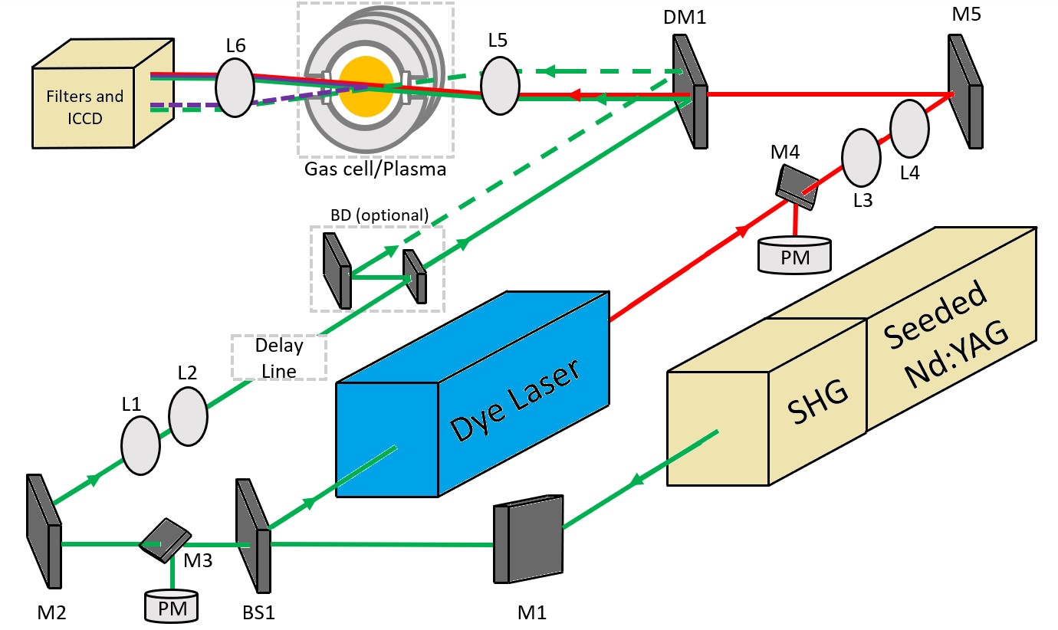
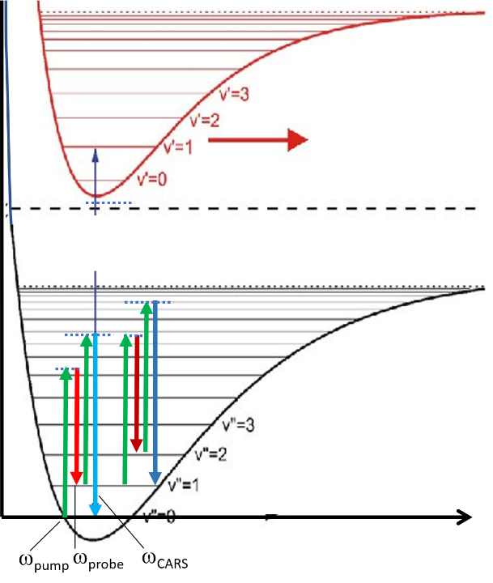
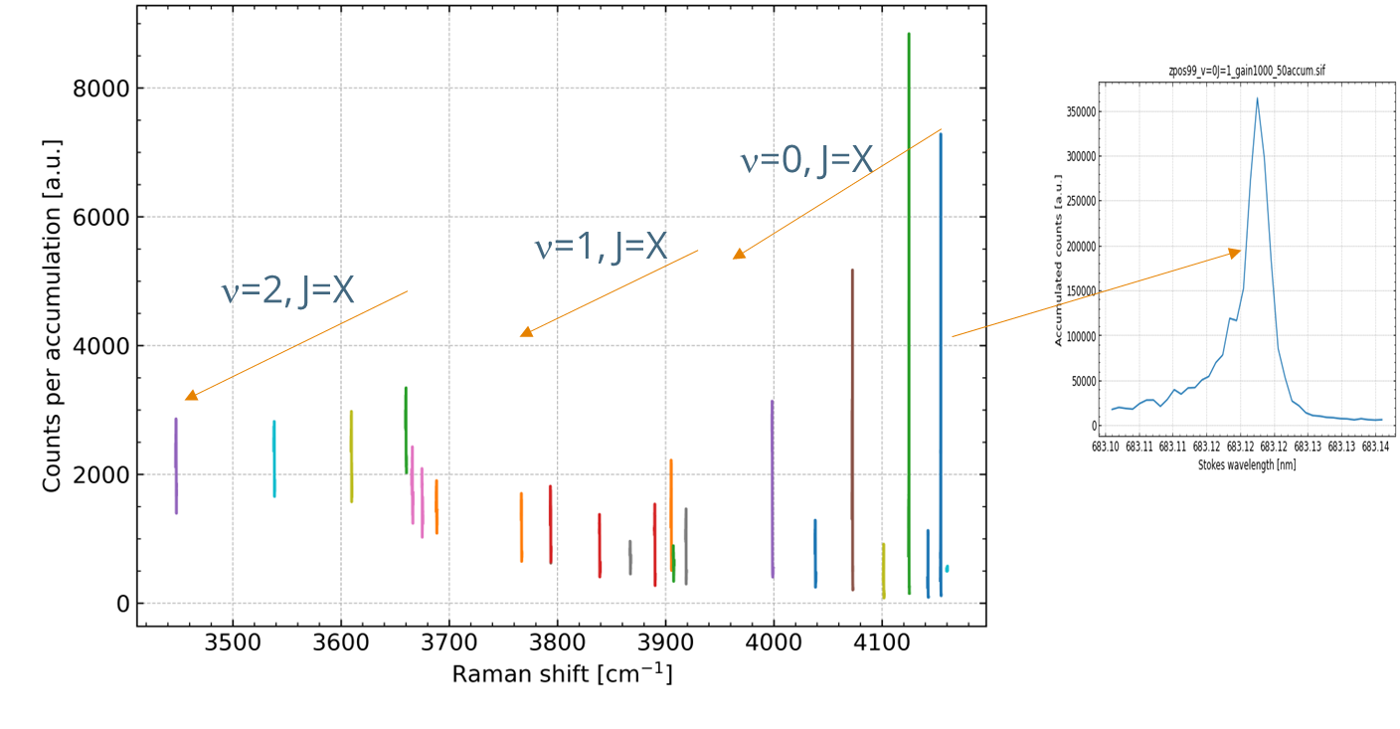
D001
D001 | CARS data on H2 on Magnum-PSI. Build database on passive spectroscopy (OES, MANTIS, CIS) on detaching plasmas. (DIFFER)
CARS: Measure H2 molecular ro-vib densities
Active spectroscopy to characterize the neutrals (H/D atoms and molecules)
In 2025:
Successful TALIF, but CARS had background issues
2026:
CARS in new setup (with in-vacuum filters)
Succesful CARS measurements in January!
Passive spectroscopy to complement the database of detaching plasmas:
MANTIS
High-res OES
CIS (velocities)

Slide 11
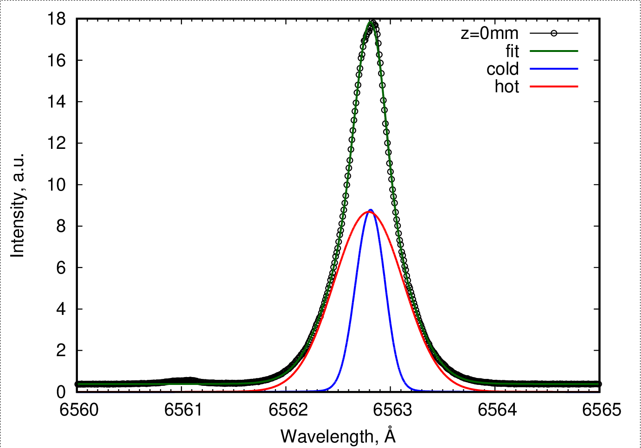
D002
D002 | Accurate measurements of the VUV Spectra lines in 120-200 nm range. Kinetics analysis based on the Balmer- and Layman lines. (FZJ)
Example of calculations
Initial reaction kinetics analysis of the PSI-2 H/D Plasma using kinetic codes
Absolutely calibrated high resolution measurements of emission of atomic and
molecular spectral lines at detached plasma conditions (VIS).
Isolation of the effect of molecular ions using VIS spectral lines.
Initial evaluation on the possibility to isolate different components in
VUV spectra
Provide accurate VUV measurements of the L_{α}-line and possibly L_{β}-line in PSI-2
plasma at different conditions
Broadband measurements of the VUV molecular bands @ 120- 180 nm
at different conditions and comparison with the kinetic analysis.
Measurements at PSI-2

Slide 12

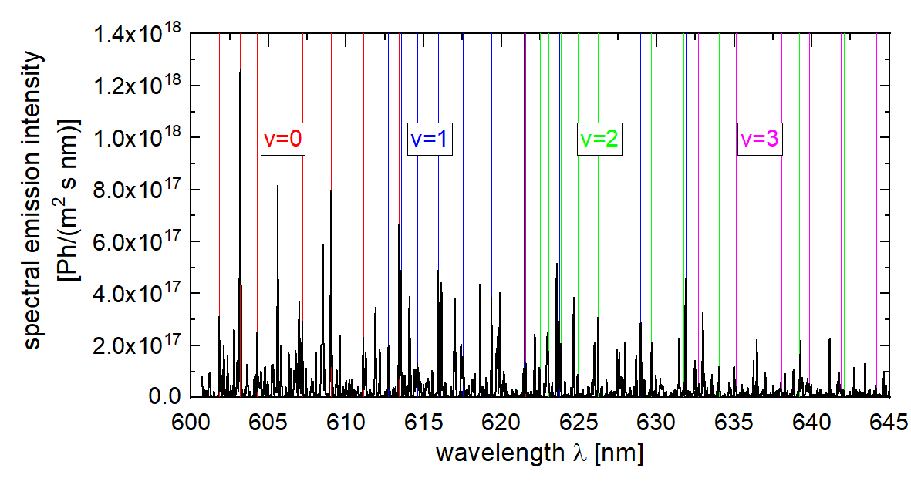
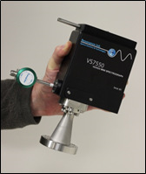
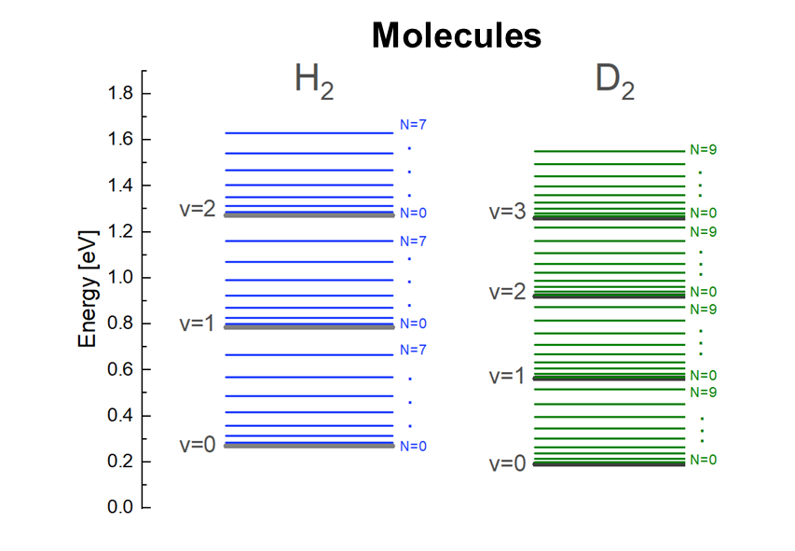
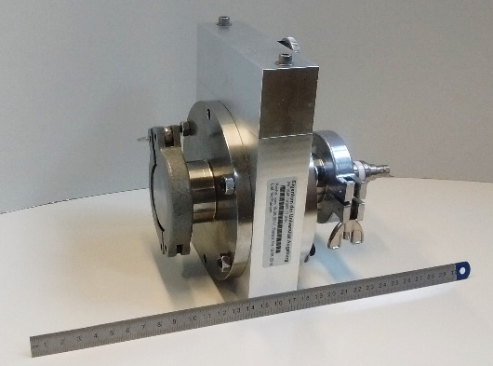
D003
D003 | Final interpretation of recorded spectroscopy results using spectra simulation and CR modelling with Yacora. Application of VUV system to Magnum-PSI with supplementary OES measurements envisaged. (MPG)
Spectroscopy at Magnum-PSI
Fulcher-α band emission from d³(v,N) → a³(v,N)
Final interpretation of recorded spectroscopy results using spectra simulation and CR modelling with Yacora.
Interpreting VIS measurements using CR modelling based on Yacora:
Including atomic Balmer lines and molecular Fulcher band.
Application of VUV system to Magnum-PSI with supplementary OES measurements envisaged.
VUV mini-spectrometer
Ly-α, Lyman band and continuum observable.
Option to use a VUV diode system for measurements down to below 113 nm.
VUV spectroscopy setup successfully tested at UPP in 2025.
In 2027: Development of CR model for D₂
VUV mini-spectrometer
VUV diode system

Slide 13
2026 Tasks SP X.2
Tasks to be performed [2026]:
Depth resolved retention measurements on Tungsten (W), Rhodium (Rh) or Tantalum (Ta). (FZJ, DIFFER, UT, VTT)
Develop LIBS on B layers (CEA, ISSP UL, UT)
Modelling of LIBS by machine learning, diffusion trapping models or automated algorithms. (IPP LM, FZJ)
Improve short pulse (ps, fs) laser techniques (LIBS, LIA-QMS) in terms of sensitivity and depth resolution. (CU, UT, ISSP UL, MPG)
Compare LIBS to other techniques (NRA, LIA-QMS, …). (DIFFER, FZJ, UT, MPG)
Study techniques to improve LIBS signal levels (DP, electrical discharges). (CU)

Slide 14


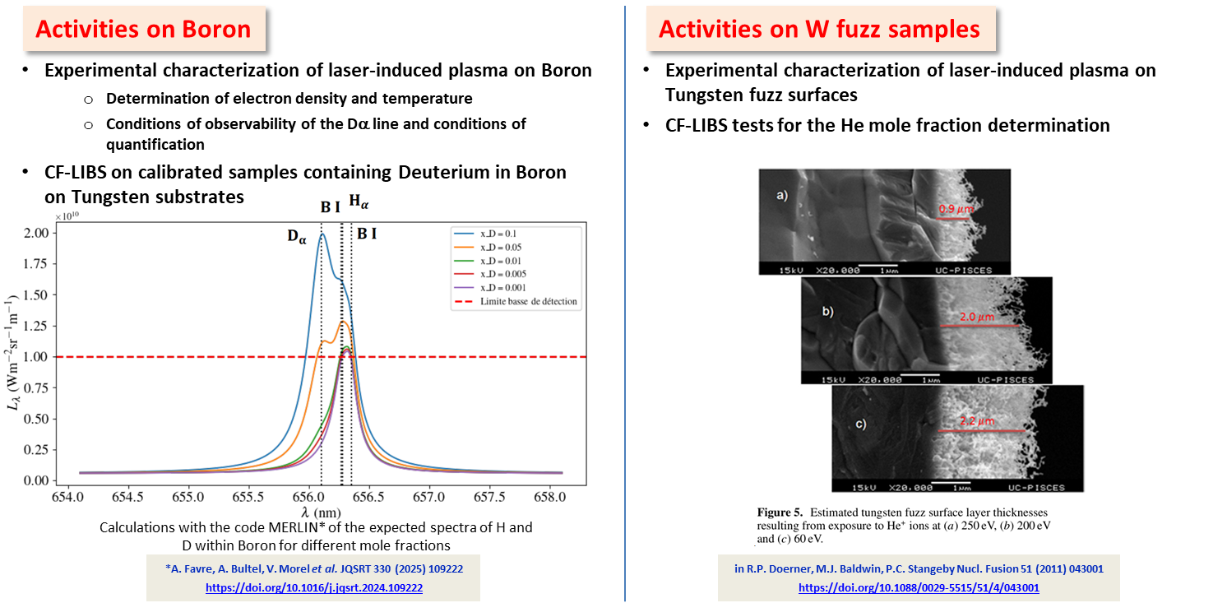
D001
D001 | Experimental characterization of laser-induced plasma on B. CF-LIBS on calibrated samples containing D in B layer on W substrates including the VUV spectral range. (CEA)

Slide 15
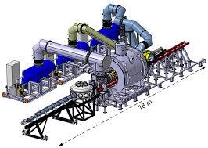
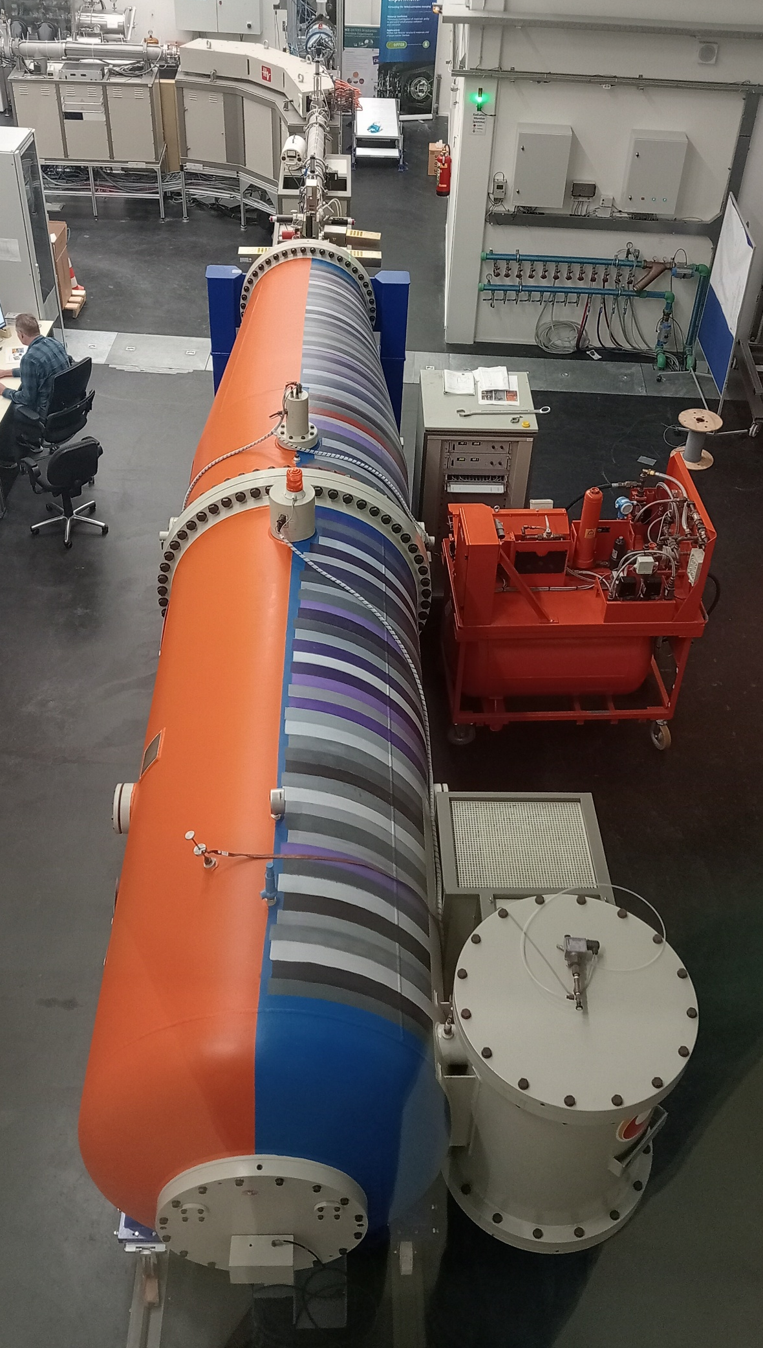
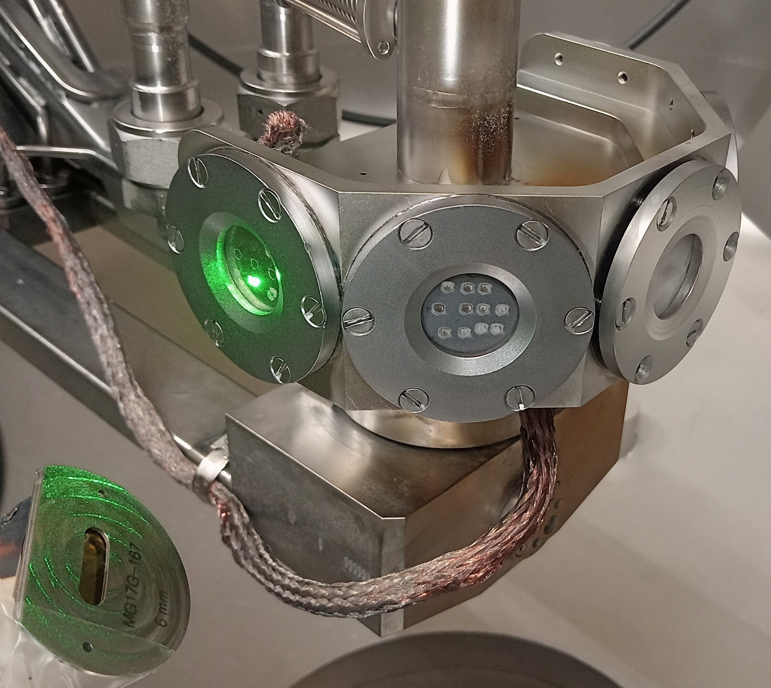
D002
D002 | LIBS and NRA on D-loaded samples (Magnum-PSI). Support LIBS studies of D006. (DIFFER)
Facilities at DIFFER offer:
Magnum-PSI to load targets with D
(ns) LIBS in the Target Analysis and Exchange Chamber (w/o breaking vacuum)
Ion Beam for in-situ NRA reference measurements
Local development of (co-deposited) B layers in progress
D002 is supporting D006 (UT)

Slide 16
D003
D003 | Initial study of hydrogen isotope depth resolved retention measurements on W, Rh and Ta samples by LIBS, LIA-QMS and LID-QMS. Initial study of LAMIS (BH&BD molecules) for hydrogen isotope resolved measurements on thin boron layers. Explore possibility to use adsorbed D on W surface for absolute calibration of D measurement by LIBS in vacuum. (FZJ)
Study of hydrogen isotope depth resolved retention measurements on W, Rh and Ta samples by LIBS, LIA-QMS and LID-QMS
All measurements will be performed in the vacuum chamber by using the same laser (λ=355 nm, 35 ps, 5 – 15 mJ, spot ∼ ∅ 1 mm) will be use for LIBS, LIA-QMS and LID-QMS
The depth profiles of deuterium atoms measured by by LIBS, LIA-QMS and LID-QMS will be compared with the depth profiles measured by NRA to improve the data evaluation procedures for each method of the measurement.
Study of LAMIS (BH&BD molecules) for hydrogen isotope resolved measurements on thin boron layers
W samples having thin layers of boron will be produced by magnetron sputtering in the presence of different H₂&D₂ mixture
W samples having thin layers of boron will be analyzed by LAMIS (laser λ=355 nm, 35 ps, 5 – 15 mJ, spot ∼ ∅ 1 mm) and will be compared with NRA and TDS measurements.
Explore possibility to use adsorbed deuterium on W surface for absolute calibration of D measurement by LIBS in vacuum
Vacuum chamber with variable D₂ gas pressure will be used to measure the LIBS Balmer-α signal versus the D₂ gas pressure.
Laser ( λ=355 nm, 35 ps, 5 – 15 mJ, spot ∼ ∅ 1 mm ) will be used for LIBS.
Experimental data will be fitted with theoretical function which will provide absolute amount of use adsorbed deuterium on W surface.

Slide 17
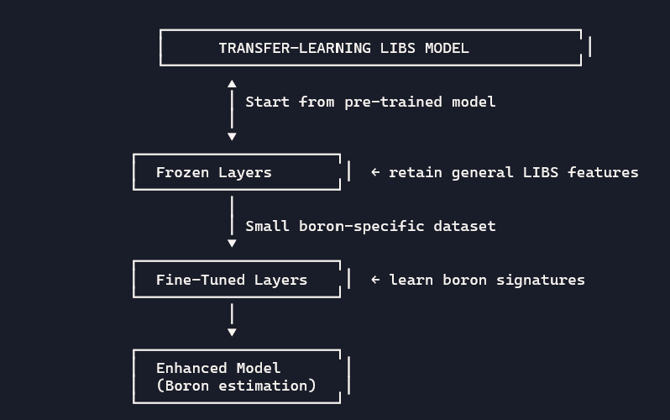
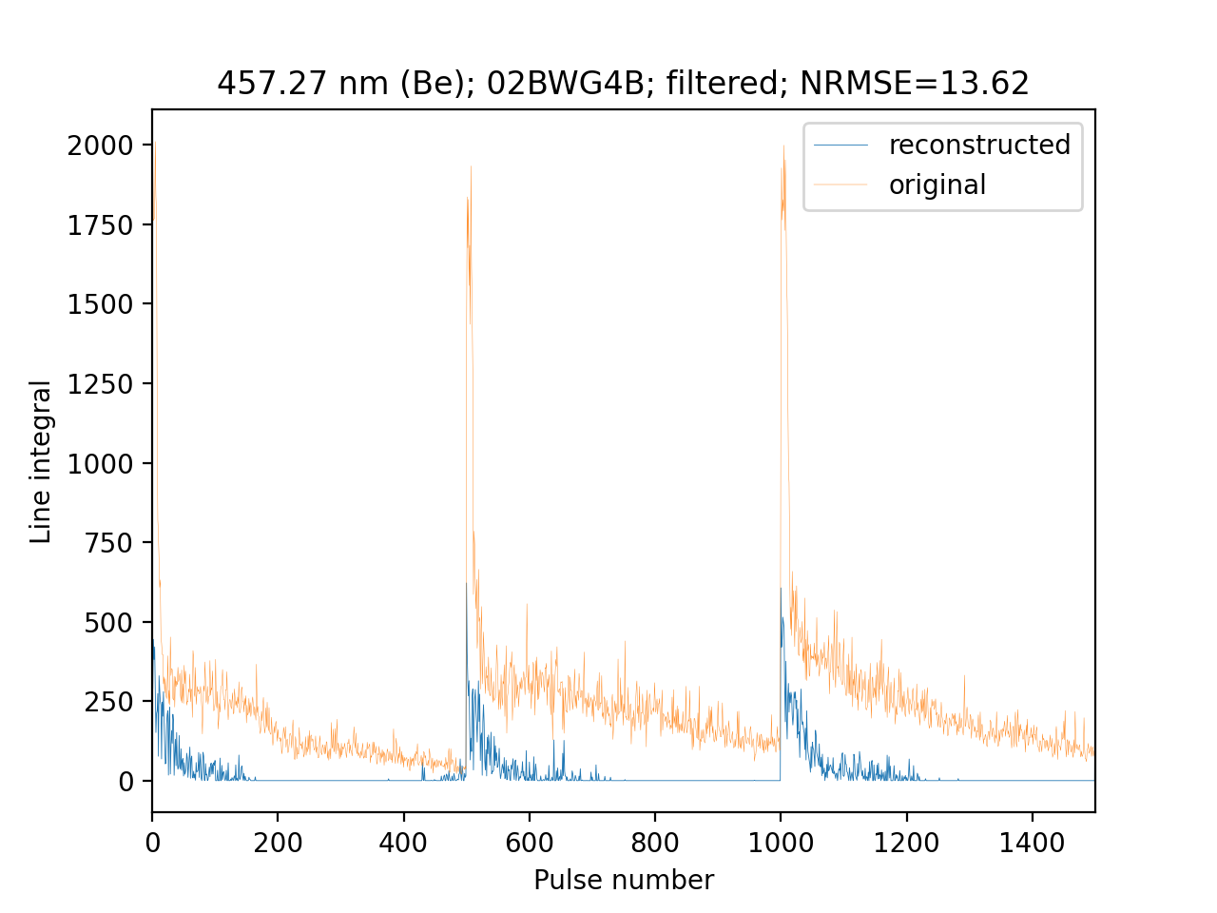
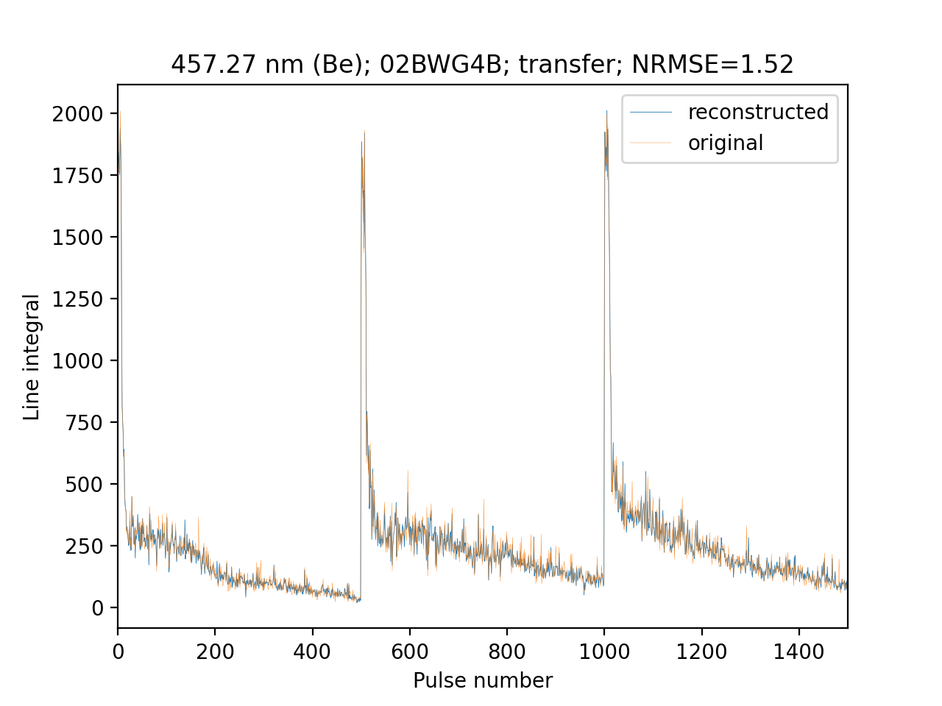
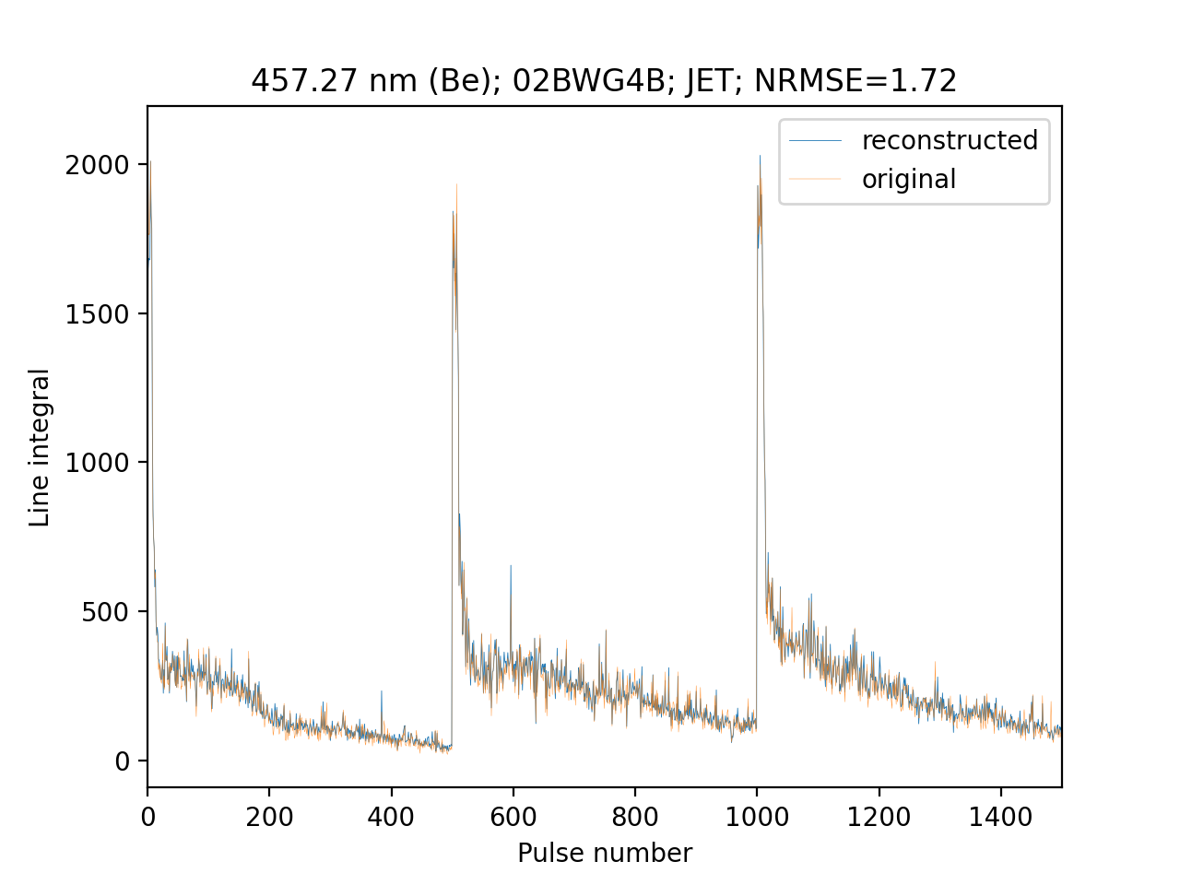
D004
D004 | Report on LIBS analysis by application of machine learning algorithm: Application of machine learning algorithms for processing of massive amounts of experimental data. Introduction of additional elements (in the context of boron) by pre-training and transfer learning. (IPPLM)
The most reliable way of introduction boron into the models is to repeat the learning proces with extended data of a representative volume of B containing spectra. In case of large data volumes it is a time and resources consuming proces;
However,
Research in 2025 showed that transfer learning for elements with a sufficient spectra representation can work efficiently.
Diagram of transfer learning is shown on the right. The proces of transfer learning for previous experiments is shown below.
Extended data predicted by the original model
Extended data predicted after transfer learning
Extended data predicted by pre-trained model

Slide 18

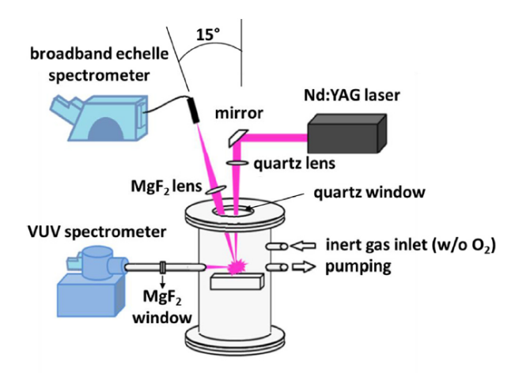
D005
D005 | Validated CF-LIBS depth-profiling methodology for quantitative elemental and ablation rate analysis using ps laser ablation and confocal microscopy. (CU)
(CF-)LIBS and depth analysis on B containing coatings with different type of fuel content in VUV- NIR region in low pressure including confocal microscopy (CU, INFLPR, LATR/CTN – IST)
CF-LIBS depth-profile analysis of reference materials and reactor-exposed samples using LIBS and/or DP-LIBS with nanosecond and picosecond laser pulses (CU).
Comparative evaluation of laser-only and discharge-assisted CF-LIBS depth profiling for fusion relevant materials (CU).
VUV-NIR LIBS setup
DP LIBS experimental setup

Slide 19
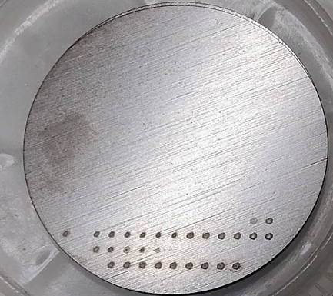
D006
D006 | Initial studies of D retention in B containing coatings and/or W coatings with in-situ LIBS in Magnum-PSI: absolute content and composition / Preliminary ps-laser measurements of D concentration and ablation rate as a function of W and/or B coating composition and density. (UT)
In-situ LIBS in Magnum-PSI for D retention in B and/or W containing coatings
Finish data analysis of LIBS induced outgassing tests in W coatings and publish the results
    - requires additional experiments for ablation rate determination by profilometry
Carry out D retention experiments by LIBS with B containing coatings exposed to Magnum-PSI plasma
    - Depends on the availability of B coatings
Ablation rate as a function of W coating composition and density
LIBS system with new Expla 30 ps laser – first tests with different W samples (bulk W and p-WO):
Bulk W
Ablation rates will be determined by mechanical profilometer
Determine ablation rates for different types of W coatings and correlate with LIBS spectra

Slide 20

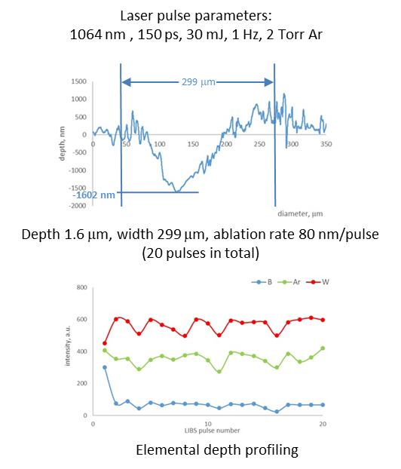
D007
D007 | Initial study of optimized ps-(CF)-LIBS for ultrathin B layers on W substrates: qualitative and quantitative contents. (ISSP UL)
ps-LIBS on magnetron-sputtered B coatings on W substrate
Sample preparation: Boron (B) coatings were deposited on tungsten (W) substrates by magnetron sputtering at ISSP UL (Laboratory of Thin Films)
Profilometry: The white-light profilometry procedure was optimized to obtain 3D profiles of LIBS laser-ablation craters
Depth profiling results: Elemental depth profiling showed that B was detectable only in the first laser pulse (higher fluence needed for B detection). The current optimal ablation rate is ~80 nm per pulse at 30 mJ, as determined by white-light and stylus profilometry
Next steps: Further optimization of LIBS parameters is planned to improve the ablation rate and depth resolution for thin-film B detection

Slide 21
D008 | Compare the information obtained using different spectrometers for the elemental composition of various Be and W-based reference samples. Make recommendations for the most optimal setup for LIBS measurements of JET samples (under SP E) (VTT)

Slide 22
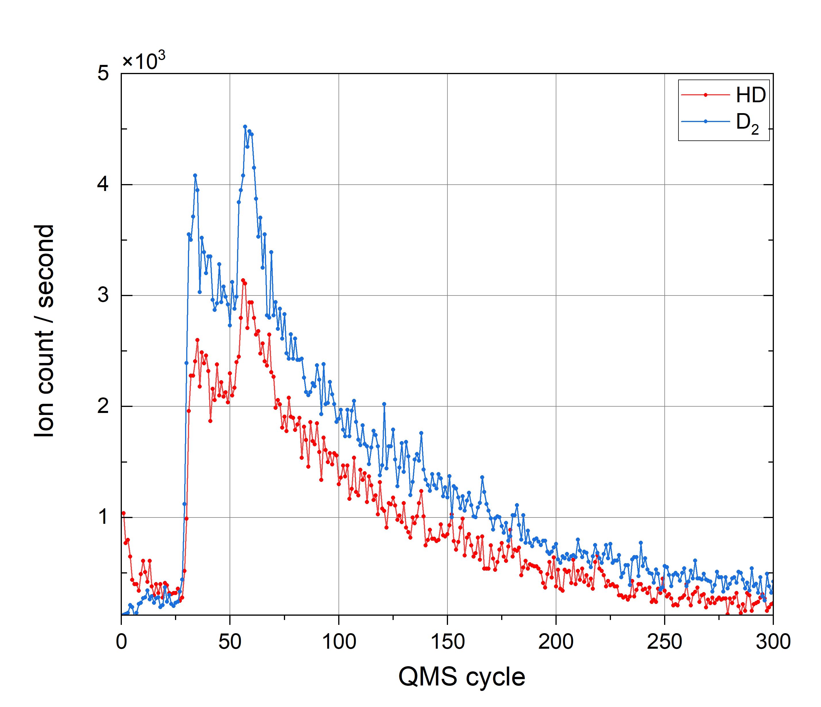
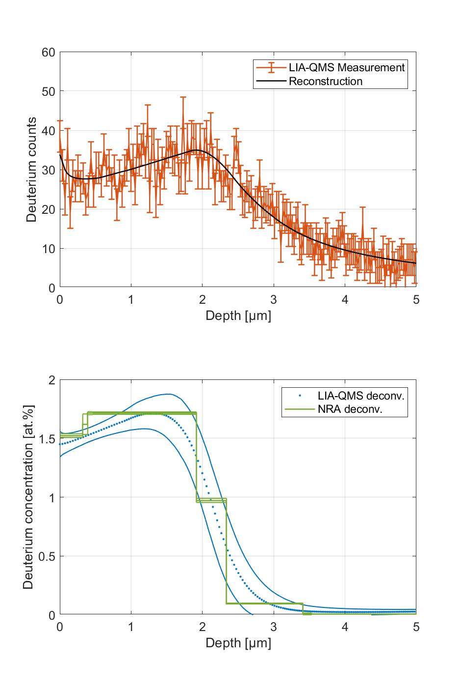
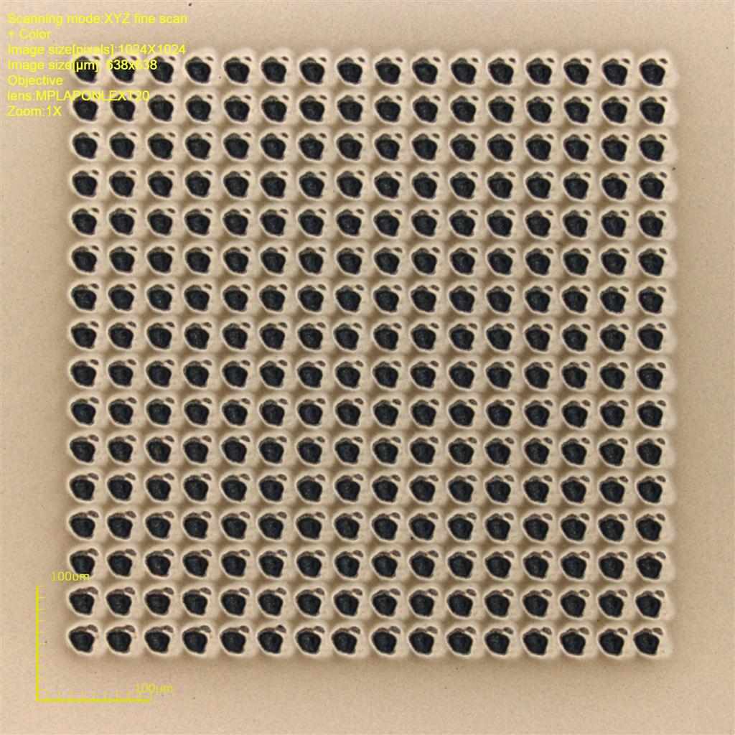
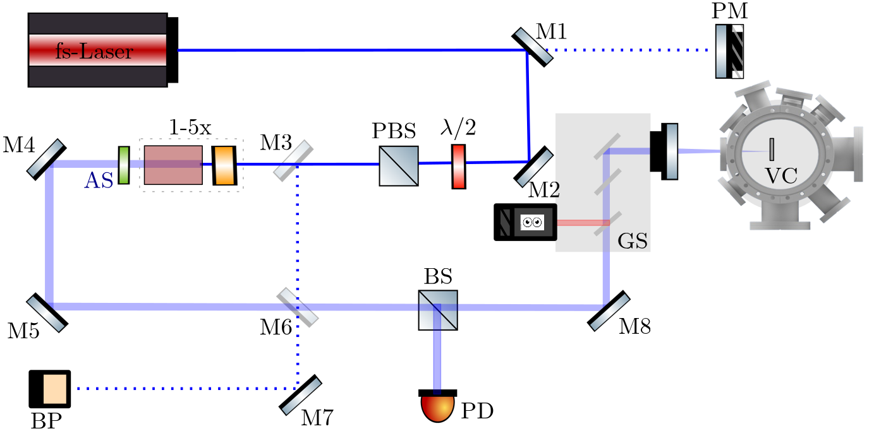
D009
D009 | In-depth analysis of deuterium and helium retention depth profiles in fusion-relevant materials using LIA-QMS. Development of an integrated system enabling simultaneous depth-resolved fuel retention analysis using LIBS and LIA-QMS (MPG)
LAMA Experiment : MPG
Analysis of D and He retention in W with fs LIA-QMS.
Development of integrated system for simultaneous depth-resolved LIBS and LIA-QMS.
Each QMS cycle lasts 473 ms and collects the D₂ signal from 224 laser pulses per layer, achieving a depth resolution of ~13 nm.
Laser pulses of 5 µJ on a ~30 µm spot ensure precise, consistent ablation for reproducible measurements.
New QMS is installed and is capable of resolving D2 and He signal simultaneously.
Deconvoluted deuterium depth profile
Typical LIA-QMS signal from mass 3 and 4
Laser Ablation Mass Analysis (LAMA)
Pulse matrix per QMS cycle

Slide 23

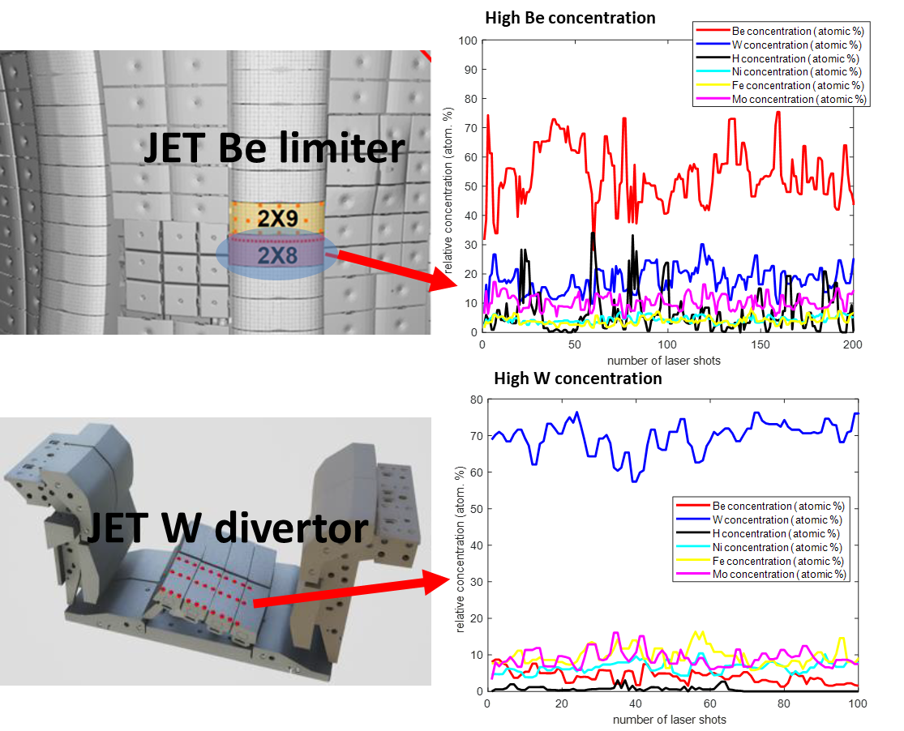
ENEA: No deliverable in 2026 (only 2027)
2027 deliverable: | Development of automated software procedure, capable of applying CF-LIBS to a large number of LIBS spectra in a short time. Application of DP-LIBS on atmospheric pressure, under Ar flux or in vacuum, to investigate the expected enhancement of the LIBS spectral signal (ENEA)
During the LIBS experimental campaign at JET (October 2024), hundreds of LIBS spectra were acquired at each of the over 800 points examined on the first wall and PFCs inside the vacuum vessel.
The calibration-free LIBS (CF-LIBS) procedure allows for quantitative determination of the chemical composition of PFCs and the depth distribution of chemical species in their surface layers.
Given the enormous number of spectra, it is necessary to automate the CF-LIBS procedure with specific data processing software capable of processing spectra quickly.

Slide 24
2027 Deliverables
Deliverable ID | Deliverable Title
D004 | CARS data on D2 on Magnum-PSI. Finalize database (passive and active spectroscopy) on detaching plasmas. (DIFFER)
D005 | Separation of the molecular and atomic components using high resolution measurements. Final reaction kinetics analysis of hydrogen plasma in PSI-2 including molecular ions. (FZJ)
D006 | Analysis of data recorded in 2026. Development of CR model for D2 with first application. (MPG)
X.1
Deliverable ID | Deliverable Title
D010 | CF-LIBS capacity exploration on W fuzz samples containing He (CEA)
D011 | ns LIBS and NRA on Boron layers. Support LIBS studies of D016. (DIFFER)
D012 | Development of automated software procedure, capable of applying CF-LIBS to a large number of LIBS spectra in a short time. Application of DP-LIBS on atmospheric pressure, under Ar flux or in vacuum, to investigate the expected enhancement of the LIBS spectral signal (ENEA)
D013 | Final study of hydrogen isotope depth resolved retention measurements on W, Rh and Ta samples by LIBS, LIA-QMS and LID-QMS. Final study of LAMIS (BH&BD molecules) for hydrogen isotope resolved measurements on thin boron layers. Explore scanning ps-LIBS for high sensitivity depth profiling. (FZJ)
D014 | Report on LIBS analysis by application of machine learning algorithm: Design of a system for real time data analysis. Testing and estimating its performance on simulated and experimental data. (IPPLM)
D015 | Comparative evaluation of laser-only and discharge-assisted CF-LIBS depth profiling for fusion relevant materials (CU)
D016 | Final studies of D retention in B containing coatings and/or W coatings with in-situ LIBS in Magnum-PSI: absolute content and composition / Continuation of ps-laser measurements of D concentration and ablation rate as a function of W and/or B coating composition and density. (UT)
D017 | Final study for ps-(CF)-LIBS method for hydrogen isotope detection and depth profiling in B/W co-deposits: absolute content and composition. (ISSP UL)
D018 | Extend the work to representative reference samples for other fusion devices (AUG, WEST) including B and W (VTT)
D019 | Comparative study of fuel retention in fusion-relevant materials using LIA-QMS and LIBS. Quantitative detection and analysis of light elements (e.g. H, D, He, and B) with LIA-QMS. (MPG)
X.2

