Slide 1

2025 Final Summary / 2026 Plans
Subproject:
Project Meeting
Plasma-Wall Interactions and Exhaust
Jn W. Coenen
Forschungszentrum Juelich GmbH – IFN-1
S. Brezinsek (PL), J.W. Coenen, A. Hakola, K. Schmid, A. Kirschner, J. Likonen, I. Classen, A. Goriaev, and D. Douai (DPL)

Slide 2
2025 Final Summary of SP A

Slide 3
SPA– 2025 - Overview
SP A.1 Synergistic Load Studies of Plasma-Facing Materials for ITER & DEMO
Focus on damage evolution of ITER-like MBs
(including WEST MBs)
Recrystallisation evolution in W (incl. modelling)
Focus on ITER-like MBs testing under multiple seeding, species, ELMs, and He
Plasma qualification of new materials for DEMO and other toroidal facilities (e.g. W7-X)
Disruption-like loading for DEMO (incl. OLMAT)
Melting of MBs => MEMETO modelling)
KIPT as possible during cicumstances
SP A.2 High Particle Fluence Exposures of Plasma-Facing Components for ITER
SP A.3 Advanced Materials under thermo-mechanical and plasma loads
SP A.4 High Temperature performance of Armour Materials: Recrystallization and Melting
SP A.5 Compass-U

Slide 4
Status 2025 Tasks and Deliverables SP A.1 –SPA.3
PWIE-SP A.1.T-T005-D001 Damage threshold for different W materials at varying loading conditions in matrix form / Understanding the damage mechanisms and changes in material properties and changes in the retention behavior (FZJ)
PWIE-SP A.1.T-T005-D002 Evaluation of redeposited tungsten microstructure and evolution under transient loading” (DIFFER) – with focus on Properties under synergistic Loading
PWIE-SP A.1.T-T005-D003 Exploitation of OLMAT as HHF facility – Testing of baseline and advanced materials – Laser & OLMAT exposures (CIEMAT)
PWIE-SP A.1.T-T005-D004 Qualification of W-Heavy Alloys for use in W7-X in conjunction with test on new tungsten mock-ups (WPMAT) and PFUs for WEST (WPTE) (MPG)
PWIE-SP A.1.T-T005-D005 Analysis of material properties after sequential HHF transient and steady-state plasma loading (KIPT)
PWIE-SP A.2.T-T005-D001 Fatigue cracking and creep evolution of W samples and W-monoblocks exposed to strike point sweeping (DIFFER)
PWIE-SP A.2.T-T005-D002 Pre- and post-characterization of samples (MPG)
All corresponding deliverables achieved and reported
PWIE-SP A.3.T-T005-D001 Analysis of Material behavior under Plasma and heat loading regarding mechanical properties e.g. cracking, embrittlement, and microstructure. Link to SP A4 (FZJ)
PWIE-SP A.3.T-T005-D002 Performance of advanced materials under high heat loads and their microstructural characterization (MPG)
PWIE-SP A.3.T-T005-D003 Results from tests of small-scale samples of W and other advanced materials and components (LPP-ERM/KMS)
PWIE-SP A.3.T-T005-D004 Investigation of advanced materials and coatings under ELM-like/disruption transient loading and subsequent analysis (KIPT)
PWIE-SP A.3.T-T005-D005 Effect of ELM loading on microstructure evolution of W-coated RAFM steels” (DIFFER)
PWIE-SP A.3.T-T005-D006 Effect of energetic ion irradiation on the strength of W wire (MPG)
All corresponding deliverables achieved and reported
All corresponding deliverables achieved and reported

Slide 5
Status 2025 Tasks and Deliverables SP A.4 –SPA.5
PWIE-SP A.5.T-T002-D001 Comprehensive pre-characterization of the 9 candidate W materials (IPP_CR)
PWIE-SP A.5.T-T002-D002 Fast transient simulation on COMPASS-U W armor by a CW laser at OLMAT (CIEMAT)
PWIE-SP A.5.T-T002-D003 Nanocracking detection studies on exposed materials from PSI-2, MAGNUM, OLMAT, JUDITH (CU)
PWIE-SP A.5.T-T002-D004 ELM-like loading effects on different W grades (CIEMAT)
PWIE-SP A.5.T-T002-D005 Post Mortem Analysis, and TDS (IPP_CR)
PWIE-SP A.5.T-T002-D006 Studies on Materials supplied for COMPASS U in on HHF (IPP_LM/MPG)
PWIE-SP A.5.T-T002-D007 Comparative Microscopy studies on samples exposed in PSI-2, MAGNUM, JUDITH & OLMAT (IPP_LM/ENEA)
PWIE-SP A.5.T-T002-D008 Establish a round robin test with other HHF Test Facilities to Benchmark HIVE (UKAEA)
PWIE-SP A.5.T-T002-D009 Tungsten High Temperature testing (UKAEA)
PWIE-SP A.4.T-T005-D001 Assessment of plasma impact on material properties linked to ITER relevant PFUs (CEA)
PWIE-SP A.4.T-T005-D002 Annealing of chosen tungsten-based materials and quantification of recrystallization kinetics (DTU)
PWIE-SP A.4.T-T005-D003 Development of MEMENTO and MEMENTO + GEANT 4 including RE - Damage (VR)
PWIE-SP A.4.T-T005-D004 Influence of plasma pre irradiation with heat loads near surface recrystallization on surface damaging with heat loads above the melting threshold (KIPT)
PWIE-SP A.4.T-T005-D005 Analysis of PSI-2 exposed materials, focusing on funding the relevant regime for fuzz formation in AUG He campaign (FZJ)
PWIE-SP A.4.T-T005-D006 Simulation of Runaway Impact by Electron Beam at 10-100MeV
All corresponding deliverables achieved and reported
All corresponding deliverables achieved and reported

Slide 6

WP PWIE SPA 1
Report for 2025 & Overview

Slide 7
Synergistic Load Studies of Plasma-Facing Materials for ITER & DEMO
Deliverable Owner | Beneficiary | PM | Deliverable (Team)
M. Wirtz | FZJ | 4 | D001 (M. Gago, D. Dorow-Gerspach*)
T. Morgan | DIFFER | 4 | D002, (T. Morgan)
P. Tabares | CIEMAT | 6 | D003 (D. Alegre)
H. Greuner | MPG | 3 | D004 (H. Greuner, H. Maier, J.Riesch)
I. Garkusha | KIPT | 15 | D005 (I. Garkusha)
Total |  | 32
Establish a test matrix for Materials utilized in WEST and ITER with respect to updated load specifications. in the available devices (DIFFER, FZJ, MPG)
Study the impact of synergistic loads on ITER and DEMO relevant baseline Materials (tungsten, W-FGMs on Steel) and new materials developments with Laser (Laser at PSI-2) and e-beam (JUDITH) as well as steady-state plasma exposure (He, H). A special focus will be the qualification of these materials under high cycle numbers and seed-impurities exposure. (FZJ)
Post-mortem analysis will characterize the induced surface modifications and damages as well as investigate changes of the materials properties due to e.g. recrystallization behavior and/or surface morphology changes. (FZJ, MPG, DIFFER, KIPT)
Determine underlying mechanisms of evolution of crack propagation in materials for ITER and current day devices. (FZJ, DIFFER, KIPT, MPG, CIEMAT)
Qualify W materials for use in W7-X. (MPG, FZJ)
Synergy effects from sequential stationary (PSI-2 / MAGNUM-PSI, OLMAT) and transient (QSPA) plasma loads. (DIFFER, MPG, FZJ, KIPT, CIEMAT)
Studies of fatigue cracks formation in deformed/re-crystalized W, fatigue damage of W_{f}/W wires, latticing W etc. (FZJ)
Combination of pulsed and steady state loading (e.g. behavior of QSPA pre-damaged targets in PSI-2, JUIDTH compared with reference samples). (FZJ, KIPT)
Study the Behavior of pre-cracked samples under edge loading conditions - links to HHF facilities such as JUDITH and WEST. (DIFFER, FZJ)
Device | Beneficiary | Days | Related Deliverable
PSI-2 | FZJ | 10 | D001
JUDITH | FZJ | 15 | D001
Accelerator | FZJ | 3 | D001 jointly with SPA 3/SPA 4
GLADIS | MPG | 5 | D004
MAGNUM-PSI | DIFFER | 5 | D002
UPP | DIFFER | 5 | D002
OLMAT | CIEMAT | 10 | D003
Deliverable ID | Deliverable Title
D001 | Damage threshold for different W materials at varying loading conditions in matrix form / Understanding the damage mechanisms and changes in material properties and changes in the retention behavior (FZJ)
D002 | “Evaluation of redeposited tungsten microstructure and evolution under transient loading” (DIFFER) – with focus on Properties under synergistic Loading
D003 | Exploitation of OLMAT as HHF facility – Testing of baseline and advanced materials – Laser & OLMAT exposures (CIEMAT)
D004 | Qualification of W-Heavy Alloys for use in W7-X in conjunction with test on new tungsten mock-ups (WPMAT) and PFUs for WEST (WPTE) (MPG)
D005 | Analysis of material properties after sequential HHF transient and steady-state plasma loading (KIPT).

Slide 8
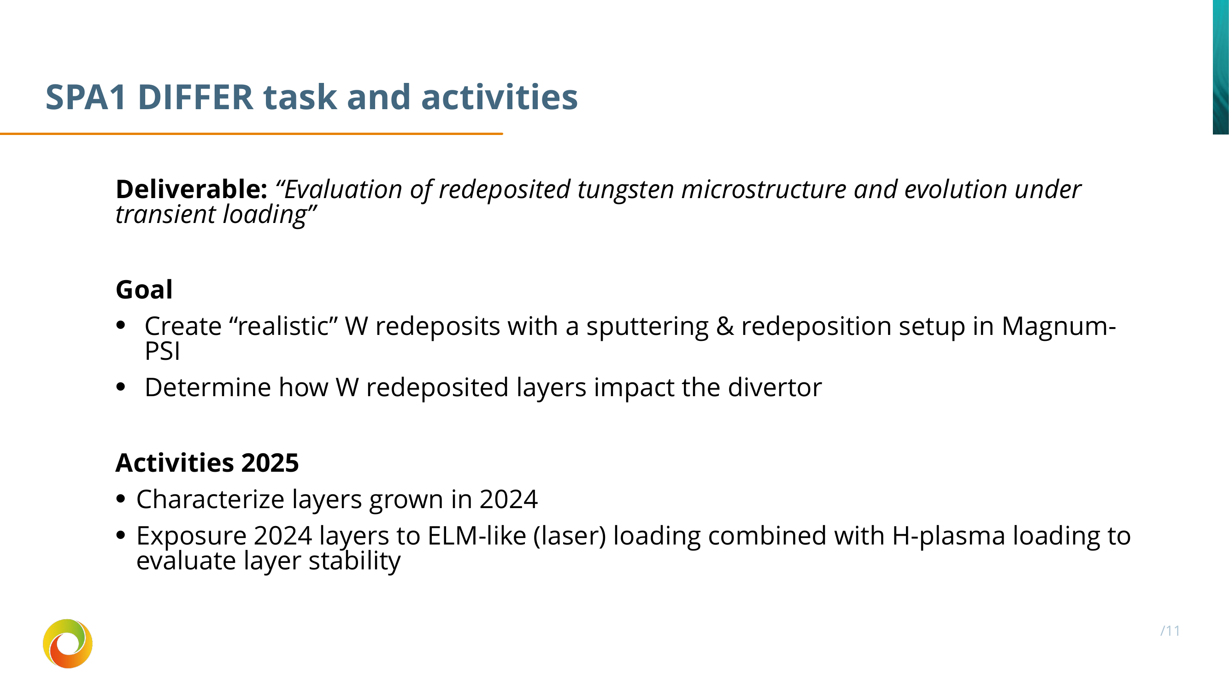

Slide 9
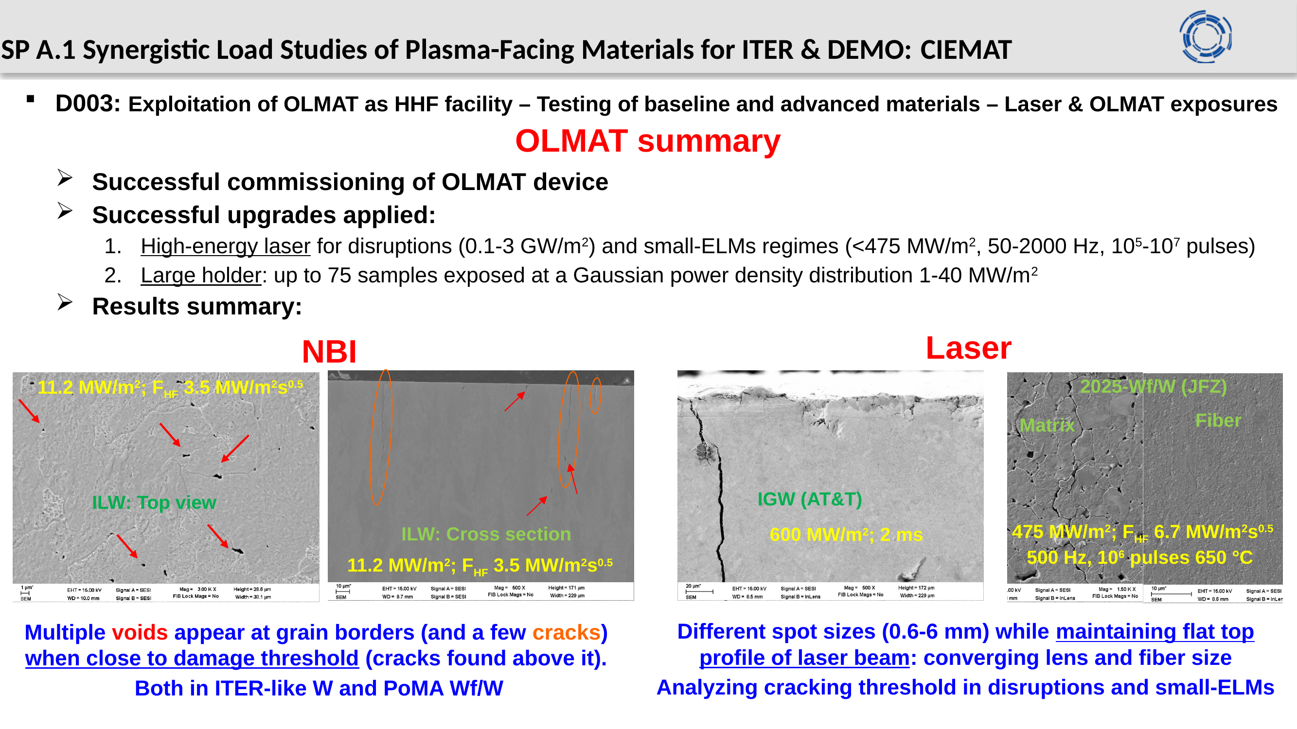

Slide 10
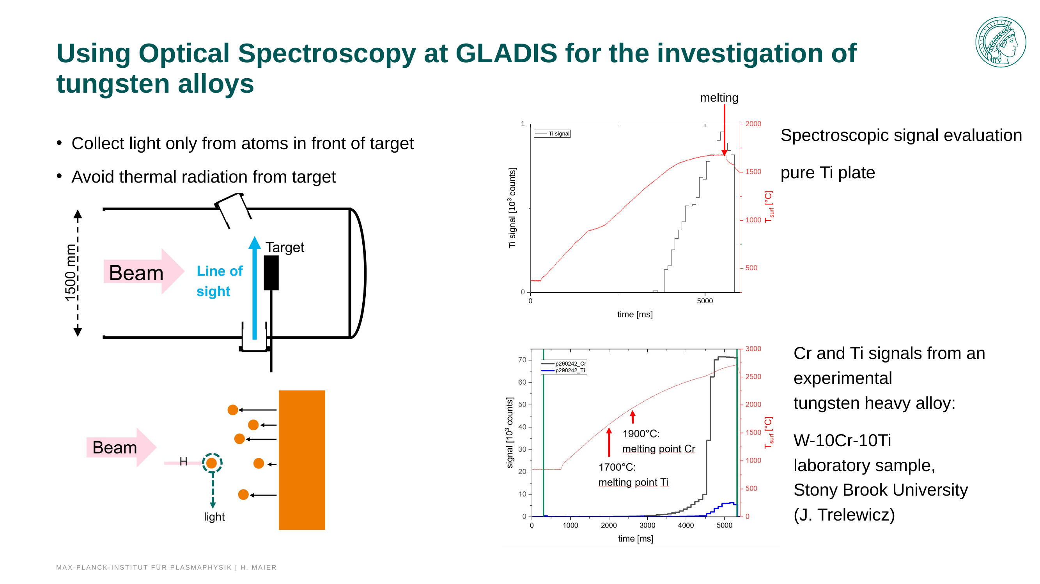

Slide 11
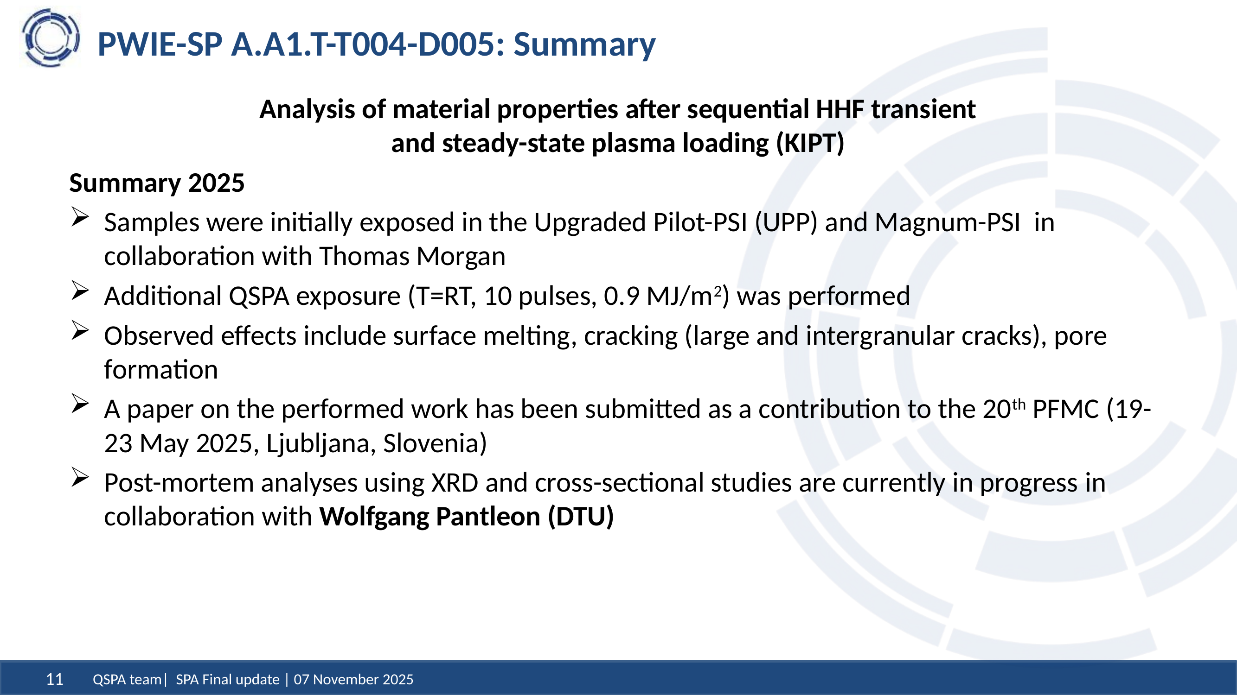

Slide 12
WP PWIE SPA 2
Report for 2025 & Overview

Slide 13
High Particle Fluence Exposures of Plasma-Facing Components for ITER
Deliverable Owner | Beneficiary | PM | Deliverable (Team)
T. Morgan | DIFFER | 5 | D001 (T. Morgan)
M. Balden | MPG | 2 | D002 (S. Elgeti)
Total |  | 7
Recrystallization behavior of DEMO tungsten grades under high flux/fluence plasma loading with impurity seeded deuterium plasmas (DIFFER)
Pre- and post-analysis of materials and components (MPG)
Further analysis linked to facilities and staffing in SP B
Device | Beneficiary | Days | Related Deliverable
MAGNUM-PSI | DIFFER | 8 | D001
UPP | DIFFER | 5 | D001
Deliverable ID | Deliverable Title
D001 | Fatigue cracking and creep evolution of W samples and W-monoblocks exposed to strike point sweeping (DIFFER)
D002 | Pre- and post-characterization of samples (MPG)

Slide 14
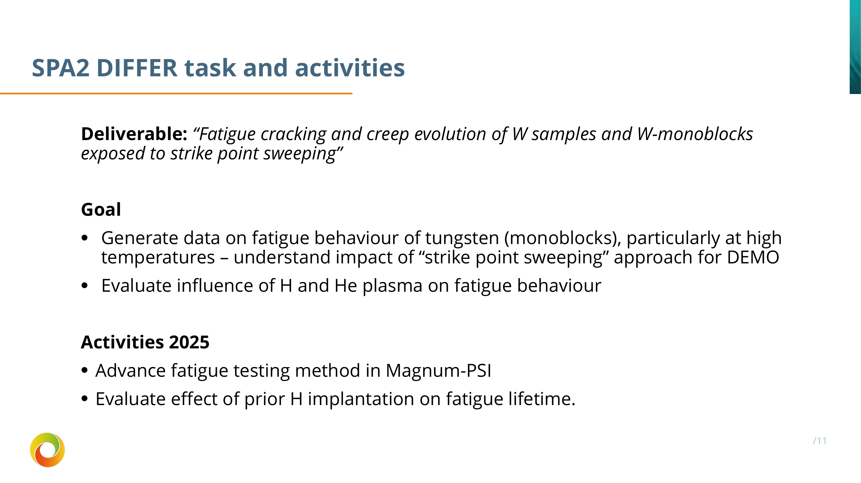

Slide 15
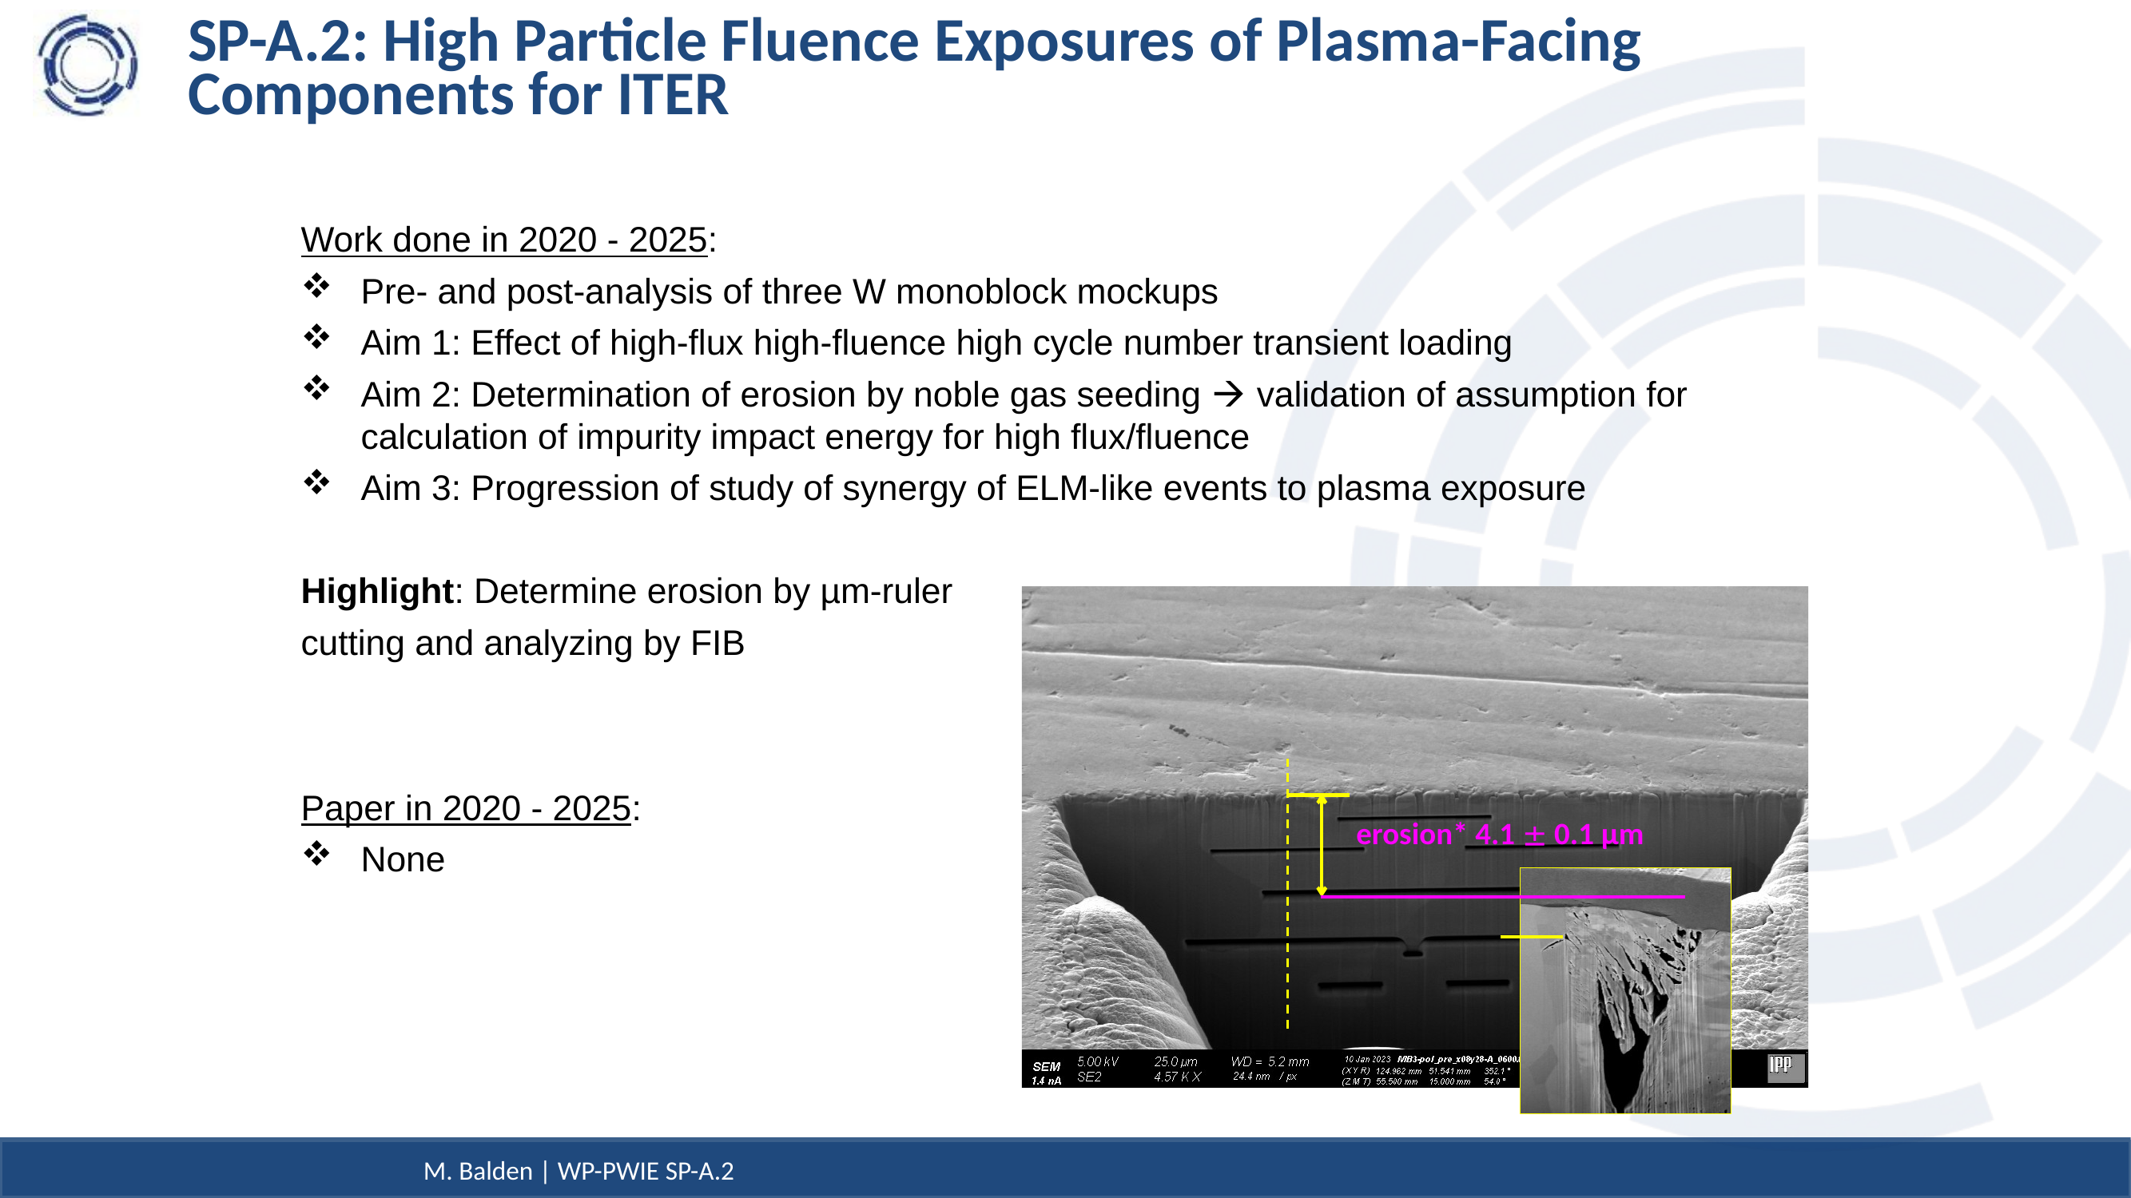

Slide 16
WP PWIE SPA 3
Report for 2025 & Overview

Slide 17
Advanced Materials under thermo-mechanical and plasma loads
Deliverable Owner | Beneficiary | PM | Deliverable (Team)
J.W. Coenen | FZJ | 5 | D001 (M. Wirtz, J.W. Coenen, A. Litnovsky)
T. Morgan | DIFFER | 3 | D005
I. Garkusha | KIPT | 15 | D004
D. Terentyev | LPP-ERM/KMS | 4 | D003
J. Riesch | MPG | 2 | D002, D006 ( S. Elgeti)
Total |  | 29
Plasma qualification of new materials (WPMAT) and components (WPDIV) for DEMO: Thermal shock and plasma synergistic loading of advanced material including exposures in Magnum-PSI (KIPT, DIFFER, FZJ)
Exposure of advanced materials e.g. W_{f}/W (WPPRD), SMART alloys (WPMAT), additively manufactured components (WPDIV) and others to heat loads and/or plasma loads for assessment of their PWI properties and exploration of limits of their application (FZJ, MPG)
Study of basic thermo-mechanical properties for advanced materials for divertor applications including reference material properties for comparison with neutron-irradiated sample in future (LPP-ERM/KMS, MPG)
  Establish experimental techniques
  Mechanical testing of W-yarns up to very high temperatures, subsequent microstructural characterization (link to neutron irradiation of W yearns & subsequent mechanical testing) (SCK-CEN as part of RU LPP-ERM/KMS)
  Establish experimental basis by e.g. self or proton damage (MPG, FZJ)
  Effect of fusion environment on the mechanical properties of W wire (MPG/ SCKCEN)
Exposure in plasma devices to study the interplay of recovery, recrystallization, plasma and ELM-like loading on surface cracking and fatigue lifetime (FZJ, KIPT, DIFFER)
Post-mortem analysis to characterize the induced surface and microstructure modifications as well as changes of the materials properties due to e.g. recrystallization behavior and/or surface morphology changes (FZJ, MPG)
Device | Beneficiary | Days | Related Deliverable
PSI-2 | FZJ | 8 | D001
JUDITH | FZJ | 10 | D001
GLADIS | MPG | 5 | D002, D003, D006
Accelerator | MPG | 12 | D002, D003, D006
QSPA | KIPT | 10 | D004
MAGNUM-PSI | DIFFER | 5 | D005
UPP | DIFFER | 5 | D005
Deliverable ID | Deliverable Title
D001 | Analysis of Material behavior under Plasma and heat loading regarding mechanical properties e.g. cracking, embrittlement, and microstructure. Link to SP A4 (FZJ)
D002 | Performance of advanced materials under high heat loads and their microstructural characterization (MPG)
D003 | Results from tests of small-scale samples of W and other advanced materials and components (LPP-ERM/KMS)
D004 | Investigation of advanced materials and coatings under ELM-like/disruption transient loading and subsequent analysis.(KIPT)
D005 | “Effect of ELM loading on microstructure evolution of W coated RAFM steels” (DIFFER)
D006 | Effect of energetic ion irradiation on the strength of W wire (MPG)

Slide 18
SPA3 DIFFER task and activities
Deliverable: “Effect of ELM loading on microstructure evolution of W coated RAFM steels”
Goal
Goal to evaluate changes to microstructure and properties of EUROfer under disruption loading to find out if disruptions will affect first wall structural materials
Activities 2025
Use transient loading by laser plus heating with plasma to simulate a disruption load on EUROfer coated with W

Slide 19
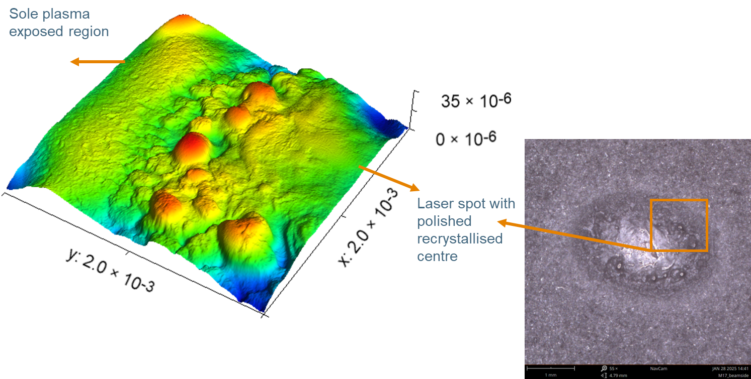
Overview of activity
EUROfer samples coated with 0.5-1 mm W
Base temperature of 500 °C generated by H plasma
ΔT=1100-2500 °C from 3-4 ms laser pulse, leading to max 950 °C at EUROfer surface
Laser spot shows strong recrystallization and morphology changes
Analysis of cross sections ongoing

Slide 20
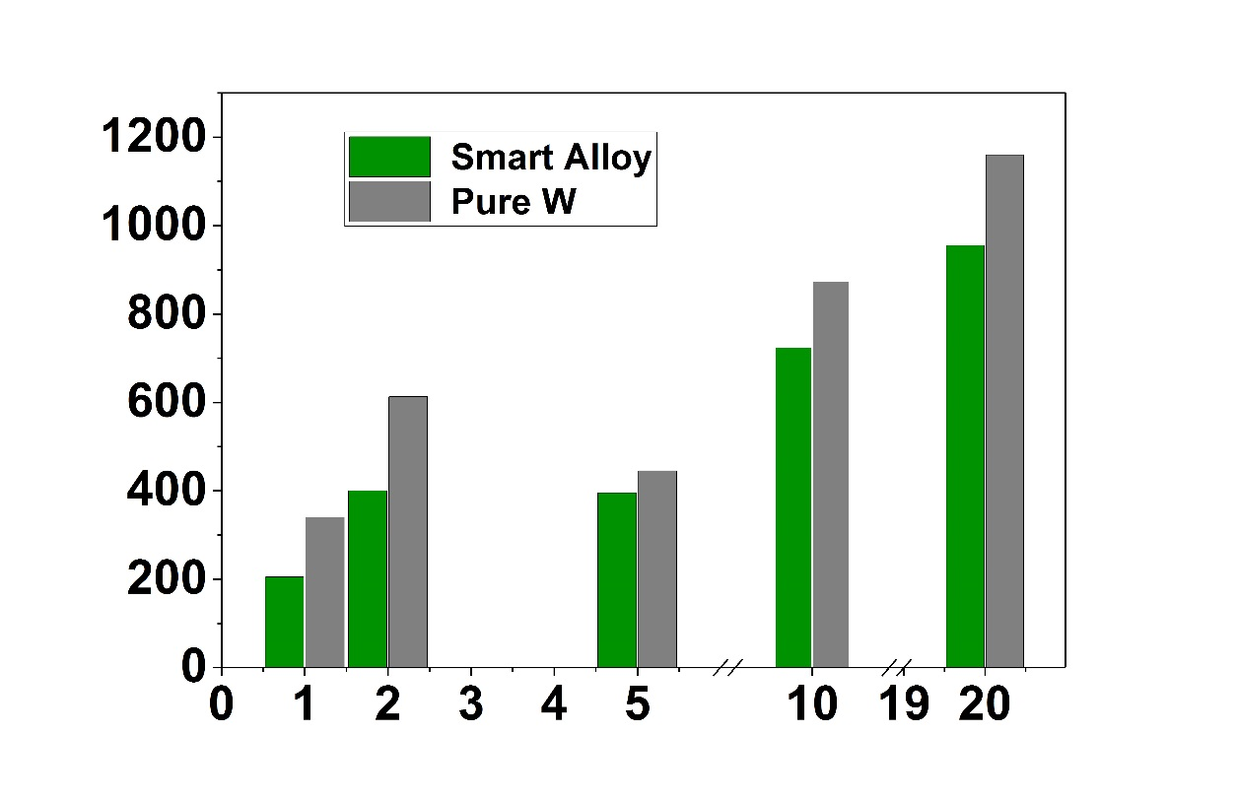
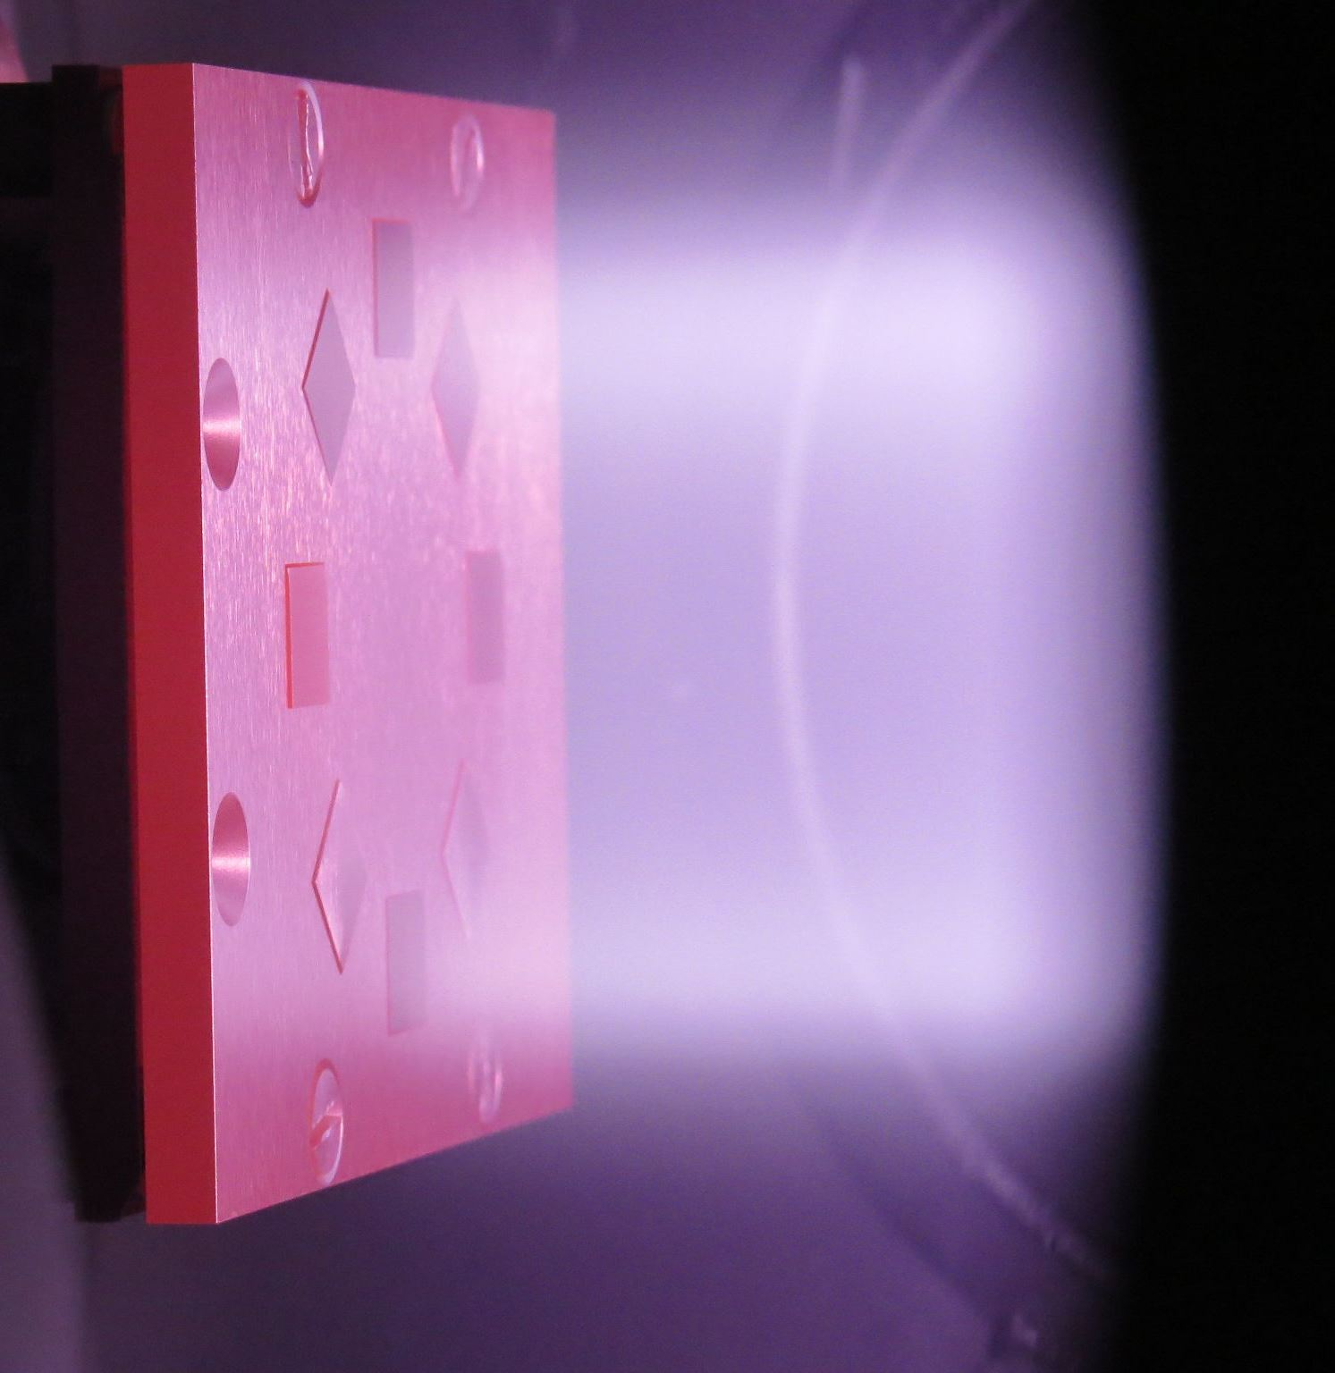
Plasma performance: sputtering resistance^{1,2}
Highlight result
Steady-state
deuterium plasma
Mass loss, microgram
Surface recession
W vs. SMART
210 nm : 220 nm
260 nm : 260 nm
DEMO operation days
Higher mass loss for pure W
Identical sputtering of W and SMART
¹J. Schmitz Ph.D. Thesis, FZJ, Univ. of Bochum and Univ. of Gent, 2020
²A. Litnovsky et al., Metals 11 (2021) 1255

Slide 21
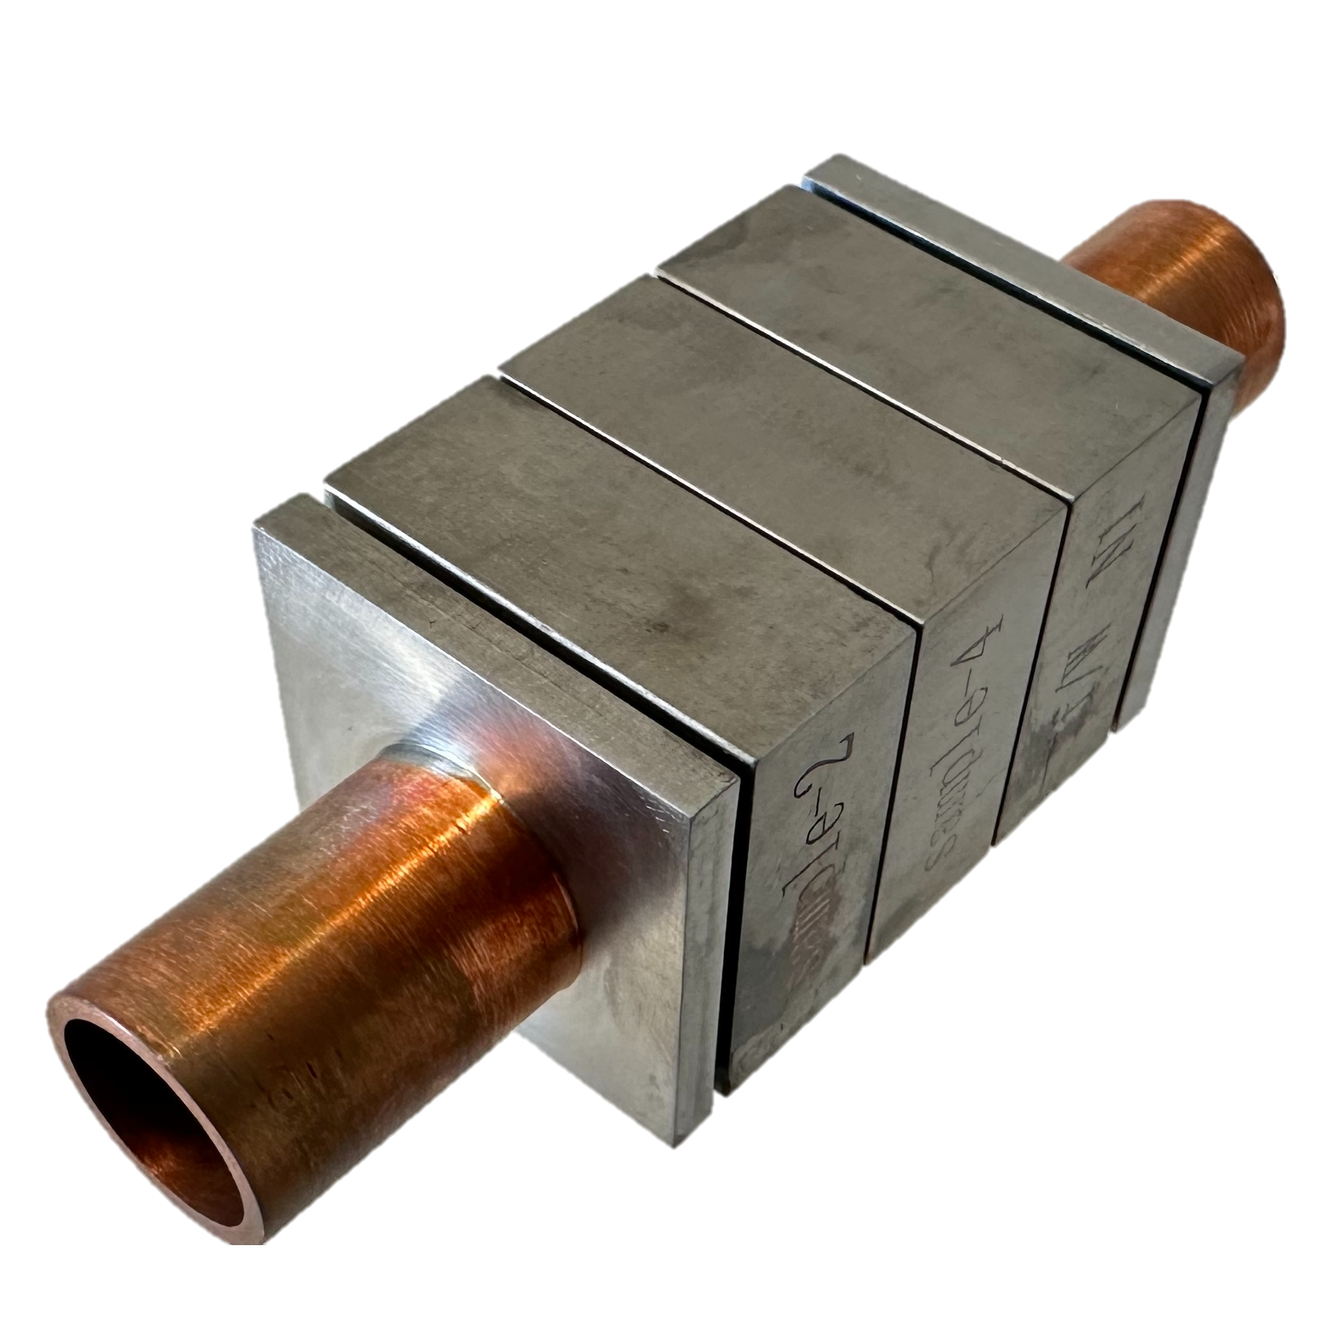

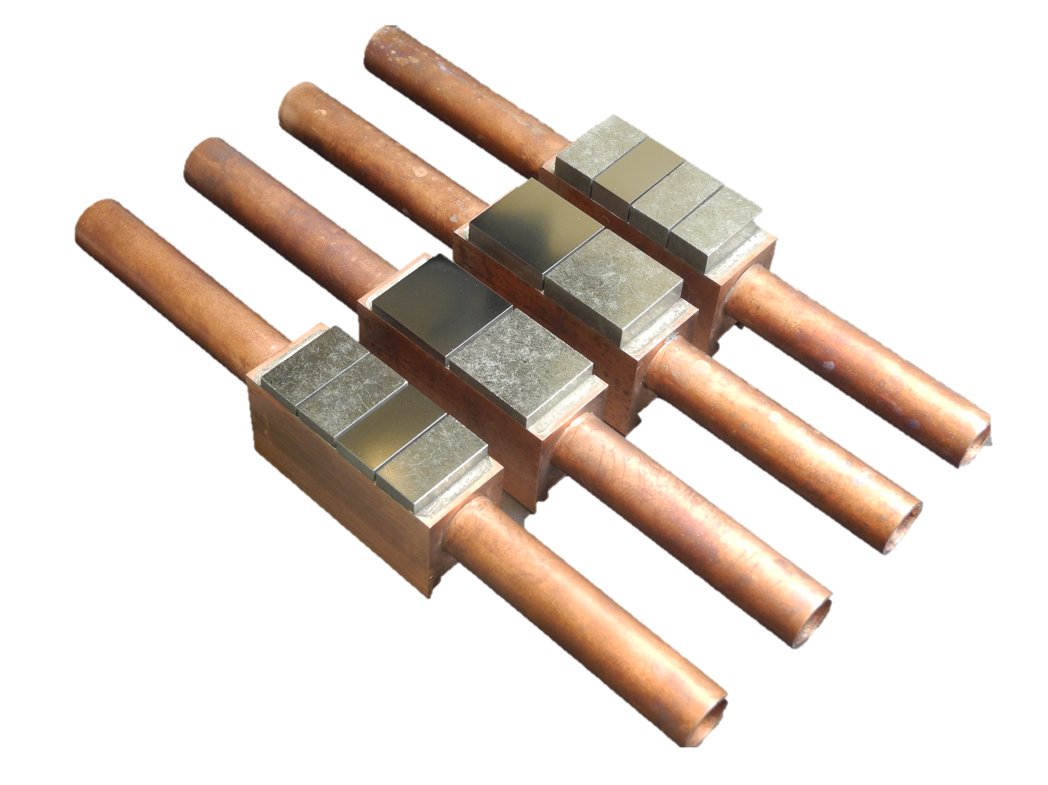
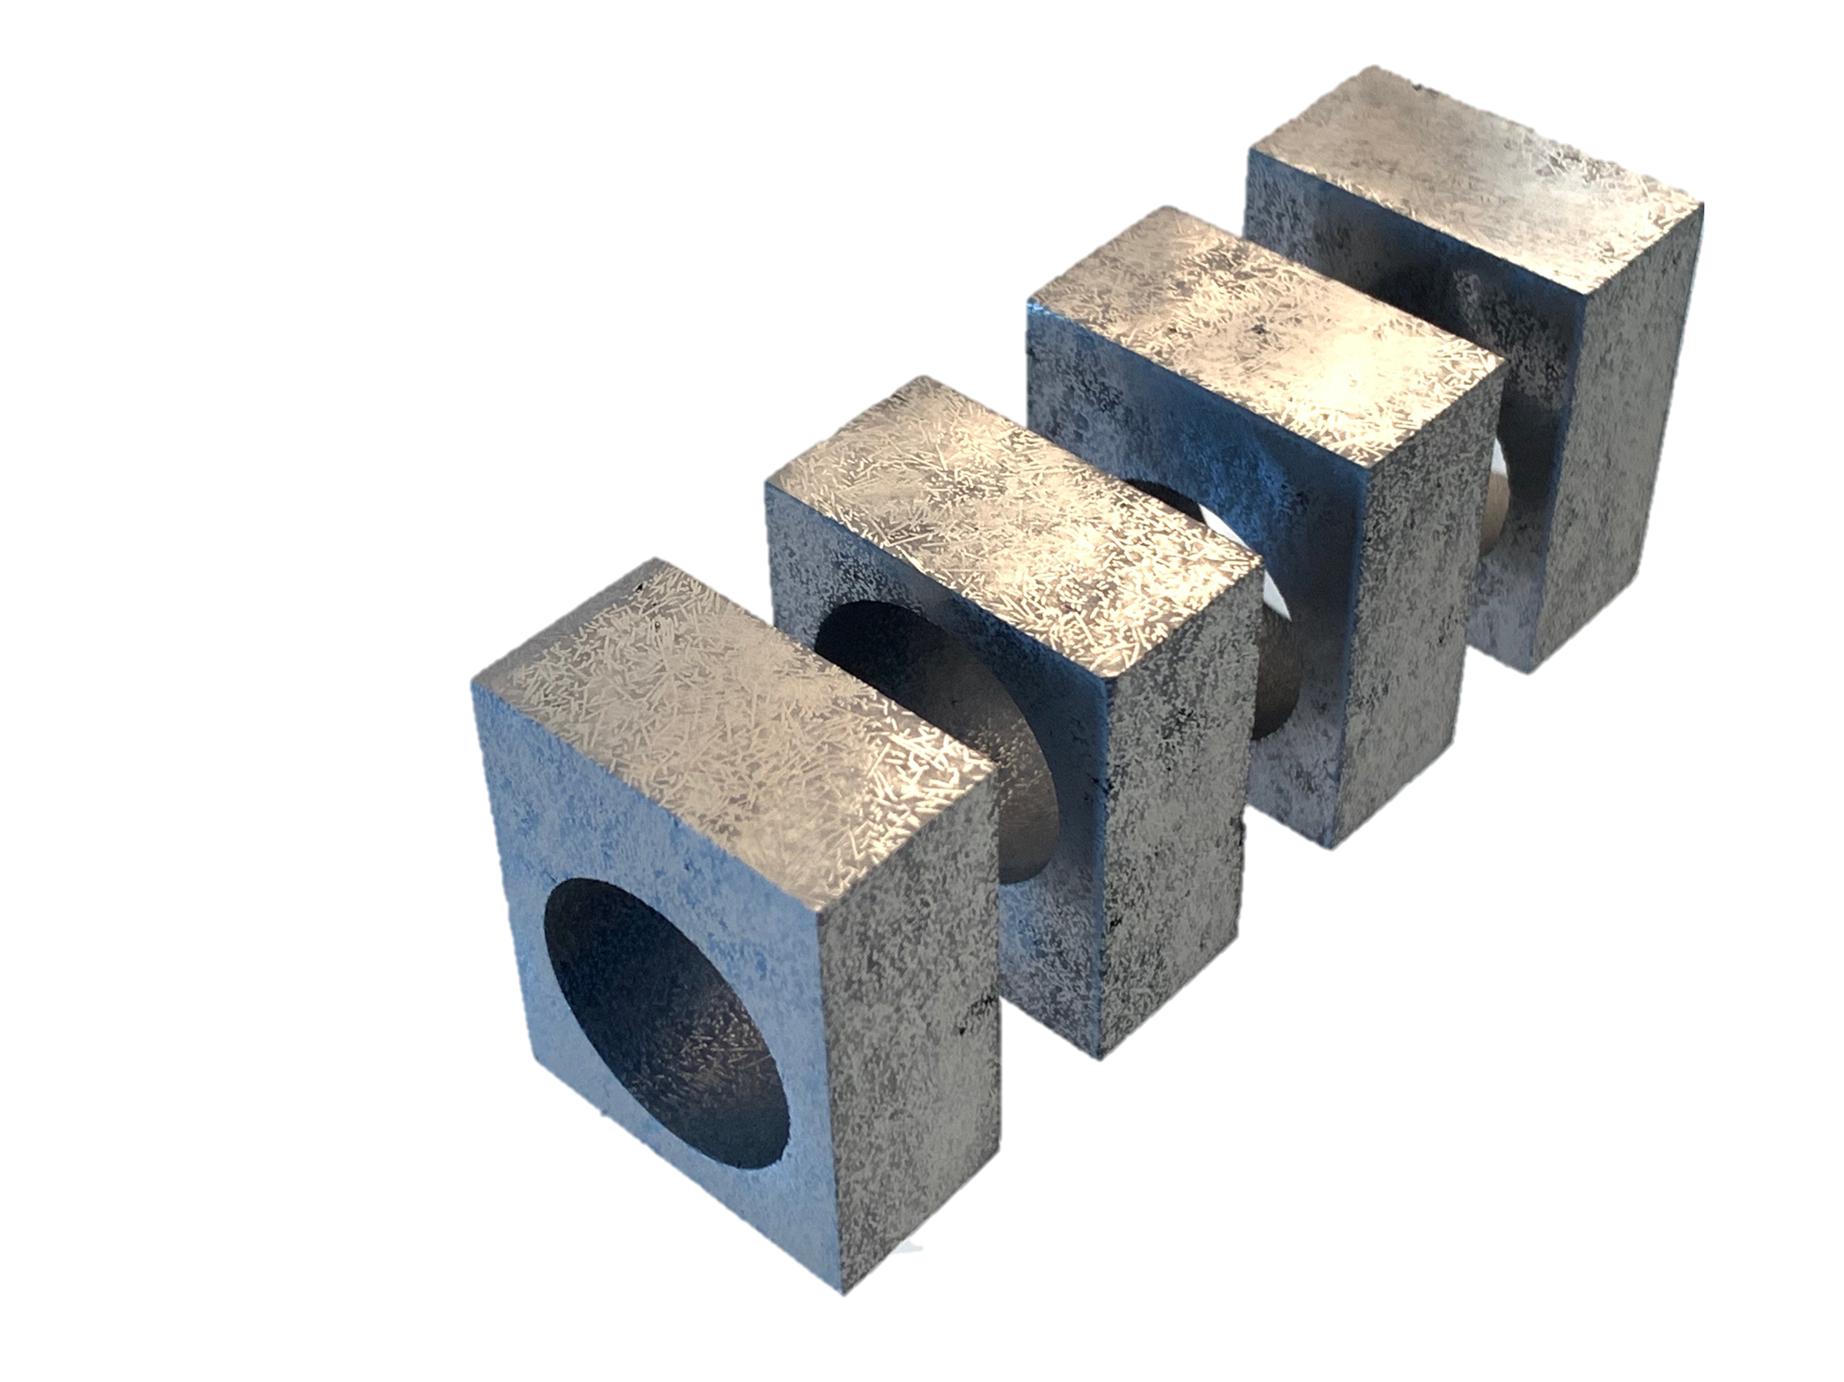

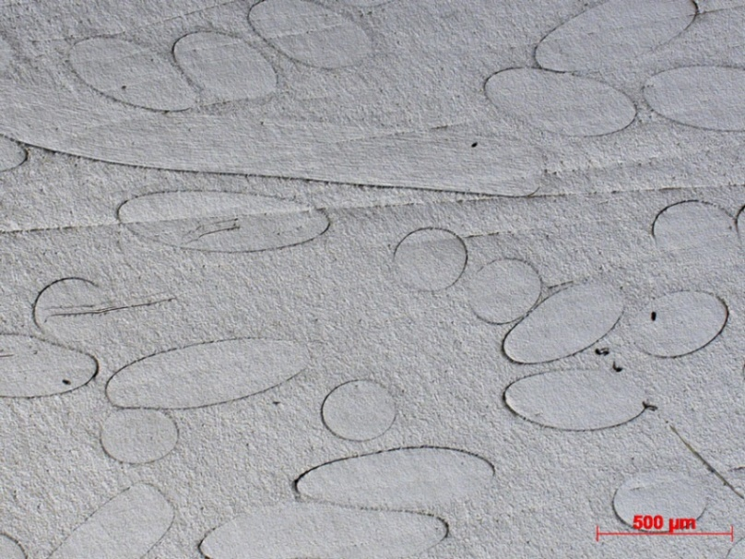



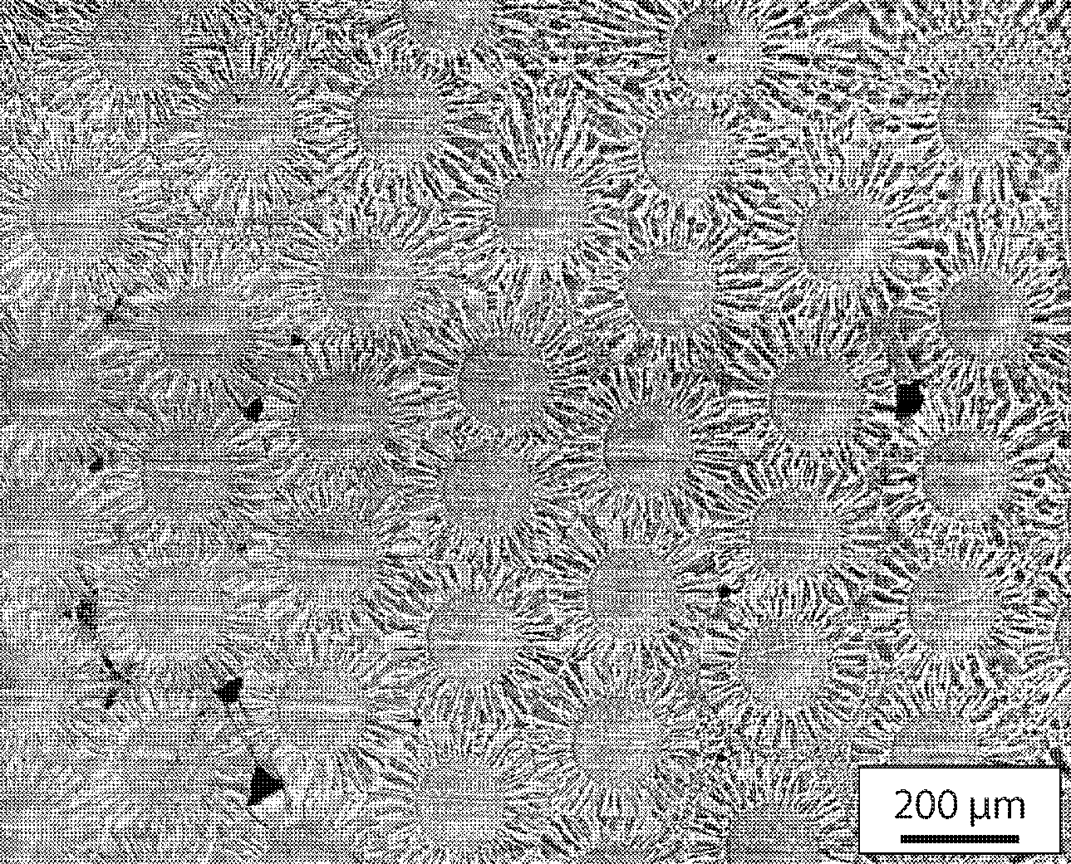
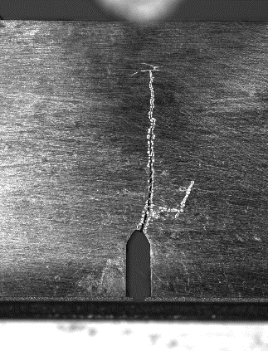
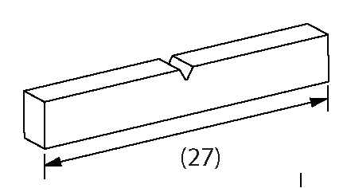

Tungsten Fibre Reinforced Tungsten
PM-W_{f}/W
Short fibres, isotropic orientation, produced by powder metallurgy
Porous Matrix
W_{f}/W
Long fibre W_{f}/W
Feb. 2023
Aug 2023
200 µm
2019
Sample | Kq (MPa m/^{1/2})
ALMT W | 11
Long Fibre 0-90 | 34 ± 2
Industrial coating long fiber | 66 ± 4
Porous matrix | 21 ± 7
Short fiber | 28 ± 9
CVD-W_{f}/W
Long fibre reinforced, continuous & directional, produced by chemical vapour depositon
2017
KLST type sample
200 µm
Test up to 20MW/m²

Slide 22
WP PWIE SPA 4
Report for 2025 & Overview

Slide 23
High Temperature performance of Armour Materials: Recrystallization and Melting
Deliverable Owner | Beneficiary | PM | Deliverable (Team)
M. Richou | CEA | 9 | D001
W. Pantleon | DTU | 9 | D002
S. Ratynskaia | VR | 12 | D003 (S.Ratynskaia, P.Tolias,K. Paschalidis, T. Rizzi, A. Kulachenko)
I. Garkusha | KIPT | 30 | D004
M. Rasinski | FZJ | 4 | D005 ( M. Rasinski, A. Kreter, M. Vogel)
Prof. Hidding | HHU | 6 | D006
Total |  | 70
Characterization of microstructural changes caused by plasma exposure. Tungsten-based material exposed to different plasma conditions will be investigated in terms of mechanical and microstructural depth profiles. Heterogeneities will be traced in hardness and orientation maps and the locally dominating restauration mechanism identified. (DTU)
Tungsten material exposures in the QSPA under giant ELMs or disruptions with pronounced surface melting (KIPT). Characterization of dust in QSPA experiments: size analysis, influence of B field on trajectories. Stick effects at the surface.
Plasma heat loads which causes surface recrystallization and changes in Microstructure and melt threshold (QSPA/PSI-2/GLADIS) (KIPT, CEA, VR)
Assessment of effect of H and He on W recrystallization with links to WP TE (FZJ, DTU, CEA)
Joint activities with WP TE on damaged components (e.g. melting) (VR)
Experiments on Recrystallization in PSI-2 linked with SP A1 (FZJ, DTU)
Further application of MEMENTO modelling to melt flows across castellated PFCs (link with WPTE experiments ).
Further development of the MEMENTO + Geant4 code chain for RE-induced bulk melting assessments.
Further development of thermomechanical modelling of RE-induced PFC brittle failure (Geant4 + COMSOL).
Initial development of full thermomechanical modelling of RE-induced explosions of brittle PFCs including fragmentation (Geant4 + LS-DYNA)"
Device | Beneficiary | Days | Related Deliverable
PSI-2 | FZJ | 3 | D005
QSPA | KIPT | 10 | D004
Accelerator | VR | 5
Deliverable ID | Deliverable Title
D001 | Assessment of plasma impact on material properties linked to ITER relevant PFUs (CEA)
D002 | Annealing of chosen tungsten-based materials and quantification of recrystallization kinetics (DTU)
D003 | Development of MEMENTO and MEMENTO + GEANT 4 including RE - Damage (VR)
D004 | Influence of plasma pre irradiation with heat loads near surface recrystallization on surface damaging with heat loads above the melting threshold (KIPT)
D005 | Analysis of PSI-2 exposed materials, focusing on funding the relevant regime for fuzz formation in AUG He campaign (FZJ)
D006 | Simulation of Runaway Impact by Electron Beam at 10-100MeV

Slide 24




PWIE-SP A.4.T-T004-D001
Assessment of plasma impact on material properties linked to ITER relevant PFUs (CEA)
A. Durif¹, A. Flament¹, M-F. Barthe², S. Kalacska³, N. Peillon³, M. Lenci³, M. Mondon³, M. Diez¹, G. Kermouche³,
Y. Corre¹, M. Richou¹, and the WEST team
¹CEA, IRFM, F-13108, Saint-Paul-lez-Durance, France
² CEMHTI/CNRS, Université d’Orléans, 3A rue de La Férollerie, 45071 Orléans CEDEX 2, France,
³Mines Saint-Etienne, CNRS, UMR 5307 LGF, Centre SMS, Saint-Etienne F - 42023, France

Slide 25
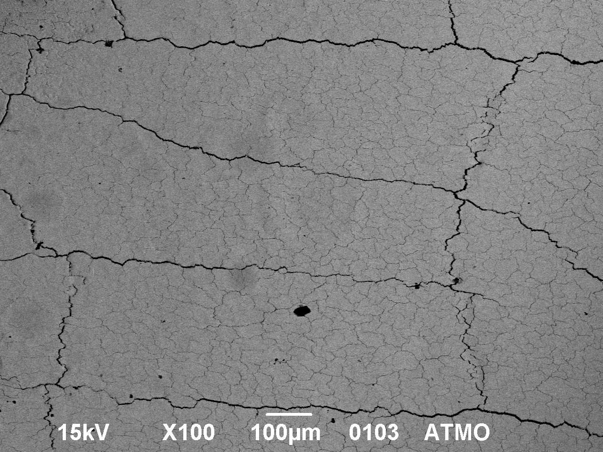
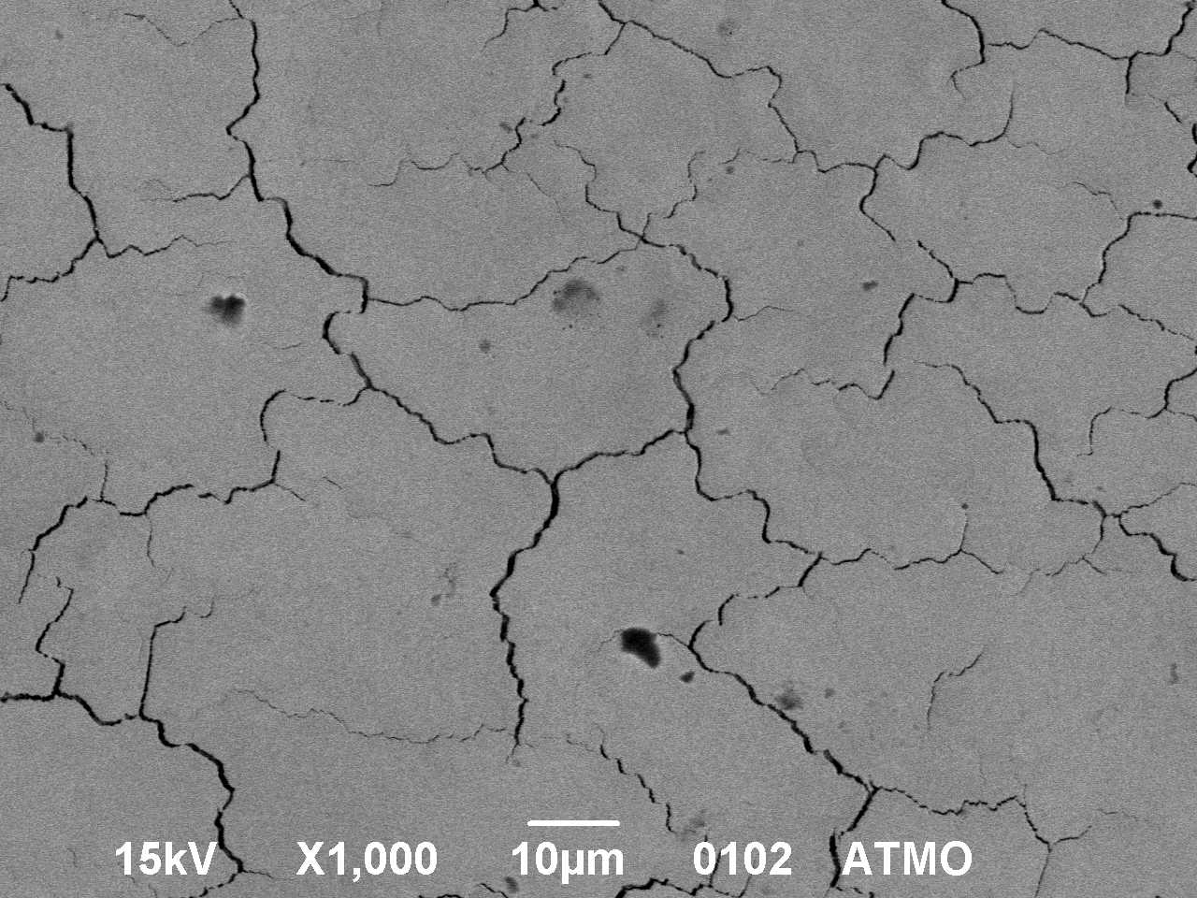
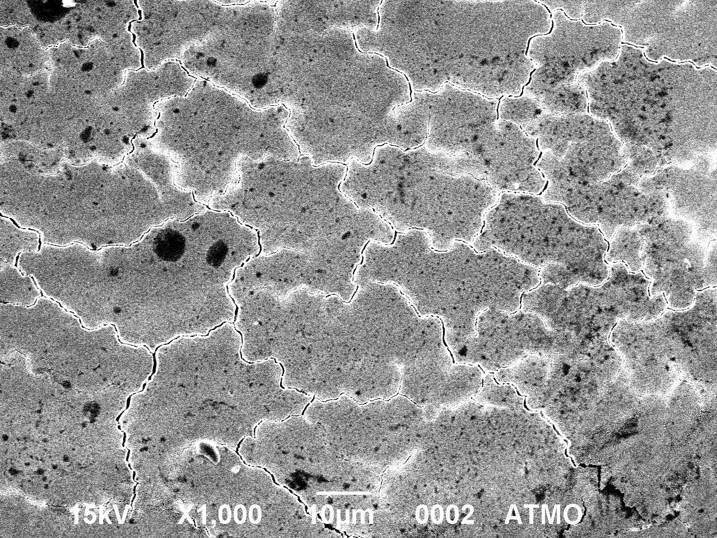
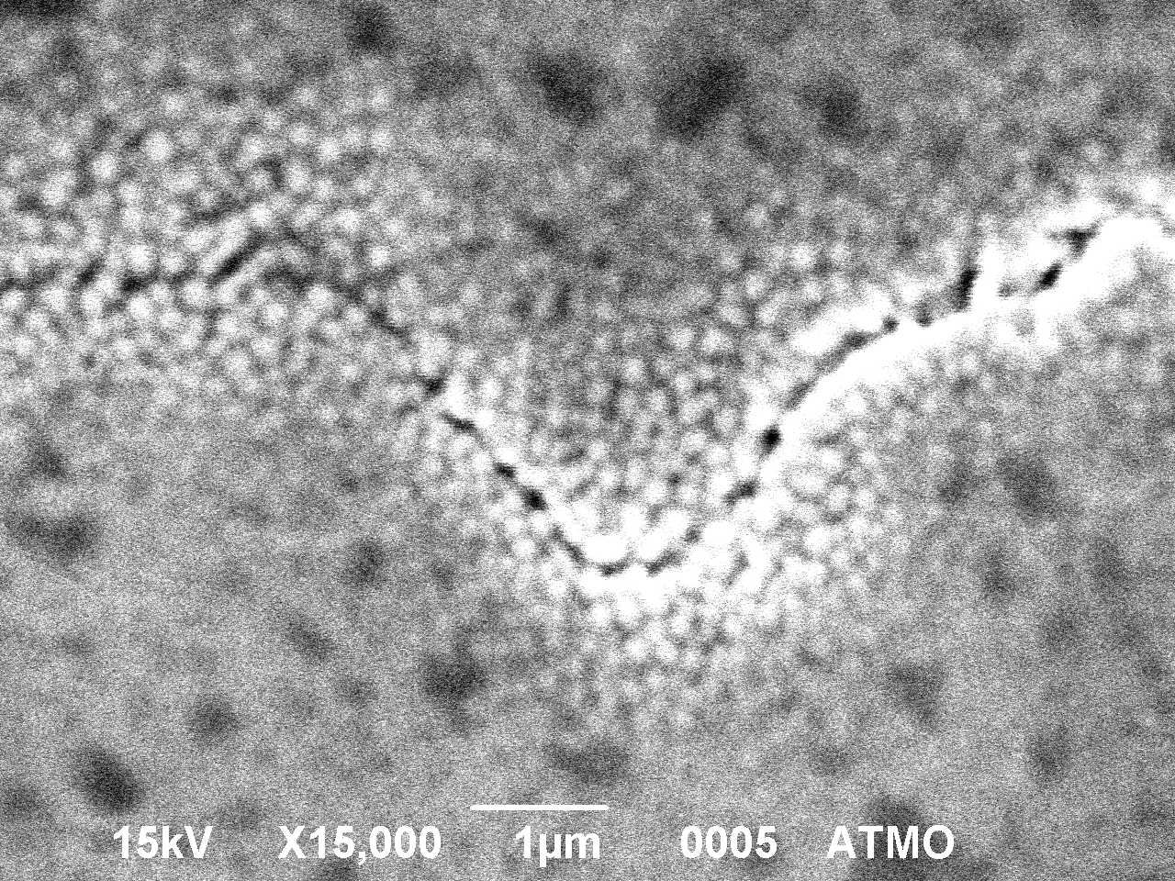
PWIE-SP A.A4.T-T004-D004: Analysis of re-melted W layers
ATM W under QSPA load above the W melting threshold
After QSPA exposure: T=RT, 10 pulses, surface heat load of 0.9 MJ/m² and a duration of 0.25 ms.
Re-solidified layer are observed on affected surface
Network of large cracks (cell sizes up to 0.5 mm)
Intergranular network of cracks with cell size up to 0.05 mm
Cracks width up to 1 μm.
Fine cellular structure in re-solidified layer along the crack edges?

Slide 26
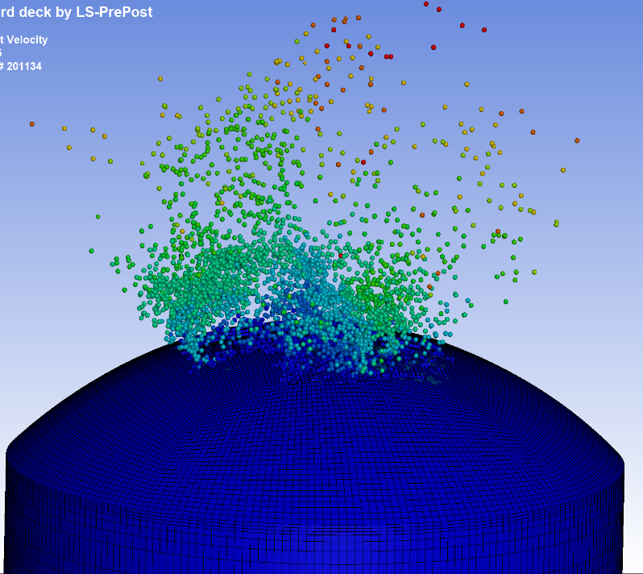
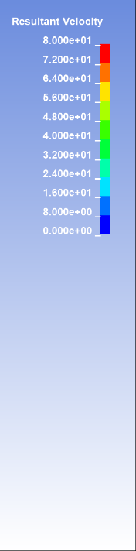

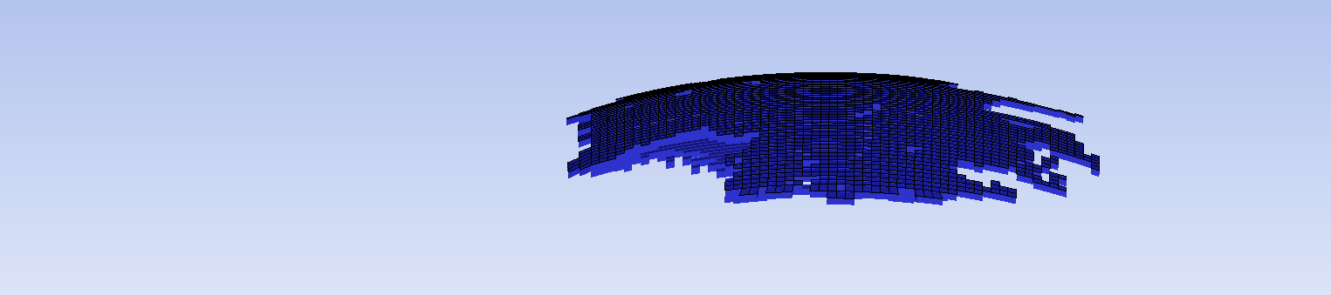
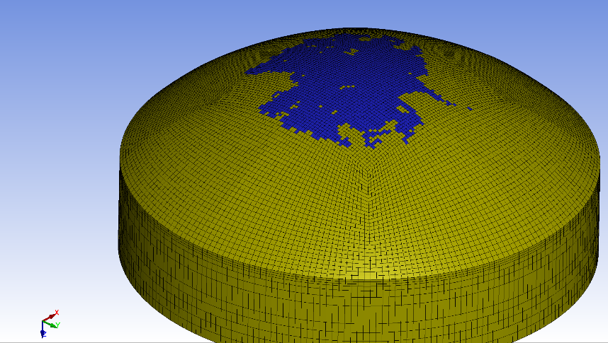
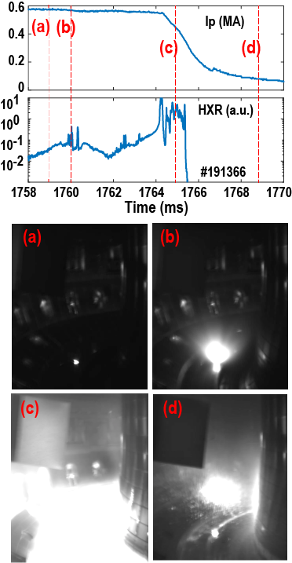
Modelling of brittle material fragmentation
Linear thermo-elastic response successfully modelled to predict onset of failure in DIII-D experiment with graphite.
Workflow: KORC + Geant4 + COMSOL.
S. Ratynskaia et al, Nucl. Fusion Letter 65 (2025)
Now developing full nonlinear response model capable of predicting also release of debris
Work-flow : Geant4 + LS-DYNA.
LS-DYNA simulations are based on FEM + SPH approach
(SPH: Smoothed Particle Hydrodynamics)
MC (Geant4) + FEM / SPH (LS-DYNA) work-flow calculations of the DIII-D
ATJ graphite sample response to REs
Blown-off
volume
DIII-D experiment
debris
DIII-D experiment
graphite
sample

Slide 27
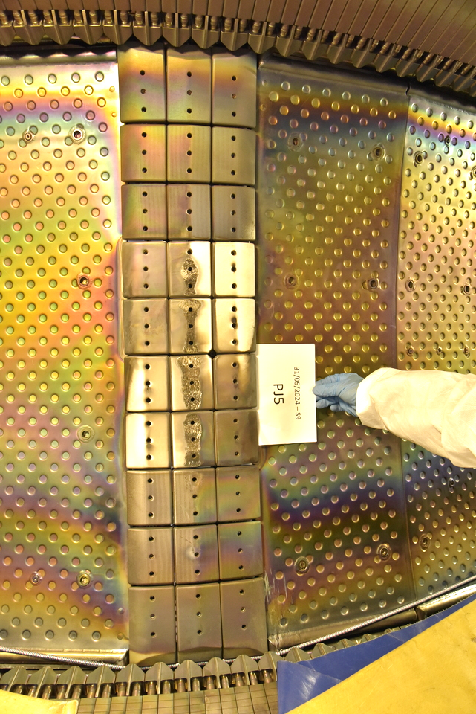
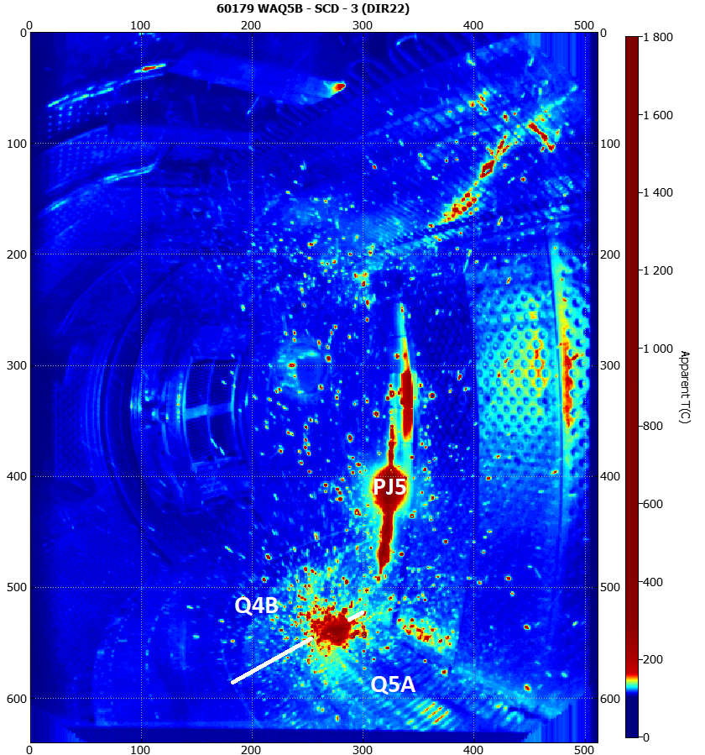
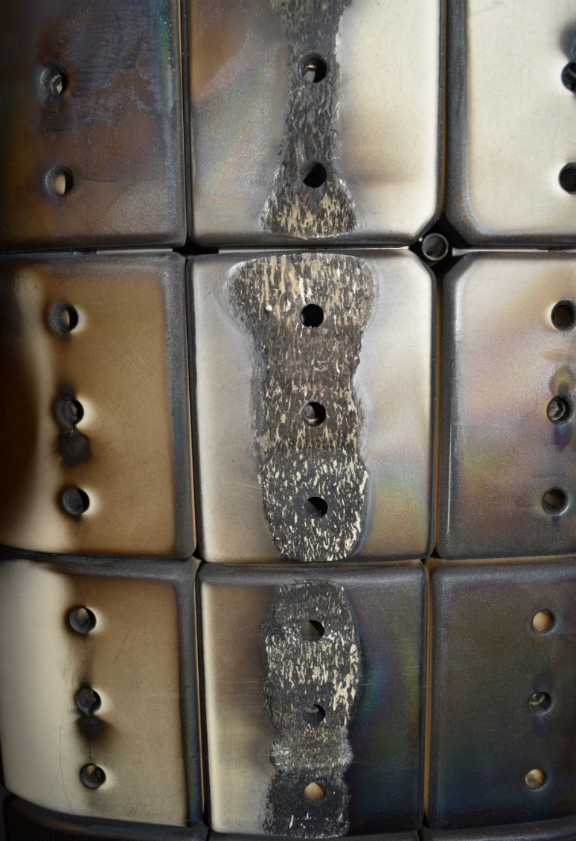
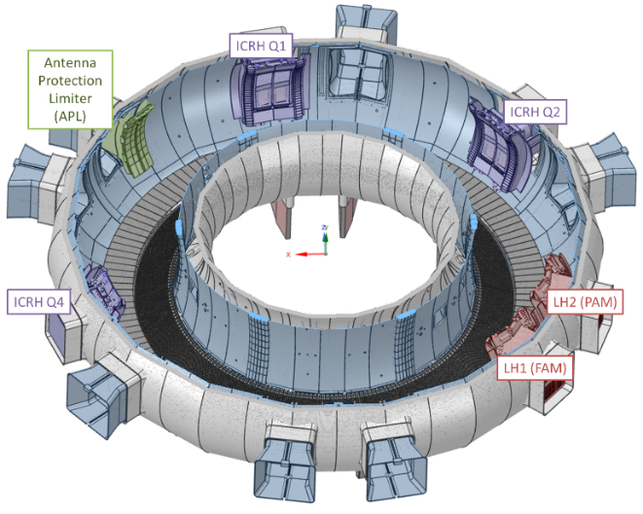
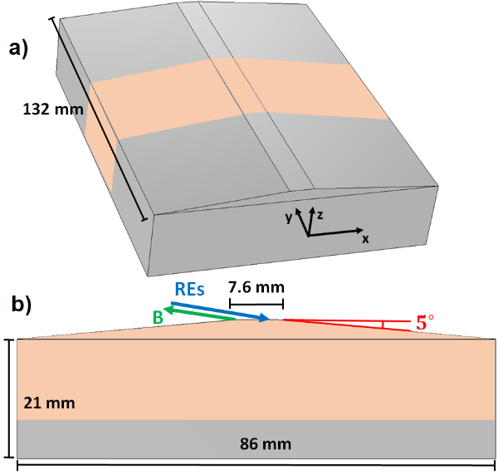
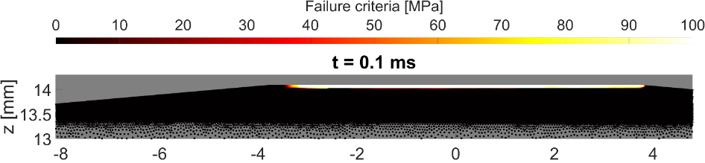
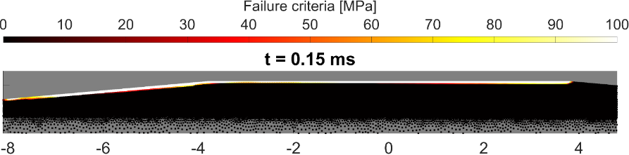
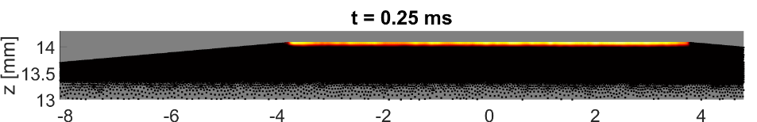
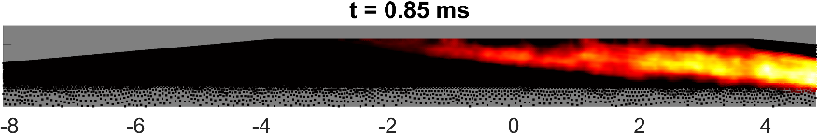
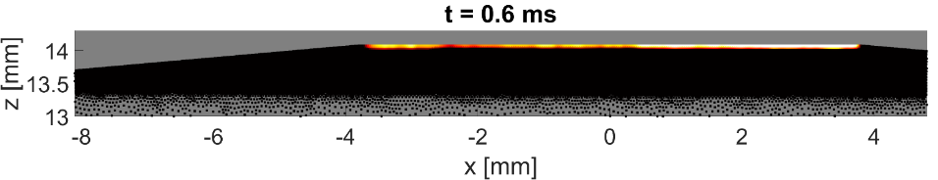
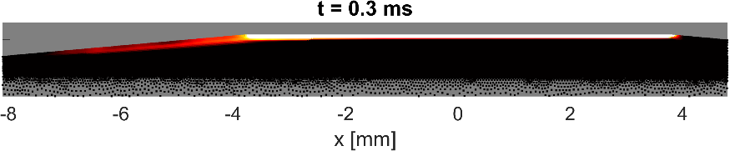
Modelling of brittle failure: BN in WEST
The developed work-flow is successfully applied to BN tiles in WEST (accidental damage)
RE
Modeling of runaway electron induced damage on boron-nitride tiles in WEST
T. Rizzi et al, submitted to NME 2025
arXiv:2509.15821
PJ5
Matching observations
Not matching observations
20 MeV 0$°$ pitch
2 MeV 0$°$pitch wetting edge
2 MeV 25$°$ pitch
20 MeV 10$°$ impact
10 MeV 10$°$ pitch
10 MeV 0$°$pitch wetting edge

Slide 28
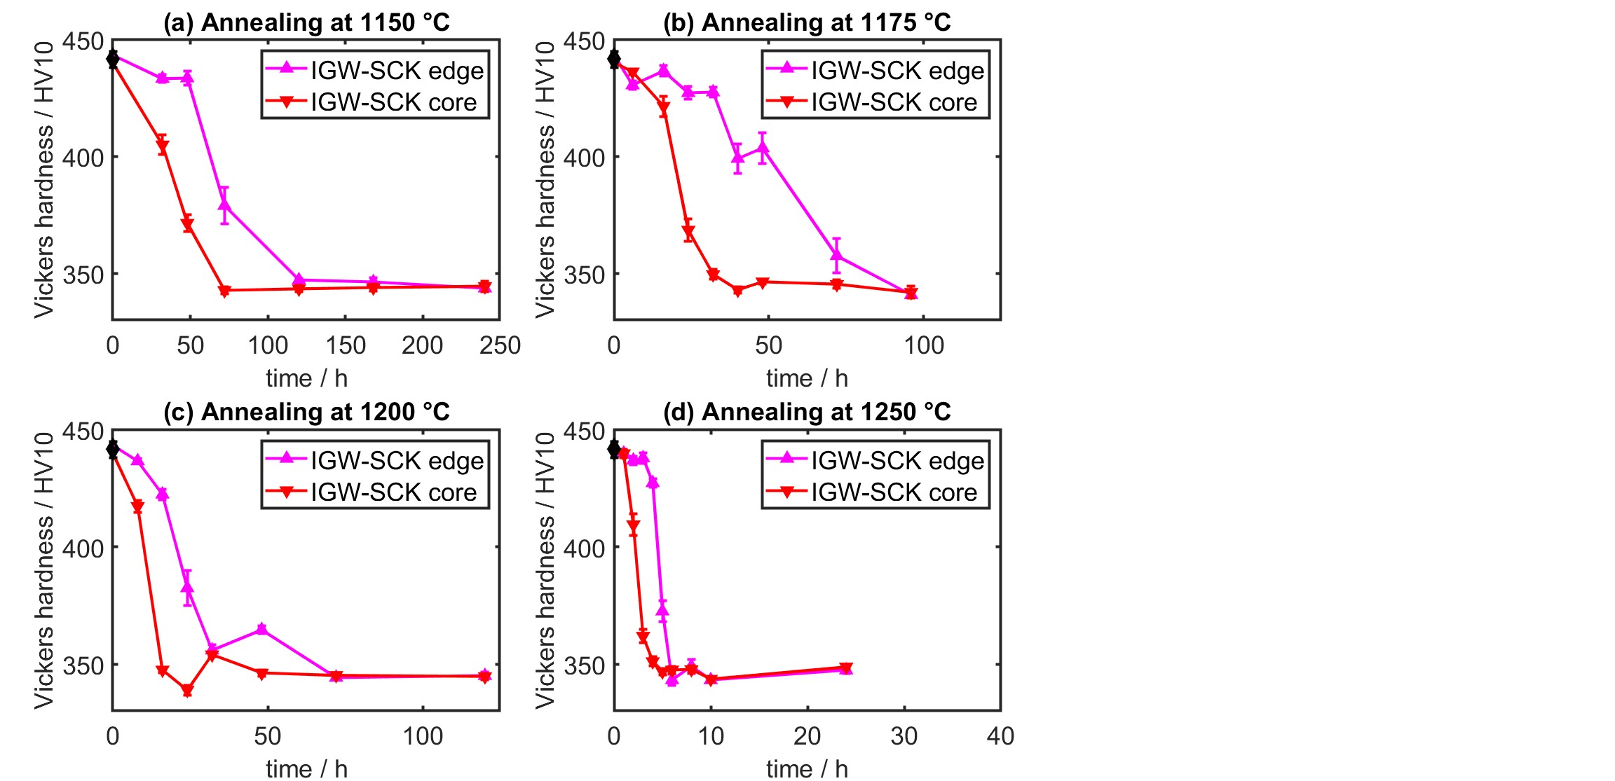
IGW-SCK – hardness evolution – Update Nov 25
Core faster than edge (as for previous A.L.M.T. plates)

Slide 29
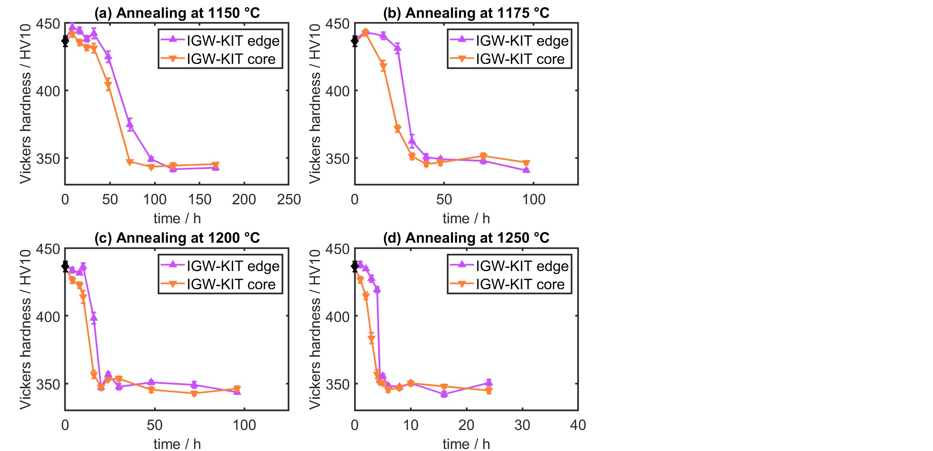
IGW-KIT – hardness evolution – Update Nov 25
Core faster than edge (as for previous A.L.M.T. plates)

Slide 30
WP PWIE SPA 5
Report for 2025 & Overview

Slide 31
Compass-U
Deliverable Owner | Beneficiary | PM | Deliverable (Team)
Renaud Dejarnac | IPP.CR | 16 | D001 (J.Mtejicek, A.Rednyk,R.Dejarnac,P.Vondracek,J.Caloud,K.Patocka,M.Durovec,M.Bousek,J.Klecka,D.Kirhetov)
Daniel Alegre | CIEMAT | 2 | D002 (D. Alegre, S. Shick, D. Tafalla, P. Fernández-Mayo, T., Hernández, A. De Castro and E. Oyarzabal)
Pavel Veis | CU | 4 | D003
Thomas Morgan | DIFFER | 2 | D004
Laura Laguardia | ENEA | 2 | D005 (Iafrati, Pedroni, Ghezzi, De Angeli)
Marius Wirtz | FZJ | 1 | D006
Elzbieta Fortuna-Zalesna | IPPLM | 6+6 | D007
James Paterson | UKAEA | 4 | D008, D009
Total |  | 39
Task under SP A5 include the preparatory work on assessing and analysing the material candidates for COMPASS-U this includes particularly heat flux performance as well as material evolution on microstructure, and surface condition. The work is based on a comprehensive pre-characterization of the 9 candidate W materials (IPPCR) with a potential down-selection to main suppliers, Plansee, ALMT, AT&M. Exposures will be performed in JUDITH, PSI-2(FZJ), OLMAT (CIEMAT) and Magnum (DIFFER). As an example, disruption simulation on the surface and at edges of COMPASS-U W armor will be performed at OLMAT. The damage threshold in terms of power density and number of pulses will be determined, especially critical at edges. The damage at maximum power densities, ~7 GW/m², will also be studied to determine the damage of mild or partially mitigated disruptions in DEMO (expected at a minimum of 30 GW/m²).
Pre- and post-Characterization including various techniques as highlighted in the deliverables will be performed (FZJ, CIEMAT, DIFFER, ENEA, IPPLM). A new addition here is particular the detection of nano-cracking in the surface layer of the first wall as it can be crucial for reducing D/T fuel retention in the wall. CW IR laser heating and IR camera scanning of heated area allows the rapid detection of nano-cracking in the top layer of the first wall (CU). Comparative analysis for the various materials will be performed also including comparing multiple analysis techniques
Deliverable ID: | Deliverable Title:
D001 | Comprehensive pre-characterization of the 9 candidate W materials
D002 | Fast transient simulation on COMPASS-U W armor by a CW laser at OLMAT
D003 | Nanocracking detection studies on sxposed materials from PSI-2, Magnum, OLMAT, JUDITH
D004 | ELM-like loading effects on different W grades
D005 | Post Mortem Analysis , and TDS
D006 | Studies on Materials supplied for COMPASS U in on HHF
D007 | Comparative Microscopy studies on samples exposed in PSI-2, MAGNUM, JUDITH & OLMAT
D008 | Establish a round robin test with other HHF Test Facilities to Benchmark HIVE (UKAEA without EUROfusion funding)
D009 | Tungsten High Temperature testing.
Device | Beneficiary | Days | Related Deliverable
OLMAT | CIEMAT | 4 | D002
MAGNUM-PSI | DIFFER | 2 | D004
PSI-2 | FZJ | 2 | D006
JUDITH-2 | FZJ | 8 | D006
Microscopy – 10+10 k€ - IPPLM
Hive + Lab – 75k€ - UKAEA

Slide 32
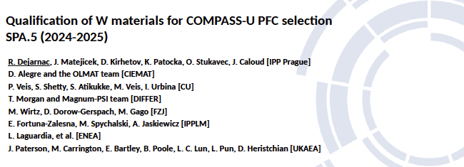

Slide 33
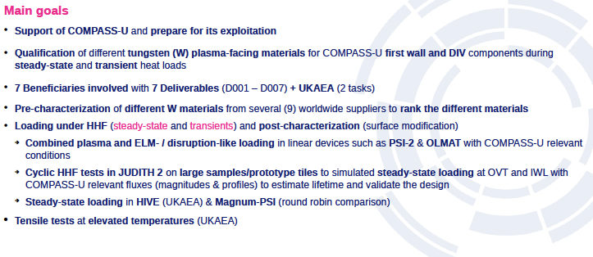

Slide 34
2026 Plans of SP A

Slide 35
PWIE Structure in 2026 and 2027
Project Leader: S. Brezinsek
Deputy Leader: D. Douai
PSO: D. Alyassin / NN
Project | Titel | Leader
SP A | Particle and heat load studies in preparation of the exploitation of ITER and a fusion power plant | J.W. Coenen
SP B | Experiments on erosion, deposition, and material migration | A. Hakola
SP C | Fuel retention and release | K. Schmid
SP D | Plasma-edge and plasma-wall interaction modelling | A. Kirschner
SP E | JET post-mortem analysis, LIBS and associated interpretation | J. Likonen
SP F | Wall conditioning and boronization physics | A. Goriaev
SP X | Plasma characterization and laser-based diagnostic development | I. Classen
In general: Tasks and Deliverables are prepared for 2026 and 2027
IMS entry of tasks and deliverables shall be completed by first week of March

Slide 36
2026 Tasks and Deliverables
SP A: Particle and heat load studies in preparation of the exploitation of ITER and fusion power plant
PFM and PFCs for the divertor and the first wall, relevant for ITER (SRO and DT-1) and DEMO design options,
are studied with respect to their performance under steady-state and transient high heat flux and plasma load mimicking
tokamak conditions to be expected. A detailed analysis of production history, thermomechanical properties connected to
exposure conditions including multiple cycles, seed species, and helium impact is required to validate lifetime estimates
for existing W divertor and first wall component solutions for ITER (SRO and DT-1) as well as to allow extrapolations to
PFC materials and PFM design for DEMO and other devices within the EUROfusion portfolio. The work in 2026-27 covers
different strands focusing on PWIE studies on materials for ITER below and above their specification as well as on
pre-damaged samples to study the performance and asses the lifetime and damage evolution until failure of the component.
These studies are carried in conjunction with exposures in tokamaks, in high heat flux facilities, and in linear devices on
different materials including ITER-grade PFUs to address critical issues related to re-crystallization, melting and vapor
shielding during runaway electron interaction. Single or combined plasma loading to address synergistic effects will be
done for DEMO, JT-60SA, W7-X proposed materials. Exposures in MAGNUM-PSI and JUDITH based on ITER W
mono-block chains will address the impact of pre-damaged materials, in connection with WPTE studies in WEST.
Pre- and post-characterization of utilized PFCs and PFMs is part of this subproject as in previous years.
Plasma exposure of W-coating solutions for ITER will be carried out in PSI-2 to mimic steady-state loads.
Dedicated modelling of runaway electron impact damage is included in order benchmark codes for ITER
with full-W first wall. Cycling tests of ITER-grade W under VDE and RE load in JUDITH are foreseen covering the
non-actively cooled PFCs foreseen in SRO and prone to many disruptions. In general, experiments in linear facilities (
MAGNUM-PSI, PSI-2, UPP), and high flux facilities (GLADIS, JUDITH, OLMAT) are connected to studies in toroidal
devices like WEST via WPTE and associated modelling.
The three task activities will be:
SP A1: Testing and qualification of ITER (-relevant) materials for SRO and DT-1 under synergistic loading at high particle fluences and heat fluxes
SP A2: Evolution of materials under accumulating Helium and extreme loading conditions for ITER (DT-1)
SP A3: Testing and qualification of standard and advanced materials under synergistic loading at high particle and heat fluxes for DEMO, JT-60SA, and W7-X

Slide 37
SP A1: Testing and qualification of ITER (-relevant) materials for SRO and DT-1 under synergistic loading at high particle fluences and heat fluxes
ITER-relevant tungsten PFMs/PFCs for divertor and first wall (SRO and DT-1) are tested under steady-state plasma, cyclic high-heat-flux and transient loads to validate lifetime estimates and damage evolution up to failure. The work quantifies the role of manufacturing route, pre-damage and exposure history, including seeded species and helium effects, and connects linear plasma and HHF facilities to toroidal device conditions via harmonised pre- and post-characterisation. Results provide traceable operating envelopes and comparability protocols supporting ITER exploitation and extrapolation toward Fusion Pilot Plant design choices.

Slide 38
Deliverables [2026]:
SPA1-D26-01 (Owner: Forschungszentrum Jülich): Matrix update + 2026 dataset: damage thresholds and dominant damage mechanisms under combined/sequential loads for baseline W variants (including seeded-impurity cases where available).
SPA1-D26-02 (Owner: DIFFER): Dust emission response of co-deposited tungsten under high-flux pulsed plasmas: first quantified trends + controlling parameters.
SPA1-D26-03 (Owner: CIEMAT): OLMAT-based threshold mapping for baseline tungsten under disruption-like/ELM-like laser and HHF-relevant loading; 2026 update of test matrix and key findings.
SPA1-D26-04 (Owner: Max Planck Institute for Plasma Physics): GLADIS cyclic HHF reference dataset for baseline tungsten/coating variants used in SPA1 synergy matrices (damage onset + fatigue response, with traceable test conditions).
SPA1-D26-05 (Owner: DIFFER): 2026 dataset: transient erosion response of damaged tungsten surfaces under high-flux/high-fluence plasma conditions (incl. first mechanistic interpretation).
SPA1-D26-06 (Owner: Max Planck Institute for Plasma Physics): Pre-/post-characterisation summary for selected component-relevant samples, including validated measurement workflow for erosion/cracking metrics.
SPA1-D26-07 (Owner: CEA): Crack-network modelling application + preliminary WEST W limiter operational feedback: implications for damage interpretation and margins.
SPA1-D26-08 (Owner: KIPT): Transient-load study: influence of plasma pre-irradiation near recrystallization threshold on subsequent damage and melting-threshold behaviour (2026 dataset).
Deliverable Owner | Beneficiary | PM | Deliverable (Team)
D.Alegre | CIEMAT | 4 | SPA1-D26-03 D.Alegre / NN
A.Durif | CEA | 6 | SPA1-D26-07 A.Durif / M.Richou
T.Morgan | DIFFER | 8 | SPA1-D26-02/05 T.Morgan / NN
V.Makhlai | KIPT | 25 | SPA1-D26-08 V.Makhlai / NN
M.Wirtz / J. Coenen | FZJ | 6 | SPA1-D26-01 M.Wirtz / J. Coenen / NN
J.Riesch | MPG | 5 | SPA1-D26-04/06 J.Riesch / M.Balden/ NN
Total |  | 54
Device | Beneficiary | Days | Related Deliverable
PSI-2 | FZJ | 7
JUDITH | FZJ | 10
Accelerator | FZJ | 3
Accelerator | DIFFER | 1
Accelerator | MPG | 5
GLADIS | MPG | 5
MAGNUM-PSI | DIFFER | 7
UPP | DIFFER | 5
QSPA | KIPT | 25
OLMAT | CIEMAT | 5 | SPA1-D26-03

Slide 39
SP A2: Evolution of materials under accumulating Helium and extreme loading conditions for ITER (DT-1)
Helium accumulation and mixed-species plasma exposure are combined with extreme transient loading to resolve how microstructural evolution (including recrystallization) changes damage thresholds and high-temperature performance relevant for ITER DT-1. The work delivers depth-resolved kinetic data and composition-dependent mappings of erosion, fuzz and recrystallization, providing traceable guidance for operation near limits and interpretation of history effects. Outputs support DT-1 exploitation and extrapolation toward Fusion Pilot Plant / Fusion Power Plant boundary conditions.

Slide 40
Deliverables [2026]:
SPA2-D26-01 (Owner: Technical University of Denmark): recrystallization kinetics deliverable: quantified kinetic trends under relevant operation conditions and relevant hardness/orientation maps.
SPA2-D26-02 (Owner: Forschungszentrum Jülich): Mixed-species plasma + transient synergy dataset (2026): erosion/fuzz/recrystallization mapping under controlled composition windows.
Deliverable Owner | Beneficiary | PM | Deliverable (Team)
W.Pantleon | DTU | 4 | SPA2-D26-01 W.Pantleon
M.Rasinski | FZJ | 3 | SPA2-D26-02 Marcin Rasinski / Marius Wirtz
Total |  | 7

Slide 41
SP A3: Testing and qualification of standard and advanced materials under synergistic loading at high particle and heat fluxes for DEMO, JT-60SA, and W7-X
Standard and advanced PFMs/PFCs (including coatings and engineered material concepts) are qualified under high particle and heat fluxes with synergistic combinations of steady plasma, HHF cycling and transients to support extrapolation toward Fusion Pilot Plant / Fusion Power Plant options. The activity provides comparable performance metrics, failure mode identification and protocol harmonisation across facilities, and integrates component performance assessment and monitoring approaches to strengthen materials down-selection for JT-60SA and W7-X relevant conditions.

Slide 42
Deliverables [2026]:
SPA3-D26-01 (Owner: Forschungszentrum Jülich): 2026 advanced-material performance dataset: plasma + HHF response for selected advanced PFM classes (incl. clear boundary conditions and observed failure modes).
SPA3-D26-02 (Owner: DIFFER): High-flux plasma performance evaluation of selected advanced PFMs: comparable metrics + first conclusions for down-selection.
SPA3-D26-03 (Owner: UK Atomic Energy Authority): HIVE testing of tungsten tiles from 3x suppliers under cyclic induction heating loading, monitoring recrystallisation behaviour.
SPA3-D26-04 (Owner: SCK CEN): Irradiated W fibre/yarn mechanical response + microstructure correlation (first closure level) relevant to Wf/W material concepts and allowables.
SPA3-D26-05 (Owner: Max Planck Institute for Plasma Physics): Advanced-PFM qualification package using GIRAFFE (screening/characterisation outputs as applicable) plus GLADIS cyclic HHF results for selected advanced materials/coatings (test conditions + observed limits).
SPA3-D26-06 (Owner: VR): MEMENTO(+energy deposition) modelling update: benchmark cases and improved capability for melt feature interpretation and extrapolation.
Deliverable Owner | Beneficiary | PM | Deliverable (Team)
M.Wirtz / J. Coenen | FZJ | 6 | SPA3-D26-01 M.Wirtz , A.Litnovsky, J. Coenen / NN
T.Morgan | DIFFER | 7 | SPA3-D26-02 T.Morgan / NN
D.Terentyev | SCK-CEN | 2 | SPA3-D26-04 D.Terentyev /NN
J.Riesch | MPG | 4 | SPA3-D26-05 J.Riesch / NN
S.Ratynskaia | VR | 12 | SPA3-D26-06 S.Ratynskaia/ NN
J.Paterson | UKAEA/ CCFE | 2 | SPA3-D26-03 J.Paterson / NN
Total |  | 39
Device | Beneficiary | Days | Related Deliverable
PSI-2 | FZJ | 7
JUDITH | FZJ | 10
Accelerator | FZJ | 2
Accelerator | DIFFER | 1
Accelerator | MPG | 5
GLADIS | MPG | 5
MAGNUM-PSI | DIFFER | 6
UPP | DIFFER | 5
QSPA | KIPT
OLMAT | CIEMAT

Slide 43
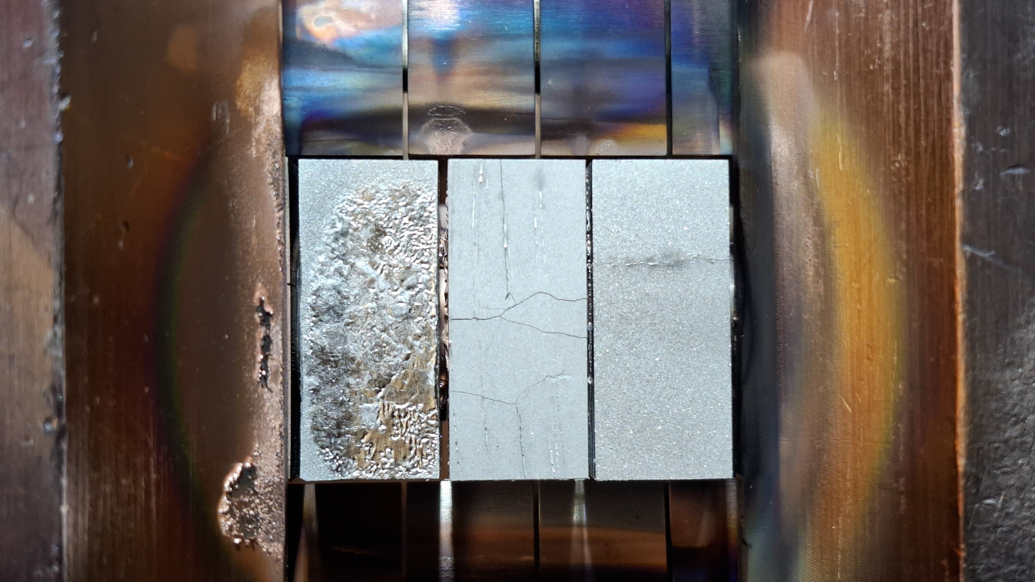
Examples of SP A Activities

