Slide 1

2025 Final Summary / 2026 Plans Subproject: D
Project Meeting
Plasma-Wall Interactions and Exhaust
A. Kirschner
FZJ
S. Brezinsek (PL), J.W. Coenen, A. Hakola, K. Schmid, A. Kirschner, J. Likonen, I. Classen, A. Goriaev, and D. Douai (DPL)

Slide 2
2025 Final Summary of SP D (PSI and SOL modelling)

Slide 3
Status 2025 - Structure of SP D
SP D.1: Plasma boundary modelling
SP D.2: Production of atomic/molecular and surface data
SP D.3: Impurity migration modelling
SP D.4: Neutral particles modelling
SP D.5: Plasma background and PWI modelling for COMPASS-U

Slide 4
Status 2025 - Tasks and Deliverables SP D.1
Deliverable ID | Deliverable Title
D001 | Plasma background parameters of WEST for modelling of impurity migration experiments (focus on long-pulse, high fluence discharges, impact of magnetic field ripple and drifts). (CEA)
D002 | Plasma background parameters of linear devices (MAGNUM-PSI and UPP) for modelling of impurity migration experiments (improvement of boundary conditions in particular for UPP). (DIFFER)
D003 | Plasma background parameters of GyM for modelling of impurity migration experiments (focus on Ar plasmas, validation against cross-machine experiments under SP B). (ENEA)
D004 | Plasma background parameters of W7-X (based on experiments in OP2.2 and OP2.3) and linear device PSI-2 (improved description of plasma source, fluid runs to cope specific boundary conditions, coupling with neutral kinetics) for modelling of impurity migration experiments. (FZJ)
D005 | PIC modelling to characterize the sheath with focus on collisional boundary conditions, study of inverse sheath. (IPP.CR)
D006 | Plasma background parameters for JET for modelling of impurity migration experiments (consideration of limiter configurations, characterisation of ELMs and SOL flows e.g. for Ni/W migration). (VTT)
D007 | Parametric SOLPS-ITER simulations executed, optimised divertor operation point (magnetic field arrangement, geometry, and divertor leg length) identified, and exhaust capabilities compared with the reference single null divertor (JT-60SA full-C) arrangement. (LPP-ERM/KMS)
All corresponding deliverables achieved and reported

Slide 5
Status 2025 - Tasks and Deliverables SP D.2
Deliverable ID | Deliverable Title
D001 | Dust production model for anomalous events and detached divertor conditions, identification of possible dust formation mechanisms like nucleation in fusion-relevant plasmas. Focus on cross section determination for neutral and charged W clusters. Connection to experimental data (e.g. dust studies in WEST). (CEA)
D002 | Sputtering and reflection data for surface systems including boron (e.g. W-B, B-O, and other combinations also containing D), including seeding projectiles (e.g. Ar, Kr, Xe). Development of according interaction potentials. (ÖAW)
D003 | Erosion information (SPRAY code, SDTrimSP-3D) of surfaces including morphology, roughness, fuzz. Influence of structure (oriented vs. random) and porosity. Comparison to experiments (e.g. PSI-2) and MD results. (ÖAW)
D004 | Modelling of tungsten gap melting and bridging including comparison to experiments (e.g. from AUG and WEST). Gap melt scenarios for ITER. (VR)
D005 | Sputtering and reflection yields from MD for W, W-D(H, T) and W-B surfaces. Application of more advanced (accurate) (ML, AI) interaction potential for tungsten and boron sputtering/reflection modelling. Comparison to BCA. (VTT)
D006 | Reflection information of 2D/3D surfaces with focus on lattice effects, comparison to MD simulations and/or experiments. (MPG)
D007 | Sputtering of W-D(H, T) surfaces, release of W-D molecules (study of impact energy and surface temperature). Study of interaction potentials: gauge, which is most reliable. Analyse the effect of electronic energy losses. (VTT)
All corresponding deliverables achieved and reported

Slide 6
Status 2025 - Tasks and Deliverables SP D.3
Deliverable ID | Deliverable Title
D001 | SOLEDGE3X-ERO2.0 simulations of tungsten transport in WEST. Determination of main tungsten sources and core contamination in WEST. Comparison with spectroscopy and post-mortem data. One focus on long-pulse, high-fluence discharges and full 3D treatment (antennae, magnetic field ripple). (CEA)
D002 | ERO2.0 simulations of tungsten dynamic morphology studies in GyM with Ar (see also SP B). Global ERO2.0 migration simulations in GyM, also for the design of diagnostics. ERO2.0 modelling of global erosion/deposition experiments in AUG He H-mode scenarios (connected to WP TE SOLPS modelling). (ENEA)
D003 | ERO modelling of ¹³C injection experiments (local) in comparison to post-mortem data in W7-X and steady-state simulations. ERO2.0 predictive modelling for full W environment in W7-X (inclusive role of CX neutrals). ERO and ERO2.0 modelling of W prompt redeposition (focus on JET experiment with varying B field), in combination with sheath characteristics from PIC. Initial simulations of ITER with full-W plasma-facing components and Ne seeding. Modelling of tungsten (prompt) redeposition at inner wall during ITER ramp-up phases. (FZJ)
D004 | Predictive material migration in full-W ITER including B transport resulting from boronisation using new SOL plasma solution with self-consistent far SOL. (MPG)
D005 | ERO2.0 simulations of AUG erosion and migration experiments in L- and H-mode D plasma and comparison with experimental data and formersimulations. Assess impact of uncertainty of OSP position and plasma conditions. (VTT)
D006 | Self-charging properties for (tritiated) boron dust. (VR)
D007 | ERO2.0 of Ni/W migration modelling in JET. (VTT)
All corresponding deliverables achieved and reported

Slide 7
Status 2025 - Tasks and Deliverables SP D.4 & SP D.5
Deliverable ID | Deliverable Title
D001 | DIVGAS modelling: effect of 3D poloidal and toroidal leakages for the DEMO baseline SN divertor case including impurities, pVT characteristics for JET. (KIT)
D002 | Atomic and molecular fluxes spatially resolved to the wall surfaces (including divertor) in JET. Explore pressure range, sub-divertor geometry and conclusions for effective pumping speed in JET. (VTT)
All corresponding deliverables achieved and reported
Deliverable ID: | Deliverable Title:
D001 | SOLPS-ITER plasma backgrounds for full-W COMPASS-U H-mode scenarios (gradual consideration of drifts, currents, pump feedback and Ne seeding). Sheath characteristics from PIC simulations, strike-line plasmas. (IPP.CR)
D002 | Supervision of ERO2.0 modelling for COMPASS-U. (FZJ)
D003 | SOLEDGE3X plasma backgrounds in comparison to SOLPS-ITER. (CEA)
All corresponding deliverables achieved and reported

Slide 8
Example of Activity in SP D.1
3D SOLEDGE3X plasma modelling for WEST
New plasma and wall mesh generated
Ripple effect correctly recovered
Plasma background to be used for migration modelling with ERO2.0
CEA

Slide 9
Example of Activity in SP D.2
MD simulations: sputtering of B₂O₃ surface by D
Differences between B and O can be attributed to the energy transfer factor 4M₁M₂/(M₁ +M₂)²
Yields of oxygen atoms increase monotonously with the energies and angles
ÖAW

Slide 10
Example of Activity in SP D.3
ERO simulations: prompt W redeposition at ITER inner wall during ramp-up
W redeposition profiles for medium-density case
Study of influence of D_{perp}
FZJ
A. Kirschner et al., NME 2025

Slide 11
Example of Activity in SP D.4
EIRENE simulations of JET neutral dynamics
support of in-vessel gas balances
study isotope effect, pressure range
get effective pumping speed
VTT

Slide 12
Example of Activity in SP D.5
SOLPS-ITER wide-grid modelling of plasma background for CAMPASS-U
High density, performance shot
Full vessel mesh
Fluid neutrals, no currents and drifts, no impurities
Good match of P_{SOL} (T_{ped}), n_{ped} from core model (METIS) and e-folding lengths based on λ_{q} scaling
Density profile at outer midplane:
IPP.CR

Slide 13
2026 Plans of SP D (PSI and SOL modelling)

Slide 14
PWIE Structure in 2026 and 2027
Project Leader: S. Brezinsek
Deputy Leader: D. Douai
PSO: D. Alyassin / NN
Project | Titel | Leader
SP A | Particle and heat load studies in preparation of the exploitation of ITER and a fusion power plant | J.W. Coenen
SP B | Experiments on erosion, deposition, and material migration | A. Hakola
SP C | Fuel retention and release | K. Schmid
SP D | Plasma-wall interaction and Scrape-Off-Layer modelling | A. Kirschner
SP E | JET post-mortem analysis, LIBS and associated interpretation | J. Likonen
SP F | Wall conditioning and boronization physics | A. Goriaev
SP X | Plasma characterization and laser-based diagnostic development | I. Classen
In general: Tasks and Deliverables are prepared for 2026 and 2027
IMS entry of tasks and deliverables shall be completed by first week of March

Slide 15
2026/2027 SP D Tasks and Deliverables
35PM
21 + 3 PM
SP D.1 Plasma background modelling
SOLPS-ITER, SOLEDGE3X, PIC codes, …
WEST, AUG, JET, COMPASS-U, ITER
W7-X
GyM/BiGyM, PSI-2, MAGNUM, UPP
CEA, DIFFER, ENEA, FZJ, IPP.CR, IPPLM, VTT
SP D.2 Production of surface and atomic/molecular data
MD, SDTrimSP, SPRAY, CRM, …
Sputtering, reflection, morphology, radiation
W, B, steel, D, seeding species, O, He, …
CIEMAT, ENEA, FZJ, MPG, ÖAW, VTT, UKAEA
32PM
SP D.3 Impurity migration modelling
WallDYN, ERO2.0, core modelling
WEST, AUG, JET, COMPASS-U, ITER
W7-X
GyM/BiGyM, PSI-2, MAGNUM, UPP
CEA, ENEA, FZJ, IPP.CR, IPPLM, MPG, VTT
Strong connection to:
ITER, TSVV, SP B, WP TE, WP W7X, …
PMs per year …

Slide 16
2026/2027 SP D Tasks and Deliverables
Main changes compared to 2025:
Former D.4 (neutral particles modelling) activities now under D.1
Former D.5 (dedicated to COMPASS-U) activities now under D.1 and D.3
No more JT-60SA activity (LPP-ERM/KMS)
No more dust activities (CEA, VR)
No more melting activity (VR)
No more DEMO-DIVGAS activity (KIT)
New: core-edge coupling (IPPLM)
New: CRM modelling for linear devices (ENEA, FZJ)
New contributors: UKAEA (MD), CIEMAT (MD), IPPLM (core-edge)

Slide 17
2026/2027 SP D Tasks and Deliverables – brief description
SP D.1 Plasma boundary modelling: 35 PM
D001/008: Plasma background parameters for WEST, possibly COMPASS-U. (CEA) 3 PM
D002/009: Plasma background parameters for MAGNUM-PSI and UPP. (DIFFER) 2 PM
D003/010: Plasma background parameters for GyM, BiGyM, possibly AUG. (ENEA) 3 PM
D004/011: Plasma background parameters for W7-X and PSI-2. (FZJ) 10 PM
D005/012: Plasma background parameters for COMPASS-U, PIC sheath modelling. (IPP.CR) 6 PM
D006/013: Plasma background parameters for JET, possibly AUG. (VTT-Aalto) 9 PM
D007/014: Plasma background parameters for JET, AUG (for core-edge coupling). (IPPLM) 2 PM

Slide 18
2026/2027 SP D Tasks and Deliverables – brief description
SP D.2 Production of surface and atomic/molecular data: 24 PM
D001/010: Emission characteristics of sputtered/reflected vs. surface morphologies. (ÖAW) 2 PM
D002/011: Erosion/deposition data for W-B-H-O and alloy surfaces. Interaction potentials. (VTT) 5 PM
D003/012: Chemical erosion yields for tungsten, recycling properties of D molecules. (VTT-Aalto) 3 PM
D004/013: Erosion data for technical W surfaces, dynamics until steady state. (MPG) 3 PM
D005/014: Erosion/deposition data for B surfaces of various morphology. (ENEA) 2 PM
D006/015: Erosion data on degraded B and W surfaces. (CIEMAT) 2 PM
D007/016: Interatomic potentials for W-B-H-O surfaces, related sputtering data. (UKAEA) 3 PM
D008/017: Collisional Radiative Model (CRM) for GyM, plasma composition. (ENEA) 2 PM
D009/018: Collisional Radiative Model (CRM) for PSI-2, plasma composition. (FZJ) 2 PM

Slide 19
2026/2027 SP D Tasks and Deliverables – brief description
SP D.3 Impurity migration modelling: 32 PM
D001/009: Impurity migration in WEST (ERO2.0) – RF source, turbulences, boron dropper,
post-mortem, W spectroscopy. (CEA) 3 PM
D002/010: Erosion and deposition in GyM and BiGyM (vs. experimental data). (ENEA) 4 PM
D003/011: ERO/ERO2.0: Prompt W deposition in AUG, local transport studies with MPM in W7-X,
global erosion and deposition maps in JET, ITER and AUG. (FZJ) 12 PM
D004/012: WallDYN: Global erosion and deposition maps (W, B) in ITER, study of SOL transport. (MPG) 2 PM
D005/013: ERO2.0: Erosion/deposition of Pt, W and Mo markers in AUG. (VTT) 3 PM
D006/014: ERO2.0: Maps of Ni/W erosion/deposition in JET. (VTT-Aalto) 2 PM
D007/015: ERO2.0: Erosion and deposition of W in COMPASS-U. (IPP.CR) 2 PM
D008/016: Edge-core transport of W in AUG, JET. (IPPLM) 4 PM

Slide 20
2026 SP D Tasks – more detailed description
(from current version of Activity Sheet)

Slide 21
Task descriptions SP D.1 in 2026
Generating of plasma backgrounds with SOLEDGE3X for attached and detached conditions in WEST, XPR, including turbulence effects. Output to be used for migration modelling under SP D.3. Guido Ciraolo (CEA)
Production of plasma background parameters with SOLPS-ITER for UPP. Hugo de Blank (DIFFER)
SOLPS-ITER simulations to produce plasma backgrounds for the linear device GyM/BiGyM and possibly other linear devices, to be used as input for migration modelling under SP D.3. Matteo Passoni (ENEA)
Generating of plasma backgrounds with SOLPS-ITER for the linear device PSI-2 and EMC3-EIRENE for W7-X. Focus on needs for impurity migration modelling. Dirk Reiser (FZJ)
SOLPS-ITER simulations for COMPASS-U with Ne and Ar seeding to be used as input for migration modelling. PIC simulations to improve description of collisional sheath and provide potential structure within and around tile gaps for divertor plasmas. PIC output to be used as input for migration modelling. David Tskhakaya (IPP.CR)
SOLPS-ITER simulations of background plasmas for JET to be used for Ni/W migration modelling under SP D.3. Effect of ELMs, flows, improved CX distributions. EIRENE simulations of gas balance in JET. Mathias Groth (VTT-Aalto)
Plasma background modelling (SOLPS-ITER, SOLEDGE, TECXY for comparison) for AUG L-mode, JET L-mode and H-mode plasmas. Results to be used for core-edge coupling task under SP D.3. Kzysztof Galazka (IPPLM)

Slide 22
Task descriptions SP D.2 in 2026 (1)
Initial BCA and SPRAY modelling of the emission characteristics of sputtered and reflected particles from various surface morphologies and comparison with experimental results (connected to SP B). Benjamin Burazor Domazet (ÖAW)
Molecular dynamics simulation of chemical erosion of boron surfaces, mixed surfaces (W-B-H-O) and fusion-relevant alloys. Related development of interaction potentials. Fredric Granberg (VTT)
Initial Molecular Dynamics simulations with focus on tungsten and boron surfaces: chemical sputtering studies, study of the influence of interaction potentials. Initial studies of deuterium recycling. Andrea Sand (VTT-Aalto)
SDTrimSP-3D modelling of technical tungsten surfaces. Dynamical change of rough surfaces and study of time-scale to reach steady-state. Difference between steady-state and initial surface (first wall and divertor) with respect to sputtering.
Udo von Toussaint (MPG)
Initial Molecular Dynamics (KALYPSO), BCA and ERO2.0 simulations of roughness and morphology effects – connected to studies at the linear device GyM with focus on tungsten and boron surfaces. Francesco Ghezzi (ENEA)
First MD and BCA modelling to study the effect of degradation on the erosion of tungsten and boron surfaces. Plasma, seed species, oxygen and helium to be used as projectiles. Elaheh Kazemi Khasragh (CIEMAT)

Slide 23
Task descriptions SP D.2 in 2026 (2)
Development of machine learning interatomic potentials to study sputtering and deposition mechanisms in tungsten materials (W-H-O-B). Duc Nguyen (UKAEA)
Development of Collisional Radiative Model (CRM) for the linear device GyM and benchmarking with spectroscopic data from GyM plasmas. Domenico Bruno (ENEA)
Development of Collisional Radiative Model (CRM) for the linear device PSI-2 and benchmarking with spectroscopic data from PSI-2 plasmas. Vladislav Kotov (FZJ)

Slide 24
Task descriptions SP D.3 in 2026
ERO2.0 modelling of tungsten erosion, migration and deposition in WEST with attached and detached plasma conditions. ERO2.0 modelling including tungsten source due to ICRH. Guido Ciraolo (CEA)
ERO2.0 modelling of global material migration in GyM and BiGyM also covering higher plasma densities and fluxes. Also other linear devices and uncovered tokamak necessities. Matteo Passoni (ENEA)
ERO modelling of tungsten prompt redeposition for AUG limiter experiments. ERO modelling of latest local transport studies with MPM at W7-X (marker injection). ERO2.0 simulations including the effect of turbulences and fluctuations for JET and AUG. ERO2.0 simulations for ITER with wide-grid SOLPS-ITER background plasma solutions for the Start-Of-Research-Operation (SRO) phase. Andreas Kirschner (FZJ)
WallDYN simulations of tungsten erosion and deposition: study of the effect of different far-SOL transport assumptions.
Klaus Schmid (MPG)
ERO2.0 modelling of W, Mo and Pt marker experiments in AUG: H-mode plasmas. Antti Hakola (VTT)
ERO2.0 modelling of Ni/W transport in JET studying the effect of ELMs, flows and using improved data for wall neutral fluxes. Mathias Groth (VTT-Aalto)
ERO2.0 global simulation of tungsten transport in COMPASS-U for Ne and Ar seeded scenarios with SOLPS-ITER wide grid plasma background. Study the effect CX neutrals on impurity transport. David Tskhakaya (IPP.CR)
Core-edge transport coupling and combining with ERO2.0 tungsten and beryllium migration modelling for AUG and JET. Kzysztof Galazka (IPPLM)

Slide 25
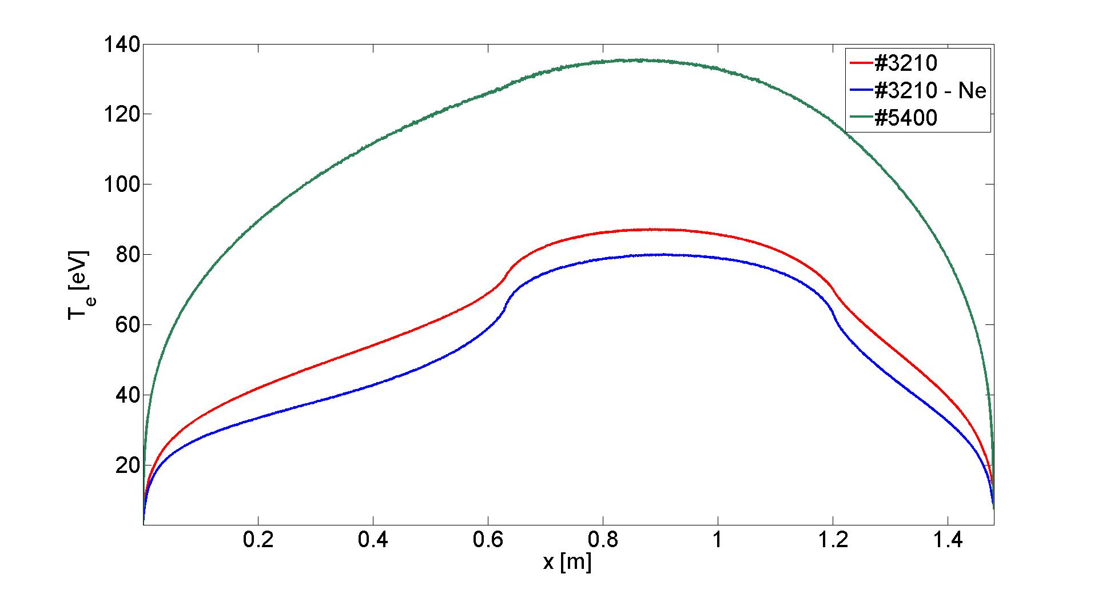
Example of SP D.1 Activities
Plasma background parameters and sheath characterisation:
- SOLPS-ITER, SOLEDGE3X for 2D/3D plasma modelling
- PIC simulations for description of sheath parameters (e.g. temperature, density, potential) for various conditions (e.g. high density plasma)
Example: BIT1
Poloidal profile of T_{e} for COMPASS-U
D. Tskhakaya et al.

Slide 26
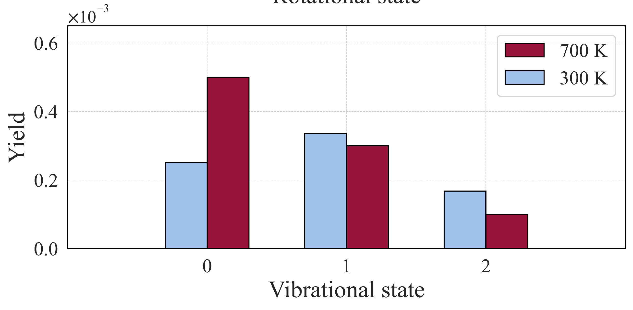
Example of SP D.2 Activities
Molecular Dynamics Simulations:
Production of erosion and reflection data (yields, reflection coefficients in dependence on impact energy and angle, surface temperature, characteristics of eroded and reflected particles)
Development of interatomic potentials
Surfaces: W-B-D-O-He, … SS, alloys, …, nano-structures, crystal orientation, damages, …
Projectiles: D, O, He, seed species, W, B, …
Chemical erosion of boron (BD) and tungsten (WD)
Example: MD
Sputtered WD molecules (1500 eV, normal incidence)
A. Sand et al.

Slide 27
Example of SP D.3 Activities
Erosion, migration and deposition in fusion devices:
Modelling of the lifetime of wall components (and boronisation), gross and net erosion sources, plasma accumulation, long-term T retention: focus and W and B, but also EUROFER …
Present devices (with benchmarking against experiments) and predictions for future machines (ITER, Fusion Pilot Plant, …)
Main tools: ERO2.0, WALLDYN and plasma simulation codes for background plasma (SP D.1)
Example: WALLDYN
Time evolution of boron surface concentration in ITER
K. Schmid, NME 2025

